Slide 1
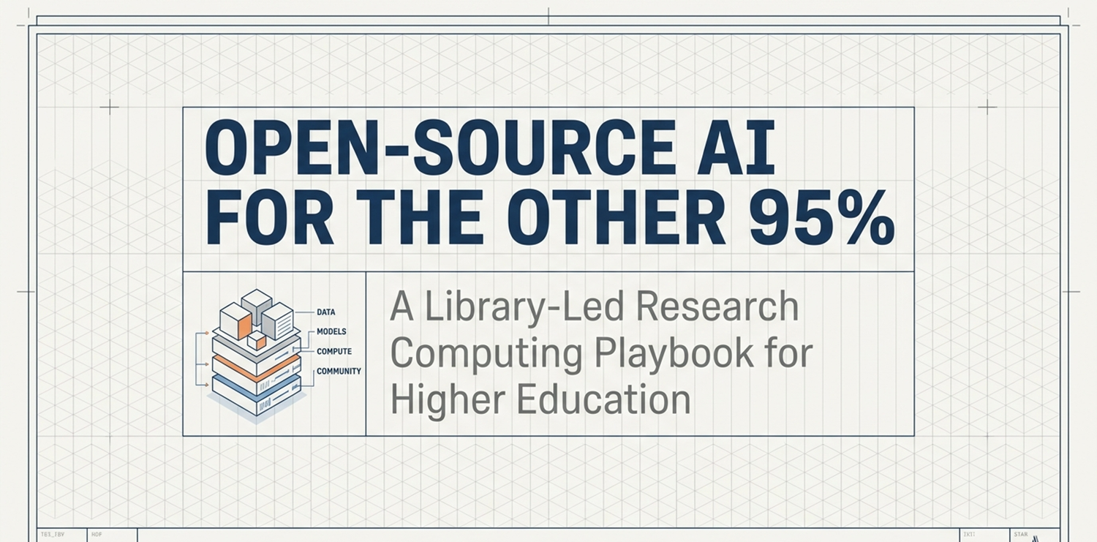


Deep Research and Open Source AI For the Other 95%
A Research Services
Library Led, AI Literacy, Research Computing Model
Presented for: RCSI Research Computing for Smaller Institutions, June 2026, Swarthmore College
Ray Uzwyshyn, Ph.D. MBA MLIS
Acting AUL for Research & Technology &
Director of Research Services
University of California Riverside Libraries, raymondu@ucr.edu ,https://rayuzwyshyn.net https://www.linkedin.com/in/rayuzwyshyn/

Slide 2
AI Infrastructure Support at
University of California
Riverside
AI Literacy, Faculty, Student &
Researcher Support
  Use of AI tools in research e.g., research design, data collection analysis
  Data management
  Model training for regular size datasets
Library
HPC &
Faculty Teaching Center,
RAISE
Information
Technology
Services
Dedicated
AI Research Librarian
Research AI/Data Scientist
University Wide AI Proprietary Licenses (Google Gemini, Limited OpenAI, Anthropic)
Broad general training
Security
High Performance AI Research Compute, Top 2-5%, Major Grant Support Costs Involved)
Instructor Development,

Slide 3
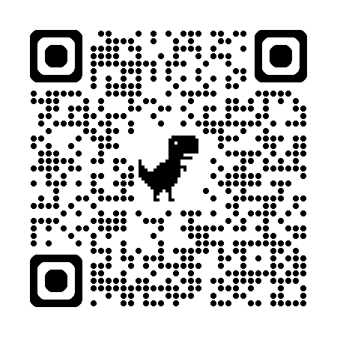
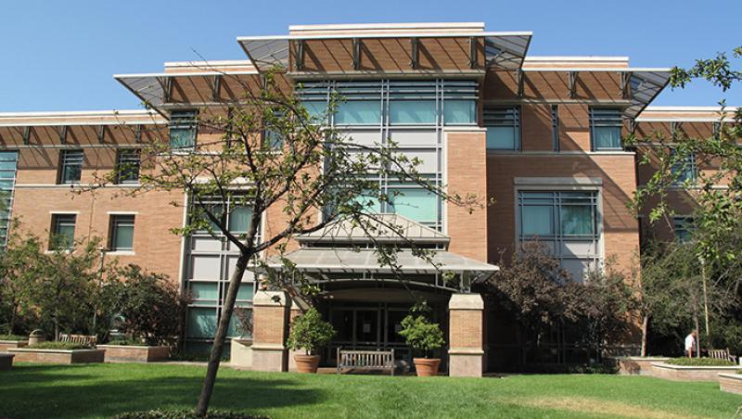
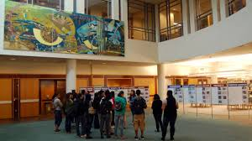
UCR Libraries Research and Technology Services
Orbach Science Library
Director of Research & Technology Services
AI Research Librarian (+1)
AI/Data Research Scientist (+1)
Cyberinfrastructure
(Core Libraries IT Infrastructure)
Innovative Media Librarian
Digital Scholarship Librarian
Geospatial Information Systems Librarian
Medical & Clinical Outreach Librarian
Maker Space/Robotics Lab Services Coordinator
Research Services Information Assistant

Slide 4
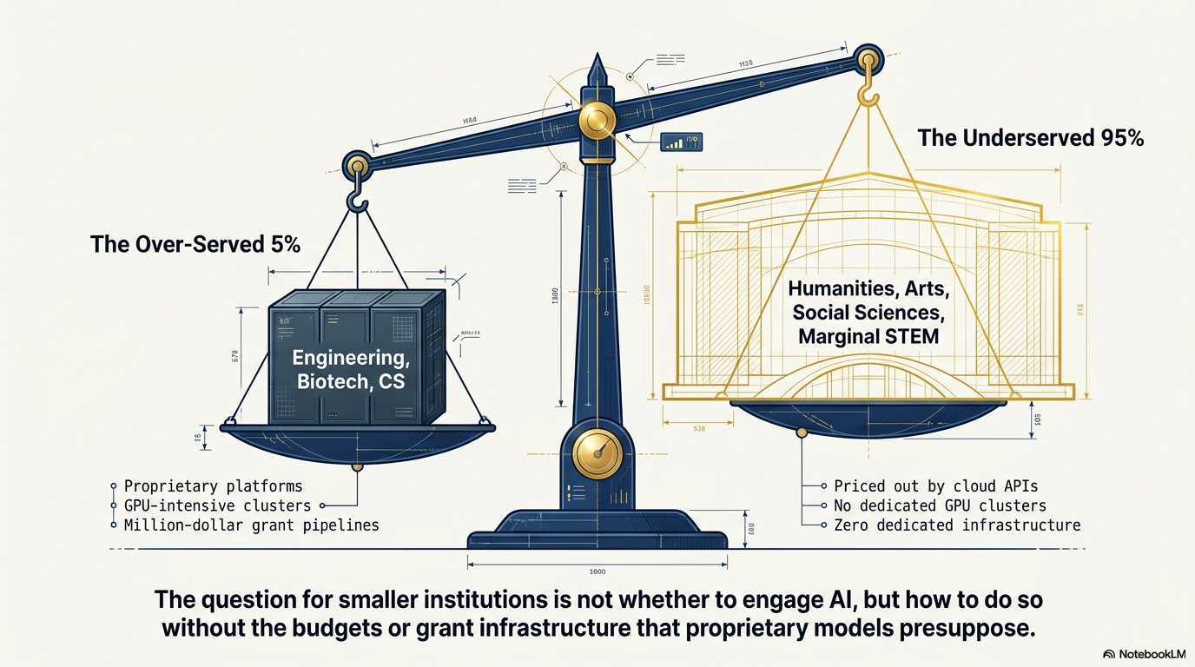
Traditional Research Computing

Slide 5
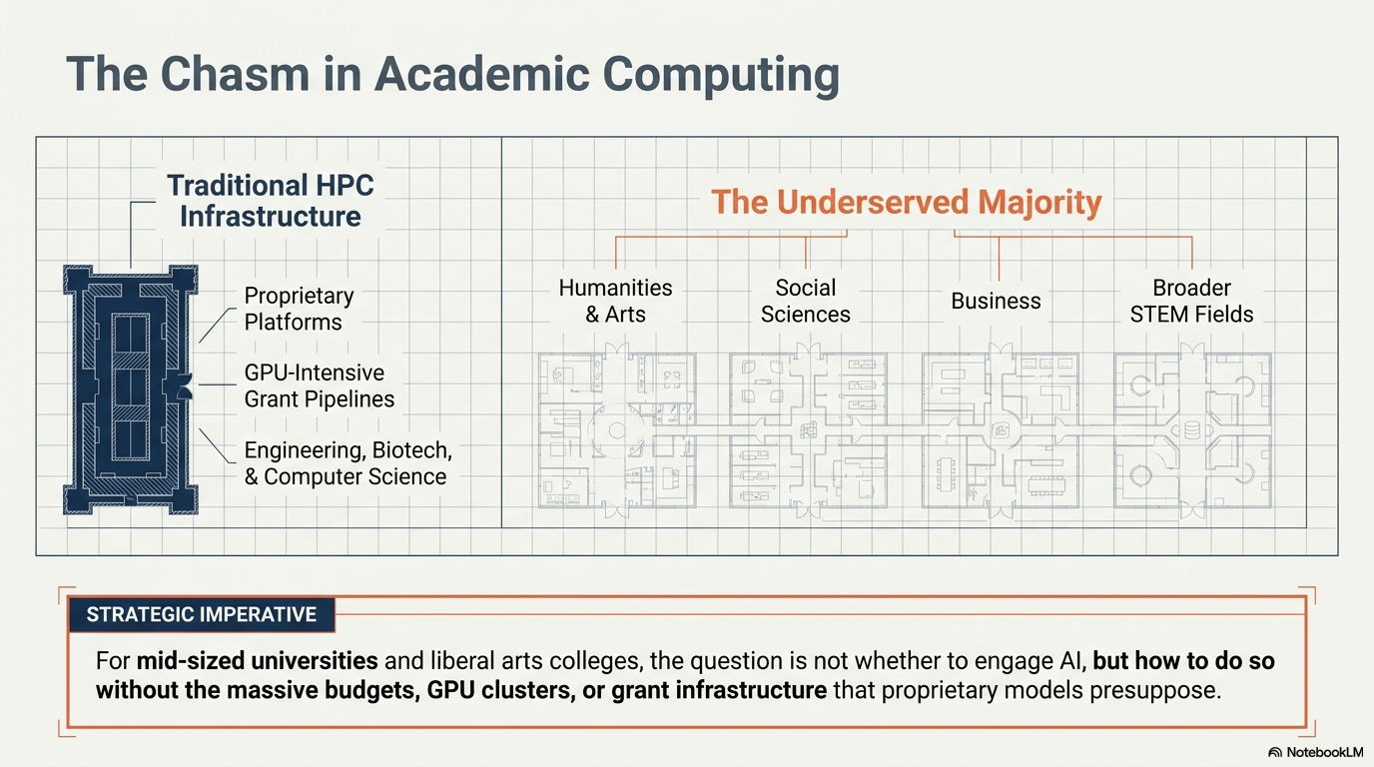
The Widening AI Divide

Slide 6
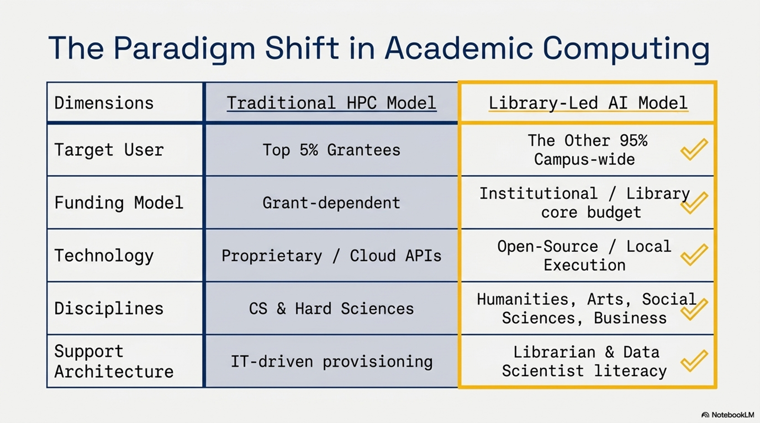

Slide 7
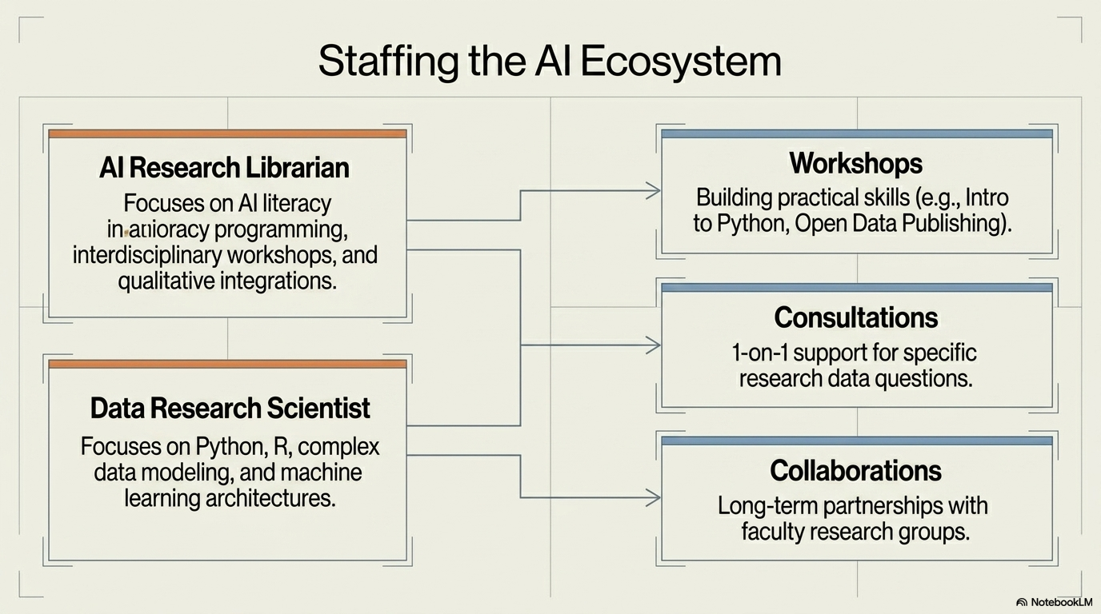

Slide 8
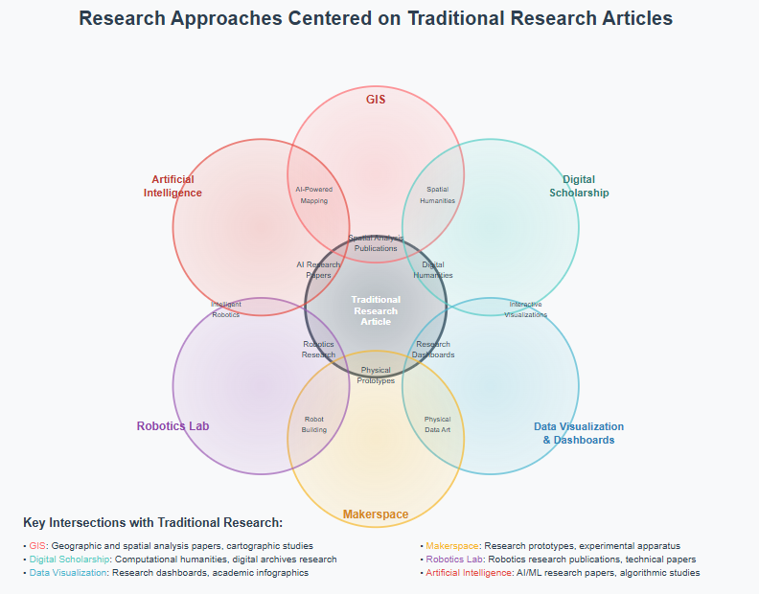
UCR Library
Research & Technology Services
Several Units
Several Technologies
Traditional Research Article, Monograph
Increasingly Focused
on AI Literacy
AI

Slide 9
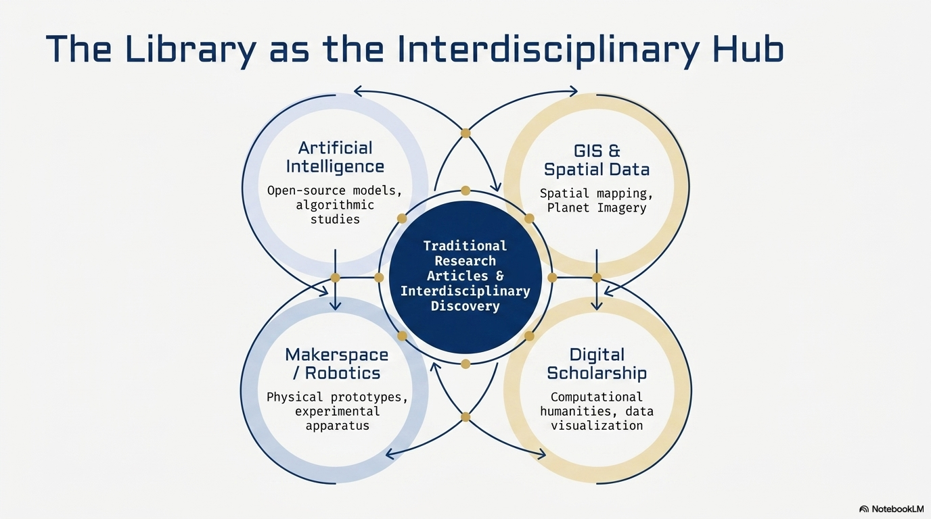

Slide 10
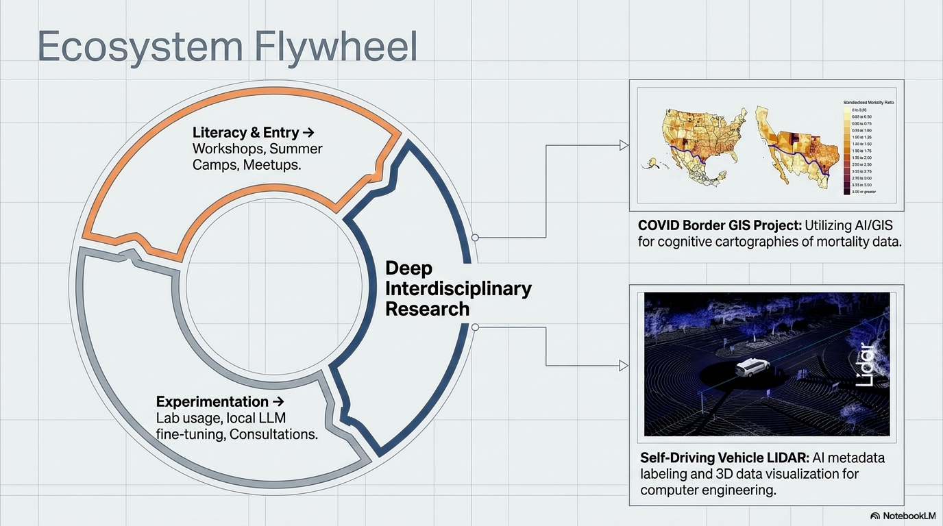

Slide 11
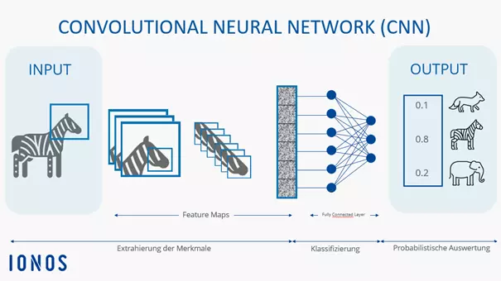
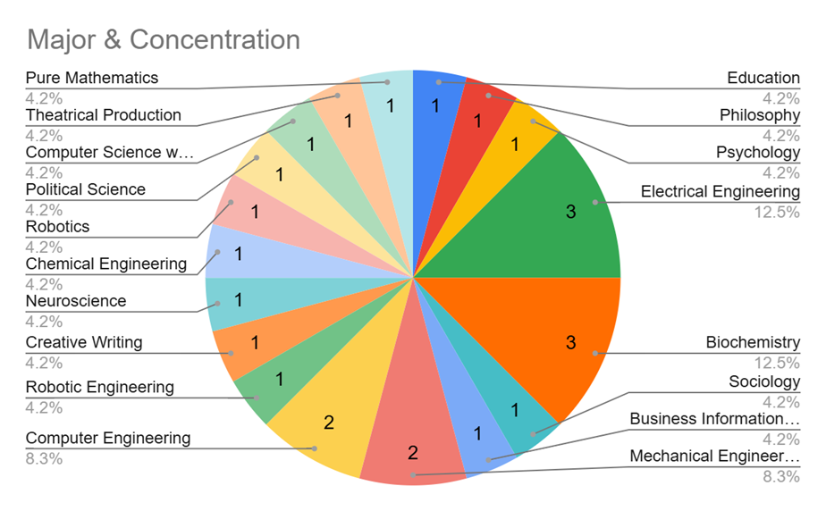
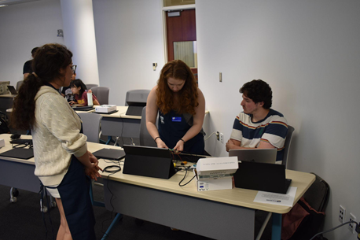
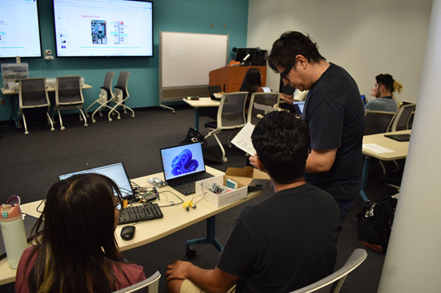
AI Enhanced Robotics Summer Camp
LAB Workshops: From Zero to Hero
An AI training method, which teaches the model to recognize items based on an image
Convolutional Neural Nets Integrated with Robotics
Students were taught how to train the model and how to use the model in a real application
75% Female
Attendees

Slide 12
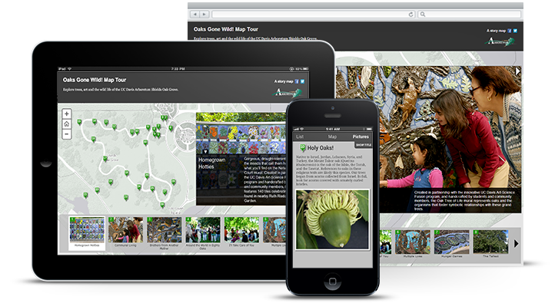
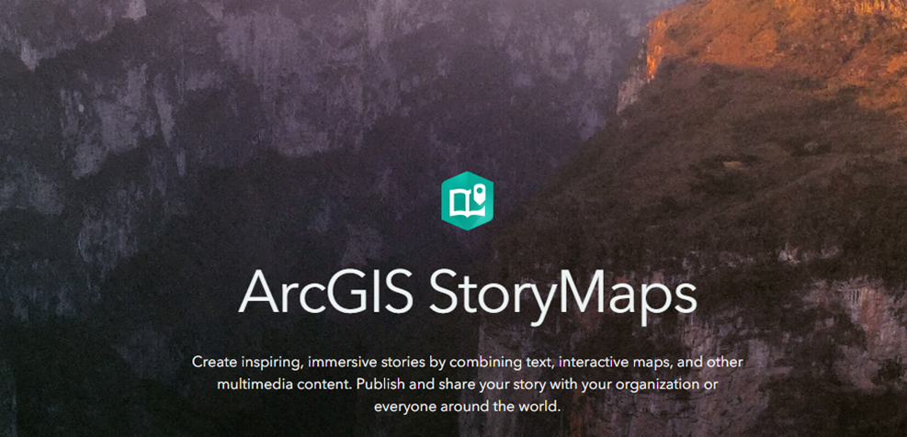


Geospatial Information Services
AI + GIS, Planet Imagery Day
Dr. Nan Li, UCR Environmental Sciences
Dr. Nicolas dos Santos, UCR Computer Science
Planet Imagery Day is supported by USDA-NIFA's Artificial Intelligence for Sustainable Agriculture project
In a collaboration with the Artificial Intelligence for Sustainable Agriculture (AI4SA) project, the library hosted Planet Imagery Day on May 2, 2025. The event featured presentations regarding using Planet imagery in Google Earth Engine and in ArcGIS products, given by staff from Planet and Esri respectively.

Slide 13
Library Workshops for Researchers
(FY25/26 Samples)
Introduction to Machine Learning
Introduction to Gemini API: How to customize AI models
Exploring AI Literature Mapping Tools (Natural Language Processing)
Finding and Using Imagery in a GIS, Arc GIS and AI, Drones &GIS
Data Cleaning for Machine Learning with Python
AI Computational Methods with Text Analysis
AI Deep Research Models/AI Video
Introduction to Deep Learning with PyTorch
Open scholarship / open access publishing
Contact:
Raymond Uzwyshyn, Director of Research Services/Acting Assistant University Librarian for Research and Technology, UCR Library

Slide 14
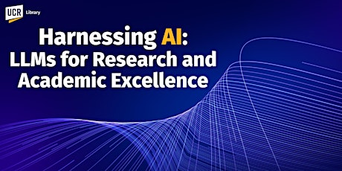
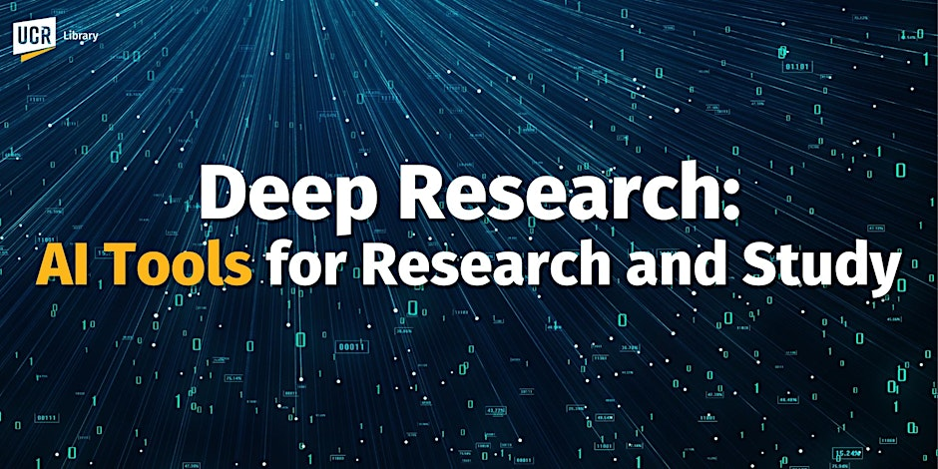
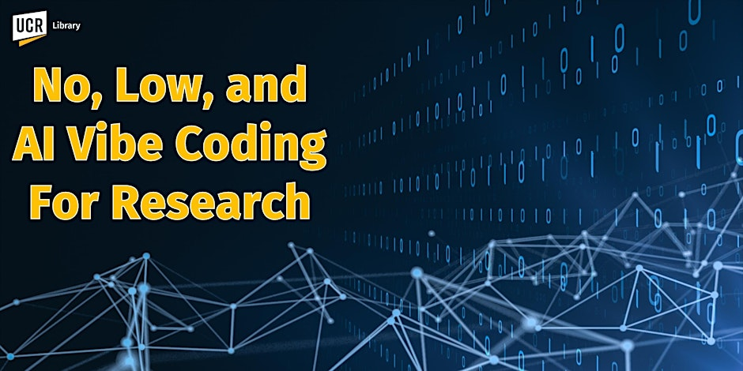
March 2025. https://www.researchgate.net/publication/389558789_Harnessing_AI_For_Research_2025_GenAI_Large_Language_Model_Introduction_AGI_and_Reasoning_Models_Multimodal_Models_and_Deep_Research_with_Autonomous_Agents
May 2025. https://www.researchgate.net/publication/391739383_Deep_Research_AI_Tools_For_Research_and_Discovery
November 12, 2025.
https://www.researchgate.net/publication/397584324_Vibe_Coding_For_AI-Driven_Development_An_Introduction_for_Research_and_Learning

Slide 15
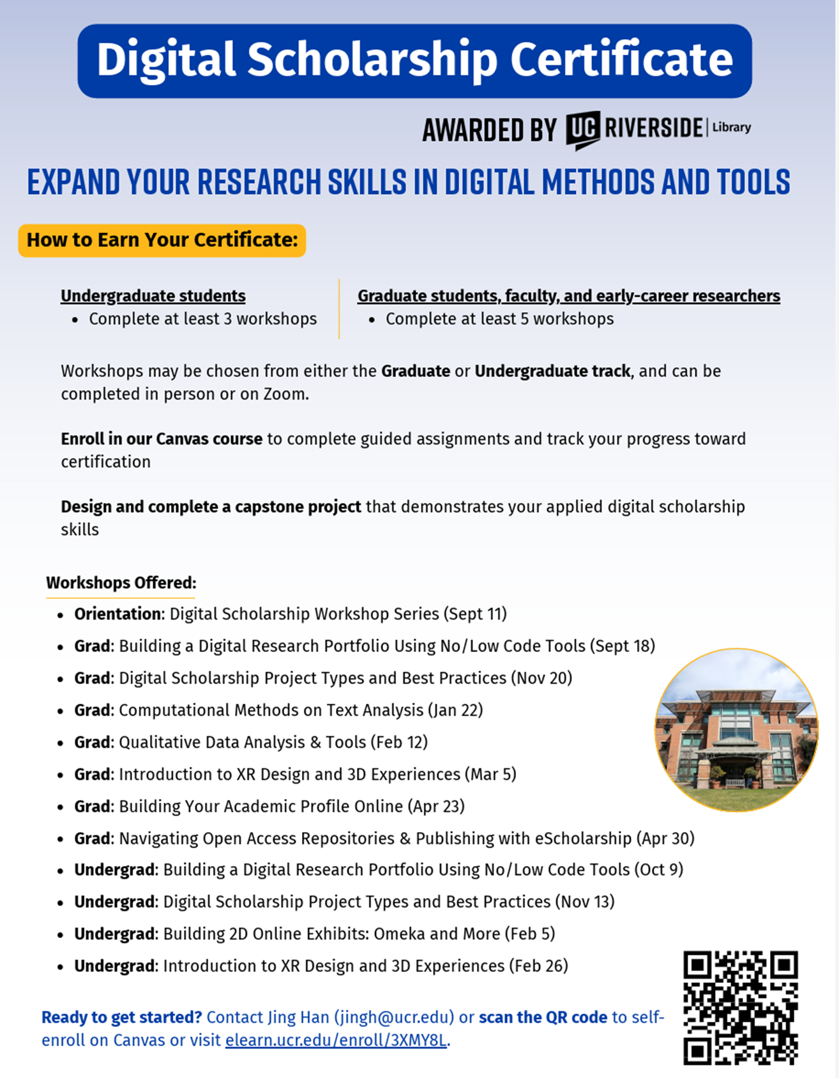

Slide 16
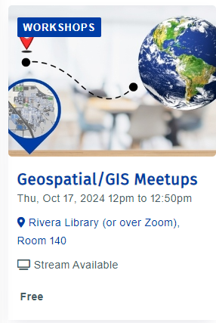
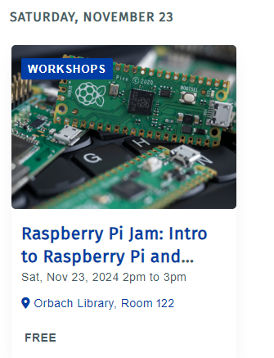
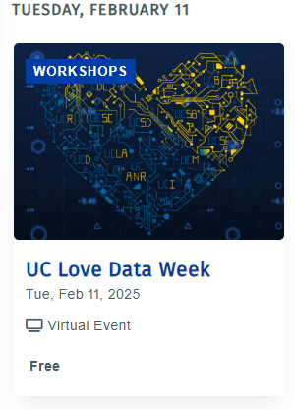

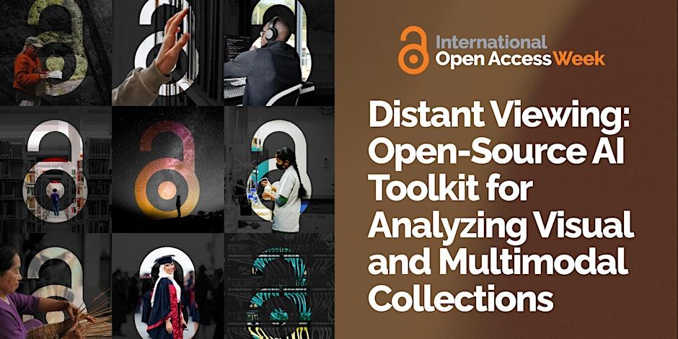
AI Research Orientation to Technology Workshops and Faculty, Student AI Related Research
Meetups, Thematic Weeks, Presentations
Data, AI,
Open Access
Global North and South Presentation
Streaming Party
For Faculty Students and Staff
AI Research Faculty
Presentations
AI/Robotics
Training Kits
Workshops

Slide 17
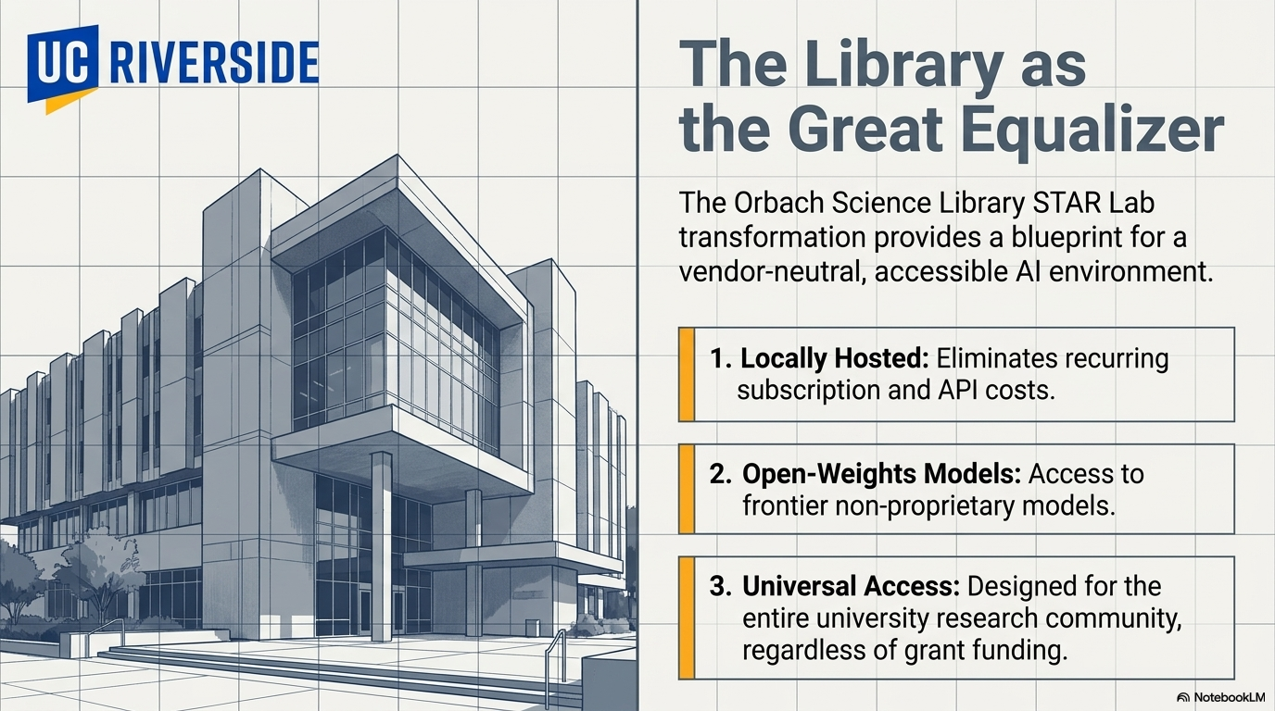
AI Local Open Source AI Lab

Slide 18
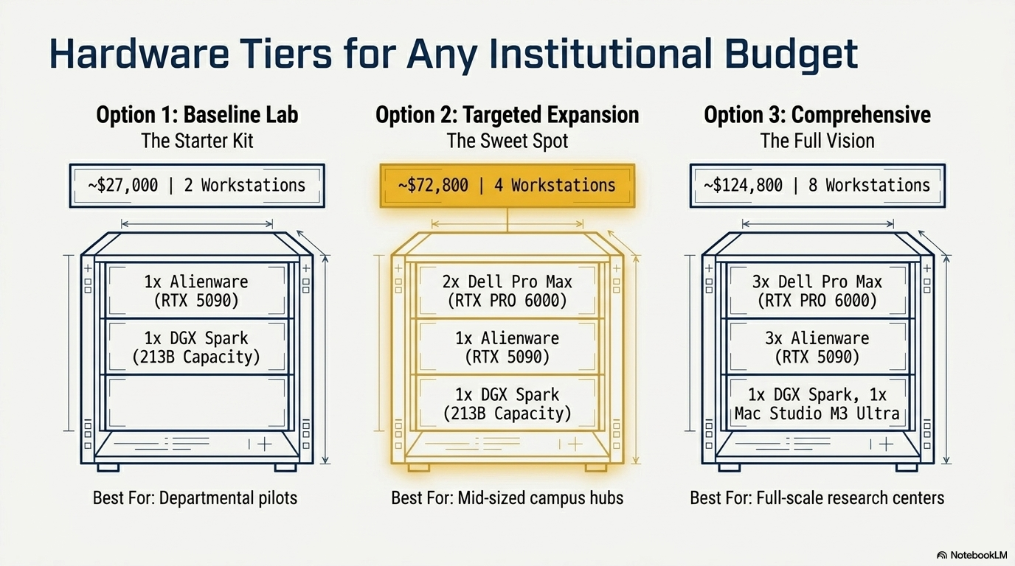
If a Bigger Lab Needed, Scale: (Option #3 x 2) = Double or Triple Size
Full Lab Project Specs

Slide 19
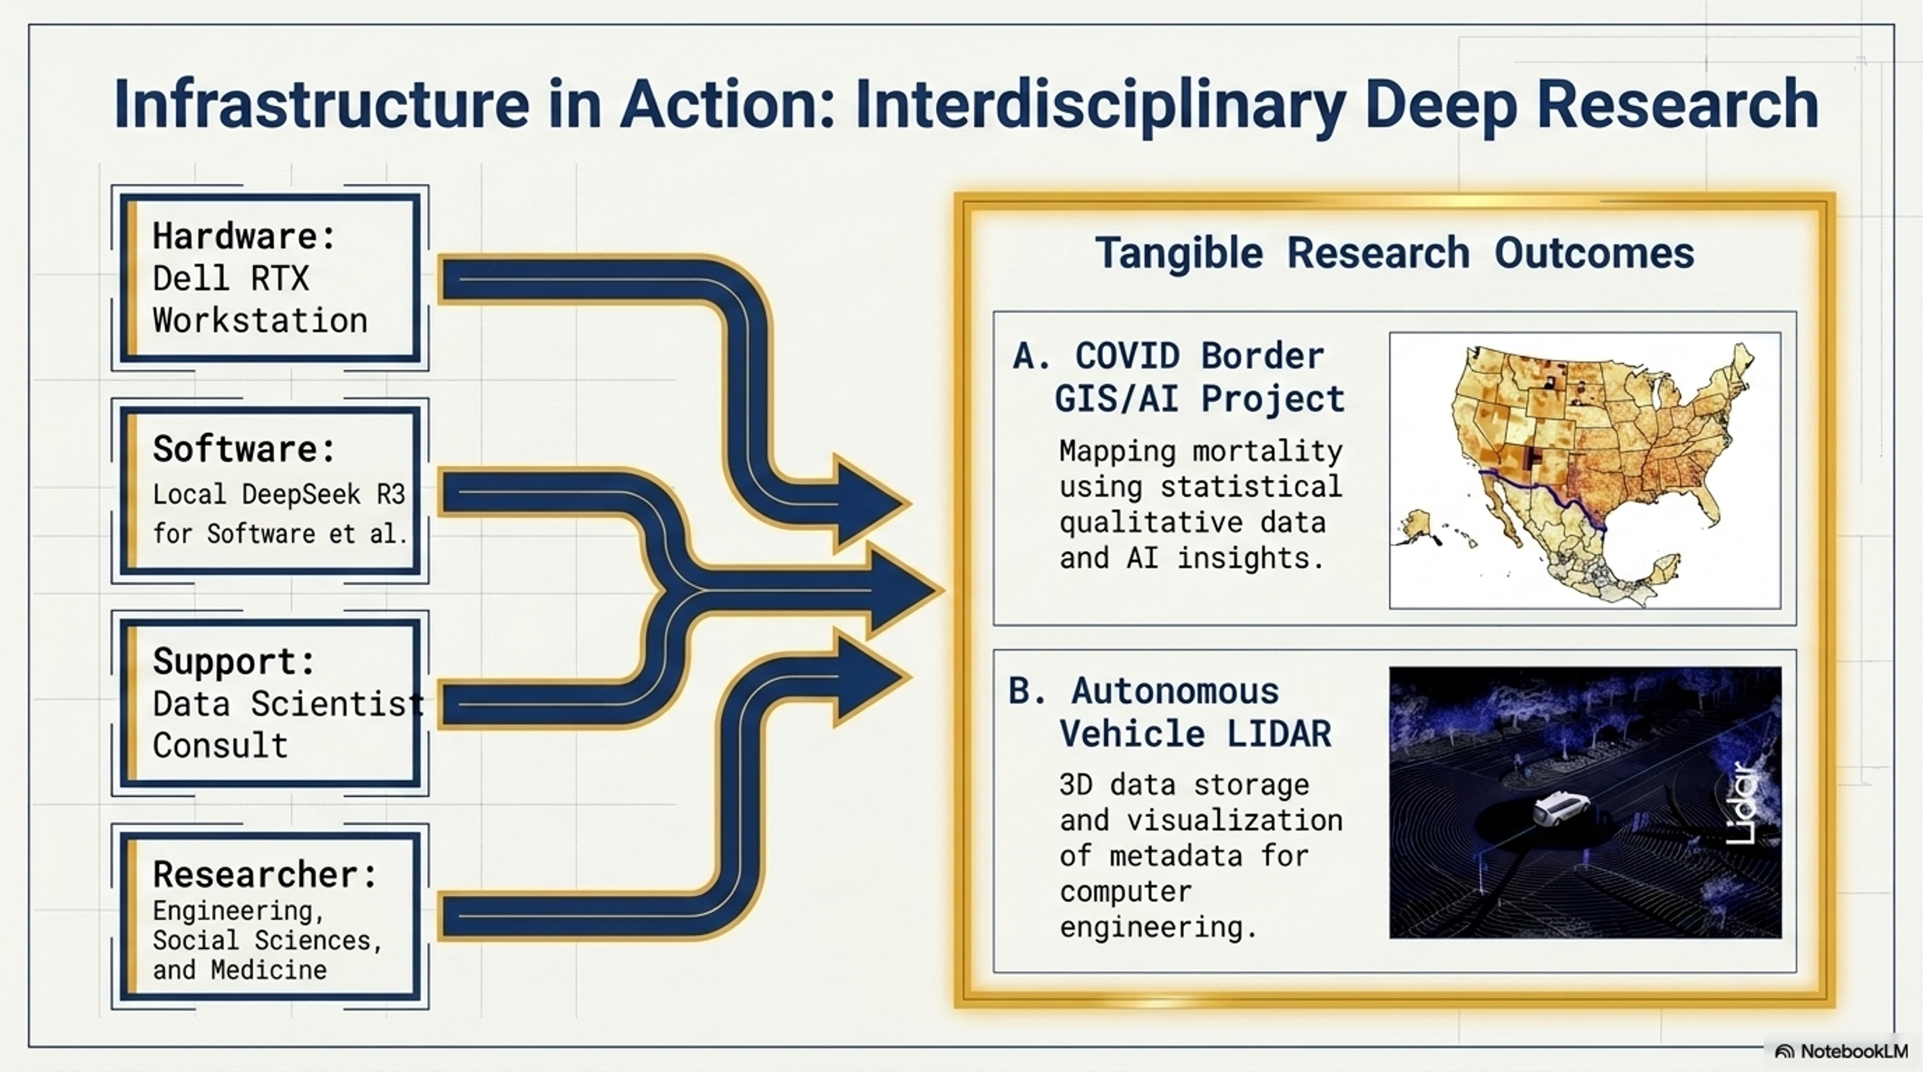

Slide 20
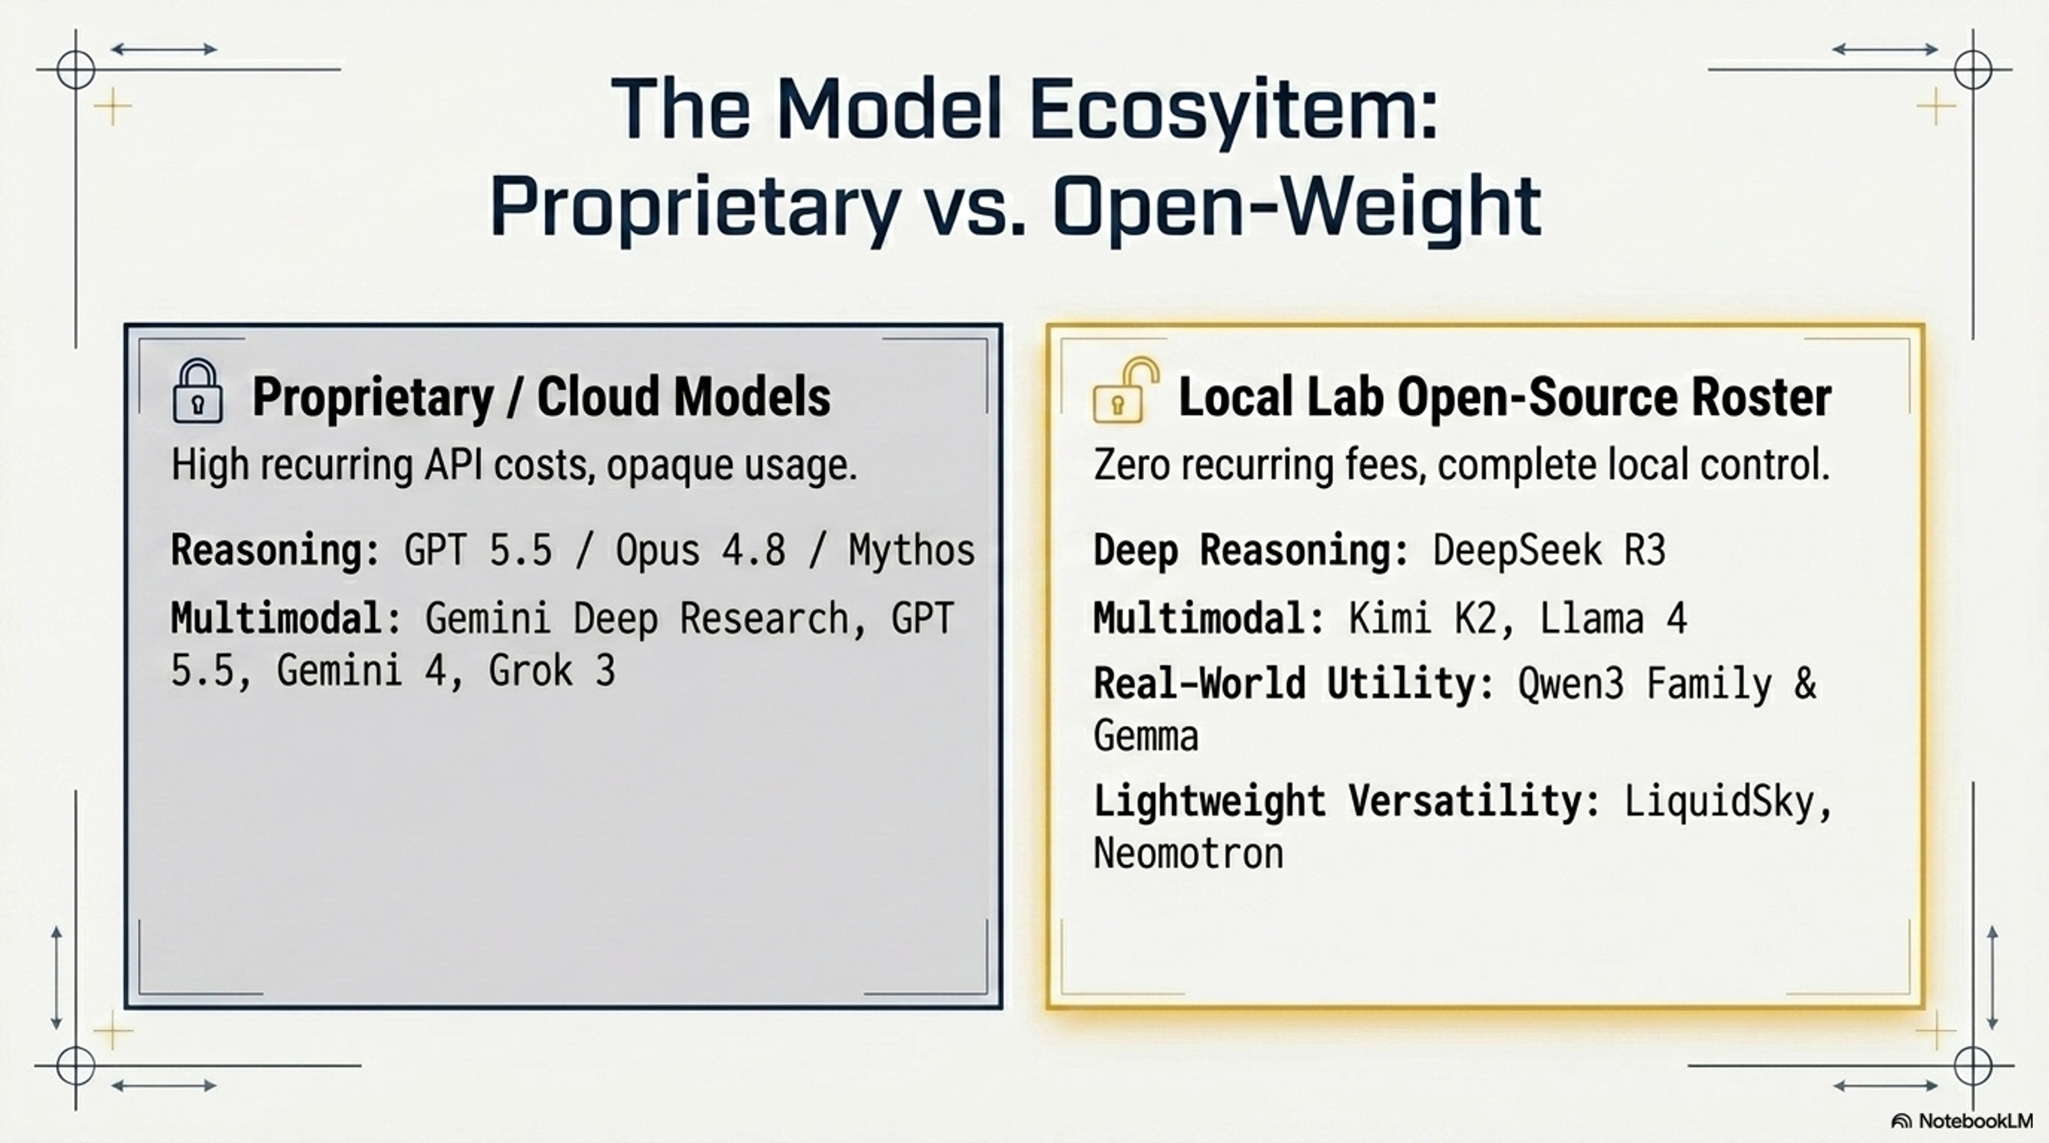

Slide 21
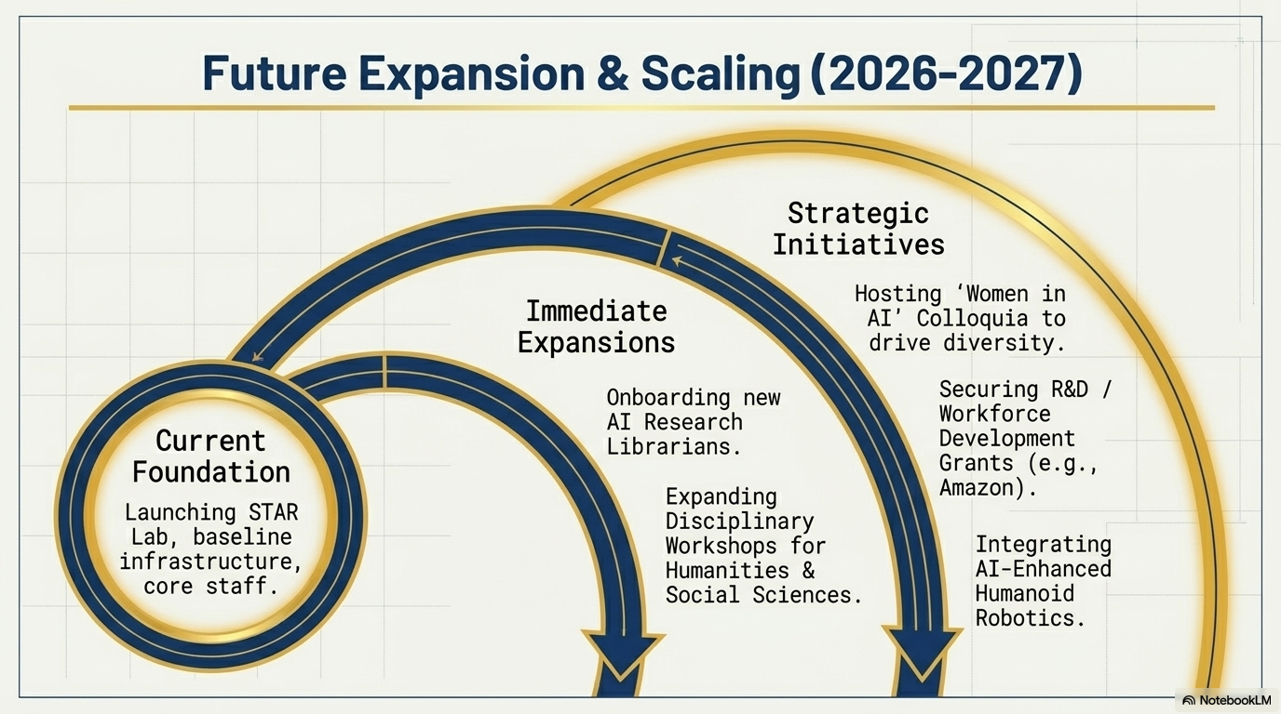

Slide 22
Comments and Questions
Thank you for Attending!
Ray Uzwyshyn, Ph.D. MBA MLIS
Acting AUL for Research & Technology Services
University of California, Riverside Libraries, raymondu@ucr.edu
https://www.linkedin.com/in/rayuzwyshyn/
https://rayuzwyshyn.net

Slide 23
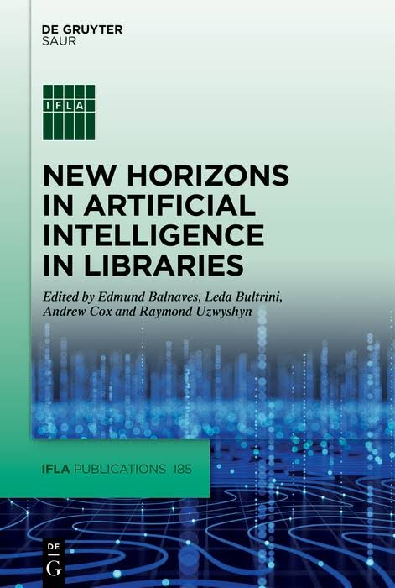
Further AI Related Library and Research Computing AI/Data Resources
UCR Research Services. Star Lab AI Lab Transformation Planning Document. June 2026.
Uzwyshyn, R. Reimagining Education In the Age of AI: From Information Scarcity to Abundant Intelligence. (CXO Print Edition). Education Technology Insight. 2025.
Uzwyshyn, R et al. New Horizons in AI for Libraries (Editor). Open Access Online Version PDF, Print Cover Section Introduction: Projects in Machine Learning and Natural Language Processing in Libraries (Proof) (Glossary Proof).IFLA Publication Series. (Online Open Access Version) Walter De Gruyter (GmbH): Berlin January 2025.
Building Library AI Infrastructures: Research Data Repositories, Scholarly Ecosystems and AI Scaffolding (Draft). New Horizons in AI for Libraries. De Gruyter: Berlin, January 2025.
From Open Science and Datasets to AI and Discovery. Trends and Issues in Library Technology: IFLA IT Section. January 2023.
Presentations, Publications
https://rayuzwyshyn.net
https://www.linkedin.com/in/rayuzwyshyn/

Slide 24
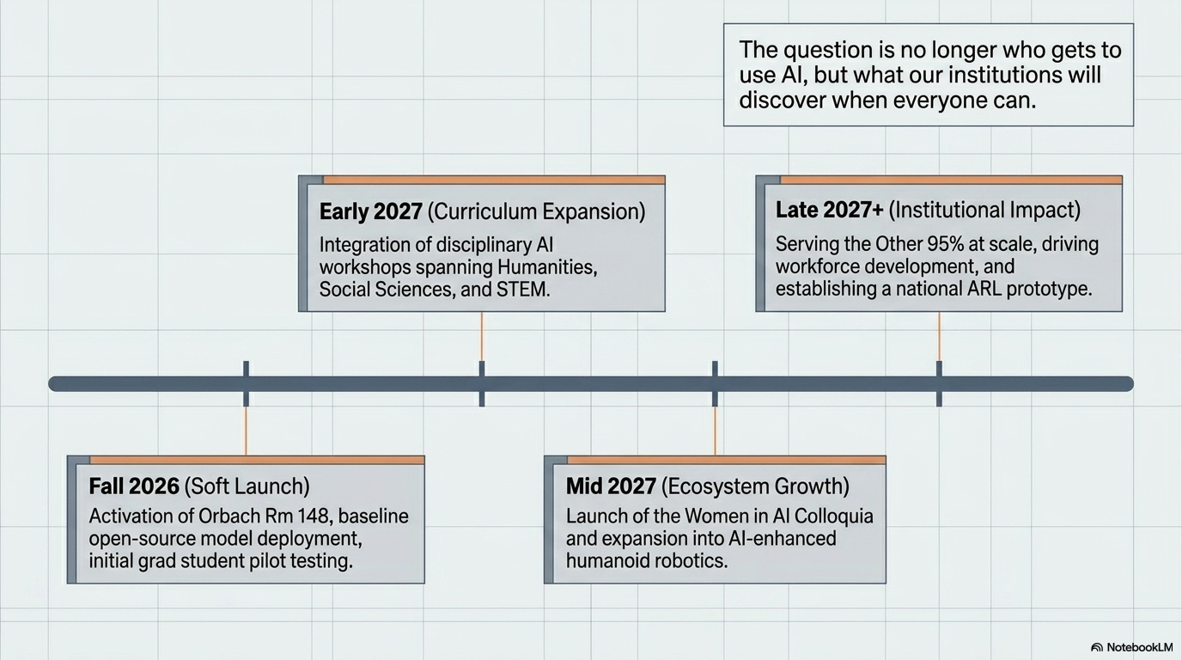

Slide 25
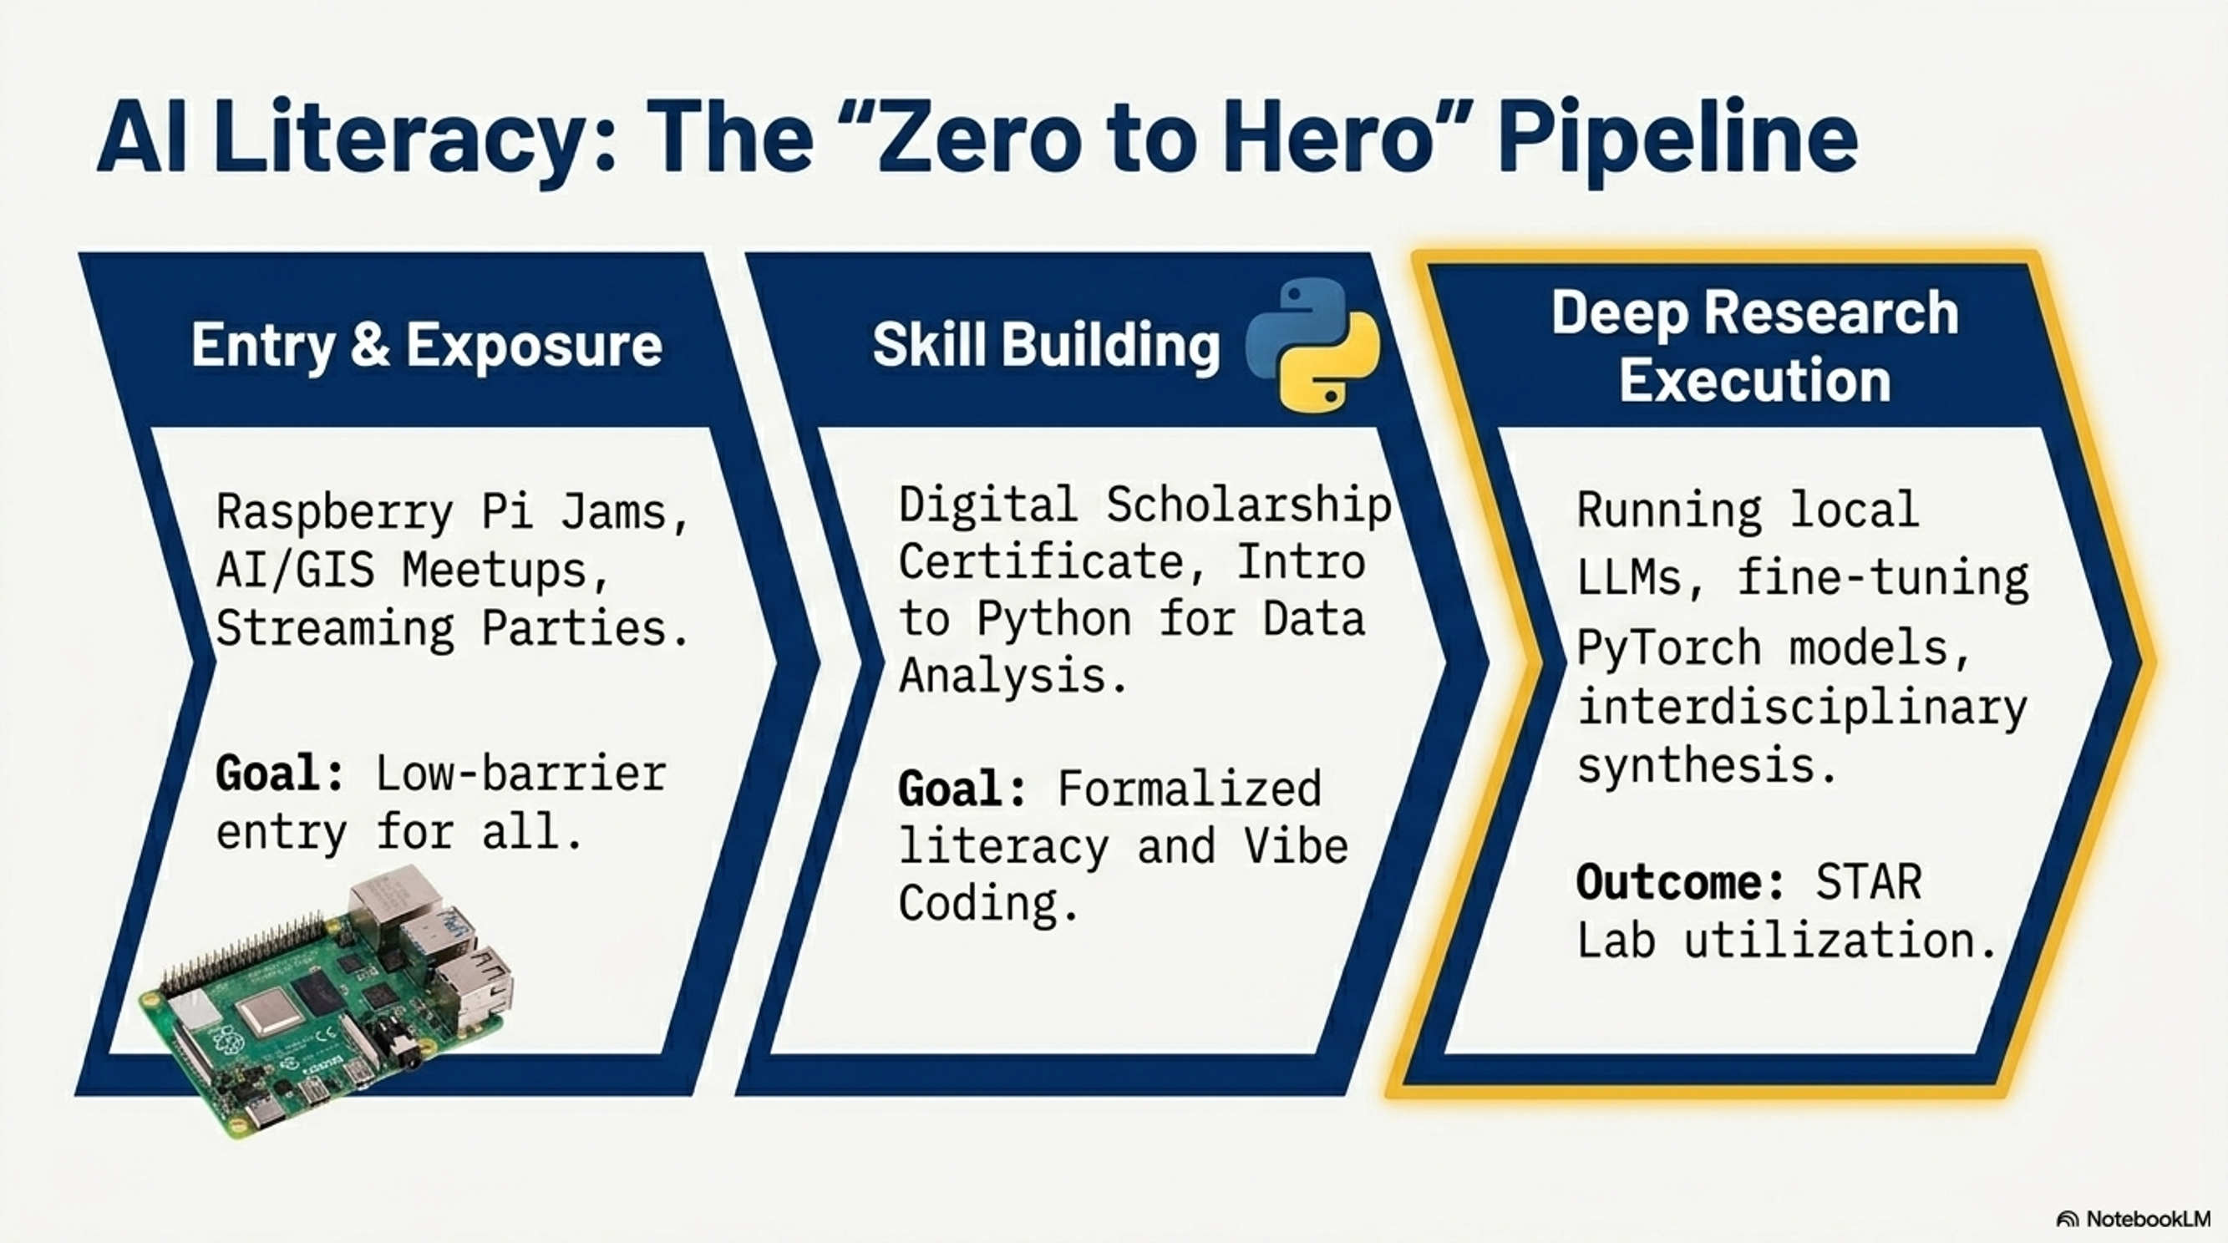

Slide 26
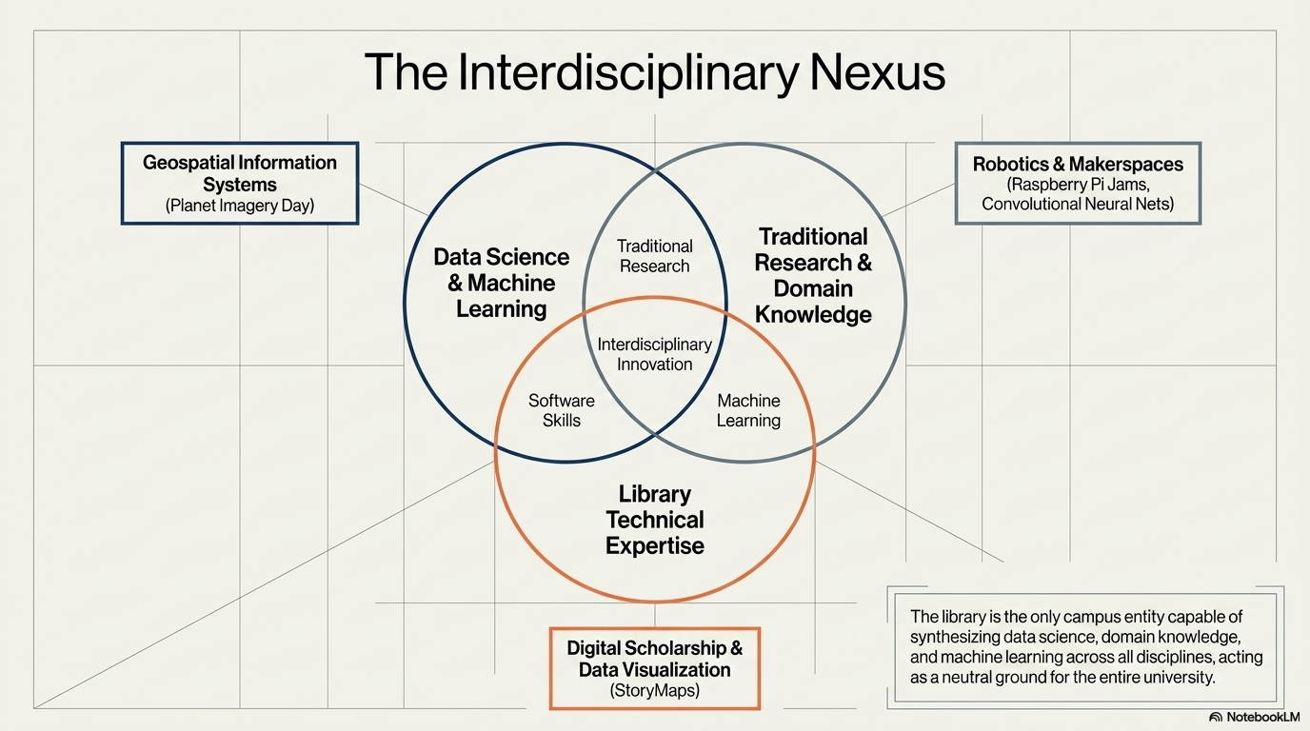

Slide 27
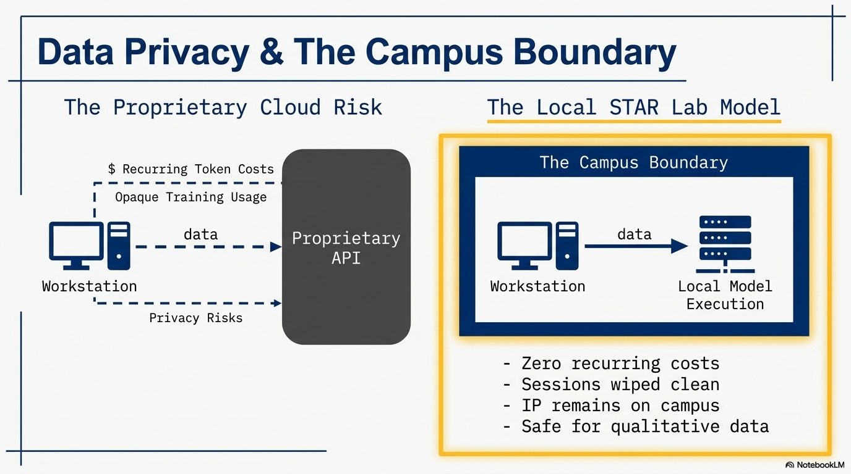

Slide 28
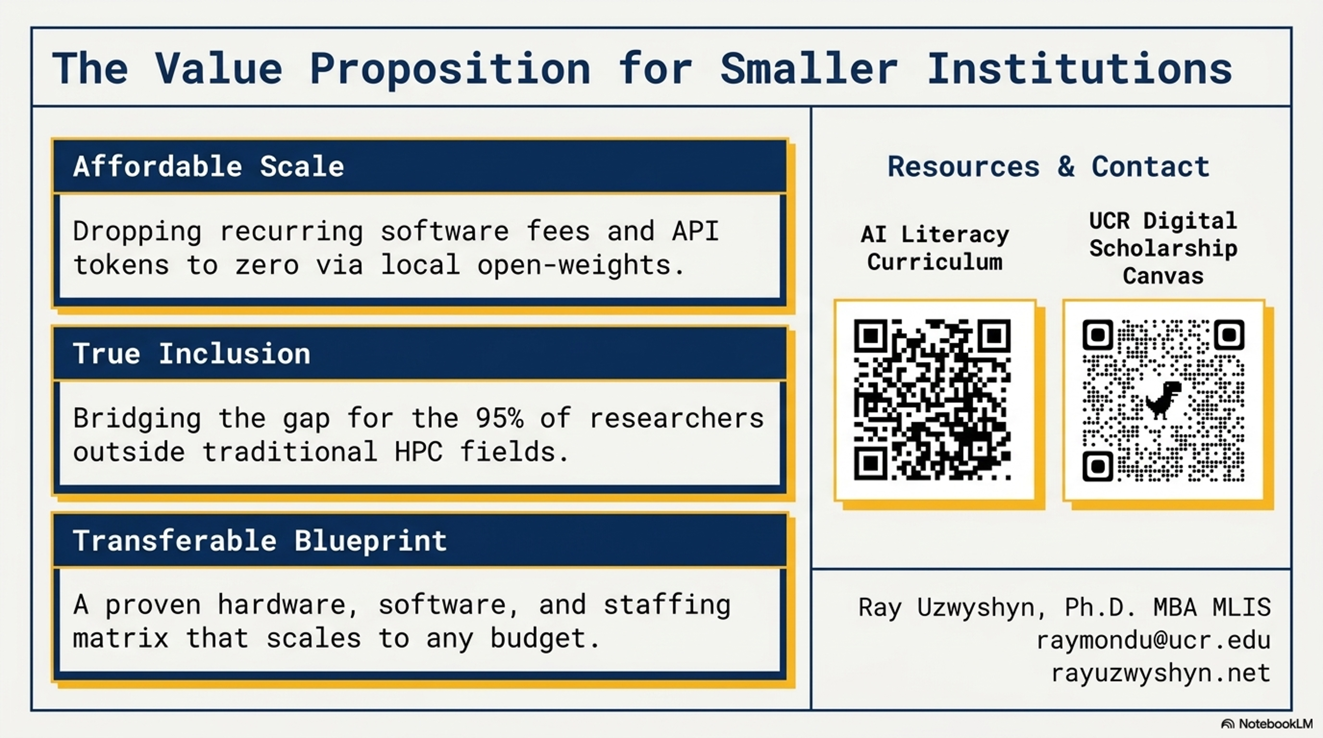

Slide 29
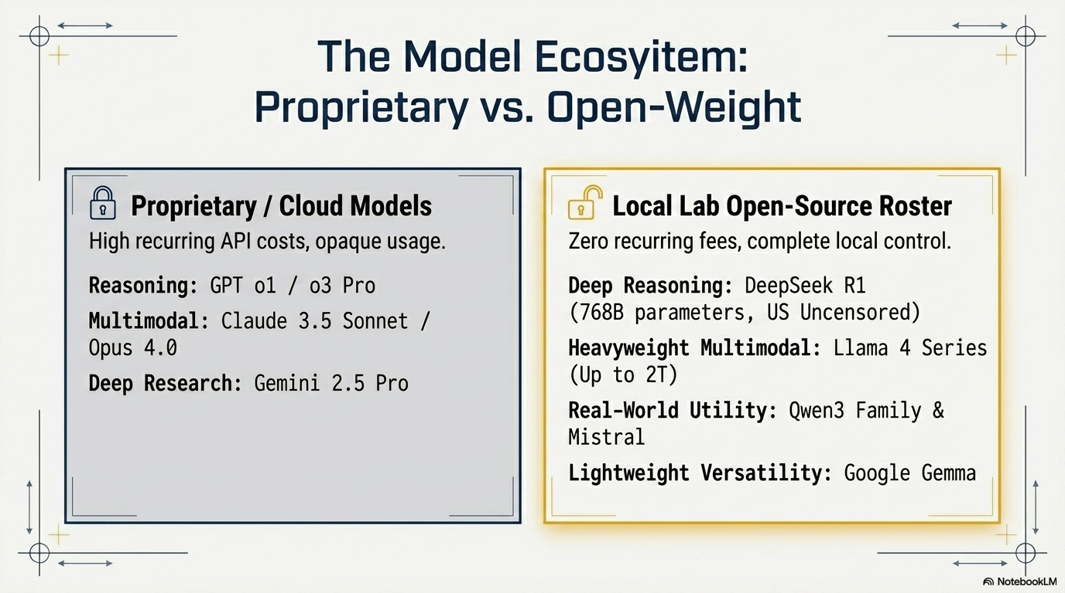

Slide 30
Digital Scholarship & Scholarly Communication
AI Computational & Qualitative Text Analysis
Data Analysis & Visualization
Web Scraping & Digital Archiving
Open Access publishing support
Learn more about the UCR Library digital scholarship & scholarly communication services

Slide 31


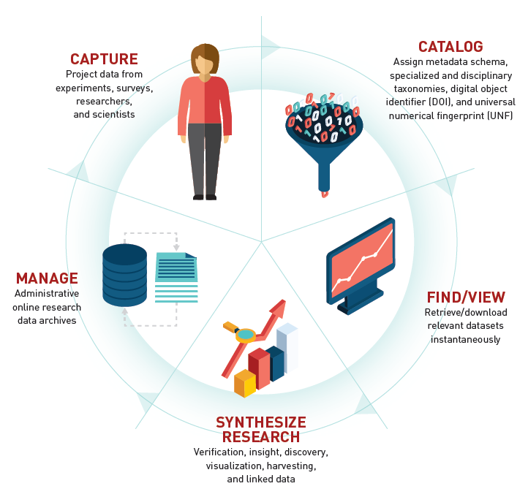


Data Services Supports The Research Lifecycle

Slide 32
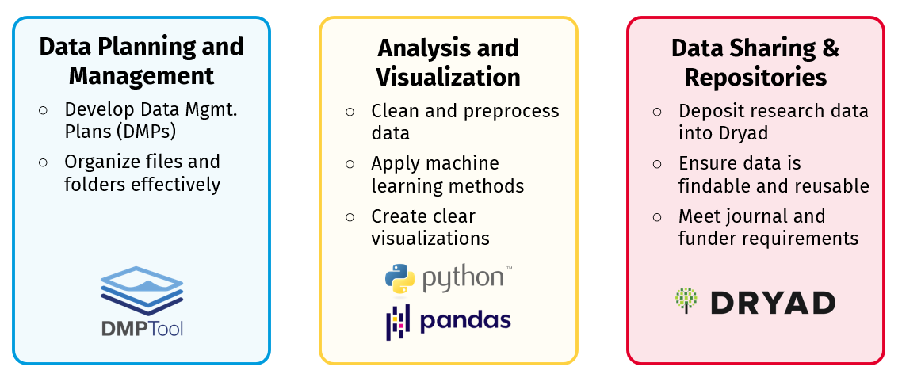
Research Data Lifecycle Support

Slide 33
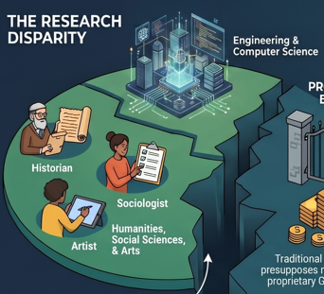
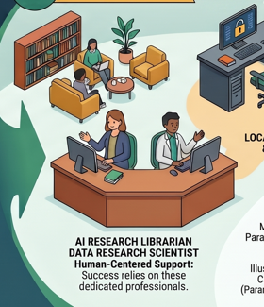
How Does This Work With
The Other 95% of University
Students and Researchers

Slide 34
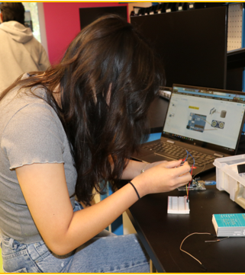
Experiential Learning Orientation to Workshops, Labs and Events
Creat'R Lab Makerspace (Room 140)
Robotics Lab (Room 146)
3D XP Lab (Room 145) – virtual reality
Events and Longer Commitments:
  Maker Week (every April) with hands-on entrepreneurial prototyping workshops
  Robotics Camp (every summer)
    Free for any interested UCR students
    For beginners and for all disciplines (20 slots)
    Hardware skills (CAD modeling) to create an object
    Software skills (Python and C++ coding)
    AI + Robotics Incorporating AI into the robot
    UC Loves Data Week

Slide 35
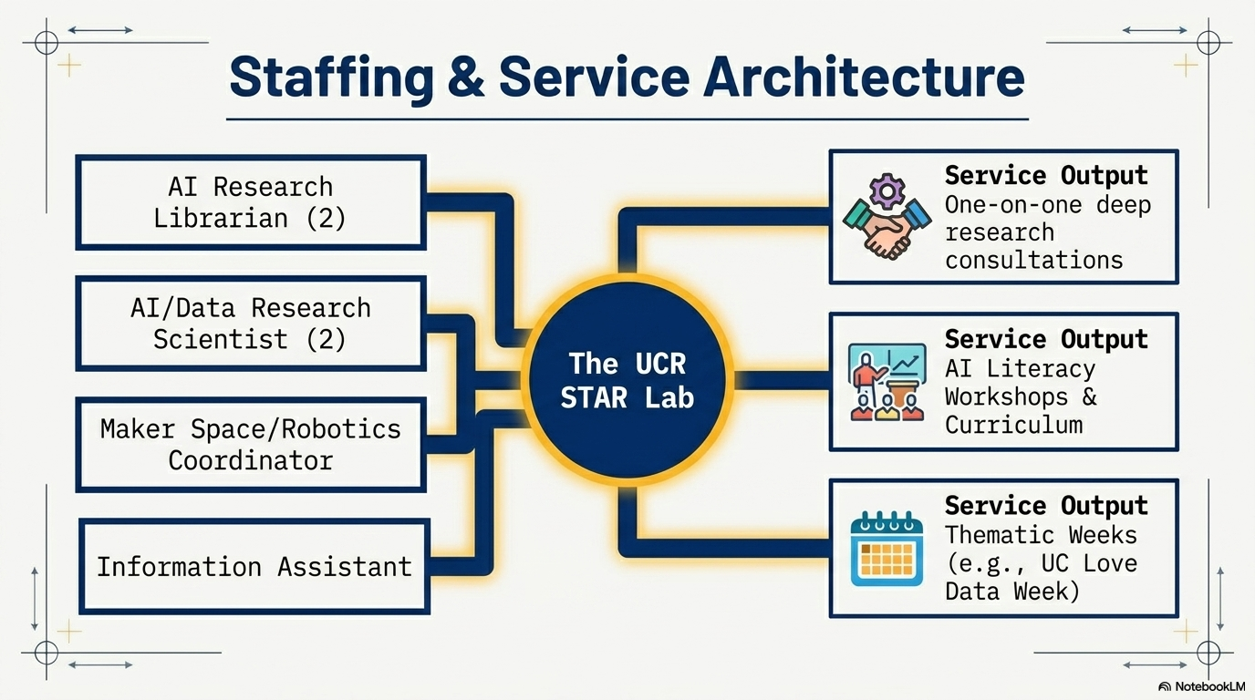

Slide 36
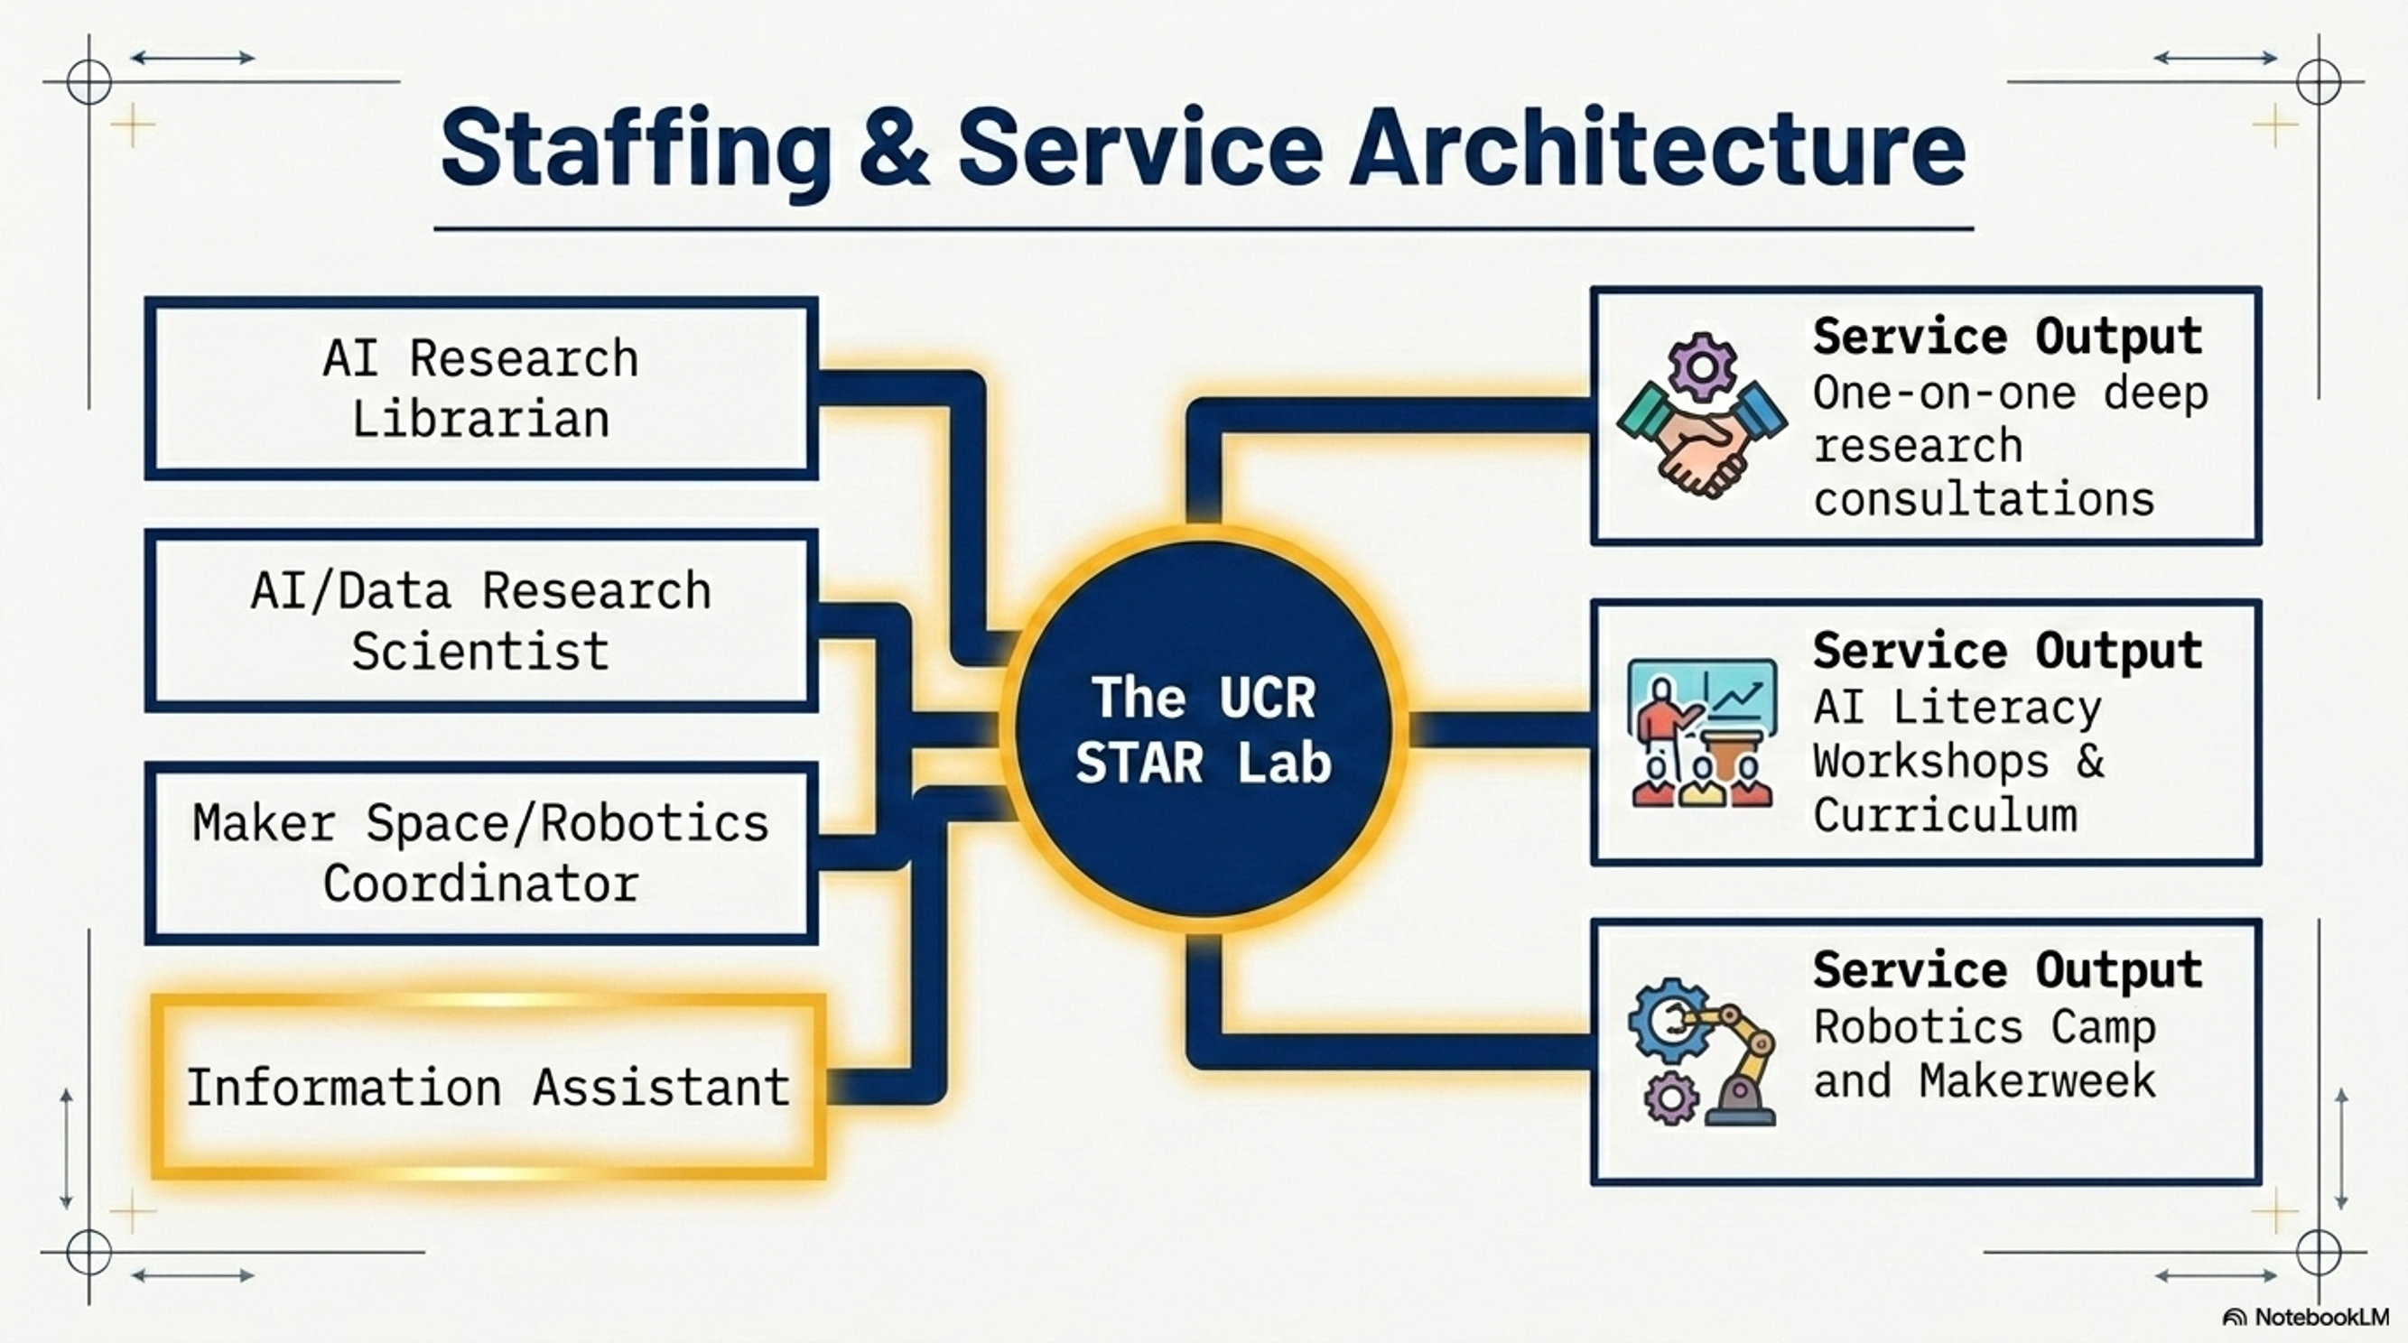
Thematic Weeks

