Slide 1
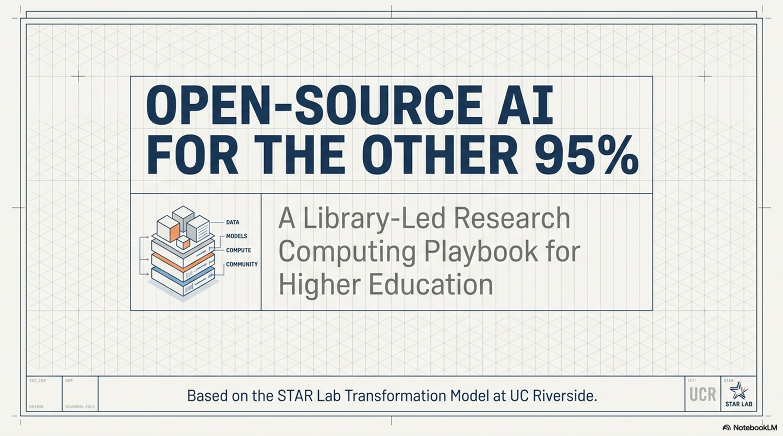


Deep Research and Open Source AI
For the Other 95%
A Research Services Library Led
AI Literacy, Research Computing Model
Presented for: RCSIS Research Computing for Smaller Institutions, June 2026, Swarthmore College
Ray Uzwyshyn, Ph.D. MBA MLIS
Acting AUL for Research & Technology &
Director of Research Services
University of California Riverside Libraries, raymondu@ucr.edu ,https://rayuzwyshyn.net https://www.linkedin.com/in/rayuzwyshyn/

Slide 2
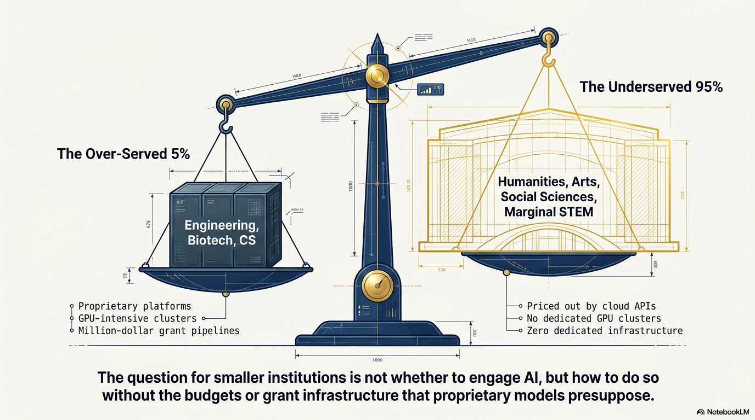

Slide 3
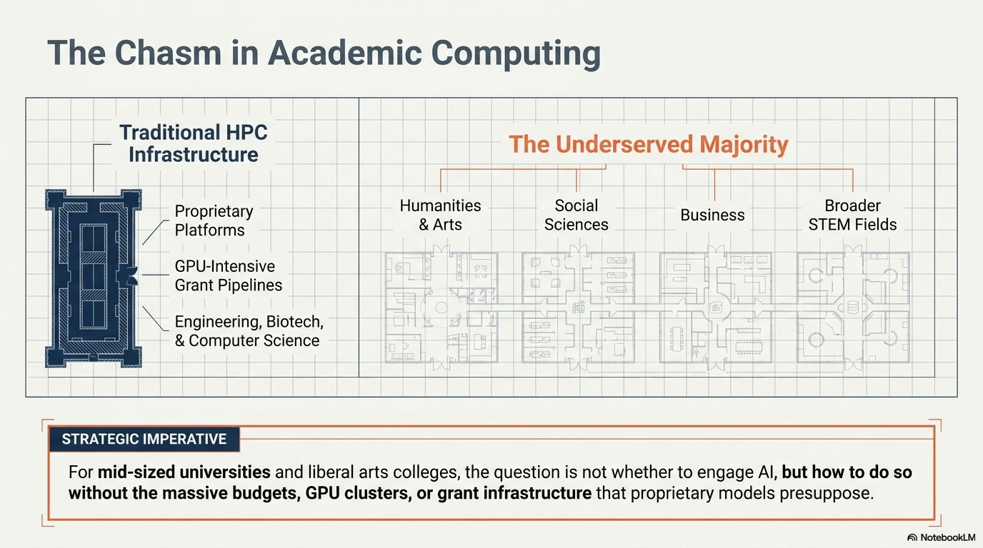

Slide 4
AI Support at UCR
AI Literacy, Faculty, Student &
Researcher Support
  Use of AI tools in research e.g., research design, data collection analysis
  Data management
  Model training for regular size datasets
Library
HPC &
Faculty Teaching Center,
RAISE
Information
Technology
Services
Dedicated
AI Research Librarian
Data Scientist
University Wide AI Proprietary Licenses (Google Gemini, Limited OpenAI, Anthropic)
Broad general training
Security
High Performance AI Research Compute, Top 2-5%, Major Grant Support Costs Involved)
Instructor Development,

Slide 5
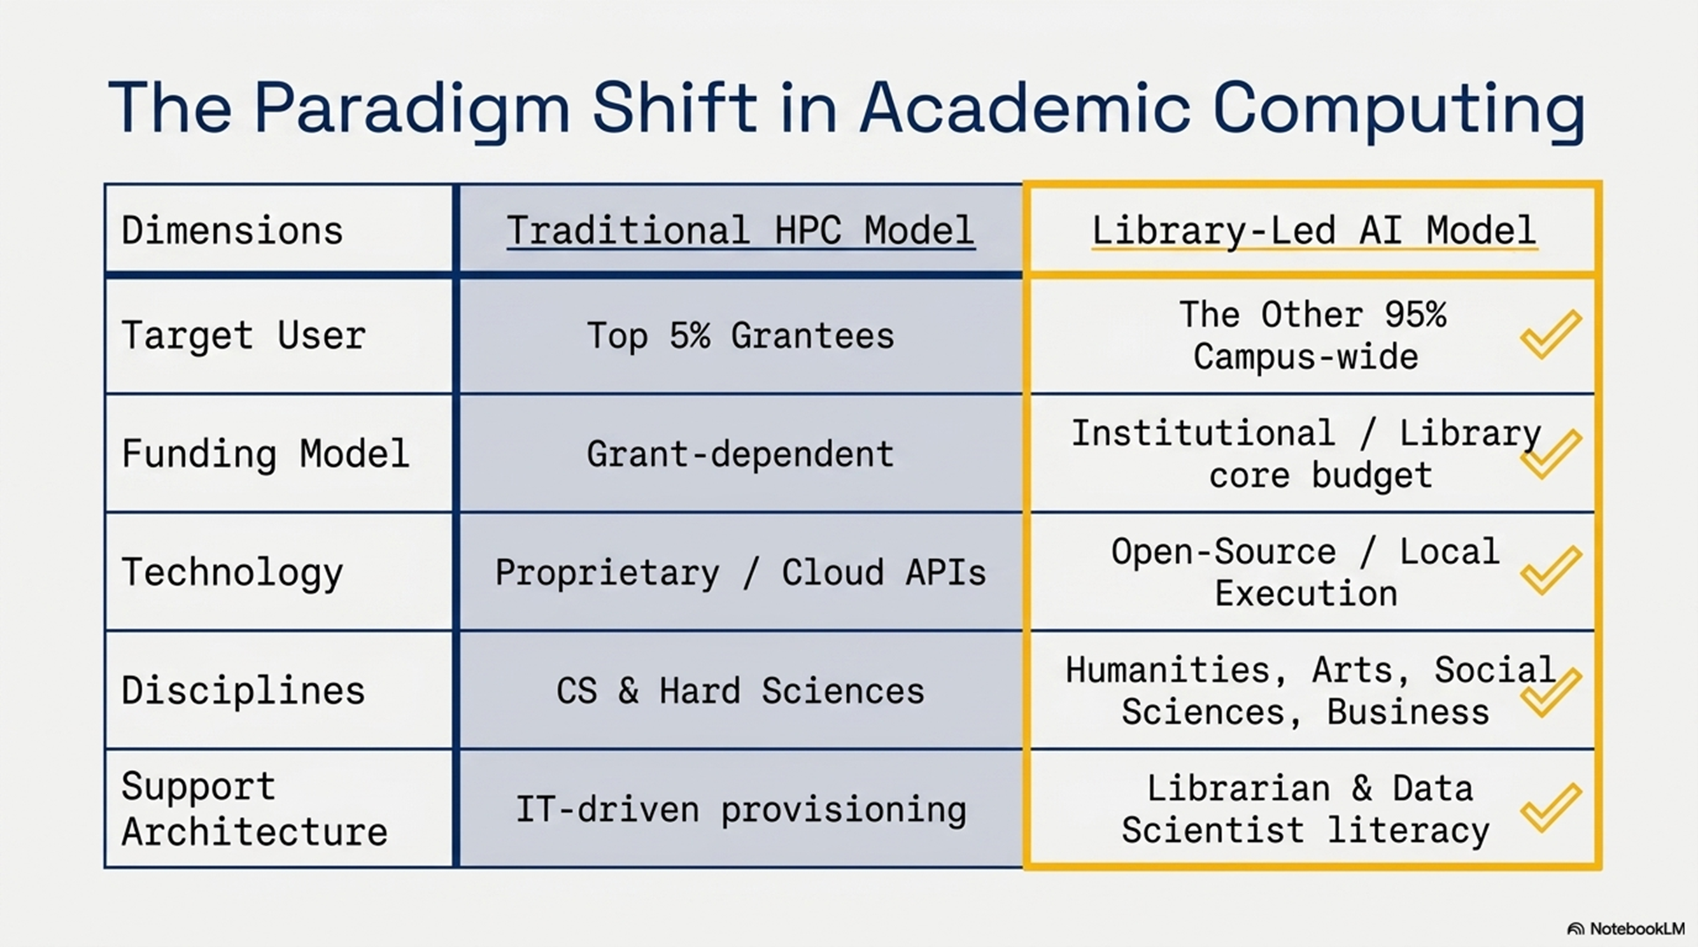

Slide 6
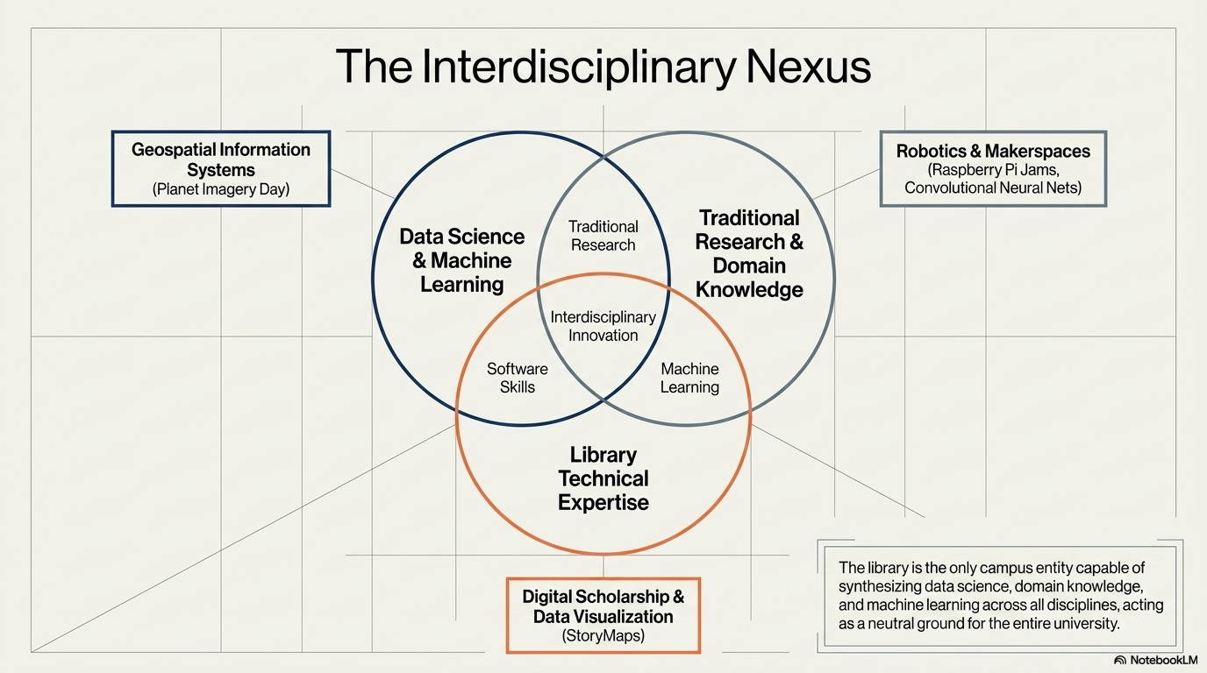

Slide 7
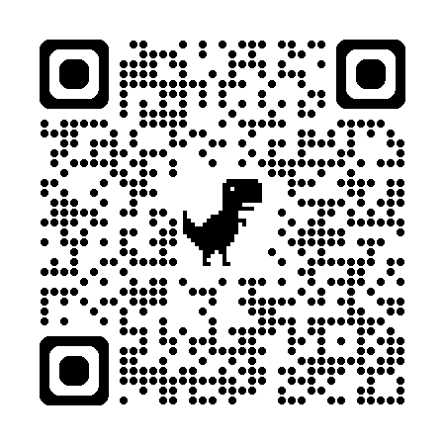
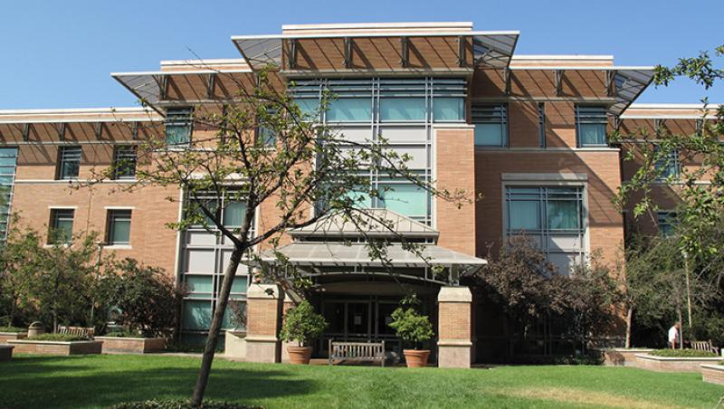
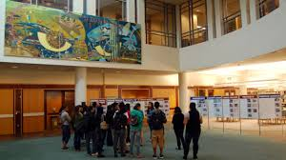
UCR Libraries Research and Technology Services
Orbach Science Library
Innovative Media Librarian
Digital Scholarship Librarian
Geospatial Information Systems Librarian
Research Data Scientist
Maker Space/Robotics Lab Services Coordinator
Research Services Information Assistant
Medical & Clinical Outreach Librarian
Director of Research Services
Cyberinfrastructure
AI Research Librarian (2)
AI/Data Research Scientist (2)

Slide 8
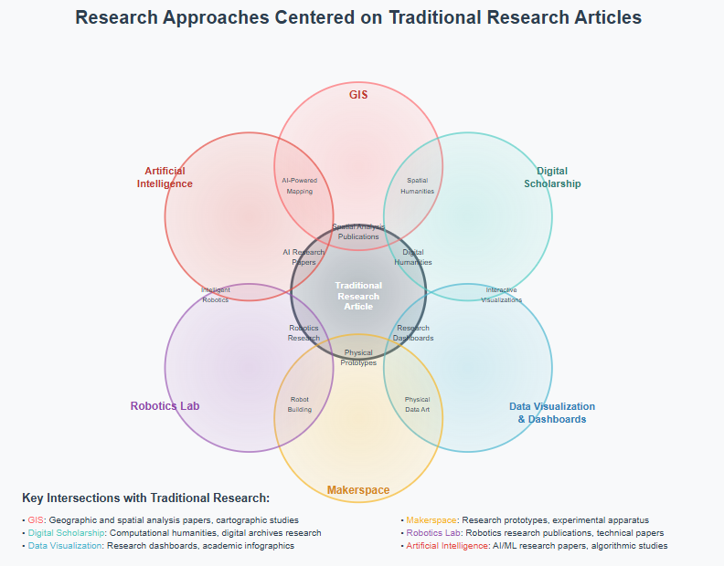
UCR Library
Research & Technology Services
Several Units
Several Technologies
Traditional Research Article, Book
Increasingly Focused
on AI Literacy
AI

Slide 9
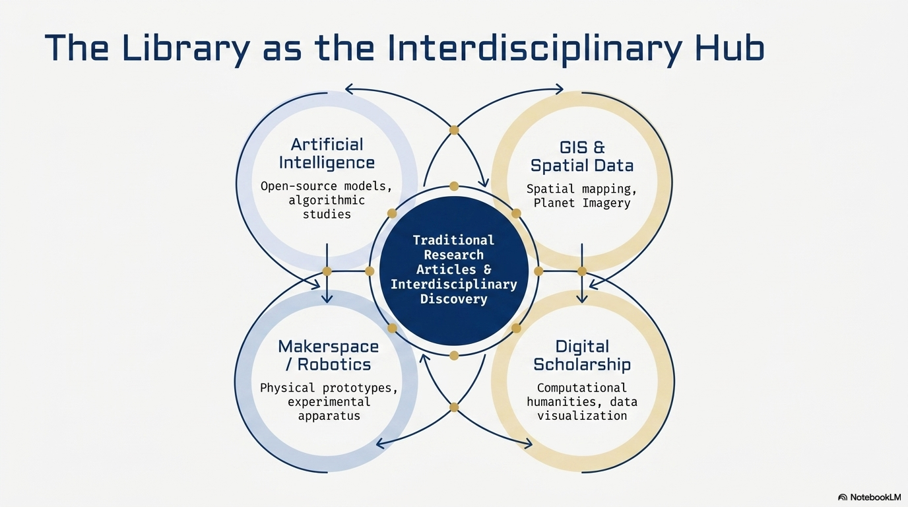

Slide 10
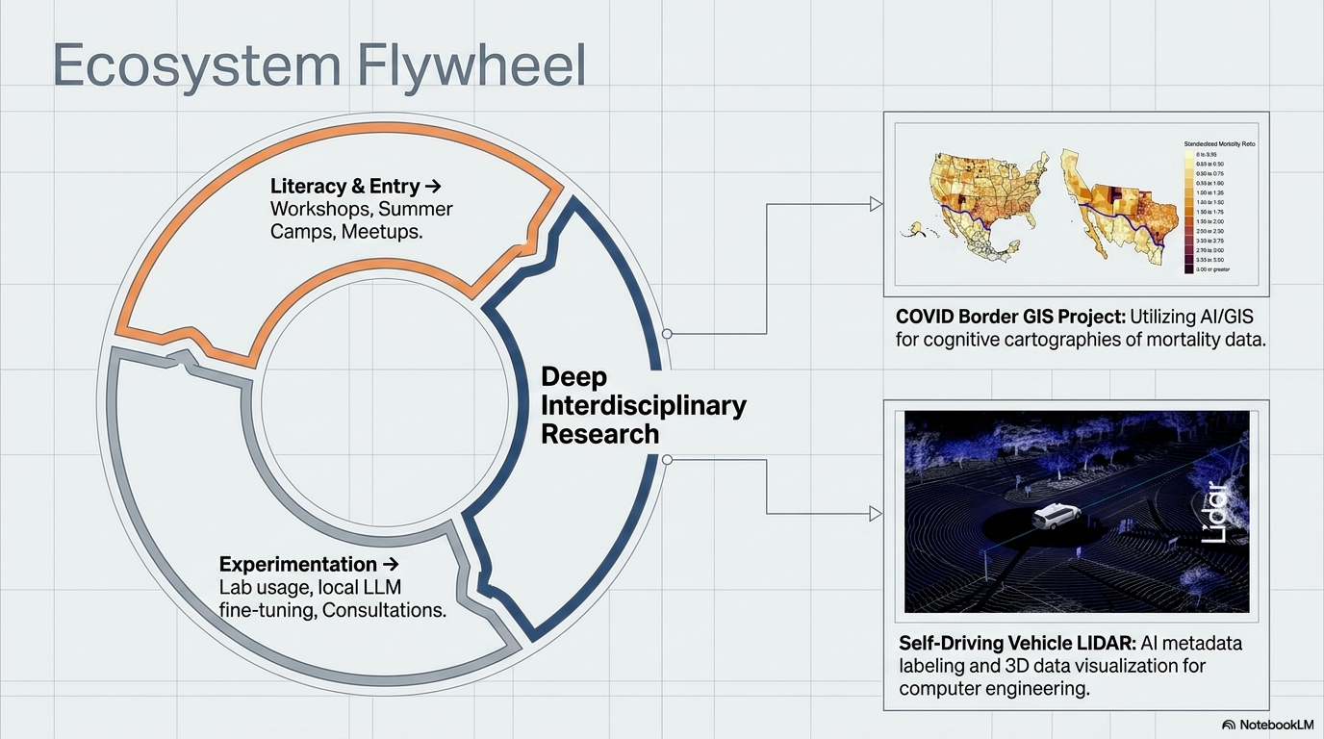

Slide 11
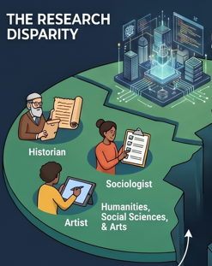
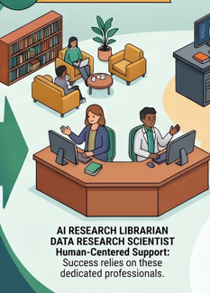
Who are The Other 95%

Slide 12


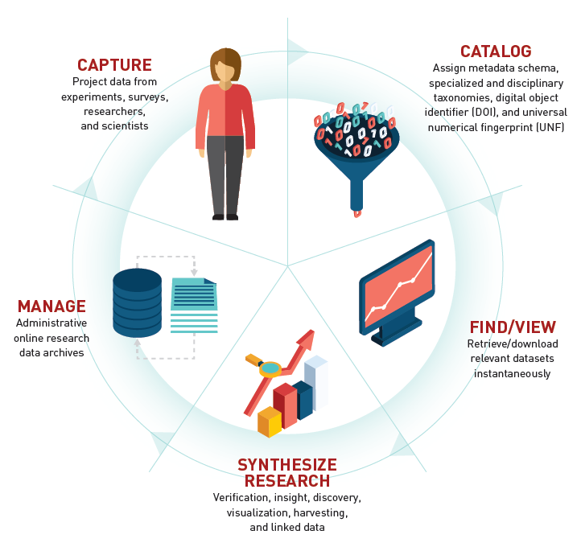


Data Services Supports The Research Lifecycle

Slide 13
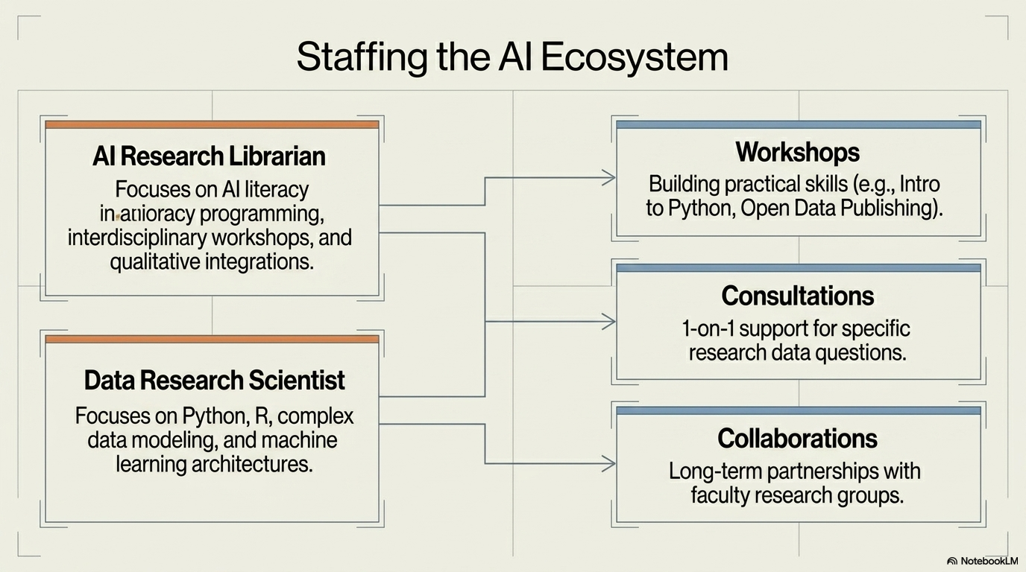

Slide 14
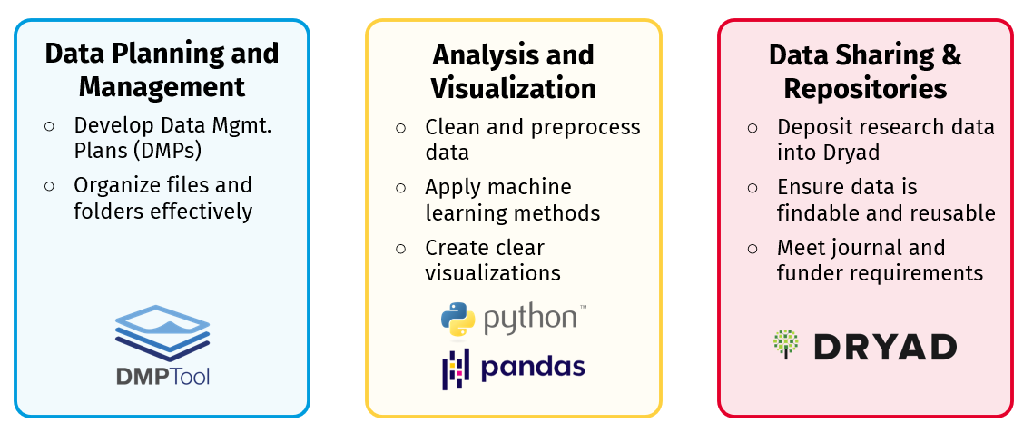
Research Data Lifecycle Support

Slide 15
Library Workshops for Researchers
(FY25/26 Samples)
Introduction to Machine Learning
Introduction to Gemini API: How to customize AI models
Exploring AI Literature Mapping Tools (Natural Language Processing)
Finding and Using Imagery in a GIS, Arc GIS and AI, Drones &GIS
Data Cleaning for Machine Learning with Python
AI Computational Methods with Text Analysis
AI Deep Research Models/AI Video
Introduction to Deep Learning with PyTorch
Open scholarship / open access publishing
Contact:
Raymond Uzwyshyn, Director of Research Services/Acting Assistant University Librarian for Research and Technology, UCR Library

Slide 16
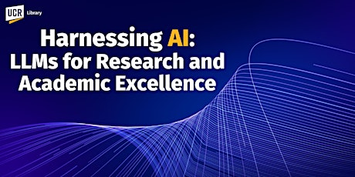
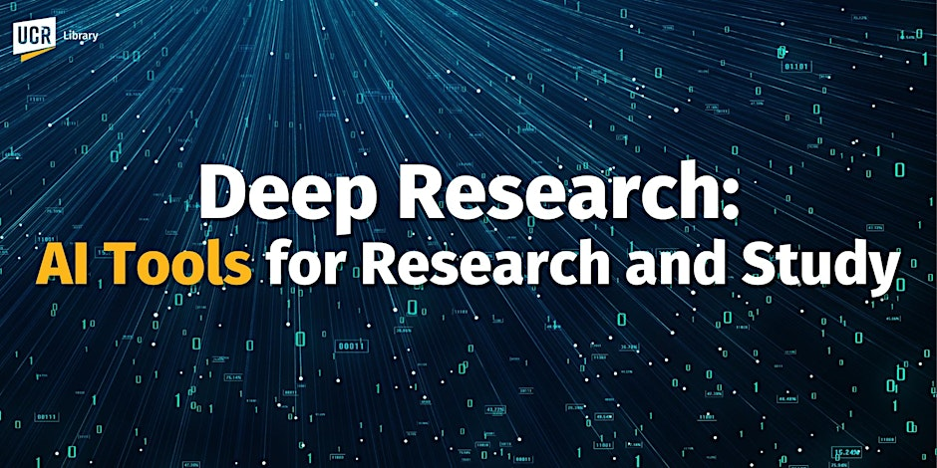
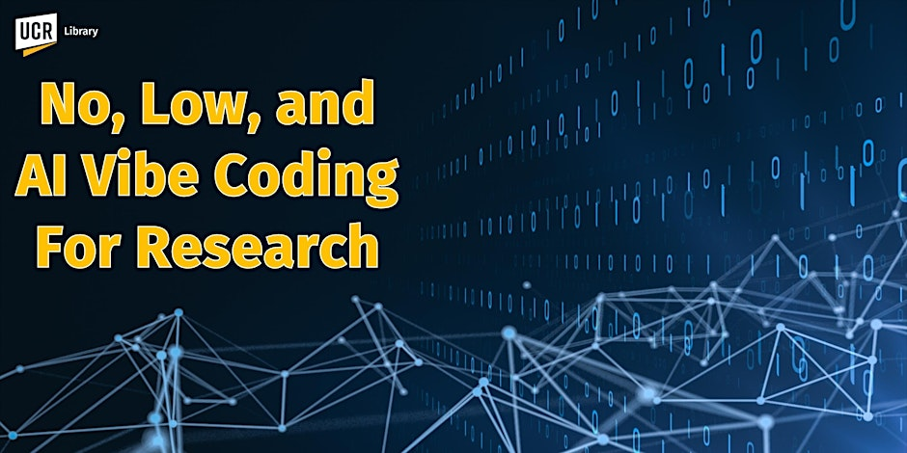
March 2025. https://www.researchgate.net/publication/389558789_Harnessing_AI_For_Research_2025_GenAI_Large_Language_Model_Introduction_AGI_and_Reasoning_Models_Multimodal_Models_and_Deep_Research_with_Autonomous_Agents
May 2025. https://www.researchgate.net/publication/391739383_Deep_Research_AI_Tools_For_Research_and_Discovery
November 12, 2025.
https://www.researchgate.net/publication/397584324_Vibe_Coding_For_AI-Driven_Development_An_Introduction_for_Research_and_Learning

Slide 17
Digital Scholarship & Scholarly Communication
AI Computational & Qualitative Text Analysis
Data Analysis & Visualization
Web Scraping & Digital Archiving
Open Access publishing support
Learn more about the UCR Library digital scholarship & scholarly communication services

Slide 18
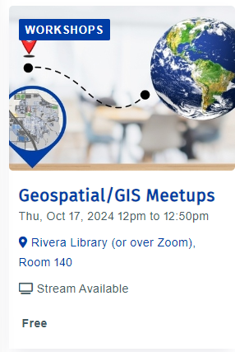
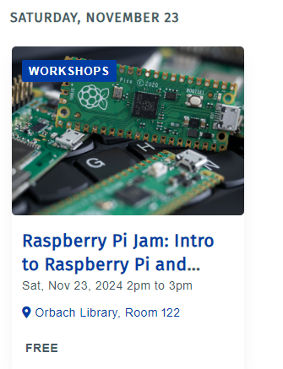
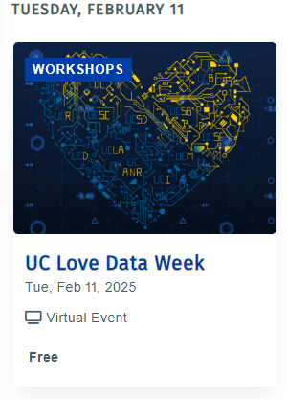

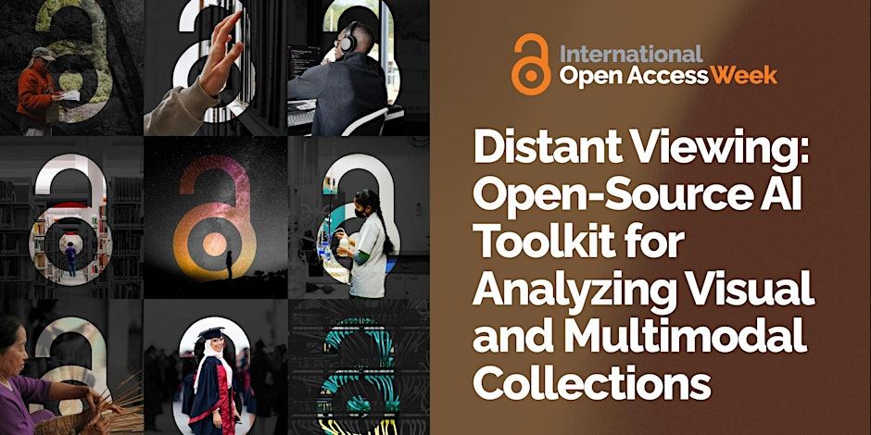
AI Orientation to Technology Workshops and Faculty, Student AI Related Research
Meetups, Thematic Weeks, Presentations
Data, AI,
Open Access
Global North and South Presentation
Streaming Party
For Faculty Students and Staff
AI Research Faculty
Presentations
AI/Robotics
Training Kits
Workshops

Slide 19
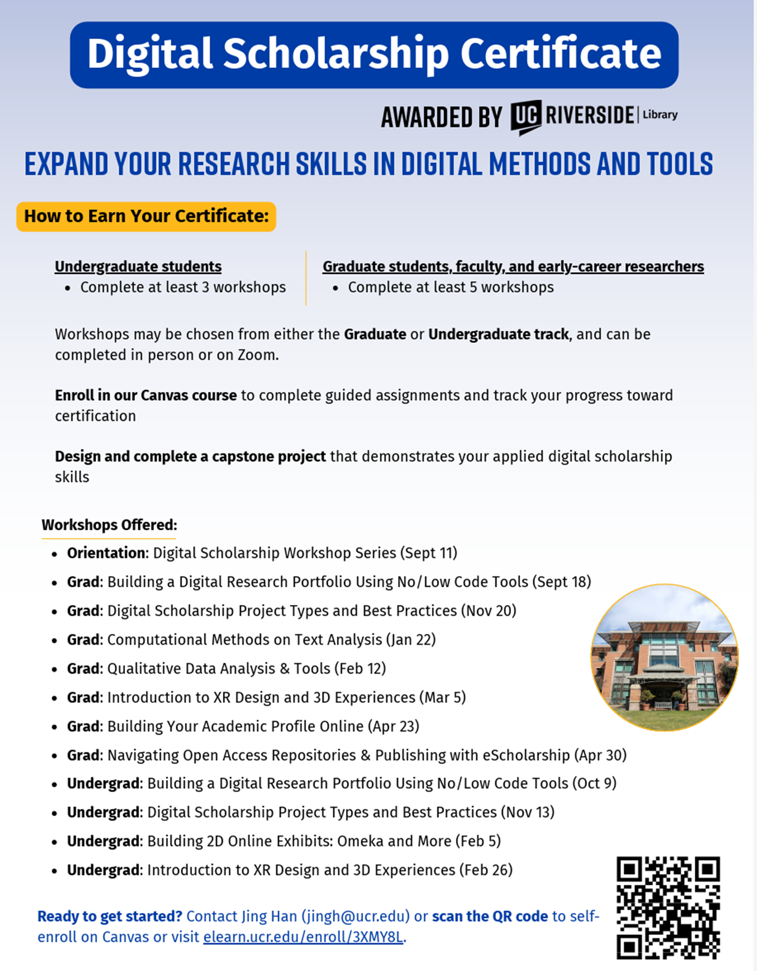

Slide 20
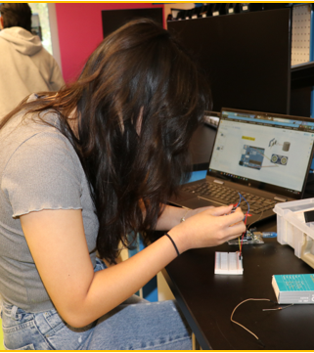
Experiential Learning at Orbach Science Library
Creat'R Lab Makerspace (Room 140)
Robotics Lab (Room 146)
3D XP Lab (Room 145) – virtual reality
Workshops:
  Maker Week (every April) with hands-on entrepreneurial prototyping workshops
  Robotics Camp (every summer)
    Free for any interested UCR students
    For beginners and for all disciplines (20 slots)
    Hardware skills (CAD modeling) to create an object
    Software skills (Python and C++ coding)
    AI + Robotics Incorporating AI into the robot
    UC Loves Data Week

Slide 21
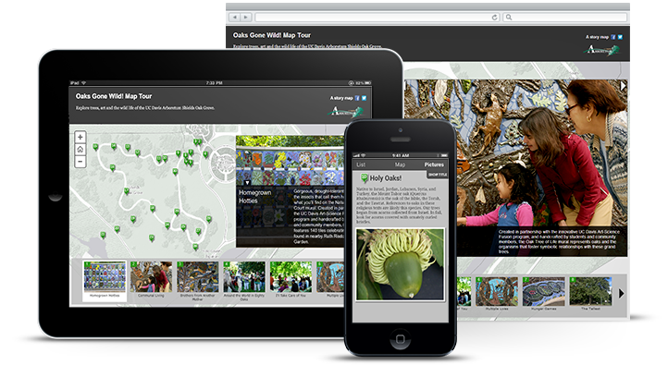
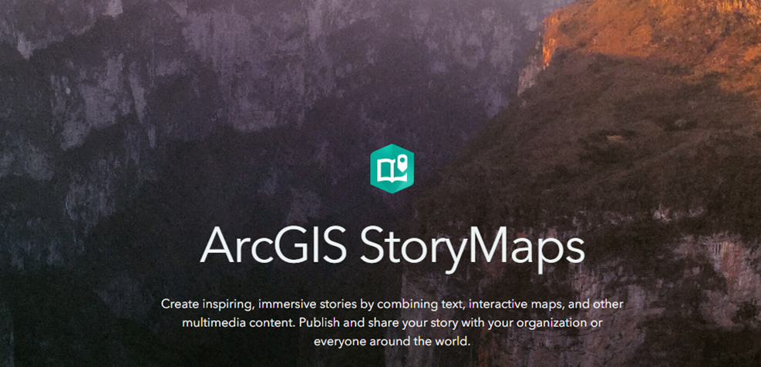


Geospatial Information Services
AI + GIS, Planet Imagery Day
Dr. Nan Li, UCR Environmental Sciences
Dr. Nicolas dos Santos, UCR Computer Science
Planet Imagery Day is supported by USDA-NIFA's Artificial Intelligence for Sustainable Agriculture project
In a collaboration with the Artificial Intelligence for Sustainable Agriculture (AI4SA) project, the library hosted Planet Imagery Day on May 2, 2025. The event featured presentations regarding using Planet imagery in Google Earth Engine and in ArcGIS products, given by staff from Planet and Esri respectively.

Slide 22
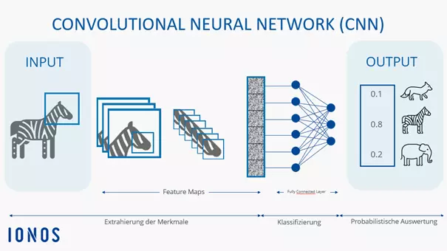
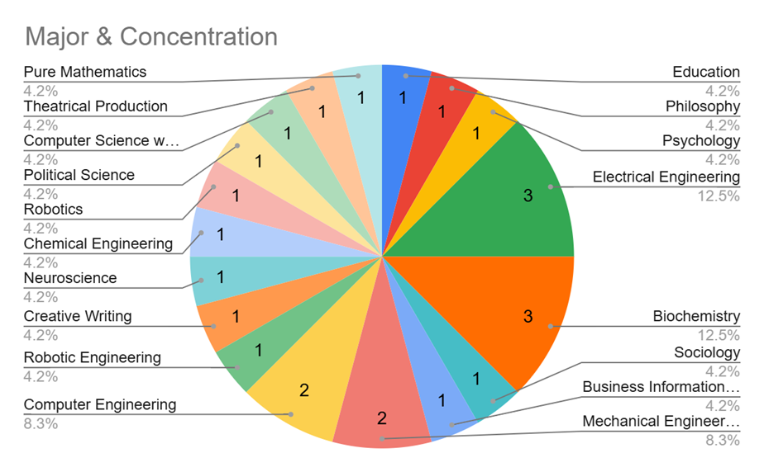
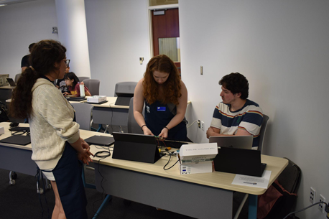
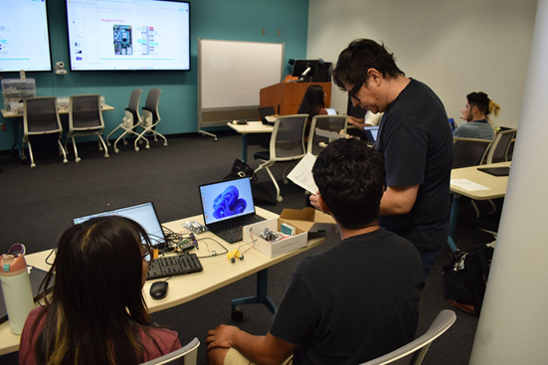
AI Enhanced Robotics Summer Camp
LAB Workshops: From Zero to Hero
An AI training method, which teaches the model to recognize items based on an image
Convolutional Neural Nets Integrated with Robotics
Students were taught how to train the model and how to use the model in a real application
75% Female
Attendees

Slide 23
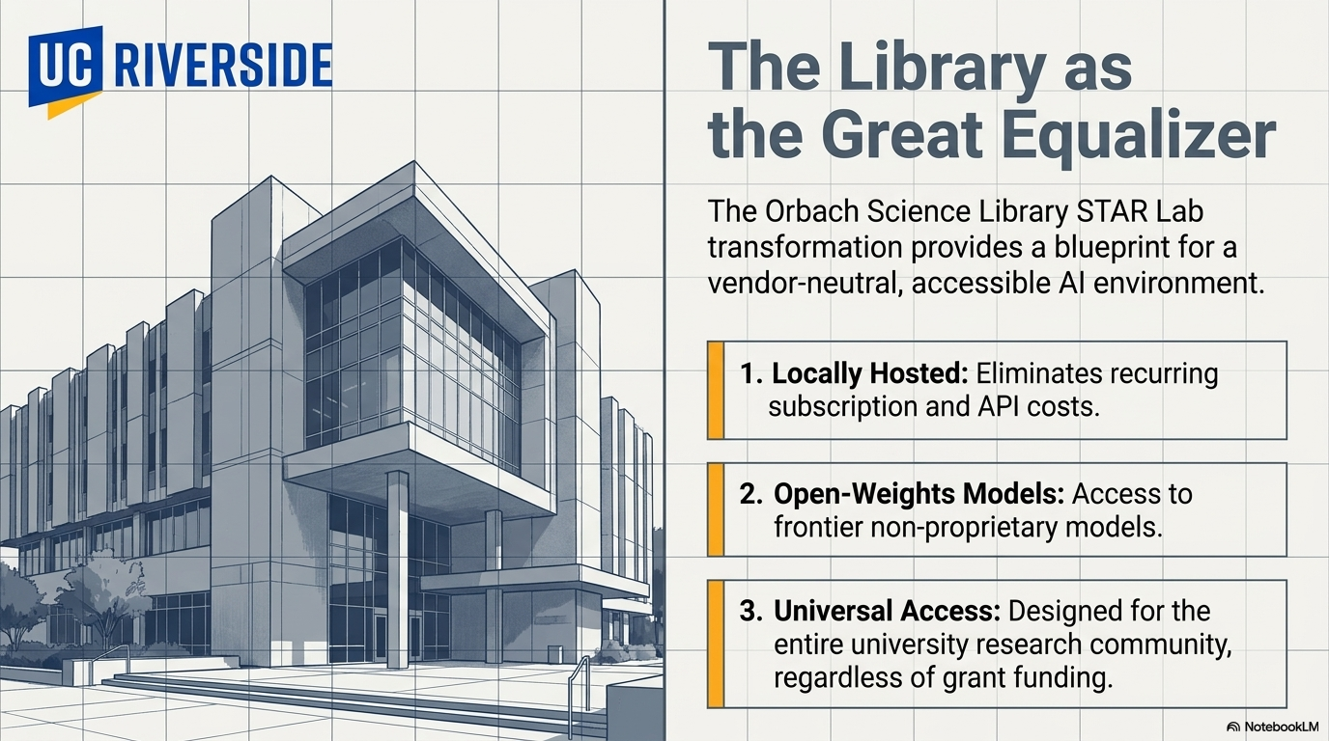

Slide 24
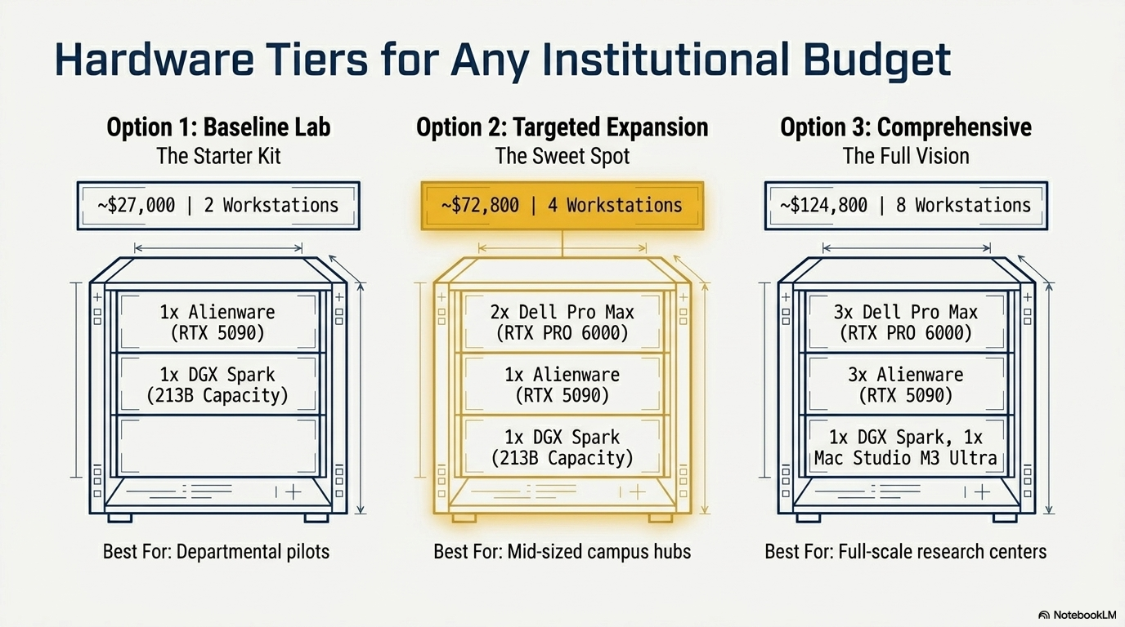

Slide 25
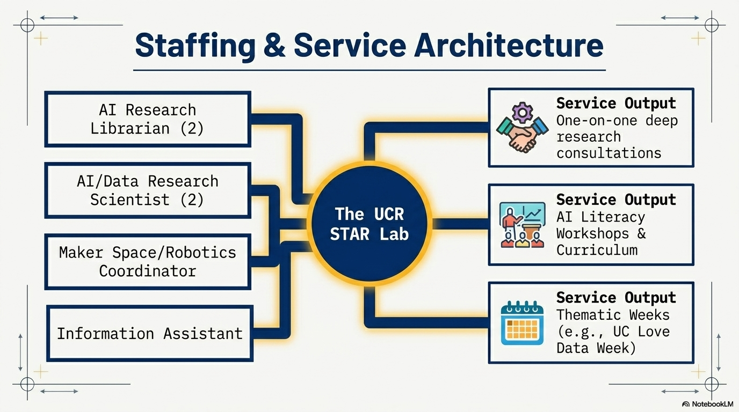

Slide 26
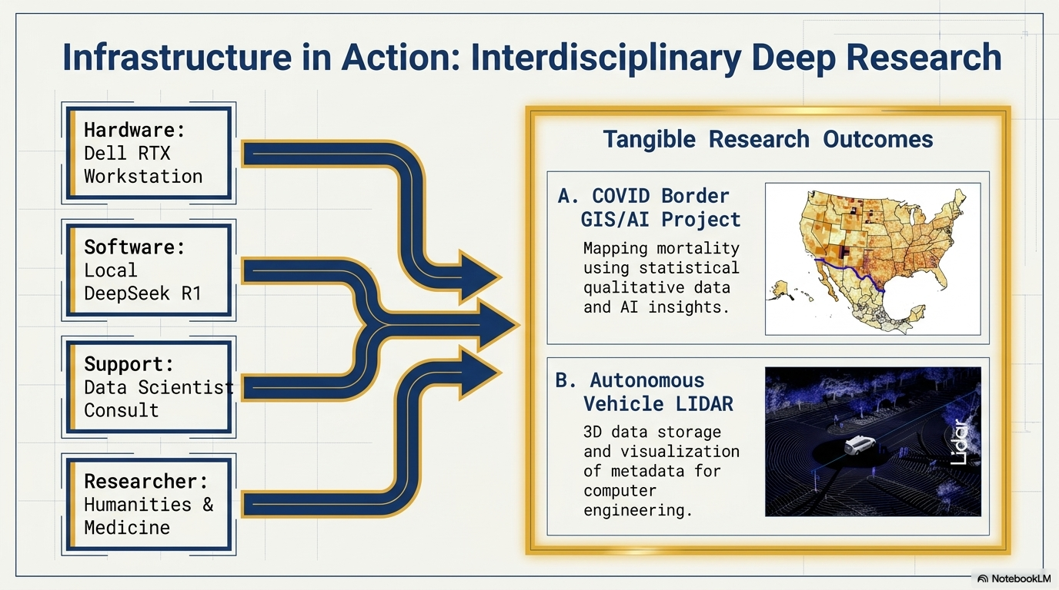

Slide 27
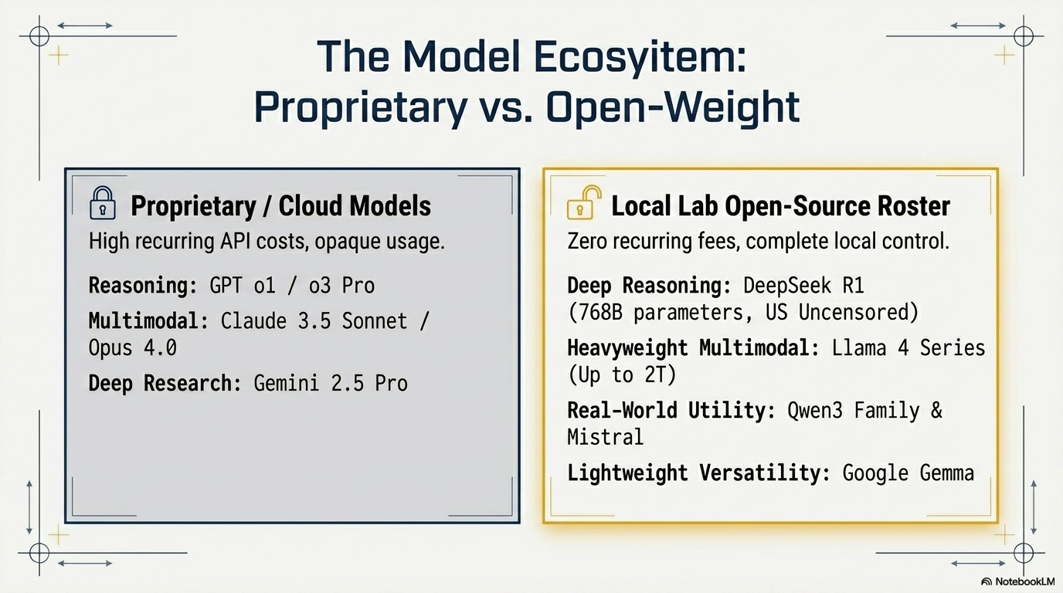

Slide 28
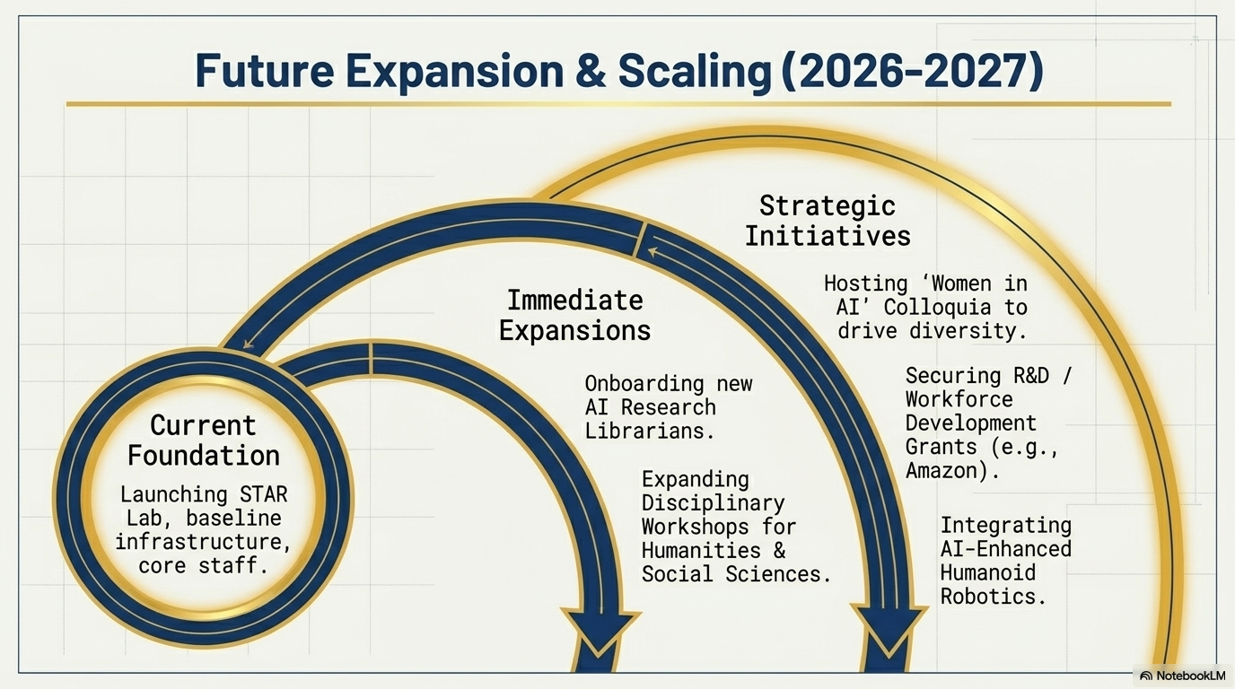

Slide 29
Comments and Questions
Thank you for Attending!
Ray Uzwyshyn, Ph.D. MBA MLIS
Acting AUL for Research & Technology Services
University of California, Riverside Libraries, raymondu@ucr.edu
https://www.linkedin.com/in/rayuzwyshyn/
https://rayuzwyshyn.net

Slide 30
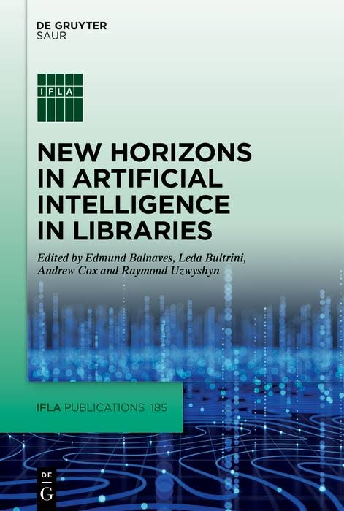
Further AI Related Library Resources
Uzwyshyn, R. Reimagining Education In the Age of AI: From Information Scarcity to Abundant Intelligence. (CXO Print Edition). Education Technology Insight. 2025.
Uzwyshyn, R et al. New Horizons in AI for Libraries (Editor). Open Access Online Version PDF, Print Cover Section Introduction: Projects in Machine Learning and Natural Language Processing in Libraries (Proof) (Glossary Proof).IFLA Publication Series. (Online Open Access Version) Walter De Gruyter (GmbH): Berlin January 2025.
Building Library AI Infrastructures: Research Data Repositories, Scholarly Ecosystems and AI Scaffolding (Draft). New Horizons in AI for Libraries. De Gruyter: Berlin, January 2025.
From Open Science and Datasets to AI and Discovery. Trends and Issues in Library Technology: IFLA IT Section. January 2023.
Presentations, Publications
https://rayuzwyshyn.net
https://www.linkedin.com/in/rayuzwyshyn/

Slide 31
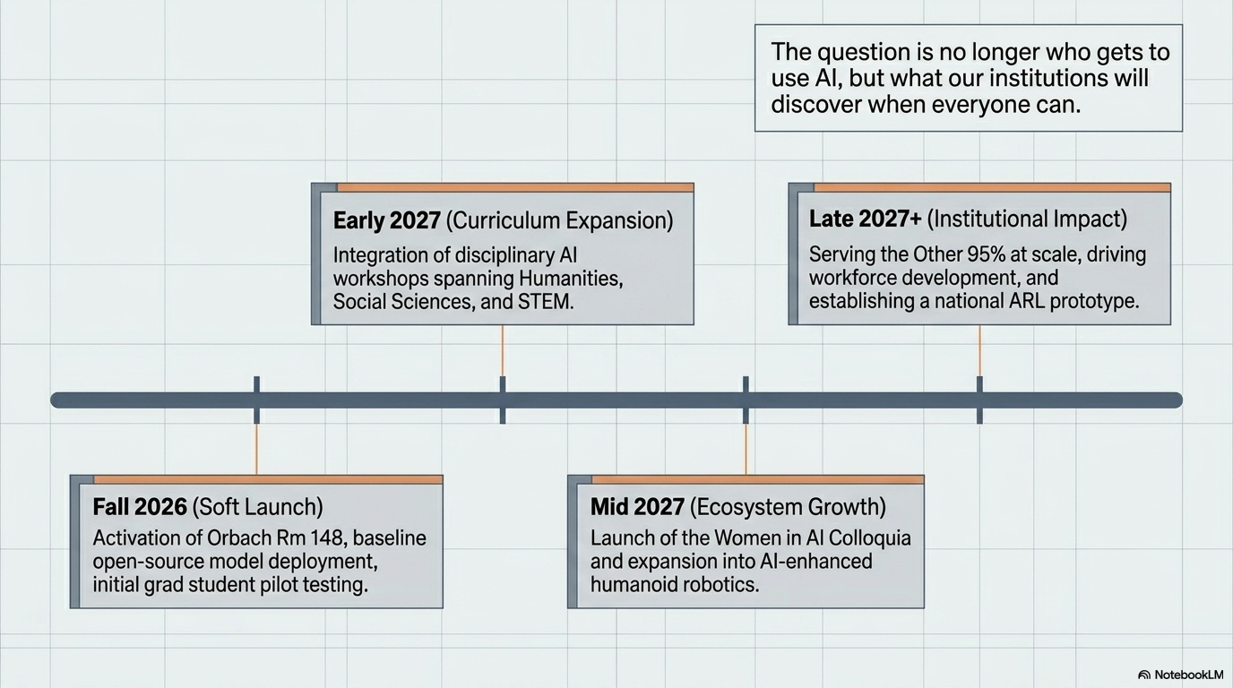

Slide 32
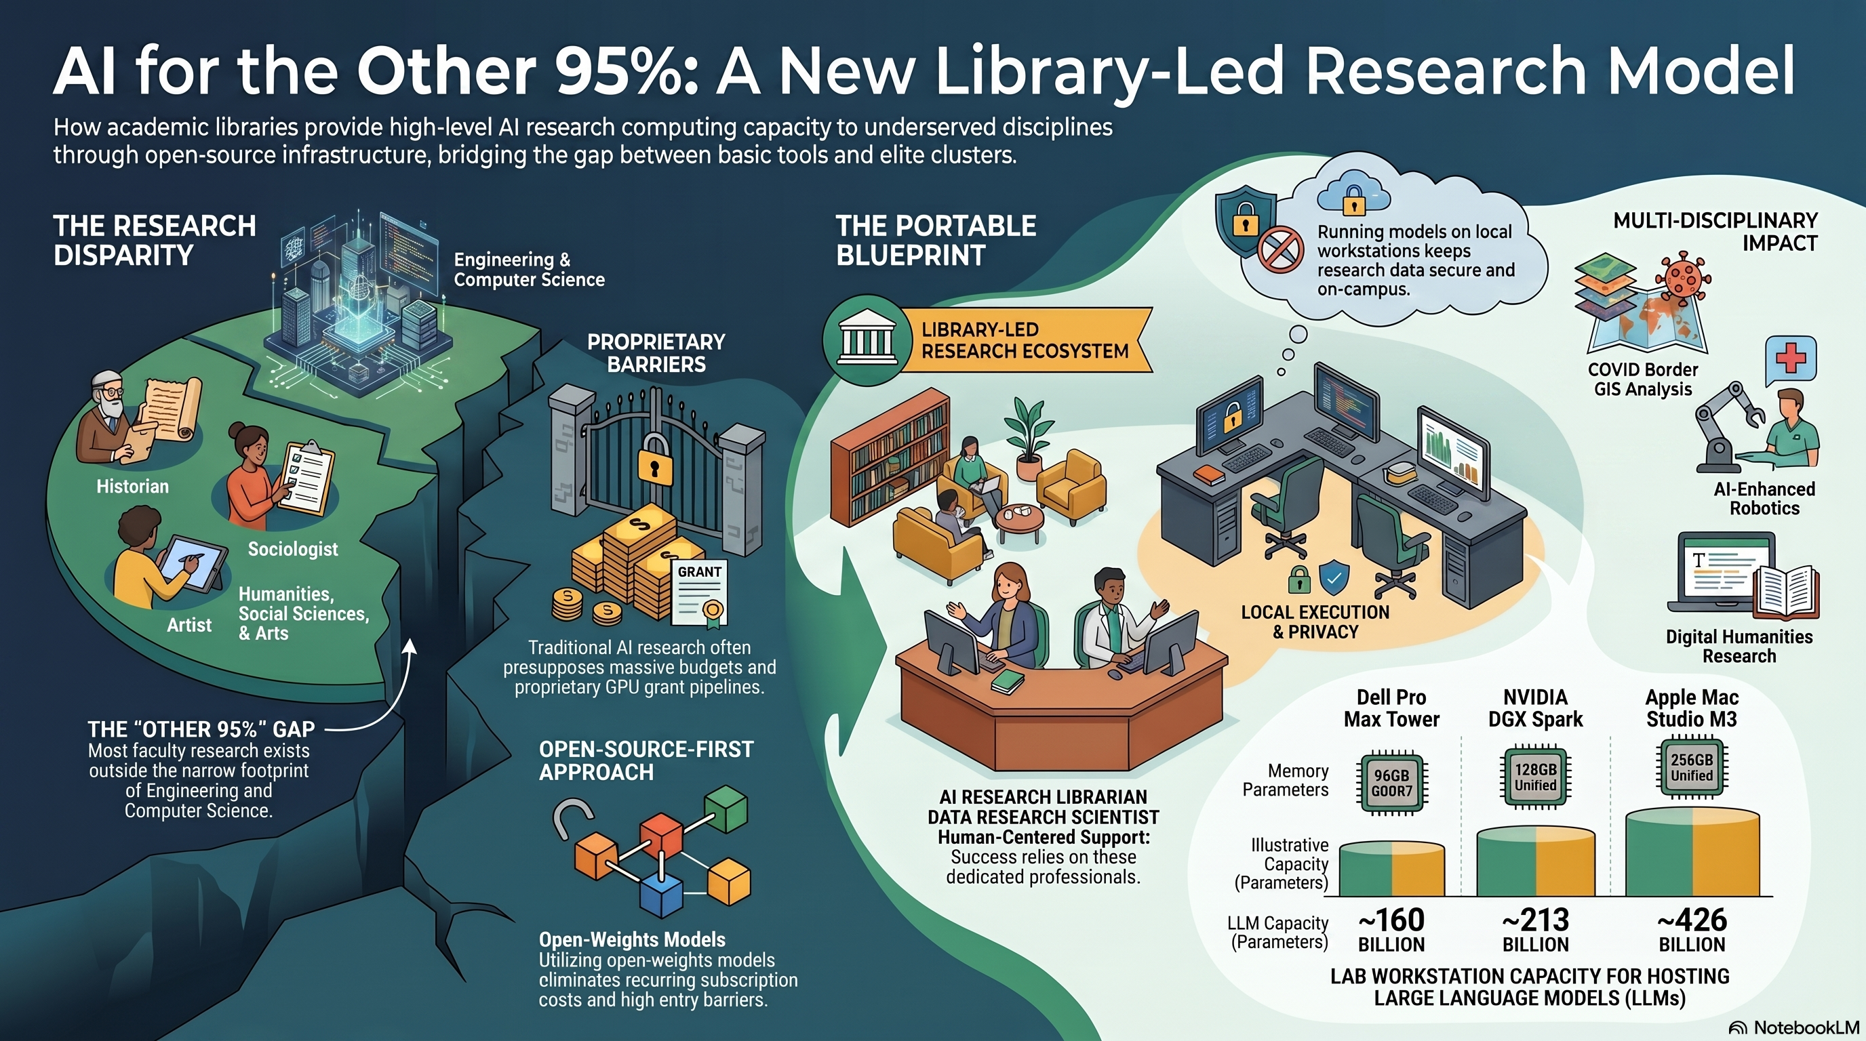

Slide 33
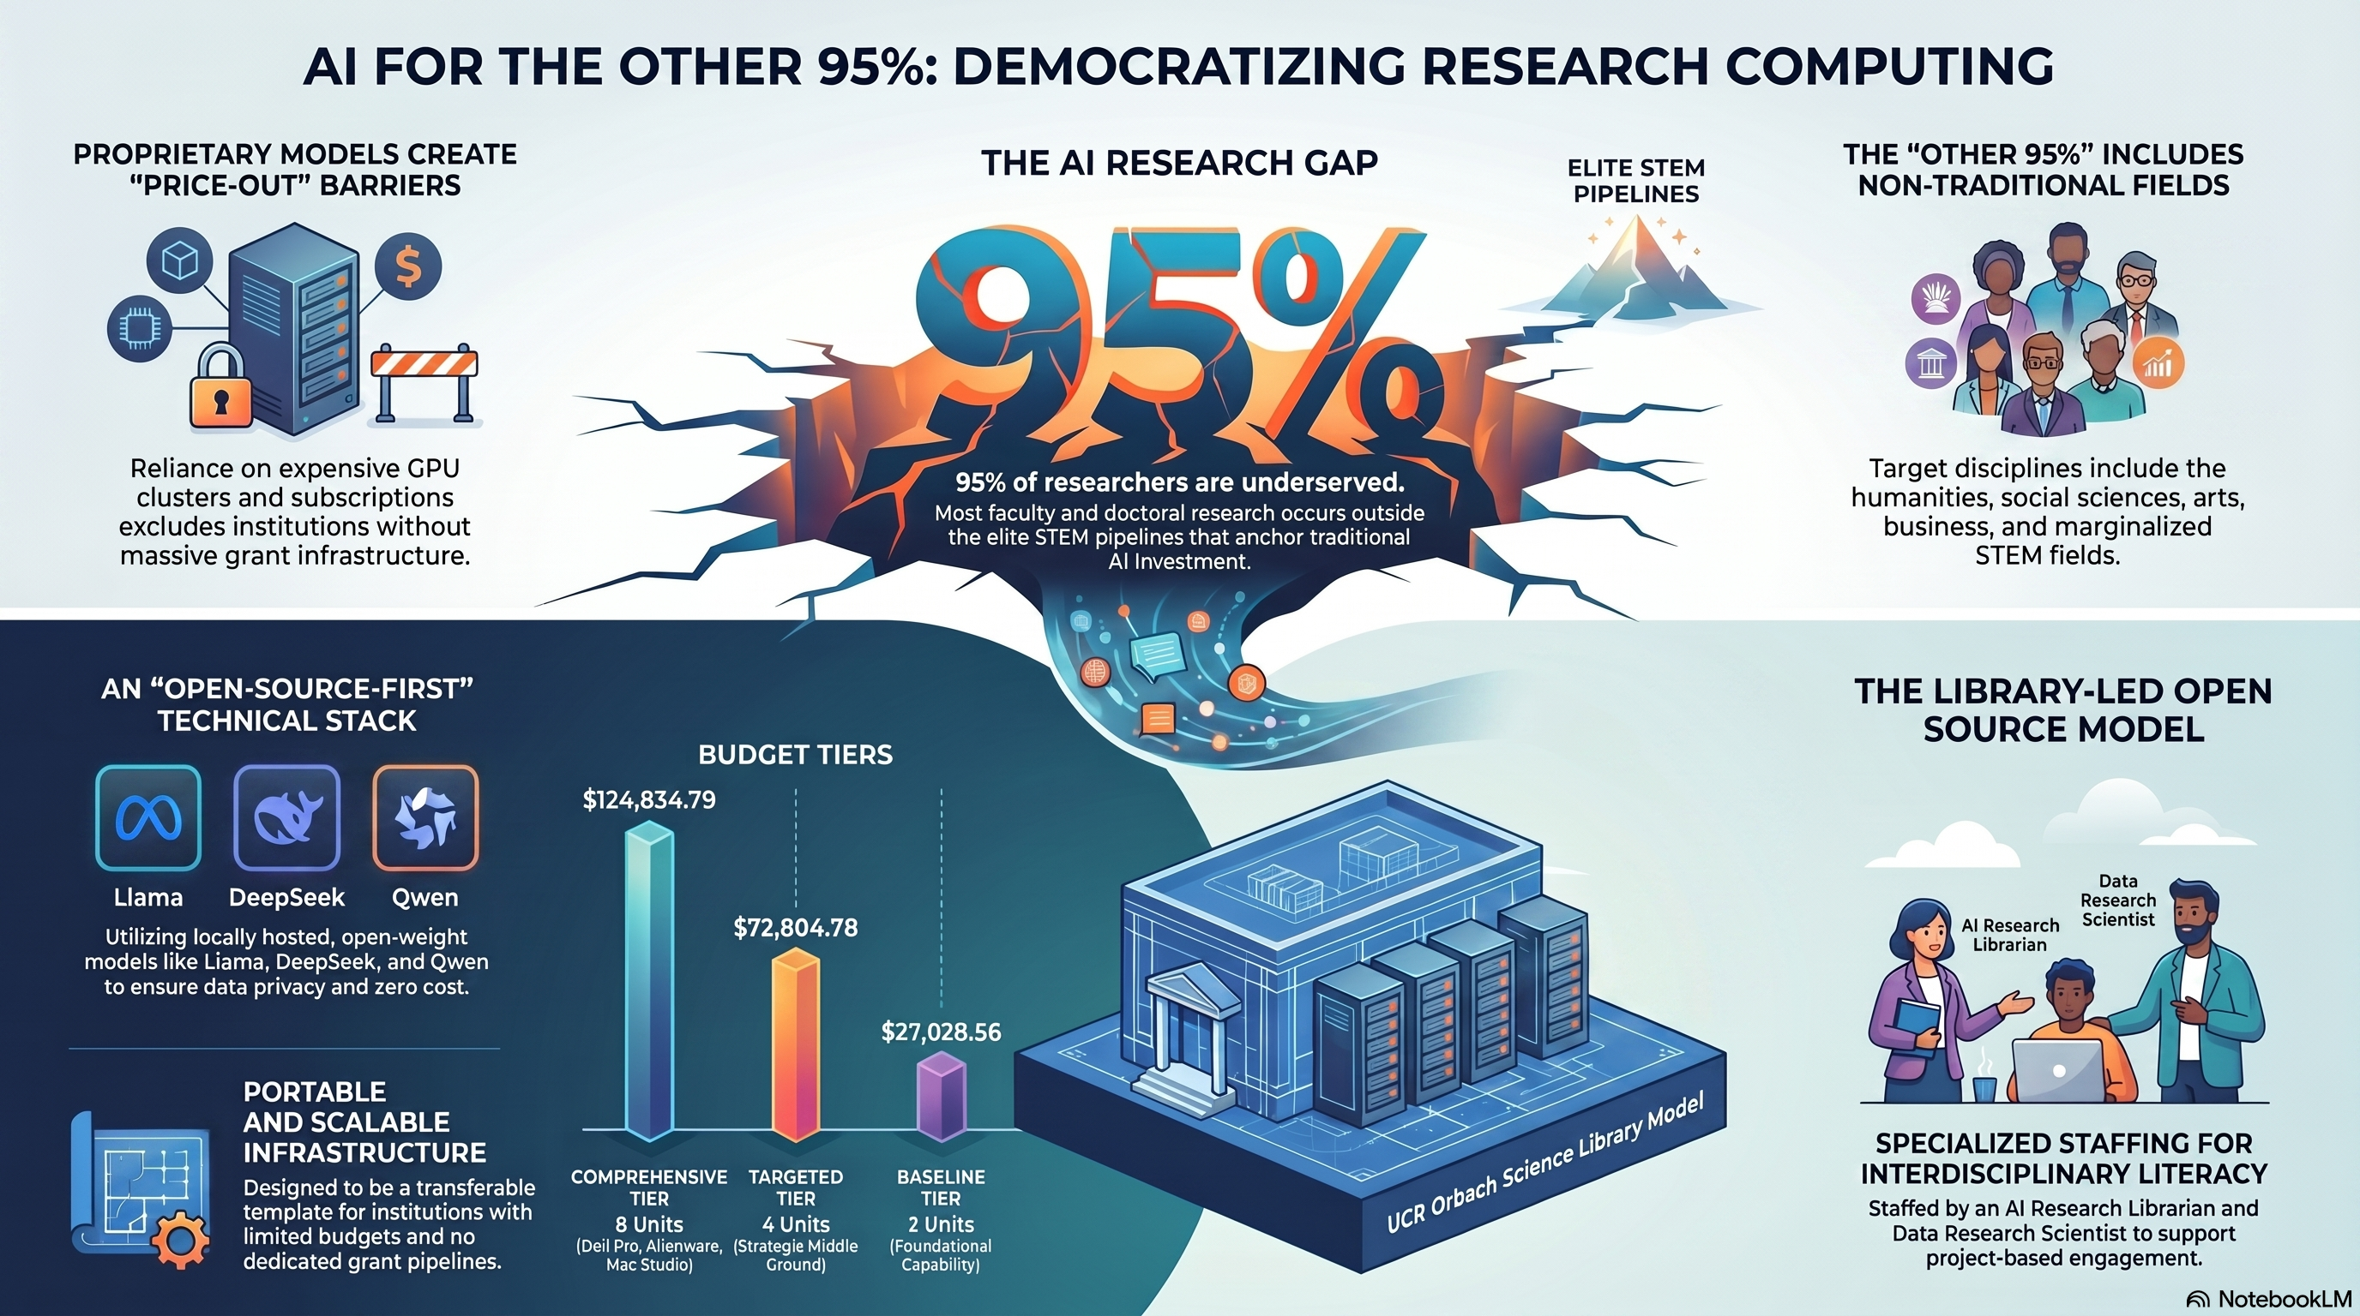

Slide 34
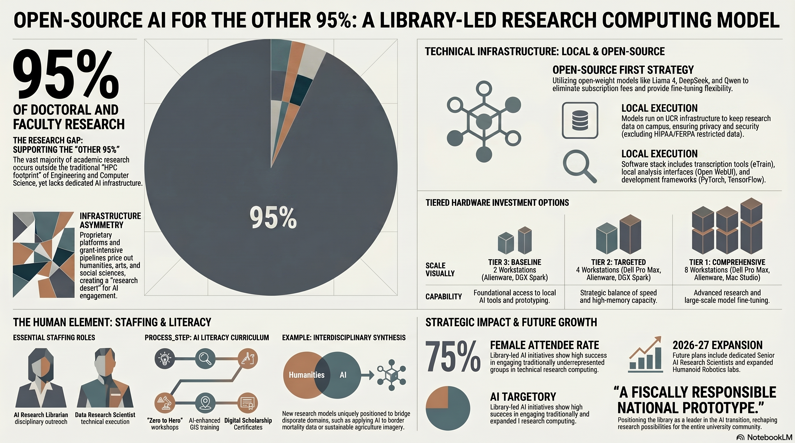

Slide 35







Research Data Scientist and Services
Consultations
Get one-on-one support for your research data questions and needs
Workshops
Build practical skills with research data and Building Towards ML AI tools
Collaborations
Partner with us to support your research group’s data needs
Upcoming Workshops
Open Data Publishing with Data Dryad - October 23
Open Data Management and Discovery - October 23
Introduction to Python for Data Analysis - November 6

Slide 36
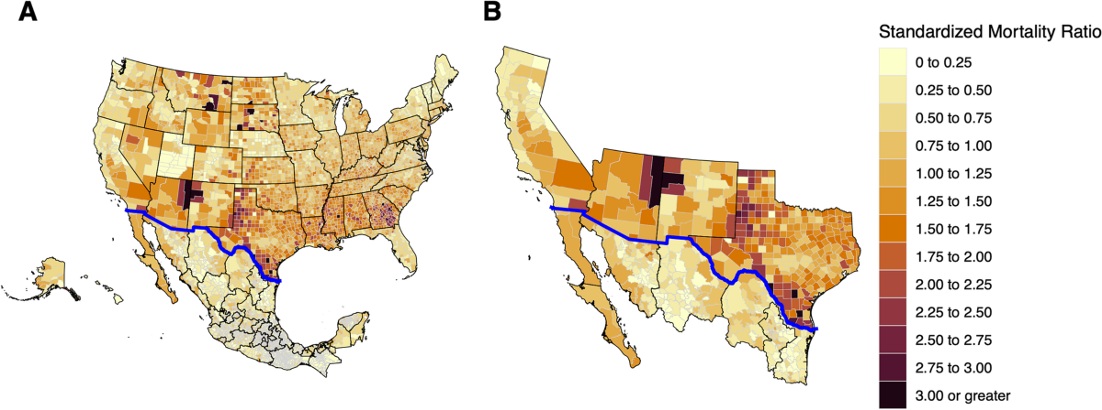
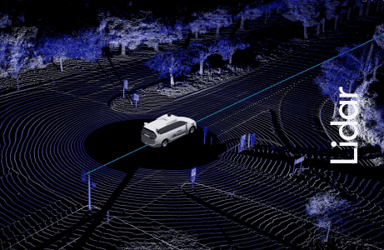
Workshops, Labs, Consultations Act as Feeder for Larger Faculty/Graduate Student Interdisciplinary Support Projects
Self-Driving Vehicle/Bluetooth/ AI/LIDAR/Labeling (Metadata) Project
3D Data Storage/Repository Project
(Visualization of 3D LIDAR Training Data, Research Faculty, Comp Eng.)
COVID Border GIS/Data/AI Project (Research Faculty, Medicine), Cognitive Cartographies and Histories
Mortality Data on The Border Regions
Statistical Qualitative/Quantitative
Data/AI Insights/GIS
Larger 3D Data File Storage, Data Segment
Visualization, Cooper Scenes

Slide 37


Digital scholarship Certificates
Want to learn how to use digital tools in your research? The UCR Library Digital Scholarship Certificate shows you how to integrate digital tools, methods, and technologies into your research, teaching, learning, and publishing.
Click the link or scan the QR code to self enroll on Canvas.

Slide 38
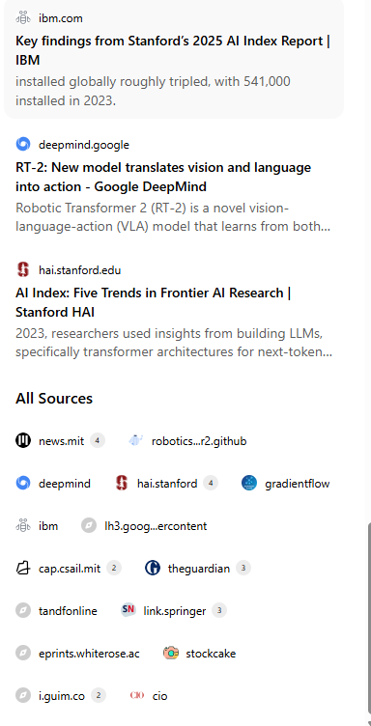
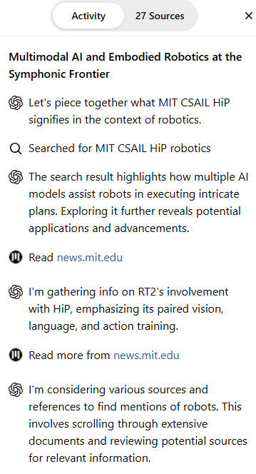
Deep Research, Reports, Articles and Papers completed in 19m ·
227 sources · 189 searches
More Precise
Thinking
Window for
Sources

Slide 39
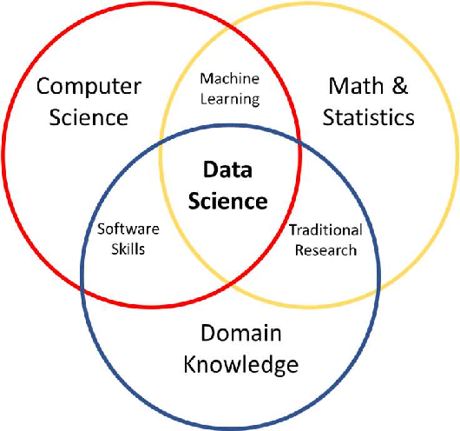
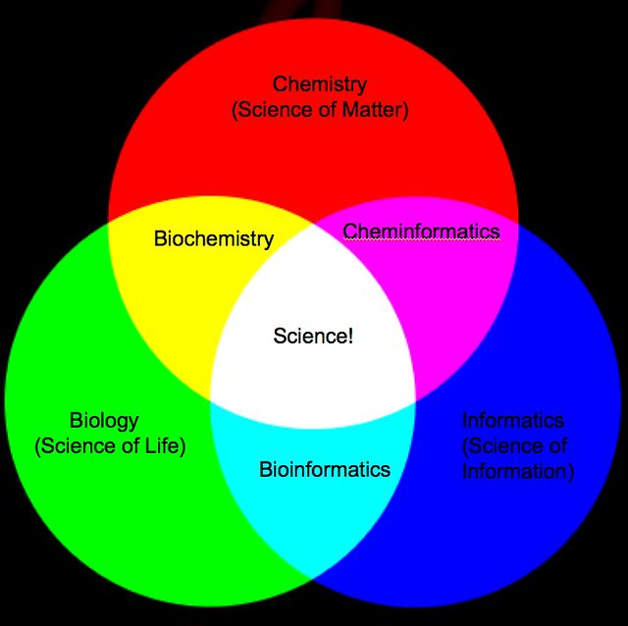
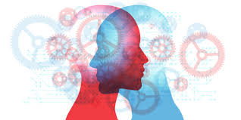
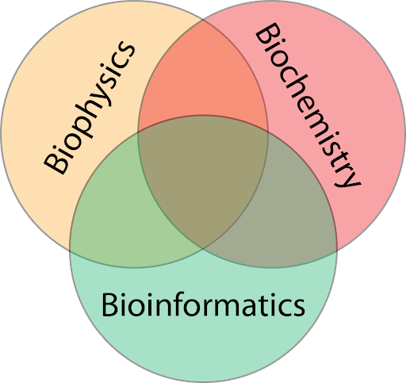
New Deep Research Models are Good at Interdisciplinary Synthesis of Disparate Domains, Making Analogies, Statistically Pattern Matching
Biochemical
Informatics
Interdisciplinary Research

Slide 40



Interactive Data
Visualization & Dashboards
https://claude.ai/public/artifacts/2514cc6a-2e92-4fbf-9818-8077e2b45611

Slide 41

AI Literacy
Curriculum Builder https://bit.ly/45AAaLc
Dr. Raymond Uzwyshyn, University of California, Riverside
raymondu@ucr.edu
https://www.linkedin.com/in/rayuzwyshyn/

Slide 42

This learning activities and lesson plan builder app allows educators to quickly design AI literacy curricula
It is inspired by the lens of several leading AI and science, technology, society theorists.

Slide 43

2026-27 Future Project Plans
(AI Expansion)
AI Research Librarian(s)
Onboarding and
AI Disciplinary Workshop Agendas
Humanities, Social Sciences, STEM
Women in AI Colloquia
Dedicated Senior
AI Research Scientist
Serving Other 95% of University
Robotics Lab Expansion
AI Enhanced Humanoid Robotics
R&D, Grant Applications (Amazon)
Workforce Development

Slide 44


Slide 45


Slide 46



3DXP Lab
Multimedia Lab, Winner of Unity and Meta Immersive Learning VR Grant
Offers research support through VR, AR and 3D Scanners, VR Headsets, skills and equipment in the lab
Lab maintains cameras, lighting and high performance computers
Student assistants and staff can help with projects

Slide 47



Open Research and Creative Activities Forum (ORCA) Signature Program
Open Research and Creative Activities (ORCA) Forum
  Quarterly event showcasing outstanding student projects from all disciplines.
  Emphasizes interdisciplinary work and open scholarship.
  Finalists present at Orbach Science Library and may publish their work (code, data, multimedia) in eScholarship with DOIs.
  Learn more & submit at the ORCA website.

Slide 48

Research Technology

Slide 50



2025 Best in Class Reasoning Models
Recommended Models
(Trial For Free)
AI AGI Research, Reasoning & Deep Research LLM’s (2025) STEM Disciplines, Science Technology Engineering Math, Coding, Language, Humanities, Social Sciences Proprietary Anthropic Claude Sonnet 4.5 Opus 4.0 , Try Open AI Chat GPT 5 (Current flagship Combined Multimodal Model Family), Try GPT o1/o3 pro o4 mini-high Try Grok 4, Try Gemini 2.5 Pro (Deep Think) 2M Context Window Try | Research, Reasoning & Deep Research LLM’s (2025) (STEM Disciplines, Science Technology Engineering Math, Coding) Proprietary GPT o1/o3 pro o4 mini-high Try Claude Sonnet Opus Model Family, Try Grok 4, Try Gemini 2.5 Pro (Deep Think) 2M Context Window Try
Open Source Llama 4 Series (2T, 400B, 109B) Qwen3 Model Family (Alibaba) Mistral Magistral | Open Source Deep Seek R1 (768 Billion Parameters), Try, Perplexity, US R1-1776 Uncensored Version R2 Release October-November 2025 Co-Scientist (Google, Beta) Co-Evolve (Deep Mind)
Web Search, Agents, Reasoning Abilities, Thinking Window

