Slide 1
Introduction to Agentic AI
Capabilities · Personas · Possibilities
From Simple office/school productivity to research-level agent teams
Live demos across Gemini, OpenAI and Claude
Ray Uzwyshyn, Ph.D., MBA, MLIS
Acting AUL for Research & Technology
Director of Research Services
UC Riverside Libraries, raymondu@ucr.edu
rayuzwyshyn.net
Notes:
0:00–1:00. Welcome. Frame: agentic AI is the 2026 buzzword, but there's real, working substance underneath. Everything shown today is something I built with these tools — the methods scale from first-year undergrad to postdoc.

Slide 2
Introduction to Agentic AI Agenda
From the Simple to the Complex
Real project examples — Built with agentic AI, 2023-2026
0-1
Background Agentic AI frontier History
Introduction, How far agents have come: deep research, benchmarks, the jagged frontier
2
Office/School Productivity (Capability Based Agents)
Sheets, slides, websites, Deep Research — everyday productivity across three model families
3
Persona Based Agents
Prompting a model into an expert role: Dr. Okoye, the Jungian app
4
Larger Agentic AI Apps, 2025-2026
AI-assisted (“vibe”) coding: from a prompt to a working websites and applications
5
Complex Agentic AI Research systems
Invisible Mile · Research Data Director · Biomedical Variant
Notes:
1:00–2:30. Walk the ladder. Emphasize: you can enter at any rung. Undergrads may stay at 2–3 today; PhDs and staff will see where 4–5 lead.

Slide 3
Opening Question: What makes Agentic AI “Agentic”?
Goal
 | Chatbot (2023) | Agent (2026)
Unit of work | One reply | A multi-step task
Tools | None | 100’s, Search, code, files, APIs
Memory | This chat only | Case files, notes, state space
Self-check | Rarely | Plans, critiques, retries, Verifies
Your role | Prompt writer | Producer, Director, Evaluator, reviewer and Audience
Reflect
Plan
loop until
done
Observe
Act
(tools)
A chatbot answers Questions.
An Agent pursues a goal or goals
Planning, using tools, checking its own work.
Notes:
2:30–5:00. Define agentic: perceive–plan–act–observe–reflect loop with tools. Key shift is in the last row: you move from writing prompts to directing and evaluating work.

Slide 4


CORE CONCEPT
What Makes Agentic AI, Agentic?
The Movement From Answering Questions to Taking Action
Standard Chatbots
Agentic AI Systems
Waits for your prompt and generates text back.
Follows a high-level goal or goals , plans creates and executes
its own plan.
Reactive: Only speaks when spoken to
Goal-Driven: Breaks complex problems into mini-steps
Single Turn: Answers one question at a time
Uses Tools: Searches web, runs Python code, calls APIs
No Hands: Cannot click, run tools, or write files
Self-Correcting: Checks its own work and fixes errors
Agentic AI Following Goals (Technical Terminology)
Optimization or The Objective Function

Slide 5


Two Types of Agentic AI Architectures and Agentic AI Thinking
The organizing idea for everything that follows
Capabilities-based Agentic AI Models
Persona-based AI Models and Teams
Start from WHAT the system must DO.
Define discrete functions — search, extract, validate, crosswalk, export — each with inputs, outputs and checks.
Strength: auditable, testable, easy to govern.
Example today: Biomedical Variant
Start from WHO would do the work well.
Define roles with expertise, voice, judgment and hand-offs — a team that deliberates (models can cooperate and chat).
Strength: context-rich, humane, great for ambiguity.
Example today: Research Data Director
Most real systems synthesize both: personas decide, capabilities execute.
Notes:
5:00–6:30. Introduce the title’s framing. Capabilities = functional decomposition (the RDA/Microsoft Data Director blueprint v0.1 is explicitly capabilities-based). Personas = role decomposition.

Slide 6
Choosing your Agentic Architecture and Model
Research
 | Capabilities-based | Persona-based
Best when | Rules are clear; audit matters | Judgment, context and ambiguity matter
Unit of design | Function with inputs/outputs | Role with expertise and voice
Testing | Per-function checks and human in the loop | Scenario, case reviews and humans in the loop
Risk | Brittle at edges | Persuasive but wrong
Today’s examples | Biomedical Crosswalks, Portfolio Creation | Research Data Director, Jungian Psychoanalyst
RDA/Microsoft Data Director Blueprint v0.1 — capabilities model (PDF)
Notes:
51:00–52:00. Quick synthesis.

Slide 7
01
How far agents have come
From translators and next-word prediction to autonomous research teams, swarms, fleets, crews, corporations and research institutions in about seven years, 2019-2026
Notes:
Section break.

Slide 8
Seven years, Seven Massive leaps in capabilities
Frontier
2019–22
2023–24
2024–25
2025
2026
GPT-2 / RoBERTa
GPT-3, 4 · Claude 3.5
o1 · DeepSeek R1
Deep Research
Agentic systems
Next-Word Prediction; translation; almost coherent sentences, almost reasoning
The Causal and Prompt Engineering Begins. More Organized, almost-causal answers; persona prompts appear and can answer questions
Agentic AI Begins. “Thinking windows” — chain-of-thought at test time, complex reasoning is achieved. Agents can talk to each other
Autonomous AI agents can search the web, research, write, edit, validate and verify researched sourced reports
Tool-using teams that code, build, deliberate together and solve both simple and very complex humanly intractable problems
Adapted from Uzwyshyn, Benchmarking Agentic AI 2026: The Topographic Jagged Frontier (UCR Orbach AI Literacy Series, May 2026)
Notes:
6:30–8:00. The ‘Why is the ocean salty?’ progression from the Jagged Frontier talk works well here if you want an anecdote: GPT-2 drifts toward an answer; GPT-4 organizes it; reasoning models show their work.

Slide 9
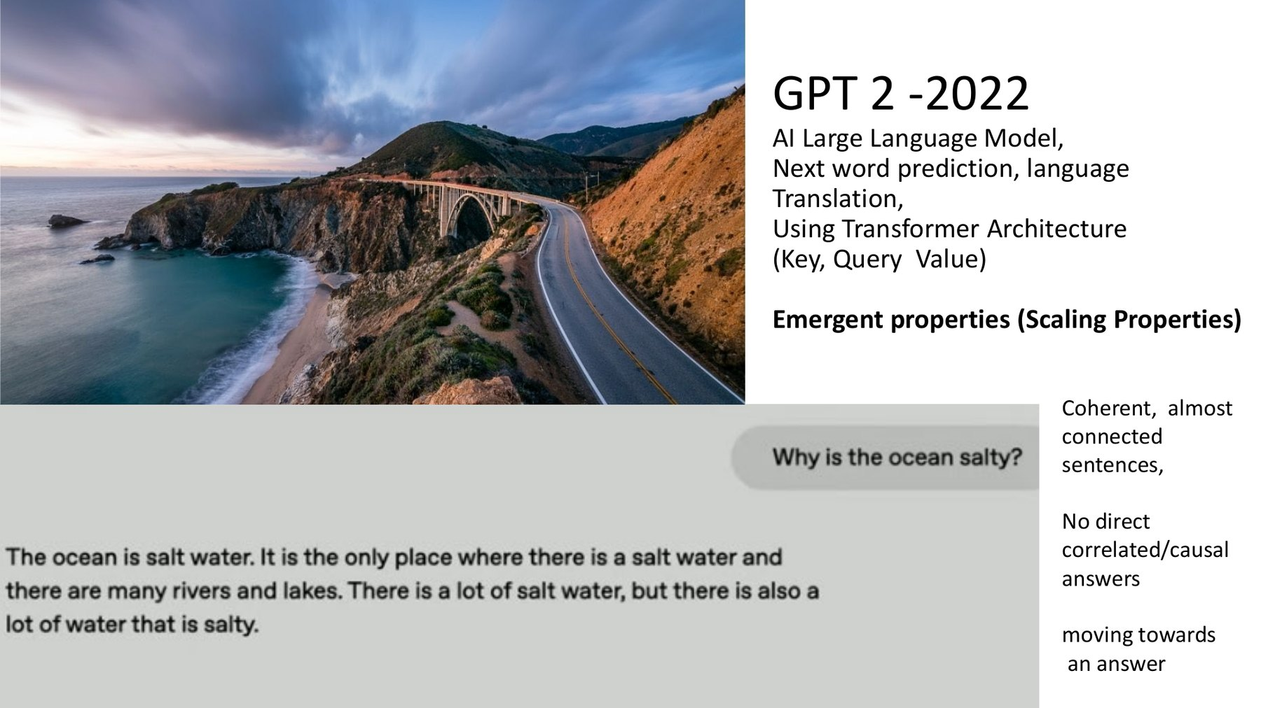
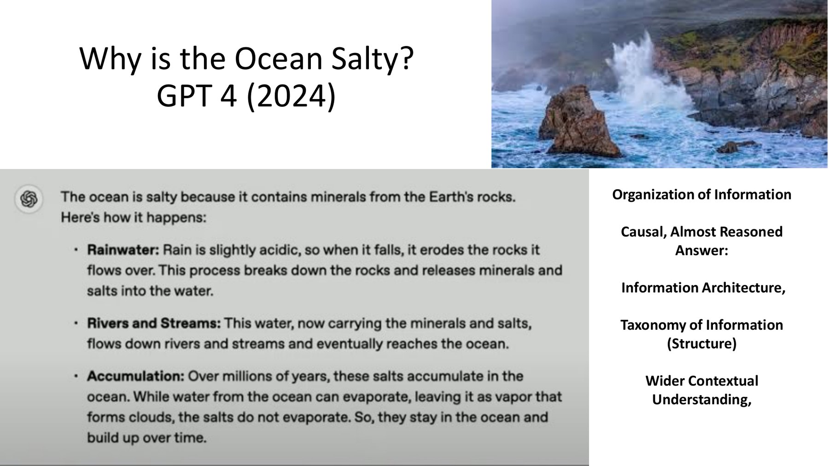
“Why is the ocean salty?”
Same question, two years apart
Frontier
GPT-2 (2022) Fluent sentences drifting toward an answer — no causal chain.
GPT-4 (2024) Organized, causal, almost reasoned — rain, rivers, accumulation.
From Benchmarking Agentic AI 2026: The Topographic Jagged Frontier (Uzwyshyn, May 2026)
Notes:
8:00–10:00. Ask the room to predict what a 2026 agent would do with this question: plan, search oceanography sources, cite them, maybe build a chart.

Slide 10
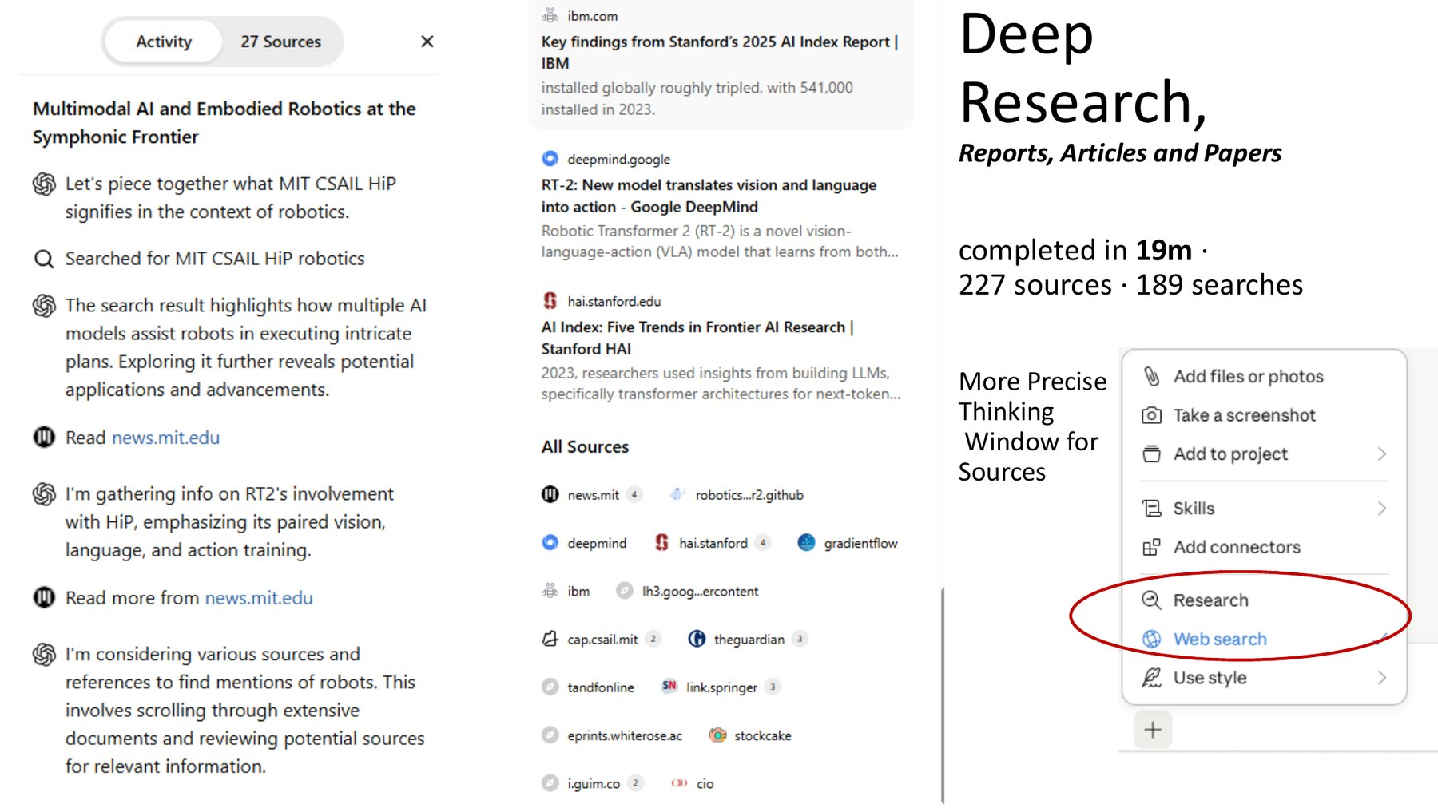
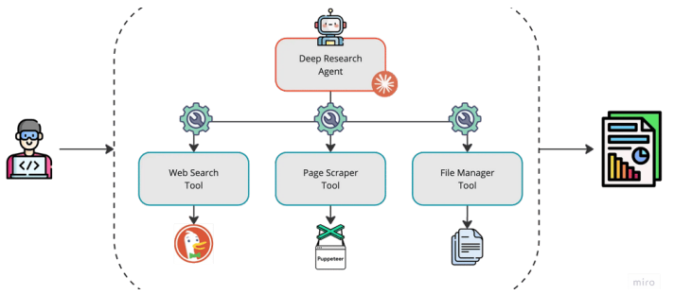
2025: Deep Research AI Agents go mainstream
The Web is Opened Up to Agents
Frontier
19 min
227
189
one report
sources read
searches run
Under the hood: a planner agent dispatches tool agents — search, scrape, file — then synthesizes. Frameworks like CrewAI and AutoGen let you build these teams yourself.
A live deep-research run: the thinking window is opened up, the agent narrates its plan, searches, reads, cites, summarizes
The useful output is a traceable synthesis that you can inspect.
Notes:
10:00–12:30. Your own run (Jagged Frontier deck). Architecture diagram from the Deep Research/CrewAI slide. Point: the agent is a loop over tools, not magic.

Slide 11
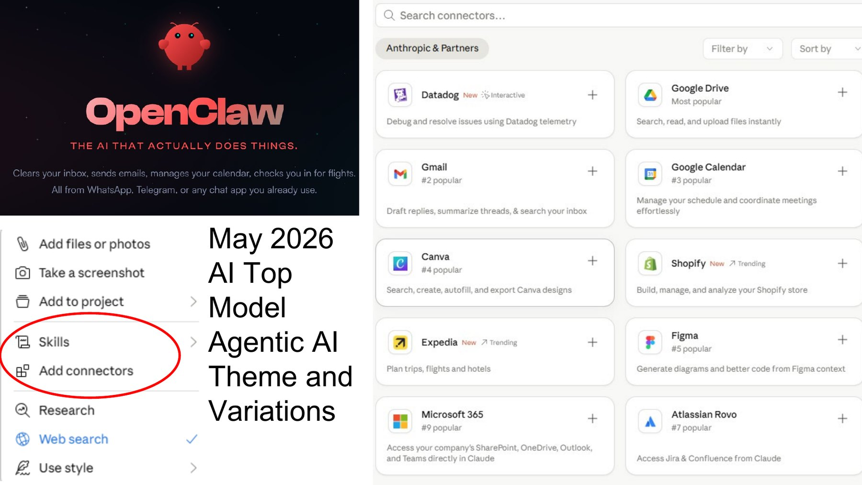

Agents now reach into your tools
Office
Skills, connectors and research modes turn a chat into a workspace
Connectors: Drive, Gmail, Calendar, Microsoft 365
Skills: reusable instructions for recurring work
Research mode: the deep-research agent on demand
Personal agents act across apps — useful, and a reason to mind permissions
Notes:
18:30–20:00. May 2026 slide from the Jagged Frontier talk. Mention UC data policies before connecting institutional accounts.

Slide 12
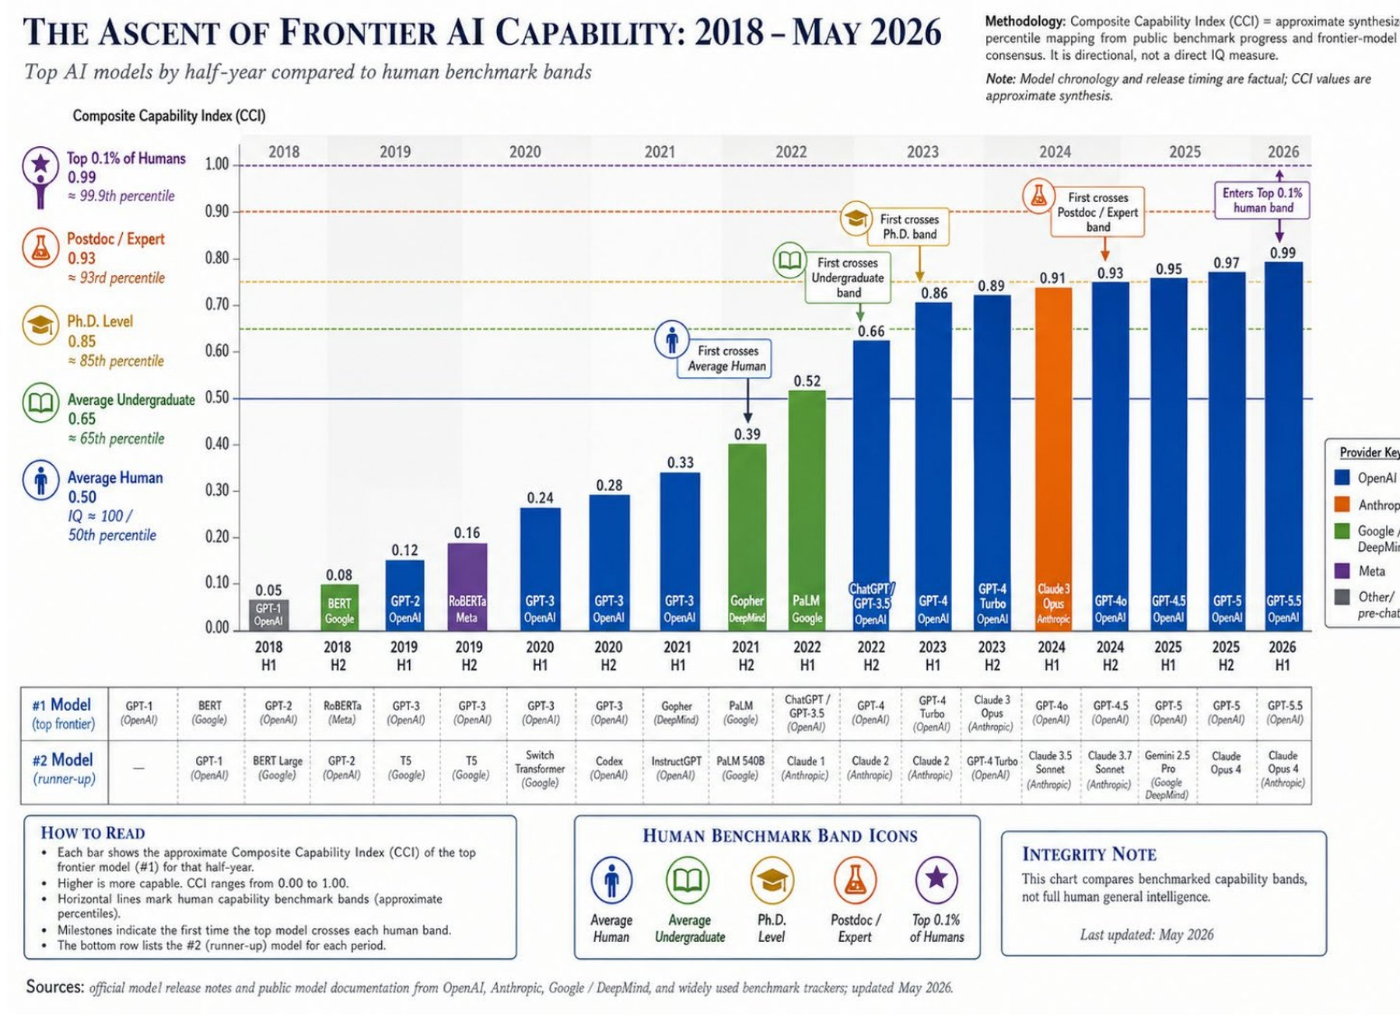
Frontier
The ascent:
2018 → May 2026
Notes:
12:30–14:00. Composite capability index vs. human bands — directional, not an IQ score. Graph illustrations generated with OpenAI image models; data synthesized from public benchmarks.

Slide 13
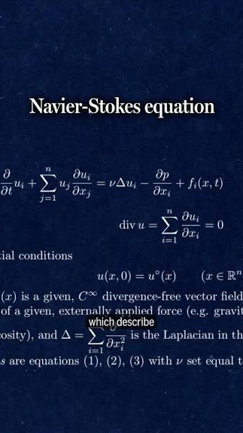
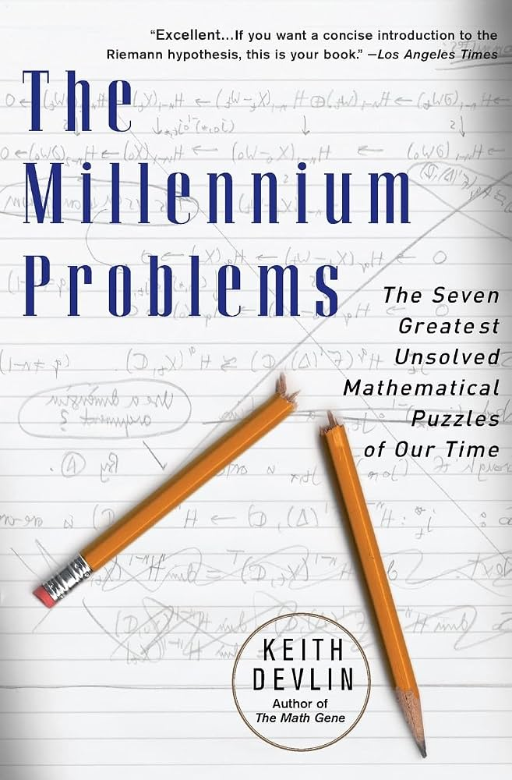
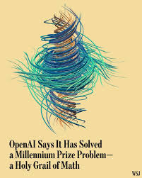
Navier Stokes Solved: 9/2026
Agentic AI: Teams, Groups, Corporations of Agents, Swarms, Research Institutions
Agentic AI September 8 2026, Navier Stokes (Fluid Dynamics):
A Research Institution of 10,000 AI agents, 88 Hours, Solution

Slide 14
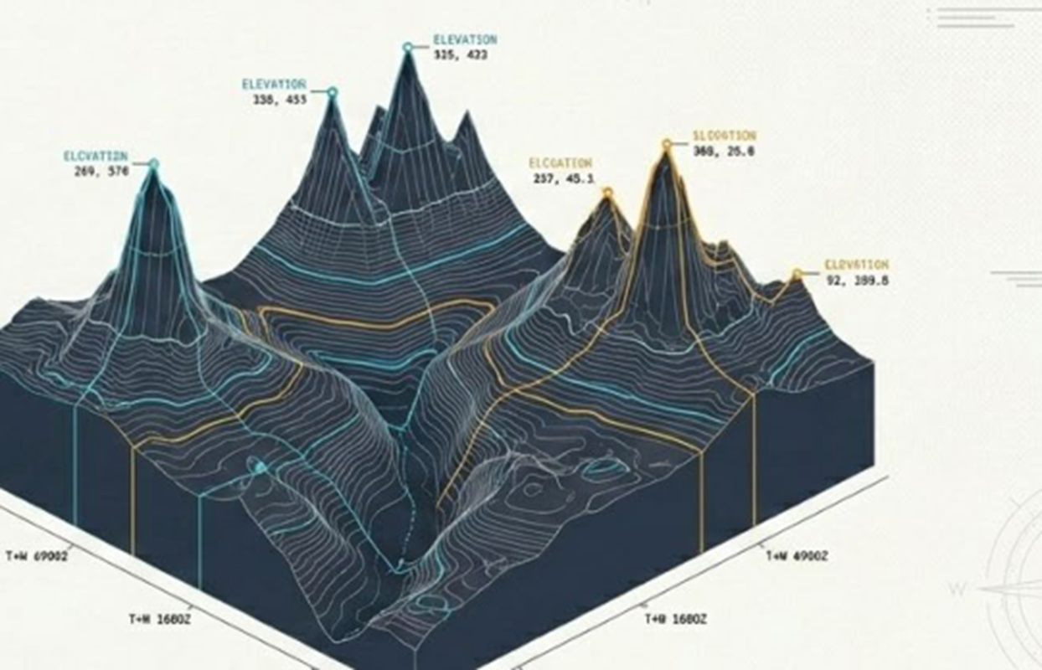
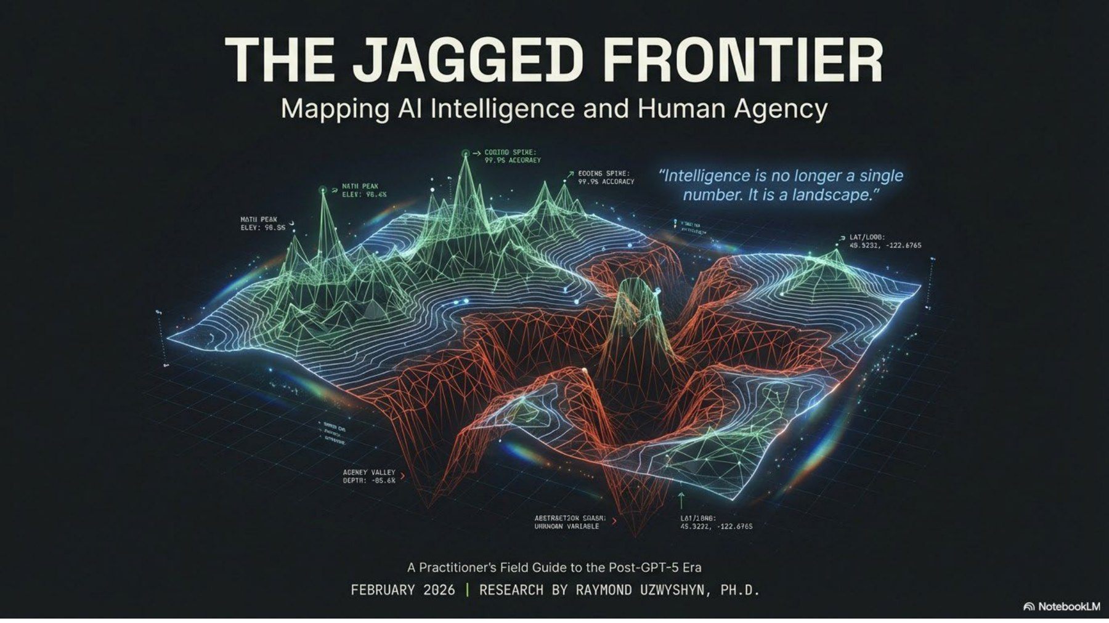
Benchmarking Study: The Jagged Agentic AI frontier
February 2026
Frontier
Superhuman at some tasks, unreliable at adjacent ones — capability is a landscape, not a line
Agentic AI Model Capability varies by task.
A model that writes well may struggle with exact calculation and vice versa.
Slides (PDF)
Background paper
10 models × 8 benchmarks
Open the interactive Topographic Atlas ↗
Notes:
14:00–16:30. DEMO: open the Atlas artifact and fly over the ‘lowlands’ vs peaks. Built with Claude from the benchmarking synthesis; illustrations via OpenAI image generation.

Slide 15
02
The Capabilities Model
Everyday office and Productivity Agents:
Start here: Tasks across three AI model families
Notes:
Section break — lowest barrier to entry.

Slide 16
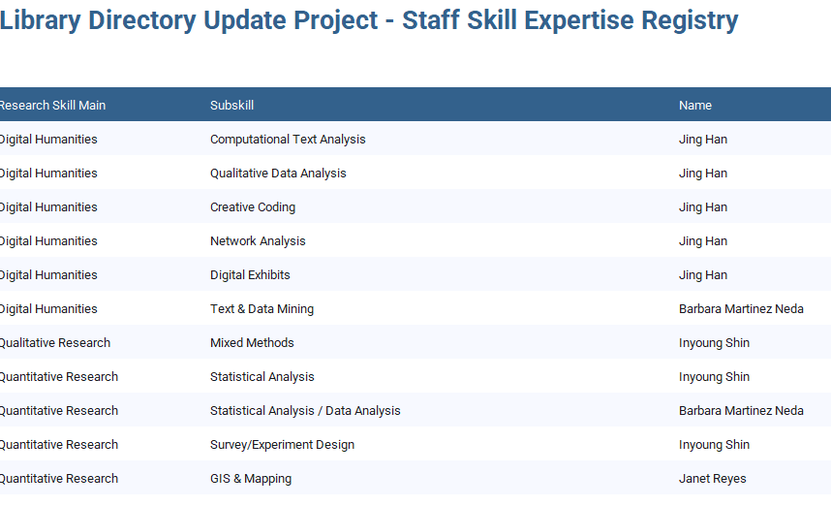
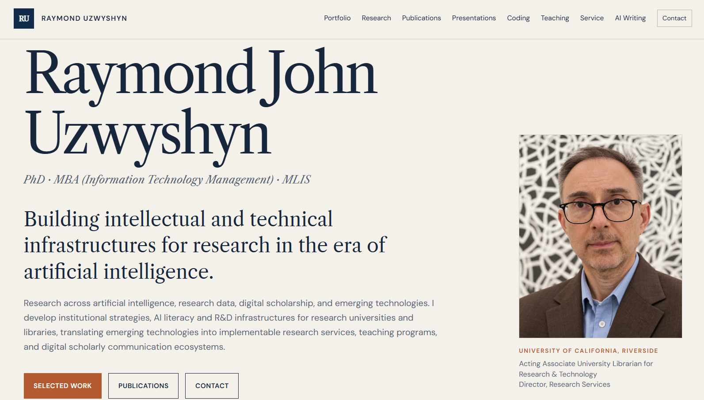



Office Productivity agents:
Three Different AI families, one workflow
Review, Verification, Iteration, Reflection
Office
Gemini · Sheets / Excel
Claude · OpenAI · Gemini ·
PPT/ Slides Refresh/Customization
OpenAI Astra · Portfolio Website
rayuzwyshyn.net/UCRiverside20
rayuzwyshyn.net/UCRiverside20
rayuzwyshyn.net/index.htm
Screenshot
Screenshot goes here — paste over this panel
Screenshot
Screenshot goes here — paste over this panel
Library Directory Skills Update Project: agent cleans, restructures and reconciles staff data inside the spreadsheet.
College of Engineering CE CERT Presentation Update Graduate Students Ph.D. research-services deck generated three ways from the same brief — compare structure, design and accuracy.
This vita site — restructured and refreshed with GPT 5.6 Sol, section by section, with human review.
Open the workbook
Claude Opus 5 version
rayuzwyshyn.net
GPT Astra version
Notes:
20:00–22:30. Tip for the room: give the same brief to all three models and compare — it’s the fastest way to learn each model’s strengths. Gemini is strongest inside Google Workspace.

Slide 17
03
Agentic Personas
Prompting a model into an domain expert role
Think 35,000 000 000 Billion Parameter Experts
Trillion parameter models (1,000,000,000,000 Trillion)
Mixture of Experts Architectures (MOE)
Notes:
Section break.

Slide 18
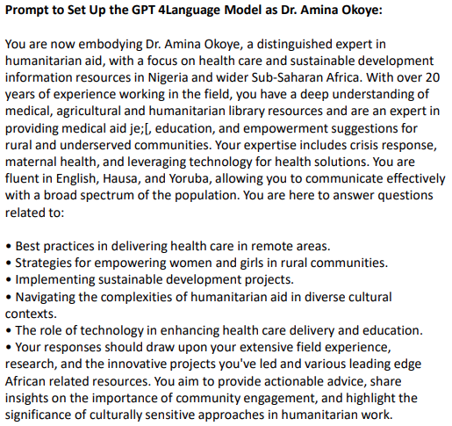

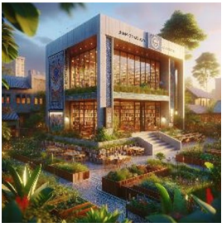
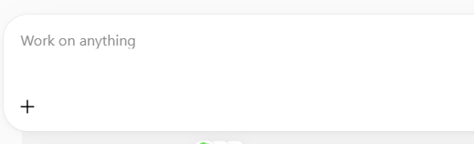
Classic persona: Dr. Amina Okoye (GPT-4, 2023)
Personas
Identity + 20 years’ field experience
Domain: health, agriculture, humanitarian resources for Nigeria and Sub-Saharan Africa
Languages: English, Hausa, Yoruba
Scoped question list + a method: actionable, culturally sensitive, community-centered
Notes:
25:30–27:00. Map each part of the six-part anatomy onto this prompt. Images generated with DALL·E. Developed alongside Nigerian national library digital literacy work.

Slide 19
Anatomy of a Persona Prompt
Personas
1
Identity
2
Expertise
3
Audience
Who you are: name, title, years of experience
Specific domains, methods, languages, sources
Who you’re helping and at what level
4
Scope
5
Method
6
Voice
The questions you handle — and those you refer out
How you reason, cite and check your work
Tone, format, length, cultural sensitivity
Notes:
24:00–25:30. The six-part pattern. Next two slides show it in a 2024 prompt and a 2025 app.

Slide 20
Copy this: a basic persona template
Personas
Adapt for a tutor, a methods advisor, a critic of your draft, or a historical thinker
You are [name], a [role] with [N] years of experience in [fields].
Your expertise includes [methods, sources, schools of thought]. You speak [languages].
You help [audience] with:
• [task 1] • [task 2] • [task 3]
Out of scope: [topics] — for these, say so and suggest where to go.
Method: ask one clarifying question if the request is ambiguous; reason step by step;
cite sources you are confident exist and flag uncertainty.
Voice: [tone], [length], [format]. End with one suggested next step.
Tip: a persona sharpens judgment and voice — it does not add knowledge the model lacks.
Notes:
29:30–30:30. Encourage everyone to write one before the next session.

Slide 21
04
Apps: Agentic AI-assisted Programming
Vibe Coding
When the prompt becomes software
Notes:
Section break.

Slide 22
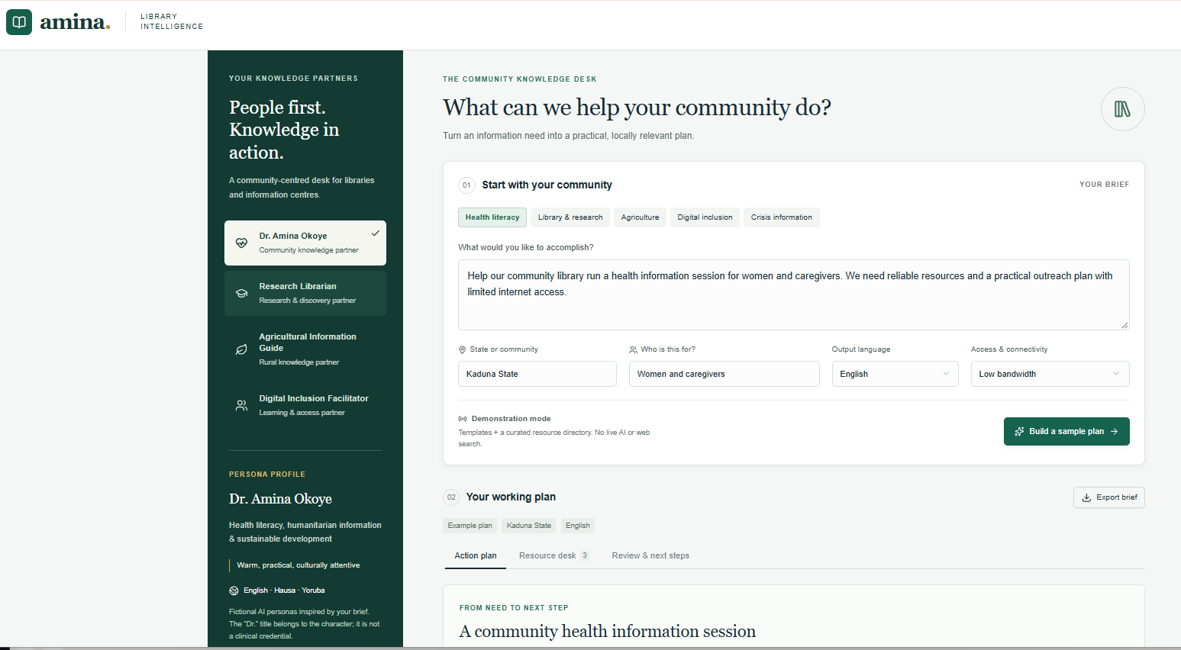
Dr. Amina Okoye
September 2026:
GPT-Astra High
Place Original
Prompt into Astra
and ask for an app
with your various
Specifications and
updated for 2026
with the latest
Innovation
From persona to website workflow:
Turns Amina’s descriptive prompt into an interactive process: define a need, develop a plan, review, and export.
Broadened expertise:
Adds research librarian, agricultural information, and digital inclusion personas alongside Amina.
Local Relevance:
Incorporates Nigerian community location, audience, language preferences, and internet-access constraints.

Slide 23


Dr Amina, Community Knowledge Partner
People First Knowledge in Action
African Library Agentic AI Intelligence
2026, GPT 6, Astra (High)
Actionable outputs:
Produces step-by-step plans with responsible roles, resource links, and questions for community partners.
Accountability: Identifies personas as fictional, distinguishes suggestions from verified evidence, and includes librarian review
Current limitation: Planning uses demonstration templates; live AI reasoning and translation require a model connection.

Slide 24
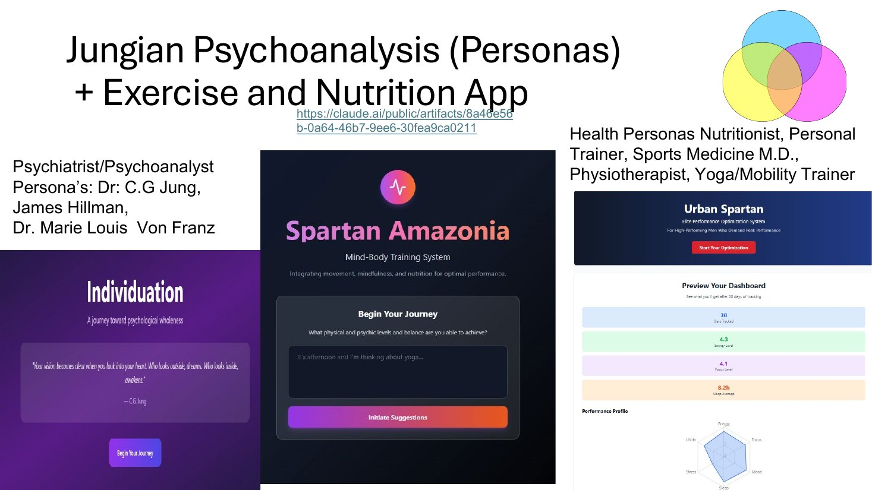
From Persona to App: the Jungian guide, 2024
Personas
Harnessing AI example — Jung, Hillman, von Franz; the same pattern powers the fitness personas
How it was built
A persona system prompt defines the analyst’s voice and theoretical grounding
Claude writes the React interface around it
The Anthropic API runs the persona live inside the app
Iterate: “make the dream-journal flow gentler”
A reflective and educational tool — not therapy. Say so in the app, and in the persona.
Open the Individuation app ↗
Harnessing AI workshop slides (PDF)
Notes:
27:00–29:30. DEMO: open the artifact; enter a short dream or image and show the persona’s response. Then show the prompt behind it.

Slide 25
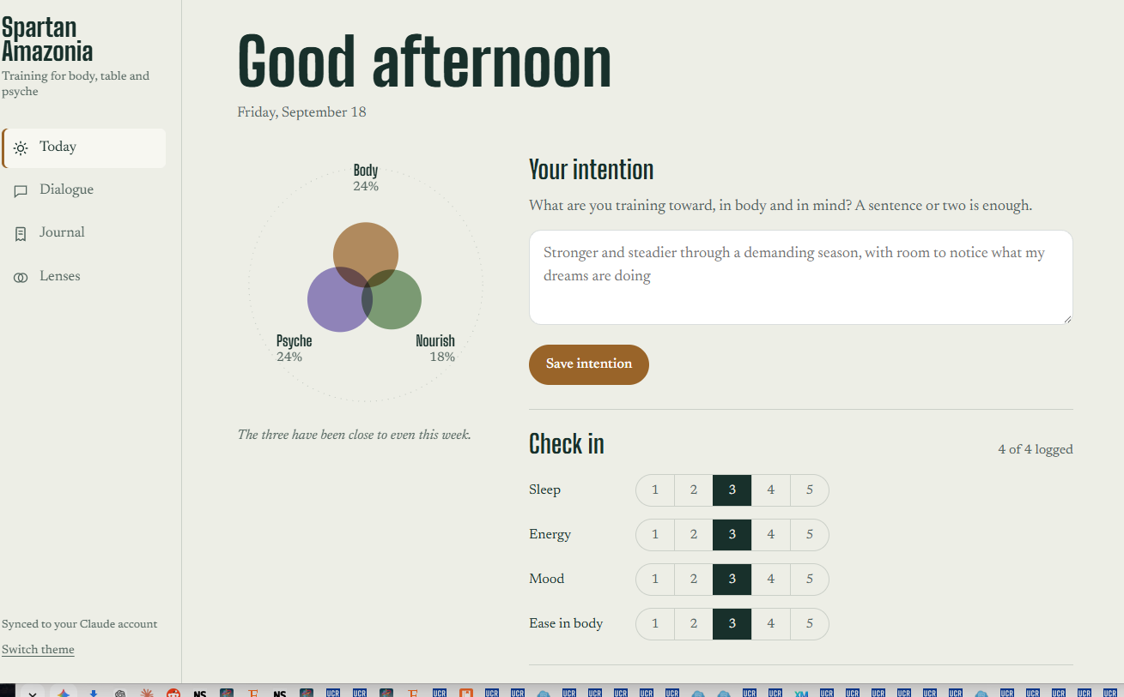
2026 Claude Opus 5 High Improvements
Memory: the guide keeps the full dialogue and reads your journal.
Chosen Personas: each theorist is picked for fit, with the reason shown, or you pin one.
Integration: movement, food, and psyche are one practice instead of three separate screens.
Daily check-in: sleep, energy, mood, and ease in body.
Composed practice: a daily plan scaled to how you feel.
Balance glyph: a seven-day view that flags the neglected domain.
Synced journal: training, meals, dreams, and reflections saved privately to your account.
Weekly reading: two-week patterns across all three domains.
Live replies: answers stream in with a Stop button, where the old app gave silent waits and cut-off replies.
Design and care: a modern light and dark look, a mobile layout, and safety guardrails
https://claude.ai/artifact/2NLcYinUeFVfFCXV39Pp5P

Slide 26
How Do You Vibe Code Persona Based Apps?
From idea to working tool in an afternoon
Apps
The vibe-coding loop I use for every app in this talk
1
2
3
4
5
Describe
Generate
Wire in AI
Iterate, Verify
Repeat
Publish
Define Goal, Persona, users, data, look-and-feel — in plain language, Accomplish
Preliminary Deep Research Blueprint and then ask the model to build the app
Claude builds a React / HTML artifact you can click
Add Anthropic API calls so the app reasons live
Test, Verify screenshot errors back, request changes, Get Feedback,
Repeat and Save Versions
Share the artifact link or export standalone HTML
Versioning: Move from V1 (hard-coded UI) → V5 (live AP, Ask Claude/Astra/Gemini to Add the AI API (LLM) → V10 ( Develop a persona team) → V12 (Add voice, graphics, video, Eleven Labs, Notebook LM, Images2, Midjourney, Veo3 etc).
Vibe Coding demos — UCSF, March 2026 (PDF)
Notes:
30:30–32:30. Step 3 is where a static page becomes agentic.

Slide 27
05
Complex Research-Level Agentic AI systems (Combining Possibilities)
Multi-model and multi-modal pipelines, persona teams, and governed capabilities
Notes:
Section break.

Slide 28
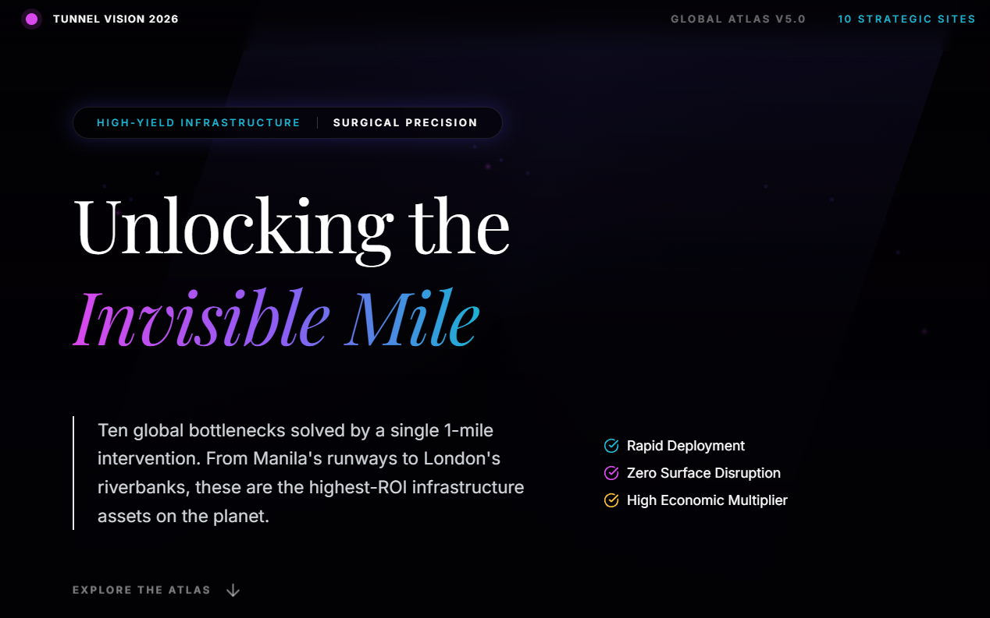
Unlocking the Invisible Mile
Research
Elon Musk’s Boring Company Competition, March 2026
Ten one-mile tunnels ranked by ROI
The Invisible Mile: Boring Company Competition
1
Gemini 3.1 GPT o3 Deep Research
Global site scan and evidence gathering
2
Claude Opus 4.6 (API)
ROI factor analysis, report and interactive site
3
NotebookLM
Podcast, Presentations and video overviews
4
Human judgment, Meta-analysis, Review
Site selection, verification, final framing, Orchestration
Full report (PDF)
ROI matrix
Podcast
Combines Deep Research: Geophysics, Property Law, Evidence Gathering, Business ROI Analysis
Agentic AI Models: Gemini, Claude, GPT 03, Interactive Multimedia, Human Self-Reflexive Verification
Notes:
35:00–38:00. DEMO: open the atlas, click one site (e.g., an airside link), then the ROI matrix. Point: each model did what it’s best at — the jagged frontier in practice.

Slide 29
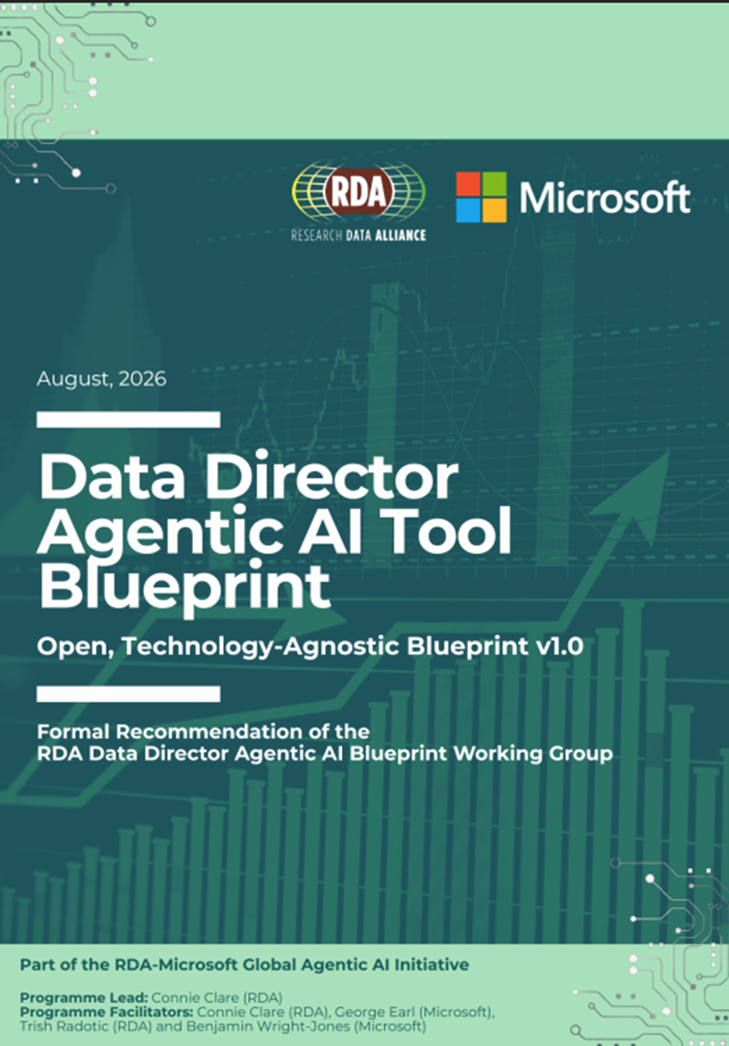

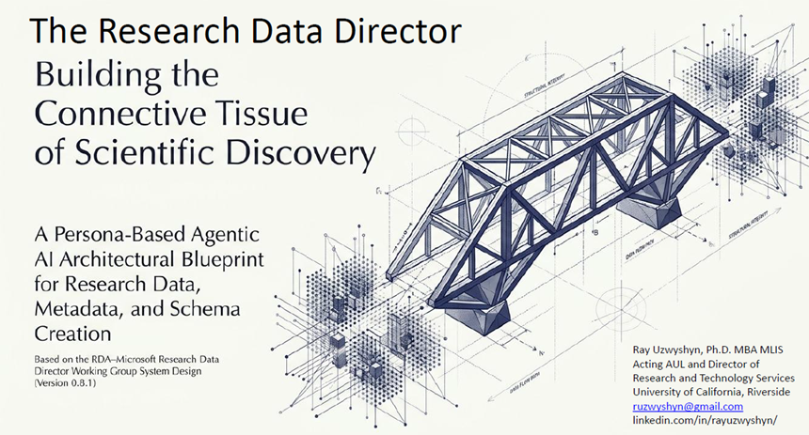

Research Data Alliance
US Cohort Participation 2026
Blueprints, Prototypes, Possibilities
April –September 2026

Slide 30
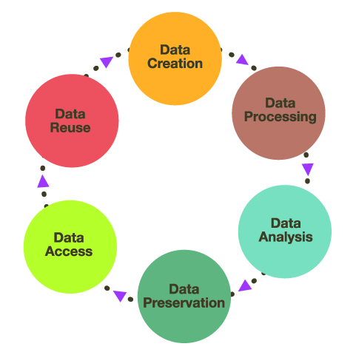
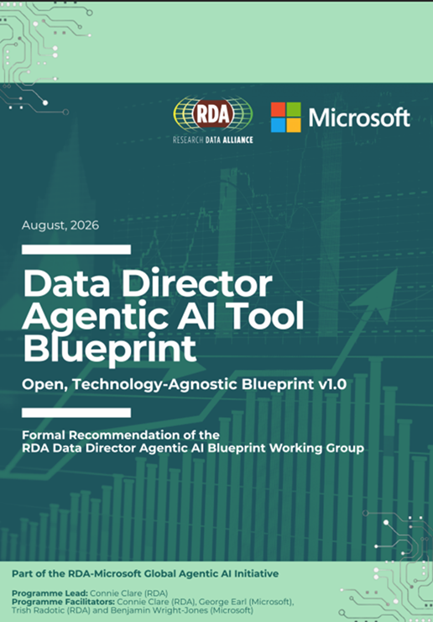
The Research Data Lifecycle, Agentic AI, the Scientific Process
& Scientific Discovery
Data Integrity, Findability, Access, Interoperability, Reproducibility (FAIR Principles, US and International Grant Compliance, Publication, Sharing, Collaboration, Automation Data, Metadata, Metadata Schema, Metadata Mappings and Crosswalks and Data and Scientific Discovery
Blueprint September 2026

Slide 31
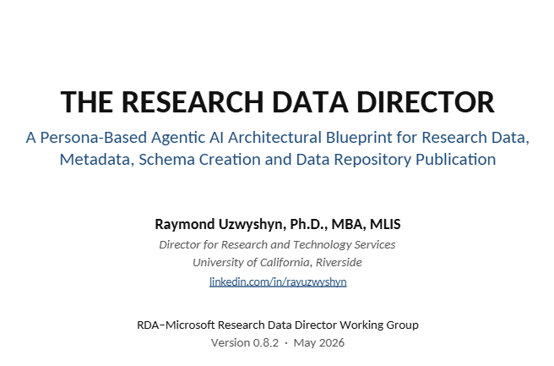
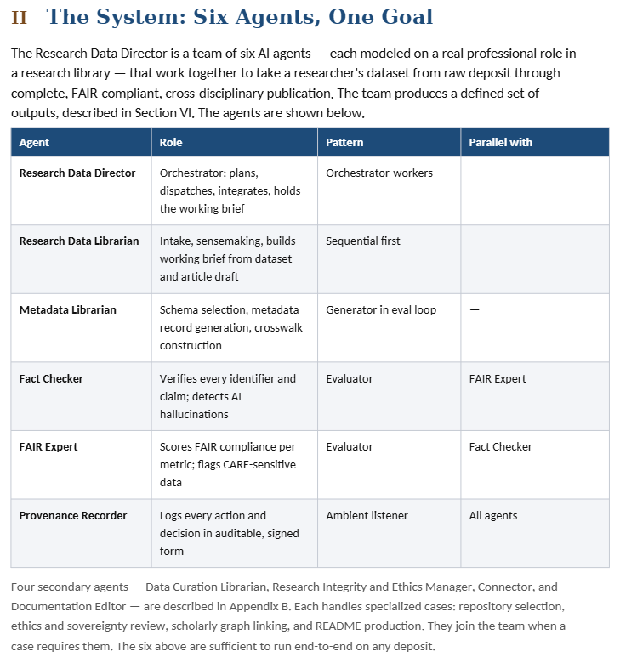
Persona Based Blueprint: Researchgate
Two Models Circulating,
Capabilities Based and Persona Based Model

Slide 32
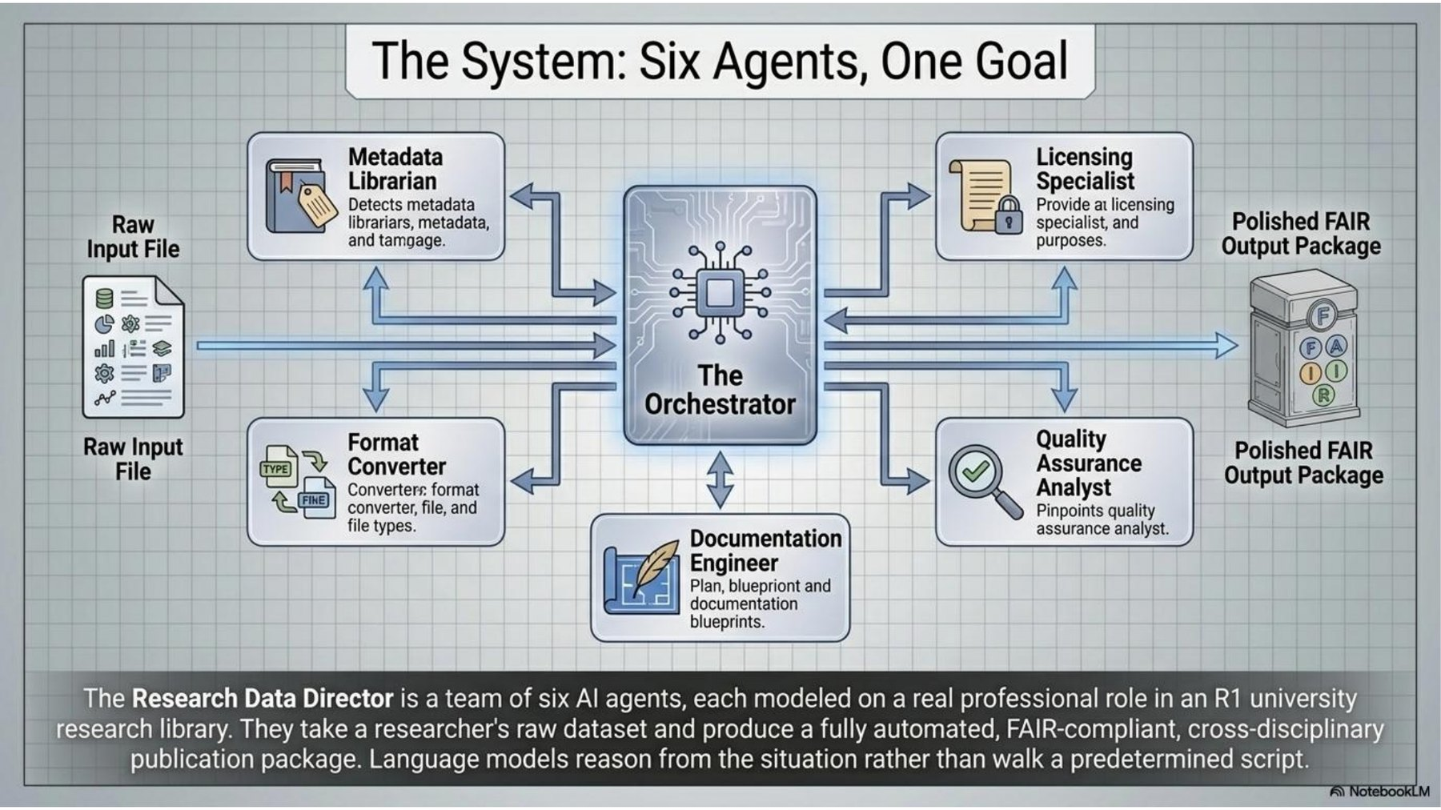
Research Data Director: six agents, one goal
Research
Research Data Alliance –Microsoft Agentic AI Collaboration and US cohort, April–June 2026
Built iteratively with Claude
V1–V4
Hard-coded, friendly UI
open
V5+
Live Anthropic API reasoning
open
V10–V11
Persona team + demo mode
open
V12
Voice experiment
open
Persona blueprint (ResearchGate)
AIDV presentation slides (PDF)
Notes:
38:00–40:30. Each agent is modeled on a real R1 library role. Raw dataset in, FAIR-ready package out. Most of the learning happened between V1 and V5.

Slide 33
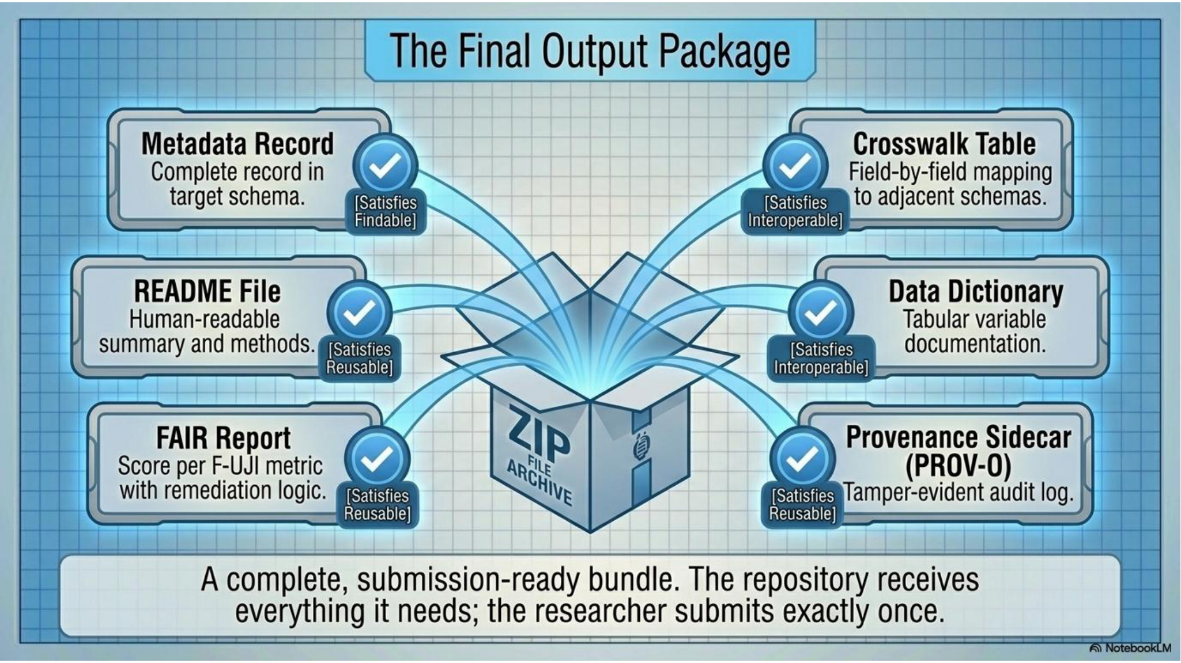
A reviewable research-data package
Target output package in the blueprint illustration
Persona architecture slides
24
Notes:
TIMING: 2 minute(s). Elapsed 38.0–40.0 minutes.
Name the artifacts: metadata record, README, data dictionary, crosswalk, FAIR report, and provenance dossier. Treat the pictured bundle as the target architecture, not a claim that the demo has produced a validated deposit package. Ask what would make this useful to a researcher tomorrow: a better README or a documented mapping can already help. Human authorization remains necessary for repository publication, licence decisions, and persistent identifiers. Transition: the biomedical variant makes the mapping problem more concrete.
SOURCES
https://rayuzwyshyn.net/UCRiverside2026/DataDirectorPersonaModel/The_Research_Data_DirectorUzwyshyn.pdf#page=14
https://rayuzwyshyn.net/UCRiverside2026/DataDirectorRDAMicrosoftCapabilitiesModel/FINAL_20260629_DRAFT_v0.1_DataDirectorAgenticAIBlueprint.pdf
DEMO LINKS
Blueprint: https://rayuzwyshyn.net/UCRiverside2026/DataDirectorRDAMicrosoftCapabilitiesModel/FINAL_20260629_DRAFT_v0.1_DataDirectorAgenticAIBlueprint.pdf
Persona architecture slides: https://rayuzwyshyn.net/UCRiverside2026/DataDirectorPersonaModel/The_Research_Data_DirectorUzwyshyn.pdf

Slide 34

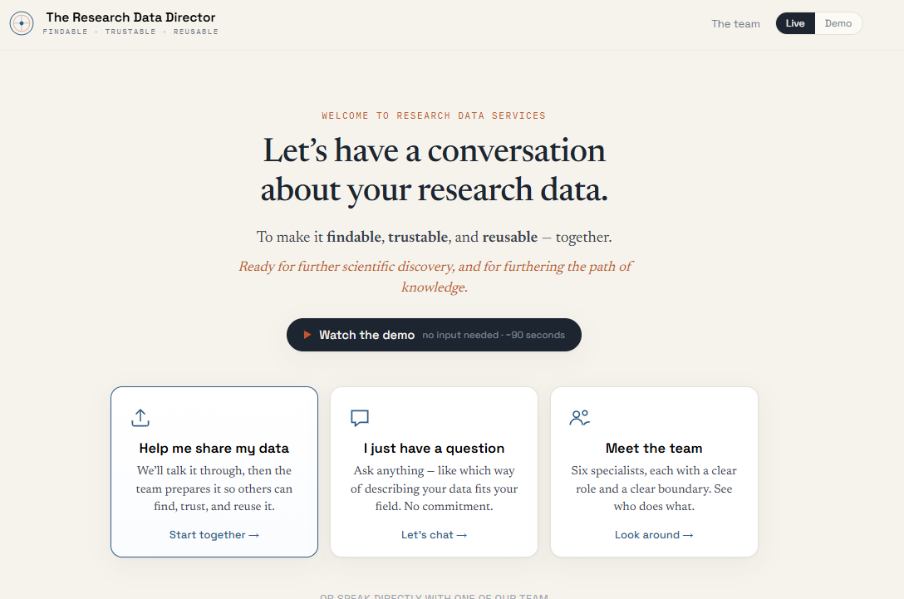
Person Based Agentic AI
Research Data Director
London Research Data Alliance Plenary
Presentation Draft
Proof of Concept: Prototypes

Slide 35
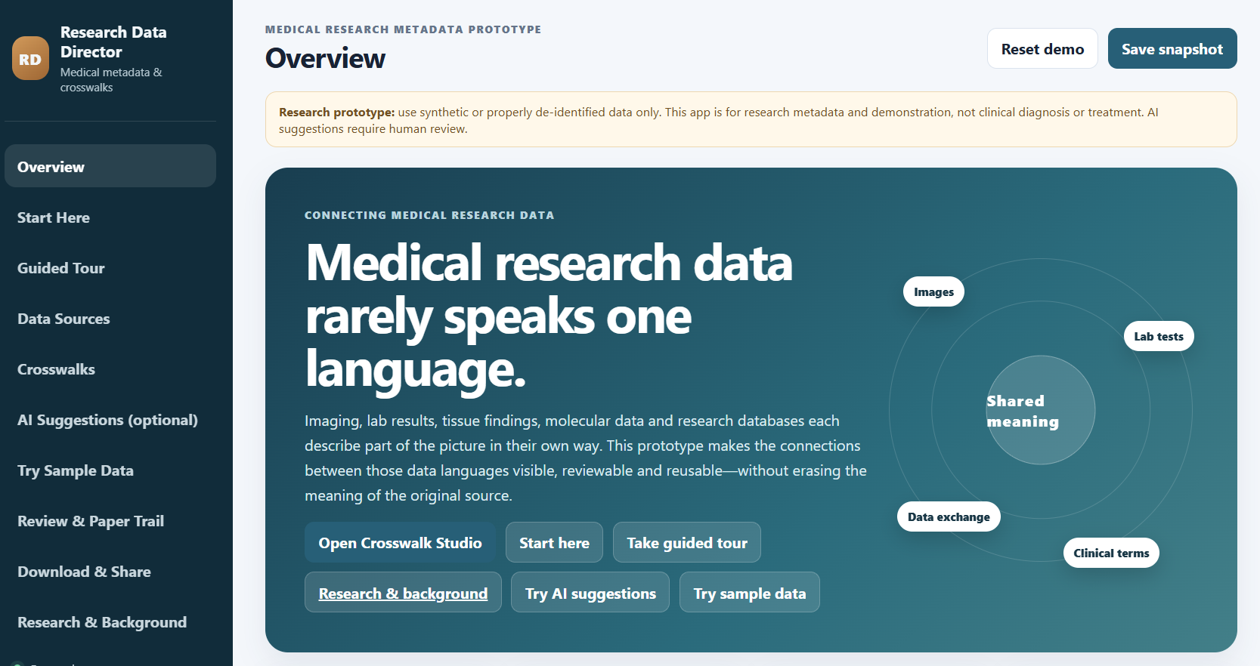
Biomedical Focused Research Data Director, August, 2026
Biomedical Variant, Background Research, Blueprint and Prototype

Slide 36
CONCLUSION
AI agents won't replace human inquiry or creativity.
They can multiply the scale, speed, and creative scope of every thinker in the university
and involved in Research and Discovery.
The Future Belongs to the next generation of Intentional, Ethical
and Creative AI Architects
Explore Demos & Syllabi: rayuzwyshyn.net

Slide 37

04 · LEARN · FALL 2026
Track 1 — AI & Data Science
From first Python program to neural networks and agentic AI
Date | Time | Session | Lead
Thu, Sept. 24 | 9:00–10:30 am | Introduction to Agentic AI: Capabilities, Personas & Possibilities | Ray Uzwyshyn
Wed, Sept. 30 | 1:00–2:00 pm | Studying with Gemini Notebook (UCR-licensed tools) | A. Zou / I. Shin
Wed, Oct. 7 | 2:00–3:00 pm | Python for Beginners Using AI | B. Martinez Neda
Wed, Oct. 21 | 3:00–4:00 pm | Introduction to Data Cleaning with Python, Pandas & AI | B. Martinez Neda
Wed, Oct. 28 | 12:00–1:00 pm | AI Literacy 101: Exploring Generative AI Through History | I. Shin
Wed, Nov. 4 | 2:00–3:30 pm | Introduction to Machine Learning | B. Martinez Neda
Thu, Nov. 5 | 3:00–4:00 pm | Web Agent: A Gemini-Powered AI Agent for Data Analysis | I. Shin
Mon, Nov. 23 | 3:00–4:00 pm | Intro to Advanced Machine Learning: Neural Networks (PyTorch) | I. Shin
Research & Technology Services
38
Notes:
Suggested pacing: 0.85 min. Recommend: Data Cleaning (Oct 21), Intro to ML (Nov 4), Web Agent (Nov 5).

Slide 38
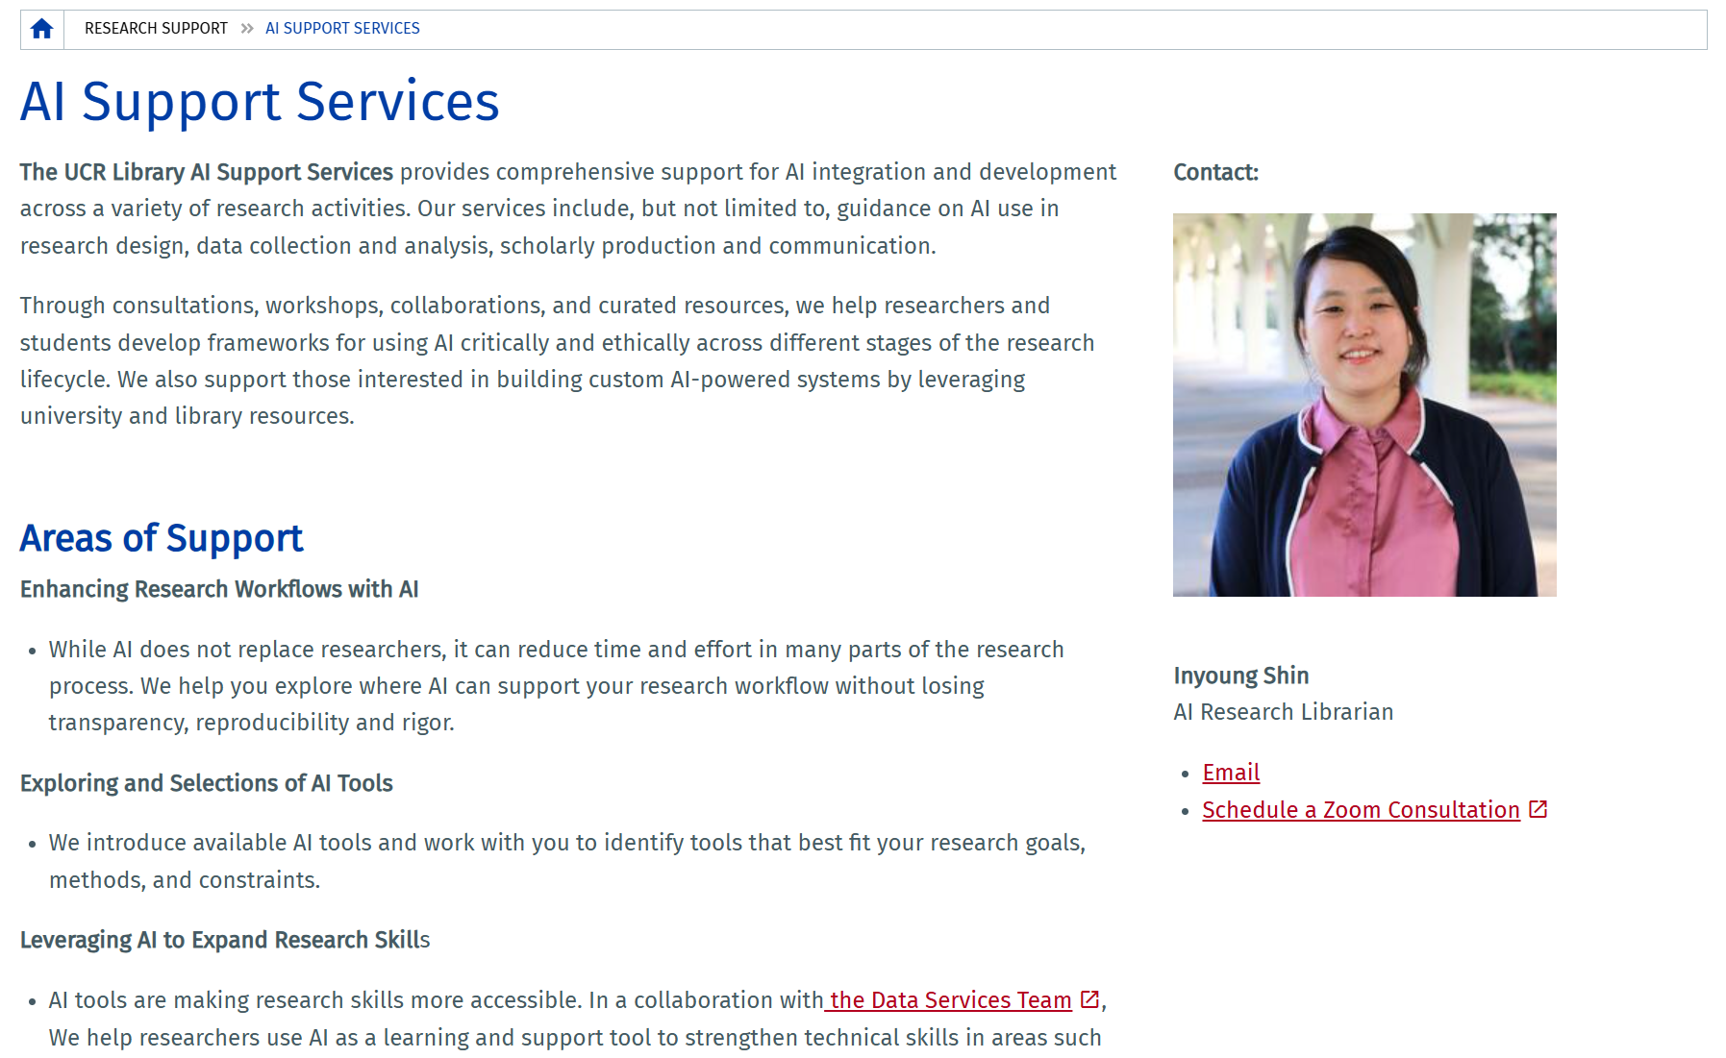
02 · CONSULT
AI Literacy Support Services
HOW TO USE IT
1
Enhance research workflows with AI — without losing transparency or rigor
2
Explore and select AI tools that fit your goals and constraints
3
Build skills with the Data Services team: coding, data processing, visualization
4
Responsible AI: privacy, bias, authorship and compliance — plus custom AI systems
GO TO
AI Support Services page
Book Inyoung Shin (30 min)
inyoungs@ucr.edu
Research & Technology Services
22
Notes:
Suggested pacing: 0.6 min. For a policy audience, stress responsible use: disclosure rules differ by publisher and funder, and interview/stakeholder data needs confidentiality. [Screenshot of the live page, September 2026.]

Slide 39
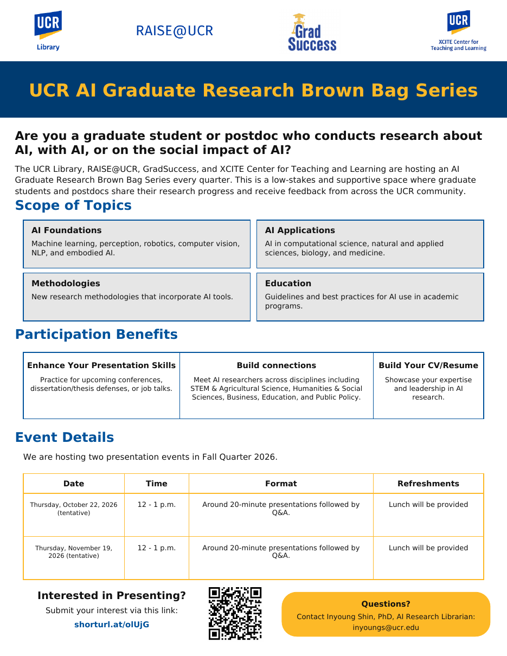

04 · LEARN
UCR AI Graduate Research Brown Bag Series
For grad students and postdocs doing research about AI, with AI, or on the social impact of AI.
AI foundations
AI applications
ML, perception, robotics, computer vision, NLP, embodied AI
Computational, natural & applied sciences, biology, medicine
Methodologies
Education
New research methods that incorporate AI tools
Guidelines and best practices for AI in programs
Thu, Oct. 22 & Thu, Nov. 19 · 12–1 pm · ~20-min talks + Q&A · lunch provided
Co-hosted by the UCR Library, RAISE@UCR, GradSuccess and XCITE Center for Teaching and Learning.
Present your work
shorturl.at/olUjG · inyoungs@ucr.edu
Research & Technology Services
41
Notes:
Suggested pacing: 0.6 min. Strong fit for SPEAKS: AI in transportation, perception, or AI policy all qualify; the audience spans STEM, social sciences and public policy. Good practice for conference talks and defenses.

Slide 40
04 · LEARN
UCR AI Graduate Research Brown Bag Series
For grad students and postdocs doing research about AI, with AI, or on the social impact of AI.
AI foundations
AI applications
ML, perception, robotics, computer vision, NLP, embodied AI
Computational, natural & applied sciences, biology, medicine
Methodologies
Education
New research methods that incorporate AI tools
Guidelines and best practices for AI in programs
Thu, Oct. 22 & Thu, Nov. 19 · 12–1 pm · ~20-min talks + Q&A · lunch provided
Co-hosted by the UCR Library, RAISE@UCR, GradSuccess and XCITE Center for Teaching and Learning.
Present your work
shorturl.at/olUjG · inyoungs@ucr.edu
Research & Technology Services
41
Notes:
Suggested pacing: 0.6 min. Strong fit for SPEAKS: AI in transportation, perception, or AI policy all qualify; the audience spans STEM, social sciences and public policy. Good practice for conference talks and defenses.

Slide 41
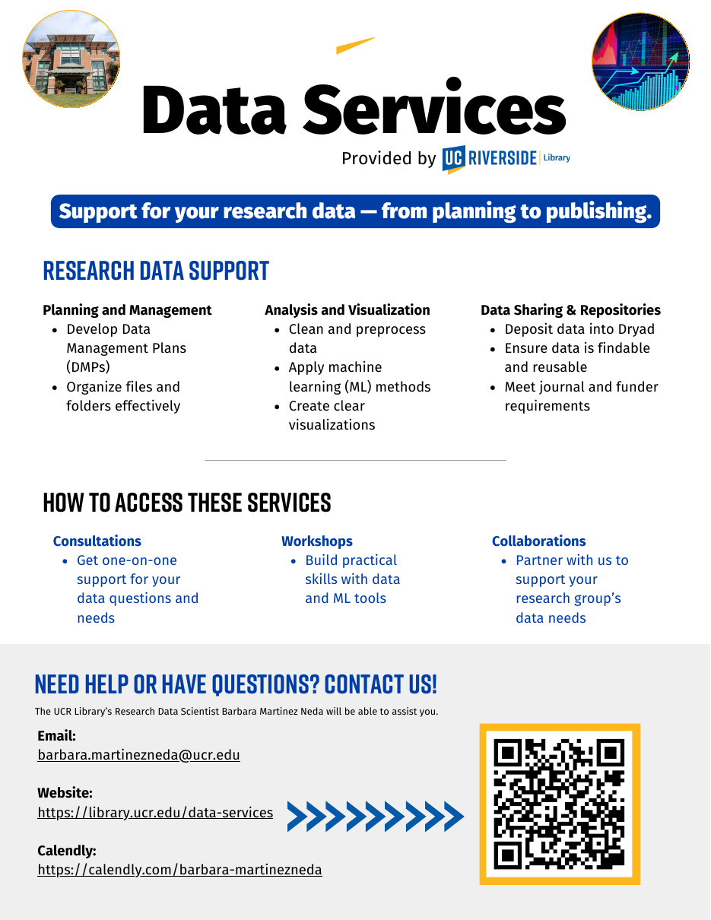
02 · CONSULT
Data Services — From Planning to Publishing
Support for your research data — from planning to publishing.
Planning & management
Analysis & visualization
DMPs, file organization
Cleaning, ML methods, clear visuals
Sharing & repositories
Collaborations
Dryad, findable & reusable data
Partner on your group’s data needs
DATA WORKSHOPS THIS FALL
Python for Beginners Using AI — Wed, Oct. 7
Data Cleaning with Python, Pandas & AI — Wed, Oct. 21
Introduction to Machine Learning — Wed, Nov. 4
Book Barbara: calendly.com/barbara-martinezneda · barbara.martinezneda@ucr.edu
Research & Technology Services
21
Notes:
Suggested pacing: 0.6 min. Barbara's Data Services flyer, with her fall workshops. The flyer QR goes to her Calendly.

Slide 42
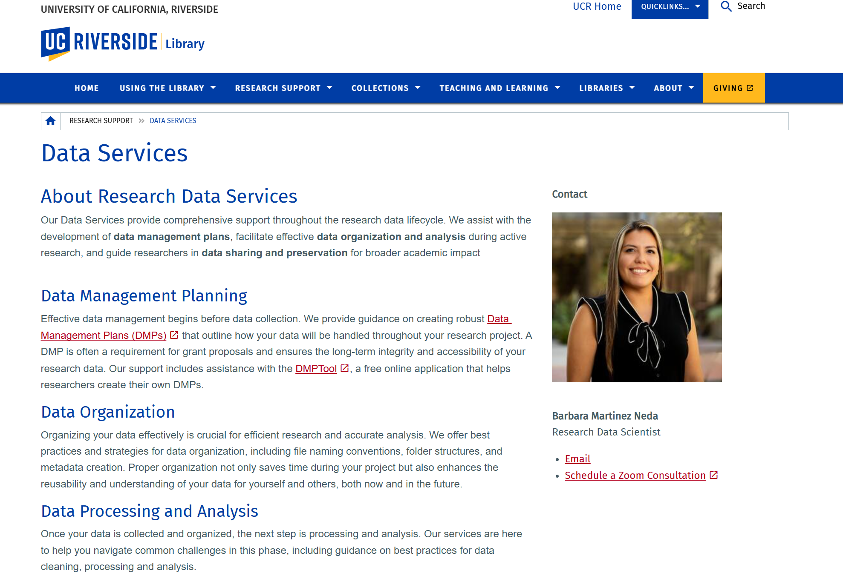
02 · CONSULT
Data Services Across the Research Lifecycle
HOW TO USE IT
1
Plan — Data Management Plans for grants, with DMPTool
2
Organize — file naming, folder structures, metadata
3
Analyze — cleaning, Python/pandas, machine learning, visualization
4
Share — deposit in Dryad; meet funder and journal requirements
GO TO
Data Services page
Book Barbara Martinez Neda
DMPTool
Dryad
Research & Technology Services
20
Notes:
Suggested pacing: 0.6 min. NSF requires DMPs — Barbara reviews them. Sensor, traffic and emissions data need cleaning and documentation. Dryad (UC-supported) publishes data with a DOI. [Screenshot of the live page, September 2026.]

Slide 43
02 · CONSULT
Data Services — From Planning to Publishing
Support for your research data — from planning to publishing.
Planning & management
Analysis & visualization
DMPs, file organization
Cleaning, ML methods, clear visuals
Sharing & repositories
Collaborations
Dryad, findable & reusable data
Partner on your group’s data needs
DATA WORKSHOPS THIS FALL
Python for Beginners Using AI — Wed, Oct. 7
Data Cleaning with Python, Pandas & AI — Wed, Oct. 21
Introduction to Machine Learning — Wed, Nov. 4
Book Barbara: calendly.com/barbara-martinezneda · barbara.martinezneda@ucr.edu
Research & Technology Services
21
Notes:
Suggested pacing: 0.6 min. Barbara's Data Services flyer, with her fall workshops. The flyer QR goes to her Calendly.

Slide 44
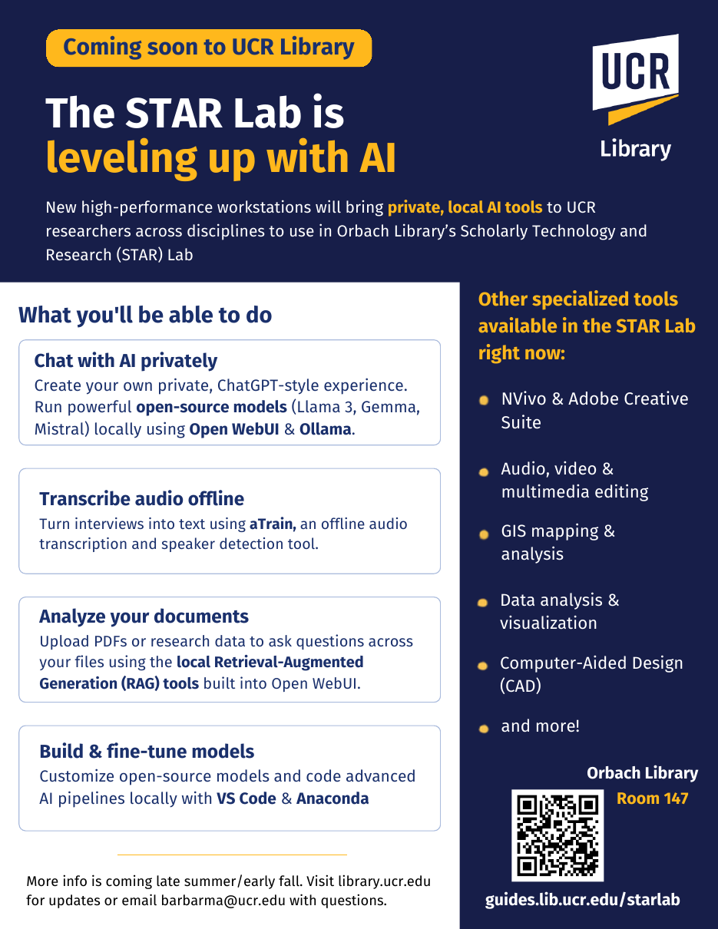




05 · CREATE
Coming Soon: The STAR Lab Is Leveling Up With AI
New high-performance workstations bring private, local AI tools to UCR researchers across disciplines.
Chat with AI privately
Open WebUI & Ollama running Llama, Gemma and Mistral locally
Transcribe audio offline
aTrain for interviews, with speaker detection
Analyze your documents
Local retrieval-augmented generation over PDFs & data
Build & fine-tune models
Custom models and AI pipelines in VS Code & Anaconda
Questions: Barbara Martinez Neda · barbarma@ucr.edu
Research & Technology Services
52
Notes:
Suggested pacing: 0.6 min. Coming this fall. Why local AI matters for policy research: no per-token costs, sensitive interview and IRB data stay on campus, and pinned open-weight model versions make methods reproducible. aTrain transcription never leaves the machine. UC-licensed cloud tools remain fine for general work.

Slide 45
Questions & Discussion
Ray Uzwyshyn, Ph.D., MBA, MLIS
Director, Research and Technology Services
UCR Libraries
raymondu@ucr.edu · linkedin.com/in/rayuzwyshyn
Vita, apps and slides
AI writing & research archive
Notes:
55:00–60:00. Q&A.

Slide 47
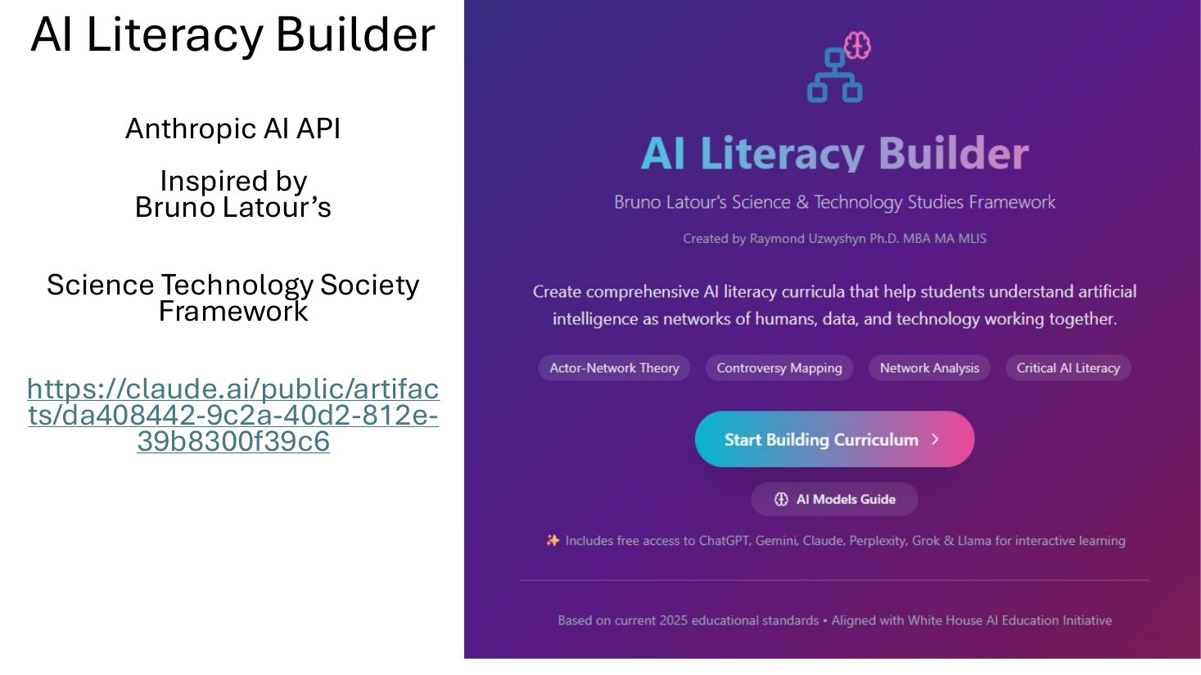
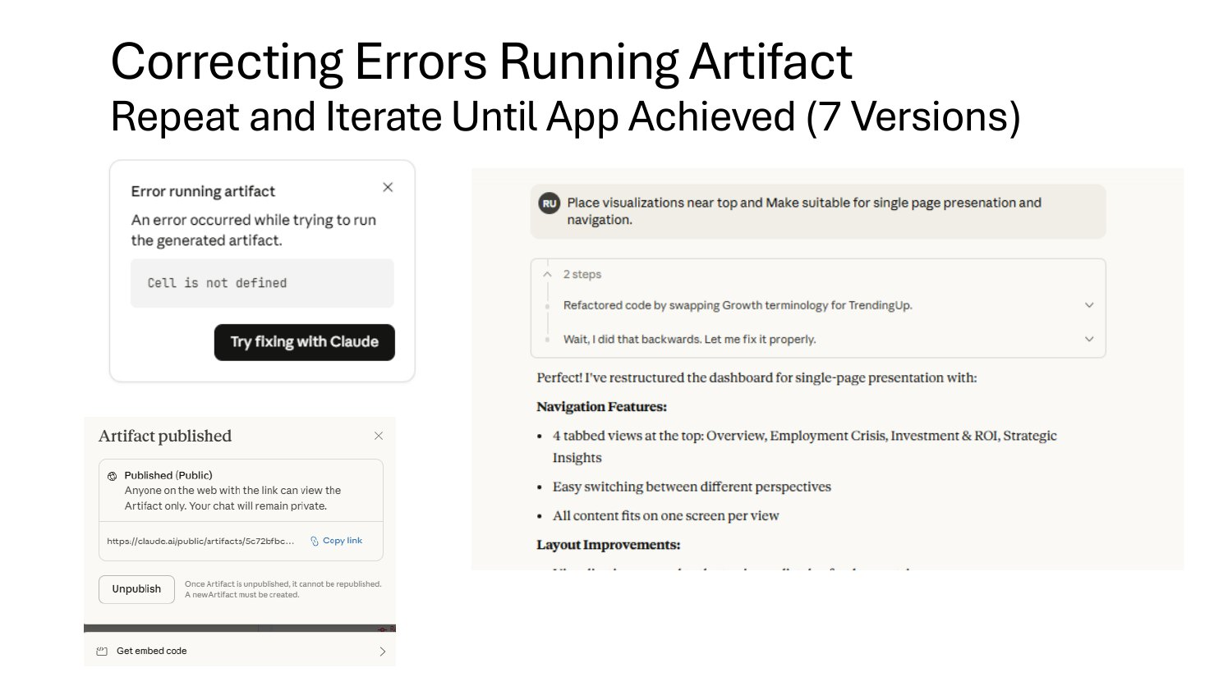
What the loop looks like in practice
Apps
The result AI Literacy Builder on Latour’s STS framework — a live Anthropic API app, shown at the NeurIPS 2025 education showcase.
The process Errors are normal: “Try fixing with Claude,” restate the goal, iterate — seven versions to get one dashboard right.
Open the Latour builder ↗
From Vibe Coding: AI-Driven Development (UCR Orbach Library, Nov 2025)
Notes:
32:30–34:00. Normalize failure. Most of the audience’s first attempts will error — the skill is iteration, not getting it right first time.

Slide 48
A gallery built this way
Apps
Click through after the session — all are live
Move 37
UC Research Starter
Latour AI Literacy Builder
Discovery engine modeled on AlphaGo’s creative leap
AI brainstorming for faculty and grad students
Curriculum builder on an STS framework
Open ↗
Open ↗
Open ↗
Research Insights Architect
Collider Bias
Graduate Employment Paradox
PRISMA systematic-review framework
Multivariate statistics through interactive visualization
Fed, StatCan and UK labor data synthesized
Open ↗
Open ↗
Open ↗
Notes:
34:00–35:00. Don’t demo these — just show range: pedagogy, research methods, statistics, economics.

Slide 49
Try it: your first deep-research run
Office
Works in ChatGPT, Gemini, Claude or Perplexity — paste, edit the brackets, run
Research question: [your question].
Scope: peer-reviewed and governmental sources, [years], [regions].
Method: first propose a research plan and wait for my approval. Then search broadly, prioritize primary sources, and flag disagreements between sources.
Output: an executive summary, a findings table with a citation per claim, gaps in the evidence, and 5 suggested next questions.
Rules: never invent a citation; label anything uncertain.
Why it works
Plan-first keeps you in the director’s chair.
A citation-per-claim table makes verification fast.
“Gaps” and “next questions” turn a report into a research agenda.
Notes:
22:30–24:00. Point to UCR Library workshops for follow-up. Remind: always open and check the cited sources.

Slide 50
Where to start — at your level
Undergraduates
Graduate students
Run one deep-research prompt on a course topic; verify three citations by hand.
Write a methods-advisor persona; have it critique your proposal draft.
PhDs & postdocs
Staff
Vibe-code a small tool for your data; add one API call that reasons.
Automate one recurring spreadsheet or slide task; compare two models.
UCR Library Research Services workshops (Fall 2026)
Notes:
52:00–53:30.

Slide 51
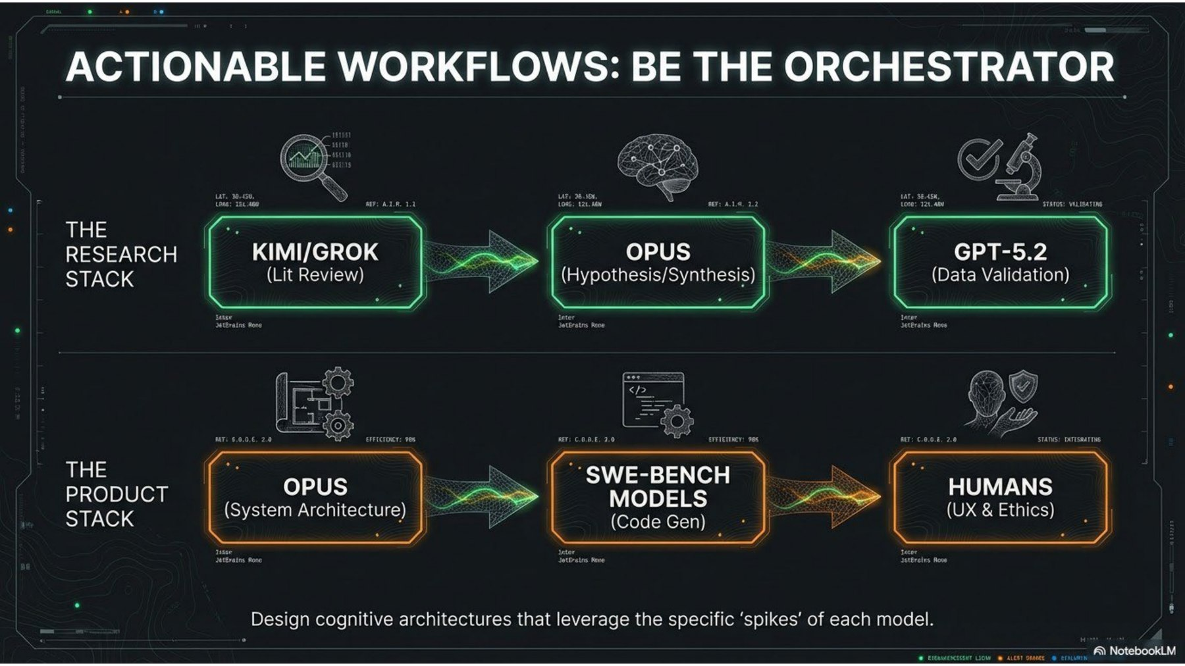
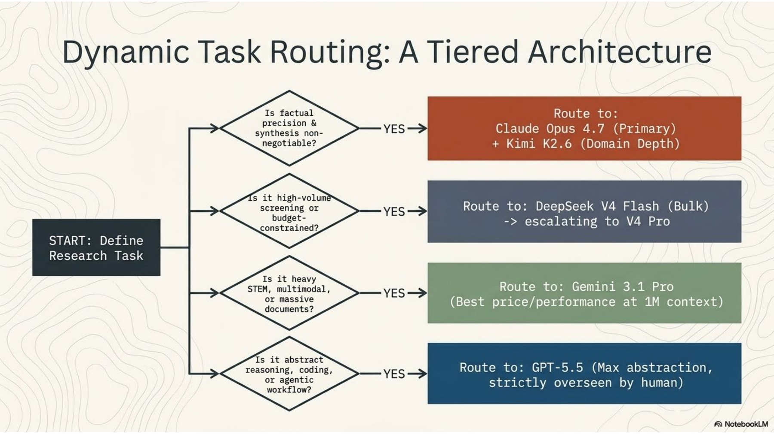
Be the Orchestrator, Producer or Director
Model selection is the new information literacy
Frontier
Don’t ask which model is smartest — ask which meets your specific task needs
Be the orchestrator: chain models by strength — the pattern behind the Invisible Mile project later in this talk.
Routing guidance as of May 2026 — the frontier moves monthly
Notes:
16:30–18:30. Bridge to hands-on. Expertise shifts from possessing information to directing cognition — everything that follows is practice in that second-order work.

Slide 52
Six roles with explicit responsibilities
Persona | Contribution | Evidence to inspect
Research Librarian | Clarifies purpose and context | Structured intake brief
Director | Coordinates the workflow | Plan and escalation decisions
Metadata Librarian | Drafts descriptions and mappings | Record and crosswalk
Fact Checker | Checks identifiers and claims | Verification results
Quality Reviewer | Examines reuse requirements | Pass, warning, or failure
Recorder | Preserves the history | Provenance log
Roles describe intended responsibilities. A demo can simulate their outputs.
21
Notes:
TIMING: 2 minute(s). Elapsed 31.0–33.0 minutes.
These names follow the friendly prototype. The source presentation uses FAIR Expert and Provenance Recorder for the last two specialist roles. Explain why separating responsibilities helps the user inspect the work. A role name or prompt is not proof that a registry lookup occurred. To demonstrate live verification, show the actual tool result and its source. The scripted mode is a teaching device.
SOURCES
https://rayuzwyshyn.net/UCRiverside2026/DataDirectorProtypeLinksandFiles/research-data-directorV1FriendlyUI.html
https://rayuzwyshyn.net/UCRiverside2026/DataDirectorPersonaModel/The_Research_Data_DirectorUzwyshyn.pdf

Slide 53
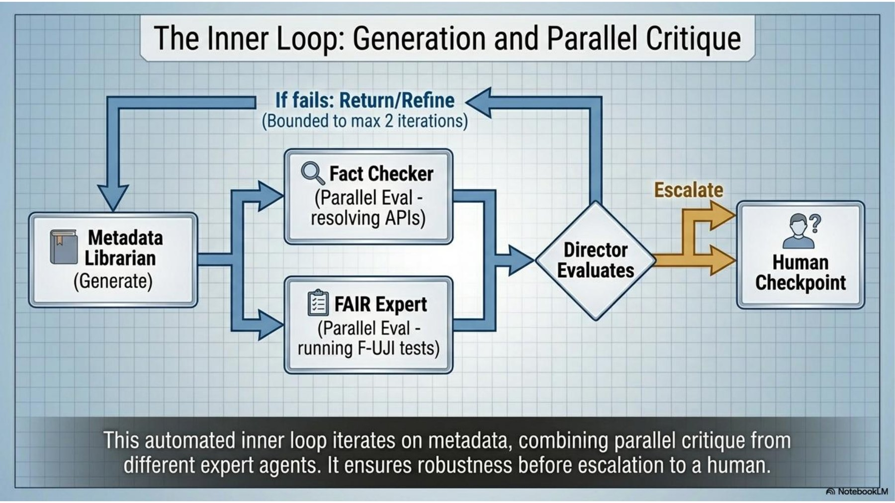
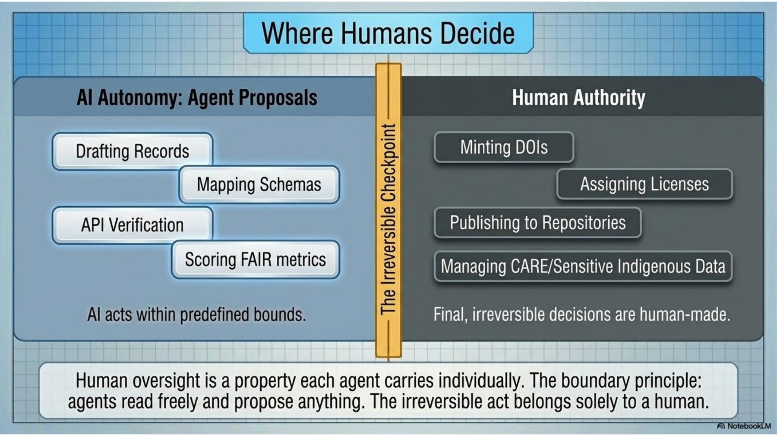
How the Research team works
Where Agentic AI and Where humans decide
Research
Architecture illustration from the Research Data Director presentation
Shared Context and a Review Loop
Irreversible checkpoint Agents draft, map and score. Humans mint DOIs, assign licenses, publish, and govern sensitive data.
Inner loop The Metadata Librarian generates; the Fact Checker and FAIR Expert critique in parallel; the Director decides — at most two rounds before Human escalation.
Notes:
42:30–44:30. Generator–evaluator loops are the single most transferable agentic pattern for students’ own projects.

Slide 54
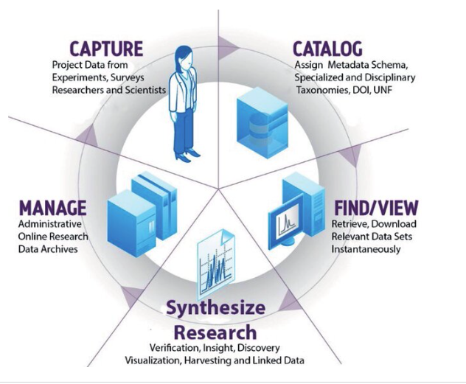
The Research Data Lifecycle & the Scientific Process, Scientific Discovery
Data Integrity, Findability, Access, Interoperability, Reproducibility (FAIR Principles
US and International Grant Compliance, Publication, Sharing, Collaboration, Automation
Data, Metadata, Metadata Schema, Metadata Mappings and Crosswalks and Data and
Scientific Discovery

Slide 55
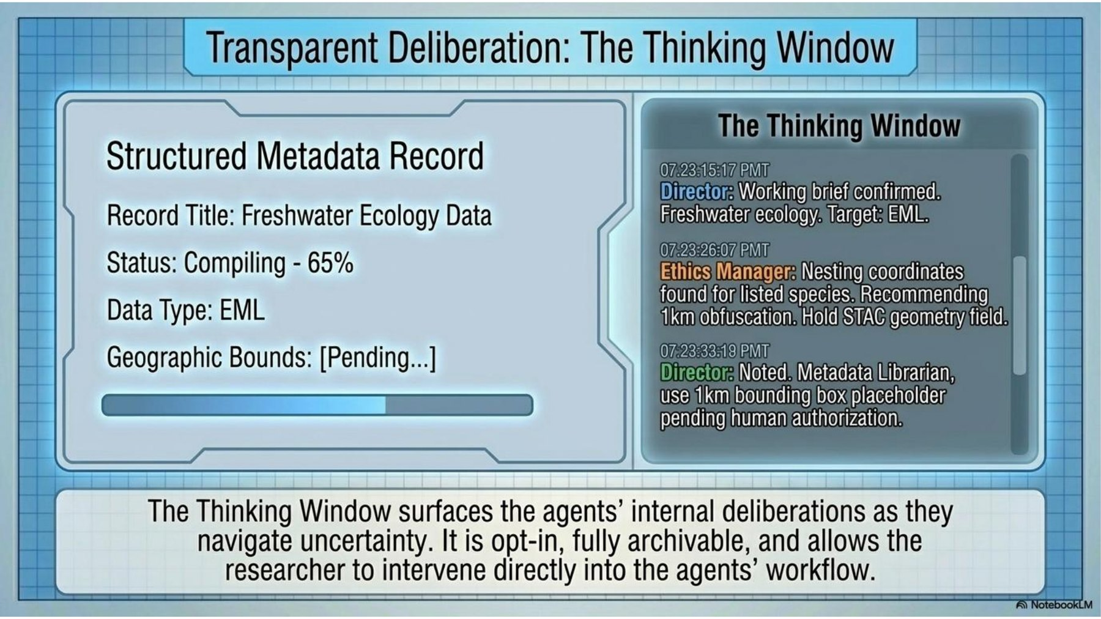
Demo: watch the team work
Research
rayuzwyshyn.net/UCRiverside2026/DataDirectorProtypeLinksandFiles/research-data-directorV11.ht
What to watch
The Director plans before anyone acts
Hand-offs between personas
The opt-in thinking window
Where a human approves the deposit
Poster at RDA P27, London — October 2026
V10 persona build
V5 API build
V1 friendly UI
The thinking window: persona deliberations, opt-in and archivable
Notes:
44:30–47:30. DEMO: load the demo case in V11. If Wi-Fi fails, use the V1 hard-coded version — it runs offline in the browser.

Slide 56
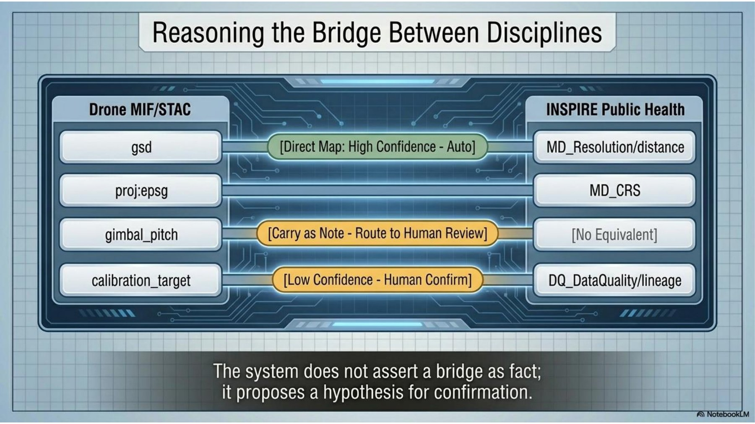
Biomedical Variant: a capabilities lens
Research
Biomedical Metadata & Crosswalk Studio — RDA VANTAGE Working Group, August 2026
Register
Multimodal datasets: imaging, genomics, sensors
Normalize
Metadata cleaned to shared vocabularies
Assess
Provenance and quality scoring
Crosswalk
AI assistant proposes mappings; humans review
Export
FHIR ConceptMap, crosswalk and research manifest
Crosswalk logic: auto-map high confidence, route the rest to human review
DICOM · LOINC · SNOMED CT · RadLex / PI-RADS · UCUM · FHIR
Open the Biomedical Crosswalk Studio ↗
Blueprint
Research background
Notes:
47:30–51:00. DEMO: register a sample dataset, run the AI Crosswalk Assistant, show a human approving a mapping, export the FHIR ConceptMap. Each capability is a discrete, auditable step — why this lens suits regulated domains. Benchmarked with Patricia Buendia on an ImmPort dataset.

Slide 57
Questions & discussion
Vita, apps and all slides
Jagged Frontier: slides + paper
Research Data Director blueprint
Biomedical Crosswalk Studio
Invisible Mile atlas
AI writing & research archive
Ray Uzwyshyn, Ph.D., MBA, MLIS
Director, Research and Technology
UCR Libraries
raymondu@ucr.edu · linkedin.com/in/rayuzwyshyn
Notes:
55:00–60:00. Q&A.

Slide 58
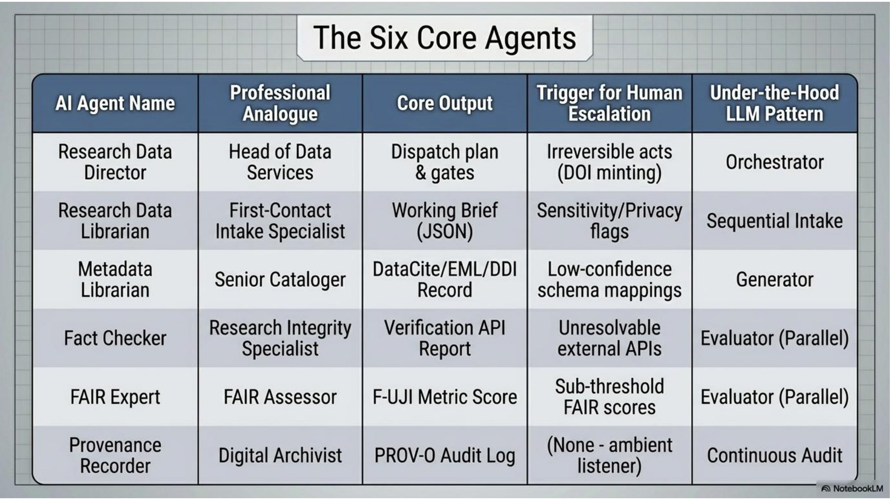
Personas as job descriptions
Research
Each agent: a professional analogue, an output, and a trigger for human escalation
The persona prompt is the role: Head of Data Services, Senior Cataloger, Digital Archivist
Escalation triggers are written into each persona
LLM patterns: orchestrator, generator, parallel evaluators, continuous audit
Notes:
40:30–42:30. Connect back to the six-part persona anatomy: identity, expertise, scope, method — plus escalation rules. This is the Okoye prompt grown into a team.

Slide 59
Open Problems, Possibilities, Challenges For Agentic AI
Guardrails for Agentic AI Work, Transparency, Understanding
Verification
Protect data
Humans in the loop
Disclose
Agents hallucinate with confidence. Check and Verify sources, numbers and code.
No FERPA, HIPAA or unpublished data in consumer tools — use UC-approved platforms.
Put human approval where consequences are real. Governance, The Human Use of Human Beings,
Say how AI was used, transparency of results following course and publisher policy.
Sensitive Data, Privacy, Security Governance
Notes:
53:30–55:00. ‘Stay in the loop’ is highlighted because every system shown today has a human approval step by design.

