Slide 1

The Arc of Experience and
Academic Library
Futures
Ray Uzwyshyn, Ph.D. MBA MLIS
Acting AUL and Director of Research and Technology Services
University of California, Riverside Libraries
https://rayuzwyshyn.net

Slide 2
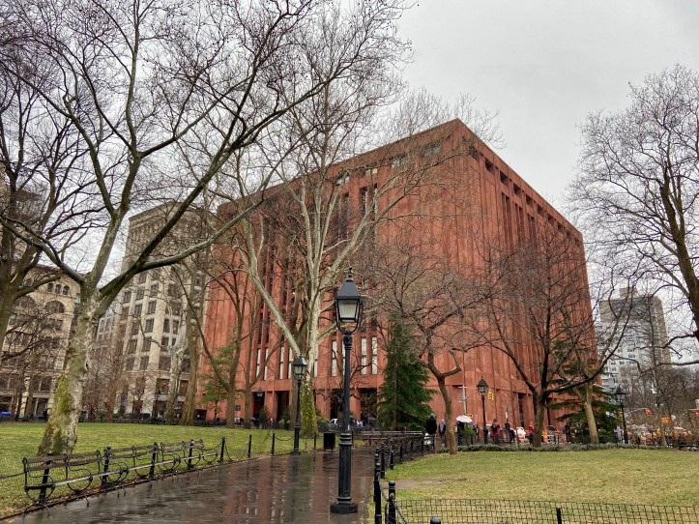
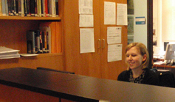

Academic Library Beginnings
NYU, Bobst Library and Amberg Media center, 1991-2001,
MA &Ph.D. Dept. Office Asst., Amberg Media Center, Bobst Library
Everson Film Archives
MA Ph.D. Graduate Student
Amberg Media Center Office Assistant
Research Assistant
William K. Everson
Dr. Antonia Lant
William K. Everson Film Archives
Lincoln Center Performing Arts Library
NYPL Research
Anthology Film Archives
Women and Film
Columbia Libraries

Slide 3


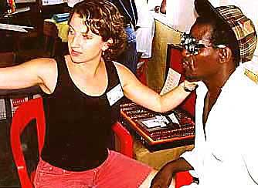
NY Internet, 1991-2001
Beginnings, Multimedia
NY’s Silicon Alley
Ph.D. Cinema/Media Studies
Dissertation: Technology, Propaganda, Aesthetics, Early Soviet Film and Issues of Post Colonialism
Certificate of Multimedia

Slide 4
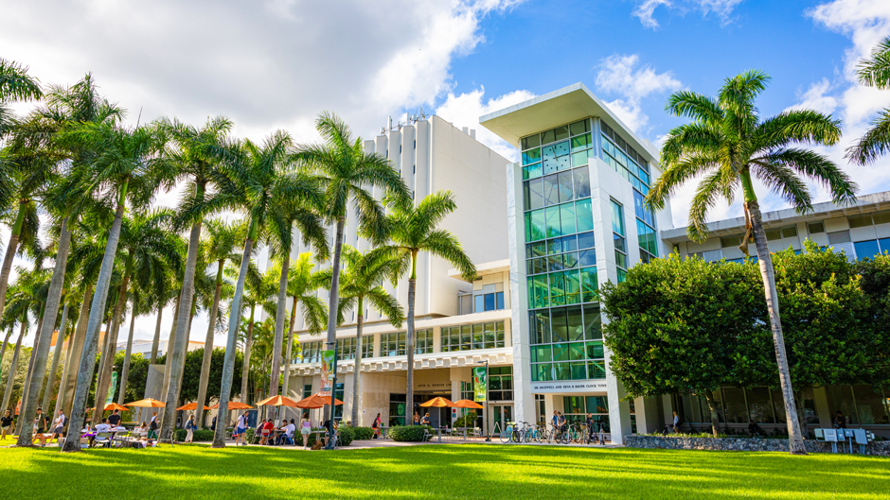
University of Miami Libraries, 2003-2006
4th Degree, MLIS University of Western Ontario, 2003
Recruited Down to University of Miami
First Webmaster, Web Services Librarian, Digital Intiatives Librarian,
Web Services Manager
Shift from Information Literacy to Digital Literacy

Slide 5
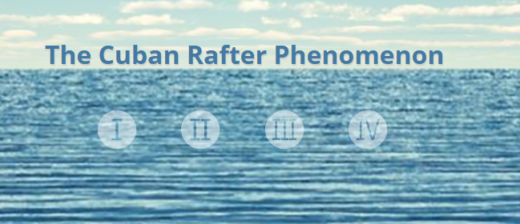
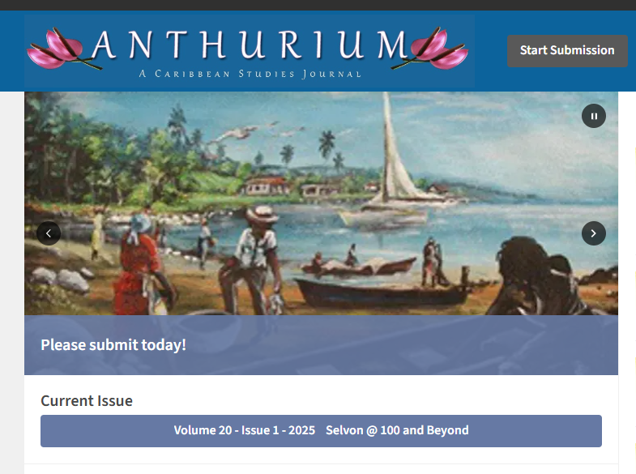
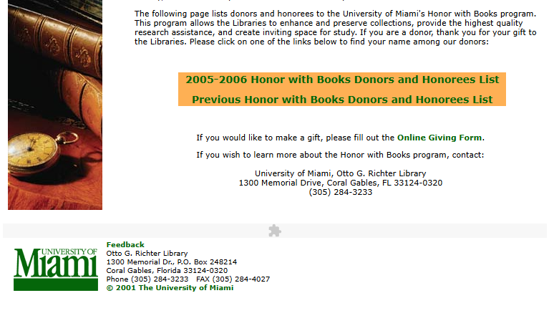
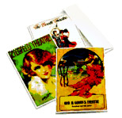
Paradigm Shift of Libraries,
2003-2006, Digital Literacy
Information Commons (Universities Largest Computing Lab)
Digital Libraries and Archives
Cuban Heritage Center
Interdisciplinary Faculty Collaborations
Refereed Online Journals
Innovative Interdisciplinary
Initiatives, Grants, Donor Engagement
Media Lab Manager
Digital Libraries,
Digital Archives
Special Collections
Online, Cuban Heritage Center

Slide 6
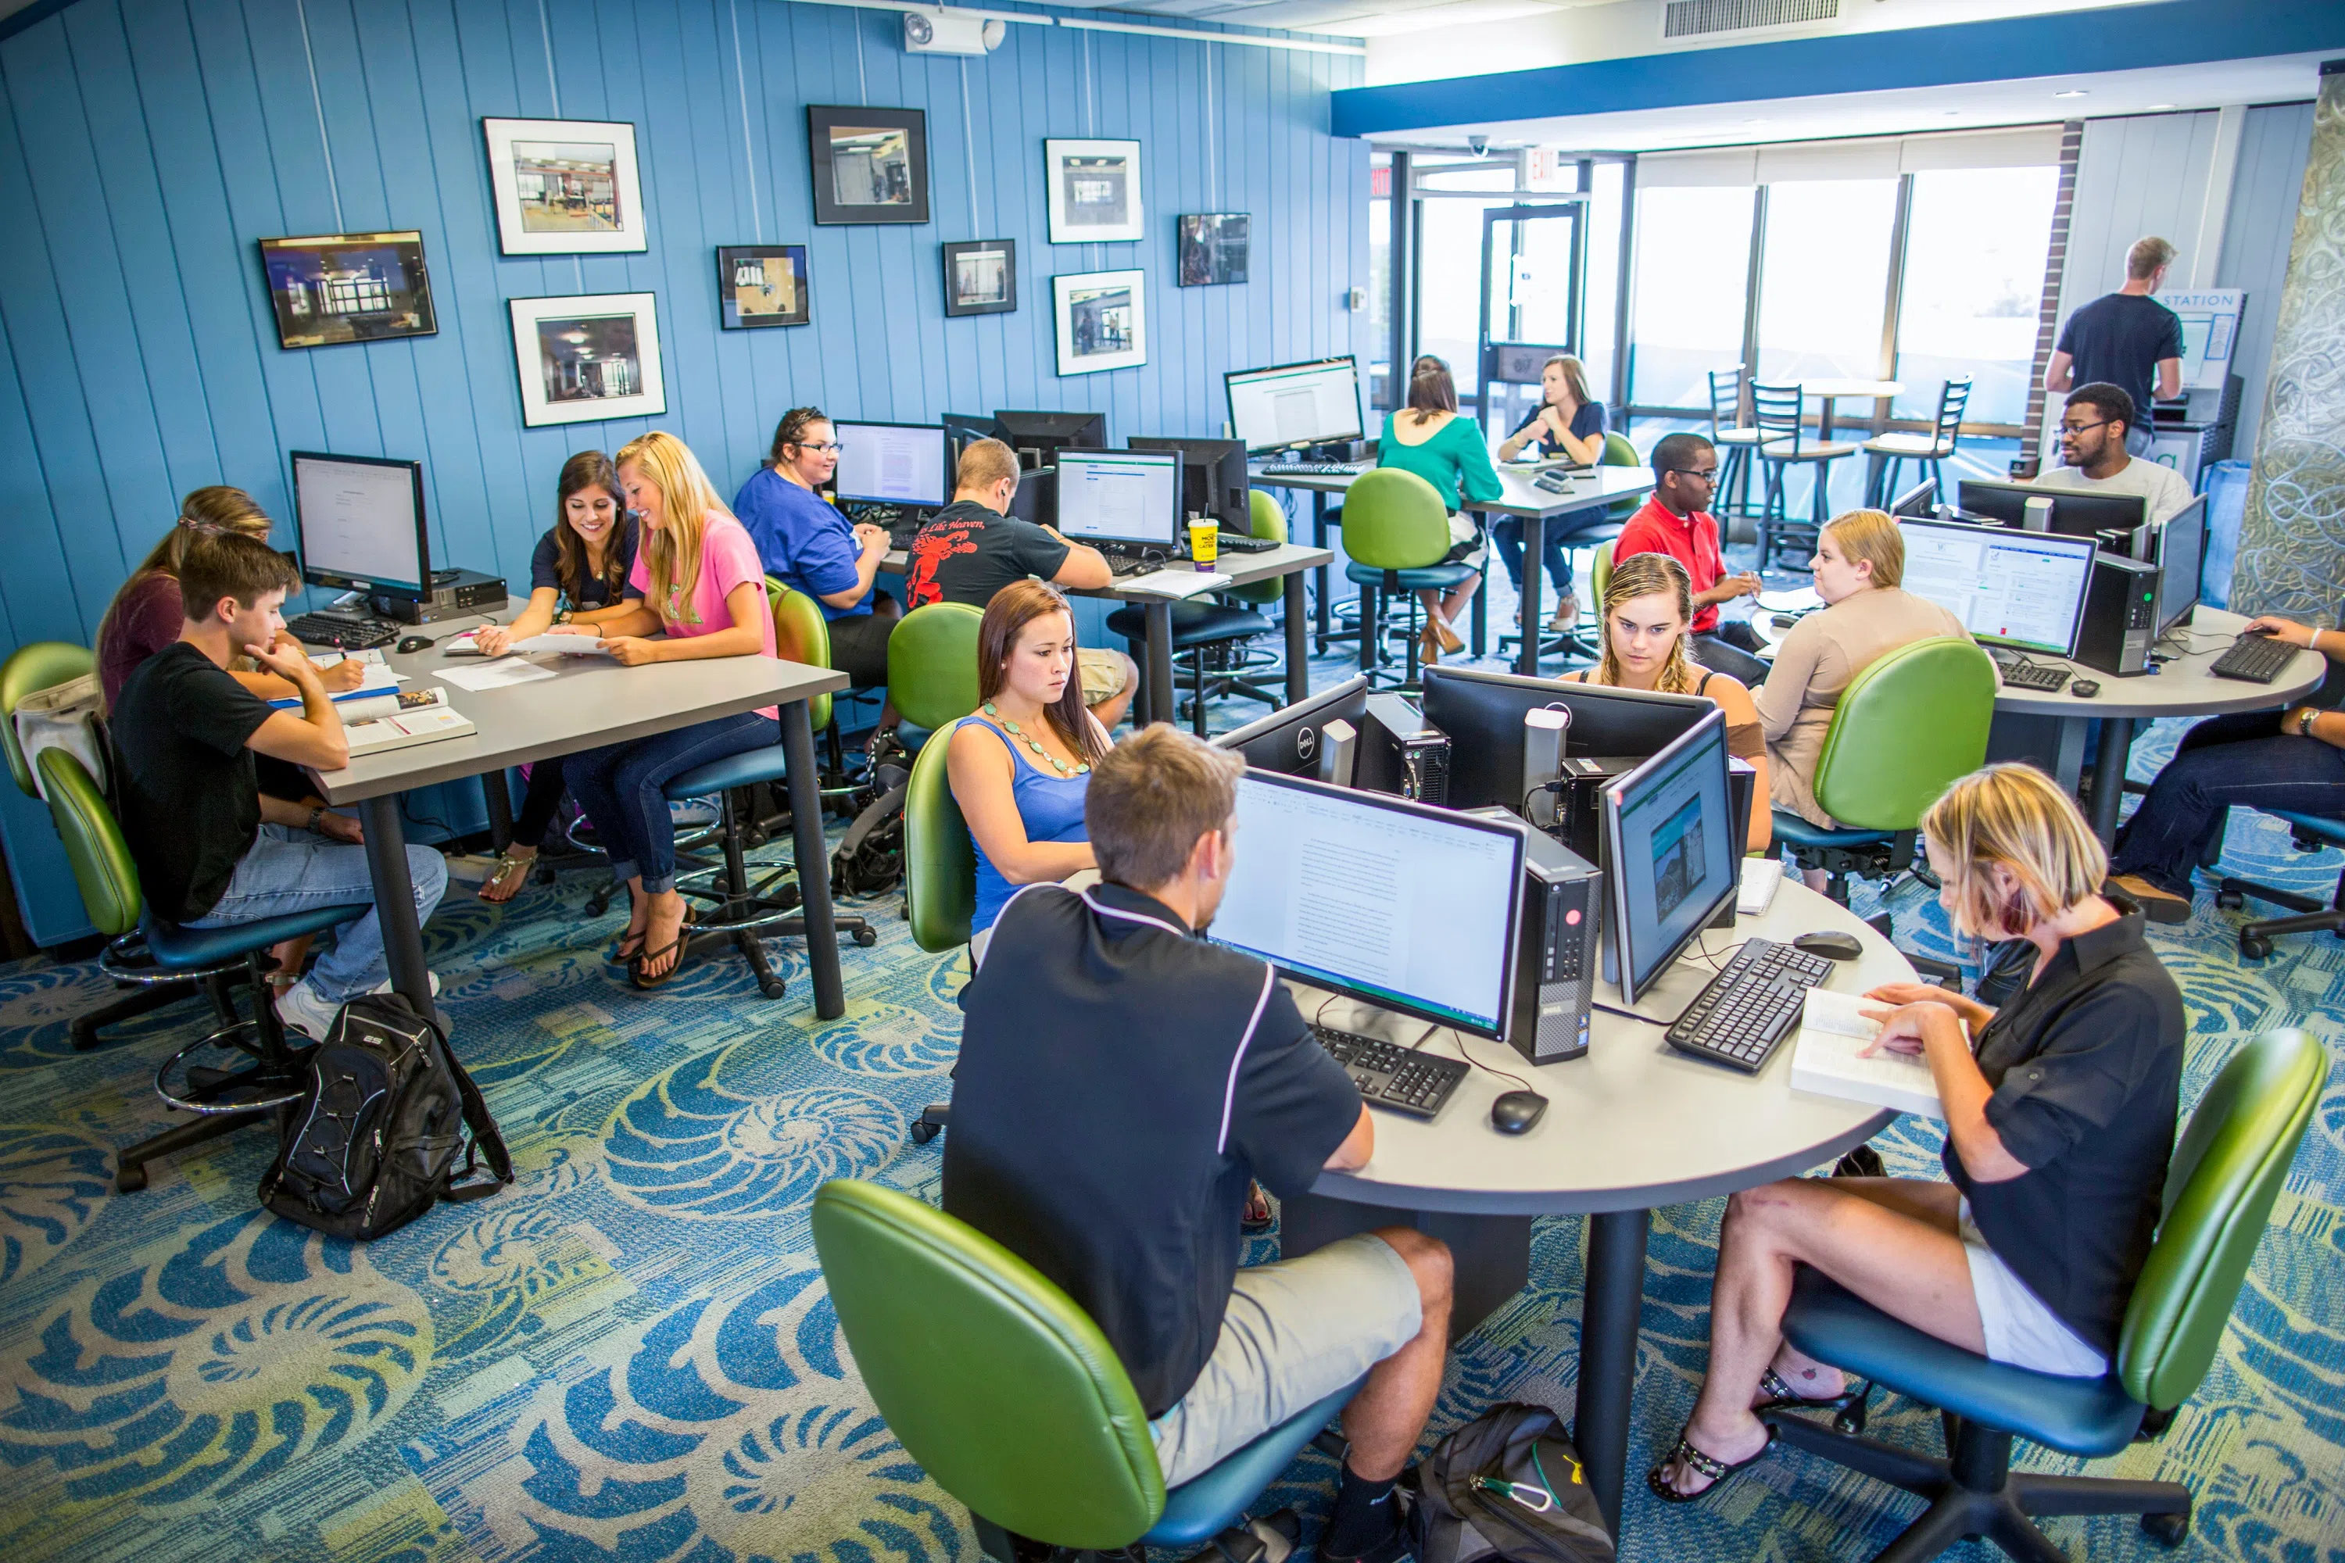
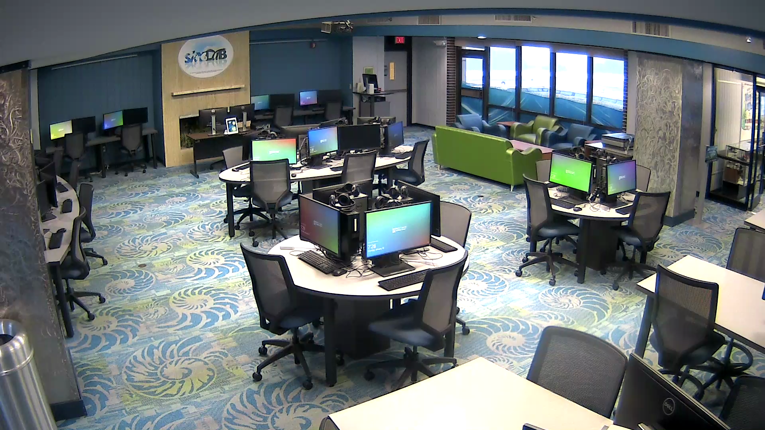
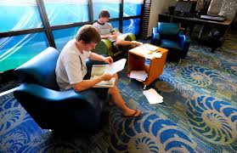
University of West Florida Libraries
2006-2010 1st Department Head Position,
Head, Digital and Learning Technologies
The Skylab: Digital Media and Archives Center, 2006-2010, Information Literacy Lab and Digital Archive
s https://visitour.io/university-of-west-florida/general-campus-tour/pace-library

Slide 7
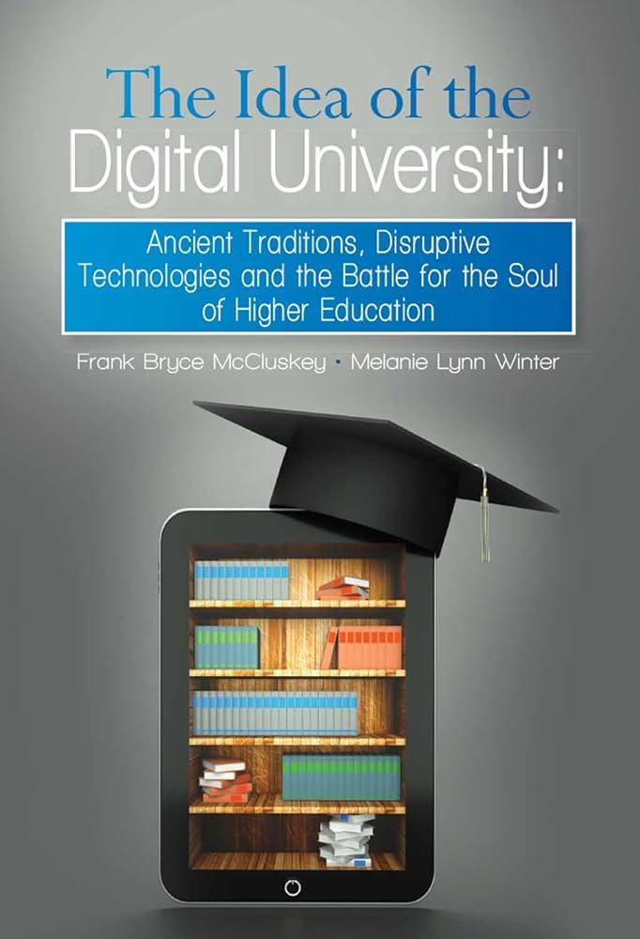
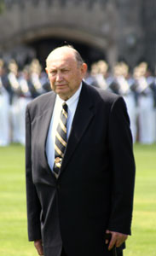
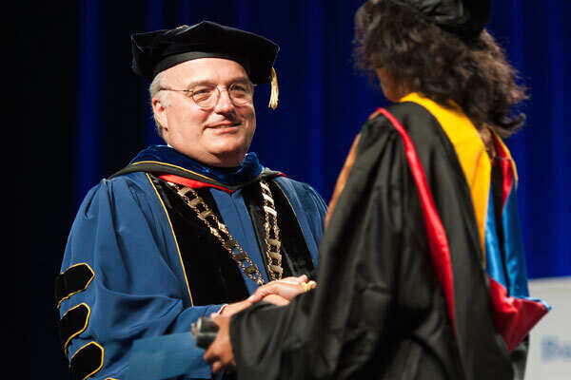



American Public University Libraries, AMU & APU
Completely Online Academic Libraries, 2010-2014
2011-2014, Director of Online Libraries and E-Resources
2 Million Dollar E-Resources Budget
Various National Awards for Online Learning
Free Online Curriculum
1800 Courses
22 Globally dispersed Librarians
NASDAQ
Traded Corporation
MBA (IT Project Management)

Slide 8
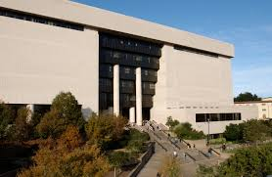
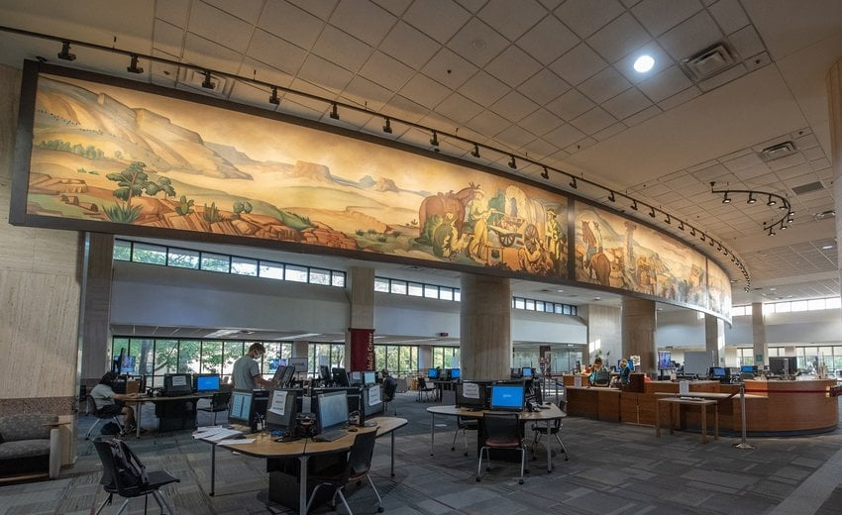
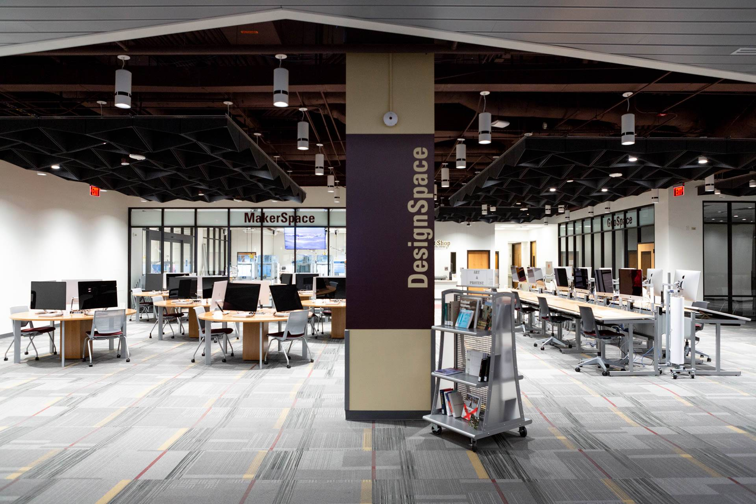
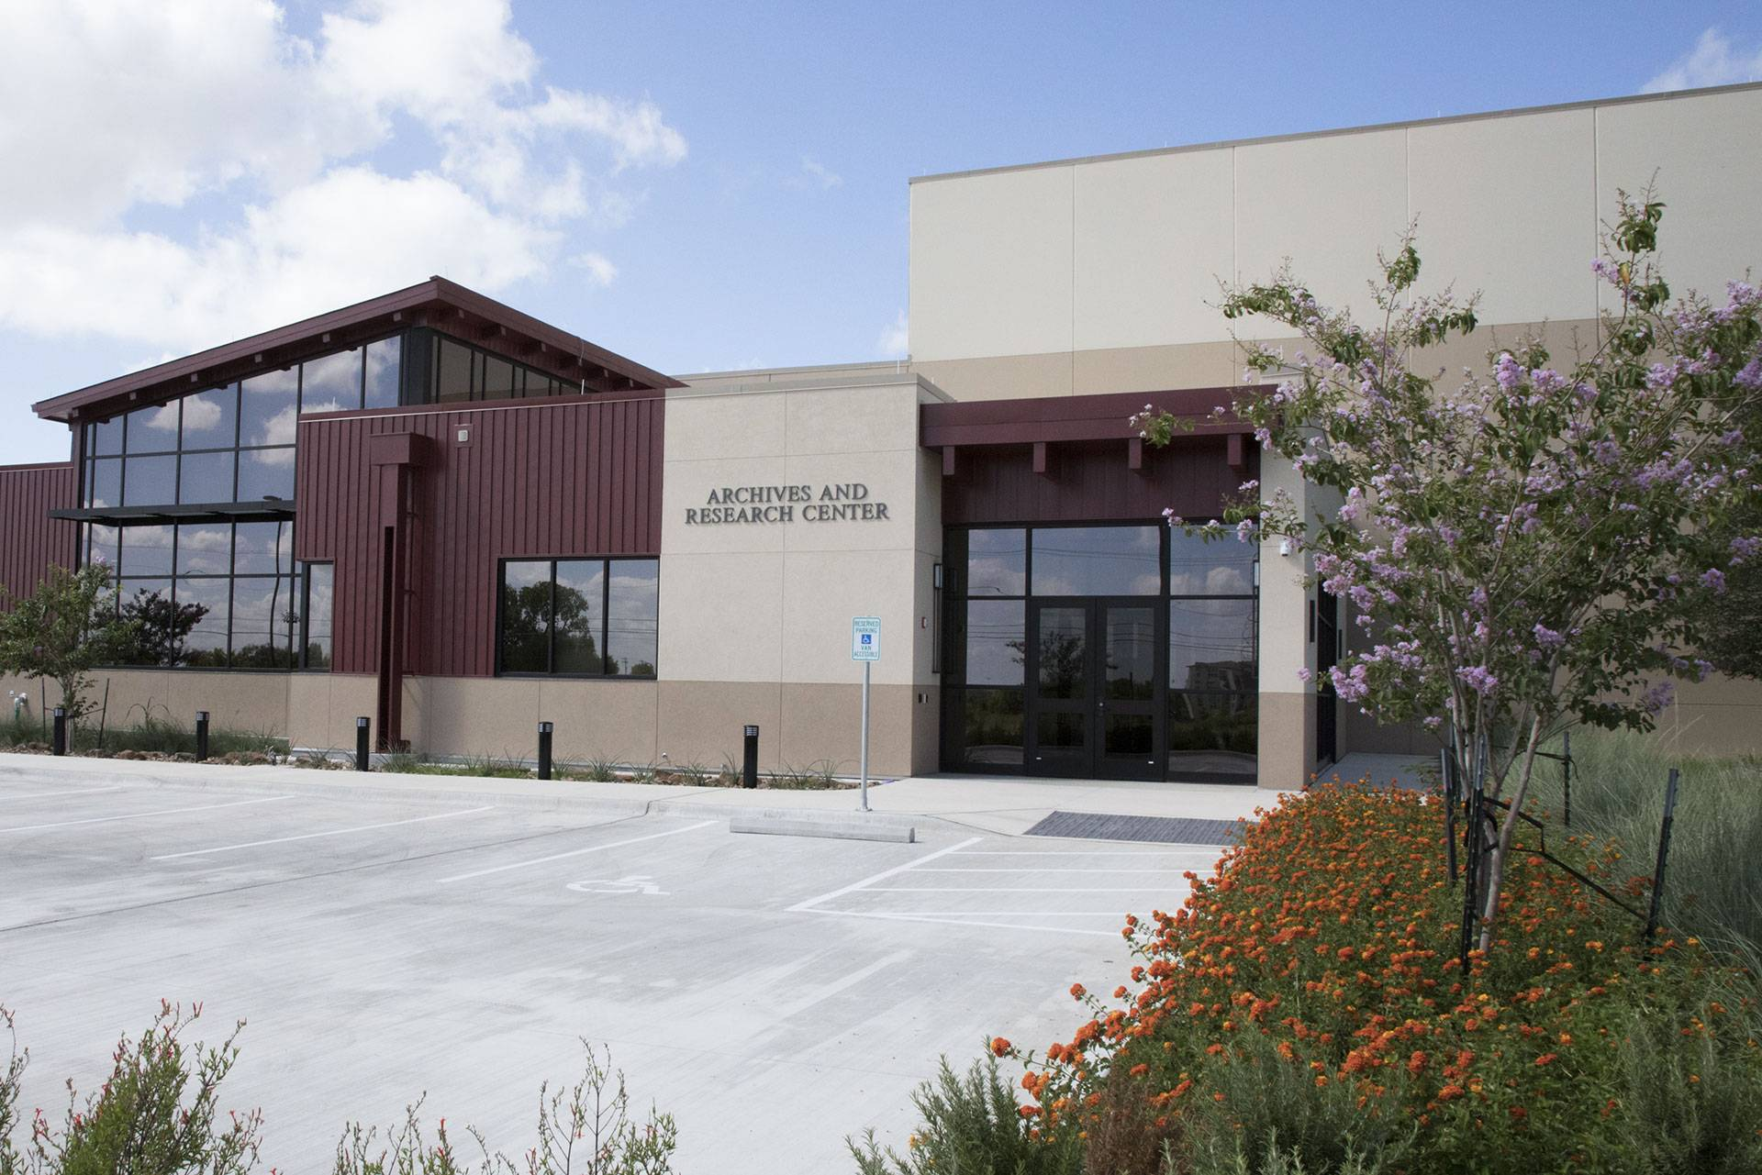
Texas State University Libraries, 2014-2022
Director of Collections, Web and Digital Services
6.2- 8.8 Million Dollar Materials Budget,
45 Staff Across 3 Departments
40 Million Dollar
Learning Commons Project
5M Electrical/Internet Furniture
10M Offsite Repository
25M Technology Enhanced Learning Commons
Digital Initiatives Infrastructure from
Zero to Hero (Wittliff Special Collections)
125th ARL Library (6 Year Journey)
Merrick Endowment (6 year streak 200k-400k yearly)
National Digital Scholarly Ecosystem (Presented from DC to Oxford)
State and National Level Consortial Data Repository 2014-2017
The Beginnings of AI, 2018-2022
Image Archives, CNN and GPU Pipelines

Slide 9
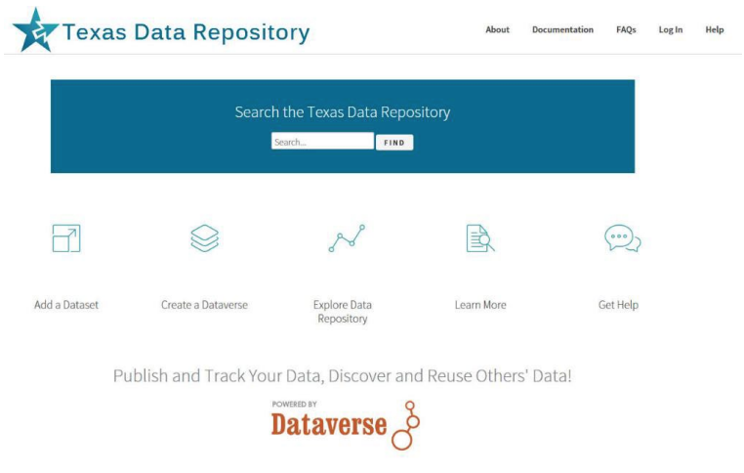
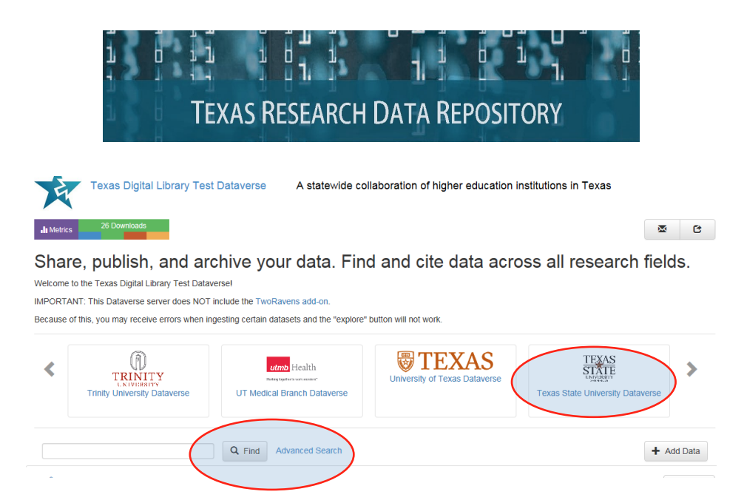
Texas State University Libraries, 2014-2017
Foundations for AI: First Global Consortial Research Data Repository: Dataverse Remix 2017,
Beginnings of Algorithmic Literacy, Data Visualization, Data Cleaning, Python, R

Slide 10
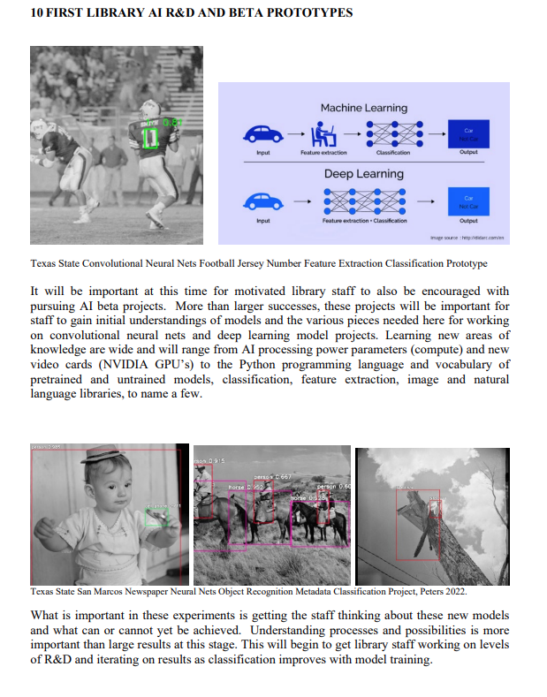
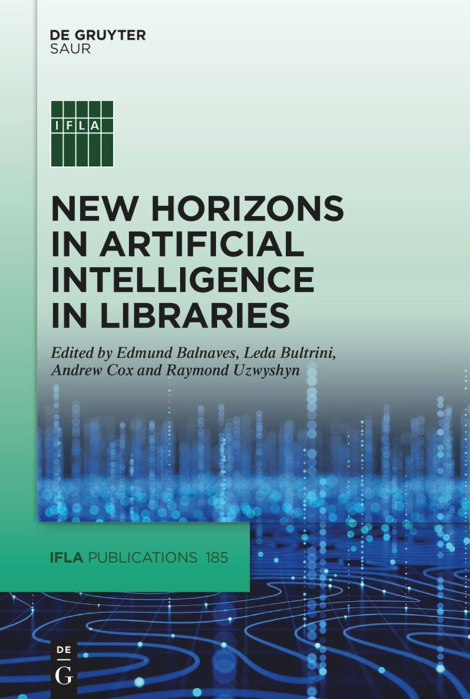
AI Begins 2018: Convolutional Neural Nets CNN, Images and
Image Classification, 100 Years of Newspaper Photographs,
Labeling, Metadata, AI in Libraries Satellite Conference
Galway, Ireland, 2022, Book Idea Publication Late 2025

Slide 11
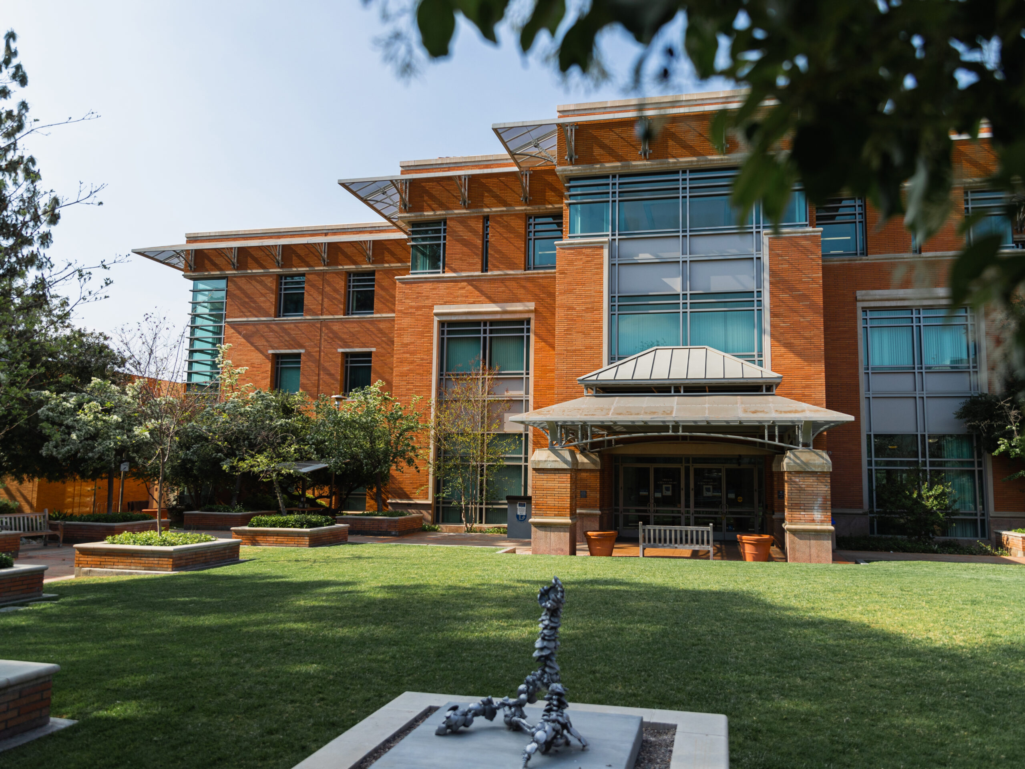
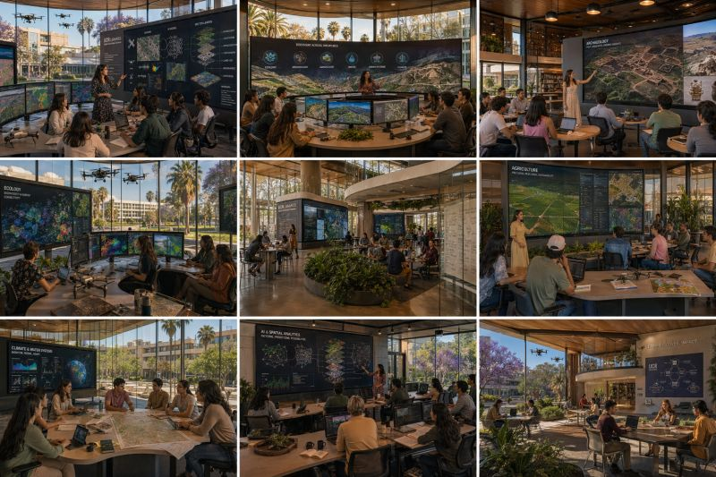
University of California, Riverside, 2024-2026
Acting AUL for Research and Technology Services &
Director of Research Services
Research Services: Traditional and Technologies, Units
GIS, Data Services, AI, Innovative Media, Digital
Scholarship and Communication, Medicine and
Cyberinfrastructure (Core Library IT and Cyberinfrastructure
Academic Technologies, 17 Staff, 10 Students)

Slide 12
UCR Enabling Research Faculty and Students through Digital and AI Literacy, the Other 97%
Workshops
Consultation
Traditional Library Research
Digital Scholarship
GIS, AI, Data Literacy
Labs
Makerspace
Innovative Media Lab
Robotics Lab
STAR Lab/AI Lab
(Coming Soon, the Future))

Slide 13

Academic Library Futures
Building Tomorrow’s Academic Library Today

Slide 14
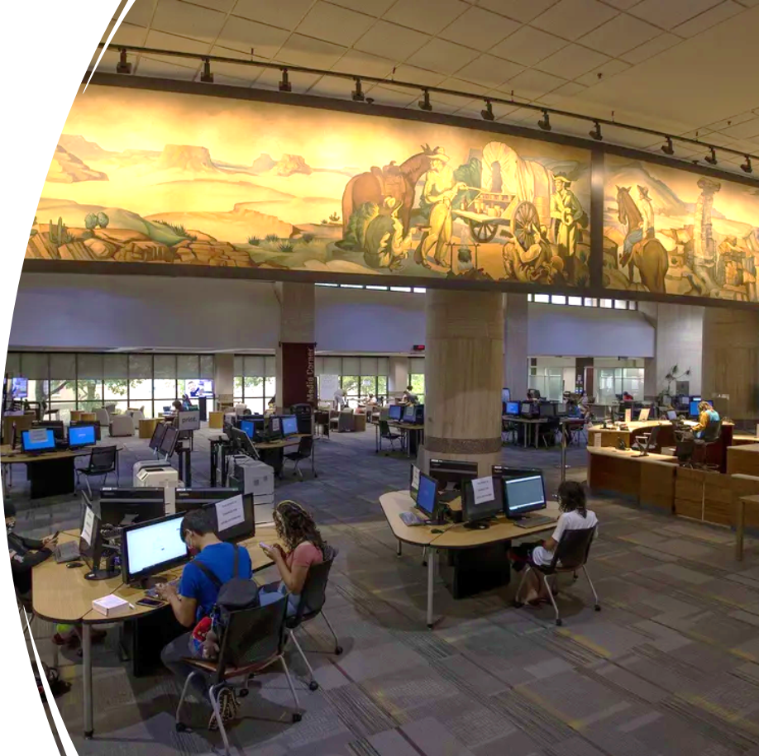
The Physical Library is Experiencing a Paradigm Shift from Book Warehouse to Online Research and Service Oriented Learning Commons
80-85 % of Materials Budgets are currently Digital Resources, e-journals and e-books.
Only 15% of purchases are print materials (12% print books, 3% print serials).
Collection Management, Budget Models and Digital Services are all Changing towards Digital and now AI.
Learning Commons, Resource, Multimedia and Tutorials Centers are integrating with the physical Library.
Digital Literacy, Information Literacy, AI Literacy.
Writing and Multiliteracy Centers are now integrating with the Libraries

Slide 15
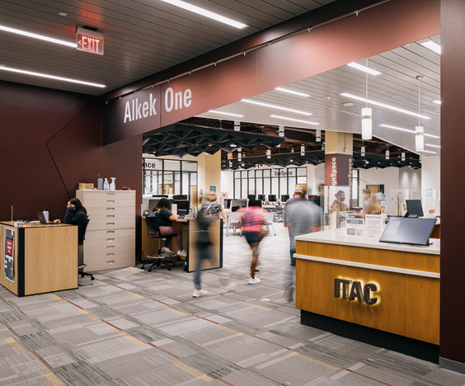
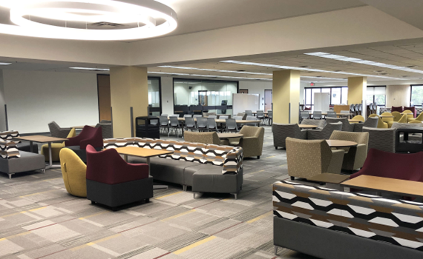
The Library is Becoming a Technology Rich Learning Commons, Focused Upon:
Student and Faculty
Research and Teaching Success
Interdisciplinarity, Digital, Information & AI Literacy
The library is also a significant third place for socialization and study

Slide 16
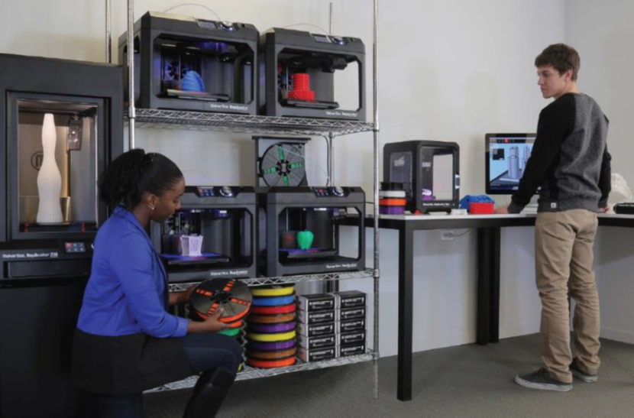
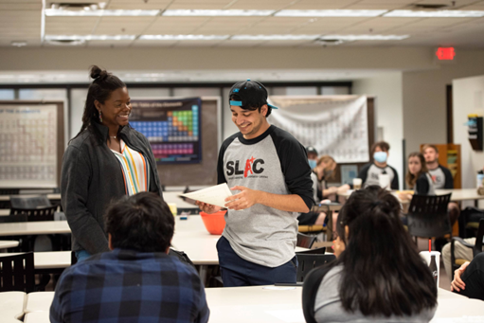
Spectrum of New Technologies, Spaces and Services Possible For Student Success and Faculty Teaching
Data Visualization Walls, Student and Research Faculty & Student Tutorial & Centers, Instant Theatres for Discussion, 3D Printing Labs and Makerspaces

Slide 17
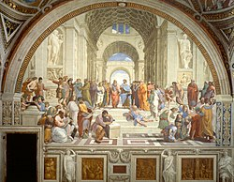
Renaissance Possibility Period for Libraries
Interdisciplinarity is Key and Natural,
Information and Digital Literacy, Technology Enhanced Spaces,
What Learning means in the 21st C.
Library
Library as
Safe Great Third Space for Higher Learning both Physically and Online
Convergence of Space, Technology, Learning
Humanities &
Social Sciences
Sciences
Technologists &
Engineering
Cross-fertilization of
Projects, Smart, Educated People, Skillsets

Slide 18
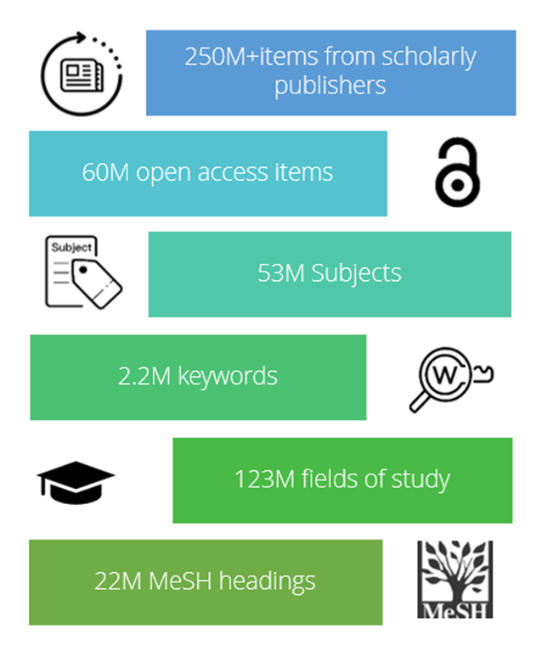


New Online Possibilities for Teaching, Research and Curricular Resources
CloudSource OA (Open Access)
Article Galaxy Scholar
>50% of all refereed scholarly research articles are published open access (2024)

Slide 19
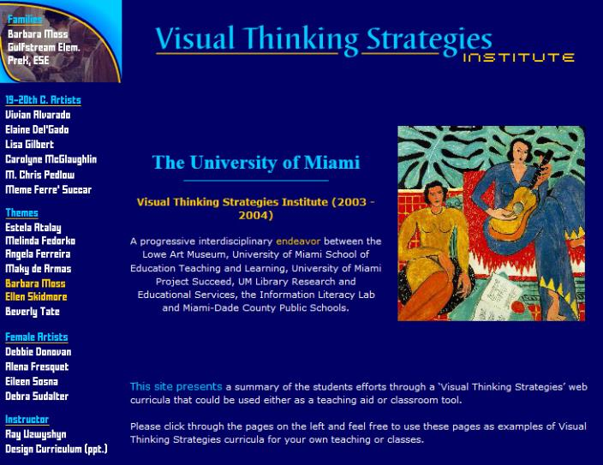
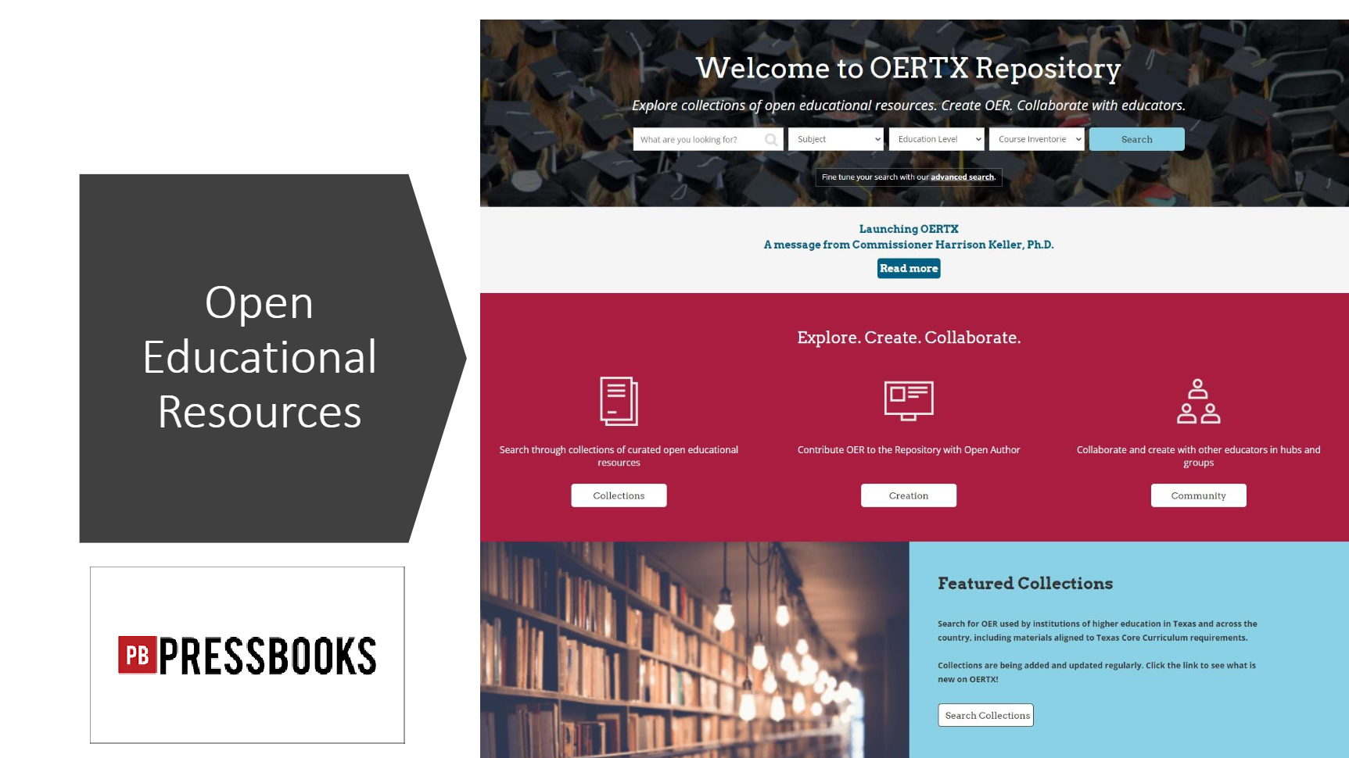
Innovative Interdisciplinary Research Grant Partnerships Are Possible with the Libraries
Among Faculty Divisions, the Library, Schools and Community
Digital & Information Literacy, Diversity
& Interdisciplinarity, 2003 U Miami
Texas State University, Faculty Training Canvas, 2022
Research Partnerships with Library
School of Education (2003), Texas State University OERTX, 2023
University Art Department/University Museum
Large State Bureau Of Education Grant

Slide 20
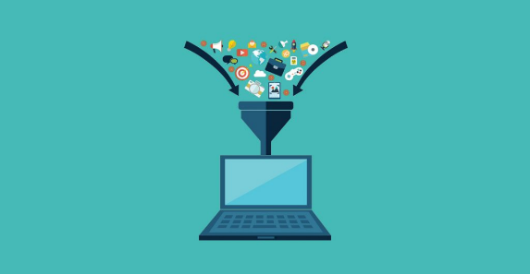
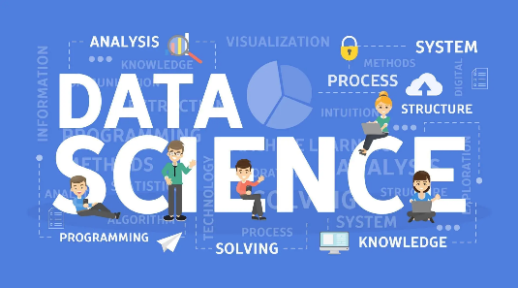
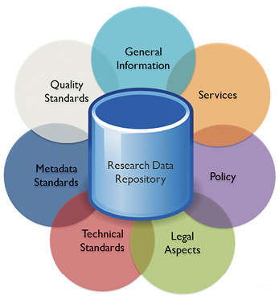

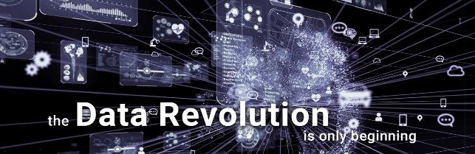
Clear Trajectory in Libraries from
Data Collection
To Data Science -> Data Research Repositories ->
Data Analytics ->
Data Visualization >
AI
Universities, Research, Libraries, Data and AI

Slide 21
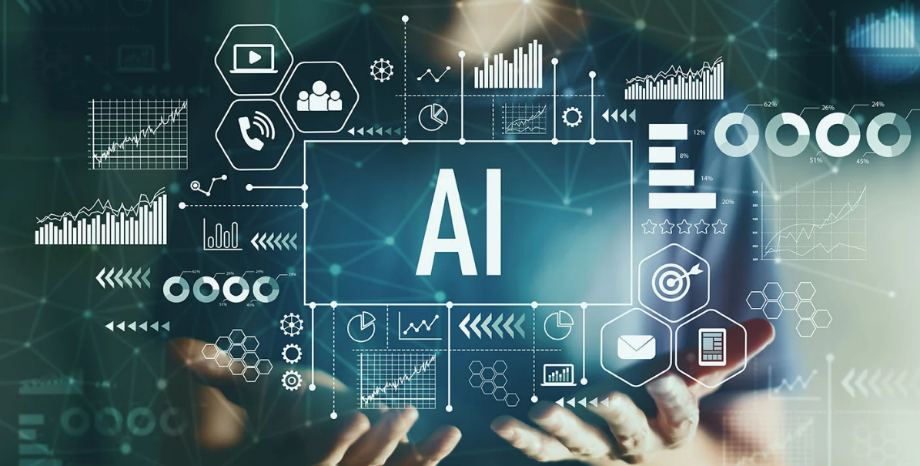
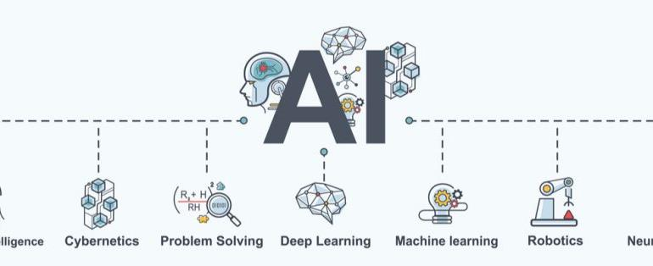
A(AI) Literacies Needs Arising
New Classes of AI Research Competencies Needed
New Positions Possible AI Research Librarian, Research Data/AI Scientist, Deep Research Models AI
Autonomous Agents, Multimodal Possibilities, Software Engineering (Devin)
Data Visualization, Analytics, AI Empowering Faculty/Student Learning Teaching and Research

Slide 22
The Research Data Lifecycle and Libraries
Setting Better Foundations & Organization for AI Infrastructures
Data Repository
provides
Basic AI, Machine
Learning, Open Science
and Research Needs.

Slide 23





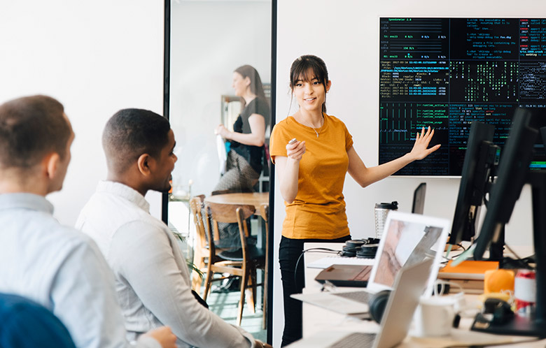

Core Academic Library Systems Services Changing
(Shift to AI)
Interlibrary Loan Service
Taking Larger Research Role
(Article Galaxy Scholar)
Larger Discovery & Research Services
Possible
Modern Integrated Library System (ILS)
New & Different Research and
New Service Possibilities

Slide 24
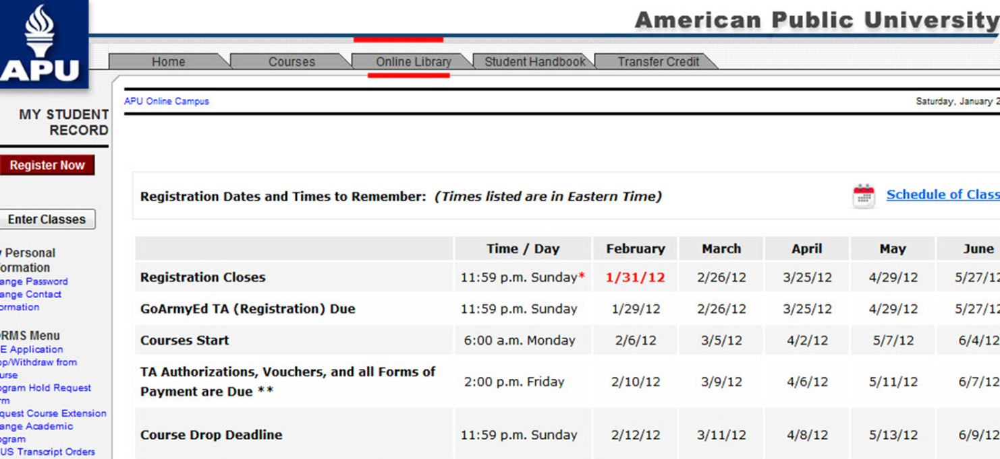
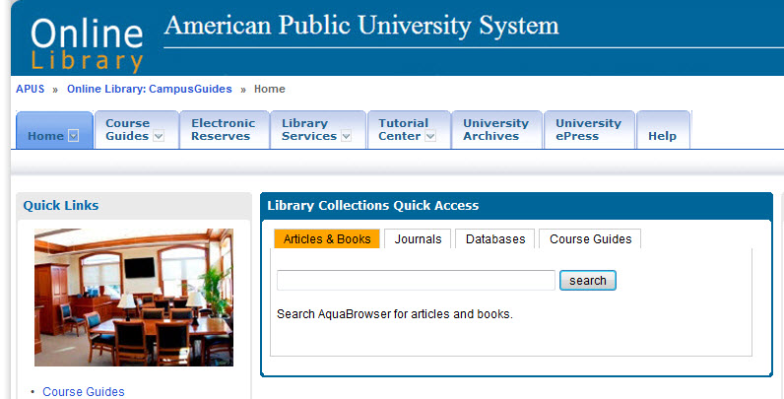
Tight Research Online Library Integration with Online Classroom is Possible
Learning Management System

Slide 25
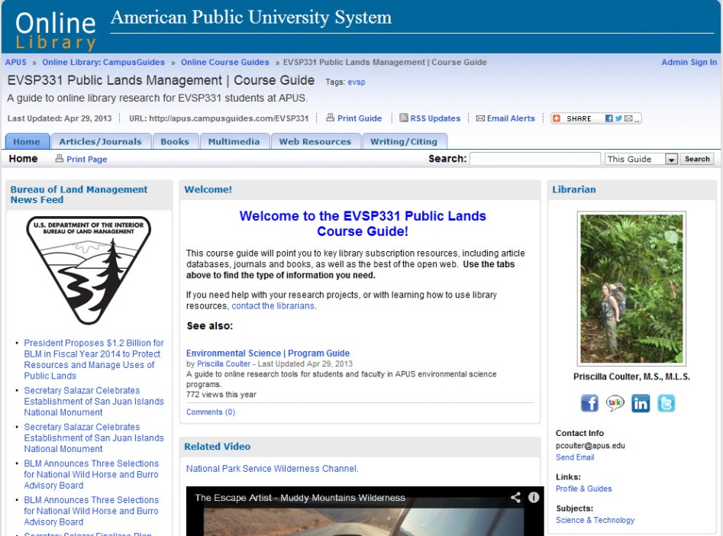

Library Partnerships with Teaching Faculty
Online Course Guides
Direct
Curricular
Replacement
Secondary
Multimedia
Bibliography
University Global
Marketing/Branding/ROI

Slide 26
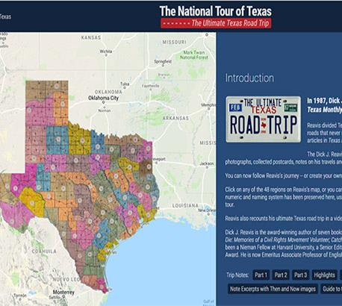
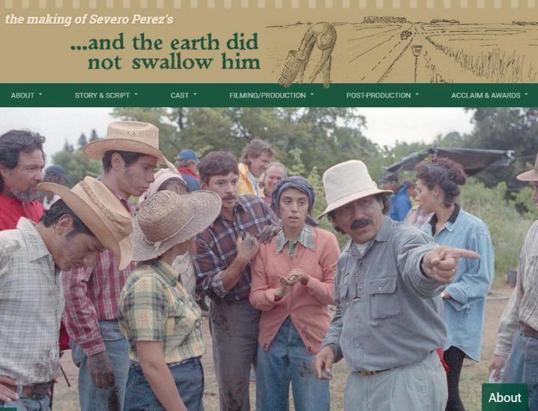
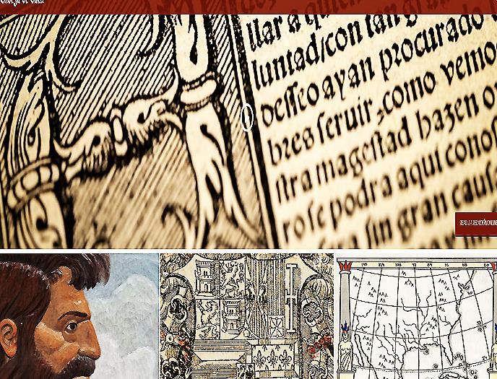
New Services
Enabling Digital Scholarship From
Digital Humanities
To STEM Sciences
Collaboration with Research Faculty, Graduate Student and the Community Connects the Library to the wider academic and cultures of the environment

Slide 27

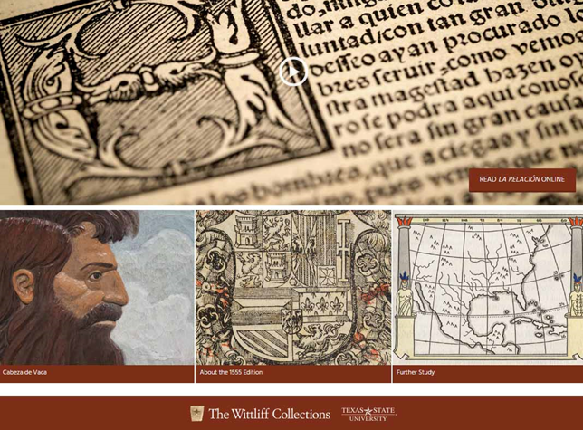
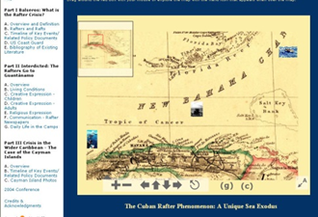

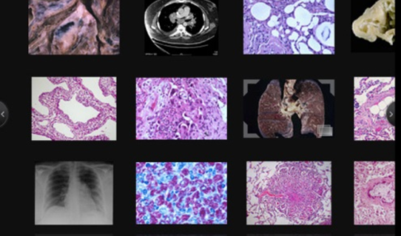
Engagement With Student & Faculty
Towards Learning, Teaching & Research Success
Special Collections/Multimedia Conference/Colloquia Possibilities
New Genres of Digital Archives Possible

Slide 28
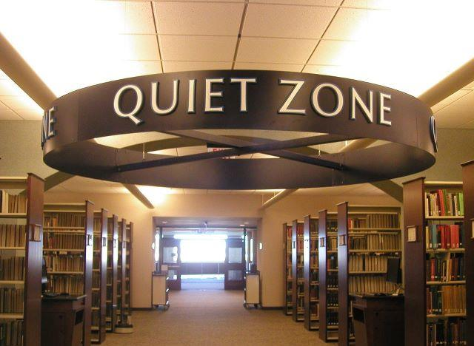

Maintaining Historical Continuity while balancing changing new possibilities and necessities
University Libraries of Tomorrow are Still Places for
Inspiration, Reflection, Study

Slide 29
Thank you!
Comments or Questions
Ray Uzwyshyn Ph.D. MBA MLIS
http://rayuzwyshyn.net
ruzwyshyn@gmail.com

