Slide 1
February 10 - 14, 2025
UC LOVE DATA WEEK:
A SERIES OF VIRTUAL TALKS, PRESENTATIONS, AND WORKSHOPS BEING OFFERED AS A WEEK-LONG EVENT FOCUSED ON DATA ACCESS, MANAGEMENT, SECURITY, SHARING, AND PRESERVATION, FOR THE UC COMMUNITY.
ALL EVENTS ARE FREE TO ATTEND AND OPEN TO ANY MEMBER OF THE UC COMMUNITY.
FOR MORE INFORMATION AND TO REGISTER FOR A
SPECIFIC WORKSHOP, PLEASE VISIT OUR WEBSITE:
https://uc-love-data-week.github.io/
Notes:
Slide created by UC Berkeley student library employee, Carla Moreno, using graphics designed by UC San Diego.
We also have a short link: https://bit.ly/UC-LDW

Slide 2
Visual Data: Data Research Repositories and 3D Data Infrastructures
Ray Uzwyshyn
Acting AUL Research and Technology Services UC Riverside Libraries
Brendon Wheeler
Maker Services Coordinator UC Riverside Libraries

Slide 3
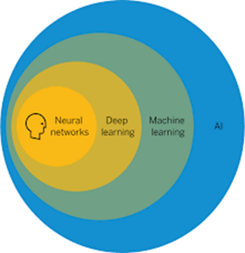
Research Data Repositories, Visual Data, Digital Scholarly Ecosystems and Paths to Open Science, AI and Discovery
Notes:
I’m going to speaking you today about Challenges and Opportunities but also divides between these areas but bridges and connections that are already in place and being utilized that you may be unaware of and that may be useful to your institutions

Slide 4
What is a Data Research Repository
Platform to Manage Researcher and Institutions Data/Metadata
Data Citation Permalinking Strategy for Data
Way to Manage Large Grant Compliance
Data Archiving and Sharing Strategy
Data Innovation Begins with Online Research Data Repositories
UC System https://datadryad.org/

Slide 5
Data Citation, Metadata, Keyword and Gratn Funding Source

Slide 6
UCR and UC System Utilize Data Dryad Share, Submit, Explore and Collaborate with Data
https://datadryad.org/

Slide 7
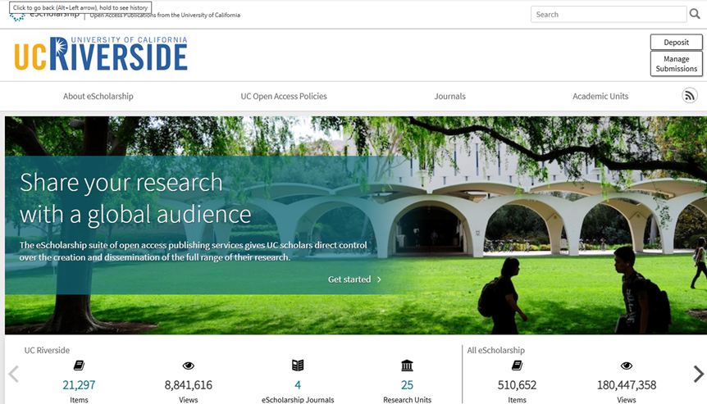
A Data Repository May Be Placed Within a Larger Digital Scholarship Research Ecosystem
(Content)

Slide 8
Insitutional Repository: White Papers, Research Drafts, Theses and Dissertations, Conference Proceedings Pre-prints https://escholarship.org/uc/ucr

Slide 9
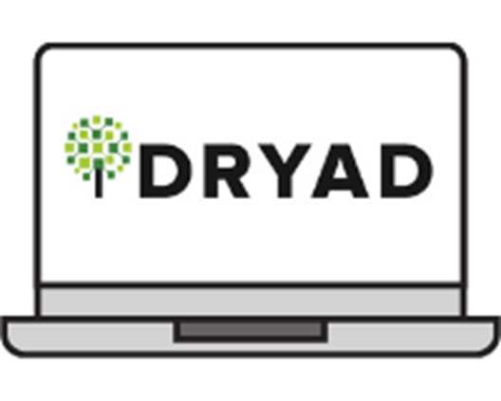
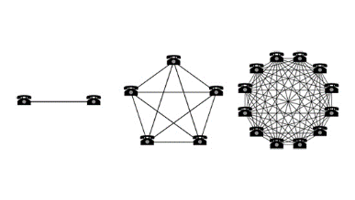
Collocating Open Access Digital Components in a Networked Research Ecosystem Enables Larger Connections and/or Network Effects
Notes:
Ecosystem Metaphor Look at Relationships in the Digital Environment Specifically Focuses Upon the Discrete Component Relationships with the Networked Digital Environment

Slide 10
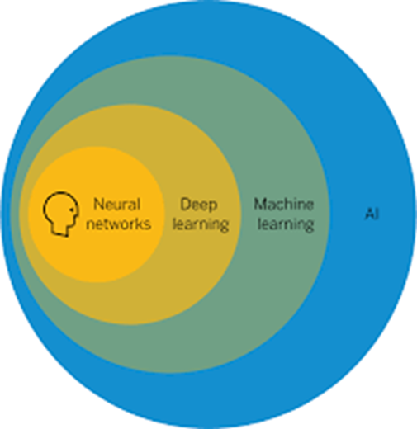
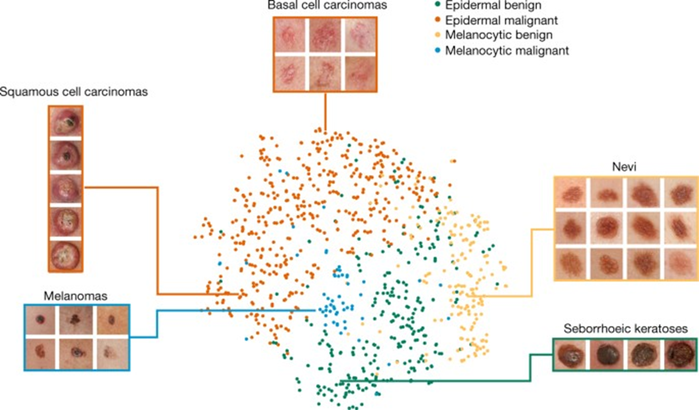
Dermatologist-Level Classification of Skin Cancer with Deep Neural Networks Diagram from Stanford Paper, Andre Esteva, Sebastian Thrun et Al, 2017
Last Ten Years Has Shown Incredible Progress of, Analytical Computational Tools, Particularly, AI Machine Learning, Deep Learning, Image Data, Metadata Object Recognition, Cancer Detection

Slide 11
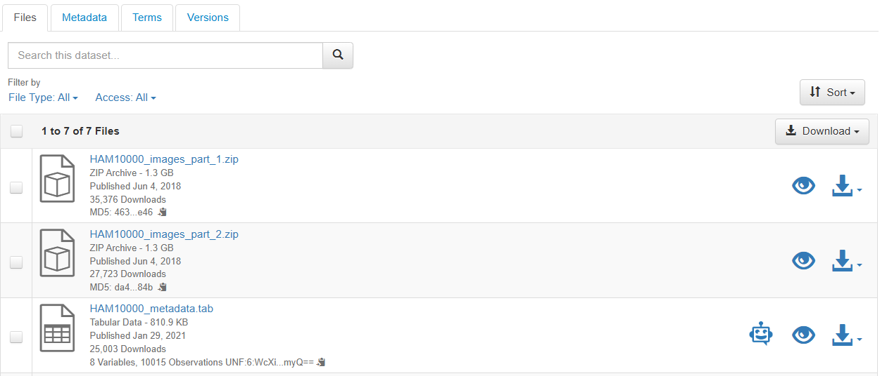
Repository Image Data and Metadata

Slide 12
Data Research Repository Upload Open Science Dermatology Image Dataset, Dr. Philip Tschandl
https://dataverse.harvard.edu/dataset.xhtml?persistentId=doi:10.7910/DVN/DBW86T

Slide 15
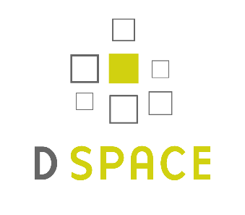
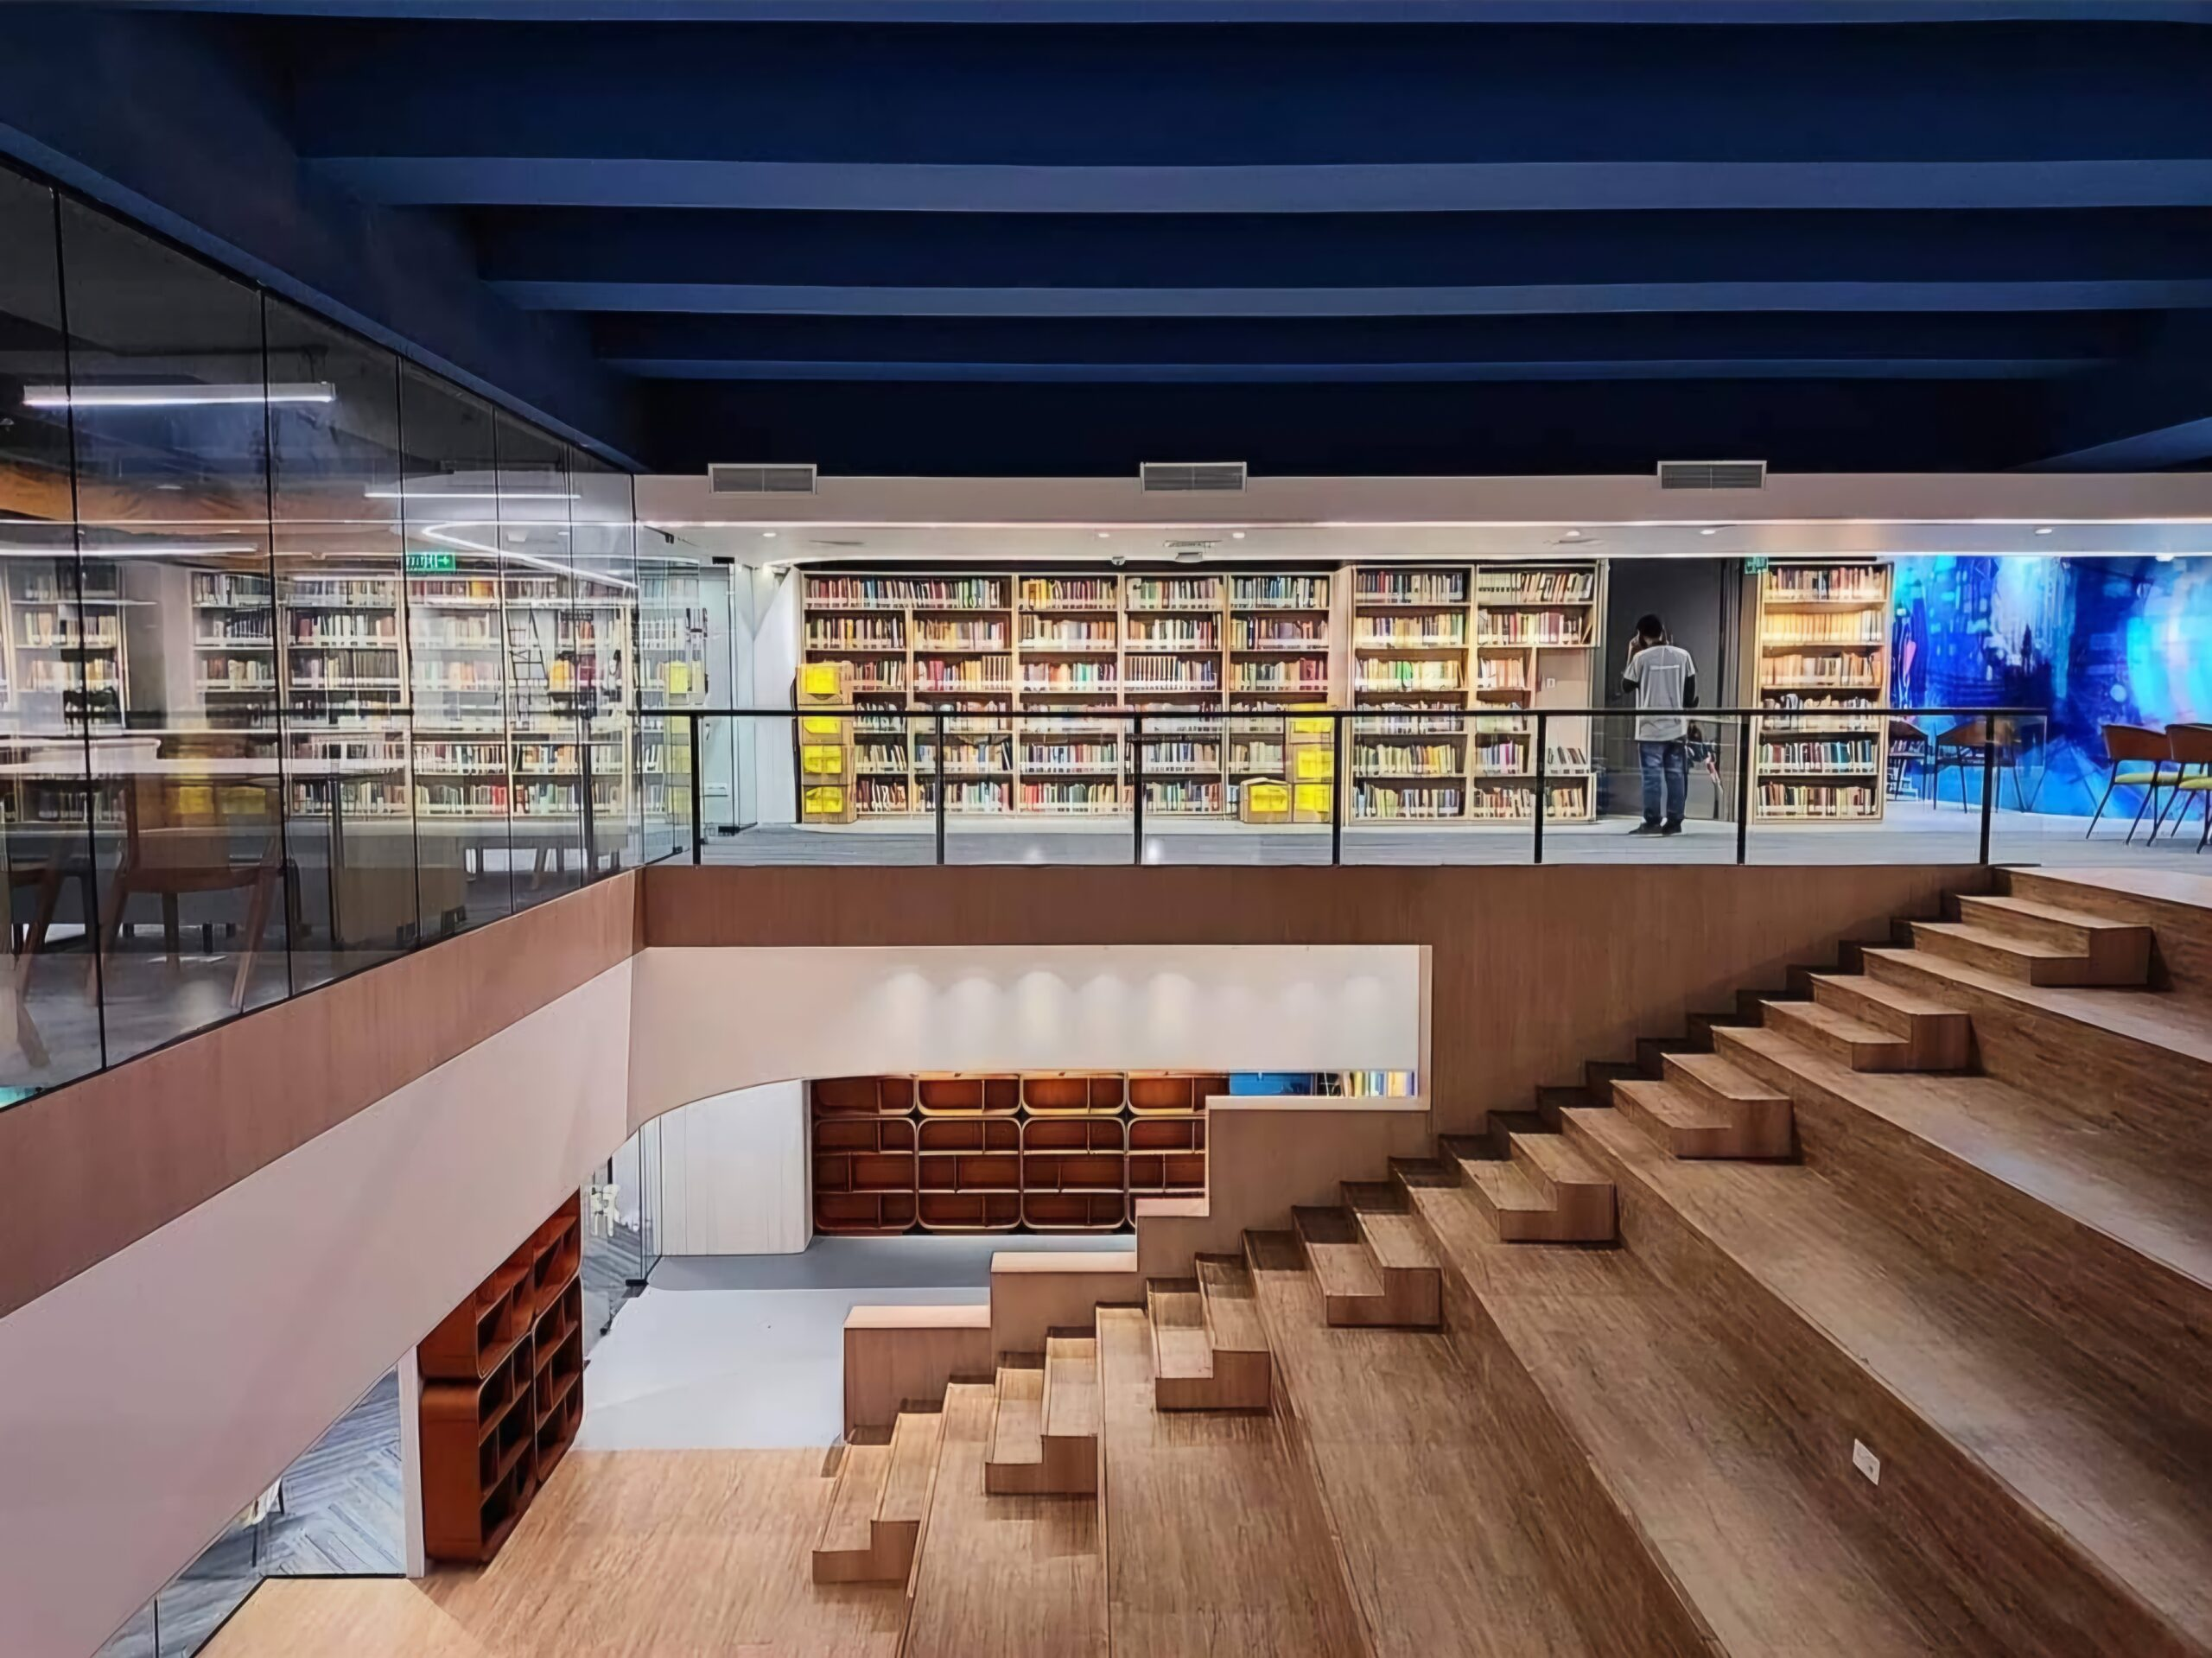
Digital Collections Institutional Repository http://dspace.bracu.ac.bd/xmlui/ handle/10361/15932
BRAC University Libraries Institutional Repository
Notes:
We have used the publicly available HAM10000 dataset, obtained from the Harvard Dataverse. The dataset contains 10,015 labeled images of skin growth

Slide 16
The Progress of Knowledge Through Global Open Science & Network Possibilities 2017 Stanford University Research Paper Nature Deep Learning
Cancer ID Article 2018 Viennesse Doctor in Austria, Dr. Phllipp Schandl uploaded Dermatalogical Image Library to Harvard Dataverse Data repository
2021 (November) Undergrad Machine Thesis Published in Dspace Repository, Utilizing both paper and dataset BRAC University, Dhaka Bangladesh, Dept. of Computer Science and Engineering All Can Be Downloaded Today in 2025 from ecosystem data/repository links here

Slide 17
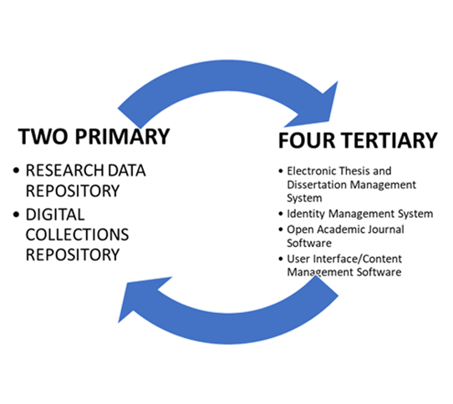
Research Data Repositories & Digital Scholarship Ecosystems Can Serve As Foundations & Organization for Later AI Infrastructures and Open Science

Slide 18
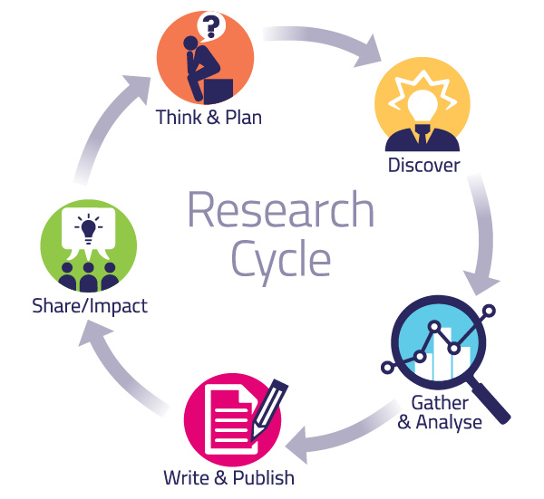
These Digital Ecosystem Components Together Enable the Academic Research Cycle on Global Levels
Pragmatic Levels

Slide 19
References and Links
Esteva, A, Thrun, S. et al. Dermatologist-level Classification of Skin Cancer with Deep Neural Networks. Nature, Volume 542 (February 2, 2017). pp. 115-119. doi:10.1038/nature21056
Islam, A., Khan, D. and Chowdhury, R. 2021. An Efficient Deep Learning Approach to Detect Skin Cancer Undergraduate Thesis. BRAC University DSpace Institutional Repository, 2021. Available: http://dspace.bracu.ac.bd/xmlui/ handle/10361/15932
University of California Data Dryad Repository. 2025. https://datadryad.org/stash
University of California, Riverside Digital Library eScholarship Repository. https://escholarship.org/uc/ucr 2025
Tschandl, Phillip et al. Human-computer Collaboration for Skin Cancer Recognition. Nature Medicine, 22 June 2020, 1229-1234. See: https://www.nature.com/articles/s41591-020-0942-0
Uzwyshyn, R. “Building Capacity for AI in Libraries”. Ed.Balnaves, E. Butrini, L., Cox, A. & Uzwyshyn. New Horizons for AI in Libraries. IFLA Publication. Berlin: De Gruyter: 2025. (Open Access Copy Available: https://www.degruyter.com/document/doi/10.1515/9783111336435)
---. 2022. Research Data Repositories and Global Scholarly Ecosystem Possibilities. Trends and Issues in Library Technology. IFLA. https://www.researchgate.net/publication/357286044_Research_Data_Repositories_and_Global_Scholarly_Ecosystem_Possibilities
Uzwyshyn, R. 2020. Developing an Open-Source Digital Scholarship Ecosystem. ICEIT2020. St. Anne’s College Oxford, United Kingdom. February 2020. Available at: https://www.researchgate.net/publication/336923249_Developing_an_Open_Source_Digital_Scholarship_Ecosystem.
- - -. 2020. Open Digital Research Ecosystems: How to Build Them and Why. Computers in Libraries, (40) 8. November 2020. https://www.researchgate.net/publication/ 345956074_Online_Digital_Research_Ecosystems_How_to_Build_Them_and_Why
---. 2016. Online Research Data Repositories: The What, When Why and How. Computers in Libraries. 36:3, April 2016. pp. 18-21. http://rayuzwyshyn.net/TXU2016/OnlineDataResearchRepositoriesUzwyshyn.pdf

Slide 20
Infrastructure of 3D Data
Notes:
Include an image of Orbach in the classroom where teaching, or picture of the CreatR Lab,

Slide 21
What is the infrastructure of 3D data?
Notes:
Great opportunity to talk through video because there is music, use verbiage on the video

Slide 22
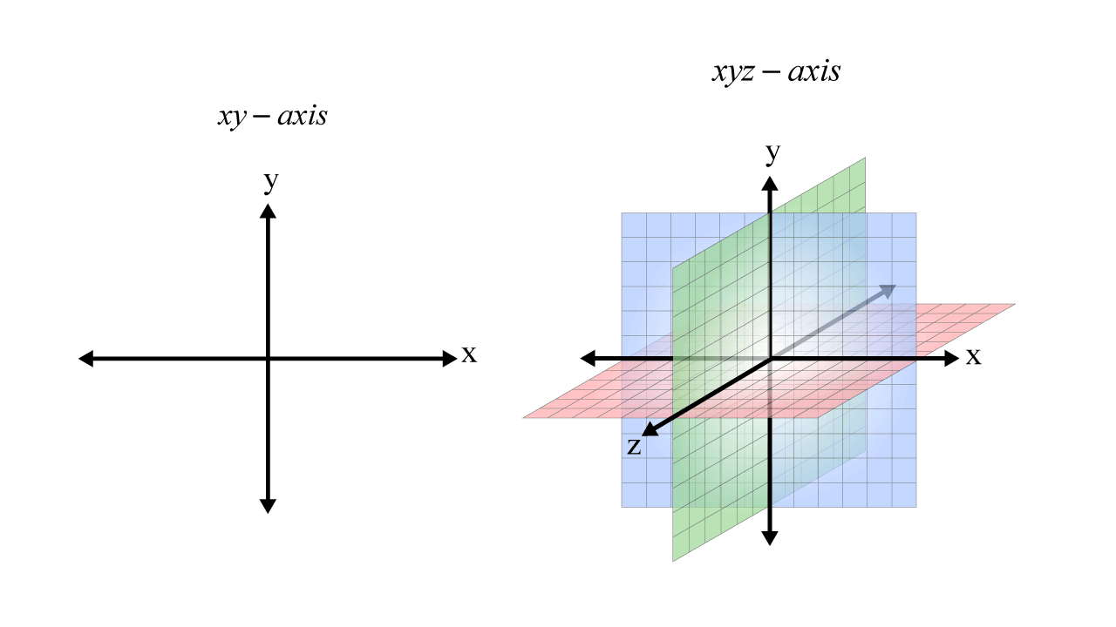
Introduction to 3D Data
What is 3D data?
3D data refers to 3D visualization that contains information about objects in three dimensions or X, Y and Z axes
3D data can be made with cameras or specialized software
Ex. photogrammetry allows pictures to be transformed into 3D data
https://library.harvard.edu/services-tools/teaching-and-learning-3d-content
https://www.ucl.ac.uk/slade/know/wp-content/uploads/What-is-3D-Data-Capture1.pdf
Notes:
B

Slide 23
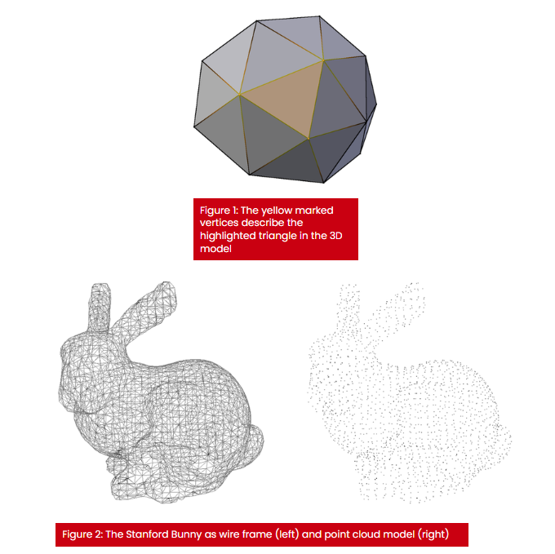
Types of 3D Data
There are many different types of 3D data:
Polygonal Geometry
Point Clouds
Volumetric Data
Boundary Representation
Appearance Data
Scene Data
https://www.adobe.com/products/substance3d/discover/3d-files-formats.html
Sources and types of 3D data – Archaeology Data Service

Slide 24
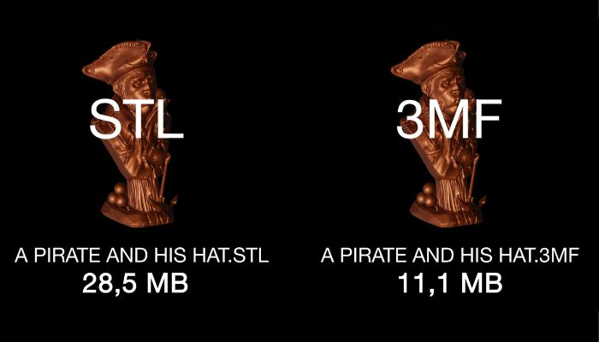
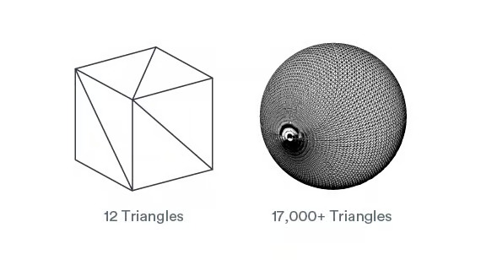
3D Data File Types
Some common 3D file types are:
StereoLithography(STL) - mostly used for 3D printing and prototyping
Represents data as a series of polygons
https://www.3dnatives.com/en/stl-vs-3mf-280620224/
Notes:
Break up the slides

Slide 25
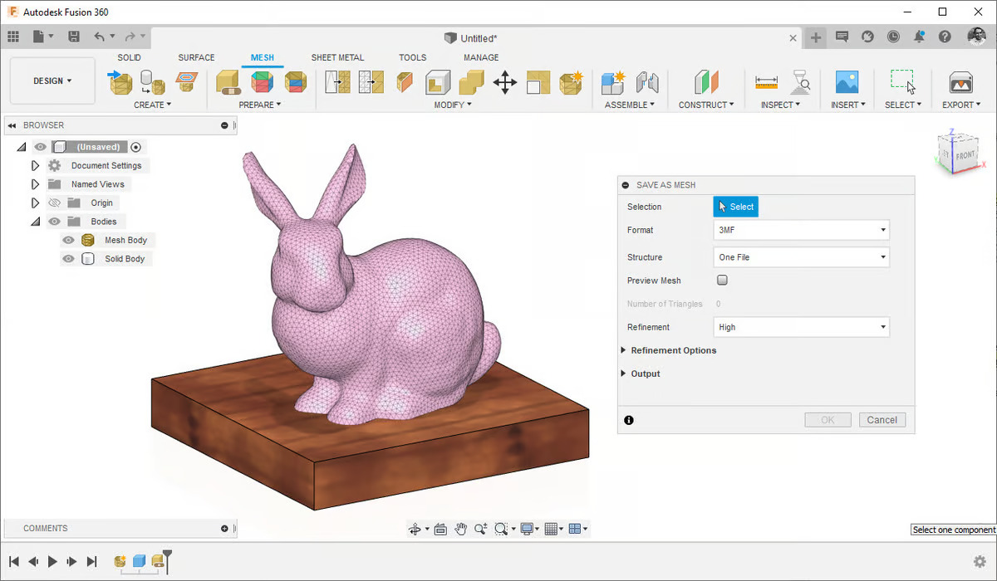
3D Data File Types
3MF - 3D Manufacturing Format
Contains data in the form of units, textures, materials, colors, mesh, thumbnail and more
https://www.3dnatives.com/en/stl-vs-3mf-280620224/
Notes:
Break up the slides

Slide 26
Data Repositories

Slide 27
Data Repositories
3D Data can be stored on numerous repositories
Including but not limited to:
GitHub
SketchFab
Unity Hub
Dryad
Notes:
B

Slide 28
Creating 3D Data

Slide 29
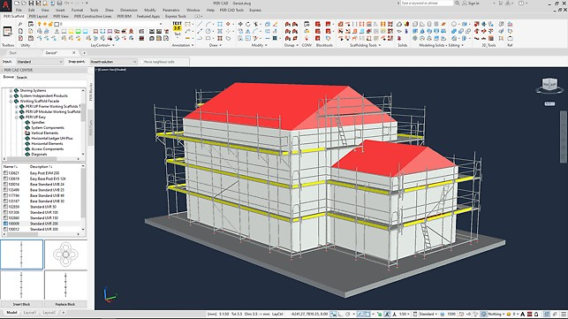
How 3D Data is Created
3D data can be created with specialized software called Computer Aided Design (CAD) modeling software
But 3D data can be made with other software such as:
Unity
Artec Studio
Reality Capture/Reality Scan
And more!
Notes:
B

Slide 30
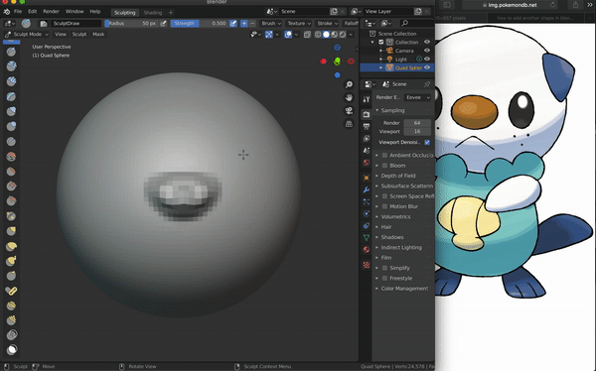
How to create 3D data
Using programs such as Blender or Maya, you can make your own 3D models
Each CAD software have their own advantages and disadvantages depending on your needs
Notes:
A

Slide 31
Applications of 3D Data

Slide 32
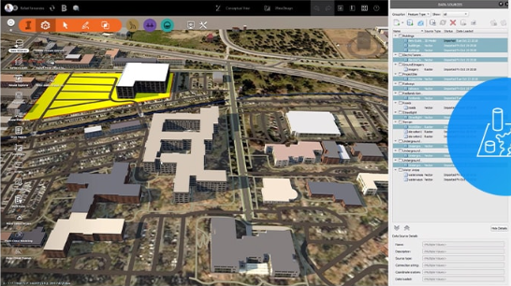
How 3D Data is Used
3D data is used just about everywhere!
ArcGis
Construction
Medical Fields
Prototyping
If you can think of an application which uses 3D data, you are most likely correct
Notes:
B

Slide 33
How to Edit 3D Data

Slide 34
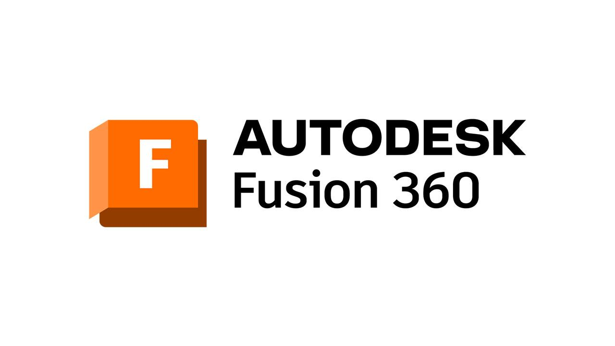
3D Modeling Software
3D Data can be edited with various free software
Some free 3D software are:
Blender
Fusion 360
Meshmixer
SketchUp
Unity
Notes:
Add another video

Slide 35
Questions and Comments
Ray Uzwyshyn, Acting AUL Research and Technology Services raymondu@ucr.edu
University of California, Riverside, Libraries
Brendon Wheeler, Maker Services Coordinator brendon.wheeler@ucr.edu University of California, Riverside, Libraries

