Slide 1

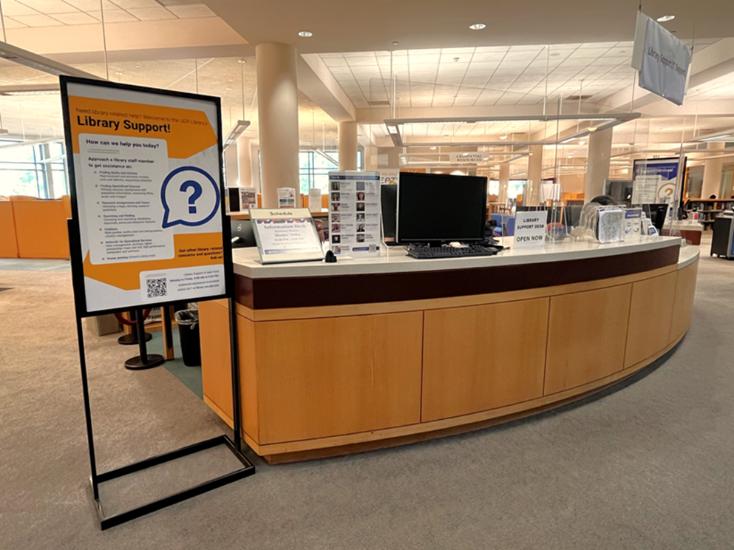
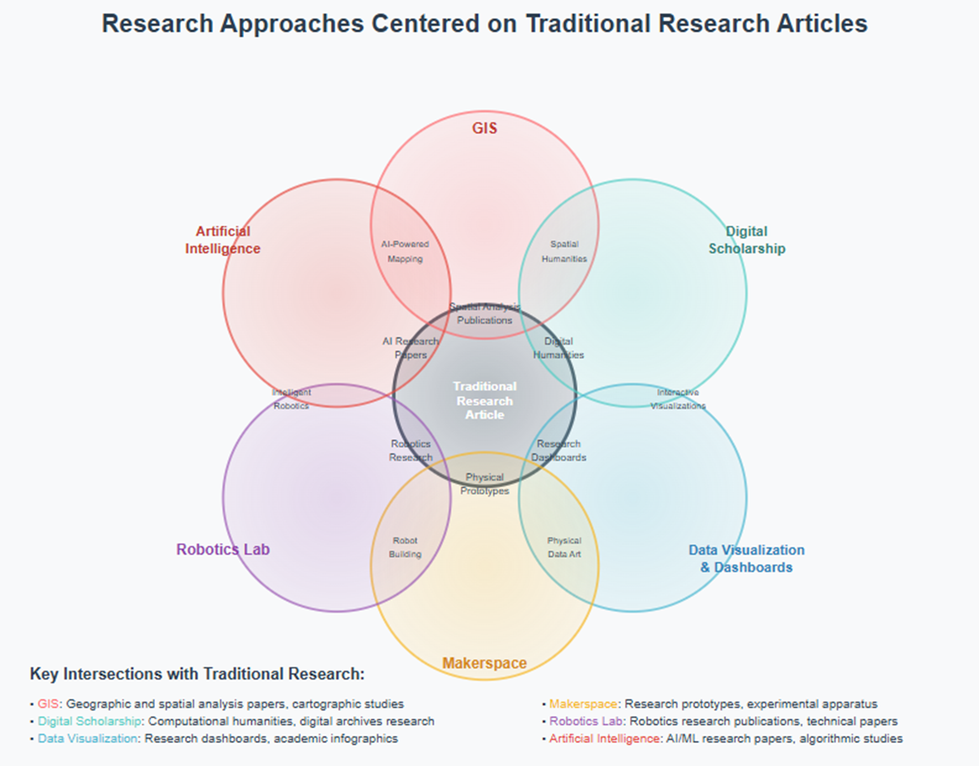
UCR Library Division of Research And Technology Services
Ray Uzwyshyn Ph.D. MBA MLIS Acting AUL and Director of Research and Technology Services University of California, Riverside, Libraries
raymondu@ucr.edu

Slide 2
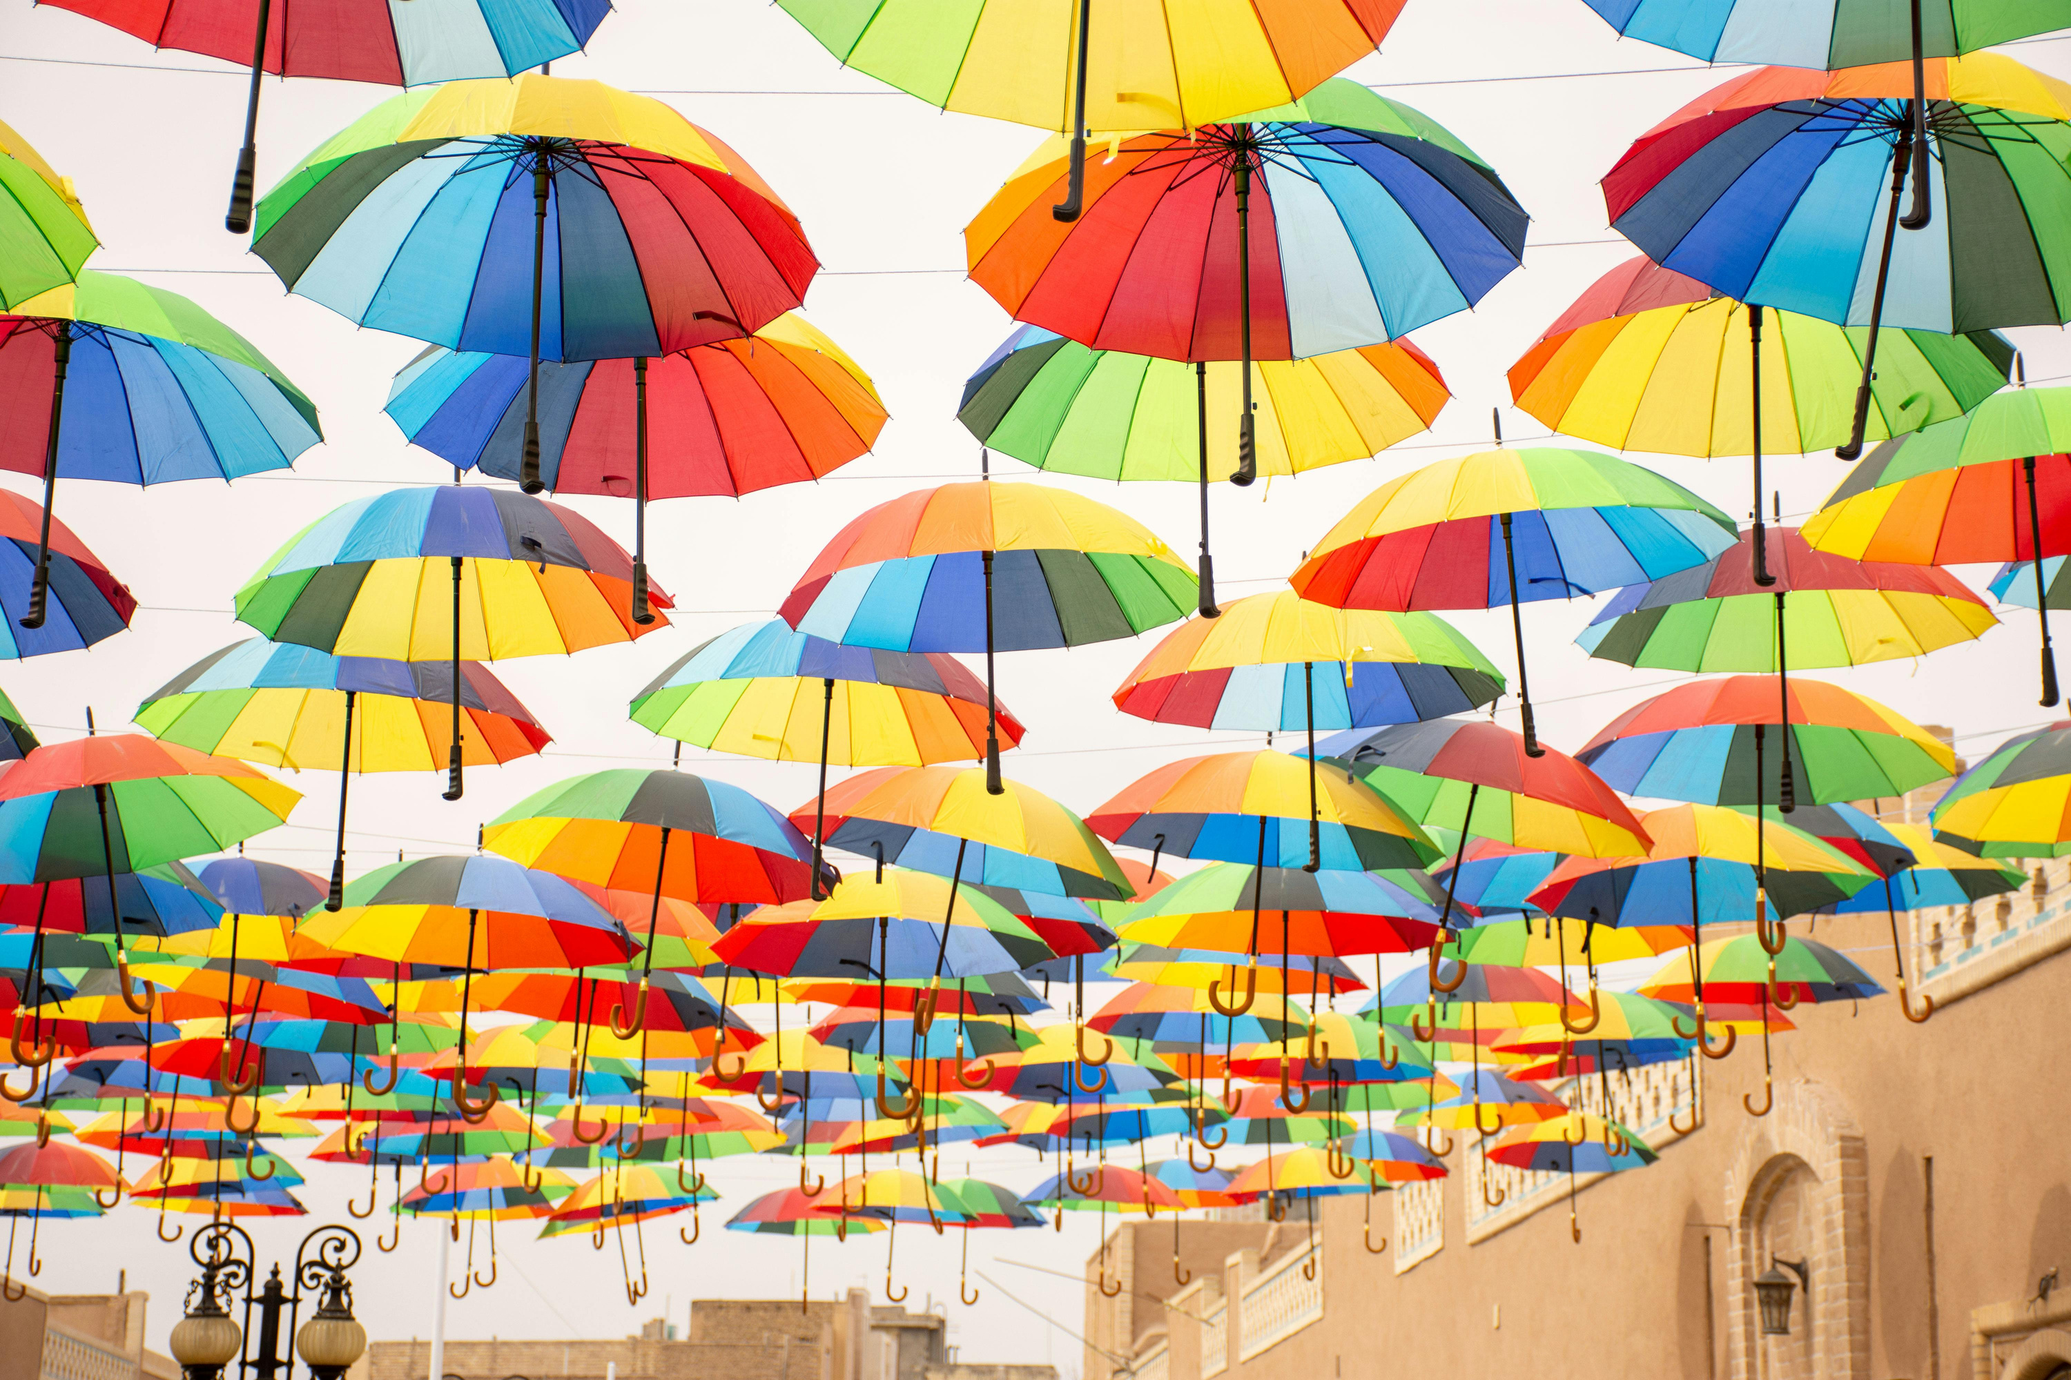
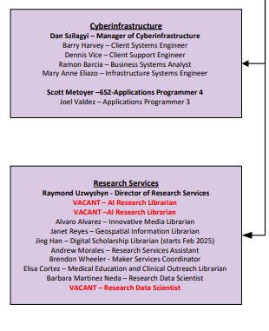
Library Research And Technology SerVices Staff, RESOURCES And& SERVICES
Collection Platforms
Interlibrary Loan & Guides
Training Resources/
Workshops/Consultations

Slide 3
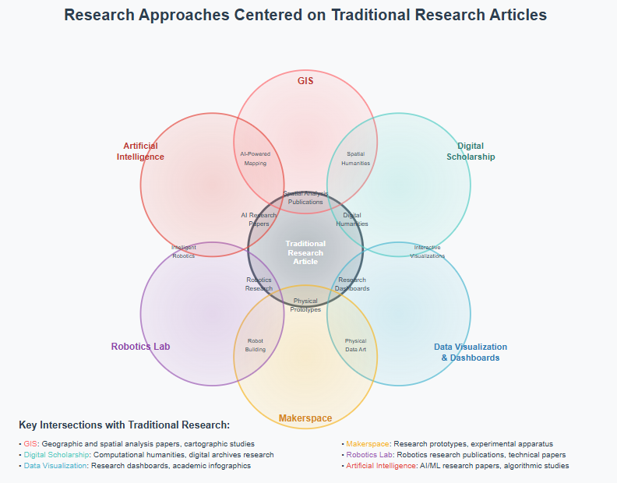
Technology Enhanced Articles and New Research Artifacts
Research Services &and Technology

Slide 4
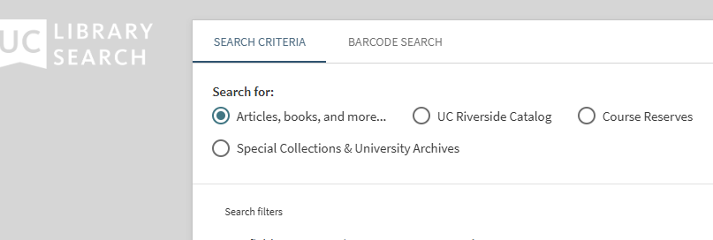
UC LIBRARY SEARCH
Searches all digital media and subscription-based e-content across the UC system
Homepage
Guide
Get it at UC: https://www.youtube.com/watch?v=RUBr-iS_Jao

Slide 5
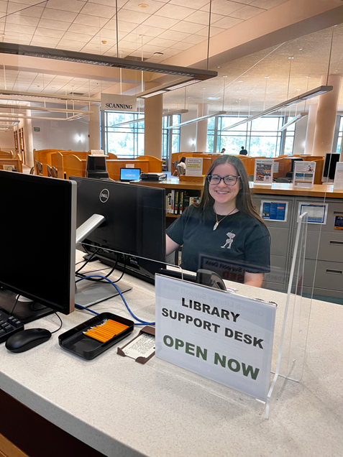

ACADEMIC DATABASES
Subscription-based academic databases enable access to e-resources
Over 548 Disciplinary and Multidisciplinary Databases & Citation Databases:
EBSCO Academic Search Complete, Web of Science, JSTOR, ProQuest Dissertations & Theses
Databases are searched using keywords or other types of search queries
Accessed using the A to Z List

Slide 6
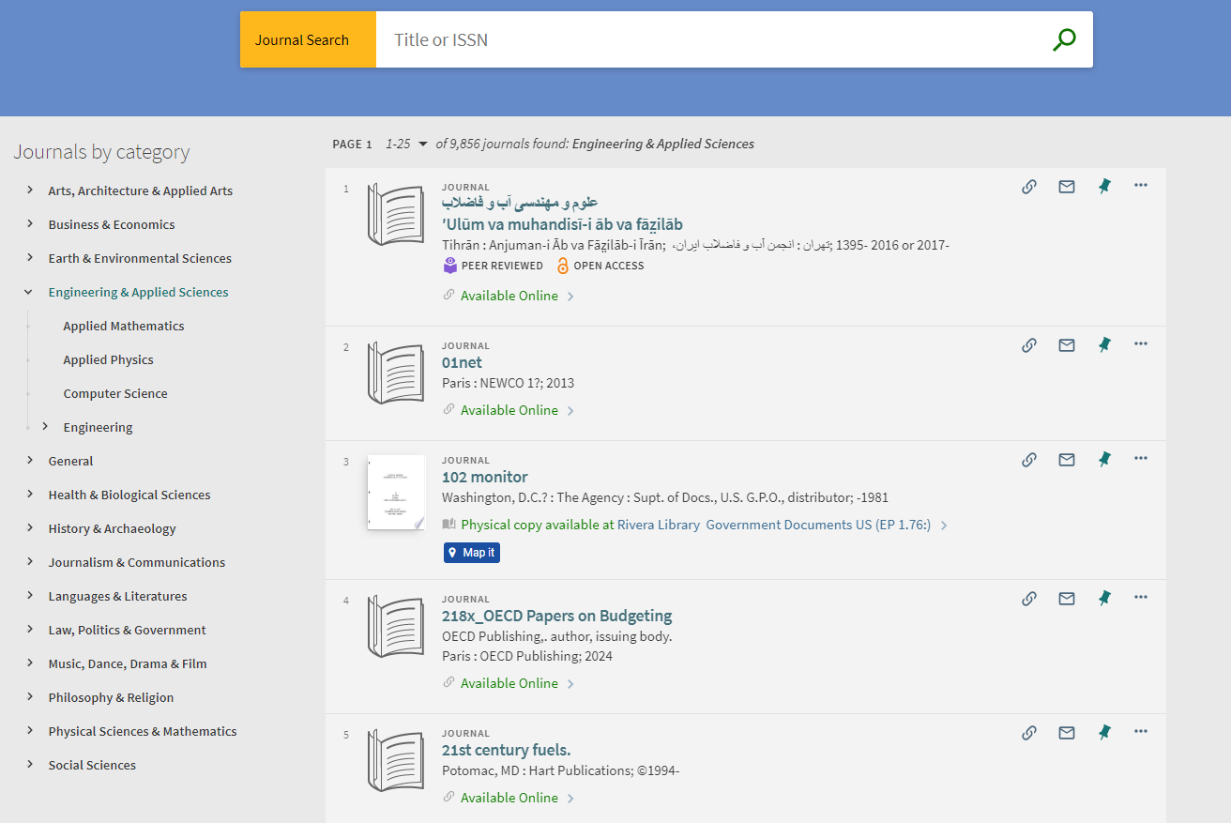
Academic
Journals

Slide 7
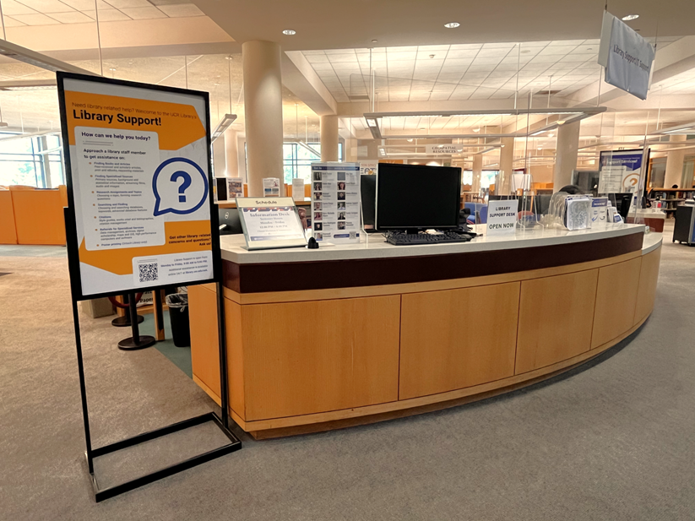
INTERLIBRARY LOAN
Interlibrary Loan is a free service that allows students, faculty, and staff to request resources not in the UC library system

Slide 8
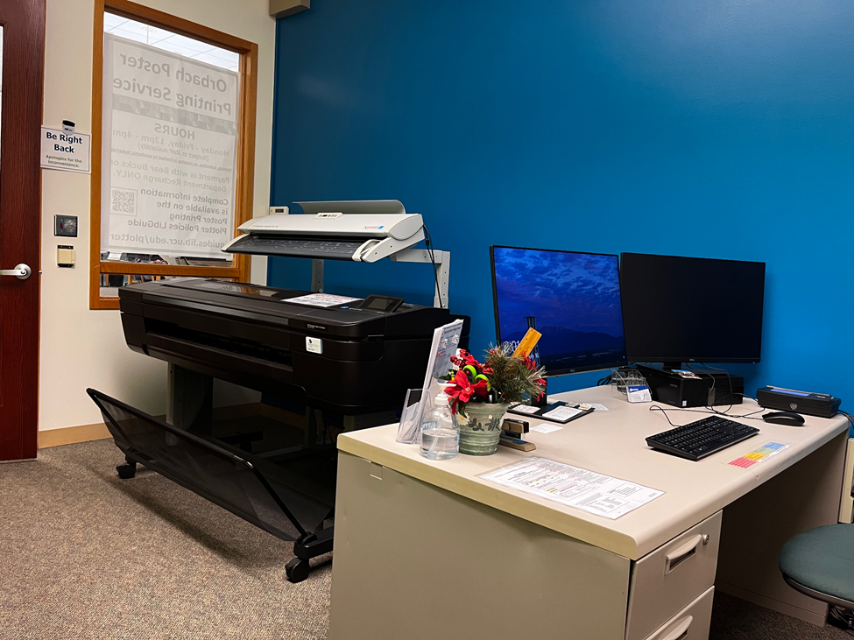
Research Poster printing Service
Our Research Poster Printing Services offer high-quality, large-format printing. Ideal for: conference presentations class projects research showcases (affordable rates)

Slide 9
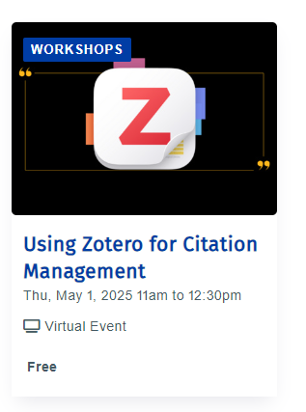
LIBRARY GUIDES
The library provides detailed guides on a wide range of Information Related Services -
Research Guides
UC Library Search
Getting Started with Research
Writing an Annotated Bibliography
Citation Management
Poster Printing

Slide 10
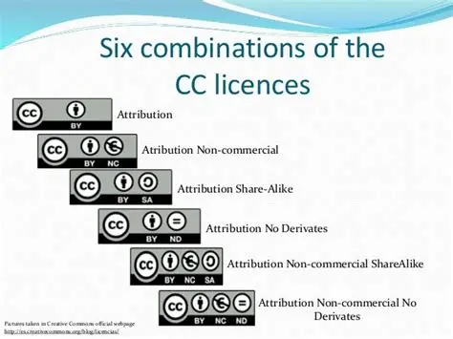
Research Help Resources
The library provides an array of research support oriented resources -
Homepage
Research Fundamentals
Finding and Evaluating
Locating Images & Photos
Locating Maps & GIS
Using Creative Commons Licenses
Managing your Data
Understanding Open Access (OA)

Slide 11
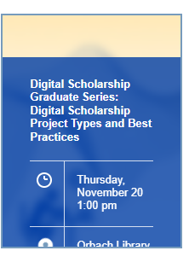
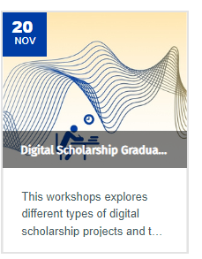
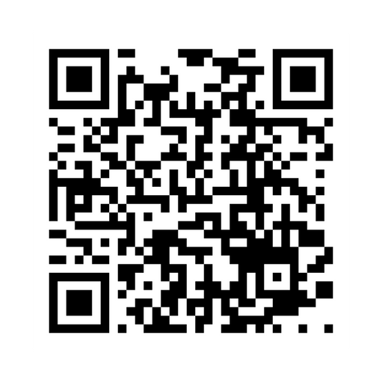
LIBRARY WORKSHOPS
The Library provides free workshops on topics like:
Citation management
Data management
Digital scholarship
GIS applications
3D printing, Arduino, and more.

Slide 12
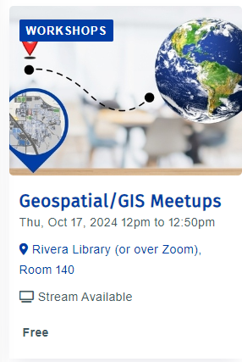
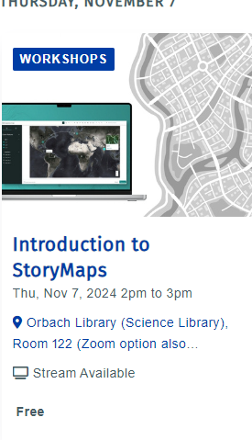
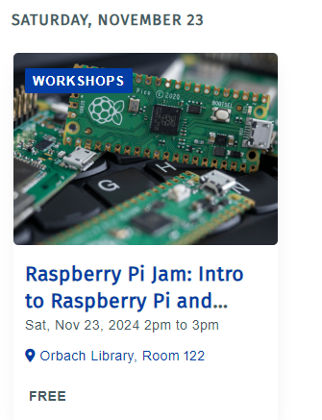
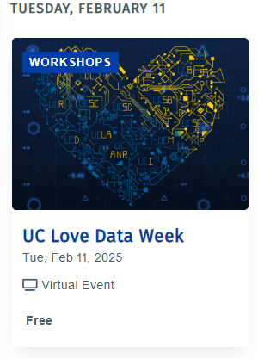
LIBRARY Research Services Monthly& Meetups, Thematic Weeks

Slide 13
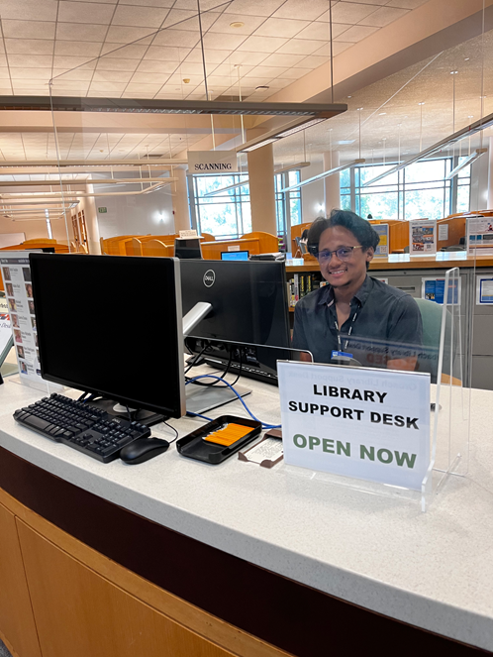
Library Support Desk
Library Support Information Desks @ Orbach and Rivera
Our Library Support Desk (Information Desk) provides in-person assistance with: Research, Printing, Navigating library resources, Helping users navigate less defined requests by Connecting them with the appropriate services or staff best equipped to support their needs.
Get it at UC: https://www.youtube.com/watch?v=RUBr-iS_Jao

Slide 14
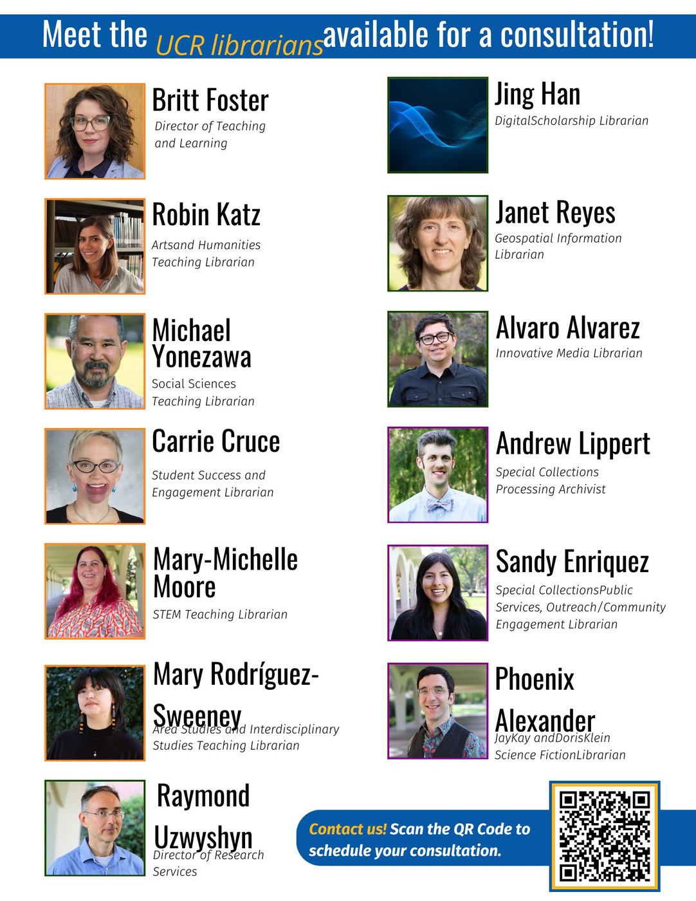


CONSULTATIONS
Students can request a one-on-one appointment with a librarian
Can be scheduled in-person or through Zoom
Students are matched with a librarian
Great way to establish a relationship with a librarian
Students fill out a form and we do the rest!

Slide 15
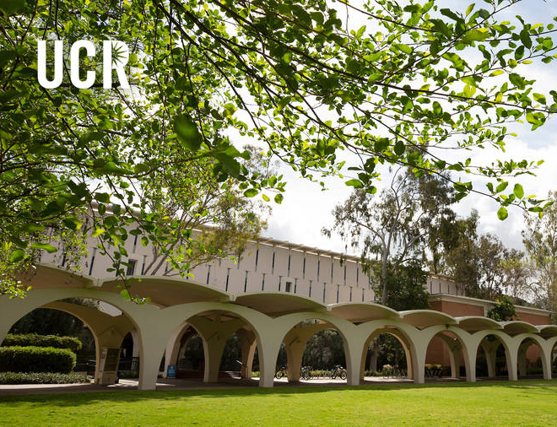
NEW AT THE LIBRARY FOR OUR GRAD STUDENTS
GradVantage
Rivera Library, 1st Floor
A new collaborative service and space hosted by Library Teaching and Learning and Grad Success, this center houses the TA Development Program and librarians and staff who are experts in teaching, learning, and assessment to support our graduate student instructors and their teaching development
Grad Student Study Space
Rivera Library, 2nd Floor
This renovated wing features more seating and a range of options, for solo study or group conversations. Limited to grad students only

Slide 16
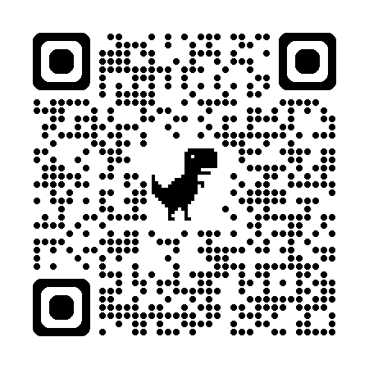
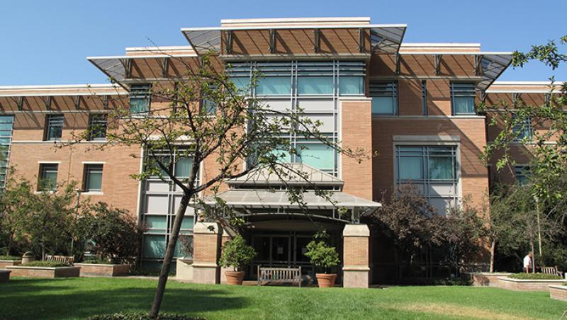
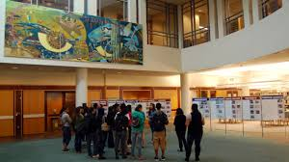
UCR Libraries Research Services Orbach Science Library
Director of Research Services
Maker Space/Robotics Lab Services Coordinator
Research Services Infrormantion Assistant
Medical & Clinical Outreach Librarian
Innovative Media Librarian
Digital Scholarship Librarian
Geospatial Information Systems Librarian
Research Data Scientist AI Research Librarian (2) AI ResearchScientist

Slide 17
RESEARCH SERVICES
Supports campus research by offering specialized expertise, resources, and services
Digital Scholarship - digital tools, methods, and technologies
GIS Services - data analysis, geospatial software, geospatial visualizations
Scholarly Communication - support navigating open access and digital publishing landscape and managing scholarly identity
Maker & Robotics Lab Services - provides access to prototyping equipment, 3D printing and modeling technologies, and fabrication resources
Data Services - consultation on data management, analysis, and visualization

Slide 18
Research Services

Slide 19
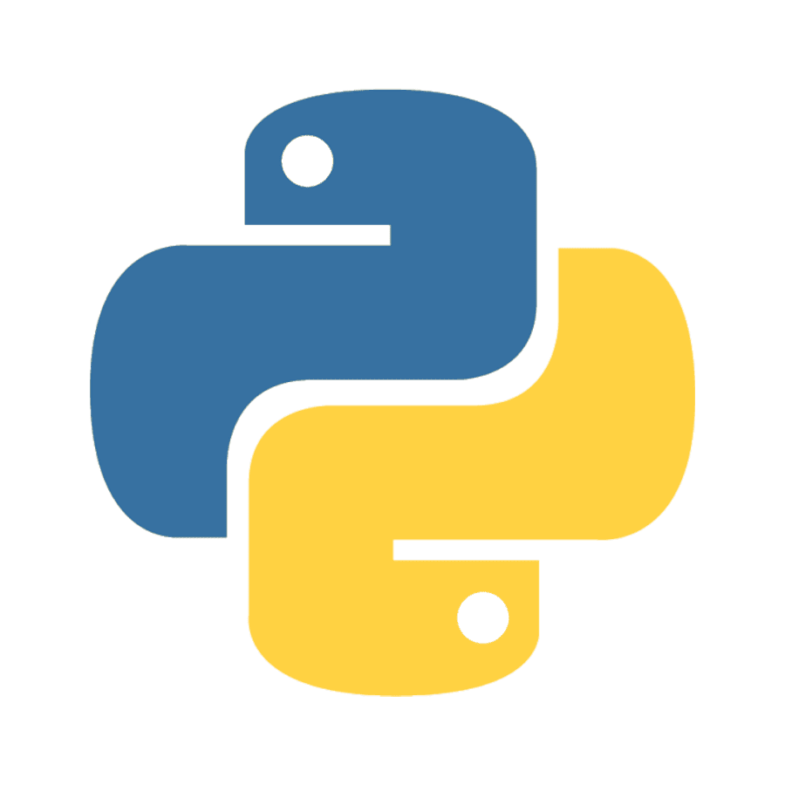

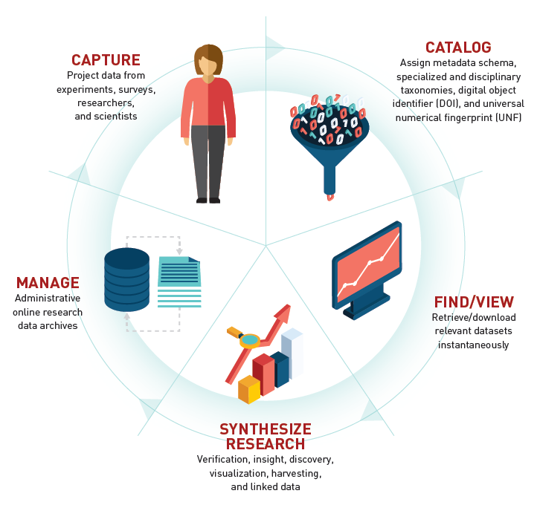


Data Services Supports The Research Lifecycle

Slide 20
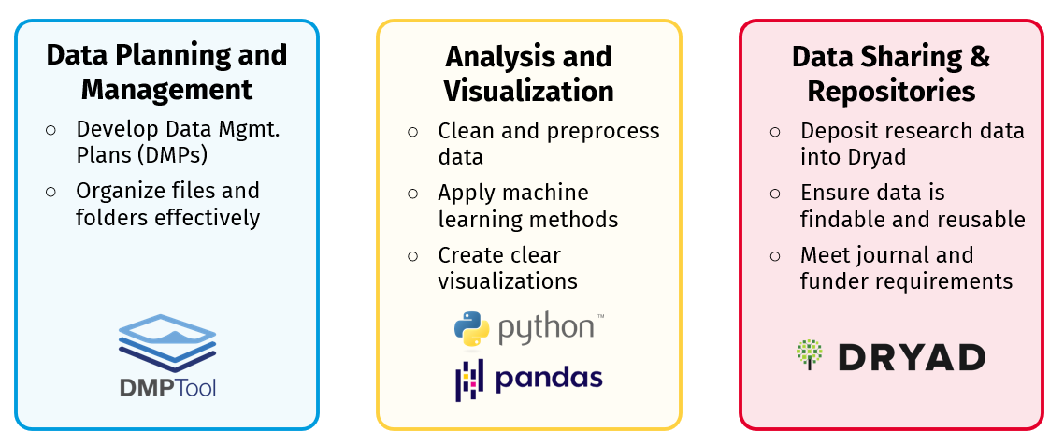
Research Data Lifecycle Support

Slide 21





How to Access Research Data Services
Consultations
Get one-on-one support for your research data questions and needs
Workshops
Build practical skills with research data and ML tools
Collaborations
Partner with us to support your research group’s data needs
Upcoming Workshops
Open Data Publishing with Data Dryad - October 23
Open Data Management and Discovery - October 23
Introduction to Python for Data Analysis - November 6

Slide 22
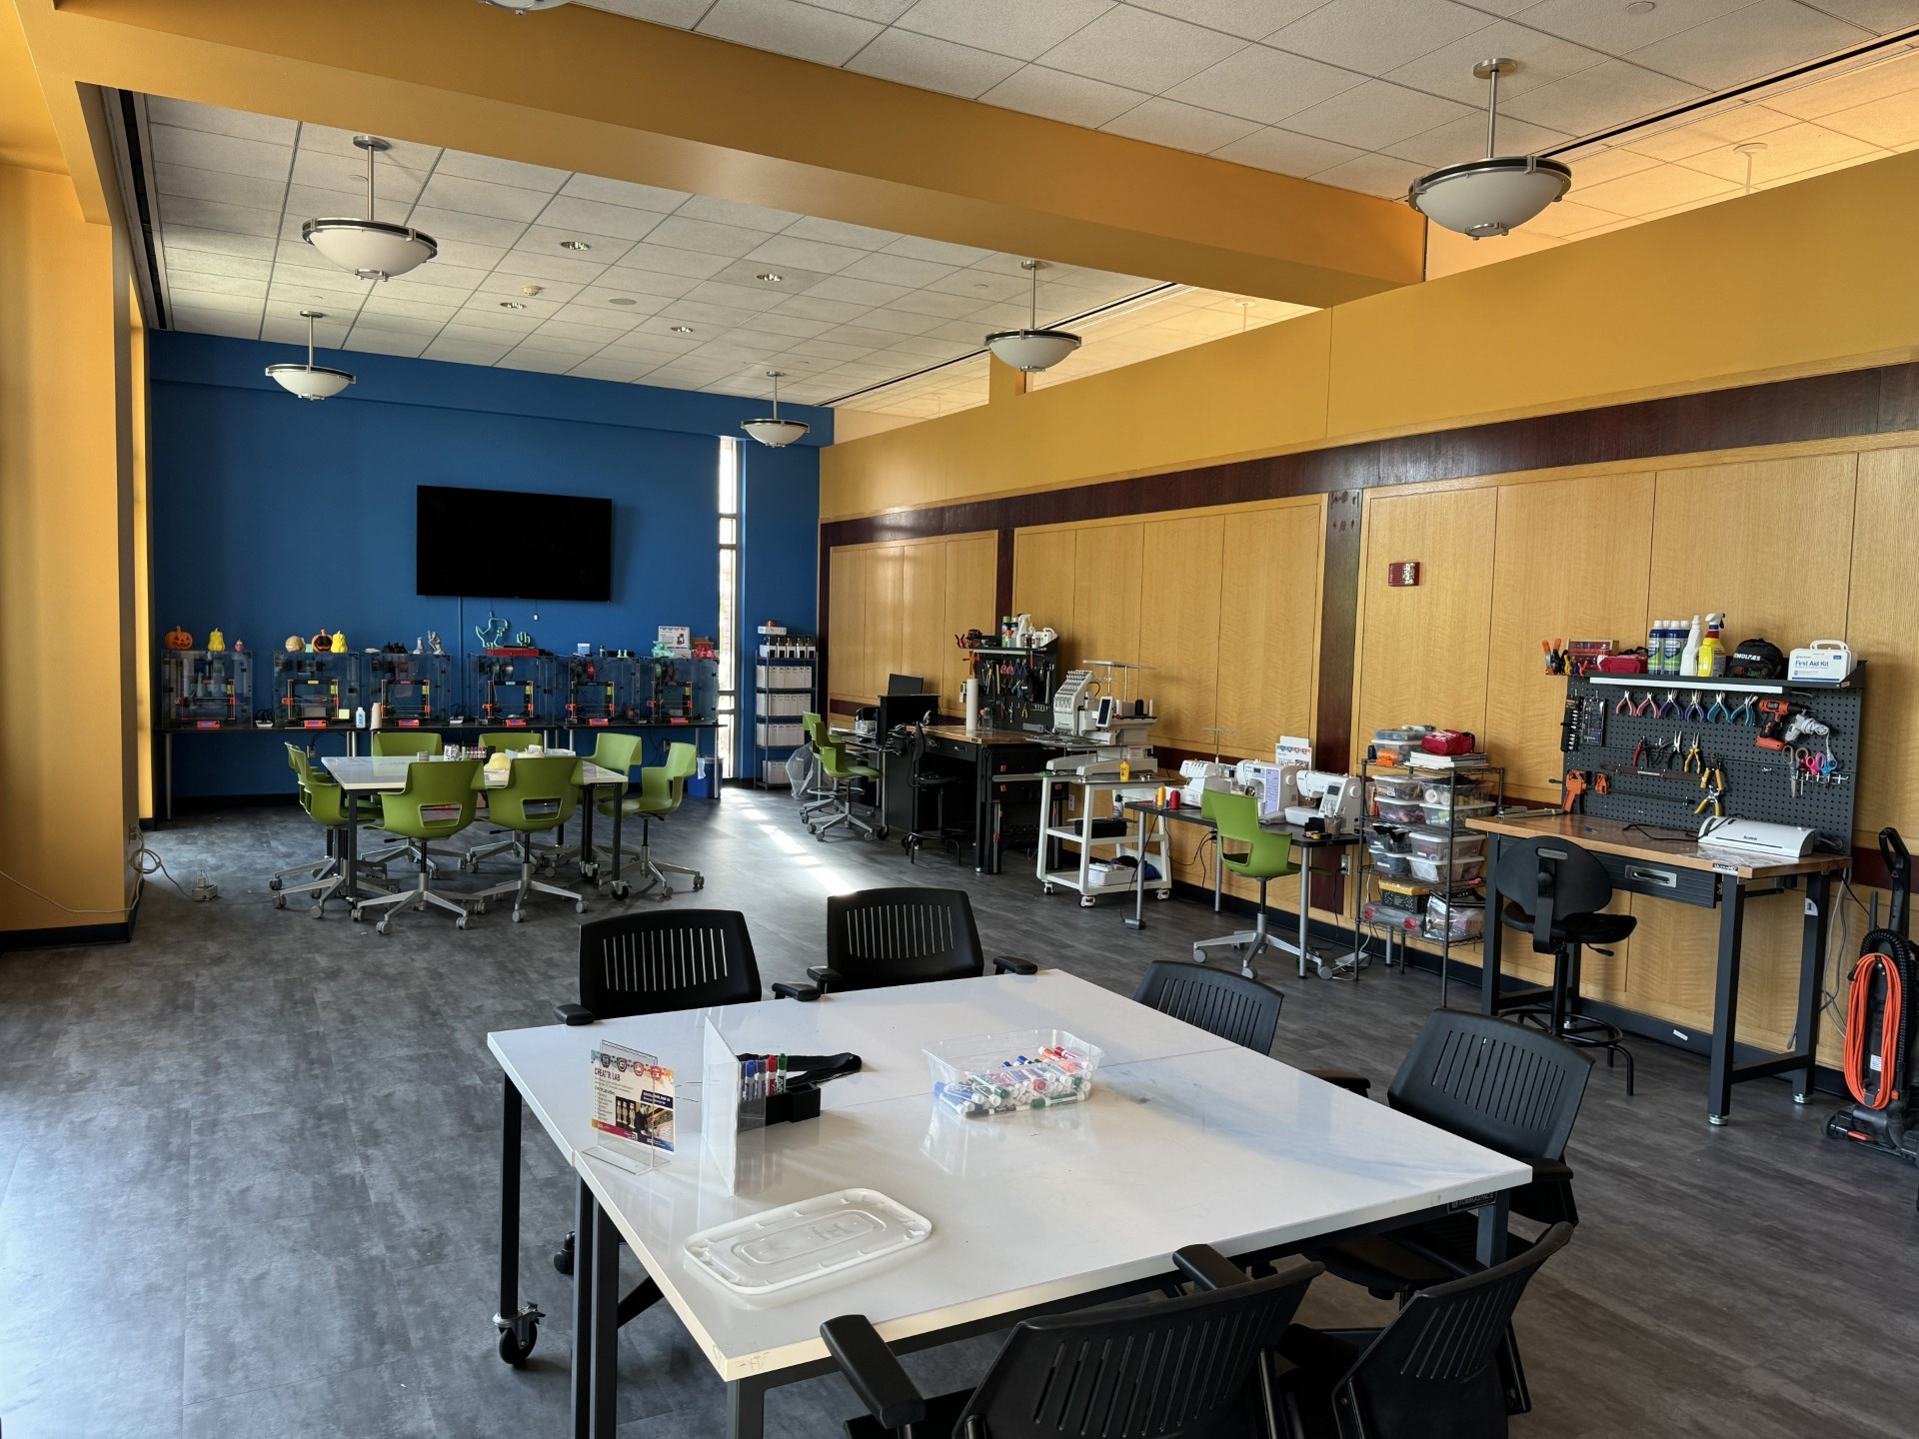
Creat’R Labs
The Creat’R Labs in Research Services offers access to innovative media and technology
Makerspace
3D printing, sewing machines, VR, electronics, media equipment
Robotics Lab sensors, kits, Arduino, raspberry pi
3DXP Lab (Mulitmedia lab. Green Screen, Digital Video, VR, XR)
STAR Lab, NVIDIA GPU’s , Specialized Software

Slide 23
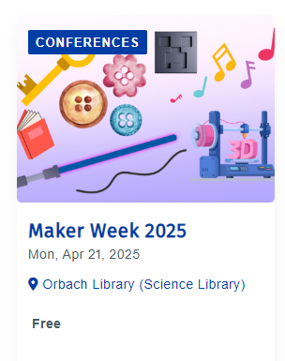
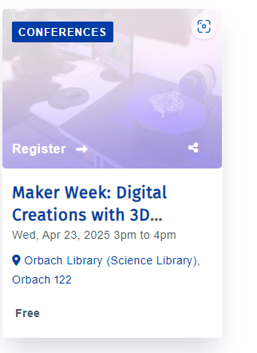
Research Support in the Labs
3D Modeling
3D Scanning
3D Printing
MultiMedia Skills (Film & Photography)
Graphic Design

Slide 24
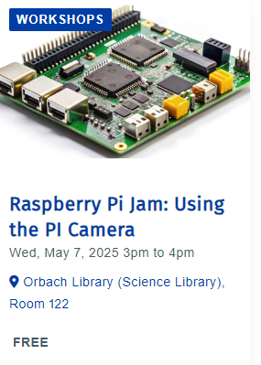
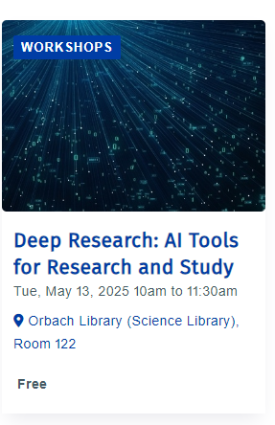
Research Support in the Labs
Robotics
Senior Design Mentorship
Artificial Intelligence Integration
Animation & Simulations

Slide 25
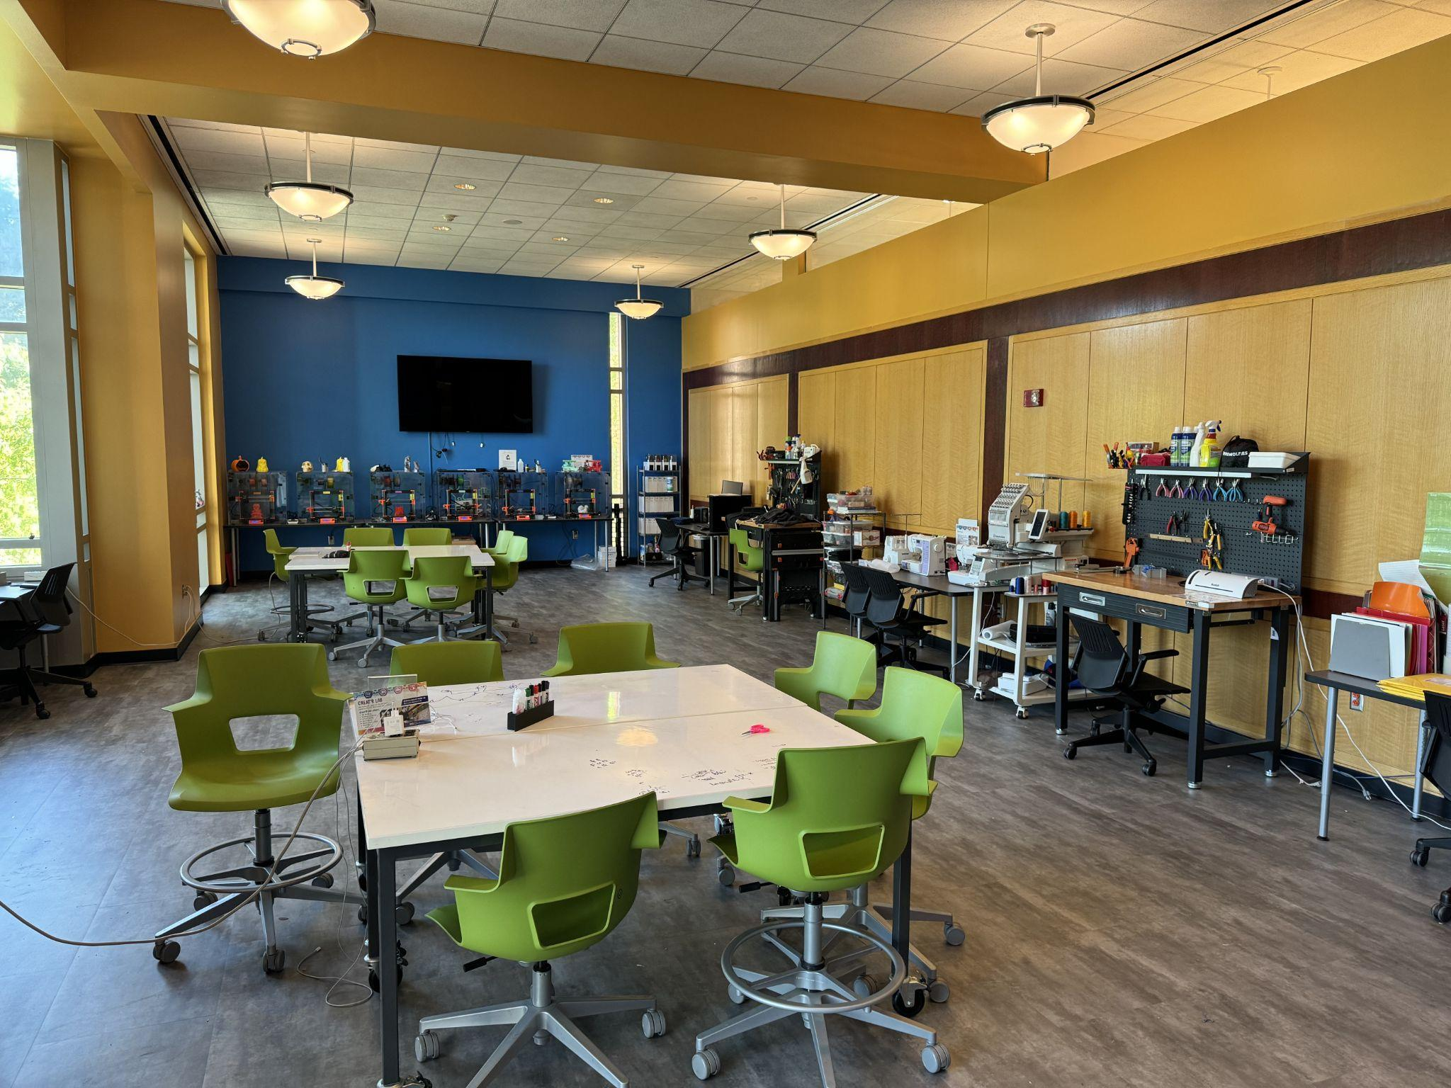
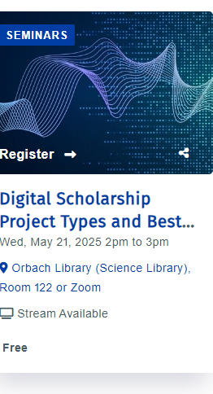
CreatR Lab, Orbach Science Library
Offers research support through skills and equipment in the lab
Lab maintains: 3D printers, textile digital equipment, laser engraver, workbench, tools
Staff and student assistants available to help with projects

Slide 26
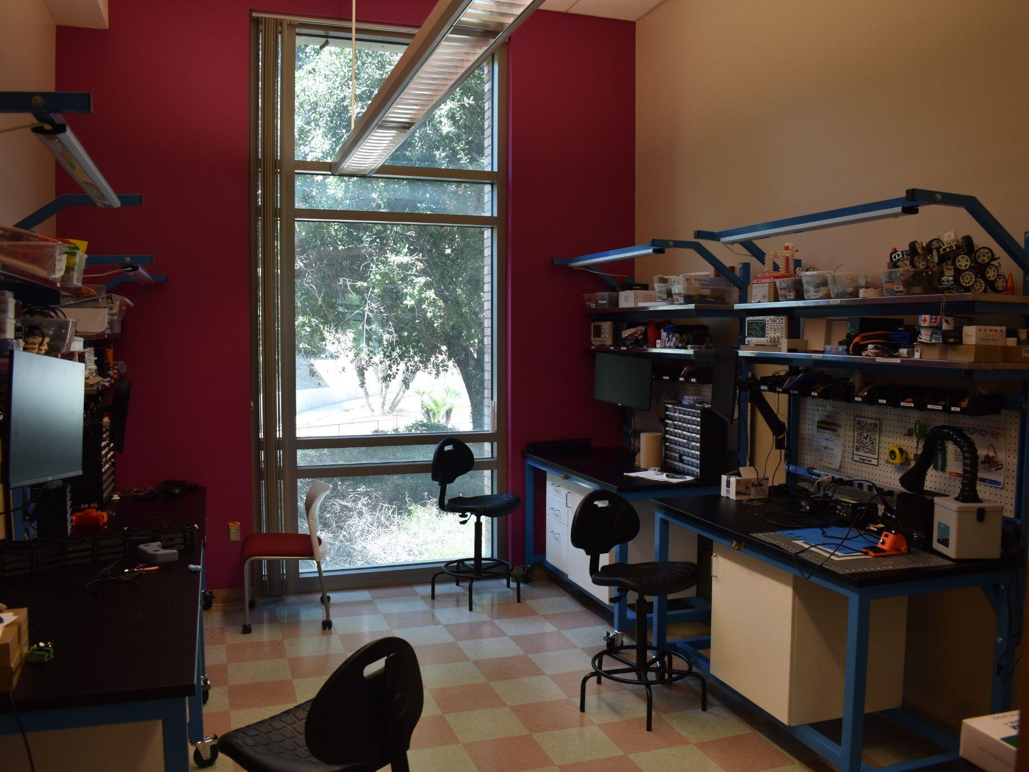
Robotics LAB
Offers research support through skills and equipment in the lab
Lab maintains microcontrollers, sensors and microcomputers
Staff and students assistants available to assist with research

Slide 27
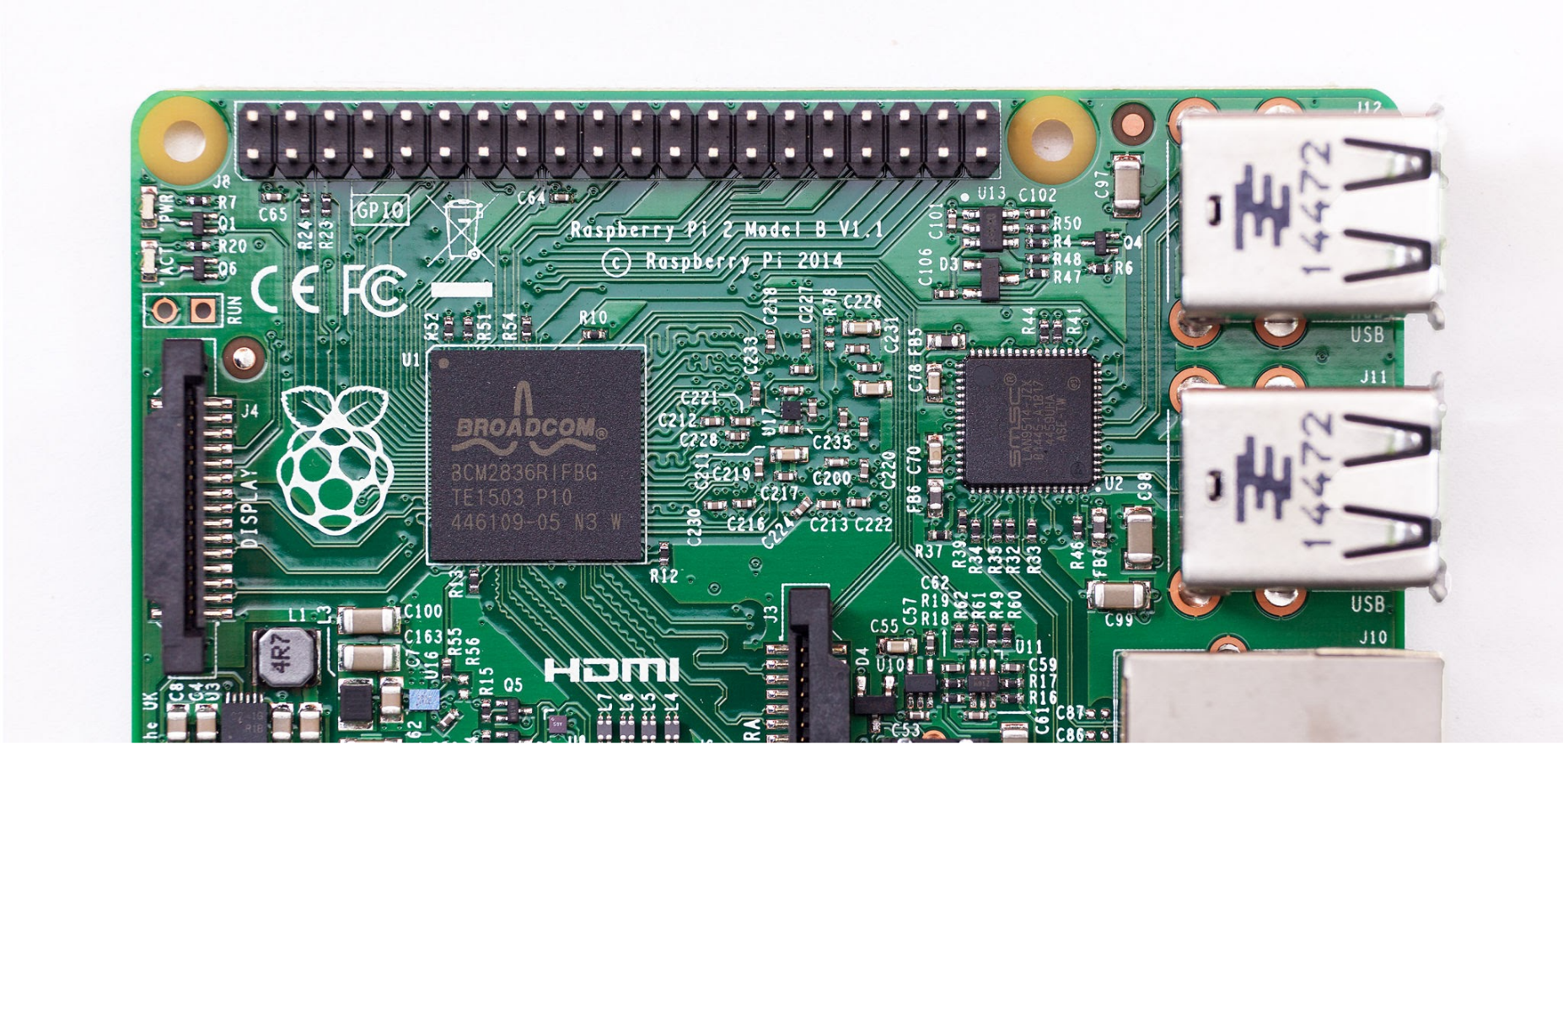
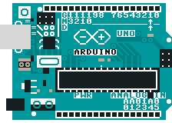
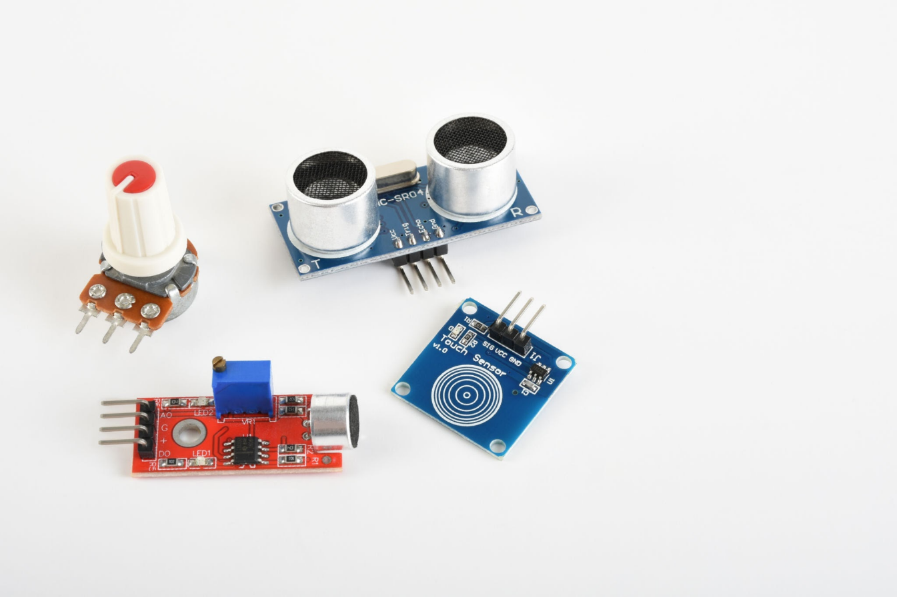
Robotics LAB
Robotics Lab Components Tools and Kits
Raspberry Pi Microcomputer
Arduino Nano Microcontroller
Sensors
Soldering Irons
Tool Kit
Nuts, bolts and fasteners
3D Printed Chassis(PLA)

Slide 28
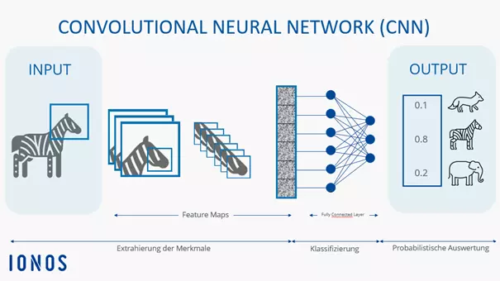
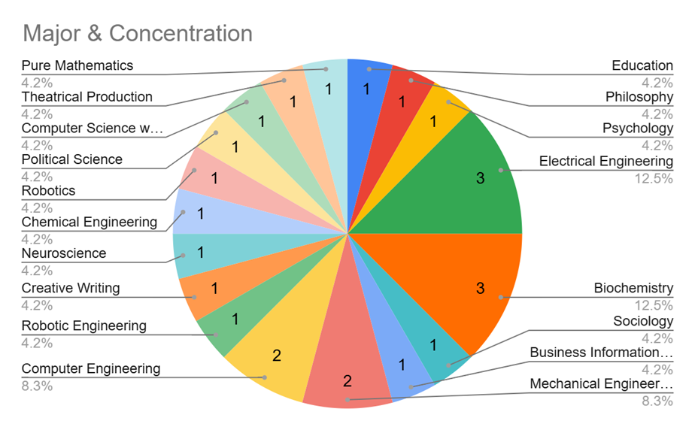
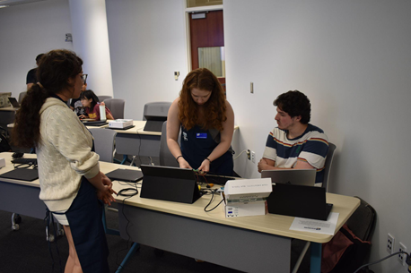
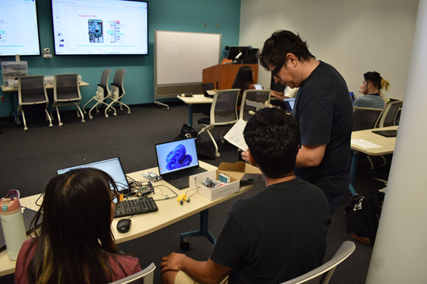
Robotics LAB Workshops And AI
An AI training method, which teaches the model to recognize items based on an image
Convolutional Neural Nets Integrated with Robotics
Students were taught how to train the model and how to use the model in a real application

Slide 29
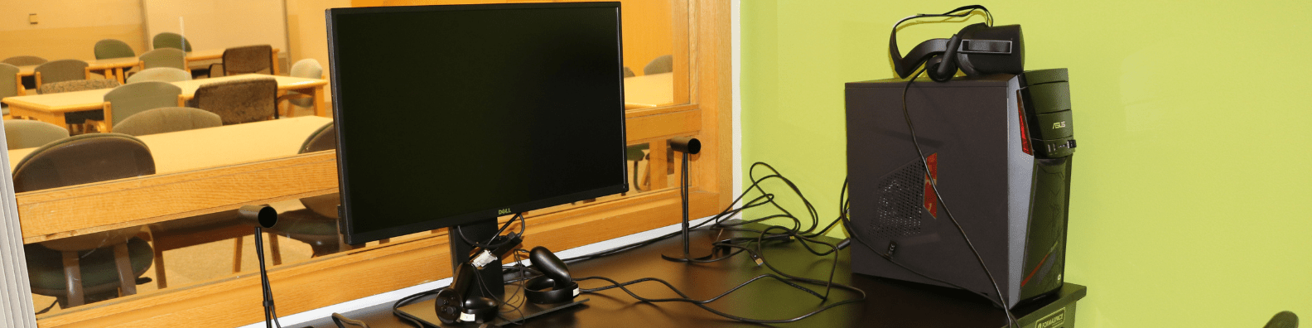

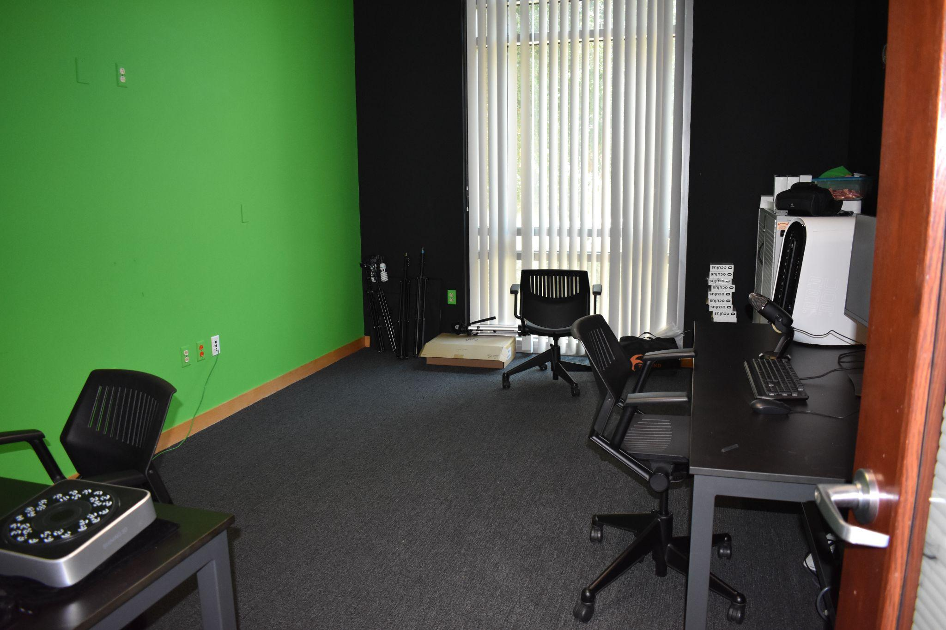
3DXP Lab
Multimedia Lab, Winner of Unity and Meta Immersive Learning VR Grant
Offers research support through VR, AR and 3D Scanners, VR Headsets, skills and equipment in the lab
Lab maintains cameras, lighting and high performance computers
Student assistants and staff can help with projects

Slide 30
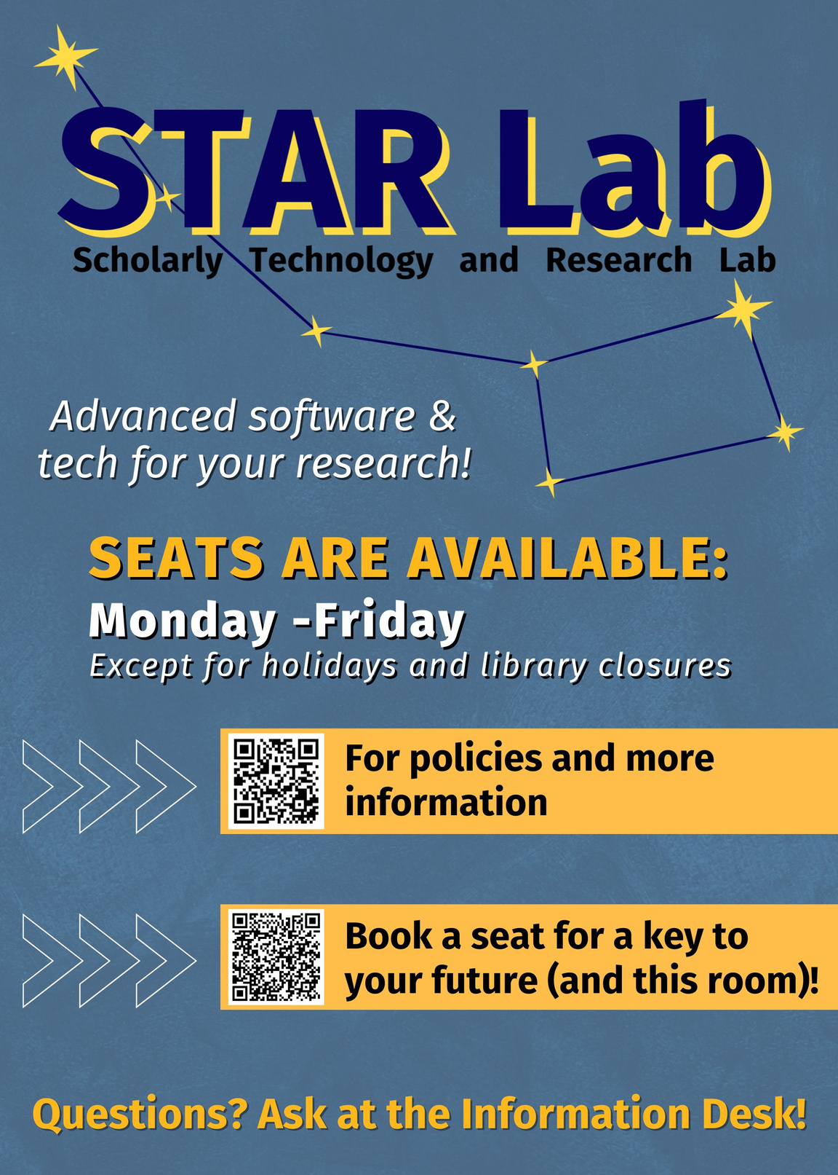
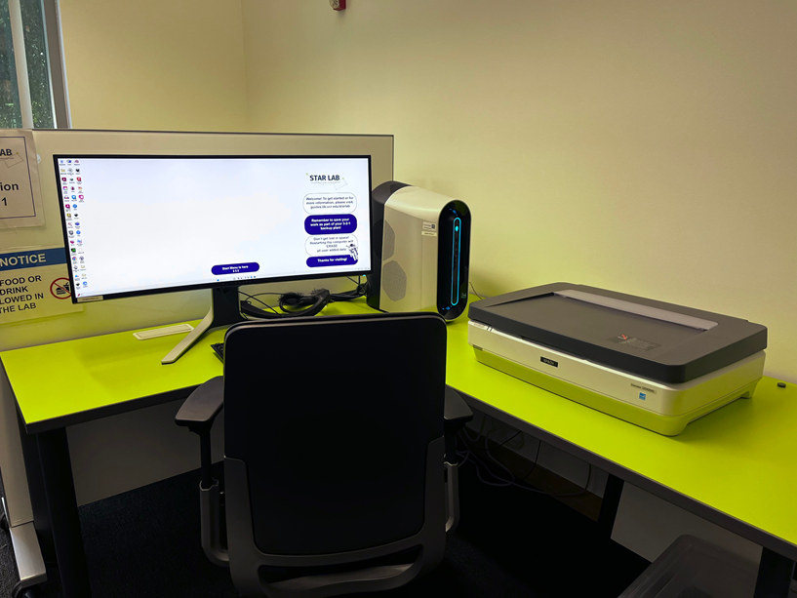
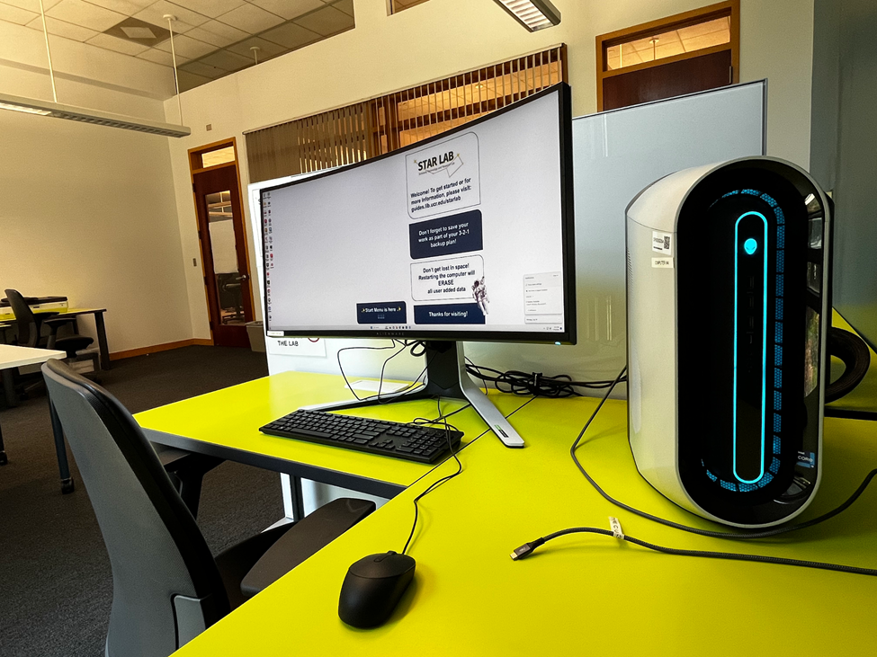
Star Lab
The STAR Lab includes high-performance Windows PC workstations and an Epson Photo Scanner.
All workstations provide software for:
Data analysis, data visualization,
AV and multimedia editing,
Computer-aided design (CAD),
Geographic information systems (GIS)

Slide 31
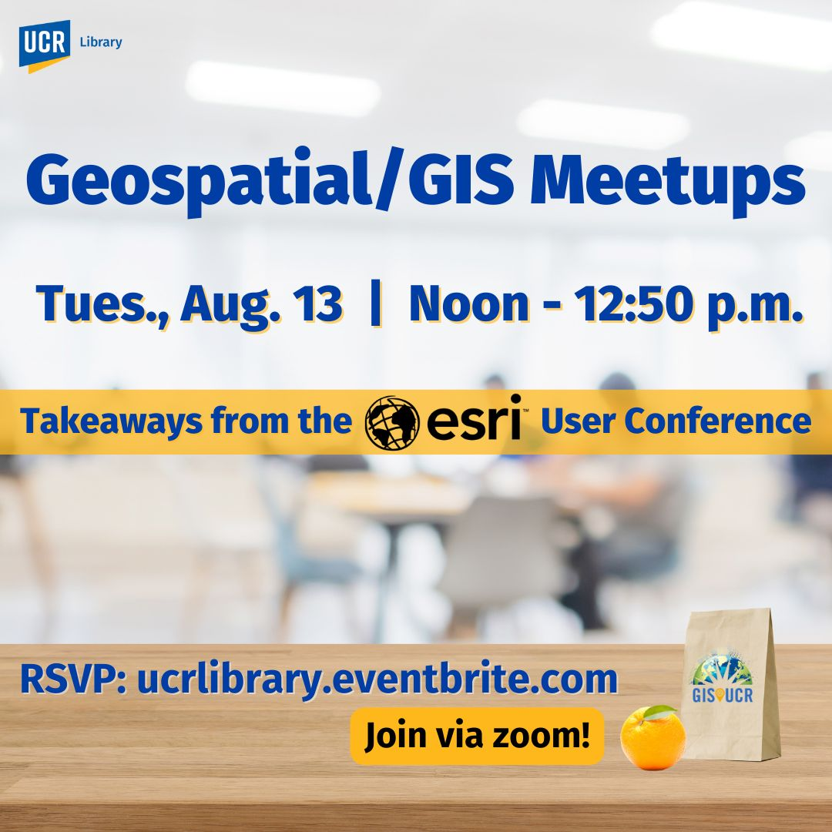
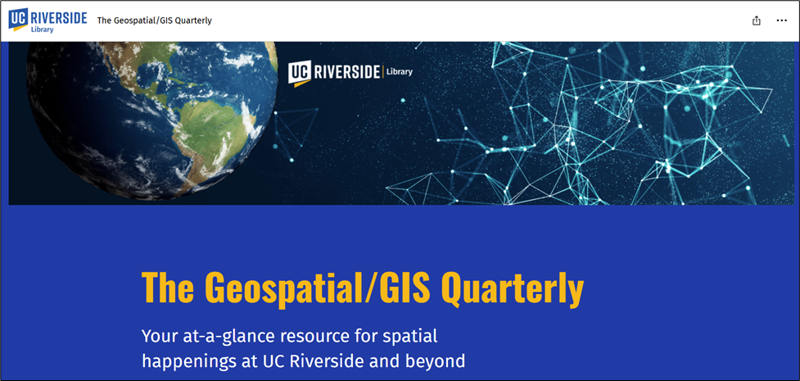
Geospatial Services (GIS
Support is available for:
• Finding and formatting geospatial data, including imagery
• Using GIS platforms
o Esri products (ArcGIS Pro, ArcGIS Online, etc.)
o QGIS (Open Source GIS)
o Google Earth and Google Earth Pro
Hexagon (Declassified Satellite Data (California)
• Performing common GIS procedures
• Participating in research projects
• Training via public or targeted workshops

Slide 32



Geospatial Services (GIS
3D Earthquake Visualization with Underground Earthquake Points (ArcGIS Pro)
GIS + Google Earth to View Changing Imagery Over Time
Open Source Tools, QGIS Transportation Planning

Slide 33





Geospatial Services GIS
In a collaboration with the Artificial Intelligence for Sustainable Agriculture (AI4SA) project, the library hosted Planet Imagery Day on May 2, 2025. The event featured presentations regarding using Planet imagery in Google Earth Engine and in ArcGIS products, given by staff from Planet and Esri respectively.

Slide 34



Digital Scholarship
Areas of Support
Open Access Publishing
Support scholars at all career stages—from undergraduate researchers to faculty and staff—in navigating publishing opportunities throughout the research lifecycle. eScholarship, Digital Preprint Repository, Janeway (Referred Online Electronic Journals, Colloquium/Conference Proceedings
Open Access
Increase the visibility and accessibility of your research through open access. Learn about open access models, funder mandates, and how to deposit your work in UC's institutional repository, eScholarship and through UC’s Publication Management System.

Slide 35



Digital Scholarship

Slide 36

Digital Scholarship
Textual Encoding (TEI, XML)
Computational & Qualitative Text Analysis
Data Analysis & Visualization
Network Analysis
Storytelling & Creative Coding
Web Scraping & Digital Archiving
Digital Media Production

Slide 37
Signature Program
Open Access Week
Each fall, the UCR Library participates in Open Access Week—an international celebration that promotes equitable access to research and scholarship.
Scholarly Communication Services hosts a week of workshops and special events highlighting open access practices and opportunities

Slide 38


Open Research and Creative Activities Forum (ORCA) Signature Program
Open Research and Creative Activities (ORCA) Forum
Quarterly event showcasing outstanding student projects from all disciplines.
Emphasizes interdisciplinary work and open scholarship.
Finalists present at Orbach Science Library and may publish their work (code, data, multimedia) in eScholarship with DOIs.
Learn more & submit at the ORCA website.

Slide 39

Digital Scholarship Signature Programs
The Reference Desk Podcast
Biweekly podcast
Features conversations with UCR faculty and student researchers.
Explores their projects, use of library tools, and the books shaping their thinking.

Slide 40


Digital scholarship certificate
Want to learn how to use digital tools in your research? The UCR Library Digital Scholarship Certificate shows you how to integrate digital tools, methods, and technologies into your research, teaching, learning, and publishing.
Click the link or scan the QR code to self enroll on Canvas.

Slide 41


Slide 42

Thank you!
Questions?
Raymond Uzwyshyn Ph.D. MBA MLIS Acting AUL and Director of Research and Technology Services
University of California, Riverside
raymondu@ucr.edu

