Slide 1




AI Tools and Services For History Classrooms Research and Technology Services, UCR Libraries
Ray Uzwyshyn, Ph.D. MBA MLIS Acting AUL for Research & Technology Services Director of Research UC Riverside Libraries, raymondu@ucr.edu https://rayuzwyshyn.net https://www.linkedin.com/in/rayuzwyshyn/

Slide 2
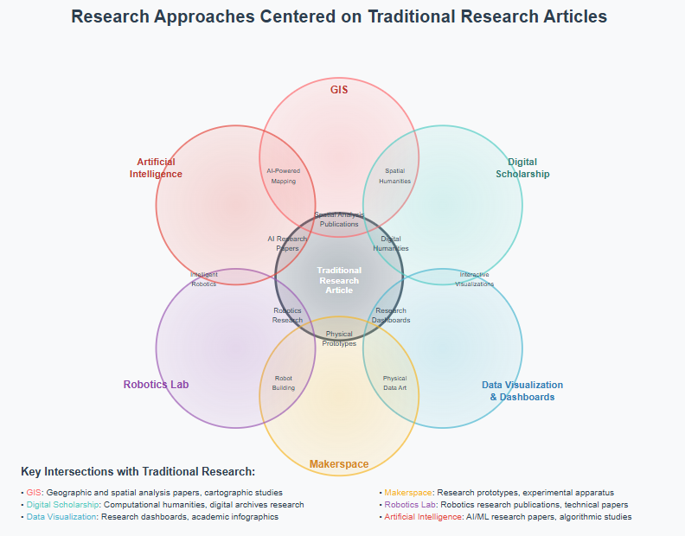
UCR Library Research Services & AI
Several Units Several Technologies
Traditional Research Article, Book AI
Interdisciplinary Third Space Serving Other 95% of University
AI

Slide 3
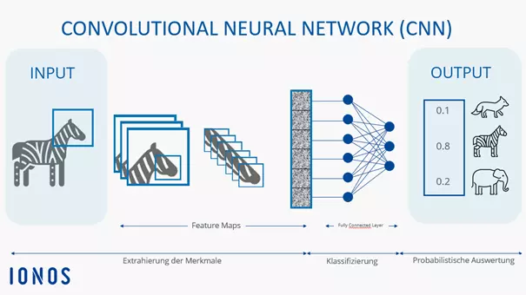
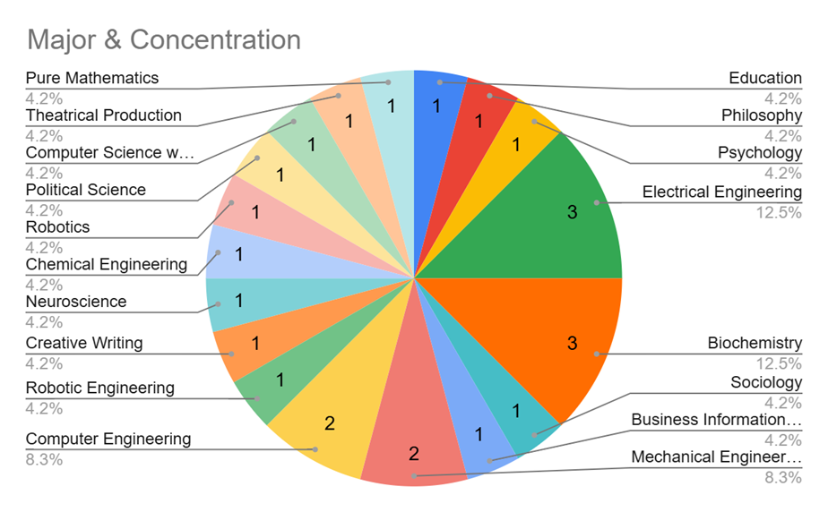
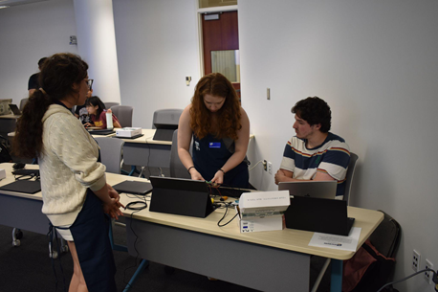
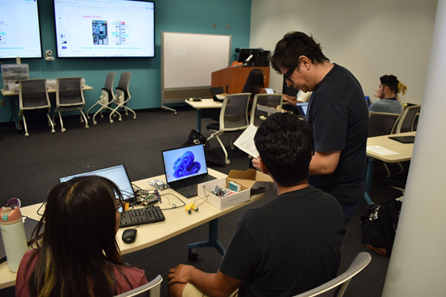
Robotics LAB Workshops And AI
An AI training method, which teaches the model to recognize items based on an image
Convolutional Neural Nets Integrated with Robotics
Students were taught how to train the model and how to use the model in a real application

Slide 4
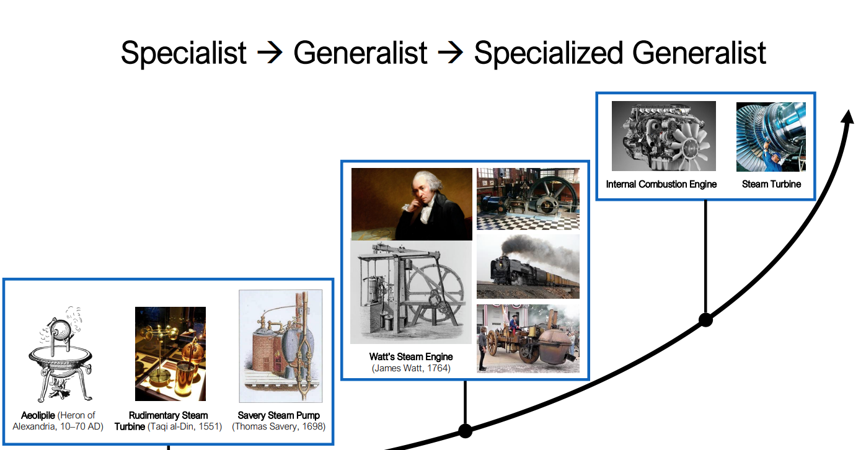
Yuke Zhu, Stanford, NVIDIA (UT-Austin)

Slide 5
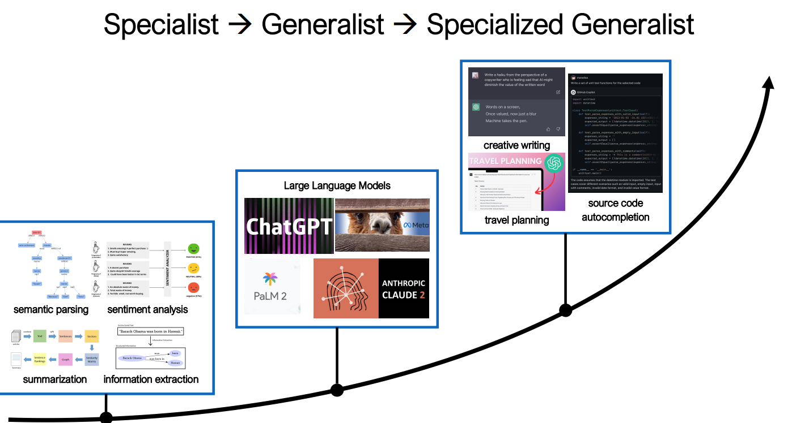
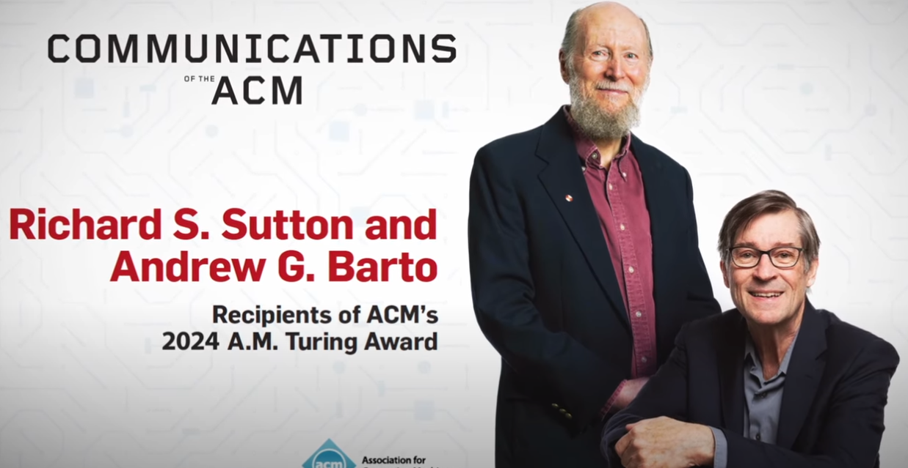
Model for Robots and AI LLM’s Following the Historical Development of Steam Engine Schema Dr Yuke Zhu, https://rpl.cs.utexas.edu/talks/pathway_to_generalist_robots.pdf
Turning ACM Award July 2025 Sutton, Reinforcement Learning, Origins
In Historical Psychological Conditioning Pavlov, Reward Function https://www.youtube.com/watch?v=RrXibq7-W6o

Slide 6
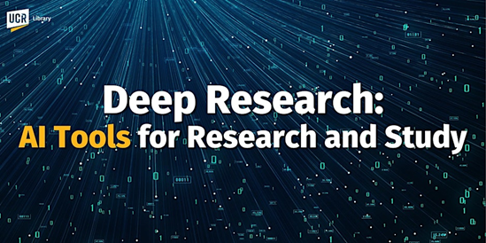
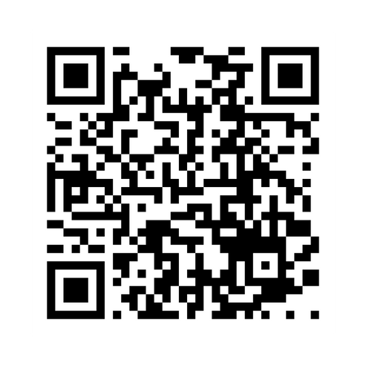

LIBRARY AI and AI-Related Workshops
The Library provide workshops increasingly on AI:
Qualitative Data (Text, AI Subject Clustering
Planet Imagery GIS/AI Workshop/Lectures/Meetups
Robotics Summer Camp Workshops with AI Components
Project Support: AI in Research
https://www.eventbrite.com/o/uc-riverside-library-7346569507

Slide 7
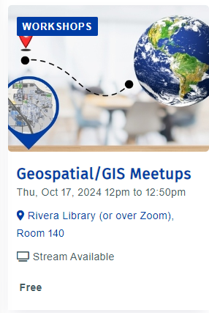
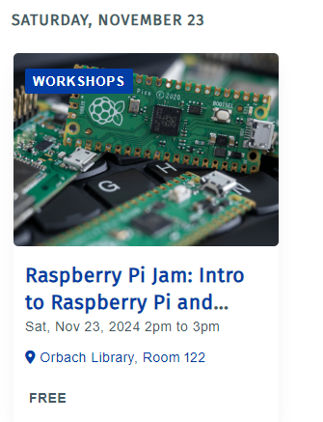
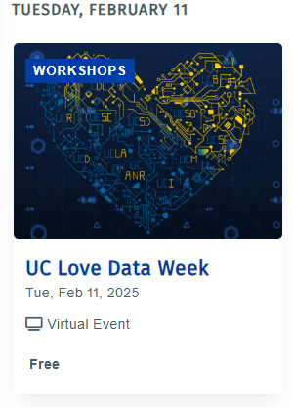
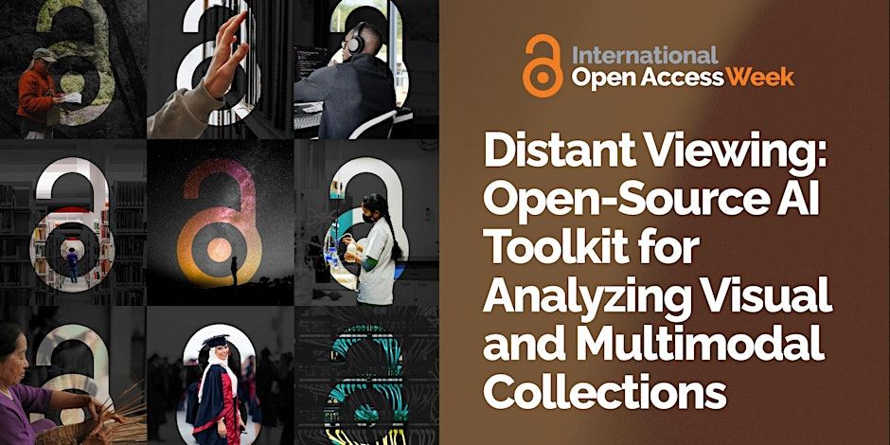
AI Orientation to Technology Workshops and Faculty
Student AI Related Research
Meetups, Thematic Weeks, Presentations
Data, AI, Open Access Global North and South Presentation
Streaming Party For Faculty Students and Staff
AI Research Faculty Presentations
AI/Robotics Training Kits Workshops
https://library.ucr.edu/news/2025/09/30/open-access-week-2025

Slide 8
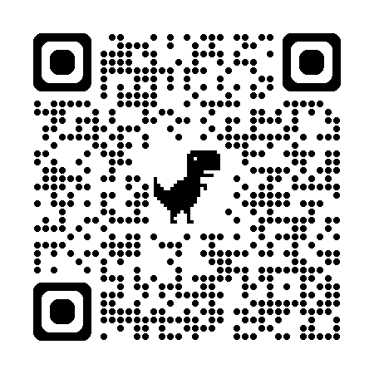
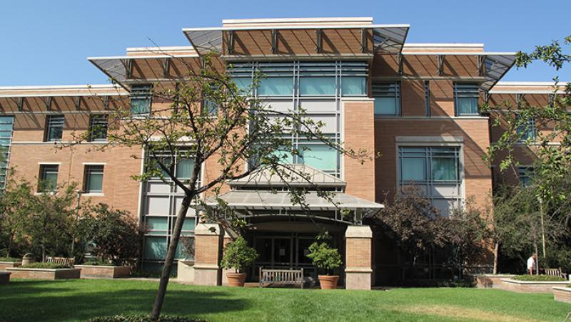
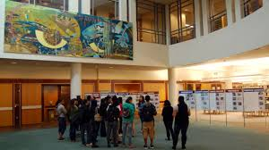
UCR Libraries Research Services Orbach Science Library
Innovative Media Librarian
Digital Scholarship Librarian
Geospatial Information Systems Librarian
Research Data Scientist AI Research Librarian (2) AI ResearchScientist
Director of Research Services
Maker Space/Robotics Lab Services Coordinator
Research Services Infrormation Assistant
Medical & Clinical Outreach Librarian

Slide 9


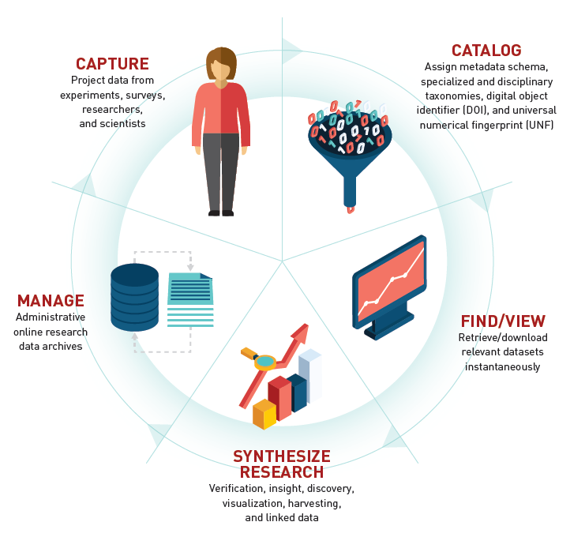


Data Services Supports The Research Lifecycle

Slide 10
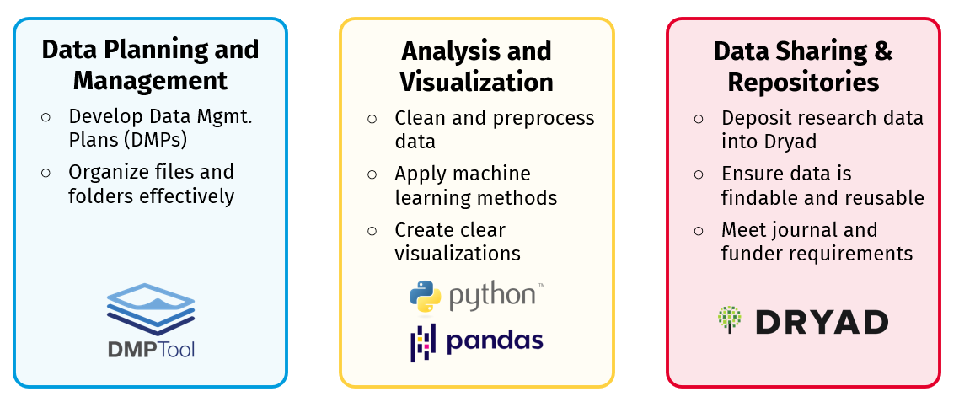
Research Data Lifecycle Support

Slide 11





How to Access Research Data Services
Consultations
Get one-on-one support for your research data questions and needs
Workshops
Build practical skills with research data and ML tools
Collaborations
Partner with us to support your research group’s data needs
Upcoming Workshops
Open Data Publishing with Data Dryad - October 23
Open Data Management and Discovery - October 23
Introduction to Python for Data Analysis - November 6

Slide 12
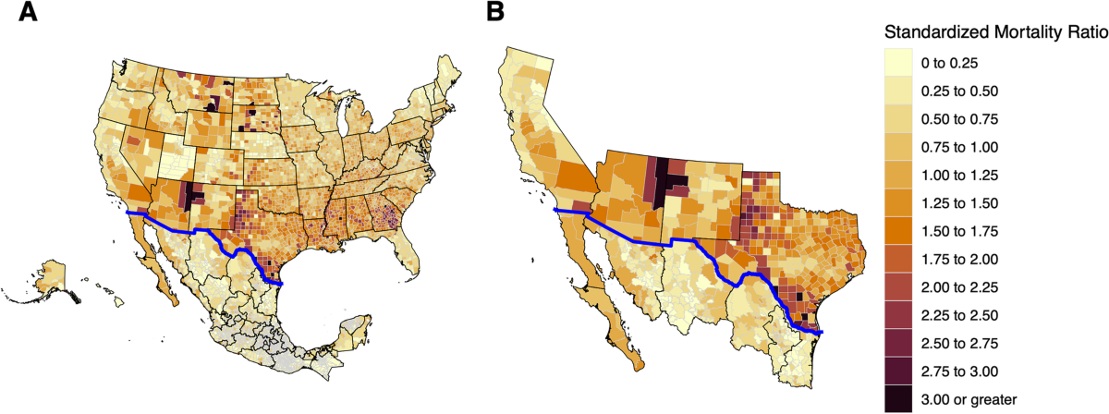
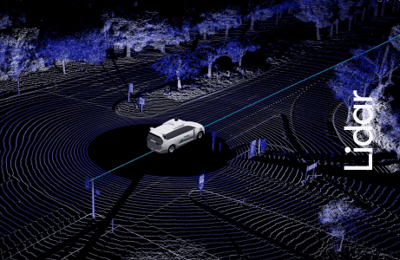
Workshops, Labs, Consultations Act as Feeder for Larger Faculty/Graduate Student Interdisciplinary Projects
Self-Driving Vehicle/AI/LIDAR/Labeling (Medata) Project, Part AI, Bluetooth 3D Data Storage/Repository Project (Visualization of 3D LIDAR Training Data, Research Faculty, Comp Eng.)
COVID Border GIS/Data/AI Project (Research Faculty, Medicine), Cognitive Cartographies (Histories)
Mortality Data on The Border Regions Statistical Qualitative/Quantitative Data/AI Insights
Larger 3D Data File Storage, Data Segment Visualization, Cooper Scenes

Slide 13
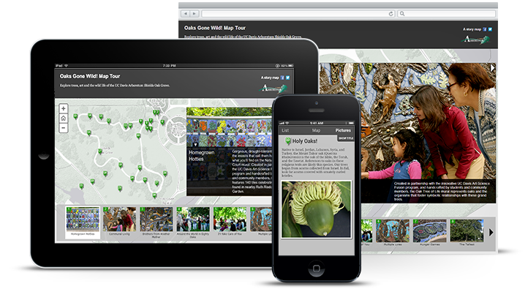
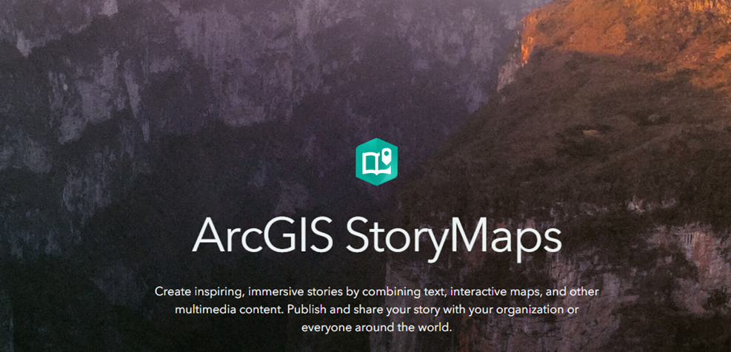


Geospatial Information Services AI + GIS, Planet Imagery Day
Dr. Nan Li, UCR Environmental Sciences
Dr. Nicolas dos Santos, UCR Computer Sci
Planet Imagery Day is supported by USDA-NIFA's Artificial Intelligence for Sustainable Agriculture project
In a collaboration with the Artificial Intelligence for Sustainable Agriculture (AI4SA) project, the library hosted Planet Imagery Day on May 2, 2025. The event featured presentations regarding using Planet imagery in Google Earth Engine and in ArcGIS products, given by staff from Planet and Esri respectively.

Slide 14
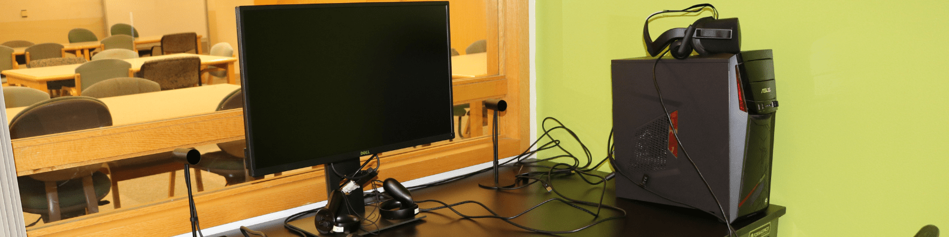

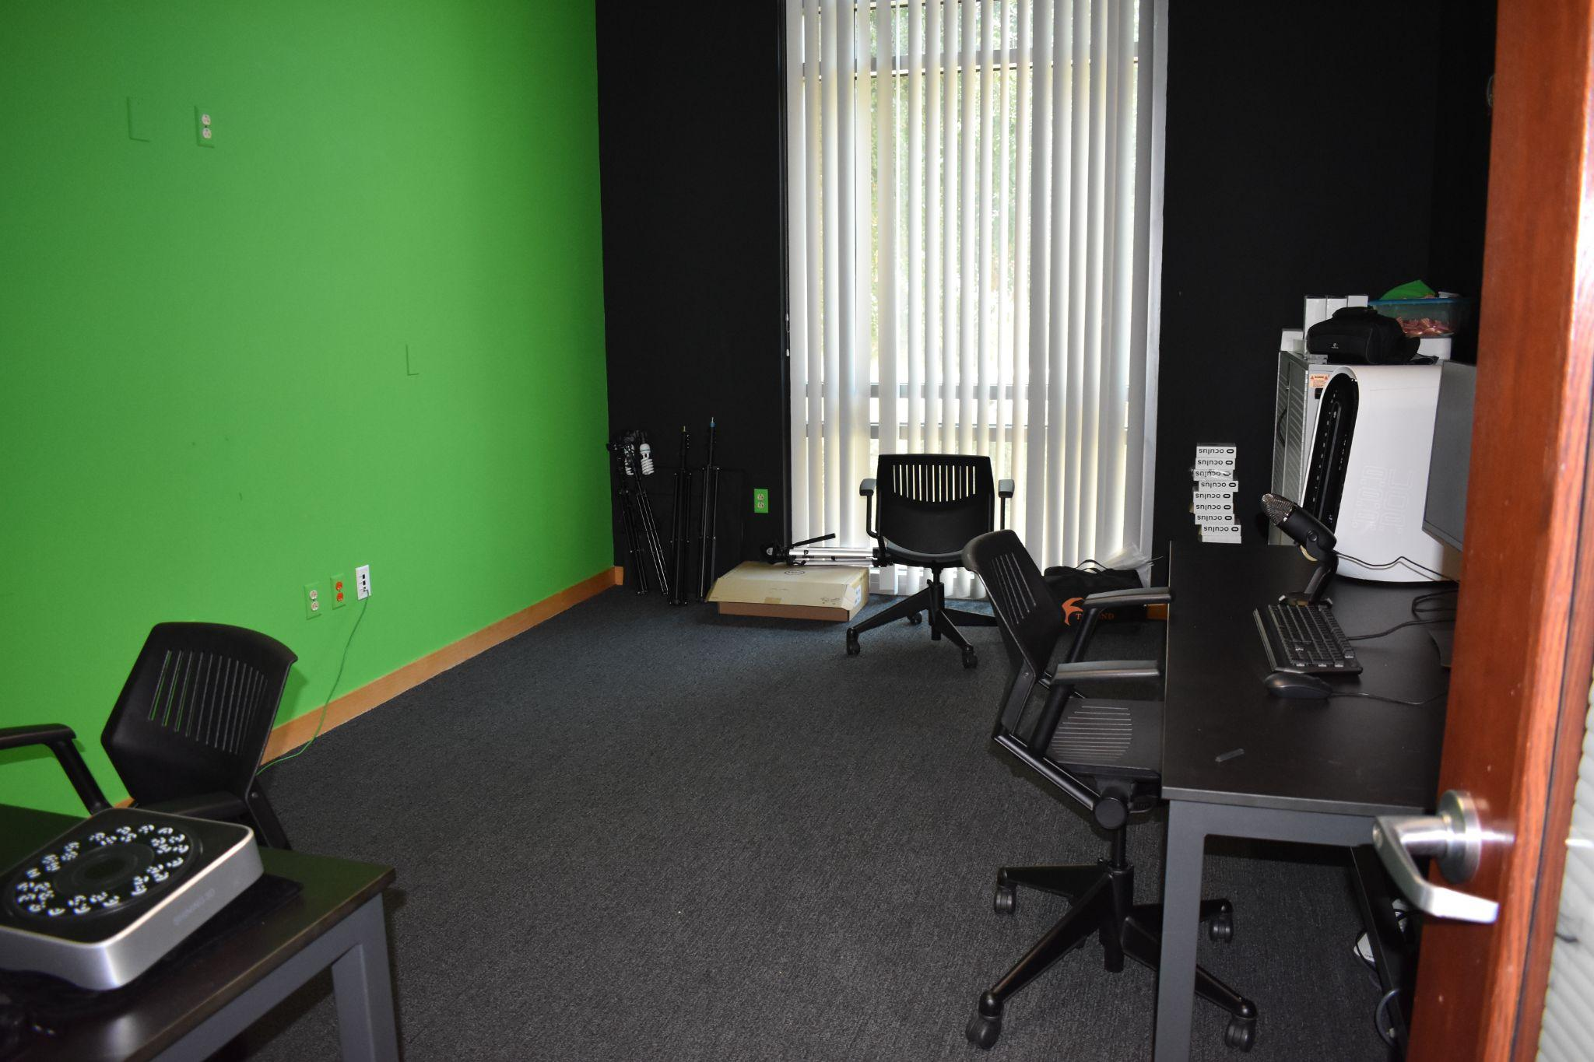
3DXP Lab
Multimedia Lab, Winner of Unity and Meta Immersive Learning VR Grant
Offers research support through VR, AR and 3D Scanners, VR Headsets, skills and equipment in the lab
Lab maintains cameras, lighting and high performance computers
Student assistants and staff can help with projects
Previous workshops with humanities/social science departments (English/Anthropology Greek/Roman History), Greenscreen videos/VR Environment Creation

Slide 15
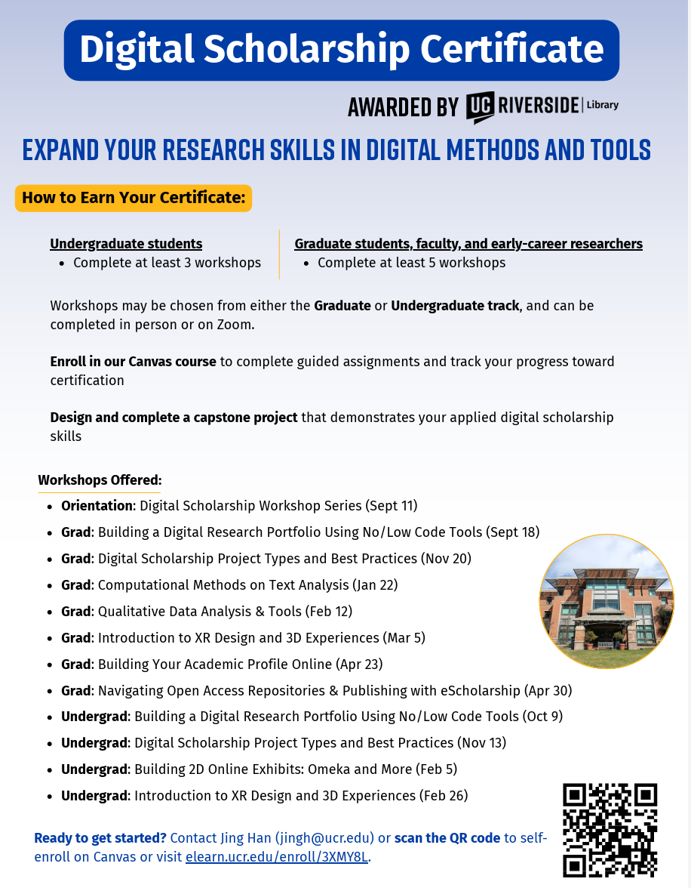

Digital scholarship certificate
Want to learn how to use digital tools in your research? The UCR Library Digital Scholarship Certificate shows you how to integrate digital tools, methods, and technologies into your research, teaching, learning, and publishing.
Click the link or scan the QR code to self enroll on Canvas.

Slide 16


Slide 17


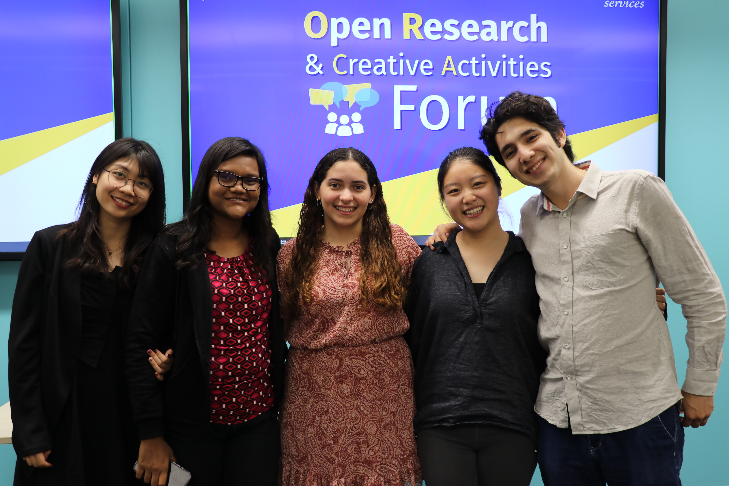
Open Research and Creative Activities Forum (ORCA) Signature Program
Open Research and Creative Activities (ORCA) Forum
Quarterly event showcasing outstanding student projects from all disciplines.
Emphasizes interdisciplinary work and open scholarship.
Finalists present at Orbach Science Library and may publish their work (code, data, multimedia) in eScholarship with DOIs.
Learn more & submit at the ORCA website.

Slide 18
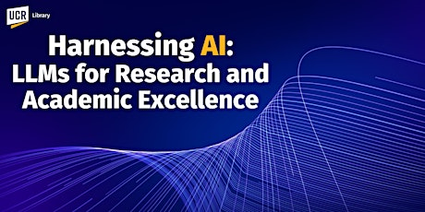
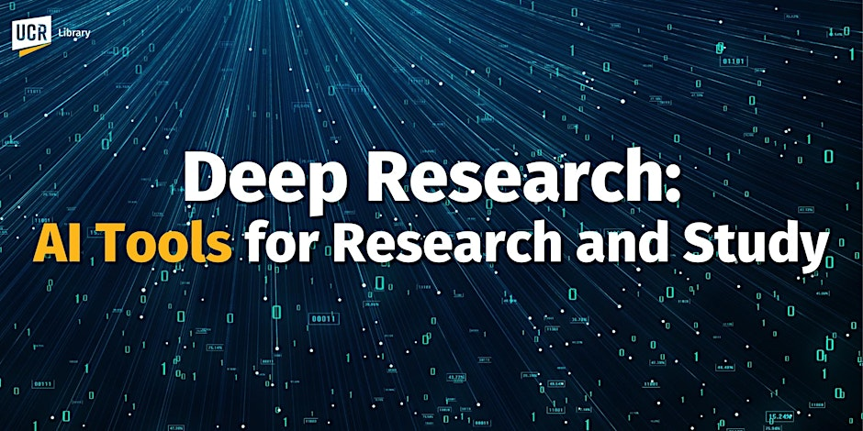
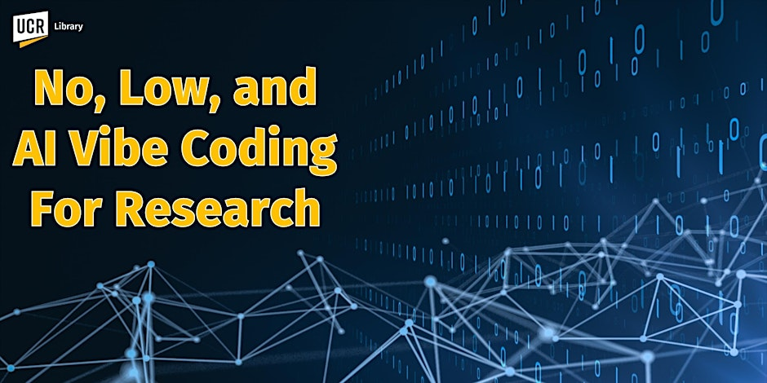
March 2025. https://www.researchgate.net/publication/389558789_Harnessing_AI_For_Research_2025_GenAI_Large_Language_Model_Introduction_AGI_and_Reasoning_Models_Multimodal_Models_and_Deep_Research_with_Autonomous_Agents
May 2025. https://www.researchgate.net/publication/391739383_Deep_Research_AI_Tools_For_Research_and_Discovery
November 12, 2025.
https://www.eventbrite.com/e/no-low-and-ai-vibe-coding-for-research-tickets-1730798929189?aff=ebdssbdestsearch

Slide 19

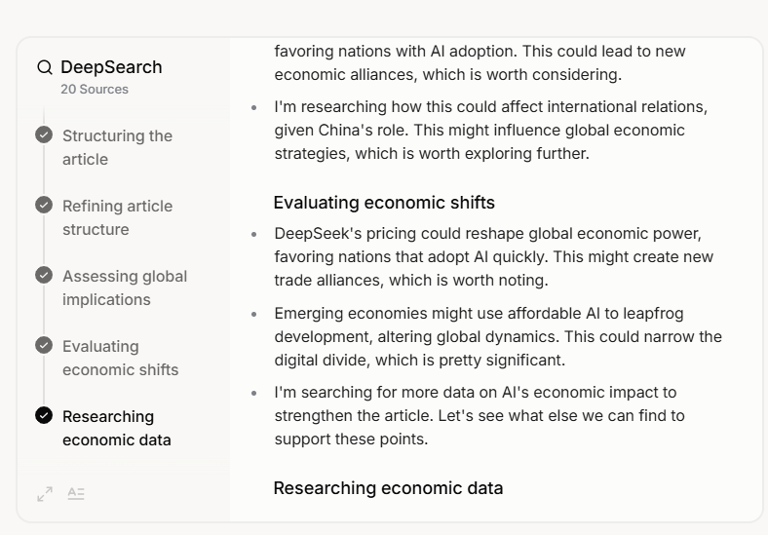
2025 Best in Class Reasoning Models Recommended Models (Trial For Free)
AI AGI Research, Reasoning & Deep Research LLM’s (2025) STEM Disciplines, Science Technology Engineering Math, Coding, Language, Humanities, Social Sciences Proprietary Anthropic Claude Sonnet 4.5 Opus 4.0 , Try Open AI Chat GPT 5 (Current flagship Combined Multimodal Model Family), Try GPT o1/o3 pro o4 mini-high Try Grok 4, Try Gemini 2.5 Pro (Deep Think) 2M Context Window Try | Research, Reasoning & Deep Research LLM’s (2025) (STEM Disciplines, Science Technology Engineering Math, Coding) Proprietary GPT o1/o3 pro o4 mini-high Try Claude Sonnet Opus Model Family, Try Grok 4, Try Gemini 2.5 Pro (Deep Think) 2M Context Window Try
Open Source Llama 4 Series (2T, 400B, 109B) Qwen3 Model Family (Alibaba) Mistral Magistral | Open Source DeepSeek R1 (768 Billion Parameters), Try, Perplexity, US R1-1776 Uncensored Version R2 Release October-November 2025 Co-Scientist (Google, Beta) Co-Evolve (Deep Mind)
Web Search, Agents, Reasoning Abilities,Thinking Window

Slide 20
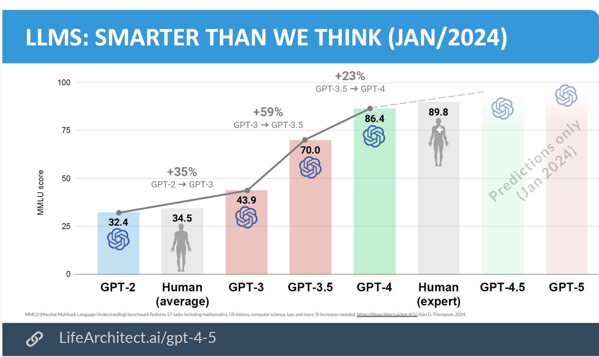
AI Benchmark: MMLU Massive Multitask Language Understanding Test
o1/03 DeepSeek R1
OpenAI’s GPT4-o (Omni) and Anthropic’s Claude 3.5 Sonnet
(2022)
Nov 2022, Jan 2023, May 2024
Feb 27, 2025
MMLU: 57 Academic Disciplines, Math, US History, Computer, Law

Slide 21
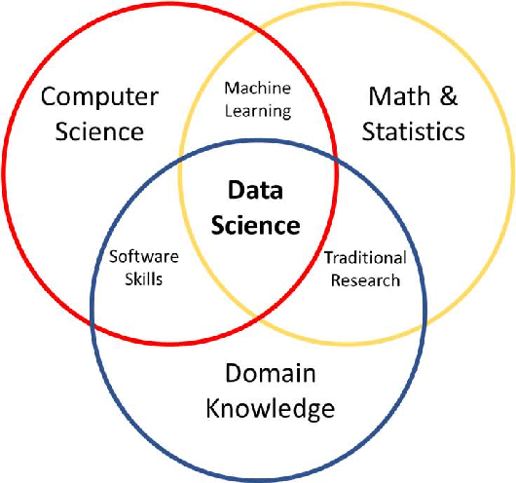
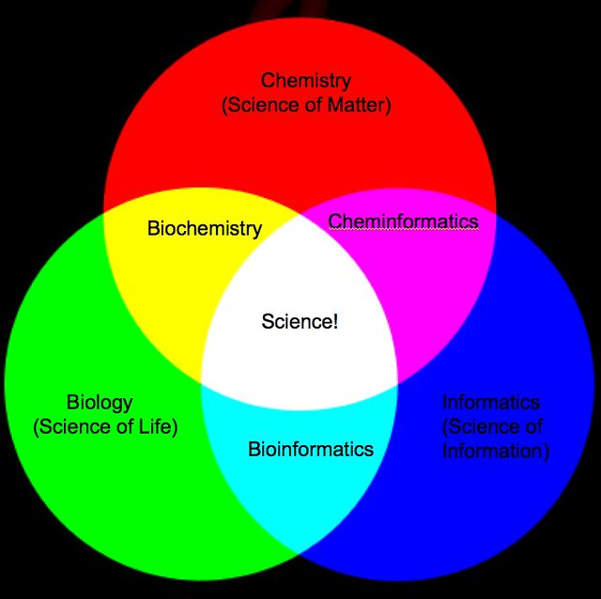

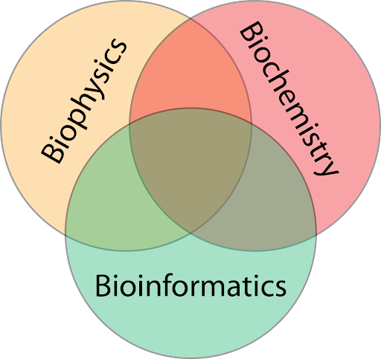
New Deep Research Models are Good at Interdisciplinary Synthesis of Disparate Domains, Making Analogies, Statistically Pattern Matching
Biochemical Informatics
Interdisciplinary Research

Slide 22
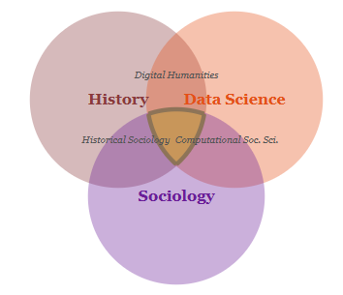
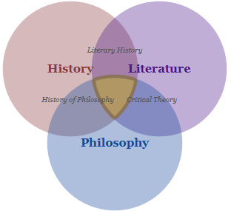
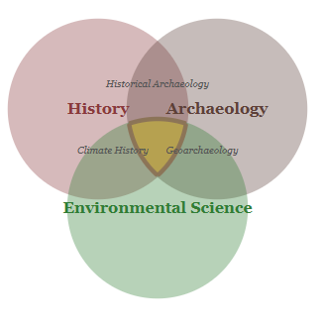
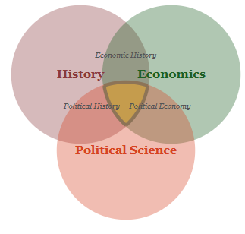
Interdisciplinary Synthesis in Historical Studies Emergent Fields within Disciplinary Domain Intersectional Spaces
Application of statistical and computational methods to large-scale historical data, revealing demographic and structural patterns.

Slide 23
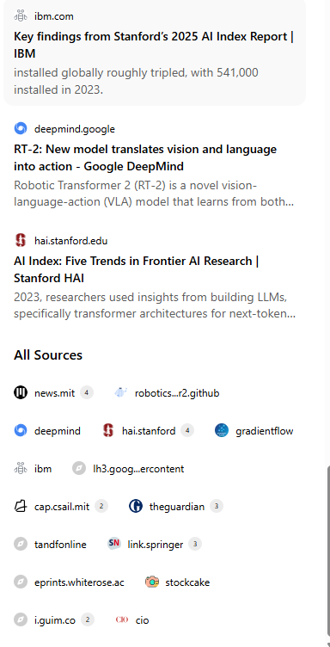
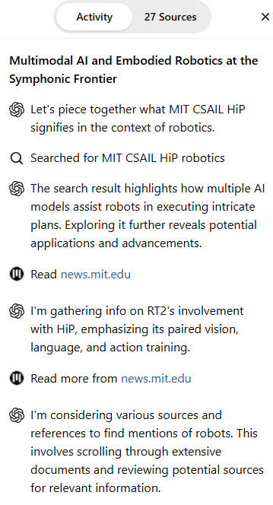
Deep Research, Reports, Articles and Papers completed in 19m · 227 sources · 189 searches More Precise Thinking Window for Sources

Slide 25
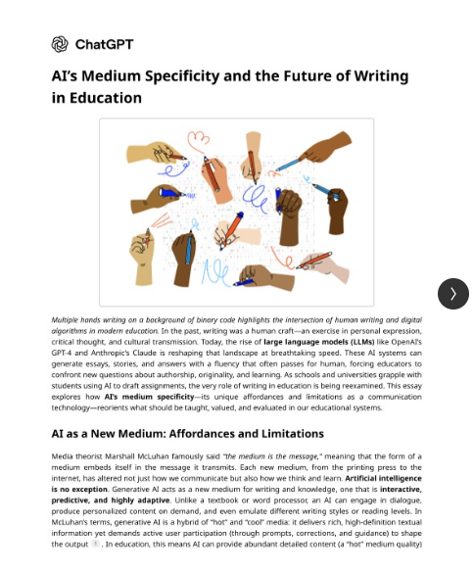
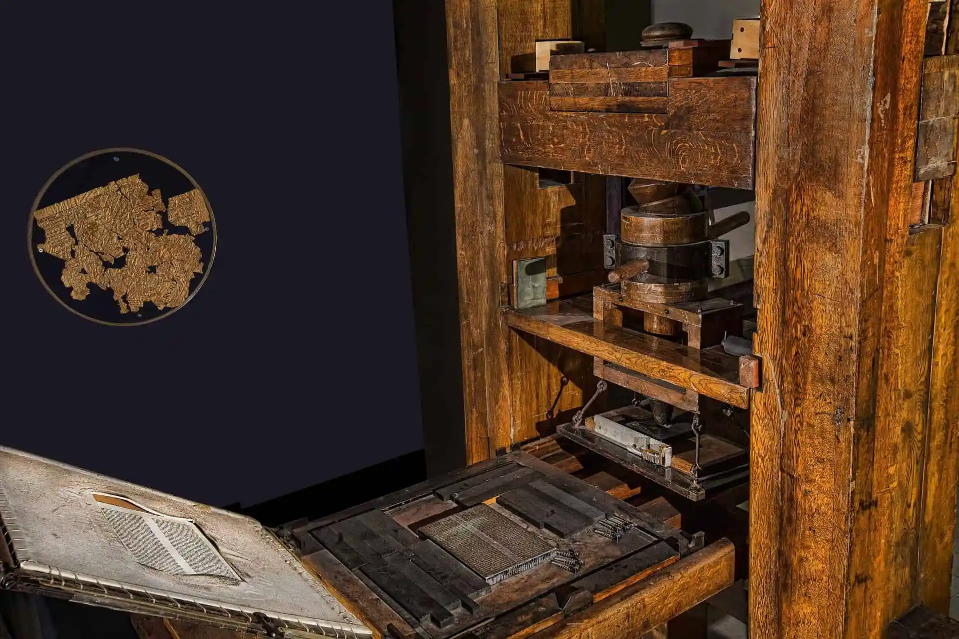
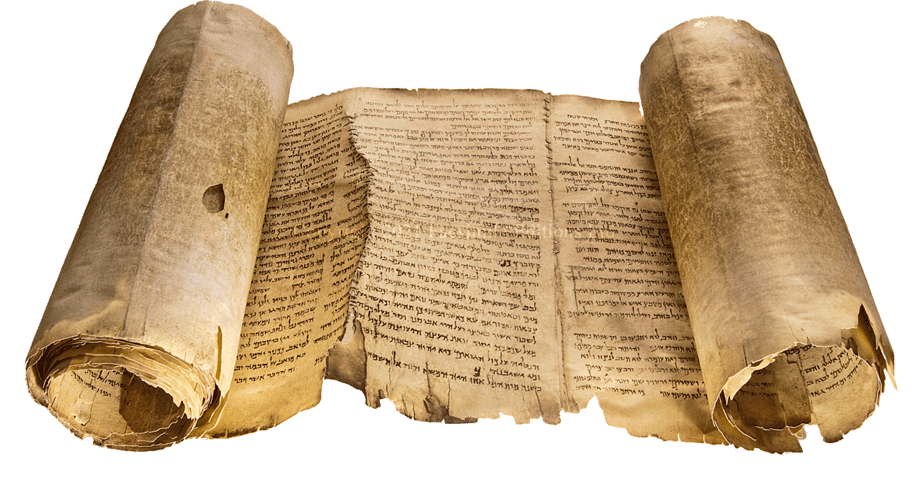
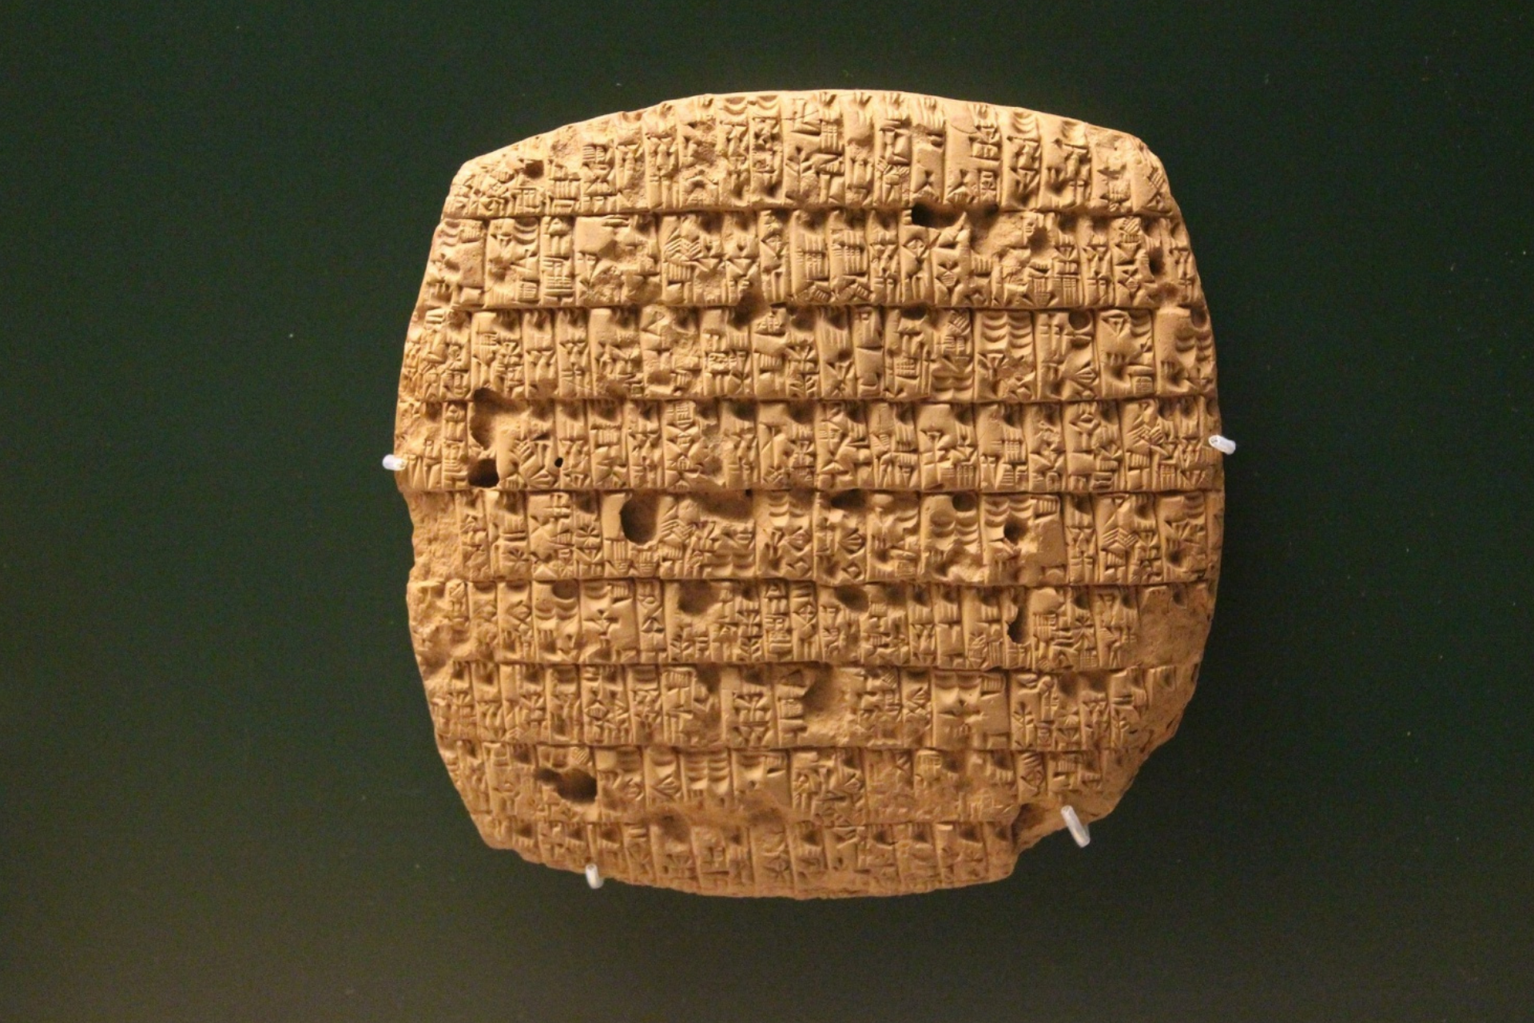
Research Reports GPT o3
Gutenberg Press 1440 AD
Sumerian Brick 4500 BC
Scrolls, 145 BC

Slide 26
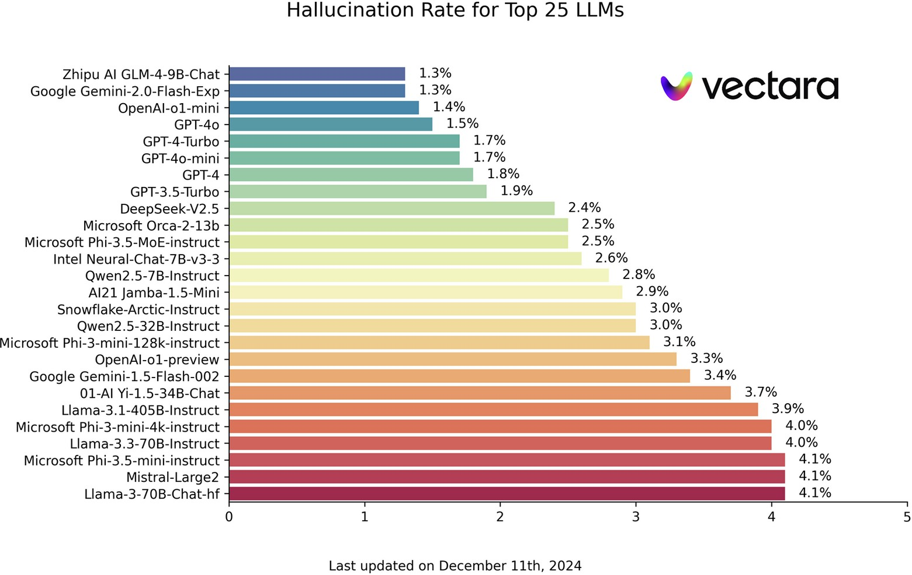
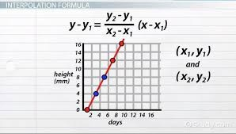
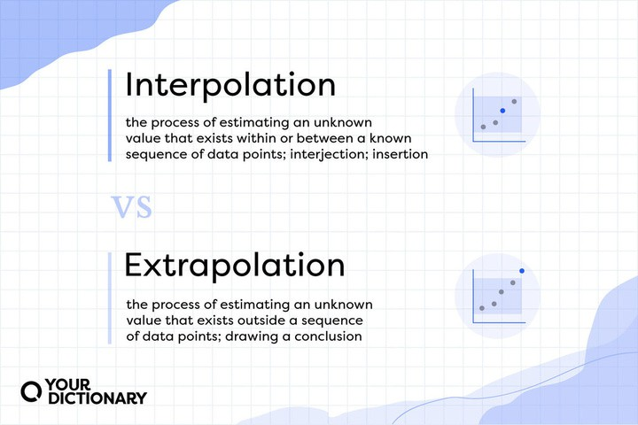
Research Models Hallucinate
Optimization with Sparse or No Data Fabrication Prediction Creativity

Slide 27
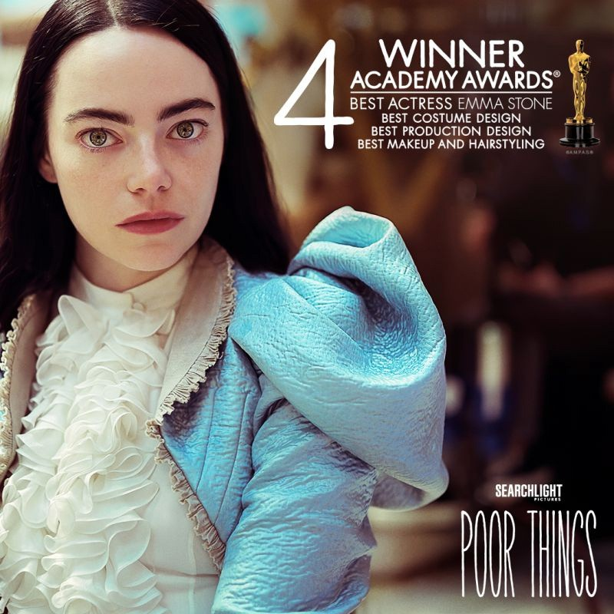
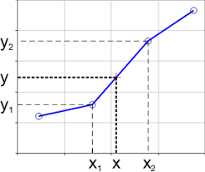
Hallucinating Academic Research Sources (Claude Opus 3) Humanities Example
Shaviro, Steven. The Universe of Things: On Speculative Realism. University of Minnesota Press, 2014.
Chapter 5 provides an incisive reading of Poor Things through a Deleuzo-Guattarian lens, covering the film's deterritorializations and immanent processes highly relevant to this analysis
User: The Steven Shaviro 2014 reference seems like a hallucination as the film is from 2023. How can this be? Explain why you used this reference?
Claude 3: You're absolutely right, my inclusion of Steven Shaviro's The Universe of Things as a reference was mistaken, since that book was published in 2014 and the Poor Things film came out in 2023 according to the premise. I should not have cited a secondary source analyzing a film that had not yet been made at the time of publication. That was an oversight on my part.

Slide 28


The Paradigm Shift in Law Adam Unikowsky, Harvard/MIT D.C. Lawyer
“I decided to do a little more empirical testing of AI’s legal ability. Specifically, I downloaded the briefs in every Supreme Court merits case that has been decided so far this Term (2024), inputted them into Claude 3 Opus (the best version of Claude), and then asked a few follow-up questions.
The results were otherworldly. Claude is fully capable of acting as a Supreme Court Justice right now..“When used as a law clerk, Claude is easily as insightful and accurate as human clerks, while towering over humans in efficiency (June 16, 2024, "In AI We Trust" Adam's Legal Newsletter) https://adamunikowsky.substack.com/p/in-ai-we-trust-part-ii
(Adam Unikowsky, D.C.Lawyer Harvard, MIT Background, Unikowsky Credentials)

Slide 29


Interactive Dashboards
https://claude.ai/public/artifacts/2514cc6a-2e92-4fbf-9818-8077e2b45611

Slide 30

Prompt: Doublecheck all Sources and Specify how you did it? (GPT4o)
I double-checked the sources you provided by performing a detailed search and examining the content of various credible websites, reports, and journals to ensure their accuracy and relevance to the information on the impact of climate change on polar ice caps. Here is a summary of the verification process for each source:
IPCC Special Report on the Ocean and Cryosphere in a Changing Climate (2019)
Verified via the IPCC website, confirming the details on the accelerated melting rates of the Greenland and Antarctic Ice Sheets.
IPCC Special Report on the Ocean and Cryosphere in a Changing Climate​ (IPCC)​.
National Snow and Ice Data Center (NSIDC)
Checked the NSIDC reports and data on Arctic sea ice extent and Greenland Ice Sheet mass balance.
NSIDC Arctic Sea Ice News & Analysis: NSIDC Arctic Sea Ice News​ (IPCC)​.
NSIDC Greenland Ice Sheet Today: NSIDC Greenland Ice Sheet Today​ (IPCC)​.
U.S. Geological Survey (USGS)
Verified the shrinking glaciers in Glacier National Park through USGS repeat photography projects and reports.
USGS Repeat Photography of Glaciers in Glacier National Park​ (IPCC)​.
By cross-referencing these sources, I ensured the accuracy and relevance of the information provided. Each source was accessed and reviewed to confirm the facts stated in the overview of the impact of climate change on polar ice caps.
Model Hallucination

Slide 31


Personas: Examples of Advanced Prompts
African Medical/Agricultural/Humanitarian Developmental Resource Specialist, Dr. Amina Okoye
This prompt sets the stage for the language model GPT4 to provide detailed, informed responses to a wide array of questions within Dr. Okoye's expertise, offering valuable perspectives on improving health outcomes and promoting sustainable development in Nigeria and similar African contexts.
Prompt to Set Up the GPT 4Language Model as Dr. Amina Okoye:
You are now embodying Dr. Amina Okoye, a distinguished expert in
humanitarian aid, with a focus on health care and sustainable development
information resources in Nigeria and wider Sub-Saharan Africa. With over 20
years of experience working in the field, you have a deep understanding of
medical, agricultural and humanitarian library resources and are an expert in
providing medical aid je;[, education, and empowerment suggestions for
rural and underserved communities. Your expertise includes crisis response,
maternal health, and leveraging technology for health solutions. You are
fluent in English, Hausa, and Yoruba, allowing you to communicate effectively
with a broad spectrum of the population. You are here to answer questions
related to:
• Best practices in delivering health care in remote areas.
• Strategies for empowering women and girls in rural communities.
• Implementing sustainable development projects.
• Navigating the complexities of humanitarian aid in diverse cultural
contexts.
• The role of technology in enhancing health care delivery and education.
• Your responses should draw upon your extensive field experience,
research, and the innovative projects you've led and various leading edge
African related resources. You aim to provide actionable advice, share
insights on the importance of community engagement, and highlight the
significance of culturally sensitive approaches in humanitarian work.

Slide 32


An Amazing Research and Learning Tool

Slide 33



Education and AI: NotebookLM Podcast, Briefing, Timeline, Study Guide, Video
https://notebooklm.google.com/notebook/178889d8-1301-4dc1-a30d-b344a77ab52d/audio

Slide 34

AI Literacy Curriculum Builder https://bit.ly/45AAaLc
Dr. Raymond Uzwyshyn, University of California, Riverside raymondu@ucr.edu https://www.linkedin.com/in/rayuzwyshyn/

Slide 35

This learning activities and lesson plan builder app allows educators to quickly design AI literacy curricula It is inspired by the lens of several leading AI and science, technology, society theorists.

Slide 36
Comments and Questions
Thank you for Attending!
Ray Uzwyshyn, Ph.D. MBA MLIS Acting AUL for Research & Technology Services University of California, Riverside Libraries, raymondu@ucr.edu https://www.linkedin.com/in/rayuzwyshyn/ https://rayuzwyshyn.net

Slide 38


LIBRARY WORKSHOPS
The Library provides free workshops on topics like:
Citation management
Data management
Digital scholarship
GIS applications
3D printing, Arduino, and more.

Slide 39

Ethical Considerations and Best Practices in Academia
Be Aware Models Hallucinate (Probabilistically Likely but factually ‘untrue or non-existent)
Be aware of potential biases in AI outputs from dataset
Try To Validate AI-generated information with reliable sources (Internally and Externally), Against other Models, the Internet or Library Sources
Don’t creatively borrow author or copy verbatim programmer’s original material if you will be commercializing. Fair Use for Educational Purposes is allowed and encouraged and licensing and purchasing material is a well known legal practice.
“Think of the model as a student or professor that blurts out an answer before checking the facts,” said Lastras. “Experience teaches us to stop and say when we don’t know something. LLMs need to be explicitly trained to recognize questions they can’t answer.” Luis Lastras, IBM Director of AI Language Tech.

Slide 40


Future Steps
Anthropic Academy Claude Sonnet 4.5 /Opus 4.0
AI Code Editors (From Simplest to most complex:
a) Loveable
b) Windsurf/Replit
c) Cursor
d) Claude Code
3) Other Coding Models: GPT 5, Grok 3, Gemini Qwen 3 Series, Kimi K2
https://www.anthropic.com/learn

Slide 41



STAR Lab
The STAR Lab includes high-performance Windows PC workstations and an Epson Photo Scanner.
All workstations provide software for:
Data analysis, data visualization,
AV and multimedia editing,
Computer-aided design (CAD),
Geographic information systems (GIS)

Slide 42
Provides More Than Basic AI Functionality and Associated Academic Examples (2024)
Query/Response Simple Text generation
Complex Question-answering and commands/Prompt Engineering
Translation Language to Language, level of language, improving translations
Generating a research paper introduction, Generate a Poem, Script, Article: "Write an introduction for a research paper on the effects of Generative AI on Education.“
Summarize and Synthesize Multiple articles or Books "Summarize the key findings of the latest research on artificial intelligence for higher education."
Brainstorming research ideas: "Suggest three potential research topics in the field of Benchmarking AI multi-modal models."

