Slide 1
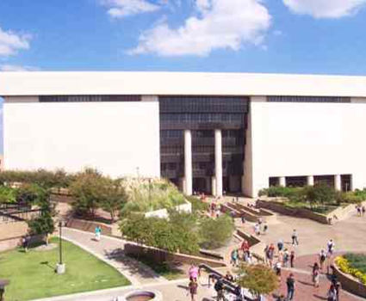
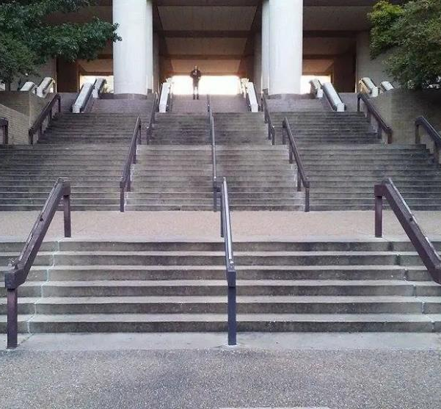
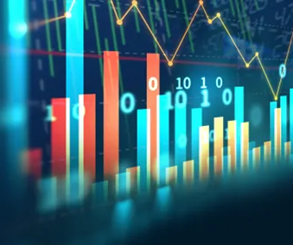
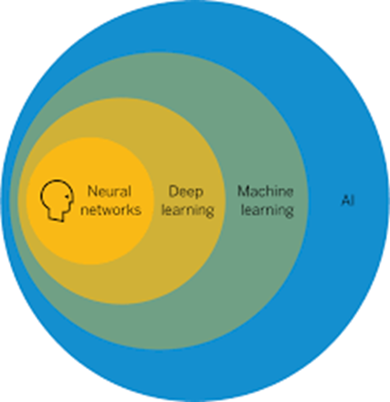
Steps Towards Building
Library AI Infrastructures and Programs
(Research Data Repositories, Scholarly Research Ecosystems and AI Scaffolding)
Presented for New Horizons in AI for Libraries
IFLA Satellite Conference, Galway, Ireland
National University of Ireland, July 21, 2022
Ray Uzwyshyn, Ph.D. MBA MLIS
Director, Collections and Digital Services
Texas State University Libraries, USA
July 2022, ruzwyshyn@txstate.edu

Slide 2
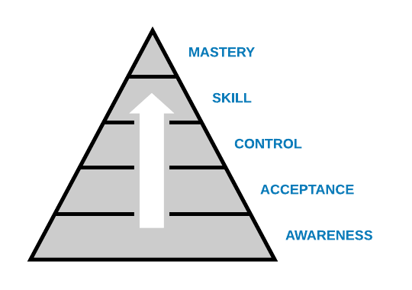
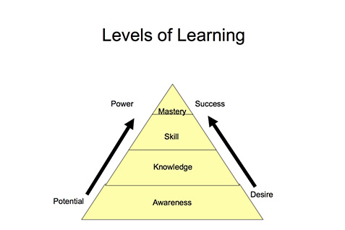
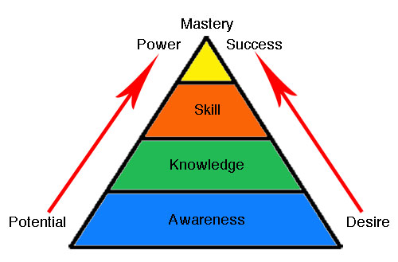
Laddered Processes Towards Building
Library AI Awareness & Competencies
Awareness, Building Skills, Knowledge, Mastery
Multi-Year Process 2014-2022

Slide 3
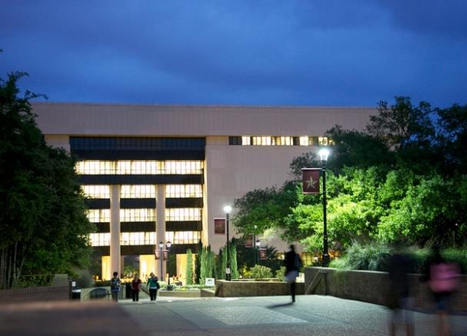
Texas State University Libraries
Large Academic Library system, ARL Library
Main campus Library and other offsite libraries (Health Professions, Austin/Roundrock)
Texas State University, Undergraduate, Graduate and Doctoral Institution 40,000 Students
Texas State Libraries,
Academic Research Library
ARL Library

Slide 4
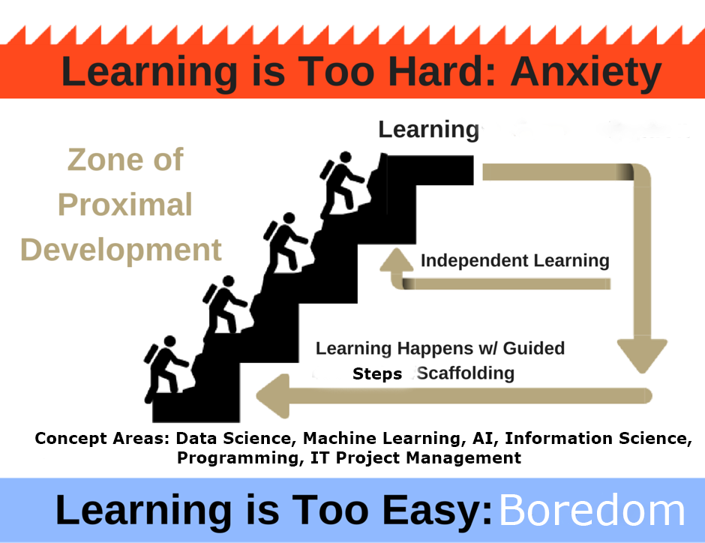

Steps and Scaffolding Towards Building
Library AI Infrastructures

Slide 5
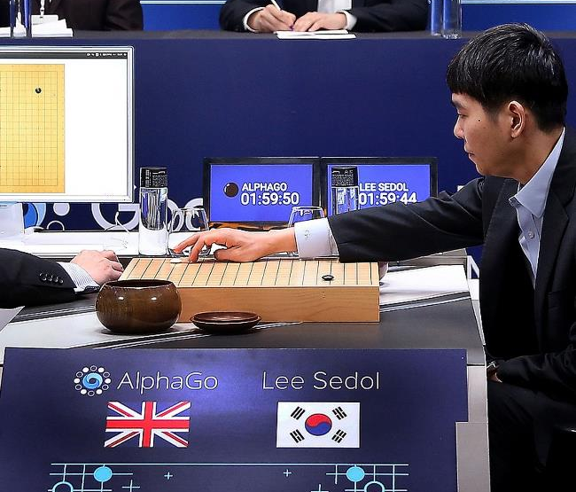
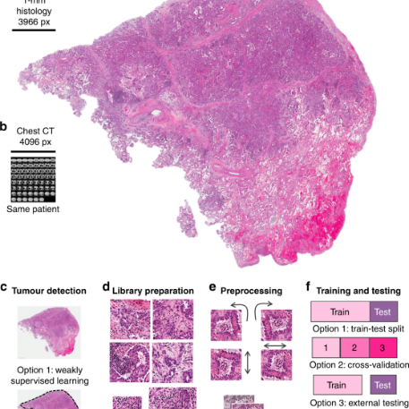
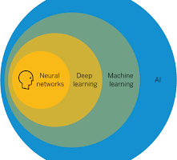
Last Ten Years Has Shown Incredible Progress of AI
AI (Machine Learning (Deep Learning)) =
Better Algorithms + Greater Computing Power + Large Data Sets
Natural Language Processing
(Speech to Text, Translation)
Fraud Detection
& Cybersecurity
Coversational Chatbots
& Robotic Agents
Strategic Reasoning (AlphaGo)
Computer Vision
(Facial + Object Recognition
Cancer Cell Detection) )

Slide 6
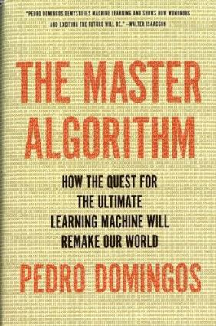
AI Has Many Paradigms and Origins
Algorithms, Suitable Problem and Solution Methods,
Dr. Pedro Domingos, University of Washington
AI Paradigm | Origin | Algorithm | Problem | Solution
Deep Learning Machine Learning | Neuroscience (Neural Nets) | Back Propagation Neural Nets | Complex Tasks, Hidden Patterns | Back propagation
Symbolic AI | Logic, Philosophy | Inverse Deduction | Knowledge Composition | Inverse Deduction
Bayesian Inference | Statistics, Probability Theory | Probabilistic Inference | Uncertainty | Probabilistic Inference
Evolutionary Computation | Evolutionary Biology (Complexity Theory | Genetic Algorithms | Structure Discovery | Genetic Programming
Reasoning by Analogy | Psychology | Kernel Machines (Support Vector Machines) | Similarity | Kernel Machines

Slide 7
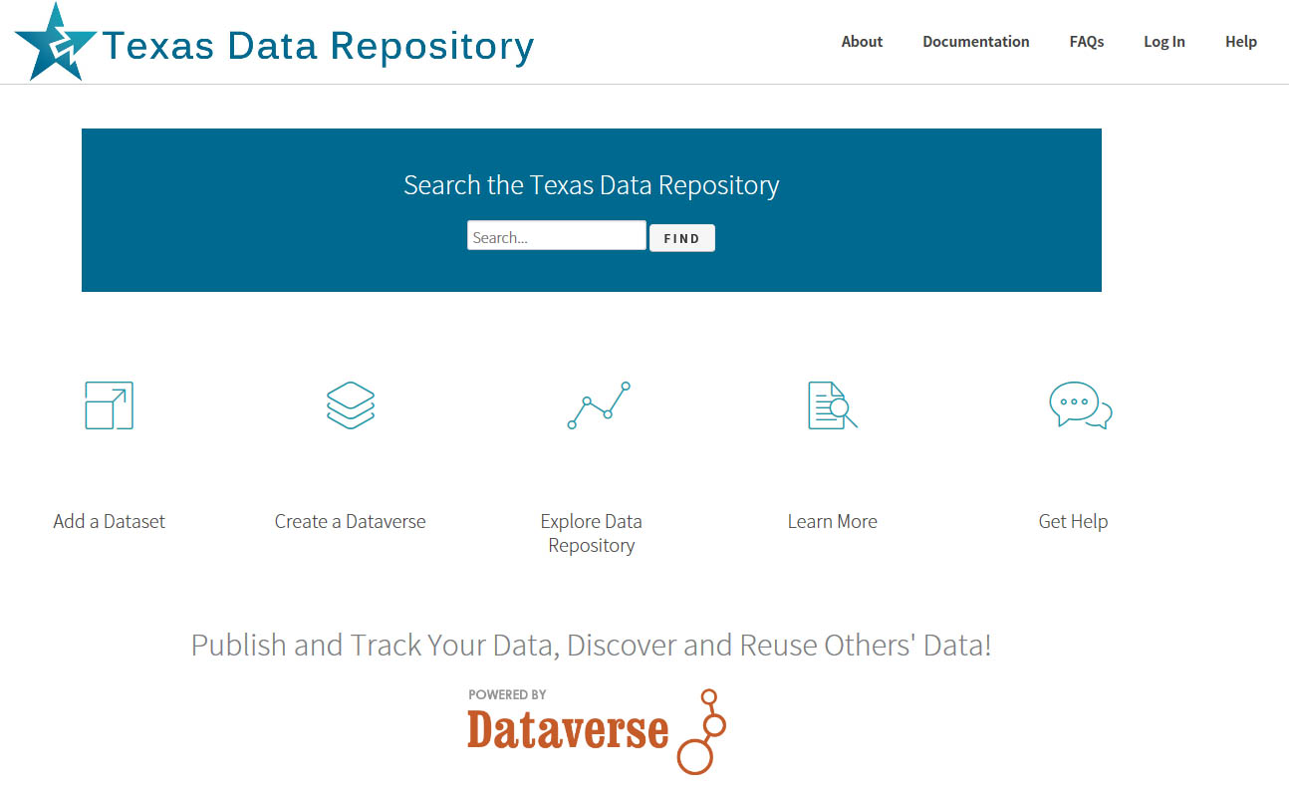
Recommendation #1: Begin with an Academic Data Research Repository
http://data.tdl.org

Slide 8

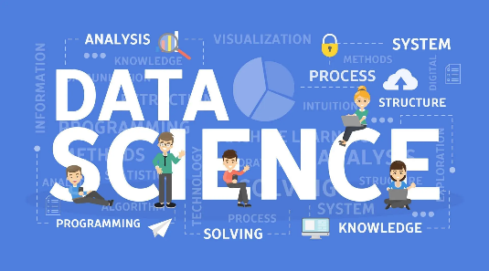
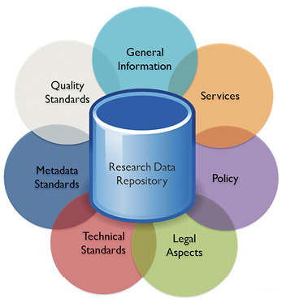
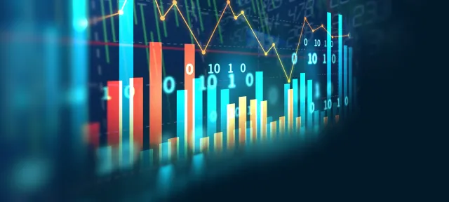
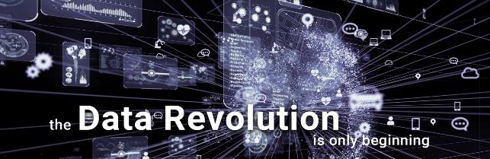
Clear Trajectory in Libraries from
Data Collection
To Data Science -> Data Repositories ->
Data Analytics ->
Data Visualization >
AI

Slide 9
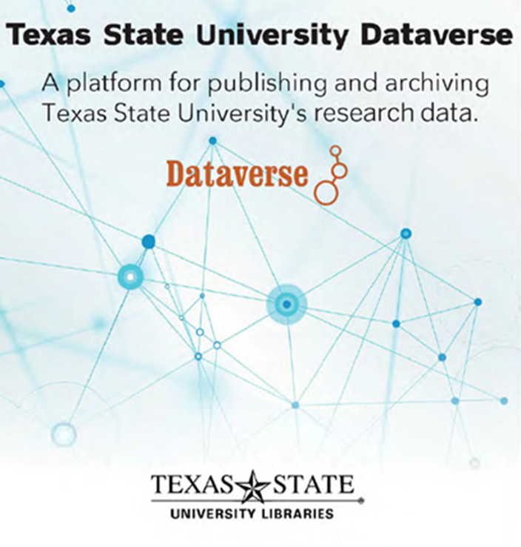

What is an Online Data Research Repository?
A Platform to Manage a Researcher’s and Institutions Data/Metadata
Permalinking Strategy for Data Citation
Way to Manage Large Grant Compliance
Data Archiving and Sharing Strategy

Slide 10
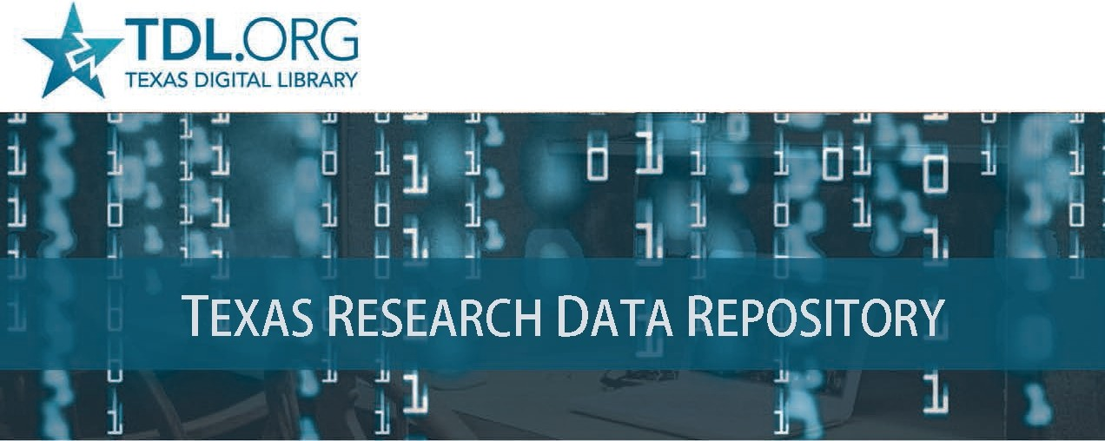
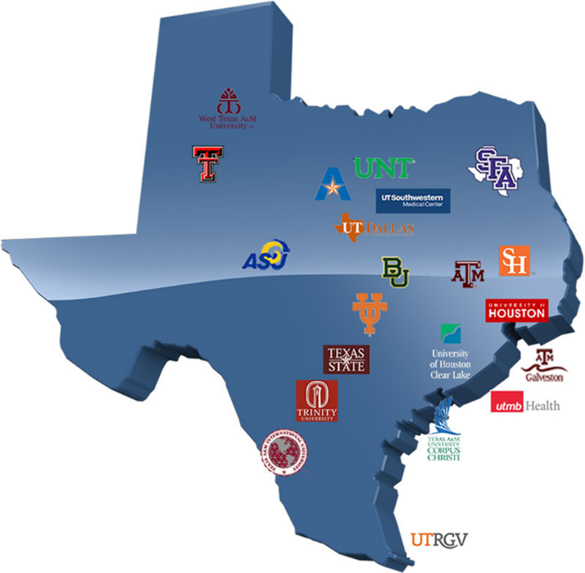
Texas Digital Library Consortium of 22 universities across Texas
leveraging technological cooperation among academic libraries

Slide 11
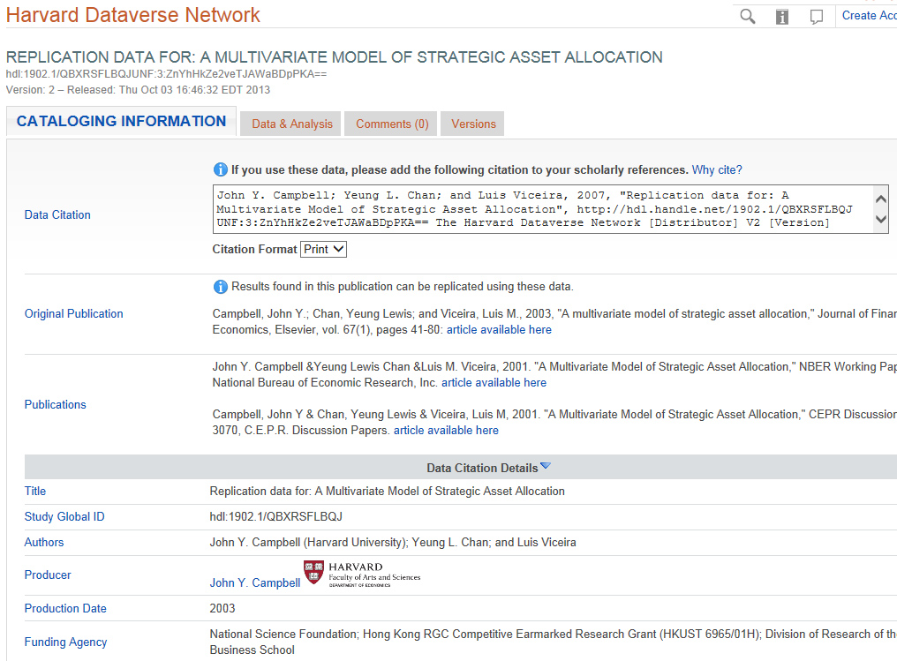

Data Repositories Allow Building Skills For AI
Data Organization, Data Cleaning, Structured Data Citation, Sensitive Data and Metadata Schemas
OpenRefine is a powerful tool for working with data: (cleaning it)

Slide 12
The Research Data Repository Lifecycle
Setting Better Foundations & Organization for AI Infrastructures
Data Repository
provides
Basic AI, Machine
Learning, Open Science
and Research Needs.

Slide 13
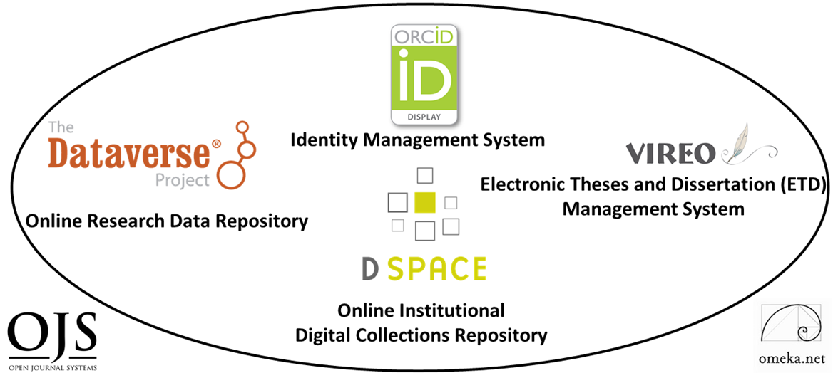
Recommendation #2: Digital Scholarship Ecosystems, Foundations for AI
Six Open Source Software Components
TWO PRIMARY COMPONENTS
DIGITAL COLLECTIONS REPOSITORY
FOUR TERTIARY COMPONENTS
(Communication)
Electronic Thesis and Dissertation Management System
User Interface/Content Management Software
Identity Management System
Open Academic Journal Software
RESEARCH DATA REPOSITORY
(Content)

Slide 14
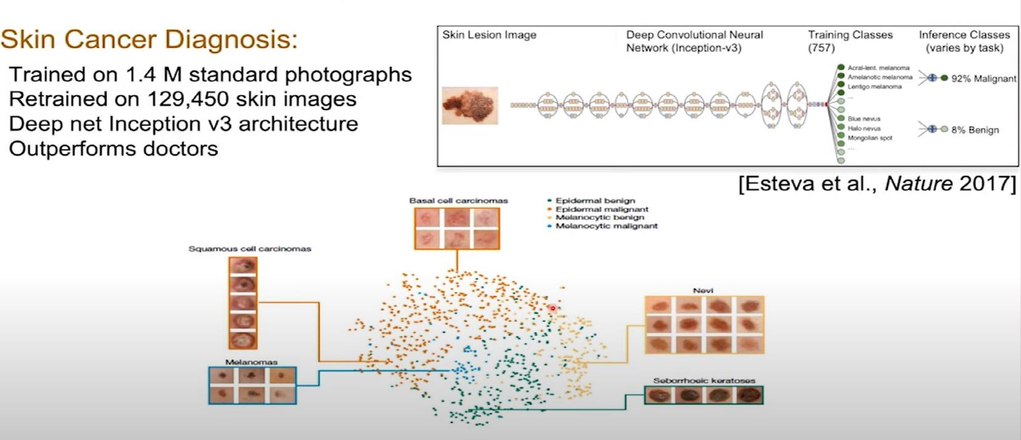
Open Science, Data Research Repositories, Discovery and AI
Dermatologist-level Classification of Skin Cancer with Deep Neural Networks,
Nature 2017,Andre Esteva, Brett Kupress, Sebastian Thrun et al.
AI Models, Deep Learning, Convolutional Neural Nets, Labeled Medical Data from Image Data Archives
Video
Stanford
Overview

Slide 15
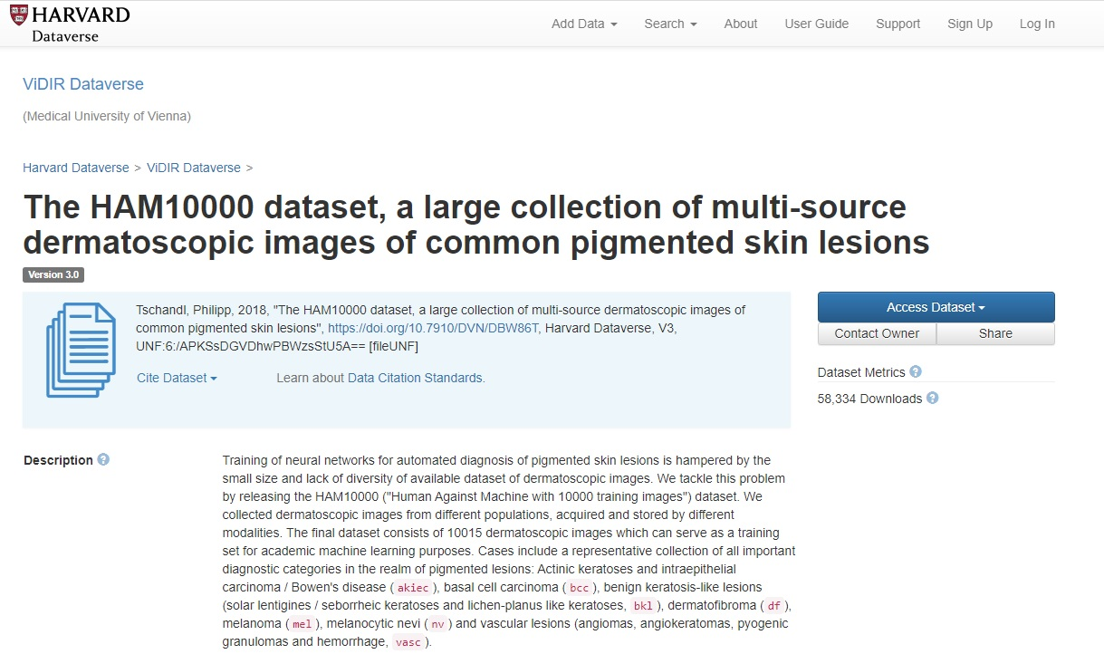
Dataverse
Data Research Repository
Dermatology Image Dataset, Dr. Philip Tschandl, Viennesse Dermatologist
Great Example of Open Science
https://dataverse.harvard.edu/dataset.xhtml?persistentId=doi:10.7910/DVN/DBW86T

Slide 16
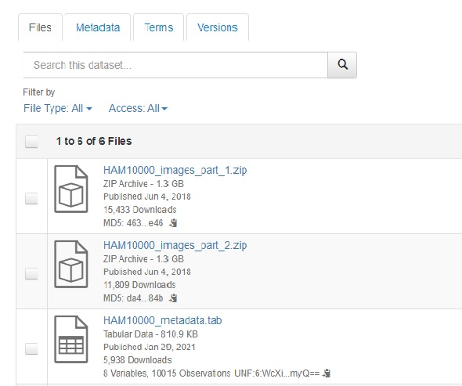
Metadata and Image Data for Download
From Data Repository

Slide 17
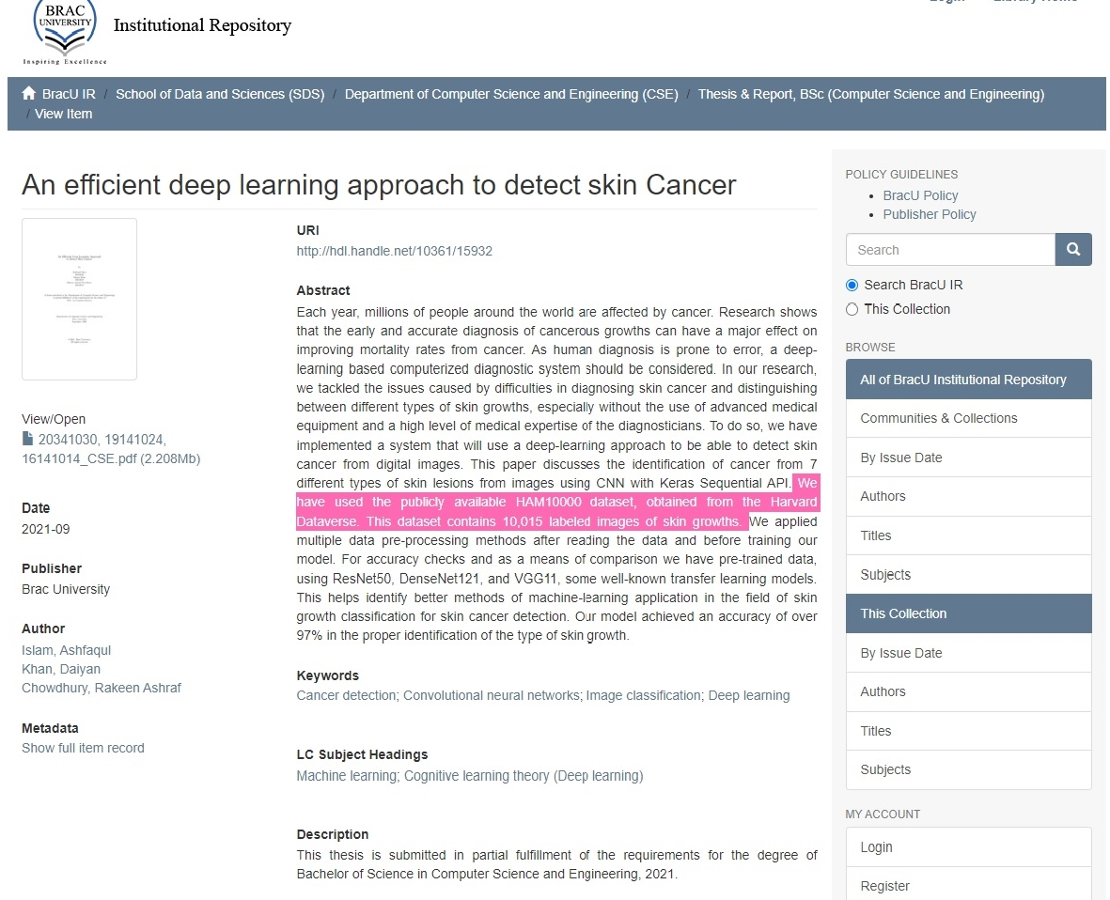
BRAC University
Dhaka, Bangladesh
Institutional Repository
Digital Collections
Repository
Dspace
http://dspace.bracu.ac.bd/

Slide 18
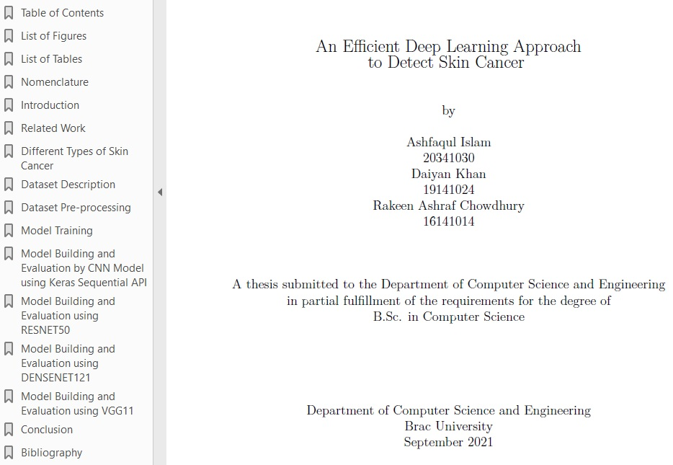
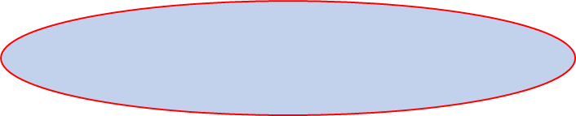
The Progress of
Knowledge
2017 Stanford
Nature Deep Learning
Cancer ID Article
2018 Harvard Dataverse
Datarepository Upload
Open Source Viennesse
Dermatalogical Image
Library
November 2021
Dspace Repository
Undergraduate Thesis
BRAC University, Dhaka
Bangladesh, Dept. of
Computer Science and
Engineering
Downloaded July 2022

Slide 19
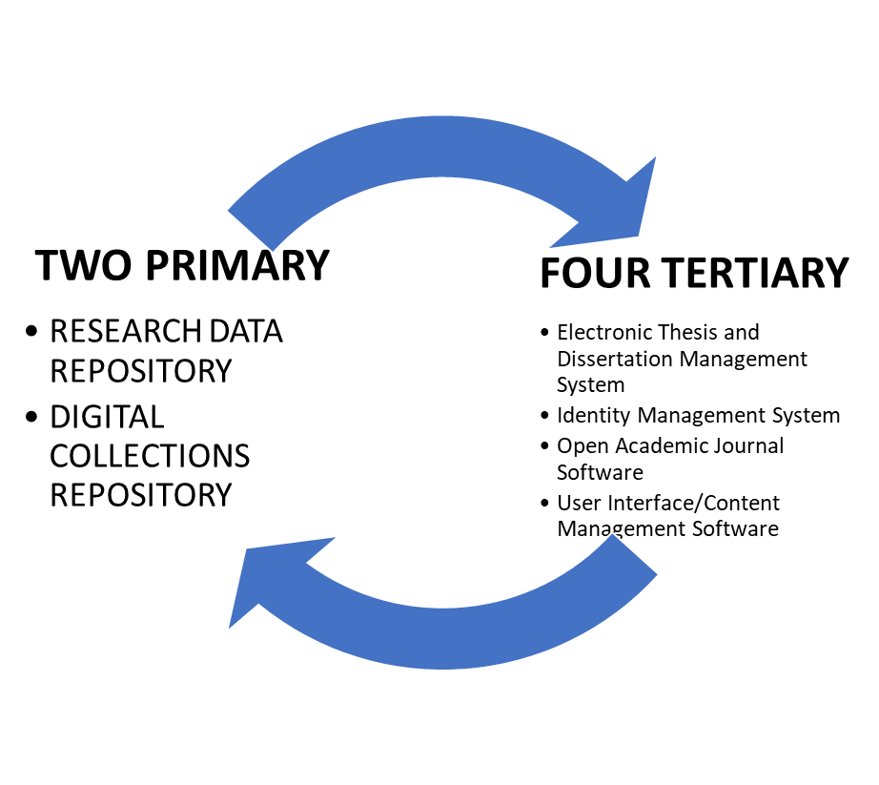
Digital Scholarship Ecosystem Centered on Research Data Repository and Collections Repository
Content
Many Useful Data Science Skills
for AI Will Be Useful Here
Metadata Schemas
Data Organization
Data Cleaning
Data Classification
Creating Dataset Benchmarks
Standardization of Data
Communication

Slide 20
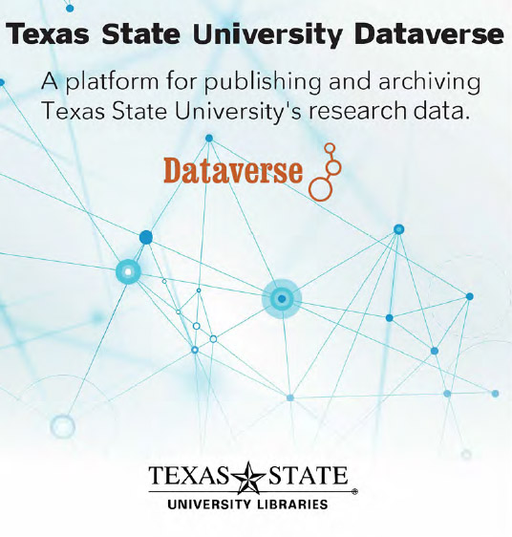
Part II: Human Resource Infrastructures
(Working Teams)
Future Hires
Machine Learning/Deep Learning/AI Specialist/ Data Scientist and/or AI Librarian (working with the data)
Data Visualization and Analytics Specialist
(Tableau, Bayesia, Power BI)
Committee for Data Repository Workflows & Policies
Onsite Staff Skills
Metadata Specialist/Cataloger
Data Repository Faculty/Student Liaison
Subject Liaisons (Outreach)
Current Staff
Digital Collections Librarian
(Texas State Data Repository Librarian
Dataverse/Publications Repository: D-Space)

Slide 21
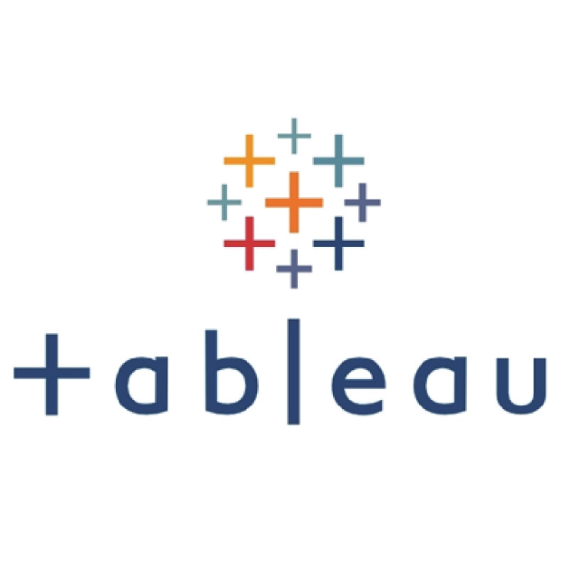
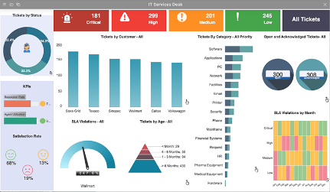
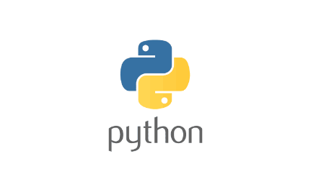
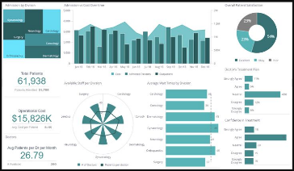
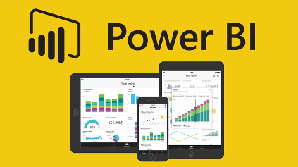
Data Visualization & Analytics Specialist
Texas State University Libraries is seeking Data Visualization & Analytics Specialist to provide library-wide support for data visualization and data analytics projects to support data-driven decision making and finding insights. This position requires a higher level of technology expertise and specialized knowledge to gather, manage, and analyze data and report complex data in easy-to-understand information visualizations.
RESPONSIBILITIES: Develop and maintain a data visualization and analytics strategy. Develop strategies to clean and normalize data for use in further analysis. Utilize data visualization strategies to report and present analytics and answer questions related to data analytics and data visualization. Pursue professional development activities to improve knowledge, skills, and abilities and perform special projects and other duties as needed.
QUALIFICATIONS:
Required: Ability to read, analyze, and understand data in a variety of formats; strong written, oral, and interpersonal skills, including ability to work effectively in a team; knowledge of data visualization applications such as PowerBI, Tableau or others; analytical skills; proficiency with Microsoft Excel; ability to utilize analytics/visualization tools in new, creative, and effective ways.
Preferred: Degree in information science, applied statistics, business analytics, computer science or another quantitative or data visualization field; experience with SQL or other query language; experience with R, Python, statistical analysis languages, predictive analytics, and/or AI software.

Slide 22
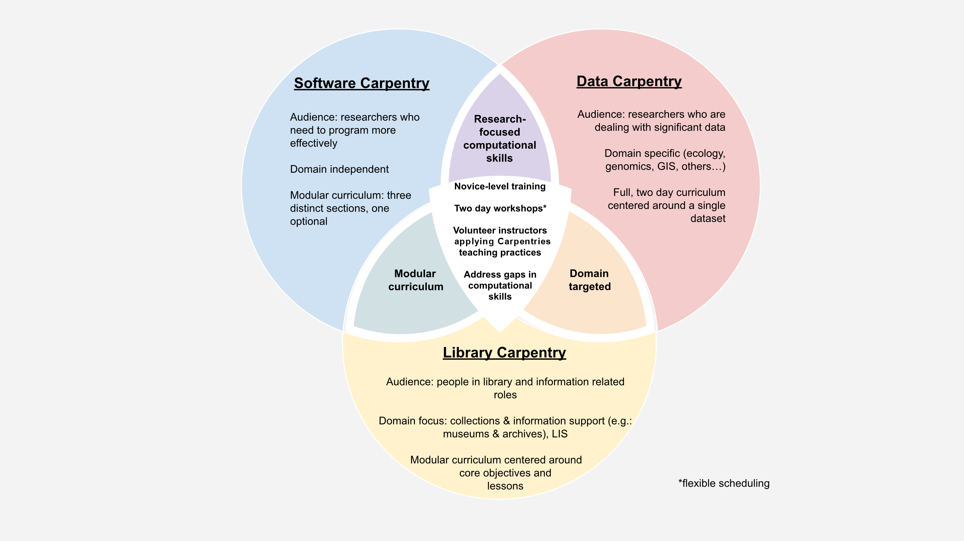

Further Learning Paths: Data to Carpentries
Foundational Coding and Data Science Skills for researchers Worldwide
Libraries Can
Host Carpentry
Workshops
https://carpentries.org/

Slide 23
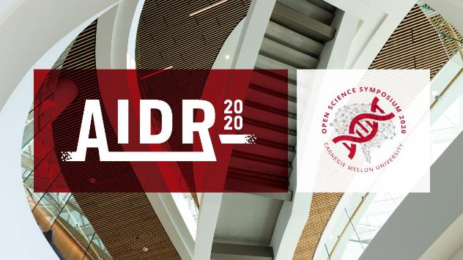
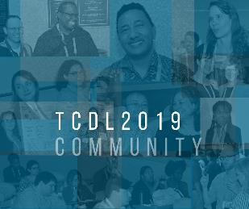
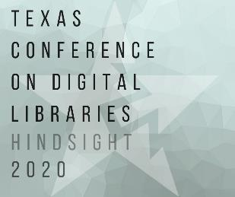
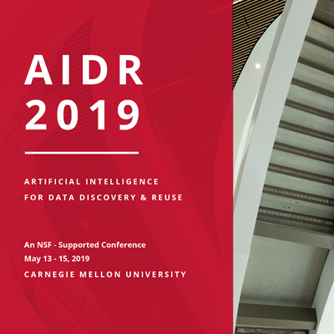
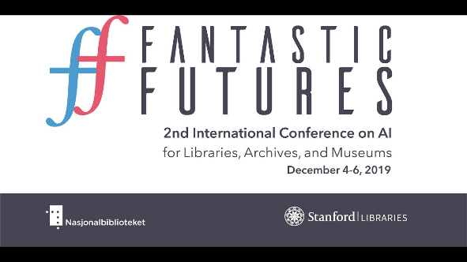
Conferences and Learning
Library IT and Digital Services May Be Getting Interested in AI
Fantastic Futures
2nd International Conference on AI
for Libraries, Archives and Museums
Stanford Libaries (2019)
Artificial Intelligence
for Data Discovery
& ReUse & Open Science
Symposium (2020), Carnegie Mellon
Texas Conference on Digital Libraries,
Patrice Andre Prud’homme (TCDL) Oklahoma State,
Computers in Libraries, Yale Art History,Pixplot (Image Categorization, CNI, C

Slide 24
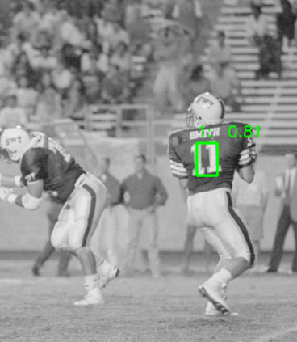
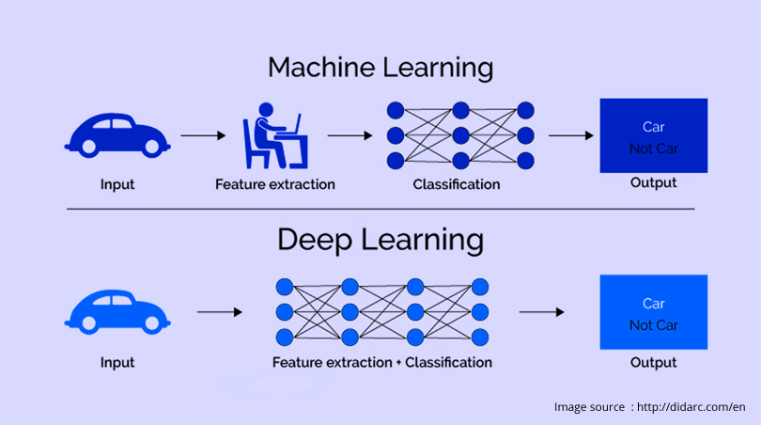
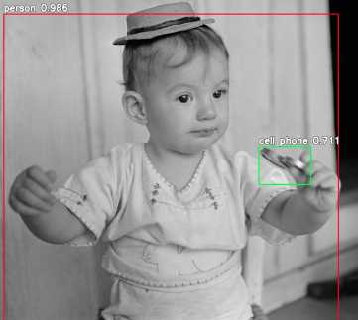
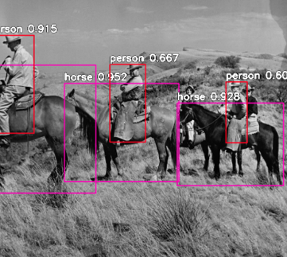
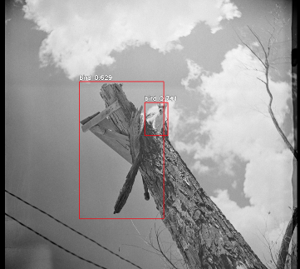
R&D & Learning, Area 1: Digital and Web Services
Deep Learning Models and Convolutional Neural Nets
University Archives
San Marcos Public
Newspaper Image Negatives
90 years of digitization 800, 000 images
Processing Power
(Compute)
Python
Video Cards
(NVIDIA GPU’s)
Pretrained Models
ResNet, YOLO, COCO
(200k labeled images, 80 categories)

Slide 25
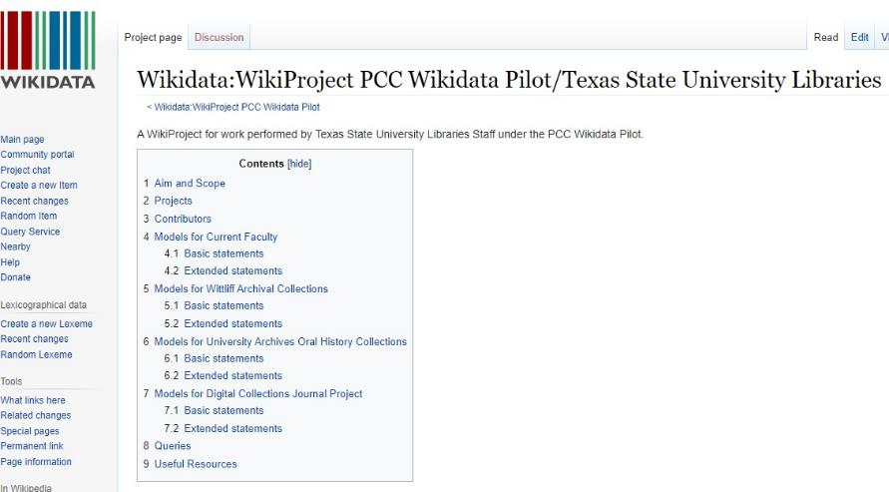
Area II: Metadata, Wikidata, Semantic Web, AI
Metadata Services Cataloger
Crosswalking between Systems
Successful Linked Data Project
Wikidata Semantic Web Project: Faculty, Oral
History Collections, Wittliff Archives, OJS Journals
(Data that is Machine Readable, ie. Google etc)
Moving from MARC Silos to Online (Wikidata)
Learning Many Data Science Skills, Data Models, Data Batch & Cleaning Tools: OpenRefine, Quickstatements,
Python (7 staff)

Slide 26
Workshops and Training IDEA Institute on Artificial Intelligence
(Recommendation Letter, July, 2022)
Week Long Fellows Program at University of Texas Austin (20 Fellows)
Onboarding, Institute,
Library Centered AI, Final Project
Networking with National Library AI Experts and Other Fellows
■ AI challenges and opportunities, Ethical considerations and guidelines
■ UX-Human/AI Interaction Lifecycle
■ Existing library, archive, and museum projects
■ AI project planning
o Project Design
o Data collection, classification, and transformation
o Roles and implementation
■ Python Basics, Python for Machine Learning
■ APIs and bibliometrics
■ AI in search and discovery
■ Machine learning and coding
■ Harvesting, evaluating, and training data sets for use in AI
■ Conversational AI – Theoretical foundations
■ Conversational AI – applications
■ Linked open data Machine learning for text with topic modeling and clustering

Slide 27
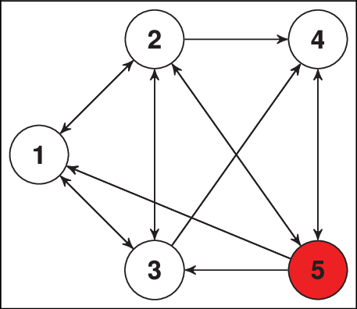
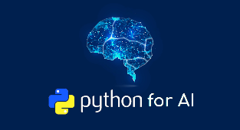

Steps Towards AI: Learning Python, Spring 2022
Carol, Library Management
System (LMS) Usage Data Insights
Hi Ray,
I wanted to let you know that we’ve started a Teams Group for myself, Carol, Alex and Amanda named “Python learners” so we could share tips and help each other on our various learning paths in an encouraging, safe space. 🙂 ---Mary
Amanda,
Collections
Budget,
Insight and
Analytics
Mary,
Metadata
AI Extraction
Todd/Jason
Image
Recognition
Neural Nets
Part II?
Alexandria
Collections Analytics, Data Visualization
Courses: Getting up to Speed with Python, Python and Machine Learning
Why Python for AI? – Artificial Intelligence with Python

Slide 28





Area III: Ocelot Chatbot Administrator
Transformation of Research and Information Outreach Services
(Reference & Subject Librarians)
University IT Adopts New Ocelot Chatbot Infrastructure
Digital and Collection Services receives New Libraries
Chatbot Administrator
Future Natural Language
Processing R&D
(GPT3-4, DeepMind Gopher)

Slide 29




Libraries are Complex Adaptive Non-Linear Dynamic Systems
Emergence, Chaos Theory Complexity, Genetic Algorithms

Slide 30

TEXAS STATE AI WORKING GROUP
(AIWG)
Technology
Purpose: An AI Working Group, information sharing, direction, responsibility and accountability for:
1) Artificial Intelligence Projects, Policy
Ethics related discussions
Membership: Metadata, Acquisitions, Digital Services, Special Collections, New Technologies, and Research Services. (9-10 Staff).
Policy
Notes:
DPWG Membership:
Technology and “system administrators”
Todd Peters
Jason Long
Erin Mazzei
Collection Managers (content specialists)
Laura Waugh IR
Nicole Critchley-University Archives
Laura Kennedy-University Archives
Lauren Goodley – Wittliff Collections
Amanda Price –General Libraries
Digital Preservation Policy for the Alkek Library at Texas State University, 2016: https://www.thewittliffcollections.txstate.edu/research/visit/policies/dig-pres-policy.html, scroll down for link to PDF. *Unanimous agreement on this policy, with membership across disciplines and departments.
Another way to think about it: DPWG initially worked on 2 legs of the stool: (1) Organizational, with the DPWG and Digital Preservation Policy, which lays out definitions, roles, and goals, and (2) Technological, with the dedicated server space for preservation and use files, and associated metadata. Also investigated, identified, and implemented Archivematica, a tool that creates Archival Information Packages, suitable for archival, long term storage.
Next steps:
Continue Organizational, by continuing to meet and make collaborative and unanimous decisions on workflows, etc. Continue relationship with TR and Windows Team.
Continue Technological, by creating these AIP packages. And, in an iterative fashion, move to the next step of storage best practices, by requesting off-site, distributed preservation storage

Slide 31


Next Steps: A Graduate Student or Two
Any University Engineering School or Computer Science Department Will Have Graduate Students and Courses Like This:
E5331 – Machine Learning for Engineering Applications (2019-2021) [Listed Fall – 2022]
EE4331 – Intro to ML for Engineering Applications (2020-2021) [Listed Fall – 2022]
Form a Relationship with the Electrical Engineering Professor and Hire His Graduate Student to Help with your team as part of their final project, graduate theses or part time Research Assistant to provide computational assistance and resources. These can be Masters Candidates or good advanced undergraduate students.

Slide 32



Future Steps: AI Postdoctoral Fellows and Permanent Library AI Positions
Postdoctoral Fellowship Program offers recent AI/Machine Learning related Ph.D. graduates the chance to develop research tools, resources, and services while exploring new career opportunities and opening Library possibilities.
https://www.clir.org/ https://www.clir.org/global/
Postdoctoral AI Fellows work with library staff, faculty and graduate students on library related projects that forge and strengthen connections among library collections, archives, special collections digital technologies, and their current AI research and skills.
https://postdoc.clir.org/ https://haira.clir.org/blog/

Slide 33



Steps and Ideas For Scaffolding Towards Library
AI Projects and Foundational Infrastructure Success

Slide 34

Questions/Comments
Ray Uzwyshyn, Ph.D. MBA MLIS
Director, Collections and Digital Services
Texas State University Libraries, USA
ruzwyshyn@txstate.edu , http://rayuzwyshyn.net
July 2022

Slide 35
References and Further Resources
Articles, Reports and Books
Bryant, R. Dortmund, A. and Lavoie, B. Social Interoperability in Research Support: Cross Campus Partnerships and the University Research Enterprise. OCLC Research Reports. 2020. https://www.oclc.org/content/dam/research/publications/2020/oclcresearch-social-interoperability-research-support-a4.pdf
Carnes, Beau. Grokking Deep Learning in Motion. Manning Publications (O’Reilly), 2019.
Cordell, R. Machine Learning and Libraries: A Report on the State of the Field. LC Labs: Library of Congress, Washington D.C. 2020.
Domingos, Pedro. The Master Algorithm: How the Quest for the Ultimate Learning Machine Will Remake Our World. New York: Basic Books, 2015.
Esteva, A, Thrun, S. et al. Dermatologist-level Classification of Skin Cancer with Deep Neural Networks. Nature, Volume 542 (February 2, 2017). pp. 115-119. doi:10.1038/nature21056
Hervieux, S. and Wheatley, A. The Rise of AI: Implications and Applications of Artificial Intelligence in Academic Libraries. ACRL 2022.
Johnson, Steven. Emergence: The Connected Lives of Ants, Brains, Cities and Software. New York: Scribner, 2001.
Kleinveldt, Lynn. Smarter high education learning environments through AI: What this means for academic libraries. Trends and Issues in Library Technology: Special Issue on AI: June 2022. pp. 12-15. https://repository.ifla.org/handle/123456789/1940
Recht, Benjamin and Hart, Moritz. 2022. Patterns, Predictions and Action: Foundations of Machine Learning (Early History). Princeton University Press. 2022.
Sanchez, Nogales, Patrana Garcia, Alicia and Cerdan Medina, Jose Carlos. Digital Transformation, Data Reuse and Heritage Collections at the National Library of Spain. Trends and Issues in Library Technology: Special Issue on AI, June 2022. pp. 16-21. https://repository.ifla.org/handle/123456789/1940
Sartorius. Understanding the Relationship Between Data Science, Artificial Intelligence and Machine Learning. 2020 https://www.sartorius.com/en/knowledge/science-snippets/data-science-vs-artificial-intelligence-vs-machine-learning-602514
Uzwyshyn, R. 2022. Online Research Data Repositories and Digital Scholarly Ecosystems: From Research Data and Datasets to Artificial Intelligence and Discovery. IFLA WLIC 2022. Dublin, Ireland. DOI: 10.13140/RG.2.2.12354.86728
---. 2022. Steps Towards Building Library AI Infrastructures: Research Data Repositories, Scholarly Research Ecosystems and AI Scaffolding. New Horizons in Artificial Intelligence in Libraries (IFLA Satellite Conference), National University of Ireland, Galway, IR. DOI: 10.13140/RG.2.2.21120.30728
---. 2020 Developing an Open-Source Digital Scholarship Ecosystem. International Conference on Education and Information Technology. St. Anne’s Oxford, United Kingdom. February 2020. Available from: https://www.researchgate.net/publication/357286044_Research_Data_Repositories_and_Global_Scholarly_Ecosystem_Possibilities.
---. 2016. Online Research Data Repositories: The What, When Why and How. Computers in Libraries. 36:3, April 2016. pp. 18-21. http://rayuzwyshyn.net/TXU2016/OnlineDataResearchRepositoriesUzwyshyn.pdf
Warren, Erica. Maximize Learning: Keeping Students in the Zone of Proximal Development. Good Sensory Learning 2021. https://goodsensorylearning.com/blogs/news/scaffolding-development

Slide 36
General AI Video Overviews/Introductions
In the Age of AI. Frontline PBS. 2021. https://www.youtube.com/watch?v=5dZ_lvDgevk
Artificial Intelligence and Algorithms: Pros and Cons. Tilman Wolff und Ranga Yogeshwar. DW 2021. Available: https://www.youtube.com/watch?v=s0dMTAQM4cw Part II, https://www.youtube.com/watch?v=-ePZ7OdY-Dw
Artificial Intelligence. Machine Learning. Neural Networks. Future Technology. Bloomberg Businessweek Canada. 2022. https://www.youtube.com/watch?v=ypVHymY715M
ColdFusion (2018). Why Deep Learning Now? (Documentary Overview). https://www.youtube.com/watch?v=b3IyDNB_ciI
Domingos, P. The Master Algorithm: Talks at Google. Nov 27, 2015, Retrieved from: https://www.youtube.com/watch?v=B8J4uefCQMc
Domingo, P. The Ultimate Software. PSW Science Talk. September 13, 2021. https://www.youtube.com/watch?v=7K9X2WiBvu
Domingos, P. Managing in the Age of AI. Miami: Transform, 2022. https://vimeo.com/694708852/9bbb077e93
Hofstadter, Douglas. Analogy as the Core of Cognition. Stanford Presidential Talk. September 10, 2009. https://www.youtube.com/watch?v=n8m7lFQ3njk
Jordan, Michael I. Machine Learning, Recommender Systems and the Future of AI. February 20, 2020. https://www.youtube.com/watch?v=EYIKy_FM9x0
Larochelle, Hugo. The Deep End of Deep Learning. TedxBox, 2017. https://www.youtube.com/watch?v=dz_jeuWx3j0
Lecun, Y. Heroes of Deep Learning: Chief AI Scientist at Facebook, 2022. https://www.deeplearning.ai/hodl-yann-lecun/
Mitchell, Tom. 2022 Where on Earth is AI Headed? Carnegie Mellon. https://www.youtube.com/watch?v=ij9vqTb8Rjc
LeCun, Yann. Is AI Just Statistics. January 22nd, 2022. https://www.youtube.com/watch?v=iug8FAl0B1U
Peters, Todd and Long, Jason. 2022. An Attempt at Metadata Enhancement through Machine Learning. Texas Conference on Digital Libraries (Zoom Video and PPT).
Perl, Judea. (2020). Causal Reasoning, Counterfactuals and the Path to Artificial General Intelligence. (Interviewed by Lex Fridman)
https://www.youtube.com/watch?v=pEBI0vF45ic
Zsolnai, Karoly. 2022. Two Minute Papers. Recent AI R&D Papers. https://www.youtube.com/c/K%C3%A1rolyZsolnai/videos

Slide 37
Machine Learning, Data Science and Python Online Courses
Dabrowski, Anna. Digital Carpentry Materials. GitHub - ajdabrowski/carpentries-instruction-materials: Materials for teaching Carpentries workshops
Carin, Lawrence. Introduction to Machine Learning. Coursera (Duke University). Free. https://www.coursera.org/learn/machine-learning-duke
Fridman, Lev. MIT Deep Learning and Artificial Intelligence Lectures. https://deeplearning.mit.edu/ 2022.
Gugger, Sylvain and Jeremy Howard. Practical Deep Learning for Coders with Fastai and Pytorch: AI Applications without a PhD. https://course.fast.ai/
Hinton, Geoff. 2016. Neural Networks for Machine Learning. (Coursera Course). https://www.youtube.com/watch?v=cbeTc-Urqak&list=PLoRl3Ht4JOcdU872GhiYWf6jwrk_SNhz9
Lateef, Zulaikha. A Comprehensive Guide to Artificial Intelligence with Python. March 29, 2022. Retrieved from: https://www.edureka.co/blog/artificial-intelligence-with-python
Machine Learning Crash Course with TensorFlow API. Google. (Free). https://developers.google.com/machine-learning/crash-course
Ng, Andrew. Deep Learning. Coursera. https://www.coursera.org/specializations/deep-learning
Severance Charles (Professor at U Michigan School of Information). Introduction to Python for Everybody. Codecamp (Free). https://www.freecodecamp.org/learn/scientific-computing-with-python/python-for-everybody/
Zhang, A, Lipton, Z., Li Mu, Smola Al. Dive into Deep Learning. https://d2l.ai/index.html
AI Library Related Conferences and Organizations.
Artificial Intelligence for Data Discovery and Reuse (2019-2022). Carnegie Mellon. https://events.library.cmu.edu/aidr2019/
The Carpentries. Foundational Coding and Data Science Skills for Researchers and Libraries Worldwide https://carpentries.org/ 2022.
CLIR Global. Council on Library and Information Resources. https://www.clir.org/global/ Postdoctoral Library AI Program: https://postdoc.clir.org/
Fantastic Futures (Stanford Based). Norway (2022). https://www.nb.no/artikler/fantastic-futures/. FY21 (France). USA Stanford https://library.stanford.edu/projects/fantastic-futures
Leonard, Peter. Neural Networks: Machine Vision for the Visual Archive. Coalition for Networked Information (CNI). 2018. https://www.cni.org/wp-content/uploads/2018/04/cni_neurel_leonard.pdf

