Slide 1
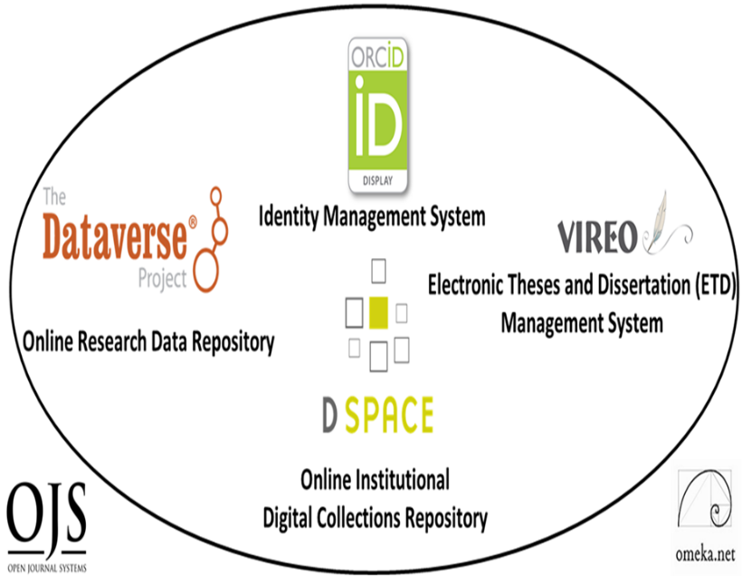
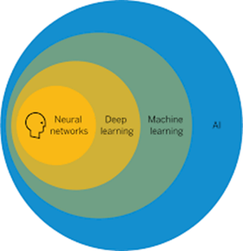
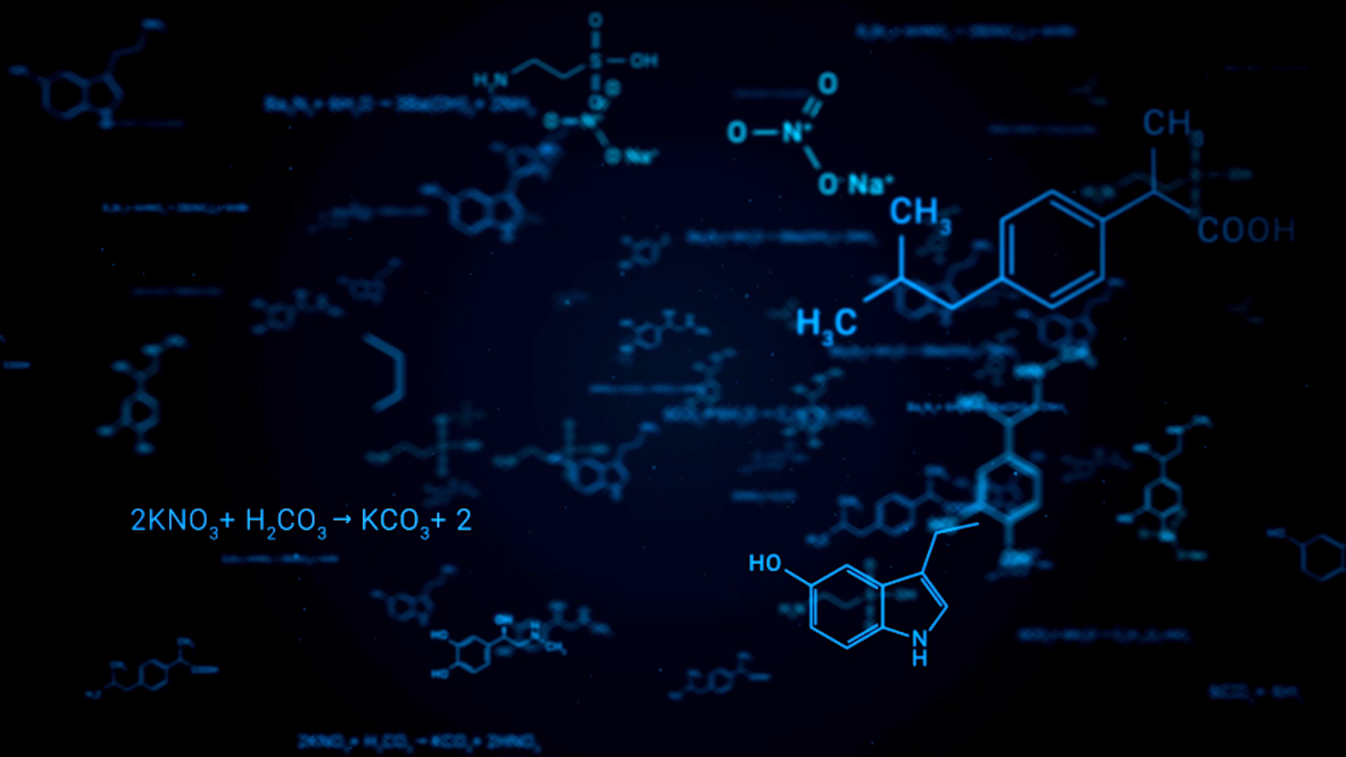


Online Data Research Repositories
From Research Data and Datasets to Artificial Intelligence and Discovery
Ray Uzwyshyn, Ph.D. MBA MLIS
Director, Collections and Digital Services
Texas State University Libraries, USA
ruzwyshyn@txstate.edu
IT Section Big Data SIG
Notes:
I’m going to speaking you today about Challenges and Opportunities but also divides between these areas but bridges and connections that are already in place and being utilized that you may be unaware of and that may be useful to your institutions

Slide 2
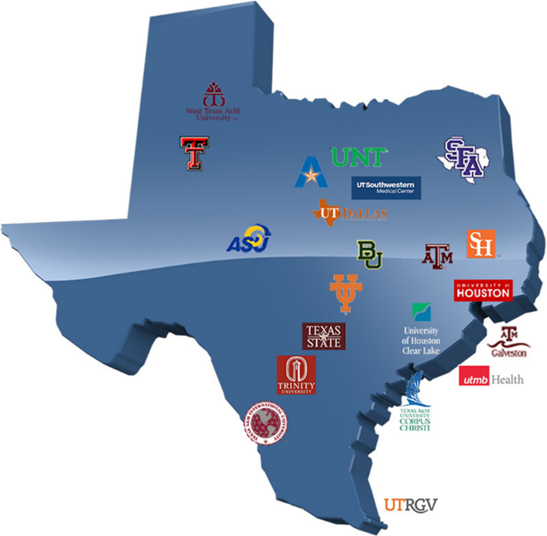
What is an Online Data Research Repository?
Texas Data Repository which is a shared repository of several Texas Universities leveraging technological cooperation and expertise among academic research libraries libraries, https://dataverse.tdl.org

Slide 3
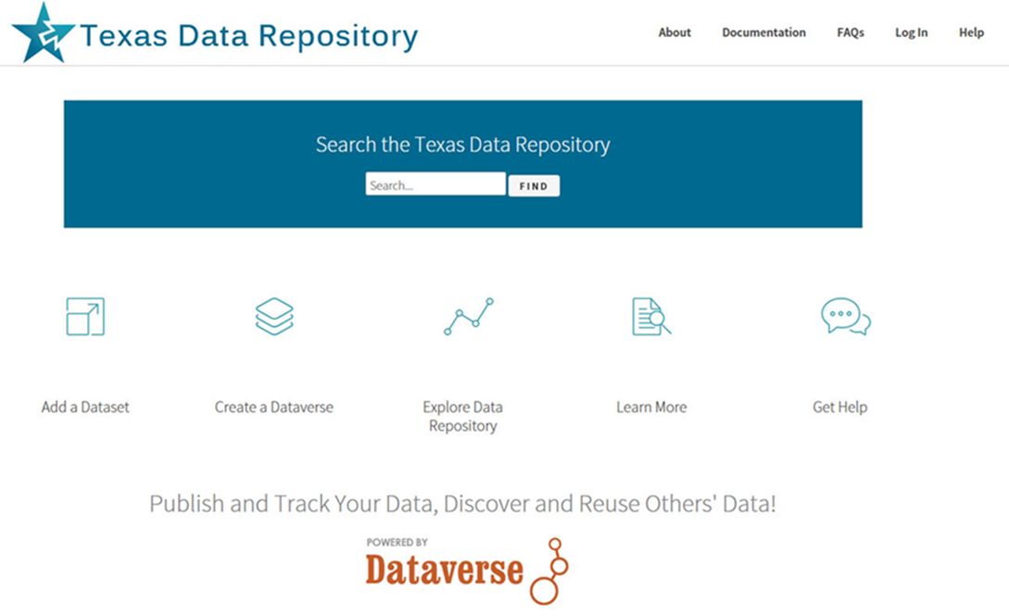

What is the Utility of
An Online Research Data Repository?
Platform to Manage Researcher and Institutions Data/Metadata
Permalinking Strategy for Data Citation
Way to Manage Large Grant Compliance
Data Archiving and Sharing Strategy
https://dataverse.tdl.org/

Slide 4
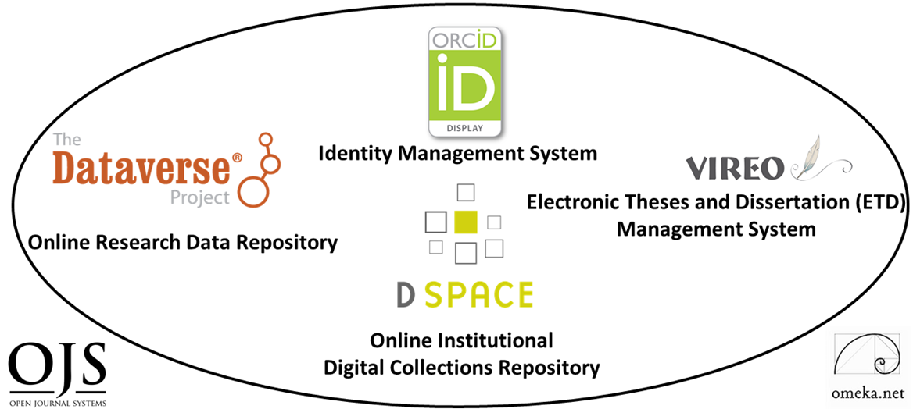
A Data Repository May Also Be Placed
Within a Larger Digital Scholarship Research Ecosystem
TWO PRIMARY COMPONENTS
DIGITAL COLLECTIONS REPOSITORY
FOUR TERTIARY COMPONENTS
(Communication)
Electronic Thesis and Dissertation Management System
User Interface/Content Management Software
Identity Management System
Open Academic Journal Software
RESEARCH DATA REPOSITORY
(Content)
Digital & Web Services : University Libraries : Texas State University (txstate.edu)

Slide 5
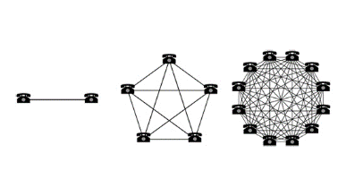
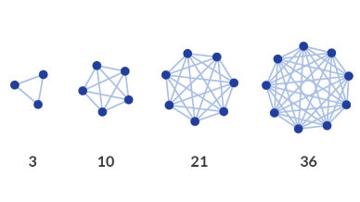

Collocating Open Source
Digital Components in a Networked
Research Ecosystem
Enables Larger Connections and/or Network Effects
Notes:
Ecosystem Metaphor Look at Relationships in the Digital Environment
Specifically Focuses Upon the Discrete Component Relationships with the Networked Digital Environment

Slide 6
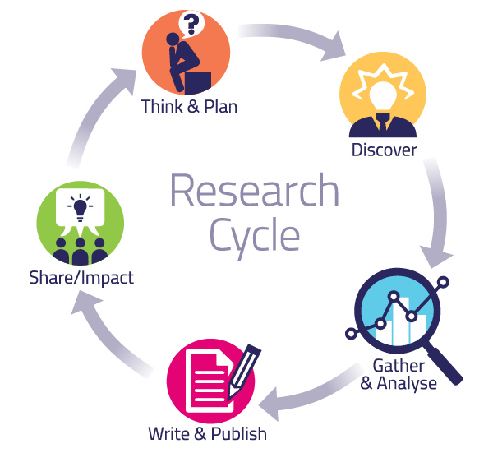
Together These Digital Ecosystem Components
Enable the Academic Research Cycle
Pragmatic Levels

Slide 7

One Size Does Not Fit All for Various
Data Research Repository Project Needs
Many Types of Data Projects (Sizes)
1) Normal range (<4GB Files <10GB Datasets)
Files/Data Fit on Server/Cloud, may be uploaded to the Data Repository, 4GB files, 10GB Datasets)
2) Large Projects, Bigger Data <TB
(Data may require specialized university IT Support, i.e. terabyte/petabyte tape drives, Pointers, Checksums)
3) Huge Projects, Big Data
(Projects require consortial possibilities, national models, Texas Advanced Computer Center TAAC, Lyrasis, Duracloud, AWS S3, Custom Solutions)

Slide 8
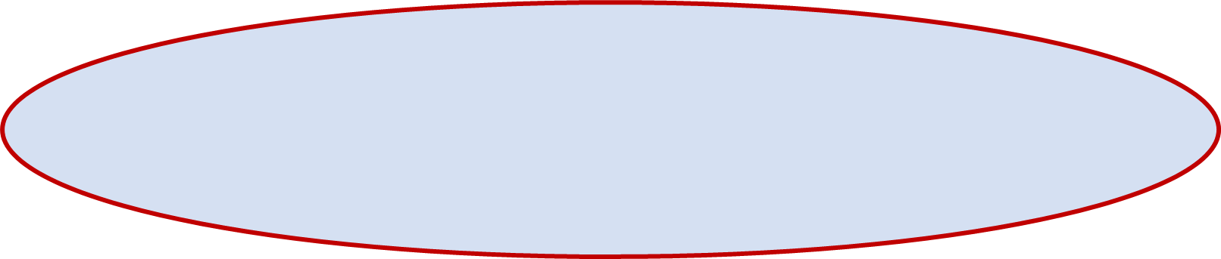
Present Sizes of Texas Data Repository Datasets
Most 1MB <1GB, Greater than 10 GB+ Rare
2
1
Waugh, L. Texas State University Annual
Usage Report 2020: TXST Dataverse Repository. Texas State University

Slide 9




Beta Prototyping Big & Bigger Data Options
2020-2022
Up to 300 GB/dataset
Fee Based Institutional Model 7.5/13.5 K/Year
<20 GB Upload
(Download Challenges)

Slide 10
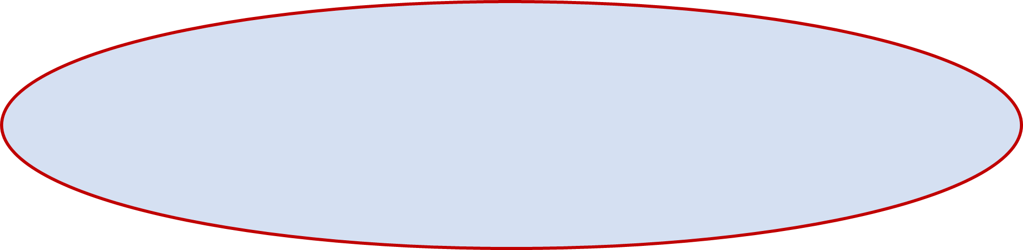
What New Data Repository Features
Would Users Like to See in 2022?
4
1
5
2
3
6
7
8
Chan- Park, C. and Sare, L. Waugh, S. Results of the Texas Data Repository User Survey, 2022. Texas Conference on Digital Libraries, 2022.

Slide 11
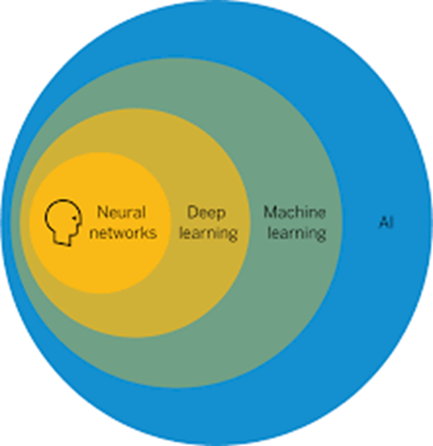

Last Five Years Has Shown Incredible Progress of,
Analytical Computational Tools, Particularly, AI
Machine Learning, Deep Learning, Computer Vision, Object Recognition, Cancer Detection

Slide 12
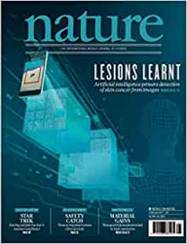
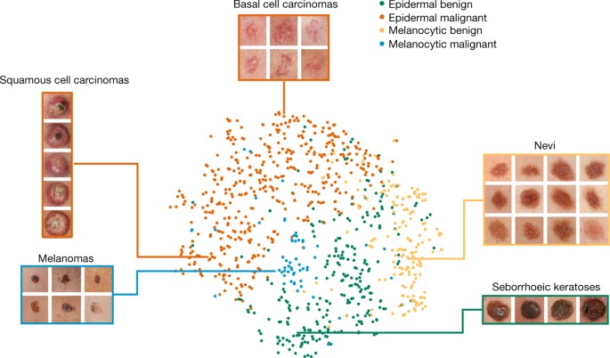
Dermatologist-Level Classification of Skin Cancer with Deep Neural Networks
2017, Nature, Esteva, Thrun et Al
Video Stanford

Slide 13

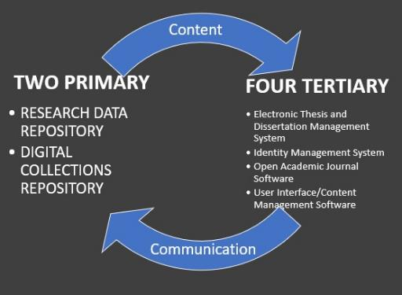
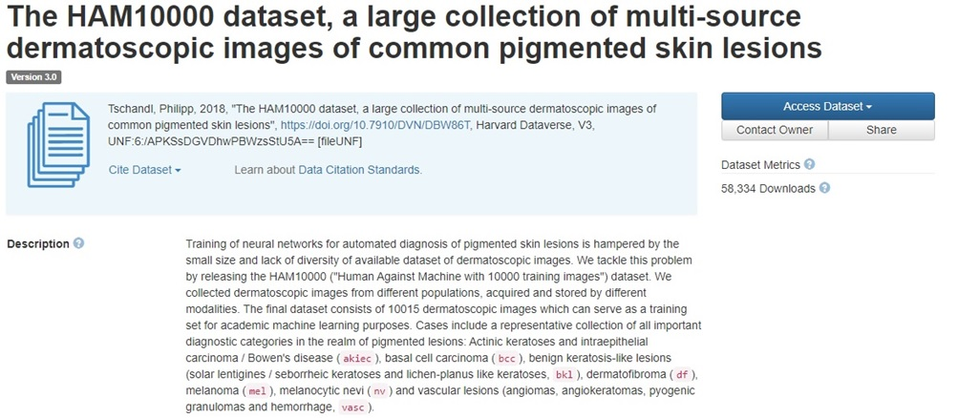
Data Research Repository Upload
Open Science Dermatology Image Dataset, Dr. Philip Tschandl
https://dataverse.harvard.edu/dataset.xhtml?persistentId=doi:10.7910/DVN/DBW86T

Slide 14
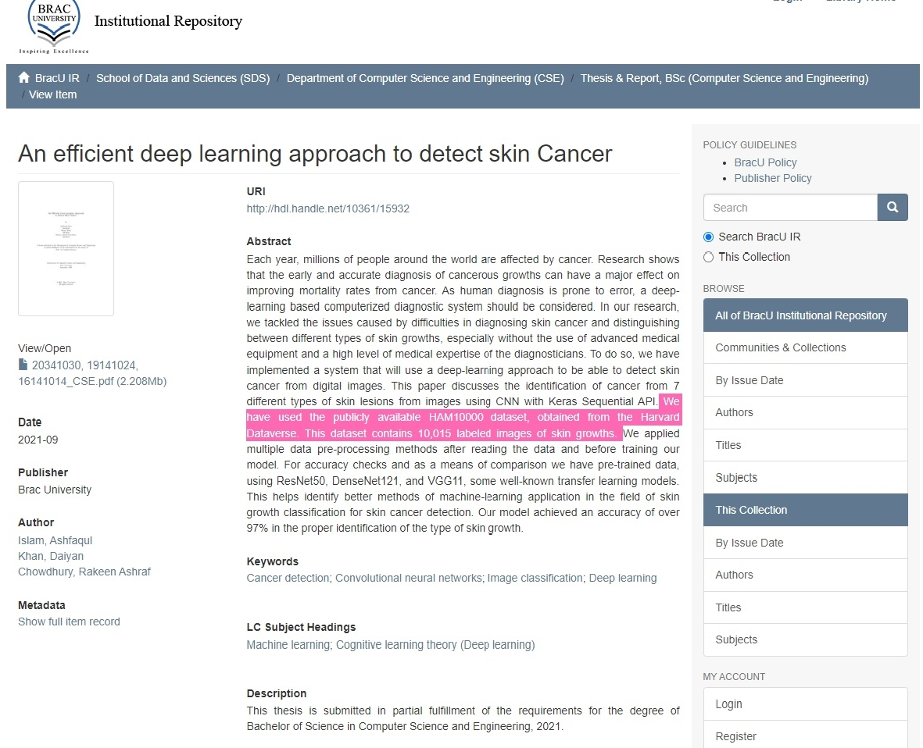

Digital Collections
Repository
Dspace
http://dspace.bracu.ac.bd/xmlui/
handle/10361/15932
BRAC University
Libraries
Institutional
Repository

Slide 15
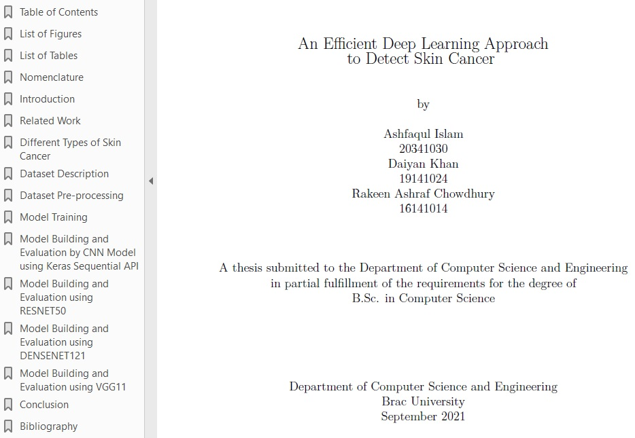
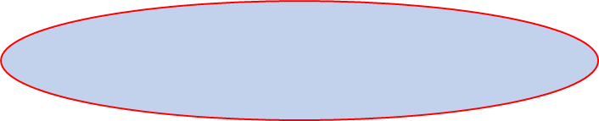
The Progress of Knowledge
Through Global Open Science
& Network Possibilities
2017 Stanford
Nature Deep Learning
Cancer ID Article
2018 Viennesse Doctor in
Austria
uploaded Dermatalogical Image
Library to Harvard Dataverse
Data repository
2021 (November) Undergrad
Thesis Published in
Dspace Repositor
BRAC University, Dhaka
Bangladesh, Dept. of
Computer Science and
Engineering
All Downloaded July 2022
Texas, USA for Dublin IFLA
Big Data Presentation

Slide 16
Questions & Comments
Ray Uzwyshyn, ruzwyshyn@txstate.edu http://rayuzwyshyn.net
Ray Uzwyshyn, Ph.D. MBA MLIS
Director, Collections and Digital Services
Texas State University Libraries, USA
IT Section Big Data SIG

Slide 17
References and Further Resources
Artificial Intelligence. Machine Learning. Neural Networks. Future Technology. Bloomberg Businessweek Canada. 2022. https://www.youtube.com/watch?v=ypVHymY715M
Cann, A., Dimitriou, K. Hooley, T. 2011. Social Media: A Guide for Researchers. Research Information Network. University of Derby, UK.
Chan-Park, C. and Sare, L. Waugh, S. 2022. Results of the Texas Data Repository User Survey, 2022. Texas Conference on Digital Libraries Presentation.
ColdFusion (2018). Why Deep Learning Now? (Documentary Overview). https://www.youtube.com/watch?v=b3IyDNB_ciI
Echle et al. Deep Learning in Cancer Pathology: A New Generation of Clinical Biomarkers. British Journal of Cancer. November 2020. https://www.nature.com/articles/s41416-020-01122-x
Esteva, A, Thrun, S. et al. Dermatologist-level Classification of Skin Cancer with Deep Neural Networks. Nature, Volume 542 (February 2, 2017). pp. 115-119. doi:10.1038/nature21056
Fridman, Lev. MIT Deep Learning and Artificial Intelligence Lectures. https://deeplearning.mit.edu/ 2022.
Islam, A., Khan, D. and Chowdhury, R. 2021. An Efficient Deep Learning Approach to Detect Skin Cancer Undergraduate Thesis. BRAC University DSpace Institutional Repository, 2021. Available: http://dspace.bracu.ac.bd/xmlui/
handle/10361/15932
Kleinveldt, Lynn. Smarter high education learning environments through AI: What this means for academic libraries. Trends and Issues in Library Technology: Special Issue on AI: June 2022. pp. 12-15. https://repository.ifla.org/handle/123456789/1940
Mitchell, Tom. 2022 Where on Earth is AI Headed? Carnegie Mellon. https://www.youtube.com/watch?v=ij9vqTb8Rjc
Peters, T. and Waugh, L. Larger Data Storage Report: Research Data Management Initiatives and Planning, January 2022. Texas State University Libraries (Unpublished White Paper)
Texas Data Repository 2022. https://dataverse.tdl.org/
Tschandl, Phillip et al. Human-computer Collaboration for Skin Cancer Recognition. Nature Medicine, 22 June 2020, 1229-1234. See: https://www.nature.com/articles/s41591-020-0942-0.
Uzwyshyn, R. 2022. Online Research Data Repositories and Digital Scholarly Ecosystems: From Research Data and Datasets to Artificial Intelligence and Discovery. IFLA WLIC 2022. Dublin, Ireland. DOI: 10.13140/RG.2.2.12354.86728
---. 2022. Steps Towards Building Library AI Infrastructures: Research Data Repositories, Scholarly Research Ecosystems and AI Scaffolding. New Horizons in Artificial Intelligence in Libraries (IFLA Satellite Conference), National University of Ireland, Galway, IR. DOI: 10.13140/RG.2.2.21120.30728
---. 2021. Frameworks for Long Term Digital Preservation Infrastructures. Computers in Libraries. September 2021. pp.4-8.
Uzwyshyn, R. 2020. Developing an Open-Source Digital Scholarship Ecosystem. ICEIT2020. St. Anne’s College Oxford, United Kingdom. February 2020. Available at: https://www.researchgate.net/publication/336923249_Developing_an_Open_Source_Digital_Scholarship_Ecosystem.
- - -. 2020. Open Digital Research Ecosystems: How to Build Them and Why. Computers in Libraries, (40) 8. November 2020. https://www.researchgate.net/publication/
345956074_Online_Digital_Research_Ecosystems_How_to_Build_Them_and_Why
---. 2016. Online Research Data Repositories: The What, When Why and How. Computers in Libraries. 36:3, April 2016. pp. 18-21. http://rayuzwyshyn.net/TXU2016/OnlineDataResearchRepositoriesUzwyshyn.pdf
Waugh, L. Texas State University Annual Usage Report 2020. TXST Dataverse Repository. Texas Conference on Digital Libraries Presentation. Texas State University.

Slide 20
Texas State Repositories Architecture
Texas State Academic Research
Research Data
TS Dataverse
(Regular to Medium Size Data Sets)
Custom Data Storage
(Big Data, Terabyte+, Research Computing)
Text, Media
D-Space
Collections Repository
Notes:
Texas State research and accompanying requirements for Federal Data Management Plan compliance is accommodated
by several tiered online solutions. Research Data for regular to medium size datasets may be uploaded and placed into the Texas State Data Repository (TSDR, Dataverse). Big Data and large datasets (Terabyte +) is accommodated through University Technology Resources (TR, research computing customized solutions) and research articles, publications and white papers is accommodated by the University Online Publications Repository, D-Space.

Slide 21
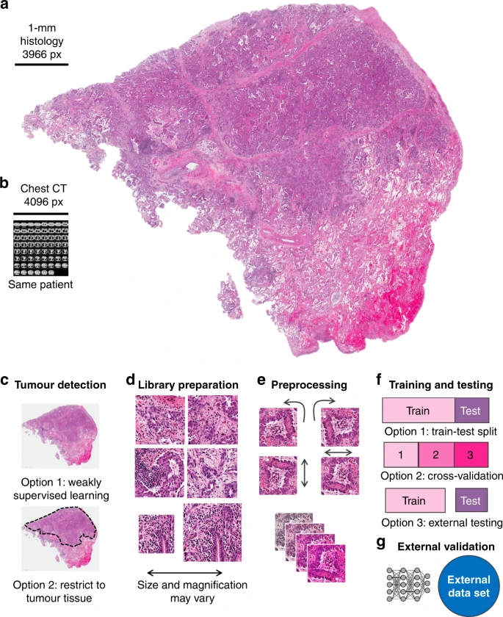

Combining Data Centered
Research Ecosystems
+ Artificial Intelligence
(Many New Possibilities for Global Open Science,
New Insights and NewDiscovery)
Deep Learning in Cancer Pathology: A New
Generation of Clinical Biomarkers. British
Journal of Cancer, Echle et al. November 2020

Slide 22
Last Five Years Has Shown Incredible Progress of,
Analytical Computational Tools, Particularly, AI
Artificial Intelligence (Machine Learning (Deep Learning)) = Better Algorithms +
Greater Computing Power +
Large Data Sets
Computer Vision
(Facial/Object Recognition
Cancer Cell Detection) )
Natural Language Processing
(Speech to Text, Translation)
Cybersecurity,
Fraud Detection
Conversational Chatbots
& Robotic Agents
Strategic Reasoning (AlphaGo)

Slide 23

Big,
Bigger Data and Big Data

Slide 24

What are the General Common Characteristics for a Data Repository and Digital Scholarship Ecosystem?
Customizable Components
Active Developer Communities
Open Source Software

Slide 25
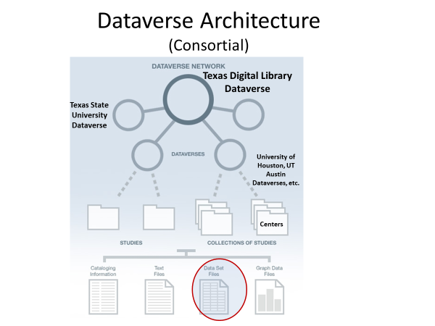

Texas State University Dataverse:
Can be configured as Single Instance or as a Consortial Model
(Texas Aggregates
Various Individual Universities through the Texas
Digital Library)
https://dataverse.tdl.org/

Slide 26
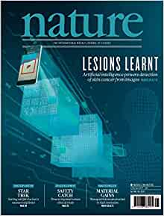

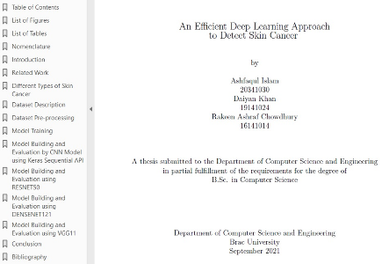
The Progress and Potential of AI, Discovery, Data and
Big Data Ecosystems for Libraries and Research Institutions
2017 Stanford
Nature Deep Learning
Cancer ID Article
2018 Viennesse Doctor
uploaded Dermatalogical Image
Library to Harvard Dataverse
Data repository
2019 Global Open Science
Through Network Possiblities
2021 (November)
Dspace Repository
Undergraduate Thesis
BRAC University, Dhaka
Bangladesh, Dept. of
Computer Science and
Engineering
Downloaded July 2022
Texas, USA

Slide 27
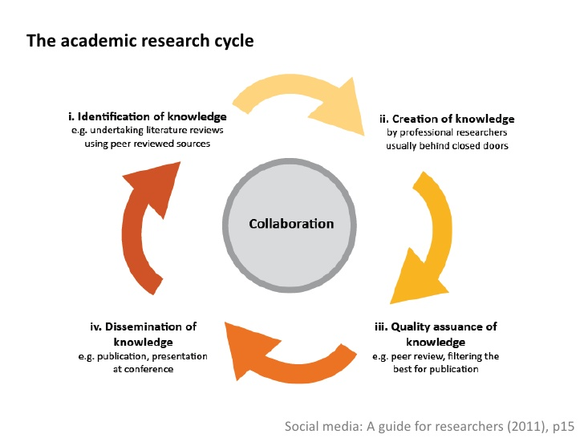
Together These Digital Ecosystem Components
Enable the Academic Research Cycle
Pragmatic Levels
Abstract Levels

Slide 28

The Research Data Repository Lifecycle
Setting Better Foundations & Organization for AI Infrastructures

Slide 29
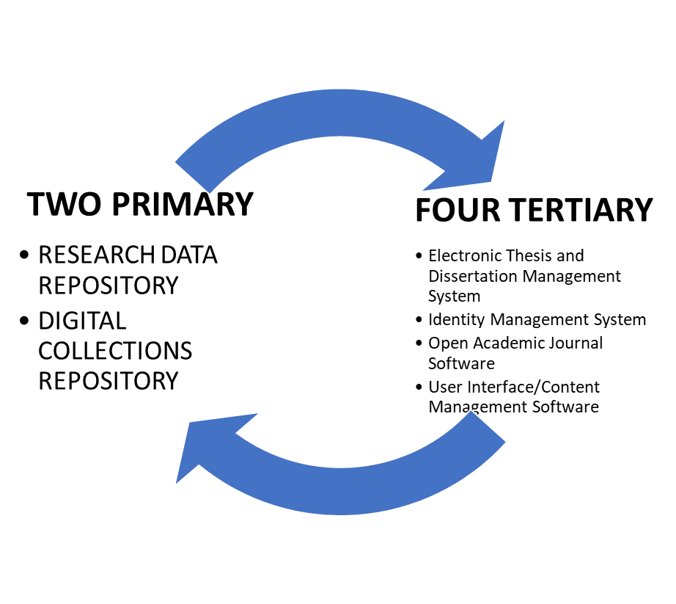
Digital Scholarship Ecosystem Centered on Research Data Repository and Collections Repository
Content
Communication

Slide 30

Questions Comments
Ray Uzwyshyn, Ph.D. MBA MLIS
Director, Collections and Digital Services
Texas State University Libraries
ruzwyshyn@txstate.edu http://rayuzwyshyn.net

