Slide 1
Research Libraries, Consortia and Technology: Challenges and Opportunities
Ray Uzwyshyn, Ph.D. MBA MLIS Director, Collections and Digital Services Texas State University Libraries
Presentation for: Center for Research Libraries (CRL) February 2021

Slide 2
Agenda
Briefly Overview Four Major Research Libraries Challenges
Deeper Dive into the Possibilities and Opportunities that Technology and Consortia Afford

Slide 3
Consortia and Technology Have Continuing Large Roles to Play in the Evolution of Scholarly Research Tools
AI
Open Source Possibilities

Slide 4
Four Research Library Challenges and Opportunities
Enabling Researchers (Faculty and Students) with Technological Possibilities for Research in the 21st Century.
Transforming the Diminishing Proposition of Print Collections with Digitization and Digital Preservation
Rethinking Multiyear Journal Packages and Big Deals in Light of OER and Open Science Possibilities.
Transitioning Unique Special Collections Content for Digital Access, Curricular Support and Online Teaching

Slide 5
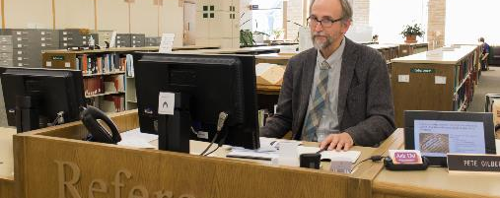
Research Libraries
Challenge Number One Bringing Research into the 21st Century and Enabling Researchers with Research Technology Possibilities
Scholarly Publishing is Changing. The Paradigm is Shifting to Online and Open Access
Traditional Scholarly Communication has moved majorly online this past year.
The fundamental ‘research’ support role of the librarian in a research library is shifting to helping faculty understand online methodologies to enable research online

Slide 6
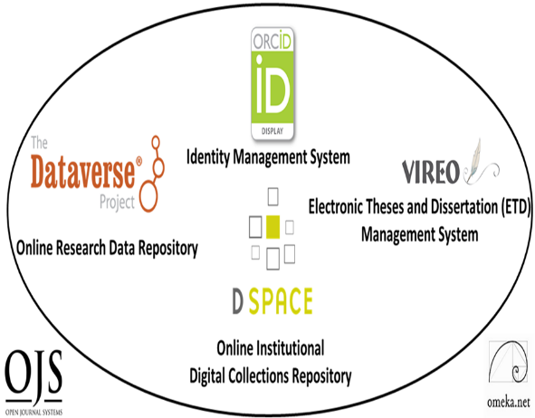
Technologically, There are Many New Possibilities
for Digital Scholarly Research Ecosystems on Consortial Levels: (Research Collaboration, Aggregation, Retrieval and Implementation Models)
PRIMARY
Digital Research Collections Repository (Hyku Commons, 2021)
TERTIARY
Electronic Thesis and Dissertation Management System (VIREO)
User Interface/Content Management Software (OMEKA)
Identity Management System (ORCID)
Academic Journal Software (OJS3)
Research Data Repository (Dataverse)
Content
Communication
Texas State Digital Scholarly Research Ecosystem

Slide 7
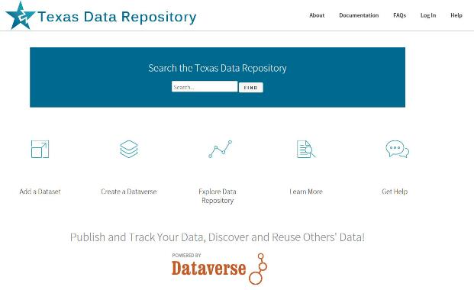
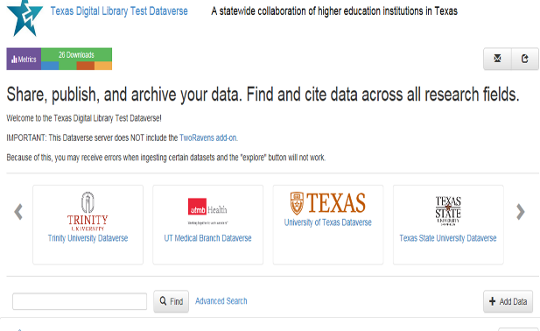
Consortial Research Data Repository Texas State University Dataverse: Consortial Texas Data Repository Based On Harvard’s Dataverse
Texas Data Repository

Slide 8
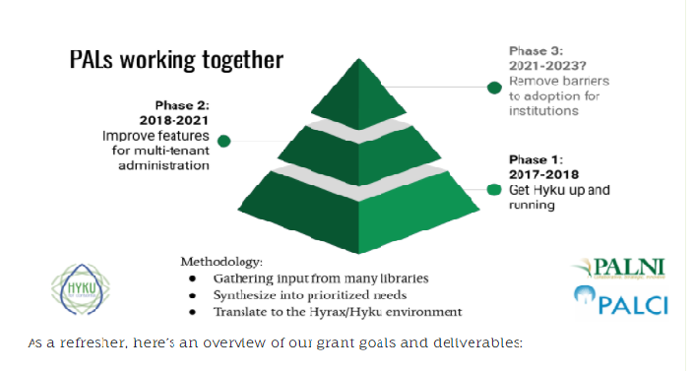
Emerging Cross-Consortial Digital Collections Repository PALCI/PALNI Partnership (Pennsylvania/Indiana Academic Library Consortia) Hyku Commons:
CNI Presentation 2020

Slide 9
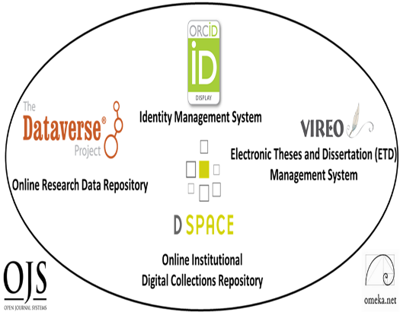
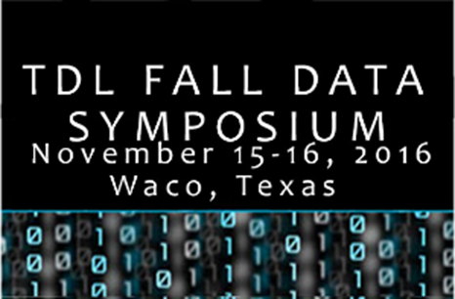
Large Roles For Consortia To Play With Technology and Education (Best Practices Models) for Scholarly Research Ecosystems
Room for wide Technological Consortial Support of these Systems on many Levels
Technology-Related Workshops, Conferences Webinars, Symposia Training

Slide 10
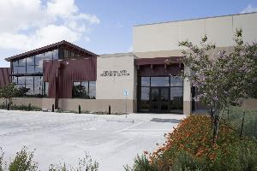
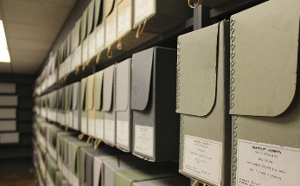
Research Libraries Challenge Number Two
Transforming the Diminishing Proposition of Physical Collections and Closed Archives with Long Term Digital Preservation and Better Access
Print Budgets Decreasing (Both Serials and Monographs)
New Physical spaces for Print are Less Viable Propositions with Learning Commons
New Technologies are replacing traditional collections spaces
Recognition of Need for Long Term Digital Preservation
Recognition of Need for More Immediate Access and Contextualization of Resources
Recognition of Need for Education and Cooperative Resources

Slide 11
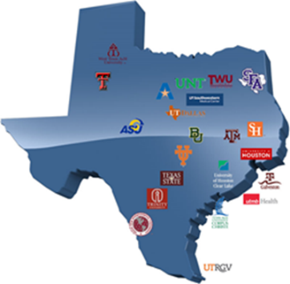
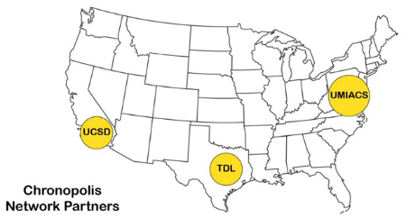
Technologically, Many Consortial Roles for Facilitating Long Term Digital Preservation Opening Possibilities for Infrastructures, New Models, Best Practices and Working Groups

Slide 12
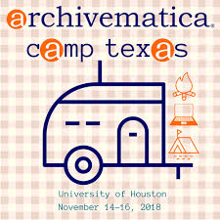
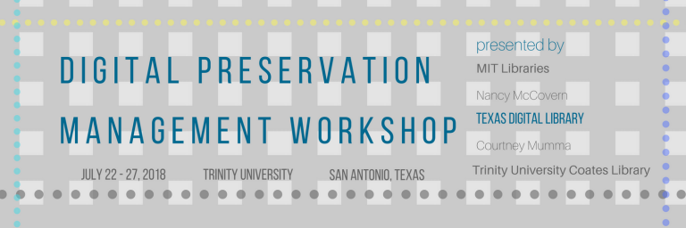
Consortia can Aggregate the Power of Community Best Practices Educating Together for Best Technological Practices Digital Preservation Workshop Series, Best in Class Speakers, National and International Possibilities
Archivematica Working Group
Texas

Slide 13
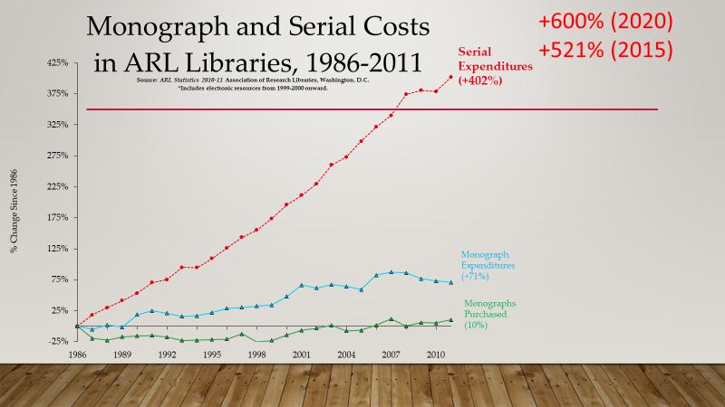
Research Libraries Challenge #3
Rethinking Multiyear Licenses, Journal Packages and Big Deals in Light of Diminishing Budgets and Rise of OER and Open Science
Serials Inflation/Costs have become unsustainable for long term academic library budgets

Slide 14
Large Roles for New Technological Infrastructures and Consortia to Play Shifting the Conversation, Facilitating New Online Research Models, Advocating for New OER Curricular Possibilities
Technology and Consortia Have Large Roles To Play in Dismantling
And Shifting These Paradigms
40 Texas Universities

Slide 15
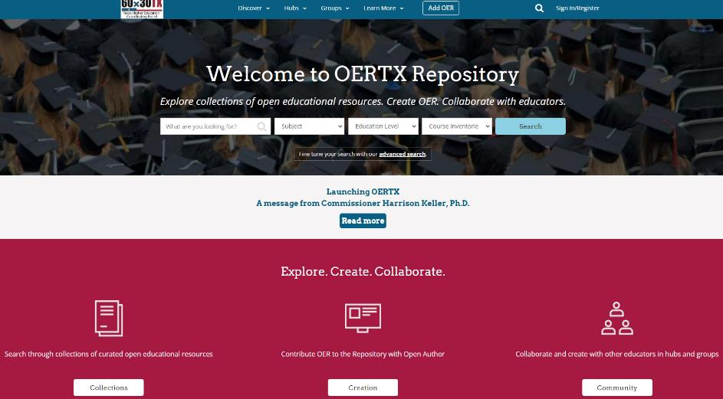
Texas OER Online Repository: Large Cross Consortia Partnership and Collaboration Online Open Educational Resources for Higher Education
https://oertx.highered.texas.gov

Slide 16
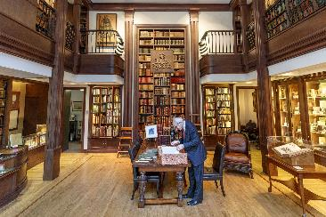
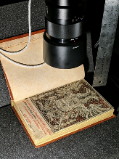
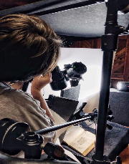
Research Libraries Challenge #4 Transitioning Unique Special Collections for Digital Access Possibilities to Support Online Research & Curricular Resources, and Online Teaching
Many Special Collections Have Fallen short in Digitizing Unique Treasures Beyond Basic IR Search/Retrieval
Better Digital Access and Marketing of Unique Material for Researchers and Online Curricular Teaching needed
Many New Technology Possibilities for Digital Humanities and Open Science Possibilities available
Consortial Possibilities for Unique Research libraries collections may be leveraged on collaborative, infrastructure and grant levels

Slide 17
Consortial Possibilities: Technology Projects, Best Practice Prototypes, Grant Partnerships, Education
Cognitive Cartography/Multimedia Archives (Video, Text, GIS, Images, Field Notes) Dick Reavis: National Tour of Texas Multimedia, Digital Archives/Consortial ETD Projects (Digital video, online exhibit images, text, digital archives) Severo Perez: And the Earth Did not Swallow Them Online Exhibits/Digital Archives/ Online Academic Journals (images and text, Omeka front end/Database back end, IIIF) Cabeza de Vaca La Relacion Digitization Santiago Tafolla: Mexican Amer. Confederate Soldier Interactive Image Archives/Consortial Data Research Projects (Image libraries, Interactive Commenting/Metadata) Texas State Flickr Commons
Digital Libraries Archiving & Documentation Projects (Text, Metadata, OCR, Search, Zoom ability, Page Turning) Pedagogs University Yearbooks
Faculty Digitization Proposals/Partnerships
Complexity
Online Digital Research Ecosystems

Slide 18
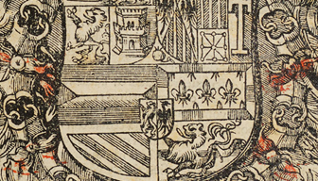
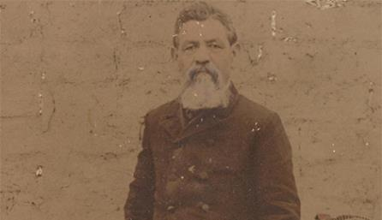
Severo Perez: Mexican American Filmmaker
Cabeza De Vaca Manuscript 15,832 Hits, January 2021
https://exhibits.library.txstate.edu/thewittliffcollections/exhibits/show/severo-perez
Leveraging Technology, Research Faculty & Consortia Possibilities
Multimedia, Research Content , New Technology, New Online Curricular and Research Resources
https://exhibits.library.txstate.edu/cabeza/
https://exhibits.library.txstate.edu/thewittliffcollections/exhibits/show/santiago-tafolla-collection/rev-tafolla
http://balseros.miami.edu/
https://anthurium.miami.edu/
Santiago Tafolla Diaries
TransAtlantic Migration

Slide 19
Bryant, Rebecca, Annette Dortmund, and Brian Lavoie. 2020. Social Interoperability in Research Support: Cross-Campus Partnerships and the University Research Enterprise. Dublin, OH: OCLC Research. https://doi.org/10.25333/wyrd-n586
Cox, Christopher. (July 2020) “Changed, Changed Utterly”. Inside Higher Ed. https://www.insidehighered.com/views/2020/06/05/academic-libraries-will-change-significant-ways-result-pandemic-opinion
Leonard C. and Morris, J. Building Hyku for Consortia: Cross-Consortial Partnerships for Community Infrastructure. https://www.cni.org/wp-content/uploads/2020/12/CNI_Building_Leonard.pdf
OERTX. Open Educational Resources Texas. https://oertx.highered.texas.gov
Uzwyshyn, R. 2020 Developing an Open Source Digital Scholarship Ecosystem (Preprint). ICEIT2020. Oxford, UK. https://www.researchgate.net/publication/336923249_Developing_an_Open_Source_Digital_Scholarship_Ecosystem
Uzwyshyn, R. 2016. Research Data Repositories: The What, When, Why and How of Data Research Repositories Computers in Libraries.
Uzwyshyn, R. Multimedia Visualization and Interactive Systems. 2007. Library High Tech.
Further References
& Links

Slide 20
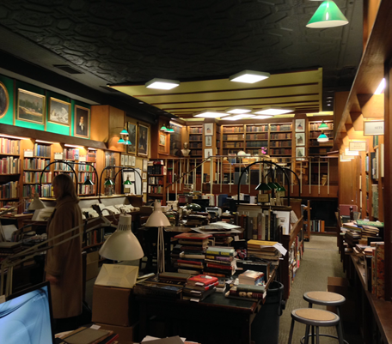
Comments and Questions
Ray Uzwyshyn, Ph.D. MBA MLIS Director, Collections and Digital Services Texas State University Libraries

