Slide 1
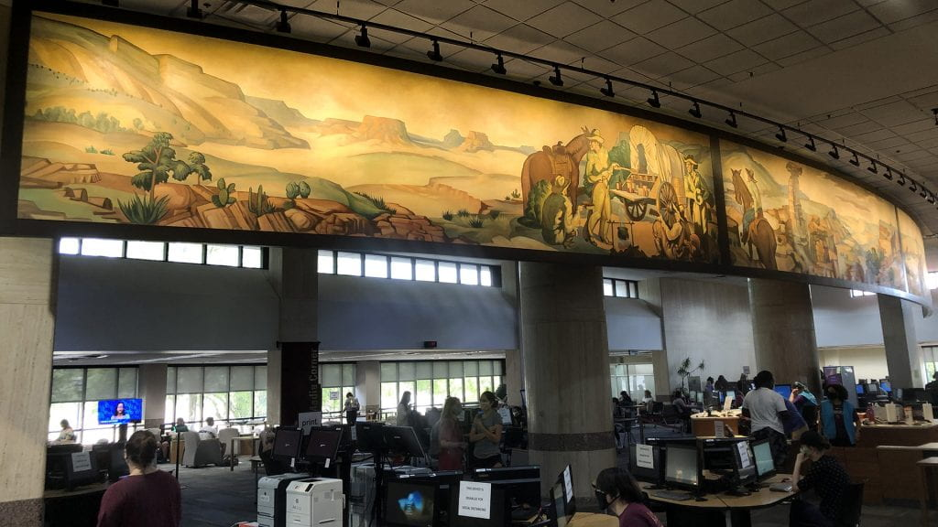
Academic Libraries, IT Infrastructures, and Technological Tools
Stakeholders and Strategies
Dr. Ray Uzwyshyn, Ph.D. MBA MLIS
Director, Library Collections and Digital Services
Texas State University Libraries, July 2021

Slide 2

Three Questions
What technological tools and infrastructures do academic libraries need to provide and support to conduct modern research, teaching and learning?
What other campus technology stakeholders should be engaged in this work?
What strategies should one employ to both collaborate with these stakeholders and stake out areas where the libraries should lead?

Slide 3

What technological tools and infrastructures do academic libraries need to provide and support to conduct modern research, teaching and learning?
From Core Needs to Future Possibilities

Slide 4
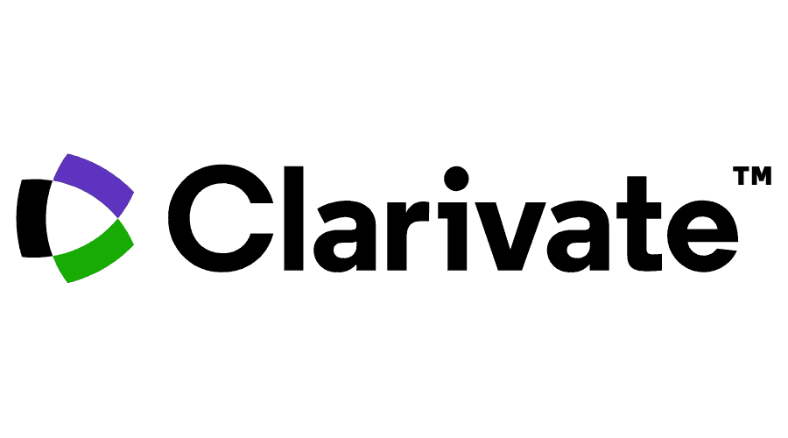


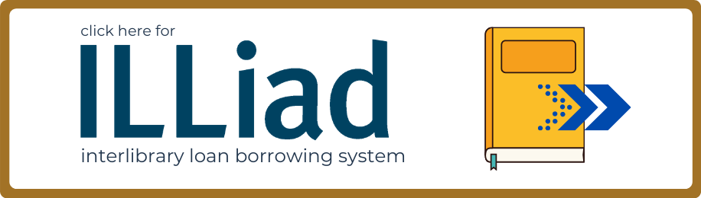



Core Academic Library Systems
Modern Integrated Library System (ILS)
Larger Discovery Service
Interlibrary Loan Service

Slide 5

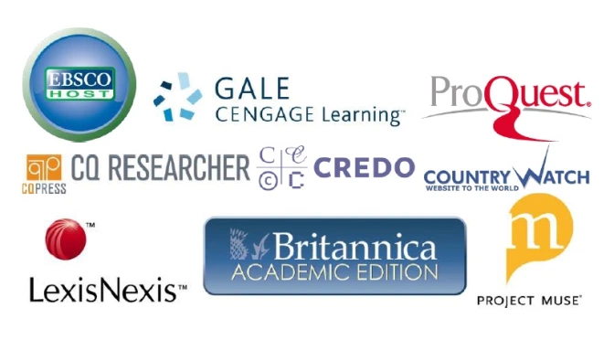
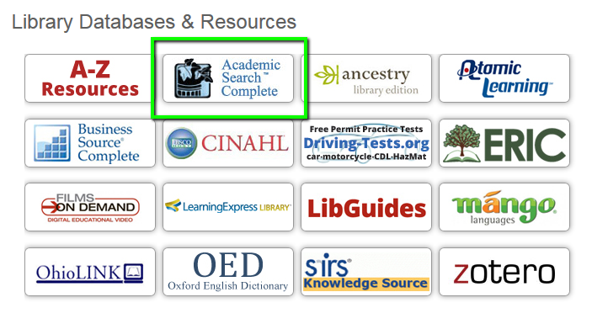
Spectrum of Academic Content Databases & eResources
Evolving into Software as a Service

Slide 6
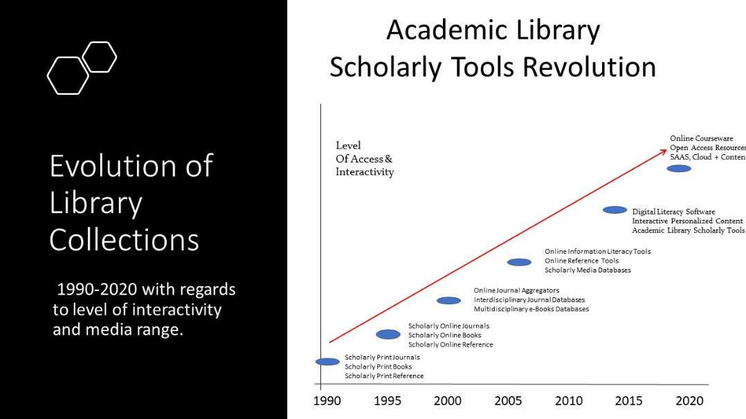
Continuing
AI
Open Source
Possibilities

Slide 7
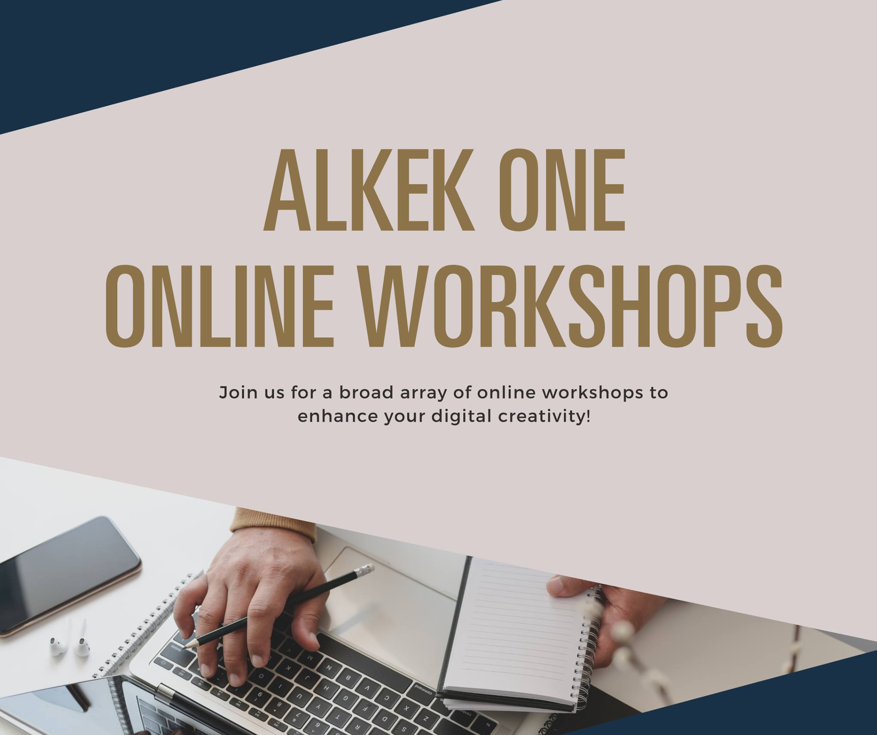
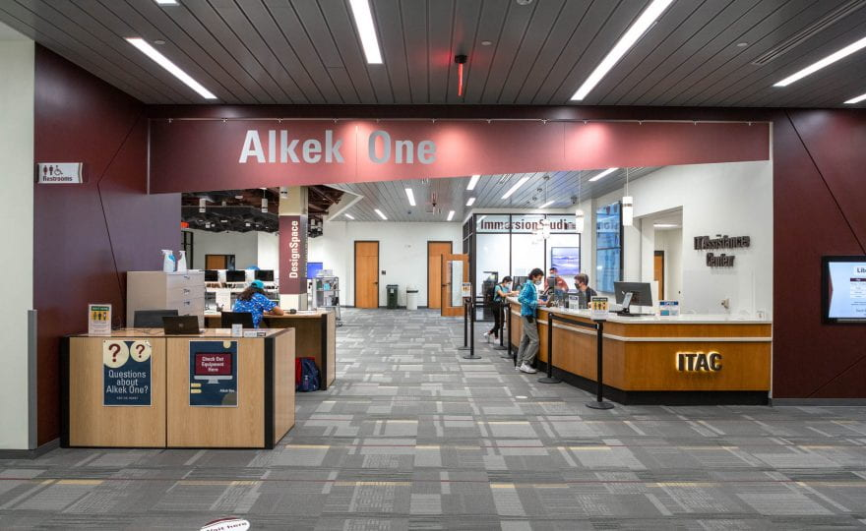
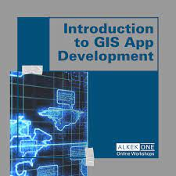
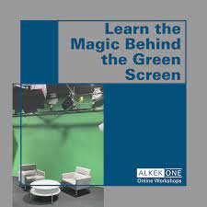
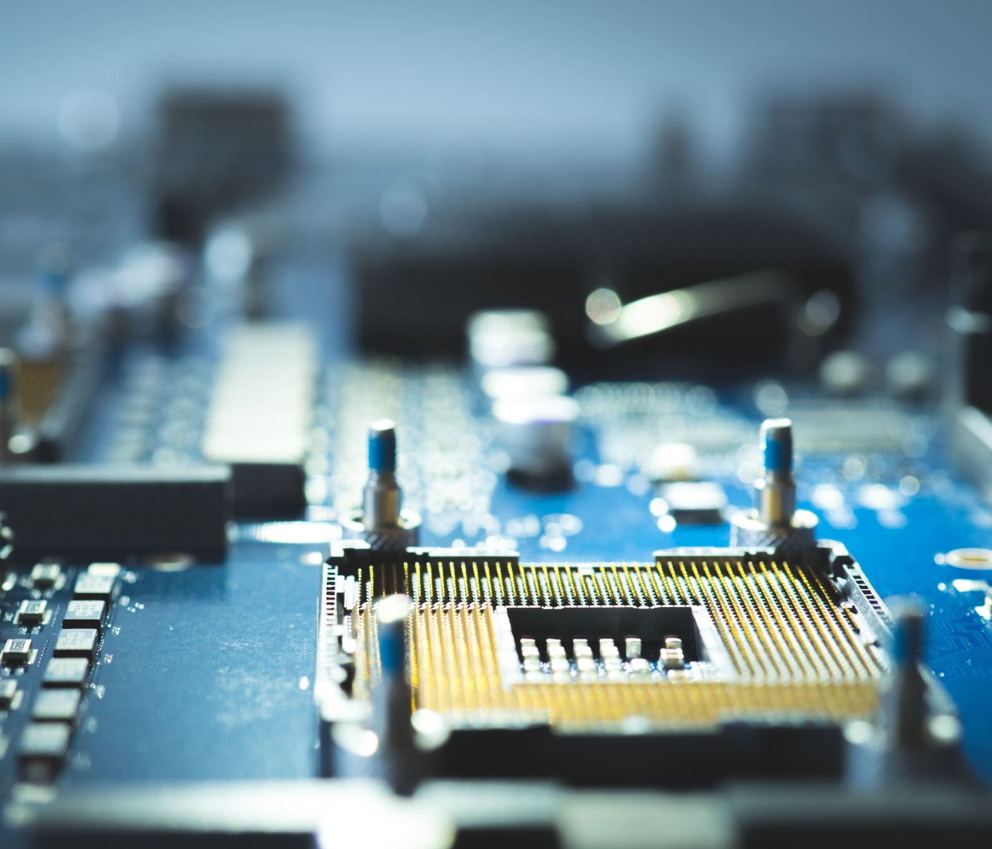
Learning Commons 2.0 For Student & Faculty Learning & Digital Literacy
Multimedia Lab
Digitization and Print Shop/ePress
GIS LAB
Digital & Information Literacy Classrooms
Makerspace
Digital Video Studio

Slide 8
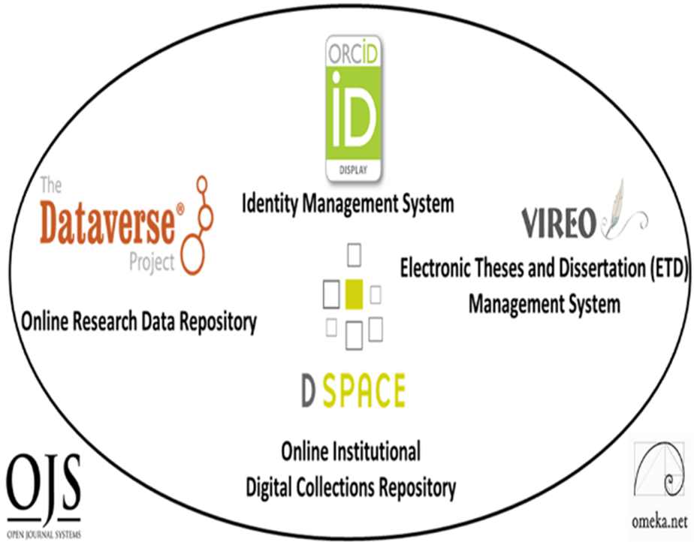
Digital Scholarly Research Ecosystem Infrastructures
Supporting Faculty and Graduate Students Research Collaboration, Sharing and Online Open Access Needs
PRIMARY
Digital Research Collections Repository (Dspace, 2021)
TERTIARY
Electronic Thesis and Dissertation Management System (VIREO)
User Interface/Content Management Software (OMEKA)
Identity Management System (ORCID)
Academic Journal Software (OJS3)
Research Data Repository (Dataverse)
Content
Communication
Texas State Digital Scholarly Research Ecosystem

Slide 9

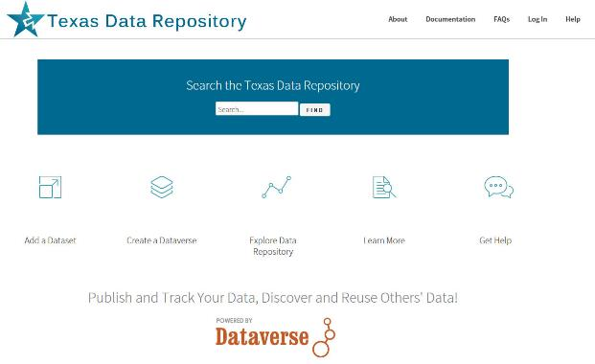
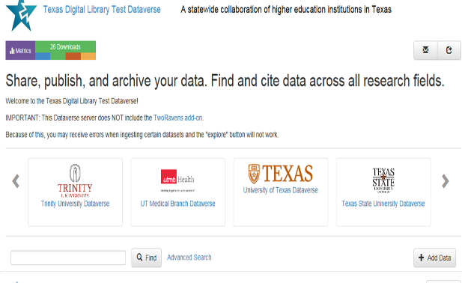
Research Data Repository
Texas State University Dataverse: Consortial Texas Data Repository Based On Harvard’s Dataverse
Data Visualization
AI
Texas Data Repository

Slide 10
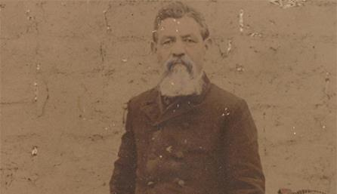


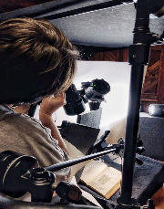
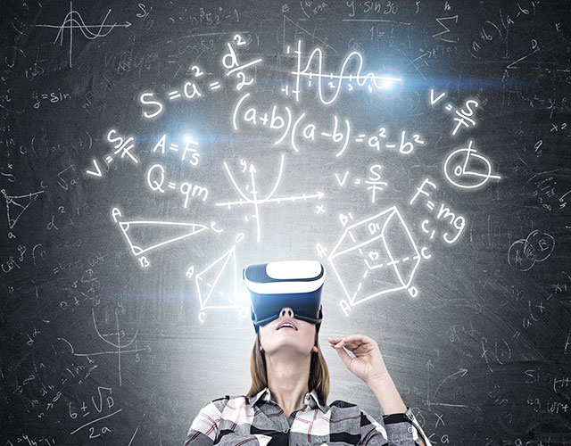

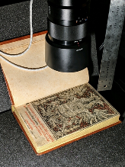
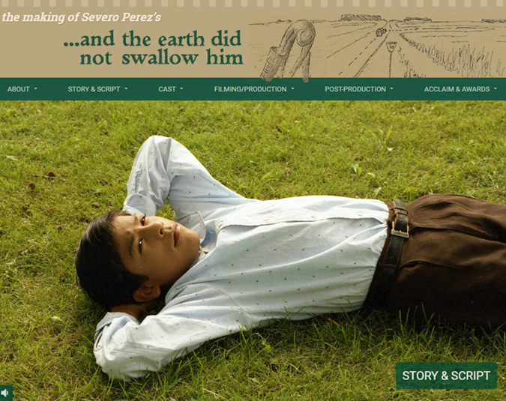
Digital Libraries 2.0 Digitization Labs and Digitization 2.0
Leveraging Technology, Research Faculty
Research Content Towards
Multimedia Possibilities ,
New Online Curricular and Research Resources
& Digital Preservation

Slide 11
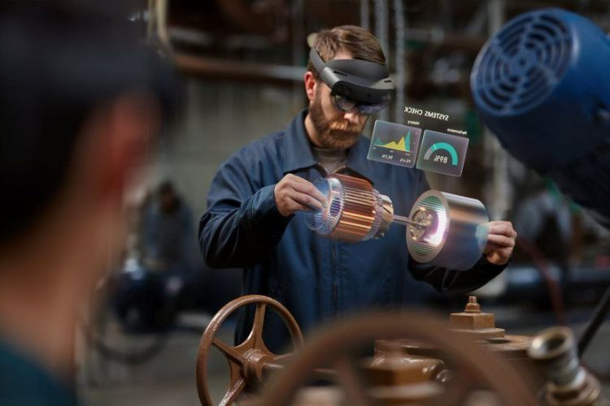
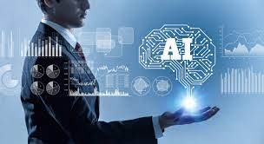
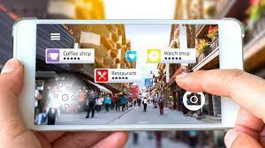
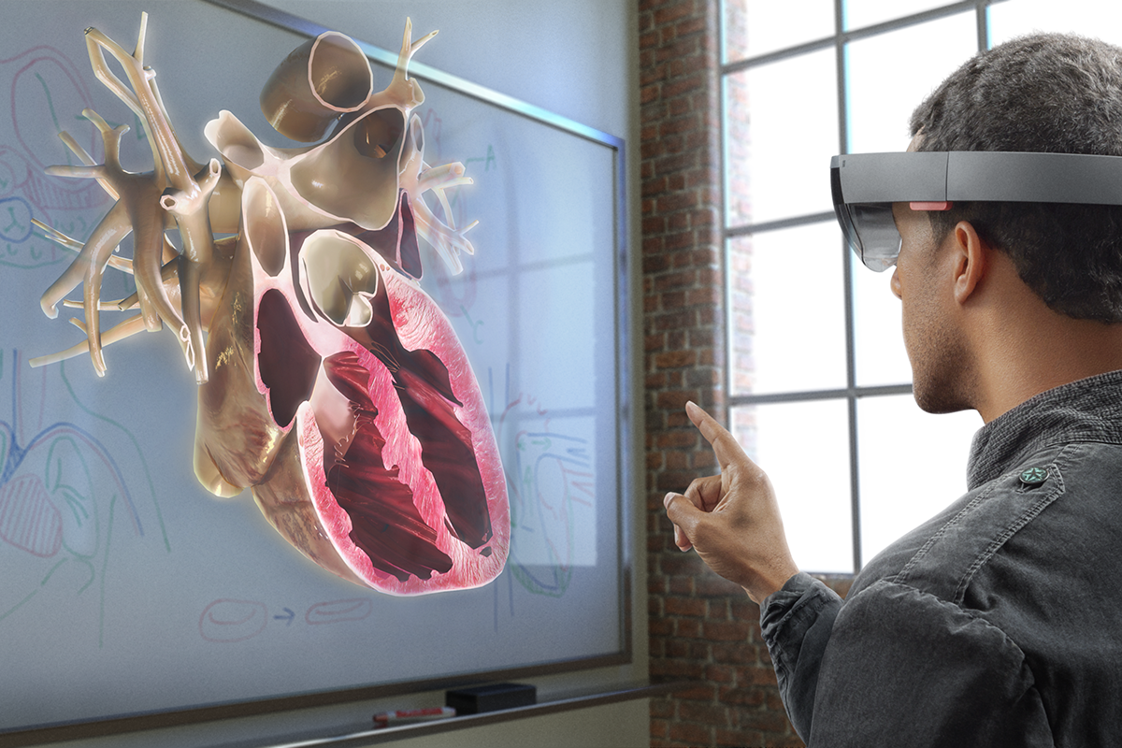
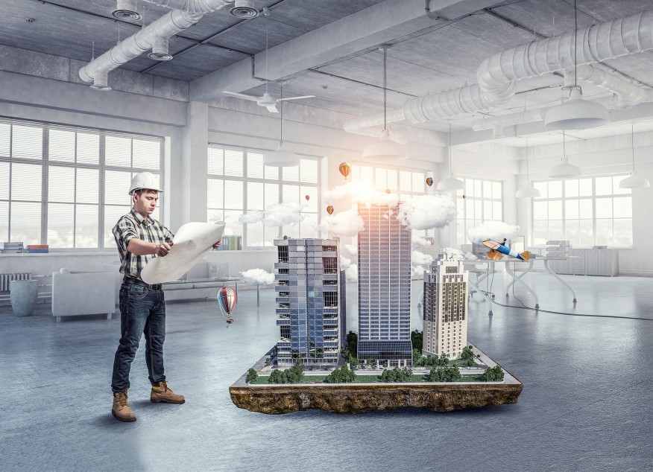
Building on and Developing Models
Integrating, Bootstrapping New Technology Possibilities
(Mobile, VR, AR, XR, Holography, AI)
Digital Libraries 1995 – 2020 +
Cognitive Cartography/Multimedia Archives
(Video, Text, GIS, Images, Field Notes)
Dick Reavis: National Tour of Texas
Multimedia, Digital Archives/Consortial ETD Projects
(Digital video, online exhibit images, text, digital archives)
Severo Perez: And the Earth Did not Swallow Them
Online Exhibits/Digital Archives/ Online Academic Journals
(images and text, Omeka front end/Database back end, IIIF)
Cabeza de Vaca La Relacion Digitization
Santiago Tafolla: Mexican Amer. Confederate Soldier
Interactive Image Archives/Consortial Data Research Projects
(Image libraries, Interactive Commenting/Metadata)
Texas State Flickr Commons
Digital Libraries Archiving & Documentation Projects
(Text, Metadata, OCR, Search, Zoom ability, Page Turning)
Pedagogs University Yearbooks
Faculty Digitization Proposals/Partnerships
Digital Libraries
2021 +
Complexity

Slide 12
What other campus technology stakeholders should be engaged in this work?
From Core Needs to Future Possibilities

Slide 13
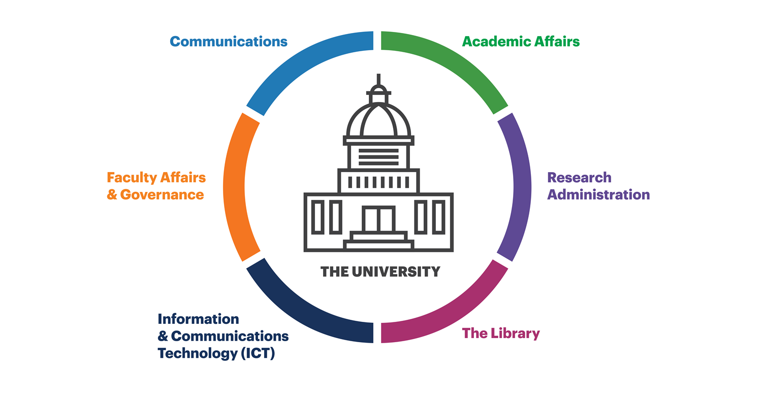
Key Campus Technology Stakeholders
(Faculty and Students)
University IT (Core Systems)
Distance or Online Learning
Faculty & Students Technology Support
Research or High Performance Computing
Academic Affairs
Office of Research and Sponsored Programs
Development and Advancement
Library Research and Information Services
Supporting the universities research, teaching and learning
Faculty and Students
“A conceptual model of campus research support stakeholders” by OCLC Research, from Social Interoperability in Research Support: Cross-campus Partnerships and the University Research Enterprise (https://doi.org/10.25333/wyrd-n586), CC BY 4.0

Slide 14

What strategies should one employ to both collaborate with these stakeholders and stake out areas where the libraries should lead?

Slide 15
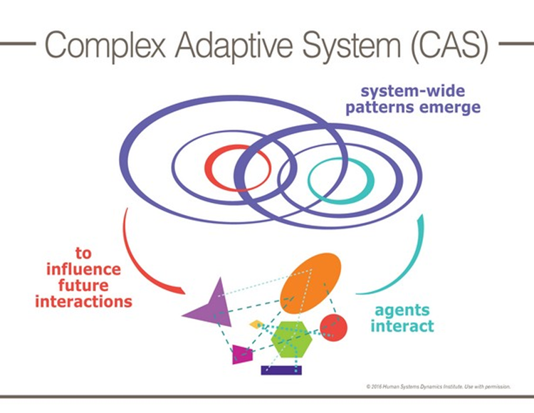
Developing Social Connections is Key for any Successful University Library Technology Service
Connection and Trust is needed among the libraries and campus groups involved in research, technology and learning. This necessarily involves relationship building
Research Universities, IT and university research library environments are Complex Adaptive Systems with non-linear dynamic behavior (William Rouse, Systems Engineer).

Slide 16
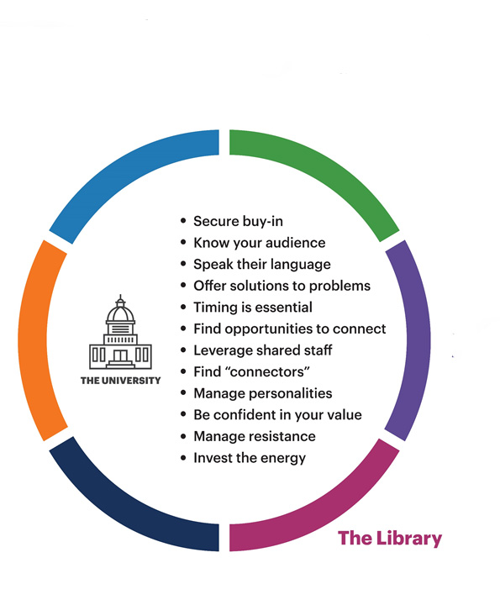
Building Partnerships, Relationships
Trust
Stakeholders, Faculty and Students
Faculty and Students First/Centered
Being Part of the University Community (Getting Out There)
The Circle is the University
Building the Best Learning and Research Environment
“Key takeaways about successful intra-campus social interoperability” by OCLC Research, from Social Interoperability in Research Support: Cross-campus Partnerships and the University Research Enterprise (https://doi.org/10.25333/wyrd-n586), CC BY 4.0

Slide 17


What technological tools and infrastructure do academic libraries need to provide and support to conduct modern research, teaching and learning?
Summary
Core Academic Library Systems, Modern Integrated Library Systems, Currency With New Electronic Resource Discovery Systems
Academic Content Databases and Resources Evolving as Collections into Software as a Service and AI enabled
Learning Commons Possibilities: Multimedia, Digitization, GIS, Digital Video, Digital Literacy, the Makerspace
Digital Scholarly Research Ecosystems for Research Faculty and Graduate Students
Digital Libraries 2.0, Digitization Labs and New Technology Possibilities: Mobile, VR, AR, XR, Holography, AI

Slide 18

What other campus technology Stakeholders should be engaged in the work?
University IT: Core Systems, Distance and Online Learning, Faculty and Student Technology Support, Research or High Performance Computing, Academic Affairs, Office of Research and Sponsored Programs, Development and Advancement, Library Research and Information Services
Keep the University, Learning, Research, Teaching, Faculty and Students Need at the Center

Slide 19

What strategies should one employ to both collaborate with these stakeholders and stake out areas where the library should lead?
Develop Social Connections
Develop and Build Trust
Build Long Term Relationships
Being Part of the University Community
(Getting out There. Presence is half the battle!)

Slide 20
Questions and Comments
Dr. Raymond Uzwyshyn, Ph.D. MBA MLIS
Director, Library Collections and Digital Services
Texas State University Libraries, July 2021

Slide 21
Questions and Comments
Dr. Raymond Uzwyshyn, Ph.D. MBA MLIS
Director, Library Collections and Digital Services
Texas State University Libraries, July 2021

Slide 22
Developing Social Connections is Key for Successful University Library Technology Services
Connections and trust is needed between the libraries and campus groups involved in research, technology and learning. This necessarily involves relationship building
Complex research and learning environments like libraries, technology groups and universities may also be characterized by:
1) Nonlinear dynamic behavior
2) Many Independent agents
3) Goals and behaviors that differ or (heterogenous behavior)
4) highly intelligent learners, able to adapt to achieve personal goals
5) Self organizing groups within established hierarchies to meet evolving needs
6) no single point of control making Centralized efforts challenging.
7) Bottom up and self organizing
Research Universities and university research library environments are Complex Adaptive Systems similar to urban environments (Wiliam Rouse, Systems).

Slide 23
Developing Social Connections is Key for Successful University
Library Technology Services
Connections and trust is needed between the libraries and campus groups involved in research, technology and learning. This necessarily involves relationship building
Research Universities, IT and university research library environments are Complex Adaptive Systems
(William Rouse, Systems Engineer).

Slide 24
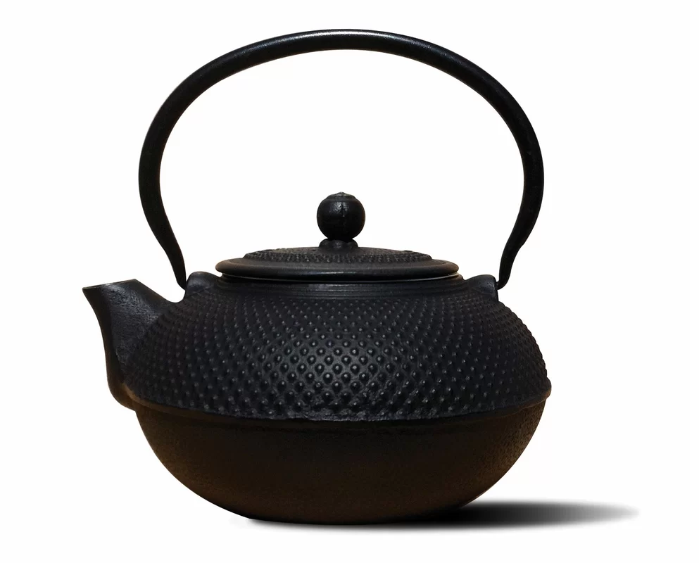


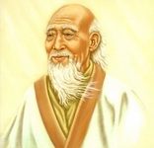
What strategies should one employ to both collaborate with these stakeholders and stake out areas where the libraries should lead?
Be like water. Put water in a teapot, it becomes the teapot. Now, water can flow or it can crash. Be water, my friend.
(Bruce Lee, Be Like Water)
Plants are born tender and pliant; dead, they are brittle and dry. Stiff and inflexible we court death. Flexible and yielding we continue in life. (Lao Tzu)

