Slide 1
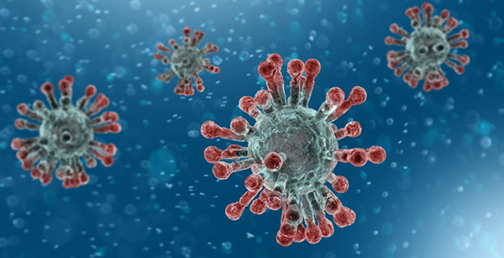
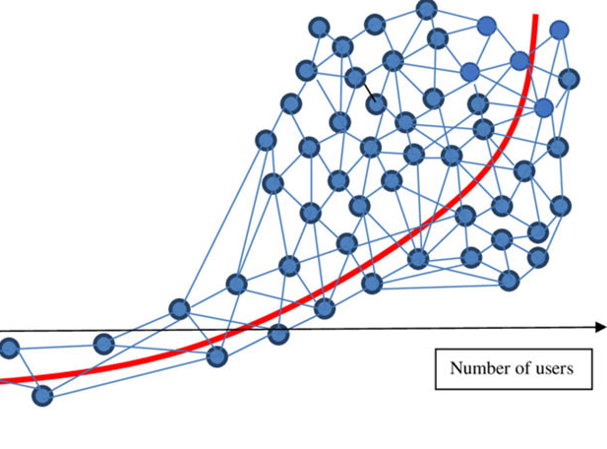
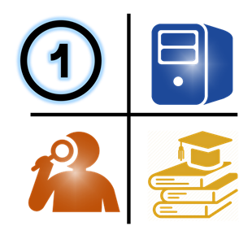
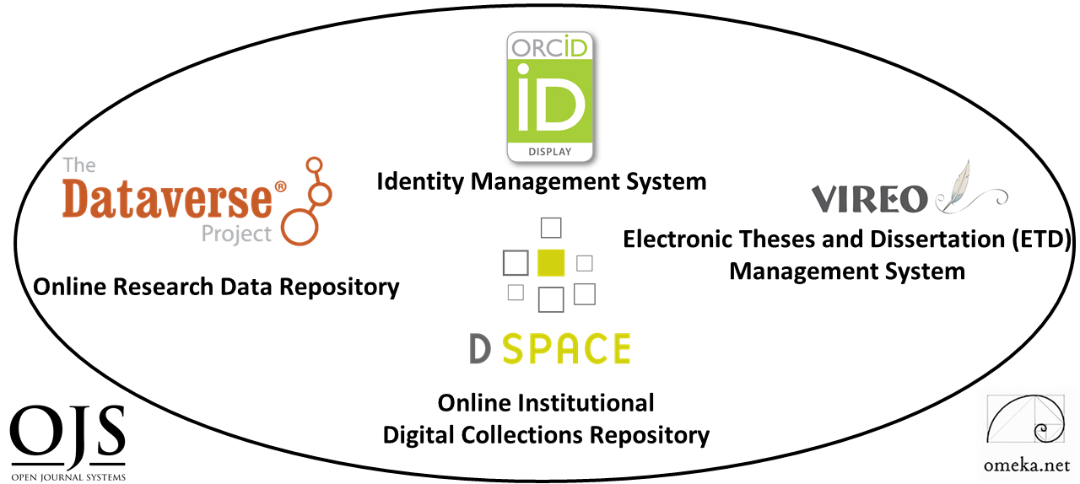
Open Source Digital Ecosystems for Accelerating Global Research, Innovation and Collaboration
(Lightning Talk)
Ray Uzwyshyn, Ph.D. MBA MLIS
http://rayuzwyshyn.net
Director, Collections and Digital Services
Texas State University Libraries
Presented for JROST 2020, Joint Roadmap for Open Science Tools, December 2020
Notes:
Successful Local Working Ecosystem we have at Texas State
and Future Visioning for Big Picture Possibilities

Slide 2

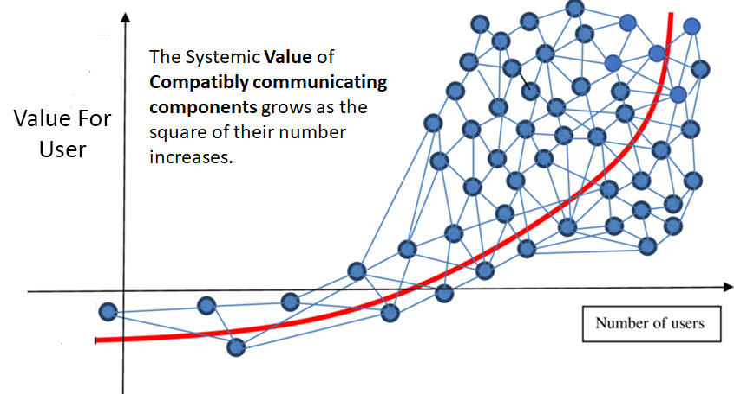

Can We ‘Better’ Enable Scholarly Research Network Ecosystem Possibilities on Global Levels?
Is it Time to Begin Thinking ‘Systematically’ About Empowering a Global Research University Community ?

Slide 3


Research University Statistics
~266-300 Research Institutions US & Canada
Carnegie R1 & R2, Very High or High Research Activity with associated Research library infrastructures
~Estimated 1000-1250 Research Intensive Universities Worldwide
QS Rankings and Times Higher Education Supplement. (40% Europe, 26.5% Asia Pacific, US/Canada 18%, Latin America 10.8% and Middle East/Africa 7%.
Is it possible to Enable Top 2-3% Research Institutions Globally, ~ 1000 Institutions with Open Digital Research Ecosystems
(Institutions beyond the few universities who already possess these)

Slide 4

How do We Define an Open Digital Scholarship Research Ecosystem?
Network of Several Software Components to Enable Research Faculty and Graduate Students to Accelerate Research, Innovation and Global Collaboration
Texas State University Digital Research Ecosystem
Notes:
Ecosystem Metaphor Look at Relationships in the Digital Environment
Specifically Focuses Upon the Discrete Component Relationships with the Networked Digital Environment

Slide 5
General Software Characteristics of an Open Digital Scholarship Ecosystem
Customizable Components
(Easy Configurability, Connectivity)
Active Developer Communities
Open Source Software
Texas State University Research Ecosystem
(General Overview)

Slide 6


What Classes of Open Source Software Components are needed to create a digital scholarship ecosystem?
TWO PRIMARY
DIGITAL COLLECTIONS REPOSITORY (Dspace)
FOUR TERTIARY
Electronic Thesis and Dissertation Management System (VIREO)
User Interface/Content Management Software (OMEKA)
Identity Management System (ORCID)
Academic Journal Software (OJS3)
RESEARCH DATA REPOSITORY (Dataverse)
Content
Communication
Texas State University Libraries Digital Research Ecosystem
(Technical/Software Overview)

Slide 7
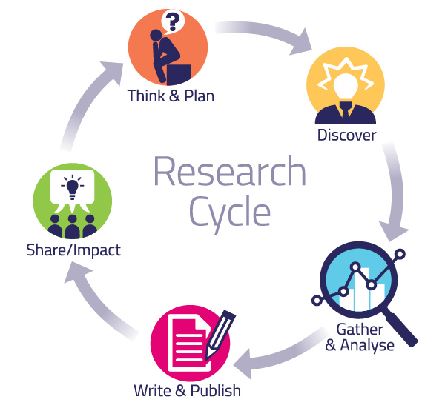
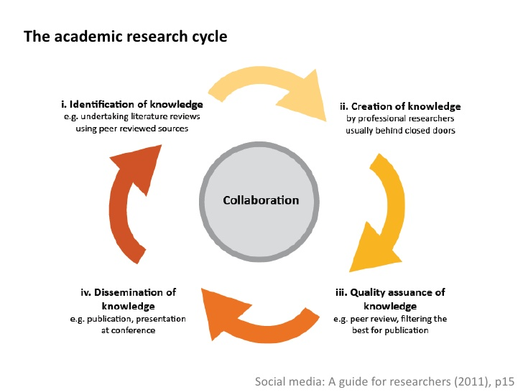
Together, these Digital Ecosystem Components
Enable the Academic Research Cycle
Pragmatic Levels
Abstract Levels

Slide 8
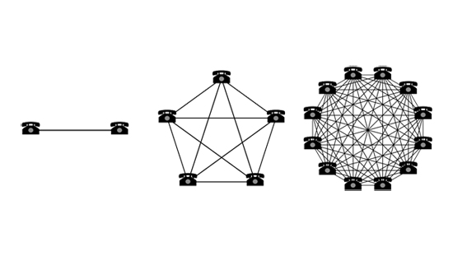
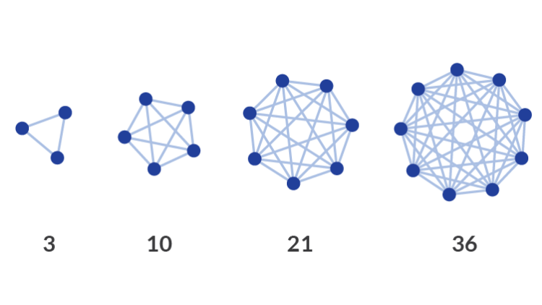

Collocating Open-Source Digital Components in a Networked Research Environment Enables Larger Connections and/or Network Effects,
Accelerating Research, Collaboration and Innovation
(Further Contextualization)
Simple Larger Idea
Notes:
Ecosystem Metaphor Look at Relationships in the Digital Environment
Specifically Focuses Upon the Discrete Component Relationships with the Networked Digital Environment

Slide 9
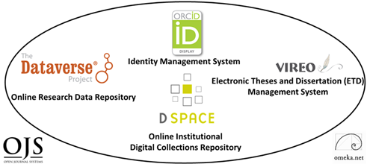
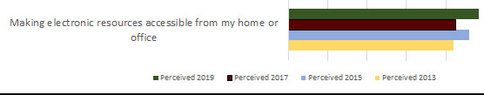
Quantitative and Qualitative Assessment, 2014-2020
This Digital Research Ecosystem Shows Very Strong and Continued Potential for Growth
Research Ecosystem Implemented at Texas State University, 2014-2019
System | 2014 | 2015 | 2016 | 2017 | 2018 | 2019
Downloads
DSpace | 326,762 | 318,742 | 385,163 | 341,224 | 972,359 | 1,010,349
ETDs | 136,985 | 158,240 | 200,373 | 328,420 | 470,437 | 505,658
Dataverse | n/a | n/a | n/a | 455 | 3,451 | 2,043
Number of Items
DSpace | 1,340 | 1,437 | 1,546 | 1,660 | 2,135 | 2,720
ETDs | 967 | 1,174 | 1,326 | 1,581 | 1,789 | 2,218
Dataverse | n/a | n/a | n/a | 28 | 33 | 53
ORCID IDs
ORCID | 101 | 190 | 316 | 438 | 545 | 669
Hosted Journals
OJS | 1 | 1 | 2 | 2 | 3 | 4
Annual Usage, Downloads, Number of Items, ORCID ID’s and Online Academic Journals Added
LibQual Biannual Survey 2013-2019, Faculty and Student System Perceptions, Comments

Slide 10


Many Beneficial Internal and External Effects of Such a System
Research
Institution A
Research
Institution B
Externally, this ecosystem enables collaborative opportunities among Researchers and Research Institutions
Internally, these digital components significantly raise and optimize search engine rankings (SEO) for researchers and their research
Research
Institution C

Slide 11
Pragmatically, how do you enable a larger set of research institutions globally?
(Top 2-3% Research Institutions, ~1000 Institutions and Research Libraries, ~ 90% of Research Universities Globally)
This is from a Larger Set of 26,000-40,000 Universities Globally. Research Universities 2.7% - 4.2% of all universities worldwide. Highest by Country: US 156, UK 76, Germany 45, Japan 44.

Slide 12





One Server Per Research University Initiative
2021-2025, V 1.0
Vision
Give ~ 1000 Research Universities/Academic Libraries Globally:
1 Configured Research Ecosystem Server with 6 Open-Source Research Ecosystem Software Components < $1000.00 US/Server or set up Fractional Server Space in the Cloud with Mirror Sites Globally (SAAS)
Hold Weeklong trainings over 6 continents
Create a global help network to get the institutions and academic libraries started
After Five Years, Gage Effects for Global Research!

Slide 13
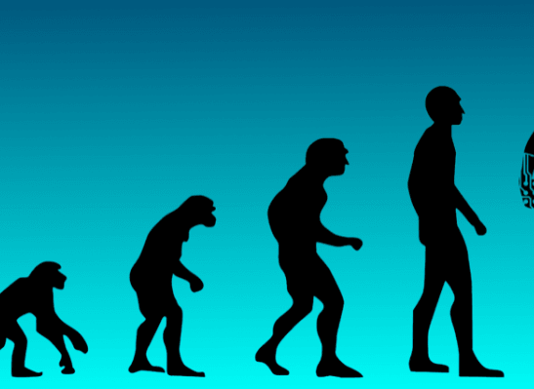
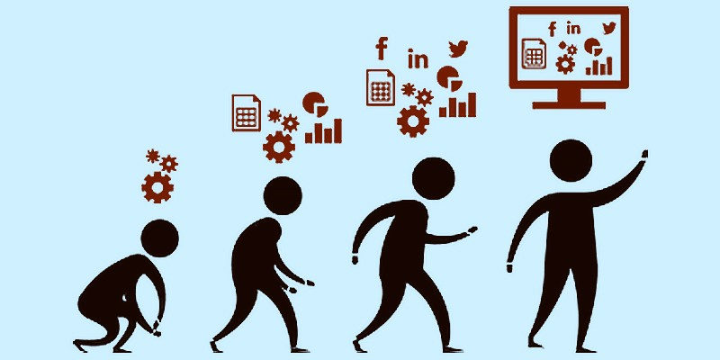
Summary Statements
Placing Open-Source Research Software Components within a Global Digital Ecosystem:
Accelerates Global Collaboration, Research Impact and Possibilities for New insights and Innovation
Opens a New Paradigm For Research Accessiblity, Retrieval and Sharing
Creates Evolutionary Milestones for Research Ecosystems Development
Enables a New Global Roadmap For the Forward Progress of Knowledge in the 21st Century.
Open Source Global Digital Research Ecosystems are needed, innovative and pragmatically possible to implement on global levels today.

Slide 14
Further References
Papers Presentations
& Working Examples
Uzwyshyn, R. 2020 Developing an Open Source Digital Scholarship Ecosystem (Preprint). ICEIT2020. Oxford, UK. February, 2020
Open Digital Research Ecosystems: How to Build Them and Why . Computers in Libraries, (40) 8. November 2020.
Digital Research Ecosystems for Open Science (Presentation). AI for Data Discovery, Reuse & Open Science Symposium. Carnegie Mellon University. October 20, 2020.
Open Source Tools for a Digital Research Ecosystem (Interview). Campus Technology C-Level View. Feature Interview. May 11, 2020.
Developing a Digital Scholarship Research Ecosystem. (PDF) Association of Southeastern Research Libraries Member's Webinar, April 29, 2020.
Working Ecosystem Examples
Texas State University Libraries Digital Scholarship Ecosystem.
Texas State Digital Collections Repository
Texas State Data Research Repository
Texas State Online Research Identity Management System (ORCID)
Texas State Electronic Thesis and Dissertation Management (VIREO
Open Journal Systems @ Texas State

Slide 15

Further Links to Open Source
Software & Downloads
Referenced
Digital Collections Repository: Dspace
https://duraspace.org/dspace/
Data Repository: Dataverse
https://dataverse.org/
Content Management System: Omeka
https://omeka.org/
Academic Journal Software:
Open Journal Systems 3
https://pkp.sfu.ca/ojs/
Identity Management Software: ORCID
https://orcid.org/
Electronic Thesis and Dissertation Management Software: Vireo
https://www.tdl.org/etds/

Slide 16
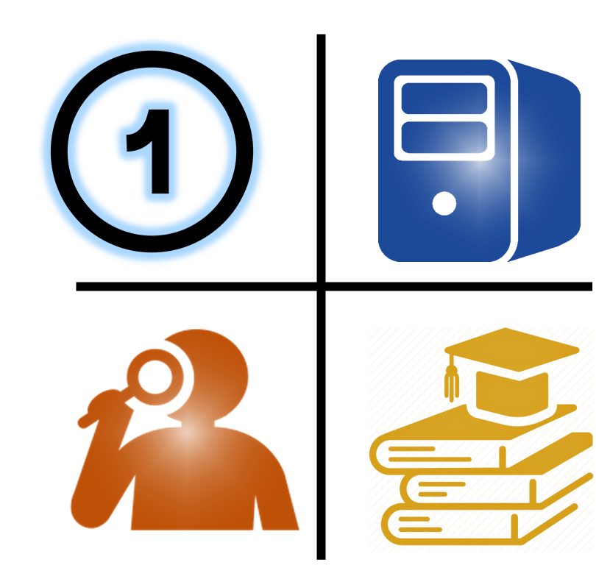

Questions and Comments
Ray Uzwyshyn, Ph.D. MBA MLIS
Director, Collections and Digital Services
Texas State University Libraries
ruzwyshyn@txstate.edu, 512-245-5687
http://rayuzwyshyn.net
Notes:
Funders and Foundations
with global vision and a passion for solving one of the 21st Centuries Grand Challenges for Global Research

Slide 18


Future
Pathways
Networked Global Scholarly Research Environment

Slide 19
Research Universities and Digital Research Ecosystems
~266-300 Research Institutions US & Canada,
Carnegie R1 & R2, Very High or High Research Activity, 124 ARL Libraries
~1000-1250 Research Universities Worldwide
QS Rankings and Times Higher Education Supplement. (40% Europe, 26.5% Asia Pacific, US/Canada 18%, Latin America 10.8% and 7% Middle East/Africa.
Larger Set of 26,000-40,000 Universities Globally. Research Universities 2.7% - 4.2% of all universities worldwide. Highest by Country: US 156, UK 76, Germany 45, Japan 44.
Enable Top 2-3% Research Institution Academic Libraries Globally, 1500 Institutions including the US and Canada. This represents ~ 90% of Research Libraries Globally

Slide 20
Together, These Research Ecosystem Components
Open Amazing Possibilities For Digital Scholarship & Collaboration
Complexity
Complex Multimedia Archives/Cognitive Cartographies
Digital Archives/ETD Projects
Online Exhibits/ Online Academic Journals
Interactive Image Archives/Data Projects
Digital Libraries, Research Documentation Projects
Faculty Digitization Proposals/Partnerships
Projects,Prototypes Grant Partnerships

Slide 21
Network Effects
Both In and Between Individual Components and In and Among Component Networks
ORCID Aggregates from Several Sources and Networks and Connects to Other Networks, Internal and External
OMEKA can act as a middleware front end connecting several components and component networks internally.
3) Digitization Lab’s IIIF Framework can create internal or globally distributed Image Libraries.
4) Dataverse can be configured as a single Instance or as a Consortial Model (Texas 22 Individual Instances, TDL)

Slide 22
Research Universities and Digital Research Ecosystems
~266-300 Research Institutions US & Canada,
Carnegie R1 & R2, Very High or High Research Activity, 124 ARL Libraries
~1000-1250 Research Universities Worldwide
QS Rankings and Times Higher Education Supplement. (40% Europe, 26.5% Asia Pacific, US/Canada 18%, Latin America 9% and Middle East/Africa.
26,000-40,000 Universities Globally. Research Universities 2.7% - 4.2% of all universities worldwide. Highest by Country: US 156, UK 76, Germany 45, Japan 44.
Other Top 2-3% Research Institution Academic Libraries Globally, 1000 Institutions beyond the US and Canada. This represents the other 90% of Research Libraries Globally

Slide 23
Research Universities and Digital Research Ecosystems
124 ARL Research Libraries (US and Canada)
131 US Research Universities (Carnegie R1, Very High Research Activity)
135 Doctoral Universities (Carnegie R2, High Research Activity, US), ~266-300 Research Institutions US & Canada
1011 Research Universities Worldwide (40% Europe, 26.5% Asia Pacific, US/Canada 18%, Latin America 9% and Middle East/Africa.
QS Rankings
1250 Research Universities Worldwide, Times Higher Education Supplement (2.7% - 4.2% of all universities worldwide)
By Country: US 156, UK 76, Germany 45, Japan 44
Global Estimates of General University #’s 26,000-40,000
Empower Other Top 2-3% Research Institution Libraries Globally,
1000 Institutions, the other 90% of Research Libraries Globally

Slide 24


One Laptop Per Child Initiative
Dreamed up mid-late 90’s, Launched 2005
Antecedent ‘Big Idea’ Model
MIT Media Lab Director Nicholas Negroponte
Vision: Give each child in world access to a laptop with open source software for less than 100.00 $US/laptop
Gage Global Effects For Education
Why not try something similarly worthy, noble and significant for academic research institutions globally?

Slide 25


One Server Per Research University Initiative
2020-2025, V 1.0
Vision: Give ~ 1000 Research Universities Globally One Configured Research Ecosystem Server: 6 Open Source Research Software Components, set up weeklong trainings over 5 continents and a help network
< $1000.00 US/Server or set up Fractional Server Space in the Cloud with Mirror Sites Globally (SAAS)
Gage Global Effects for Research!

Slide 26
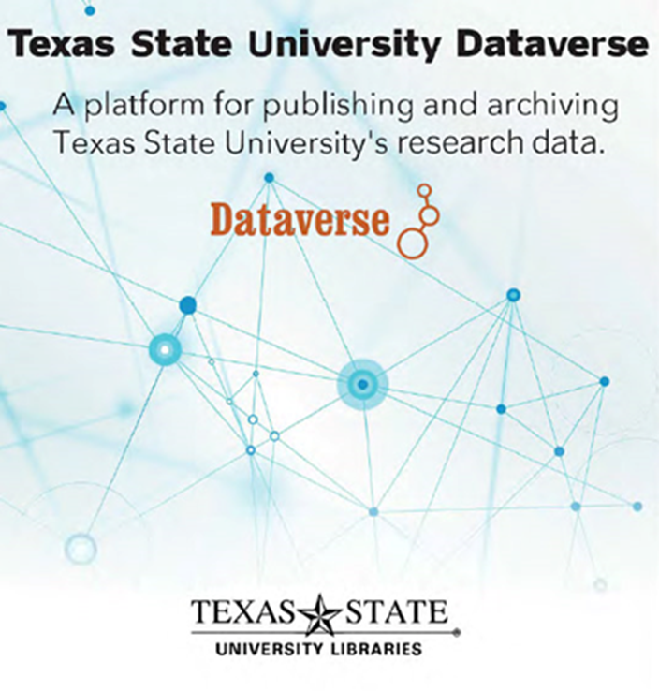
#1 Component for Open Science,
Research Data Repository
https://dataverse.tdl.org/dataverse/txstate

Slide 27
Research Data Repository
https://dataverse.tdl.org/dataverse/txstate

Slide 28
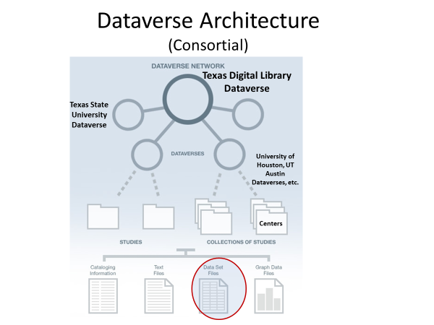
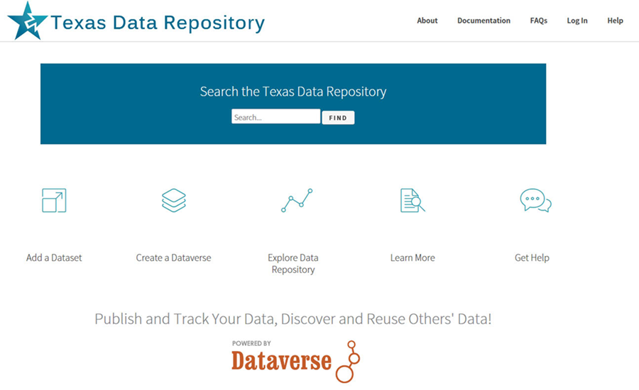
Dataverse can be configured as Single Instance or as a Consortial Model
(Texas Aggregates
22 Individual Instances, through the Texas
Digital Library)
https://dataverse.tdl.org/

Slide 29
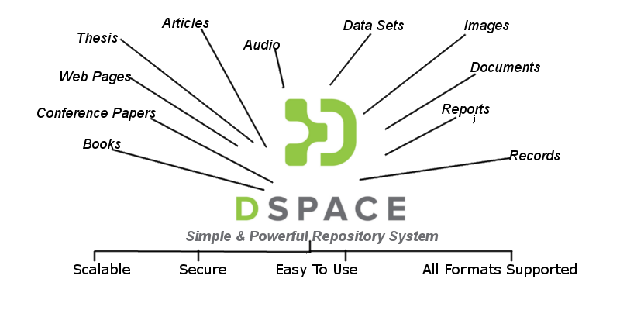
#2 Institutional Digital Collections Repository (Dspace)
Organizes, centralizes and makes accessible
research and knowledge generated by the institution’s research community (Research Faculty and Graduate Students):
Pre-prints
Faculty Publications
White Papers
Conference Presentations
Graduate Student Theses
and Dissertations

Slide 30
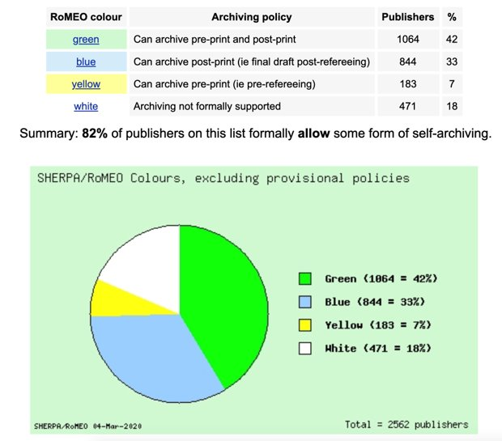
A Vast Majority of Publishers Allow Digital Archiving
in some form. (82% from 2562 publishers)
March 2020 Sherpa/Romeo Copyright Polices & Self Archiving
Source: www.sherpa.ac.uk/romeo/statistics.php?la=en&fIDnum=|&mode=simple
Clicto adtext

Slide 31
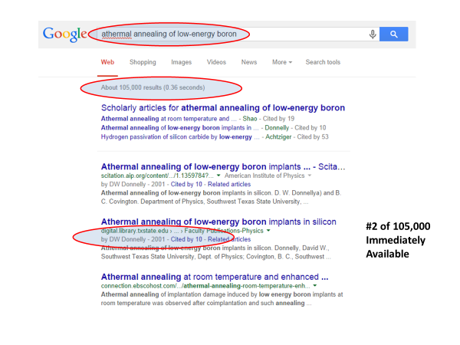
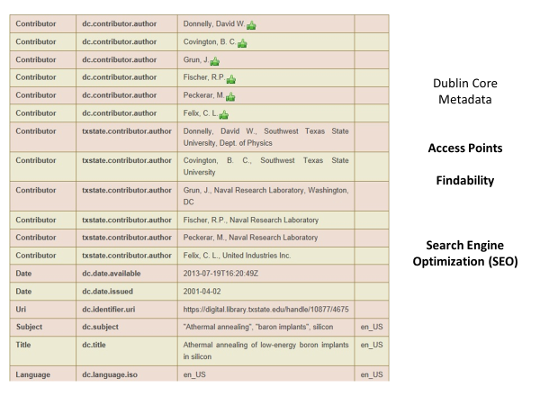


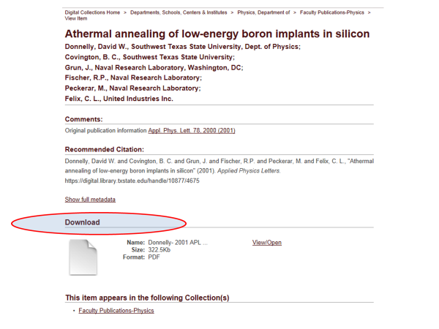
Primary Use Case Value
Application of Structured Metadata Schema for Search Engine Optimization

Slide 32
https://digital.library.txstate.edu/

Slide 34
Percent Increase in Article Citations by Discipline with Open Access Online Availability Through Google
Range = 36%-250% Increase in Citations over 2 Year period
(Data: Stevan Harnad and Heather Joseph, 2014)

Slide 35
Percent Increase in Article Citations by Discipline with Open Access Online Availability Through Google
Range = 36%-250%
(Data: Stevan Harnad and Heather Joseph, 2014)

Slide 36

Vireo
Electronic Thesis and Dissertation Management System
Bridges Student Thesis/Dissertation Submission with Graduate School Review,
Connects the Collections Repository And Data Repository so graduate students can publish and link their theses/dissertations, data and research
Addresses Intermediary steps in the ETD Process

Slide 37
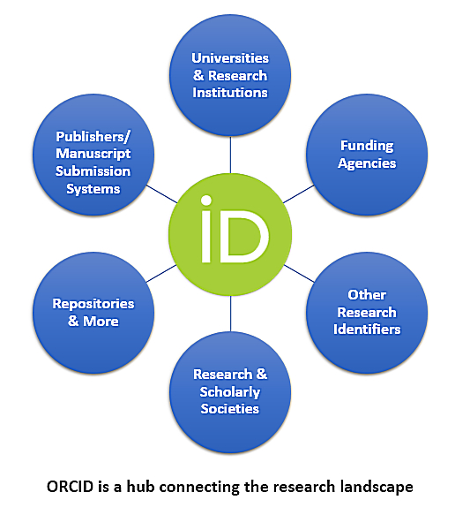

Researcher Identity Management System
Gives Researchers Unique Number (ORCID ID) Connecting and Disambiguate Scholars names:
Maria Hernandez, Biochemist
Maria Hernandez, M.D. or Astrophysicist
Allows Papers in the collections repository and datasets in data repository to be associated with ORCID ID’s for aggregation of research profiles.
Orcid can act as a Network Hub aggregating from several sources and connecting to other internal and external networks

Slide 38


Omeka and OJS3
Open Source User Interface Software
Provides a front end gateway for more complex research projects - linking text, image media and datasets and acting as a front end for connecting components.
Open Access Academic Journal Software for refereed journal online publishing, workflow and connections with background research and datasets etc. through Dataverse/Dspace connections

Slide 39

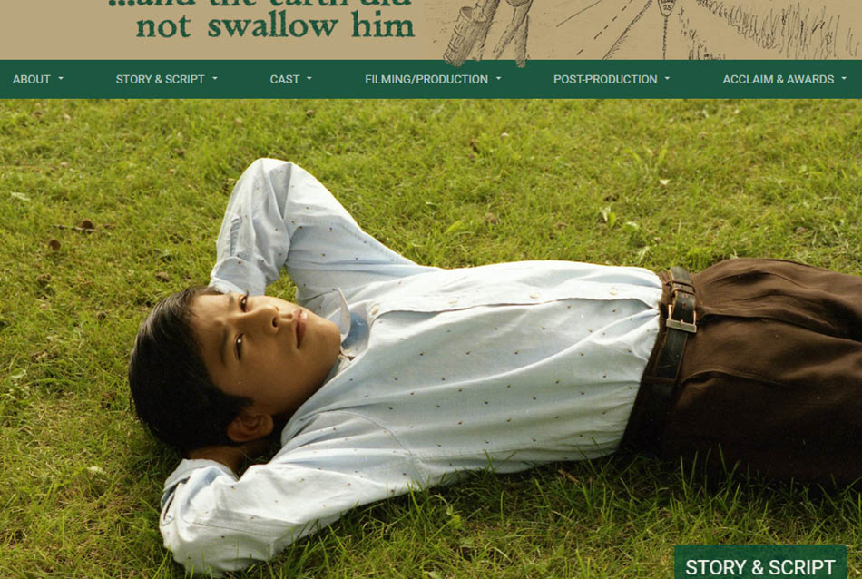
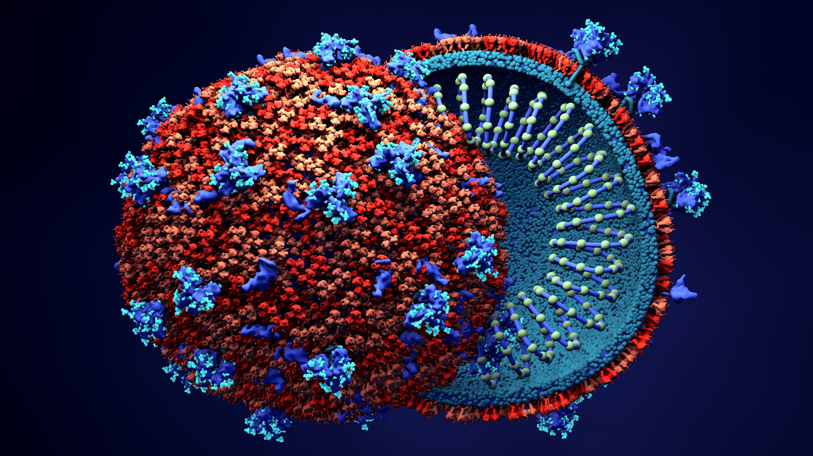
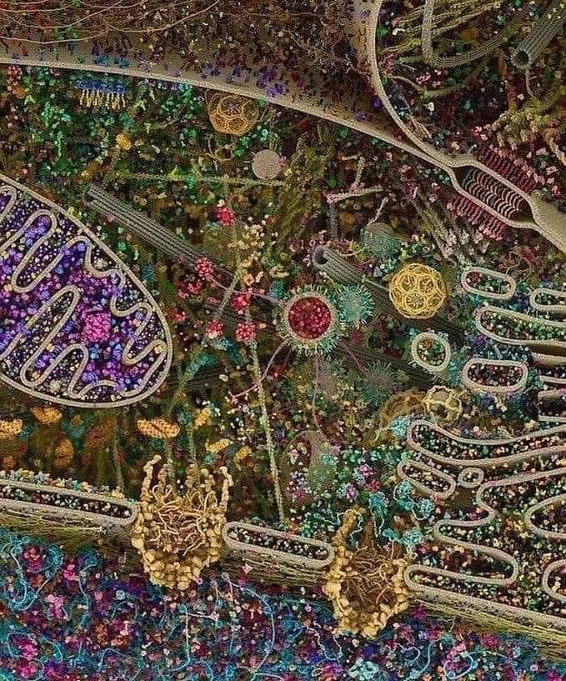
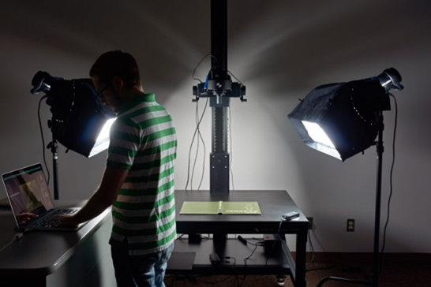

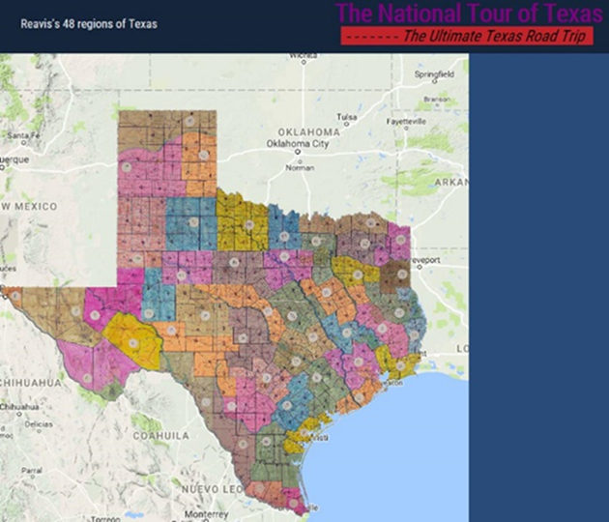
The Digitization Lab
Expands Possibilities for depth of Faculty/Graduate Student Research Projects
Possibilities range from OCR, scientific slides, GIS image, manuscript & journal digitization to 3D objects, audiovisual material and visualization technologies

Slide 40

Human Resources
Essential
System Administrator/Programmer
server infrastructure set-up/maintenance/basic customization
Digital Collections Librarian: Administration, Marketing, User Support, Collections and Data Repository, OJS/ORCID
Optional as System Expands
Metadata Librarian: Dublin Core, Specialized Schema
Web Developer/Programmer: OMEKA, System Integration
Project Manager/Department Head (PMP Certification)
Digitization Specialist
GIS Specialist/Data Visualization Specialist
AI Specialist/Post-Doc/CLIR Fellow

Slide 41


Implementation Paths
For Open Science
(Many Roads To Rome for Timelines, 1-5 Year Paths)
Year 1
Data Repository and Digital Collection Repository
Year 2
User Interface Software (OMEKA), Identity Management System, ORCID
Year 3
Digitization Lab
Year 4
ETD Middleware (VIREO) and OJS Software
Year 5
Complex Digitization Projects, IIIF Server, Faculty Grant Projects etc.

Slide 42

Questions, Comments and
Funders and Foundations with global vision and a passion for solving one of the 21st Centuries Grand Challenges for Global Research
Ray Uzwyshyn, Ph.D. MBA MLIS
Director, Collections and Digital Services
Texas State University Libraries
ruzwyshyn@txstate.edu, 512-245-5687
http://rayuzwyshyn.net

