Slide 1
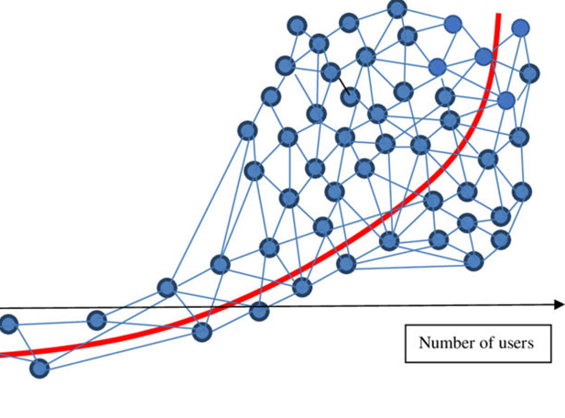
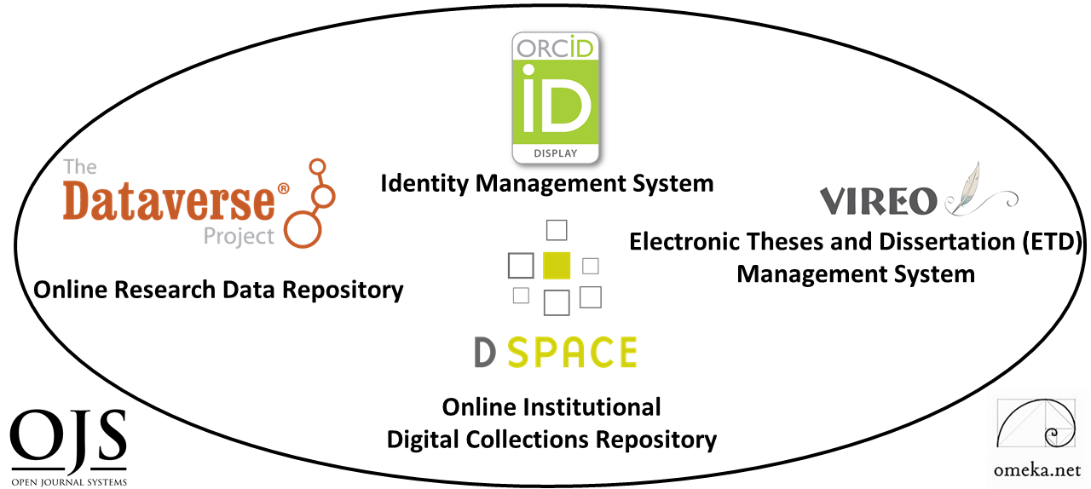
Digital Scholarship
Ecosystems for Open Science
Lightning Talk
Ray Uzwyshyn, Ph.D. MBA MLIS
http://rayuzwyshyn.net
Director, Collections and Digital Services
Texas State University Libraries
Presented for AI for Data Discovery, Reuse and Open Science Symposium, Carnegie Mellon University
October 20, 2020

Slide 2
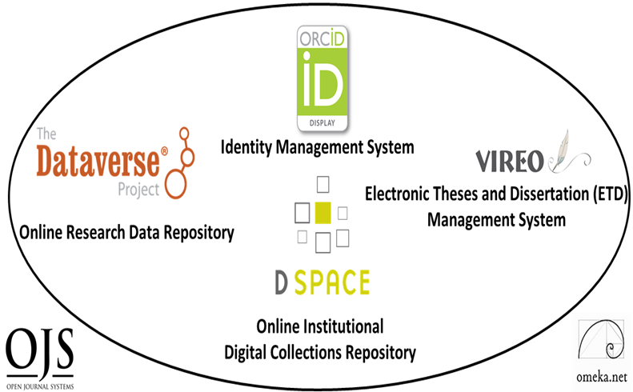

What is a Digital Scholarship Ecosystem for Open Science?
Network of Several Software Components to Enable Research Faculty and Graduate Students and Raise Research Profiles
Notes:
Ecosystem Metaphor Look at Relationships in the Digital Environment
Specifically Focuses Upon the Discrete Component Relationships with the Networked Digital Environment

Slide 3
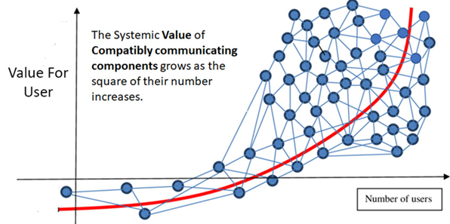
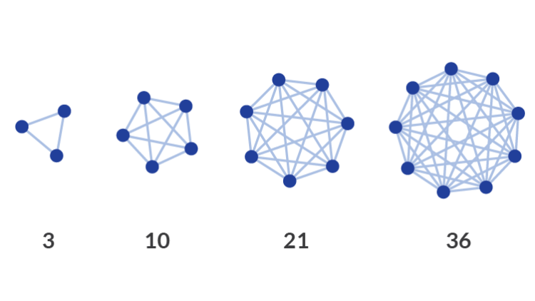

Collocating Open Source Digital Components in a Networked Research Ecosystem Enables Larger Connections and/or Network Effects raising the value for the researcher
Simple Larger Idea
Notes:
Ecosystem Metaphor Look at Relationships in the Digital Environment
Specifically Focuses Upon the Discrete Component Relationships with the Networked Digital Environment

Slide 4
What are the General Characteristics of this Digital Scholarship Ecosystem?
Customizable Components
Active Developer Communities
Open Source Software

Slide 5

Digital Scholarship Ecosystem Consists of Six Open Source Software Components
2 PRIMARY
Digital Collections Repository
4 TERTIARY
Research Data Repository
Electronic Thesis and Dissertation Management System
User Interface/Content Management Software
Identity Management System
Open Academic Journal Software

Slide 6
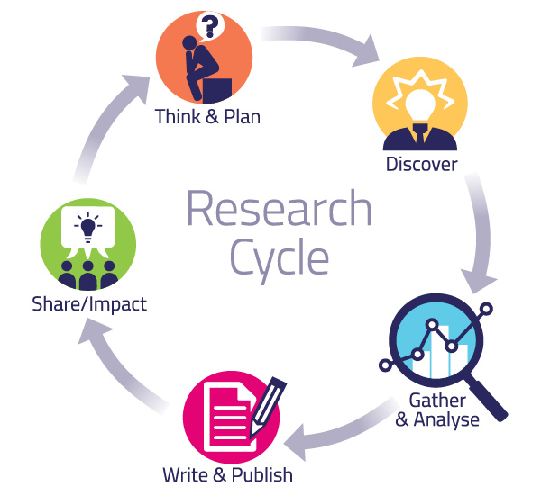
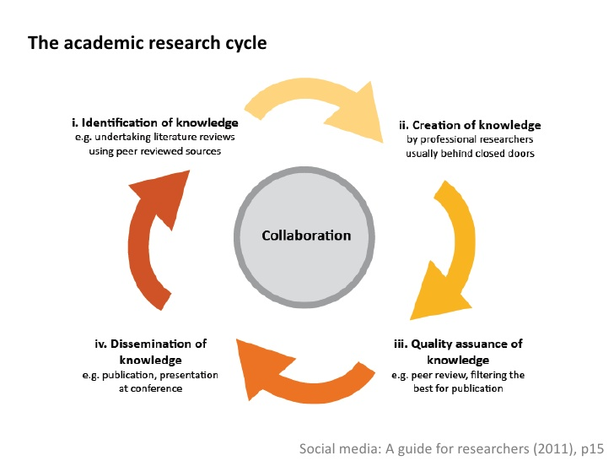
Digital Ecosystem Components Together
Enable the Academic Research Cycle
Pragmatic Levels
Abstract Levels

Slide 7
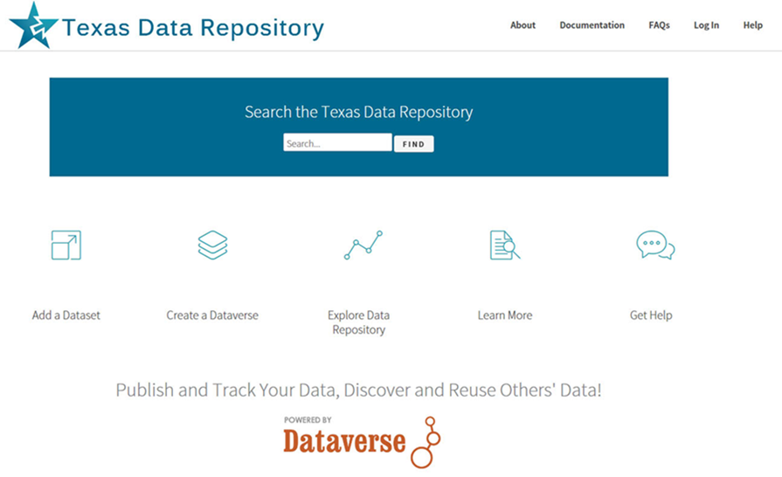

#1 Research Data Repository
https://dataverse.tdl.org/dataverse/txstate

Slide 8
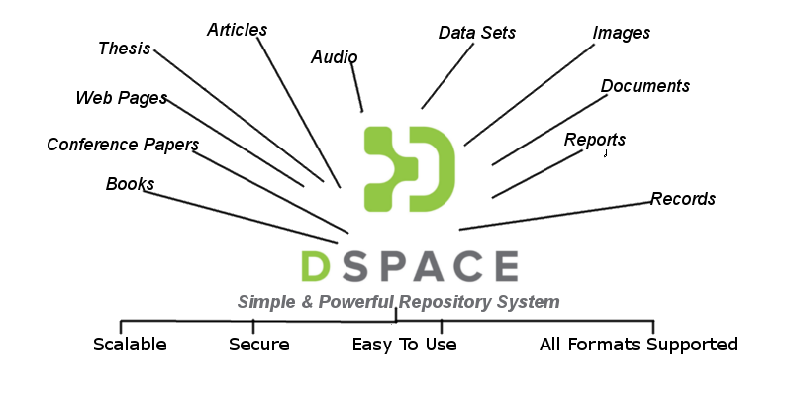
#2 Digital Collections Repository (Dspace)
Organizes, centralizes and makes accessible
research and knowledge generated by the institution’s research community (Research Faculty and Graduate Students):
Pre-prints
Faculty Publications
White Papers
Conference Presentations
Graduate Student Theses
and Dissertations

Slide 9




Tertiary Components
(OJS3, Vireo, Omeka & ORCID)
Open Access Academic Journal Software for refereed online journal creation and connections with background research and datasets (i.e. Dataverse/Dspace)
Electronic Thesis and Dissertation Management System bridging the Graduate School Review process and connecting with the Collections and Data Repositories
User Interface/Content Management Software providing a gateway for complex research projects - linking text, image media and datasets.
Research Identity Management System giving researchers Unique ORCID ID’s to disambiguate names and allow aggregation of research profiles.

Slide 10
Together, These Research Ecosystem Components
Open Amazing Possibilities For Digital Scholarship & Collaboration Opportunities
Complex Multimedia Archives
(Cognitive Cartographies)
Digital Archives/ETD Projects
Online Exhibits/ Online Academic Journals
Interactive Image Archives/Data & Research Projects
Digital Libraries, Research Documentation Projects
Faculty Digitization Proposals/Partnerships
Complexity
Projects,Prototypes Grant Partnerships

Slide 11
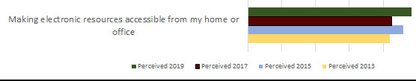
Assessment and Results
Quantitative and Qualitative Measures
Annual Usage Growth
(Downloads, Number of Items, ORCID ID’s
and Hosted Journals)
LibQual Biannual Survey 2013-2019, Faculty and Student System Perceptions, Comments
Ecosystem Implemented in Stages, 2014-2019
System | 2014 | 2015 | 2016 | 2017 | 2018 | 2019
Downloads
DSpace | 326,762 | 318,742 | 385,163 | 341,224 | 972,359 | 1,010,349
ETDs | 136,985 | 158,240 | 200,373 | 328,420 | 470,437 | 505,658
Dataverse | n/a | n/a | n/a | 455 | 3,451 | 2,043
Number of Items
DSpace | 1,340 | 1,437 | 1,546 | 1,660 | 2,135 | 2,720
ETDs | 967 | 1,174 | 1,326 | 1,581 | 1,789 | 2,218
Dataverse | n/a | n/a | n/a | 28 | 33 | 53
ORCID IDs
ORCID | 101 | 190 | 316 | 438 | 545 | 669
Hosted Journals
OJS | 1 | 1 | 2 | 2 | 3 | 4

Slide 12
Further References,
Papers
& Working Examples
Uzwyshyn, R. 2020 Developing an Open Source Digital Scholarship Ecosystem (Preprint). ICEIT2020. Oxford, UK. https://www.researchgate.net/publication/336923249_Developing_an_Open_Source_Digital_Scholarship_Ecosystem
Texas State University Libraries Website. https://www.library.txstate.edu/
Texas State Digital Collections Repository https://digital.library.txstate.edu/
Texas State Data Research Repository https://dataverse.tdl.org/dataverse/txstate
Texas State Online Research Identity Management System:
https://guides.library.txstate.edu/researcherprofile/orcidTexas State Electronic Thesis and Dissertation Management (VIREO): https://www.tdl.org/etds/
Texas State Digital & Web Services:
https://www.library.txstate.edu/services/faculty-staff/digital-web-services.html

Slide 13
Further Links to Open Source
Software & Downloads
Dspace
https://duraspace.org/dspace/
Dataverse
https://dataverse.org/
Omeka
https://omeka.org/
Open Journal Systems 3
https://pkp.sfu.ca/ojs/
ORCID
https://orcid.org/
Vireo
https://www.tdl.org/etds/

Slide 14
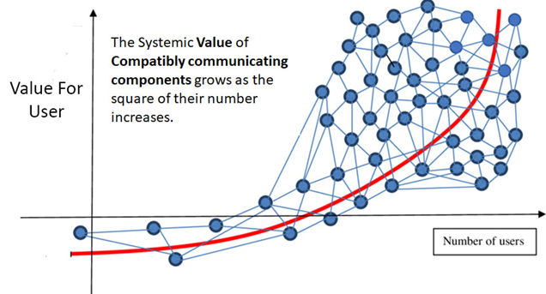
Questions, Comments
Ray Uzwyshyn, Ph.D. MBA MLIS
Director, Collections and Digital Services
Texas State University Libraries
ruzwyshyn@txstate.edu, 512-245-5687
http://rayuzwyshyn.net

