Slide 1
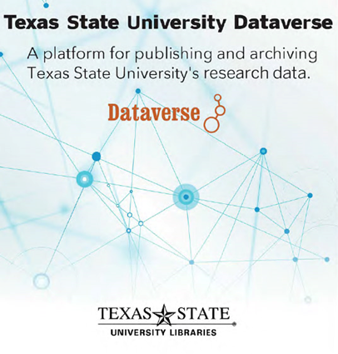
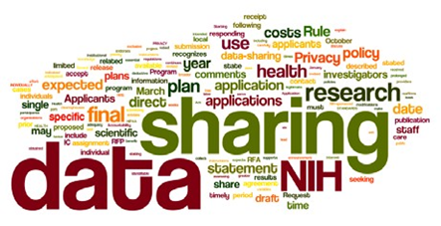
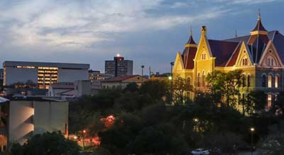
Research Data Repositories
Developing and Implementing Infrastructures for Institutional and Consortial Environments
Ray Uzwyshyn, Ph.D. MBA MLIS
Director, Collections and Digital Services,
Texas State University Libraries

Slide 2

Online Data Research Repositories
What are They?
Way to Manage a Researcher’s Data/Metadata
Permalinking Strategy for Data Citation
Way to Manage Federal Grant Compliance
Middle-Term Data Archiving and Sharing Strategy

Slide 3
The Research Data Repository Lifecycle
Becoming part of Science, Social Science and Humanities Research Process
Promotes: accuracy, efficiency, sharing

Slide 4
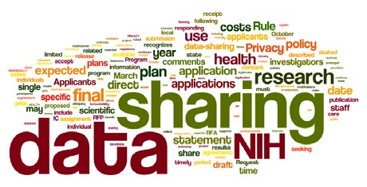
Why are Data Management Repositories Necessary?
Most major Federal grant agencies require data access as mandatory part of the grant proposal/oversite process. (NIH, NSF, NEH,USDA)
Wordle of the Final NIH Statement on Sharing Research Data, Mandatory 2003

Slide 5
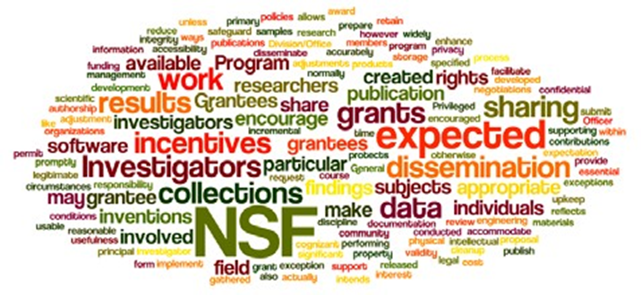
What makes Data Management Repositories useful?
Makes available faculty, departmental and institutional research
Allows publication of negative data (lessens research replication)
Wordle of the National Science Foundation’s Award and Administration Guide. Chapter VI.D.4, Mandatory 2011

Slide 6

Types of Research Data Repositories
1) Project specific
large single faculty/ team projects
2)Discipline specific
i.e. Purdue Nanohub/Nanotechnology
3) Institutional or Consortial
(either institution wide or consortial repositories)

Slide 7
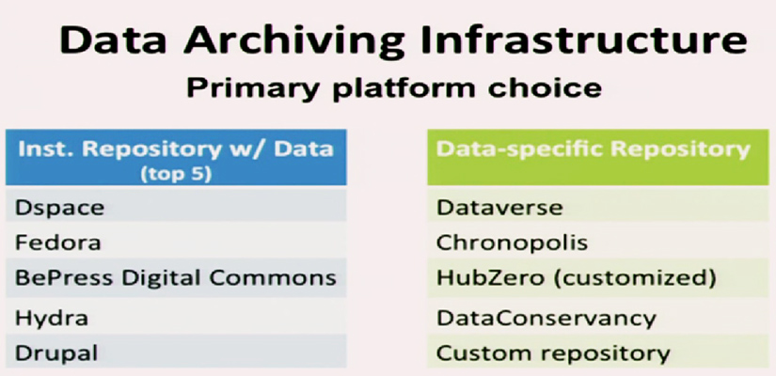
All-Purpose and Specialized
Data Repository Platforms
Fearon, D & Sallans, A. C. (January 2014) Institutional Research Data Management: Policies, Planning, Services and Surveys. Coalition for Networked Information. https://www.youtube.com/watch?v=rvbrW7S2fes (54 ARL Libraries currently offer data management services_)

Slide 8
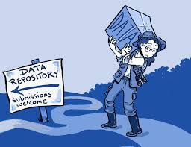
Research Data Repository
Software Characteristics
Hosted or on a server
Software contains management and collaborative options
Open source or proprietary software
Wide Variety of Data Types
(Excel to SPSS to various disciplinary specific formats)

Slide 9
Part I: Planning Your Repository
Environmental Scan of Needs for Your Institution or Consortium
Evaluation Criteria
System Performance/ Robustness
Usability
an active open source community
Gather Finalists:
Harvard’s Dataverse, Purdue’s Hubzero Figshare
Make Final Choice: Harvard’s Dataverse
Data Repository
Working Group Report
(August 28, 2015)

Slide 10
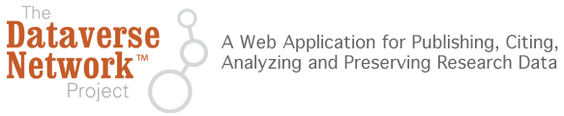

Dataverse
Harvard’s Open Source Research Data Solution
Data sharing, data citation, data publishing and versioning management
Social Sciences Beginnings (IQSS)
Data Science (site)
http://thedata.org
Dataverse Open Source Download (Github), Software Background

Slide 11
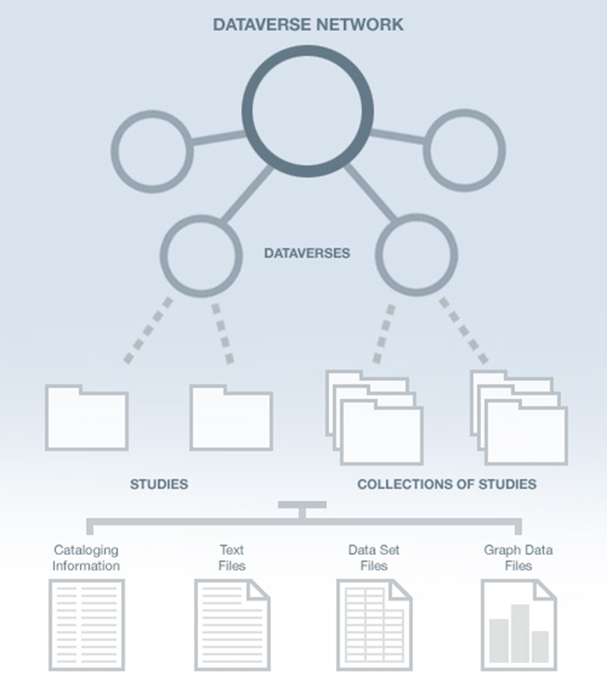
Dataverse Architecture
(Consortial)
Texas Digital Library
Dataverse
Texas State University
Dataverse
University of Houston, UT Austin Dataverses, etc.
Centers
Research Study Data
Original Data Set Files
Metadata
Paratextual Materials
(Methodology, Field Notes , Multimedia, Graphs, Programs etc.)

Slide 12
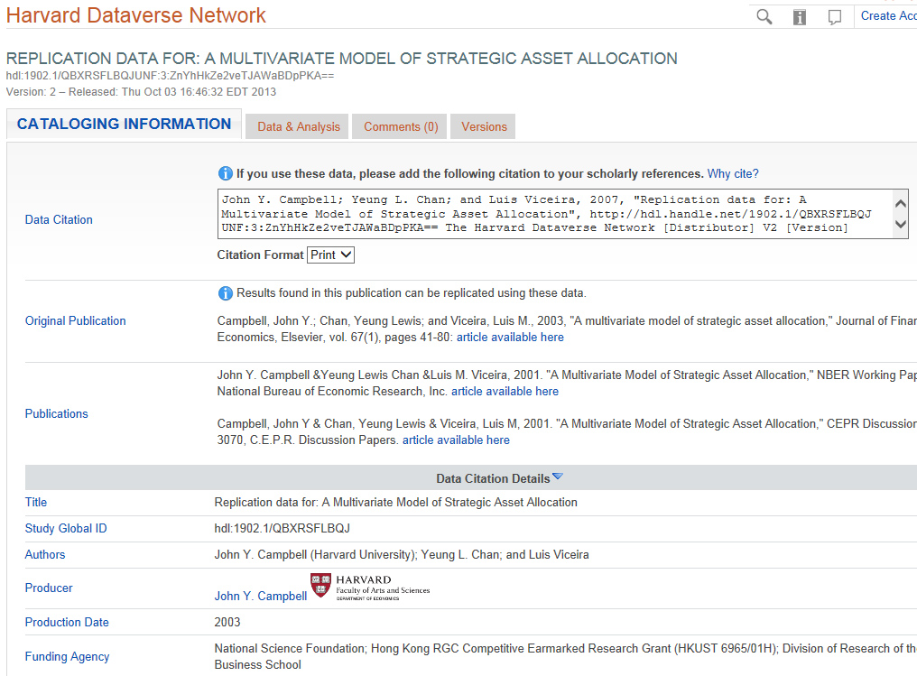
Data Citation and Metadata

Slide 13
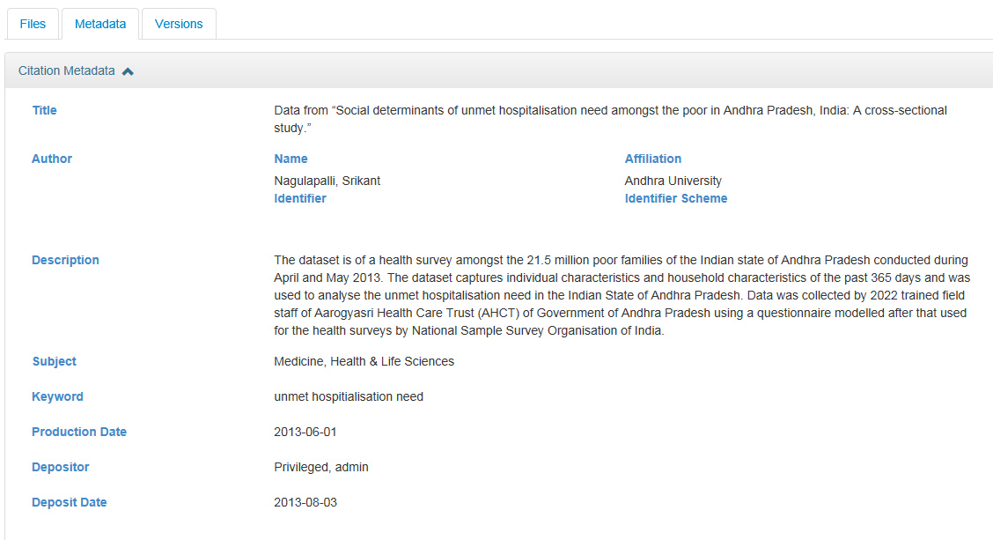
Dataverse Metadata Example
(From the Simple to Complex)
Schemas Supported: GeoSpatial, Life Sciences, Astronomy and Physics, Georeferenced Data

Slide 14
The Many Planning Aspects of Data Research Repositories
Planning Principles
Wide Flexibility
on Institutional
Levels.
Guiding Consortial
Templates which
can be customized
on institutional levels

Slide 15







Part II: Developing Your Data Repository
TDL Dataverse State Working Group
(August 2015 – December 2016)
Charge: Develop, Pilot and launch a consortial repository for research data archiving and management.
14
Working
Group members
Main Working Group (14)
(4 Subcommittees)
Policy and Governance
Workflows and Outreach
Budget/Business Model
Technology
State Data Repository Symposium Group (Baylor)
7
Texas Universities
5
Final Report October, 2016
Sub-Committees

Slide 16
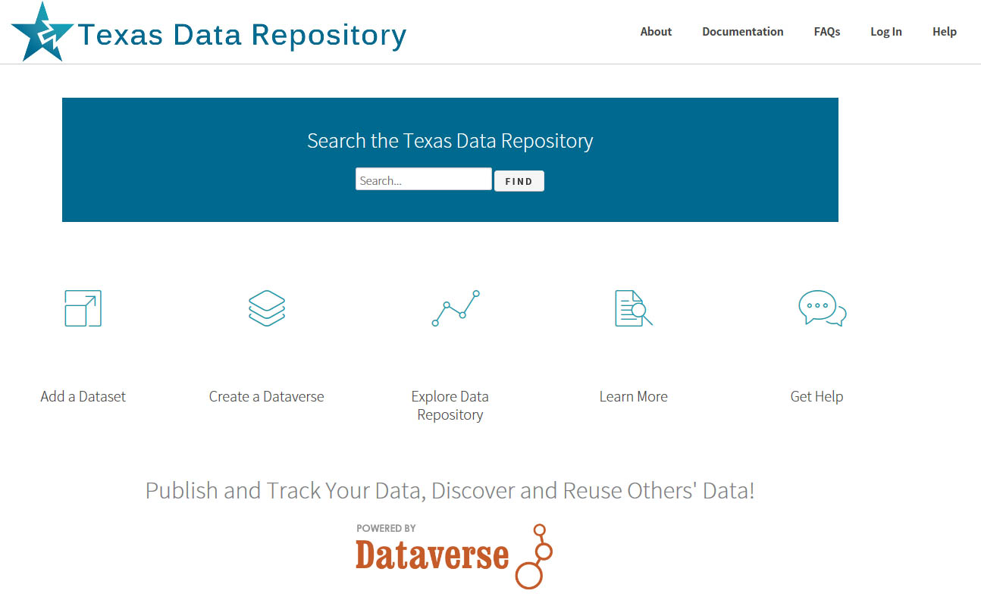
Interface Design & Usability
http://data.tdl.org

Slide 17
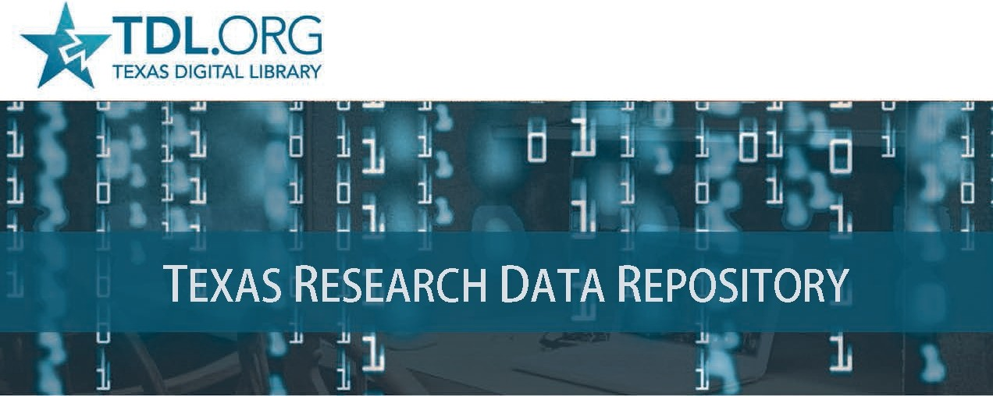

Slide 18





Service Models
Texas Data Repository
Member University Libraries (service & outreach)
Researchers
(deposit, search, publish)
1) Mixed 2) Mediated 3) Unmediated
(Direct)
Notes:
Administering the Texas Data Repository will be done in a hybrid model.
There is a single Dataverse repository hosted by the Texas Digital Library.
TDL provides organizational support in the form of training, tech support, and limited coordination.
Member institutions will provide services based on their local needs and resources. Their roles include:
Each member institution will supply a data repository librarian to manage the data uploaded from their respective institutions, act as a local expert for the repository, and serve on the TDL data librarian repository steering committee.
The steering committee will help TDL recognize trends in research data management, address repository issues, and recommend future groups needed for sustaining data management support.
Any data curation support will also be provided by the member institution
The user is responsible for depositing data
This hybrid model is flexible enough to accommodate different processes at different institutions (some requiring library intervention during ingest, some may not).

Slide 19
Texas State Repositories Architecture
Texas State Academic Research
Research Data
TS Dataverse
(Regular to Medium Size Data Sets)
Custom Data Storage
(Big Data, TB+, TR)
Text
D-Space
Publications Repository
Notes:
Texas State research and accompanying requirements for Federal Data Management Plan compliance is accommodated
by several tiered online solutions. Research Data for regular to medium size datasets may be uploaded and placed into the Texas State Data Repository (TSDR, Dataverse). Big Data and large datasets (Terabyte +) is accommodated through University Technology Resources (TR, research computing customized solutions) and research articles, publications and white papers is accommodated by the University Online Publications Repository, D-Space.

Slide 20

One Size Does Not Fit All
Types of Data Projects (Sizes)
1) Normal Range Projects
Files/Data Fit on Server, may be uploaded, Dataverse, Hubzero)
2) Large Projects
(Data may require specialized university IT Support, i.e. terabyte/petabyte drives, Pointers etc.)
3) Huge Projects
(Projects require consortial possibilities, national models, Texas Advanced Computer Center TAAC, DEEPN, Duracloud, AWS, Custom Solutions)

Slide 21
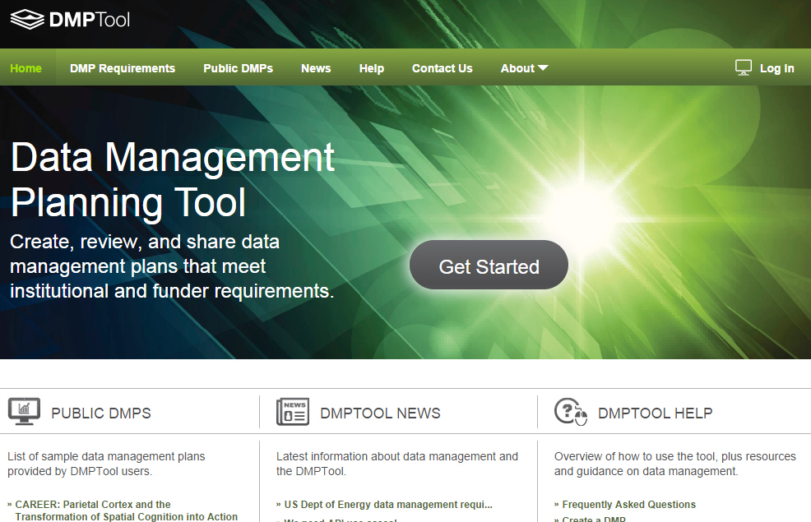
Faculty Data Management Plan
Documentation/Policy Tool
Overview Video
Customizable
Plan Outline Tool
Resource Links
Supports All Major Funders
Connections with
Office of Sponsored
Research and
Other Relevant
University Offices
Library/Dataverse
Templates
https://dmptool.org/
California Digital Library

Slide 22
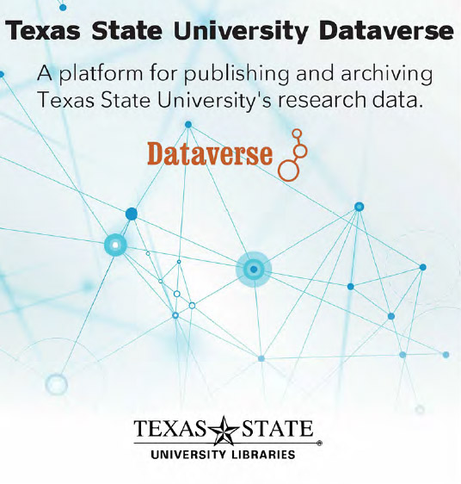
Part III: Human Resource Infrastructures (Working Teams)
Full or Part Time
Data Repository Liaison
Publication Repository Liaison
Metadata Liaison
Subject Liaisons (Outreach)
Committee for Workflows & Policies
Current Hires
Digital Collections Librarian
(Texas State Data Repository
Dataverse/Publications Repository: D-Space)
Data Visualization and Analytics
Librarian (Tableau, Bayesia)
Future Hires
Machine Learning/Neural Networks/AI Librarian (working with the data)

Slide 23
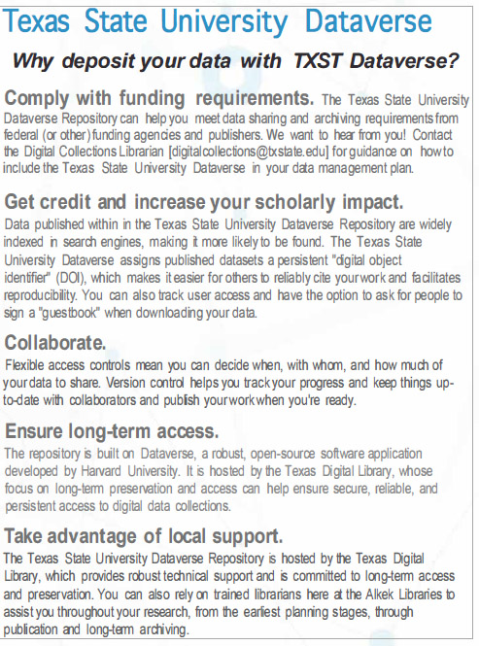
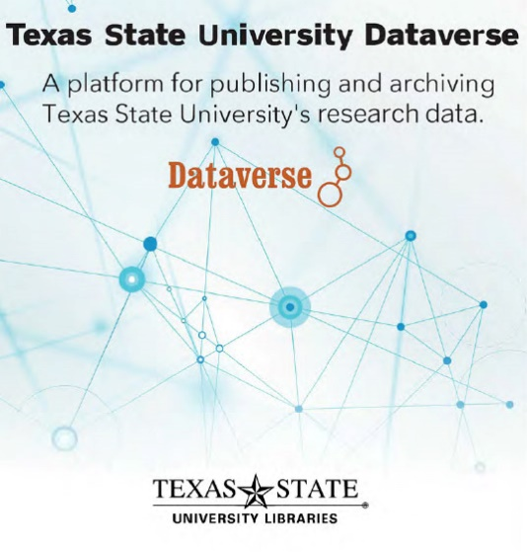
Marketing and Other Possibilities
Electronic Thesis and Dissertations (ETD) Repository (D-Space)
Future Possibilities: VIREO, DATA REPOSITORY CONNECTIONS
Working with the Data – Support Mechanisms
Data Literacy (Workshops/Education)
Data Visualization, Data Analytics
Machine Learning/Neural Networks/ AI

Slide 24
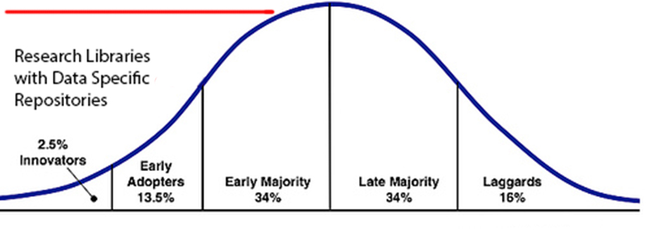
Research Data Repository
Adoption Lifecycle
(2018)

Slide 25
Further Links/References
ARL NSF Data Sharing Policy and Resource Links, http://www.arl.org/focus-areas/e-research/data-access-management-and-sharing
ARL (White House Directives and Funded Research Data ) http://www.arl.org/focus-areas/public-access-policies#.VoaV0I-cFzo
Borgman, C. 2015. Big Data, Little Data, No Data. Scholarship in the Networked Age. MIT Press
Baker, Monya. 1500 Scientists Lift the Lid on Reproducibility. www.nature.com/news/1-500-scientists-lift-the-lid-on-reproducibility-1.19970
Harris, Richard. (April 2017). Rigor Mortis How Sloppy Science Creates Worthless Cures
California Digital Library DMT Tool: https://dmptool.org/
Chronopolis: http://www.digitalpreservation.gov/partners/chronopolis.html
Data Reproducibility Crisis. Nature. http://www.nature.com/news/1-500-scientists-lift-the-lid-on-reproducibility-1.19970
Dataverse. http://thedata.org/
Dataverse (Data Science Site). http://datascience.iq.harvard.edu/dataverse
Data Information Literacy Guide. http://www.datainfolit.org/dilguide/
Data Information Literacy Competencies (Purdue). http://blogs.lib.purdue.edu/dil/the-twelve-dil-competencies/
DPN (Digital Preservation Network) http://www.dpn.org/
Duracloud: http://www.duracloud.org/
Force 11. Data Citation Principles. https://www.force11.org/group/joint-declaration-data-citation-principles-final
Purr. (Purdue Institutional Data Repository). https://purr.purdue.edu/
Hubzero. https://hubzero.org/

Slide 26
Further Links/References
Figshare. http://figshare.com/
ICPSR Data Management & Curation. http://www.icpsr.umich.edu/icpsrweb/content/datamanagement/
Research Data Management. Principles, Practices, and Prospects (November 2013). Council on Library and Information Resources. http://www.clir.org/pubs/reports/pub160
Cox, A. and Pinfield, S. Research Data Management and Libraries. Journal of Librarianship and Information Science. June 2013.
Fearon, D & Sallans, A. C. (January 2014). Institutional Research Data Management: Policies, Planning, Services and Surveys. Coalition for Networked Information. https://www.youtube.com/watch?v=rvbrW7S2fes (video presentation)
Data Management for Libraries: (LITA Guide) http://www.alastore.ala.org/detail.aspx?ID=10737
NMC Horizon Report: 2014 Library Edition. http://cdn.nmc.org/media/2014-nmc-horizon-report-library-EN.pdf
“Research Data Management”. pp. 6-7 and pp 24 – 45.
Holden, J. Memorandum for Heads of Executive Departments and Agencies: Increasing Access to the Results of Federally Funded Research (2013). http://www.whitehouse.gov/sites/default/files/microsites/ostp/ostp_public_access_memo_2013.pdf
Green, A. Macdonald, S and Rice, R. Policy-making for Research Data in Repositories: A Guide. DISC-UK. http://www.disc-uk.org/docs/guide.pdf
Research Data Management in the Arts and Humanities (2013). University of Oxford. http://www.dcc.ac.uk/events/research-data-management-forum-rdmf/rdmf10-research-data-management-arts-and-humanities (Conference Presentations)
Texas Data Repository. TDR Final Report (October, 2016), Selection Process, Aug. 2015, Peace Williamson et al. UT Arlington, Data Competencies. TDL Texas Data Repository Presentation. Video., Kristy Park, Santi Thompson et al (October, 2016)
Uzwyshyn, R. 2016. Research Data Repositories: The What, When, Why and How of Data Research Repositories Computers in Libraries.

Slide 27
Comments/Questions
Contact Information:
Ray Uzwyshyn, Ph.D. MBA MLIS
Director, Collections and Digital Services
Texas State University Libraries
ruzwyshyn@txstate.edu (512)245-5687

Slide 28
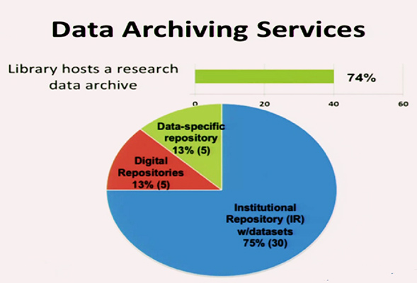
Academic Research Libraries Environmental Scan
Online Data Research Repositories (CNI)
Fearon, D & Sallans, A. C. (January 2014) Institutional Research Data Management: Policies, Planning, Services and Surveys. Coalition for Networked Information. https://www.youtube.com/watch?v=rvbrW7S2fes (54 ARL Libraries currently offer data management services_)

Slide 29
Dataverse Network Architecture
Why the Dataverse Network?
(silent video overview)
Open Journal Systems
Dataverse Integration
Research Study Data
Data Set Files
Metadata ( Data Describing the data)
Paratextual Research Material
(Methodology, Field Notes etc.)
Graph Data Files

Slide 30
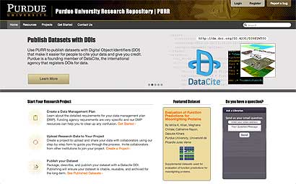
PURR and Hubzero: Purdue’s Data Management System
1.) Create Data Management Plans
2) Collaborate with other Researchers
3) Publish Data Sets (Purdue can publish a DOI: Digital Object Identifier for Data Sets)
Useful For Citation
4) Archive Data Sets
Boilerplate text for data management proposals available
Purr is part of Hubzero platform for scientific collaboration (Originally Nanohub)
Purr: Purdue University Research Repository (video)
Purr Site (Proprietary to University)
Purr Background

Slide 31
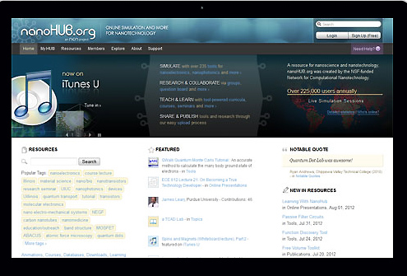
Hubzero: Open Source Platform for Scientific Collaboration
Research Collaboration and Data Management
Solution
Research Data Types
Spreadsheets
Instrument or Sensor Readings
Software Source Code
Surveys
Interview Transcripts
Images and Audiovisual Files
https://hubzero.org/
Getting Started, Downloadable and Hosted Options
Hubzero Video, Hubzero2

Slide 32

Figshare/Cloud based/Proprietary
Repository where users make their research
available in citable, shareable and discoverable
manner
Figures, datasets, media, papers, posters
presentations and file sets can be disseminated
In a way that the current scholarly publishing
Model does not allow
Open Source Platform for Sharing Research
Figshare (video)
Figshare for Institutions (Video)

Slide 33
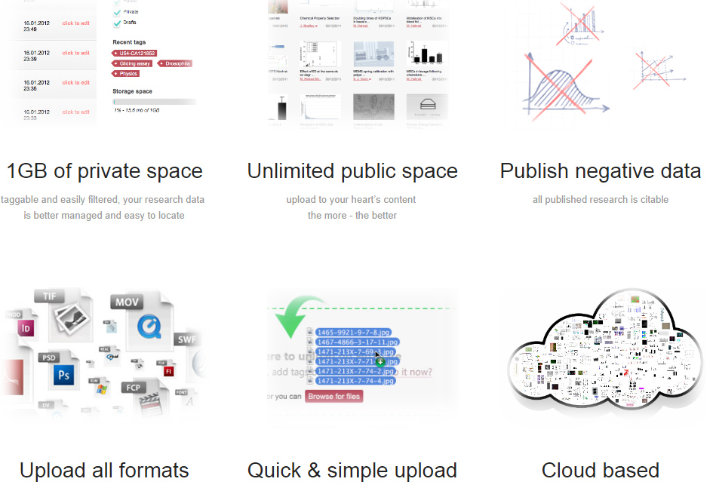
Figshare Features
(Cloud Based/Proprietary)

Slide 34


Data Citation Principles
https://www.force11.org/group/joint-declaration-data-citation-principles-final

Slide 35
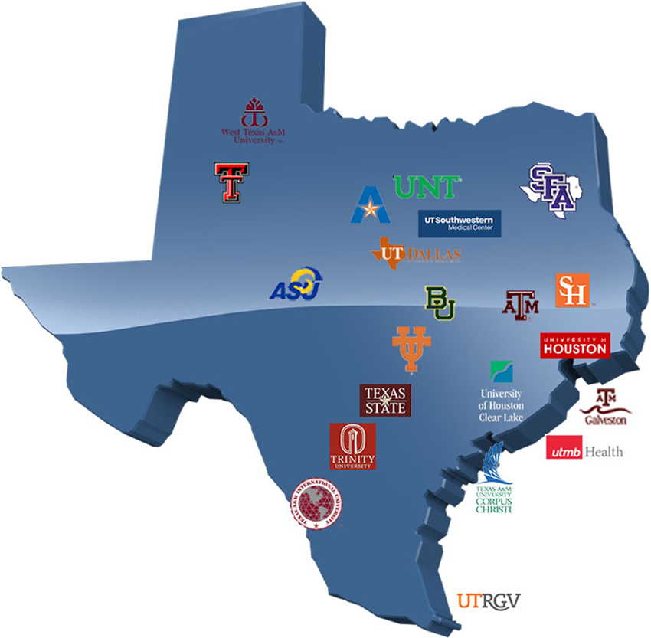
Texas Data Repository
Texas Digital Library Initiative, 2014 -2016
TDL Consortium of 22 universities across Texas
leveraging technological cooperation among academic libraries

Slide 36
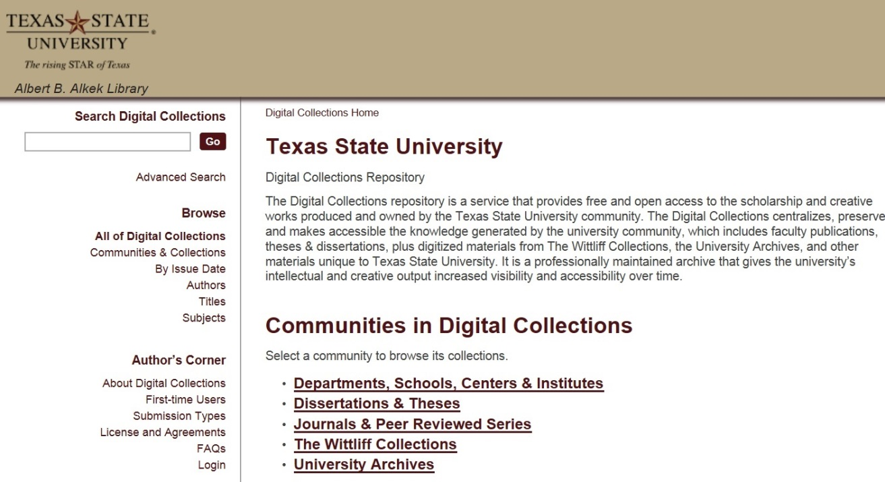
Institutional Repository (MIT, D-Space)
Faculty publications, white papers, preprints, theses, dissertations, working projects, reports, grey literature
Larger Idea, Grant Compliance, Enabling Faculty Research Online, Raising Research Visibility,
https://digital.library.txstate.edu/

Slide 37
Pilot Study Responses
Perceived Benefits of Data Repository
Fulfill federal mandates for sharing publications and research data
Make research data more widely available
Statistics on downloads and citations of my data
Make my data citeable through the assignment of a DOI (digital object identifier)
Saving various versions of the dataset (data lifecycle)
Collecting all my data in one place

Slide 38
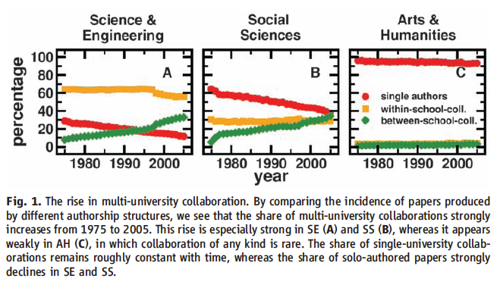
Collaboration Across Institutions
Jones et al. (2008). Science 322: 1259-1262.
Notes:
The model assumes that each lead author forms a core team through a Poisson process.
Extended teams arise from core teams by adding new members in proportion to the productivity of the team.
This process of cumulative advantage leads to the appearance of the power-law component of large teams at later times.

Slide 39

Data Sharing
Currently, 80% of researchers do not share their data
Andreoli-Versbach, P., Mueller-Langer, F. (November 2014). Open access to data: An ideal professed but not practiced. Research Policy., http://dx.doi.org/10.1016/j.respol.2014.04.008

Slide 40
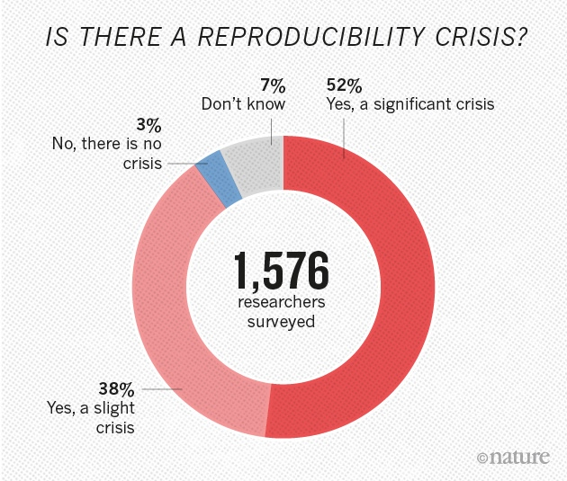
Research Data Reproducibility Crisis
(Nature. 2016)
http://www.nature.com/news/1-500-scientists-lift-the-lid-on-reproducibility-1.19970
Harris, Richard. (April 2017). Rigor Mortis How Sloppy Science Creates Worthless Cures

Slide 41
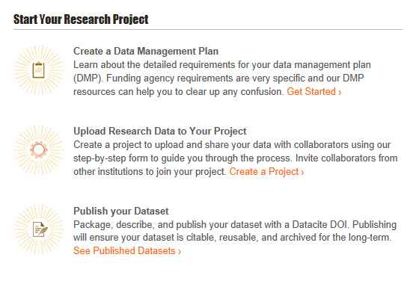
Hubzero/Purr Customization

