Slide 1
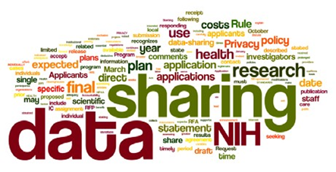

Developing and Implementing An
Online Research Data Repository for Your University or College Campus
Ray Uzwyshyn, Ph.D. MBA MLIS
Director, Collections and Digital Services,
Texas State University Libraries

Slide 2

Online Data Research Repositories
What are They?
Online Way to Manage a Researcher’s Data/Metadata
Permalinking Strategy for Online Data Citation/Access
Way to Manage Federal Grant Compliance
Long Term Data Archiving, Preservation, Sharing Strategy

Slide 3
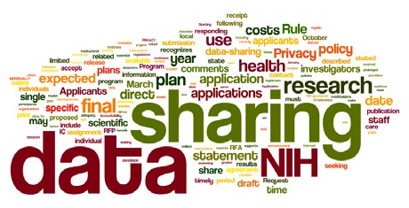
Why are Data Management Repositories Necessary?
Most major Federal grant agencies require data access as mandatory part of the grant proposal/oversite process. (NIH, NSF, NEH, 2013 USDA)
Wordle of the Final NIH Statement on Sharing Research Data, Mandatory 2003

Slide 4
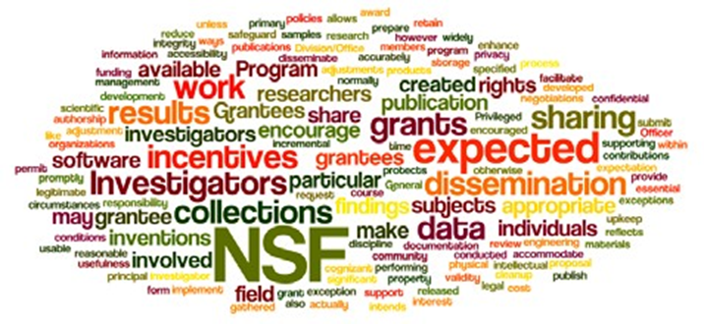
What makes Data Management Repositories useful?
Leverage and make available faculty, departmental and institutional research
Allow publication of negative data (less research replication)
Wordle of the National Science Foundation’s Award and Administration Guide. Chapter VI.D.4, Mandatory 2011

Slide 5
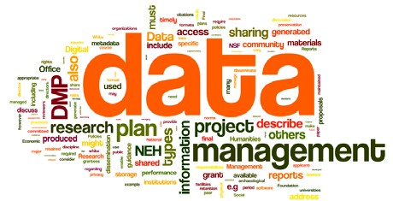
Data Management Repositories
Becoming Integral Part of Evolving Science, Social Science and Humanities Research Process (Promote accuracy, efficiency, sharing)
Wordle of the data management policy of the Office of Digital Humanities, National Endowment for the Humanities, 2013

Slide 6
The Research Data Repository Lifecycle

Slide 7

Types of Research Data Repositories
1) Project specific
(usually large single faculty/faculty team projects)
2)Discipline specific
(i.e. Purdue Nanohub/Nanotechnology, Archeological Data from Academic Center, etc. )
3) Institutional Repository
(either institution wide or consortial)

Slide 8
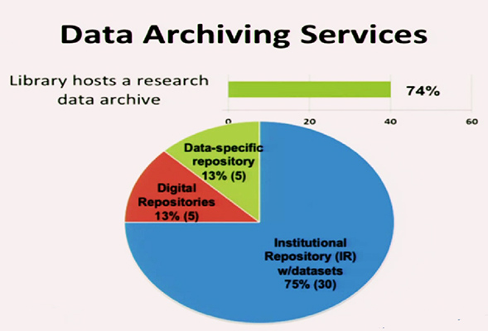
Academic Research Libraries Environmental Scan
Online Data Research Repositories (CNI)
Fearon, D & Sallans, A. C. (January 2014) Institutional Research Data Management: Policies, Planning, Services and Surveys. Coalition for Networked Information. https://www.youtube.com/watch?v=rvbrW7S2fes (54 ARL Libraries currently offer data management services_)

Slide 9
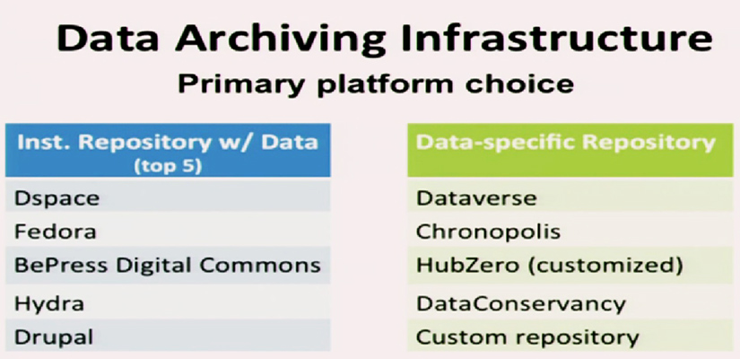
Specific and All-Purpose
Data Repository Platforms
Fearon, D & Sallans, A. C. (January 2014) Institutional Research Data Management: Policies, Planning, Services and Surveys. Coalition for Networked Information. https://www.youtube.com/watch?v=rvbrW7S2fes (54 ARL Libraries currently offer data management services_)

Slide 10
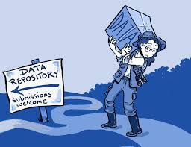
Research Data Repository
Software Characteristics
May be hosted or installed on a university’s server
Each software contains different ranges of management, collaborative options
Open source and proprietary options
Ingestion of Various Data Types
(from Excel to SPSS to more esoteric disciplinary specific formats)

Slide 11
Environmental Scan of Current Possibilities for Your Institution
System Performance
Robustness
Usability
platform availability
an active open source community
Conclusion: The group recommends that TDL adopt Harvard’s Dataverse to facilitate the discovery of research data.
Data Repository
Working Group Report
(August 28, 2015)

Slide 12
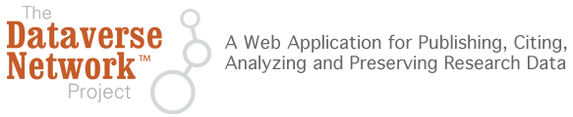

Dataverse
Harvard’s Open Source Research Data Solution
Software framework that enables institutions to host research data repositories
Allows data sharing, control, persistent data citation, data publishing and versioning management
Social Sciences Beginnings (IQSS)
Data Science (site)
http://thedata.org
Dataverse Open Source Download (Github), Software Background

Slide 13
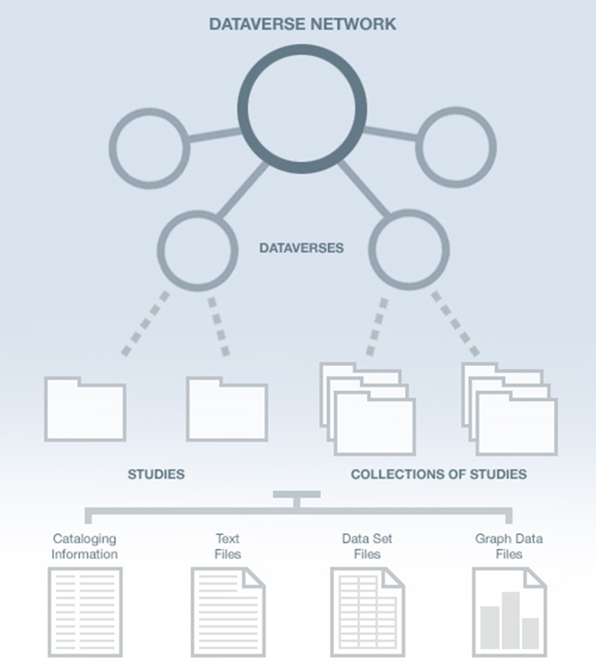
Dataverse Network Architecture
Why the Dataverse Network?
(silent video overview)
Open Journal Systems
Dataverse Integration
Research Study Data
Data Set Files
Metadata ( Data Describing the data)
Paratextual Research Material
(Methodology, Field Notes etc.)
Graph Data Files

Slide 14
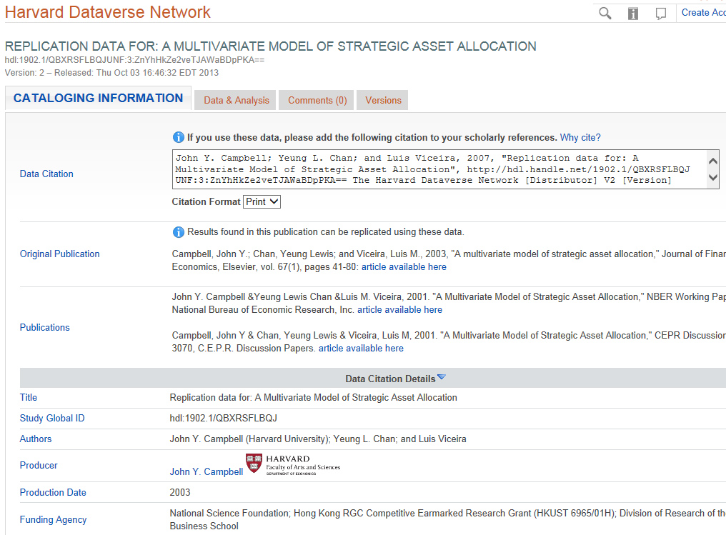
Dataverse Data Citation and Metadata Example

Slide 15
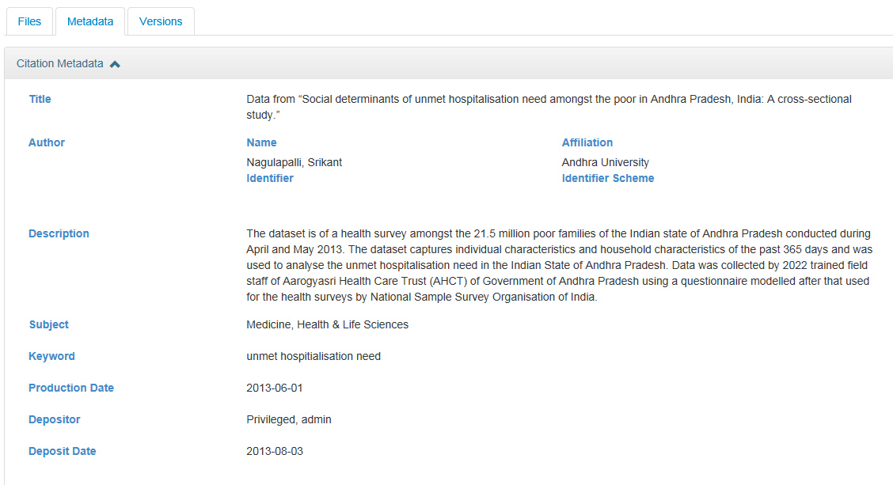
Dataverse Metadata Example
(From the Simple to Complex)
Metadata Schemas Supported: GeoSpatial, Life Sciences, Astronomy and Physics, Georeferenced Data

Slide 16


Data Citation Principles
https://www.force11.org/group/joint-declaration-data-citation-principles-final

Slide 17
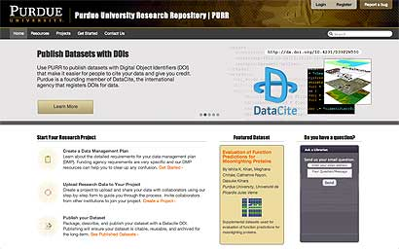
PURR and Hubzero: Purdue’s Data Management System
1.) Create Data Management Plans
2) Collaborate with other Researchers
3) Publish Data Sets (Purdue can publish a DOI: Digital Object Identifier for Data Sets)
Useful For Citation
4) Archive Data Sets
Boilerplate text for data management proposals available
Purr is part of Hubzero platform for scientific collaboration (Originally Nanohub)
Purr: Purdue University Research Repository (video)
Purr Site (Proprietary to University)
Purr Background

Slide 18
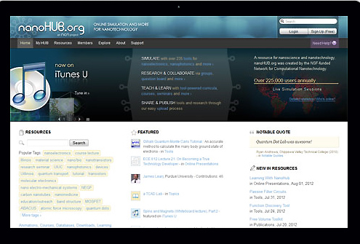
Hubzero: Open Source Platform for Scientific Collaboration
Research Collaboration and Data Management
Solution
Research Data Types
Spreadsheets
Instrument or Sensor Readings
Software Source Code
Surveys
Interview Transcripts
Images and Audiovisual Files
https://hubzero.org/
Getting Started, Downloadable and Hosted Options
Hubzero Video, Hubzero2

Slide 19

Figshare/Cloud based/Proprietary
Repository where users make their research
available in citable, shareable and discoverable
manner
Figures, datasets, media, papers, posters
presentations and file sets can be disseminated
In a way that the current scholarly publishing
Model does not allow
Open Source Platform for Sharing Research
Figshare (video)
Figshare for Institutions (Video)

Slide 20
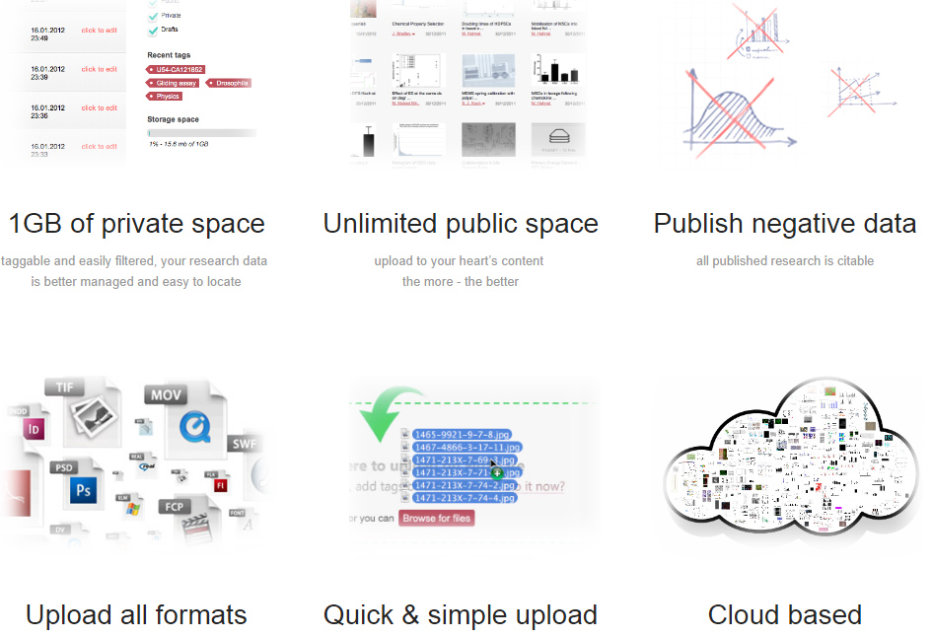
Figshare Features
(Cloud Based/Proprietary)

Slide 21







Developing and Testing Your Data Repository
TDL Dataverse Implementation Working Group (August 2015 – December 2016)
Charge: Pilot test, assess, and launch a consortial repository for research data archiving and management.
14
Working
Group members
Main Working Group
& Subcommittees:
Policy and Governance
Workflows and Outreach
Budget/Business Model
Technology
State Data Repository Symposium
7
Texas Universities
5
Final Report October, 2016
Sub-Committees

Slide 22
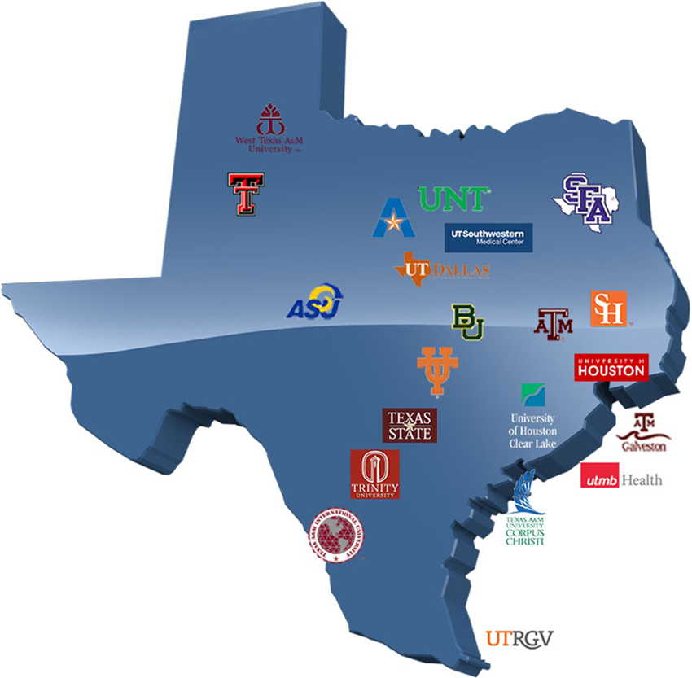
Texas Data Repository
Texas Digital Library Initiative, 2014 -2016
TDL Consortium of 22 universities across Texas
leveraging technological cooperation among academic libraries,

Slide 23
The Many Planning Aspects of the New World of Data Research Repositories

Slide 24
Texas Data Repository Consortial Architecture
TDL
Institutions
(i.e. Texas State)
Research Study Data
Data Set Files
Metadata ( Data Describing the data)
Paratextual Research Material
(Methodology, Field Notes , Multimedia, Graphs, Programs etc.)

Slide 25
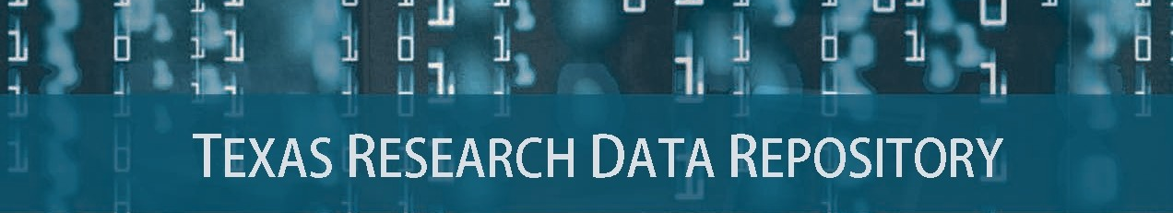

Slide 26
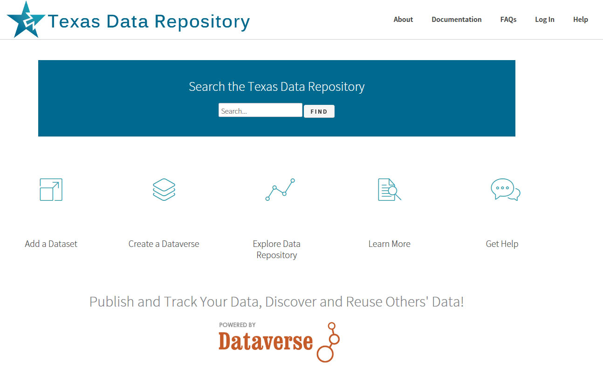
http://data.tdl.org
(UX Usability Focus)

Slide 27





Repository Service Models
Texas Data Repository
Member Libraries
(service & outreach)
Researchers
(deposit, search, publish)
Service Models 1) Mixed 2) Mediated 3) Unmediated (Direct)
Notes:
Administering the Texas Data Repository will be done in a hybrid model.
There is a single Dataverse repository hosted by the Texas Digital Library.
TDL provides organizational support in the form of training, tech support, and limited coordination.
Member institutions will provide services based on their local needs and resources. Their roles include:
Each member institution will supply a data repository librarian to manage the data uploaded from their respective institutions, act as a local expert for the repository, and serve on the TDL data librarian repository steering committee.
The steering committee will help TDL recognize trends in research data management, address repository issues, and recommend future groups needed for sustaining data management support.
Any data curation support will also be provided by the member institution
The user is responsible for depositing data
This hybrid model is flexible enough to accommodate different processes at different institutions (some requiring library intervention during ingest, some may not).

Slide 28
Texas State Data Repository Architecture
Texas State Academic Research
Research Data
TS Dataverse
(Regular to Medium Size Data Sets)
Custom Data Storage Solution
(Big Data, TB+, TR)
Reports and Publications
D-Space
Publications Repository
3.
2.
1.
Notes:
Texas State research and accompanying requirements for Federal Data Management Plan compliance is accommodated
by several tiered online solutions. Research Data for regular to medium size datasets may be uploaded and placed into the Texas State Data Repository (TSDR, Dataverse). Big Data and large datasets (Terabyte +) is accommodated through University Technology Resources (TR, research computing customized solutions) and research articles, publications and white papers is accommodated by the University Online Publications Repository, D-Space.

Slide 29

One Size Does Not Fit All
Data Project Needs
Types of Data Projects (Sizes)
1) Normal range
Files/Data Fit on Server/Cloud, may be uploaded, Dataverse, Purr)
2) Large Projects
(Data may require specialized university IT Support, i.e. terabyte/petabyte tape drives, Pointers possible)
3) Huge Projects
(Projects require consortial possibilities, national models, Texas Advanced Computer Center TAAC, DEEPN, Duracloud, AWS, Custom Solutions)

Slide 30
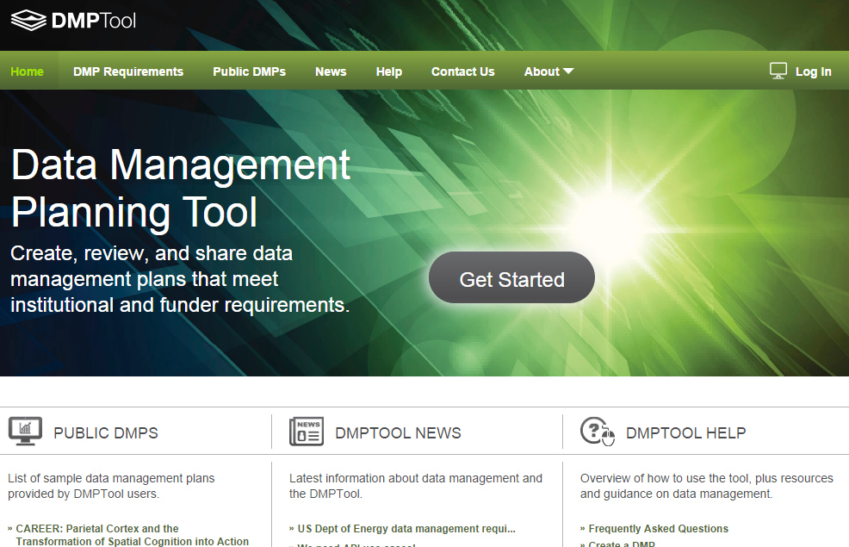
Data Management Plan
Documentation/Policy Tool
Overview Video
Customizable
Plan Outline Tool
Resource Links
Supports All Major Funders
Connections with
Office of Sponsored
Research and
Other Relevant
University Offices
https://dmptool.org/
California Digital Library

Slide 31
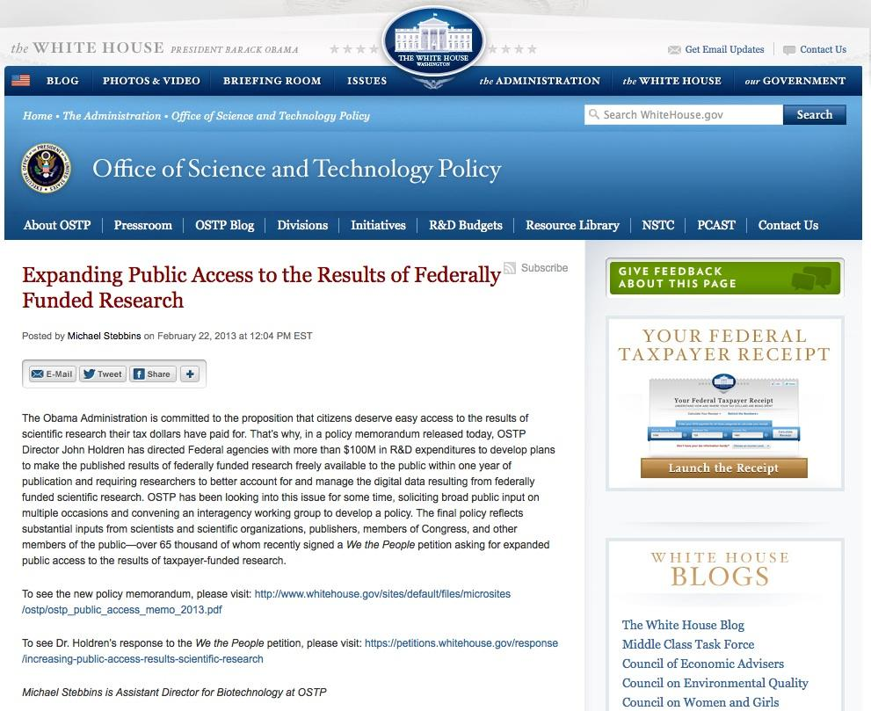
Data Management Plan Support
The Library Supports:
Publication repositories
D-Space
Data repositories, Texas Data Repository
Human Resource Infrastructure
Data Repository Liaison
Publication Repository Liaison
Specialized Metadata Liaison
Subject Liaisons (Outreach)
Committee for Workflows, Standard & Policies
Current/Future Hires
Data Visualization and Analytics
Librarian (Tableau, Bayesia)
Digital Collections Librarian
(TDR Dataverse/D-Space
http://www.whitehouse.gov/blog/2013/02/22/expanding-public-access-results-federally-funded-research

Slide 32
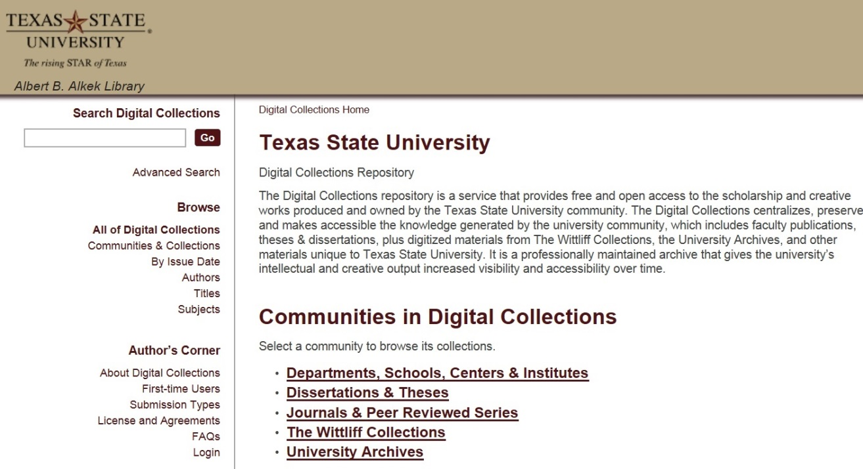
Institutional Repository Connections
(MIT, D-Space)
Faculty publications, white papers, preprints, theses, dissertations, working projects
Larger Idea, Grant Compliance, Enabling Faculty Research Online, Raising Research Visibility,
https://digital.library.txstate.edu/

Slide 33
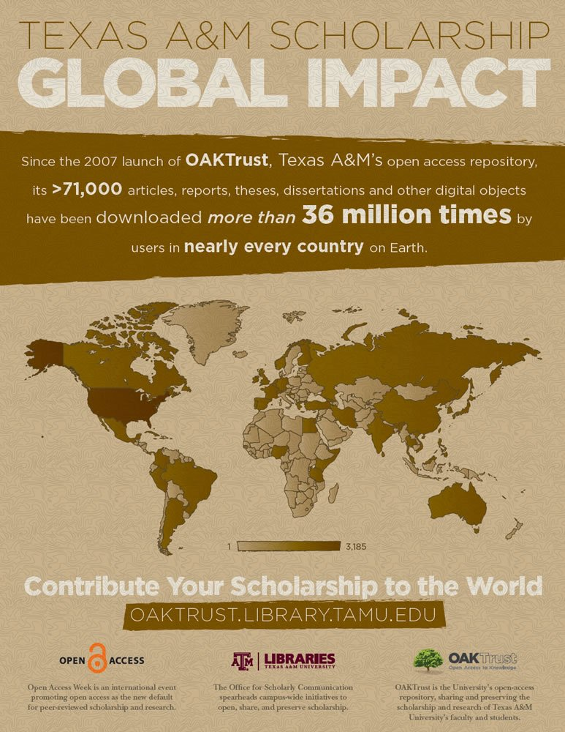
Electronic Thesis and Dissertations (ETD) Repository (D-Space) Possibilities
Co-publish data sets in ETD (D-SPACE) and Data Repository, Links in metadata in D-SPACE and DATA REPOSITORY
Future Possible ETD (D-Space), VIREO, DATA REPOSITORY CONNECTIONS

Slide 34
Data Repository Adoption Lifecycle
(2017)

Slide 35
Further Links/References
ARL NSF Data Sharing Policy and Resource Links, http://www.arl.org/focus-areas/e-research/data-access-management-and-sharing
ARL (White House Directives and Funded Research Data ) http://www.arl.org/focus-areas/public-access-policies#.VoaV0I-cFzo
Borgman, C. 2015. Big Data, Little Data, No Data. Scholarship in the Networked Age. MIT Press
Baker, Monya. 1500 Scientists Lift the Lid on Reproducibility. www.nature.com/news/1-500-scientists-lift-the-lid-on-reproducibility-1.19970
Harris, Richard. (April 2017). Rigor Mortis How Sloppy Science Creates Worthless Cures
California Digital Library DMT Tool: https://dmptool.org/
Chronopolis: http://www.digitalpreservation.gov/partners/chronopolis.html
Data Reproducibility Crisis. Nature. http://www.nature.com/news/1-500-scientists-lift-the-lid-on-reproducibility-1.19970
Dataverse. http://thedata.org/
Dataverse (Data Science Site). http://datascience.iq.harvard.edu/dataverse
Data Information Literacy Guide. http://www.datainfolit.org/dilguide/
Data Information Literacy Competencies (Purdue). http://blogs.lib.purdue.edu/dil/the-twelve-dil-competencies/
DPN (Digital Preservation Network) http://www.dpn.org/
Duracloud: http://www.duracloud.org/
Force 11. Data Citation Principles. https://www.force11.org/group/joint-declaration-data-citation-principles-final
Purr. (Purdue Institutional Data Repository). https://purr.purdue.edu/
Hubzero. https://hubzero.org/

Slide 36
Further Links/References
Figshare. http://figshare.com/
ICPSR Data Management & Curation. http://www.icpsr.umich.edu/icpsrweb/content/datamanagement/
Research Data Management. Principles, Practices, and Prospects (November 2013). Council on Library and Information Resources. http://www.clir.org/pubs/reports/pub160
Cox, A. and Pinfield, S. Research Data Management and Libraries. Jounral of Librarianship and Information Science. June 2013.
Fearon, D & Sallans, A. C. (January 2014). Institutional Research Data Management: Policies, Planning, Services and Surveys. Coalition for Networked Information. https://www.youtube.com/watch?v=rvbrW7S2fes (video presentation)
Data Management for Libraries: (LITA Guide) http://www.alastore.ala.org/detail.aspx?ID=10737
NMC Horizon Report: 2014 Library Edition. http://cdn.nmc.org/media/2014-nmc-horizon-report-library-EN.pdf
“Research Data Management”. pp. 6-7 and pp 24 – 45.
Holden, J. Memorandum for Heads of Executive Departments and Agencies: Increasing Access to the Results of Federally Funded Research (2013). http://www.whitehouse.gov/sites/default/files/microsites/ostp/ostp_public_access_memo_2013.pdf
Green, A. Macdonald, S and Rice, R. Policy-making for Research Data in Repositories: A Guide. DISC-UK. http://www.disc-uk.org/docs/guide.pdf
Research Data Management in the Arts and Humanities (2013). University of Oxford. http://www.dcc.ac.uk/events/research-data-management-forum-rdmf/rdmf10-research-data-management-arts-and-humanities (Conference Presentations)
Texas Data Repository. TDR Final Report (October, 2016), Selection Process, Aug. 2015, Peace Williamson et al. UT Arlington, Data Competencies. TDL Texas Data Repository Presentation. Video., Kristy Park, Santi Thompson et al (October, 2016)
Uzwyshyn, R. 2016. Research Data Repositories: The What, When, Why and How of Data Research Repositories Computers in Libraries.

Slide 37
Comments/Questions

Slide 38
Pilot Study Responses
Perceived Benefits of Data Repository
Fulfill federal mandates for sharing publications and research data
Make research data more widely available
Statistics on downloads and citations of my data
Make my data citeable through the assignment of a DOI (digital object identifier)
Saving various versions of the dataset (data lifecycle)
Collecting all my data in one place

Slide 39
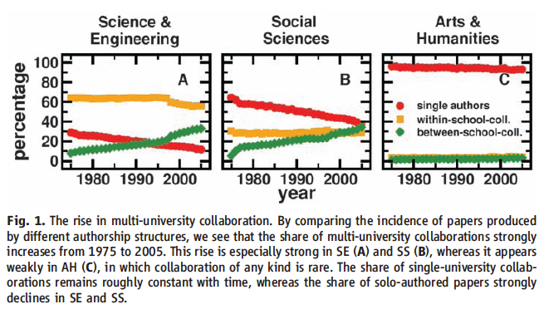
Collaboration Across Institutions
Jones et al. (2008). Science 322: 1259-1262.
Notes:
The model assumes that each lead author forms a core team through a Poisson process.
Extended teams arise from core teams by adding new members in proportion to the productivity of the team.
This process of cumulative advantage leads to the appearance of the power-law component of large teams at later times.

Slide 40

Data Sharing
Currently, 80% of researchers do not share their data
Andreoli-Versbach, P., Mueller-Langer, F. (November 2014). Open access to data: An ideal professed but not practiced. Research Policy., http://dx.doi.org/10.1016/j.respol.2014.04.008

Slide 41
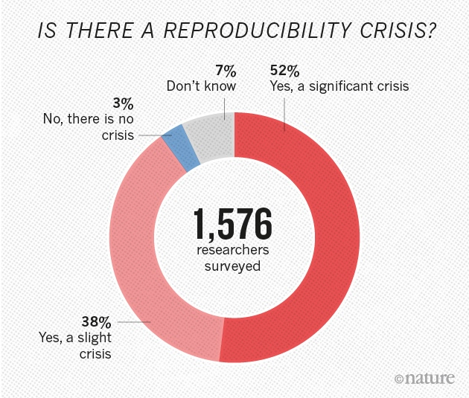
Research Data Reproducibility Crisis
(Nature. 2016)
http://www.nature.com/news/1-500-scientists-lift-the-lid-on-reproducibility-1.19970
Harris, Richard. (April 2017). Rigor Mortis How Sloppy Science Creates Worthless Cures

Slide 42
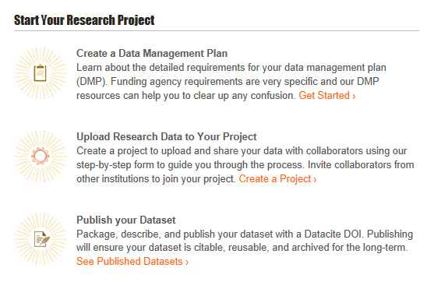
Hubzero/Purr Customization

