Slide 1
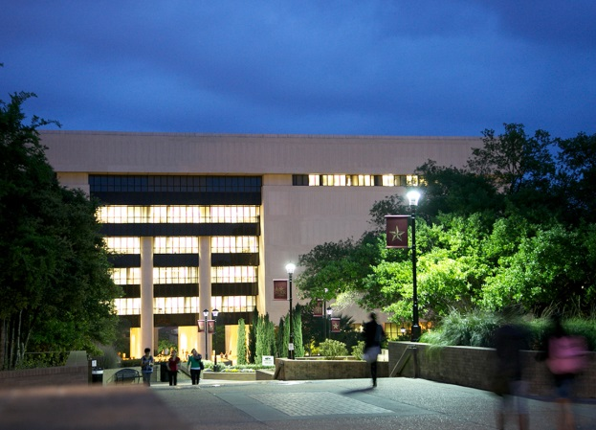
Transforming Academic Libraries for the New Millennia
From Book Warehouses to Technology-Centered Learning Commons
Ray Uzwyshyn Ph.D. MBA MLIS
Dir. Technology & Collections
Texas State University
March 25, 2016
9:00-9:40 am

Slide 2
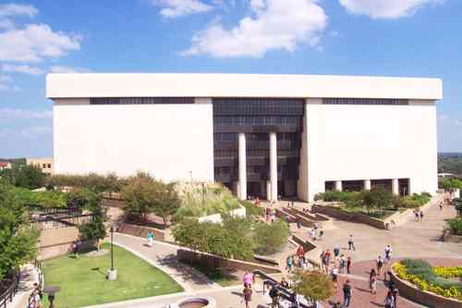
Alkek Library Learning Commons
2015-2022
Reconfiguration of Alkek Library From Book Warehouse to Learning Commons
Large Academic Library (7 Fl.)
Texas State University, 36,000 Students
Carnegie Class Doctoral University (Higher Research Activity)
Designated Emerging Research
Institution (Texas)
Overview Video
Multi-Stakeholder IT Division Project
Multi-Year 5-7, 3 Large Phases
~ 40 Million Total Budget

Slide 3
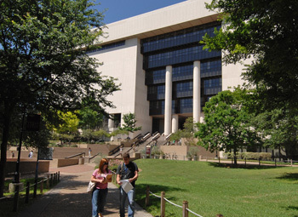
Learning Commons Phases/Timelines
Phase I: Infrastructure Upgrade, Off-site Repository (2015-2017, ~5M, ~10M), Underway
Phase 2: Mid-Term, Learning Commons, 2016-2018, ~15M, Architectural Programming, Design Phase
Phase 3 Long Term, Future Learning Commons, 10 M
(2017-2022)

Slide 4
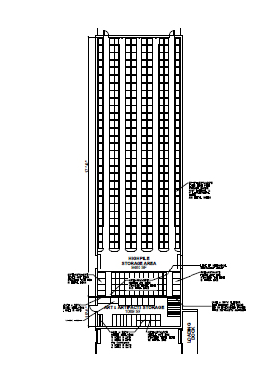
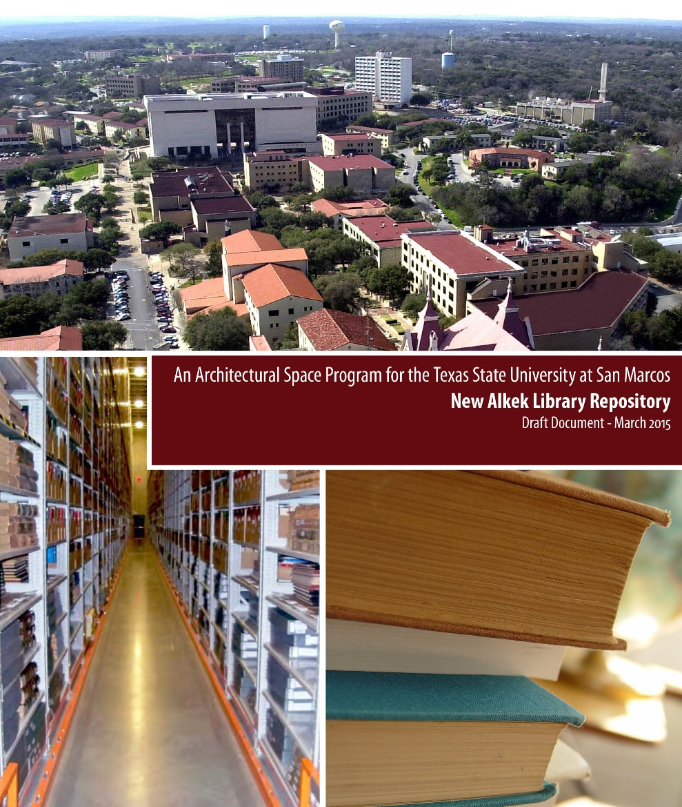
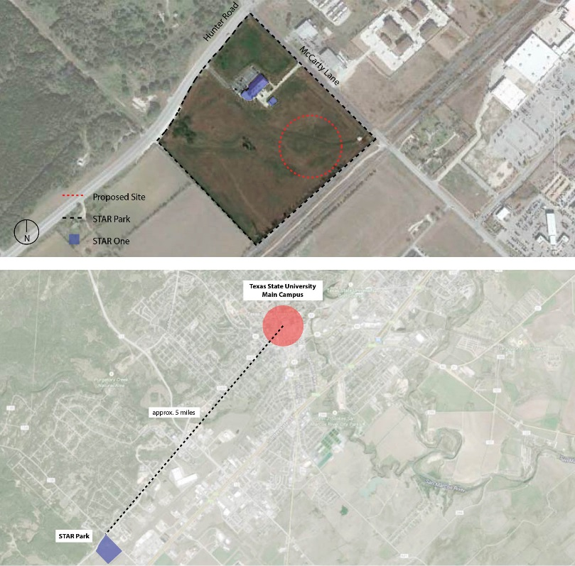
Offsite Repository
(Phase 1, 2015-2017)

Slide 5
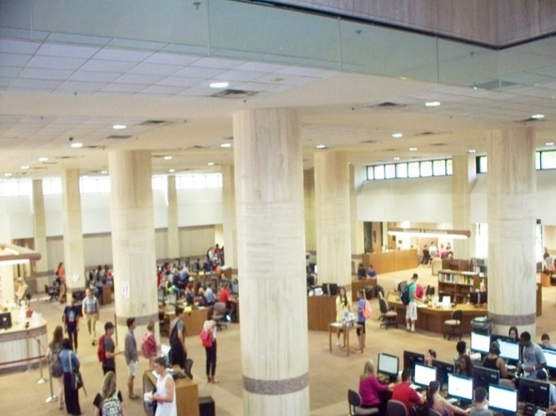
Alkek Library Learning Commons Phase I Infrastructure Planning Principles
Technologies deployed in the library will change over time. Planning should reflect this by allocating appropriate space without necessarily establishing a specific technology for each space

Slide 6

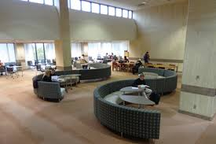
Alkek Library Infrastructure Upgrade
Planning Considerations 2016
Planning associated with technologies should not be constrained based on current technology equipment or practices.
Library planning should anticipate technologies we don’t expect to see in the library, and in our current expectation, more technology is probably an underestimate.
Upgrade should provide infrastructure throughout building holistically
Technology-driven activities will continue to expand and will eventually dominate library use

Slide 7
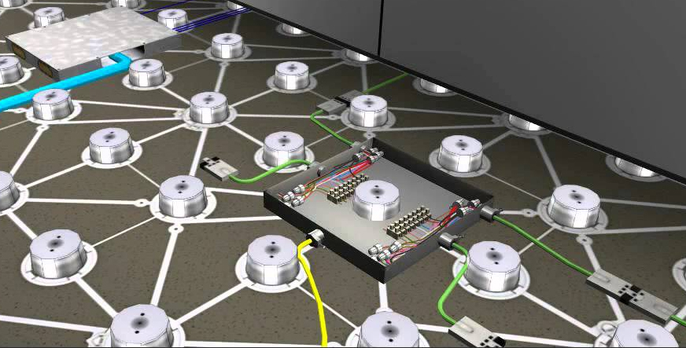
Phase 1 High Data/Electrical Floors (F. 1-2)
Phase 2 Throughout Building
(Technological Reconfigurability)
Learning Commons Floor Video (DIRRT)

Slide 8
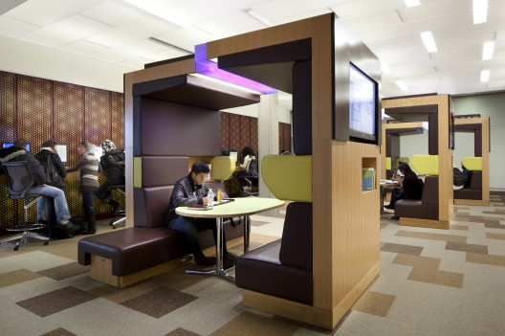
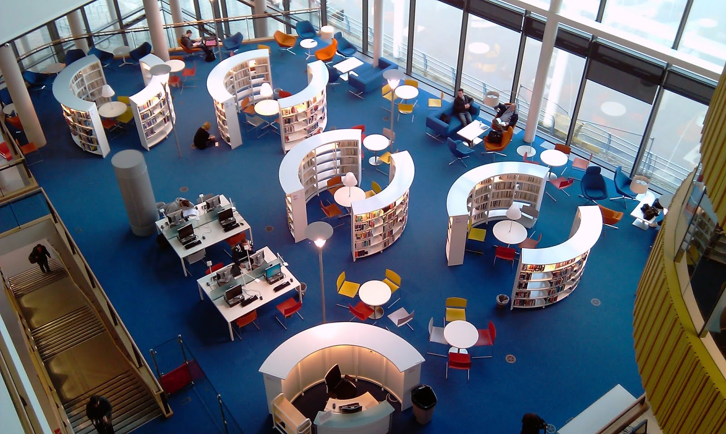
Themed Moveable Centers
Large Emphasis on:
Reconfigurability
Interdisciplinarity
Collaboration
Library as Third Space

Slide 9
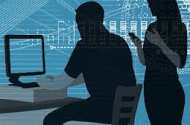
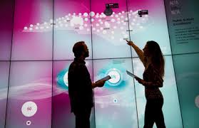
New Academic Library
Learning CommonsTechnology (Possible Considerations)

Slide 10
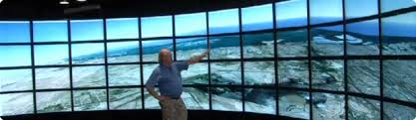
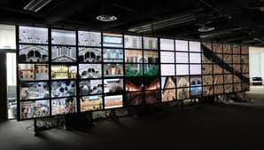
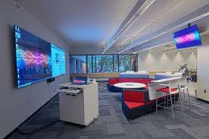
Visualization Technologies
Wider definitions of computing & digital literacy
Hunt Library NCSU (video)
Rice (video, rationale, science)
UT Austin (video, humanities)
Deloitte University (video, business)
University of Calgary

Slide 11
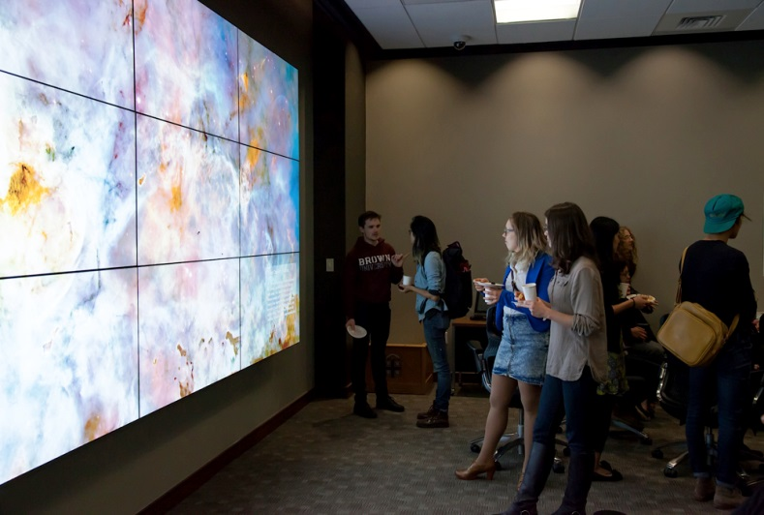
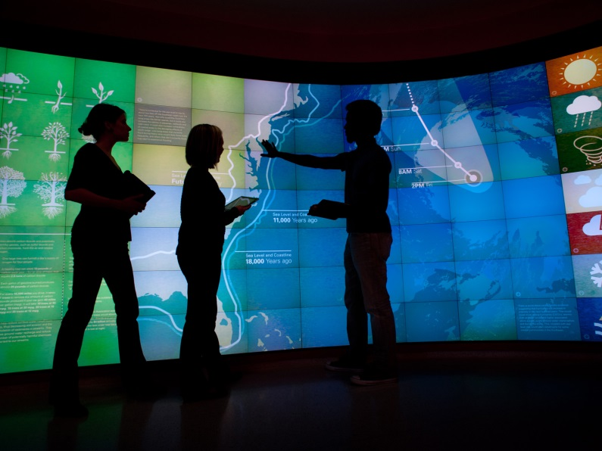
Visualization Walls (VizWall)
Brown University Rockefeller Library (article)
NCSU Hunt Library (infrastructure link)

Slide 12
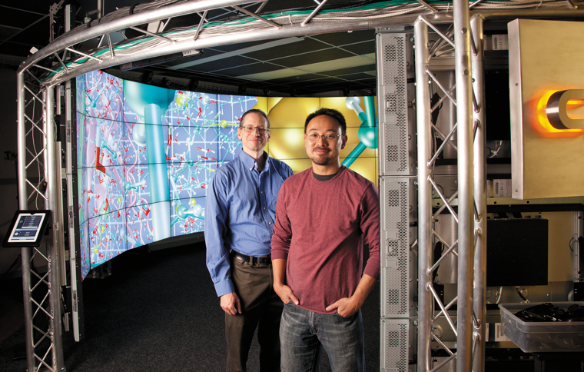
3D Immersive & Interactive Environments
Microsoft Holo Len Lab (video), Site
University of Chicago CAVE (article and video)
John Hopkins Libraries Brody Learning Commons
Display Wall (video)

Slide 13
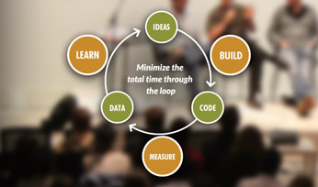
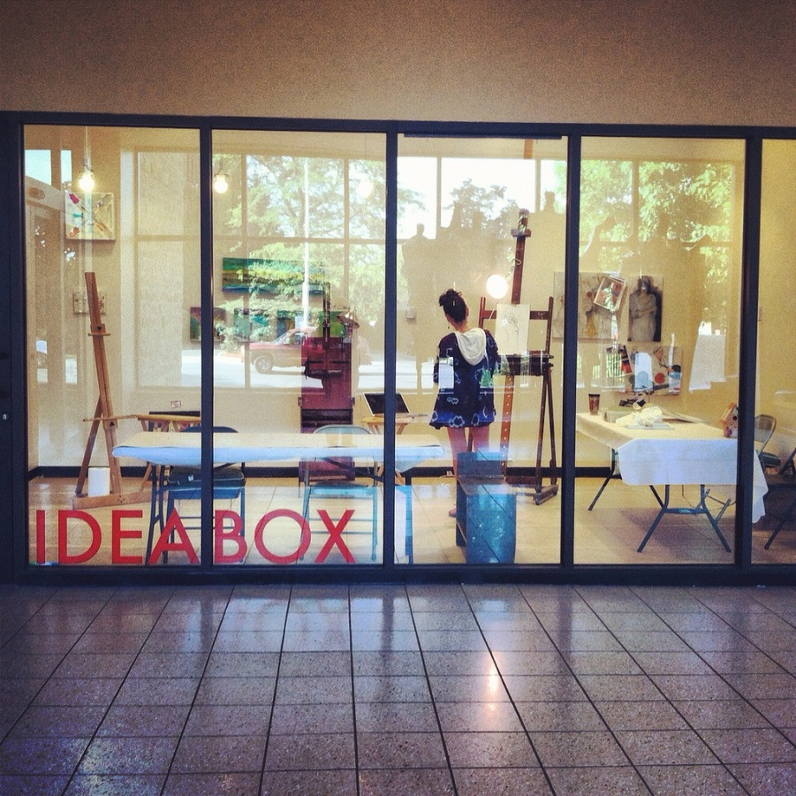
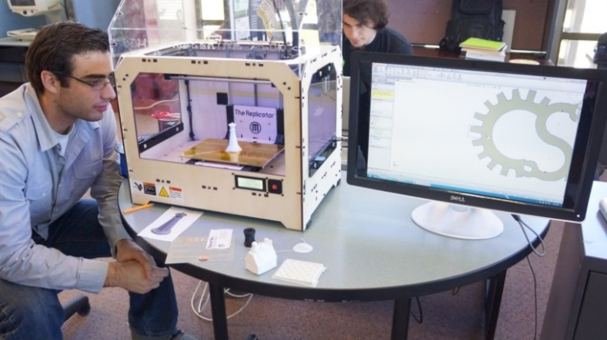
Academic Library Maker Spaces
ACRL: Academic Library Makerspaces (article), Video (TedX)
Library Makerspaces (Resource List), Examples

Slide 14
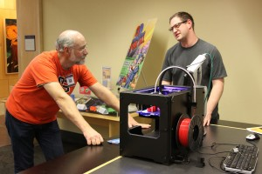
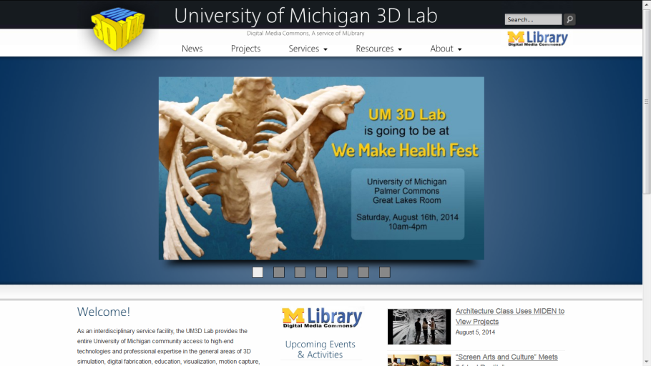
Academic Makerspaces
Oregon State University Valley Library (article)
University of Michigan 3D Lab (example infrastructure)
Traditionally include 3-D printing, but can include other spaces to create content
(e.g., large-format printing, physical computing, prototyping sandboxing)

Slide 15
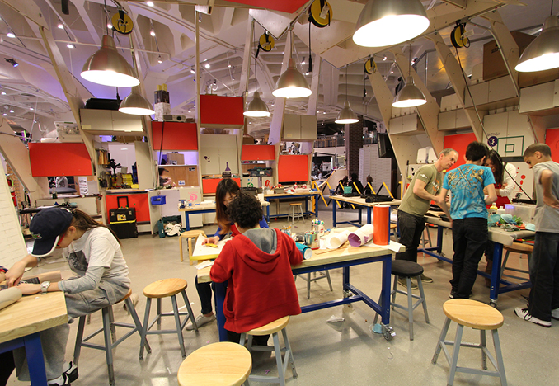
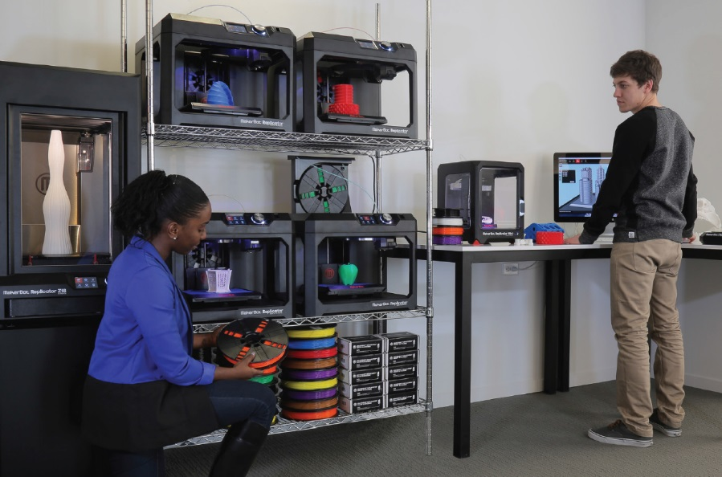
Library Makerspaces
(Considerations)
Fire codes/Ventilation/Internet Connectivity/Expanded Electrical
3D Printing Prototype Lab (Video)
Academic Purposes (Video)

Slide 16
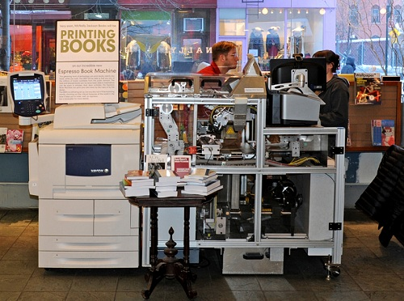
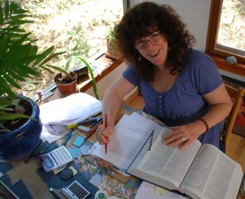
In House Library e-Presses
University Publishing Infrastructures
E-Press
Editor
Esspreso Book Machine Animated Video, Espresso Book Machine Video, Site

Slide 17
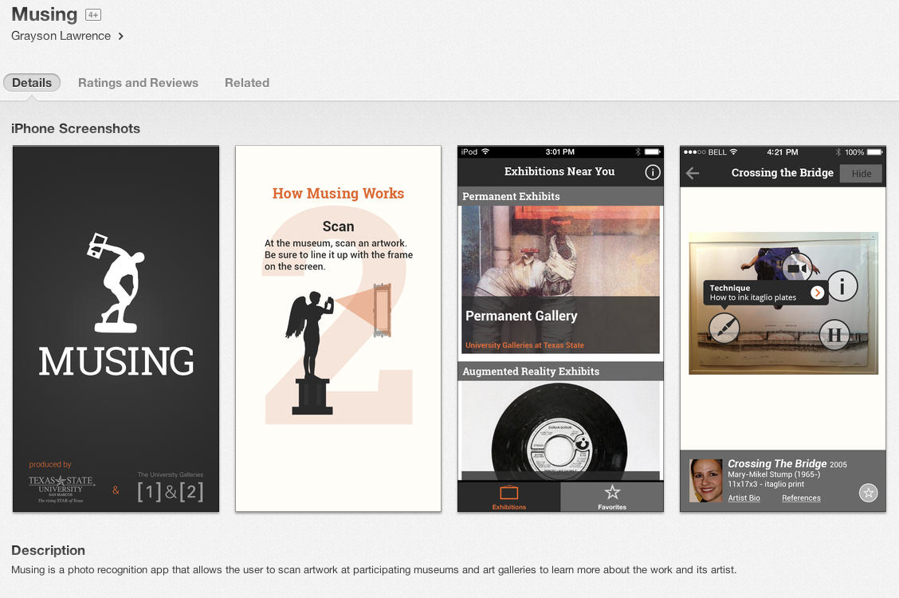
Interactive Museums: Wittliff Collections
Interactive displays, visual media displays, audio/podcast tours and electronic multimedia guides. Examples:
                MUSING: an iPhone app developed by Texas State (Link)

Slide 18
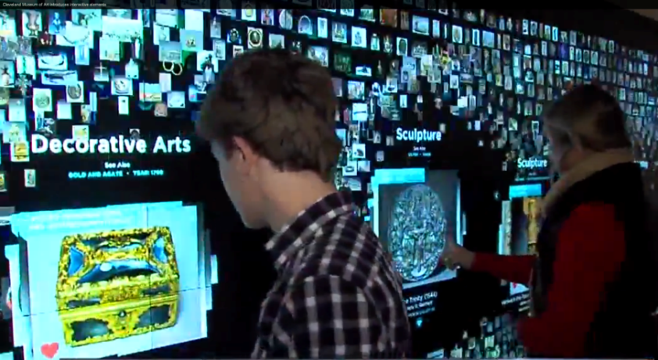
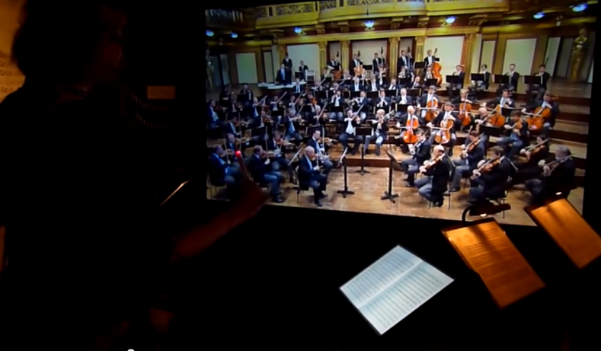
Interactive Museum technologies
Cleveland Museum of Art - Collection Wall and more (video)
Interactive Museum of Sound, Haus der Music, Vienna
(video)

Slide 19
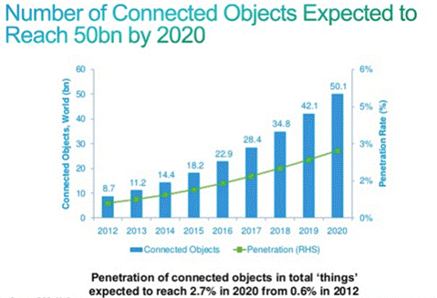
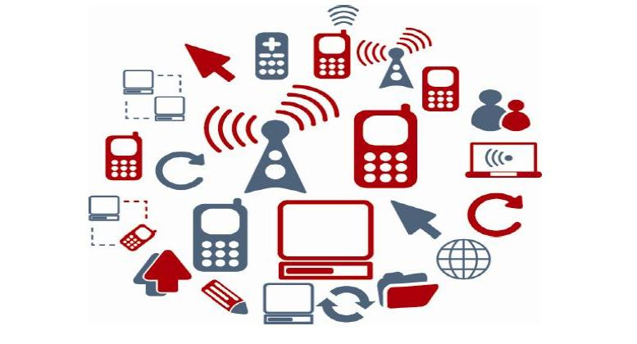
Internet of Things
Things mapped to IP addresses/library/university spaces.
Wiring Library Spaces for IP address level connectivity.

Slide 20
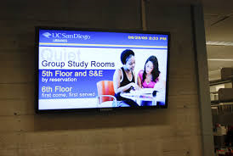
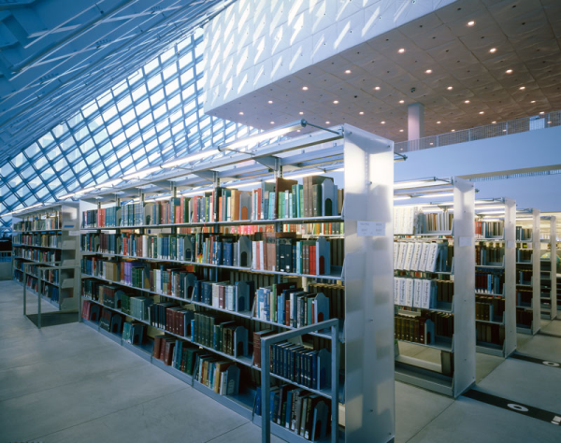
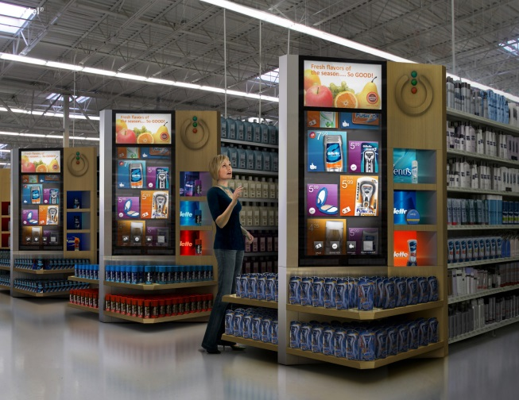
RFID, Bookshelves, Digital Signage
Electrical/Connectivity Needs for Digital Signage, RFID, Geo-locating,
smart scholarly spaces

Slide 21
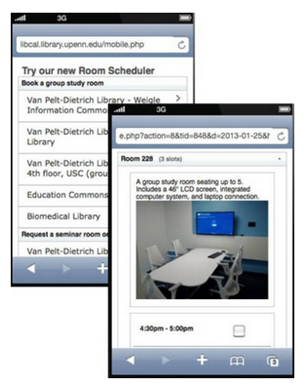
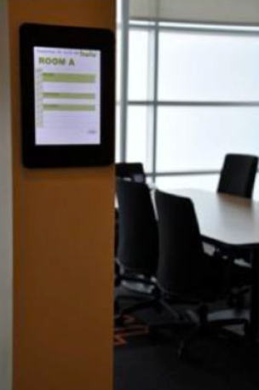
Smart Rooms and Scheduling Software

Slide 22
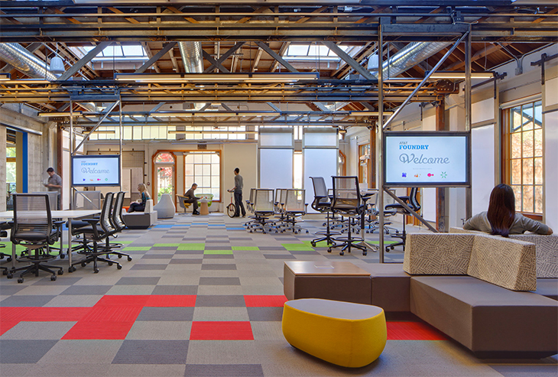
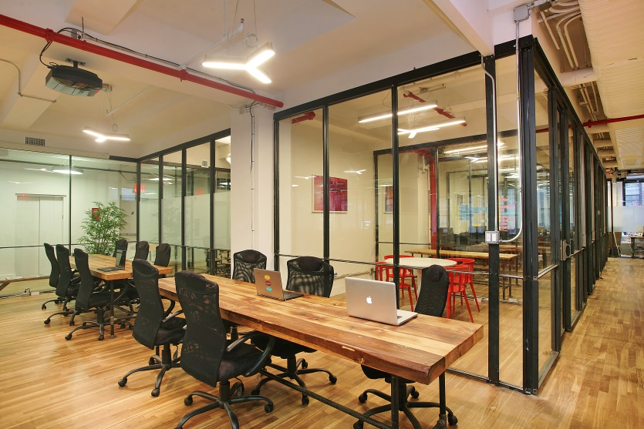
Staff Work Spaces
Mobile, quickly (re)assembled
Wireless Connectivity, Hoteling, Moveable Walls, Electrical
Workplace of the Future (video), Examples (video), Moveable Walls (video),

Slide 23
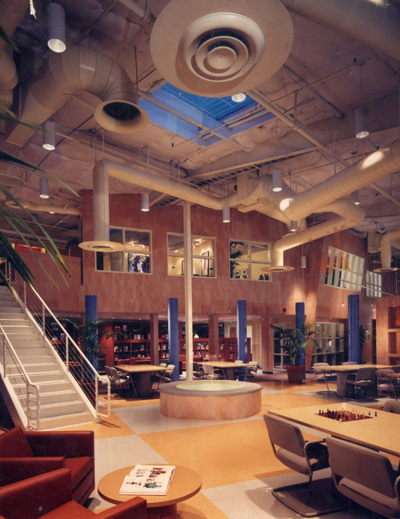
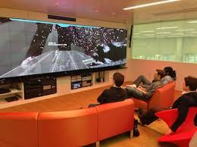
Imagineering Design Potential
For Academic Library Spaces
Hunt Library Video, Learning Space Design Playlist
Instant Theatres, Learning Work Spaces (video)
Lighting Museums and Libraries (lecture video)

Slide 24
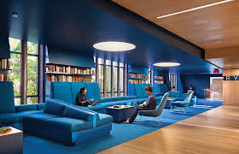
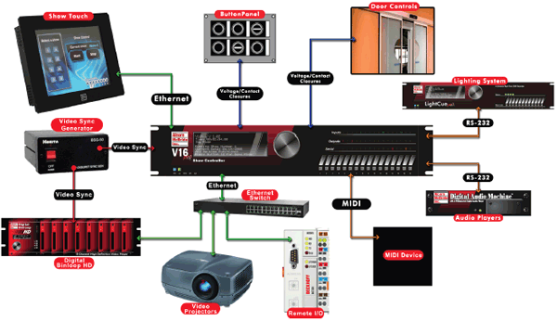
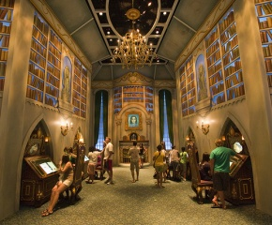
Imagineering Academic Library Spaces
Show Controller Technology
Learning Commons ODU (Student video), cafes, computers and journal kiosks, lighting-narrative, show controllers (vendor website) in academic environments, Expanded electrical/connectivity/plumbing, U Calgary Design Thinking

Slide 25
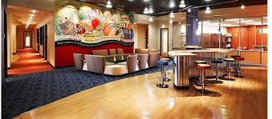
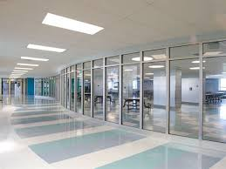
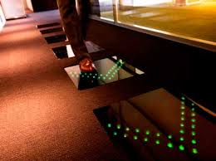
Wayfinding Design
Smart Flooring/Tiles, Spaces, Library Cafes
Electrical Needs/Connectivity, Wireless & Higher Bandwidth
Wayfinding Design, Digital Carpet,
Plumbing for food & drink in the library, bathroom spaces

Slide 26
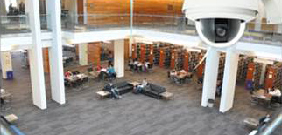
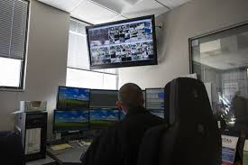



Expanded Building Security for Technology Rich Environments
Keyless Access Readers, Cameras, Other Security

Slide 27

Prototyping/Scaling/Phasing
Future Trajectories
Learning Commons 10 M +
(Multi-Tiered, Many Labs, Visualization, Multimedia, 3D Printing, Makerspace, Traditional etc.
Makerspace 1-2 M
(Physical/Digital Computing Space), Lasercutter, 3D Printing, Arduino etc.
3D Printing Lab, 100-500 K
Multiple and Varying Capability, 3D Printing Space, Scanners, Lab
3D Printer Prototype, 15-40K
3D Printer, 3D Scanner, Software, HR Infrastructure

Slide 28
Contact Information
Contact Info
Ray Uzwyshyn, Ph.D. MBA MLIS
TEXAS STATE UNIVERSITY ruzwyshyn@txstate.edu
Further Information, Presentations, Downloads http://rayuzwyshyn.net https://www.linkedin.com/in/rayuzwyshyn

Slide 29

Questions/Comments

