Slide 1
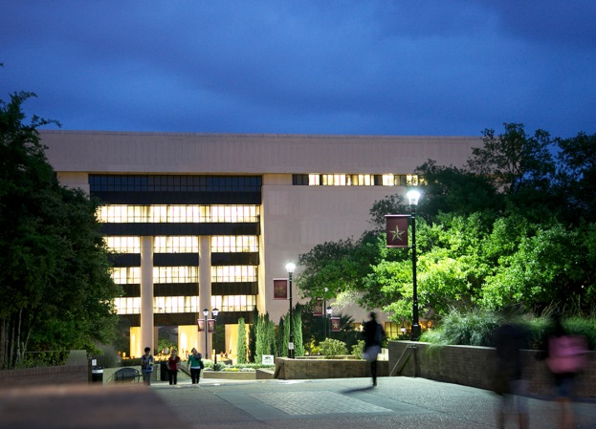
Transforming Academic Libraries for the New Millennia From Book Warehouses to Technology-Centered Learning Commons
Ray Uzwyshyn Ph.D. MBA MLIS
Director. Digital & Collection Services Texas State University
March 25, 2016
9:00-9:40 am

Slide 2
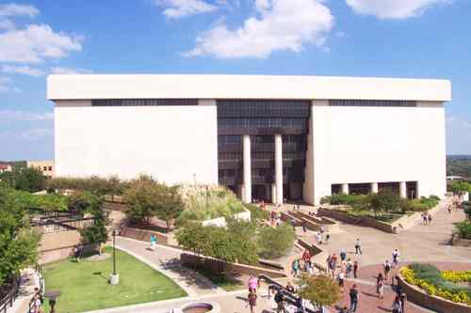
Alkek Library Learning Commons 2015-2022
Large Academic Library Project (7 Fl.)
Texas State University, 36,000 Students
Carnegie Class Doctoral University (Higher Research Activity)
Designated Emerging Research Institution (Texas)
Overview Video
Multi-Stakeholder IT Division Project
Multi-Year 5-7, 3 Large Phases
~ 40 Million Total Budget

Slide 3
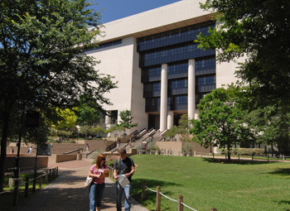
Learning Commons Timelines
Phase I: Infrastructure Upgrade, Off-site Repository (2015-2017, ~5M, ~10M), Construction
Phase 2: Mid-Term, Learning Commons, 2016-2018, ~15M, Architectural Programming/ Design Phase
Phase 3 Long Term, Future Learning Commons, 10 M (2017-2022)

Slide 4
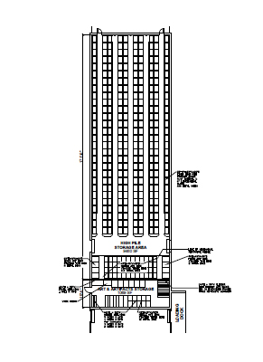
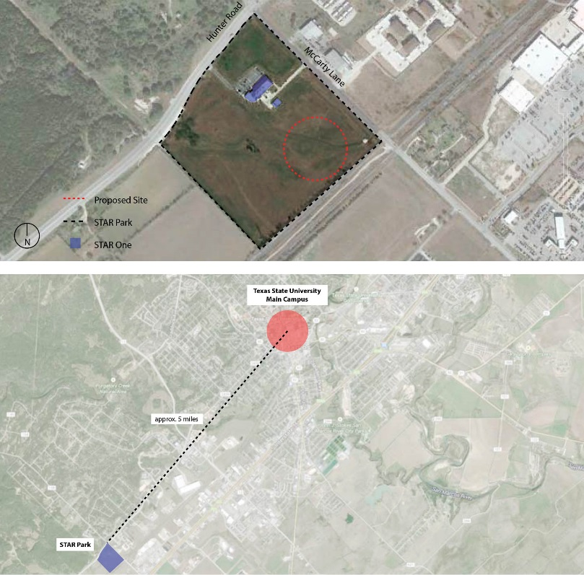
Offsite Repository (2015-2017)

Slide 5
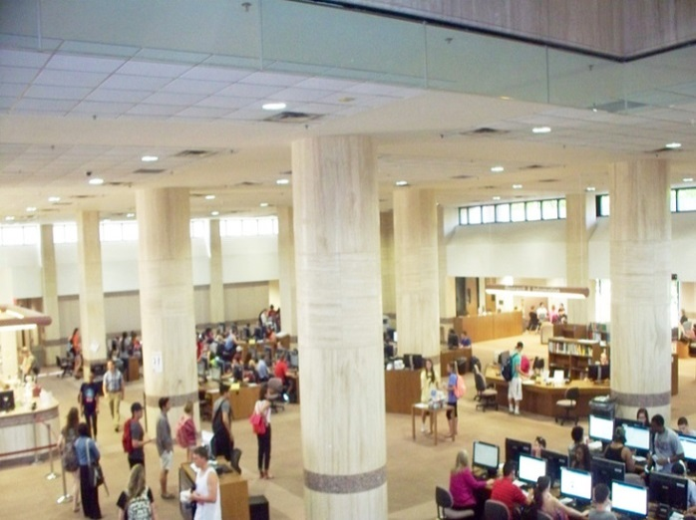
Larger Learning Commons Infrastructure Planning Principles
Technologies deployed in the library will change over time. Planning should reflect this by allocating appropriate space without necessarily establishing a specific technology for each space

Slide 6
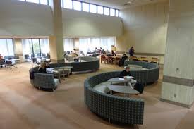
Alkek Library Infrastructure Upgrade Planning Considerations 2016
Planning associated with technologies should not be constrained based on current technology equipment or practices.
Library planning should anticipate technologies we don’t expect to see, and in our current expectation, more technology is probably an underestimate.
Upgrade should provide infrastructure throughout building holistically

Slide 7
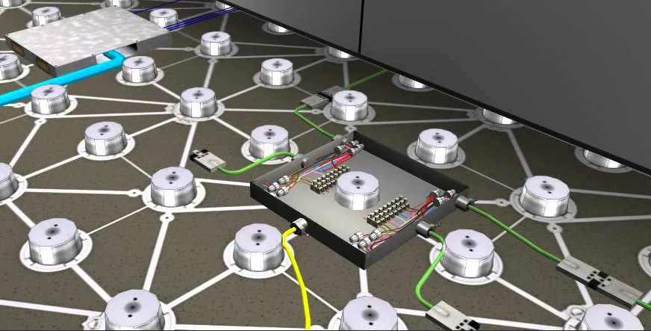
High Data/Electrical Floors (fl. 1-2, P.1) Throughout Building (P.2) (Technological Reconfigurability)
Learning Commons Floor Video (DIRRT)

Slide 8
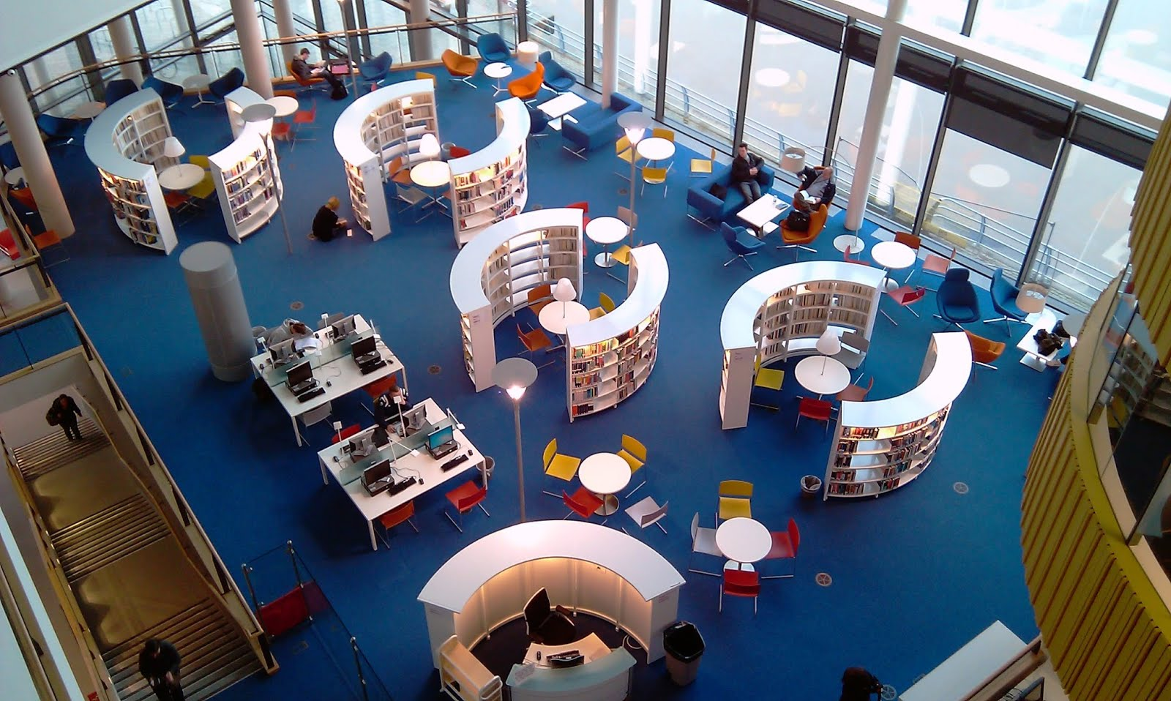
Themed Moveable Centers
Emphasis on: Reconfigurability Interdisciplinarity Collaboration Library as Third Space

Slide 9
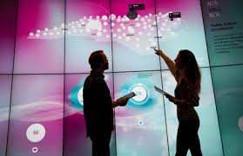
Learning Commons (P.2) Current Technology Considerations

Slide 10
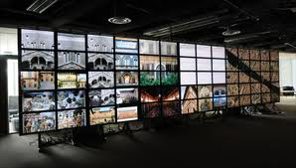
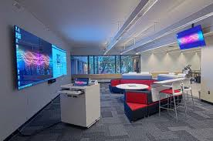
Visualization Technologies Wider definitions of computing & digital literacy
Hunt Library NCSU (video) Rice (video, rationale, science) UT Austin (video, humanities) Deloitte University (video, business) University of Calgary

Slide 11
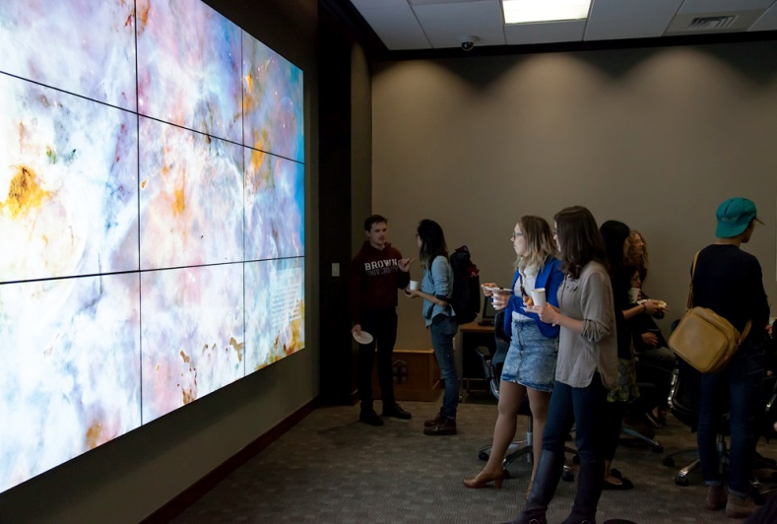
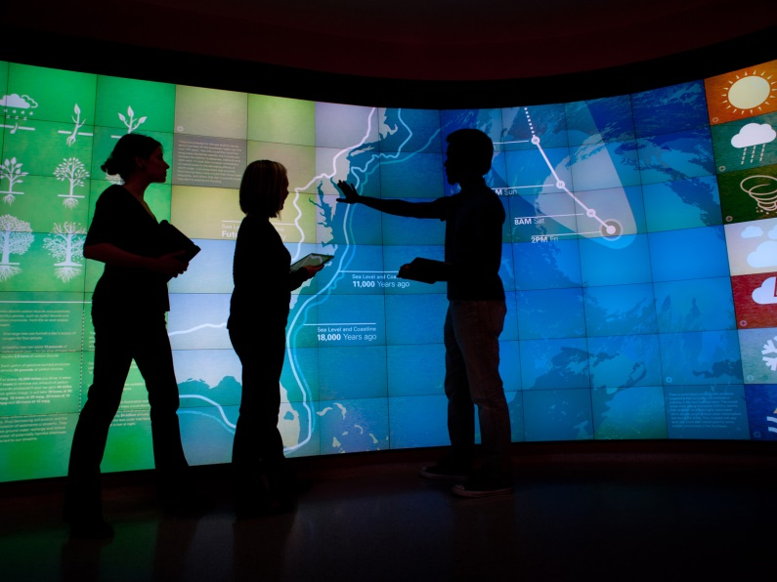
Visualization Walls (VizWall)
Brown University Rockefeller Library (article)
NCSU Hunt Library (infrastructure link)

Slide 12
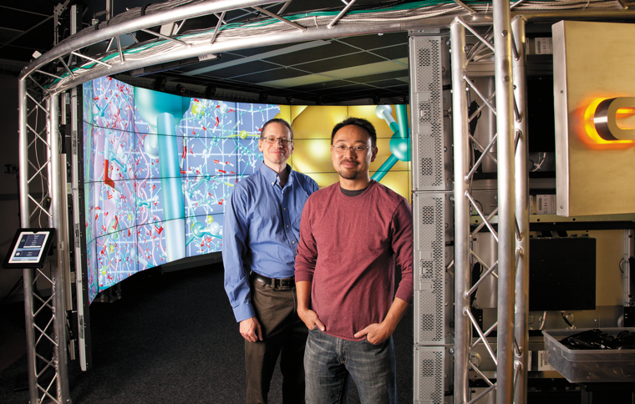
3D Immersive & Interactive Environments
Microsoft Holo Len Lab (video), Site University of Chicago CAVE (article, video, cost)
John Hopkins Libraries Brody Learning Commons Display Wall (video)

Slide 13
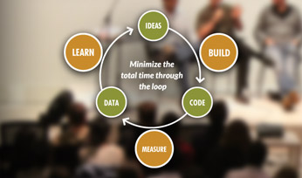
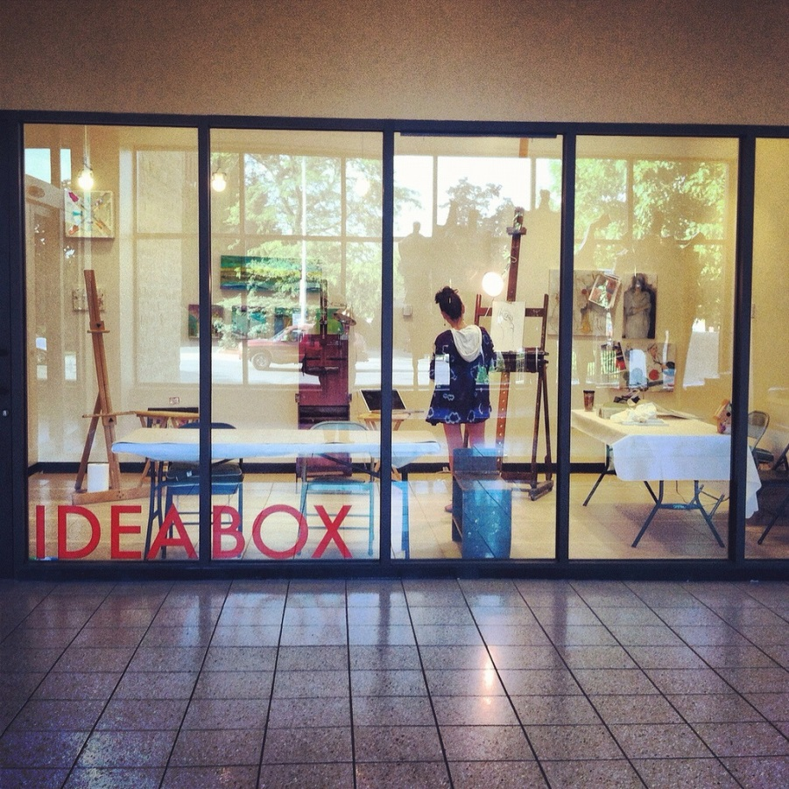
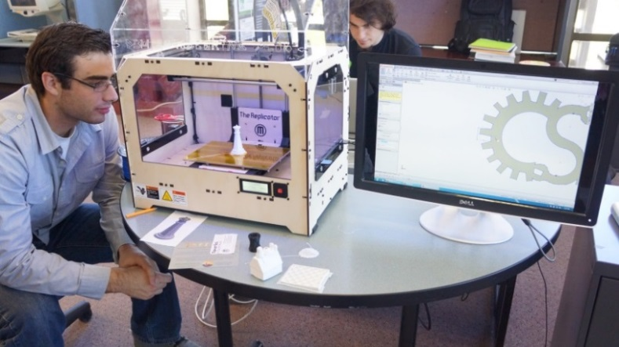
Academic Library Maker Spaces
ACRL: Academic Library Makerspaces (article), Video (TedX)
Library Makerspaces (Resource List), Examples

Slide 14
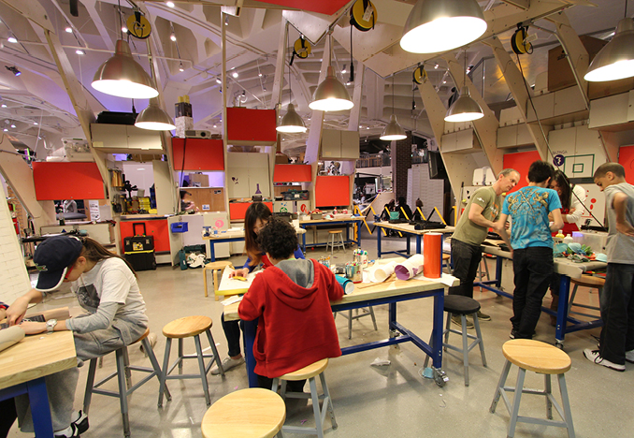
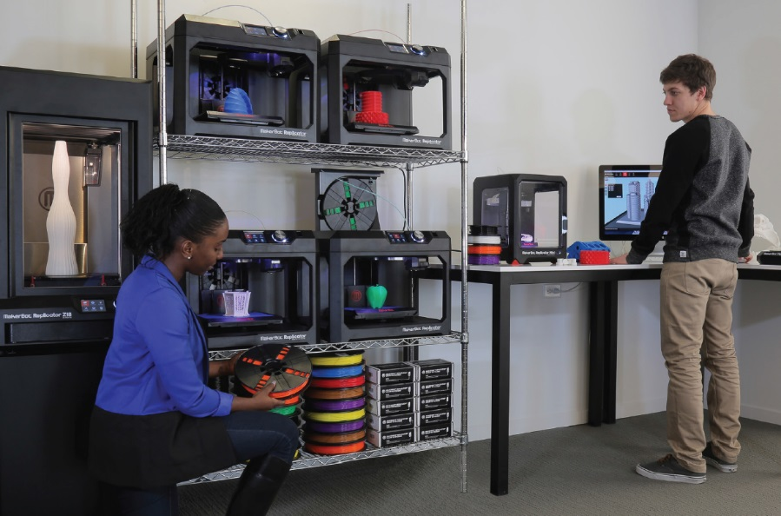
Library Makerspaces (Considerations)
Fire codes/Ventilation/Internet Connectivity/Expanded Electrical
3D Printing Prototype Lab (Video) Academic Purposes (Video)
Traditionally include 3-D printing, but can include other spaces to create content (e.g., large-format printing, physical computing, prototyping sandboxing)

Slide 15
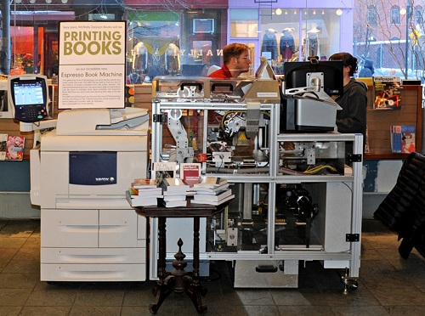
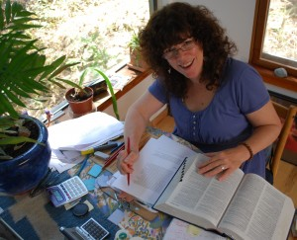
In House Library e-Presses University Publishing Infrastructures
E-Press Editor
Esspreso Book Machine Animated Video, Espresso Book Machine Video, Site

Slide 16
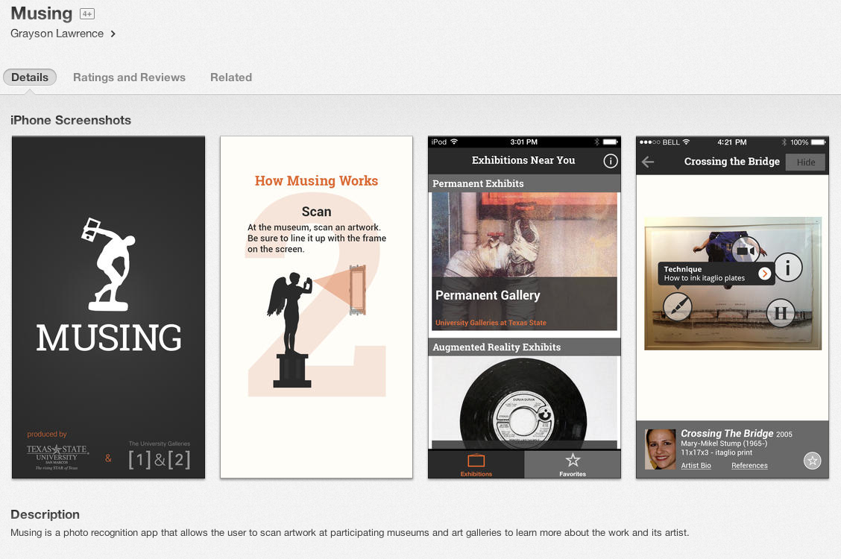
Interactive Museums: Wittliff Collections
Interactive displays, visual media displays, audio/podcast tours and electronic multimedia guides. Examples:
MUSING: an iPhone app developed by Texas State (Link)

Slide 17
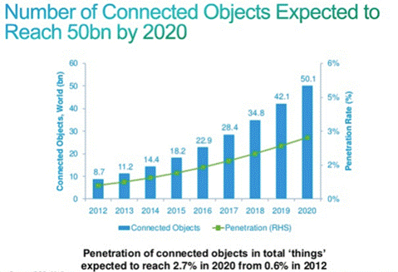
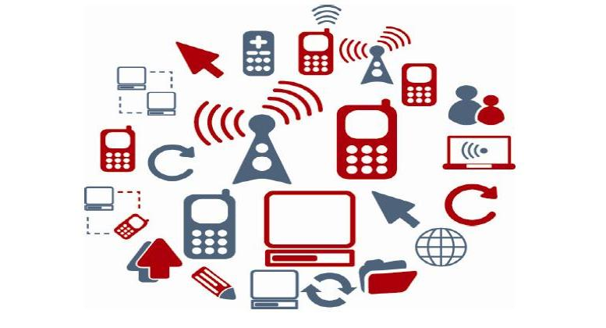
Internet of Things
Things mapped to IP addresses/library/university spaces. Wiring Library Spaces/Books for IP address level connectivity.

Slide 18
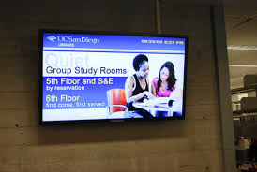
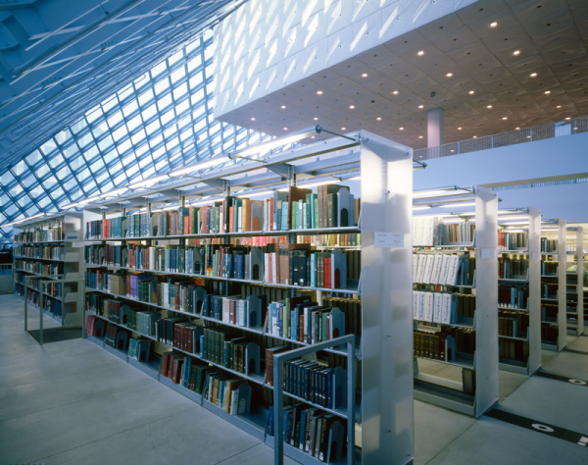
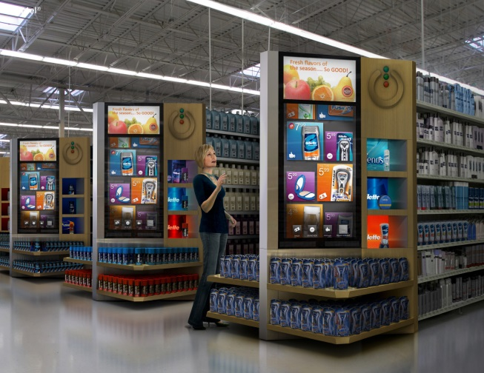
Bookshelves, Digital Signage, RFID
Electrical/Connectivity Needs for Digital Signage, RFID, Geo-locating, smart scholarly spaces

Slide 19
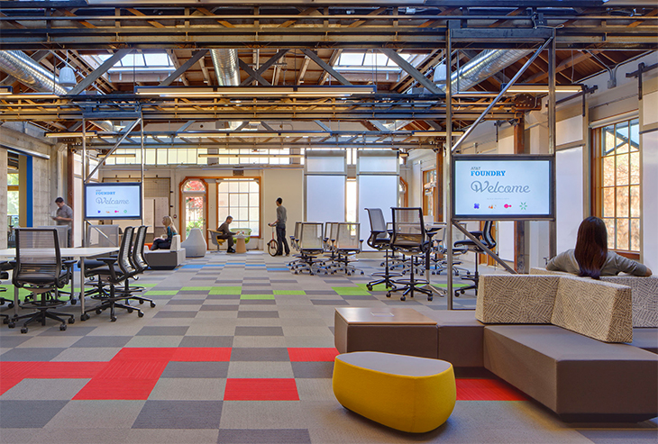
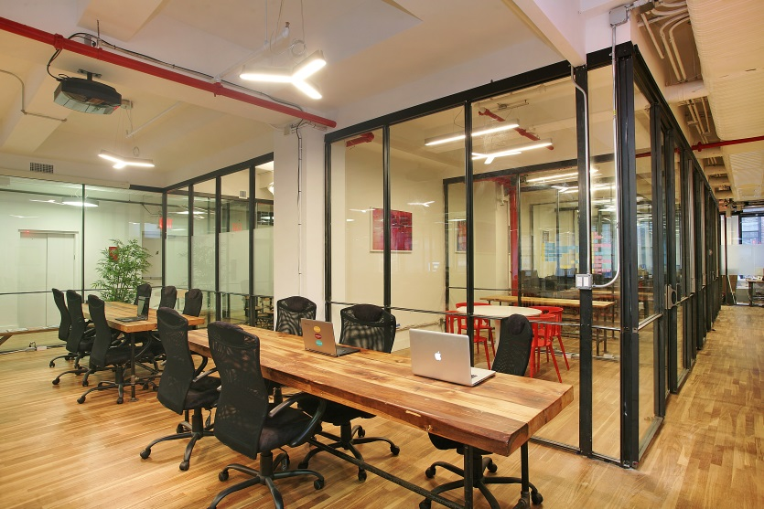
Staff Work Spaces, Hoteling Mobile, quickly (re)assembled
Wireless Connectivity, Moveable Walls, Electrical Workplace of the Future (video), Examples (video), Moveable Walls (video),

Slide 20
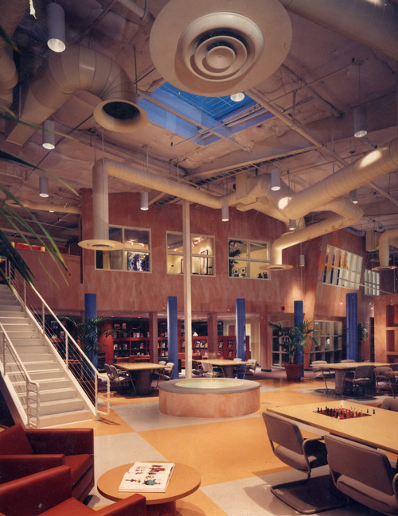
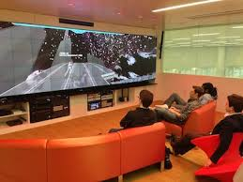
Imagineering Design For Academic Library Spaces
Hunt Library Video, Learning Space Design Playlist Instant Theatres, Learning Work Spaces (video) Lighting Museums and Libraries (lecture video)

Slide 21
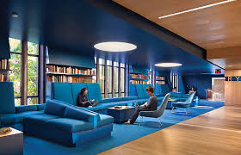
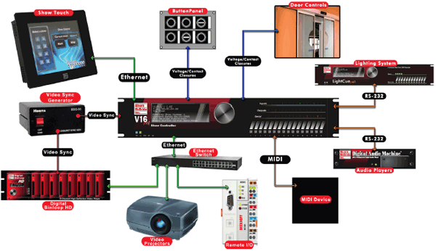
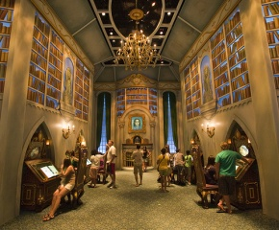
Imagineering Academic Library Spaces Show Controller Technology
Learning Commons ODU (Student video), cafes, computers and journal kiosks, lighting-narrative, show controllers (vendor website) in academic environments, Expanded electrical/connectivity/plumbing, U Calgary Design Thinking

Slide 22
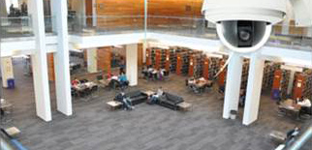
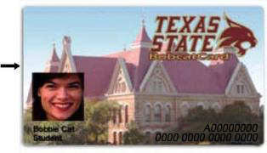
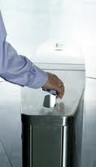
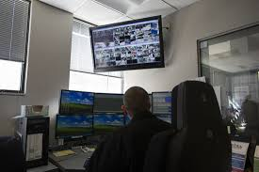
Expanded Building Security for Technology Rich Environments
Keyless Access Readers, Cameras, Other Security

Slide 23
Scaling/Prototyping/Phasing
Learning Commons 10 M + (Multi-Tiered,Visualization, Multimedia, 3D Printing labs, Makerspace etc. Makerspace & Centers 1-2 M Physical/Digital Computing Spaces
3D Printing Lab, 100-500 K Expanded Capability, Scanners, Lab
3D Printer Prototype, 15-40K Basic 3D Printer Infrastructure
Building Future Trajectories

Slide 24
Contact Information Contact Info Ray Uzwyshyn, Ph.D. MBA MLIS TEXAS STATE UNIVERSITY ruzwyshyn@txstate.edu Further Information, Presentations, Downloads http://rayuzwyshyn.net https://www.linkedin.com/in/rayuzwyshyn

Slide 25
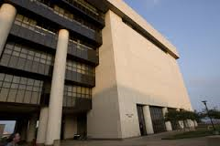
Questions/Comments

Slide 26
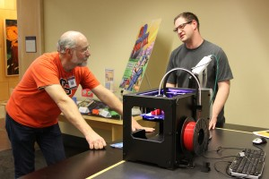
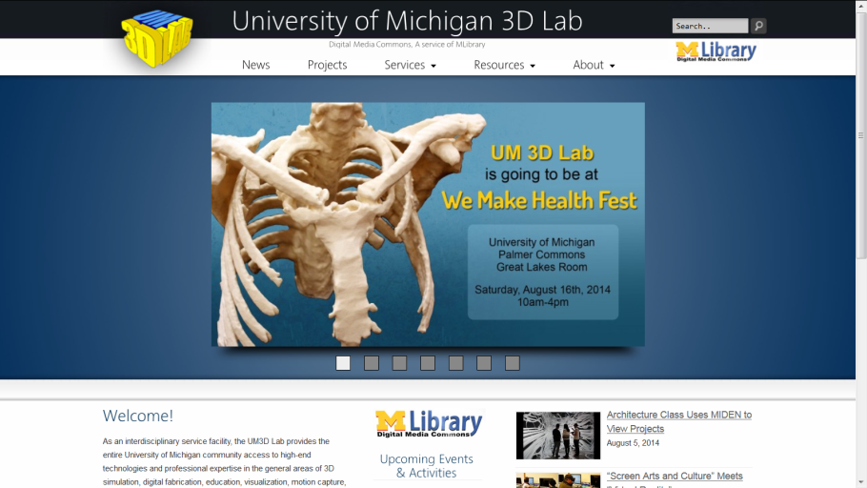
Academic Makerspaces
Oregon State University Valley Library (article)
University of Michigan 3D Lab (example infrastructure)
Traditionally include 3-D printing, but can include other spaces to create content (e.g., large-format printing, physical computing, prototyping sandboxing)

Slide 27
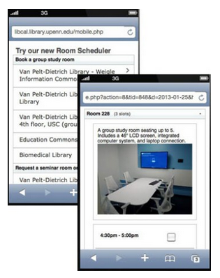
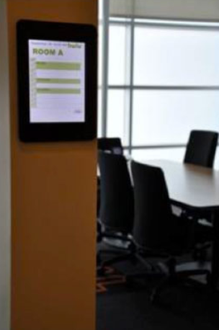
Smart Rooms and Scheduling Software

Slide 28
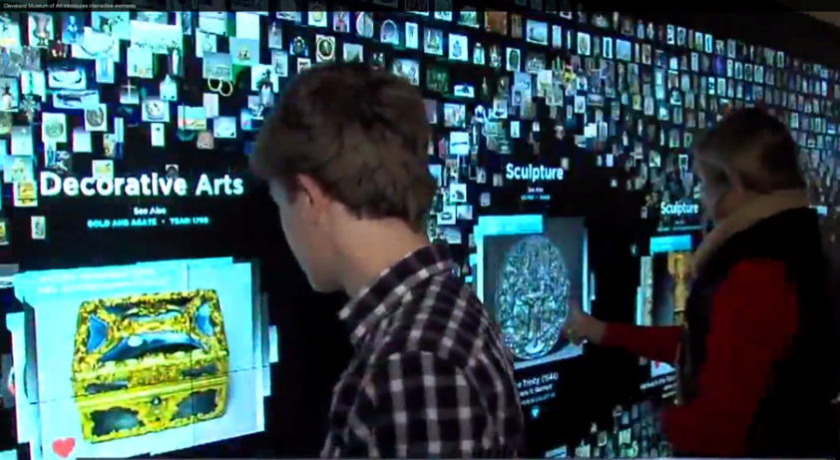
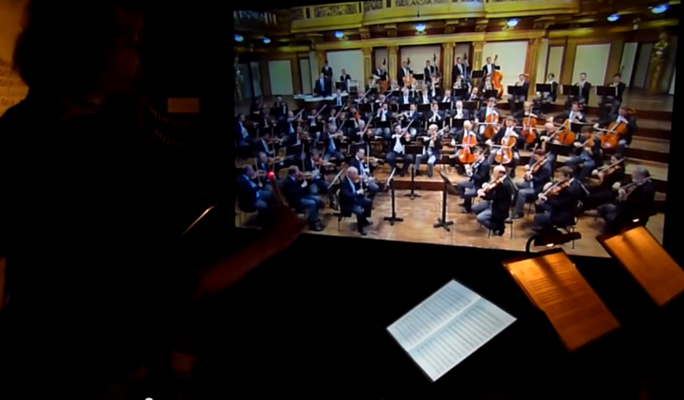
Interactive Museum technologies
Cleveland Museum of Art - Collection Wall and more (video)
Interactive Museum of Sound, Haus der Music, Vienna (video)

Slide 29
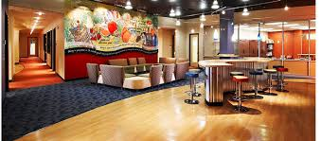
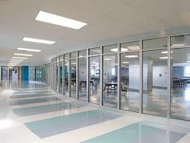
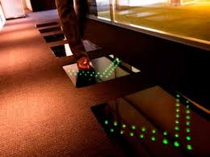
Wayfinding Design Smart Flooring/Tiles, Spaces, Library Cafes
Electrical Needs/Connectivity, Wireless & Higher Bandwidth Wayfinding Design, Digital Carpet, Plumbing for food & drink in the library, bathroom spaces

