Slide 1
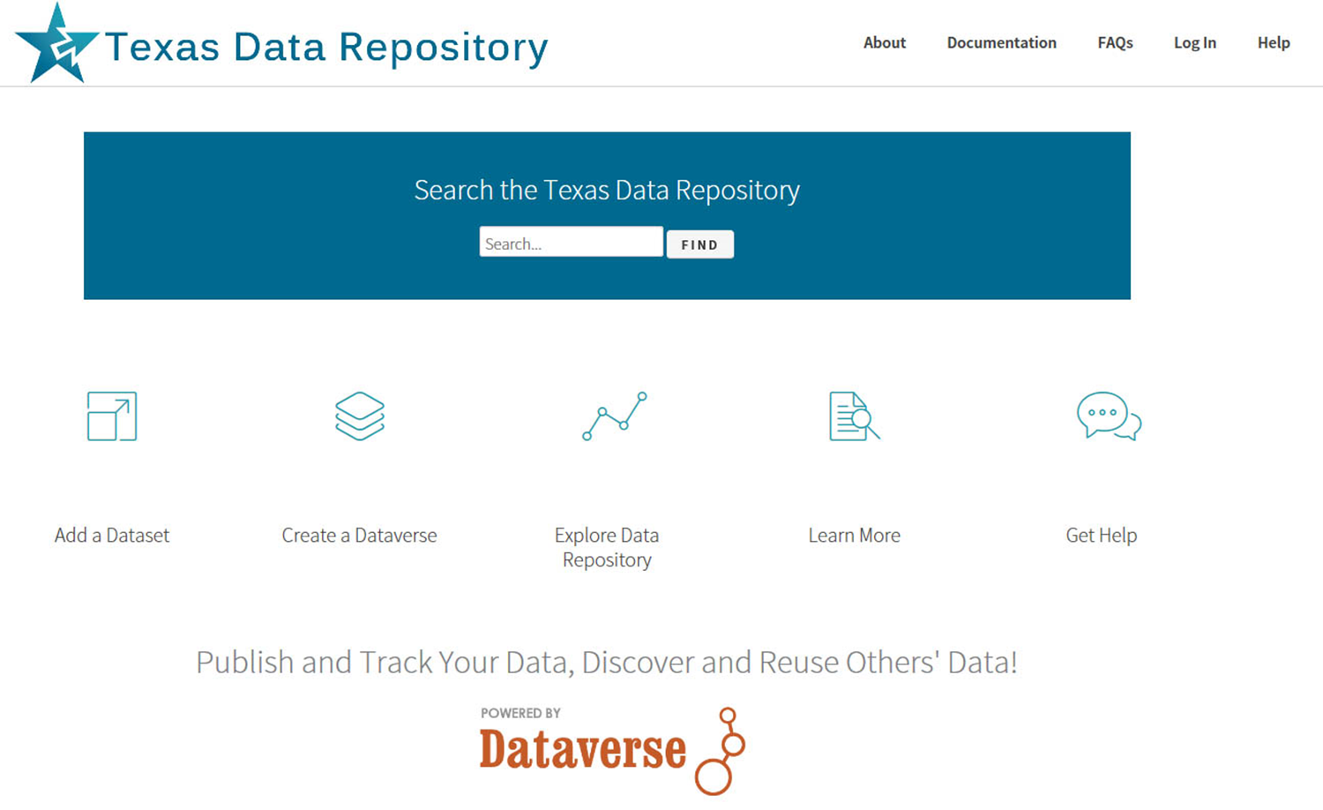
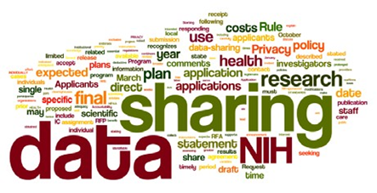
The Texas Data Repository Initiative
@ Texas State University
Ray Uzwyshyn,
Director, Collections and Digital Services,
Texas State University Libraries
ruzwyshyn@txstate.edu , 512-245-5687

Slide 2

Online Data Repositories (Background)
Online Way to Manage a Researcher’s Data/Metadata
Long Term Data Archiving, Preservation, Sharing Strategy
(data, paratextual material, field notes, docs, multimedia and programs)
Permalinking Strategy for Online Data Citation/Access (DOI: Digital Object Identifier, UNF:University Numerical Fingerprint, Linked Data, Interoperability)

Slide 3
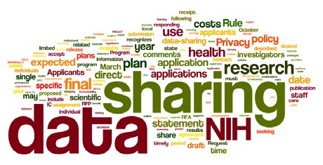
Why are Data Management Repositories Required?
Most major Federal grant agencies require data management plans as mandatory part of the grant proposal/oversite process.
(NIH 2003; NSF 2011; NEH, 2013 USDA)

Slide 4
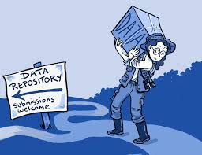
Research Data Repository Software
May be hosted or installed on a university’s server
Each software contains different ranges of management, collaborative options
Open source and proprietary options
Ingestion of Various Data Types
(from Excel to SPSS to more esoteric disciplinary specific formats)

Slide 5
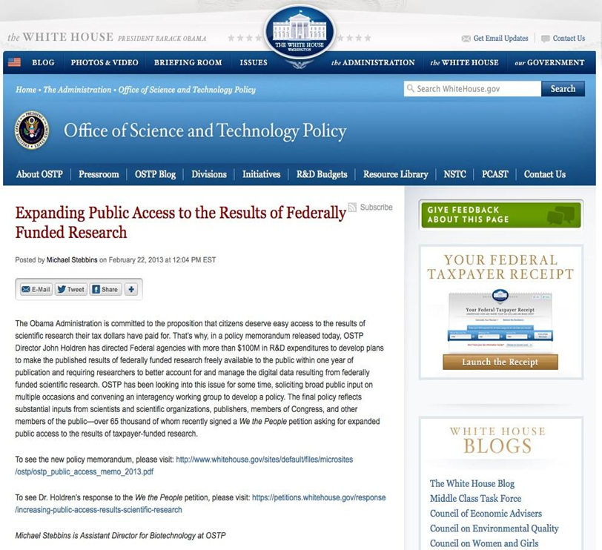
State of Texas Data Repository Group
Formed in 2014 (Texas Digital Library)
Charge: To Determine a Suitable Data repository infrastructure and management model at a consortial (State Level)
Evaluate software models
Develop Needs Assessment
Make service recommendations
Document findings

Slide 6
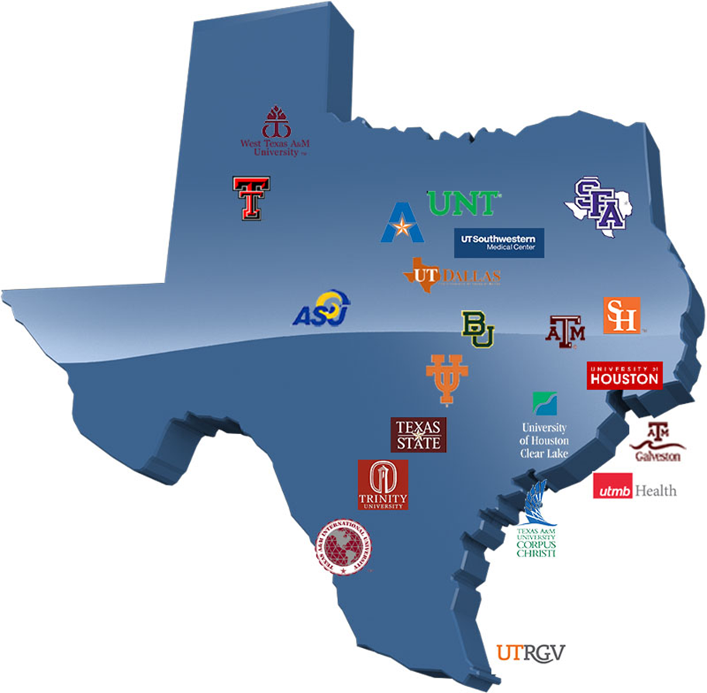
Texas Digital Library (TDL)
TDL is a Texas Consortium of
22 universities across Texas
leveraging technological
cooperation among
academic libraries
Coordinated through Texas Digital Library at UT Austin, connected with other bodies (TACC, Texas Advanced Center Computing, DPN, Digital Preservation Network, Duracloud)

Slide 7
2014: Data Repository Working Group Formed
Conclusion: The group recommends that TDL adopt Harvard’s Dataverse to facilitate the discovery of research data.
Dataverse provides the best :
system performance
Robustness
Usability
platform availability
an active open source community
Working Group Report
(August 28, 2015)

Slide 8
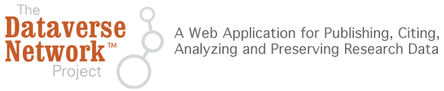
Dataverse
Harvard Provides a Software framework that enables institutions to host research data repositories
Digital Preservation and archival Infrastructure: allows sharing, control, persistent data citation, data publishing and management

Slide 9
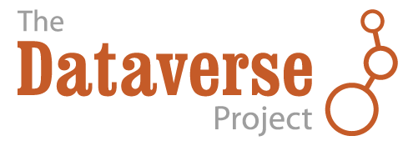
Dataverse Details
Relatively simple ingest for researchers
Ability to share with trusted research groups prior to publication
Ability to version datasets
Supports data citations (e.g. DOIs, recognition and credit)
Allows for control over branding (customization)
Helps researchers fulfill Data Management Plan requirements
Sustainable platform with growing open source community led by Harvard

Slide 10
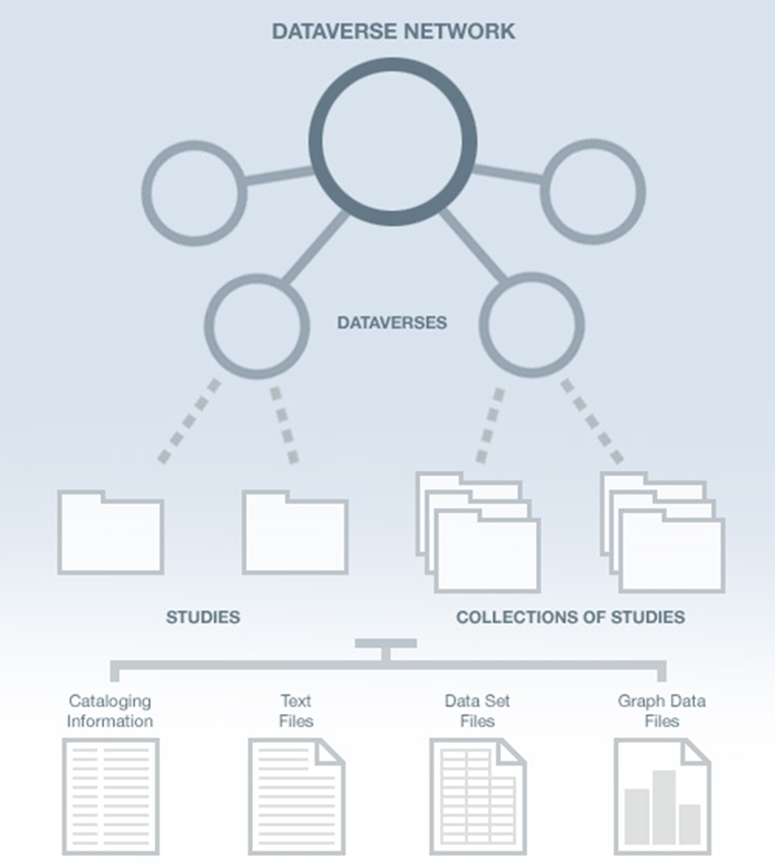
Texas Data Repository
Network Architecture
TDL
Consortium
Why the Dataverse Network?
(silent video overview)
Open Journal Systems
Dataverse Integration (2014)
Research Study Data
Data Set Files
Metadata ( Data Describing the data)
Paratextual Research Material
(Methodology, Field Notes , Multimedia
Graphs, Programs etc.)
Institutions
(i.e. Texas State)

Slide 11
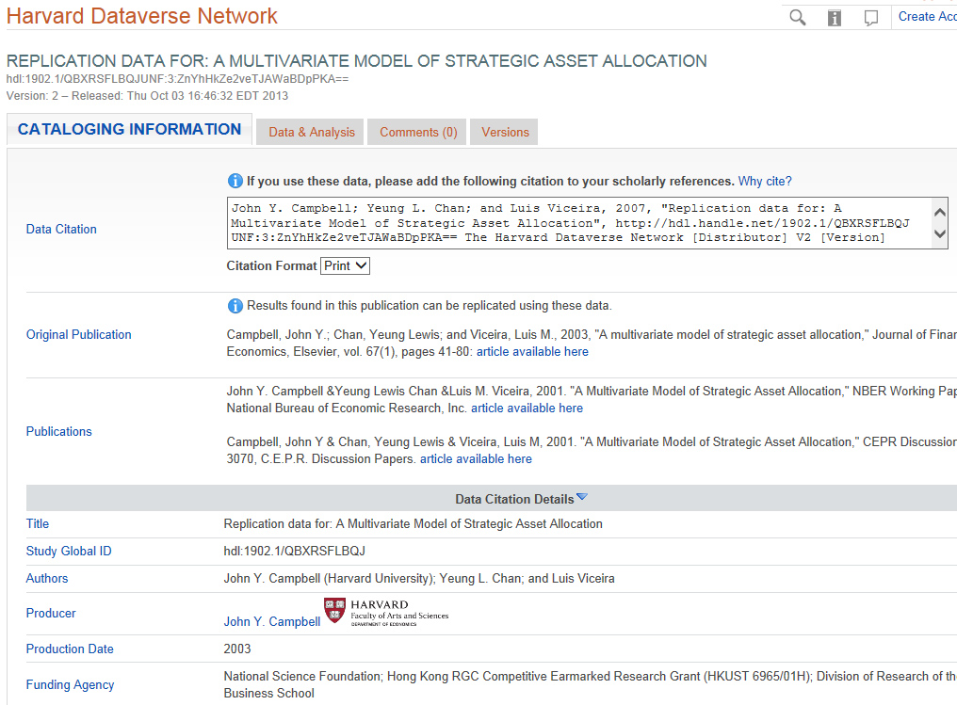
Dataverse Metadata Example

Slide 12
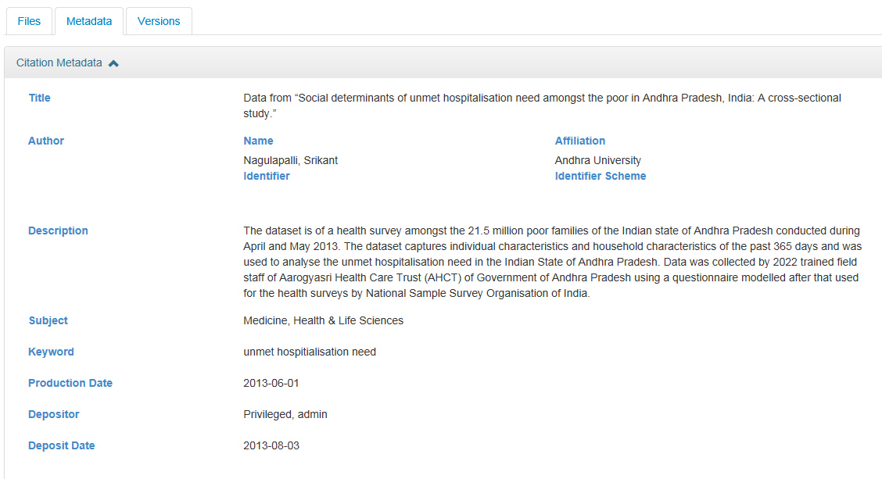
Dataverse Metadata Example
(From the Simple to Very Complex)

Slide 13







TDL Dataverse Implementation Working Group (August 2015 – December 2016)
Charge: Pilot test, assess, and launch a consortial repository for research data archiving and management.
14
Working
Group members
Main Working Group
& Subcommittees:
Policy and Governance
Workflows and Outreach
Budget/Business Models
Technology
7
Texas Universities
5
Texas State University Part of Main, Policy, Governance and Technology Implementation Groups
Committees

Slide 14
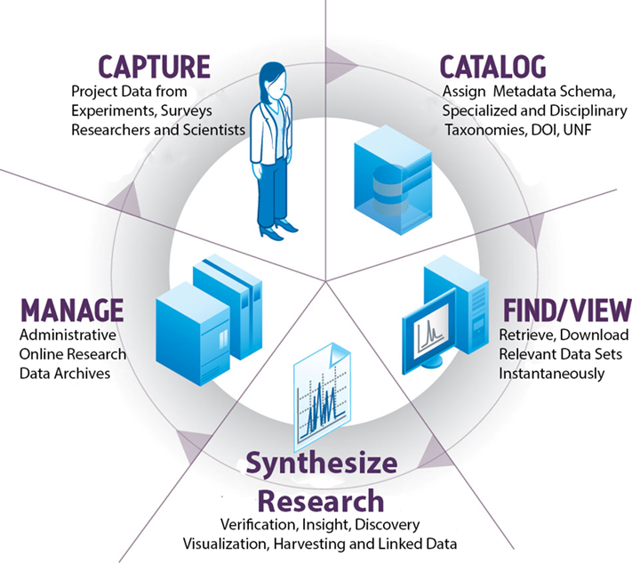
Working Group Areas
Many Planning Aspects of Data Research Repositories
August 2015 – April 2016
The Research Data Repository
Lifecycle

Slide 15
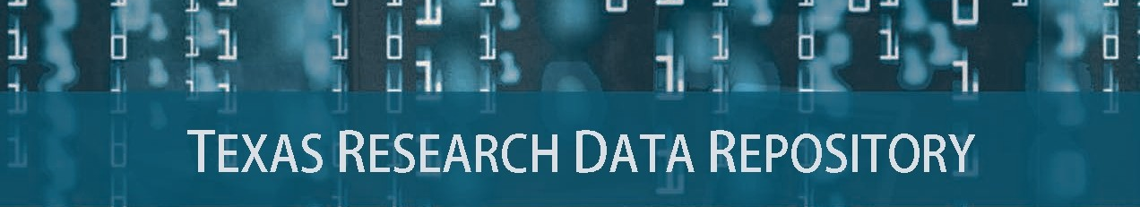
Prototype and Pilot Study, May-August 2016
Consortial Repositories, http://www.tdl.org/data-repository

Slide 16

http://data.tdl.org/
UX (Usability Focus)

Slide 17
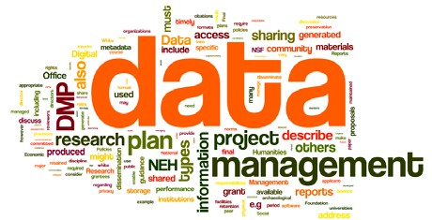
Texas Data Repository Initiative
Sept. 2016 - December 2016
Current
Dates Soft launch, September – November 2016
Online Research Data Symposium (Baylor, November 15-16)
Official Launch of Data Repository (December 1st, 2016)
Inaugural Year/Local Infrastructure (January – December, 2017)

Slide 18

Texas State University Library Infrastructures
& Federal Mandates For Public Access to Research
The Library Supports:
Publication repositories (D-Space)
Data repositories, Texas Data Repository
Human Resource Infrastructure
Data Repository Librarian
Subject Liaisons (Outreach)
Publication Repository Librarian
Workflows, standards, & policies
http://www.whitehouse.gov/blog/2013/02/22/expanding-public-access-results-federally-funded-research

Slide 19

Texas Data Repository Accommodates
Most Sizes of Data Projects
Normal to Mid-Range, 90%
Files/Data Fit on Server/Cloud, may be uploaded, Dataverse, 2GB File size max currently, unlimited number of files/faculty/dataverse)
Huge, Global Scale Projects, 10%
(Data may require specialized university IT Support, i.e. terabyte/petabyte online storage, consortial possibilities, Chronopolis, Texas Advanced Computer Center, DEEPN, Duracloud)
Borgman, C. 2015. Big Data, Little Data, No Data: Scholarship in the Networked Age

Slide 20

Types of Data Repositories
Institutional/Consortial Repository
(Texas State University and/or or consortial)
Project/Discipline specific
(usually large single faculty/faculty team projects, i.e. Academic Specialization, Purdue Nanohub, Engineering etc. )

Slide 21
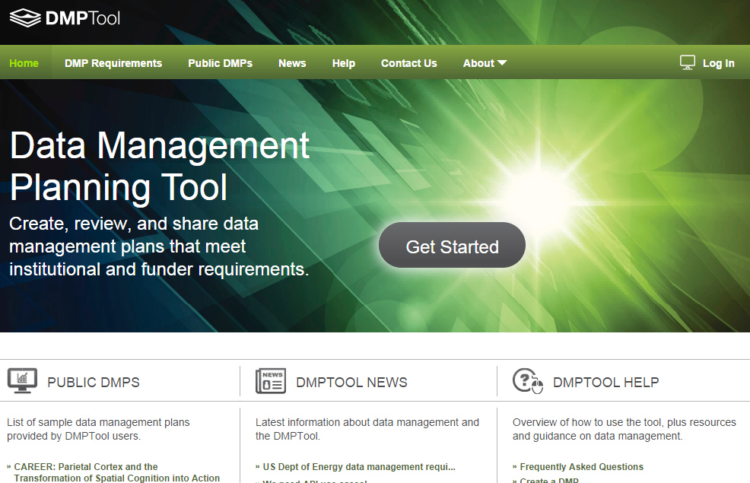
DMP Policy Tool Integration
Overview Video
Customizable
Plan Outline Tool
Resource Links
Supports All Major Funders
Texas Data Repository Template Boilerplate
https://dmptool.org/
California Digital Library

Slide 22
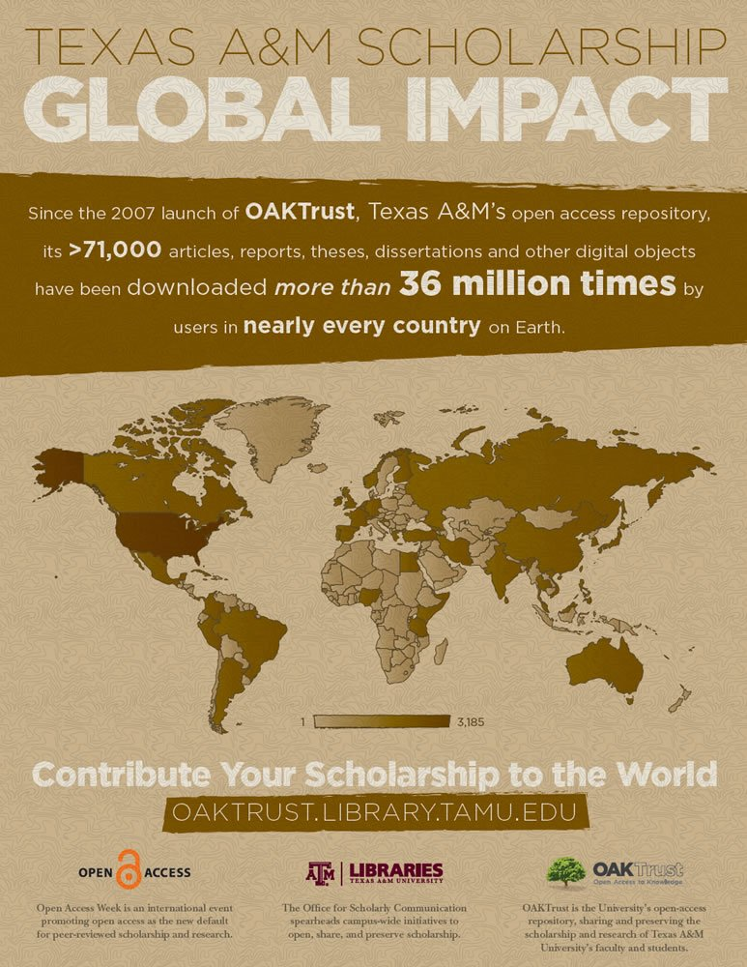
Electronic Thesis and Dissertations (ETD) Repository (D-Space) Connections
Co-publish data sets in ETD (D-SPACE) and Data Repository, Links in metadata in D-SPACE and DATA REPOSITORY
Future Possible ETD (D-Space), VIREO, DATA REPOSITORY CONNECTIONS

Slide 23
Research Data Repository
Adoption Lifecycle (2016)
Research Universities &

Slide 24
Comments/Questions

Slide 25
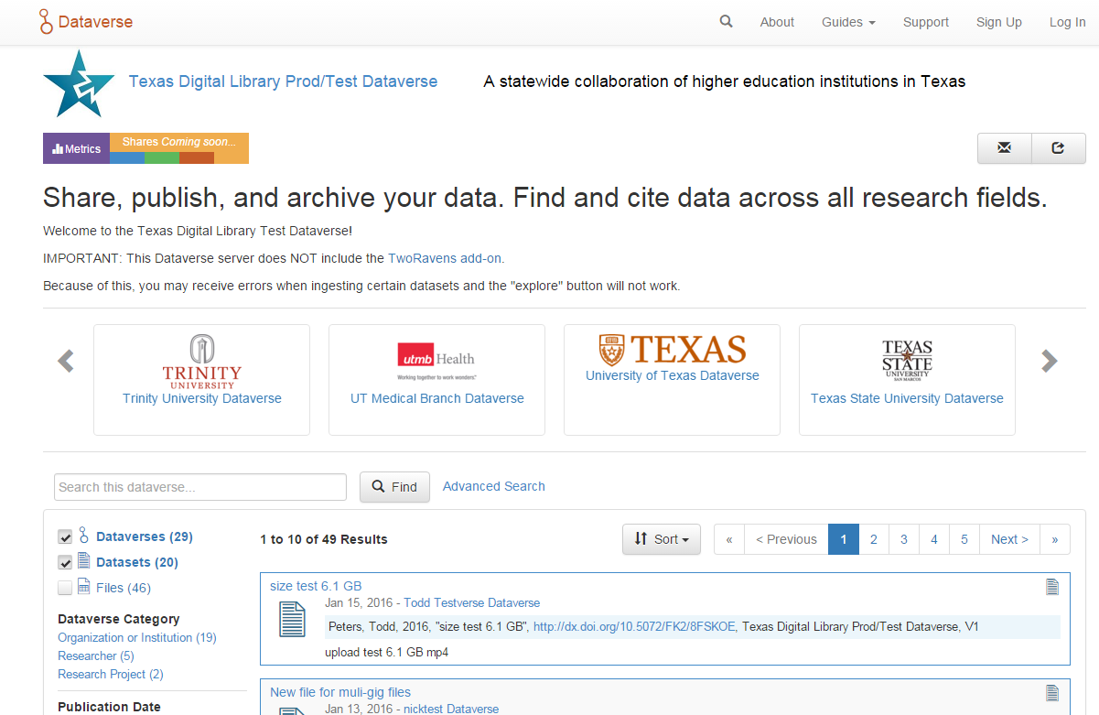
Add Data
Share, publish, and archive
Find Data
Search across disciplines
Cite Data
Obtain a citation and unique identifier

Slide 26
Use Cases: Make Research Data Publicly Available and/or Sharing Data
Primary Actors:
PIs of federally funded research
Researchers working on unfunded research/ funded research with no retention requirements
Graduate students working on theses, dissertations, or other data-generating projects.
Geographically Dispersed Researchers and Project Teams Wishing to Collaborate

Slide 27
Use Case: Seek Data to (Re)Use
Primary Actors:
Researcher is interested in conducting a meta study reusing data developed in earlier studies
Public using data for personal needs
Organizations seeking data for their needs.

Slide 28
Pilot Study Responses
Perceived Benefits of Data Repository
Fulfill federal mandates for sharing publications and research data
Make research data more widely available
Statistics on downloads and citations of my data
Make my data citeable through the assignment of a DOI (digital object identifier)
Saving various versions of the dataset (data lifecycle)
Collecting all my data in one place

Slide 29
Further Links/References
ARL NSF Data Sharing Policy and Resource Links, http://www.arl.org/focus-areas/e-research/data-access-management-and-sharing
ARL (White House Directives and Funded Research Data ) http://www.arl.org/focus-areas/public-access-policies#.VoaV0I-cFzo
Borgman, C. 2015. Big Data, Little Data, No Data. Scholarship in the Networked Age.
California Digital Library DMT Tool: https://dmptool.org/
Chronopolis: http://www.digitalpreservation.gov/partners/chronopolis.html
Dataverse. http://thedata.org/
Dataverse (Data Science Site). http://datascience.iq.harvard.edu/dataverse
DPN (Digital Preservation Network) http://www.dpn.org/
Duracloud: http://www.duracloud.org/
Purr. (Purdue Institutional Data Repository). https://purr.purdue.edu/
Hubzero. https://hubzero.org/
Figshare. http://figshare.com/
ICPSR Data Management & Curation. http://www.icpsr.umich.edu/icpsrweb/content/datamanagement/
Research Data Management. Principles, Practices, and Prospects (November 2013). Council on Library and Information Resources. http://www.clir.org/pubs/reports/pub160
Cox, A. and Pinfield, S. Research Data Management and Libraries. Jounral of Librarianship and Information Science. June 2013.
Fearon, D & Sallans, A. C. (January 2014). Institutional Research Data Management: Policies, Planning, Services and Surveys. Coalition for Networked Information. https://www.youtube.com/watch?v=rvbrW7S2fes (video presentation)
Data Management for Libraries: (LITA Guide) http://www.alastore.ala.org/detail.aspx?ID=10737
NMC Horizon Report: 2014 Library Edition. http://cdn.nmc.org/media/2014-nmc-horizon-report-library-EN.pdf
“Research Data Management”. pp. 6-7 and pp 24 – 45.
Holden, J. Memorandum for Heads of Executive Departments and Agencies: Increasing Access to the Results of Federally Funded Research (2013). http://www.whitehouse.gov/sites/default/files/microsites/ostp/ostp_public_access_memo_2013.pdf
Green, A. Macdonald, S and Rice, R. Policy-making for Research Data in Repositories: A Guide. DISC-UK. http://www.disc-uk.org/docs/guide.pdf
Research Data Management in the Arts and Humanities (2013). University of Oxford. http://www.dcc.ac.uk/events/research-data-management-forum-rdmf/rdmf10-research-data-management-arts-and-humanities (Conference Presentations)

Slide 30
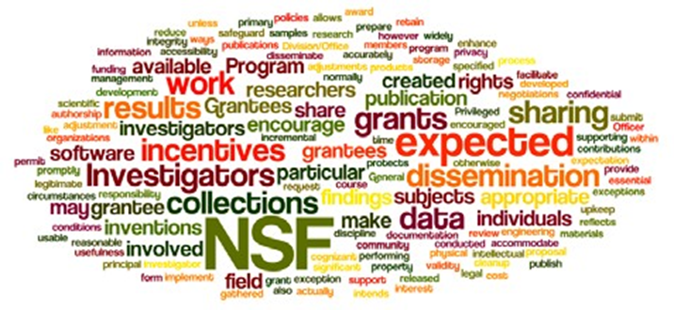
Why Are Data Management Plans Required
Leverage and make available faculty, departmental and institutional research
Allow publication of negative data (less research replication)
Wordle of the National Science Foundation’s Award and Administration Guide. Chapter VI.D.4, Mandatory 2011

Slide 31
Data Management Plans
Part of Evolving Science, Social Science and Humanities Research Process (Accuracy, efficiency, sharing)
Wordle of the data management policy of the Office of Digital Humanities, National Endowment for the Humanities, 2013

Slide 32
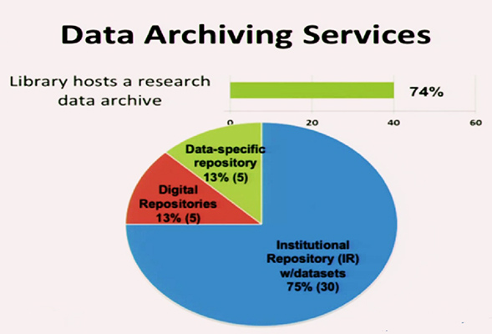
ARL Libraries 2015
Online Data Management Plan Implementation
Fearon, D & Sallans, A. C. (January 2014) Institutional Research Data Management: Policies, Planning, Services and Surveys. Coalition for Networked Information. https://www.youtube.com/watch?v=rvbrW7S2fes (54 ARL Libraries currently offer data management services_)

Slide 33
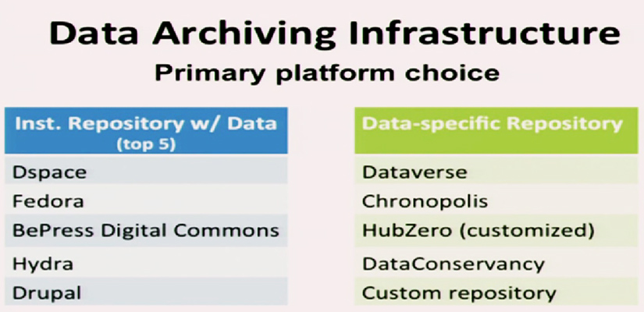
Current DMP Platforms (2015)
Fearon, D & Sallans, A. C. (January 2014) Institutional Research Data Management: Policies, Planning, Services and Surveys. Coalition for Networked Information. https://www.youtube.com/watch?v=rvbrW7S2fes (54 ARL Libraries currently offer data management services_)

Slide 34

Data Sharing
Currently, 80% of researchers do not share their data
Andreoli-Versbach, P., Mueller-Langer, F. (November 2014). Open access to data: An ideal professed but not practiced. Research Policy., http://dx.doi.org/10.1016/j.respol.2014.04.008

Slide 35
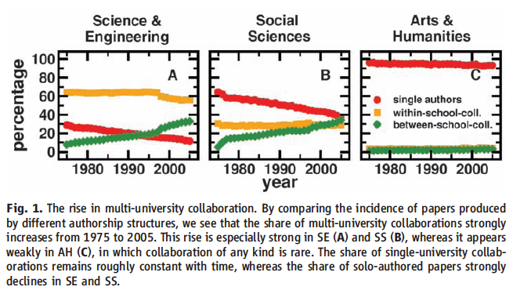
Collaboration Across Institutions
Jones et al. (2008). Science 322: 1259-1262.
Notes:
The model assumes that each lead author forms a core team through a Poisson process.
Extended teams arise from core teams by adding new members in proportion to the productivity of the team.
This process of cumulative advantage leads to the appearance of the power-law component of large teams at later times.

Slide 37
