Slide 1
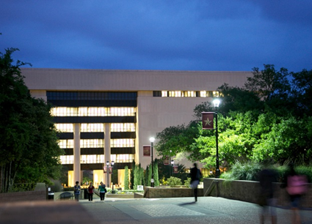
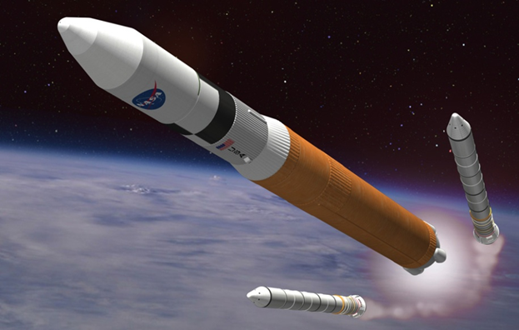
New Directions in Student Learning Spaces
Ray Uzwyshyn, Ph.D. MBA MLIS Director, Digital and Collection Services Texas State University
March 25, 2016
10:00-10:45 am

Slide 2
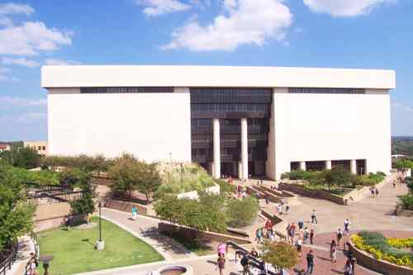
Alkek Library Learning Commons 2015-2022
Large Academic Library (7 Fl.)
Texas State University, 36,000 Students
Carnegie Class Doctoral University (Higher Research Activity)
Designated Emerging Research Institution (Texas)
Overview Video
Multi-Year, Project, 3 Large Phases
~ 40 Million Total Budget

Slide 3
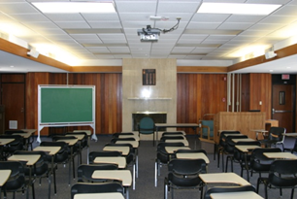
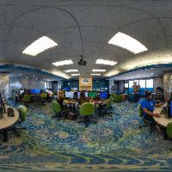
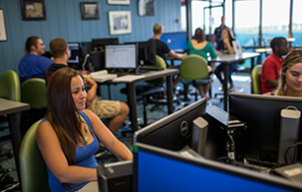
University of West Florida Skylab Library Fifth Floor Reconfiguration
Information Literacy Lab/Classroom
Multimedia Studio
Digital Media Conversion Center
Unifying Theme: Digital Literacy
University of West Florida, ~12000 FTE
500K Project (2010-2011)
Proposal, Presentation, Video
Overview White Paper

Slide 4
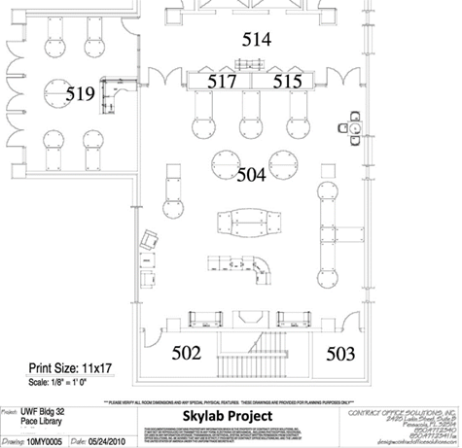
Space, Technology, Learning
Information/Digital Literacy Lab
Multimedia Studio
Collaboration Third Space for Learning.
Cross fertilization of Projects, People Skillsets.
Technology
Media Conversion Center

Slide 5
Prototyping/Scaling/Phasing
Learning Commons 10 M + (Multi-Tiered, Visualization, Multimedia, 3D Printing labs, Makerspace etc. Makerspace, Centers 1-2 M (Physical/Digital Computing.
3D Printing Lab, 100-500 K Expanded Lab Capability
3D Printer Prototype, 15-40K Basic 3D Printer Infrastructure
Building Future Trajectories

Slide 6
Discussion, Questions, Comments

Slide 7
Contact Information Contact Info Ray Uzwyshyn, Ph.D. MBA MLIS TEXAS STATE UNIVERSITY ruzwyshyn@txstate.edu Further Information (Presentations and Downloads) http://rayuzwyshyn.net https://www.linkedin.com/in/rayuzwyshyn

Slide 8
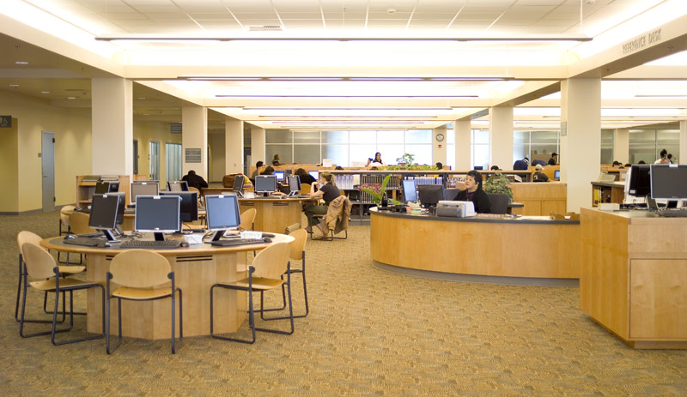
Learning Spaces
Learning Space Directions
Interdisciplinarity
Digital Literacy
Multimedia
Specialized Software/ Hardware
Technological Facilitation
Collaboration Among Divisions Academic Technology, Faculty Teaching Centre, Library, University IT Writing Center
Faculty Students, Community

