Slide 1
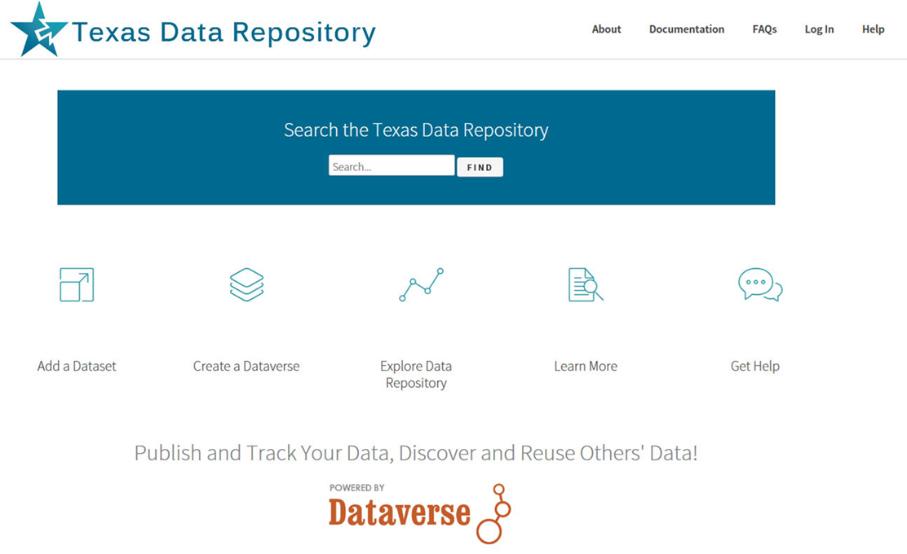
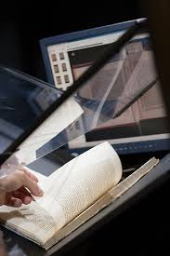

New Library Digital Initiatives for Research Faculty
Research Data Repositories and Digital Services

Slide 2
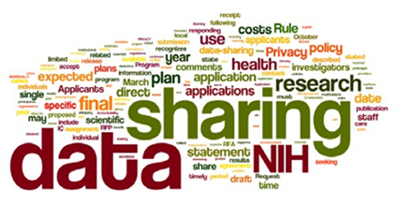
Presentation Agenda
Texas Data Repository Initiative
Background Dataverse Application
Characteristics of the Repository
PresentTimeline
Alkek Digital Library & Online Archive Services
Background on Dept. of Digital and Web Services
Partnership Opportunities for Research Faculty
Overview of Research Project Possibilities: Online Exhibits, Digital Archives/Libraries

Slide 3

The Texas Data Repository Initiative
@ Texas State University
Launching December 2016
https://data.tdl.org/

Slide 4
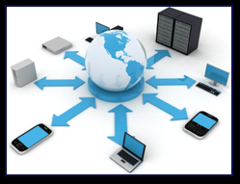
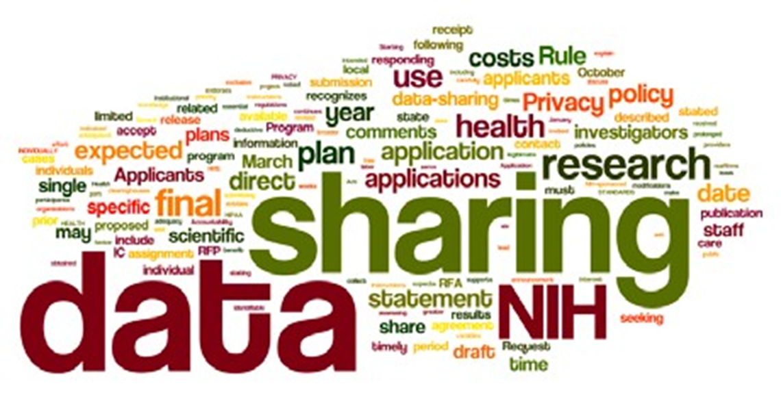
Online Data Repositories
Online Way to Manage a Researcher’s Data/Metadata
Permalinking Strategy for Online Data Citation/Access
Way to Manager Federal Grant Compliance
Most major Federal grant agencies require data access as mandatory part of the grant proposal/oversite process. (NIH, NSF, NEH, 2013 USDA)
Long Term Data Archiving, Preservation, Sharing Strategy

Slide 5
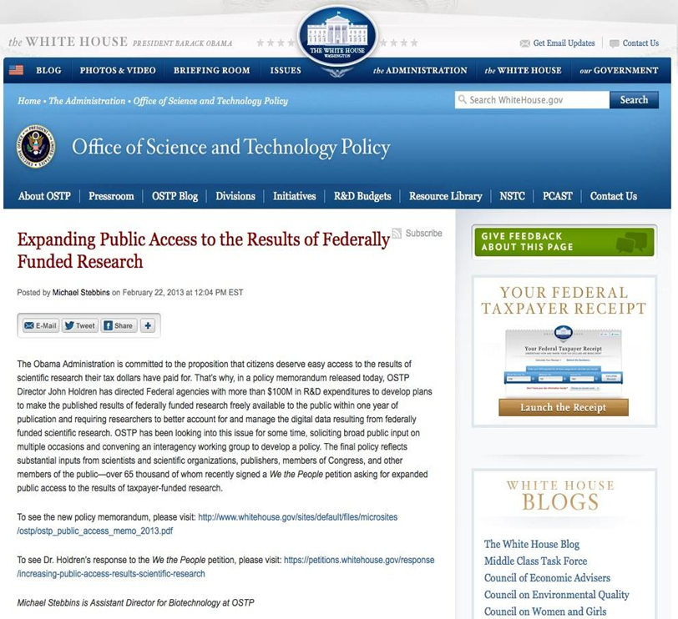
Texas Data Repository Background
Texas Digital Library State of Texas Data Repository Group Initiative
Began Work in 2014
Charge: To Determine a Suitable Data repository infrastructure and management model at a consortial (State Level)
Evaluate software models
Develop Needs Assessment
Make service recommendations
Coordinating Body: Texas Digital Library at UT Austin

Slide 6
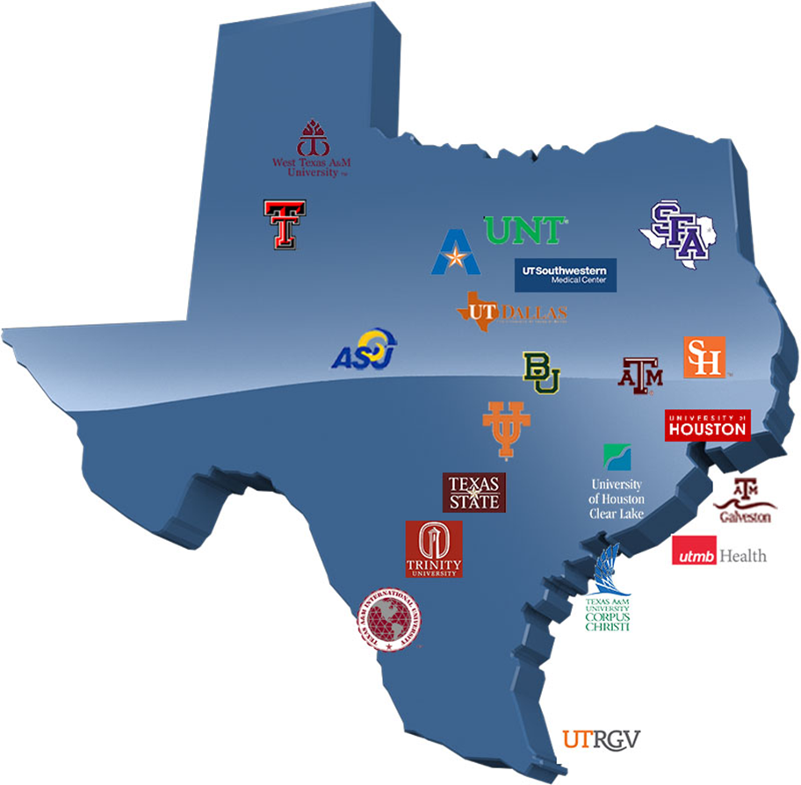
Texas Digital Library (TDL)
TDL is a Texas Consortium of
22 universities across Texas
leveraging technological
cooperation among
academic libraries
Coordinated through Texas Digital Library at UT Austin, Connected with other state and national bodies (TACC, Texas Advanced Center Computing, DPN, Digital Preservation Network, Duracloud)

Slide 7







TDL Dataverse Implementation Working Group (August 2015 – December 2016)
Charge: Pilot test, assess, and launch a consortial repository for research data archiving and management.
14
Working
Group members
Main Working Group
& Subcommittees:
Policy and Governance
Workflows and Outreach
Budget/Business Model
Technology
State Data Repository Symposium
7
Texas Universities
5
Final Report October, 2016
Sub-Committees

Slide 8
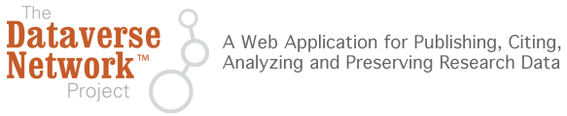
Texas Data Repository
Foundation Layer: Dataverse
Sustainable open source general platform led by Harvard
Fulfill Federal Data Management Plan requirements
Simple ingest process
Ability to share with trusted research groups prior to publication
Ability to version datasets
Supports data citations (e.g. DOIs, recognition and credit)
Allows for control over branding (customization)

Slide 9
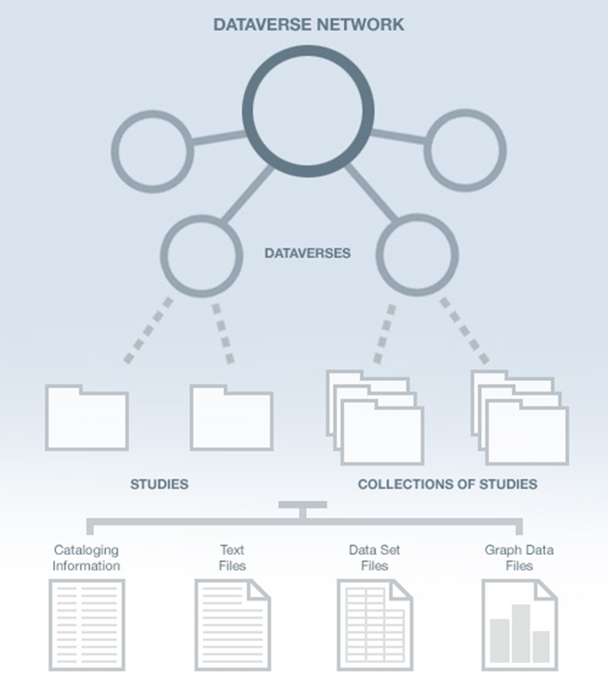
Texas Data Repository
Architecture
TDL
Consortial
Instance
Research Study Data
Data Set Files
Metadata ( Data Describing the data)
Paratextual Research Material
(Methodology, Field Notes , Multimedia
Graphs, Programs etc.)
Institutions
(i.e. Texas State)

Slide 10
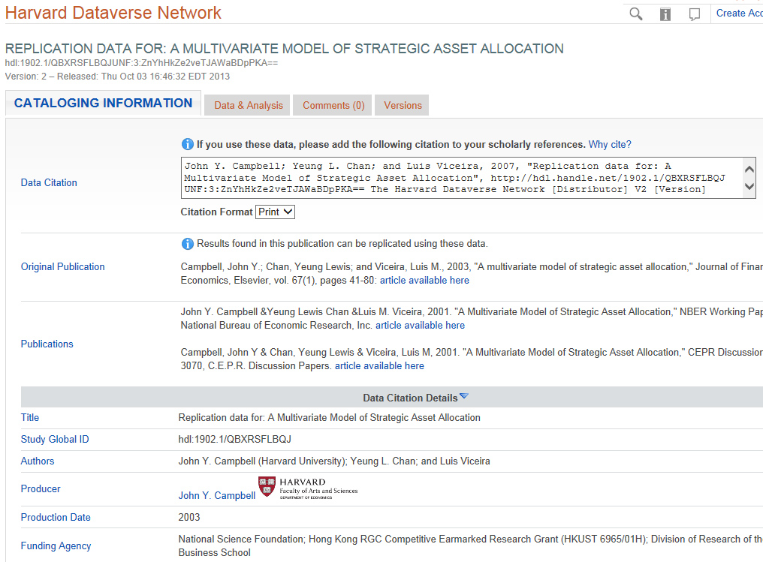
Dataverse Metadata Example

Slide 11
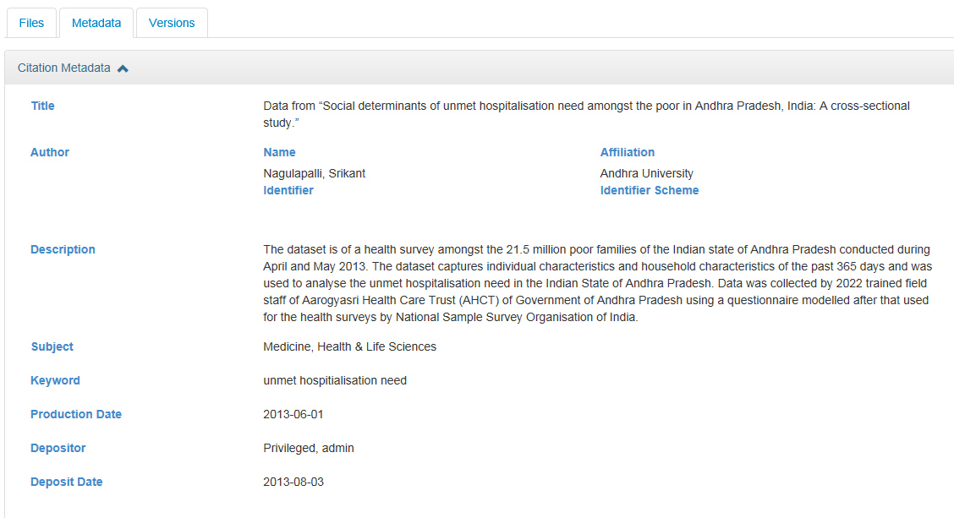
Dataverse Metadata Example
(From the Simple to Very Complex)
Metadata Schemas Supported: GeoSpatial, Life Sciences, Astronomy and Physics, Georeferenced Data

Slide 12
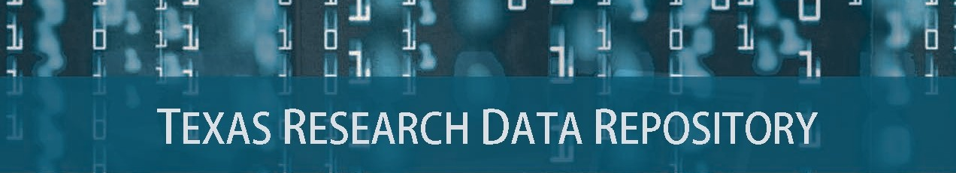
Prototype and Pilot Study, May-August 2016

Slide 13

http://data.tdl.org/
UX (Usability Focus)

Slide 14
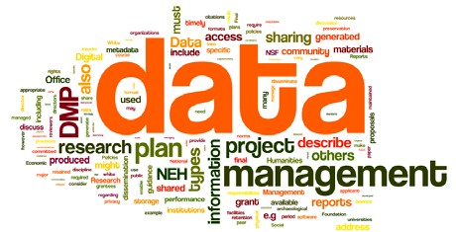
Texas Data Repository Initiative
Sept. 2016 - December 2016
Current
Dates Soft launch, September – November 2016
Online Research Data Symposium (Baylor, November 15-16)
Texas State – Shibboleth Authentication/MOU Signoff, November
Official Launch of Data Repository (December 1st, 2016)
Inaugural Year/Local Infrastructure (January – December, 2017)

Slide 15

Texas State University Library Infrastructures
& Federal Mandates
The Library Supports:
Article Publication repositories
D-Space
Data repositories
Texas Data Repository
Human Resource Infrastructure
Data Repository Liaison
Publication Repository Liaison
Subject Liaisons (Outreach)
http://www.whitehouse.gov/blog/2013/02/22/expanding-public-access-results-federally-funded-research

Slide 16
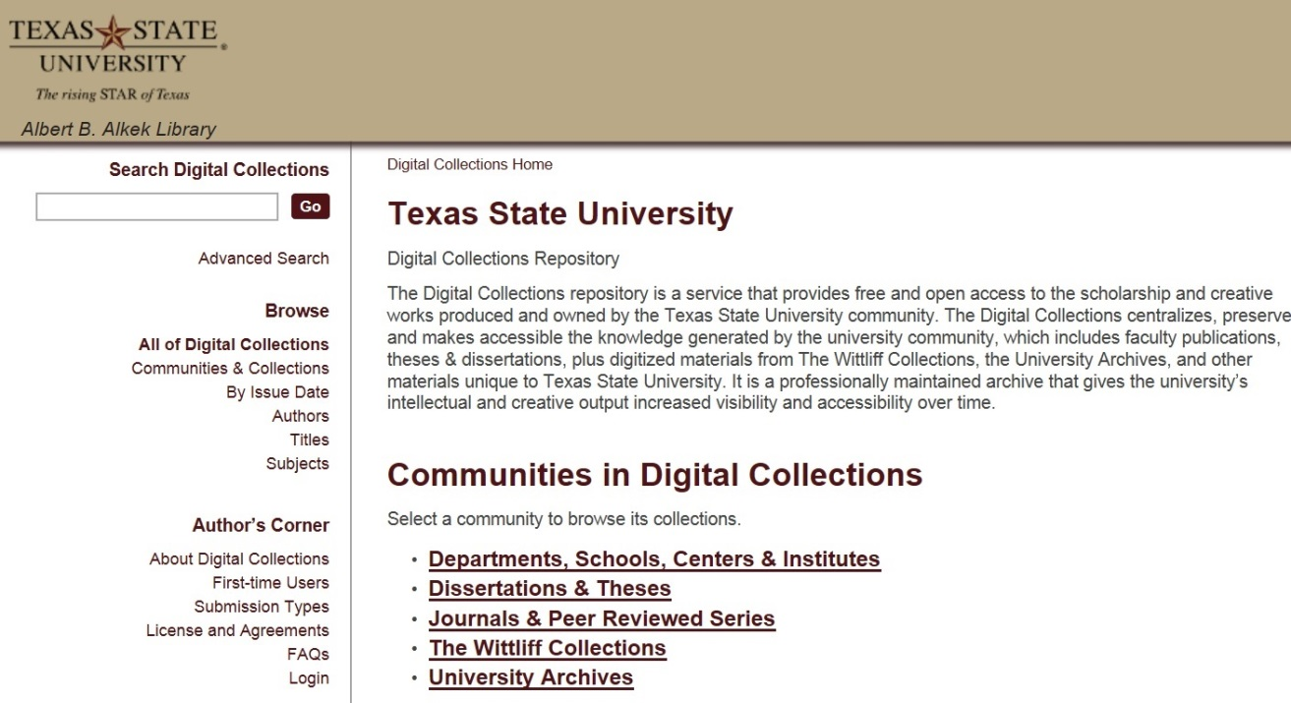
Institutional Repository (MIT, D-Space)
https://digital.library.txstate.edu/
Faculty publications, white papers, preprints, theses, dissertations, working projects
Jeanne Hazzard
Digital Collections Librarian
Stephanie Towery, JD
Copyright Officer
Larger Idea, Grant Compliance, Enabling Faculty Research Online, Raising Research Visibility,

Slide 17
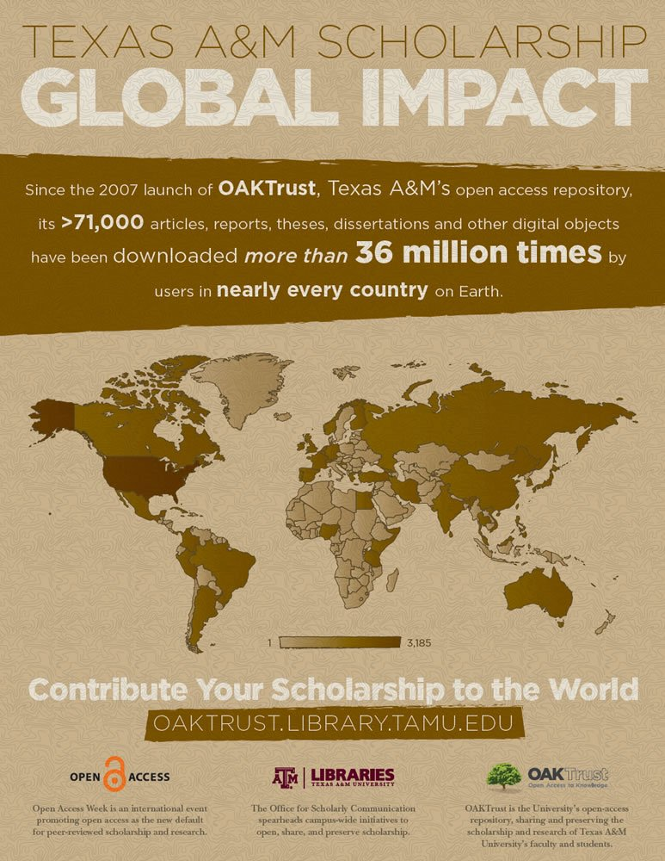
Future Possibilities
Electronic Thesis and Dissertation (ETD) Connections
Co-publish data sets in Electronic Thesis and Dissertations and Data Repository, Links
Future Possible ETD (D-Space), VIREO, DATA REPOSITORY CONNECTIONS

Slide 18
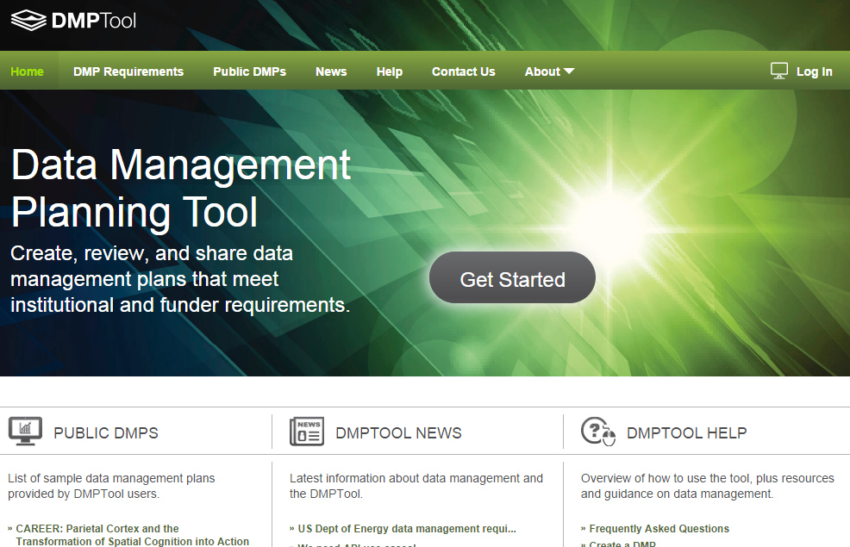
DMP Policy Tool Integration
Customizable
Plan Outline Tool
Resource Links
Supports All Major Funders
Texas Data Repository Template Boilerplate
(Texas A&M, UNT)
https://dmptool.org/
California Digital Library

Slide 19
Research Data Repository
Adoption Lifecycle (2016)
Research Universities &
Uzwyshyn, R. Research Data Repositories: The What, Why, When and How. Computers in Libraries, April 2016.

Slide 20
Part II
Alkek Digitization Services

Slide 21
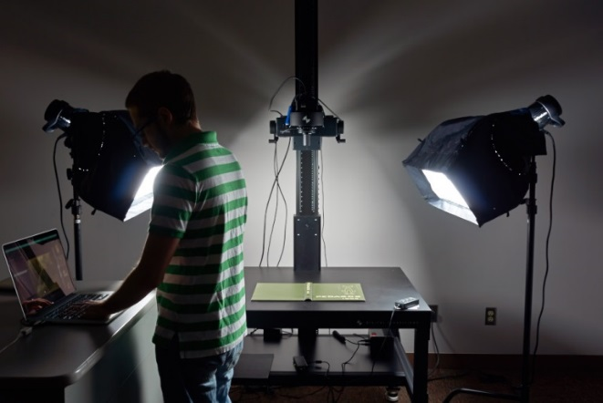
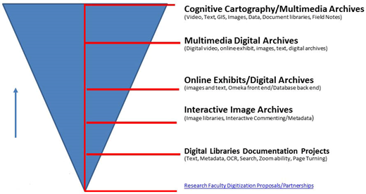
New Digital Initiatives Possibilities For Research Faculty
Alkek’s Dept of Digital and Web Services possesses spectrum of both programming and imaging Possibilities
Programming possibilities range from creating digital libraries & online exhibits to more technologically complex projects
Digital imaging possibilities involve museum level setup: with OCR for book, journal digitization, 3D Objects, Posters & Maps, Audio and Video

Slide 22
Faculty Digital/Partnership Opportunities
(Research Projects)
GIS Multimedia Archives
(Video, Text, GIS, Images, Data, Documents, Field Notes, Cognitive Cartographies)
Multimedia Digital Archives
(Digital video, online exhibit, images, text, digital archives)
Online Exhibits/Digital Archives
(images and text, Omeka front end/Database back end)
Interactive Image Archives
(Image libraries, Interactive Commenting/Metadata)
Digital Libraries Documentation Projects
(Text, Metadata, OCR, Search, Zoom ability, Page Turning)
Research Faculty Digitization Proposals/Partnerships
Faculty Research Projects,Prototypes Grant Partnerships

Slide 23
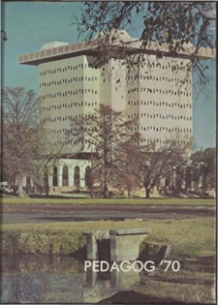
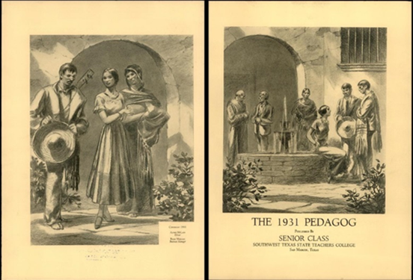

Large Documentation Projects
Significant Digital Libraries/Manuscripts/Books/Journals
Pedagogs Digital Archives
Pedagogs Project
90,000 pages
Documentation Project
100 Years of University Yearbooks
Page Turning/Zoom
Features
Searchability across
Decades and project

Slide 24
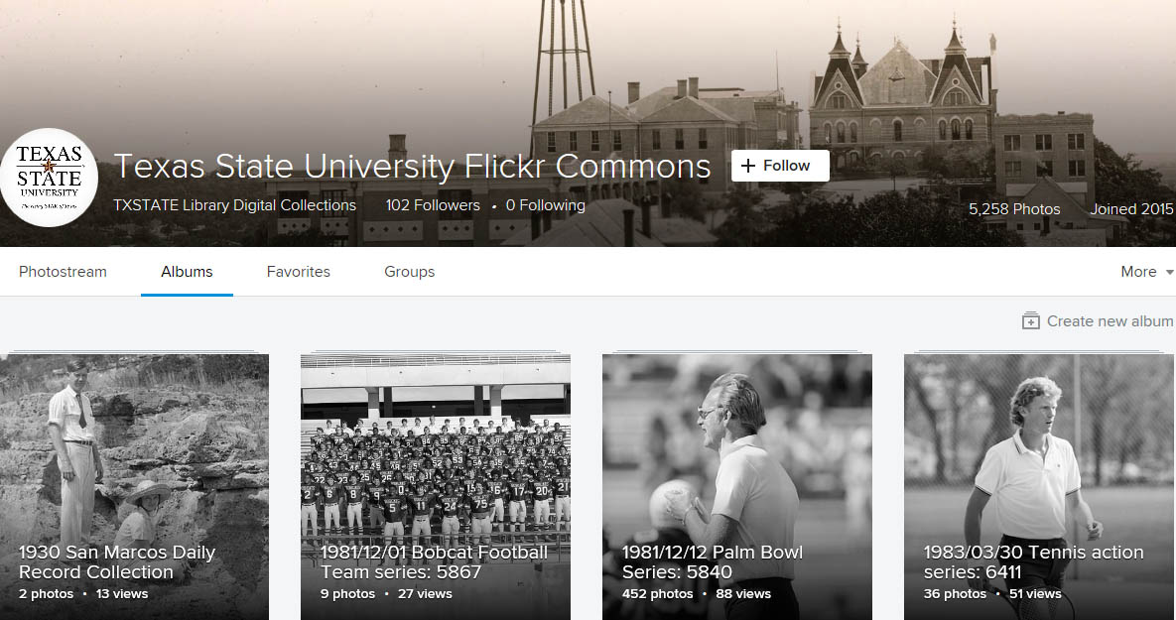
Digital Image Libraries
Interactivity/Social Tagging (Metadata)
Texas State University Flickr Commons

Slide 25
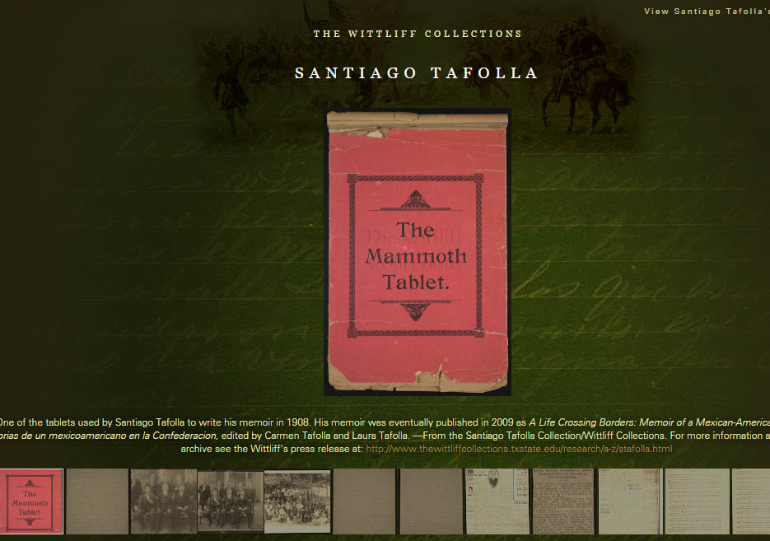

Online Exhibit/Digital Archives
Santiago Tafolla
Online Exhibit
Front End
Online Exhibit/Omeka
Presentation Layer
Backend
D-Space Database
(Manuscript)

Slide 26
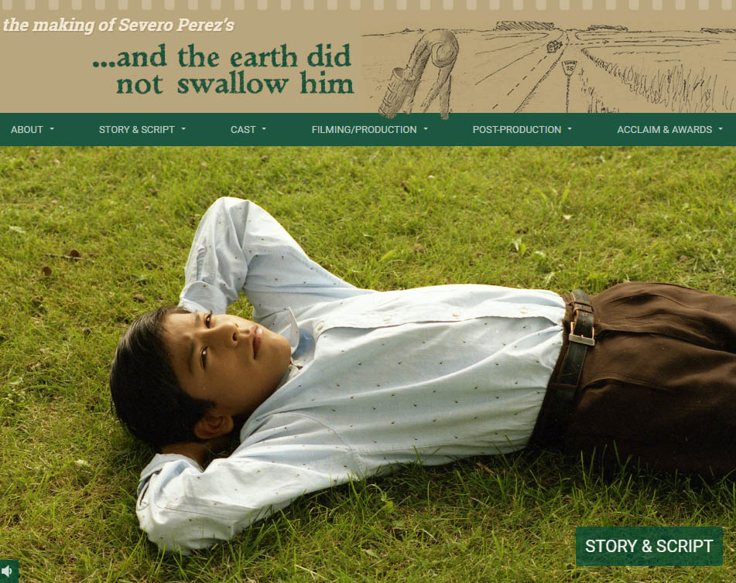

Multimedia Digital Libraries
The Making of Severo Perez’s And the Earth Did Not Swallow Him
Complex
Cognitive Cartographies
Text, Images, Video
Oral Histories, Field Notes

Slide 27
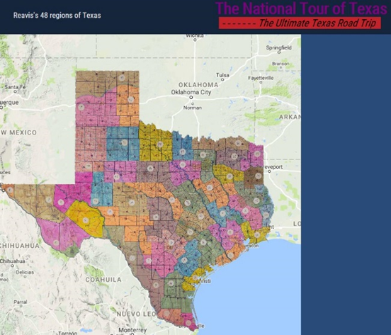
Multimedia/GIS/Data Archives
The National Tour of Texas
Dick Reavis 1987 National Tour of Texas
GIS Physical/Cognitive
Map
Digital Library
articles (Reavis)
Field Notes, Paratextual Material, Images, Objects,
Contextualized Video
(30 years later)

Slide 28
Faculty Online Research
Partnership Opportunities
Cognitive Cartography/Multimedia Archives
(Video, Text, GIS, Images, Field Notes)
Dick Reavis: National Tour of Texas
Multimedia, Digital Archives
(Digital video, online exhibit images, text, digital archives)
Severo Perez: And the Earth Did not Swallow Them
Online Exhibits/Digital Archives
(images and text, Omeka front end/Database back end)
Santiago Tafolla: Mexican Amer. Confederate Soldier
Interactive Image Archives
(Image libraries, Interactive Commenting/Metadata)
Texas State Flickr Commons
Digital Libraries Documentation Projects
(Text, Metadata, OCR, Search, Zoom ability, Page Turning)
Pedagogs University Yearbooks
Faculty Digitization Proposals/Partnerships
Faculty Research Projects,Prototypes Grant Partnerships

Slide 29
Further Links
Alkek Library Digitization Services
Library Digital and Web Service Services Department
Faculty Digitization Services (Proposal outlines)
Digitization Services For New Faculty (Proposal outlines)
Texas Data Repository
Texas Data Repository
Texas Data Repository Final Report (October, 2016), Selection Process, Aug. 2015
Uzwyshyn, R. 2016. Research Data Repositories: The What, When, Why and How of Data Research Repositories Computers in Libraries.
Texas Digital Library. Texas Data Repository Presentation. Video. (October, 2016)

Slide 30
Comments and Questions

Slide 31

Texas Data Repository Accommodates
Most Sizes of Data Projects
Normal to Mid-Range, 90%
Files/Data Fit on Server/Cloud, may be uploaded, Dataverse, 2GB File size max currently, unlimited number of files/faculty/dataverse, 10Gigs for Projects)
Deidentified Data (No SSN or Other Identifiable Data)
Secure Infrastructure: Controlled Access, Data Backups, Amazon Web Services
Huge, Global Scale Projects, 10%
Data may require specialized university IT Support, i.e. terabyte/petabyte online storage, consortial possibilities, Chronopolis, Texas Advanced Computer Center, DEEPN, Duracloud
Borgman, C. 2015. Big Data, Little Data, No Data: Scholarship in the Networked Age

Slide 32

Types of Data Repositories
Institutional/Consortial Repository
(Texas State University and/or or consortial)
Project/Discipline specific
(usually large single faculty/faculty team projects, i.e. Academic Specialization, Purdue Nanohub, Engineering etc. )

Slide 33
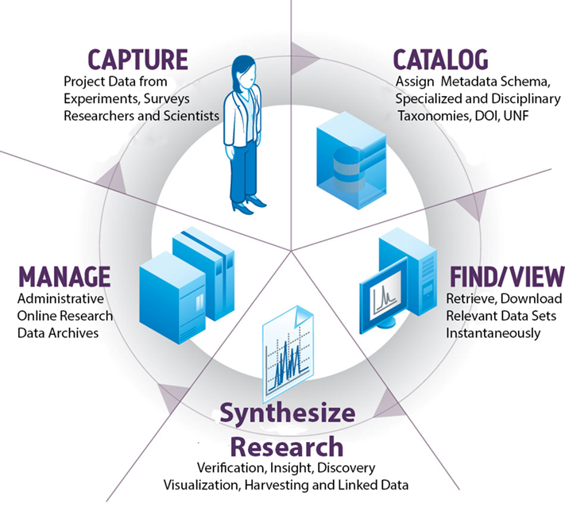
Working Group Areas
Many Planning Aspects of Data Research Repositories
August 2015 – April 2016
The Research Data Repository
Lifecycle

Slide 34
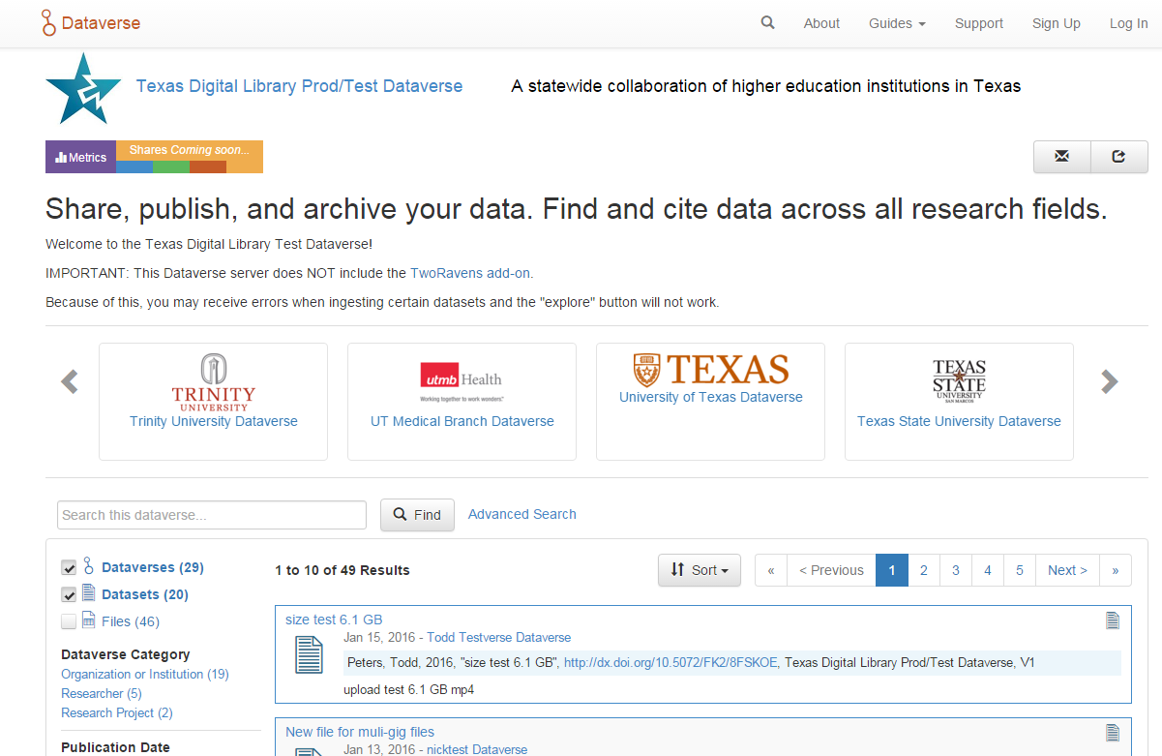
Add Data
Share, publish, and archive
Find Data
Search across disciplines
Cite Data
Obtain a citation and unique identifier

Slide 35
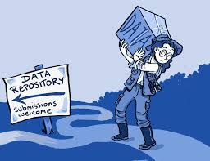
Research Data Repository Software
May be hosted or installed on a university’s server
Each software contains different ranges of management, collaborative options
Open source and proprietary options
For Archived versus Active Data
Ingestion of Various Data Types
(from Excel to SPSS to more esoteric disciplinary specific formats)

Slide 36
2014: Data Repository Working Group Report
Conclusion: The group recommends that TDL adopt Harvard’s Dataverse to facilitate the discovery of research data.
System Performance
Robustness
Usability
platform availability
an active open source community
Working Group Report
(August 28, 2015)

Slide 37
Use Cases: Make Research Data Publicly Available and/or Sharing Data
Primary Actors:
PIs of federally funded research
Researchers working on unfunded research/ funded research with no retention requirements
Graduate students working on theses, dissertations, or other data-generating projects.
Geographically Dispersed Researchers and Project Teams Wishing to Collaborate

Slide 38
Use Case: Seek Data to (Re)Use
Primary Actors:
Researcher is interested in conducting a meta study reusing data developed in earlier studies
Public using data for personal needs
Organizations seeking data for their needs.

Slide 39
Pilot Study Responses
Perceived Benefits of Data Repository
Fulfill federal mandates for sharing publications and research data
Make research data more widely available
Statistics on downloads and citations of my data
Make my data citeable through the assignment of a DOI (digital object identifier)
Saving various versions of the dataset (data lifecycle)
Collecting all my data in one place

Slide 40
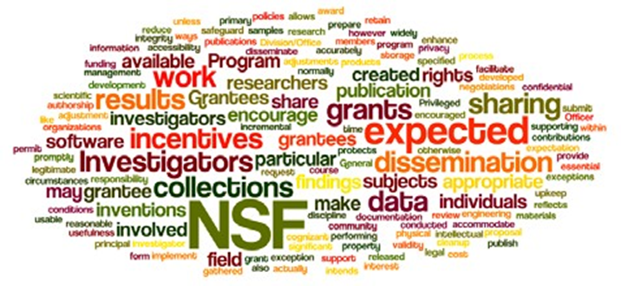
Why Are Data Management Plans Required
Leverage and make available faculty, departmental and institutional research
Allow publication of negative data (less research replication)
Wordle of the National Science Foundation’s Award and Administration Guide. Chapter VI.D.4, Mandatory 2011

Slide 41
Data Management Plans
Part of Evolving Science, Social Science and Humanities Research Process (Accuracy, efficiency, sharing)
Wordle of the data management policy of the Office of Digital Humanities, National Endowment for the Humanities, 2013

Slide 42
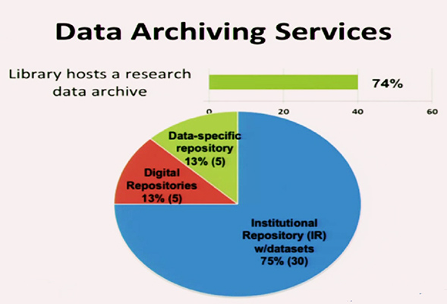
ARL Libraries 2015
Online Data Management Plan Implementation
Fearon, D & Sallans, A. C. (January 2014) Institutional Research Data Management: Policies, Planning, Services and Surveys. Coalition for Networked Information. https://www.youtube.com/watch?v=rvbrW7S2fes (54 ARL Libraries currently offer data management services_)

Slide 43
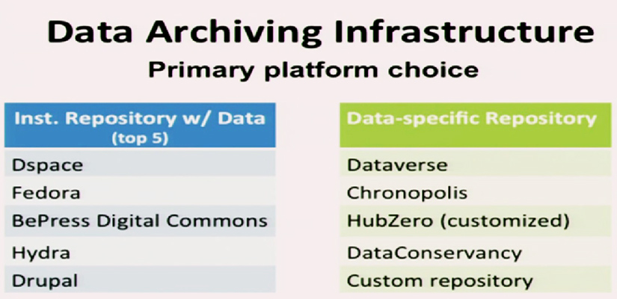
Current DMP Platforms (2015)
Fearon, D & Sallans, A. C. (January 2014) Institutional Research Data Management: Policies, Planning, Services and Surveys. Coalition for Networked Information. https://www.youtube.com/watch?v=rvbrW7S2fes (54 ARL Libraries currently offer data management services_)

Slide 44

Data Sharing
Currently, 80% of researchers do not share their data
Andreoli-Versbach, P., Mueller-Langer, F. (November 2014). Open access to data: An ideal professed but not practiced. Research Policy., http://dx.doi.org/10.1016/j.respol.2014.04.008

Slide 45
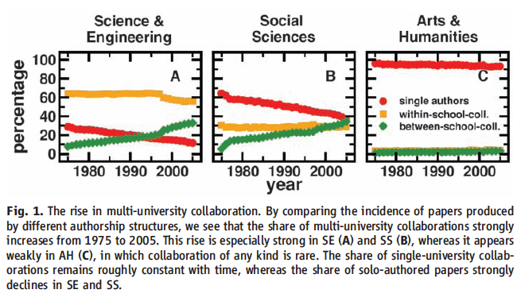
Collaboration Across Institutions
Jones et al. (2008). Science 322: 1259-1262.
Notes:
The model assumes that each lead author forms a core team through a Poisson process.
Extended teams arise from core teams by adding new members in proportion to the productivity of the team.
This process of cumulative advantage leads to the appearance of the power-law component of large teams at later times.

Slide 46
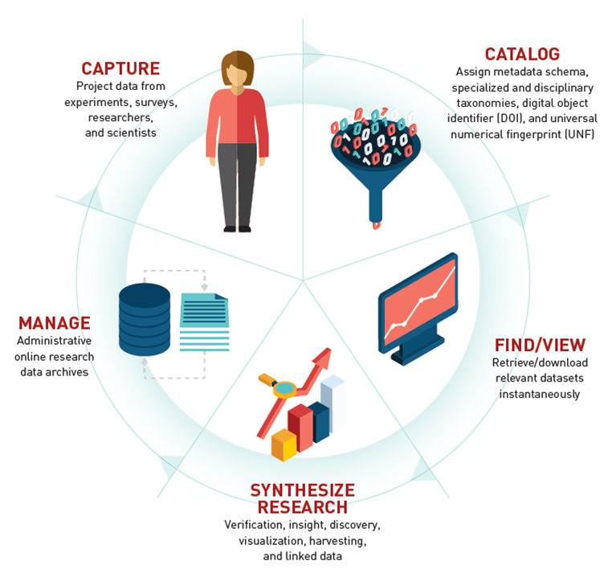
Data Repository Research Cycle

Slide 47
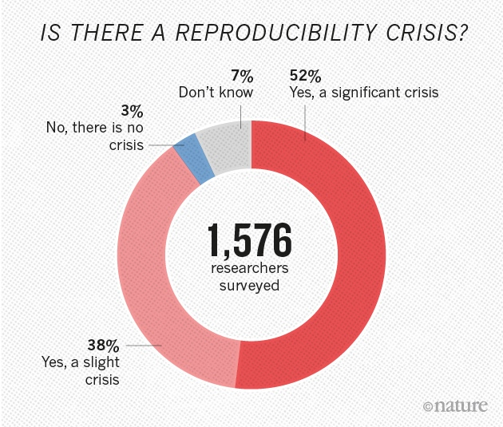
Nature. 2016. Data Reproducibility.
http://www.nature.com/news/1-500-scientists-lift-the-lid-on-reproducibility-1.19970

Slide 48
Wider Links/References
ARL NSF Data Sharing Policy and Resource Links, http://www.arl.org/focus-areas/e-research/data-access-management-and-sharing
ARL (White House Directives and Funded Research Data ) http://www.arl.org/focus-areas/public-access-policies#.VoaV0I-cFzo
Borgman, C. 2015. Big Data, Little Data, No Data. Scholarship in the Networked Age.
California Digital Library DMT Tool: https://dmptool.org/
Chronopolis: http://www.digitalpreservation.gov/partners/chronopolis.html
Data Reproducibility Crisis. Nature. http://www.nature.com/news/1-500-scientists-lift-the-lid-on-reproducibility-1.19970
Dataverse. http://thedata.org/
Dataverse (Data Science Site). http://datascience.iq.harvard.edu/dataverse
Data Information Literacy Guide. http://www.datainfolit.org/dilguide/
Data Information Literacy Competencies (Purdue). http://blogs.lib.purdue.edu/dil/the-twelve-dil-competencies/
DPN (Digital Preservation Network) http://www.dpn.org/
Duracloud: http://www.duracloud.org/
Purr. (Purdue Institutional Data Repository). https://purr.purdue.edu/
Hubzero. https://hubzero.org/
Force 11. Data Citation Principles. https://www.force11.org/group/joint-declaration-data-citation-principles-final
Figshare. http://figshare.com/
ICPSR Data Management & Curation. http://www.icpsr.umich.edu/icpsrweb/content/datamanagement/
Research Data Management. Principles, Practices, and Prospects (November 2013). Council on Library and Information Resources. http://www.clir.org/pubs/reports/pub160
Cox, A. and Pinfield, S. Research Data Management and Libraries. Jounral of Librarianship and Information Science. June 2013.
Fearon, D & Sallans, A. C. (January 2014). Institutional Research Data Management: Policies, Planning, Services and Surveys. Coalition for Networked Information. https://www.youtube.com/watch?v=rvbrW7S2fes (video presentation)
Data Management for Libraries: (LITA Guide) http://www.alastore.ala.org/detail.aspx?ID=10737
NMC Horizon Report: 2014 Library Edition. http://cdn.nmc.org/media/2014-nmc-horizon-report-library-EN.pdf
“Research Data Management”. pp. 6-7 and pp 24 – 45.
Holden, J. Memorandum for Heads of Executive Departments and Agencies: Increasing Access to the Results of Federally Funded Research (2013). http://www.whitehouse.gov/sites/default/files/microsites/ostp/ostp_public_access_memo_2013.pdf
Green, A. Macdonald, S and Rice, R. Policy-making for Research Data in Repositories: A Guide. DISC-UK. http://www.disc-uk.org/docs/guide.pdf
Research Data Management in the Arts and Humanities (2013). University of Oxford. http://www.dcc.ac.uk/events/research-data-management-forum-rdmf/rdmf10-research-data-management-arts-and-humanities (Conference Presentations)

Slide 49
Wider Links/References
Texas Digital Library. Data Repository Webinars and Learning Materials. https://tdl.org/training/webinars/, https://tdl-ir.tdl.org/tdl-ir/

Slide 50


Data Citation Principles
https://www.force11.org/group/joint-declaration-data-citation-principles-final

Slide 51
Dataverse Specialized Metadata Schemas
Dublin Core
Geospatial
Social Sciences and Humanities
Astronomy and Astrophysics
Life Sciences and Biology

