Slide 1
Archivematica
Alkek Library Technology Infrastructure Development & Possibilities

Slide 2
Archivematica: Open Source Digital Preservation System Software
Archivematica software:
Processing Digital Materials,
Preparing For Long Term Digital Storage
Desired by: Wittliff (Digital Preservation), University Archives
For Long Term Online Storage and Preservation Management
Connects variously to other systems we use or will be using: D-Space, Dataverse, Archivists Toolkit, LOCKSS, Duracloud
Parent Company
Artefactual (library centered/library technologist created.
Part of larger library trend of open source library software(KOHA, Evergreen, recent purchases by EBSCO, Curriculum Builder, @mire)
Offers paid services in software development technical support, consulting, data migration, training and hosting

Slide 3
Archivematica Used By Larger List of Library ARL & Community Users
University of Houston Libraries (ARL)
MIT Libraries (ARL)
Columbia University Libraries (ARL)
Yale University Library (ARL)
University of British Columbia Library (ARL)
University of Alberta Libraries (ARL)
City of Vancouver Archives;
University of York (ARL)
University of Saskatchewan University Library (ARL)
Bentley Historical Library, University of Michigan (ARL)
Harvard Business School
University of Texas at San Antonio
Art Center College of Design
Baker Library Historical Collections
MoMA-The Museum of Modern Art
Rockefeller Archive Center
Simon Fraser University Archives and Records Management
UNESCO
Ontario Council of University Libraries
University of Hull

Slide 4
Archivematica Set-up
Archivematica Architecture
Open Source Architecture
Ubuntu/Python
Many dependencies on open source
packages which use Ubuntu standard packages
Preferred Technology Staff set-up
Front end application for library
Staff on Ubuntu server located in Library
File Storage located in Data Center (files.txstate.edu)
Relational Database Management
System Located in the Data Center
(MySQL)
Archivematica is not a public access Platform so direct access through the university firewall would not be required
Staff would connect using HTTPS located in Alkek (various floors)

Slide 5
Red Hat Linux Possibility
Contract with Archivematica (Artefactual) for porting to Red Hat Linux
Several European libraries. Earlier interest this possibility. No consortium for footing bill. Need for someone to step to plate.
Porting would involve several modules associated with Archivematica and as with D-Space this would involve a multi-year commitment
With porting we would be in same position as with Sierra/Single Server Set-up, D-Space (non-standard community and these challenges: cost)
Leadership role though is possible (funding: Stanford: LOCCKS, MIT: DSPACE Models)

Slide 6
Questions, Comments

Slide 7
Further Documentation Available
Archivematica in the Library (Background Proposal). Digital Preservation Working Group (January, 2016)

Slide 10
ARL Library Technology Perspectives
ARL have responsibilities as leaders with new library technologies
Generating open source applications, setting models and infrastructures for others to follow
Shared, trickle down effect to larger academic library market (college and state university libraries, i.e. D-Space, LOCCKS)
The Enterprise market for ARL Library needs is not large (smaller club). Much open sources software is generated in-house
ARL library IT shops typically separate from central university IT. Specialization of software/skills/technology
Texas State is currently operating with aspiring ARL needs without
the infrastructure required (pushing on limits)
125 ARL Libraries Globally 4000 Academic Libraries, US & Canada
ARL Top 3% in North America ARL Top 1% Globally

Slide 11
Archivematica Architecture
Open Source Architecture
Ubuntu/Python
Many dependencies on open source
packages which use Ubuntu standard packages

Slide 12
Archivematica Set-up
Preferred Technology Staff set-up
Front end application for library
Staff on Ubuntu server located in Library
File Storage located in Data Center (files.txstate.edu)
Relational Database Management
System Located in the Data Center
(MySQL)
Archivematica is not a public access Platform so direct access through the university firewall would not be required
Staff would connect using HTTPS located in Alkek (various floors)

Slide 13
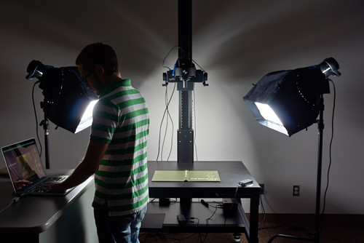
Expansion of Digital Media Lab
Digital Media Lab/Specialist
Need to begin to engage Faculty-level projects for ARL research university projects over next five years.
Currently more work than we can handle (straining seams)
This will require more staff, space, equipment
This can be leveraged towards larger university research aspirations
Digital Libraries, Digital Archives, Online Exhibits for Research Projects

Slide 14
Expanding Library Technology Human Resource Needs
Data Visualization, Analytics Specialist
Facilitation of Library Analytics, Dataverse (Tableau, Bayesia, Decision Analysis AI and Visualization Software)

Slide 15
Interdivisional Synergies ADA Access
ADA Access Specialist Questions of central ADA, Access Specialist, Technologist. Currently, this is in ITS and the library projects involving Media flow, closed captioning, ripping DVD’s for streaming if licenses permit, is stretching resources.

