Slide 1
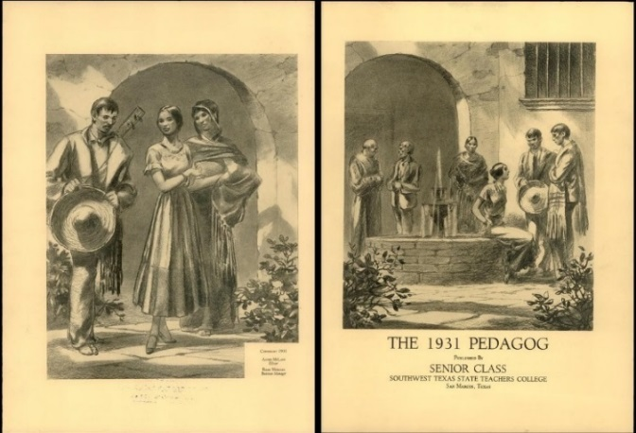
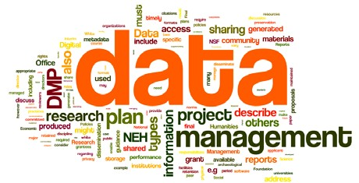
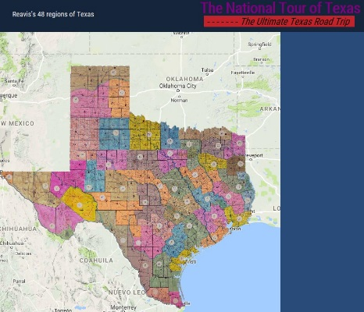
Division of Collections and Digital Services Services for Faculty
Ray Uzwyshyn Director, Collections and Digital Services
Texas State University Library R_U15@txstate.edu, (512) 245-5687

Slide 2
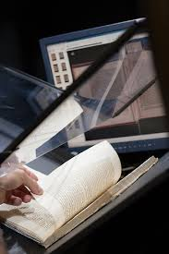
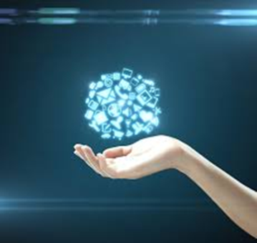
Digitization Services for Faculty
1) Digital Access Services Online Institutional Repository For Faculty Publications, ETD Submission & Archiving, Digital Projects
2) Scanning, Metadata For Digital Preservation Scanning Services and Metadata Schema/applications for Projects
3) Creation of Digital Libraries & Online Archives Building Online Exhibits and Digital Archives/Libraries Online Research projects, Grant Partnership Opportunities,

Slide 3
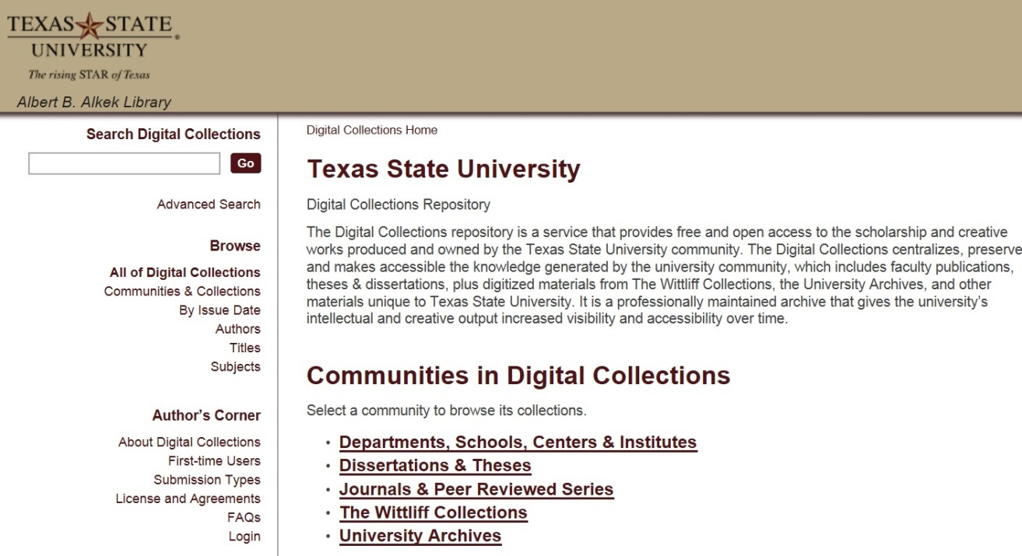
Institutional Repository (MIT, D-Space)
https://digital.library.txstate.edu/
Larger Idea
Enabling Faculty Research Online
Open Access to Research Scholarship
Grant Compliance
Raising Research Visibility
Jeanne Hazzard Digital Collections Librarian
Stephanie Towery, JD Copyright Officer
Faculty publications, white papers, preprints, theses, dissertations, working projects

Slide 4
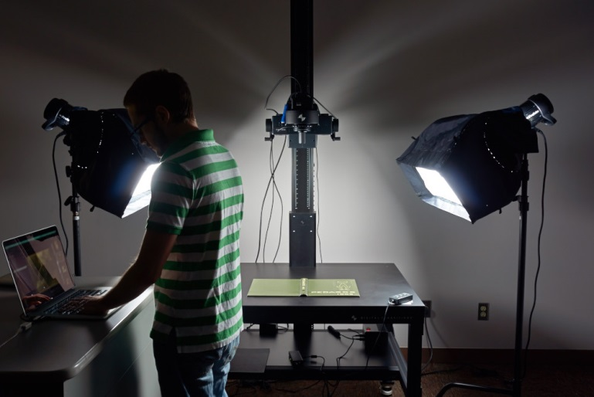
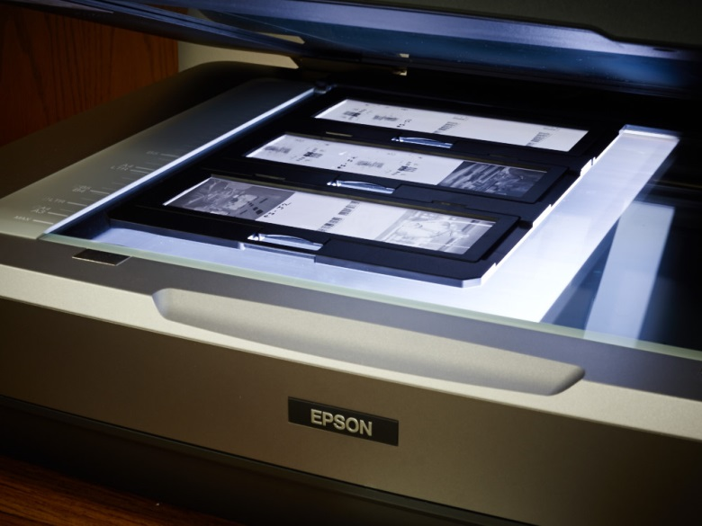
Alkek Digitization & Web Services Unit
Spectrum of Hardware & Software Possibilities
Museum Level Setup: Digital Transitions Imaging & OCR
Books & Journal digitization, rare materials, 3D Objects, Posters & Maps, Audio and Video
Spectrum of Software, Programming Possibilities: (Proven team) Digital Libraries/Online Archives, Digital Exhibits, More Technologically Complex Projects

Slide 5
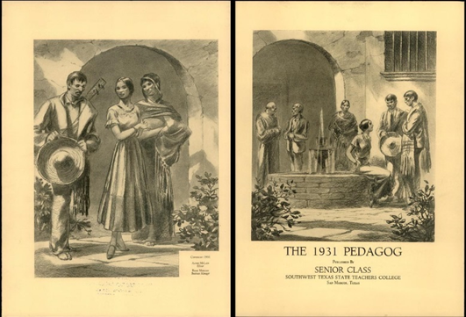
Research Projects Prototypes, Grant Partnerships
Digitization Projects FY15 – FY16
Pedagogs University Yearbooks 1900-2000’s, Cormac McCarthy’s Blood Meridian, Wittliff
Santiago Tafolla: Mexican Amer. Confederate Soldier
Severo Perez: And the Earth Did not Swallow Them (Digital Video, online Exhibit, Digital Archive, multimedia)
Dick Reavis: National Tour of Texas (Interactive GIS, Digital Video, Online Exhibit and Digital Archives)
Faculty Digitization Proposals/Partnerships

Slide 6
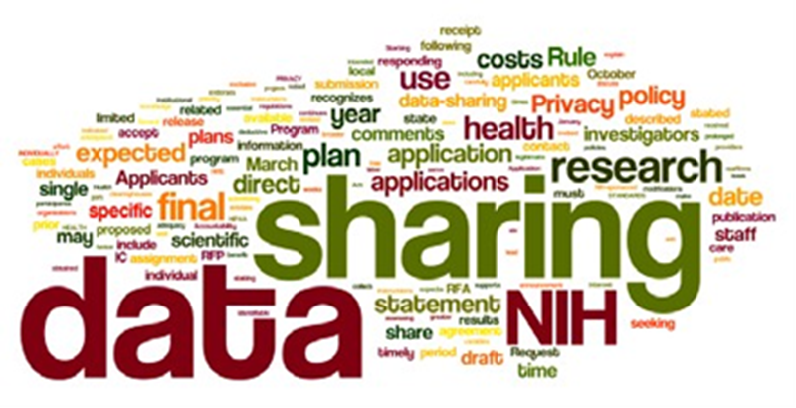
Texas Online Data Repository Initiative Sept. 2015 - Dec. 2016
Texas Data Repository
Consortial initiative/ software framework that enables universities across Texas with regards to research data
Allows sharing, control, persistent data citation, publishing and management
Soft launch, September – Nov. 2016 Research Data Symposium - Nov. 15-16 Official launch - December 1st, 2016
Grant Compliance

Slide 7
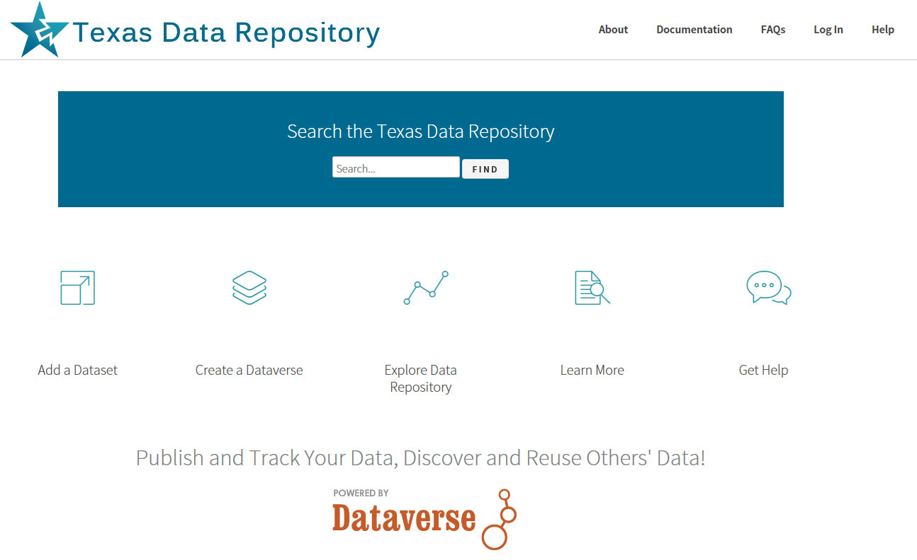
Landing Page:
http://data.tdl.org/

Slide 8
Consortial Repositories, http://www.tdl.org/data-repository

Slide 9
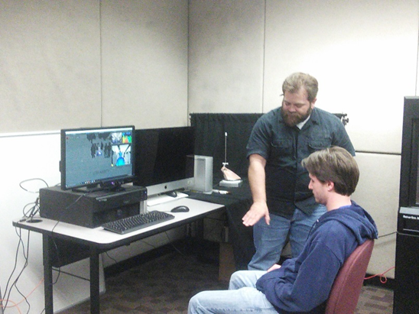
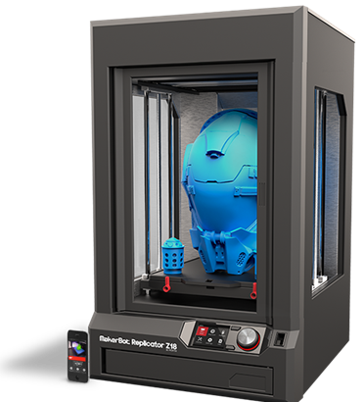
3D Printer Lab & Services Fourth Floor
Interdisciplinary Collaborative Environment
3D Printers
3D Scanners
Spectrum of Software Hardware Infrastructure (PC’s, peripherals, filament Etc.)

Slide 10
Hybrid Research Tools (Pilot Year 2) SAAS + Content Database
Reading List
Browzine
Online Academic Journals
Online Library Content + LMS (TRACS)

Slide 11
Comments/Questions

Slide 12
Contacts
Ray Uzwyshyn, Dir. Coll. and Digital Services, r_u15@txstate.edu
Todd Peters, Head Digital and Web Services, tp09@txstate.edu
Ginger Williams, (Head, Acquisitions) ginger.Williams@txstate.edu
Jeremy Moore, Digital Media Specialist, jeremy.moore@txstate.edu
Jason Long, Library Programmer, j_l408@txstate.edu
Jeanne Hazzard, Digital Collections Librarian, jh201@txstate.edu
Stephanie Towery, Copyright Officer, sst25@txstate.edu

Slide 13
Percent Increase in Article Citations by Discipline with Open Access Online Availability
Range = 36%-250%
(Data: Stevan Harnad and Heather Joseph, 2014)

