Slide 1
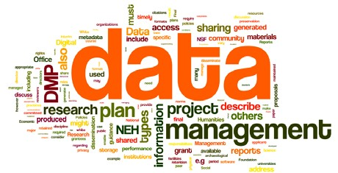
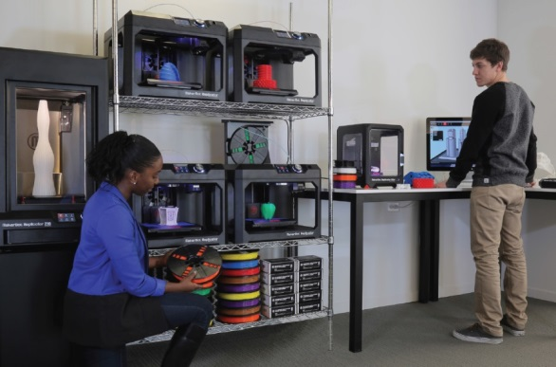
Collections and Digital Services Upcoming Initiatives, Continuing Projects and Larger Trajectories
Ray Uzwyshyn, Ph.D. MBA MLIS Director, Collections and Digital Services
Texas State University Library R_U15@txstate.edu, (512) 245-5687

Slide 2
Hybrid Research Tools (Pilot Year 2) SAAS + Content Database
Curriculum Builder
Browzine
Online Academic Journals
Online Library Content + LMS (TRACS)
Datasets in Realtime (Live)

Slide 3
Online Library Resources
Level Of
Interactivity
Content Database + Cloud-Based SAAS
Information Literacy Tools & Scholarly Media Databases
Online Multidisciplinary Database Aggregators & Discovery
Online Journals & eBooks
Print Books & Journals
1990 1995 2000 2005 2010 2015 2020

Slide 4
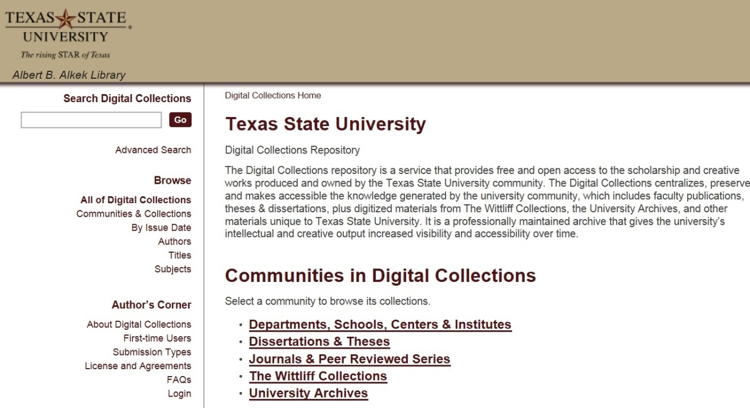
Institutional Repository (MIT, D-Space)
Enabling Faculty Research Online
https://digital.library.txstate.edu/
Larger Idea
Open Access to Research Scholarship, Creative Works
Grant Compliance
Raising Visibility
Jeanne Hazzard Digital Collections Librarian
Stephanie Towery, JD Copyright Officer
Faculty publications, white papers, preprints, theses, dissertations, working projects

Slide 5
Percent Increase in Article Citations by Discipline with Open Access Online Availability
Range = 36%-250%
(Data: Stevan Harnad and Heather Joseph, 2014)

Slide 6
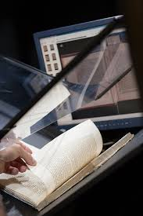
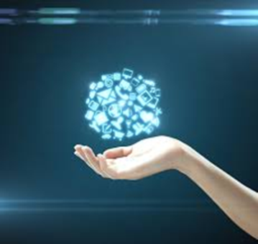
Digitization Services for Faculty
1) Digital Access Services (Online Institutional Repository, ETD Submission & Archiving, Faculty Publications, Digital Projects)
2) Scanning, Metadata & Preservation (Advanced Metadata and Scanning Services)
3) Digital Libraries & Online Exhibits (Online Research, Preservation)

Slide 7
Research Project Digitization
Empowering Faculty Research
Prototypes for Larger Grant Projects
1
More Info: Faculty Applications:
http://www.library.txstate.edu/about/departments/dws/faculty-digitization.html

Slide 8
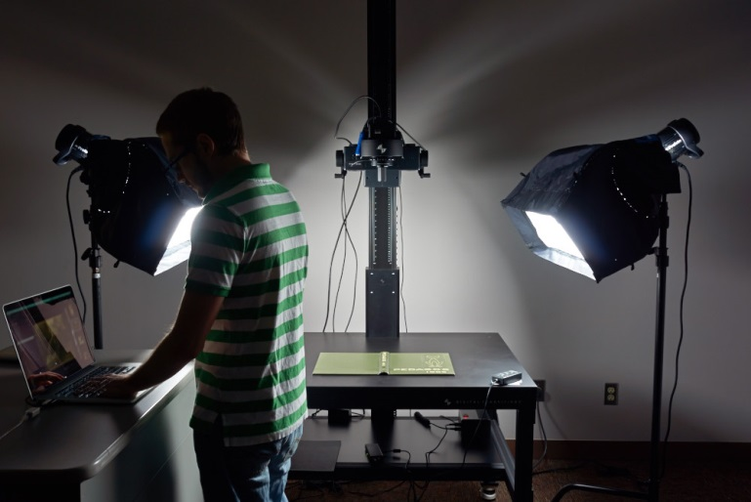
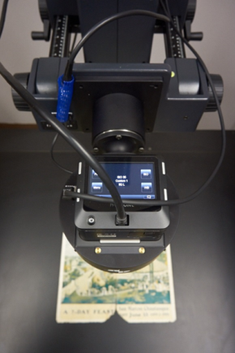
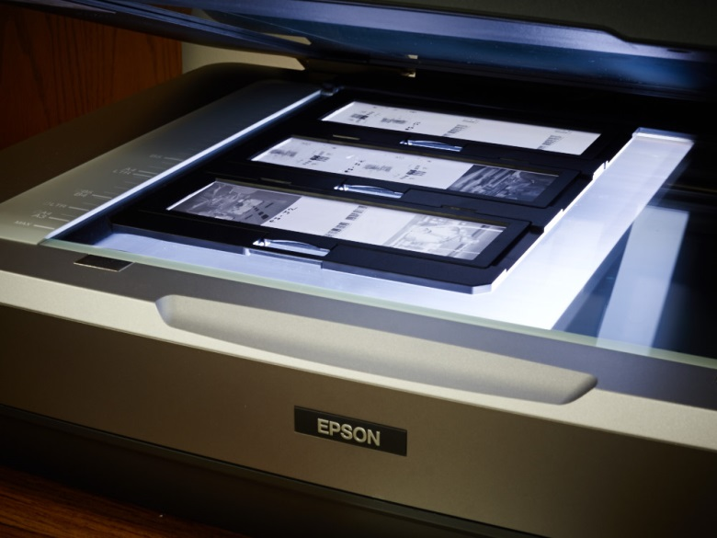
Alkek Digitization Lab
Spectrum of Hardware & Software Possibilities
Museum Level Setup: Digital Transitions Imaging & OCR, Standards
Books & Journal digitization, rare materials, 3D Objects, Posters & Maps
Audio and Video
Jeremy Moore, Digital Media Specialist, Todd Peters, Head of Digital and Web Services

Slide 9
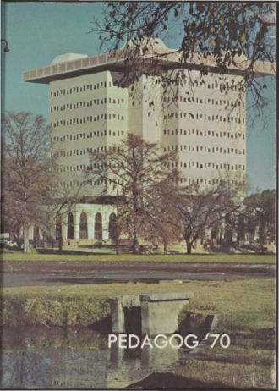
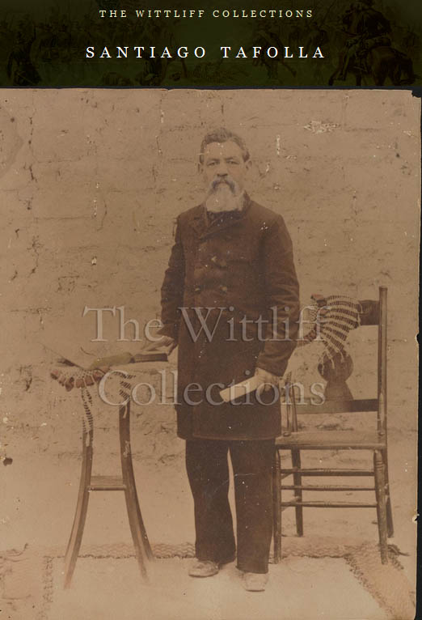
Digital & Web Services FY15/FY16
Digitization Projects FY15 (Pedagogs University Yearbooks 1900-2000’s, Cormac McCarthy’s Blood Meridian, Wittliff, Santiago Tafolla: Mexican Amer. Confederate Soldier)
FY16 Expansion into Multimedia (Oral History and Video Projects:, Lonesome Dove Dailies, Austin Film Festival Videos)
FY16 Digital Preservation Projects (Duraspace/DPN, New Committee on Digital Preservation)

Slide 10
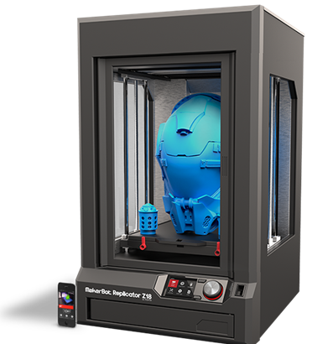
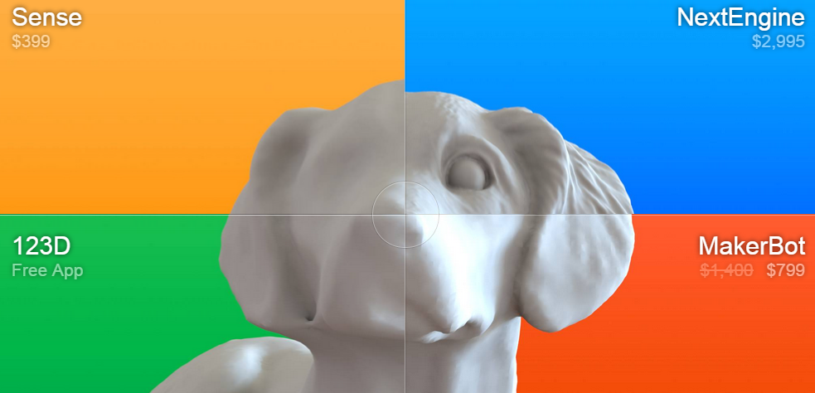
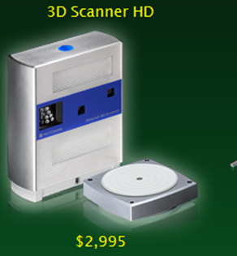
Upcoming 3D Printer Services Infrastructure Pilot 2016
3D Printer
3D Scanner
Spectrum of Software Hardware Infrastructure (PC’s, peripherals, filament Etc.)
(Video)

Slide 11
TXU 3D Printing Landscape Cost vs. Quality
100,000+
Forensic Anthropology
50,000
3D Printer Cost in USD
Engineering, STEM
10,000
Library Makerspace
5000
Art & Design
2000
Education
Increasing Quality
0
3D Printer Quality Resolution and Speed

Slide 12
Data Management Repository Initiative Sept. 2015 - 2016
NSF, NIH, NEH, USDA Grant Compliance
Dataverse: Software framework that enables institutions to host research data repositories.
Allows sharing, control, persistent data citation, publishing and management
Dataverse (TDL Pilot) Texas Digital Library Partnership, Key Dates: Sept 2015-March 2016 Set-up/Pilot April 2016- July 2016 Pilot Assessment August 2016 Launch

Slide 13
Questions
Contacts
Ray Uzwyshyn, Dir. Coll. and Digital Services, r_u15@txstate.edu
Todd Peters, Head Digital and Web Services, tp09@txstate.edu
Scott Pope, (Acquisitions Interim, pope@txstate.edu
Paivi Rentz (Library Systems Coordinator, prentz@txstate.edu
Jeremy Moore, Digital Media Specialist, jeremy.moore@txstate.edu
Jeanne Hazzard, Digital Collections Librarian, jh201@txstate.edu
Stephanie Towery, Copyright Officer, sst25@txstate.edu

Slide 14
Further Open Access References/Bibliography
Harnad, S. & Brody, T. (2004) Comparing the Impact of Open Access (OA) vs. Non-OA Articles in the Same Journals, D-Lib Magazine 10 (6) June (Japanese translation) http://eprints.ecs.soton.ac.uk/10207/
Harnad, S. The Open Access Paradigm – Why, What, How?. UNESCO Conference on Open Access. Denmark, December 6 2010.
Brody, T., Harnad, S. and Carr, L. (2006) Earlier Web Usage Statistics as Predictors of Later Citation Impact. Journal of the American Association for Information Science and Technology (JASIST) 57(8) pp. 1060-1072. http://eprints.ecs.soton.ac.uk/10713/
Gargouri, Y., Hajjem, C., Lariviere, V., Gingras, Y., Brody, T., Carr, L. and Harnad, S. (2010) Self-Selected or Mandated, Open Access Increases Citation Impact for Higher Quality Research. PLOS ONE 5 (10) e13636 http://eprints.ecs.soton.ac.uk/18493/
Joseph, Heather, Emerging Trends in Scholarly Communication. ALA Midwinter Presentation, Jan. 26, 2014.
And here’s more: http://sparceurope.org/oaca/

