Slide 1

Alkek Library
Collections and Digital Services
Spring Forum 2015
Initiatives, Innovation and Upcoming Events
Ray Uzwyshyn, Ph.D. MBA MLIS
Director, Collections and Digital Services

Slide 2
CDS Strategic Operating Plan
FY15 & FY16
CDS moved in past year from 80% incomplete strategic plan projects in FY14 plan to 90% complete projects for FY15
Thank you for all your efforts in day-to-day operations, projects completed and workflow process streamlining in the past year.
Stay tuned for FY16 planning which we will begin later in the summer/early fall.

Slide 3
Acquisitions Budget Proposal FY16
Return on Investment (ROI)
Library Materials Budget proposal submitted. Currently rising from approximately 6.8 Million (FY15) to 7.2 million (FY16) in annual expenditures.
As the University transitions to a research institution acquisitions expenditures becomes increasingly important.
Tenopir Study (2010): For every monetary unit invested in the libraries, the institution receives a return in grant income ranging from approximately 0.64:1 for teaching institutions to 15.54:1 for an intensive research institute.

Slide 4
FY 16 Acquisitions Budget Request
SERIAL INFLATION: $244,025
NEW STRATEGIC INITIATIVES: $274,435
TOTAL INCREASE: $518,460
FY16 ACQ BUDGET: $7,252,736 (FY15 $6,734,276 )
New Initiatives identified for FY16:
1) Online Research & Analytics Tools: New Tools to leverage and gain insight into the university’s research performance and support university researchers
2) New Online Research Content: Access to all of EBSCO’s full-text content and Elsevier’s Scopus
3) 2nd Year of Hybrid Online Tools Initiative

Slide 5




Online Hybrid Research Tools Initiative Phase 2: 2015-2016
Renewals of dataZoa and Browzine
2nd Year Pilot of Curriculum Builder (Currently Free)
Not currently renewing Artstor Shared-shelf
Curriculum Builder

Slide 6
TXU & Return on Investment: Academic Resources from 9 Academic Libraries (TXU FY16 $6,978,301.00 )
Highest ROI from research intensive science and technology oriented institutions
Lowest ROI from comprehensive liberal arts teaching institutions without research mission
Middle ROI from multi-disciplinary research institutions (Texas State emerging research aspirant)
University Investment in the Library, Carol Tenopir, 2010

Slide 7

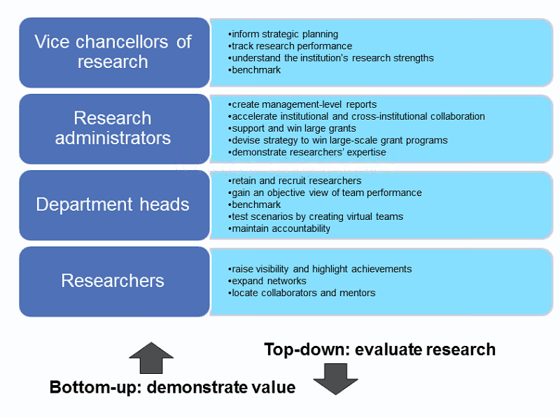
Acquisitions Research Tools Exploration
Scival (Elsevier)/Thomson Reuters Incites/ EBSCO Plum Analytics
Acquisitions
Collections Development
Subject Specialist
Librarians

Slide 8


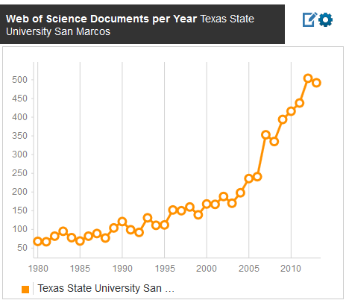
Incites: Texas State University
Shift Towards Research Institution / Main Areas of Research
Peer Reviewed Documents
(2004-2013:150-500 D/Y)
(1980-2003: 50-175 D/Y)

Slide 9

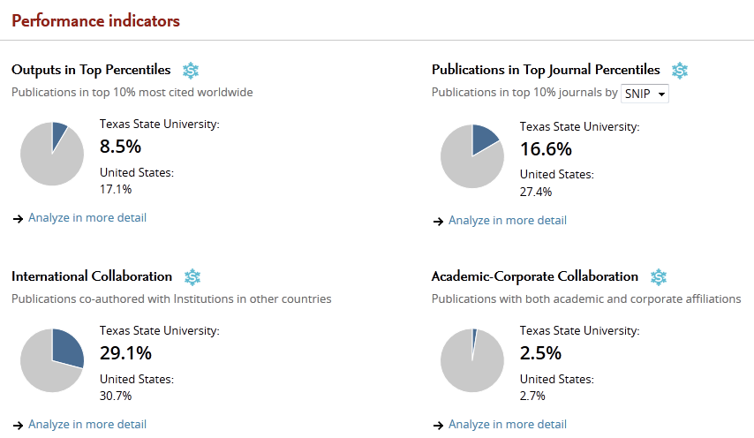
Texas State vs. US University institutions Research Performance Indicators

Slide 10

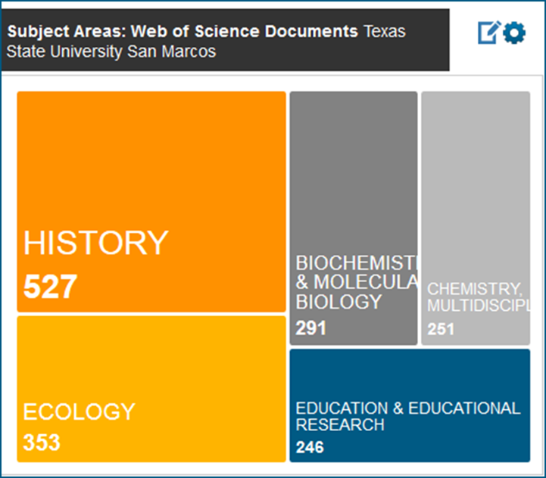
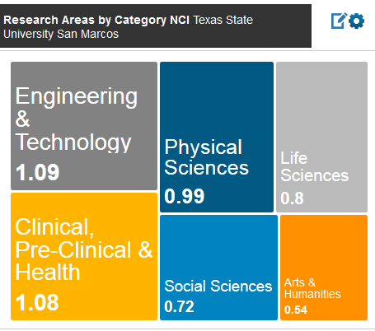
Incites: Measuring Areas of Research and Impact Factors
(Highly Cited Documents)

Slide 11

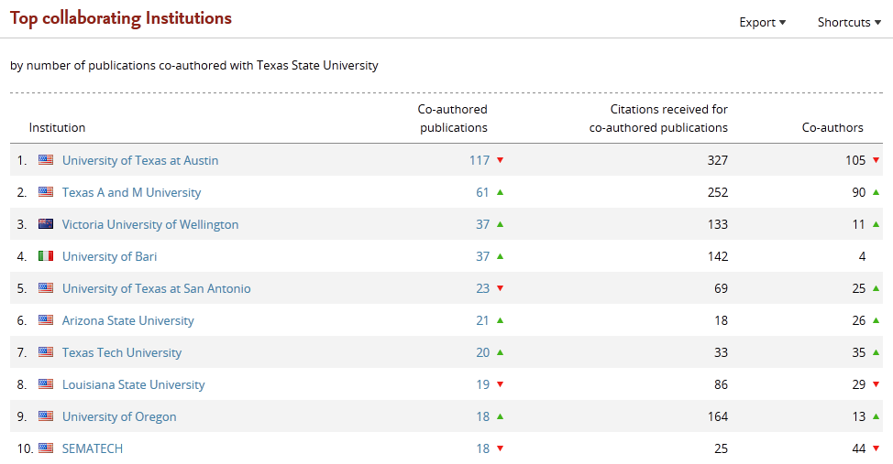
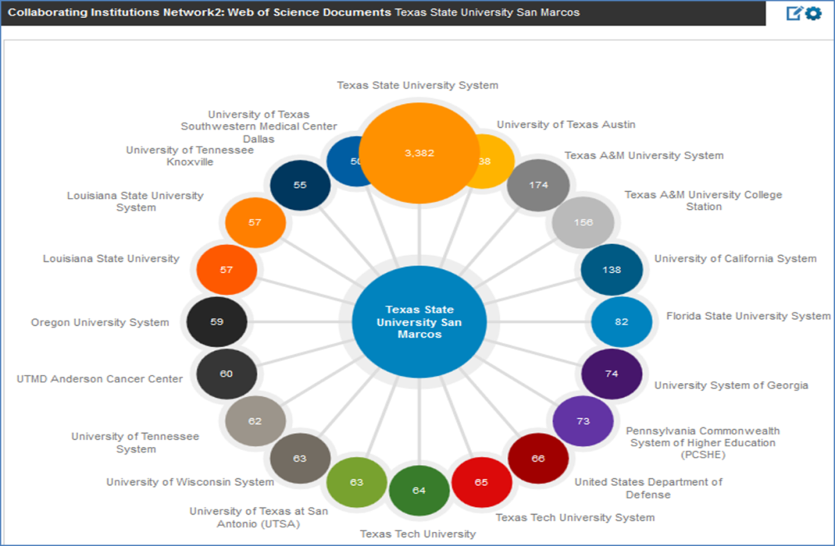
Texas State Collaboration
Grant Seeking Opportunities
Web of Science Database
Scopus Database

Slide 12
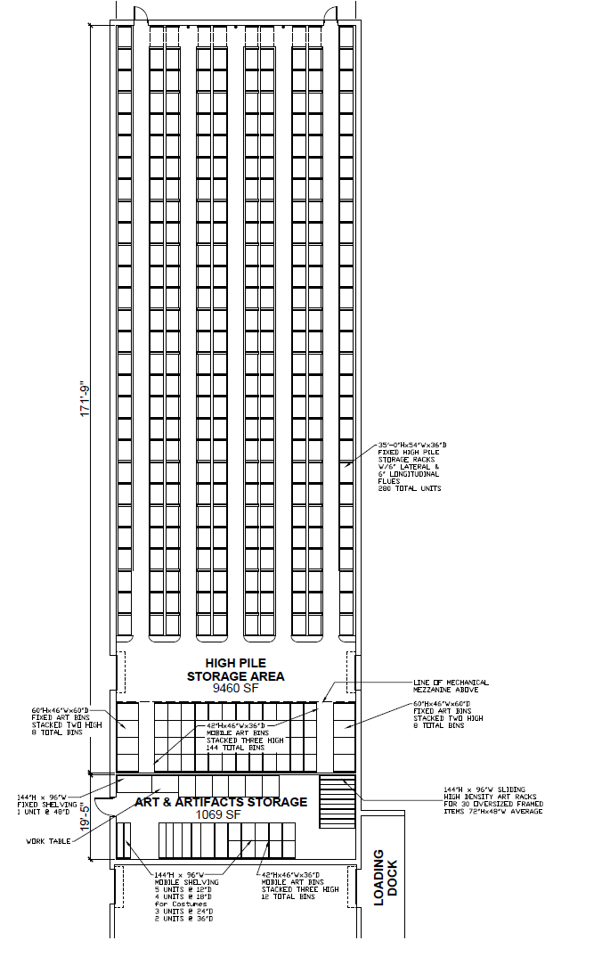
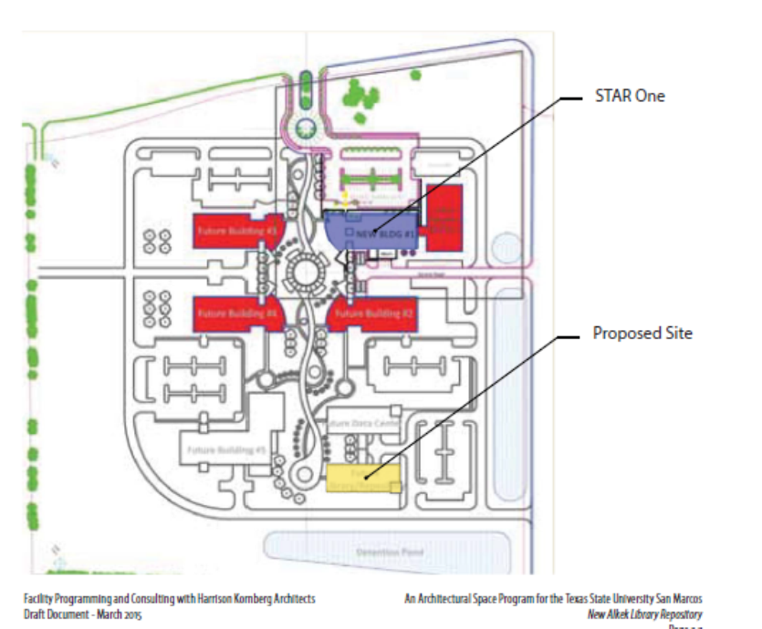
Offsite Repository (STAR Park)
Board of Regents Funding Approval Currently in Process
Next: Programming Phase Completion & Design Phase
CDS not moving in first phase of build

Slide 13
Building Infrastructure Upgrade
Including 2nd Floor Alkek (New Power & Data Grid)
Winter 2015/Spring 2016

Slide 14
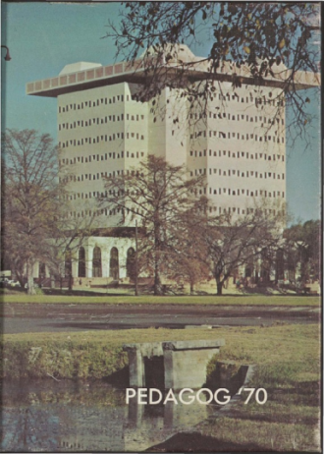

Digital & Web Services FY15/FY16
Several New Digitization Projects Completed FY15
(Pedagogs, University Archives, Cormac McCarthy’s Blood Meridian, Wittliff, Santiago Tafolla: Mexican Amer. Confederate Soldier)
FY16 Expansion into Multimedia
(Oral History and Video Projects: Increased Capacity, Lonesome Dove Dailies, Austin Film Festival Conference Videos)
FY16 Expanded Programming/Metadata Capabilities
(OCR Projects: Cormac McCarthy and Complex Back End Database (Metadata) to Front End Visualization (Mapping, Visualization, New Version of Sierra)
FY16 Digital Preservation Projects
(Duraspace, DPN, New Committee on Digital Preservation)

Slide 15









Long Term Digital Preservation Ecosystem
(Partnership with Texas Digital Library)
EC2
Glacier
S3
CloudFront
DPN
5 nodes UT Austin/ TPN, Stanford, Hathi, Chronopolis, AP Trust.
  DuraCloud as ingestion point for
Amazon S3 – high availability
Amazon Glacier – cost efficient slow retrieval
iRODS at Texas Advanced Computing Center

Slide 16
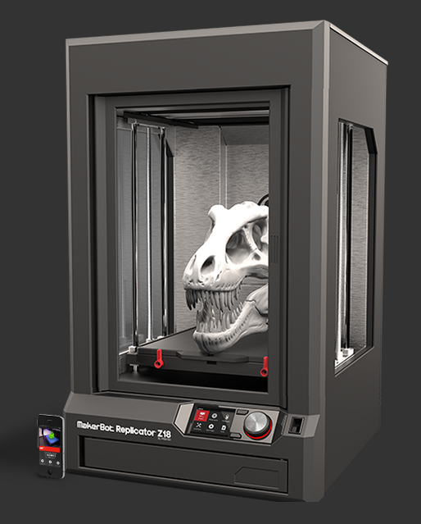
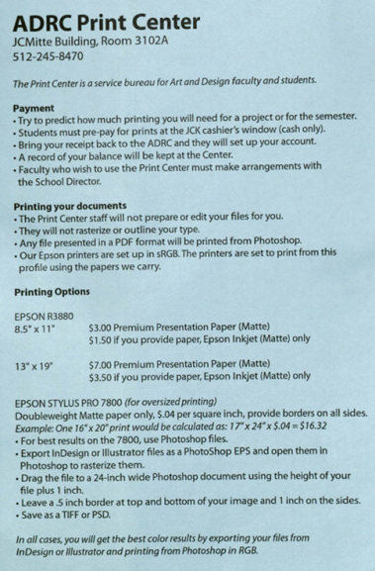
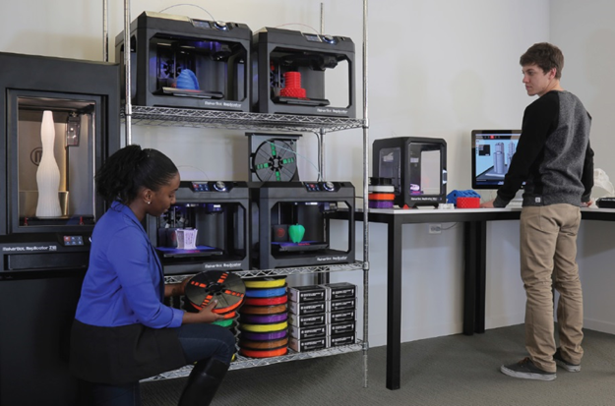
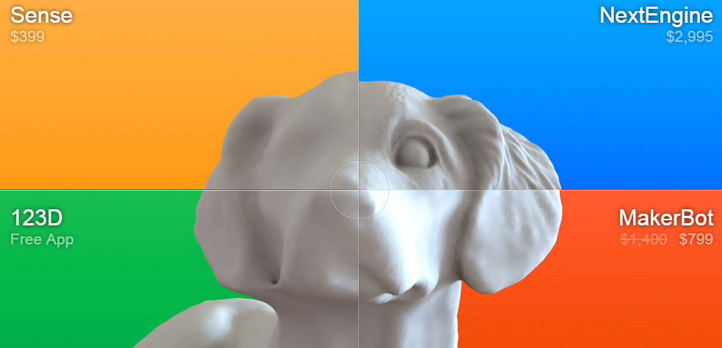
3D Printer/Scanner Services
Learning Commons Fall Semester V1.0 Roll-out
Makerbot Replicator Z18 $ 5,602.54
Makerbot Cart 964.87
Extra Extruder (Print Head) 172.92
2 Year Protection Plan 1,224.40
Subtotal: $7964.73
Next Engine 3D Scanner 2,795.000
Two Repurposed Computers $0.00
3D Scanner 3 Year Extended Warranty 295.00
Next Engine MultiDrive 895.00
HD Pro Scanner Software 995.00
20 Spools of Filament 267.12
Sketchup Pro – 2015 (Commercial) 590.00
1 Rhino 3D License 799.00
LC 1200 Line Conditioner 125.00
Subtotal: $6771.12
Grand Total (Est): $14,725.85

Slide 17
TXU 3D Printing Environmental Scan
Cost vs. Quality
100,000+
Forensic
Anthropology
50,000
3D Printer
Cost in USD
Engineering, STEM
10,000
Library 3D Printer
Makerspace
5000
Art & Design
2000
Education
Increasing Quality
0
3D Printer Quality
Resolution and Speed

Slide 18

Alkek 25th Anniversary Fall 2015
Anniversary Events
CDS Digital Projects: Football Negatives Flickr Site, Pedagogs 80’s and 90’s , 1st Fl. Digital Exhibit
Volunteers Needed:
Library Open House 25th Anniversary, Homecoming Day Saturday November 7th
Re-enactment of Symbolic Library Move from Old Main to Alkek (September 23rd 10:00-11:30 am)

Slide 19
Current CDS Summer/Fall Searches
Head of Acquisitions (Chair: Paivi Rentz)
Database Maintenance and Metadata Librarian
(Chair: Sheila Torres-Blank)
Simmons Cataloger, Special Collections
(Chair: Karen Sigler)
Timelines: Hopefully all hired by early Fall Semester
New VPIT and AVP ITS to begin summer/Fall

Slide 20
Questions/Comments

