Slide 1
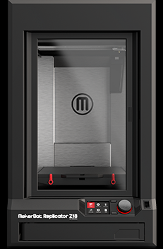
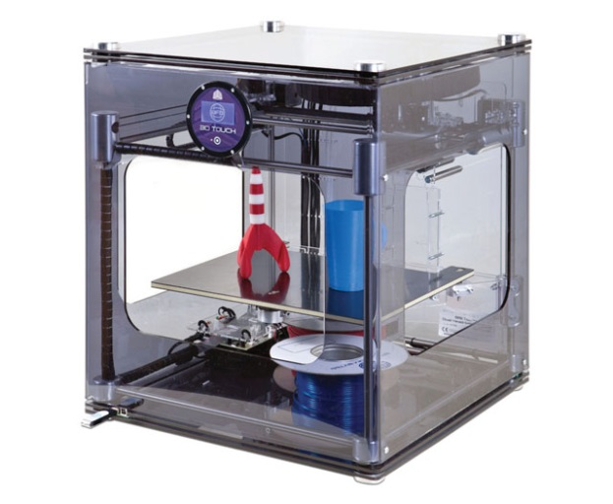
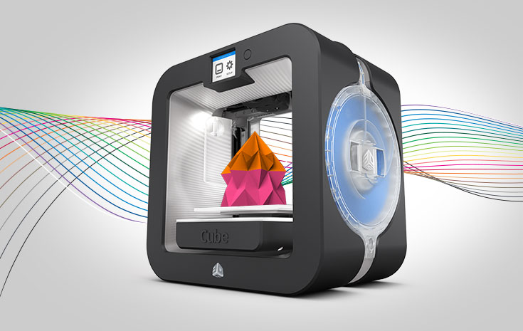
3D Printer Learning Commons Selection Background Process Overview
Texas State University 2015

Slide 2
Two 3D Printer Subcommittees Formed
3D Printer Selection Subcommittee #1 Recommend 3D printer, surrounding equipment, possibly 3D scanner, software, filament
3D Printer Policy/Procedures Subcommittee #2: Develop policies, procedures, library space allocation and human resource infrastructure recommendations

Slide 3
3D Printer Selection Meeting Timelines April – May 2015
April 13, 2015,Subgroup Charge and Overview
April 23rd, 3D Printer Selection Discussion
May 7 Joint Subgroups Meeting
May 8 Final Discussion/Decision making
May 15 Recommendation shared with policy subgroup
May 21 Joint Meeting to exchange feedback/finalize discussion
June 3D Printer Purchase
July- August Printer/Supplies/Lab Set-up
Fall Semester 2015 Launch New 3D Printing Service

Slide 4
Review Environmental Scan Use Case Scenarios (No Need to Reinvent the Wheel) Full Report: http://tinyurl.com/mgkkc6e
Background: Six Areas Visited on Campus December 2014 – January 2015, Four with 3D Printers ranging in size from a couple hundred dollars to half million dollar set ups. Two others departments wishing to explore this technology further. Areas:
Educational Technology
Art & Design
Engineering/Engineering Technology
Forensic Anthropology
Geography
STEM Education

Slide 5
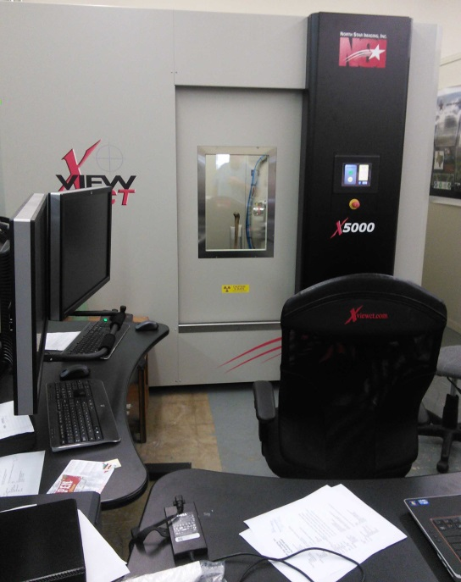
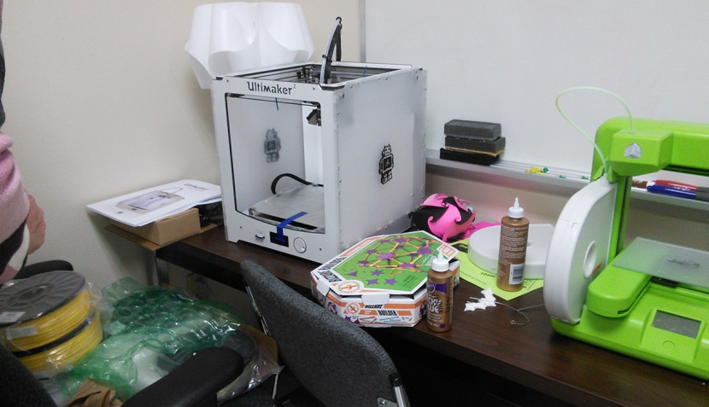
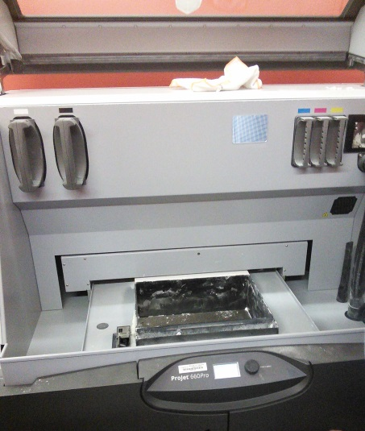
TXU 3D Printer Landscape Review
Low End – Education < $ 2000.00 – Primarily Geared to Future K-12 Teachers
High End – Forensic Anthropology,
~$ 1,500,000.00 Set-up (800,000.00 Scanner)

Slide 6
TXU 3D Printing Landscape Needs Assessment Cost vs. Quality
100,000+
Forensic Anthropology
50,000
3D Printer Cost in USD
Engineering, STEM
10,000
Library Makerspace
5000
Art & Design
2000
Education
Increasing Quality
0
3D Printer Quality Resolution and Speed

Slide 7
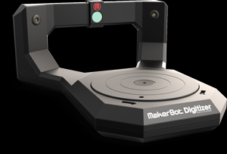
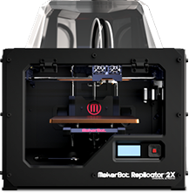
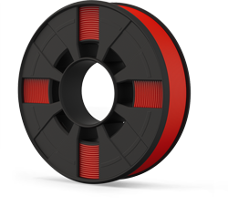
Closest TXU Learning Commons Analogue Art & Design Lab
Makerbot Replicator 3000.00 Software: Rhino (25 Copies, 119 Alkek) Sketchup
Makerbot
3D Scanner 800.00
Filament
Susan Thompson st12@txstate.edu Mike Guardiola mg60@txstate.edu Microcomputer Lab Coordinators
Replicator 2X
(Double Headed Extruder)

Slide 8
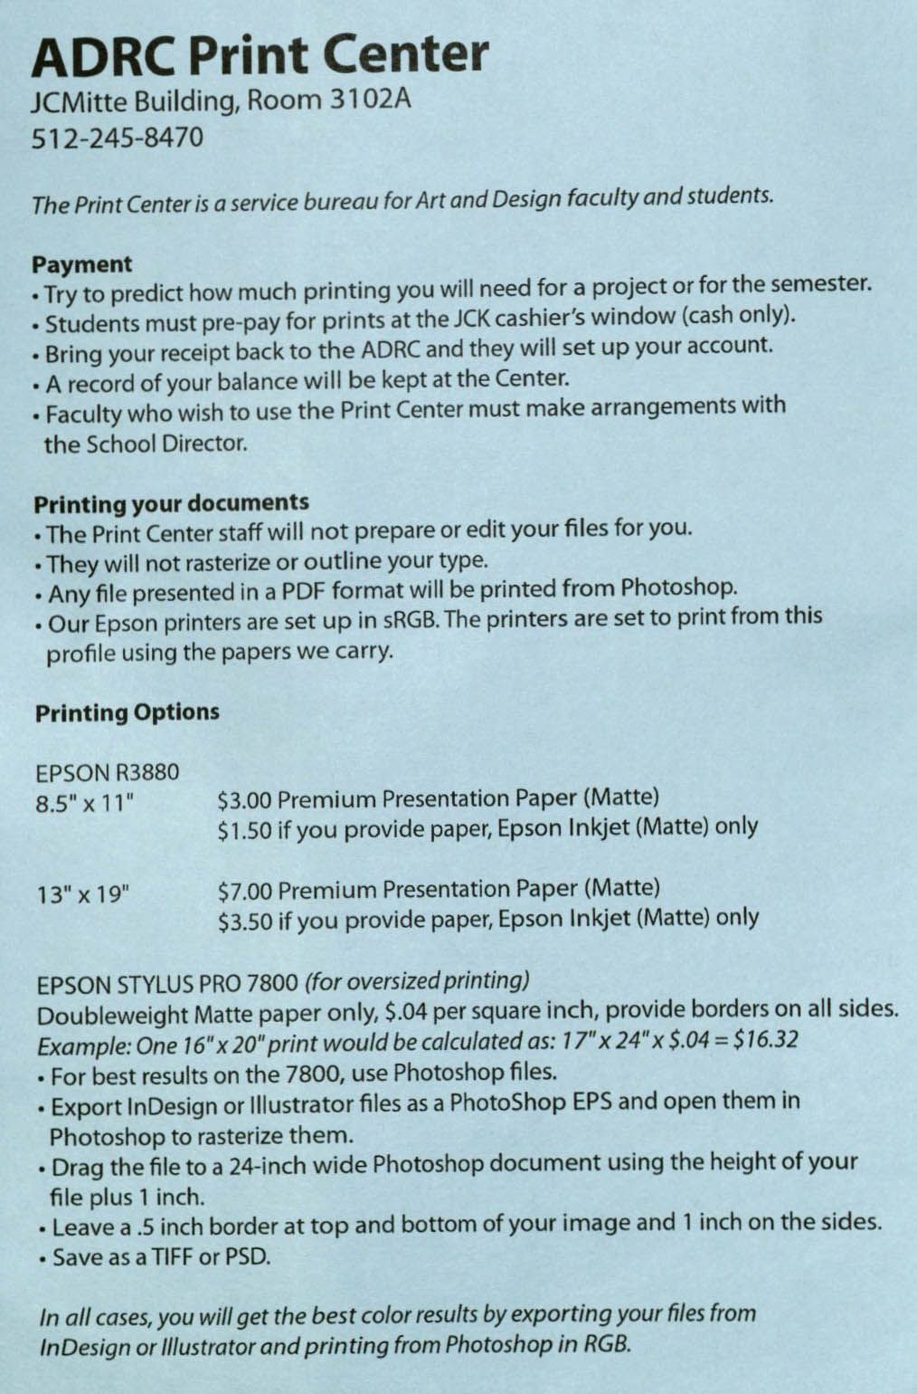
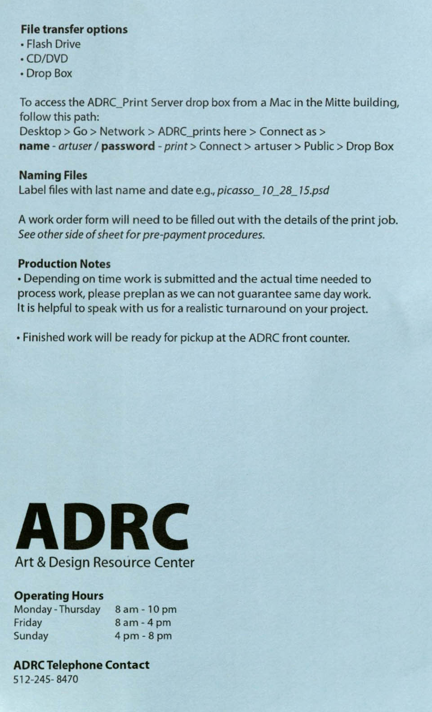
3D Printer Service Policy Directions

Slide 9
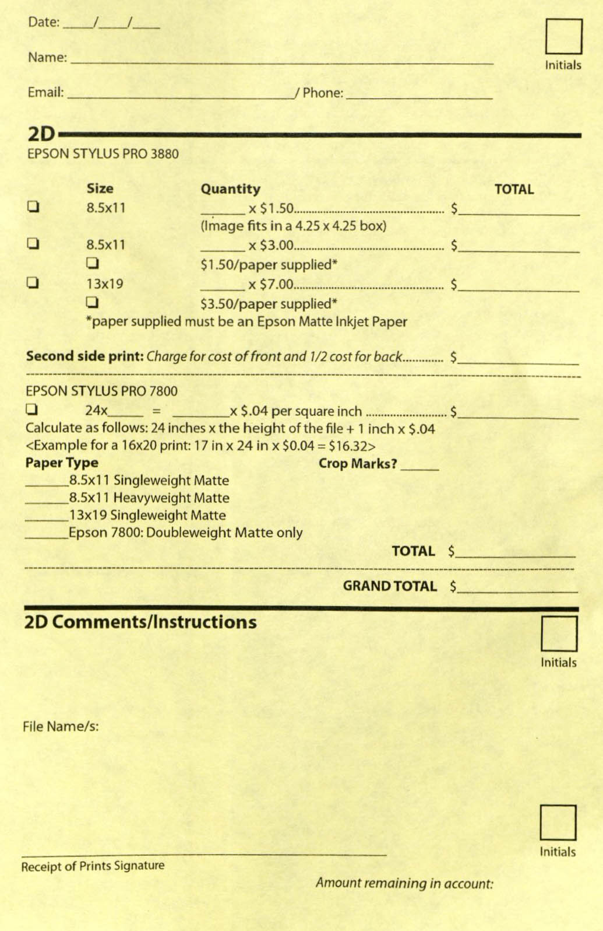
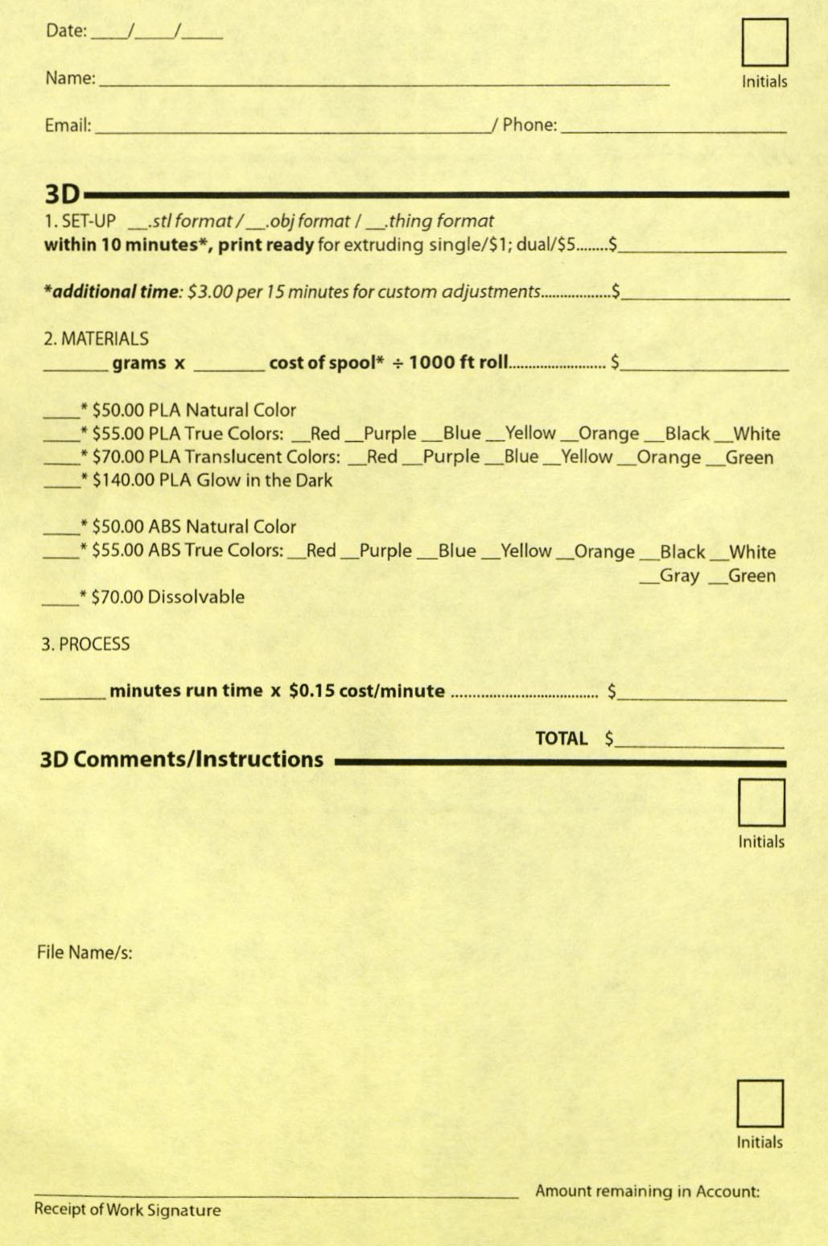
3D Printer Service Set-up Example

Slide 10
From Scenarios & Discussion Generated Desired 3D Printer Parameters
Speed of 3D Printer
Resolution (How finely the printer prints)
Cost (Budgetary implications of 15k)
Safety (Biodegradable Filament, APL, Ventilation)
Congruence with other University/Library Setups
Caveats: (1) 3D Printer/Scanner 1 extra Extruder

Slide 11
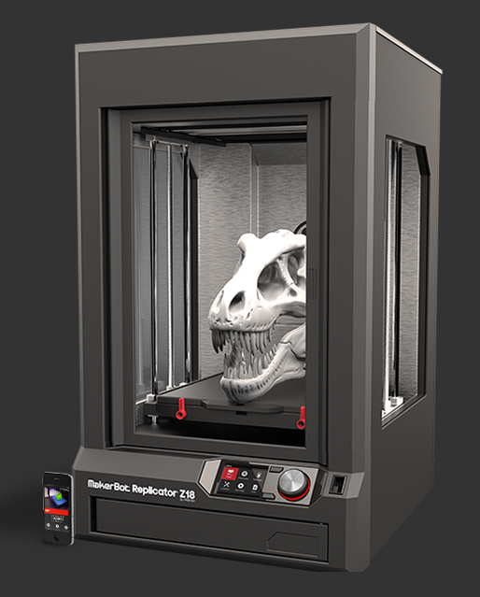
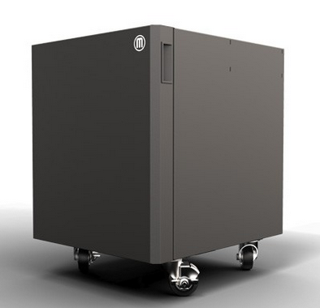
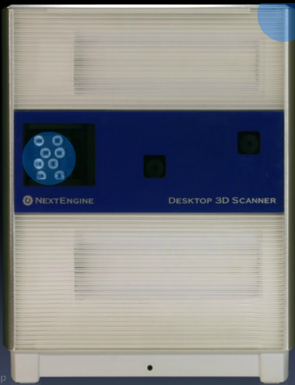
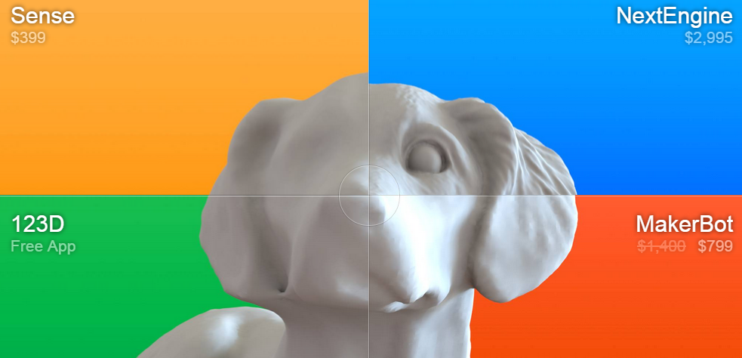
Final 3D Printer/Scanner Setup Recommendation
Makerbot Replicator Z18 $ 5,602.54 Makerbot Cart 964.87 Extra Extruder (Print Head) 172.92 2 Year Protection Plan 1,224.40 Subtotal: $7964.73 2 Repurposed Computers $0.00
Next Engine 3D Scanner 2,795.00 3D Scanner 3 Year Extended Warranty 295.00 Next Engine MultiDrive 895.00 HD Pro Scanner Software 995.00 20 Spools of Filament 267.12
Sketchup Pro – 2015 (Commercial) 590.00
1 Rhino 3D License 799.00 LC 1200 Line Conditioner 125.00 Subtotal: $6771.12
Grand Total (Est): $14,725.85
Z18 Intro

Slide 12
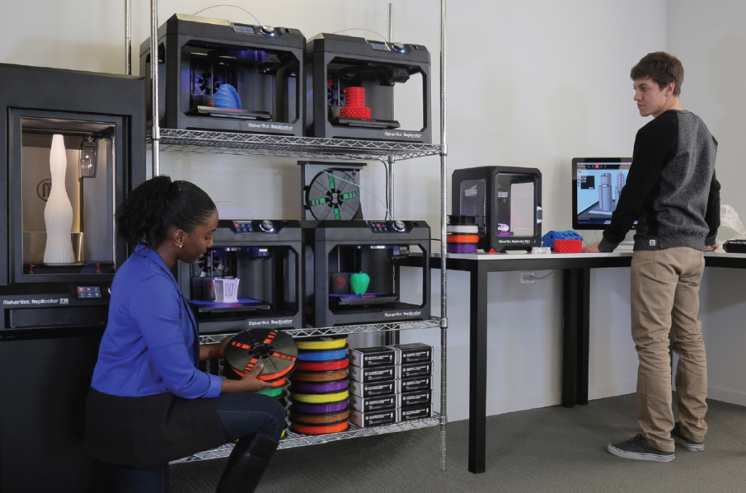
Next Steps (Purchase, Summer Set-up, Fall Semester Lunch)
Assessment & Evaluation
(3D Printer Lab Possibility)

