Slide 1
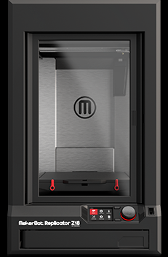
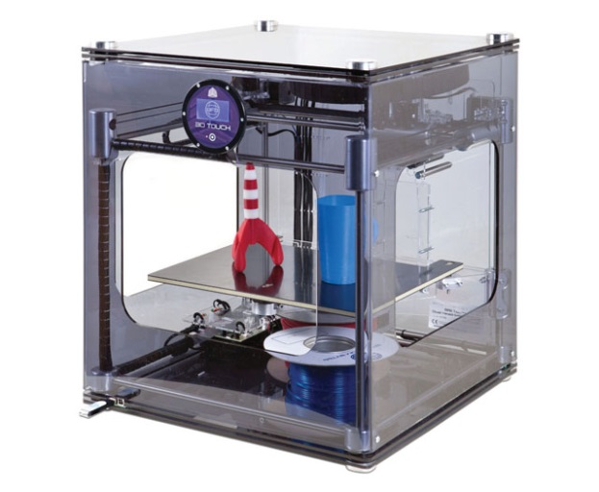
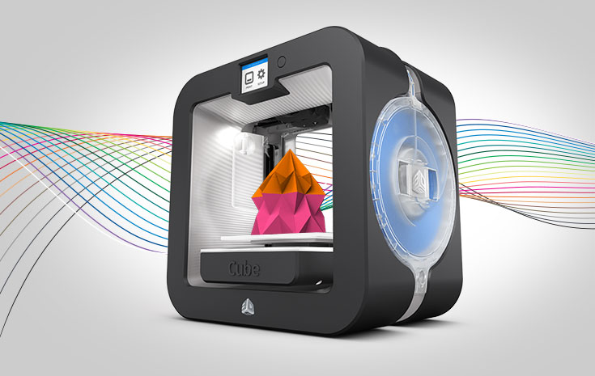
3D Printer Learning Commons Selection Background Overview and Next Steps
Texas State University 2015

Slide 2
Background Overview
October, 2014, 3D Printer Prototype for University Learning Commons Proposed, ~ 15K Allocation, PBS 3D Printing Overview
November 2014 – January 2015 Environmental Scan on TXU Campus. Current 3D Printer Landscape, Scenarios and Needs Assessment Conducted

Slide 3
Environmental Scan Background Scenarios Full Report: http://tinyurl.com/mgkkc6e
Six Areas Visited on Campus December 2014 – January 2015, Four with 3D Printers ranging in size from a couple hundred dollars to half million dollar set ups. Two others wishing to explore this technology further:
Educational Technology
Art & Design
Engineering/Engineering Technology
Forensic Anthropology
Geography
STEM Education

Slide 4
Background (Cont’d)
February 26 2015 Environmental Scan Presented. Approval given the library/project to move forward with 3D Printer Infrastructure from environmental scan results.
April, 2015 Two Subgroups Formed
1) 3D Printer Selection Subcommittee 2) 3D Printer Infrastructure Policy Committee

Slide 5
3D Printer Subcommittees Charges
3D Printer Selection Subcommittee: Recommend 3D printer, surrounding equipment, possibly 3D scanner, software, filament
3D Printer Policy Infrastructure Subcommittee: Develop policies, procedures, library space allocation and human resource infrastructure recommendations

Slide 6
Timelines
1) Monday April 13, 2013, 10:00-11:30 am (Subgroup Charge and Preliminary Work Overview) CDS Conference Room Alkek 221
2) Thursday April 23rd, 2013 3:00-5:00 pm (3D Printer Selection, preliminary recommendation) CDS Conference Room, Alkek 221
3) Wednesday, May 6 10:00-11:30 am (Final recommendation and finalization, as needed) Alkek 207 Library Admin Conference Room
4) Friday, May 15 Recommendation shared with subgroup two (Policy Infrastructure Subgroup: Email)
5) Thursday Wednesday May 21, 2:00-4:00 pm Both subgroups meet to exchange feedback/finalize discussion
6) Printer/Supplies Purchased June 1, Set-up, July- August
7) Launch New 3D Printing Service September 1/Fall Semester 2015

Slide 7
Scenarios: Desired 3D Printer Parameters Generated
Speed of Printing
Resolution (How finely the printer prints)
Cost (Budgetary implications of 15k
Safety (Biodegradable Filament, APL, Ventilation)
Congruence with other University/Library Setups

Slide 8
TXU 3D Printing Landscape Cost vs. Quality
100,000+
Forensic Anthropology
50,000
3D Printer Cost in USD
Engineering, STEM
10,000
Library Makerspace
5000
Art & Design
2000
Education
Increasing Quality
0
3D Printer Quality Resolution and Speed

Slide 9
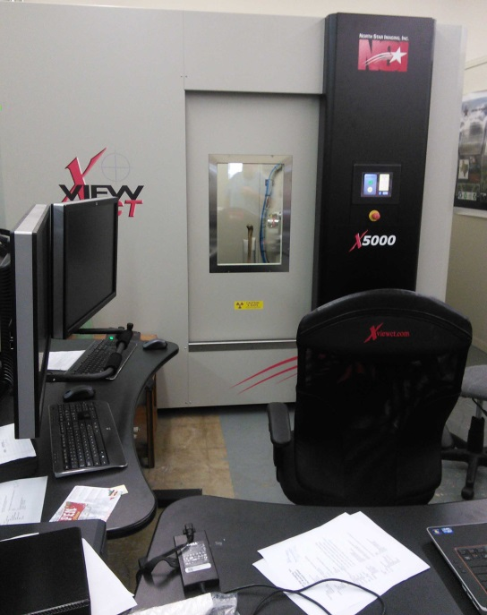
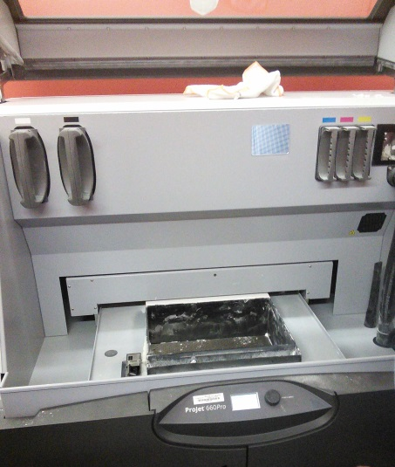
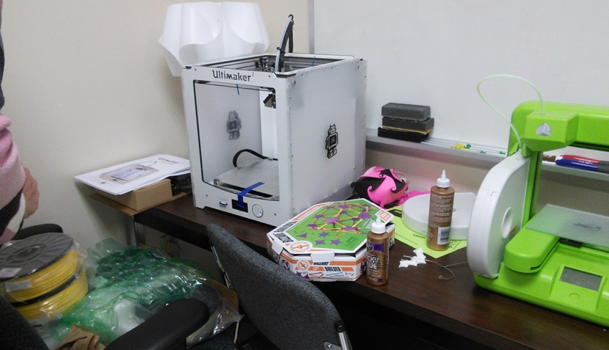
TXU 3D Printer Landscape
Low End – Education < $ 2000.00 – Primarily Geared to Future K-12 Teachers
High End – Forensic Anthropology,
~$ 1,500,000.00 Set-up (800,000.00 Scanner)

Slide 10
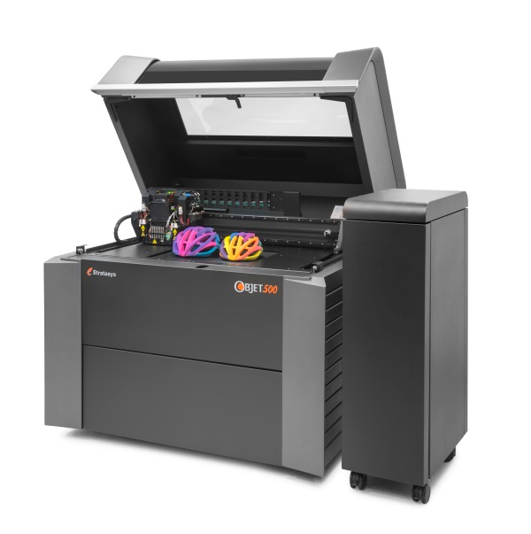
Very High End Stratasys multi-material full color 3D Printer Objet500 Connex3
$330,000.00 (Star Park, Science Technology Applied Research Park Set-up (Other Additions Here include Laser Cutter and 3D Scanner Set-ups)

Slide 11
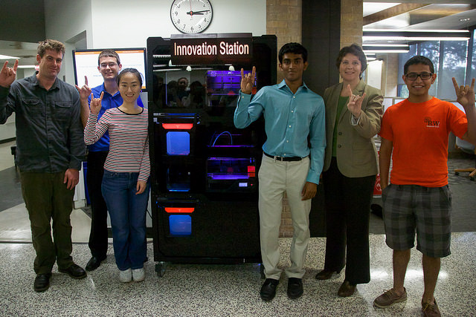
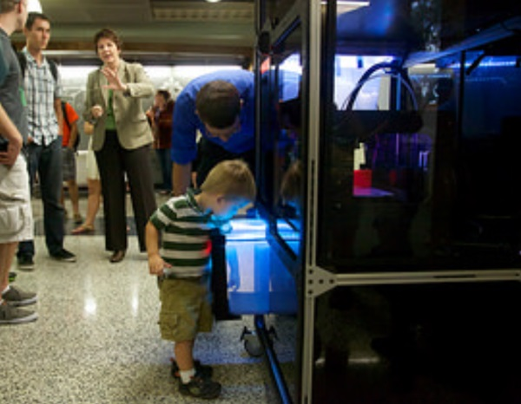
Hands Off Example: UT Austin Innovation Station
Makerbot Vending Machine Innovation Station Video

Slide 12
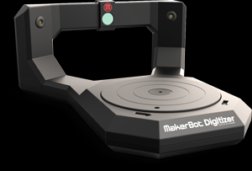
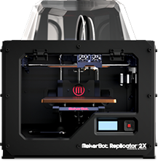
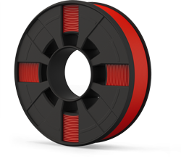
Closest TXU Learning Commons Analogue Art & Design Lab
Makerbot Replicator 3000.00 Software: Rhino (25 Copies, 119 Alkek) Sketchup
Makerbot
3D Scanner 800.00
Filament
Susan Thompson st12@txstate.edu Mike Guardiola mg60@txstate.edu Microcomputer Lab Coordinators
Makerbot Replicator
2X (Double Headed Extruder)

Slide 13
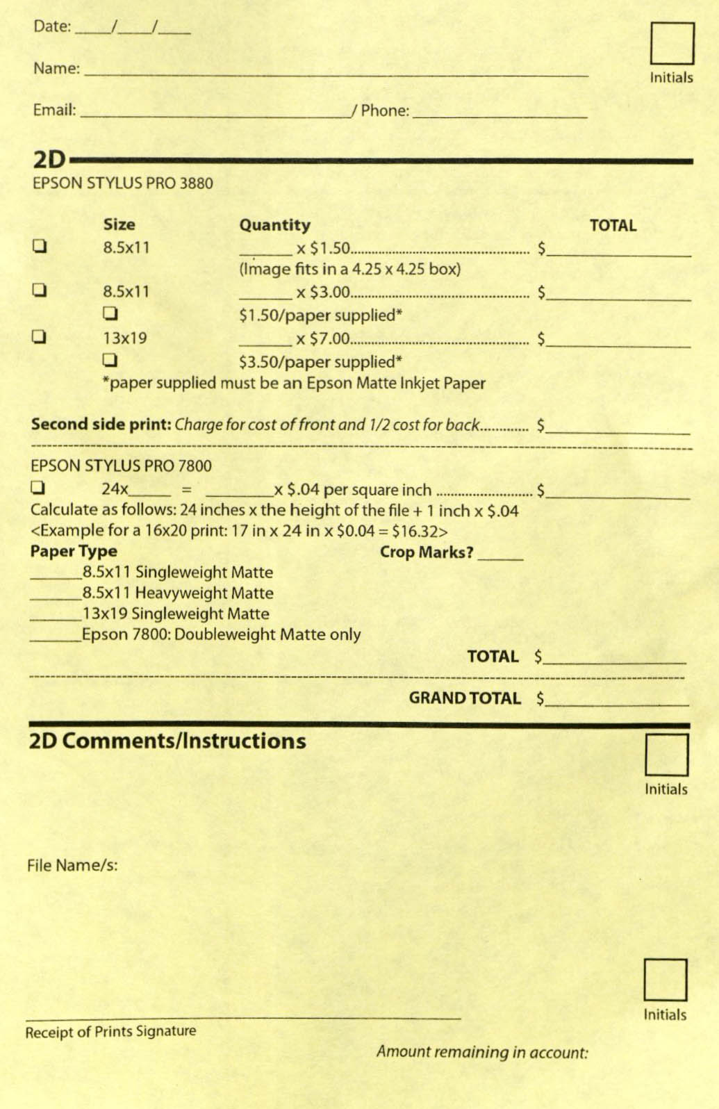
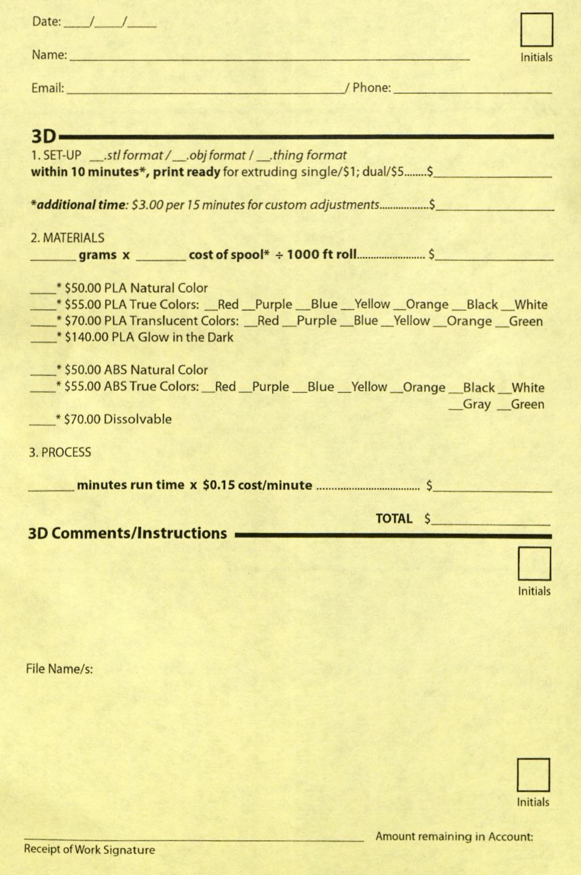
3D Printer Service Set-up Example

Slide 14
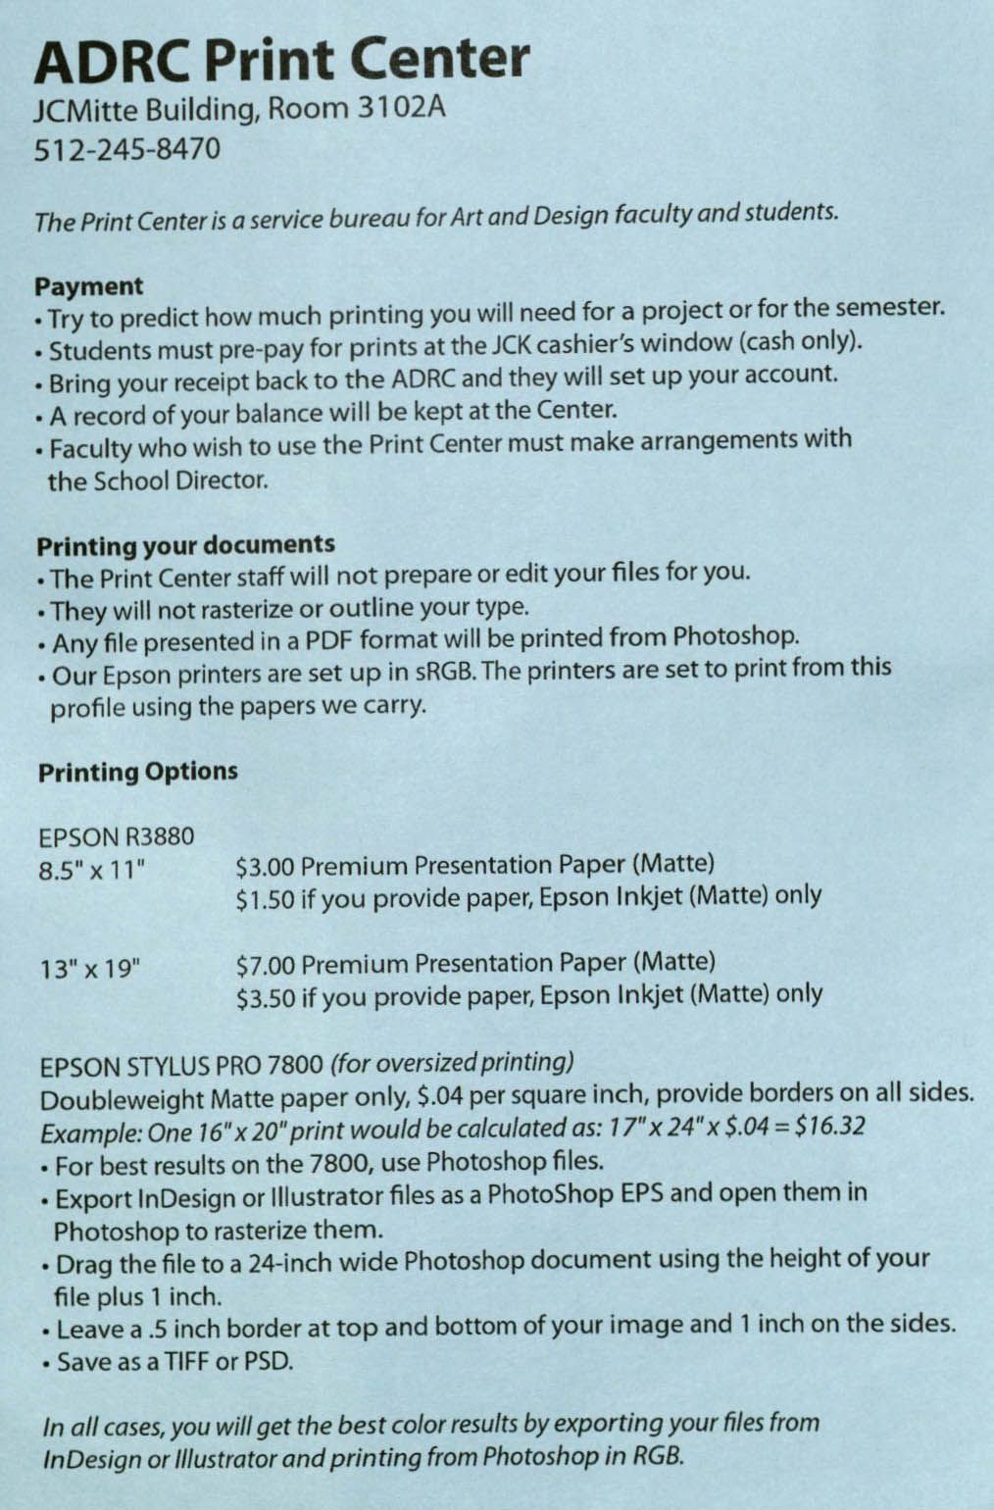
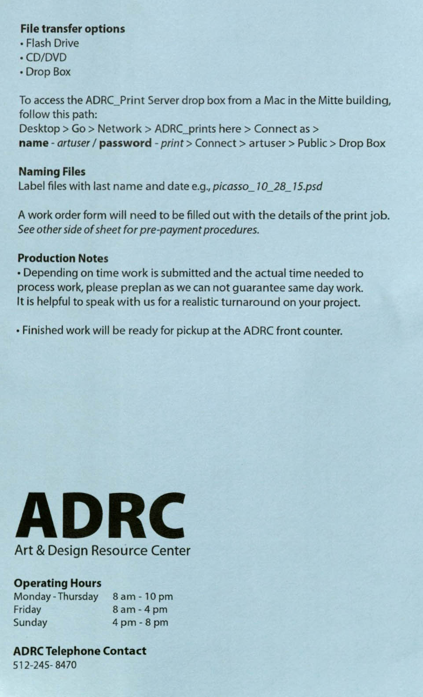
3D Printer Service Policy Example

Slide 15
3D Printer Selection Preliminary Caveats
Requirements
~ 15,000.00 Budget
1 3D Printer/1 extra Extruder
1 3D Scanner
Filament/Software
5-10k 3D Printer Desired (Scenario Constituents)
Safety (Biodegradable Plastic, APL, No hood)
Preferred Congruence with other Universities

Slide 16
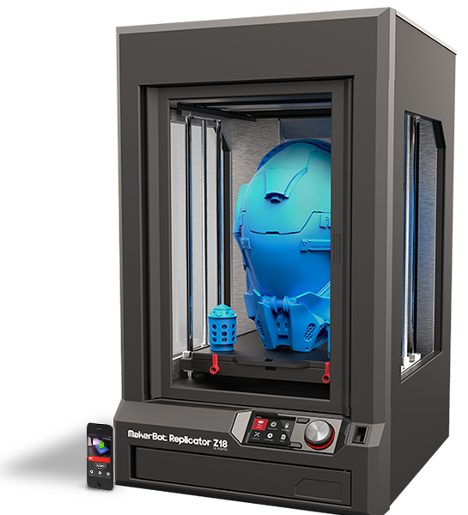
Example in Range Spec Requirements Purchase
Makerbot Replicator Z18 $ 6,500.00 Filament Case 225.00 Makerbot Cart 1,250.00 Extra Extruder (Print Head) 175.00 2 Year Protection Plan 1,540.00
Subtotal: 9,689.00 Next Engine 3D Scanner 2,995.00 (20 Spools Filament 960.00 assorted colors (1 Rhino 3D License) 799.00 (Sketchup Pro Education Lic. ?)
TOTAL: ~14,443.00

Slide 17
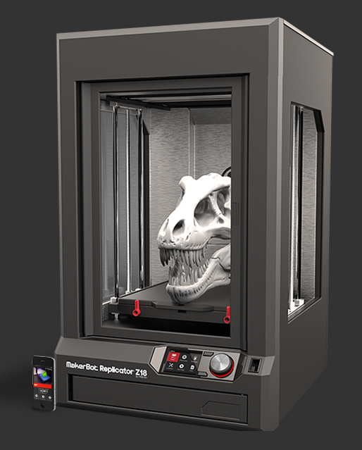
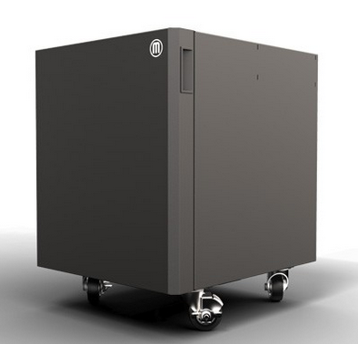
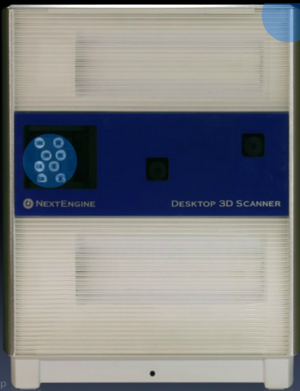
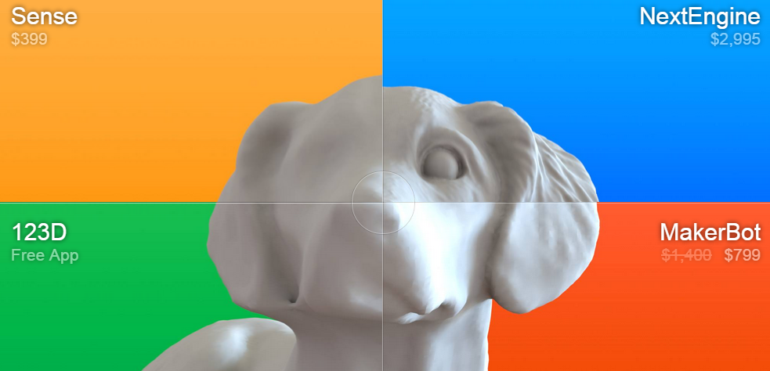
Recommendation/Final 3D Printer/Scanner Setup
Makerbot Replicator Z18 $ 5,602.54 Makerbot Cart 964.87 Extra Extruder (Print Head) 172.92 2 Year Protection Plan 1,224.40 Subtotal: $7964.73 2 Repurposed Computers $0.00
Next Engine 3D Scanner 2,795.00 3D Scanner 3 Year Extended Warranty 295.00 Next Engine MultiDrive 895.00 HD Pro Scanner Software 995.00 20 Spools of Filament 267.12
Sketchup Pro – 2015 (Commercial) 590.00
1 Rhino 3D License 799.00 LC 1200 Line Conditioner 125.00 Subtotal: $6771.12
Grand Total (Est): $14,725.85
Z18 Intro

Slide 18
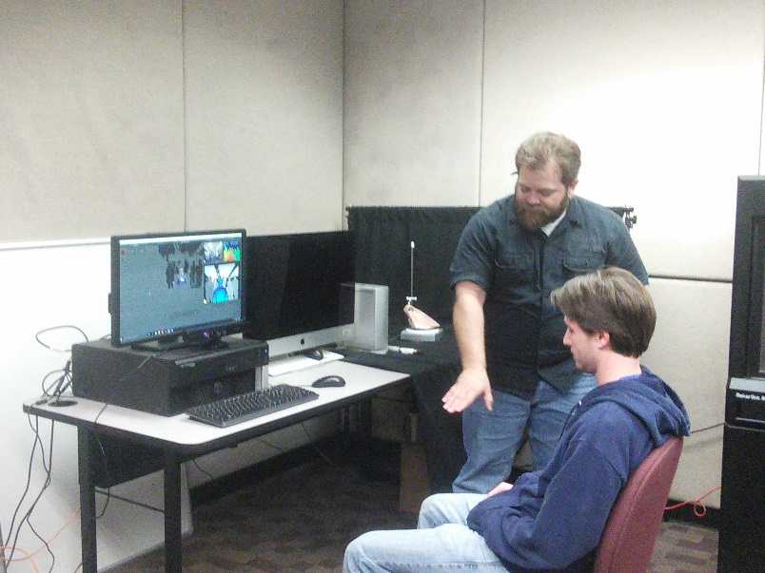
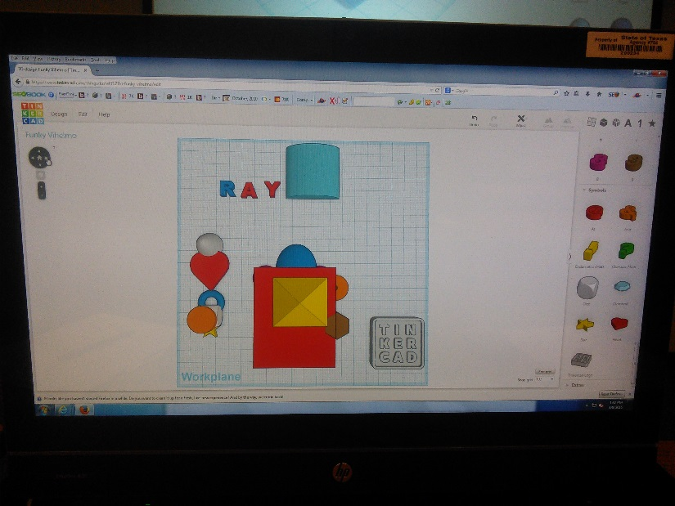
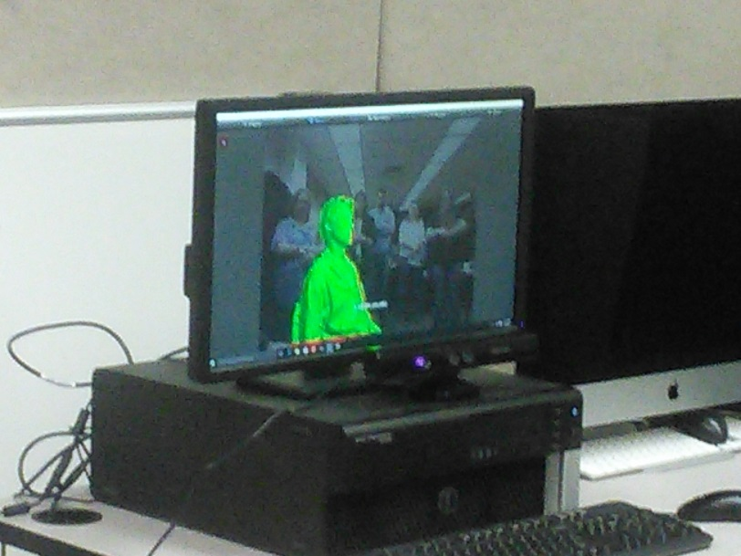
Initial Lab Set-up

Slide 19
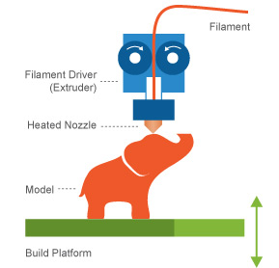
Alkek 3D Printing Service Page/FAQ
http://tinyurl.com/zx6sqon

Slide 20
3D Printing Remote Service Form
http://tinyurl.com/gwk3cjn

Slide 21
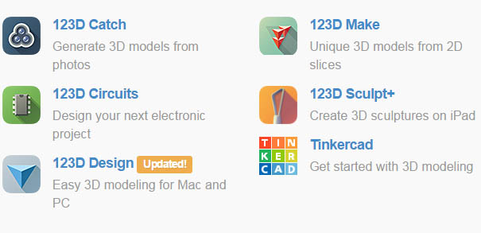
3D Software
Rhino
Sketchup 3d (Free & Conversion)
Autodesk123D (Free 3D Toolset/ Scanning Software)
Other Services Shapeways
Shapeways.com

Slide 22
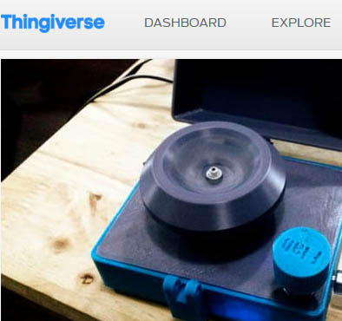
Further Resources
Http://http://3d.si.edu/
https://www.thingiverse.com/

Slide 23
Room Space/Product Dimensions Considerations
Printer Dimensions:49.3 L x 56.5 W x 86.1 H [19.4 W x 22.2 D x 33.9 H IN]
1 Tables – 6 ft x 3 ft. Computer Tables
1 Small Table – 4ft x 3ft. Separate Scanning Table
Extra Computers

Slide 24
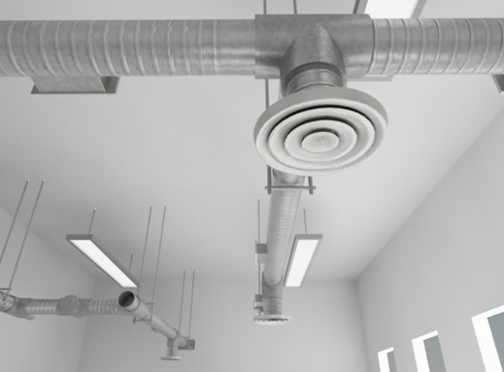
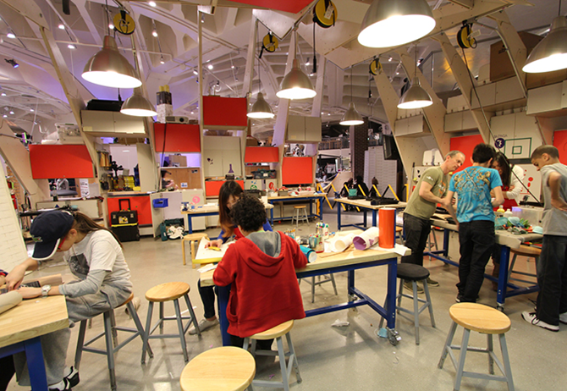
Ventilation ABS vs. PLA

Slide 25
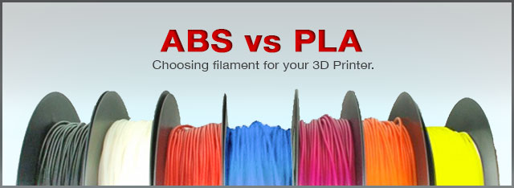
Safety Considerations
ABS – Acrylonitrile Butadien Styrene, Hot Plastic (Oil/Petroleum Based)
PLA, Polylactic Acid Biodegradable, Plant Based, corn, potatot, sugar-beet derived, eco-friendly, Sugar smell

Slide 26
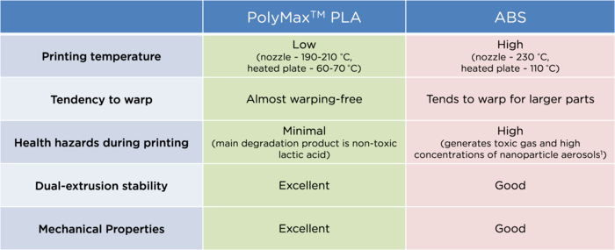
PLA vs ABS Comparisons
PLA is Safer than ABS but ventilation is still recommended
Good Study on Ultrafine Particles and Potential Risks of Printing (Molitch-Hou, 2013, Stephens, Azimi et al, 2013)

Slide 27
Further Overview Notes Recommendation Specification (Cable Hott)
Makerbot is the leader in this price range.
Low end competitors.
Afinia H800
Dremel Ideabuilder
High end competitors.
3D Systems, pricing is subjective and support community smaller. Geared for enterprise.
https://www.youtube.com/watch?v=ujAT6NxrCZ0
Makerbot cart not necessarily needed at almost 1k price. Location will dictate mounting options to avoid theft
Additional considerations
The filament ships with a standard moisture level. Filament has absorbed moisture from humidity leads to sputtering.
Given the quality and speed of print jobs PLA is the preferred method of printing in the library due to ventilation and temperature constraints.
Scanner selected by Ray appears to be best in class.
Updated Pricing from B&H photo. (TSUS Marketplace)
Makerbot Replicator Z18 with Case and Cart 7,974.00 Extra Extruder (Print Head) 165.00 1.5 Year Protection Plan 598.50 Subtotal: 8,737.50 Next Engine 3D Scanner 2,995.00 (20 Spools Filament 267.12 assorted colors (1 Rhino 3D License) 799.00 (Sketchup Pro Education Lic. ?)
TOTAL: ~12,798.62

Slide 28
Subcommittee Expectations
Next Meeting: Thursday April 23rd, 2013 3:00-5:00 pm (3D Printer Selection Discussion)
Individual Environmental Scan
Possible Other Models/Configuration Suggestions
Individual Art & Design Visit (before meeting)
Preliminary Recommendations
Wednesday, May 6 10:00-11:30 am (Final Recommendation/Finalization, as needed)
Friday, May 15 Recommendation Shared With Subgroup Two (Policy Infrastructure Subgroup: Email)
Thursday, May 21, Final Joint Sub-groups Meeting
Summer Purchase and Implementation for Fall Launch

Slide 29
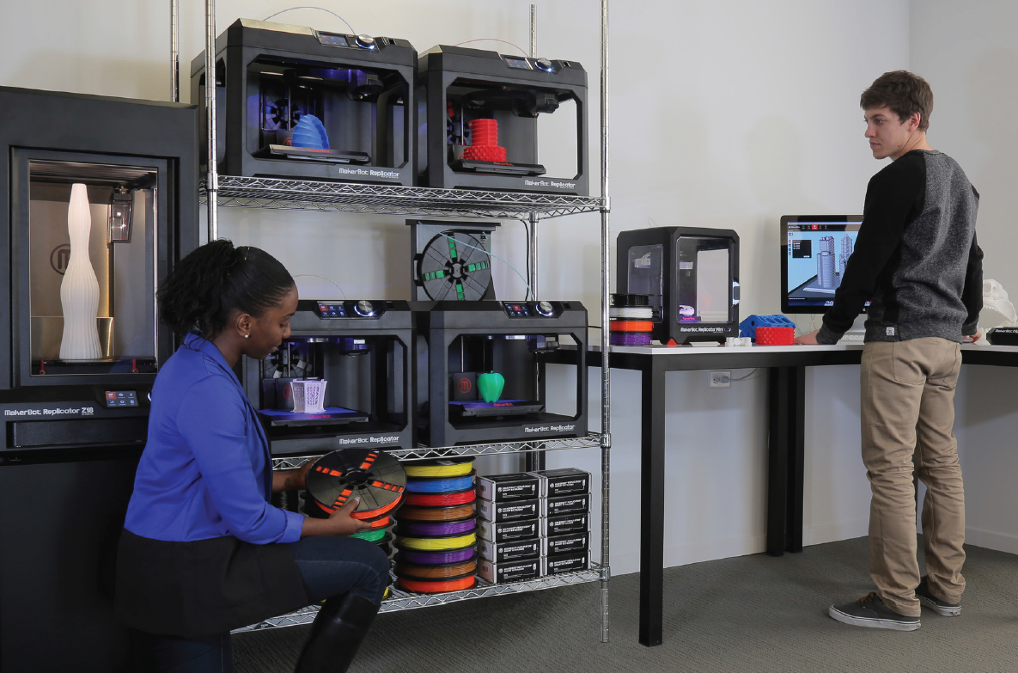
Next Steps: Assessment & Evaluation for 3D Printer Lab Possibility
(3D Printer Lab Possibility)

Slide 30
Future Trajectories (Scaling)
Learning Commons 10 M + (Multi-Tiered, Many Labs, Visualization, Multimedia, 3D Printing, Makerspace, Traditional etc. Makerspace 1-2 M (Physical/Digital Computing Space), CNC Lasercutter, digital embroidery, 3D Printing, Arduino etc.
3D Printing Lab, 100-500 K Multiple and Varying Capability, 3D Printing Space, Scanners, Lab
3D Printer Prototype, 15-40K 3D Printer, 3D Scanner, Software, HR
Infrastructure

Slide 31
Discussion and Questions Contact Info: Ray Uzwyshyn, R_U15@txstate.edu Director, Digital and Collections Services Texas State University http://rayuzwyshyn.net

Slide 32
Further Resources Special Thanks to Dr. Shaunna Smith, Texas State, for these references
Access 3D Models
Smithsonian X 3D (3D scans of historical artifacts)
Morphosource (3D scans of skeletal remains)
Digimorph (3D scans of skeletal remains)
NASA 3D Models (3D scans of topography and aerospace equipment)
Thingiverse (downloadable 3D model files and open community sharing)
Learn more about ways to connect existing 3D models to teaching and learning here.
Create Your Own 3D Models
Autodesk 123d Website (free, must set up account)
TinkerCAD App (free, web-based app to create 3D models)
Tinkercad “quest” lessons and video tutorials
"3D Printing with Autodesk 123D, TinkerCAD, and Makerbot" by Lydia Sloan Cline"
“3D Modeling/Printing with Tinkercad: Create/Print3D Models. James Floyd Kelly”
Autodesk 123d Design (free, downloadable software to create 3D models)
Autodesk 123d Make (free, slice 3D models into 2D puzzle pieces)
Autodesk 123d Sculpt (free, manipulate digital clay on an iPad)
Autodesk 123d Catch (free, upload photos of objects to create 3D models)
Learn more about scanning your own 3D models here.
Order a 3D Print from an Online Service or go to a Makerspace
Shapeways (online service, upload file and they mail print to you, lots of materials choices)
3D Hubs (online network of 3D printers in your community, upload file and pick it up at store)

