Slide 1
Division of Collection & Digital Services Texas State University Libraries Strategic Operational Plan Kickoff
Fiscal Year 2015

Slide 2
Collection and Digital Services New Division, Renewed Strategic Plan & Rowing in the Same Direction
Department of Digital and Web Services Department of Cataloging and Metadata Services Department of Acquisitions

Slide 3
Strategic Operational Plans and Rowing
Getting everyone in an organization rowing in the same direction solves challenges in any environment, against any barriers, at any time.

Slide 4
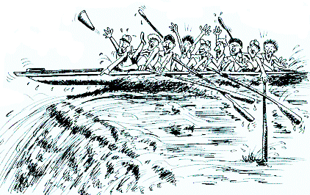
Strategic Operational Plans and Cooperation
Staff, Other Divisions
External University Departments

Slide 5
Tip #1 for Rowing Together The Mission Statement
Texas State University is a public, student-centered, Emerging Research University dedicated to excellence in serving the educational needs of the diverse population of Texas and the world beyond.

Slide 6
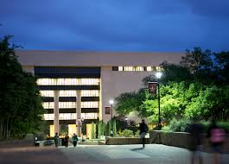
Tip #2 for Rowing Together The Texas State University Library Mission Statement
The University Library advances the teaching and research mission of the University and supports students, faculty, and other researchers by providing user‐centered services, comprehensive and diverse collections, individual and collaborative learning environments, and opportunities to learn, create, and discover.

Slide 7
Updated University and Library Mission (2012)
Texas State University is a public, student-centered, Emerging Research University
The University Library advances the teaching and research mission of the University
Texas State University Library ARL Trajectory
(Association of Research Libraries)

Slide 8
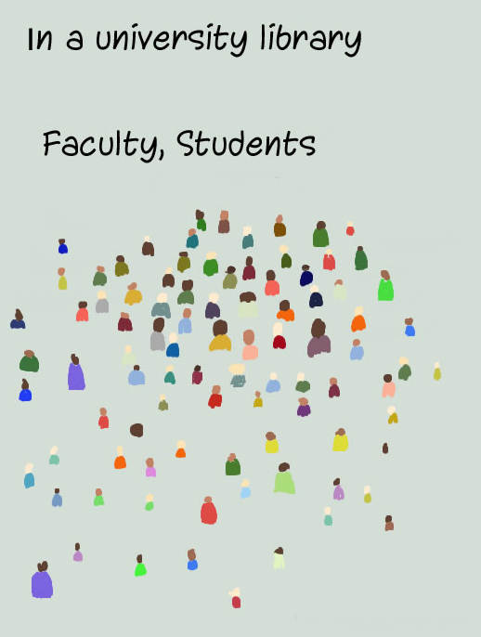
Big Picture: Strategy for who?
Students, Faculty, Departments, Centers, Schools, Community Members
Communities of Scholars
Student-Centered

Slide 9
Strategic Operational Plan FY15
Summary Overview
22 Strategic Initiatives over 3 Departments
Vetted from originally 58 originally listed projects
Emphasis in 2015 0n completion of projects
2014, 85% uncompleted projects, 15% completed
2015, 80% completed projects, 20% uncompleted multiyear

Slide 10
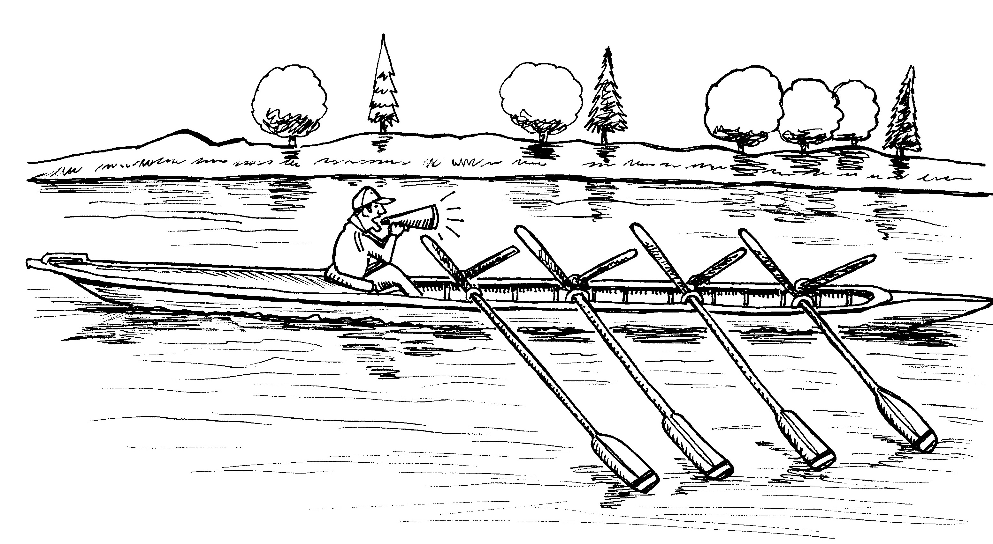
Chain of Command, Strategic Priorities and Operational Plans
Staff, Unit Heads, Dept Heads, Directors, AVPUL, VPIT

Slide 11
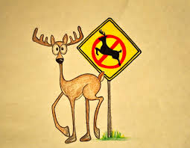
FY 2015 Strategic Plan Represents:
A Consolidation/Culling of Initiatives (58 -> 22)
Refocus Away from Day to Day Initiatives
Deletion of projects that have been lingering (in progress or delayed) without significant progress in past three years

Slide 12
FY 2015 Strategic Plan Good News
New Grassroots Initiatives generated from Staff Workflow Workshops
Department by Department focus on strategically aligned initiatives
A few significant completely new projects/ Staffsharing Initiative
A few Interdivisional/University and AVPUL Projects

Slide 13
FY 2015 Categories of Projects
Scholarship and Research (6)
Collections and Digital Content (7)
Teaching and Learning (1)
Library Spaces (2)
Organizational Agility (6)
22 Initiatives fairly evenly divided over three departments, 5-7 Initiatives/Department, several interdivisional initiatives
Library & CDS Plan Available on Sharepoint

Slide 14
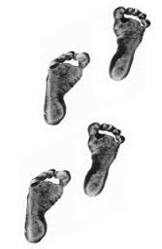
FY15 Strategic Operational Plan 2015 - Transitional Year
Clearing the Deck (58 -> 22)
Cleaning House For the Future (Workflow Processes)
Initial Steps into Larger Digital Initiatives Infrastructures

Slide 15
CDS Strategic Directions 2014- 2019
University and Library Divisions Ecosystems
Digital and Web Services
Cataloging and Metadata Services
CDS
Faculty
Students
Acquisitions

Slide 16
3 Highlights FY 2015

Slide 17
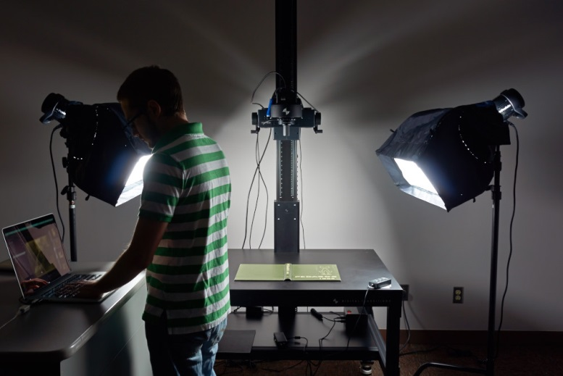
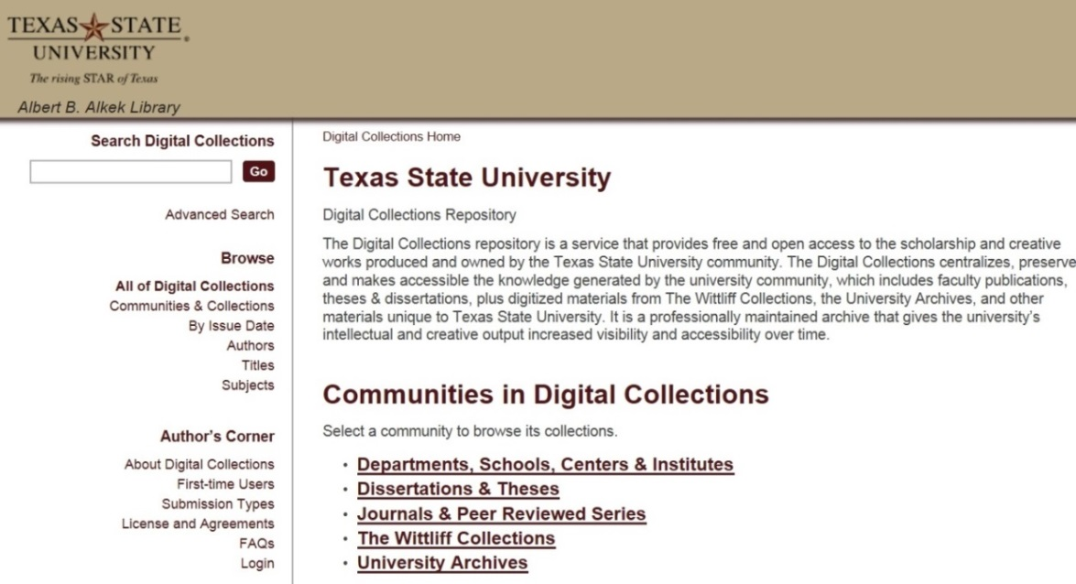
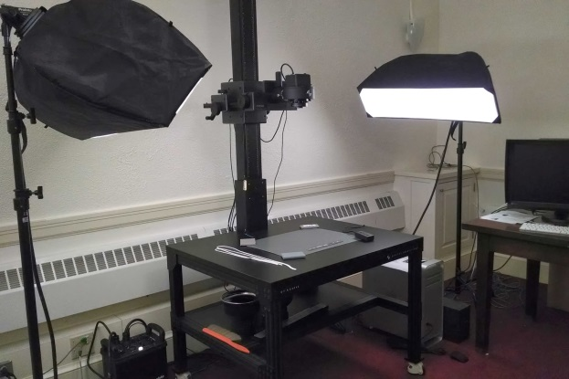
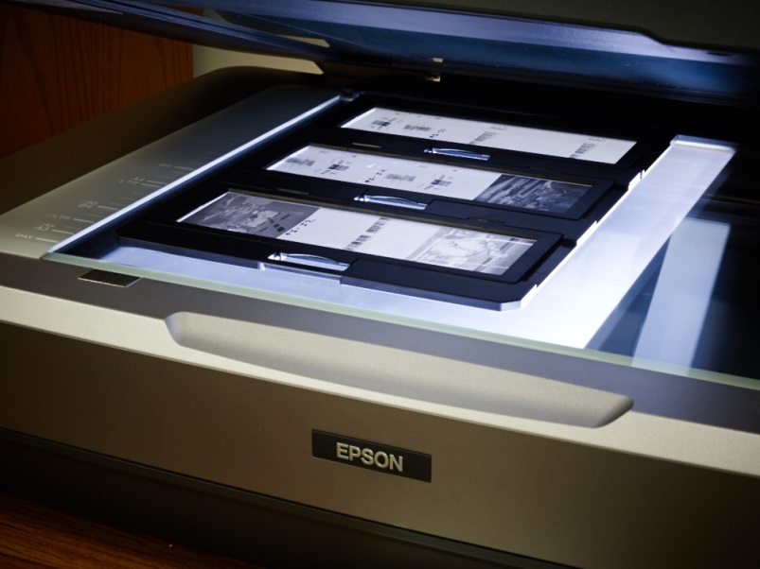
Digital and Web Services
Scholarship and Research: Digitize and add 40,000 objects to the Digital Collections Repository: University Archives, Wittliff, Archeology

Slide 18
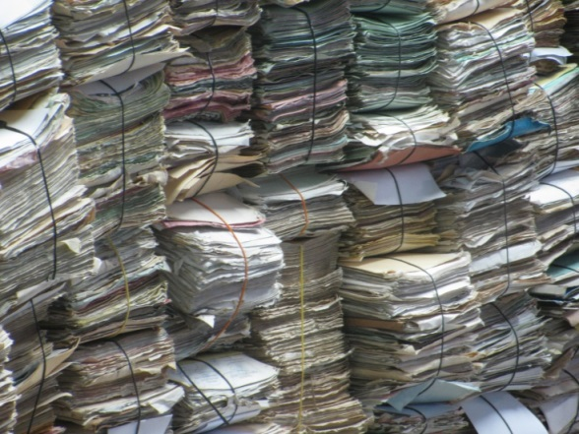
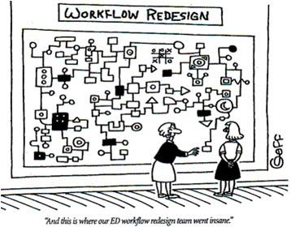
Highlights Cataloging FY15
Catalog every item in the federal documents collection
Interdepartmental Cataloging Workflow Initiatives

Slide 19
Highlights: Acquisitions
Hybrid Online Tools Project
Licensing, Development and deployment for Research and Teaching Tools Initiative: marketing, implementation, assessment 2014-2015
Datazoa, Data Management Tools
Artstor Shared Shelf, Image Libraries
Browzine, Current Awareness Tools
Curriculum Builder, Online Learning

Slide 20
Acquisitions

Slide 21
Paperback Binding
Amazon!
Wittliff Acq Workflow
Serials Weeding
EBSCO Invoicing
Thesis Printing
CONGRATULATIONS!

Slide 22
FY15 Acquisitions Initiatives
Ebooks Task Force
Order Request System Task Force
Adjusting Target Dates
Faculty Grant Change Proposal
Online Tools Pilot

Slide 23
BUILDING A BUDGET…
FOR THE FUTURE!
Collection Action Plans
FY15 Budget SUCCESS
& Planning
New Budget Model

Slide 25
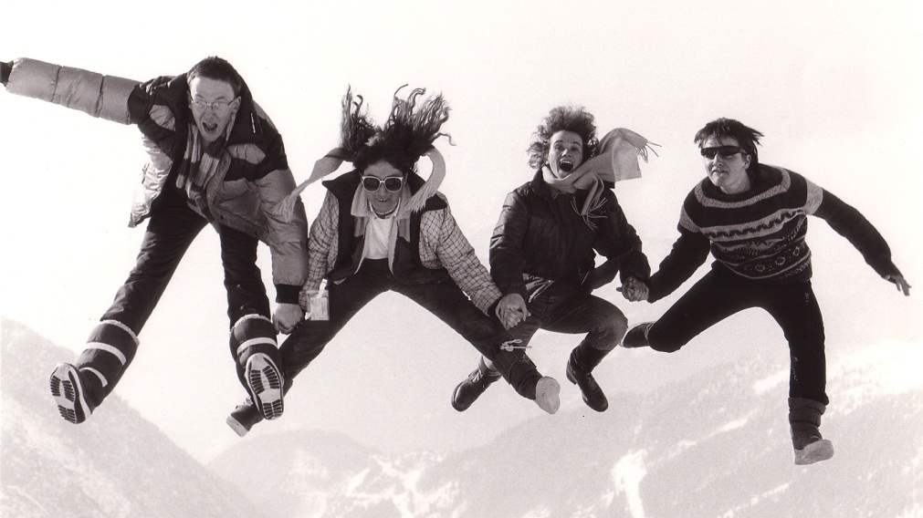
"Never doubt that a small group of thoughtful, committed people can change the world. Indeed, it is the only thing that ever has.” –Margaret Mead

Slide 26
Digital and Web Services

Slide 27
Scholarship & Research I
Digital & Web Services FY15
Key Initiatives
Continue to develop a robust and accessible digital collections repository that effectively gathers and promotes the scholarship and digital collections produced by the university community
Specific Projects & Activities
Dspace - 1) install page-turning module;
2) customized item layout

Slide 28
Dspace - install page-turning module; customized item layout Background
Digital Collections at Texas State includes the Institutional Repository, which is a repository for scholarship produced by academics at TXSTATE, and other digital objects from collections at TXSTATE such as the University Archives and the Wittliff Collections.
The platform hosting Digital Collections at Texas State is Dspace. Our installation of Dspace is managed through a partnership between the library, Technology Resources, and @mire, a private company specializing in Dspace installations and customization. TXSTATE mainly provides system level and hardware support.
Programming, such as functionality and look and feel customization is provided by @mire. The University pays @mire based on programming hours required to complete a project.

Slide 29
Specific Projects & Activities Dspace - install page-turning module; customized item layout
Look and Feel improvements
Jeanne Hazzard, Lauren Goodley, and Megan North worked together to come up with changes to the overall look and feel to for the overall and site their individual collections. The changes were submitted to @mire for development of a quote.
We are also requesting Dspace be upgraded to the latest version 4.1
It is expected @mire will be able to complete the work by the end of the Fall 2014 semester. The upgrade and enhancements will require extensive testing by library staff before they are copied to the production server.

Slide 30
Scholarship & Research II
Key Initiatives
Continue to develop a robust and accessible digital collections repository that effectively gathers and promotes the scholarship and digital collections produced by the university community
Specific Projects & Activities
Organize and staff a department to support digital and web services

Slide 31
Specific Projects & Activities Organize and staff a department to support digital and web services
A lot has been accomplished on this Initiative during the first two years. Accomplishments include:
Creating the Digital & Web Services department and realigning staff from Computer & Information Services, Continuing Resources, and Cataloging & Metadata Services.
Identifying space and infrastructure requirements, and creating new spaces for digitization in part of the bindery area.
Developing a GOJA for a new position, Digital Media Specialist, and hiring an enthusiastic and qualified person to fill it.
Identifying needs and ordering specialized digitization equipment.

Slide 32
Organize and staff a department to support digital and web services Additional Detail for Year 3
1) Hire Programmer Analyst
The University Library has needed additional programming support for a long time. A new GOJA was developed for programmer with a variety of skills, but mainly strengths in web development, such as scripting and markup with HTML and XML.
Help with Web Development needs for platforms such as Gato, EDS, and Dspace, working with ITS and TR as necessary.
Help create SQL queries for Sierra
Develop scripts to manage digital objects and associated metadata and automate creation and ingestion into display and preservation repositories.
Another key duty of this position is to be a backup for management of Library Applications such as Ezproxy, Illiad, Eres, Archivist’s Toolkit and Archon.
The position was originally posted internally to campus in July but did not receive any applications. The position has now been posted nationally.

Slide 33
Organize and staff a department to support digital and web services Additional Detail for Year 3
2) Increase student worker allocation:
Digital & Web Services plans to use student workers to increase the productivity of the unit. Jeremy has extensive experience managing students in the digitization lab at the University of North Texas, where a majority of the digitization is performed by students.

Slide 34
Organize and staff a department to support digital and web services Additional Detail for Year 3
3) Spaces for Digitization and Equipment:
The transfer of content on magnetic media to a more permanent format is of critical concern to archives. Audio cassettes, reel to reel tapes and VHS tapes are in danger of deteriorating beyond salvaging. Depending on the type of tape used, many recording from the 1970’s and earlier are already lost.
The Southwestern Writer’s Collection has hundreds of cassettes in its collection, such as recordings authors used during interviews. The University Archives has a number of recordings including oral histories of persons notable to the University.
The main digitization lab and department head’s office were created in 2013. A new room for Audio/Visual digitization is being created adjacent to to the digitization lab.
Once skills are mastered and procedures developed the Digital & Web Services department plans to offer its Audio/Visual digitation services to other units and faculty and help preserve materials in danger of being lost forever.

Slide 35
Scholarship & Research III
Key Initiatives
Continue to develop a robust and accessible digital collections repository that effectively gathers and promotes the scholarship and digital collections produced by the university community
Specific Projects & Activities
Digitize and add 40,000 objects to the Digital Collections Repositories

Slide 36
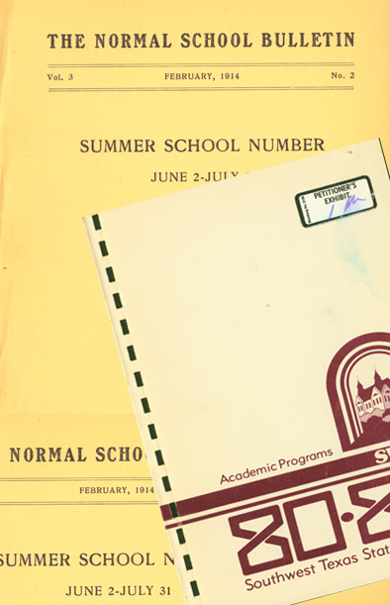
Digitize and add 40,000 objects in FY15 Additional Detail for Year 3
The Digital & Web Services department plans to begin full production mode in FY15 and work on projects in and outside the Library.
Jeremy has already completed a major project with the University Archives scanning the University Undergraduate Catalog from 1904- 2006, encompassing more than 16,000 images. The collection is now available on the Digital Collection site.

Slide 37
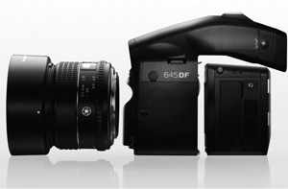
Digitize and add 40,000 objects in FY15 Additional Detail for Year 3
The Digital & Web Services department just acquired a state of the art high resolution digital photography setup. Our new equipment consists of:
Phase One IQ180 digital back with 80 megapixel resolution
Phase One 645DF+ camera

Slide 38
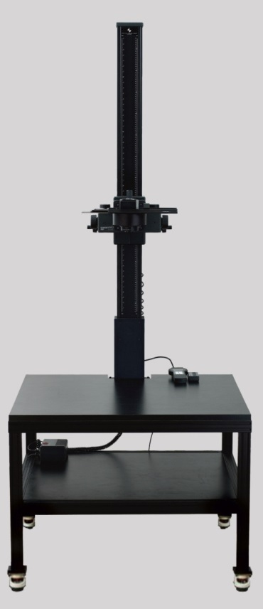
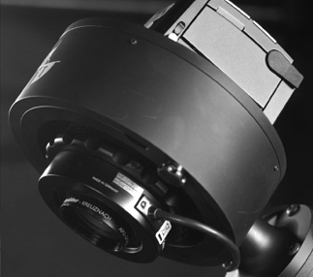
Digitize and add 40,000 objects in FY15 Additional Detail for Year 3
Digital Transitions Rcam Reprographic Camera with 72mm SES lens
DT RG3040 Reprographic System.

Slide 39
Digitization projects for FY15

Slide 40
Digitize and add 40,000 objects in FY15 Additional Detail for Year 3
Digitize Pedagog. It spans 1904-1999 and at completion it will consist of around 30,000 digital images. We expect to be able to complete it by the end of FY15
Digitize R.H. Bing Collection - Bing is a distinguished alumni and also was a professor at UT-Austin. The Mathematics department wants to do an exhibit for an up coming event celebrating him.

Slide 41
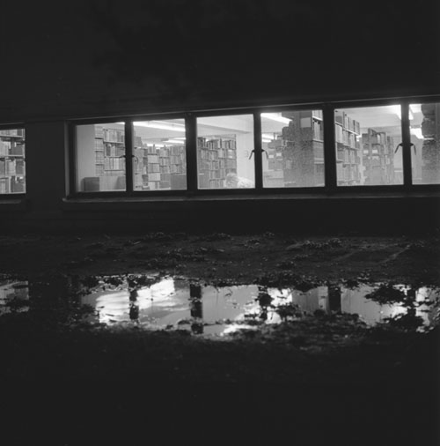
Digitize and add 40,000 objects in FY15 Additional Detail for Year 3
Digitize Pedagog Negative Collection – Several boxes of unlabeled negatives were discovered that are related to production of the Pedagogs during the 60’s and 70’s. Many may predate the University News service and may contain important or useful images.

Slide 42
Digitize and add 40,000 objects in FY15 Additional Detail for Year 3
Digitize Center for Archeological Studies Tom Miller Collection (1 box). The CAS contains many materials in need of preservation through digitization. The Tom Miller collection would be the first of, hopefully, many collaborations.

Slide 43
Future Projects
Faculty Digitization Services
Allow faculty to submit applications for digitization of primary source research materials.
The Wittliff Collections
Austin Music Posters, Austin Film Festival, UT Press Book Series, Wittliff Gallery

Slide 44
Future Projects
University Archives
San Marcos Springs, Burleson Mills Tract, Aquarena, Meadows Center, Presidential Papers, President’s Reports to the Board of Regents, Commencement Programs, Oral History Collection, Graduate Catalogs
San Marcos Public
Collaborate with University Archives on SMPL local history collections

Slide 45
Cataloging & Metadata Services Department
Strategic goals for the upcoming year

Slide 46
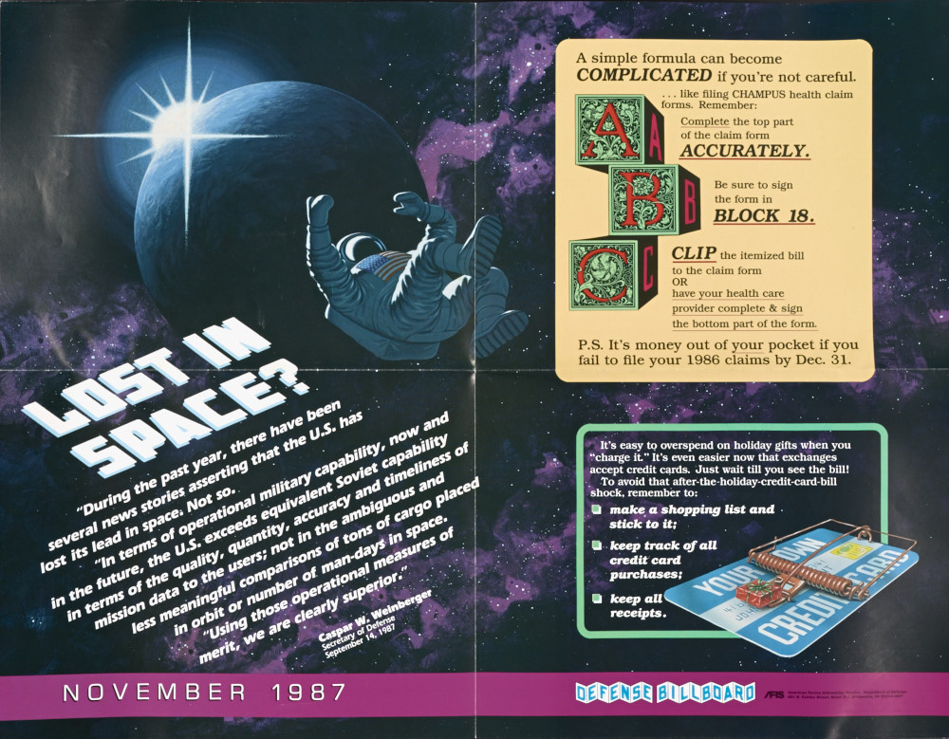
Catalog the Entire Federal Documents Collection – FY2015
Catalog the entire
federal Defense
Department
Collection,
approximately:
23,400 volumes

Slide 47
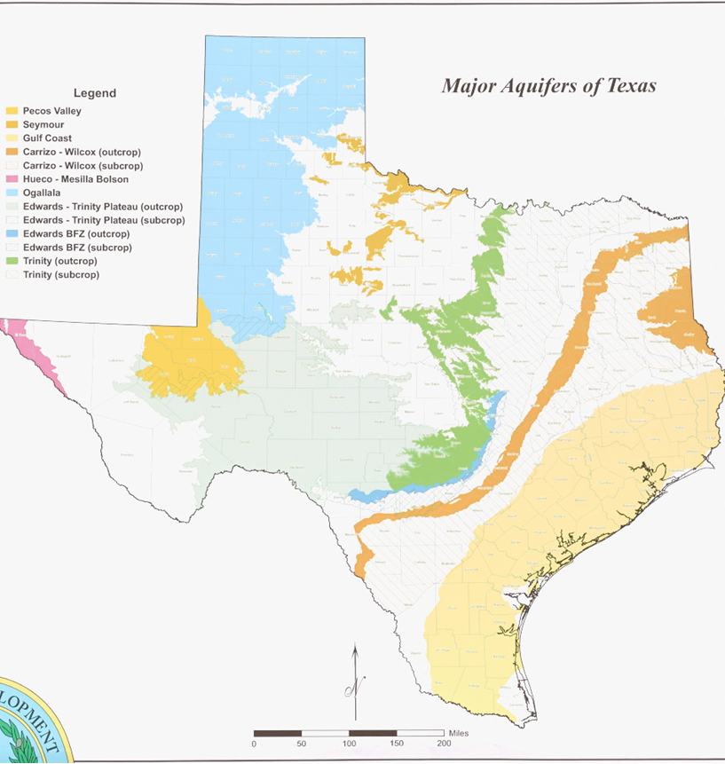
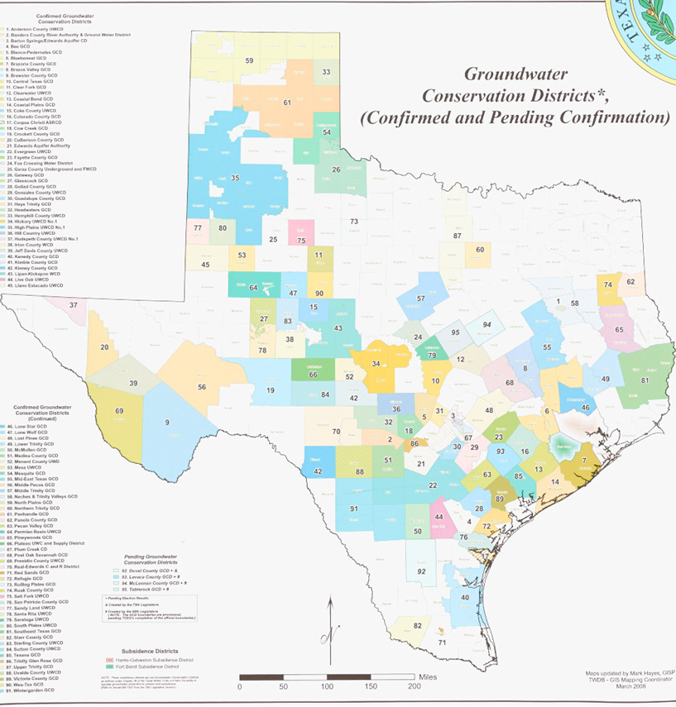
More Federal Cataloging …
Complete the map
collection cataloging
project:
ca. 4,000 maps
Complete the Geological Survey Bulletin cataloging project: SuDoc I19.3
approximately 700 volumes

Slide 48
HathiTrust Membership
HATHI
TRUST
Digital Library
Over the next three years we will work towards becoming a member of HathiTrust. HathiTrust is a partnership of academic & research institutions offering a collection of millions of titles digitized from libraries around the world. This will enable us to increase access to primary source out-of-print material to help support our research initiatives and ARL application.
Year 1, FY2015: Add holdings on OCLC for e-resources to better represent our research collections.
Year 2, FY2016: Inventory Library collections and OCLC reclamation (synchronize holdings with our local system) Year 3, FY2017: Apply to HathiTrust

Slide 49
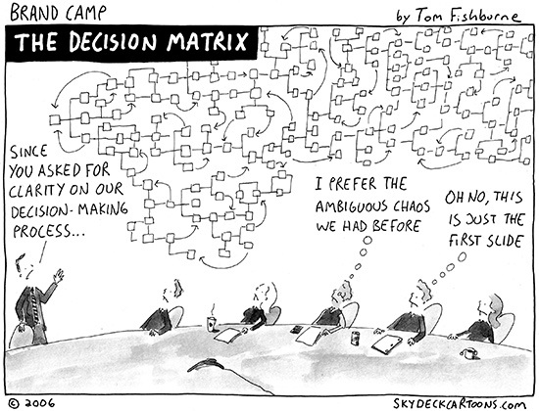
Library Webpage for Managing Workflows
Staff will be able to access information regarding ordering, weeding, cataloging/collection projects and other information.
Eventually page will contain links to information on:
Workflows
Subject librarian lists
Request forms
Project status
Services offered
Completed projects
Training documents
Staff contacts
FAQs

Slide 50
Workflow Request form for Collection/Cataloging Projects
By September 1st we will have a bare bones website up and running with request forms including one for Collection/Cataloging Projects. This link will e-mail members of the Project Team whose members represent areas in CDS & RLS:
Misty Hopper (Chair), Paivi Rentz, Rory Elliott, Lynn Smeal, Selene Hinojosa, Sheila Torres-Blank, Arlene Salazar, Megan Ballangee, Jerry Weathers

Slide 51
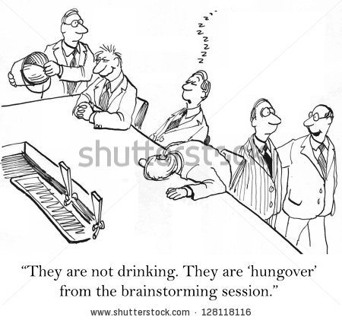
What will happen next?
The Collection/Cataloging Team will evaluate each request. For larger projects team members will work with their staff to decide who should be involved in the project
For each large project, an initial meeting of selected project members will be held to:
Plan
Brainstorm
Prioritize
Distribute duties
Set timeline for start and finish
Evaluate project
Advertise completion
Project will be added as a task on a Sharepoint so that interested parties can see where the project is regarding completion.

Slide 52
Task Force for Missing/Replacements
Paivi Rentz has agreed to chair this task force and is currently building her committee
The task force will work to develop simplified, streamlined, and standardized processes for all formats regarding missing/replacements including:
Status’
Searching
Replacement or add copy
Regular replacement schedule
Record cleanup
Reinstatements
And everything else

Slide 53
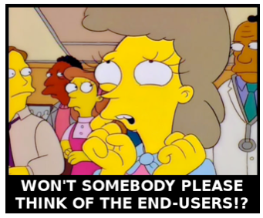
What’s Next with RDA
Many cataloging staff members are already cataloging original records in RDA. The next step is to create the RDA training committee. This Committee will develop standardized RDA guidelines for CDS catalogers to follow, provide training documentation and investigate other methods for staff training.
Committee members:
Misty Hopper
Sheila Torres-Blank
Karen Sigler
Lisa Francis
Lynn Smeal

Slide 54
Questions and Comments
FY15 CDS Strategic Plan Available on Sharepoint At: https://bobcatshare.txstate.edu/IT/Library/techserv/Strategic%20Planning/Forms/AllItems.aspx
FY15 Library Strategic Plan Available on Sharepoint At: https://bobcatshare.txstate.edu/IT/Library/Strategic%20Planning/Forms/AllItems.aspx

