Slide 1



Lightning Source & Lulu
Online Print-on-Demand/eBook Publishers (Overview & Comparison)
Ray Uzwyshyn, Ph.D. MBA MLIS
Director, Collection and Digital Services
Texas State University Libraries

Slide 2
Lulu and Lightning Source
What are they?
Online Print on Demand Publishers, Print Distributors, e-Book supply chain infrastructure & Author Support Services
https://www1.lightningsource.com/
https://www.lulu.com/

Slide 3

Lightning Source
Lightning Source Divides Print-on-Demand Services into Two Different Market Segments
Medium and Large Publishers
Small Independent Publishers
Video Introduction Introduction Link Reviews

Slide 4

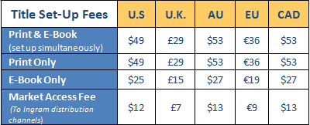
Ingram Spark Strengths
1) Print-on-Demand
Receive orders, print, deliver, ship, customized labels with press name” etc. Various book types, sizes, color choices and binding options, Print Options, Video Pricing PDF File Checklist File Creation Guide Shipping Costs & Publisher Compensation,
Set-Up Cost: 49.00$, 12.00 Market Access/Year, ISBNs $ 395.00
2) E-Book Distribution
(Amazon, Kindle, Apple ibooks, Kobo: Administrative Consolidated Sales Dashboard)
3) Color Printing
Various Options
4)Global Reach
Online Ebook Distribution (Multiple Partners),
Print Distribution Multiple Partners

Slide 5

Ingram Spark Workflow
Account Set-up
ISBN Purchase Bowker (10 ISBNs $395.00)
Add Book Metadata
Upload PDF (Print Ready PDF – Specification)
Credit Card Payment Required for Set-Up
Bank Account Set-Up Required for Retail Sales Compensation

Slide 6
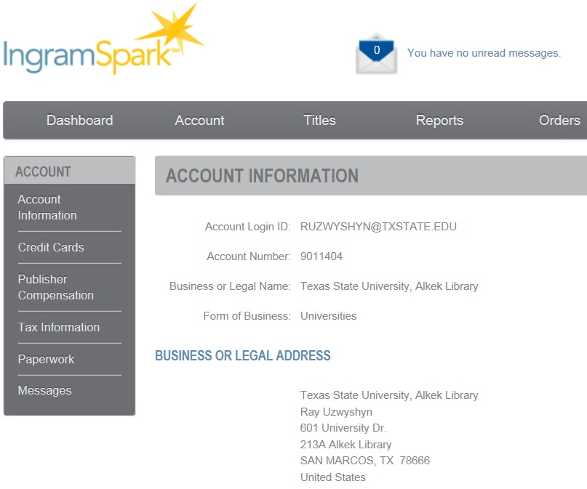



Slide 7
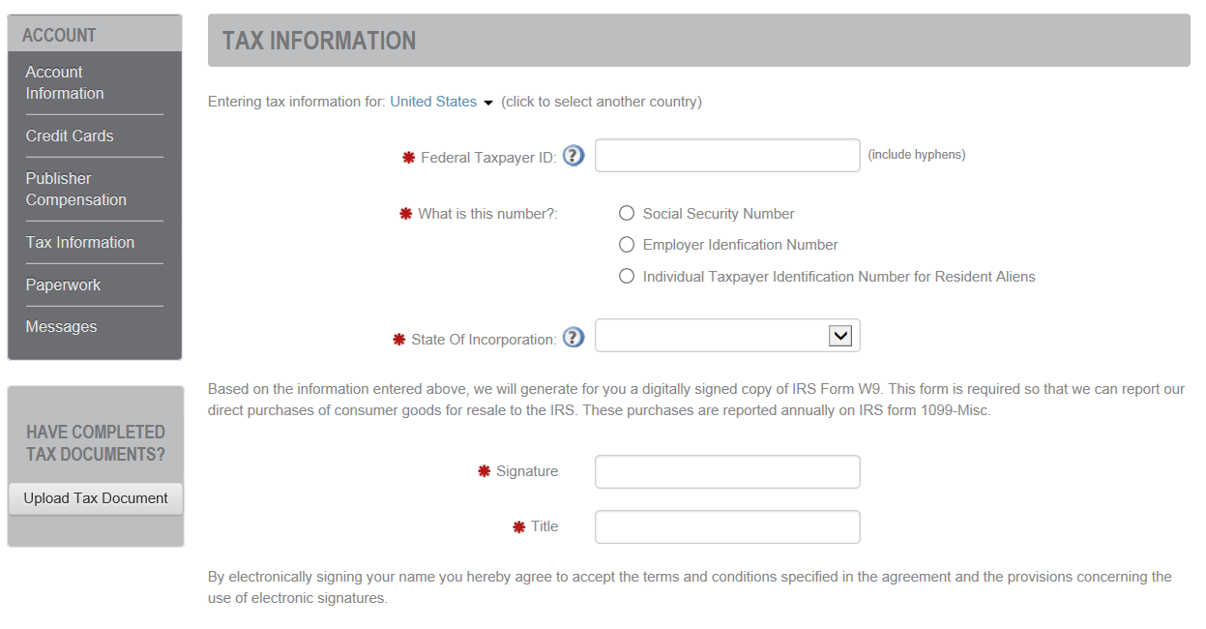
Tax Information

Slide 8
Paperwork: License Agreements
Ingram Spark
A) IngramSpark Print on Demand Agreement
B) IngramSpark Ebook Agreement
External Distribution (Optional)
C) Amazon/Ebook/Kindle Distribution Agreement
D) Apple/iTunes Distribution Agreement

Slide 9
Ingram Spark Publisher Compensation
When books are sold through Ingram’s distribution network, Local Publisher is paid:
Printed (POD) Title -- Dependent upon wholesale discount, Choice of 45% or 60% of List Price minus print costs
(ex. $20.00 list, 5.30 Print costs, large BW/Paperback)
$20.00 * .45 = $9.00 – $5.30 = $3.70 local publisher (standard retail trade)
$20.00 * .6 = $12.00 -$5.30 = $6.70 local publisher (academic discount)
E-book Title -- 40% of List and Agency Price
$20.00 * .40 = $8.00 local publisher
Compensation and Shipping Costs Calculator

Slide 10

Lulu.com
Distribution Platform
Print on Demand Platform
eBook Platform
Publishing Services – Proofreading, cover design etc.
Marketing Services (Publicity, Professional Reviews/Events, Author Website, video)

Slide 11

Lulu Print Process
Process Outline
Choose Book size, Paper Binding (Many Choices)
Title/author name
Upload Formatted Book File
Create Book Cover
Publish

Slide 12
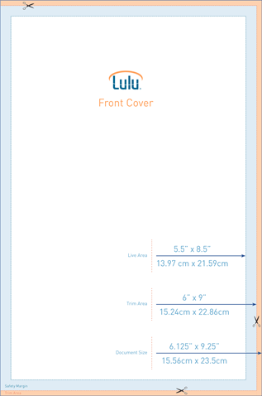

Various Templates Based on Choices
Cover Image Templates
The Orange area (Bleed) will be trimmed from the cover. Book cover graphics should extend through this area. Text and important images should NOT extend into this area.
The Blue area (Margin) is outside of the safe zone. Make sure text (title, author, description, ISBN) does not extend into this area. It could be trimmed from the cover during the printing process.
The White, center area is the safe zone. Place what you want here and be confident it will display, in its entirety, when your book prints.

Slide 13

Lulu Notes
Many Binding, Print Size and Paper Choice Combinations
Volume DiscountsCover Wizard (Seems not Overly Customizable)
Many Standardized Book Distribution Requirements
License Agreements on Website

Slide 14

Lulu – Publishing Ebooks
Separate Process from Print Publication
1) Lulu eBook Creator Guide
2) Lulu Creates eBooks in ePub Formats
3) Manuscript must be separately formatted
4) Lulu offers many help options: manuscript conversion ($99.00) for ebook format; ($149.00) ePub conversion and 6x9 paperback version; Print Book Help $119.00

Slide 15
Print Publishing Services - Lulu
Many Author Services: Bundled By Price
Various Book Quality Product Lines:
  Value: Perfect bound paperbacks, no retail distribution at this time.
  Standard: Bookstore quality paperbacks, multiple binding options, distribution-eligible formats are designated by the green distribution symbol.
  Premium: Hardcovers, dust jackets, photo books and calendars, distribution-eligible formats are designated by the green distribution symbol

Slide 16
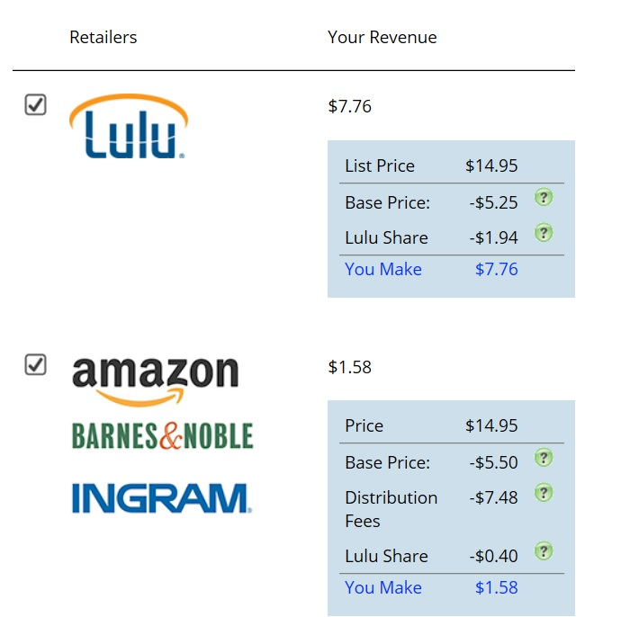
Lulu B/W Paperback Revenue Example (6x9 200 pages)
Base Price = Printing Costs
Lulu’s Share = 20% of net profit

Slide 17

Major Differences – Lulu and Ingram Spark
Ingram Spark is more of a strictly DIY Print on Demand/Distribution Company. Does not offer marketing, proofreading, editing, typesetting or Design, FAQ
Lulu is more of a Author Services Company with a variety of Pay For Fee/Package Options

Slide 18
Lulu Premier Services vs Ingram Spark Low Range Pricing Model #1
Service | Ingram Sparc | Lulu
Classic Package |  | $999.00
Set-up Fee | $49.00
Market Access | $12.00
Local Cover Design * | 200.00
Book Design (250 Pages)* | $200.00
ISBN's (10) | $395.00
Total | $856.00 | $999.00
Links |  | Lulu Option Prices
*Based on $25.00/hr and 8 hours work for a cover and 8 hours work for print Design.

Slide 19
Lulu Premier Services vs Ingram Spark/Outsourcing High Range Pricing Model 2
Service | Ingram Sparc | Lulu
Deluxe Package |  | $2,999.00
Set-up Fee | $49.00
Market Access | $12.00
Custom Cover Soro Design | $1,600.00
Book Design (250 Pages) | $1,750.00
ISBN's (10) | $395.00
Total | $3,806.00 | $2,999.00
Links | Soro Pricing | Lulu Option Prices
 | Soro Portfolio

Slide 20
Lulu vs Ingram Spark Summary
Company and Publishing Model | Pricing
Ingram Spark w/(Local Cover/Book Design) | $856.00
Lulu with Classic Author Services Package | $999.00
Lulu with Deluxe Author Services Package | $2999.00
Ingram Spark w/(Higher End Cover/Book Design) | $3806.00
$1000.00 Contingency/Book Expenses

Slide 21
Preliminary Conclusions
If you are to outsource cover and publication design, Ingram Spark is a solid choice for Print on Demand and Distribution. Tied to Larger Networks and Solid Reputation
If you wish to encapsulate Author Services, design or ever need more marketing & other options, Lulu.com as a pay for Service Model Seems a Solid Secondary Choice

Slide 22
Comments/Questions?

