Slide 1
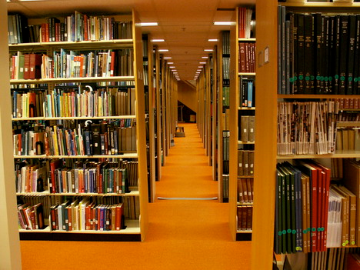
Licensing Online Tools for Research and Learning
From Reference Bookshelves to the Next Generation of Academic Research Library e-Resources, Alkek Library Pilot Proposal
Liane Taylor, MLIS, Interim Head, Acquisitions
Ray Uzwyshyn, Ph.D. MBA MLIS, Director Collections and Digital Services
Texas State University Library

Slide 2
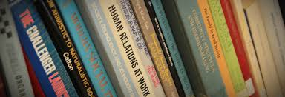
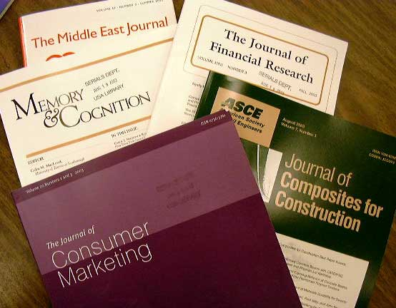
Introduction
The Traditional Acquisitions Model, 1950’s – 1990’s
100% of Acquisitions Budget
Print Books
Print Journals
Academic Library Acquisitions
Begin to Change 1990’s
Shift towards Online Content

Slide 3


1st Phase Library Acquisitions Paradigm Shift, 1990’s-2010
Online Books
Online Journals
Online Databases
Paying for Access to Information
Shift from Single Discipline Database to Multi and Interdisciplinary Database Content Aggregators and Publishers (EBSCO, Proquest)

Slide 4


Texas State Online vs. On Shelf
FY 2013 Expenditures
FY13 TOTAL EXPENDITURES: $6,431,620
FY13 EXPENDITURES: ONLINE VS ON SHELF
ONLINE | $5,141,144.29 | 79.9%
ON SHELF | $1,290,475.92 | 20.1%

Slide 5
Books vs Periodicals Expenditures
FY13 JOURNALS/SERIALS EXPENDITURE BREAKDOWN
EJOURNALS/EJ PACKAGES | $2,079,355 | 81% of serial expenditures
PRINT JOURNALS/SERIALS | $385,807.23 | 15.1% of serial expenditures
DUAL FORMAT (print + online) | $99,697.9 | 3.9% of serial expenditures
FY13 BOOK EXPENDITURE BREAKDOWN
EBOOKS/EBOOK PACKAGES | $681,566.32 | 48% of book expenditures
PRINT BOOKS | $736,237.89 | 52% of book expenditures

Slide 6
Texas State Library Materials Budget
(FY13, 6.4 M)
79.9% of Acquisitions budget is online expenditures ($5.1 mil) 20.1% of Total Acquisitions, $1.3 mil is Print

Slide 7
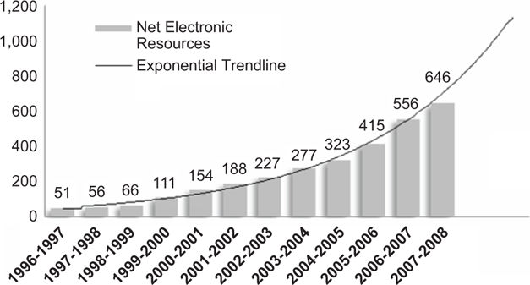
Net Academic Library Electronic Resource Purchases (Long Term Trends)
Trend is exponential and shift up, currently towards aggregator interdisciplinarity
(NCSU Library Electronic Resources Statistics)

Slide 8
2nd Phase Academic Library
Acquisitions Expenditures Paradigm Shift
2010 -

Slide 9
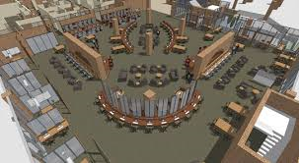
Physical and Virtual Changes
On a Physical Level: Academic Libraries are shifting to Learning Commons and wider definition of computing (Digital Literacy)
On Electronic Resource Level:
  Textual content databases are transforming (becoming more powerful)
  Morphing from simple content repositories to software applications
  Students and faculty can manipulate their research (Save, Store, Cite, manipulate)

Slide 10
Academic Online Library
Scholarly Tools Evolution
Level
Of Access/
Interactivity
Online Digital Literacy Tools
Interactive Personalized Content
Hybrid Academic Library Scholarly Tools
Online Information Literacy Tools
Online Reference Tools
Scholarly Media Databases
Online Journal Aggregators
Interdisciplinary Journal Databases
Multidisciplinary e-Books Databases
Scholarly Online Journals
Scholarly Online Books
Scholarly Online Reference
Scholarly Print Journals
Scholarly Print Books
Scholarly Print Reference
1990 1995 2000 2005 2010 2015 2020

Slide 11
Hybrid Library/Learning Tools Applications
Academic Research Libraries have large roles to play with these applications which further library support trajectories and empower the academic research community.
Interdisciplinary Tools. Natural evolution in terms of Library Subscription Content Services/Continuing Resources/SAAS Subscription-based applications for university-wide use.

Slide 12
Library Applications 2.0
Examples, What they are and how they connect to libraries

Slide 13

From Citation Management Tools to Data Management Tools
Researchers have always turned to libraries and librarians for finding statistics/data. Librarians are still needed to help find data and statistics hidden on web sites.
dataZoa assists with helping researchers manage statistics – a statistics “bookmarking” system
  Librarians help researchers find the statistics AND libraries provide a tool to help researchers keep track of the data.
  Similar to library-provided citation management tools to help researchers keep track of their citations

Slide 14
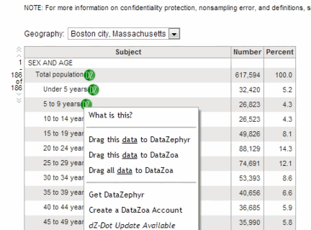
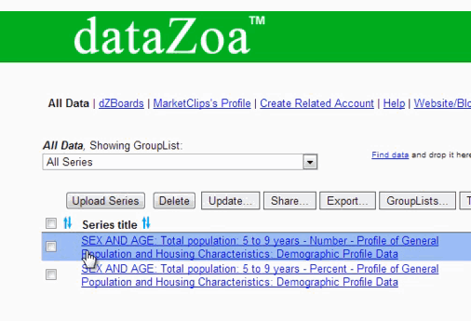
dataZoa
FBI Crime Statistics Demo
Data Display Function

Slide 15



Image Archive, Access & Discovery Tool
  TRENDS:
  ArtStor Digital Library
  Library database subscription
  Core Art History resource
  Digitization/interdisciplinary needs:
  Art department slide collections move to digital
  Other departments are building image collections (Biology, Archaeology, etc.)
  Library Missions - Collection Digitization & Creation making discoverable and accessible unique, university-created content (from library as ‘warehouse’ to library as ‘content creators’)

Slide 16
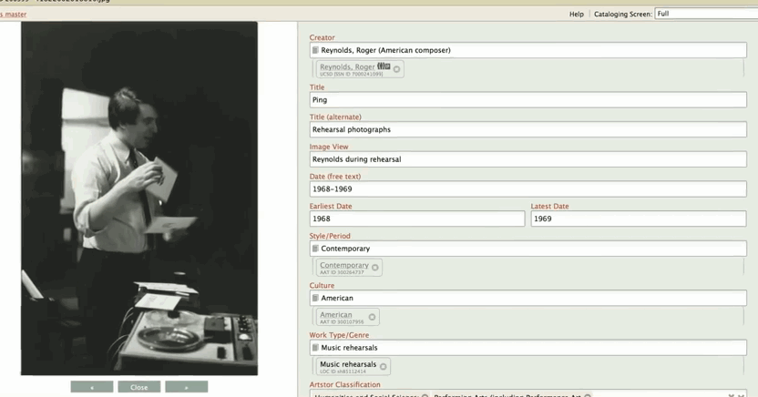
Natural Next Step: Shared Shelf
  Enables university community to digitize and catalog their own images (art, archeological images, biological specimens, etc.)
  Make images discoverable to the university community & public
Promotes the university’s unique value to the worldwide community of researchers
VIDEO: How Shared Shelf can Help Faculty and Libraries

Slide 17

The next step in Current Awareness Tools
Researchers increasingly want to use tablets to read journal articles, and need a simplified platform to track their research interests
Current awareness services – Demand exists, but technology hasn’t “clicked” yet

Slide 18
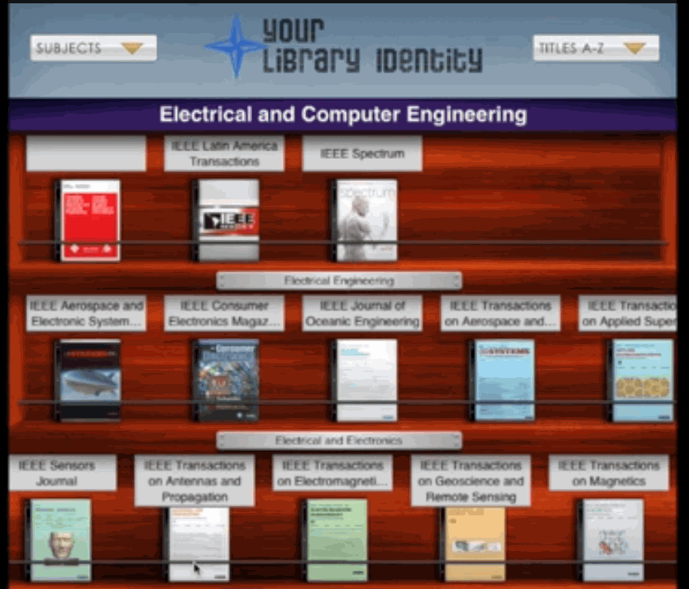
The next generation: BrowZine
Uses as its base the library’s ejournal subscriptions
Helps researchers
  track the latest journal publications in their field
  discover new journals
  read journals on their tablets in one unified display
How it works

Slide 19

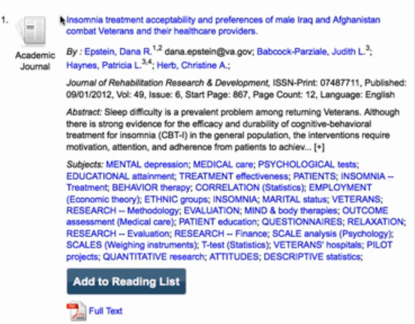
CURRICULUM BUILDER
A plug-in to the university’s learning management system (TRACS)
Uses the library’s discovery system (EBSCO Discovery Service)
Enables faculty to easily create course readings utilizing licensed content, without leaving TRACS

Slide 20
CURRICULUM BUILDER
Curriculum Builder simplifies the integration of library content into course curricula.
Faculty have had difficulty with integrating the millions’ of dollars of content that libraries license into their course readings
Copyright fees are paid for content we already own
Library Discovery Systems make discovering licensed content easier, but linking to that content is still a challenge (Faculty, Librarians, ITS staff)

Slide 21
Budget Implications
Library Budgets and the Future

Slide 22

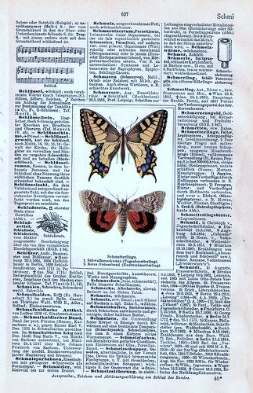
Content vs Tools
Libraries are already in the research tool business
  In the early 2000s, libraries began licensing online citation management tools as a natural extension of supporting the library research process.
The line between CONTENT and TOOLS has become blurred
  Traditional content databases are adding tools/plug-ins that help libraries to expand support of the library research process.
Our budgets may not yet reflect this new resource landscape
  Citation management tools & Discovery tools paid for out of Operating Budgets; “tools” considered separate and distinct – under different review criteria

Slide 23

Budgeting Needs
Library budget models across the country are evolving to meet the needs of this changing resource landscape and expanding interdisciplinarity.
Budget flexibility & scope widening is required to take advantage of new acquisition models, new content/application hybrid resources, and growth in interdisciplinarity.

Slide 24
Budgeting for the Future
Strategies from Other Libraries:
Move from discipline-based fund lines
Create fund lines in materials budgets to support hybrid content applications or create a Digital Initiatives Budget
Combine Vendor Purchases

Slide 25
Transition Steps: Library Pilot Program
Purpose: To begin exploring 2nd Generation Academic Library Online Resources
Strategic Goal: Academic Research Library-Level Applications (ARL) suited towards emerging research institution
Need: Not currently targeted and challenging to find University wide financial support for these new hybrid tools (Technology, Academic Disciplines, Academic Content, Access-Based Resources)

Slide 26
Library Pilot Rationale
Funding: $35,000 to support one year of licensing of these new tools
Structure & Assessment: Library/university academic stakeholder committee (Library/IT, office of Provost and VP for Academic Affairs, Associate VP for Research, Library Faculty Committee) Selection, Review and Evaluation of Tools
Support Infrastructure: Library Staff and Library Expertise in licensing, access and support to online resources, corps of subject specialized librarians in Faculty/Student support role

Slide 27
Comments/Questions?

