Slide 1
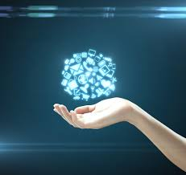
Faculty Digitization Services Raising Research Visibility and Access
Ray Uzwyshyn
Director, Collections and Digital Services Texas State University Libraries

Slide 2
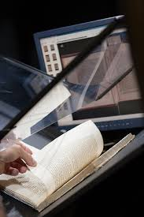
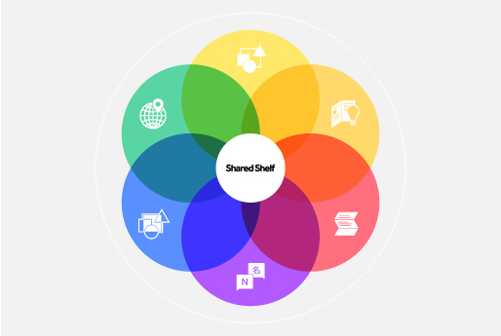
Faculty Research New Digital Service Possibilities
1) Online Institutional Repository (Faculty Related Research Publications, Copyright)
2) Digitization & Metadata Services (Projects Infrastructures, Primary Document Digitization)
3) Visual Collections Tools Pilot ( Artstor Shared Shelf)

Slide 3
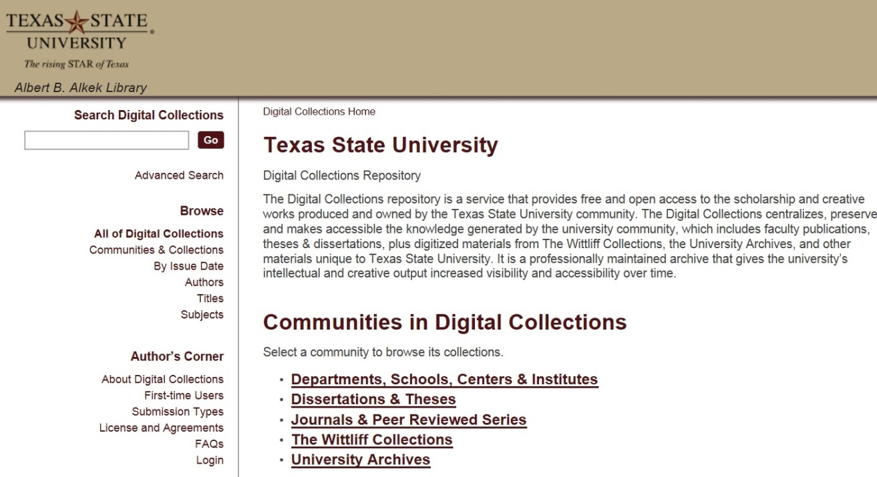
The Institutional Repository: IR
https://digital.library.txstate.edu/
D-Space, MIT Open Source Application
Larger Idea
Open Access to Research Scholarship, Creative Works
Raising Visibility
Faculty publications, white papers, preprints, theses, dissertations, working projects

Slide 4
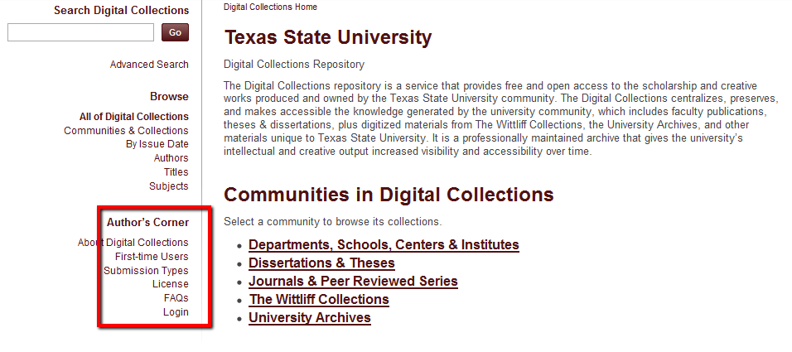
Faculty Research
https://digital.library.txstate.edu/
Self Submission Process, Help: Jeanne Hazzard, Digital Collections Librarian, Non-Exclusive Distribution License: http://www.library.txstate.edu/research/digital-collections/authors-corner/license.html

Slide 5
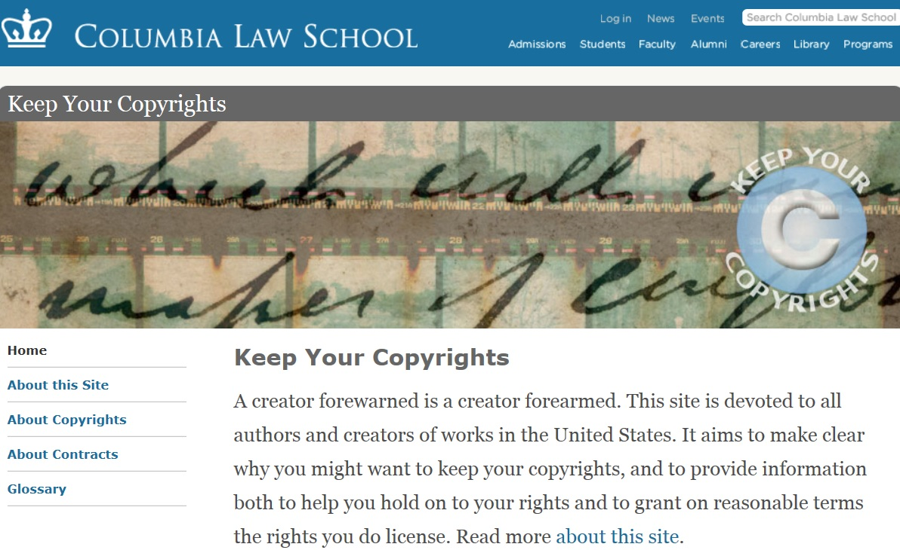
Published Research
Copyright Contracts

Slide 6
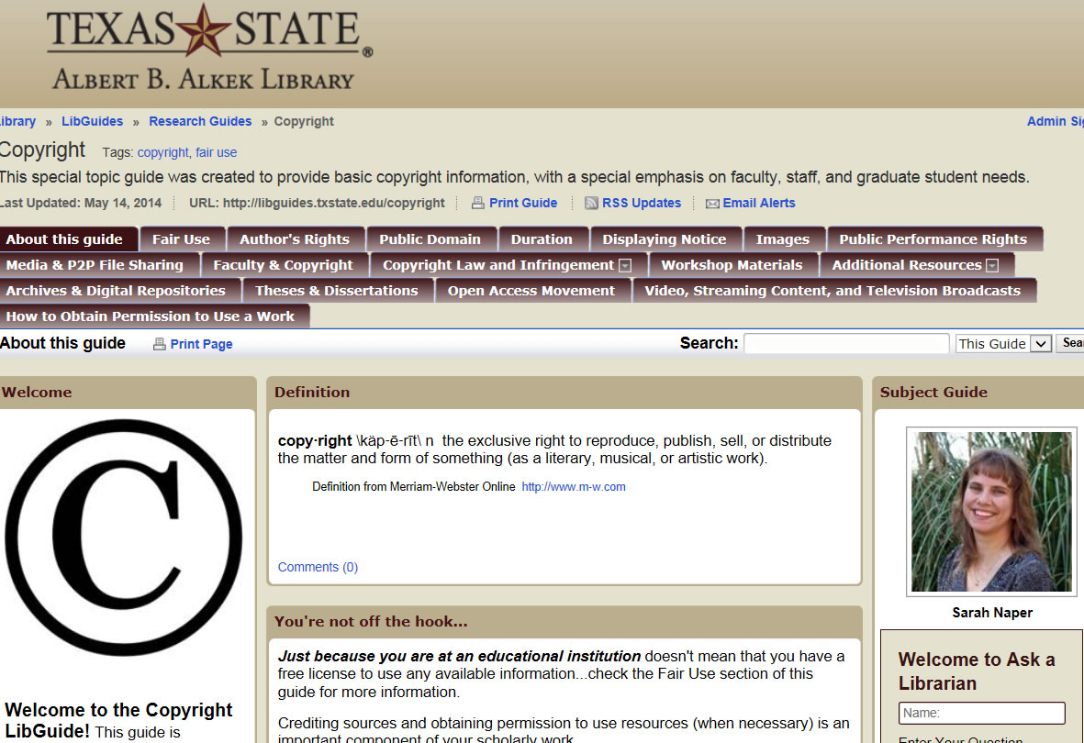
Texas State Library Copyright Guide
http://libguides.txstate.edu/copyright
(Sarah Naper, Director, Research & Learning ) Send Questions to Copyrightoffice@txtate.edu

Slide 7
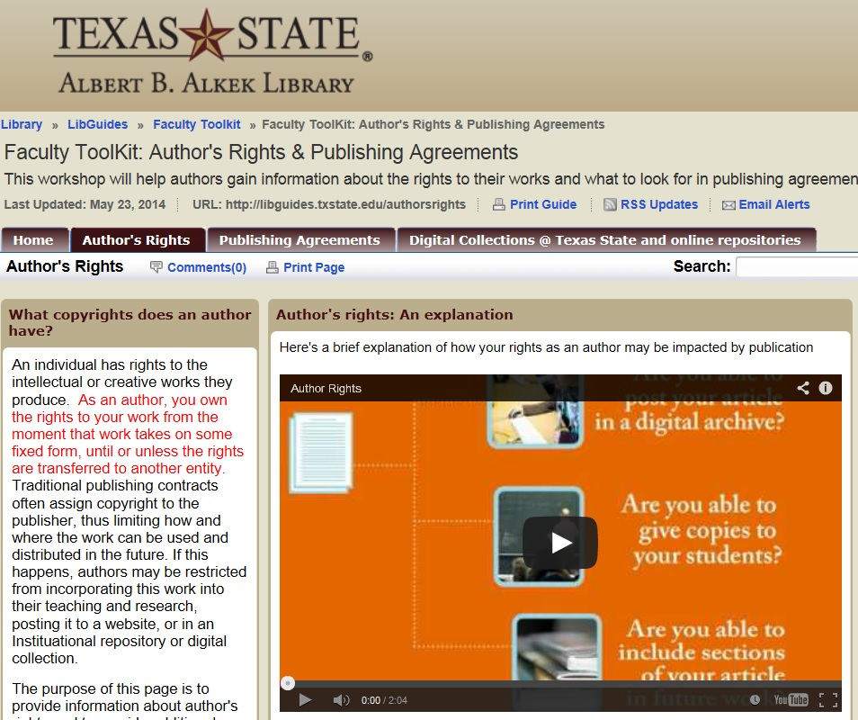
Faculty Online Toolkit
Author’s Rights and Publishing Agreements
http://libguides.txstate.edu/content.php?pid=587036&sid=4840133
Margaret Vavarek, Outreach@txstate.edu , Selene Hinojosa, gh14@txstate.edu

Slide 8
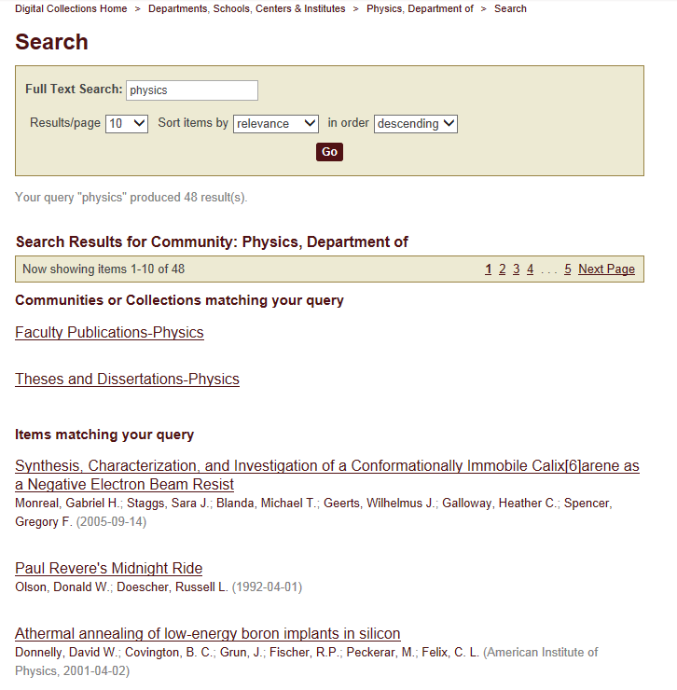
Why Use the IR?

Slide 9
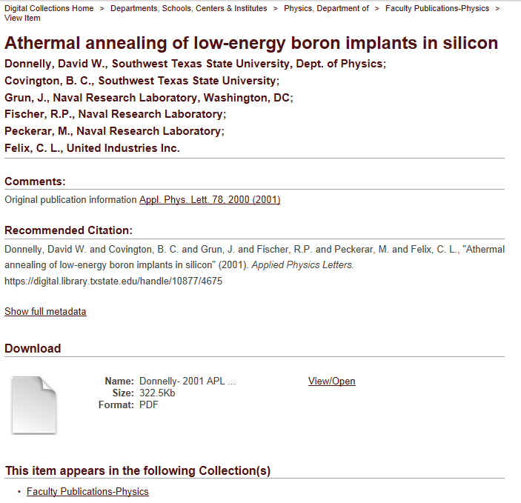

Slide 10
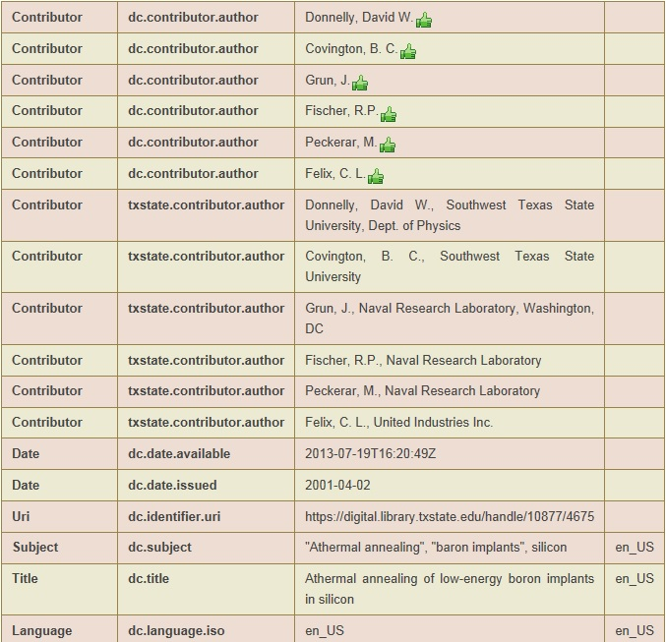
Dublin Core Metadata
Access Points
Findability
Search Engine Optimization (SEO)

Slide 11
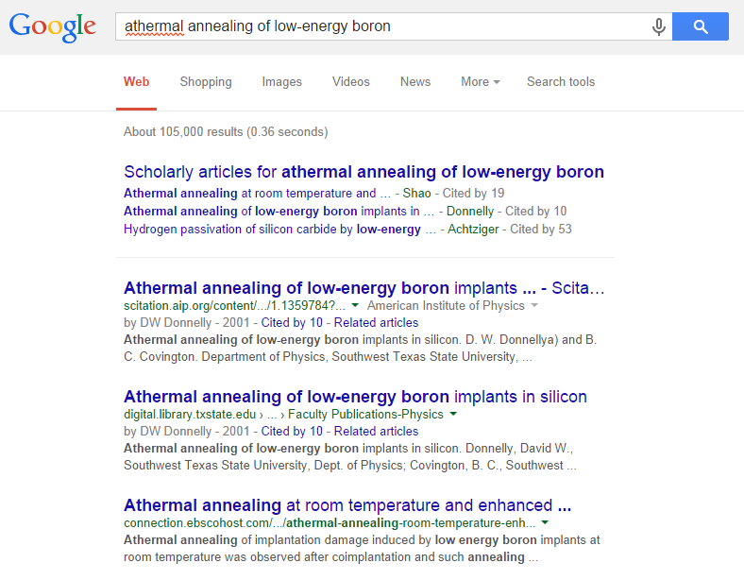
#2 of 105,000
Immediately Available

Slide 12
Percent Increase in Article Citations by Discipline with Open Access Retrieval Points
Range = 36%-250%
(Data: Stevan Harnad and Heather Joseph, 2014)

Slide 13
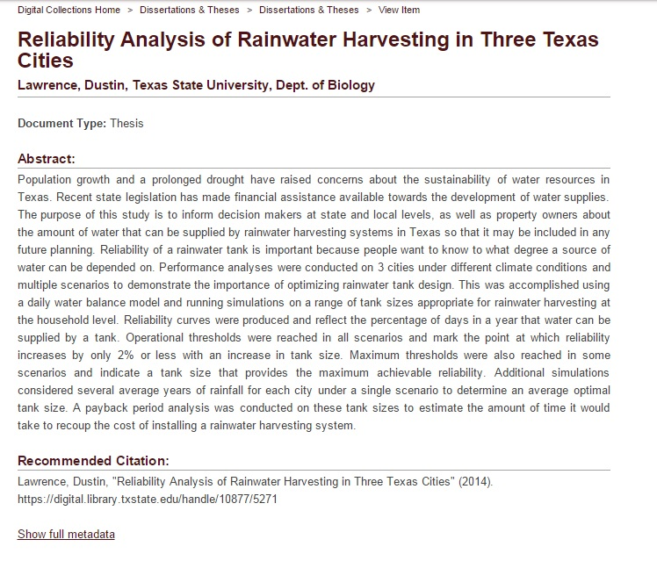
Example 2: Unpublished Research
White Paper, Thesis & Dissertations

Slide 14
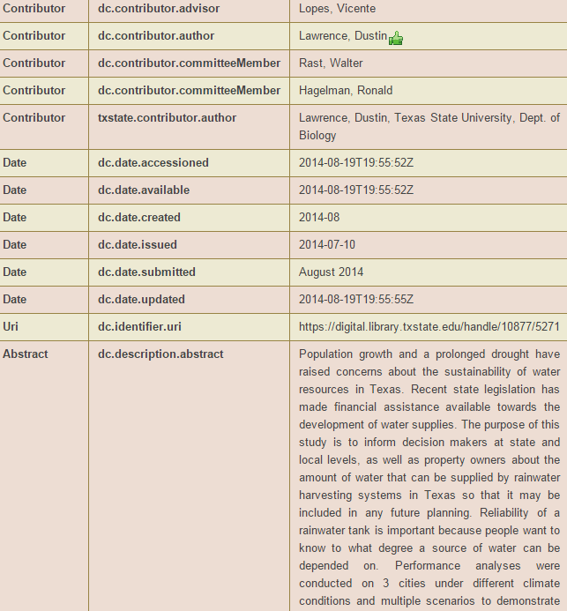
Dublin Core Metadata

Slide 15
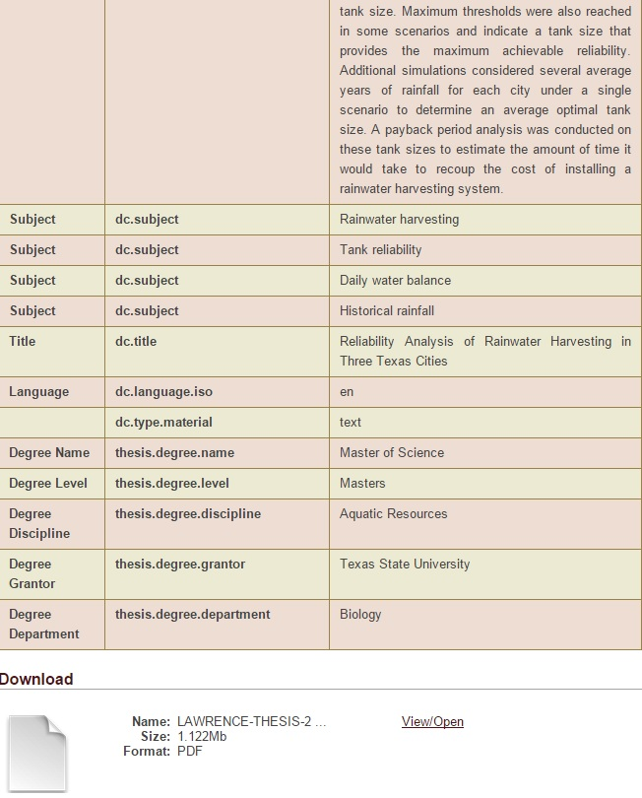
Interoperability
With other
Scientific Archives
Another Possibility for Search & Retrieval

Slide 16
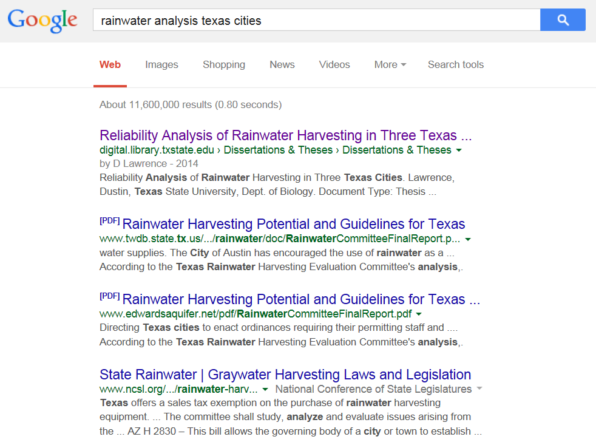
#1
Immediate Access & Relevance

Slide 17
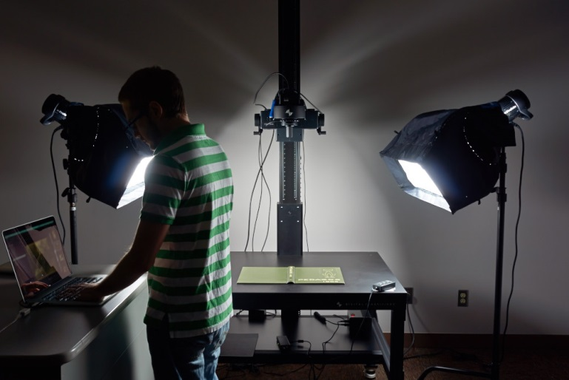
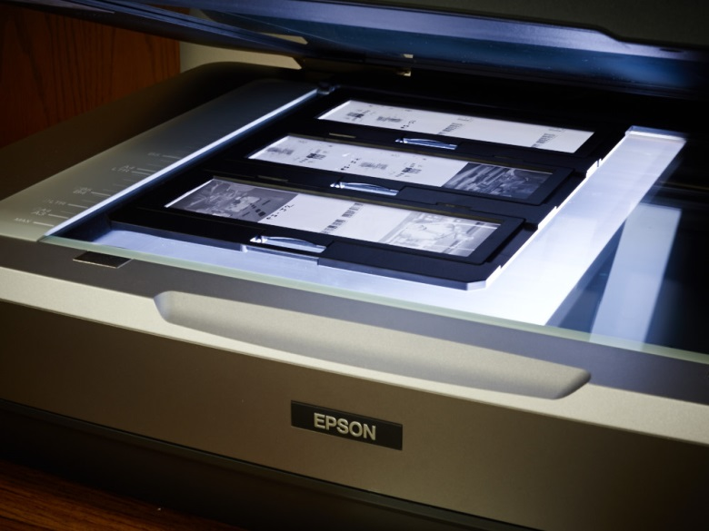
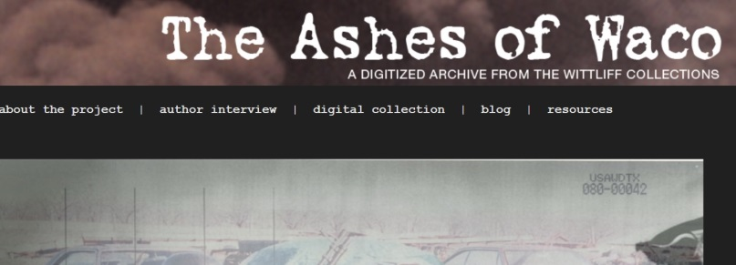
Faculty Research Project Digitization
Spectrum of Hardware & Software Possibilities
Digital Transitions
Museum Level Setup
Image & OCR, Standards
Books & Journal runs, Documents, rare materials
3D Objects
Posters & Maps,
Audio and Video
Projects
Jeremy Moore, Digital Media Specialist, Todd Peters, Head of Digital and Web Services

Slide 18
The Digitization Lifecycle
Empowering Faculty Research
Prototypes for Larger Grant Projects
1

Slide 19
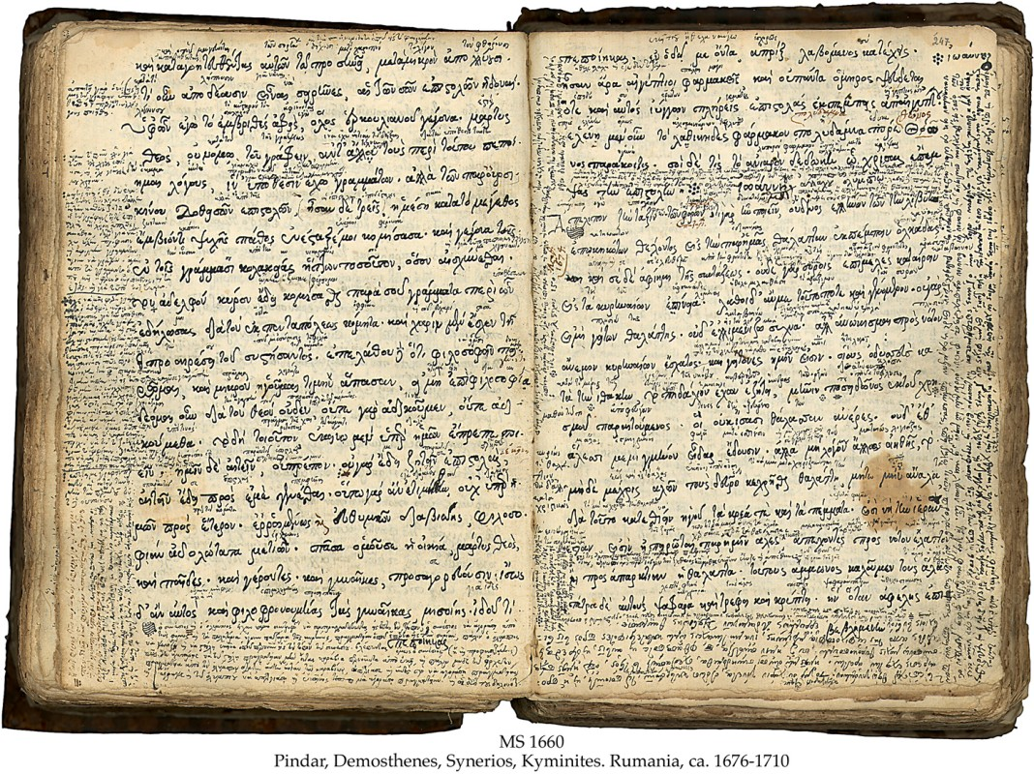
Project Proposal Process
Brief Email:
Project scope, contextual outline, copyright ownership
Preliminary meeting to get questions answered
Ray Uzwyshyn: ruzwyshyn@txstate.edu
http://www.library.txstate.edu/about/departments/dws/faculty-digitization.html
http://www.library.txstate.edu/about/departments/dws/new-faculty-digitization.html

Slide 20
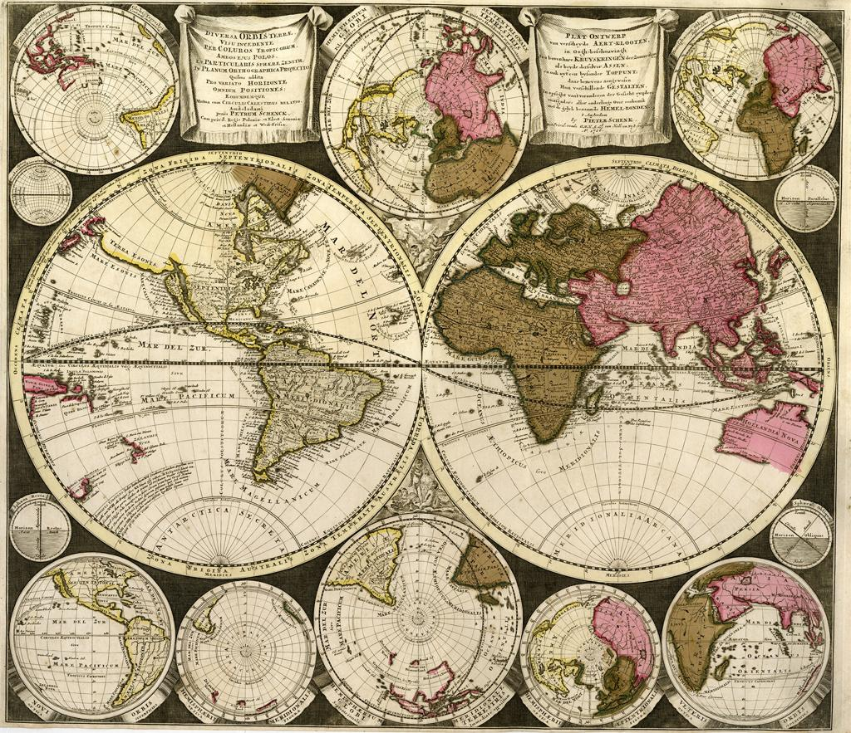
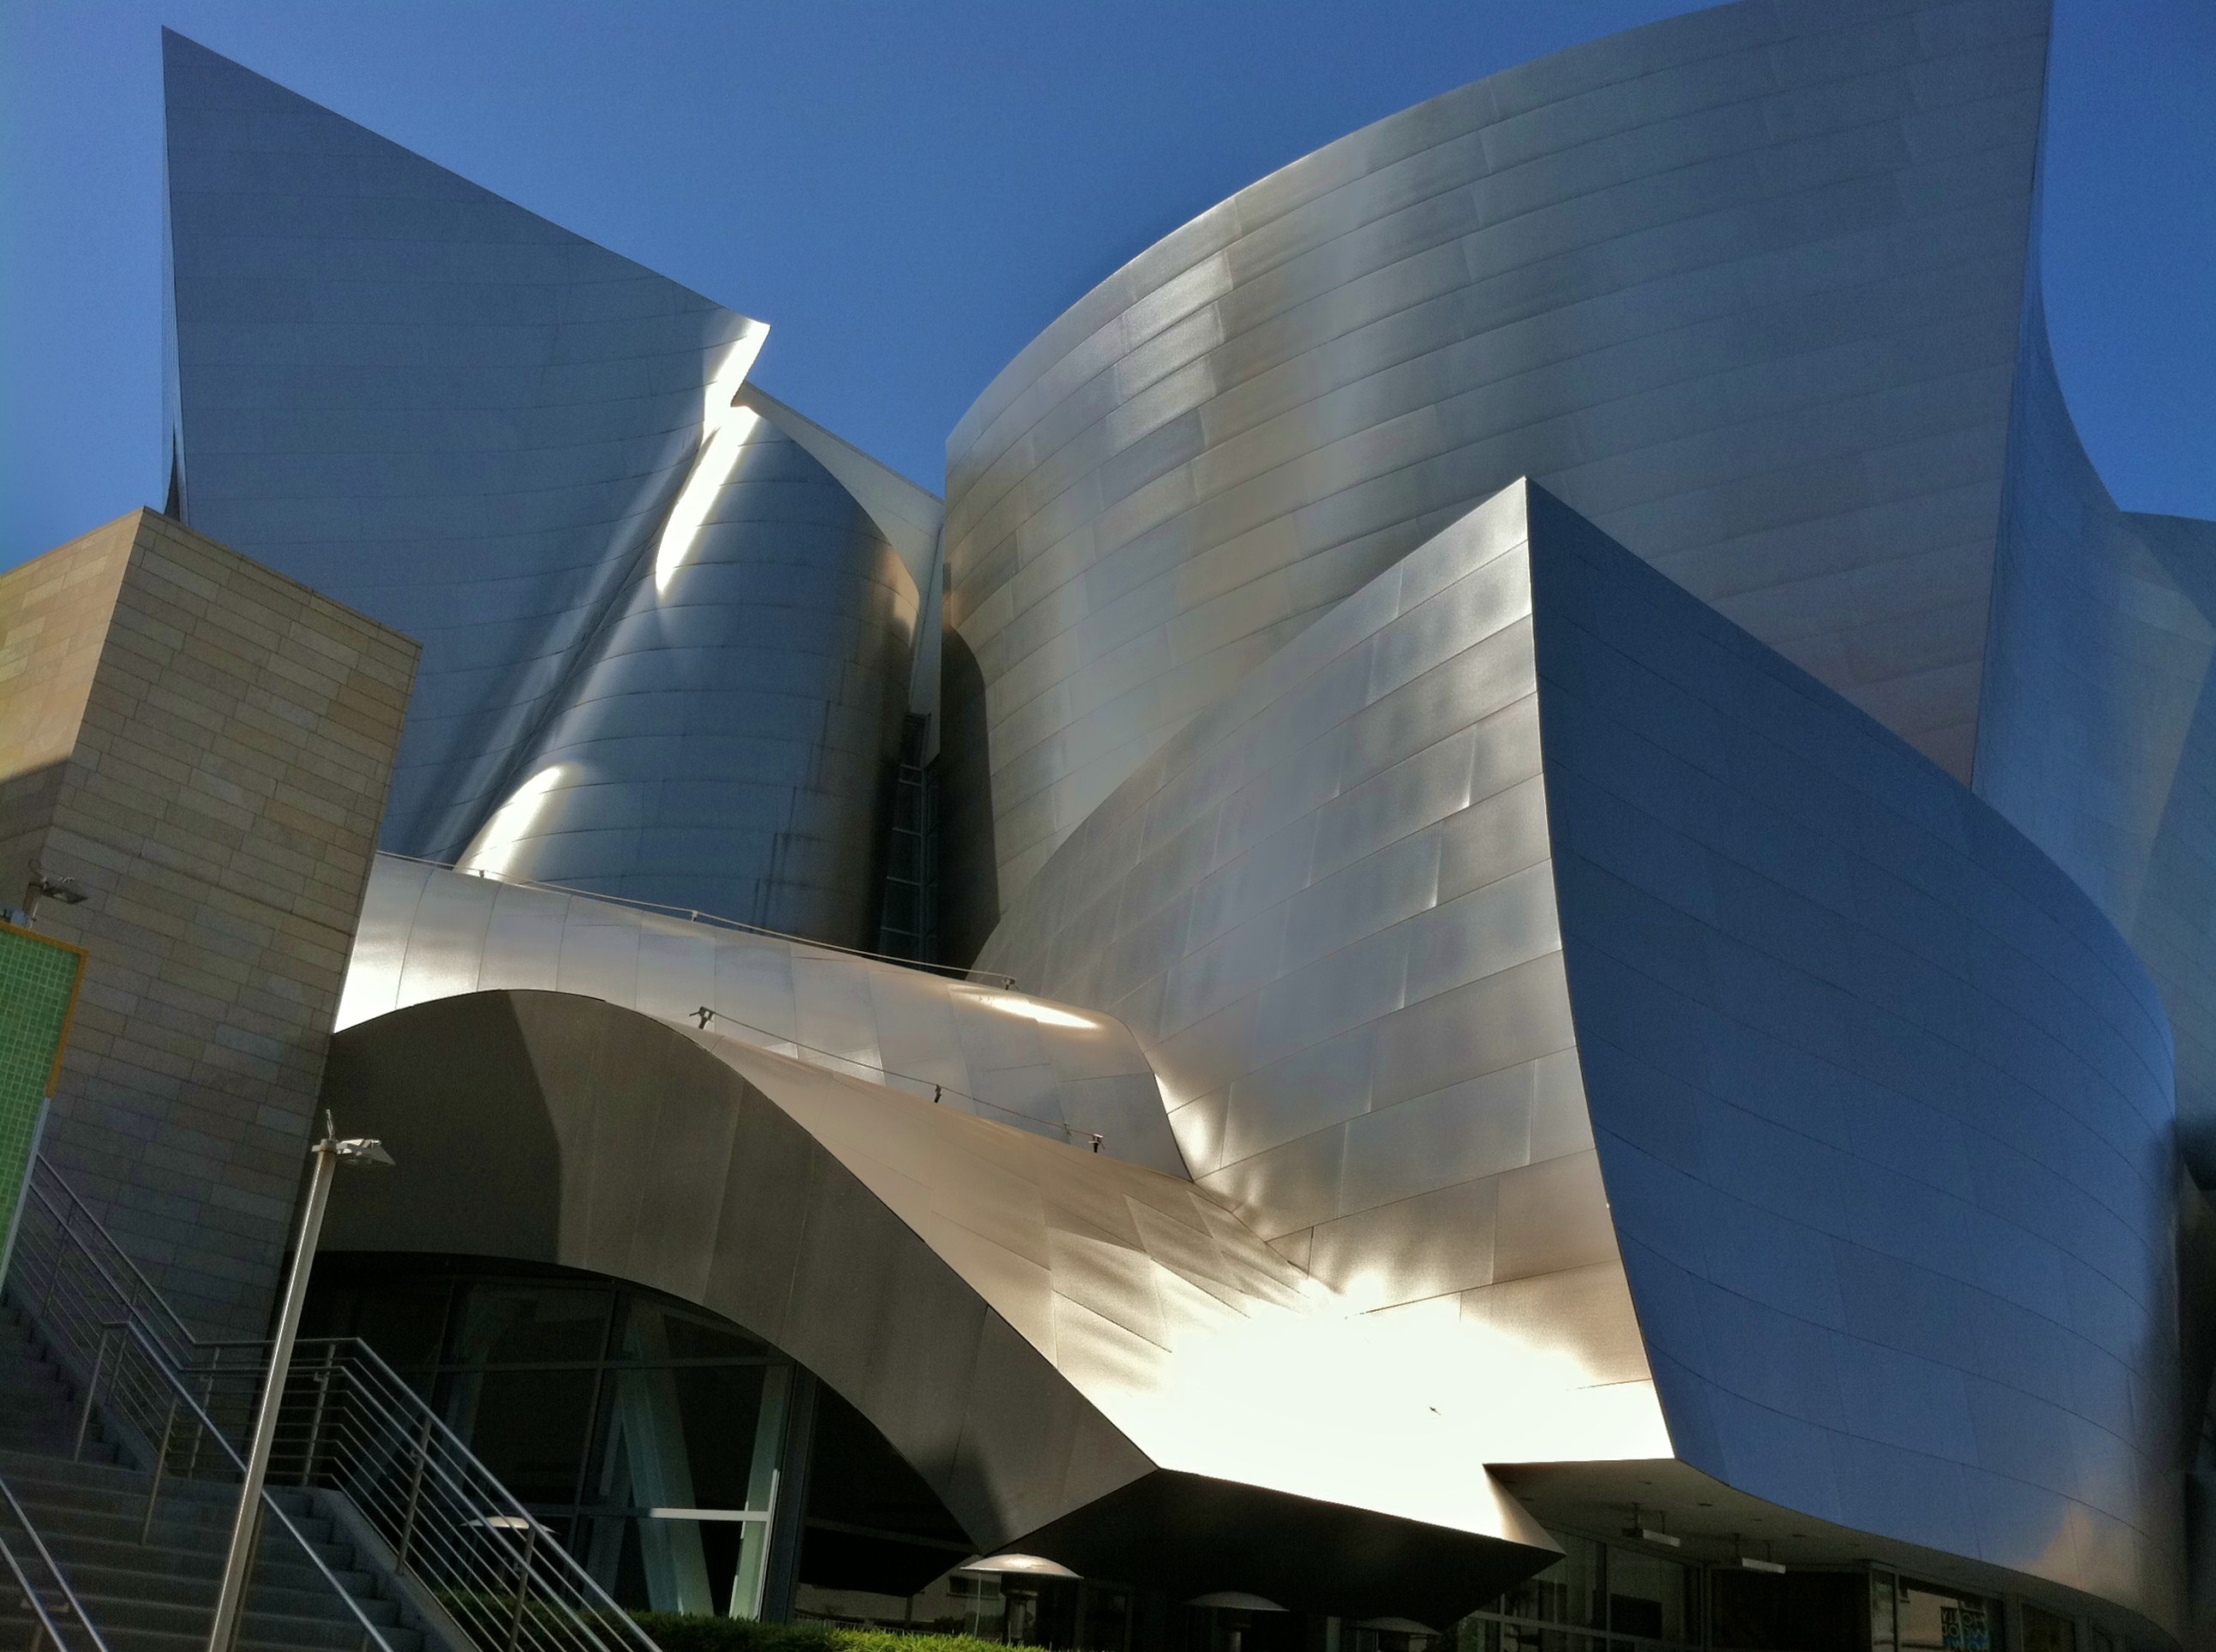
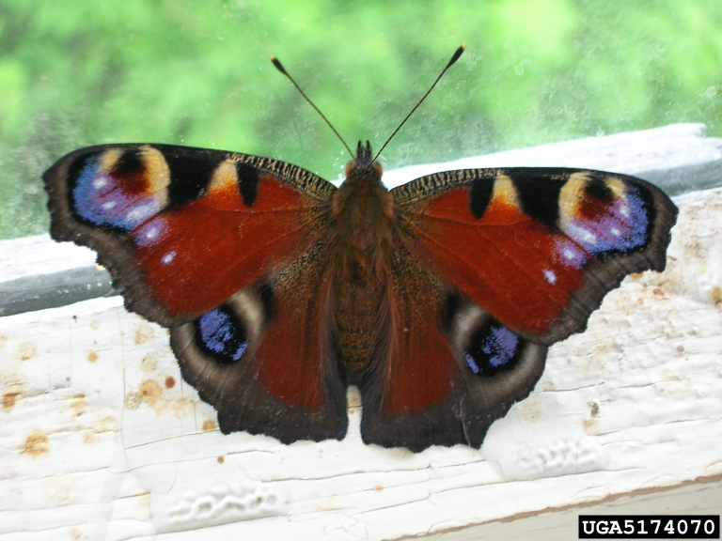
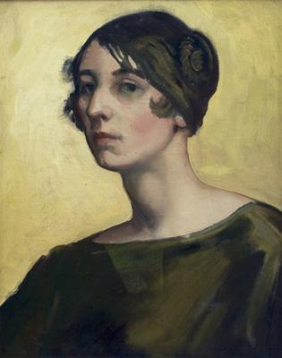
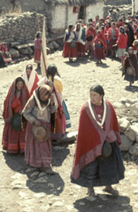
Artstor Shared Shelf Online Visual Image Database Collection Creation Tool
Humanities
Social Sciences
Natural Sciences Faculty collections
Teaching collections
Museum/Dept collection
Visual & Performing Arts
Video Overview
Shared Shelf supports non-art metadata models

Slide 21
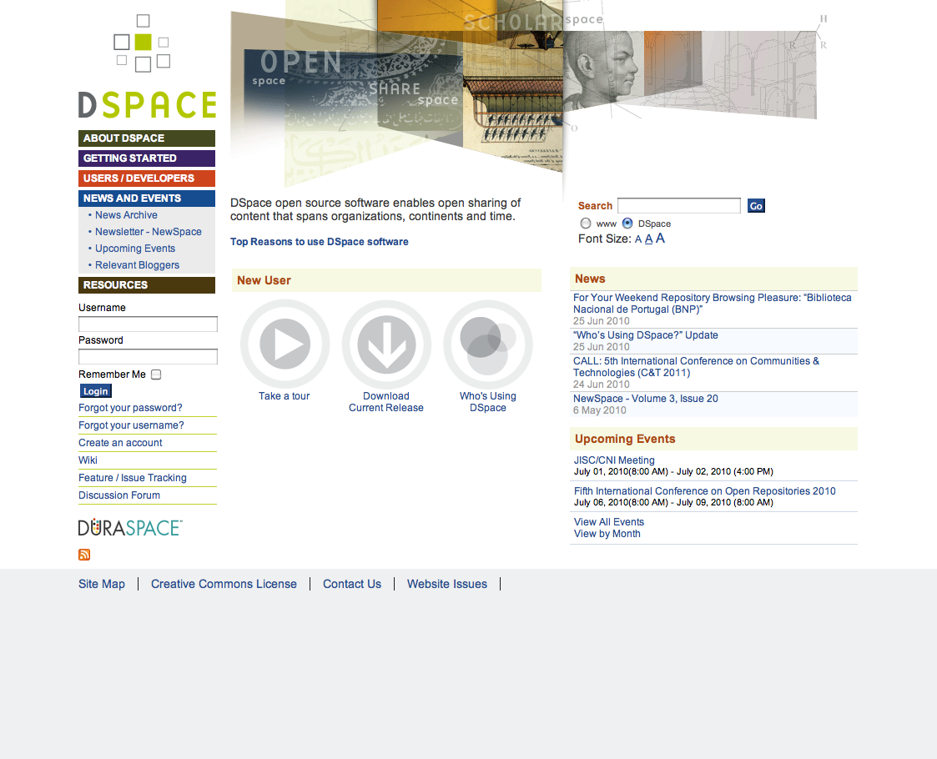
Creating & Sharing Visual Scholarly Collections
Public on the World Wide Web
1,600+ institutions subscribing to Artstor
TXU and designated others
Texas State
Private
Instructor Collection
Shared Shelf Commons;
Omeka sites
TXU Visual Repository
Shared Shelf hosted
collections
Contributed collection
Restricted Access
Shared Access
Open Access

Slide 22
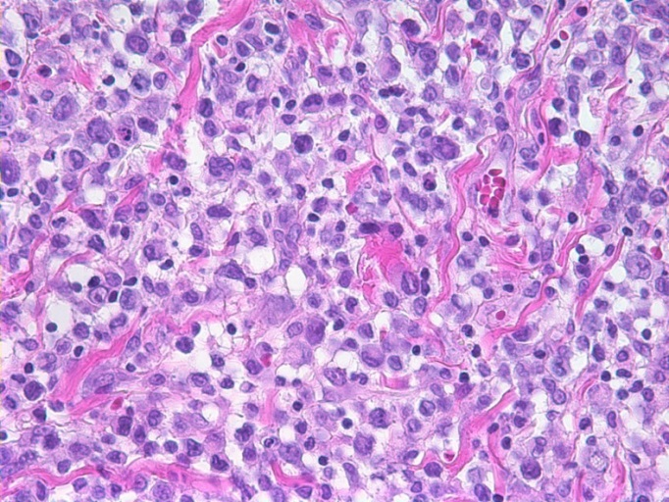
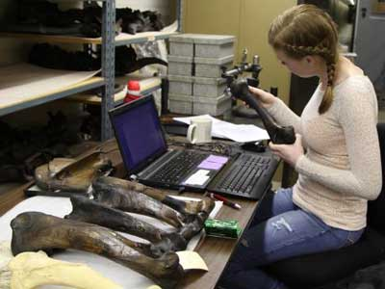
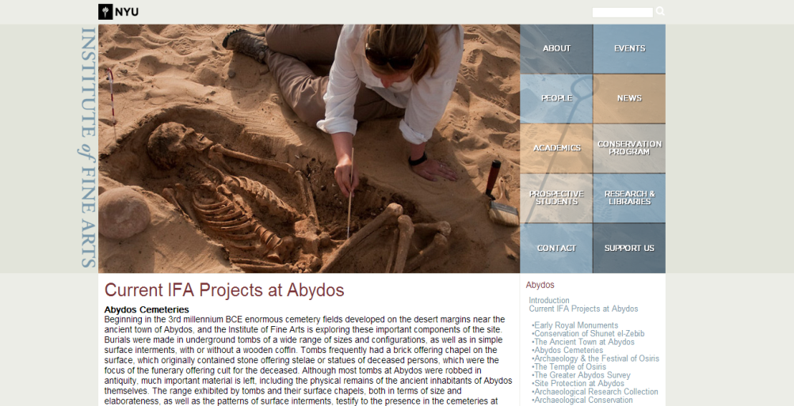
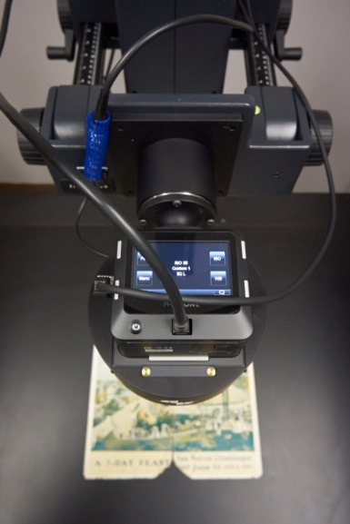
Multidisciplinary Visual Research Collection Possibilities

Slide 23
Comments/Questions?
Contact Info: Ray Uzwyshyn Director, Collections and Digital Services ruzwyshyn@txstate.edu
(512) 245-5687

Slide 24
Further Open Access References/Bibliography
Harnad, S. & Brody, T. (2004) Comparing the Impact of Open Access (OA) vs. Non-OA Articles in the Same Journals, D-Lib Magazine 10 (6) June (Japanese translation) http://eprints.ecs.soton.ac.uk/10207/
Harnad, S. The Open Access Paradigm – Why, What, How? UNESCO Conference on Open Access. Denmark, December 6 2010.
Brody, T., Harnad, S. and Carr, L. (2006) Earlier Web Usage Statistics as Predictors of Later Citation Impact. Journal of the American Association for Information Science and Technology (JASIST) 57(8) pp. 1060-1072. http://eprints.ecs.soton.ac.uk/10713/
Gargouri, Y., Hajjem, C., Lariviere, V., Gingras, Y., Brody, T., Carr, L. and Harnad, S. (2010) Self-Selected or Mandated, Open Access Increases Citation Impact for Higher Quality Research. PLOS ONE 5 (10) e13636 http://eprints.ecs.soton.ac.uk/18493/
Joseph, Heather, Emerging Trends in Scholarly Communication. ALA Midwinter Presentation, Jan. 26, 2014.
And here’s more: http://sparceurope.org/oaca/

