Slide 1

Texas State University Libraries
Faculty Digitization Services Overview
Ray Uzwyshyn, Ph.D. MBA MLIS
Director, Collections and Digital Services

Slide 2
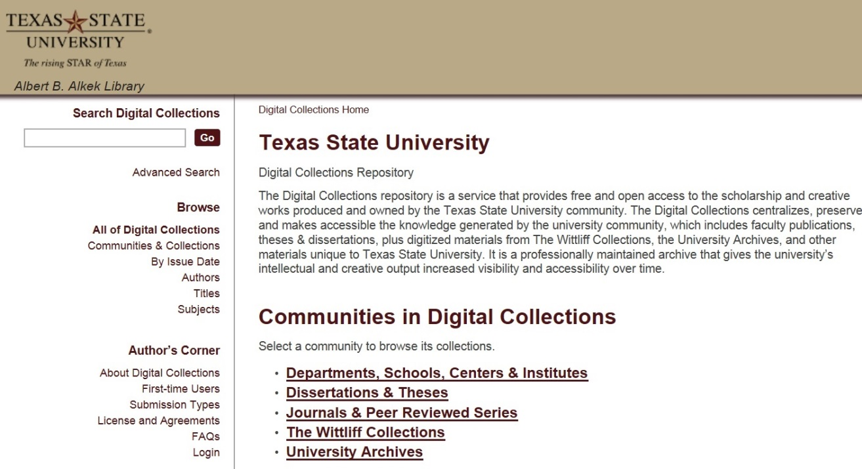
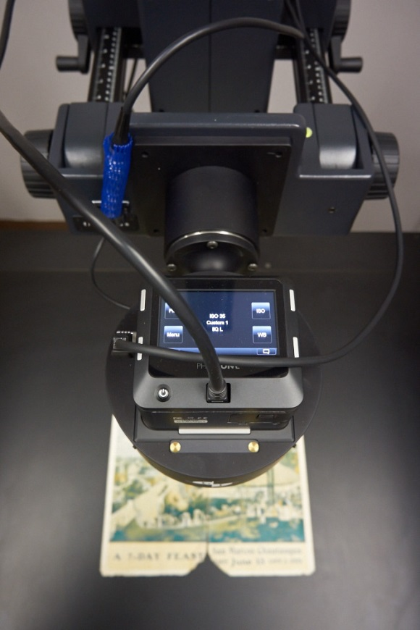
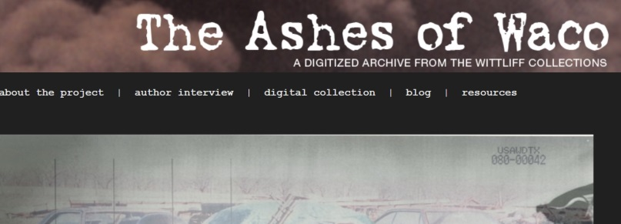
Digitization Services for Faculty
Alkek Library & Virtual (From your Desk!)
Spectrum of Software, Hardware, Infrastructure and Larger Project Digitization Possibilities

Slide 3
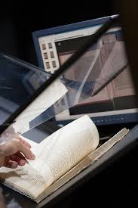

Digitization Services Overview
Digital Access Services
(Online Institutional Repository, ETD Submission
& Archiving, Faculty Publications, Digital Projects)
Scanning & Metadata Services
(Basic and Advanced Scanning Infrastructures, Metadata Services)
Preservation
(Dark Archiving, Duracloud)
Upcoming Services, 2015-2016
(Data Management Infrastructures and Shared Shelf)

Slide 4
Faculty Research/Publications
Institutional Repository
Larger Idea: Free and Open
Access to Scholarship and
Creative Works
Online Access & Long Term
Preservation
Increasing Visibility, Accessibility of Work
Faculty Publications, White papers, Preprints, theses, dissertations, working projects
D-Space, MIT Open Source Application
https://digital.library.txstate.edu/

Slide 5
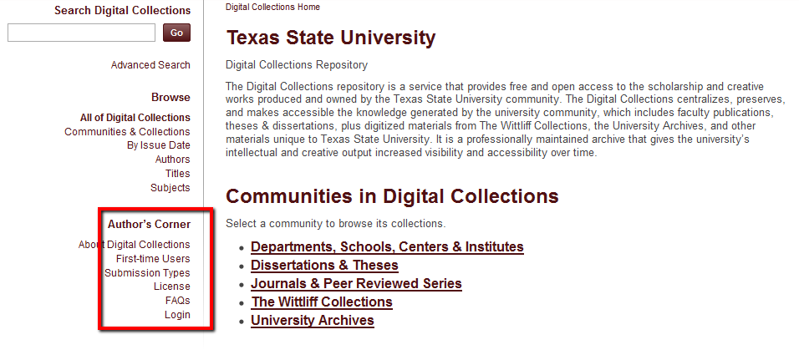
Faculty Research Papers
(Institutional Repository, DSpace)
https://digital.library.txstate.edu/
Self Submission Process, Help: Jeanne Hazzard, Digital Collections Librarian

Slide 6
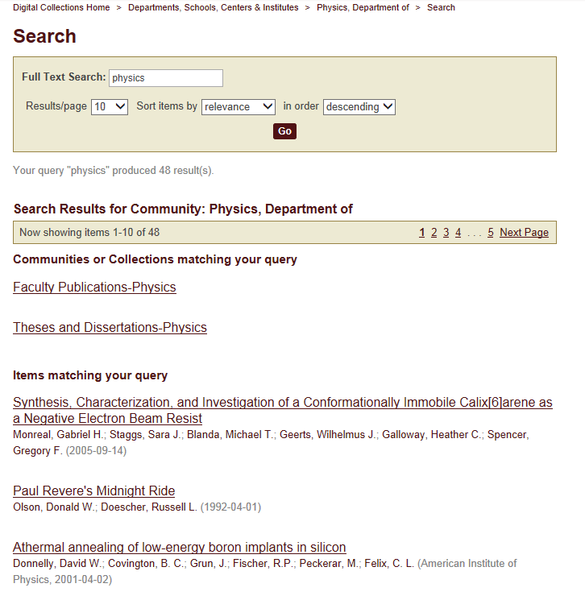


Faculty Publications - Physics

Slide 7
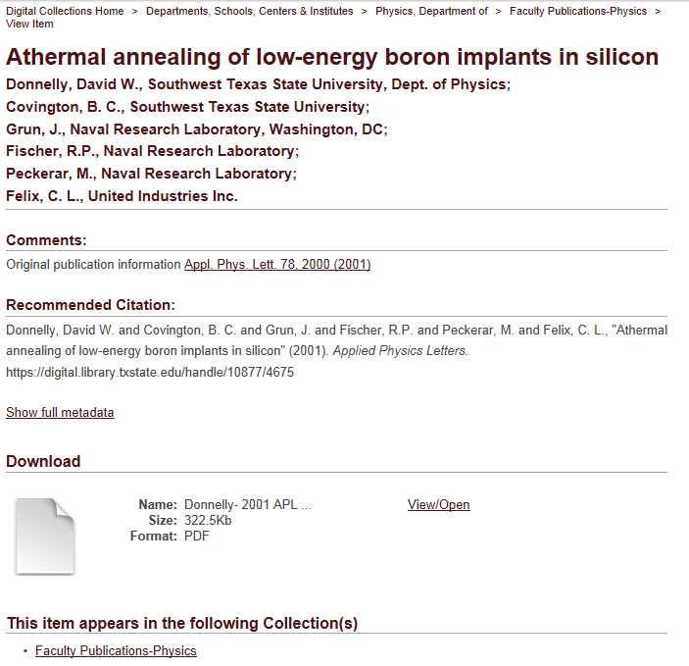

Slide 8
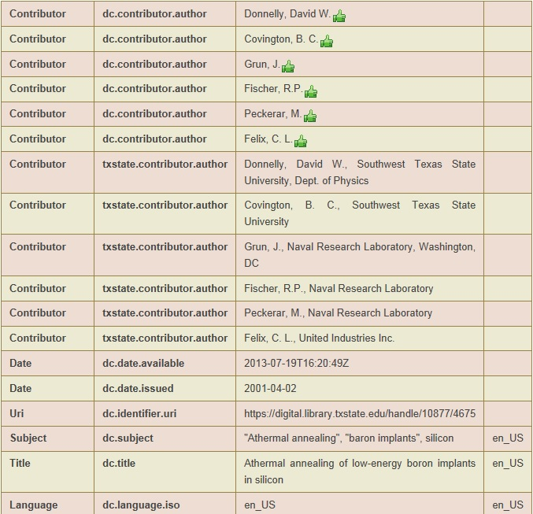
Dublin Core
Metadata
Access Points
Findability
Search Engine Optimization (SEO)

Slide 9
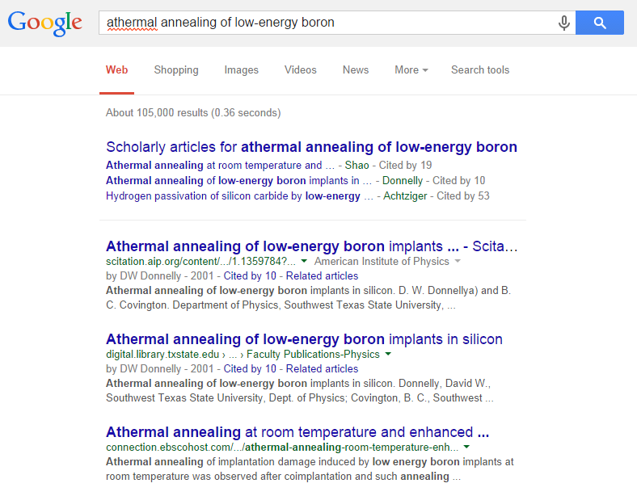
#2 of 105,000
Immediately
Available

Slide 10
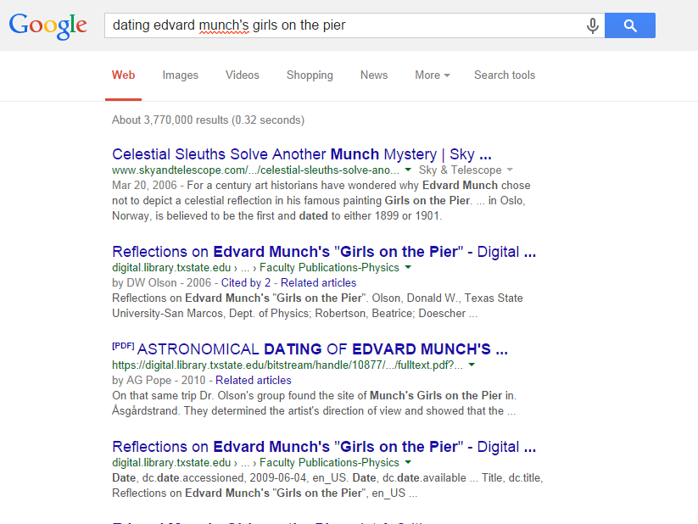
Immediate Access
& Relevance
#2
#3
#4, etc. . .

Slide 11
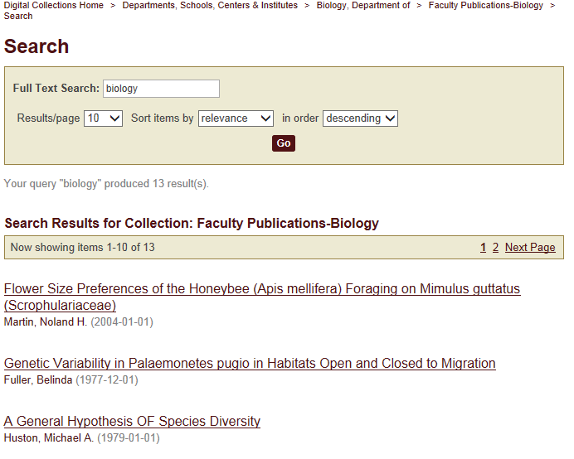
Faculty Publications - Biology

Slide 12
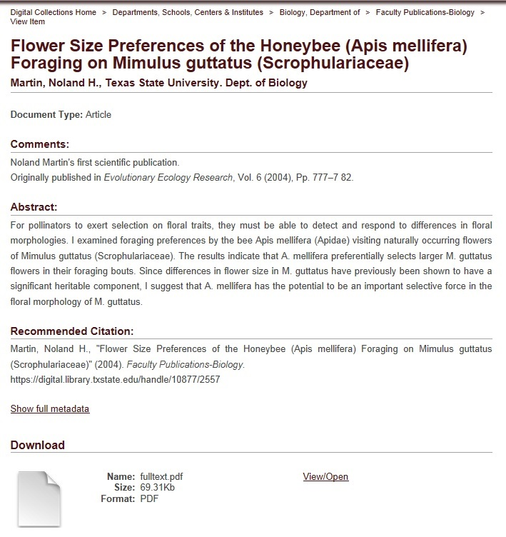

Slide 13
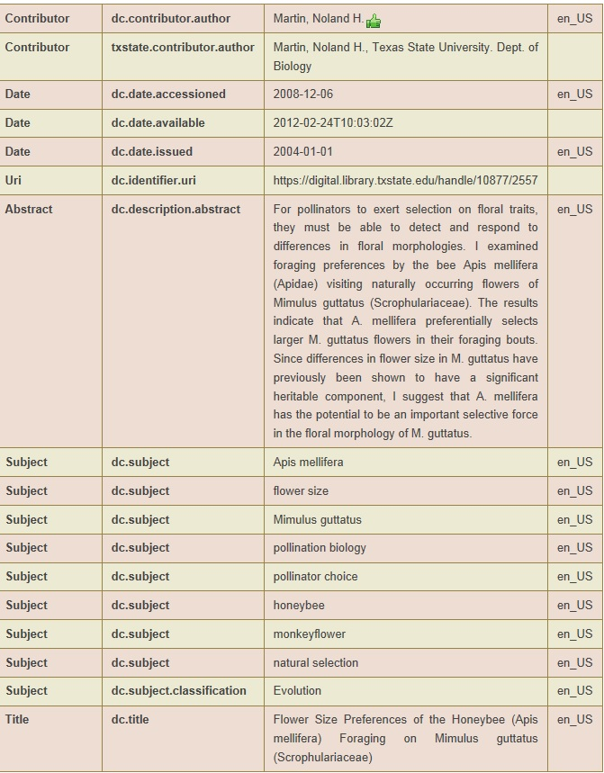
Dublin Core
Metadata
Interoperability
With other
Scientific Archives
Another Possibility for
Search, Retrieval,
Access, Recognition,
Open Networks

Slide 14

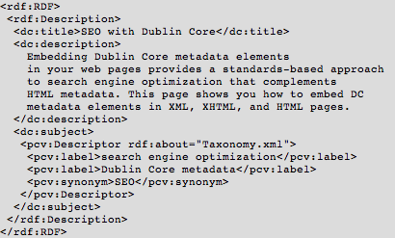
Metadata Services
Standards Based Approach
Metadata Schema and Taxonomies
SEO, Search Engine Optimization, Several Experts with regards to Dublin Core and other standards, XML Schemas
Jeanne Hazzard, Digital Collections Librarian

Slide 15
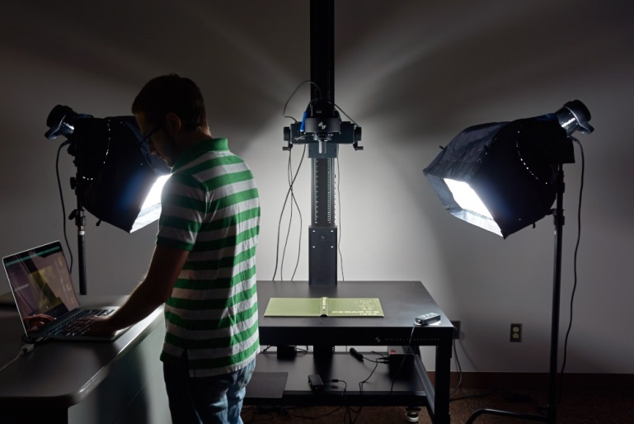
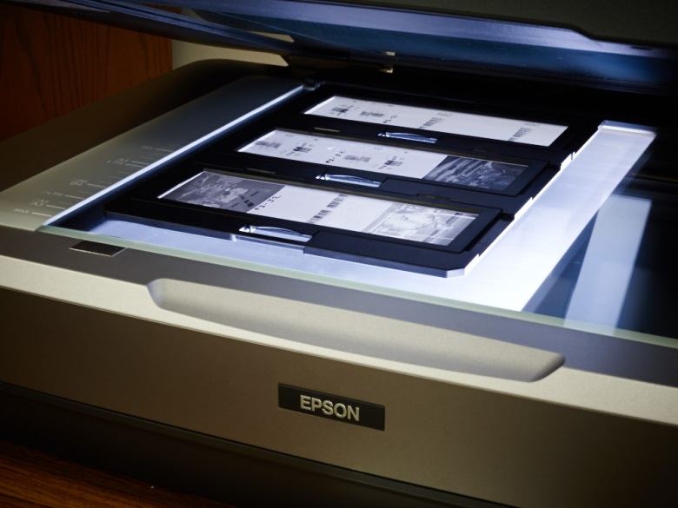
Scanning &Digitization Services
Digital Transitions Museum Level Setup
Image & OCR, Standards,
Books, Journal runs, Documents, Rare materials, 3D Objects, Posters, Projects, Audio and Video
Jeremy Moore, Digital Media Specialist, Todd Peters, Head of Digital and Web Services

Slide 16

The Digitization Lifecycle and Projects
Empowering Faculty
Research
Prototypes for Larger
Grant Projects
1

Slide 17
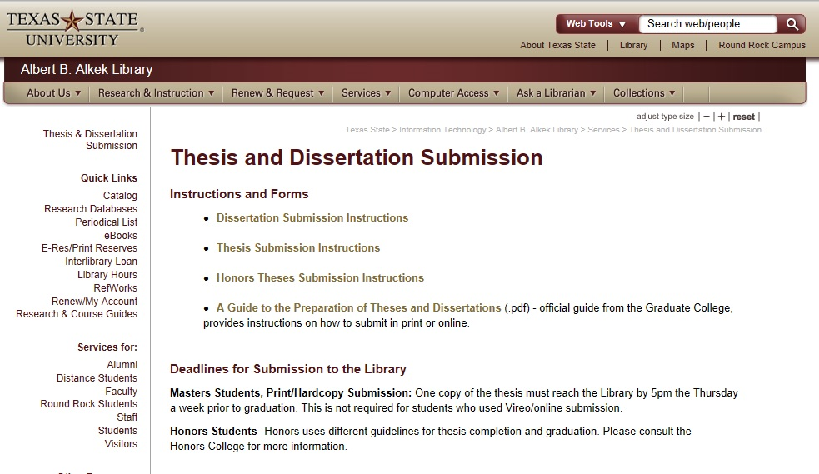
Supervising Graduate Students?
Online Thesis/Dissertation Repository
Vireo/D-Space (Graduate School)/ Dspace /Catalog, Stephanie Larrison
http://www.library.txstate.edu/services/thesis-dissertation-binding.html

Slide 18
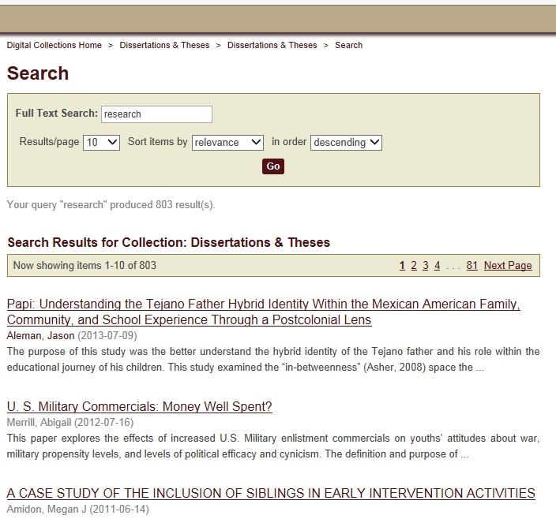

Slide 19
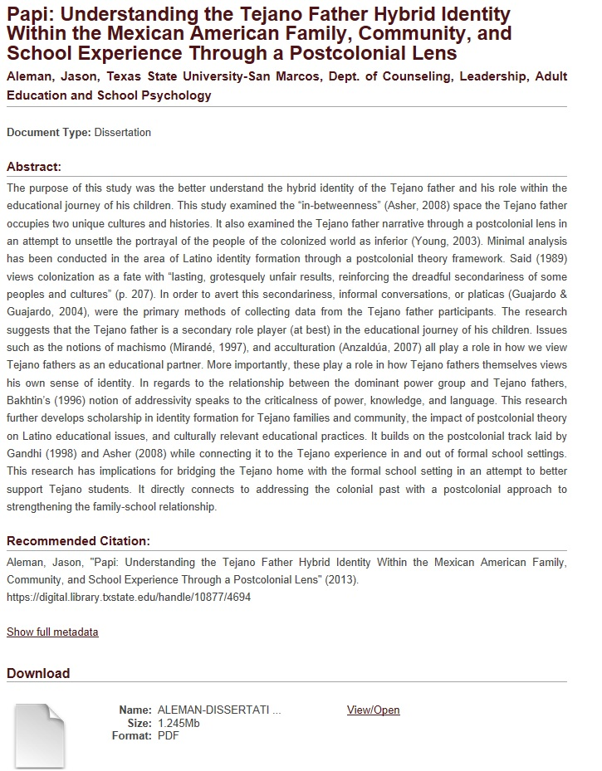

Robust
Abstract

Slide 20
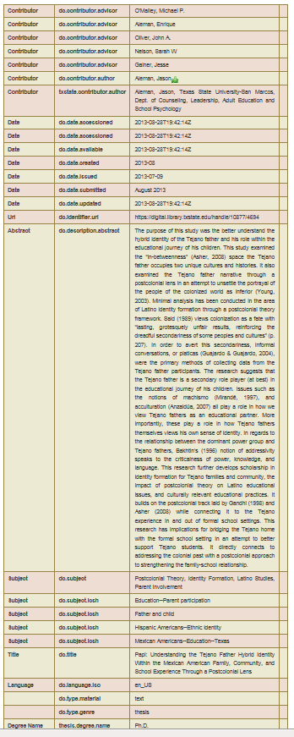
Robust Metadata
Application

Slide 21
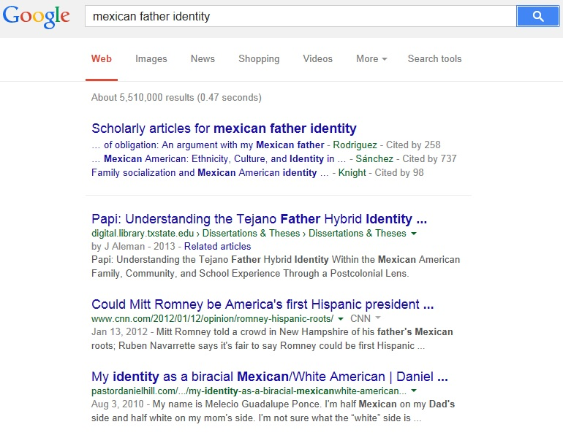
Network Connections/Alt-Metrics
Great Way for Graduate
Student
Networking
#1

Slide 22
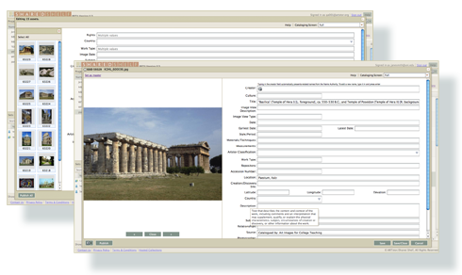
Upcoming Possibilities
(2015 - 2016)
University Data Management Plans - Library Data Repository Investigation
Artstor Shared Shelf (Visual Image Collections Repository), 2015

Slide 23
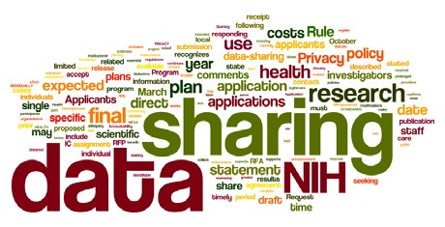
Data Management Repository
Increasingly, major grant agencies require data management plans as mandatory part of the grant proposal process.
(NIH 2003; NSF 2011; NEH, 2013 USDA)
University Opening Discussions Stage, 2015-2016

Slide 24
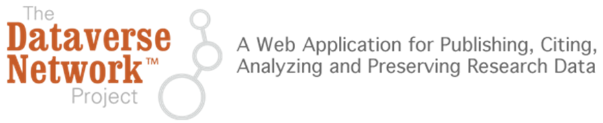
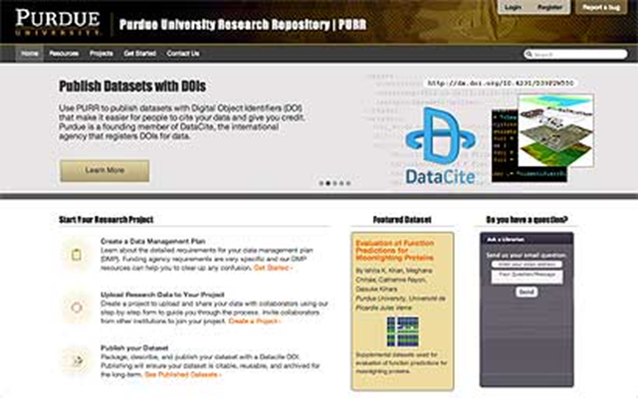
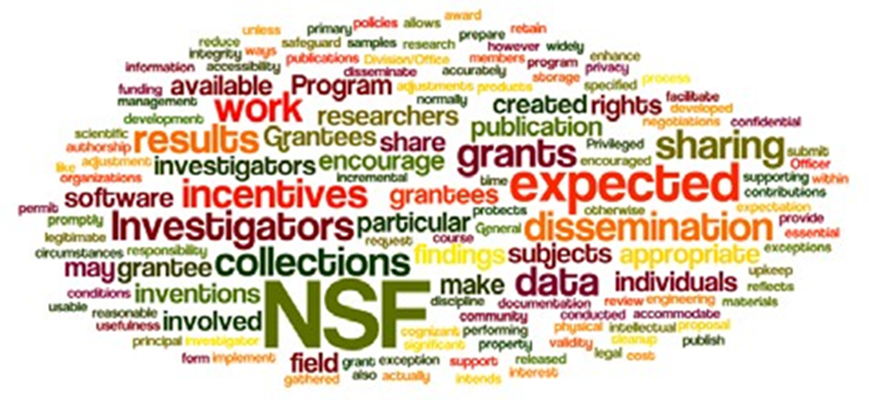
DMP Repository Infrastructure Investigation
Office of Sponsored Research/VPIT Special Projects/Library
Hubzero, Dataverse, DMPTool, 2015-2016

Slide 25
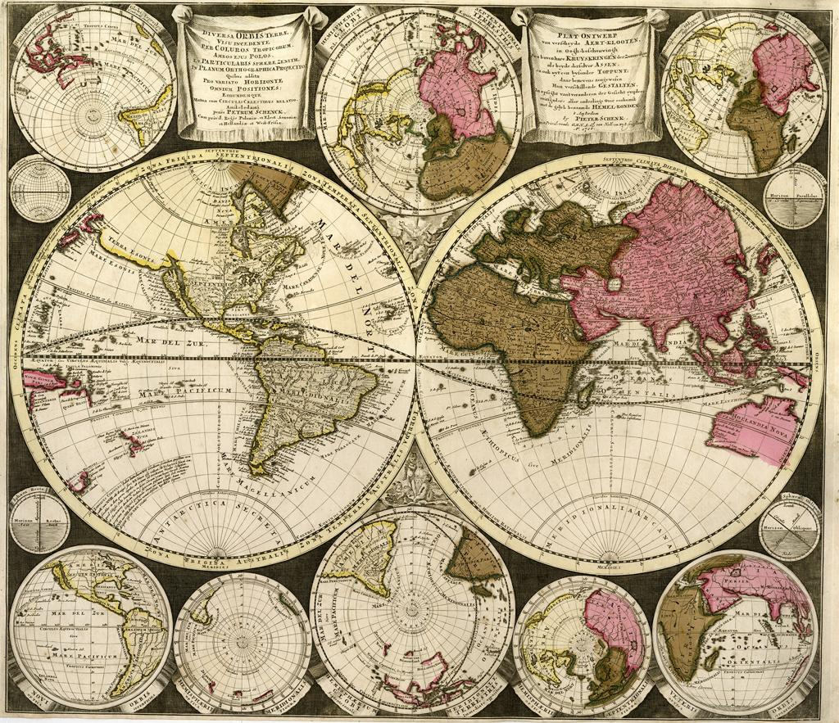
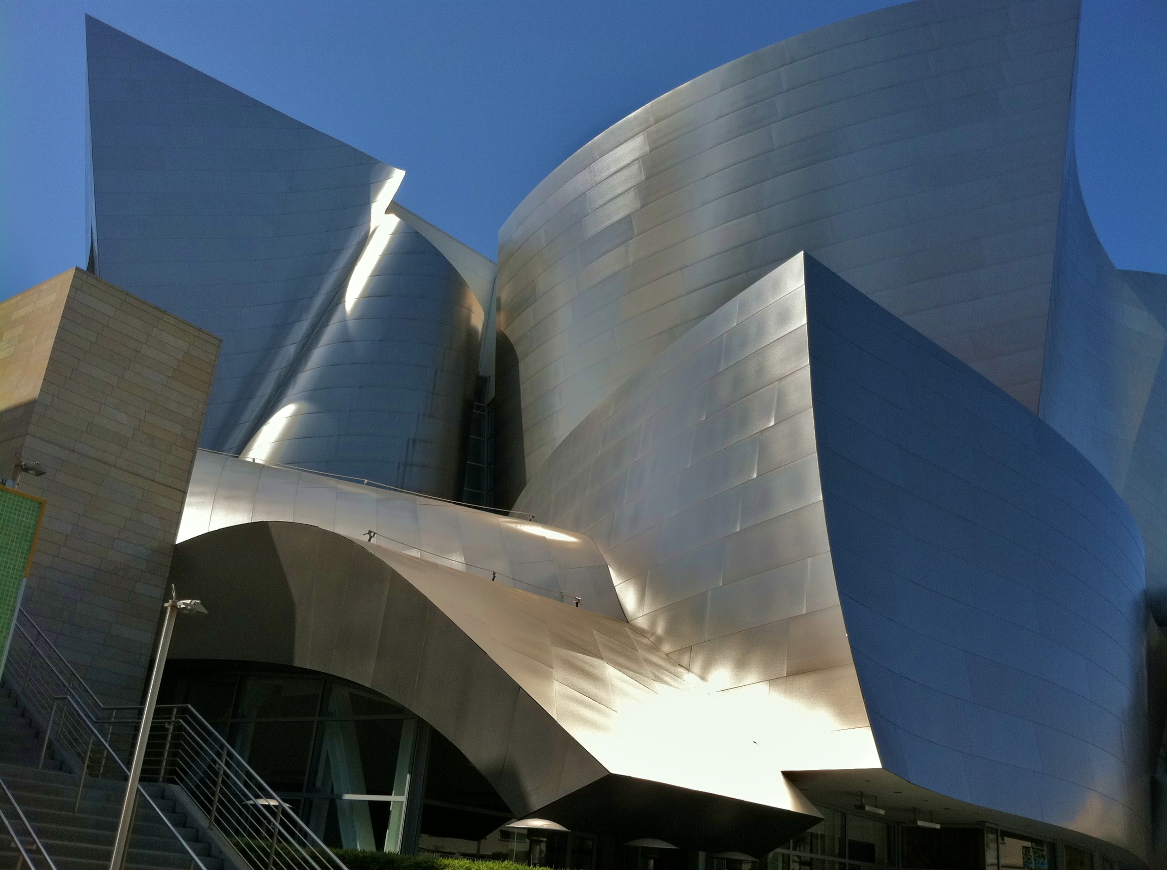
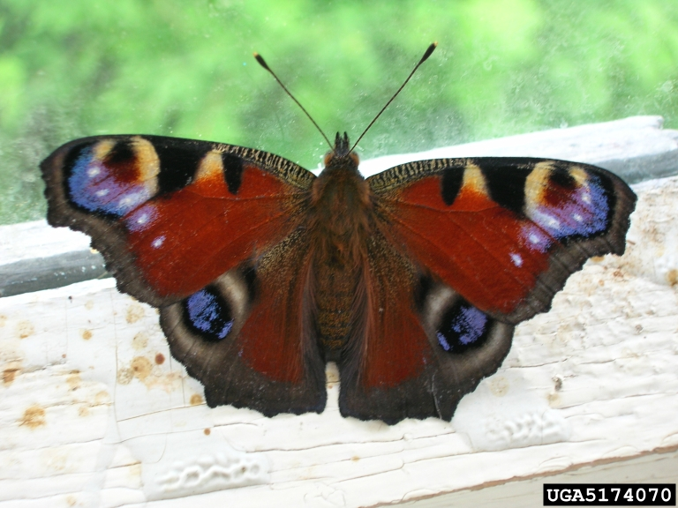
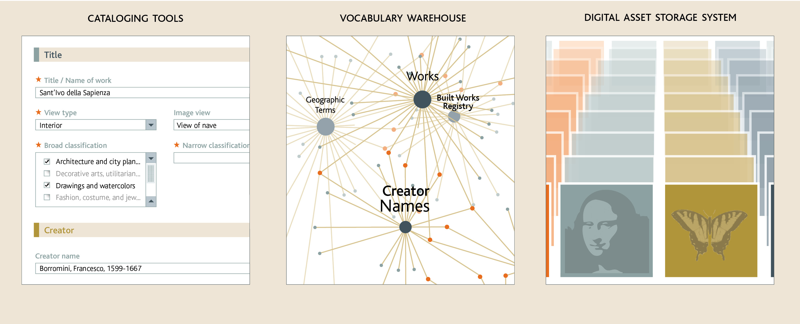
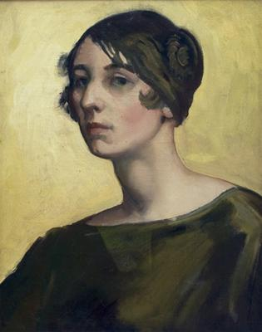
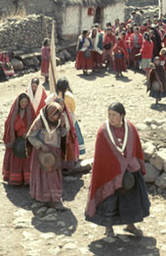
Artstor SharedShelf, January 2015
Online Visual Image Database Collection Creation Tool
Humanities
Social Sciences
Natural Sciences
Faculty collections
Teaching collections
Museum/Dept collection
Visual & Performing Arts
Video Overview
  *Shared Shelf supports non-art metadata models/ Licensed October 1, 2014

Slide 26




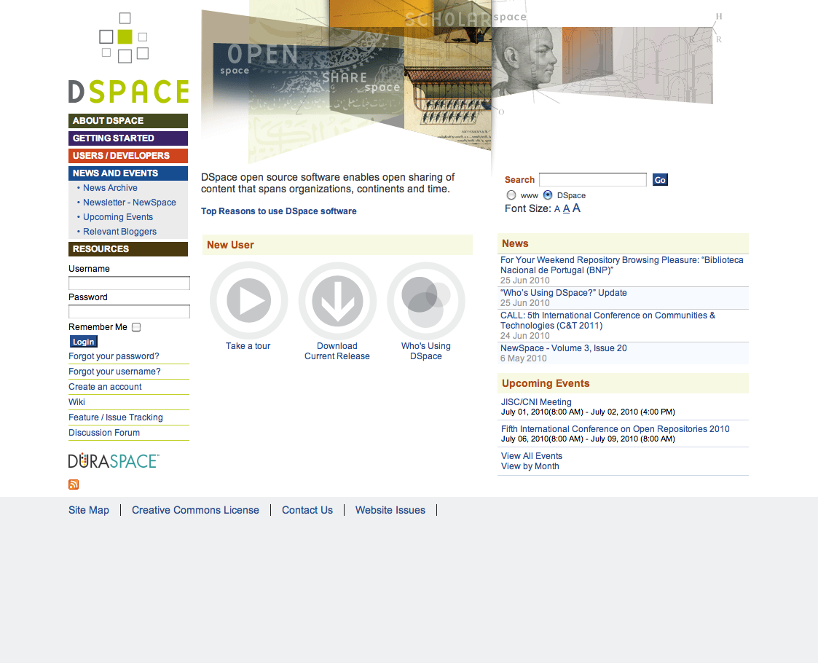
Creating & Sharing Visual Scholarly Collections
Public on the World Wide Web
1,600+ institutions subscribing to Artstor worldwide
TXU and designated others
TXU Collection
Private
Instructor Collection
Shared Shelf Commons;
DPLA;
Omeka sites
TXU Visual Repository
Shared Shelf hosted
collections
Contributed collection
Restricted Access
Shared Access
Open Access

Slide 27
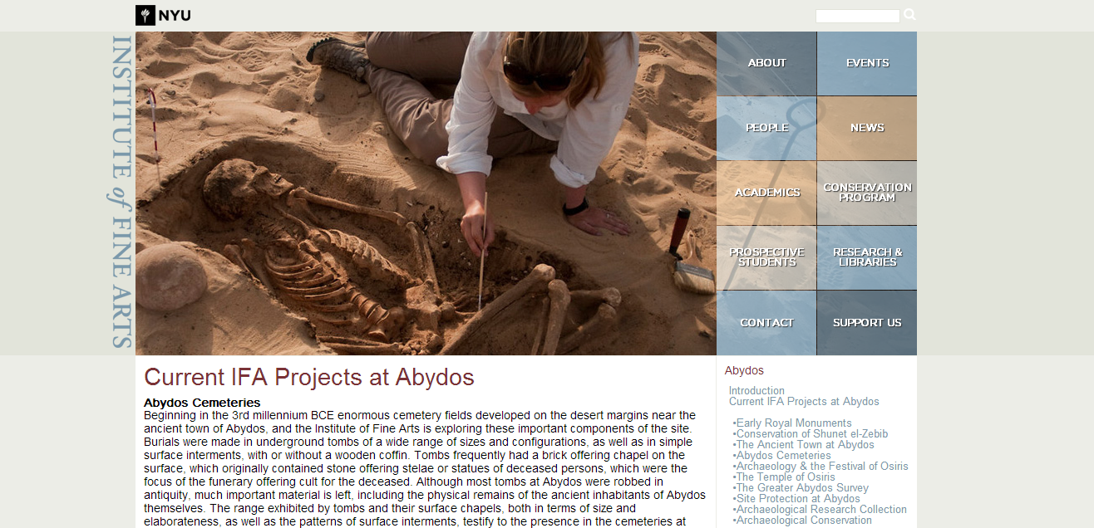
Online Visual Fieldnotes Database
NYU Archeology Collections
http://www.nyu.edu/gsas/dept/fineart/academics/abydos/abydos-cemeteries.htm

Slide 28
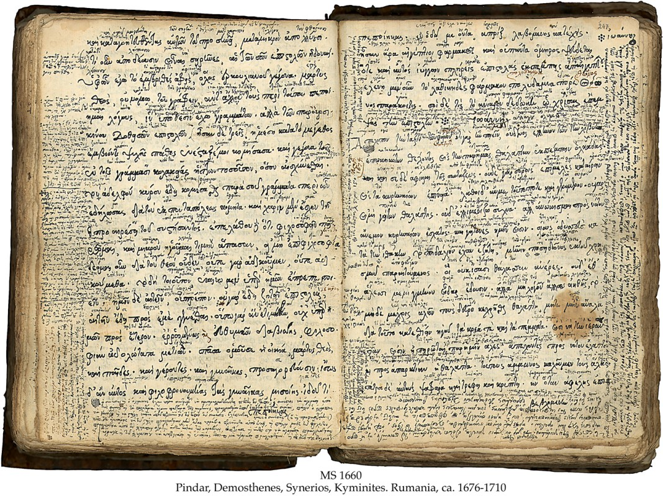
Larger Project Proposals
http://www.library.txstate.edu/about/departments/dws/faculty-digitization.html
http://www.library.txstate.edu/about/departments/dws/new-faculty-digitization.html

Slide 29
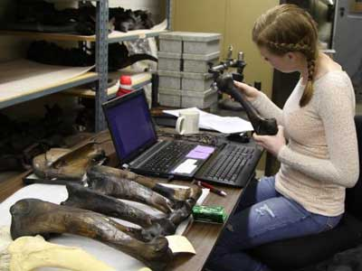
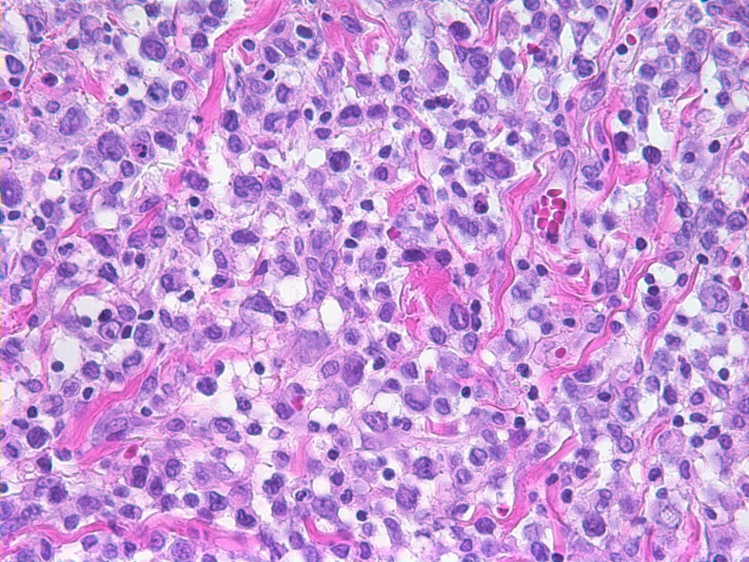
Faculty Project Proposal Process
Brief Email:
Project scope, list of present material assets, rough contextual outline, statement of copyright ownership
Preliminary Admonitions:
Copyright, Focus on Academic Research Projects, Online Access
Preliminary meeting to discuss or get questions answered
Ray Uzwyshyn:
ruzwyshyn@txstate.edu

Slide 30

Comments/Questions?

