Slide 1
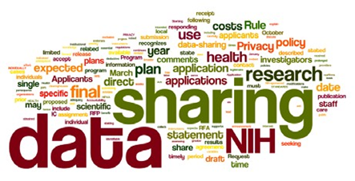
Online Research Data
Management Repositories
(For Universities and Institutes of
Higher Education and Research)
Ray Uzwyshyn, Ph.D. MBA MLIS
Director, Collections and Digital Services,
Texas State University Libraries

Slide 2
Data Management Plans: What are They?
Plans to Manage a Researcher’s Data Outputs
Long Term Archiving/Preservation Strategy
Ingestion of Various Data Types (from Excel to SPSS to more esoteric forms)
Permalinking Strategy for Online Citation and Access (DOI: Digital Object Identifier, UNF:University Numerical Fingerprint, Linked Data, Interoperability)
Paratextual Research Material Archiving/Sharing Possibilities (field notes, docs, data, multimedia and programs)

Slide 3
The Research Data Repository Lifecycle

Slide 4

Types of Data Set Project Repositories
1) Project specific
(usually large single faculty/faculty team projects)
2)Discipline specific
(i.e. Academic Specialization, Purdue Nanohub, Engineering etc. )
3) Institutional Repository
(either institution wide or consortial)

Slide 5
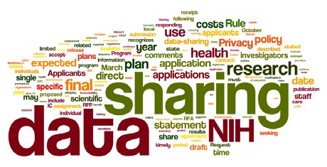
Why are Data Management Plans Required?
Increasingly, major grant agencies require data management plans as mandatory part of the grant proposal process.
(NIH 2003; NSF 2011; NEH, 2013 USDA)
Wordle of the Final NIH Statement on Sharing Research Data, Mandatory 2003

Slide 6

Data Sharing
Currently, 80% of researchers do not share their data
Andreoli-Versbach, P., Mueller-Langer, F. (November 2014). Open access to data: An ideal professed but not practiced. Research Policy., http://dx.doi.org/10.1016/j.respol.2014.04.008

Slide 7
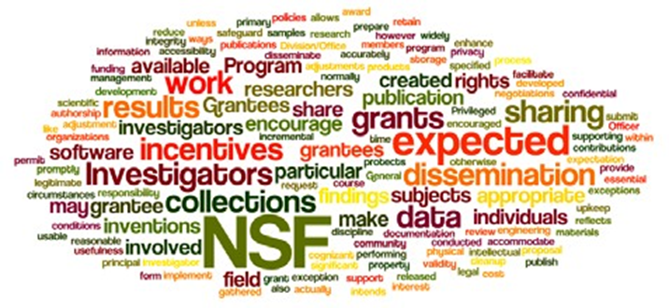
Why Are Data Management Plans Required
Leverage and make available faculty, departmental and institutional research
Allow publication of negative data (less research replication)
Wordle of the National Science Foundation’s Award and Administration Guide. Chapter VI.D.4, Mandatory 2011

Slide 8
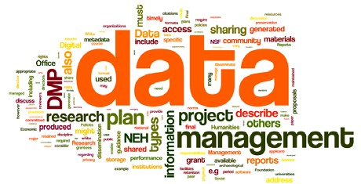
Data Management Plans
Part of Evolving Science, Social Science and Humanities Research Process (Accuracy, efficiency, sharing)
Wordle of the data management policy of the Office of Digital Humanities, National Endowment for the Humanities, 2013

Slide 9
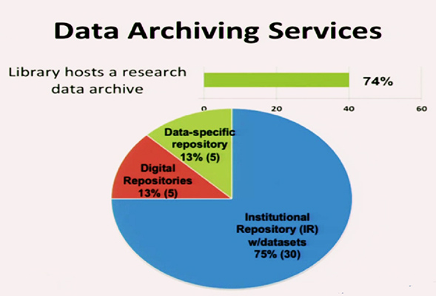
ARL Libraries 2015
Online Data Management Plan Implementation
Fearon, D & Sallans, A. C. (January 2014) Institutional Research Data Management: Policies, Planning, Services and Surveys. Coalition for Networked Information. https://www.youtube.com/watch?v=rvbrW7S2fes (54 ARL Libraries currently offer data management services_)

Slide 10
Research Data Management Software
Online Repositories/Infrastructures created to manage a researcher’s data (sharing, archiving, preservation, metadata)
May be hosted or installed on a university’s server
Each software contains different ranges of management/collaborative options
Open source and proprietary options

Slide 11
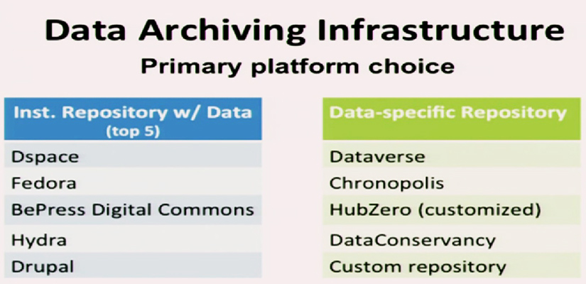
Current DMP Platforms (2015)
Fearon, D & Sallans, A. C. (January 2014) Institutional Research Data Management: Policies, Planning, Services and Surveys. Coalition for Networked Information. https://www.youtube.com/watch?v=rvbrW7S2fes (54 ARL Libraries currently offer data management services_)

Slide 12
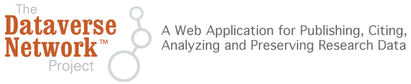

Dataverse: Harvard’s Research Data Open Source Solution
Software framework that enables institutions to host research data repositories
Preservation and archival Infrastructure: allows sharing, control, persistent data citation, publishing and management
Social Sciences Beginnings (IQSS)
Data Science (site)
http://thedata.org
Dataverse Open Source Download (Github), Software Background

Slide 13
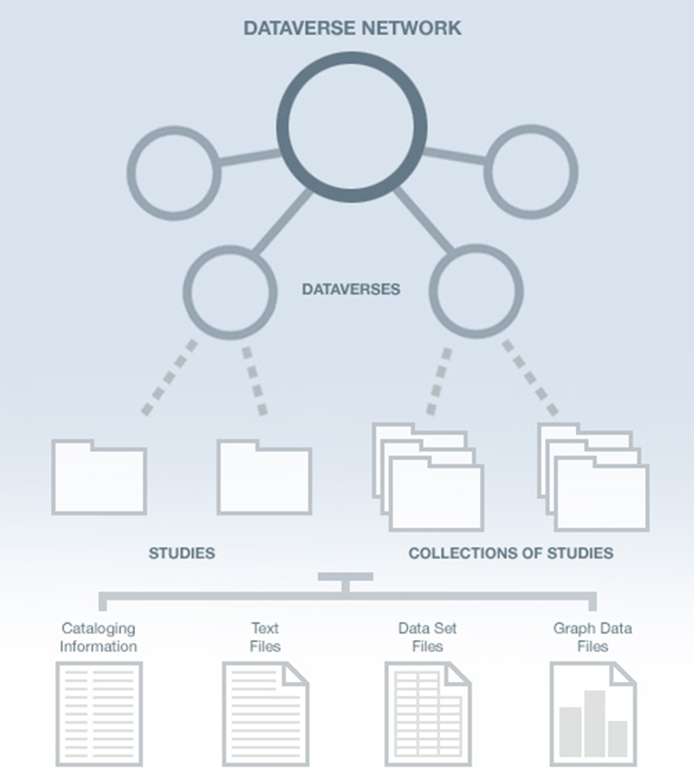
Dataverse Network Architecture
Why the Dataverse Network?
(silent video overview)
Open Journal Systems
Dataverse Integration (2014)
Research Study Data
Data Set Files
Metadata ( Data Describing the data)
Paratextual Research Material
(Methodology, Field Notes etc.)
Graph Data Files

Slide 14
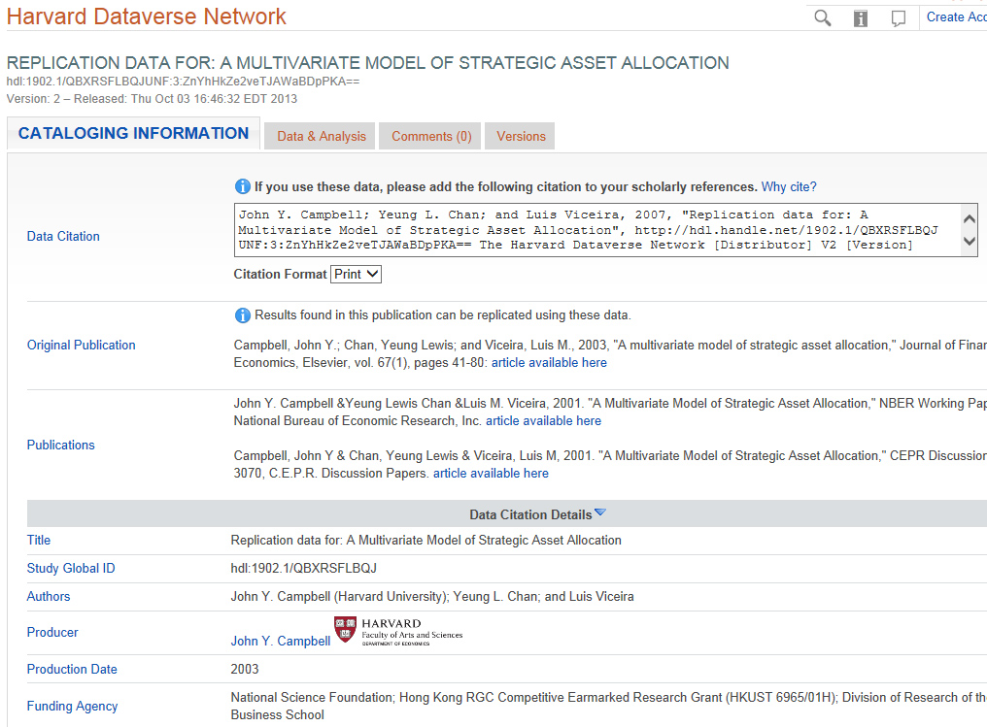
Dataverse Metadata Example

Slide 15
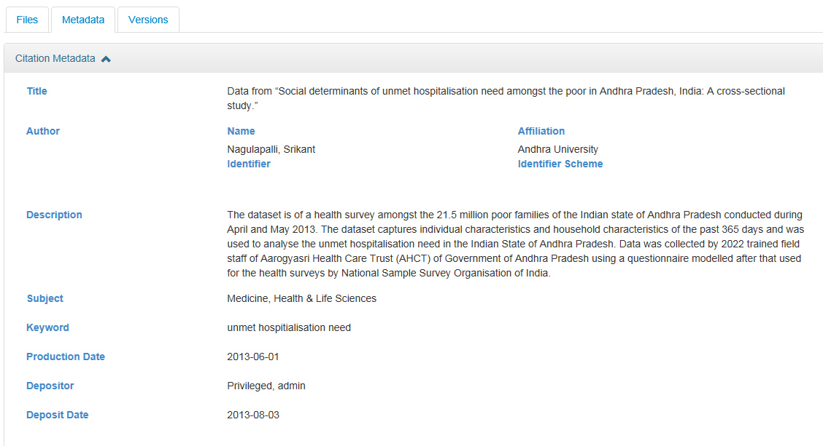
Dataverse Metadata Example

Slide 16
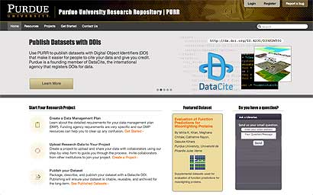
PURR and Hubzero: Purdue’s Data Management System
1.) Create Data Management Plans
2) Collaborate with other Researchers
3) Publish Data Sets (Purdue can publish a DOI: Digital Object Identifier for Data Sets)
Useful For Citation
4) Archive Data Sets
Boilerplate text for data management proposals available
Purr is part of Hubzero platform for scientific collaboration (Originally Nanohub)
Purr: Purdue University Research Repository (video)
Purr Site (Proprietary to University)
Purr Background

Slide 17
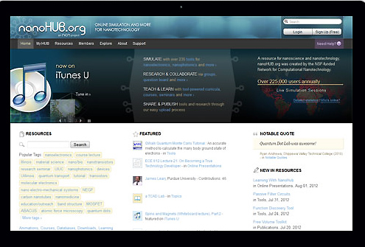
Hubzero: Open Source Platform for Scientific Collaboration
Research Collaboration and Data Management
Solution
Research Data Types
Spreadsheets
Instrument or Sensor Readings
Software Source Code
Surveys
Interview Transcripts
Images and Audiovisual Files
https://hubzero.org/
Getting Started, Downloadable and Hosted Options
Hubzero Video, Hubzero2

Slide 18
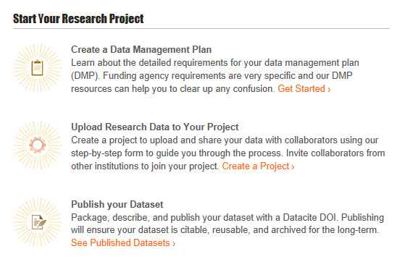
Hubzero/Purr Customization

Slide 19
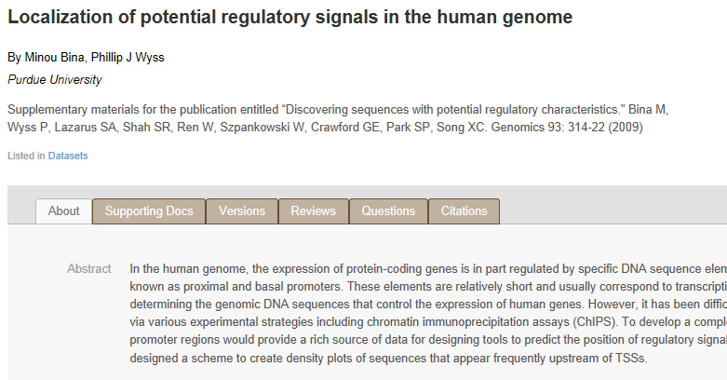
Hubzero/Purr
File Level Research Data View

Slide 20

Figshare/Cloud based/Proprietary
Repository where users make their research
available in citable, shareable and discoverable
manner
Figures, datasets, media, papers, posters
presentations and file sets can be disseminated
In a way that the current scholarly publishing
Model does not allow
Open Source Platform for Sharing Research
Figshare (video)
Figshare for Institutions (Video)

Slide 21
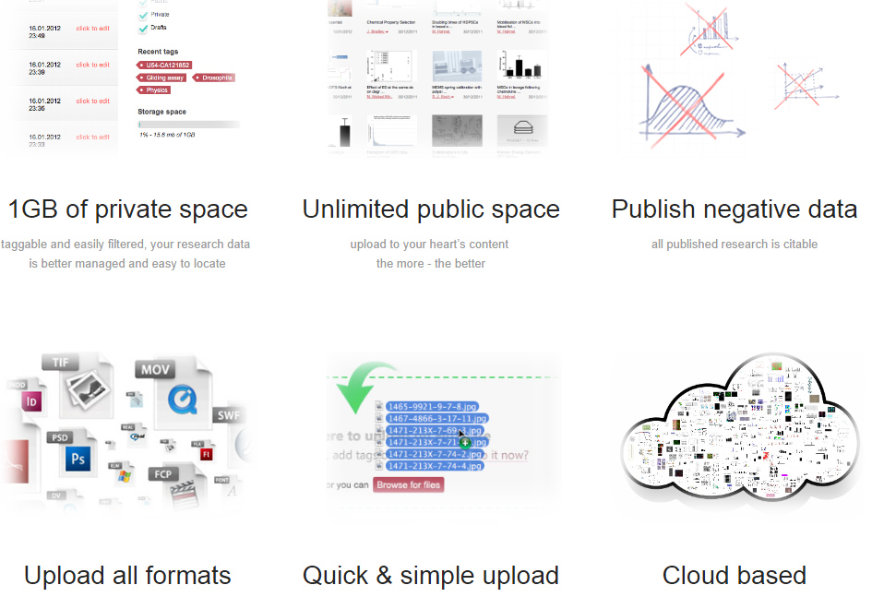
Figshare Features
(Cloud Based/Proprietary)

Slide 22
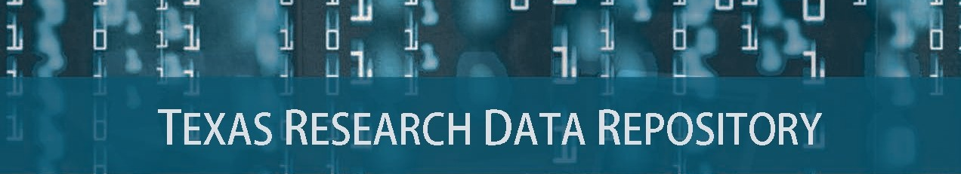
Consortial Repositories, http://www.tdl.org/data-repository

Slide 23

One Size Does Not Fit All Data Project Needs
Types of Data Projects (Sizes)
1) Normal range
Files/Data Fit on Server/Cloud, may be uploaded, Dataverse, Purr)
2) Large Projects
(Data may require specialized university IT Support, i.e. terabyte/petabyte tape drives)
3) Very Large
(Projects require consortial possibilities, national models, Chronopolis, Texas Advanced Computer Center, DEEPN, Duracloud)

Slide 24
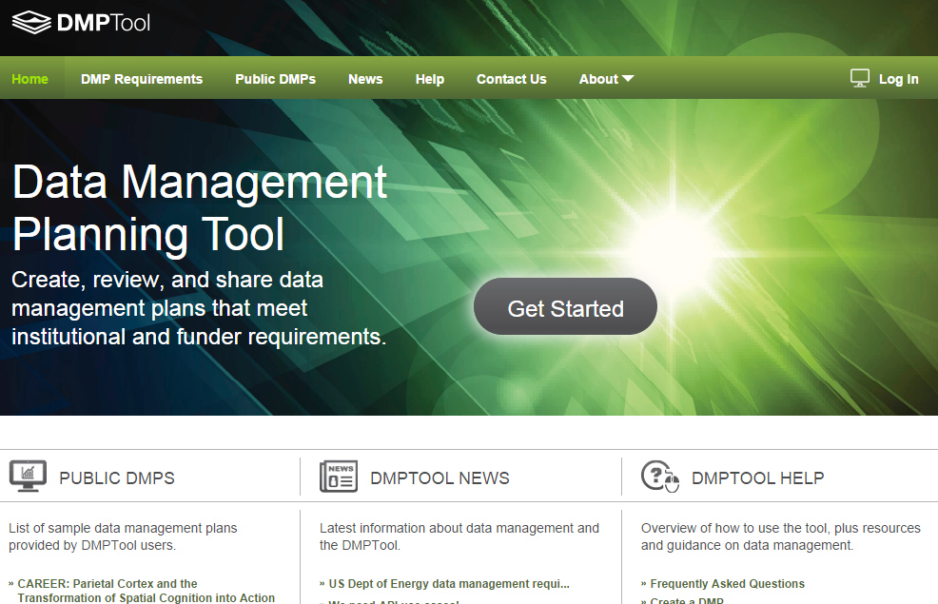
DMP Documentation/Policy Tool
Overview Video
Customizable
Plan Outline Tool
Resource Links
Supports All Major Funders
https://dmptool.org/
California Digital Library

Slide 25
The Many Planning Aspects of the New World of Data Research Repositories

Slide 26
Data Repository Adoption Lifecycle
(2016)

Slide 27
Further Links/References
ARL NSF Data Sharing Policy and Resource Links, http://www.arl.org/focus-areas/e-research/data-access-management-and-sharing
ARL (White House Directives and Funded Research Data ) http://www.arl.org/focus-areas/public-access-policies#.VoaV0I-cFzo
California Digital Library DMT Tool: https://dmptool.org/
Chronopolis: http://www.digitalpreservation.gov/partners/chronopolis.html
Dataverse. http://thedata.org/
Dataverse (Data Science Site). http://datascience.iq.harvard.edu/dataverse
DPN (Digital Preservation Network) http://www.dpn.org/
Duracloud: http://www.duracloud.org/
Purr. (Purdue Institutional Data Repository). https://purr.purdue.edu/
Hubzero. https://hubzero.org/
Figshare. http://figshare.com/
ICPSR Data Management & Curation. http://www.icpsr.umich.edu/icpsrweb/content/datamanagement/
Research Data Management. Principles, Practices, and Prospects (November 2013). Council on Library and Information Resources. http://www.clir.org/pubs/reports/pub160
Cox, A. and Pinfield, S. Research Data Management and Libraries. Jounral of Librarianship and Information Science. June 2013.
Fearon, D & Sallans, A. C. (January 2014). Institutional Research Data Management: Policies, Planning, Services and Surveys. Coalition for Networked Information. https://www.youtube.com/watch?v=rvbrW7S2fes (video presentation)
Data Management for Libraries: (LITA Guide) http://www.alastore.ala.org/detail.aspx?ID=10737
NMC Horizon Report: 2014 Library Edition. http://cdn.nmc.org/media/2014-nmc-horizon-report-library-EN.pdf
“Research Data Management”. pp. 6-7 and pp 24 – 45.
Holden, J. Memorandum for Heads of Executive Departments and Agencies: Increasing Access to the Results of Federally Funded Research (2013). http://www.whitehouse.gov/sites/default/files/microsites/ostp/ostp_public_access_memo_2013.pdf
Green, A. Macdonald, S and Rice, R. Policy-making for Research Data in Repositories: A Guide. DISC-UK. http://www.disc-uk.org/docs/guide.pdf
Research Data Management in the Arts and Humanities (2013). University of Oxford. http://www.dcc.ac.uk/events/research-data-management-forum-rdmf/rdmf10-research-data-management-arts-and-humanities (Conference Presentations)

Slide 28
Comments/Questions

