Slide 1
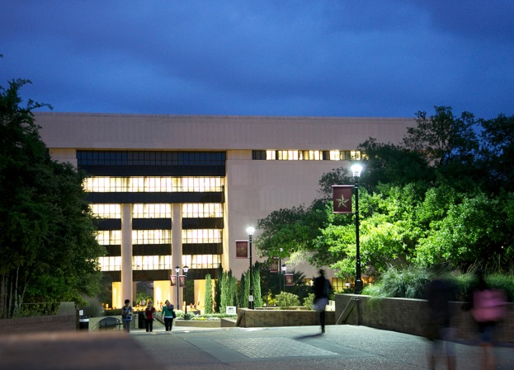
Alkek Library Learning Commons Infrastructure Planning Considerations (2014) Revisioning & New Possibilities

Slide 2
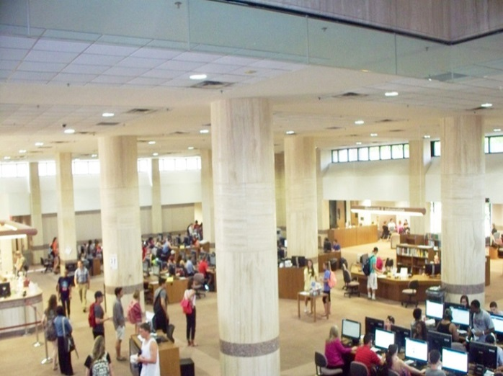
Alkek Library Learning Commons Infrastructure Planning Principles
Technologies deployed in the library will change over time. Planning should reflect this by allocating appropriate space without necessarily establishing a specific technology for each space

Slide 3
Alkek Library Infrastructure Planning Considerations 2014
Planning associated with technologies should not be constrained based on current technology equipment or practices.
Library planning should anticipate technologies we don’t expect to see in the library, and our current expectation of more technology is probably an underestimate.

Slide 4
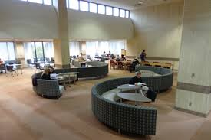
Alkek Library Infrastructure Planning Considerations
Provide infrastructure throughout building – holistically
Technology driven activities will continue to expand and will eventually dominate library use
Adjust Infrastructure project to account for work already done on fire control system, intercom, and elevators

Slide 5
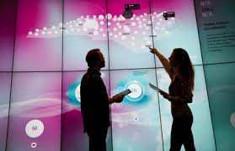
New Academic Library Learning Commons Technology Considerations

Slide 6
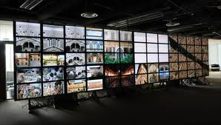
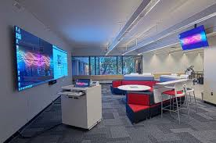
Visualization Technologies Wider definitions of computing & digital literacy
Hunt Library NCSU (video) Rice (video, rationale, science) UT Austin (video, humanities) Deloitte University (video, business)
Electrical and Connectivity Needs

Slide 7
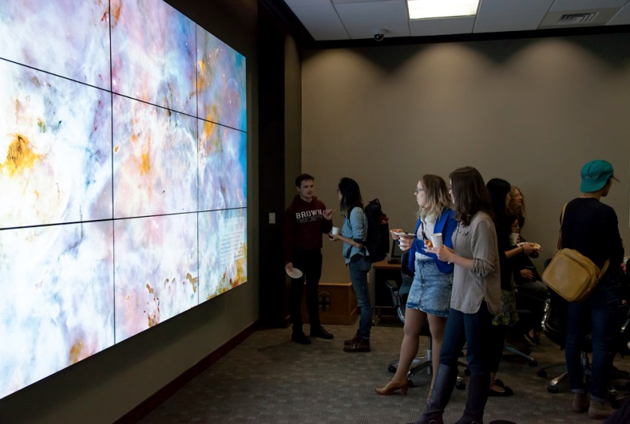
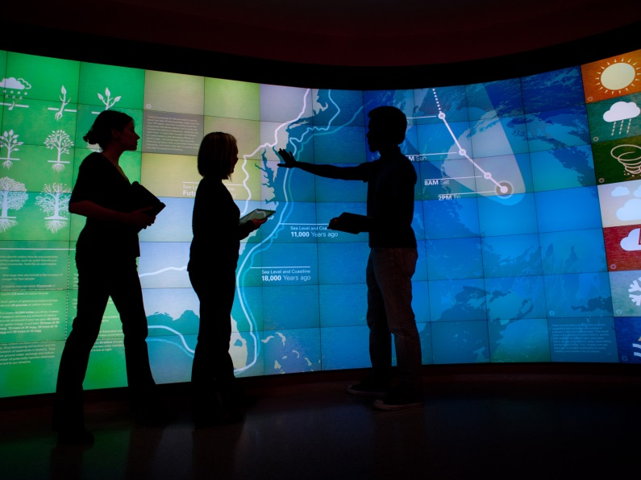
Visualization Walls (VizWall)
Brown University Rockefeller Library (article)
NCSU Hunt Library (infrastructure link)

Slide 8
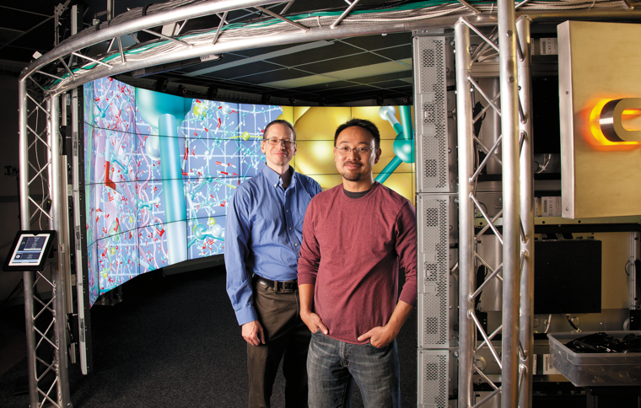
3D Immersive & Interactive Environments
University of Chicago CAVE (article and video)
John Hopkins Libraries Brody Learning Commons Display Wall (video)

Slide 9
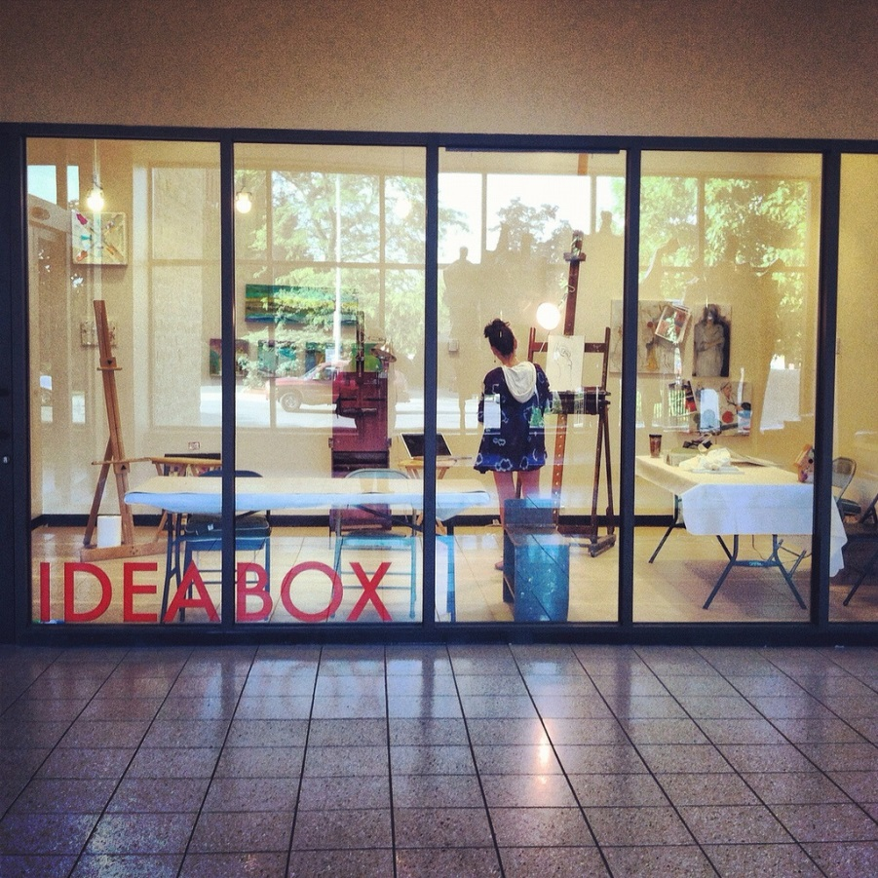
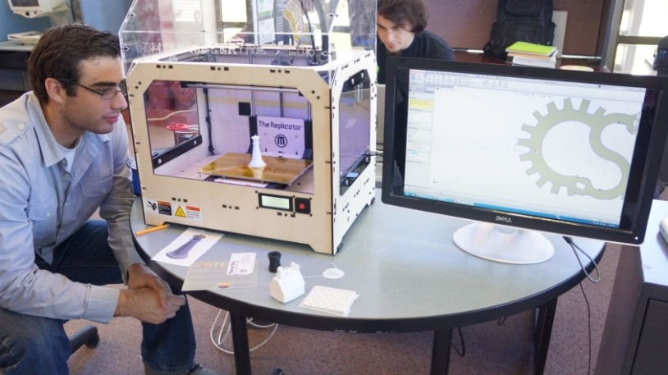
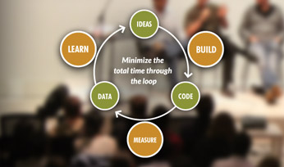
Academic Library Maker Spaces
ACRL: Academic Library Makerspaces (article)
Library Makerspaces (Resource List), Examples

Slide 10
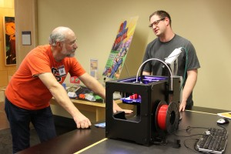
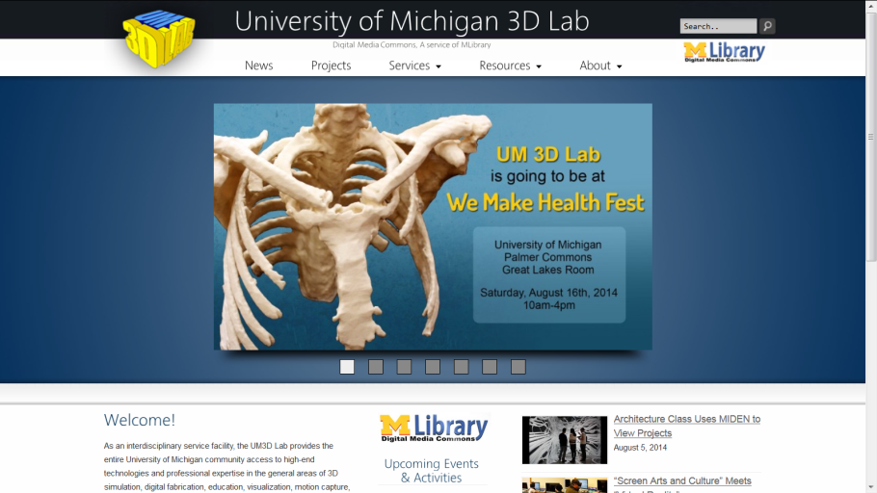
Academic Makerspaces
Oregon State University Valley Library (article)
University of Michigan 3D Lab (example infrastructure)
Traditionally include 3-D printing, but can include other spaces to create content (e.g., large-format printing, physical computing, prototyping sandboxing)

Slide 11
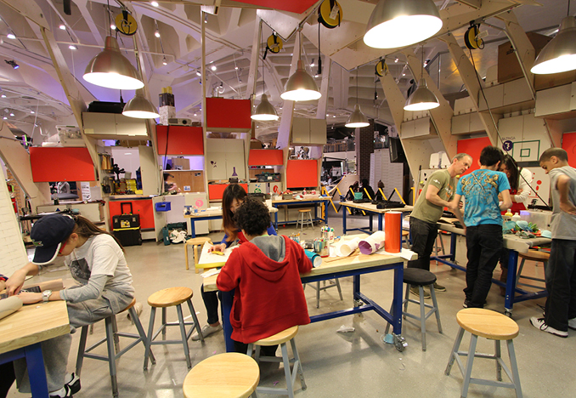
Library Makerspace Considerations
Fire codes/Ventilation/Internet Connectivity/Expanded Electrical

Slide 12
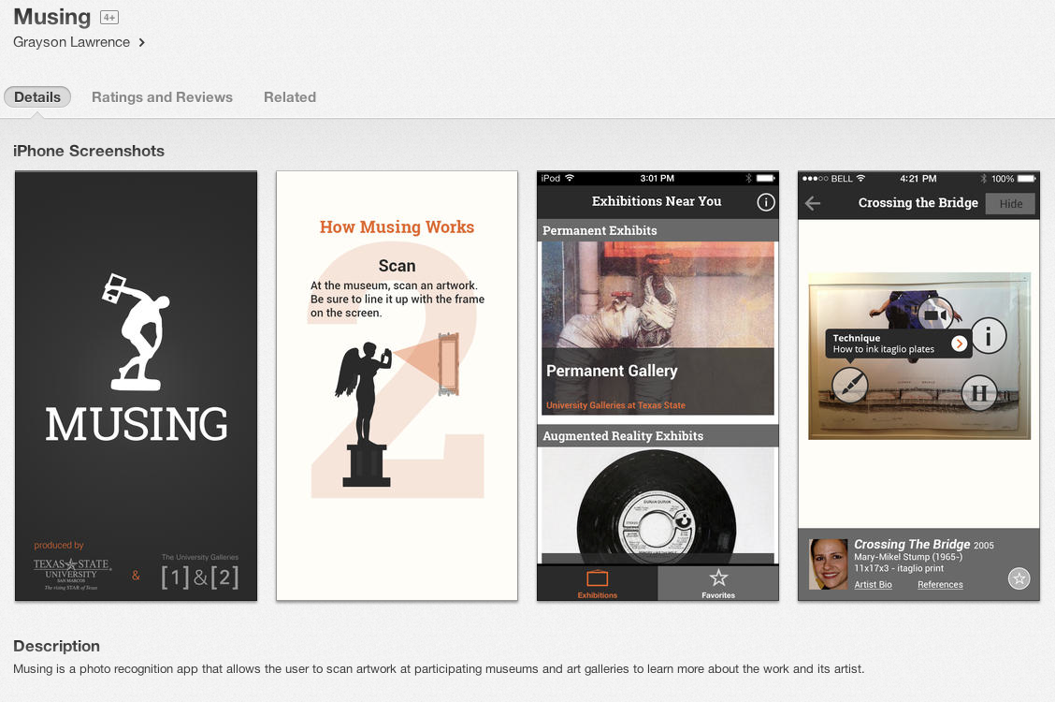
Interactive Museums
Interactive displays, visual media displays, audio/podcast tours and electronic multimedia guides. Examples:
MUSING: an iPhone app developed by Texas State (Link)

Slide 13
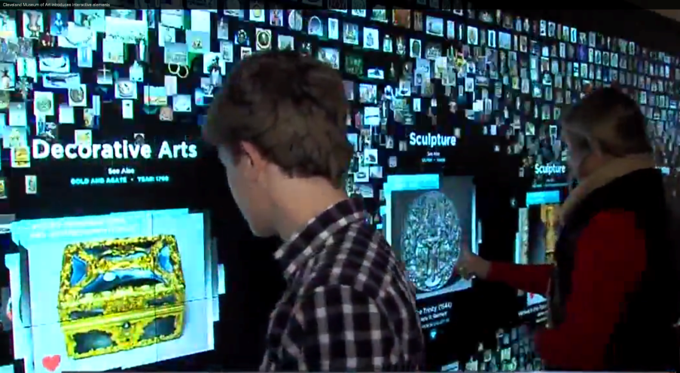
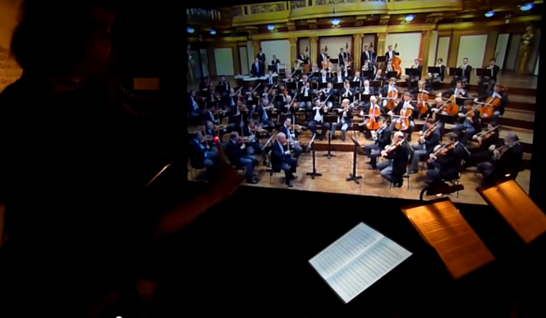
Interactive Museum technologies
Cleveland Museum of Art - Collection Wall and more (video)
Interactive Museum of Sound, Haus der Music, Vienna (video)

Slide 14
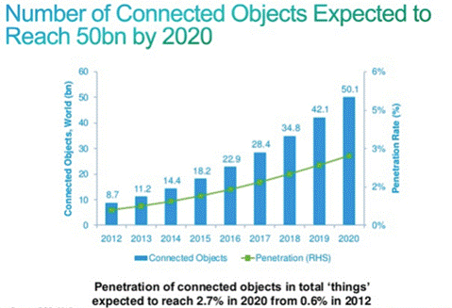
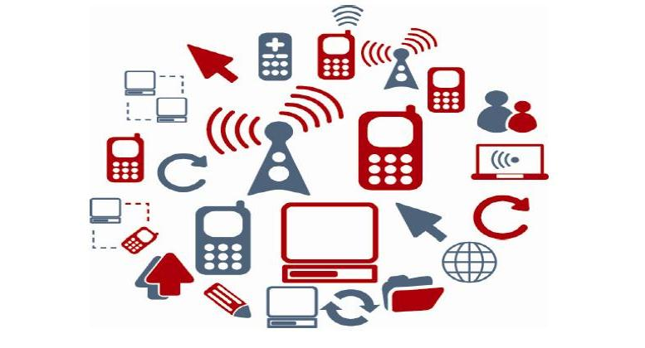
Internet of Things
Things mapped to IP addresses/library spaces. Wiring Library Spaces for IP address level connectivity.

Slide 15
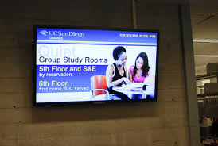
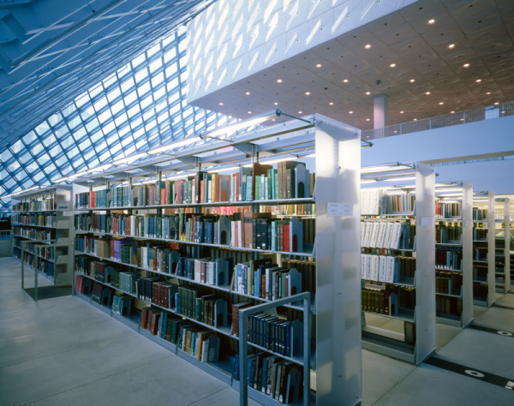
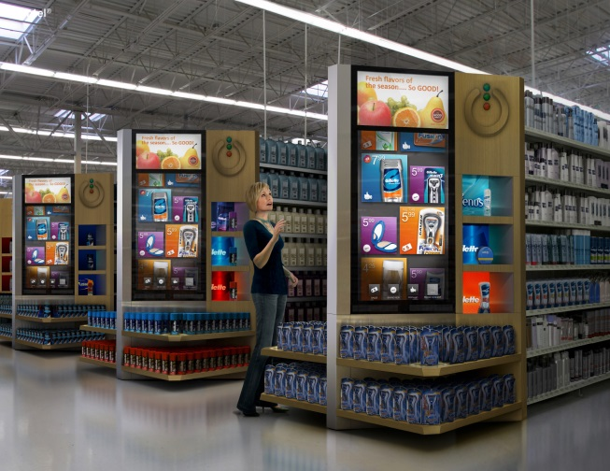
RFID, Bookshelves, Digital Signage
Electrical/Connectivity Needs for Digital Signage, RFID, Geo-locating, smart scholarly spaces

Slide 16
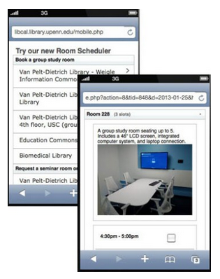
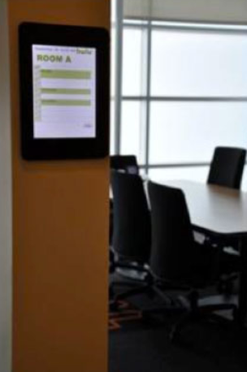
Smart Rooms and Scheduling Software
Electrical/Connectivity Needs

Slide 17
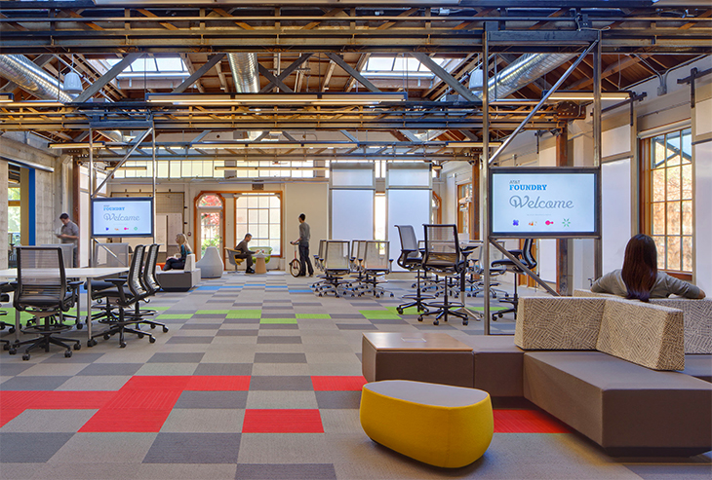
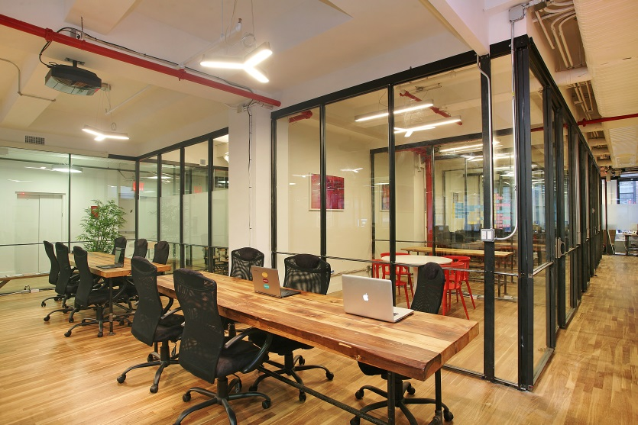
Staff Work Spaces Mobile, quickly (re)assembled
Internet Connectivity, Moveable Walls, Electrical Workplace of the Future (video), Examples (video), Moveable Walls (video),

Slide 18
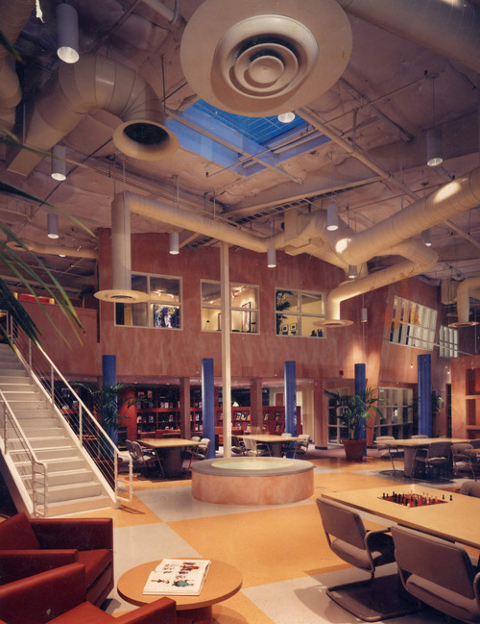
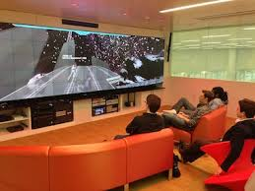
Imagineering Design Potential For Academic Library Spaces
Hunt Library Video, Learning Space Design Playlist Instant Theatres, Learning Work Spaces (video) Lighting Museums and Libraries (lecture video)

Slide 19
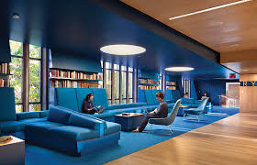
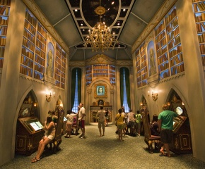
Imagineering Academic Library Spaces Show/Lighting Controller Technology
Learning Commons ODU (Student video), cafes, computers and journal kiosks, lighting-narrative, show controllers (vendor website) in academic environments, Expanded electrical/connectivity/plumbing

Slide 20
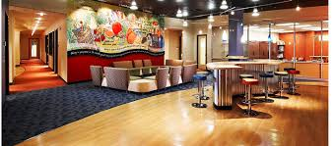
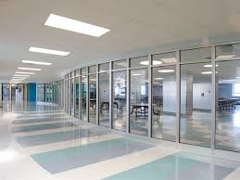
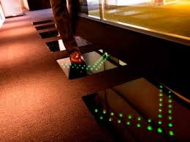
Wayfinding Design Smart Flooring/Tiles, Spaces, Library Cafes
Electrical Needs/Connectivity, Wireless & Higher Bandwidth Wayfinding Design, Digital Carpet, Plumbing for food & drink in the library, bathroom spaces

Slide 21
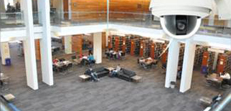
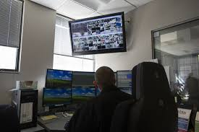
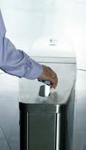
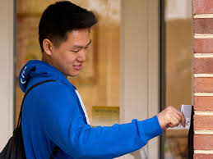
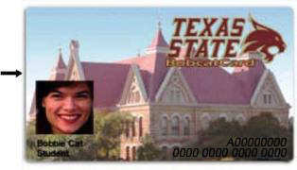
Expanded Building Security for Technology Rich Environments
Keyless Access Readers, Cameras Electrical/Connectivity Needs

Slide 22
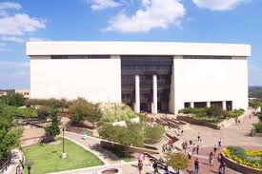
Final Considerations
Electrical/Connectivity
Expanded Electrical/Next Generation Bandwidth
Plumbing
Expanded plumbing needed to support increased use of food and drink (cafes) updated restrooms
Water Infiltration Leaks
Expanded Use of Indoor Outdoor Spaces
Increased Connectivity / Library Security

Slide 23
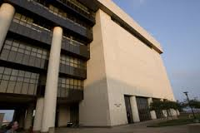
Questions/Comments

