Slide 1
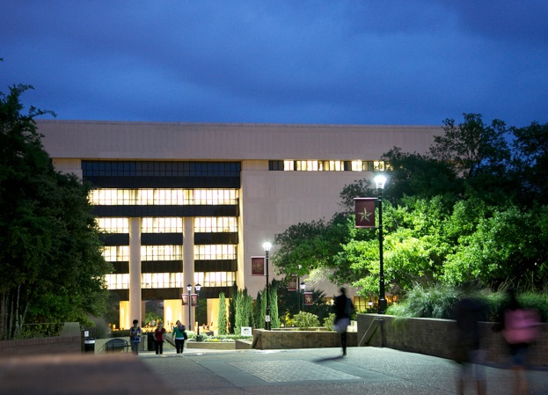
New Millenia Academic Research Library Technology/Budgetary Considerations (Texas State University, 2014)
Ray Uzwyshyn, Ph.D. MBA MLIS Director, Collections and Digital Services Texas State University Libraries

Slide 2
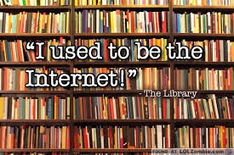
The greatest danger in times of turbulence is not the turbulence; it is to act with yesterday’s logic.
(Peter Drucker, ALA Trends Report, Snapshot of a Turbulent World, 2014)

Slide 3
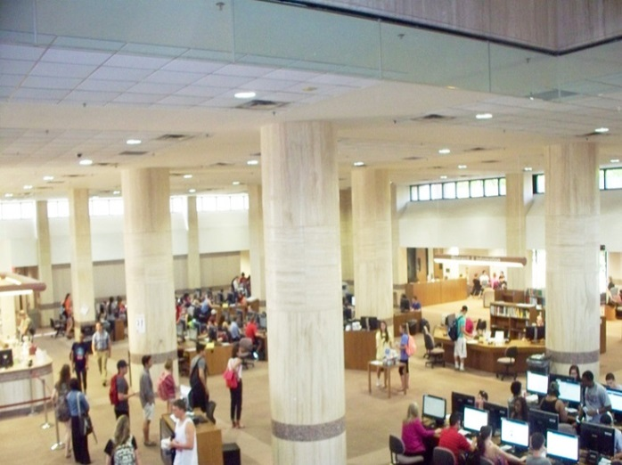
Alkek Library Technology/Budgetary Considerations
Technologies deployed in the library will change over time. Budgets should reflect this by allocating into flexible categories without necessarily establishing a long termspecific compartment for each new area

Slide 4
Alkek Library Budget/Technology Planning Considerations 2014
Planning associated with technologies and budgets should not be constrained based on current technology equipment or practices.
Library budgets should anticipate technologies we don’t expect to see in the library, and our current expectation of more technology is probably an underestimate.

Slide 5
Trends Impacting Budgetary Needs in Academic Research Libraries with Regards to Technology
Transformation of Scholarly Record (How Research is being pursued, accessed, transformed)
New Forms of Multidisciplinary Research
Increased Need for Data Management, Digitization and Learning Tools Infrastructures
Shift Towards Mobile Content

Slide 6
Serials Expenditures Effacing Other Technology Budgetary Considerations
What Gets Lost in the 340% increase?

Slide 7
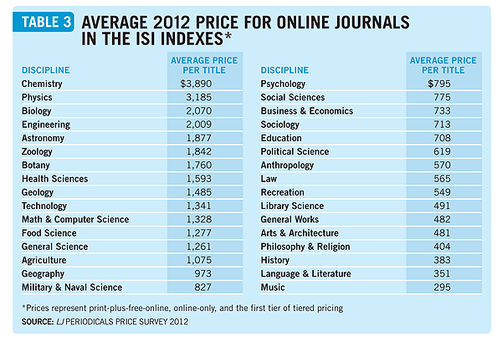
Average Price for Online Journals in ISI Indexes

Slide 8
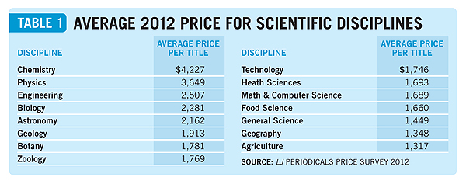
Differences for Average Price Per Title by Academic Disciplines

Slide 9
Evolving Nature of Scholarly Record: Budgetary Implications
Multidisciplinary Budget Lines for Research Universities (Horizon Report, p. 16-17)
Shift from acquiring Content (both Print and electronic) to Digital Production, Training, infrastructures, human resources
Open Source Journal Publishing and Print on Demand Presses (Infrastructure) Budgetary Lines Needed

Slide 10
Trends Report (ALA)
Information Technology: Fast Moving and Disruptive, Budgets Must Flexibly Allow for this
Information Institutions: Budgetarily Navigating Changing Ground, Changing Materials Budget of Library of 20th Century as Content Centered
Information Use and Consumption: Scholarly Generational Shift from old (paper based) to new Media budgetary Implications

Slide 11
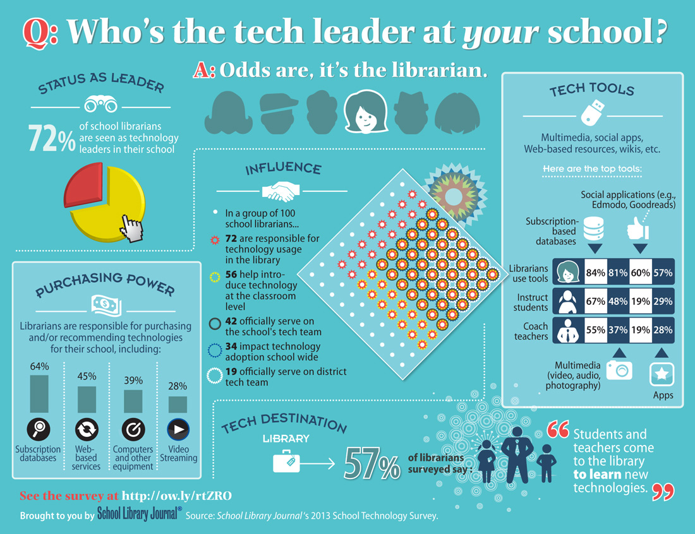
Budgetary Implications for Library Technology Adoption

Slide 12
Budgetary Trends (ALA)
Information Use and Consumption Trends
Increasing Connectivity
Integration of Physical/Digital Life
Overlap of Old and New (Demographic Differences in Media)
Physical Space Paradigm/Budgetary Shift to Learning Commons should also be reflected in Budgetary Content Shift of Materials Budget

Slide 13
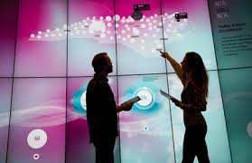
New Academic Library Budgetary Technology Considerations

Slide 14
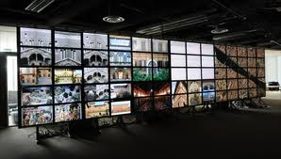
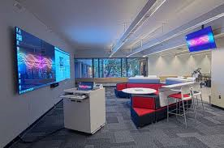
Visualization Technologies Wider definitions of computing & digital literacy
Hunt Library NCSU (video) Rice (video, rationale, science) UT Austin (video, humanities) Deloitte University (video, business)
Electrical and Connectivity Needs

Slide 15
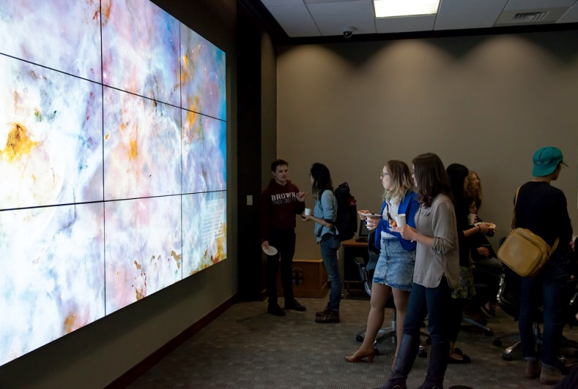
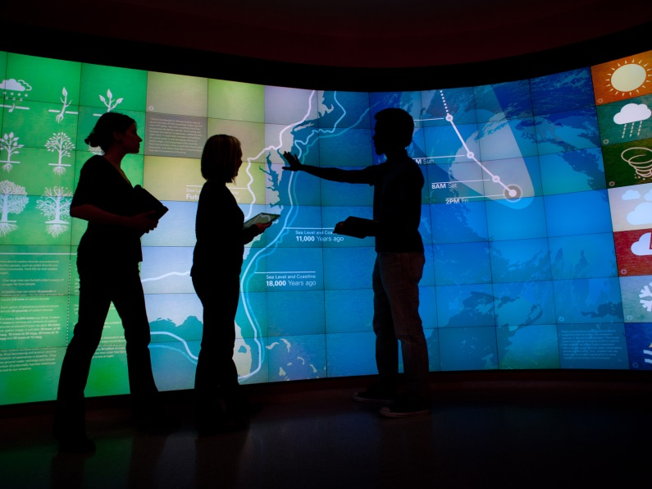
Visualization Walls (VizWall)
Brown University Rockefeller Library (article)
NCSU Hunt Library (infrastructure link)

Slide 16
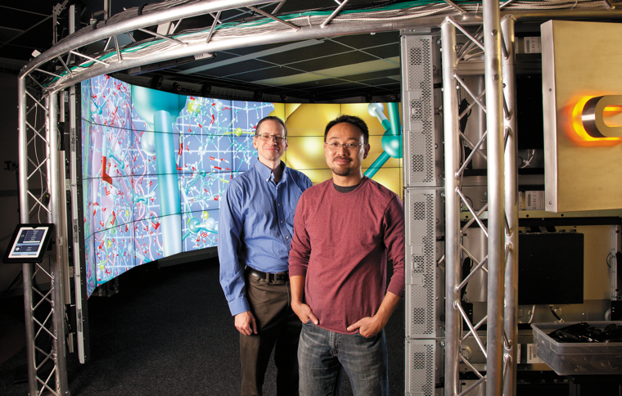
3D Immersive & Interactive Environments
University of Chicago CAVE (article and video)
John Hopkins Libraries Brody Learning Commons Display Wall (video)

Slide 17
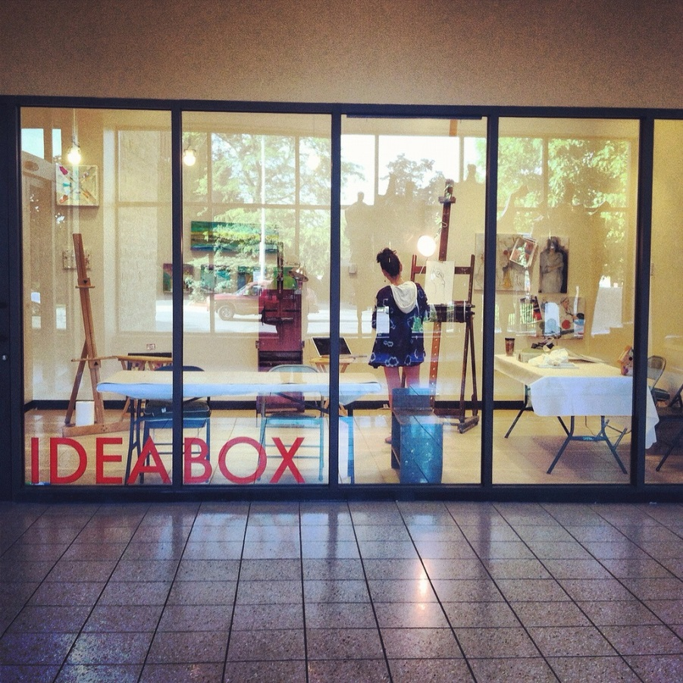
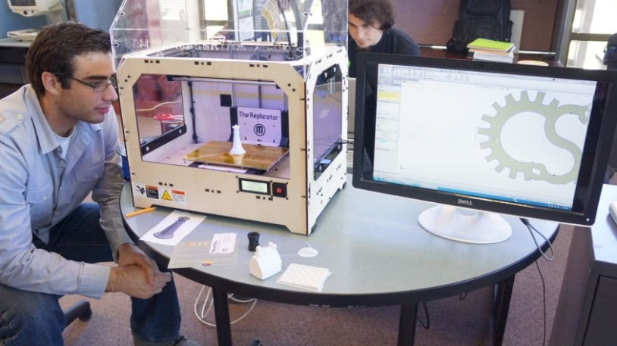
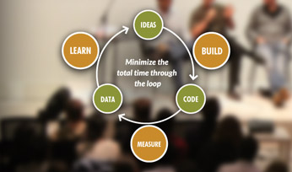
Academic Library Maker Spaces
ACRL: Academic Library Makerspaces (article)
Library Makerspaces (Resource List), Examples

Slide 18
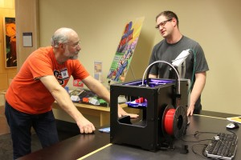
Academic Makerspaces
Oregon State University Valley Library (article)
University of Michigan 3D Lab (example infrastructure)
Traditionally include 3-D printing, but can include other spaces to create content (e.g., large-format printing, physical computing, prototyping sandboxing)

Slide 19
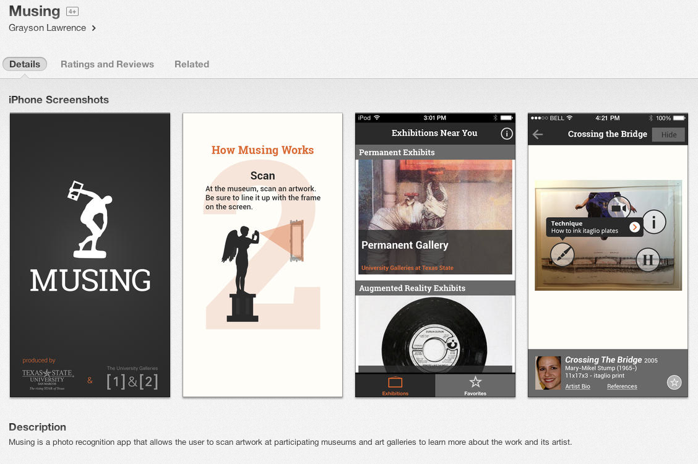
Interactive Museums
Interactive displays, visual media displays, audio/podcast tours and electronic multimedia guides. Examples:
MUSING: an iPhone app developed by Texas State (Link)

Slide 20
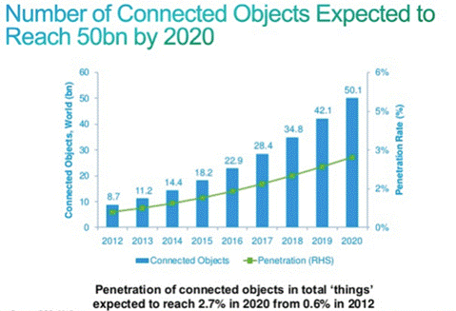
Internet of Things
Things mapped to IP addresses/library spaces. Wiring Library Spaces for IP address level connectivity.

Slide 21
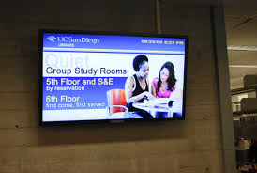
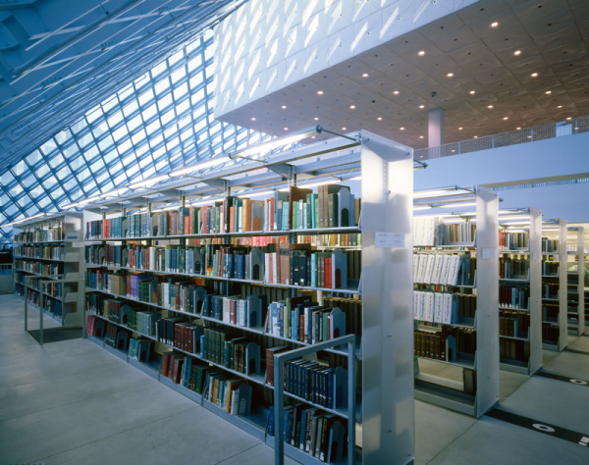
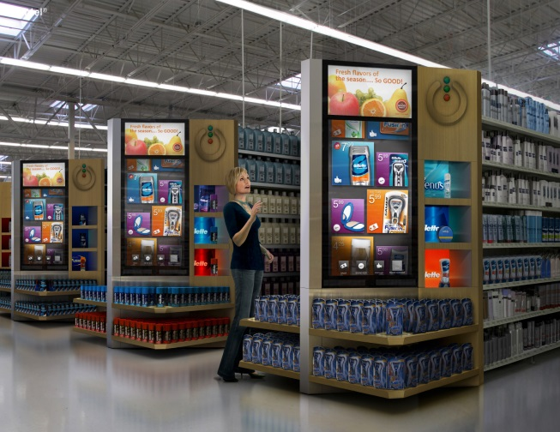
RFID, Bookshelves, Digital Signage
Electrical/Connectivity Needs for Digital Signage, RFID, Geo-locating, smart scholarly spaces

Slide 22
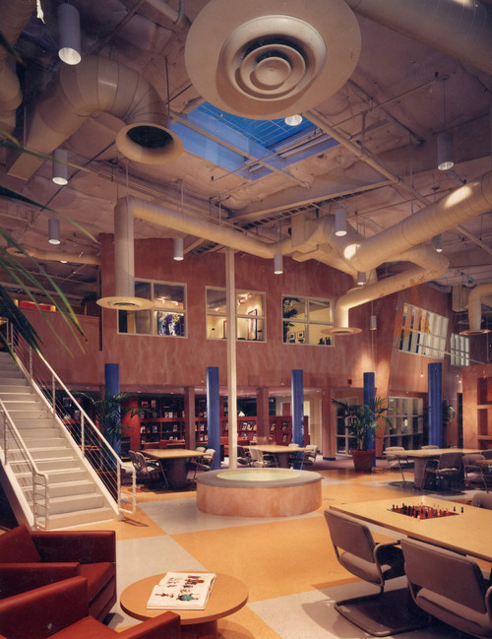
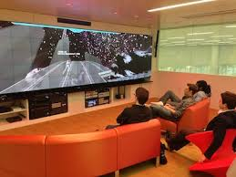
Imagineering Design Potential For Academic Library Spaces
Hunt Library Video, Learning Space Design Playlist Instant Theatres, Learning Work Spaces (video) Lighting Museums and Libraries (lecture video)

Slide 23
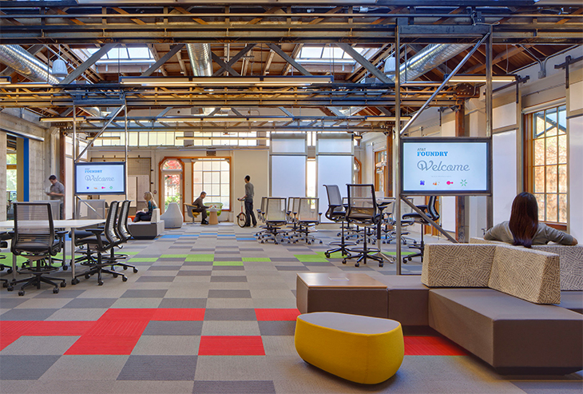
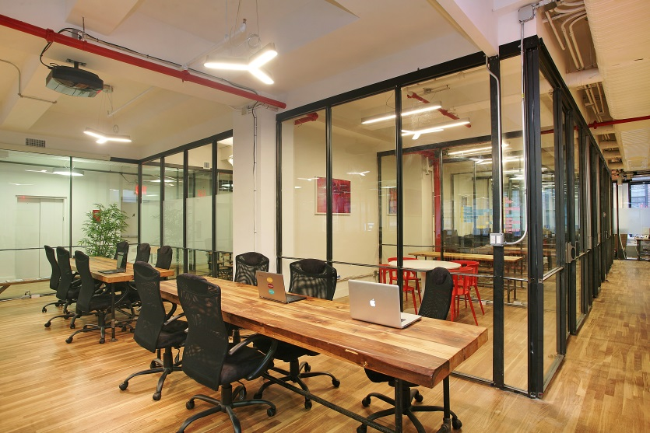
Staff Work Spaces Mobile, quickly (re)assembled
Internet Connectivity, Moveable Walls, Electrical Workplace of the Future (video), Examples (video), Moveable Walls (video),

Slide 24
Larger Thoughts
University is shifting to ARL directions, larger materials budget should innovatively reflect this with content disciplines in an innovative forward thinking manner in a similar fashion to what is going on with the paradigm shift of the physical library space and transformation to learning commons

Slide 25
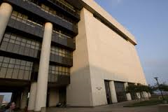
Questions/Comments

