Slide 1
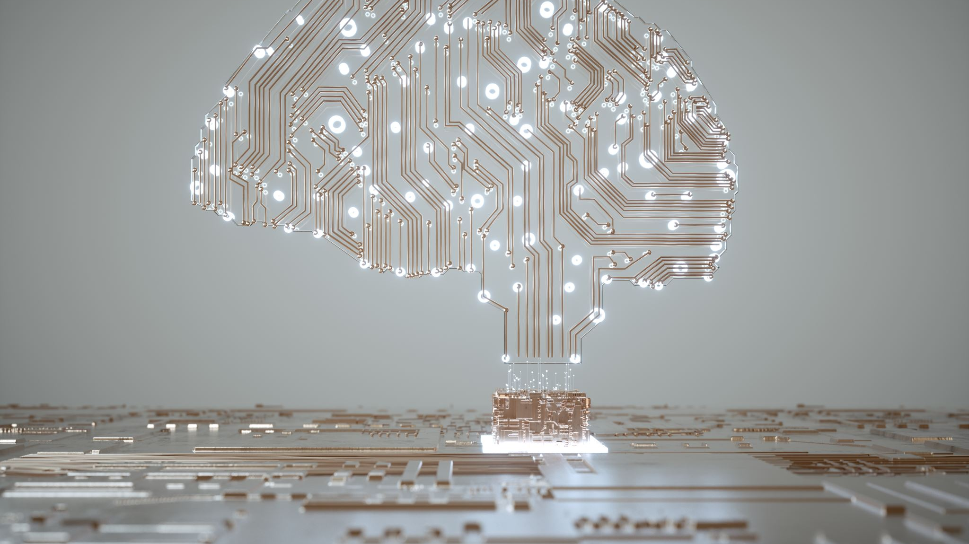
Exploring Artificial Intelligence A Pragmatic Overview and Future Applications in Information Management
Dr. Raymond Uzwyshyn Associate Dean, Collections Management and Strategy Mississippi State University Libraries, 2024

Slide 2
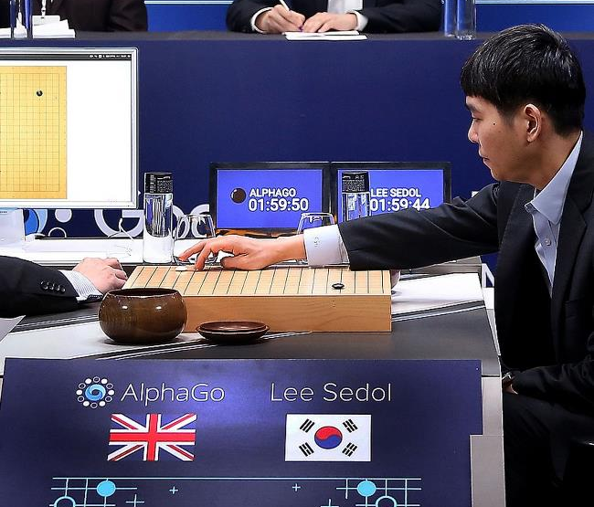
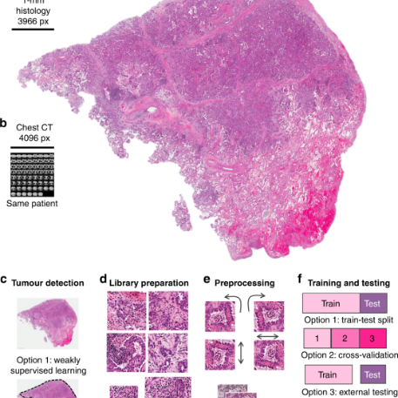
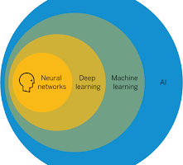
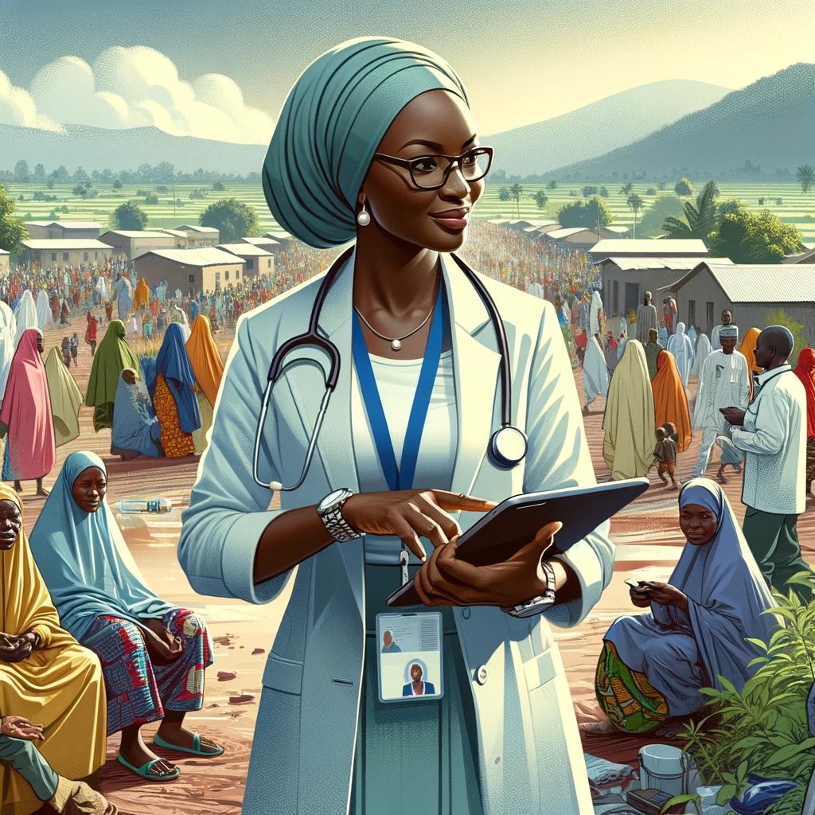
Last Ten Years Has Shown Incredible Progress of AI AI (Machine Learning (Deep Learning)) = Algorithms (Better) + Computing Power (Greater) + Data Sets (Larger)
Natural Language Processing (Speech to Text, Translation)
Computer Vision (Facial + Object Recognition Cancer Cell Detection) )
Strategic Reasoning (Deep Mind’s AlphaGo)
Ethics & Fraud Detection & Cybersecurity
Conversational Chatbots, ChatGPT & Robotic Agents

Slide 3
AI Histories
1950’s
Begins in the 1950’s, mostly US and Britain. Main Figures, Alan Turing (Turing Test), John McCarthy Dartmouth Conference (Artificial Intelligence name is coined), Marvin Minsky
1960’s
Continues in 1960’s Josef Weizenbaum (Eliza, First Chatbot), Marvin Minsky, Neural Nets Introduced (processing power issues)
1980’s -1990’s
AI winter, Expert Systems, IBM’s Deep Blue (1997) beats Kasparov in Chess
2000’s
(Geoffrey Hinton, U Toronto), Push Singh (MIT), Chris Mckinstry, Deb Roy (Waterloo, MIT, Early Voice Recognition)
2010’s
Deep Learning/Neural Net Renaissance Ilya Sutskevar (U Toronto, AlexNet, Images), Yoshua Benjio, Yann LeCun (Meta) Google Deep Mind (Demis Hassabis, Cambridge, UC London, AlphaGo Beats Lee Sedol, S. Korea Go)

Slide 4
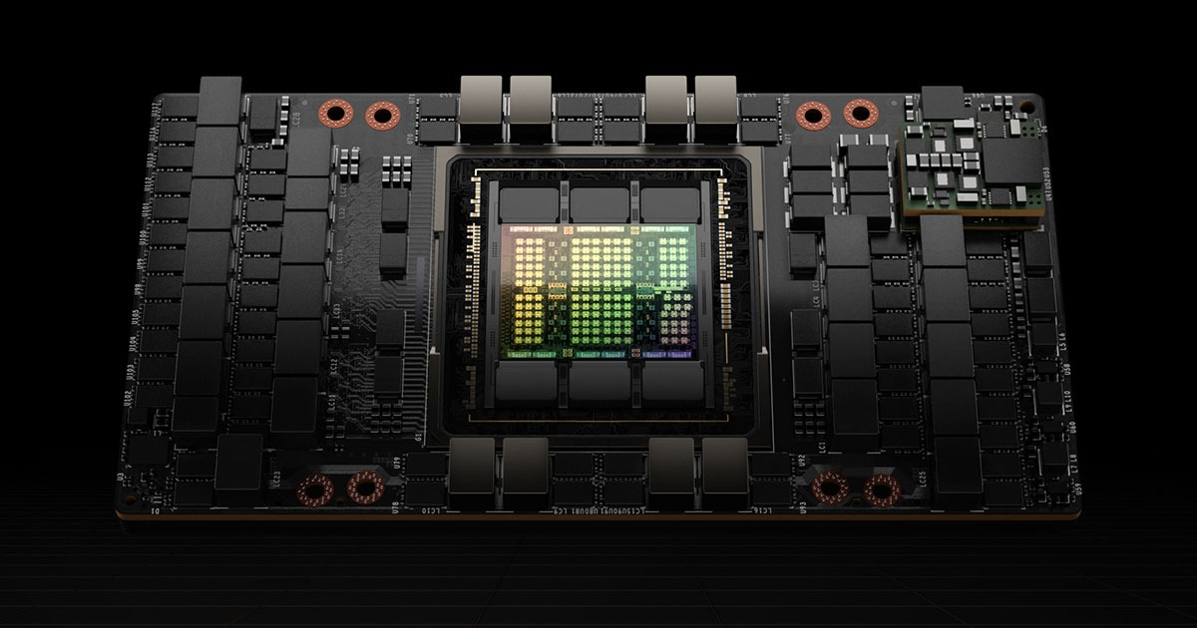
Moore’s Law, Processing Power/Compute and AI Number of Transistors on an Integrated Circuits Doubles Every 2 years
NVIDIA A/H100
5000, 000, 000 Transistors (2014)
Deep Blue/Kasparov 5000,000 Transistors (1997)
Eliza: Mainframe and Terminal 50,000 Transistors (1982)
5000 Transistors (1970)

Slide 5
Data Storage, Memory and AI Cost/TB (AI Requires Massive Datasets For Training Neural Nets)
1 Byte = 0.001 Kilobytes (KB)
1 Kilobyte (KB) = 1 KB
1 Megabyte (MB) = 1,000 KB
1 Gigabyte (GB) = 1,000,000 KB
1 Terabyte (TB) = 1,000,000,000 KB (1 Billion KB, Trillion Bytes
1 Petabyte (PB) = 1,000,000,000,000 KB
1 Exabyte (EB) = 1,000,000,000,000,000 KB
1 TB (2024) = 50.00-100.00 USD (Hard Drive or Cloud)

Slide 6
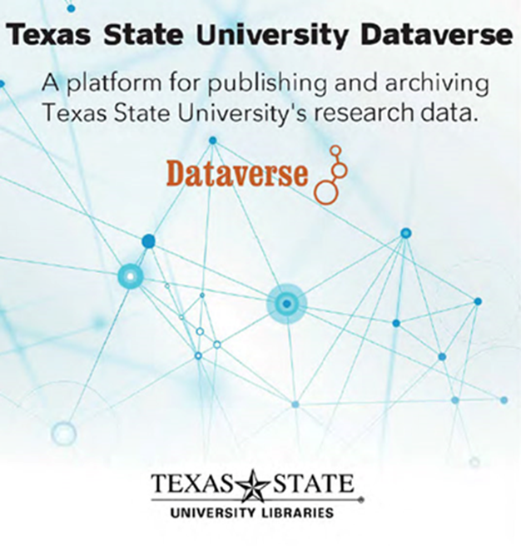
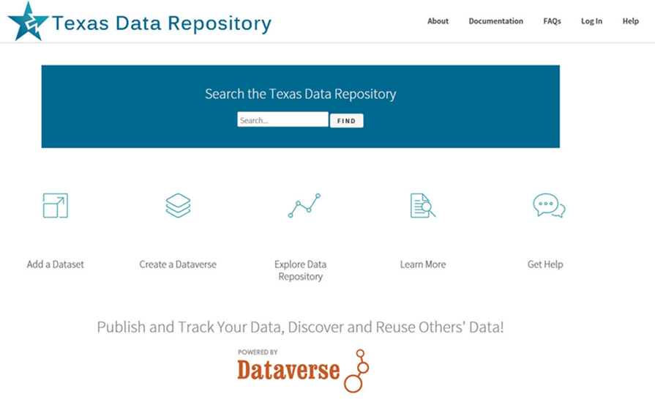
AI Requires: Processing Power(Microprocessor, GPU’s or TPU’s) + Data (Content) + Storage (Memory) + Global Networks
2014-2017, Texas Data Research Repository, Data Sharing, Collaboration, Data Visualization, Tableau, Discovery and Insights, Artificial Intelligence

Slide 7
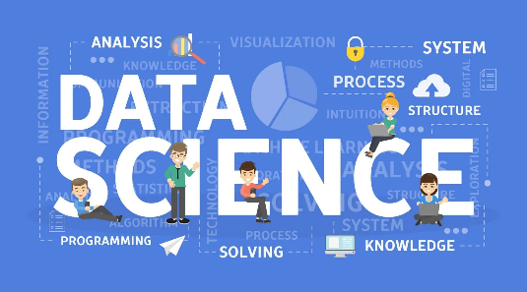
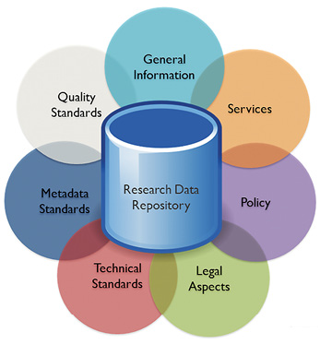
Clear Trajectory in Libraries from Data Collection To Data Science -> Data Repositories -> Data Analytics -> Data Visualization > AI

Slide 8
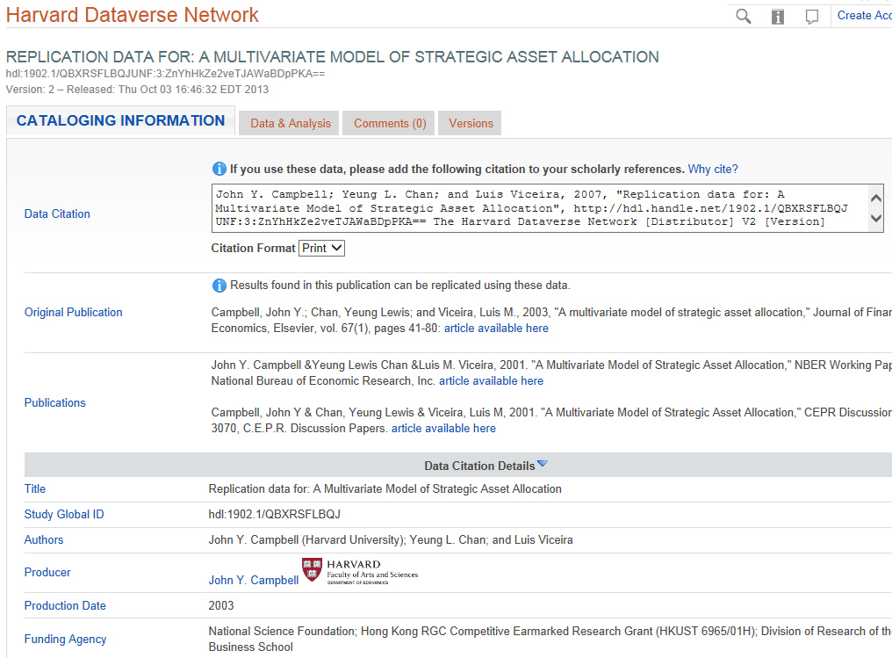
Data Repositories Allow Building Skills For AI Data Organization, Data Cleaning, Structured Data Citation, Sensitive Data and Metadata Schemas
OpenRefine is a powerful tool for working with data: (cleaning it)
‘Clean Data’ Is needed
For further processing
Including data visualization and AI.

Slide 9
The Research Data Repository Lifecycle Setting Better Foundations & Organization for AI Infrastructures
Data Repository provides Basic AI, Machine Learning, Open Science and Research Needs.

Slide 10
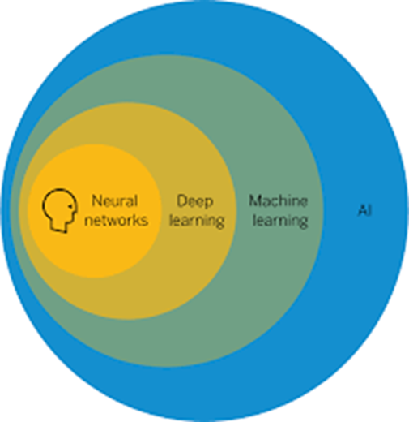
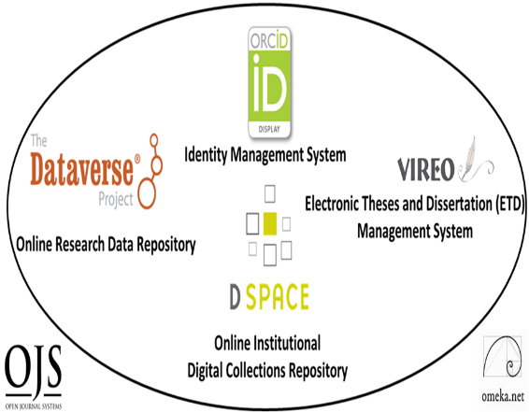
Last Five Years Has Shown Incredible Progress of, Analytical Computational Tools, Particularly, AI Machine Learning, Deep Learning, Computer Vision, Object Recognition, Cancer Detection

Slide 11
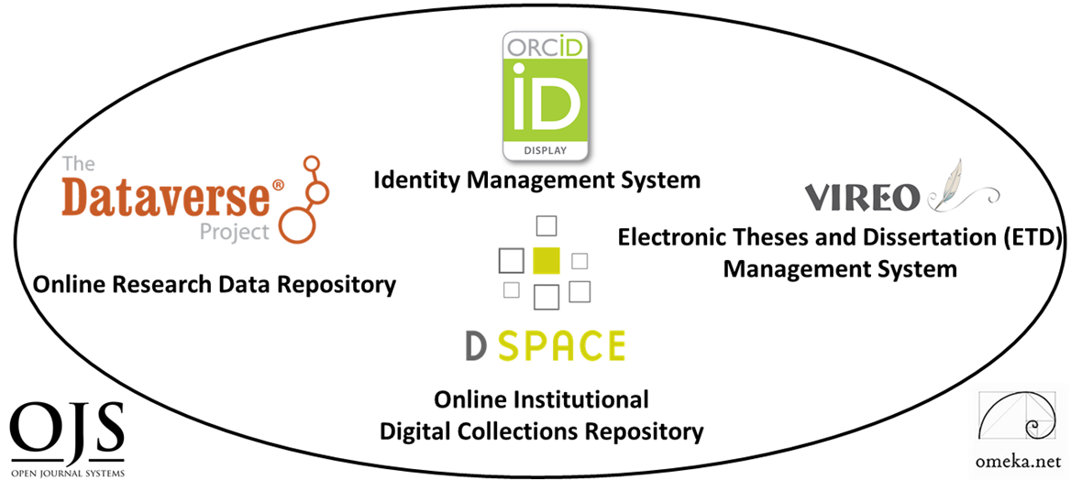
Recommendation: Digital Scholarship Ecosystems, Foundations for AI Six Open Source Software Components
TWO PRIMARY COMPONENTS
DIGITAL COLLECTIONS REPOSITORY
FOUR TERTIARY COMPONENTS (Communication)
Electronic Thesis and Dissertation Management System
User Interface/Content Management Software
Identity Management System
Open Academic Journal Software
RESEARCH DATA REPOSITORY
(Content)

Slide 12
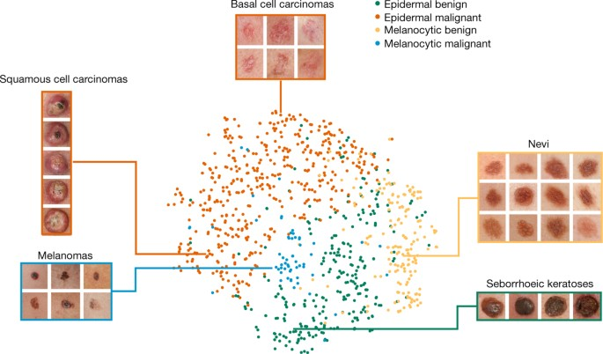
Dermatologist-Level Classification of Skin Cancer with Deep Neural Networks 2017, Nature Article, Esteva, Thrun et Al Labeled Medical Metadata from Dataverse Image Data Archives to Training AI (Deep Learning Models (Neural Networks)
Video Stanford

Slide 13
Dataverse Data Research Repository Metadata
Dermatology Image Dataset, Dr. Philip Tschandl, Viennesse Dermatologist
Great Example of Open Science & Metadata
https://dataverse.harvard.edu/dataset.xhtml?persistentId=doi:10.7910/DVN/DBW86T

Slide 14
Open Science, Data Research Repositories, Discovery, Reuse and AI
Dermatologist-level Classification of Skin Cancer with Deep Neural Networks, Nature 2017,Andre Esteva, Brett Kupress, Sebastian Thrun et al.
Video Stanford Overview

Slide 15
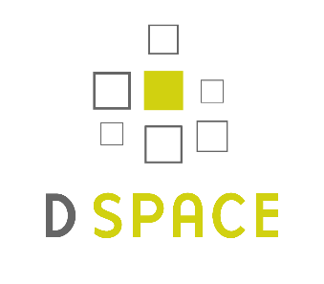
Digital Collections Repository Dspace http://dspace.bracu.ac.bd/xmlui/ handle/10361/15932
BRAC University Libraries Institutional Repository

Slide 16
The Progress of Knowledge Through Global Open Science & Network Possibilities 2017 Stanford Nature Deep Learning
Cancer ID Article 2018 Viennesse Doctor in Austria uploaded Dermatalogical Image Library to Harvard Dataverse Data repository
2021 (November) Undergrad Thesis Published in Dspace Repositor BRAC University, Dhaka Bangladesh, Dept. of Computer Science and Engineering All Downloaded July 2022 Texas, USA for Dublin IFLA Big Data Presentation

Slide 17
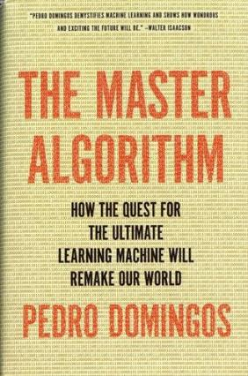
AI Has Many Paradigms and Origins Approaches for Different Solution Spaces Dr. Pedro Domingos, University of Washington
AI Paradigm | Origin | Algorithm | Problem | Solution
Deep Learning Machine Learning | Neuroscience (Neural Nets) | Back Propagation Neural Nets | Complex Tasks, Hidden Patterns | Back propagation
Symbolic AI | Logic, Philosophy | Inverse Deduction | Knowledge Composition | Inverse Deduction
Bayesian Inference | Statistics, Probability Theory | Probabilistic Inference | Uncertainty | Probabilistic Inference
Evolutionary Computation | Evolutionary Biology (Complexity Theory | Genetic Algorithms | Structure Discovery | Genetic Programming
Reasoning by Analogy | Psychology | Kernel Machines (Support Vector Machines) | Similarity | Kernel Machines
2015, 2018

Slide 18
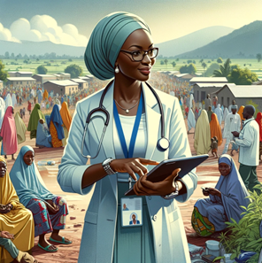
Last Ten Years 2014-2024 Amazing Progress of AI AI Deep Learning)) = Better Algorithms + Greater Computing Power + Large Data Sets + Good Metadata (Labeling)
LLM’s, GPT’s, Conversational Chatbots & Robotic Agents
Natural Language Processing (Speech to Text, Next Word Translation)
Computer Vision Cancer Cell Detection(Alexnet) (Facial + Object Recognition
Strategic Reasoning (AlphaGo, 2015-2017)
Fraud Detection & Cybersecurity

Slide 19
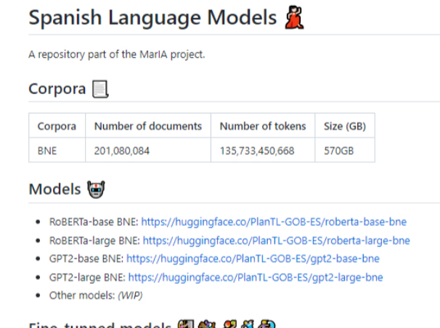
AI, Large Language Models (LLM’s) and GPT’s Generative Pretrained Transformers, Trends and Issues In Library Technology, June 2022
Digital Transformation, Data Reuse and Heritage Collections ANational Library of Spain, Partnership with Supercomputing Center ( Mare Nostrum), January 2022

Slide 20
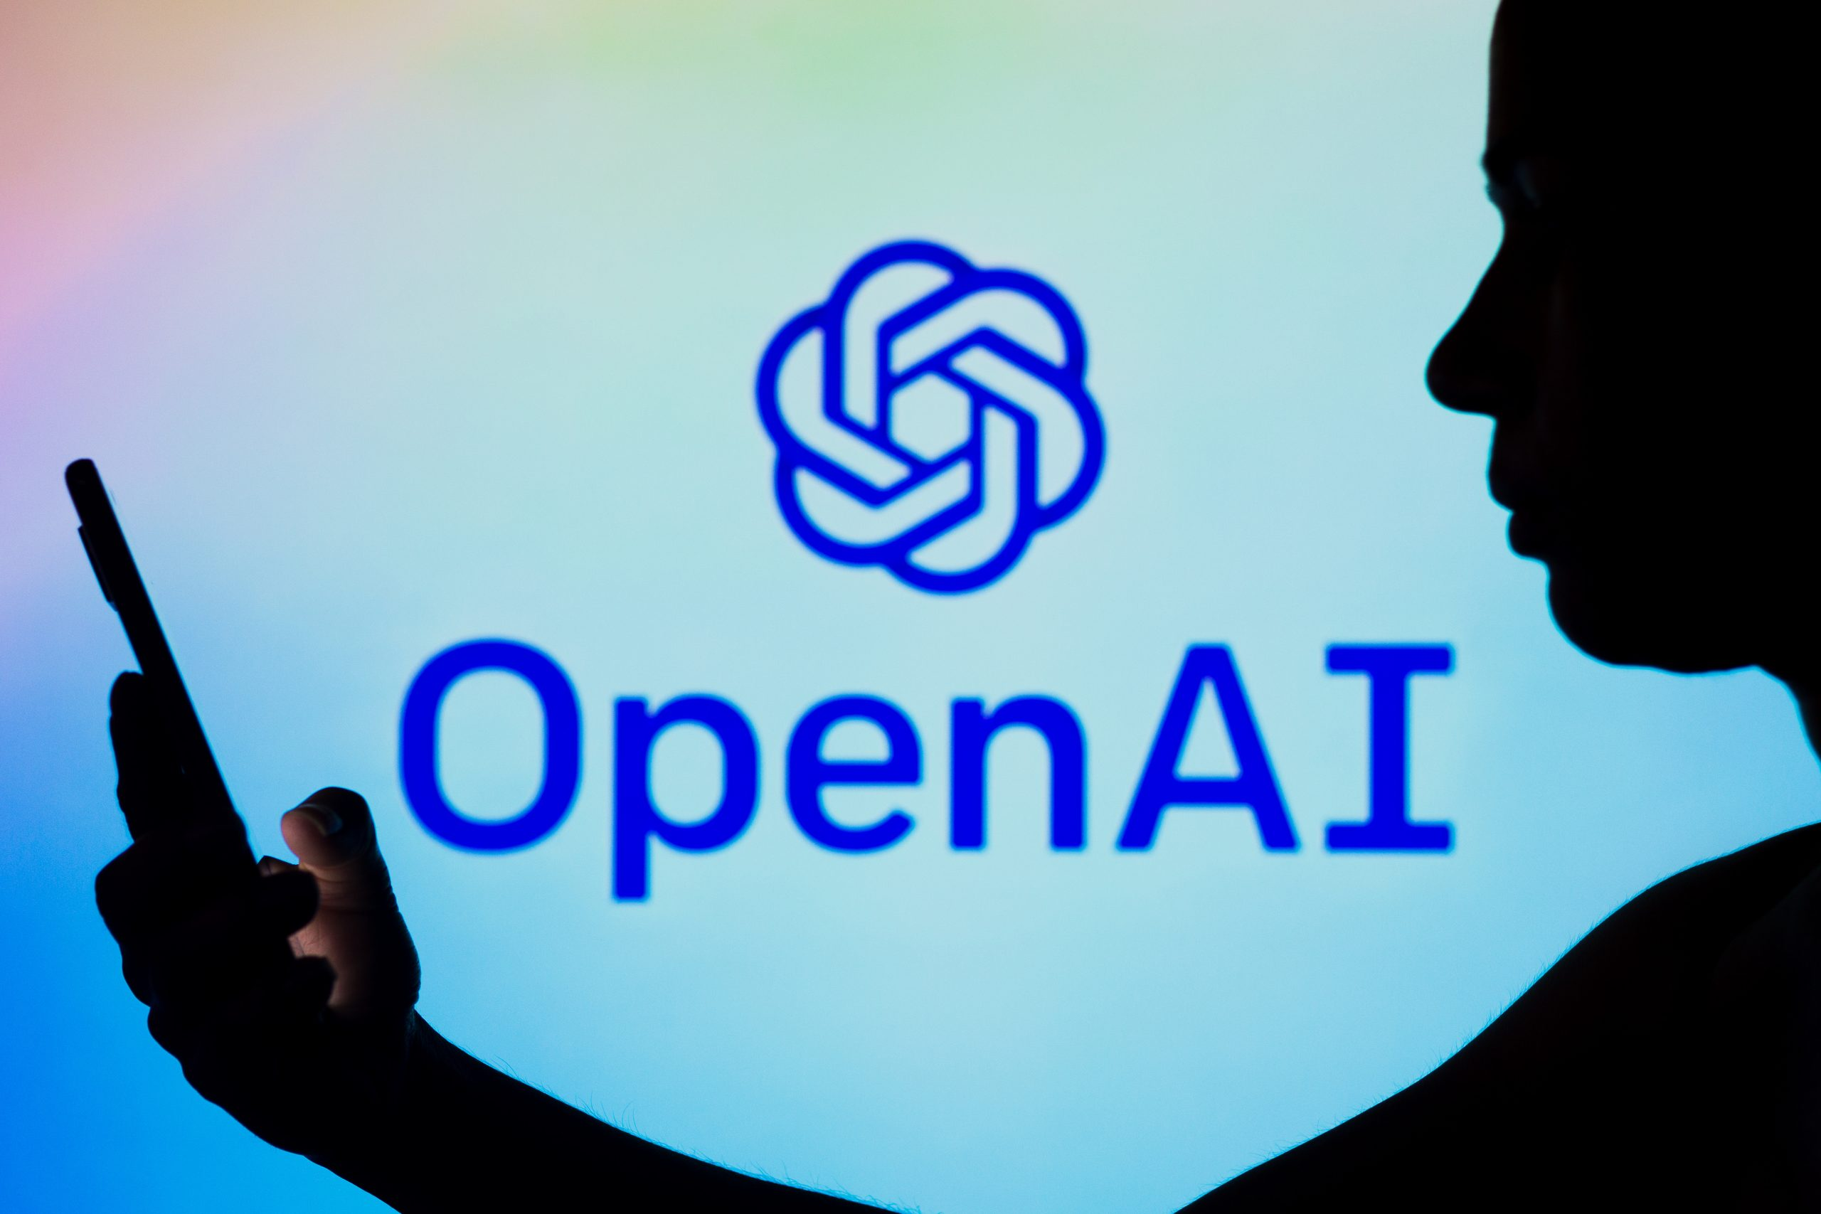
Open AI, November 2022, Chat GPT3.5 Release Chatbot version of the Language Model GPT3, Current Release GPT4.0
Generates Human-like Text: Writes and chats naturally. Next word model extended. Probabilistic Language Model
Based on Transformer Model + Neural Nets: Efficient, smart text processing. Trained on over 175 Billion Parameter (massive learning capacity)
Uses Attention Mechanism: Focuses on relevant information. and Transformers (Query, Key(words), Value model)
Trained on Massive Amount Text and Can Perform multiple tasks: Understands massive amount of topics to Answer questions translate, create (synthesize new knowledge)
Makes Predictions: Infers answers from data, language, words
Context-Aware Responses: Understands conversation history.
Handles Complex Instructions: Understands nuanced requests.
Availability: Through Bing (Microsoft, Free) and OpenAI (Paid, 20.00/month, Android/Apple (App Download)
Sam Altman, CEO, Ilya Sutskever, Chief Scientist, Satya Nadella, Microsoft CEO, Greg Brockman, President Main other Competing Models Gemini Pro/Ultra (2024) Claude 2 Anthropic Mixtral

Slide 21
(Baidu Search Engine)
Olympus (Amazon)
Dr. Alan Thompson
GPT-4’s Mixture of Experts Model (MoE model) is believed to house 16 expert models, each with around 111 billion parameters each. The Mixture of Experts (MoE) is offering a unique approach to efficiently scaling models while maintaining, or even improving, their performance. Traditionally, the trade-off in model training has been between size and computational resources

Slide 22
Large Language Models (LLM’s) GPT1, GPT2, GPT3, GPT3.5 and GPT4 GPT – Generative Pretrained Transformers
Characteristics of Large Language Models and GPT4
GPT-4 Model: Advanced AI language model, 175 trillion parameters.
Mixture of Experts (MoE): Architecture using specialized networks for varied tasks.
Parameters Defined: Components in the model learned and adjusted from data. Used for next word prediction/understanding
Training Data: Diverse textual sources, books, web content, language styles and information
Number of Tokens: Trillions of text pieces, words, or characters.
Adaptive Learning: Appears contextually responsive, but doesn't learn post-training.
Task Versatility: Handles translation, answering, summarization, and creative tasks.
Ethical Considerations : Trained on addressing bias and misuse Searchunify.com

Slide 23
ChatGPT 3.5 and ChatGPT 4.0 on several well recognized Human intelligence tests Visualcapitalist.com

Slide 24
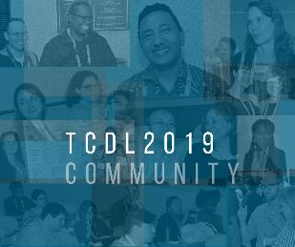
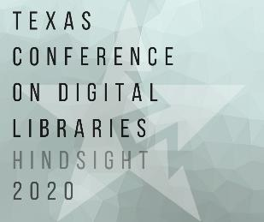
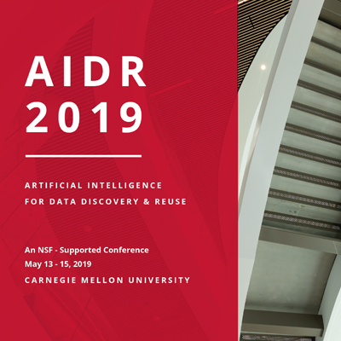
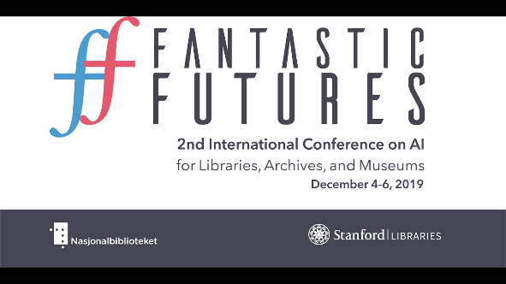
R&D, Academic Library Technology Conferences AI and Learning, 2018-2022
Coalition for Networked Information (D.C.) , Yale Art History Project ,Pixplot (Image Categorization), 2018, Peter Leonard (Neural Nets) Artificial Intelligence for Data Discovery & ReUse & Open Science Symposium (2020), Carnegie Mellon, Pittsburgh Fantastic Futures
2nd International Conference on AI for Libraries, Archives and Museums Stanford Libaries (2019) Texas Conference on Digital Libraries, Patrice Andre Prud’homme (TCDL) Oklahoma State (2019),

Slide 25
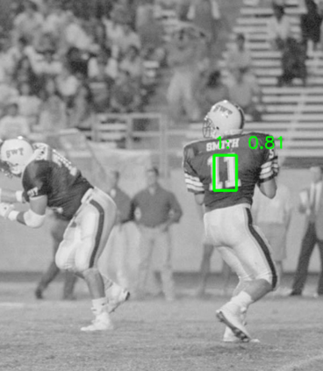
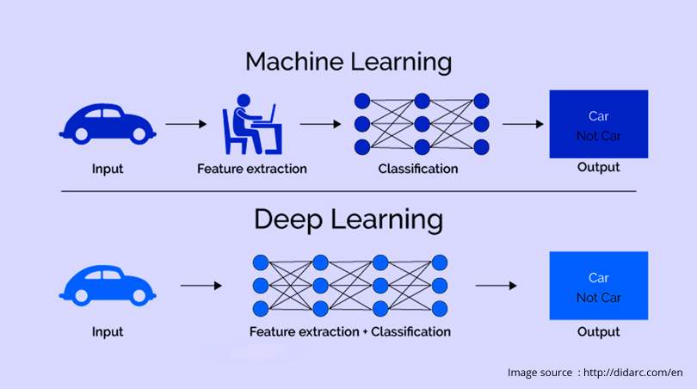
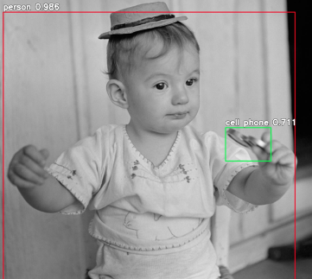
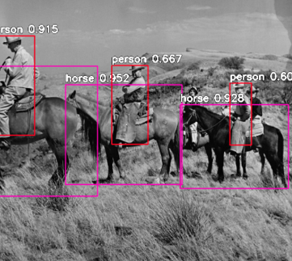
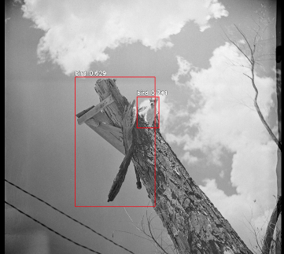
R&D & Learning: Digital and Web Services Deep Learning Models and Convolutional Neural Nets (2019 Projects Begun, Early 2022 Presented, TCDL, Galway, National University of Ireland, IFLA Dublin, IR)
University Archives San Marcos Public Newspaper Image Negatives 90 years of digitization 800, 000 images
Processing Power (Compute)
Python
Video Cards (NVIDIA GPU’s)
Pretrained Models
ResNet, YOLO, COCO (200k labeled images, 80 categories)

Slide 26
Massive Multitask Language Understanding Test, MMLU (57 Tasks) from Math to Law and Computer Science

Slide 27
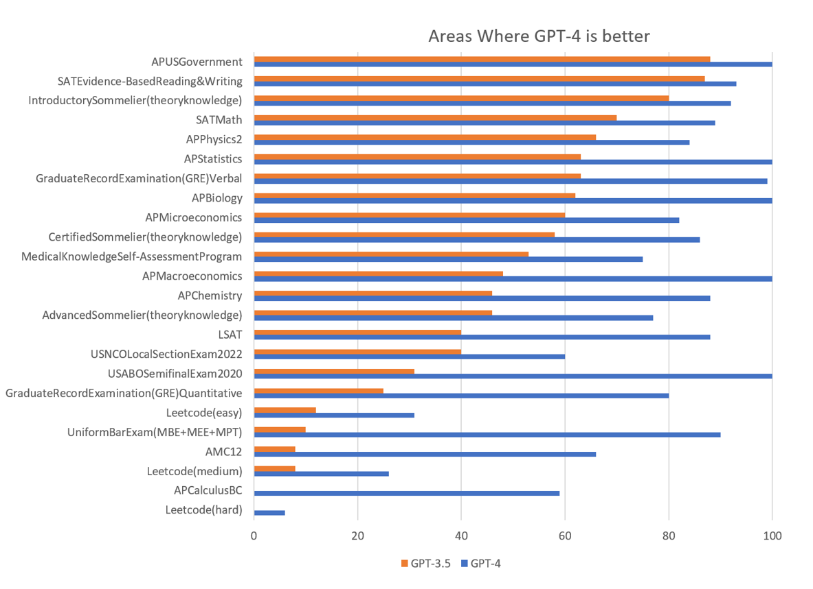
How Intelligent is GPT 4? Standardized NA High School, University & Graduate School Tests (GPT3.5 & GPT4.0 Humans vs. Artificial Intelligence
90%
85%
100%
100%
85%
80%

Slide 28
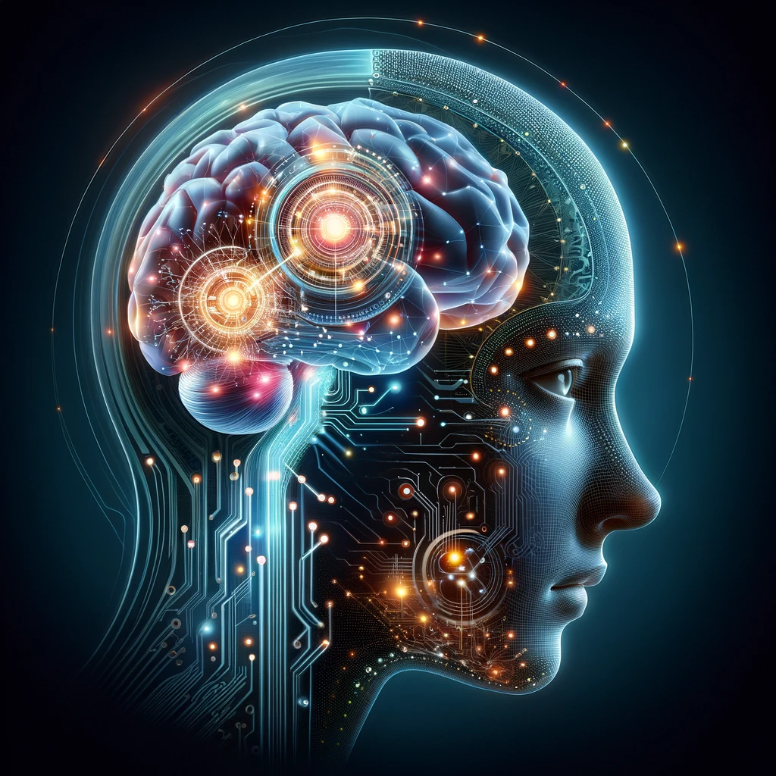
ChatGPT AI Available Through MS Copilot and Open AI Shift in Knowledge Seeking from Search Engine Search to Direct Answers and Outcomes
Use Case Scenarios
General Knowledge Seeking, Language Translation, Knowledge Synthesis
Business: Business Development, Marketing, Analysis, Decision Making, Customer Support/Service, Troubleshooting, Business Plans
Education and Learning: Tutoring, language learning, homework, K-12, Undergraduates and Graduates
Content Creation: Articles, stories, administrative help and documents, creative ideas, poetry, scripts
Data Analysis: Summarization, analyzing data, generating reports, business analysis Wellness and Mental Health: empathetic and professional responses Personal Assistant: Managing Schedules, organizing reminders

Slide 29
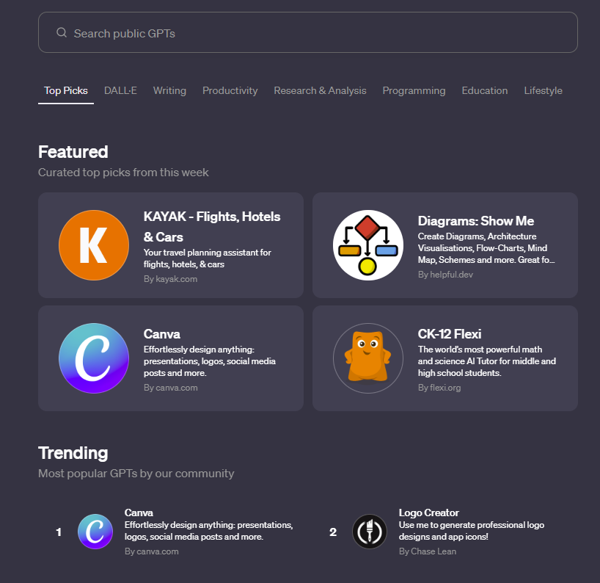
Open AI’s GPT Store Memberships for ChatGPT but Apps are free (Individual and Teams)
Featured and Trending Dalle (Multimodal Based) Writing Related Research and Analysis Programming Education Video Making, Marketing Related

Slide 30
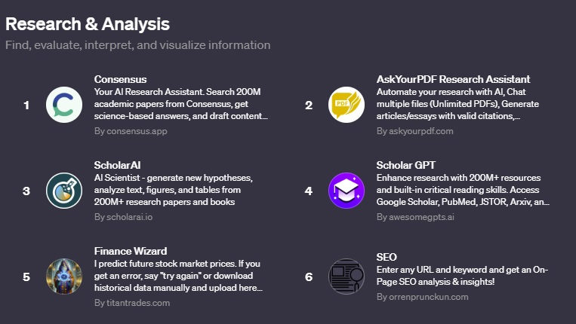
Research & Analysis GPT 4.0 Store

Slide 31
Education, GPT’s 4.0

Slide 32
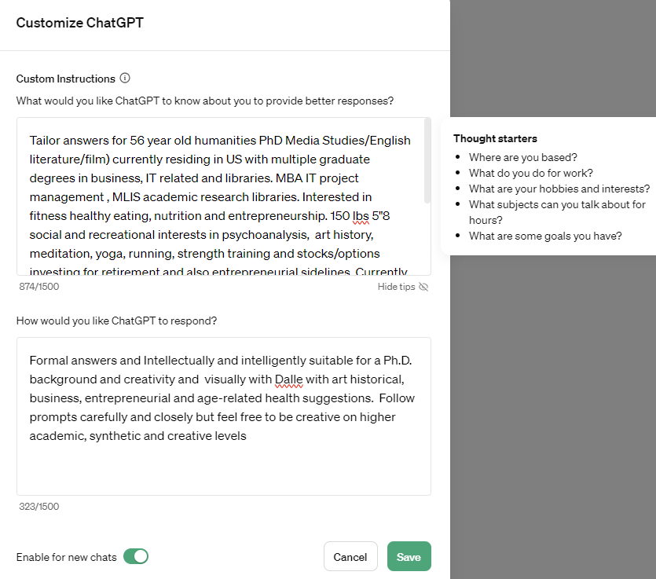
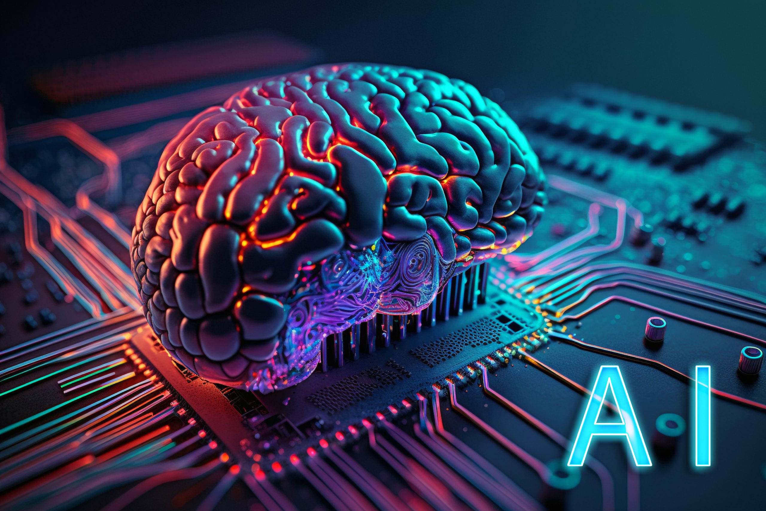
GPT 4.5 Contextual Answers Personalized Memory and Storage

Slide 33
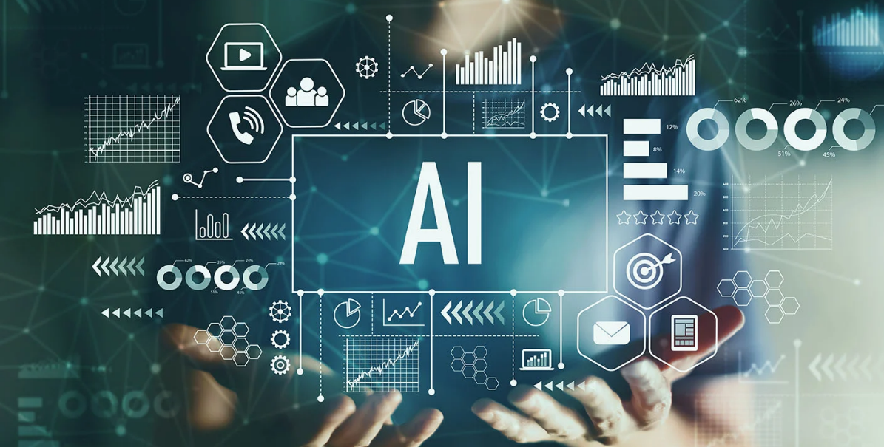
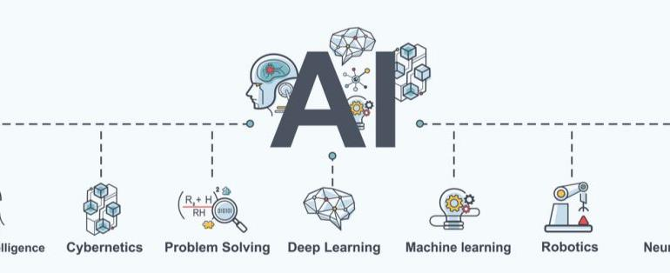
AI For Libraries Many New Possibilities
New Classes of AI Competencies Needed for Research, Subject Access Analysis, Metadata Renaissance
Prompt Engineering, GPT4+, Dalle-3,
New Learning Opportunities for Faculty and Staff (Mentoring and Enabling Employees (IMLS AI Bootcamp, AI)
New Horizons for AI in Libraries IFLA/ De Gruyter (2024): Several Library/AI Digitization Papers

Slide 34
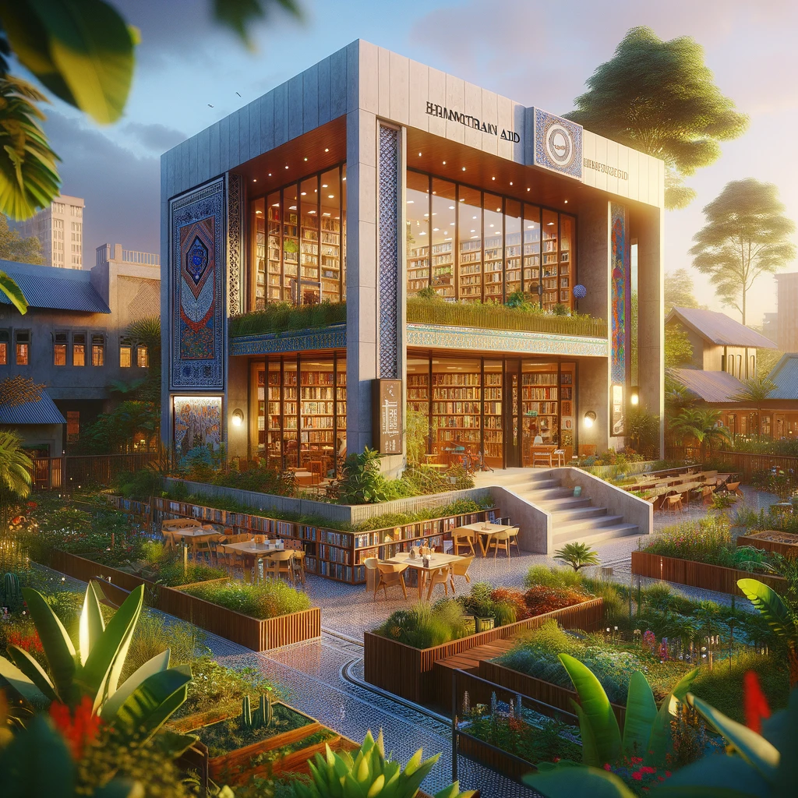
Prompt Engineering and GPT4 Model Personas For Nigeria and Africa, Dr. Amina Okoye
Prompt to Set Up the GPT 4Language Model as Dr. Amina Okoye:
You are now embodying Dr. Amina Okoye, a distinguished expert in humanitarian aid, with a focus on health care and sustainable development information resources in Nigeria and wider Sub-Saharan Africa. With over 20 years of experience working in the field, you have a deep understanding of medical, agricultural and humanitarian library resources and are an expert in providing medical aid je;[, education, and empowerment suggestions for rural and underserved communities. Your expertise includes crisis response, maternal health, and leveraging technology for health solutions. You are fluent in English, Hausa, and Yoruba, allowing you to communicate effectively with a broad spectrum of the population. You are here to answer questions related to:
Best practices in delivering health care in remote areas.
Strategies for empowering women and girls in rural communities.
Implementing sustainable development projects.
Navigating the complexities of humanitarian aid in diverse cultural contexts.
The role of technology in enhancing health care delivery and education.
Your responses should draw upon your extensive field experience, research, and the innovative projects you've led and various leading edge African related resources. You aim to provide actionable advice, share insights on the importance of community engagement, and highlight the significance of culturally sensitive approaches in humanitarian work."
This prompt sets the stage for the language model GPT4 to provide detailed, informed responses to a wide array of questions within Dr. Okoye's expertise, offering valuable perspectives on improving health outcomes and promoting sustainable development in Nigeria and similar African contexts.

Slide 35
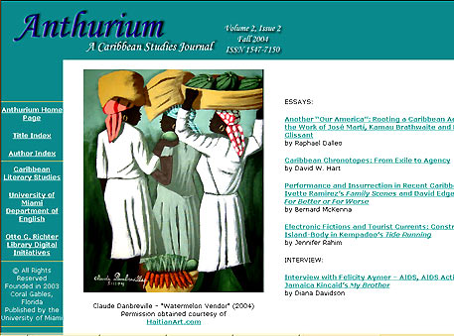
New Genres of AI Digital Library Services For Content and Access
Scholarly Refereed E-Journals /Open Source Publishing (OJS) Upload PDF’s or Content (Metadata): GPT4 and Gemini 1.5 Natural Language PDF to AI Answering

Slide 36
E-Resources & Core Academic Library Systems Transforming Through AI
Paradigm Shift to AI
Larger Discovery & Research Services Possible
More Helpful Modern Integrated Library System (ILS)
New Research Help Possibilities
Changing Models From Access to Information to Immediate AI Natural Language Answers
Better Insight and Discovery for Vendor and Open Access Models, OER (Open Educational Resources)
Fine Tuning Large Language Models Base Foundation model (iGPT4/5, Gemini Ultra) Fine Tuned Model Proquest or Exlibris Trained on Top of This Model with Specific Datsets (Corpus) or Indexes/Metadata

Slide 37
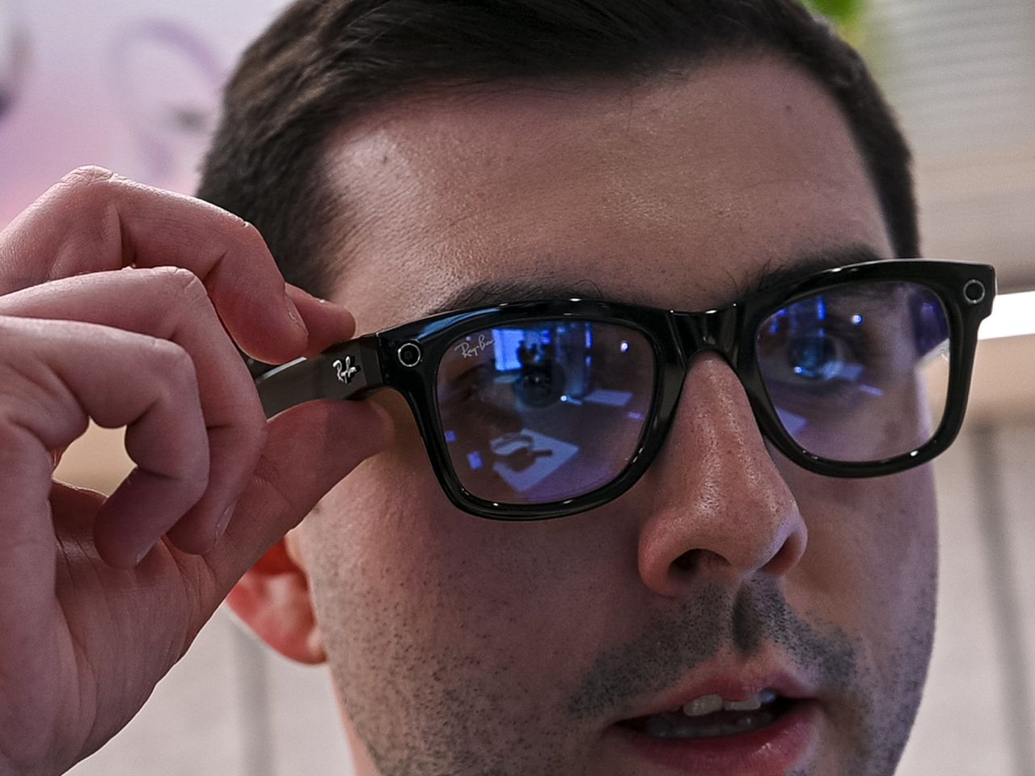
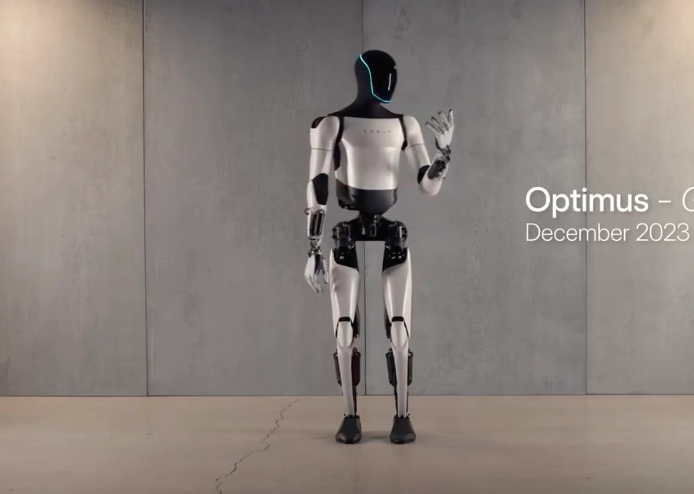
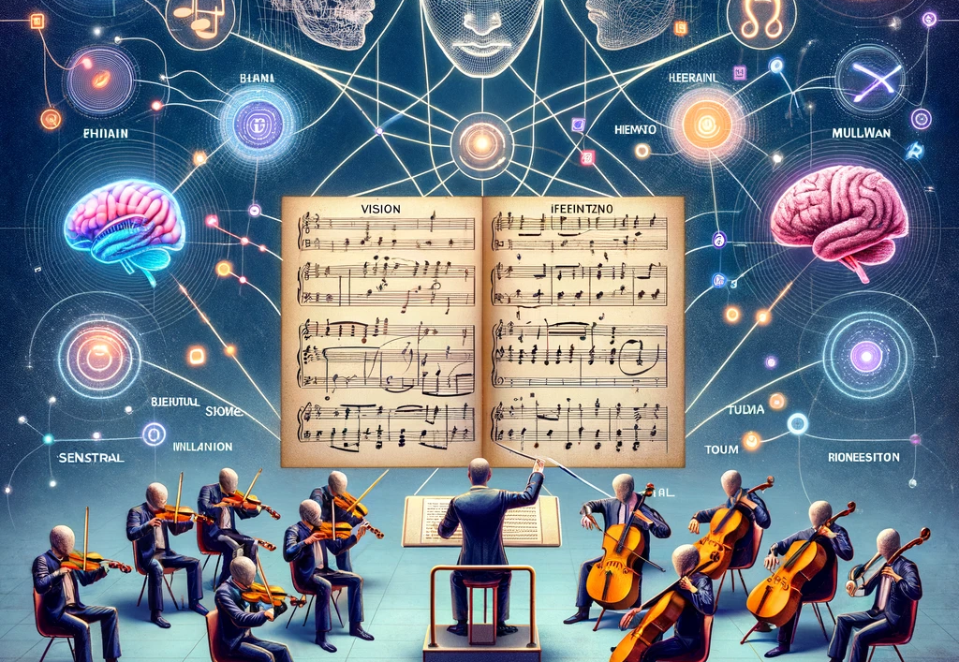
Multimodal AI, GPT4 + Image/Voice/Audio-visual and Force Feedback Models (Robotics), 2024+
Image Generators Dalle-3, Midjourney Stable Diffusion Text to Image and Image to Video Models
Video Generators: Runway, PIKA, Stable Diffusion Video, Lumiere, SORA Image to Video, Text to Video, Video to Video
Device Integration & Robots: Optimus (Tesla Bot), Boston Dynamics, NVIDIA, Meta’s Rayban Glasses AI + XR Smart Phone Integration
Use Case Scenarios: Powerpoint to Essay, Natural Human Instructions: No code movement, PDF to Image Augmenting the Senses: XR (Extended Mixed Media Reality + AI Artificial Intelligence Memory and Customization of Models

Slide 38
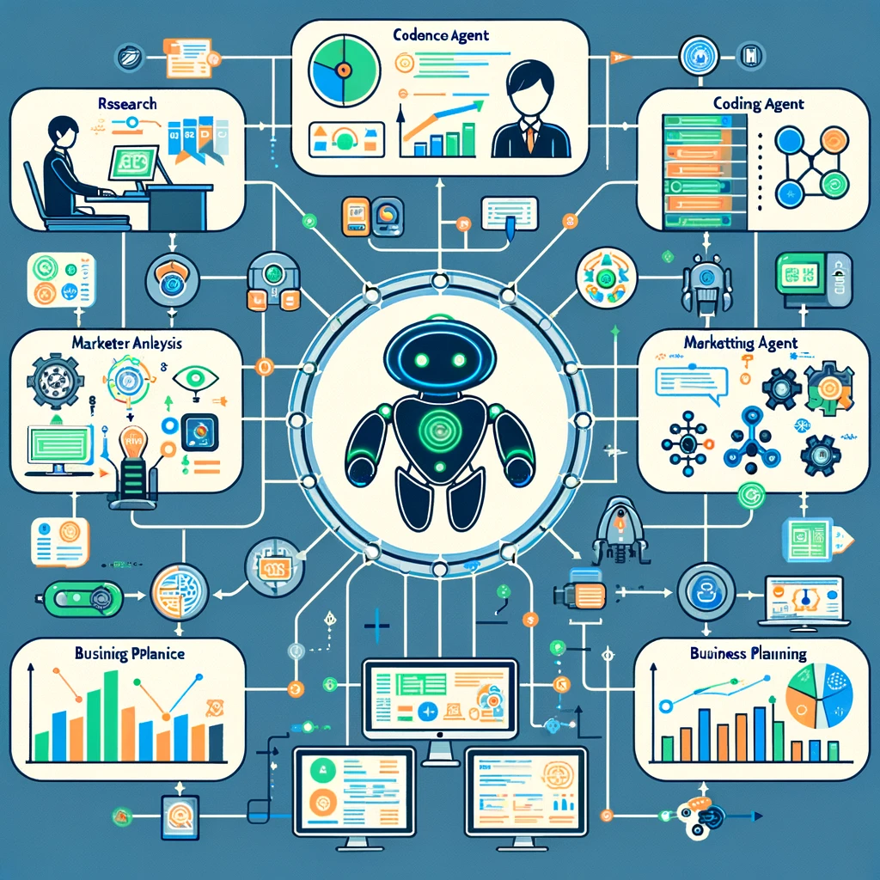
Autonomous Agents 2024 Linked AI’s working together
Autonomous agents are AI systems or entities that operate independently to perform tasks or make decisions
Autonomy: Operates independently without human intervention.
Adaptability: Learns and adapts to new environments and experiences.
Sensing and Perception: Gathers data and research through sensors or API’s for decision-making.
Goal-Oriented: Designed to achieve specific objectives or tasks.
Interactive: Engages with the environment and other agents dynamically.
Examples Autogen, Agent GPT, OpenAI GPT Store List: https://toplist-central.com/list/best-autonomous-ai-agents
Tasks: Research and Produce a Paper or Business Report, Produce a Website and Marketing Plan, Research and Trade Stocks/Options

Slide 39
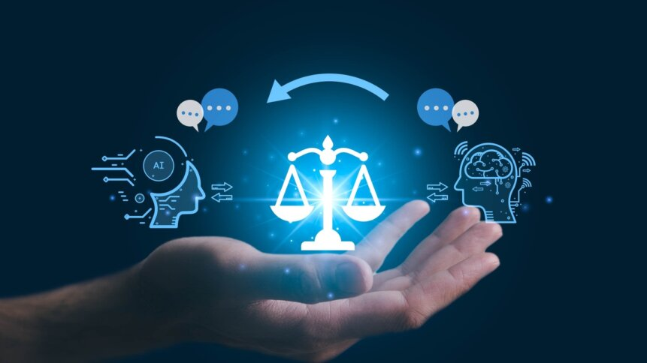
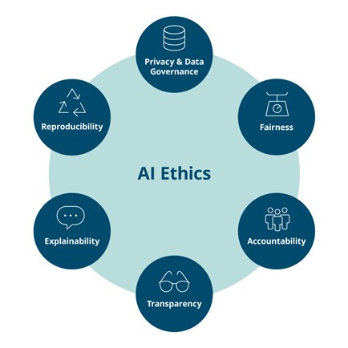
AI Ethics, Safety, Alignment, Accuracy and Precision
AI Hallucination (False Comments, Made up Results)
Bias and Data (Began 2017)
Neural Nets and Complexity
Ethics and Censorship
Ethics and Law
Alignment: Alignment with Human Values
Deep Fakes and Elections, Manipulation, Propaganda, Information Literacy
Constitution (Anthropic)
New Horizons for AI in Libraries (De Gruyter)

Slide 40
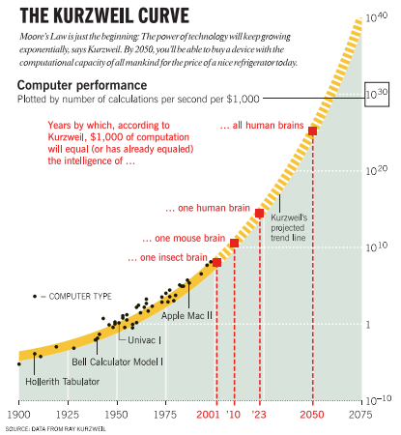
AI, AGI, Artificial General Intelligence ASI, Artificial Superintelligence
AGI, Artificial General Intelligence A form of AI that equals average human intelligence, capable of performing any intellectual task that a human being can.
ASI, Artificial Super Intelligence An AI that surpasses human intelligence across all areas, including creativity, general wisdom, and problem-solving.

Slide 41
Select Bibliography, Further General Sources, February 2024
Language Models
GPT 4: Open AI (Dalle-3, Multimodal, GPT Store, 20.00$)
Gemini Ultra (2024)
Mixtral (More Technical Knowledge Needed, Open Source)
Microsoft Copilot (GPT4, Dalle, Free, Limited Horizons on Knowledge)
Image and Video Generators
Dalle-3 (Open AI), Midjourney PIKA Labs, Runway Lumiere (2024)/SORA
Autonomous Agents Top Lists Top 5 Top 11
AI Websites and Youtube AI News Wes Roth: General AI News MattVidPro AI: Uninversity Millenial Perspectives Mattew Berman: Programming and AI The AI Grid (Good British AI News Site, Ph.D. Candidate) Academic ResearchGate, Dr Raymond Uzwyshyn, Papers, Presentations, Projects Dr. Alan Thompson: Human/AI Benchmarking Two Minute Papers, Dr. Karoly Zsolnai-Feher
Presentation https://www.researchgate.net/profile/Raymond-Uzwyshyn/research

Slide 42
Select Scholarly/Academic References and Further Resources
Artificial Intelligence. Machine Learning. Neural Networks. Future Technology. Bloomberg Businessweek Canada. 2022. https://www.youtube.com/watch?v=ypVHymY715M
ColdFusion (2018). Why Deep Learning Now? (Documentary Overview). https://www.youtube.com/watch?v=b3IyDNB_ciI Echle et al. Deep Learning in Cancer Pathology: A New Generation of Clinical Biomarkers. British Journal of Cancer. November 2020. https://www.nature.com/articles/s41416-020-01122-x
Esteva, A, Thrun, S. et al. Dermatologist-level Classification of Skin Cancer with Deep Neural Networks. Nature, Volume 542 (February 2, 2017). pp. 115-119. doi:10.1038/nature21056 Fridman, Lev. MIT Deep Learning and Artificial Intelligence Lectures. https://deeplearning.mit.edu/ 2022.
Islam, A., Khan, D. and Chowdhury, R. 2021. An Efficient Deep Learning Approach to Detect Skin Cancer Undergraduate Thesis. BRAC University DSpace Institutional Repository, 2021. Available: http://dspace.bracu.ac.bd/xmlui/ handle/10361/15932
Kleinveldt, Lynn. Smarter high education learning environments through AI: What this means for academic libraries. Trends and Issues in Library Technology: Special Issue on AI: June 2022. pp. 12-15. https://repository.ifla.org/handle/123456789/1940
Mitchell, Tom. 2022 Where on Earth is AI Headed? Carnegie Mellon. https://www.youtube.com/watch?v=ij9vqTb8Rjc
Texas Data Repository 2022. https://dataverse.tdl.org/
Tschandl, Phillip et al. Human-computer Collaboration for Skin Cancer Recognition. Nature Medicine, 22 June 2020, 1229-1234. See: https://www.nature.com/articles/s41591-020-0942-0.
Uzwyshyn, R. 2022. Online Research Data Repositories and Digital Scholarly Ecosystems: From Research Data and Datasets to Artificial Intelligence and Discovery. IFLA WLIC 2022. Dublin, Ireland. DOI: 10.13140/RG.2.2.12354.86728 ---. 2022. Steps Towards Building Library AI Infrastructures: Research Data Repositories, Scholarly Research Ecosystems and AI Scaffolding. New Horizons in Artificial Intelligence in Libraries (IFLA Satellite Conference), National University of Ireland, Galway, IR. DOI: 10.13140/RG.2.2.21120.30728
---. 2021. Frameworks for Long Term Digital Preservation Infrastructures. Computers in Libraries. September 2021. pp.4-8.
Uzwyshyn, R. 2020. Developing an Open-Source Digital Scholarship Ecosystem. ICEIT2020. St. Anne’s College Oxford, United Kingdom. February 2020. Available at: https://www.researchgate.net/publication/336923249_Developing_an_Open_Source_Digital_Scholarship_Ecosystem.
- - -. 2020. Open Digital Research Ecosystems: How to Build Them and Why. Computers in Libraries, (40) 8. November 2020. https://www.researchgate.net/publication/ 345956074_Online_Digital_Research_Ecosystems_How_to_Build_Them_and_Why
---. 2016. Online Research Data Repositories: The What, When Why and How. Computers in Libraries. 36:3, April 2016. pp. 18-21.

Slide 43
Questions and Comments?

Slide 45
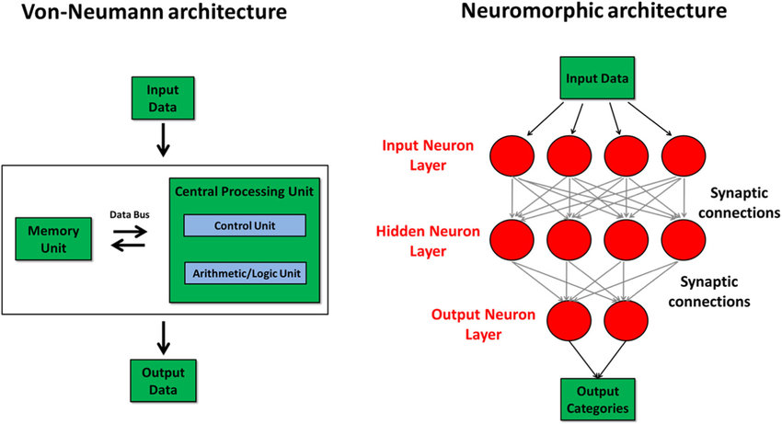
Next Generation GPT’s will Combine a Neural Net (Deep Learning) Neuromorphic Architecture with a traditional Von Neumann Architecture (Memory)
Generative Pretrained Transformer Trained on Neuromorphic Architecture
Traditional PC Laptop Mobile Device

