Slide 1
Mississippi State University libraries moving to a Transformative open access and document delivery model for resource management

Slide 2
The Team
Anita Winger, Director of Mississippi Library Partnership
Dr. Ray Uzwyshyn, Associate Dean for Collection Management & Strategy
Cathy Austin, Interim Director for Resource Management
Paul Huddleston, Director for Access, Systems & Discovery
Chris Kolb, Business Manager II

Slide 3
Presentation Format/Content
CloudSource OA
Qualitative, Quantitative and Overlap Analysis
Article Galaxy Scholar
Q&A

Slide 4
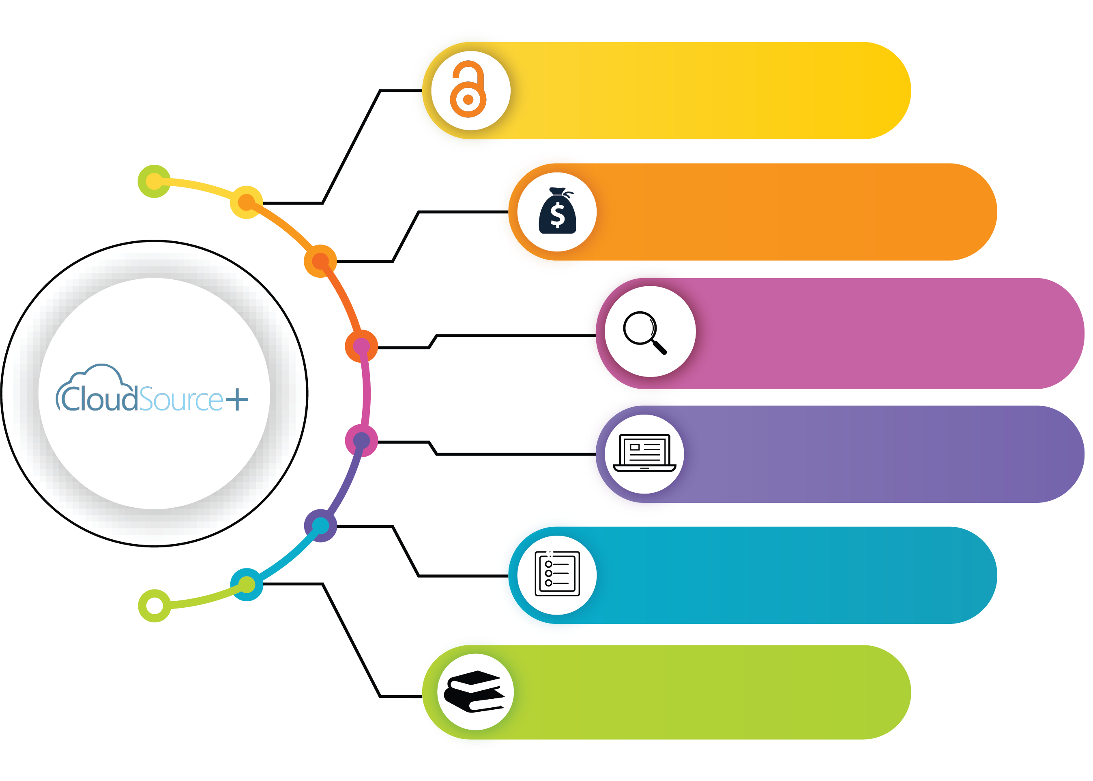
Overall Benefit and Increase in Access via CloudSource+
Open Access
Journal Subscriptions
https://library.msstate.edu
https://mlp.ent.sirsi.net/client/msstate

Slide 5
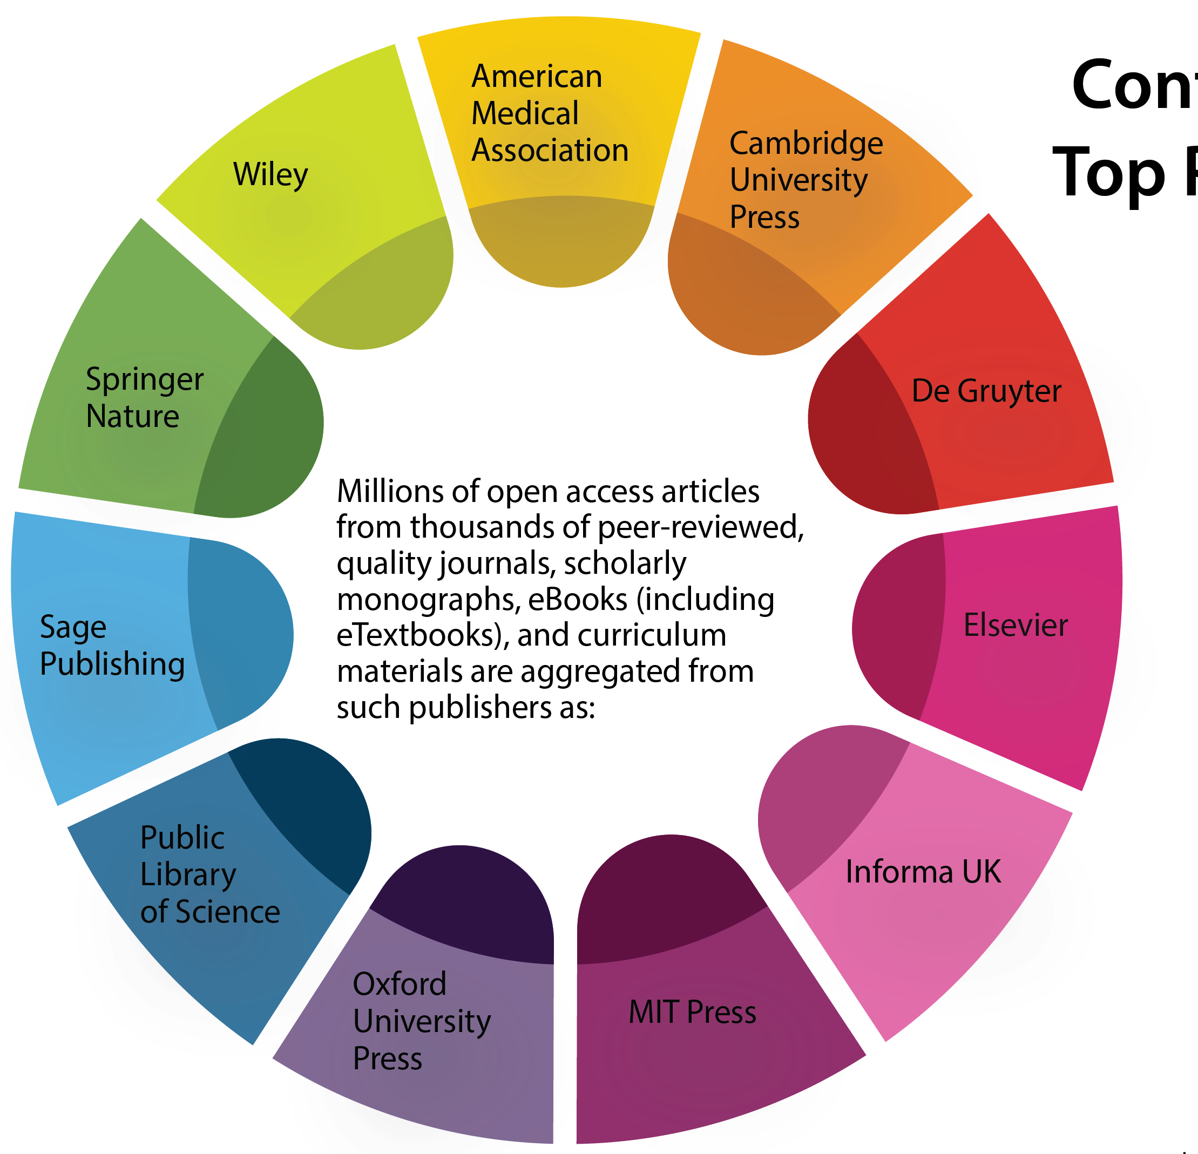

Content from Top Publishers

Slide 6
Overall Benefit and Increase in Access via CloudSource+
Open Access
Journal Subscriptions
Access to over 55 million high-quality scholarly journal articles, open textbooks, open eBooks, and open education resources with a single-click
Additional access to 17 million Open Access articles from over 85K journals added to our discovery results without subscription cost.
Access to indexed information from sources not in our subscriptions
Ability to support Open Education Resources, Open Textbook initiatives, and more.
https://library.msstate.edu
https://mlp.ent.sirsi.net/client/msstate

Slide 7
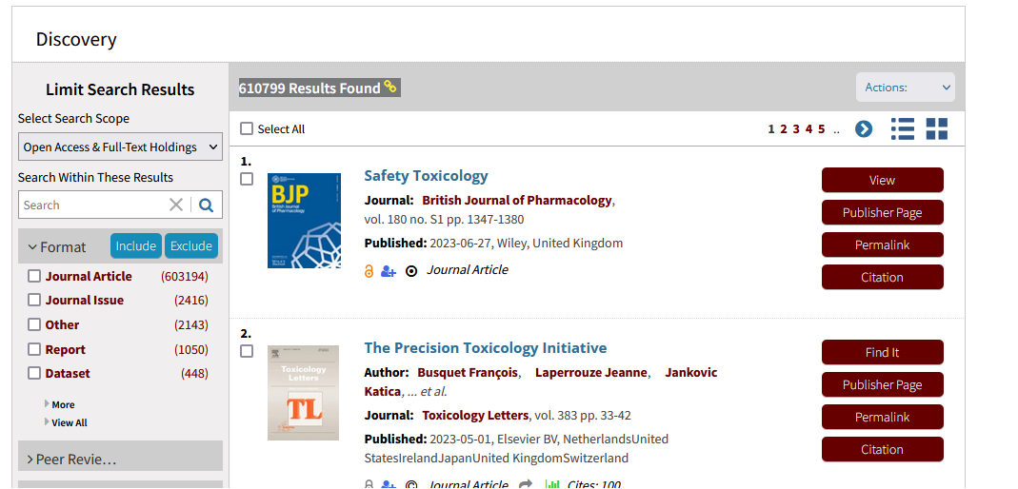
Catalog Screenshots - Hitlist
View to immediately download article
Find It to locate copies of the article

Slide 8
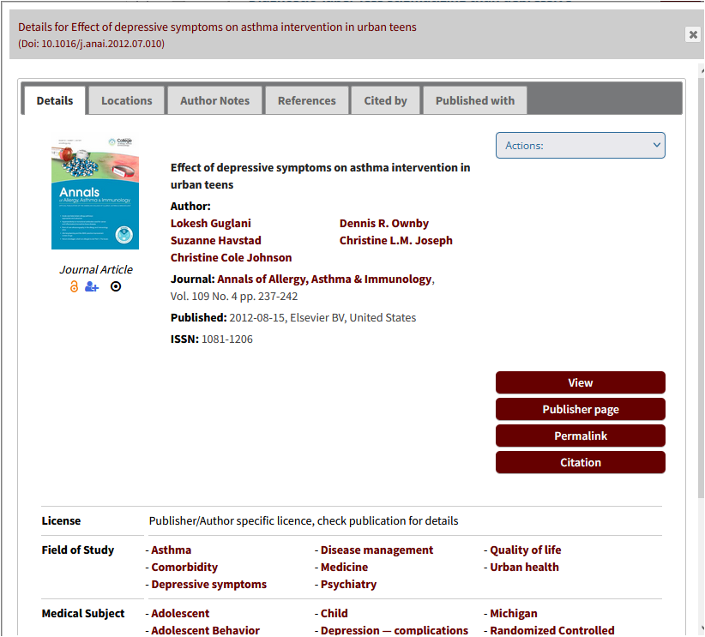
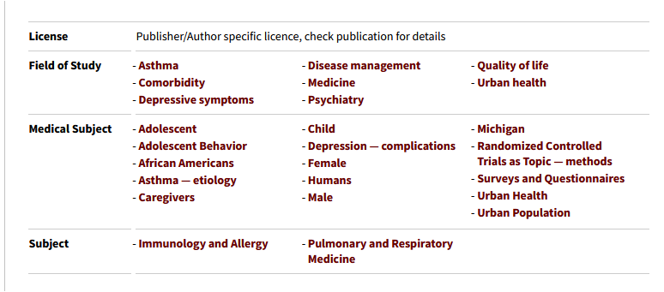
Catalog Screenshots detail page

Slide 9
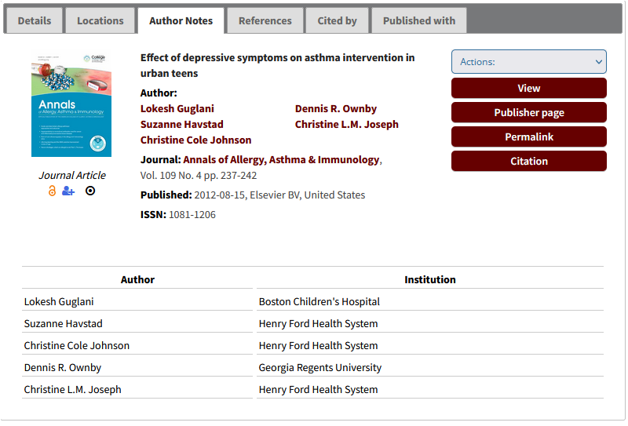
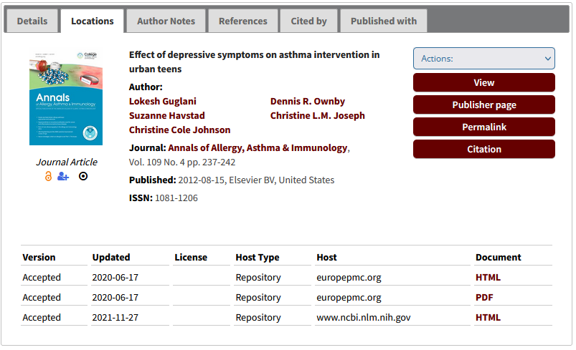
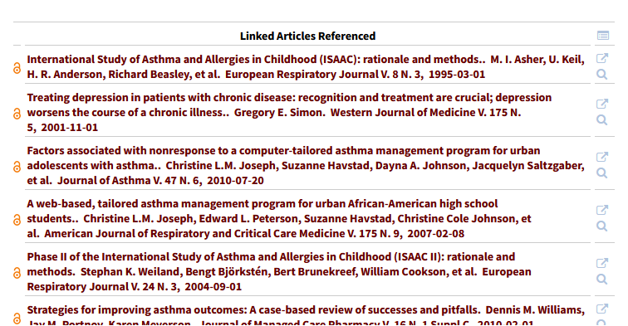
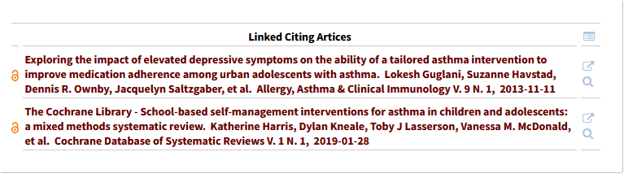
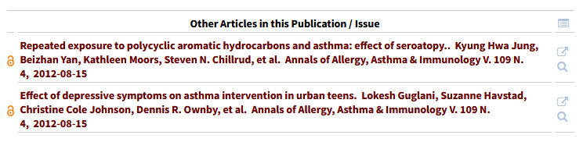
Catalog Screenshots
Enhanced Metadata

Slide 10
Qualitative Analysis
Email sent to Department Heads (April 13, 2023)
The library is currently engaged in a comprehensive evaluation of our electronic resource subscriptions. To make data-informed decisions regarding subscription renewals, we are seeking input from our teaching and research faculty on quantitative and qualitative aspects of our e-resource usage. In this regard, we would be grateful if you could provide feedback on your use of the following EBSCO databases: America: History and Life with Full Text, and American Antiquarian Society (AAS) Historical Periodicals Collection, which are among our subscribed resources. We have enclosed forms that seek your input on these databases, and we would appreciate it if you could kindly complete them and return them to us no later than Tuesday, April 25th. Please forward this message to others who may use these resources in their research and teaching as well. Your feedback will be valuable in helping us enhance our services and make better data-driven decisions. Thank you for your time and consideration.

Slide 11
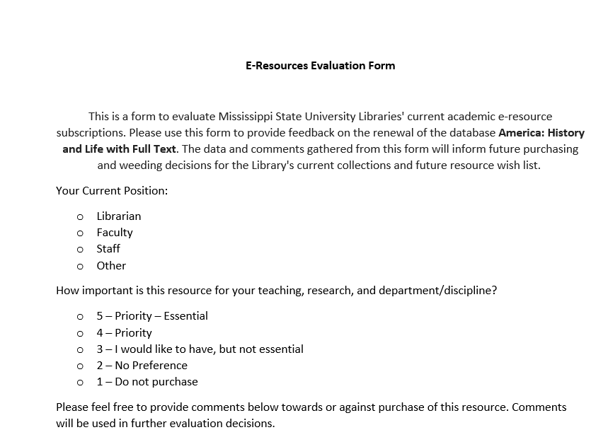
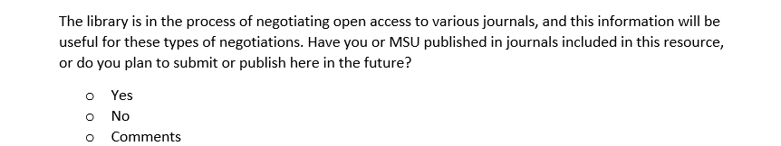
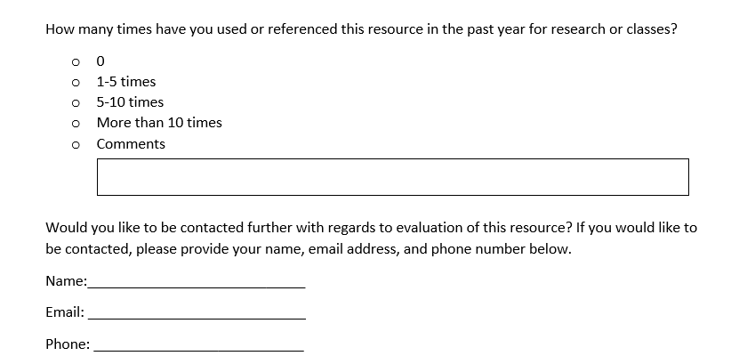
Qualitative Analysis: Evaluation Form
From email sent to Department Heads (April 13, 2023)

Slide 12
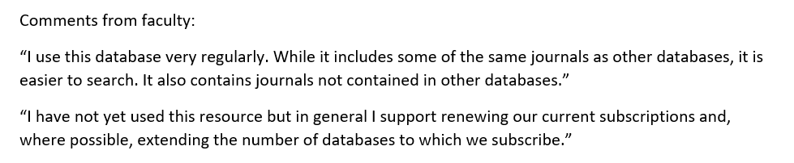
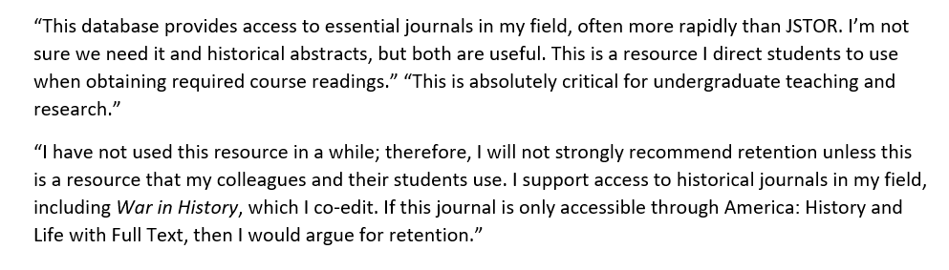
Qualitative Analysis
Stakeholders:
Department Heads
Library Representatives
Faculty
Graduate Students

Slide 13
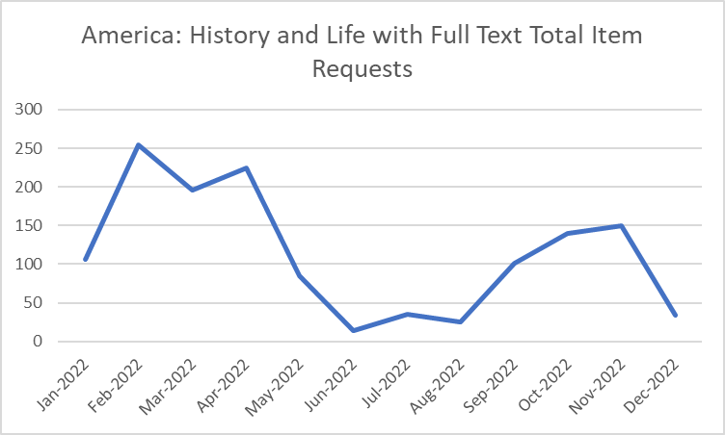
Quantitative Analysis
Additional Metrics include:
Searches
Investigations
Site visits
Unique site visitors

Slide 14
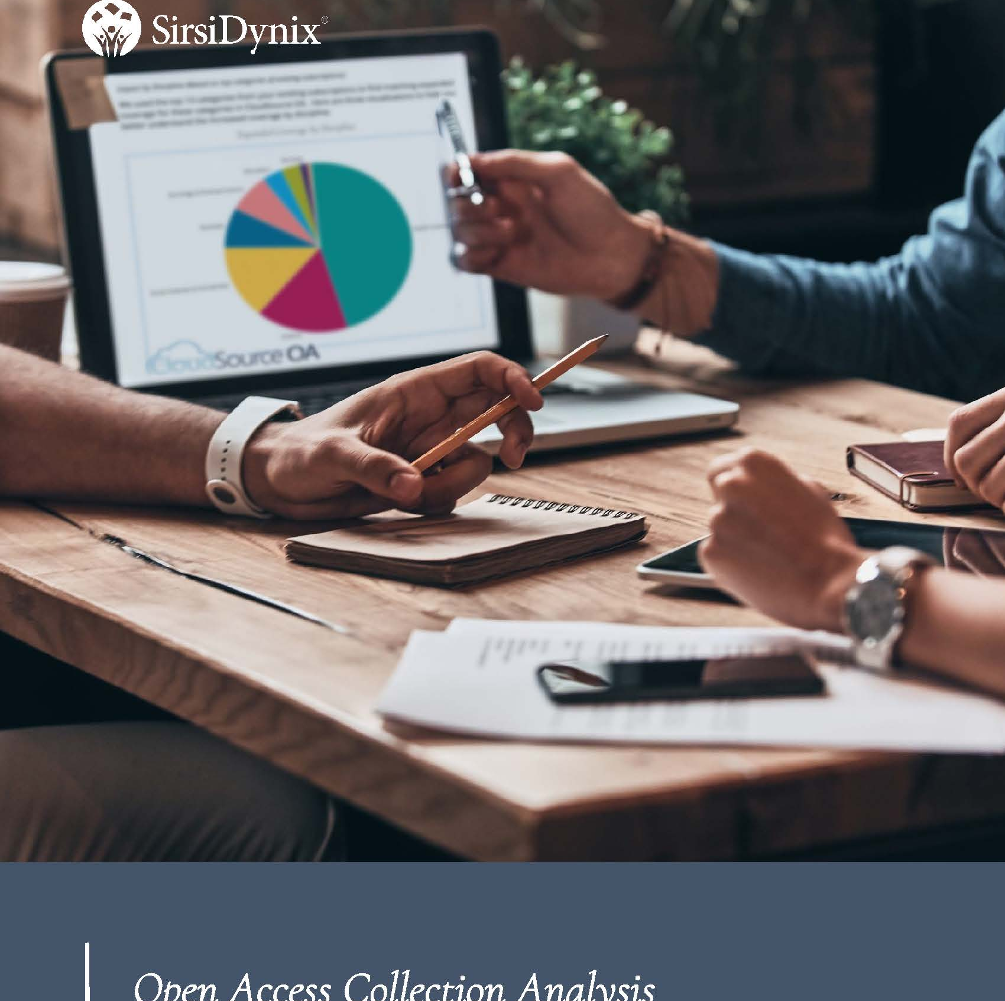
Cloud Source + Open Access
Overlap Analysis
Mississippi State
University Libraries Database and Journal
Subscriptions
February 2023- May 2023

Slide 15


Cloud Source Plus Aggregates Open Access Scholarly Books and Journals
Executive Summary
There are over 55 million open access (OA) refereed scholarly journal articles and academic scholarly books now available on the open web.
Freely available open access material accounts for more than half of all released scholarly academic journal articles.
This trend has been accelerating and Cloud Source+ Aggregates this open access material.
The libraries are leveraging these trends with Cloudsource+ and Galaxy Article Scholar towards our budget and new open access possibilities

Slide 16
Cloudsource+
Overlap Analysis and Metrics
Select MSU Databases
Reviewed between
February – May 2023
Wide Range of Database Overlap for Full Text article Coverage
in Cloudsource+
Mediated coverage available through Article Galaxy Scholar
Database | CloudSource+ OA Coverage 2017+
AAS Historical Periodicals Collection | 42%
Academic Search Complete | 69%
America: History and Life | 29%
APA PsycInfo | 52%
Art and Architecture Source | 43%
Atla Religion with Atla Serials | 34%
Avery Index to Architectural Periodicals | 52%
BioOne | 30%
CAB Abstracts 1990-present | 75%
Communication & Mass Media Complete | 42%
EconLit | 52%
EconLit with Full Text | 51%
GeoRef | 51%
Historical Abstracts | 33%
Historical Abstracts with Full Text | 41%
Library and Information Science Source | 72%
Linguistics & Language Behavior Abstracts (ProQuest) | 66%
MedLine | 54%
MLA International Bibliography | 48%
Music Index | 29%
Philosopher’s Index | 53%
Public Affairs Index | 36%
SocIndex with Full Text | 43%
SportDiscus with Full Text | 53%
Wildlife and Ecology Studies Worldwide | 51%
Average % of coverage | 48.04%

Slide 17
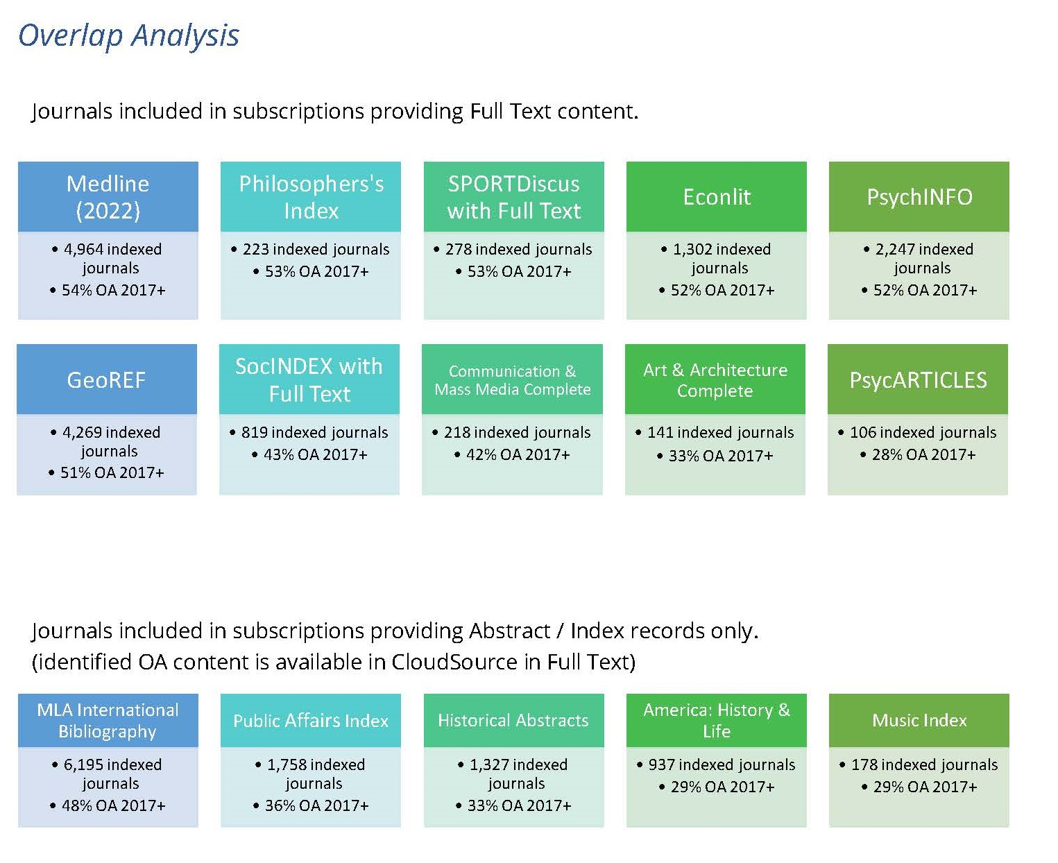
MSU Libraries
Database Holdings,
Cloudsource+
Overlap Analysis
Select MSU Databases and
Journal Subscriptions
Select MSU Abstracts, Indexes
and Bibliographies
(May-June 2023 MSU License Expirations)

Slide 18
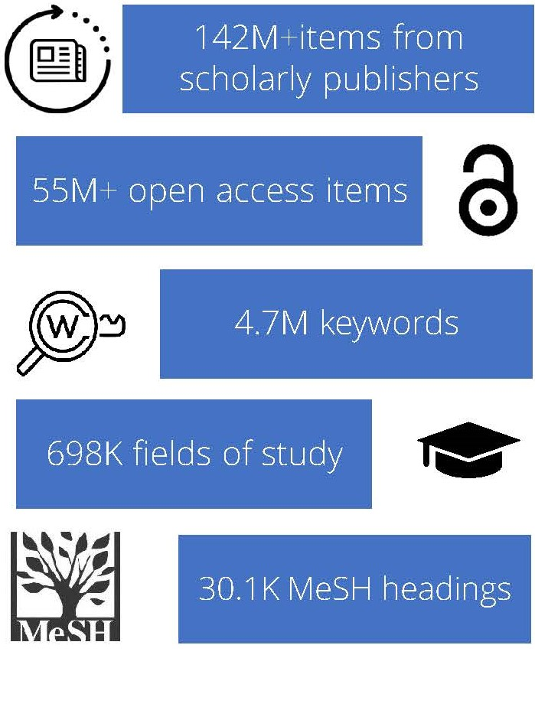
Open Access
Research Collections Methodology
Cloudsource +
The libraries utilize Quantitative, Qualitative Data collection and overlap analysis as metrics to aid in data driven decision making
Qualitative Surveys, Quantitative Usage Data and Overlap analysis are utilized to review usage and needs
The libraries are enabling a wealth of Cloudsource open access material and also leveraging Article Galaxy Scholar on individual vendor journal article and faculty, graduate and department levels.

Slide 19
Article Galaxy Scholar
Supplement subscriptions
Document Delivery/On-demand Articles
Fills the gap for needed resources for research
Over 30,000 journals from leading European and North American publishers

Slide 20
Article Galaxy Scholar
Will allow researchers to request access to journals that were previously unavailable
Request process will be mediated by library
Access can be granted to varied populations:
  Single faculty
  Group of students enrolled in a particular course
  Entire department

Slide 21

Future Directions
Obtain ARL status by increasing the collections budget over a period of five years with a focus on purchasing primary source databases, backfiles, data sets, monographs in an intentional collection model & rare items.

