Slide 1

Enhancing E-Resource Management:
Novel Technologies and New Methodological Approaches
Cathy Austin, MSIS, caustin@library.msstate.edu
Interim Director for Resource Management
Mississippi State University Libraries
Ray Uzwyshyn, Ph.D. MBA MLIS, rju13@mstate.edu
Associate Dean for Collection Management & Strategy
Mississippi State University Libraries

Slide 2




Cloud Source Plus Aggregates Open Access Scholarly Books and Journals
Executive Summary
There are over 55 million open access (OA) refereed scholarly journal articles and academic books available on the open web.
Freely available open access material accounts for more than half of all released scholarly academic journal articles.
This trend has been accelerating and Cloud Source+ aggregates this open access material.
MSU Collections Budget Strategy:
MSU libraries are leveraging these trends with Cloudsource+ and Galaxy Article Scholar to backstop holdings towards budget savings and new open access possibilities

Slide 3
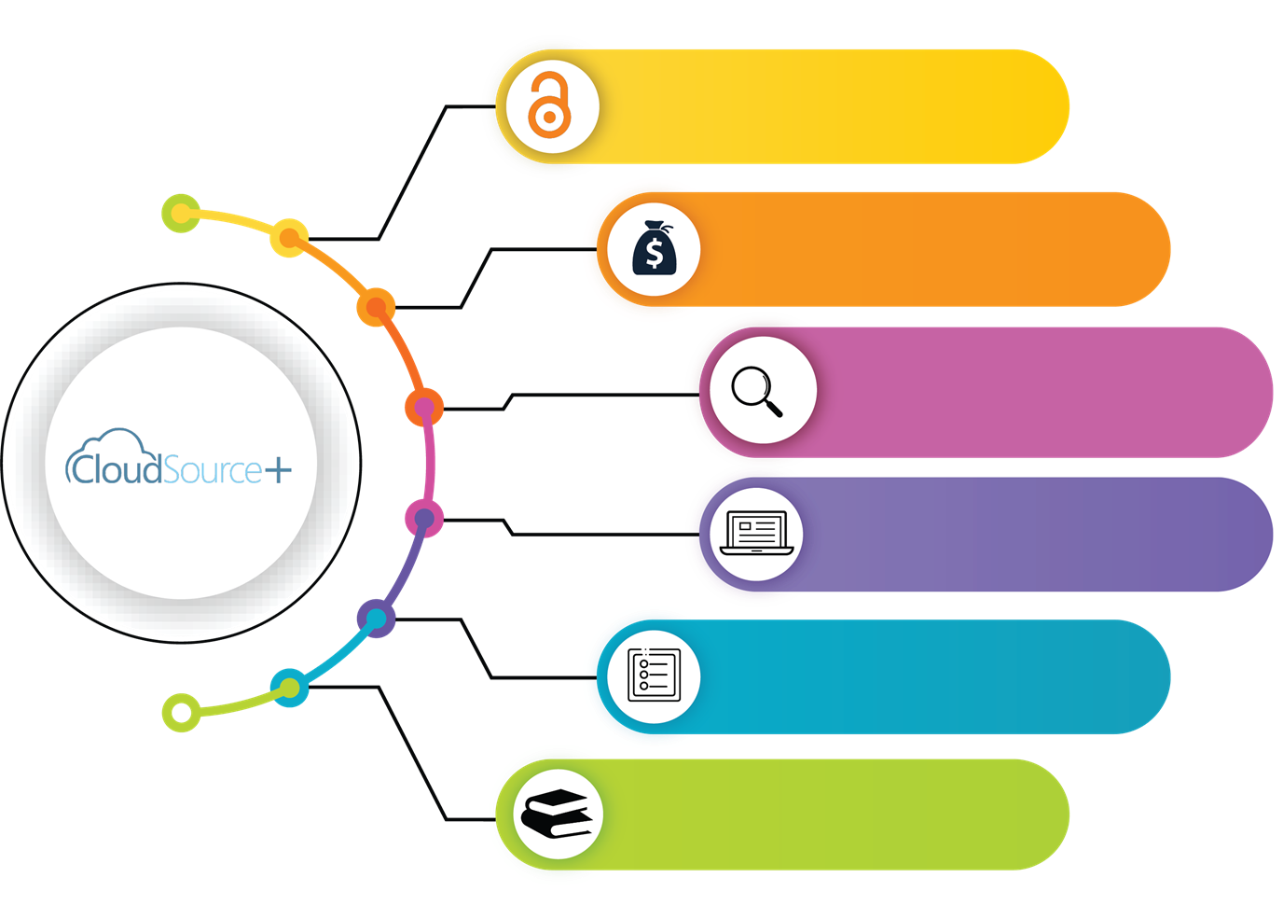
Journal Subscriptions
Open Access Savings
Features
55 Million high quality
scholarly resources
17 Million Open Access Articles (85K Journals)
High Quality Indexes
Support for OER &
Open Textbooks
Back stop

Slide 4
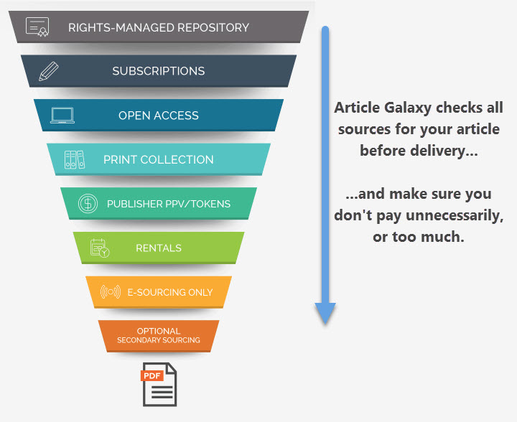

Article Galaxy Scholar
Targeted, Budget Efficient and Focused
Journal/Article Backup Source​

Slide 5
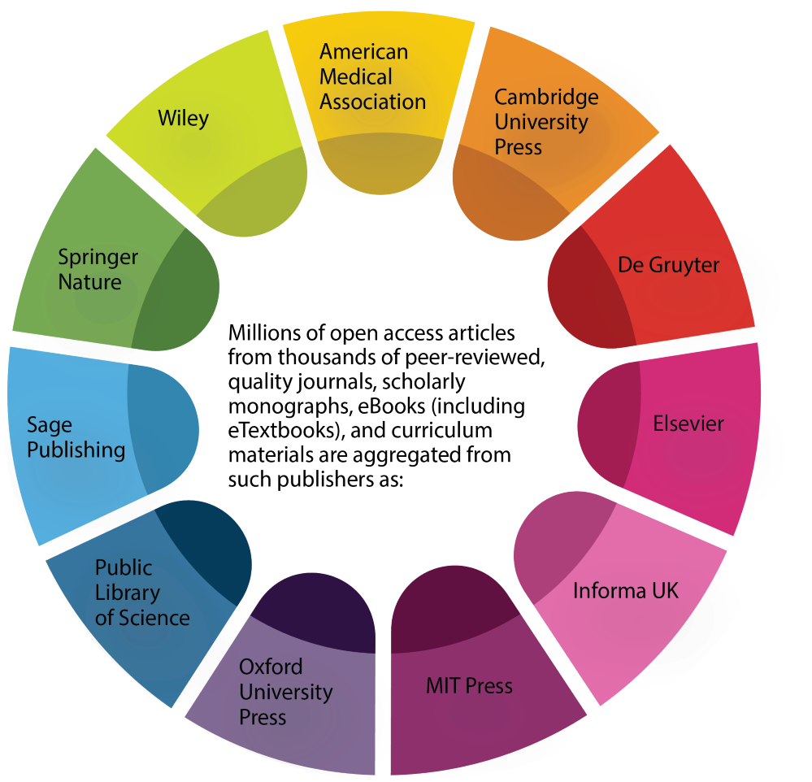
Aggregates Content from the High Quality Publishers
Large Cost/Benefit Strategy
Allows purchase of focused Journal/Articles not Available

Slide 6

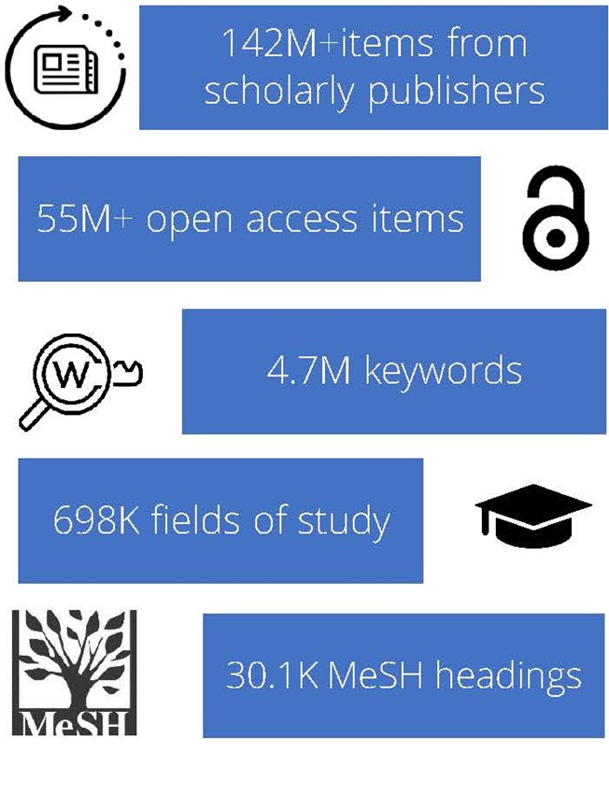
•The libraries' strategy is to enable an increasing new wealth of Cloudsource+ open access material and leverage Article Galaxy Scholar on individual vendor journal article and faculty, graduate and department levels.
•The libraries are utilizing Quantitative, Qualitative Data collection and overlap analysis as metrics to reimagine budget possibilities and aid in data informed decision making

Slide 7
Goals for E-Resources Subscriptions Evaluation Process
Create cost savings for library budget while maintaining access to scholarly journals and resources
Leverage open access and document delivery services

Slide 8
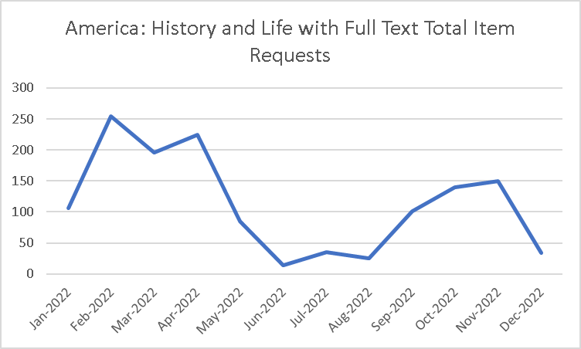
Quantitative Analysis
Quantitative evaluation metrics:
Downloads
Searches
Investigations
Site visits
Unique site visitors

Slide 9
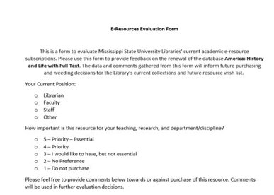
Qualitative Analysis
Qualitative Feedback from Stakeholders:
Department Heads
Faculty
Graduate Students

Slide 10
Qualitative Analysis
Have you or MSU published in journals included in this resource, or do you plan to submit or publish here in the future?
How many times have you used or referenced this resource in the past year for research or classes?

Slide 11
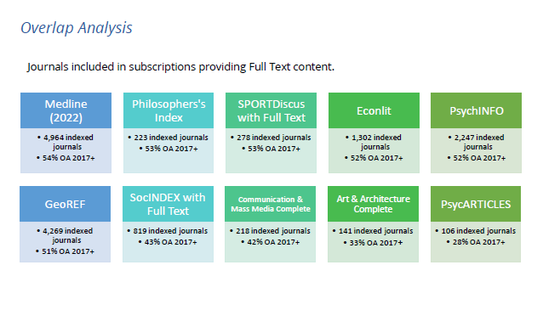
Cloudsource Open Access Overlap Analysis
The overlap analysis showed that many of our paid subscriptions contained as much as 50 % open access content.

Slide 12
Thank you!
Questions?
Contact us:
Caustin@library.msstate.edu
Ruzwyshyn@library.msstate.edu

