Slide 1
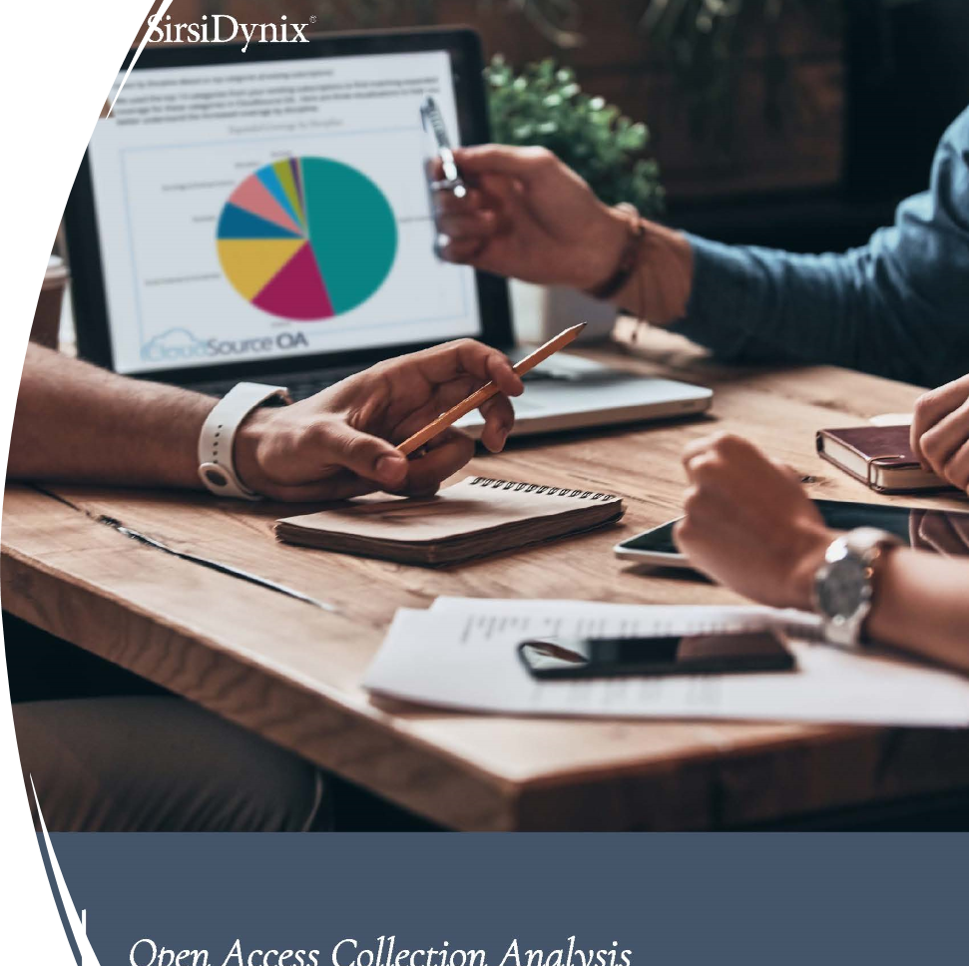
Cloudsource+ and Article Galaxy Scholar
New Paradigm Models Analytic Methods New Budgetary Possibilities
Ray Uzwyshyn, Ph.D. MBA MLIS, rju13@mstate.edu Associate Dean for Collection Management & Strategy Mississippi State University Libraries

Slide 2
MSU Collections Budget Strategy New Technology + Synthetic Analysis
MSU libraries are strategizing utilizing Open Access high quality academic e-resources and technology: CloudSource+ and with Article Galaxy Scholar to leverage current holdings towards: Large Budget Savings, New Open Access Possibilities & New Methodologies for analyzing and purchasing Digital e-resources

Slide 3
E-Resources Materials Strategy Cost /Benefit Analytic Approach Three Pronged Synthetic Evaluation Strategy
Qualitative Analysis +
Quantitative Analysis +
Overlap Analysis =
Goals: Better Budgetary Data-Informed Decision Making Better Resource Allocation

Slide 4
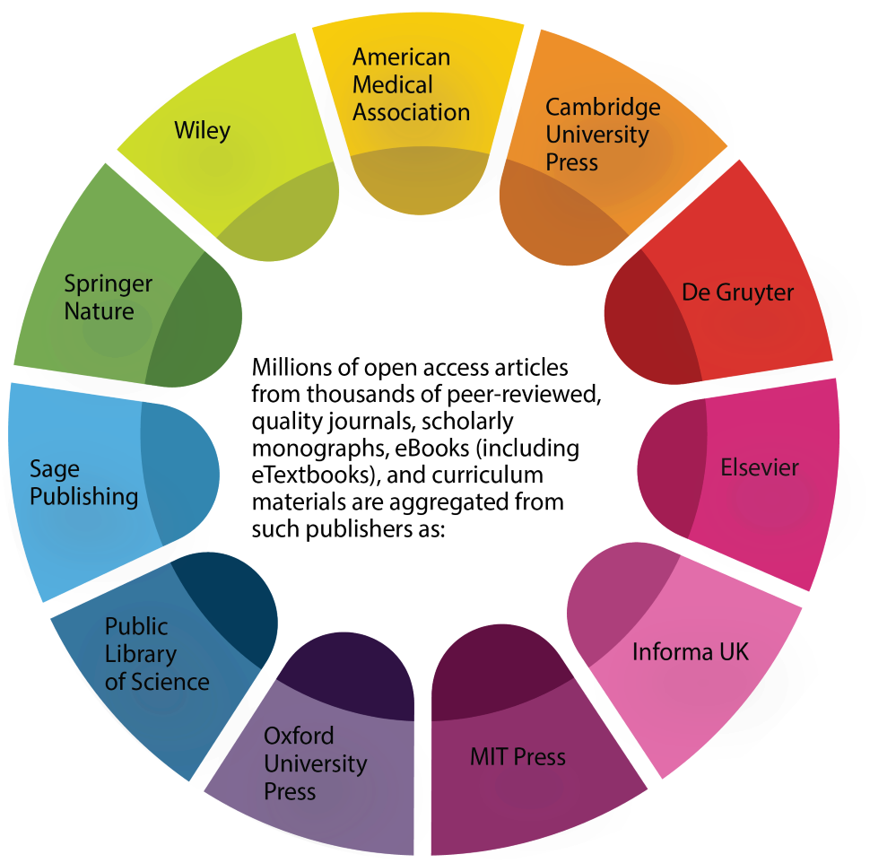
Cost / Benefit Strategy
Aggregates Open Access Content from High Quality Publishers
Allows purchase of focused Journal/Articles not Available in Present Collections/OA

Slide 5
Qualitative Analysis
Email Subject: The library is currently engaged in a comprehensive evaluation of our electronic resource subscriptions. To make data-informed decisions regarding subscription renewals. We are seeking input from our teaching and research faculty on quantitative and qualitative aspects of our e-resource usage. In this regard, we would be grateful if you could provide feedback on your use of the following Database . . . We have enclosed forms that seek your input on these databases. . .
Emails, Survey Form, Focus Groups, & Individual/Group Meetings

Slide 6
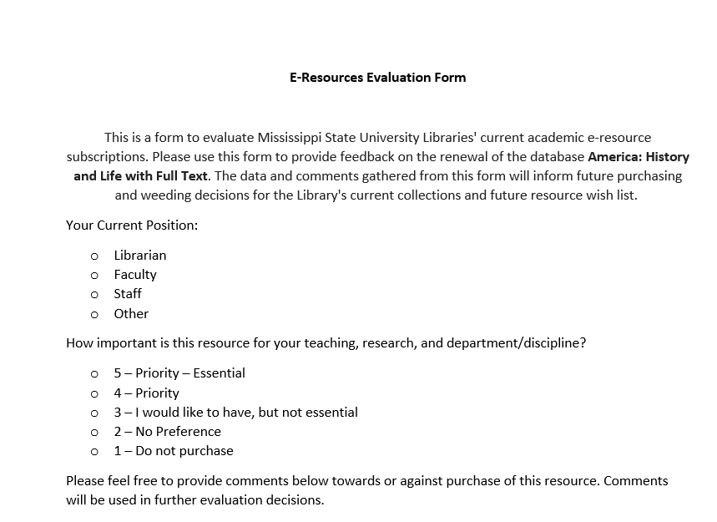
Qualitative Analysis Evaluation Form
Stakeholders:
Department Heads
Faculty
Graduate Students

Slide 7
Qualitative Comments
Stakeholders:
Department Heads
Library Representatives
Faculty
Graduate Students

Slide 8
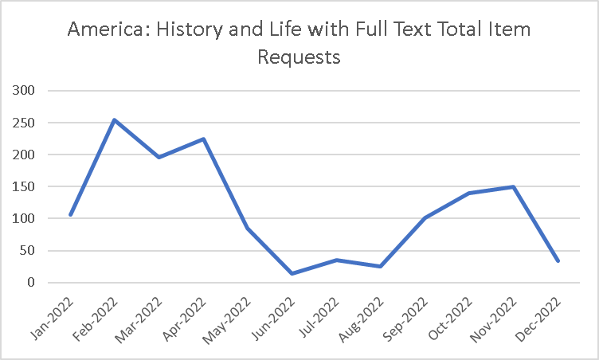
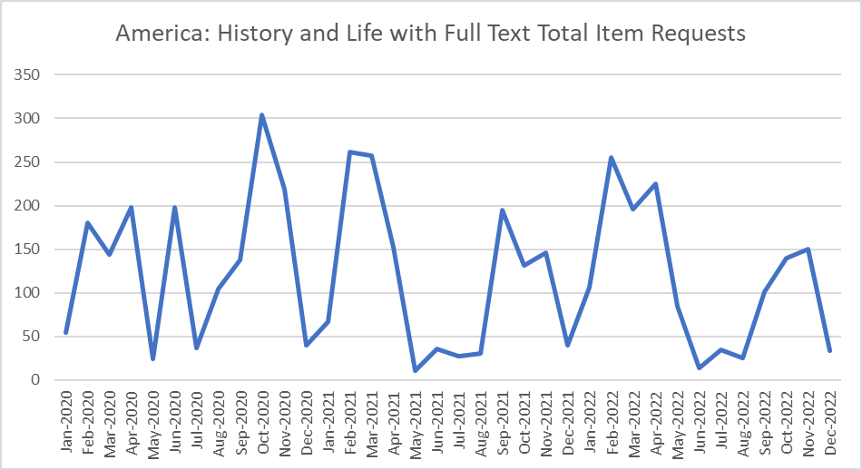
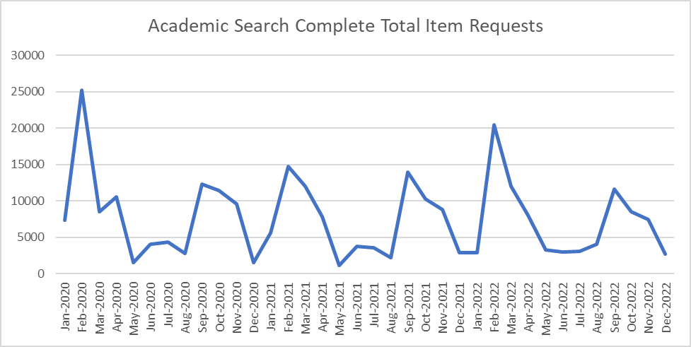
Quantitative Analysis
Quantitative evaluation metrics:
Downloads
Searches
Investigations
Unique Site visits
Unique site visitors
Cost/Use

Slide 9
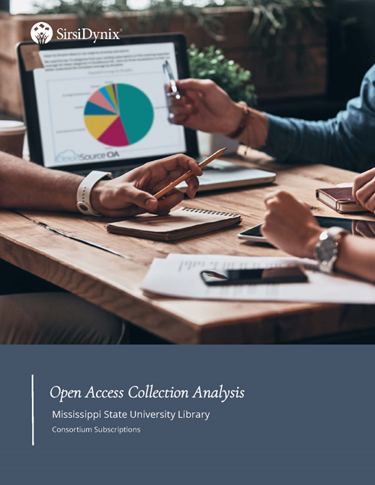
Overlap Analysis Open Access Collection Analysis Report Cloud Source + /Sirsi Dynix

Slide 10
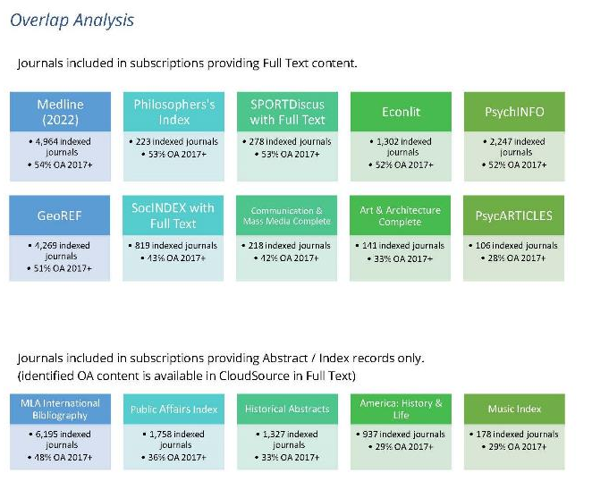
MSU Libraries Database Holdings, Cloudsource+ Overlap Analysis Select MSU Databases and Journal Subscriptions
Overlap Analysis Shows that our paid subscriptions ranged from 19-79% overlap open access content
Select MSU Abstracts, Indexes and Bibliographies

Slide 11
Cloudsource+ Overlap Analysis and Metrics
Select MSU Databases Reviewed between February – May 2023
Wide Range of Database Overlap for Full Text journal article Coverage
aggregated in Cloudsource+ Mediated coverage available through Article Galaxy Scholar
Database | CloudSource+ Open Access Coverage
Academic Search Complete | 69%
CAB Abstracts 1990-present | 75%
Communication & Mass Media Complete | 42%
EconLit | 52%
EconLit with Full Text | 51%
GeoRef | 51%
Historical Abstracts | 33%
Historical Abstracts with Full Text | 41%
Library and Information Science Source | 72%
Linguistics & Language Behavior Abstracts (ProQuest) | 66%
MedLine | 54%
MLA International Bibliography | 48%
Music Index | 29%
Philosopher’s Index | 53%
Public Affairs Index | 36%
SocIndex with Full Text | 43%
SportDiscus with Full Text | 53%
Wildlife and Ecology Studies Worldwide | 51%
Average % of coverage | 48.04%

Slide 12
Synthetic Analysis Conversations and Discussions
Decision Making Data Informed Data Driven
Overlap Analysis
Intersectional Space
Quantitative Analysis
Qualitative Analysis

Slide 13
Analytic Measures | E-Resources Database 1 | E-Resources Database 2 | E-Resources Database 3
Qualitative Analysis | N (Not Needed) | Y (Needed) | S (Split/Mixed)
Quantitative Analysis (Usage) | L (Low Usage | H (High Usage) | S (Split/Mixed)
Open Access Overlap Analysis | H (Overlap >60%) | L (Overlap <40%) | Mixed (40-60%)
Cost | High | Low | Medium
Recommendation Decision | Drop | Keep | Further Discussion Needed

Slide 14
MSU E-Resources Budget Strategy Project Summary Conclusions
Better E-Resources Budget Decisions & E-Resources Digital Resource Allocation Can Be Achieved through:
Synthetic Methodologies Cost/Benefit Analysis Data Informed Decision Making Affordances of New Technology

Slide 15
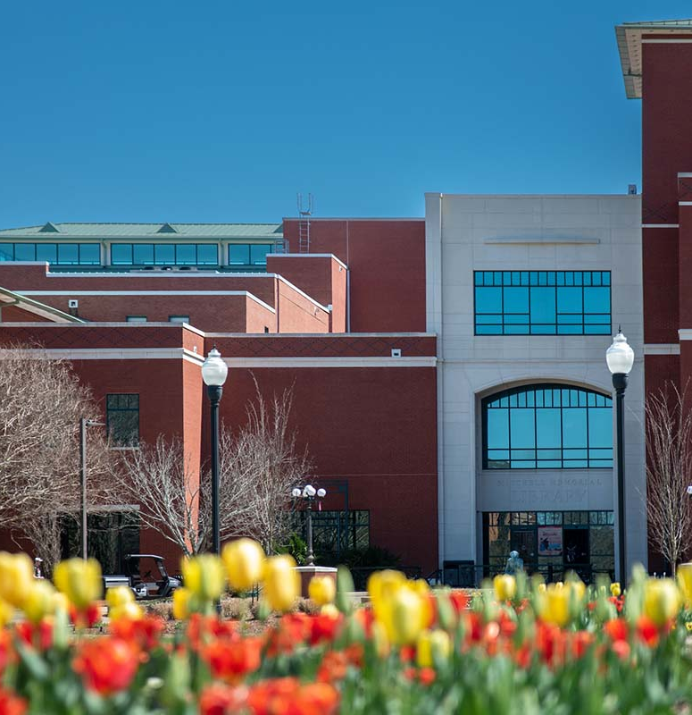
E-Resources Budget Evaluation Summary Conclusions
Cost savings for library budget can be achieved through new possibilities of leveraging open access and document delivery Savings from Cloudsource+
Open Access Savings can fund new focused intentionally aligned possibilities through Article Galaxy Scholar
Evaluation/Project Continuing 2023-2024 Fiscal Years

Slide 16
Thank you!
Questions?
Contact: Ray Uzwyshyn, Ph.D. MBA MLIS Associate Dean, Collections Management and Strategy Mississippi State University Libraries ruzwyshyn@library.msstate.edu, 512521-6893

Slide 18
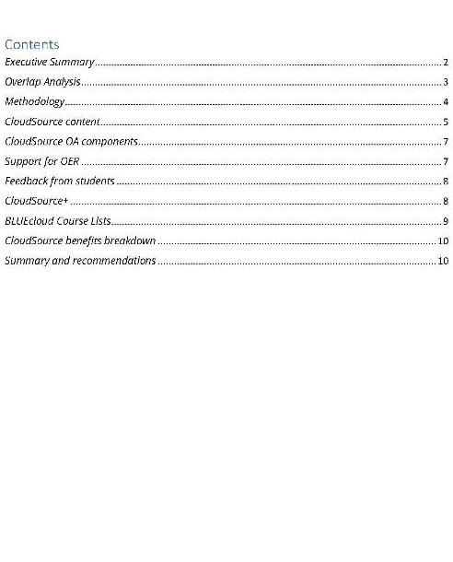

Slide 19
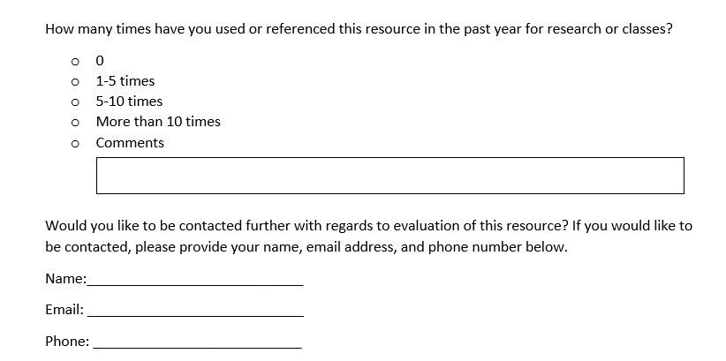
Qualitative Analysis: Evaluation Form
Stakeholders:
Department Heads
Faculty
Graduate Students

