Slide 1
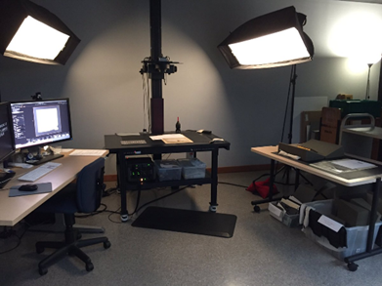
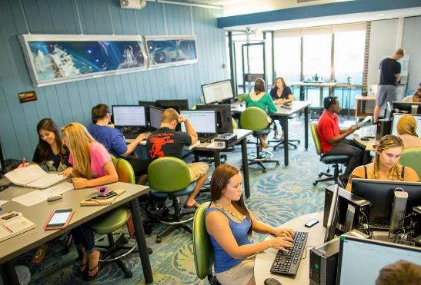

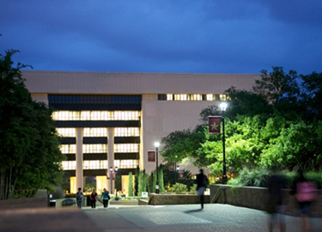
Developing Technologically Enhanced learning Spaces for New Millennia Academic Libraries
Presented For WLIC 2023, Rotterdam Netherlands
Ray Uzwyshyn, Ph.D. MBA MLIS
Associate Dean, Collections Management and Strategy
Mississippi State University Libraries
ruzwyshyn@gmail.com, 512-521-6893

Slide 2
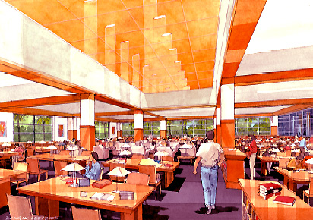
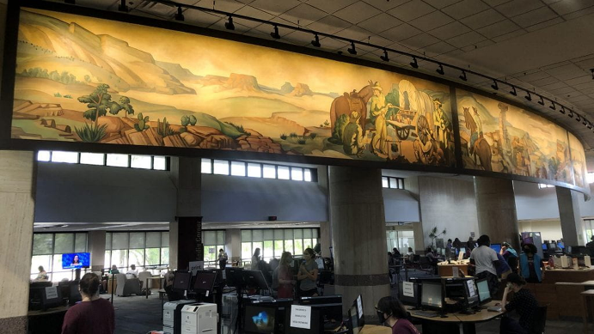
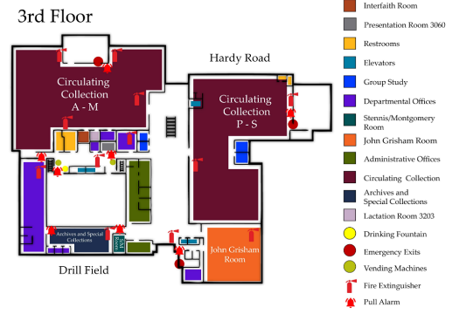
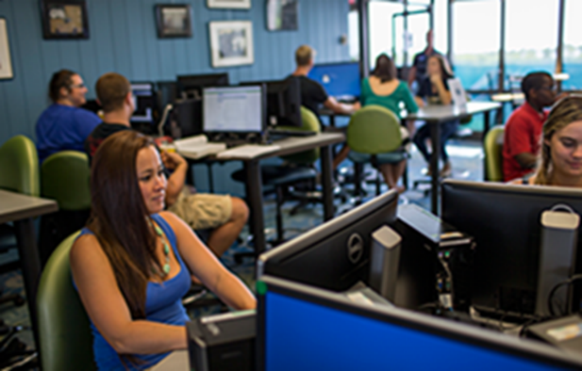
Technology, Space and Learning Possibilities for Libraries
Vision, Imagination, Reimagination
Four US Academic & Teaching University Libraries
University of West Florida
John Pace Library, 2006-2010
Texas State University
Albert Alkek Library, 2014-2021
University of Miami
Otto Richter Library, 2003-2006
Mississippi State University
Mitchell Memorial Library , 2023+
Small, Medium, Large and XL Library & Project Sizes
Enhanced Technology/Space Projects, 20 + Years,
UM Information Commons
& Multimedia Lab (2003-2006)
Texas State Learning Commons/Alkek One 2014-2021)
MSU Library Transformation Project 2023
UWF Skylab (2006-2010)

Slide 3

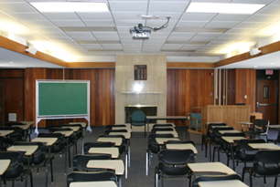
University of West Florida Skylab
2006-2010 (~1M USD)
Unifying Theme:
Digital Literacy
University of West Florida, ~12000 FTE
1M Project, 600k architecture/design, 350k Technology
Envisioned 2006 - Completed 2010)
Library Fifth Floor Reclamation/Redesign
Information Literacy Lab/Classroom
Multimedia Digital Literacy Studio
Digital Media Conversion Center
1st Industrial Revolution
Classroom Space
Skylab Presentation, Video
Skylab Original Overview White Paper

Slide 4
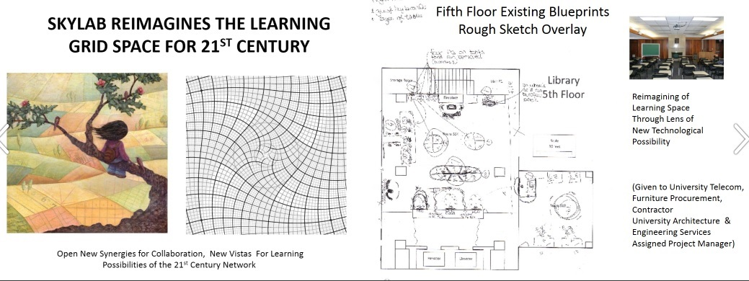

Slide 5


Characteristics of Learning Spaces | 19th Century Classroom (1st Industrial Revolution) | 21st Century Classroom (4th Industrial Revolution)
Learning Methodology | Rote learning, focused on memorization and repetition | Active learning, emphasizing creativity, critical thinking, and problem-solving skills
Classroom Setting | Uniform grid-like Cartesian rows of desks, with teacher at the front; a "one-size-fits-all" approach | Flexible and varied layouts that promote collaboration and adaptability; personalized learning environments
Teaching Role | Teacher-centered instruction, with teachers as the primary source of information | Student-centered instruction, with teachers as guides and facilitators
Resource Availability | Limited resources - primarily textbooks and physical materials | Abundance of resources - digital textbooks, online materials, multimedia resources
Technology Usage | Little to no technology in classrooms | Integration of advanced technologies (,aptops/tablets, phones learning management systems online library catalogs digital whiteboards, multimedia enabled PC’s)
Collaboration | Individual-focused tasks and desks, with limited group work | Emphasis on teamwork and collaborative projects, both within and beyond the classroom (including global internet enabled collaborations)
Student Engagement | Passive receipt of information, limited student engagement | Active student engagement via interactive and particpantory learning technologies
Access to Information | Limited access to information, confined to school hours and materials | Anytime, anywhere access to information due to digital connectivity
Skills Emphasis | Focus on basic literacy and numerical skills | Emphasis on 21st century digital, information and algorithmic literacy, creativity, critical thinking, problem-solving, communication, collaboration)
Learning Pace | Uniform pace of instruction for all students | Personalized learning pace, enabled by adaptive learning technologies

Slide 6

Space, Technology, Learning
Collaboration
Third Space for Learning
Cross fertilization of:
Projects
People
Skillsets
Information/Digital Literacy Lab
Multimedia Studio
4th Industrial Revolution Spaces of Learning
Reflecting rapid
technological change
In societal patterns,
processes, interconnectivity and
Technological
possibilities
Technology
Media
Conversion Center

Slide 7
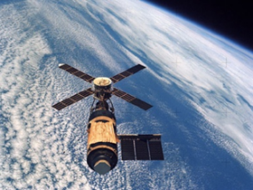
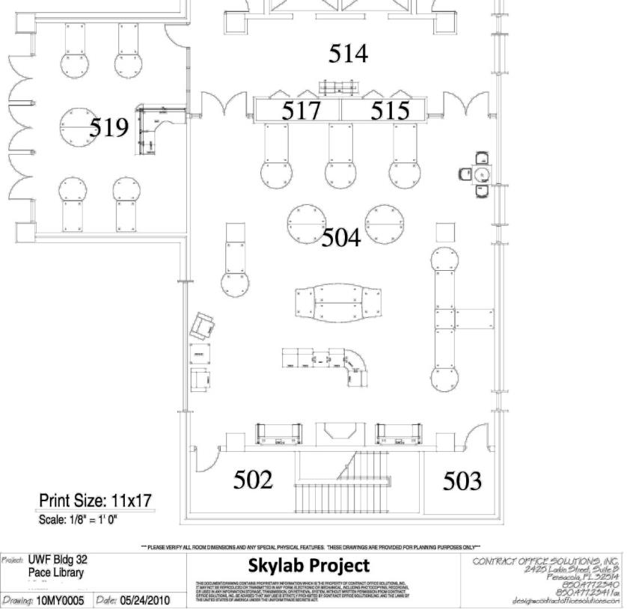
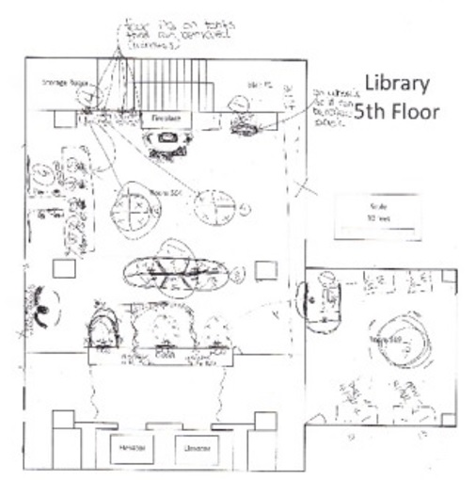

Project Possibilities, 2006-2010
Circulation of Documents
UWF Skylab
Handouts:
Tech. Equipment ,
Schematics
Skylab Conceptualization/Grant
Binders
Complete Hardware, Software Tech. Specifications
Budget Binders
Budgetary Documents
Skylab Date Log with Primary Documents
Presentations
Library Stakeholders
Outside Constituents
National Awareness/Marketing

Slide 8
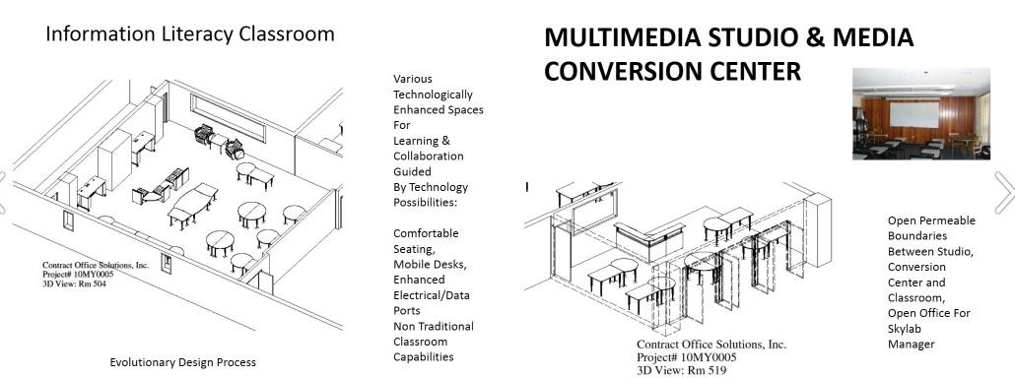
University of West Florida Skylab, 2009, Architectural Renderings

Slide 9
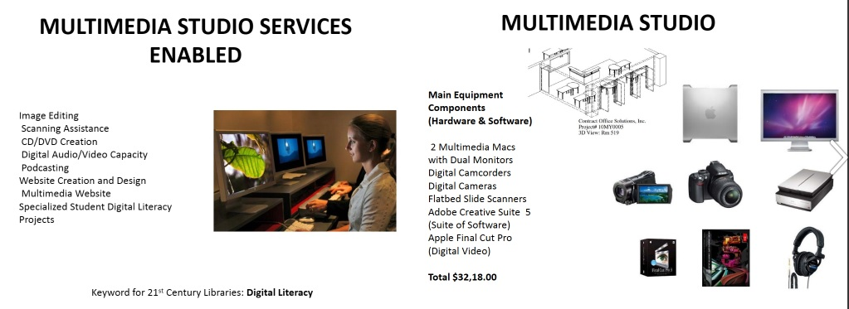
University of West Florida Skylab, 2010, Technology Services & Equipment

Slide 10
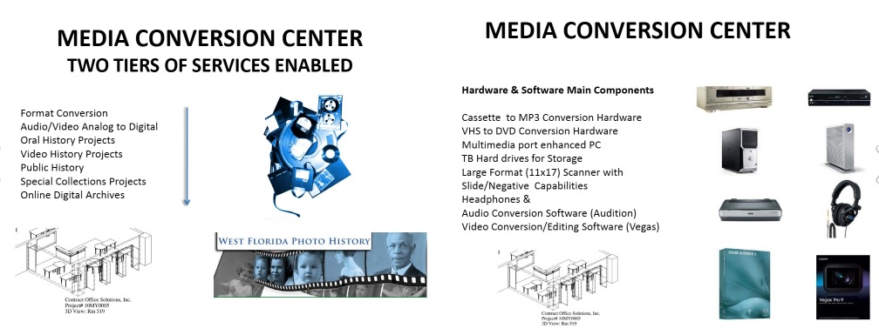
University of West Florida Skylab, 2009, Technology Services & Equipment

Slide 11
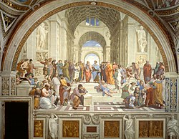


Reestablishment of a Renaissance Model of
Interdisciplinarity
Convergence of Space, Technology, Learning
Library
Humanities &
Social Sciences
Sciences
Cross-fertilization of
Projects, People, Skillsets
Technologists &
Engineering
Library as
Third Space for Learning

Slide 12
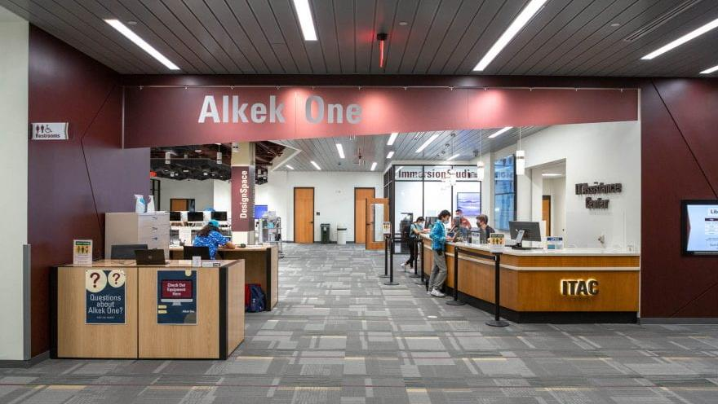
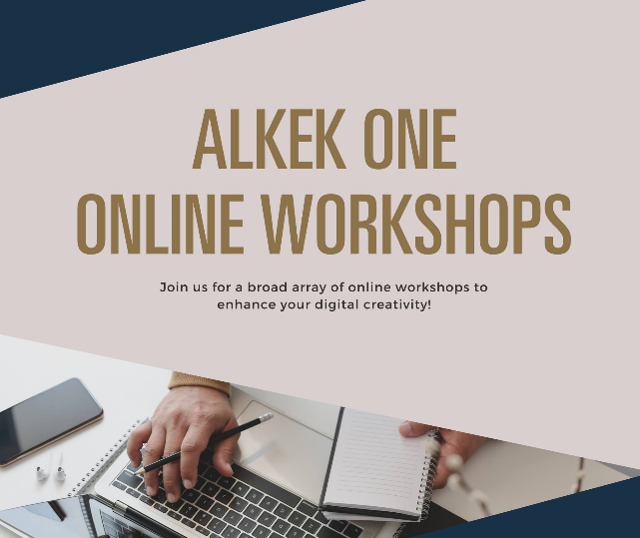

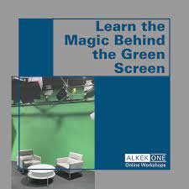
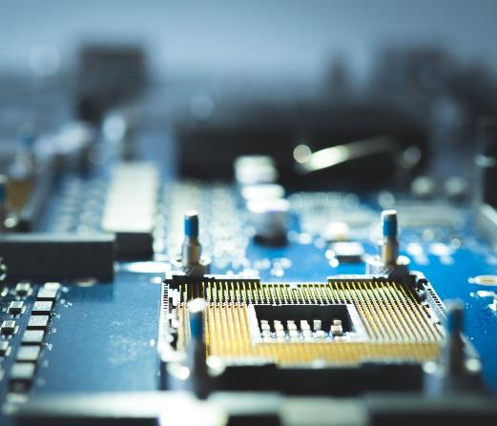
Texas State Alkek Library
Learning Commons 2.0 For Student & Faculty Success
Information, Digital and
Algorithmic Literacies
Badging, Microcredentialing and Digital Certificate Program
Multimedia Lab
Digitization and Print Shop/ePress
GIS LAB
Digital, Information and Algorithmic Literacy Classrooms
Makerspace
Digital Video Studio

Slide 13
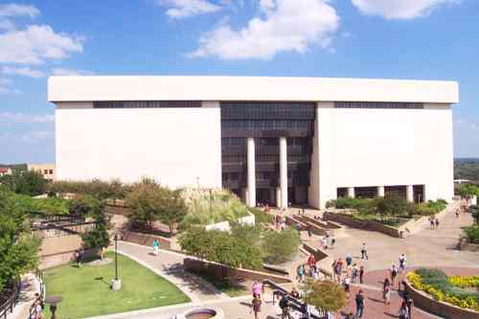
Case Study: Texas State University
Alkek Library Space/Technology Transformation Project, 2014-2020
Large Academic Library (7 Fl.)
Reconfiguration of Alkek Library From Book Warehouse to Learning Commons focused on Student Success
Texas State University,Carnegie Class R2 Doctoral University (Higher Research Activity, approximately 40,000 students)
Designated Emerging Research
Institution (Texas State Legislature)
Project was Part of Libraries Association of Research Libraries Membership Application Strategy (ARL, Achieved 2020)
Multi-Stakeholder Project: University/Library/IT Division, 5-7 years, 3-4 Large Phases

Slide 14
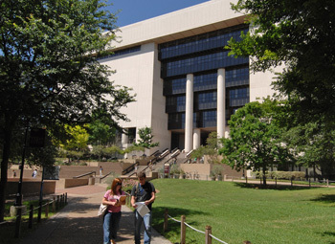
Texas State University Alkek Library
Architectural Programming, Design & Implementation
Three Large Overlapping Architectural Space/Technology,
Buildout Phases (2014-2021)
Phase I: Infrastructure Upgrade: Electrical/Data; Off-Site Repository/1M Books, ARC, 2014-2017
Phase II: Mid-Term Learning Commons/Library Transformation of Spaces/Floors: Furniture/Special Collections, 2016-2019
Phase III: Alkek I, Future Learning Spaces/Themed Centers, 1st Floor Technology, Immersion Studio (VR),GIS Lab, Makerspace, Smart Classrooms (2018-2020)
Multi-Stakeholder Project: University/Library/IT Division, Multi-Year 5-7, 3-4 Large Phases
Learning Commons Spaces and Technology Video: https://www.youtube.com/watch?v=QpYPbOuZWp4

Slide 15

Preliminary Caveats for Technology/Spatial Redesign
Environmental Scans, Planning, Project Management
Before going into any larger technology and space transformation projects several possibilities and constraints should be addressed:
Budgetary Possibilities
University Administrative Directions
Donor Possibilities
5) Human Resource Requirements/Possibilities
6) Staff, Stakeholder and University Interests
7) Work Culture and Social Factors
8) Current and Future Library Needs

Slide 16
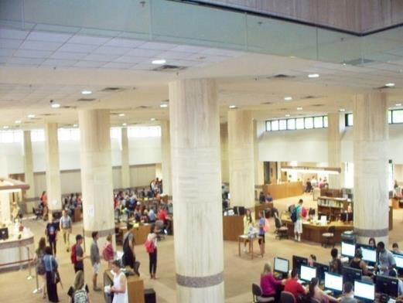
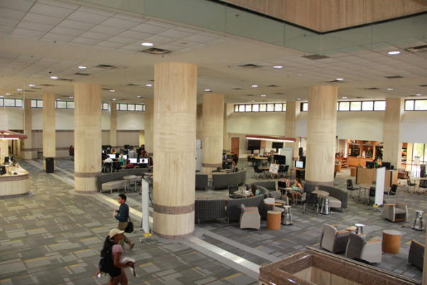

Planning Principles, 2000-2023
Technology Enhanced Learning Spaces
Technologies deployed in the library will change over time. Planning should reflect this by allocating appropriate space without necessarily establishing a specific technology for each space
Alkek Library 2014 2017 2020 +
Texas State University Alkek Library Learning Commons Transformation, 2014-2022

Slide 17



Conceptual Changes in Library Learning Spaces, 2000 – 2023
Period | Space/Technology Conceptual Changes in Library Learning Spaces
2003-2012 | Initial Technology Transition Phase
 | - Libraries still primarily viewed as physical repositories of books and materials.
 | - Initial integration of technology: PC’s and digital databases starting to complement traditional resources.
 | - Onset of information commons, PC’s and Wi-Fi enabled spaces allowing users to use their own devices.
 | - Early adoption of e-books and digital media content.
 | - Some innovative libraries start experimenting with makerspaces.
2012-2016 | Digital Integration Phase
 | - Rapid proliferation of mobile technologies leads to increased demand for digital resources.
 | - Libraries adopt more technology, including self-service kiosks, digital catalogs, and more computer workstations.
 | - E-books, online journals, and digital databases become more common and accepted.
 | - Libraries transform into collaborative spaces with areas for group study and digital collaboration.
 | - Introduction of digital literacy programs and technology training workshops.
2016-2023 | Digital Transformation Phase
 | - The rise of mobile technology reshapes libraries into multidimensional learning spaces.
 | - Wide acceptance of BYOD (Bring Your Own Device) culture, with libraries providing charging stations, digital resources, and robust Wi-Fi.
 | - The shift towards cloud-based resources for storage and access to digital materials.
 | - Further integration of emerging technologies like AI, AR/VR, IoT, etc. into library services.
 | - Libraries increasingly serve as makerspaces, digital media labs, and community innovation centers.

Slide 18
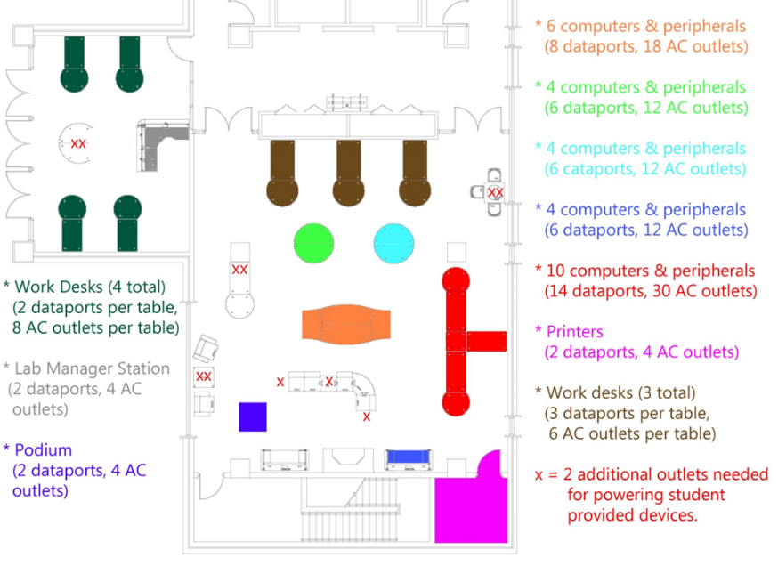
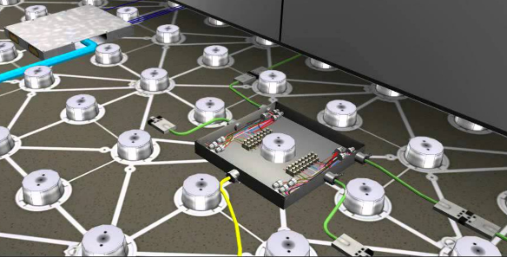
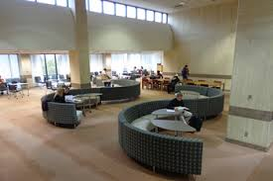
Library Technology Infrastructure Planning Considerations
Provide infrastructure throughout building – holistically
Technology driven activities will continue to expand and will eventually dominate library use
High Data/Electrical Floors 2015
Throughout Building (
(Technological Reconfigurability)
Learning Commons Floor Video (DIRRT)
Texas State University (2012)
University of West Florida Sklylab (2010)
Data Ports and Electrical Outlets for Students, Faculty and Patrons

Slide 19
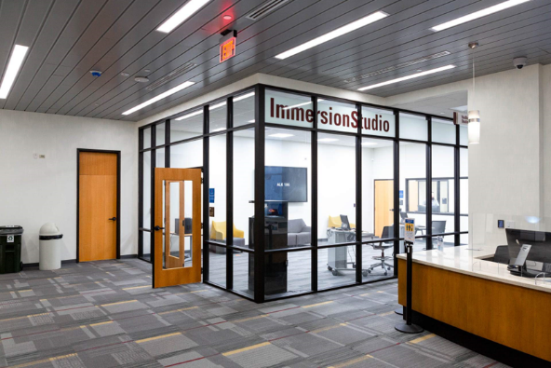
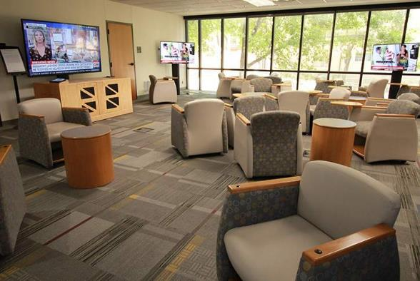
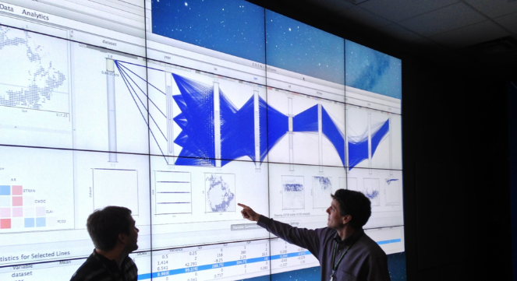
Library Technology Space Planning Considerations
Planning associated with technologies should not be constrained based on current technology equipment or practices as technology and practices will change
Library planning should anticipate technologies we don’t expect to see in the library, and our current expectation of more technology is probably an underestimate.
Alkek One Immersion Studio, Learning Commons Instant Theatre (2020)
AI Lab & Data Visualization Wall MSU, 2023+)

Slide 20
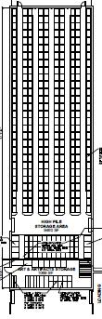
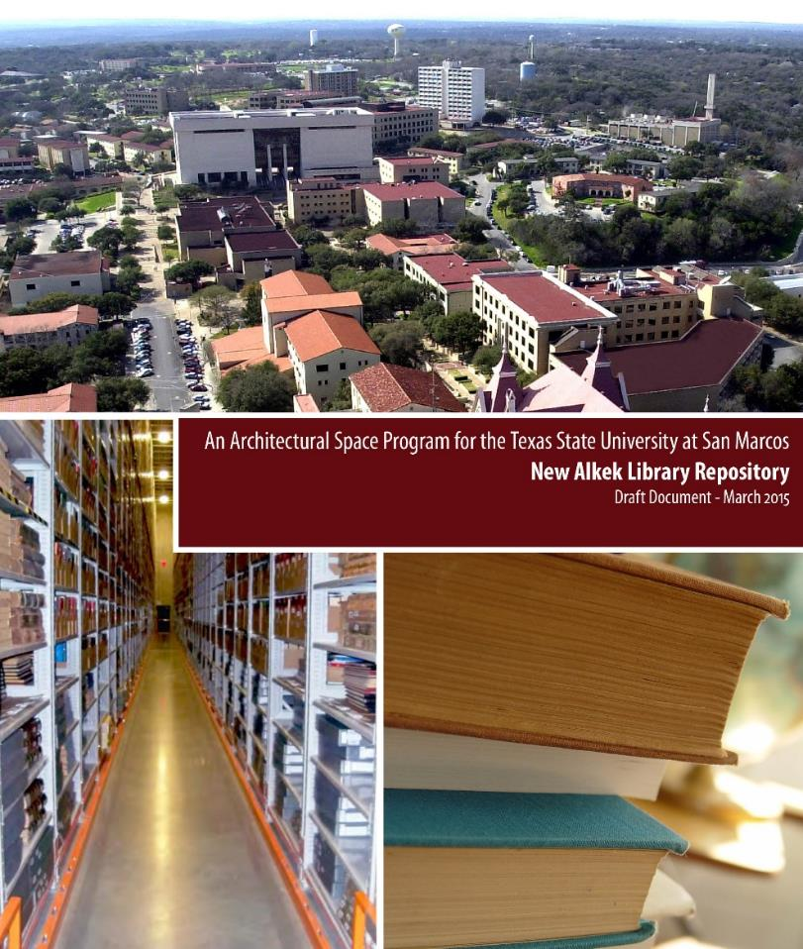
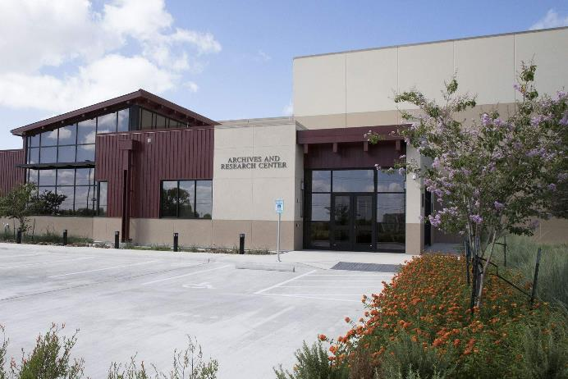
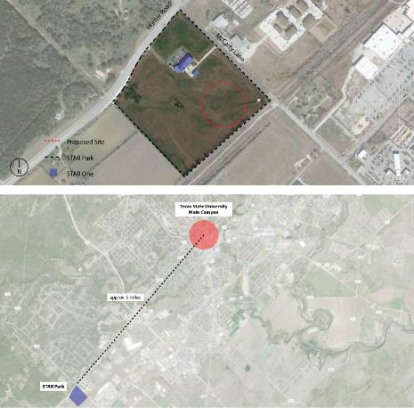
From Book Warehouse to Learning Commons
Offsite Repository, Archival Research Center, Texas State, 2015-17 , 1 Million Books

Slide 21
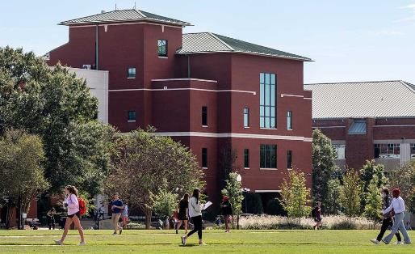

Mitchell Memorial Library, Mississippi State University (2023)
Five Floor Academic Library
Approximately 70,000 sq ft.
Space to be Freed Up
Circulating Holdings (Monographs)
3rd Floor: A-M: 257,000
P-S: 194,000
4th Floor:T-Z: 42,000
Total ~500,000

Slide 22
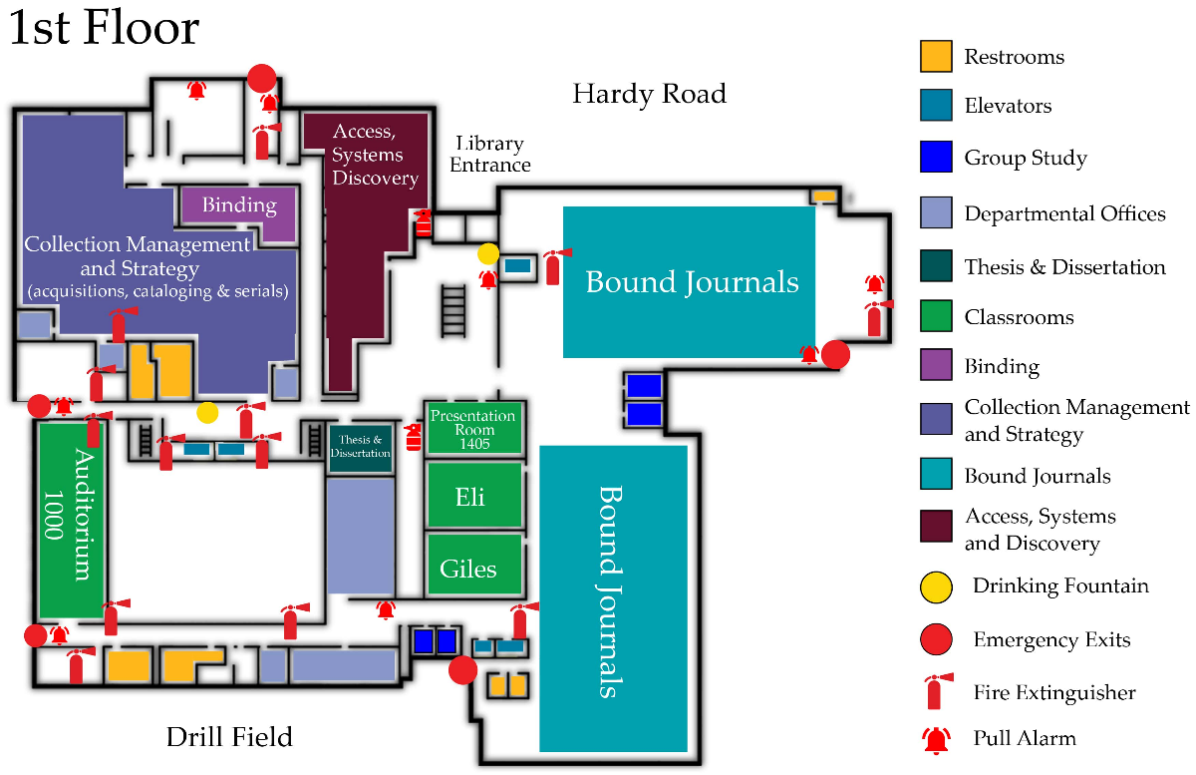
Conversion to Digital Resources, Other Space Possibilities, JSTOR, IEEE Backfiles,
1st Floor Bound Journals ~300,000
1st Floor Government Docs ~100,000
Total: ~400,000
Replacing Monographs into Bound Journals and placing Remaining Print Journals into Offsite Rented or University
owned Facility
Digital Resource Conversion, 2023+
IEEE Digital Backfiles
JSTOR Digital Backfiles
Weeding Print Copies
Bindery Becoming Digitization Lab

Slide 23
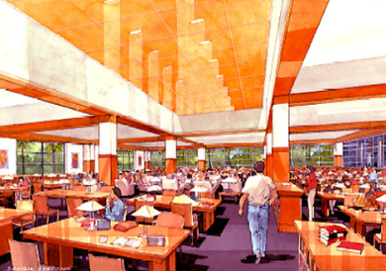
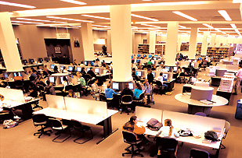
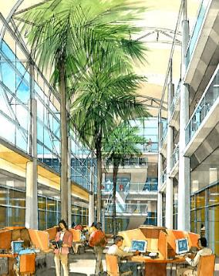
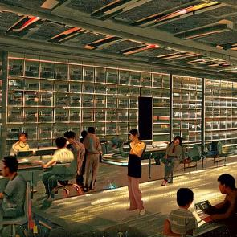
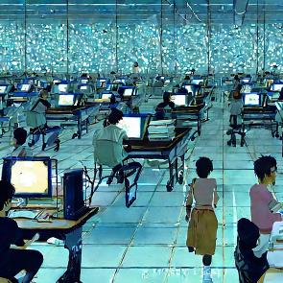
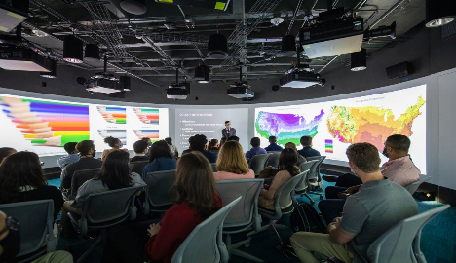
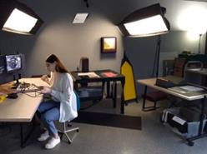
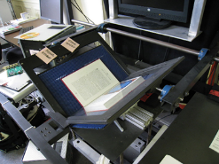
Funding and Donors,
Vision and Reality
MSU Libraries Research Data Visualization/AI Center, 2023
Purpose Enabling Research faculty and grad students with their research and research data through Data Visualization and AI Possibilities
Immediate Needs, $5.75M
MSU Digitization Lab, 2023 +
Purpose: Enabling Research Faculty, Students and Community with National Level Digitization Lab and Online Multimedia Digital Library/Archives Possibilities
Immediate Needs $4.75M
University of Miami Libraries Information Commons 2003
Stable Diffusion & Photoshop Generative AI, Student Library Study Spaces and Library Stacks, 2023
University of Miami Libraries
Architectural Renderings, 2003

Slide 24
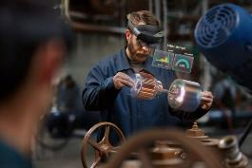
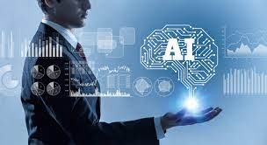
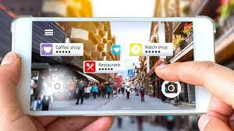
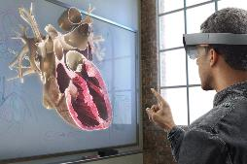
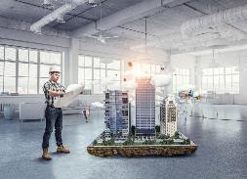
Building and Developing New Models
Integrating, New Technology & Learning Spaces
(Mobile, VR, AR, XR, Research Ecosystems, AI)
Digital Libraries 1995 – 2023 +
Cognitive Cartography/Multimedia Archives
(Video, Text, GIS, Images, Field Notes)
Dick Reavis: National Tour of Texas
Multimedia, Digital Archives/Consortial ETD Projects
(Digital video, online exhibit images, text, digital archives)
Severo Perez: And the Earth Did not Swallow Them
Online Exhibits/Digital Archives/ Online Academic Journals
(images and text, Omeka front end/Database back end, IIIF)
Cabeza de Vaca La Relacion Digitization
Santiago Tafolla: Mexican Amer. Confederate Soldier
Interactive Image Archives/Consortial Data Research Projects
(Image libraries, Interactive Commenting/Metadata)
Texas State Flickr Commons
Digital Libraries Archiving & Documentation Projects
(Text, Metadata, OCR, Search, Zoom ability, Page Turning)
Pedagogs University Yearbooks
Faculty Digitization Proposals/Partnerships
Digital Libraries
2023 +
Complexity
Focused on Student & Faculty Learning and Research Success:
https://www.youtube.com/watch?v=1c2zd-P69QU
1995

Slide 25
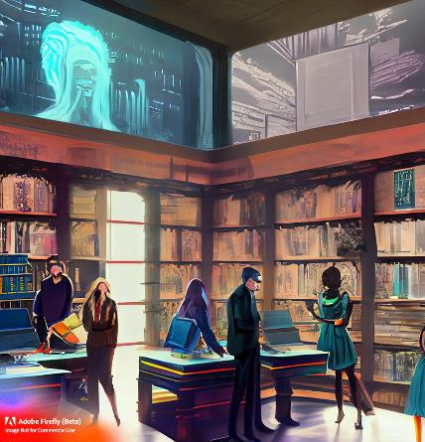
Library Spaces and Technology Initiatives Bibliography
Papers, Presentations, Architectural and Technology Planning Documents
Articles, Book Chapters and Interviews
Uzwyshyn, R (2019). “Choosing What Technology Goes Into a Learning Commons (Interview). In Lynn D. Lampert and Colleen Meyers-Martin (Eds.). Creating a Learning Commons: A Practical Guide for Librarians (Ch. 6, pp. 75-90). London: Rowman and Littlefield, 2019.
Uzwyshyn,R(2018). Academic Libraries and Technology: An Environmental Scan Towards Future Possibility, Proofs. In J. G. Holbrook (Ed.), Academic and Digital Libraries: Emerging Directions and Trends (pp. 63-86). New York: Nova Publishers, 2018.
Uzwyshyn, R (October 2016). Back to the Future: From Book Warehouse to Library Learning Commons. Informed Librarian, October 2016.
Uzwyshyn, R. (2015). One Size May Not Fit All: Pragmatic Reflections on 3D Printers for Academic Learning Environments. Computers in Libraries. Special Issue on Innovation. 35:10, December 2015. pp. 4-8.
Uzwyshyn, R (2003). "Teaching Vermeer in Miami: Interdisciplinarity, Visual Information and a Visual Thinking Strategies Institute" Books and Bytes: The University of Miami Libraries Journal. Volume 2, Issue 2, Winter, 2003.
Uzwyshyn, R. (2016). How to Build a 3D Printing Center: Experts Share Their Advice for Setting up a Campus 3D Printing Lab. Weldon, D. CampusTechnology Interveiw. October 27, 2016.
Uzwyshyn, R (2010). "Envisioning the Skylab: The New University of West Florida Libraries 21st Century Learning Space"(Panel Presentation). For Academic Learning Spaces Conference: Invention, (Re)Invention and Innovation, June 7 & 8, 2010, Florida State University. (PDF), Books & Bytes Article.
Uzwyshyn (2003). "Teaching Vermeer in Miami: Interdisciplinarity, Visual Information and a Visual Thinking Strategies Institute" Books and Bytes: The University of Miami Libraries Journal. Volume 2, Issue 2, Winter, 2003.
Conference Presentations,
Uzwyshyn, R(2017). S, M, XL: Libraries & Learning Commons. Campus Technology Annual Conference, Coffee Talk Conversations, Chicago, McCormick Convention Center, July 18, 2017. “
Uzwyshyn, R. (2016). From Zero to Hero: 3D Printer Infrastructures for College and University Campuses. Campus Technology Annual Conference, Boston, MA, August 1-4, 2016.
Uzwyshyn, R. (2016) Transforming Your University or College Library: From Book Warehouse to Innovation-Centered Learning Commons. For Transformational Technology in Higher Education: Thriving as a Connected Campus. Quick v., 2016.

Slide 26

Bibliography Continued
Conference Presentations Continued
Uzwyshyn, R (2016). New Directions in Student Learning Spaces. (Panel Presentation). Transformational Technology in Higher Education. Quick v., 2016.
Uzwyshyn, R (2014). Makerspaces, Vizualization Walls and Imagineering Design for Learning Commons (PPT), 2014.
Uzwyshyn, R (2010). "Envisioning the Skylab: The New University of West Florida Libraries 21st Century Learning Space"(Panel Presentation). For Academic Learning Spaces Conference: Invention, (Re)Invention and Innovation, June 7 & 8, 2010, Florida State University. (PDF), Books & Bytes Article.
Internal Presentations, White Papers and Planning Documents
Keith, J., Pankl, L & Uzwyshyn, R. (2023). Mississippi State University Exploration, Research and Learning Environment Proposal: The ERLE. (PDF, PPT). 2023.
Uzwyshyn, R (2023). Research Data Repository and AI Learning Center Proposal. 2023. Mississippi State University. 2023.
Uzwyshyn, R. (2023) MSU Digitization Lab, Digital Media Center and AI/Data Center Donor Funding Proposal, 2023.
Uzwyshyn, R (2014). Makerspaces, Vizualization Walls and Imagineering Design for Learning Commons (PPT), 2014.
Uzwyshyn, R (2010). Skylab Information Commons 2010 (Award equipment/space, Skylab Manager).
Uzwyshyn, R. (2010) UWF Libraries Digital Literacy Studio.
Uzwyshyn, R (2008). UWF Libraries Learning Commons: White Paper; Library Digital Initiatives Program and Literacy Studio; IT Departmental Space, Human Resources Needs; University Libraries New Media Centre.
Uzwyshyn, R (2006). Library Digital Literacy Studio/Laboratory Proposal (PDF).

Slide 27

Thank You
Questions and Comments
Ray Uzwyshyn, Ph.D. MBA MLIS
Associate Dean, Collections and Strategy
Mississippi State University, USA
ruzwyshyn@gmail.com

Slide 29


