Slide 1
Academic Libraries
In The 21st Century
Vision, Development, Implementation
Ray Uzwyshyn, Ph.D. MLIS

Slide 2
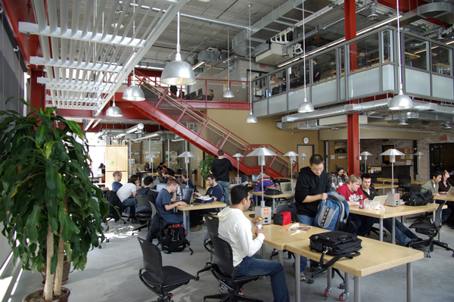
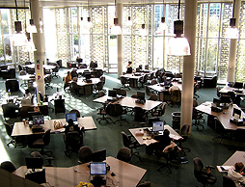
21st Century Library Learning Commons
Academic Libraries are Changing

Slide 3
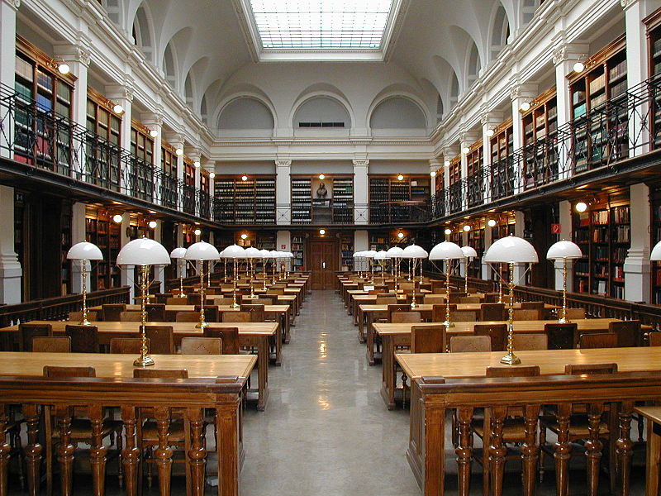
Some Academic Libraries
Have Not Yet Taken The Curve

Slide 4
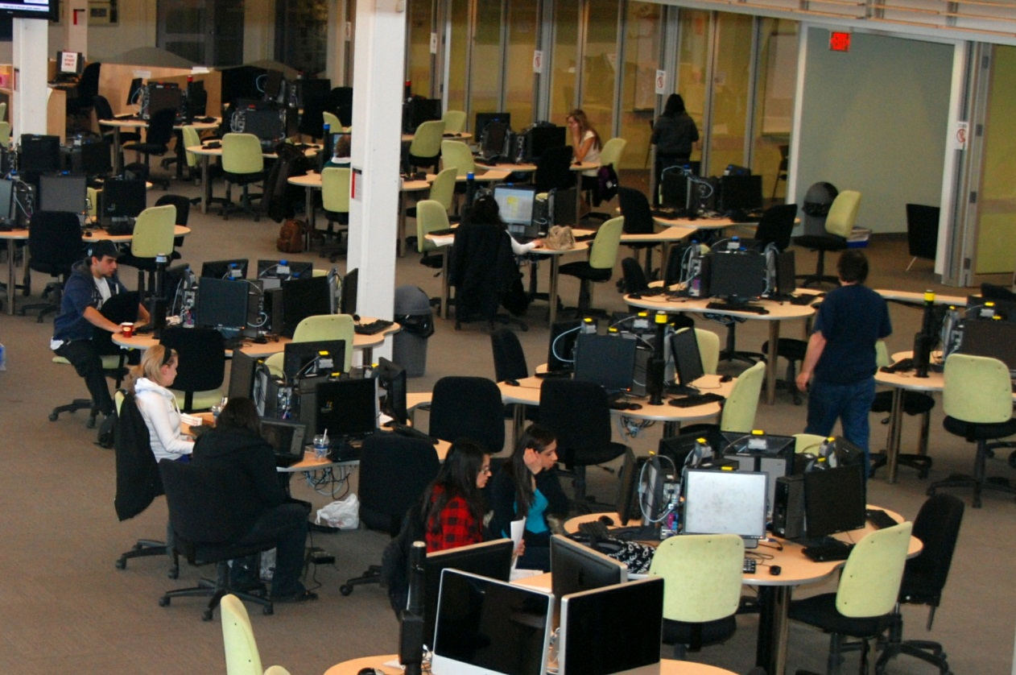
Collaborative Learning Spaces, Digital Literacy Labs, Multimedia Studios
Embracing Change

Slide 5

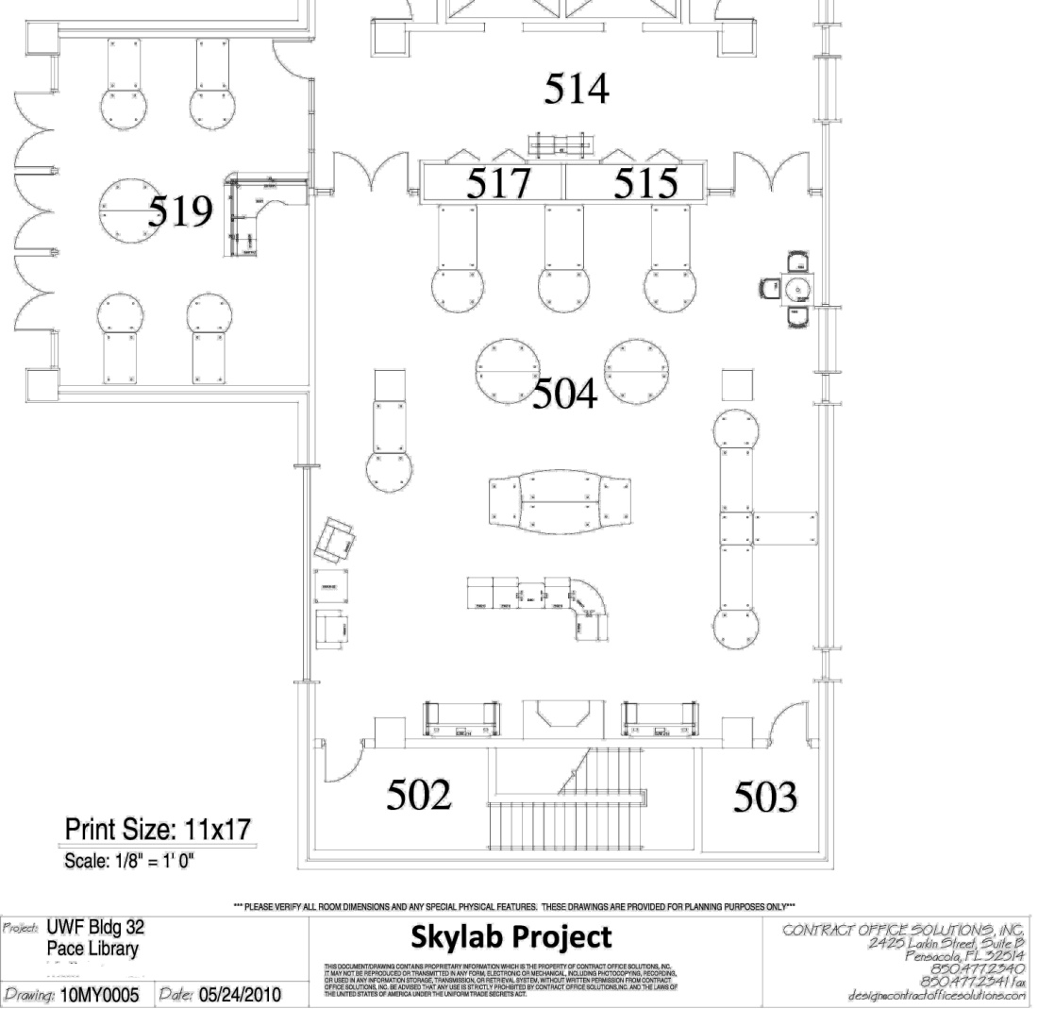
Project Possibilities
Circulation of Documents
UWF Skylab
Handouts:
Tech. Equipment ,
Schematics
Skylab Conceptualization/Grant
Binders
Complete Hardware, Software Tech. Specifications
Budget Binders
Budgetary Documents
Skylab Date Log with Primary Documents
Presentations
Library Stakeholders
Outside Constituents
National Awareness/Marketing

Slide 6

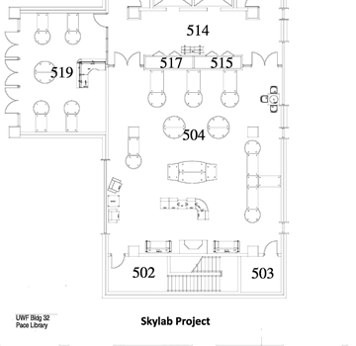
Learning, Spaces, Technology
Third Space
for Learning.
Cross-fertilization of
Projects,
People and
Skillsets.
Information & Digital Literacy
Multimedia Studios & Archival Media Conversion
Traditional Study,
Books, e-books, journals
Technology
Virtual and Physical Spaces

Slide 7

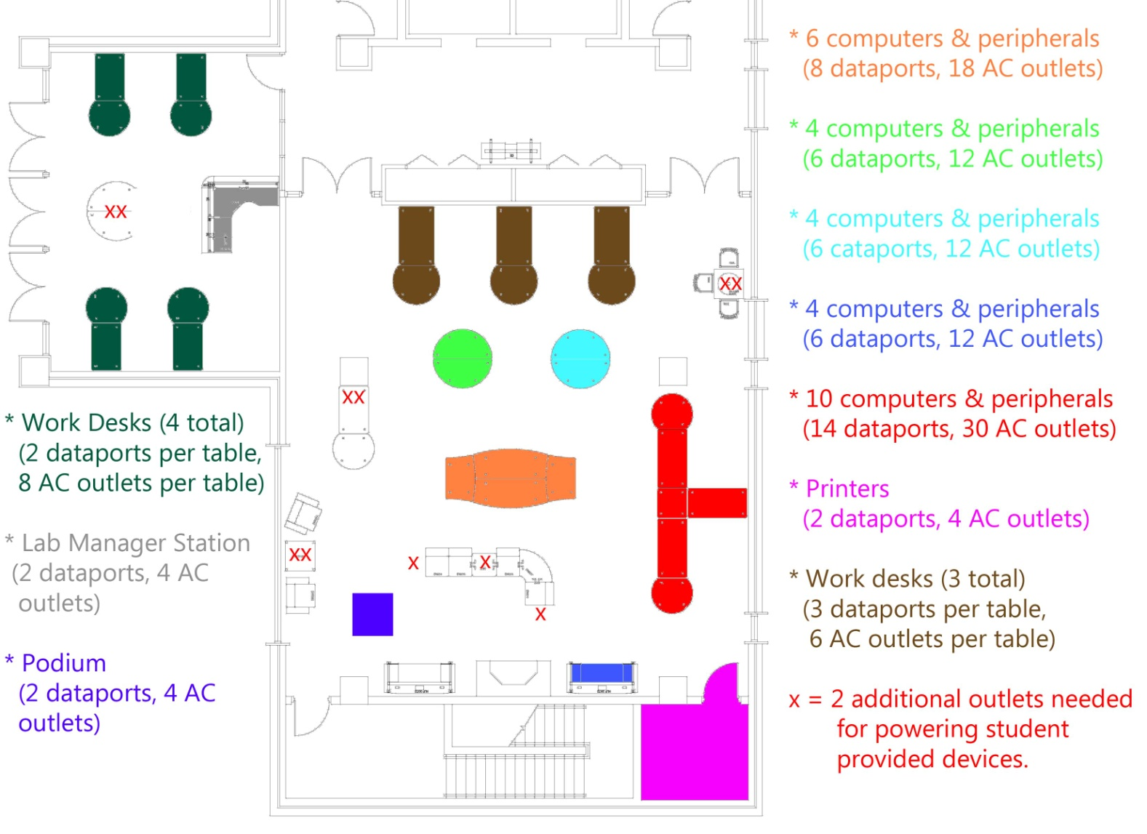
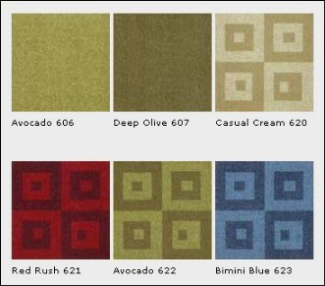

UWF Skylab
Planning: Arch & Eng.: Electrical Data
Data ports and Electrical Outlets: Diagrams for Telecom, Contractors,Cable Management & Adequate Power Supplies

Slide 8



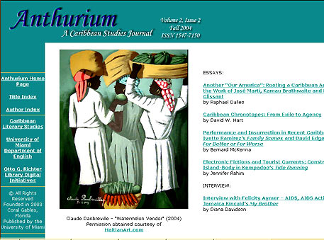
New Library Services
New Genres of Digital Collections e-Press Partnerships/Bookstore Partnerships
Scholarly E-Journals
POD Text Books and Faculty Publications
Institutional Repositories
(Theses/Archives)
Scholarly Communications Publishing Opportunities

Slide 9
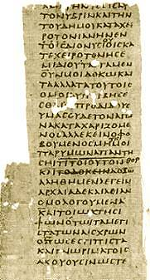

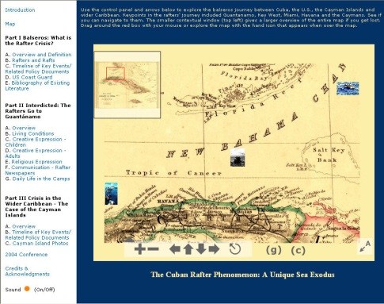
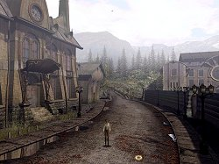
New Types of Digital Libraries & Library Services Emerging
200 B.C
1940
2003
2018
Institutional Online Repositories, Multimedia Archives

Slide 10

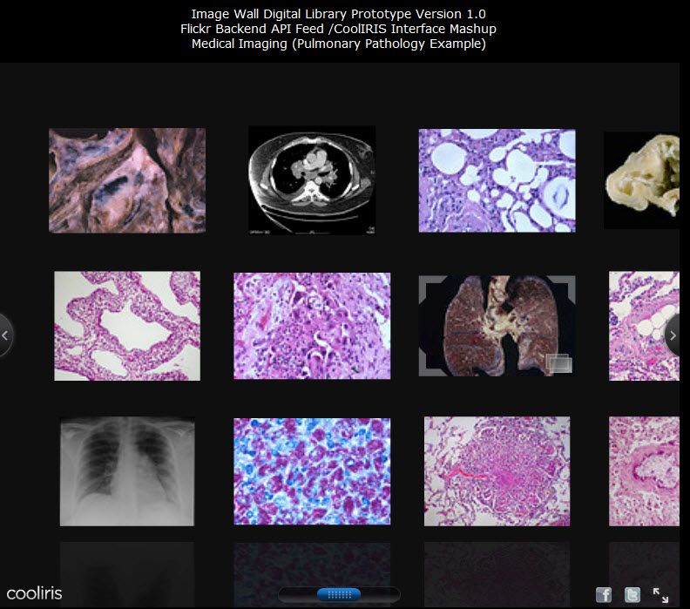
Digital Archives
Library Academic University Community Connections

Slide 11
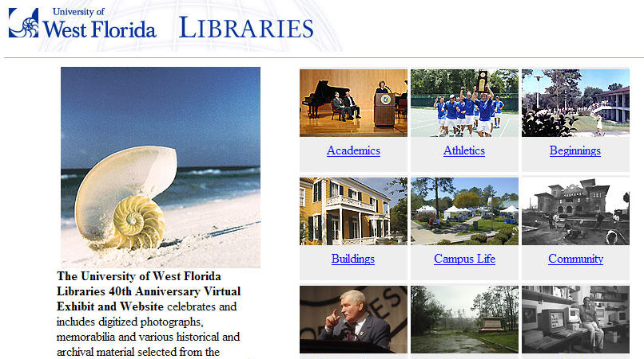
University/Library/Community Bridges

Slide 12
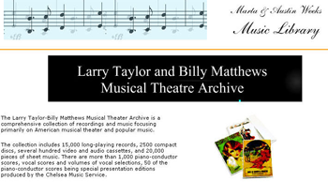
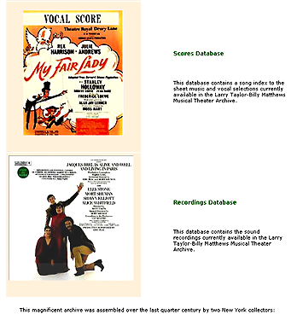
Branding and Marketing the University Intellectual Riches Globally
Hybrid Digital/Paper/Audio/Video Collections

Slide 13
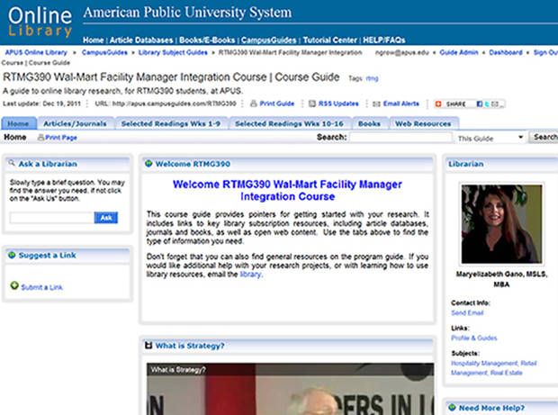


21st C. Online Education
Direct
Curricular
Replacement
Secondary
Multimedia
Bibliographic Resource
Global
Marketing/Branding
ROI
APUS Online Course Guides

Slide 14
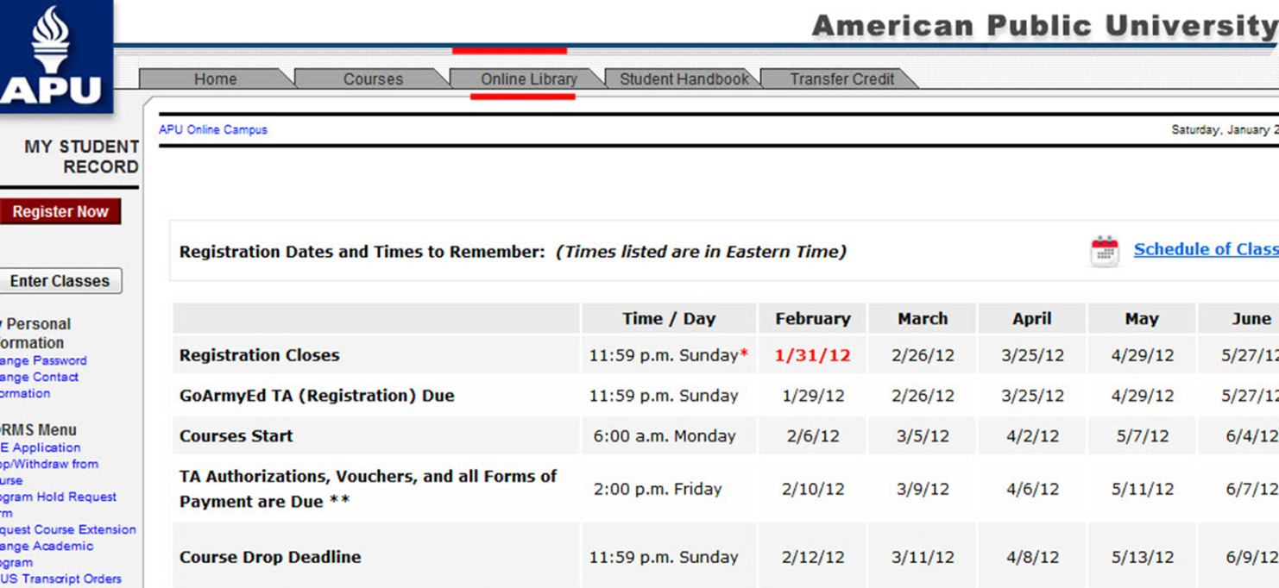

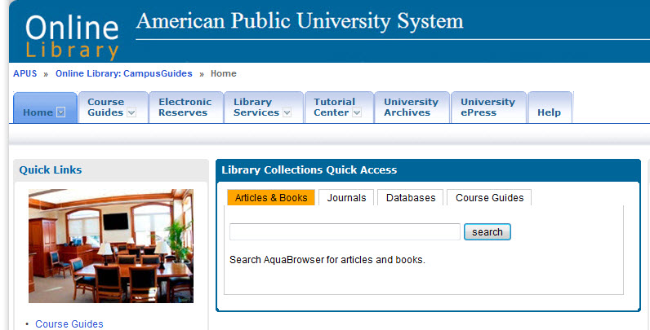
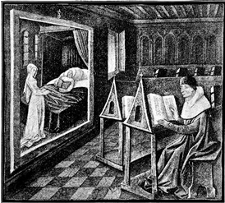

Library Integration with Online Classroom
Learning Management System

Slide 15

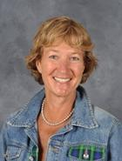


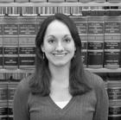
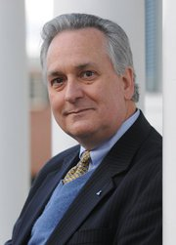

Library/faculty/Technology/ Synergies
Faculty || Academic Technology || Librarians

Slide 16
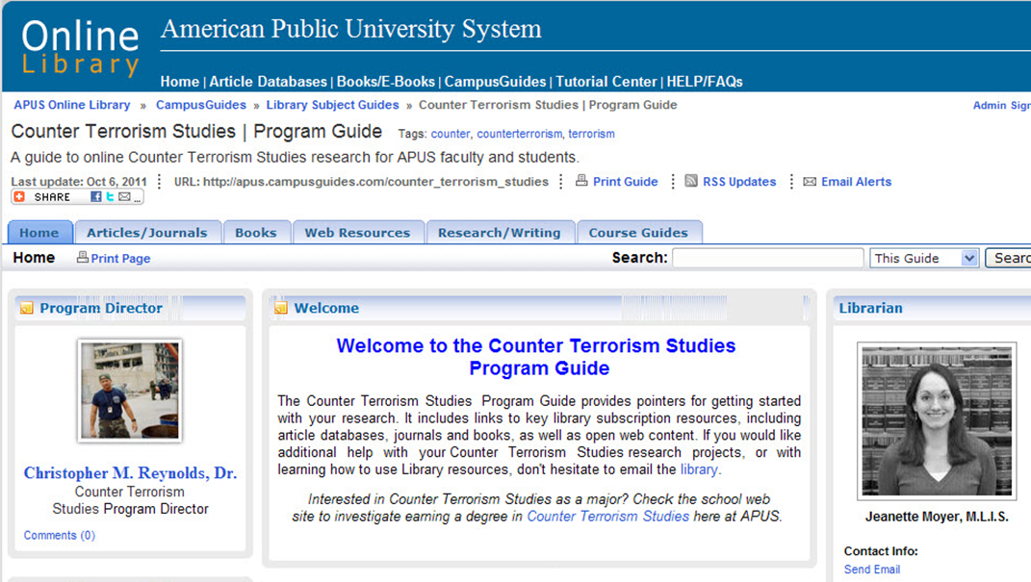
Faculty/Library
Program & Course Synergies

Slide 17


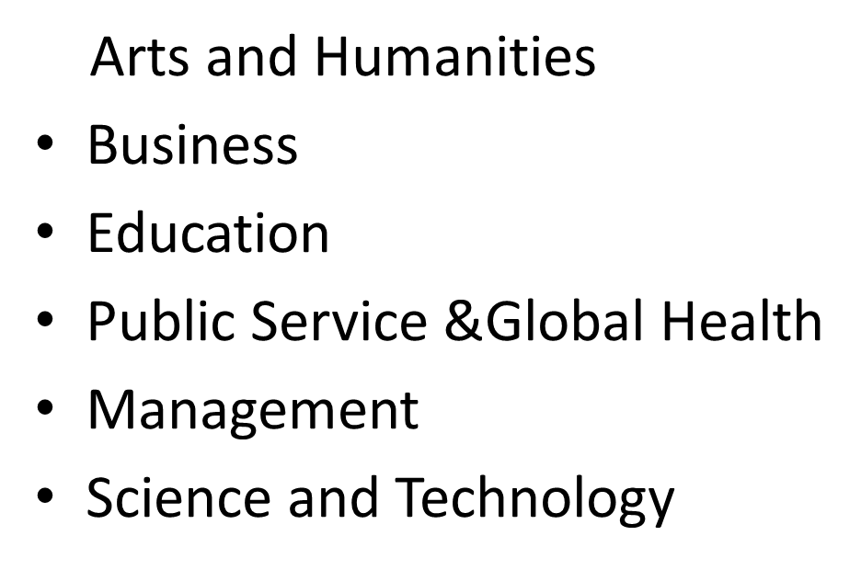
Changing Library Services
From Online Research Help to MOOC’s
Online Curricular Needs
(OER, E-Books, E-Articles)
Seven Schools, Over 1800 Online Courses

Slide 18
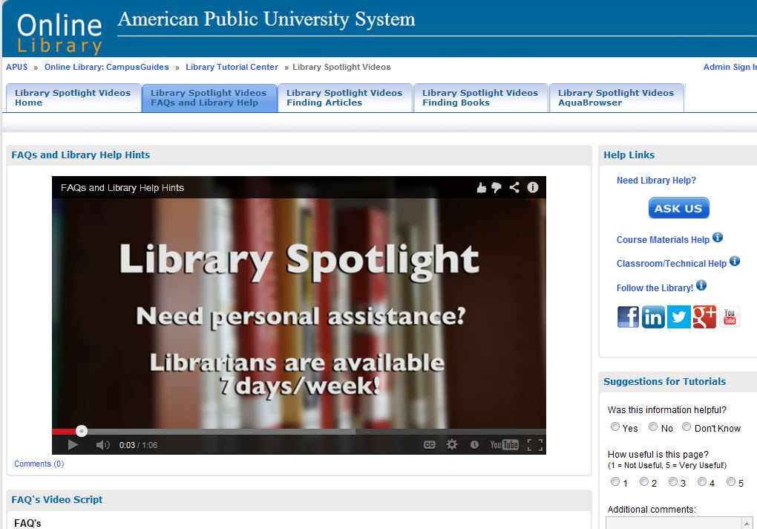
Reaching Students/Faculty through Video
New Media
Help and Research
Possibilities

Slide 19
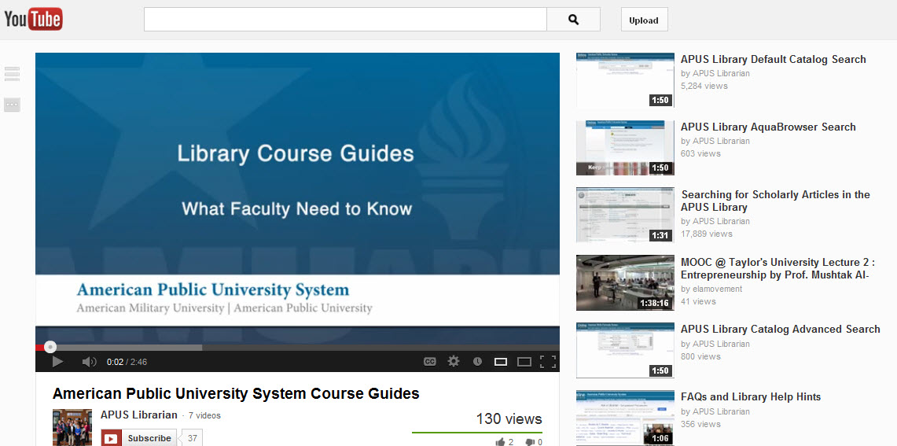
Libraries, Media
Broadcasting , Embedding

Slide 20
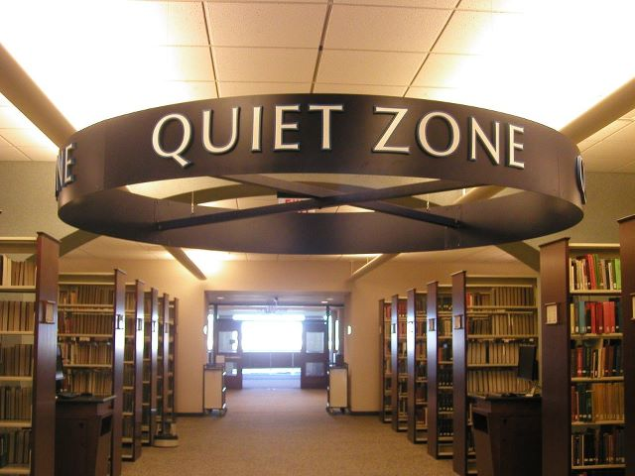
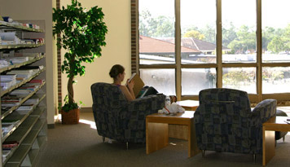
Designated Study/Quiet Zones
Traditional Continuity

Slide 21


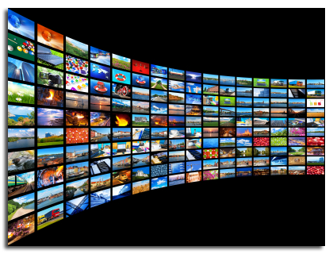
Collecting Books & Media
E-books, e-journals, article aggregrator databases
150,000 eBooks, 40,000 ejournals
Changing Models
Ownership to Access

Slide 22
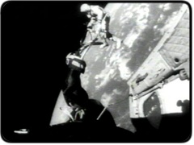
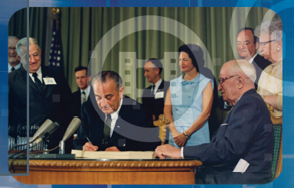

INCREASING Academic Video Databases
Business
Psychology
Counseling and therapy
Education
Economics
Public Health
History
Humanities
Criminal Justice and Law
Political Science
Public Safety/Intel
Literature/Philosophy
Religion/theatre
Science/Technology
Security/Military
Space

Slide 23
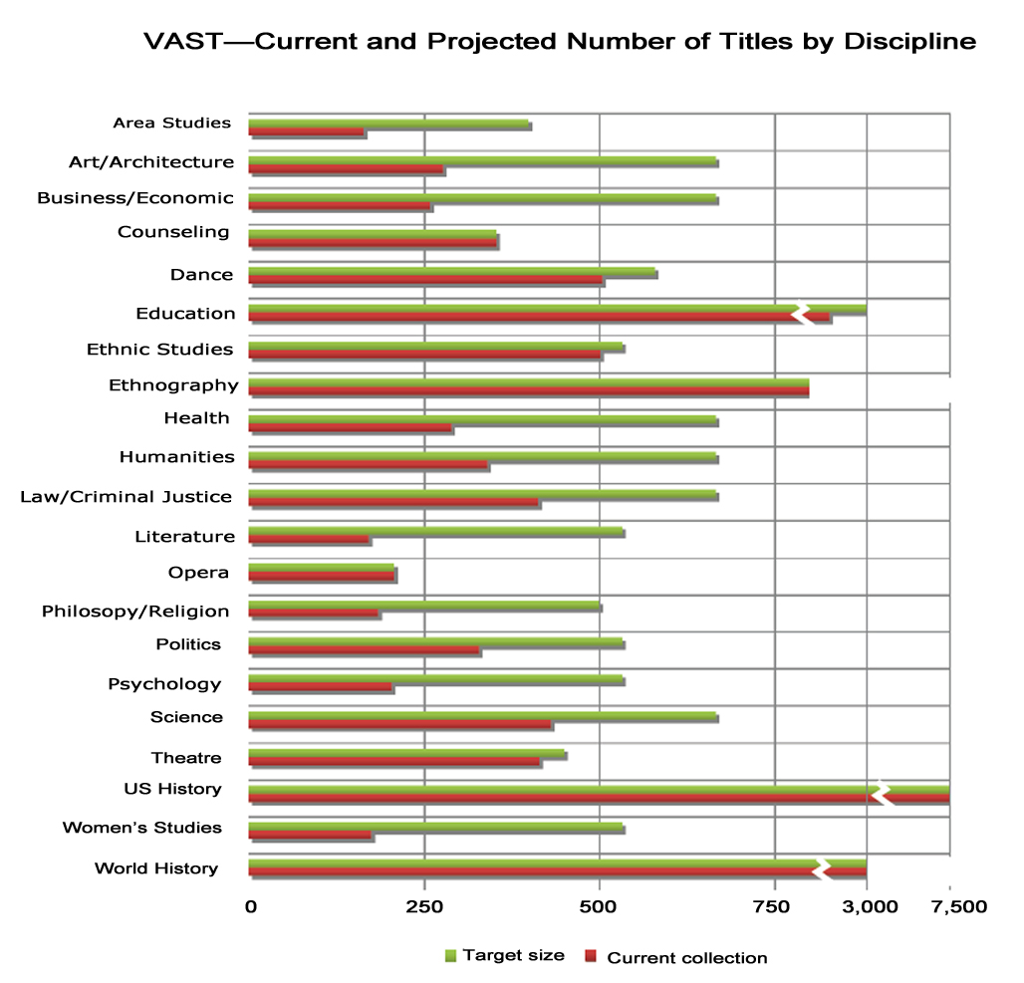
Increasing
Interdisciplinarity &
Interactivity
Simulations &
Software Packages
Alexander Street
Press Vast,
20,000 videos
2013.

Slide 24
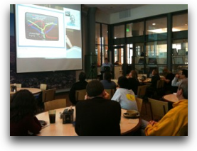
Library Learning Series
Faculty Authors
Digital Literacy Series
Community Connections
Technology/Industry Connections
Library Technology R&D

Slide 25
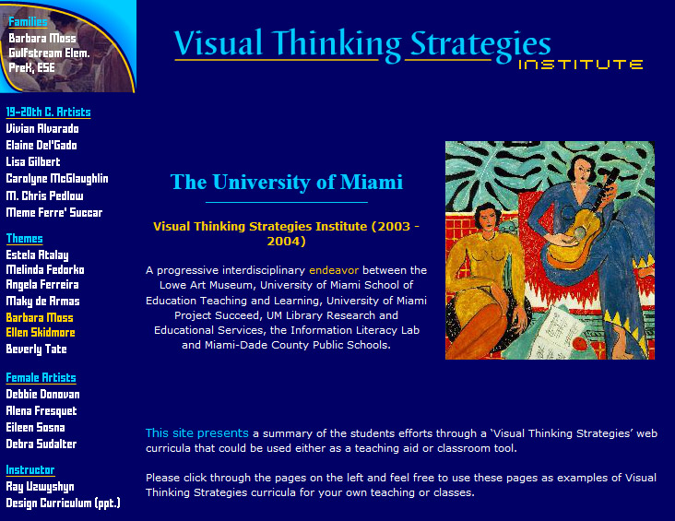
Physical Library/University Connections
Digital Literacy/ Interdisciplinarity
Library Technology and Information Literacy Services
School of Education
University Art Department/Museum
State Dept, Of Education Grant Opportunities

Slide 26
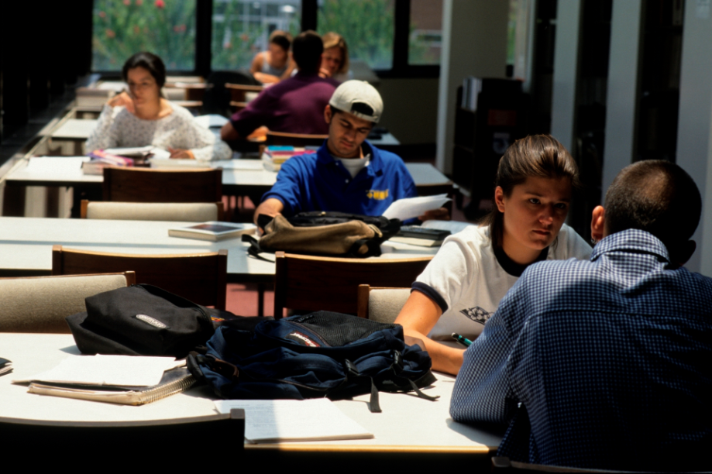
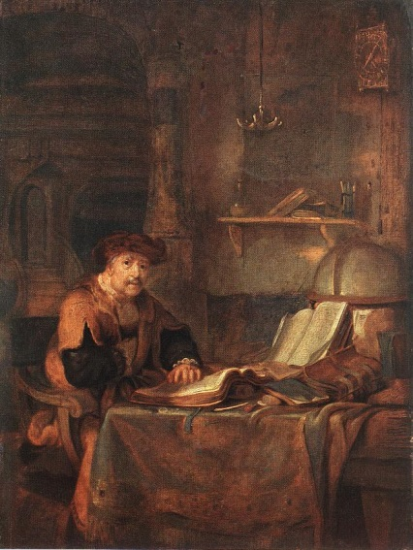
Research, Study
Resources, Scholarship
Balancing Needs for Gainful Employment
Scholarship Innovation and Inspiration

Slide 27
Ray Uzwyshyn Ph.d. MLIS
Ruzwyshyn@GMAIL.com
Thanks!

