Slide 1
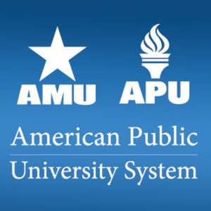
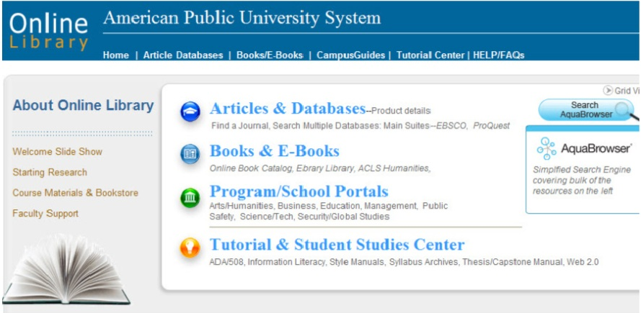
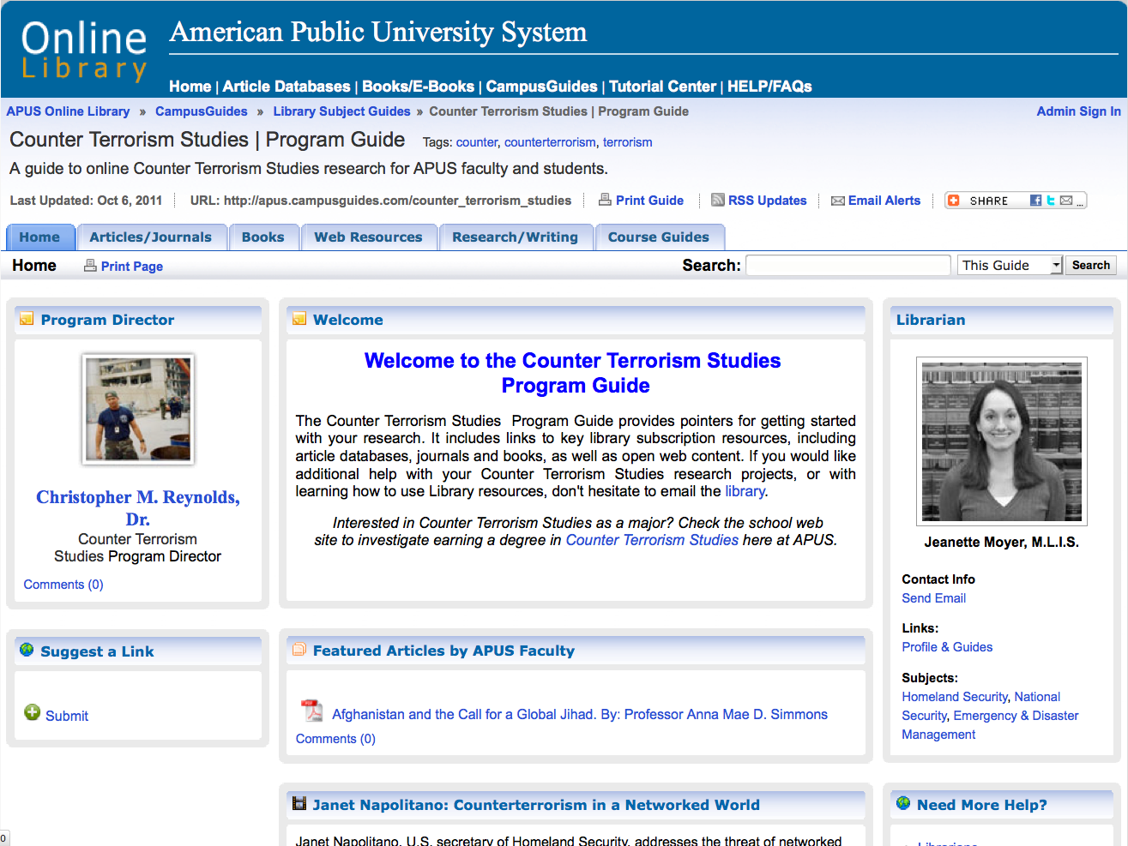
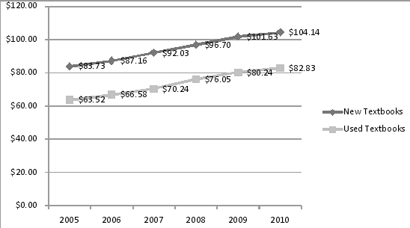
APUS Online Course Guides
A University Alternative to Text Books | http://apus.campusguides.com
Online Course Guides Effectively Respond to the Needs of Online Education
The American Public University System Online Course Guides Initiative An University Alternative to Textbooks
http://apus.campusguides.com
The Online Course Guides Demonstrate High Levels of Student and Faculty Satisfaction
Curriculum Quality: Peer Reviewed eBooks and Articles
Cost Control: Open Source Resources Vetted by Librarians and Faculty
Multimedia Pedagogy
Information Literacy Focus
5) Tutorial Center Integration.
This project demonstrates a high level of student and faculty satisfaction in three key aspects:
• Scope: The project aims to create and maintain a guide for each course and program in the entire online University (80 programs, 1800 courses) providing a robust foundation for all faculty and an easy open web doorway for students to find an retrieve course materials and begin the research process online .
• Collaborative Component with Faculty: The project creates a new infrastructure among librarians and teaching faculty opening curricular possibilities to multimedia and web 2.0 methodologies and connecting faculty with subject specialists to create new bridges for research and scholarship.
• Curricular Replacement Possibility, The project creates curricular components on the open web harnessing student learning preferences with regards to robust academic video, podcasts and a range of vendor and curricular materials.
Online Course Guides Advance Distance learning Practice in the 21st Century
When online students need to read curricular material online or conduct academic online research for a class assignment, they can look in their virtual classroom for help. A direct link to the corresponding course guide will be made available by the course instructor.
The Online Course Guides Innovatively utilize New Technology
The significance of the project became clear when program directors and teaching faculty began realizing the paradigm shift and advantage of the web for curricular possibilities and enabling broader populations of students globally. The initiative now includes widespread curricular elements of multimedia, Web 2.0, video and is gearing up with a third e-press component.
Online Course Guides Have Broad Application and Can Be Easily Duplicated
The Online Course Guides gives American Public University System an intuitive, web-based production environment that would not otherwise be available for faculty and students. It is extremely innovative in providing direct use of online library resources as curricular replacement and yet can be easily duplicated by other providers with simply willing faculty and a cadre of online librarian subject specialists.
Project Brief
The American Public University System Online Library Subject Guides Project is an initiative led by APUS's Online Library, collaborating with the university’s globally geographically distributed teaching faculty. The project’s goal is to create a brief companion website, called an online subject guide, for each school, program and course offered by the university and creating an innovative and powerful new millennia set of curricular resources for over 1800 courses and 80 undergraduate, graduate and certificate programs. The guides combine the library’s key licensed resources and the best of open source and multimedia range of content, in direct curriculum support of the course or program.
The Online Course Guides Forward New Millennia Pedagogy
The American Public University Course Guides open a new pedagogy by forwarding an intuitive, web-based production environment that would not otherwise be available for faculty to create pedagogical bridges between the library and twenty first century university. This new pedagogical model provides a foundation for a range of multimedia curricular sources makes serving our students and collaborating with teaching faculty easy, particularly in a global online learning environment.
Contributors
Project lead: Dr. Fred Stielow, VP, Ph.D. MLS Institution: American Public University System
Primary Contributors: A. Marissa Smith, MLIS Online Librarian, Campus Guides Project Manager Dr. Ray Uzwyshyn, Ph.D. MLIS, Director of Libraries 16 online part time librarians working with a faculty of 1800.
•Online Librarians/Course Guide Authors: Mustafa Abdelwahid, Sudanese-born with a Ph.D. in Public Policy & Administration from Auburn; M.L.I.S., Wisconsin; B.A., MA in Political Science & International Development, UNC, L.L.M., Law, Baku, Russia; Political Science and International Affairs Liaison. ABU DHABI & GEORGIA •Kimberly Adams, M.L.S., M.A. in History, MA in Teaching English as a Second Language Reference; History & Military Studies Liaison; SerialSolution and Jane's lead. VIRGINIA •Prudence Cendoma, M.L.S., Graduate Certificate in Latin American Studies; Hispanic/Latin Studies, Psychology Liaison. PENNSYLVANIA •Linda Cranston, M.S.L.S., M.A. in Geography; Criminal Justice Liaison, Cataloging Head. VIRGINIA •Priscilla Coulter, M.L.S., M.S. in Biology; Math & Sciences Liaison, TEXAS •Susan Fingerman, M.L.S., Former editor of SciTech News. RefWorks, IT, Science & Space Studies Liaison, MARYLAND •Maryelizabeth Gano, MLS Catholic U., MBA Hood College; Tutor.Com chief librarian. Logistics and Hospitality Program Liaison, Shepardstown, WEST VIRGINIA •Emily Harrell, M.L.S. and RN from Florida State University. Former U.S. Navy Nurse. TurnItIn, IT, and Nursing Liaison, FLORIDA •Susan Gilroy,M.L.S., M.Ed. in Education, M.P.A, in Business; Online Reference, Education Liaison; LexisNexis specialist. Former Head Librarian, Travis, AFB. IDAHO. •Neville Grow, M.L.S., M.B.A.; Business and Legal Studies Liaison; Librarian in private law firm. CALIFORNIA •Susan Hyland, M.L.S., Associate Director, Head of Reference; National Security, Intelligence Liaison; Lois Law and Ebsco Databases Lead. Former Head of NSA Libraries. VIRGINIA & FLORIDA •Jeanette Moyer, M.L.I.S.; Homeland Security Liaison; Praeger Security
Online Course Guides are Cost-Effective
The innovation with the course guides provides large cost savings to students, faculty and the university. It keeps tuition low by directly utilizing online library resources for needed curriculum. By identifying supplementary multimedia open source materials, the university and students benefit by both free text books/e-textbooks to undergraduate students and curricular components that take advantage of twenty first century methodologies and combine the best of vendor worlds, new media and open source materials.
Notes:
Dr. Ray Uzwyshyn, Ph.D., MLIS , APUS Online Course Guides, Poster for IMS Global 2012 International Learning Impact Award.

