Slide 1
21st Century online Academic librarY Services
Vision, Development, Implementation
Ray Uzwyshyn, Ph.D. MBA MLIS

Slide 2

Learning, Online Libraries, Technology
Scholarly Resources
Rich Space
for Learning.
Cross-fertilization of Projects, People and Skillsets.
Integrated Information
Ecosystem
Press
Learning Management System
(University)
Online Library,
e-books, e- journals
Resources
Faculty
Students
Librarians
Technologists
Community

Slide 3


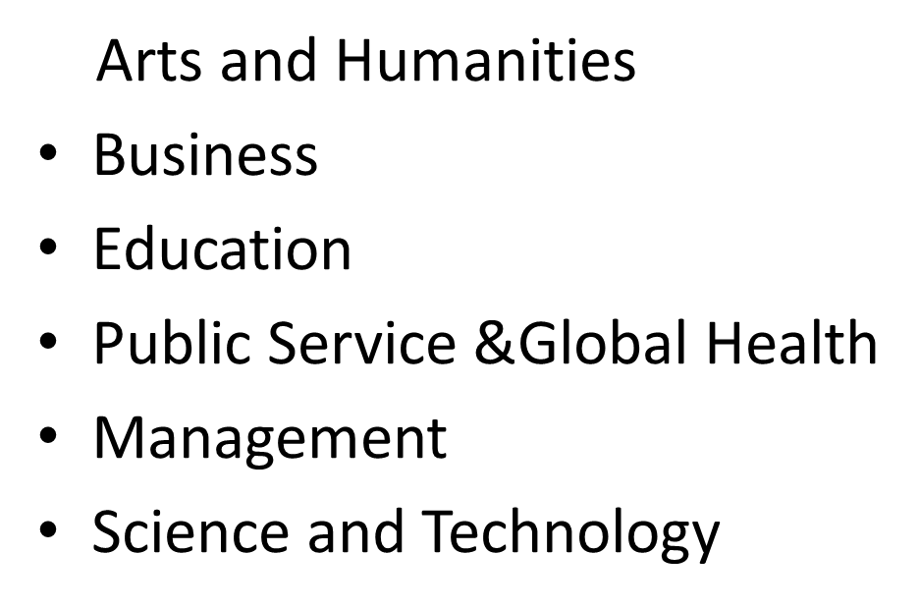
Digital Library Services
From Online Research Help Systems & Knowledge bases to MOOC’s
Online Curricular & Classroom Needs
(OER, E-Books, E-Articles, Media)

Slide 4



Collections, Resources & Media
E-books, e-journals, article aggregrator databases
Changing Models From
Ownership to Access to Production and Distribution

Slide 5
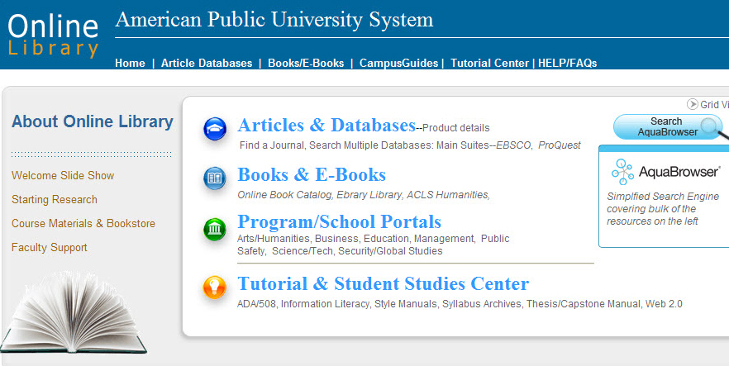
Strong Library
Learning Management System
University Integration

Slide 6
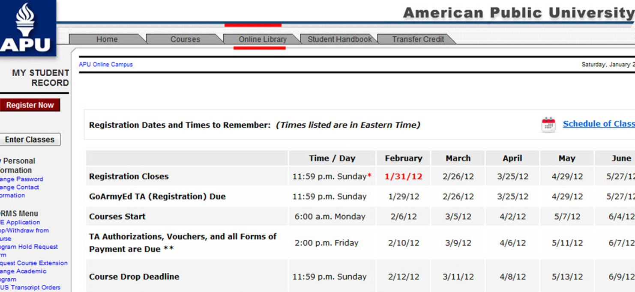

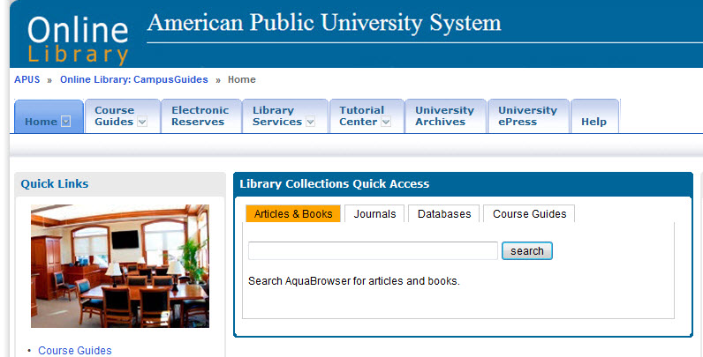
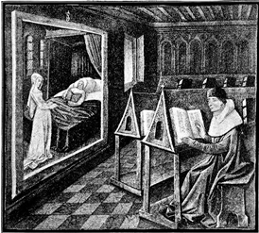

Library Integration with Online Classroom
Learning Management System
Looking forward through the rearview
mirror of history (McLuhan)

Slide 7

Paradigm Shift
Academic/Technology Opportunity
Reimagining University Classroom/Library/Press/
Faculty/Student/Curriculum Relationships
REIMAGINING University For 21st Century

Slide 8
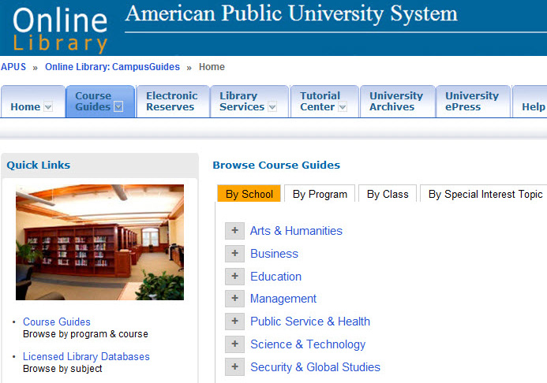



APUS Online Course Guides
National Award Winning Academic Technology Project
1800 Courses
7 Schools
3 Year Project
Massive ROI,
Innovation
Learning
Potential
National University Technology Network Award f
or Distance Education Innovation (2012).
Association for Continuing Higher Education,
Most Creative Use Of Technology Award (2013)
Gold Medal for IMS Global 2012
Learning Consortium’s Learning Impact competition

Slide 9
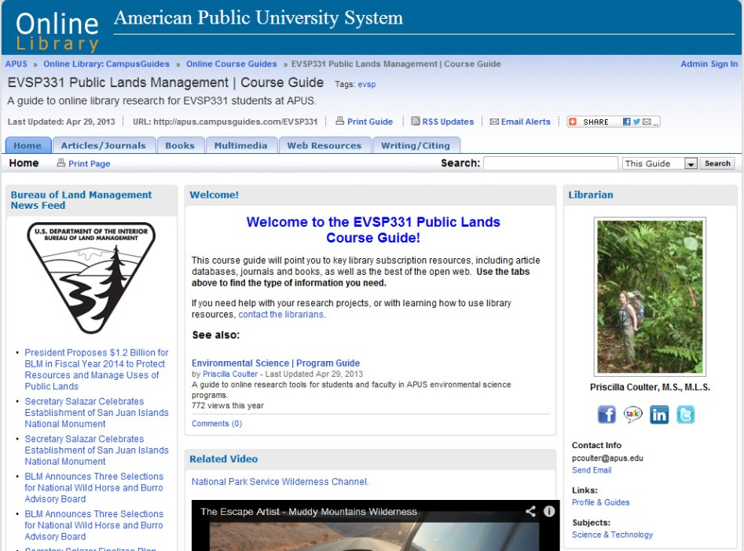
Reconfiguring Library/Online Curriculum
Relationships
Direct
Curricular
Replacement
Secondary
Multimedia
Bibliographic Resource
Global
Marketing/Branding
ROI
Open Source Publishing
Possibility

Slide 10
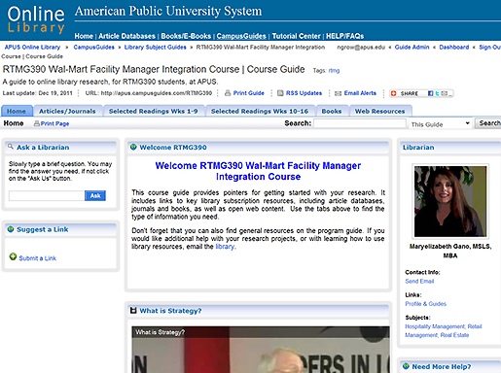
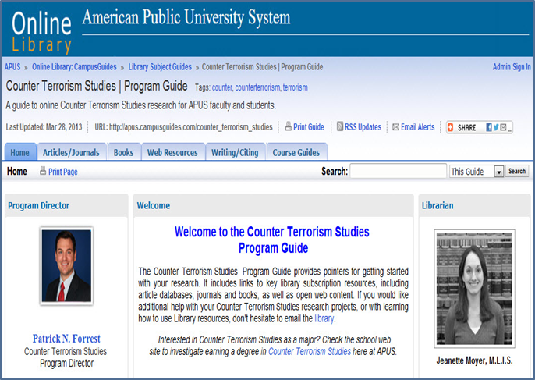
Open Source Curriculum Possibilities
Online Customization
School, Program, Department or Course
New Partnerships For Course Possibility
Focused Material, Trustworthy Sources

Slide 11
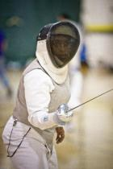
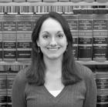
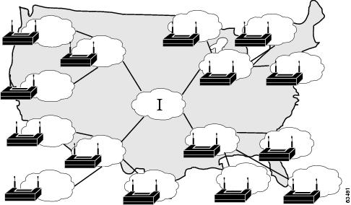


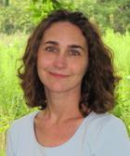
Online Human Help Networks
Online Globally Geographically Dispersed Librarian Subject Specialists/Technologists (Masters/MLIS)
Human Touch and Help:
24/7: Librarian@apus.edu,

Slide 12
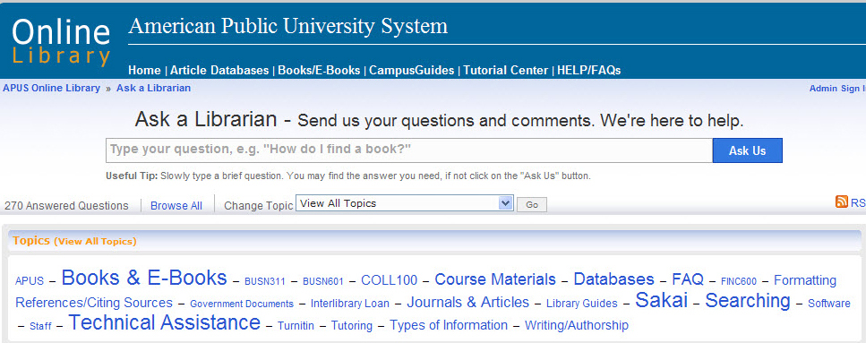
Online Digital Help Systems
Online Semantic Knowledge Base
Knowledgebase:
Semantic Knowledge Base for LMS and Libraries

Slide 13
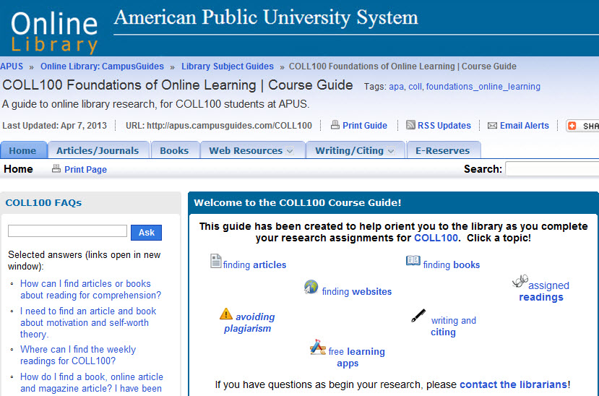
Library/Program
Partnerships:
College 100
Foundations
Adobe Connect
Embedded Library Information Literacy Programs

Slide 14


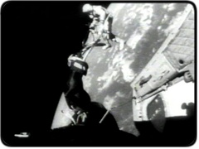
Robust Academic Video Database Infrastructure
Business
Psychology
Counseling and therapy
Education
Economics
Public Health
History
Humanities
Criminal Justice and Law
Political Science
Public Safety/Intel
Literature/Philosophy
Religion/theatre
Science/Technology
Security/Military
Space
Copyright Compliant
Accessibility
Compliant
Student Retention

Slide 15
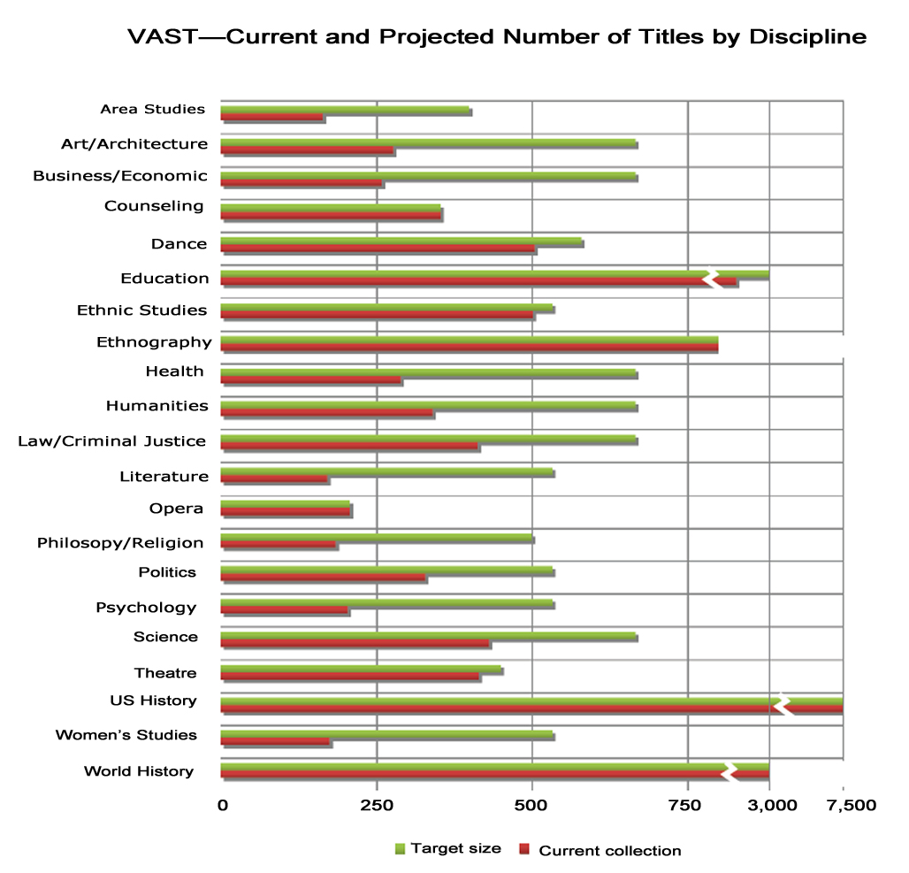
Interdisciplinarity &
Interactivity
Simulations &
Software Packages from Remedial Reading/Writing (Tutor.com) to Accounting to Language Acquisition
Alexander Street Press VAST,
20,000 videos
2013.

Slide 16

Academic Video and Integrated Curricular Design Possibilities
Discussion Forum Weekly Posting
Course Length
Semester etc.
Adult
non-traditional students
Analytics Based Learning/
Course Objectives Tie-In
Video Assignment
Review Questions
Alternative Essay Topic, Citation
Curricular Week Design
To vary/ reading
assignments

Slide 17
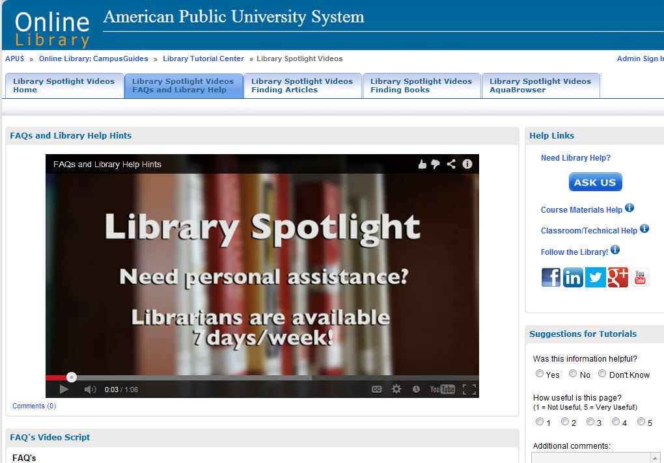
Reaching Students/Faculty through Video
New Media
Help and Research
Possibilities

Slide 18
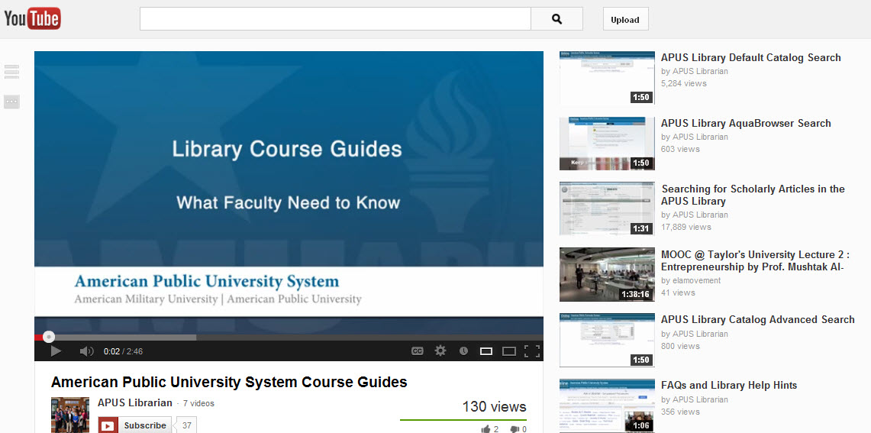
Libraries, Media
Broadcasting , Embedding/Linking Possibilities
Media Channels & Social Media Networks

Slide 19
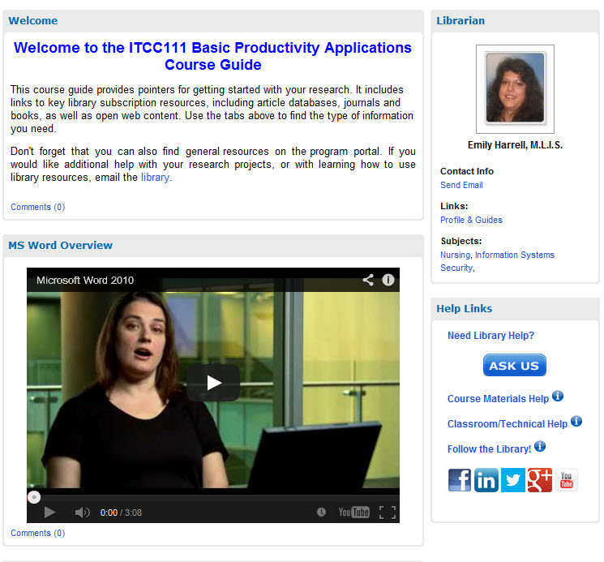
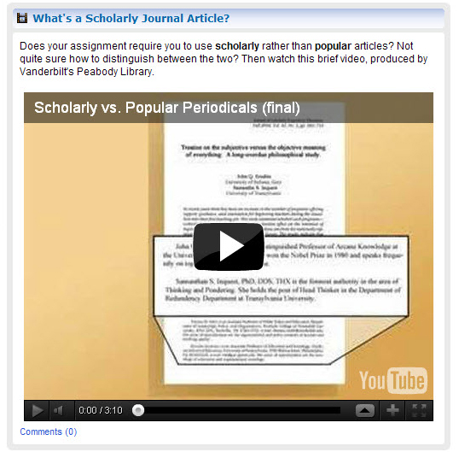
MANIFEST multimedia Possibilities

Slide 20
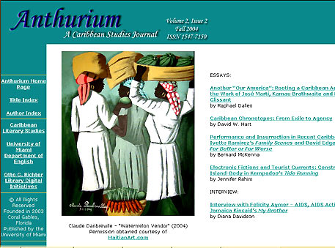

New Genres of Online Library Services
Scholarly Refereed E-Journals
Communications ePress/Library/Faculty
Scholarly Publishing Opportunities

Slide 21


Library as Producer e-Press/Bookstore/FacultY Synthesis
Publish on Demand (POD) Monographs, Text Books and Faculty Publications/Online Course Guides/ROI Student/Faculty Benefits

Slide 22
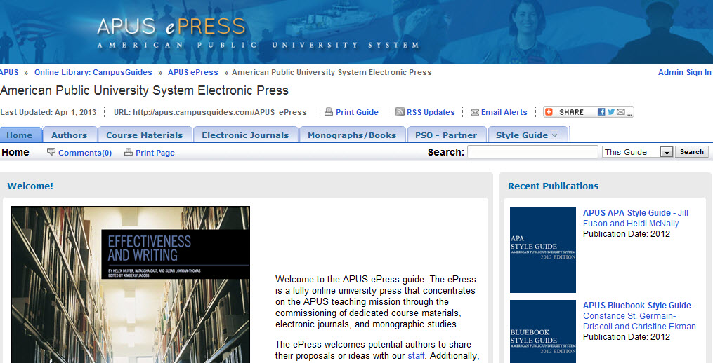
APUS ePress/Course Materials
Synergies with Library
ePress: Style Guides, Monographs/ Course Collection Development

Slide 23
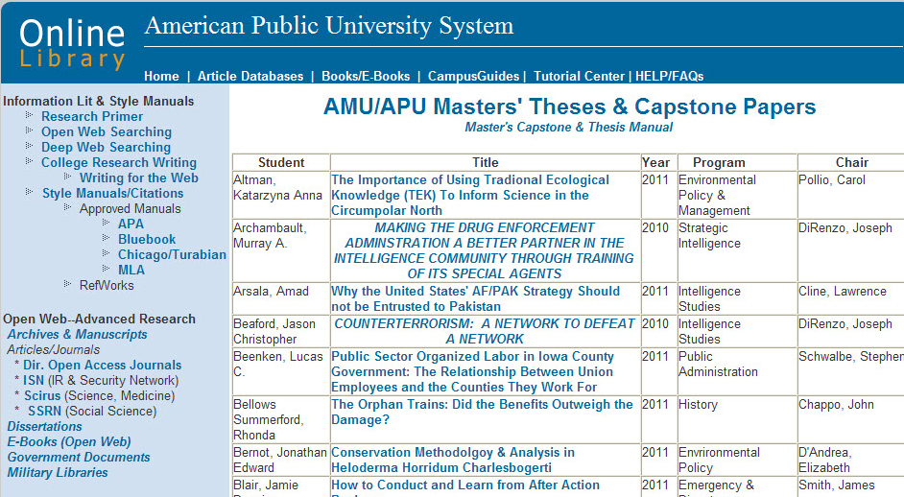
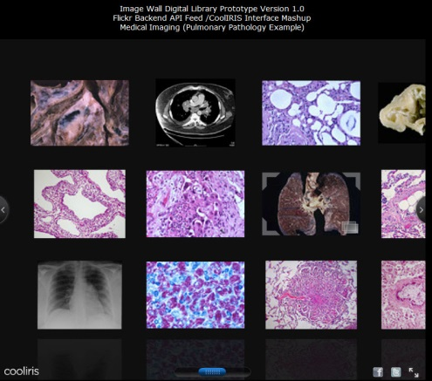

Digital Archives & Special Collections
Library Academic University Community Connections
Synergies with ePress

Slide 24
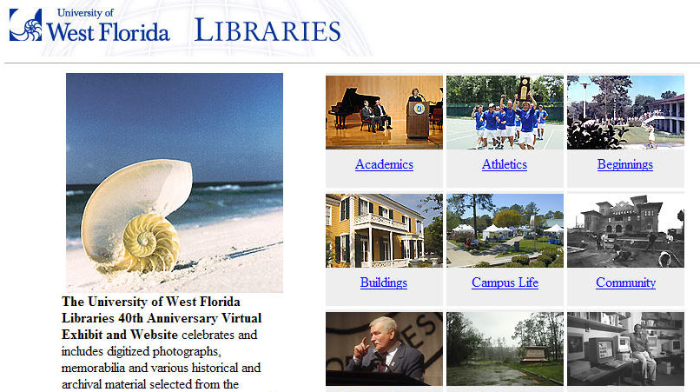
University/Library/Community Bridges

Slide 25
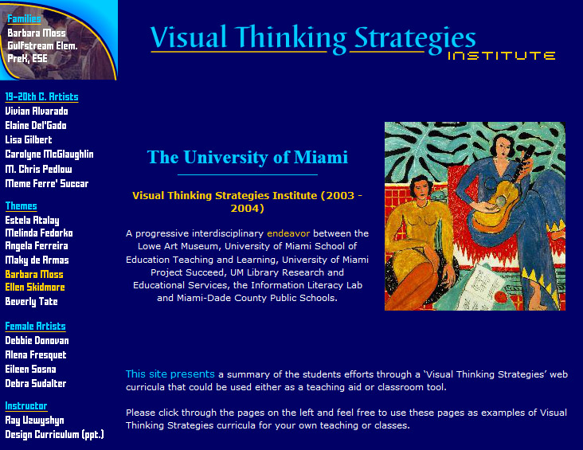
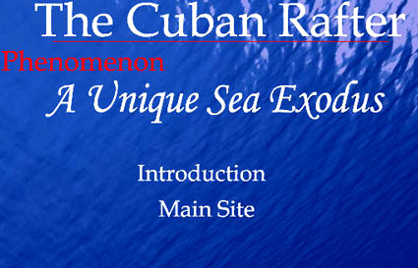
OnliNE Library/University/Press Connections
Digital Literacy/ Interdisciplinarity
Library Technology/Information Literacy Services
School of Education
University Art Department/Museum
State Dept, Of Education Grant Opportunities

Slide 26
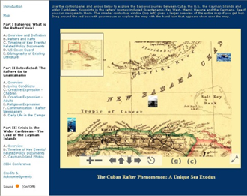
New Genres of Digital Archives
Library/Faculty/ Academic/ Community Connections
http://balseros.miami.edu

Slide 27
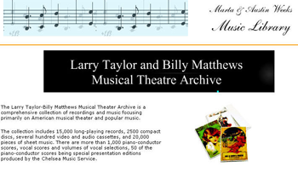
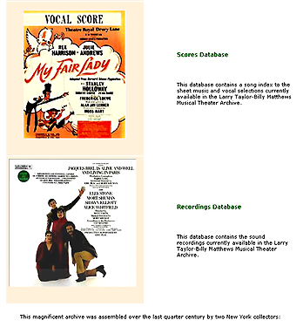
Branding and Marketing the University Intellectual Riches Globally
Hybrid Digital/Paper/Audio/Video Collections

Slide 28

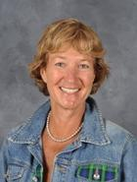

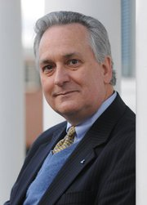
Library/faculty/Technology/ Students/ Synergies
Faculty || Academic Technologists || Subject Specialists Librarians || Students || Press

Slide 29

Ray Uzwyshyn Ph.d MBA MLIS httP://RAYUZWYSHYN.NET
Ruzwyshyn@GMAIL.com
Thanks!
Questions?

