Slide 1
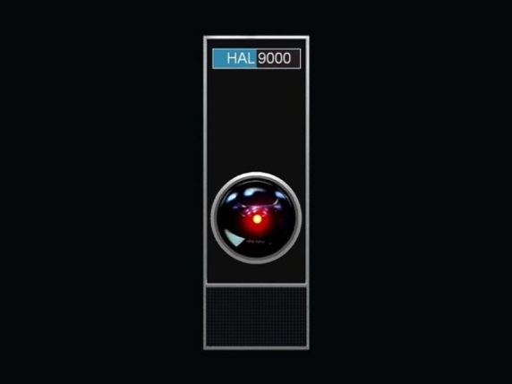
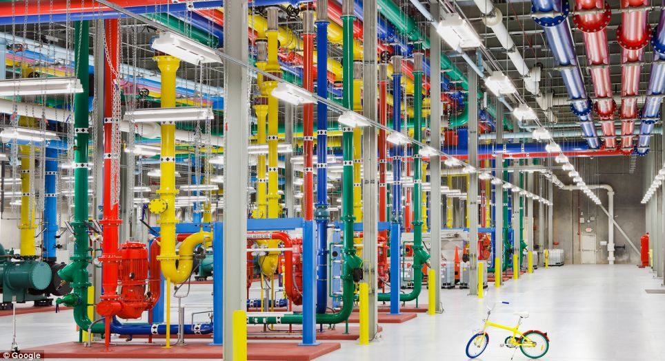
Between Kubrick’s HAL and Brin & Page’s Google
Key Factors in Evaluating and Transitioning to Web-Scale Library Management Systems
Ray Uzwyshyn, Ph.D. MBA MLIS

Slide 2
What is a Web Scale Library Management System?
Term Originated with OCLC
Next Generation Enterprise Online Library Management System
Software as a Service (SaaS), Cloud Computing
Amalgam of Online Platform Integration, Web 2.0, industry ideas (Google, Facebook, Apple and Amazon)
Several Current Competing Systems Available: Both Open Source (Koha, Evergreen) and Proprietary (OCLC Worldshare, Serial Solutions Intota, Ex Libris ALMA)

Slide 3
LMS Web-Scale Advantages
Reduces Cost: Eliminates need for hosting multiple servers and equipment (hardware/software upgrades)
Institutional IT Refocus: allows Human resources refocus on other possibilities/challenges
Better Analytics: User Trends, Click Streams,Library Database Usage. Insight, Business Intelligence (BI)

Slide 4
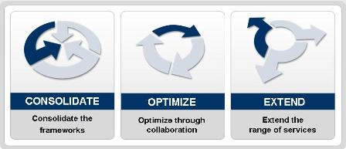
Web Scale LMS General Characteristics and Evaluation Benchmarks
Consolidates: Disparate Library Systems (Electronic, Digital and Print Resource Systems)
Optimizes Workflows: through Shared Data, Collaborative Services, Cloud Based Infrastructure
Extends Services: Redirect Library resources to focus on extending library services in support of students/faculty and teaching and research goals

Slide 5
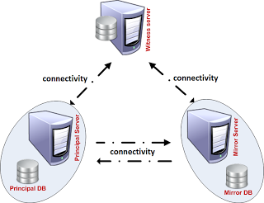
Web-Scale Technical System Evaluation Characteristics
Transparency & System Redundancy: Transaction level redirection, Quiet Failover (Backup Systems in Cloud)
Available & Reliable 99.99% Online and Running
High Performativity: Fast Response time, Quick Search/Worklevel
Scalable: As University community population grows

Slide 6
LMS Evaluation Characteristics
Interoperability: Integration with External Services (new API’s, other systems and software possibilities, Social Media, Mobile etc)
Secure: identity management, data protection, personal and institutional privacy
Usable: Usability, Human/Computer Interaction (HCI)
Economical: Cost Benefits analysis compared to current system conglomeration

Slide 7
LMS Key Evaluation Factors
Entirely Web Based Applications: No need to purchase hardware/software
Shared Data Possibility: Silos between applications, databases eliminated (i.e. Worldshare/Worldcat)
Existing System Integration: Ordering, Receiving, Dataloging, higher end digital library and other integration

Slide 8
Key Transitioning Factors Web Scale Disadvantages
Loss of Customization/configuration options
Loss of Immediate In House Access (Local Expertise may be better than far flung experts)
Loss of Complete Control/Security Implications
Tied Strongly to One System (Integration, Legacy Systems and Future Forward Moves)

Slide 9
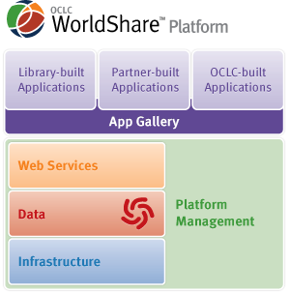
Web-Scale LMS Marketplace Players
OCLC (WorldShare Management Services)
- oldest system, strong app sharing, open API
- strong ties with WorldCat Local data, leveraging metadata, cooperative possibilities, platform focus
- strong ties with ContentDM, Digital Library Integration, MetadataFocus, OCLC cooperative analytics

Slide 10
OCLC Worldshare Live Metadata Integration

Slide 11
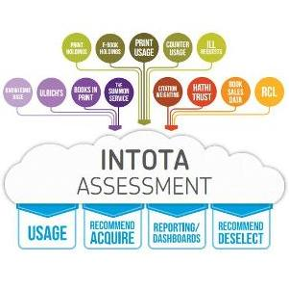
Serials Solutions Intota
Strong Integration with Proquest, Summon (Queens Connection)
Strong Integration with Serials Solutions 360 Electronic Resource Management, Reconceptualizing Collection Management
Strong Assessment/ Analytics Reporting, Intota Assessment (Accreditation)
Subscription Model

Slide 12
Ex Libris Alma
Strong integration with Ex Libris Product Family (Primo, Metalib, SFX)
Unified Resource Management Focus (electronic, print, digital)
Alma Community Zone, SaaS

Slide 13
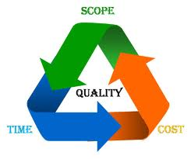
Web Scale LMS Evaluation Project Management Steps
Environmental Scan of Existing Systems
Convene Committee of Various Library Stakeholders
Evaluate Systems at Hand
Create Evaluation Matrix from Factors Identified
Meet with Major Vendors/Presentations
Peer Review/Benchmark ARL Colleagues
Local Consortial Considerations
Evaluate Outside Possibilities (Open Source etc/Other Contenders)

Slide 14
Quantitative and Qualitative Analysis Factors
Assign System Factors & Factor Weights
A= Reliability (.8) B = Response Time (.8) C = Scalability (.8) D = Interoperatiblity (.7) E = Security (.8) F = Cost (.6) G= Human Resources (.7) H = Analytics (.9) I = Customization (.5) J = Peer Group (.8)
Develop Weighting Formula
A(.8) + B(.8) + C(.8) . . .J(.8) = Total

Slide 15
Matrix Evaluation/Peer Discussion
Web Scale Library Management Systems Factor Evaluation
Weighted Factor vs/ System | OCLC WorldShare |  | Serials Solutions Intota |  | Ex Libris Alma |  | Other
A= Reliability (.8) | 8 | 6.4 | 7 | 5.6 | 7 | 5.6 | 8 | 6.4
B = Response Time (.8) | 7 | 5.6 | 8 | 6.4 | 7 | 5.6 | 7 | 5.6
C = Scalability (.8) | 6 | 4.8 | 8 | 6.4 | 8 | 6.4 | 5 | 4
D = Interoperatiblity (.7) | 7 | 4.9 | 6 | 4.2 | 9 | 6.3 | 7 | 4.9
E = Security (.8) | 7 | 5.6 | 4 | 3.2 | 3 | 2.4 | 7 | 5.6
F = Cost (.6) | 8 | 4.8 | 8 | 4.8 | 7 | 4.2 | 7 | 4.2
G= Human Resources (.7) | 7 | 4.9 | 9 | 6.3 | 7 | 4.9 | 8 | 5.6
H = Analytics (.9) | 6 | 5.4 | 9 | 8.1 | 8 | 7.2 | 6 | 5.4
I = Customization (.5) | 6 | 3 | 7 | 5.6 | 9 | 4.5 | 4 | 2
J Peer Group (.8) | 8 | 6.4 | 6 | 3 | 8 | 6.4 | 8 | 6.4
Totals: |  | 51.8 |  | 53.6 |  | 54 |  | 50.1
Gather Committee Scorecards

Slide 16
Discussions, Recommendations and Decisions (Analytic Tools and Intuition)
Aggregate and Tabulate Results OCLC Committee Member Score (1) + OCLC Committee Member (N). . .= OCLC Total Committee Score/N Intota Committee Member (1) + Intota Committee Member (N). . .= Intota Total Committee Score/N Alma Committee Member (1) + Alma Committee Member (N). . .= Alma Total Committee Score/N Analytic Metric Results . . .
Intuitive Tools

Slide 17
Thanks!
Questions?
Ray Uzwyshyn, Ph.D. MBA MLIS http://rayuzwyshyn.net ruzwyshyn@gmail.com

Slide 18
Bibliography/Web Links
Penn State Evaluation
http://www.libraries.psu.edu/psul/groups/webscale/overview.html
Library Web Scale: Definitions (Marshall Breeding)
http://www.librarytechnology.org/ltg-displaytext.pl?RC=16577
OCLC WorldShare
http://oclc.org/worldshare-platform.en.html
Serials Solutions Intota
http://www.serialssolutions.com/en/services/intota
Intota Assessment
http://www.serialssolutions.com/en/services/intota/assessment
ALMA
http://www.exlibrisgroup.com/category/AlmaOverview

