Slide 1
TRanSforming Today’s Undergraduate Library Into Tomorrow’s Research Library
Through Engagement and Partnership with Faculty Students & Administrators
Ray Uzwyshyn, Ph.D. MBA MLIS

Slide 2
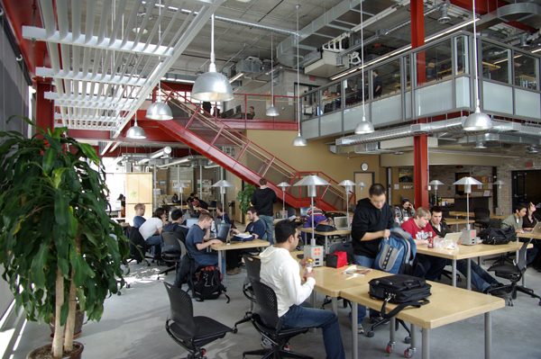
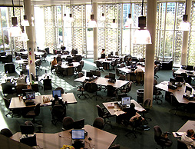
21st Century Library Learning Commons
Academic Libraries are in a State of Paradigm Shift & Transformation

Slide 3
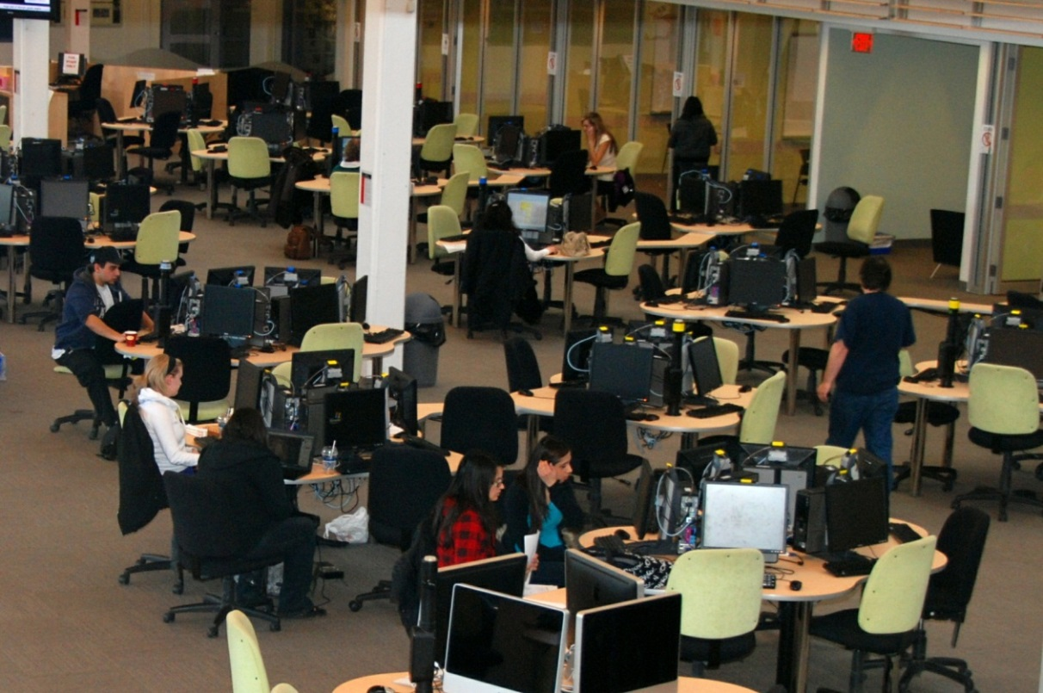
Student/Faculty Centered Collaborative Learning Spaces,
Digital Literacy Labs, Multimedia Studios
Engaging Students,Partnering with
Various Academic Divisions

Slide 4

engaging Learning, Spaces, Technology
Creating New Spaces
for Learning
& Research
Cross-fertilization of Research
Projects,
Faculty,
Students and
Skillsets.
Information & Digital Literacy
Classrooms
Multimedia Studios & Archival Media Conversion Labs
Technology
Traditional Study,
Books, e-books, journals
Virtual and Physical Spaces

Slide 5

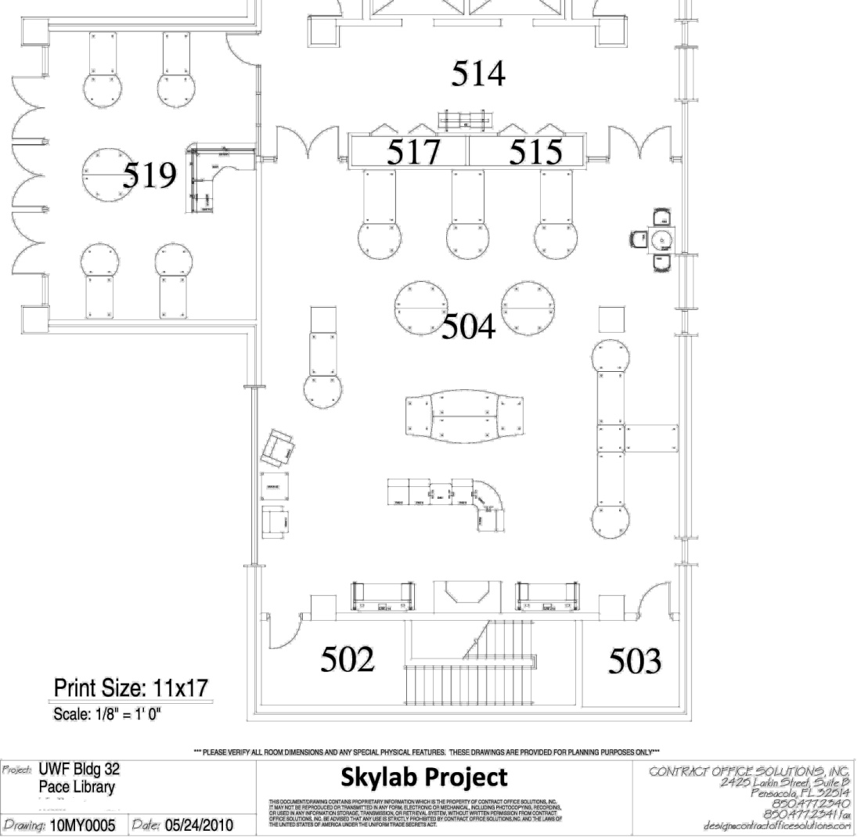
UWF Skylab
Engaging Various Stakeholders
Handouts:
Tech. Equipment ,
Schematics
Skylab Conceptualization/Grant
Binders
Complete Hardware, Software Tech. Specifications
Budget Binders
Budgetary Documents
Skylab Date Log with Primary Documents
Presentations
Library Stakeholders
University Administration/Faculty
National Awareness/Marketing
Circulation of Documents, Buy-In and Ownership

Slide 6

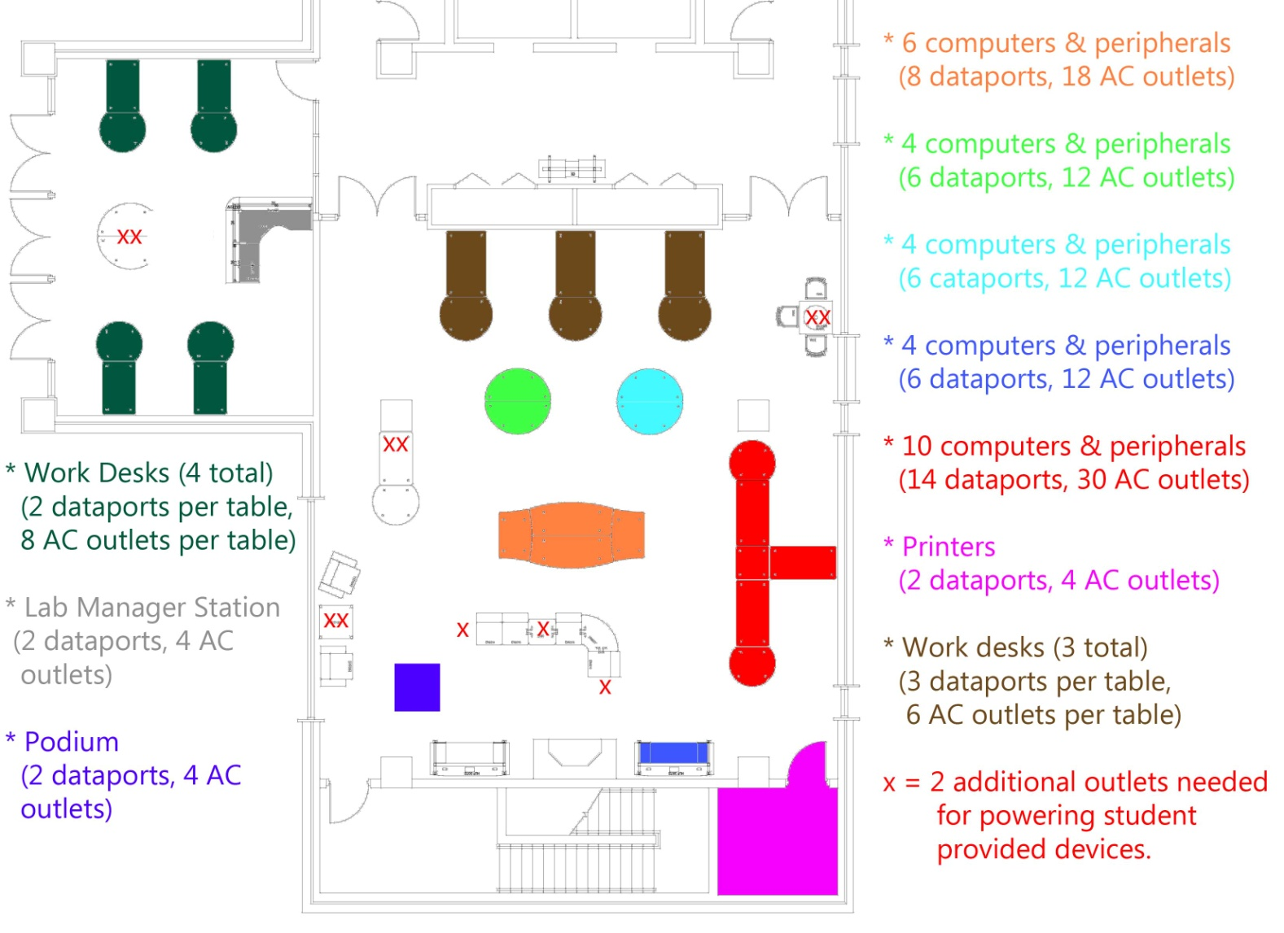
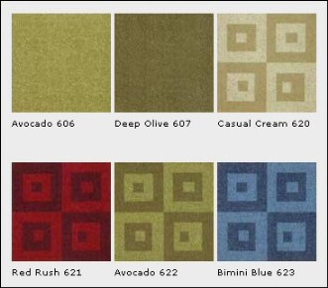

UWF Skylab
Planning: Arch & Eng.: Electrical Data
Engaging and Transforming the Library through
Partnership with Faculty, Students and Administrators

Slide 7



TranSforming Collections, Resources & Media
Engaging and Partnering with Faculty for
Collection Development
Changing Models From
Ownership to Access to Aggregation and Distribution

Slide 8

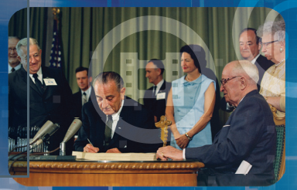

Engaging Students
Academic Video Databases
Business
Psychology
Counseling and therapy
Education
Economics
Public Health
History
Humanities
Criminal Justice and Law
Political Science
Public Safety/Intel
Literature/Philosophy
Religion/theatre
Science/Technology
Security/Military
Space

Slide 9
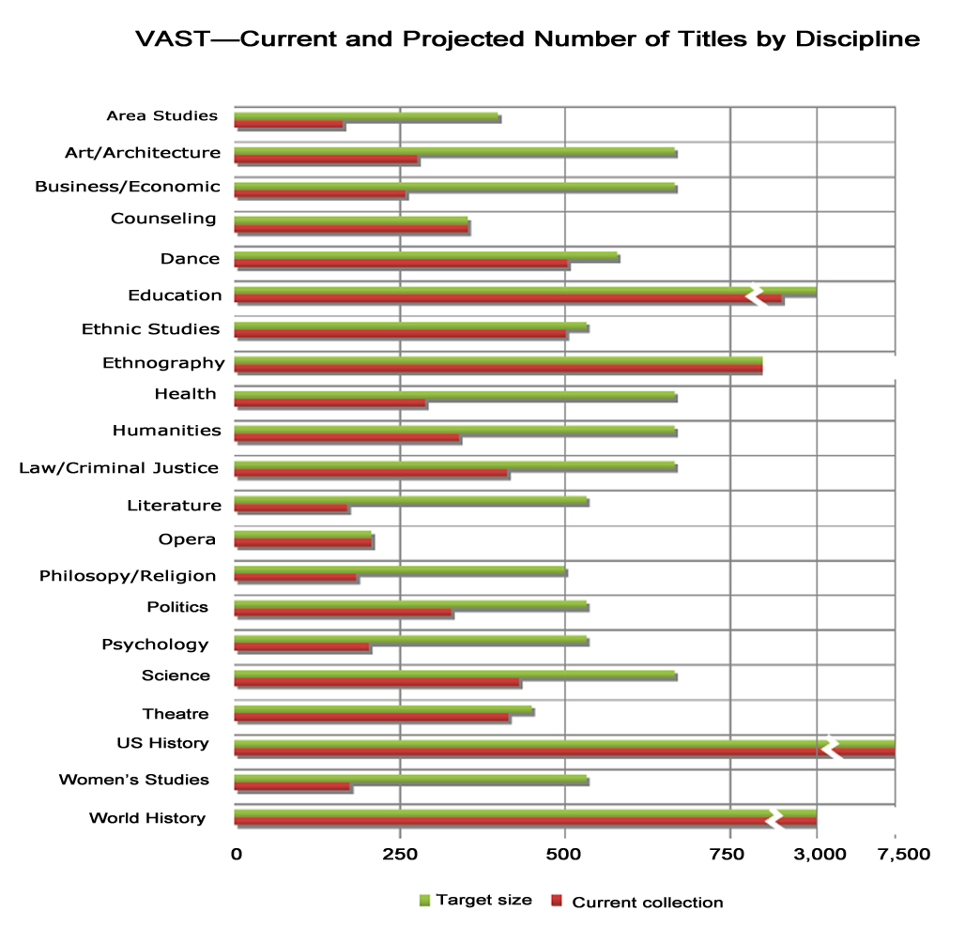
Interdisciplinarity, Interactivity,
Multi-modal Research Possibility
Alexander Street Press VAST,
20,000 videos
2013.

Slide 10
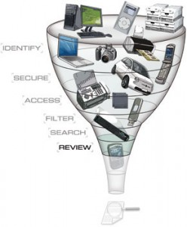
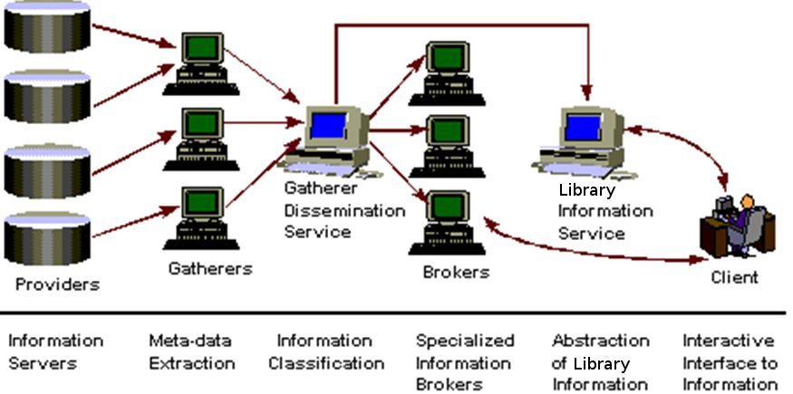
New genres of Library Web-Scale
Information Discovery Tools
Engaging Faculty and Students Through New
Research Possibilities (Summon, Primo, Web-Scale Discovery tools: Worldshare, Intota: Analytics Focus

Slide 11
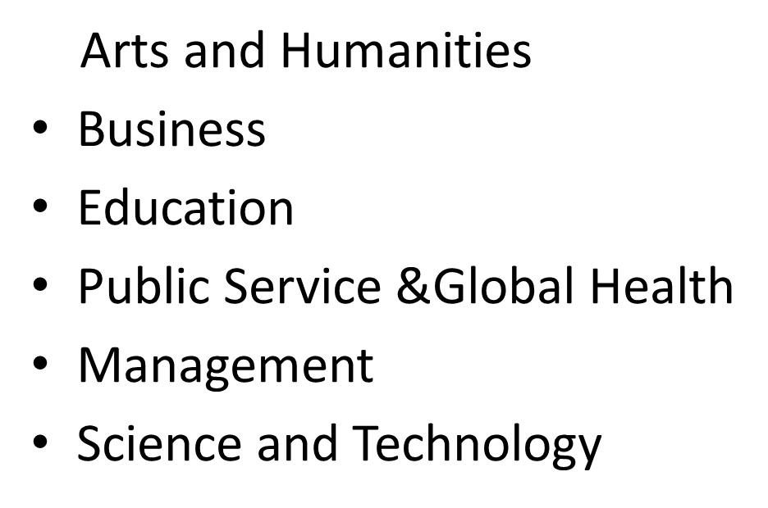


Changing Library Services
From Online Research Help Systems & Knowledge bases to MOOC’s
Online Curricular Needs/Flipped Classroom/Blended Learning
(OER, E-Books, E-Articles, Media)

Slide 12
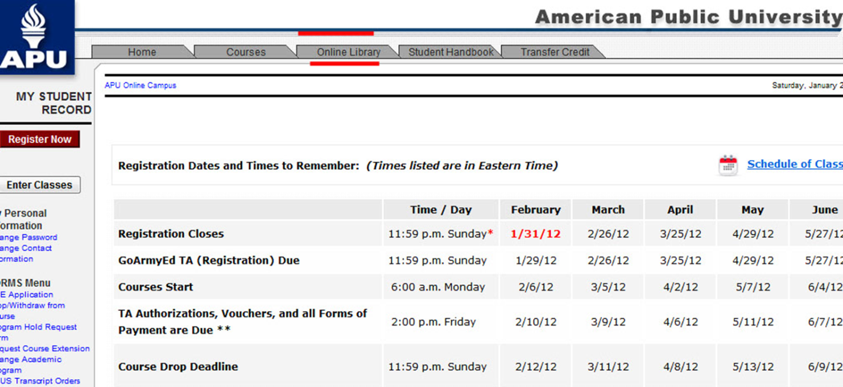
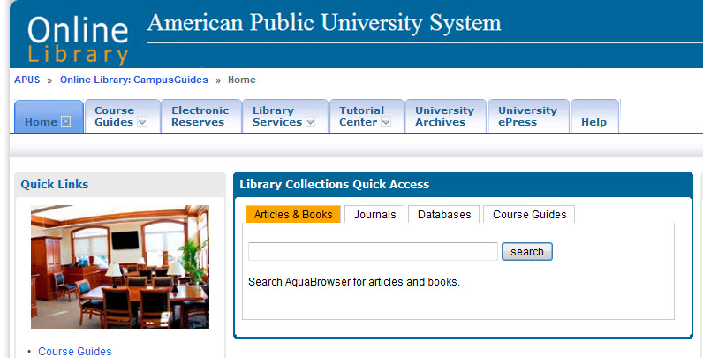

Library Integration with Online Classroom
Learning Management System
Student Engagement

Slide 13
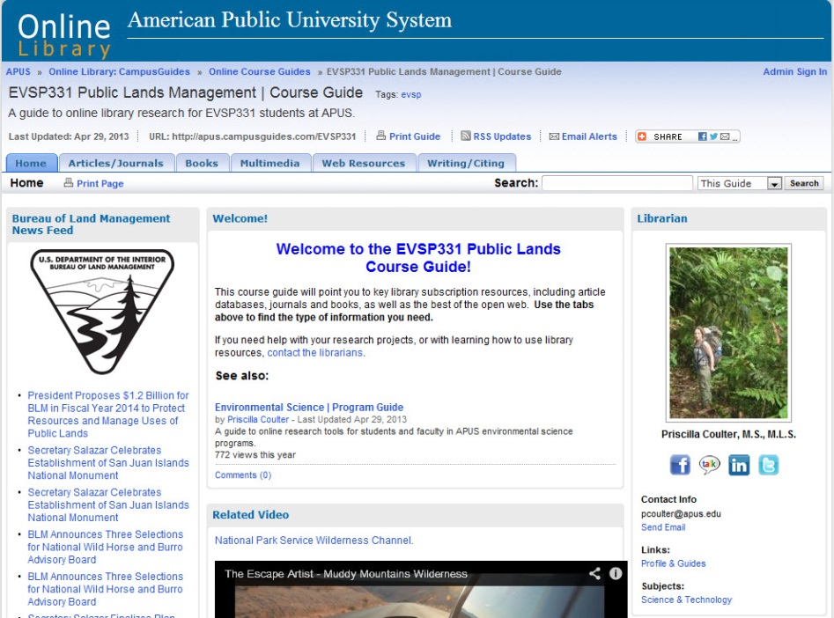



Online Course Guides powerful Research Tools
Direct
Curricular
Replacement
Secondary
Multimedia
Bibliographic Resource
Global
Marketing/Branding
ROI
Engaging Student Research and
Partnering with Faculty Online

Slide 14
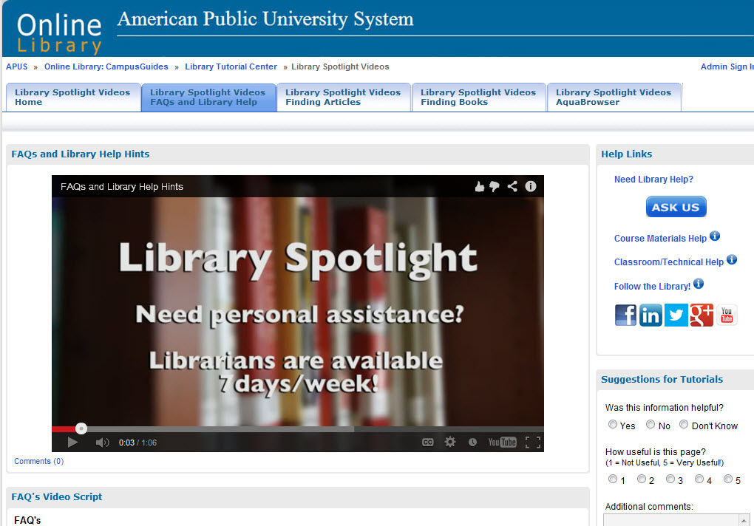
Engaging Students/Faculty through Online Video

Slide 15
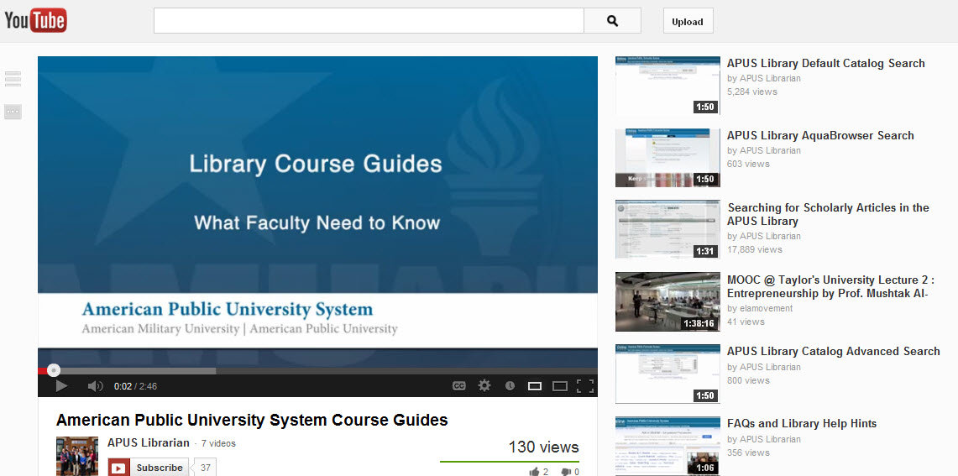
Faculty Engagement
Curricular Embedding

Slide 16
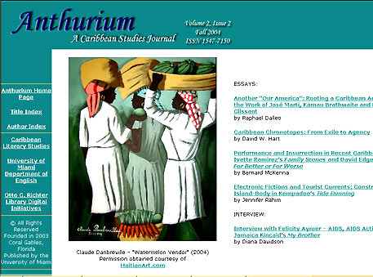

Partnering with Faculty
New Genres of Online Library Services
Scholarly Refereed E-Journals
Open Source Publishing Opportunities

Slide 17


Partnerships with Faculty/Other Divisions e-Press/Bookstore
Publish on Demand (POD)
Books and Faculty Publications, Revenue Generation
Student/Faculty Benefits

Slide 18
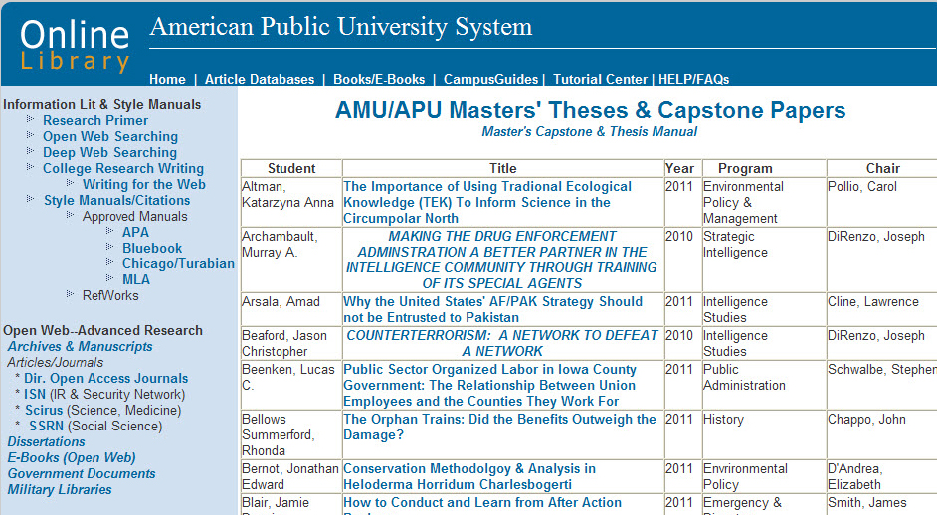
Engagement With Student Research
Online Masters Thesis Archive/Capstone/Online Library
(Dark Archives & Repositories)

Slide 19
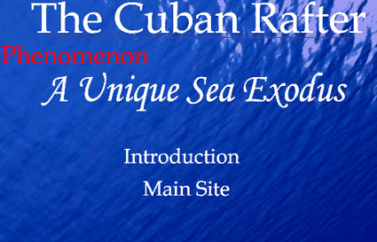
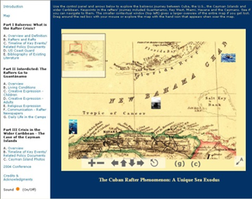
Engagement With Faculty Research
New Genres of Digital Archives

Slide 20

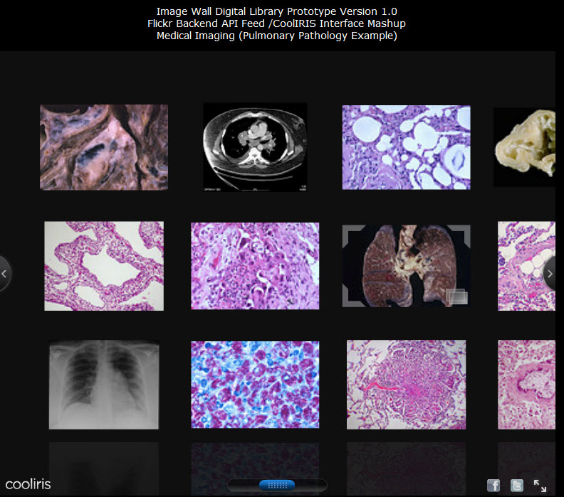
Research PartnershipS with Faculty/Students
Digital Archives & Media
Library Academic/University/Community Connections

Slide 21
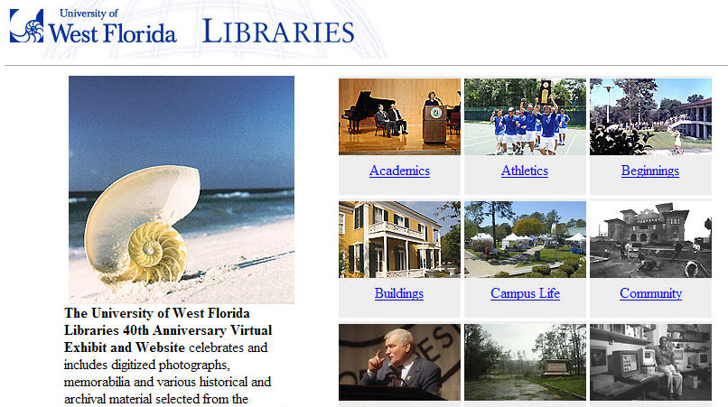
Engagement with University Administration
University/Library/Community Bridges

Slide 22
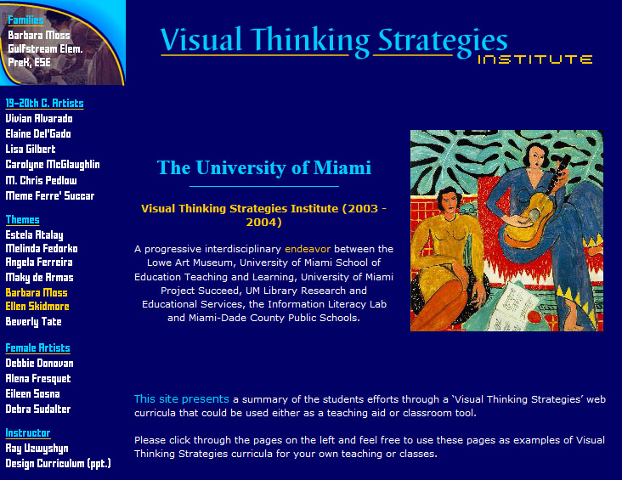
Engagement/Partnership with Faculty Divisions and Schools
Digital Literacy/ Interdisciplinarity
Library Technology/Information Literacy Services
School of Education
University Art Department/Museum
State Dept, Of Education Grant Opportunities

Slide 23


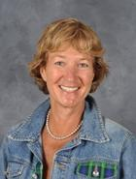


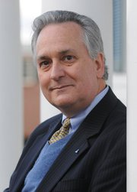

Tomorrows Research Library
Through Partnerships
Technology/Ideas//People
Student/Faculty/Administration Working Together

Slide 24
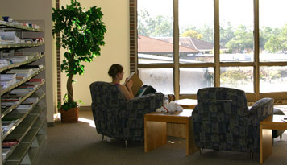
thanks!
Questions?
Ray Uzwyshyn Ph.D. MBA MLIS
http://rayuzwyshyn.net
ruzwyshyn@gmail.com

