Slide 1

Opportunities and Challenges for Academic Research Libraries in the New Millennia
Ray Uzwyshyn, Ph.D. MLIS MBA
Director, Collections and Digital Services
Texas State University Libraries, 2022

Slide 2
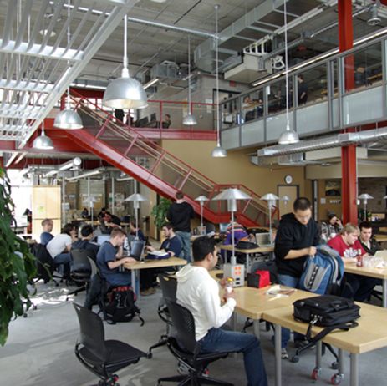
The Physical Library is Transforming
80-85 % of Materials Budgets are currently Electronic Resources, e-journals and e-books.
Only 15% of purchases are print materials (12% print books, 3% print serials).
Collection Management, Budget Models and Digital Services are in the middle of a large Paradigm Shift towards open access and various online and digital areas

Slide 3
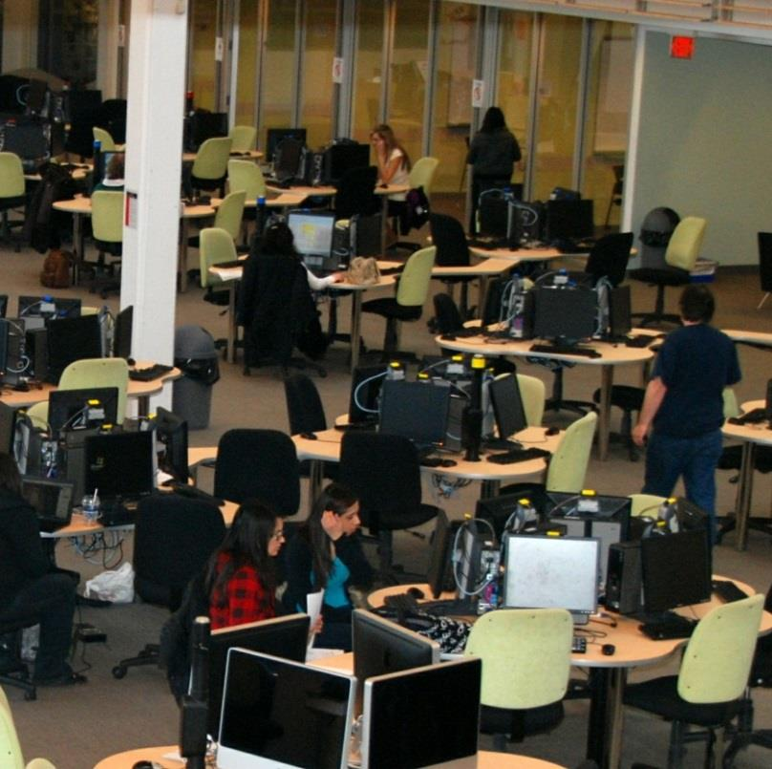
Book Warehouse Model Disappearing
Open Access, eResources,
Courseware Digital Services &
Digital Collections increasing
Student/Faculty Centered Collaborative Learning Spaces, Digital Literacy Labs, Multimedia Studios Expanding

Slide 4
The Physical Library Warehouse Model is Shifting into a Technology Rich Learning Commons, Focused Upon:
Interdisciplinarity
Digital Literacy,
Multimedia
Specialized Software
Hardware
Human Resources

Slide 5
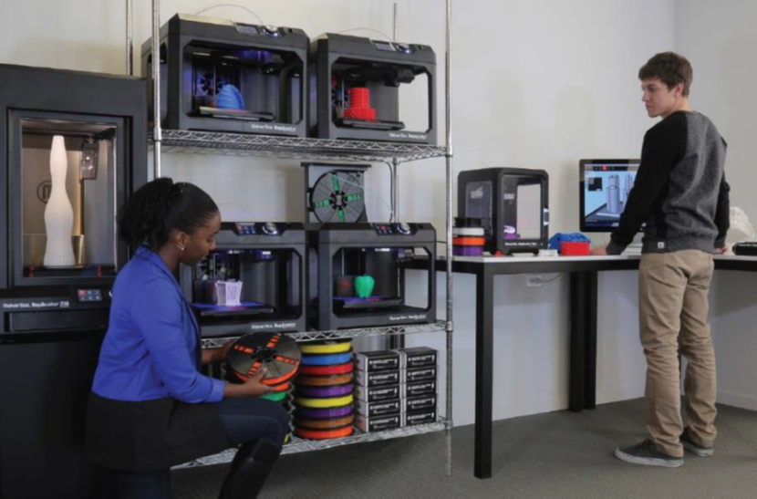
Spectrum of New Technologies Possible
Visualization Walls, Makerspaces, Instant Theatres, 3D Printing Labs

Slide 6
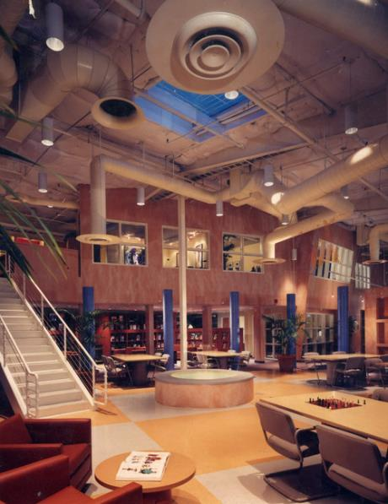
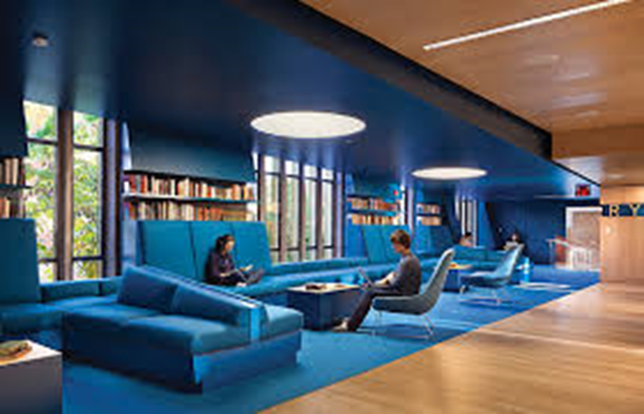
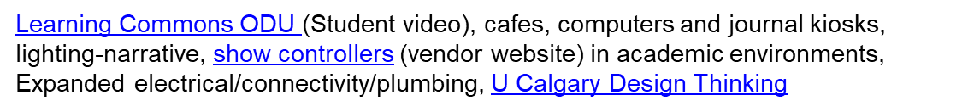
Era of Imagineering and New Millennia Design Potential
For Academic Library Spaces
Hunt Library Video, Learning Space Design Playlist
Instant Theatres, Learning Work Spaces (video)
Lighting Museums and Libraries (lecture video), Alkek One

Slide 7


Many Opportunities to Reimagine Digital and Library Services for 21st Century
Faculty/Student/
Curriculum, Teaching &
Research Relationships
University/ Classroom/Library Relationships

Slide 8
New Varieties of Information Literacies Possible
(Period of High Relevancy for Information Literacy)
Era of Fake News, Misinformation, Disinformation & Unreliable Information Sources. These are widespread.
Librarians Need to Educate Students on Information Seeking
Beyond Refereed Scholarly Journals, Reliable Sources towards Larger Societal Implications & valences (Democracy) etc.
The ACRL Framework for Information Literacy and the Six Major Frames.

Slide 9
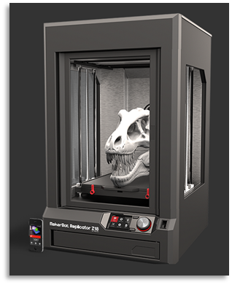
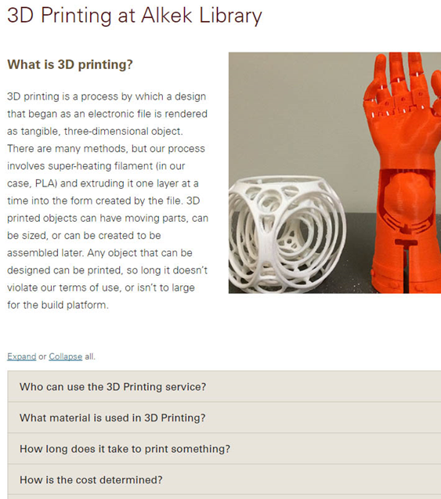
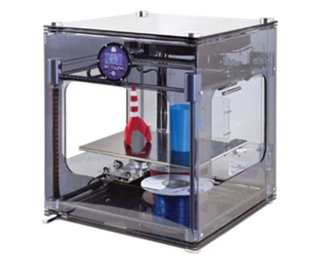
New Digital Literacies Possible
Student and Faculty as Producer

Slide 10
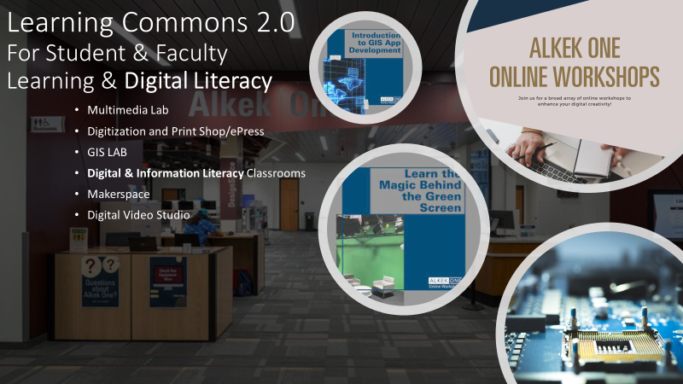
Alkek One

Slide 11
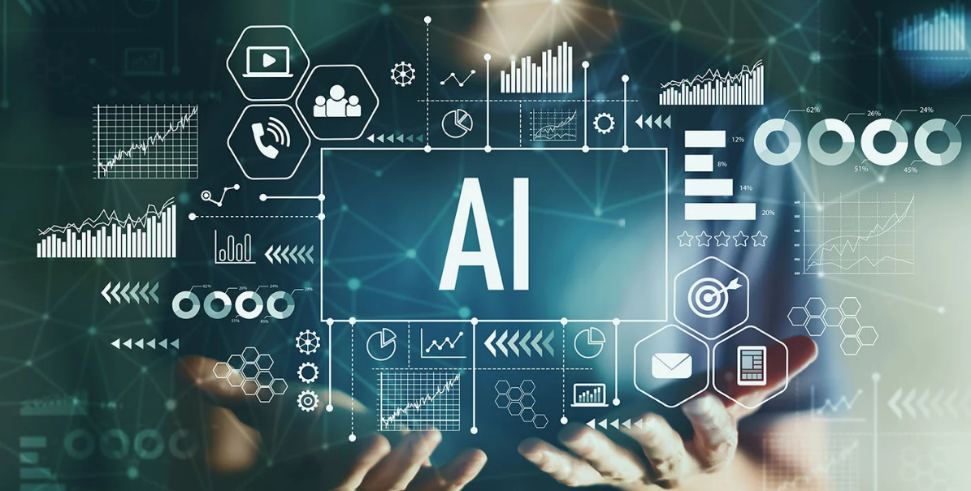
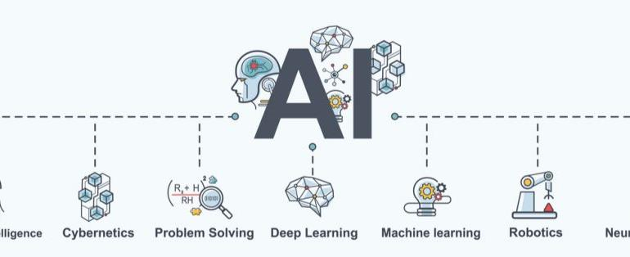
Algorithmic Programmatic (AI) Literacies Arising
Digital Carpentries
AI, Machine Learning,
Deep Learning
Data Visualization, Analytics
Natural Language Processing
Cyber Physical Systems

Slide 12
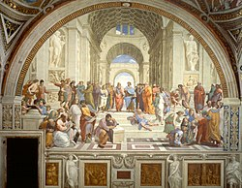
Renaissance Possibilities of
Interdisciplinarity Arising,
Redefining What Literacy means in the New Millennia
Library
Sciences
Convergence of Space, Technology, Learning
Library as
Safe Great Third Space for Higher Learning
Humanities &
Social Sciences
Technologists &
Engineering
Cross-fertilization of
Projects, Smart, Educated People, Skillsets

Slide 13
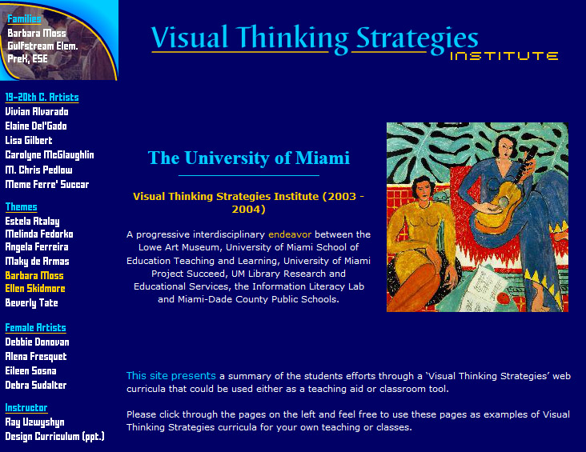
Innovative Grant Partnerships Are Possible
AmongFaculty Divisions, the Library, Schools and Community
Digital & Information Literacy
& Interdisciplinarity
Partnerships with Library
School of Education
University Art Department/University Museum
Large State Bureau Of Education Grant

Slide 14


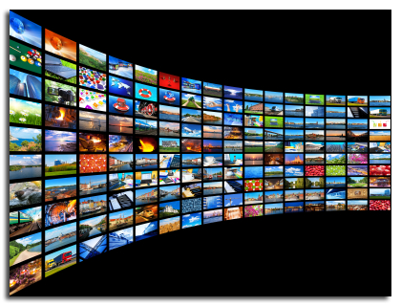
Collection Development Priorities Transforming Through Digital Resource Possibilities & Media
Priorities Shifting From Purchasing Physical Materials
To eResource Access, Open Access Models and
OER (Open Educational Resources)
Changing Models From
Ownership of Books to Access to Information

Slide 15

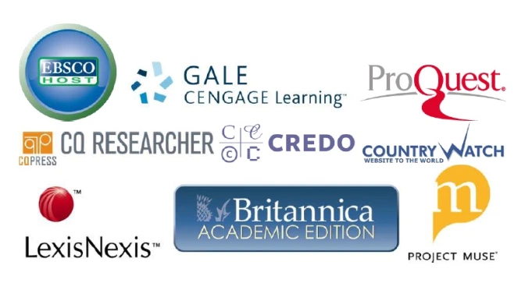
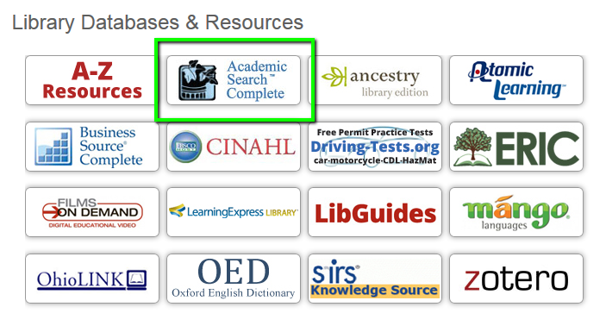
Spectrum of Academic Content Databases & eResources evolving into Software as a Service,
Cloudeware,
& Courseware

Slide 16







Core Academic Library Systems Changing
Interlibrary Loan Service
Taking Larger Role
Larger Discovery & Research Services
Possible
Modern Integrated Library System (ILS)
New & Different Research and
Open Source Flavors

Slide 17
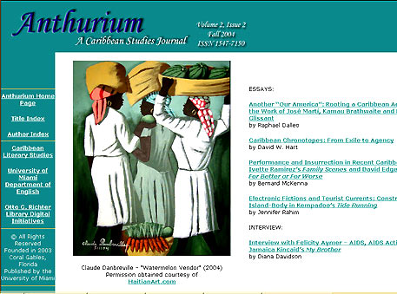

New Genres of Digital Library Services Appearing
Enabling Faculty Research/Reputation on Global Levels
Scholarly Refereed E-Journals
Open Source Publishing Opportunities (OJS)

Slide 18

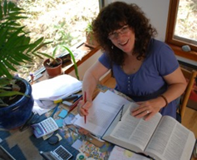
Library/University Press Scholarly Publishing
Academic Books and Scholarly Journals
E-Press Editor & Marketing Director,
Graduate English Student
Grad MBA or Marketing Student
In House Library e-presses (Espresso Book Machine ~200K)
University Publishing Infrastructures

Slide 19


Faculty Library/E-Press Synergies Possible
Teaching
Research
Publishing on Demand (POD)
Books and Faculty Publications
University Value Added Models
(Open Access Text Books)

Slide 20
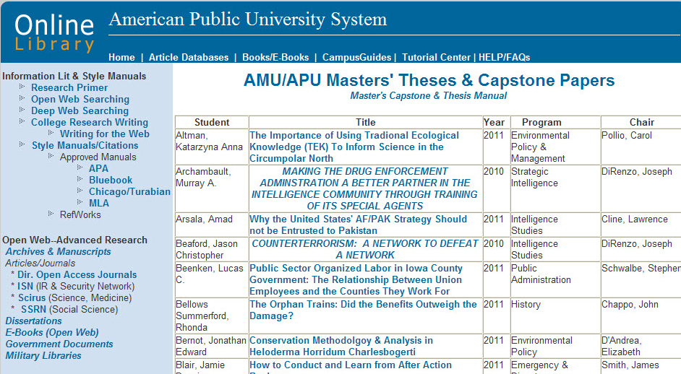
ETD’s Electronic Thesis and Dissertations Systems
Enabling Student Research Online
Online Masters and Ph.D. Thesis Archive/Capstone/Online Library
(Dark Archives & Institutional Repositories)

Slide 21

Data Literacy and Data Research Repositories
The Texas Online Data Research Repository.

Slide 22
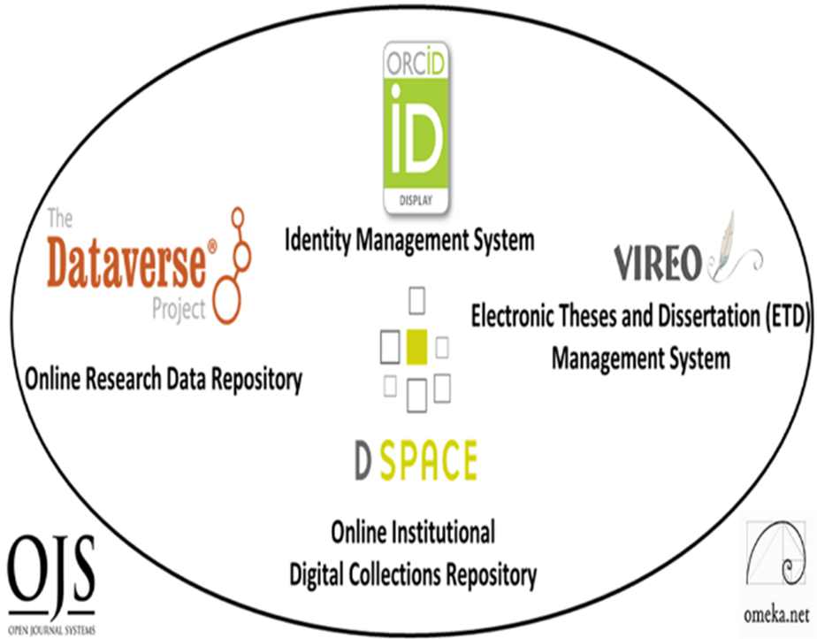
Digital Scholarly Research Ecosystem Infrastructures
Supporting Faculty and Graduate Students Research Collaboration, Sharing and Online Open Access Needs
PRIMARY
Digital Research Collections Repository (Dspace, 2021)
TERTIARY
Electronic Thesis and Dissertation Management System (VIREO)
User Interface/Content Management Software (OMEKA)
Identity Management System (ORCID)
Academic Journal Software (OJS3)
Research Data Repository (Dataverse)
Content
Communication
Texas State Digital Scholarly Research Ecosystem

Slide 23
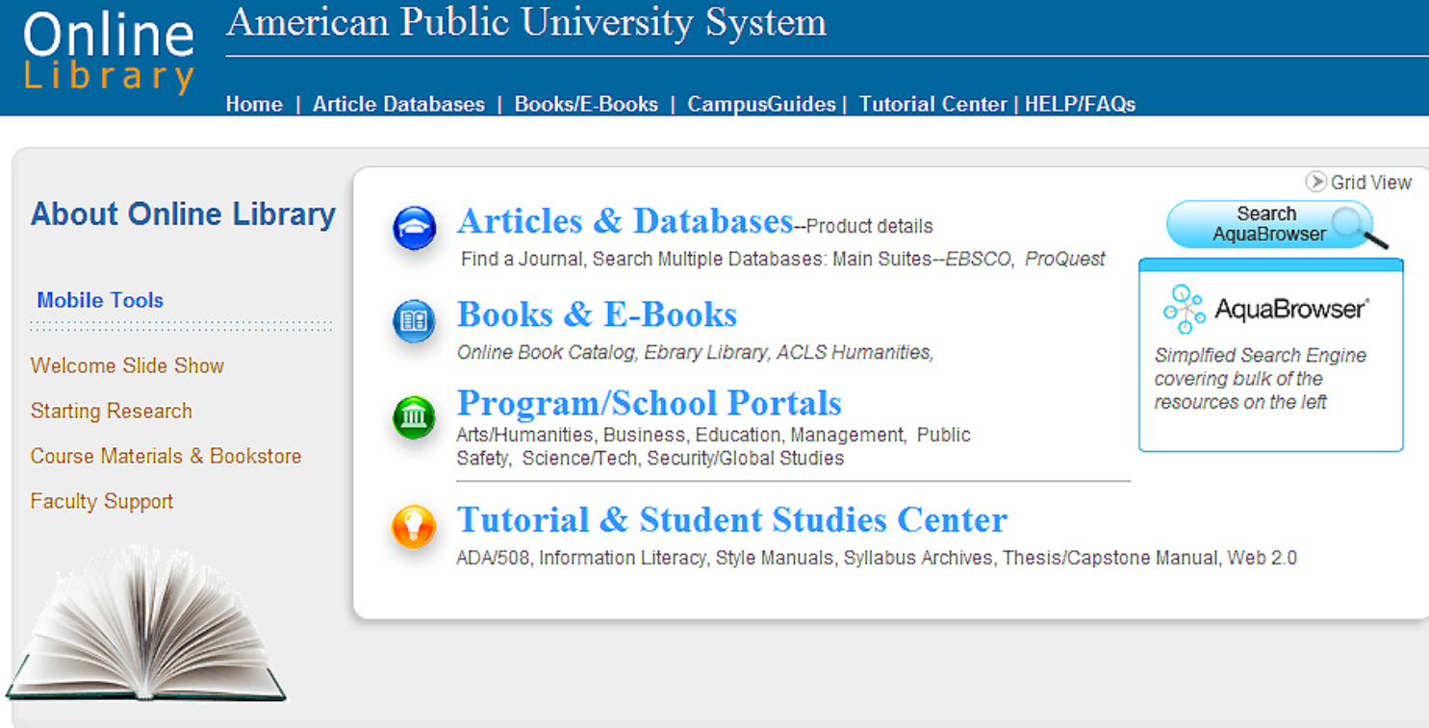
The Textbook is Evolving to Online &
Courseware Modalities
Many Possibilities for Synthesis with Library Resources
The Online Library is Central for
Physical, Online and Hybrid
University Models.
Serving Curricular, Teaching and Research Needs
(E-Books, E-Articles, OER, Media)

Slide 24

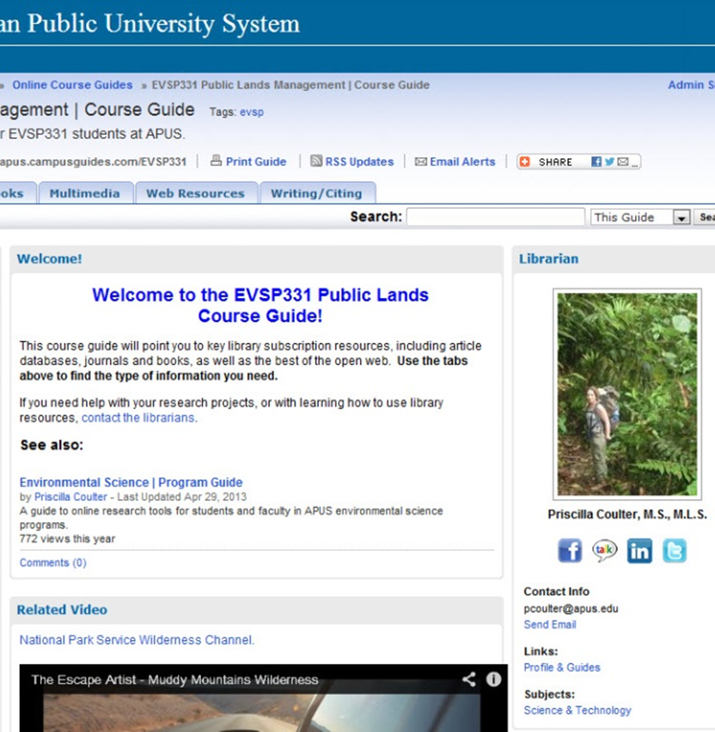
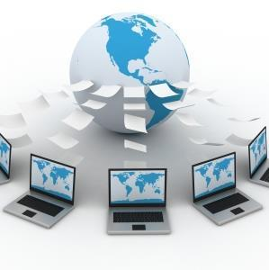

Online Library Services are Expanding
Online Research Help Systems,
Knowledge bases
Combining Online Libraries & Learning Management Systems

Slide 25
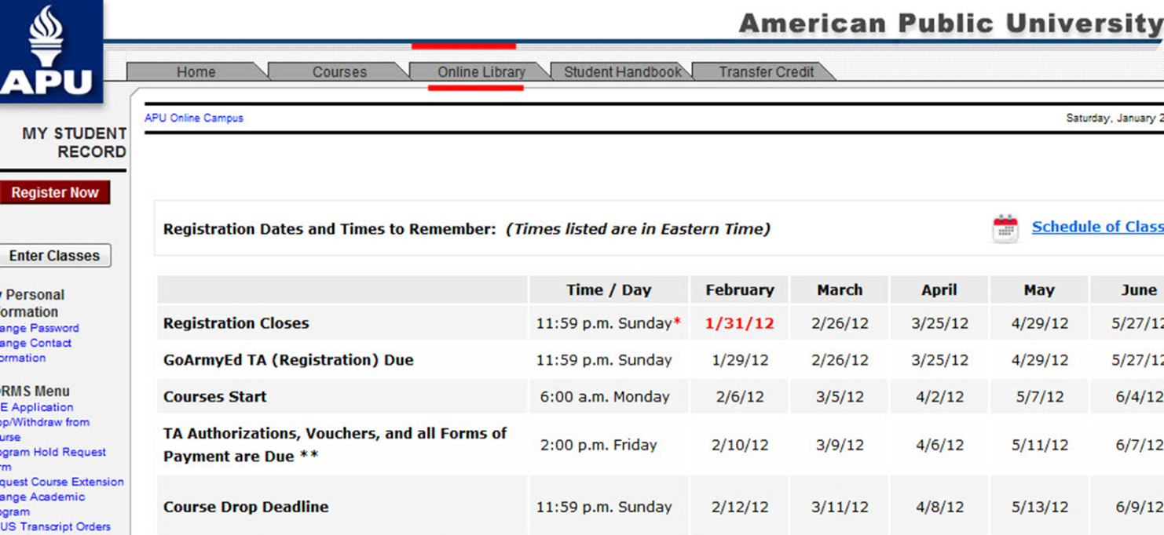
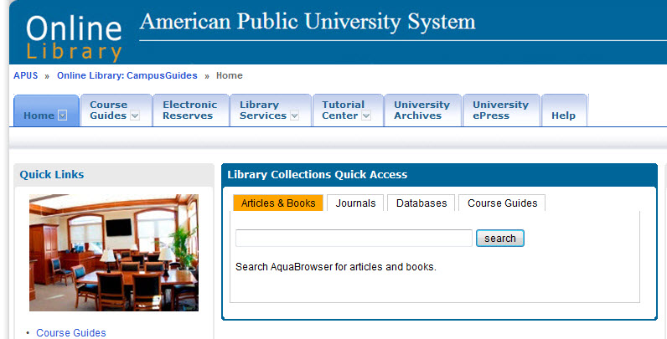
Tight Library Integration with Online Classroom is Possible
Learning Management System

Slide 26


Library Partnerships with Faculty
Online Course Guides
Direct
Curricular
Replacement
Secondary
Multimedia
Bibliography
University Global
Marketing/Branding/ROI

Slide 27
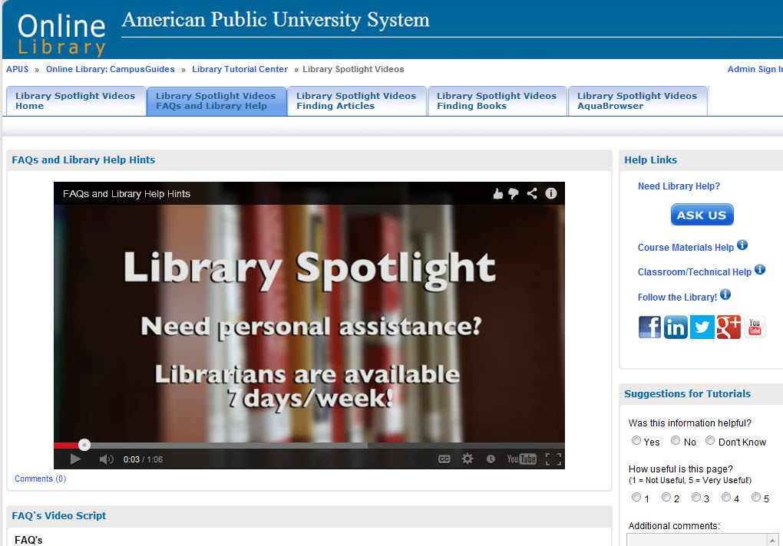
Many Online Video Possibilities
New
Help Systems

Slide 28
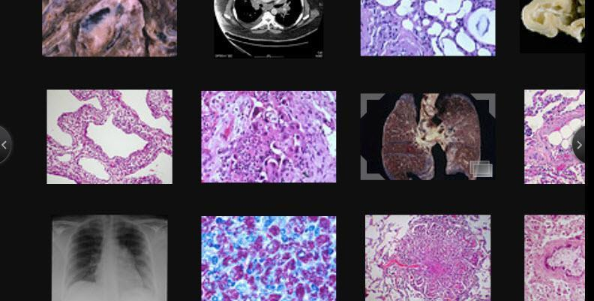
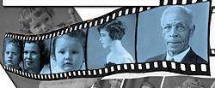
University Archives Special Collections and
Research are Going Digital and Online
From Biomedical Science (Pulmonary Pathology) to
Public History

Slide 29
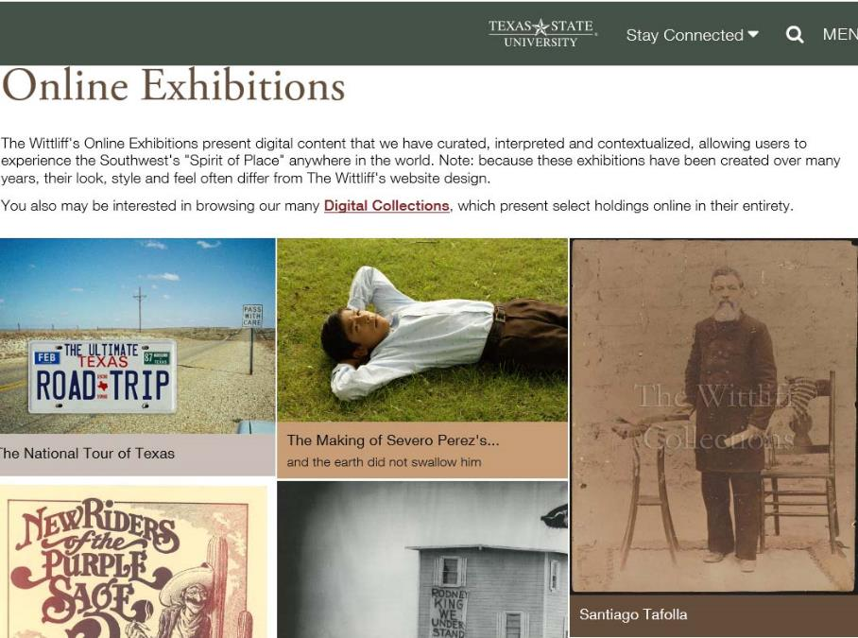

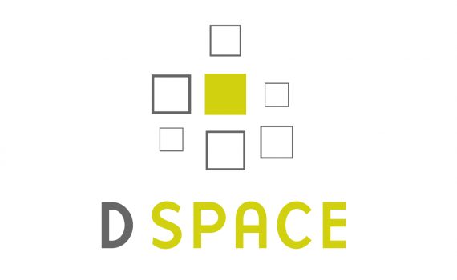

New Online Exhibition and Digital Library Possibilities
Front End Exhibitions
Underlying Research
Depth Structure Possibilities
Many Software Options

Slide 30
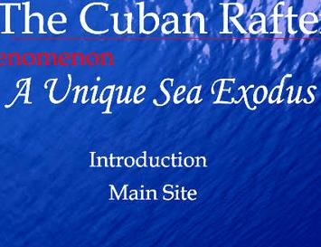
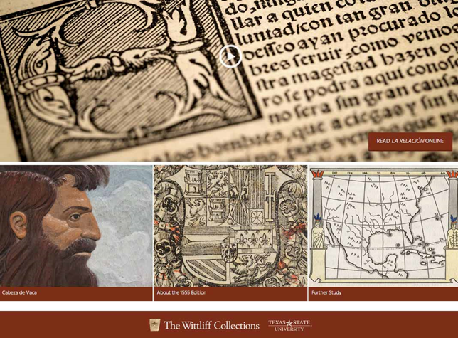
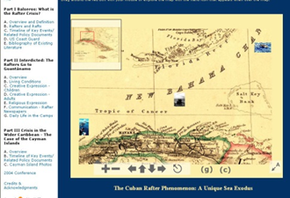

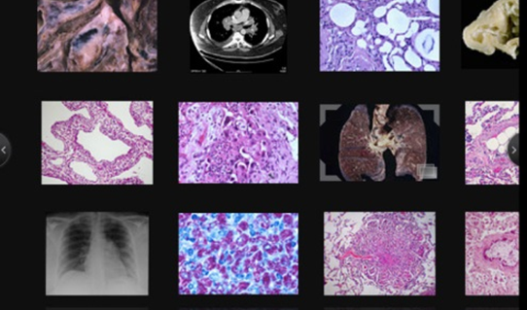
Engagement With Faculty Research/ Special Collections/Multimedia Conference/Colloquia Possibilities
New Genres of Digital Archives Possible

Slide 31
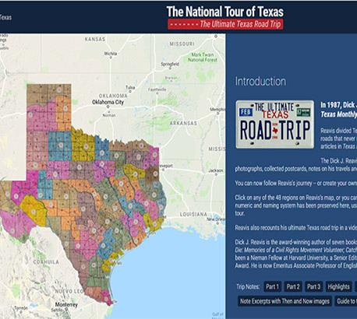
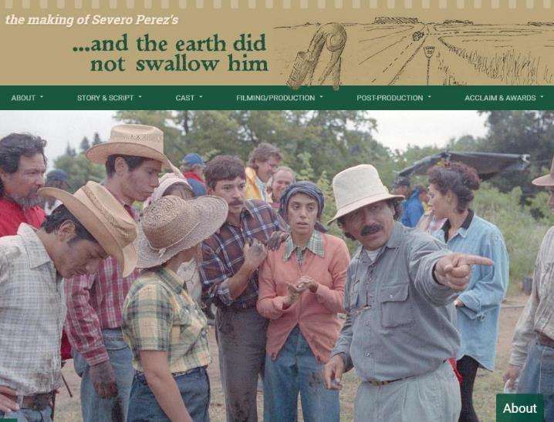
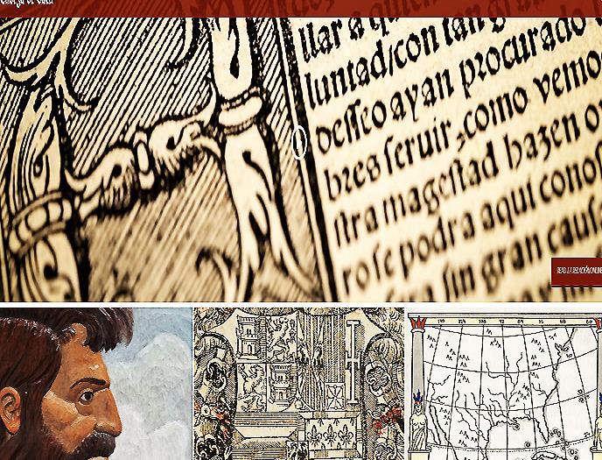
Enabling Digital Scholarship From
Digital Humanities
To STEM Sciences
Collaboration with Research Scholars
Special Collections and the Global Community

Slide 32

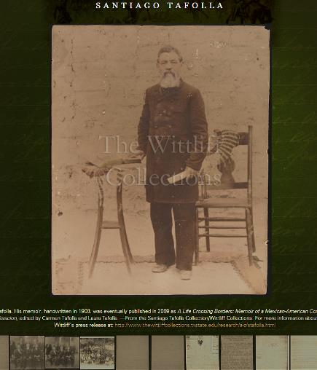
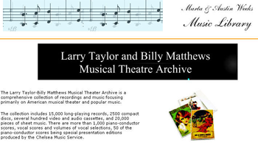
Branding and Marketing the Libraries and University’s Intellectual Riches Globally

Slide 33
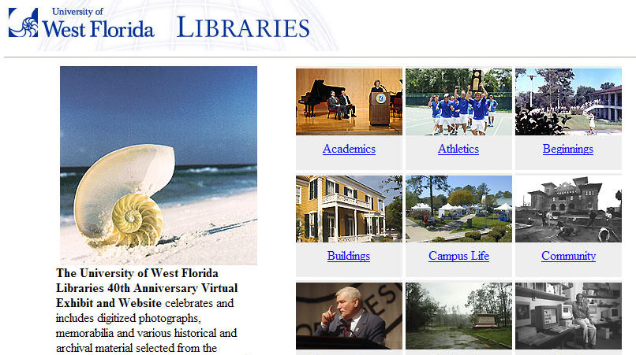
Creating University, Library, Local and Global Community Bridges

Slide 34
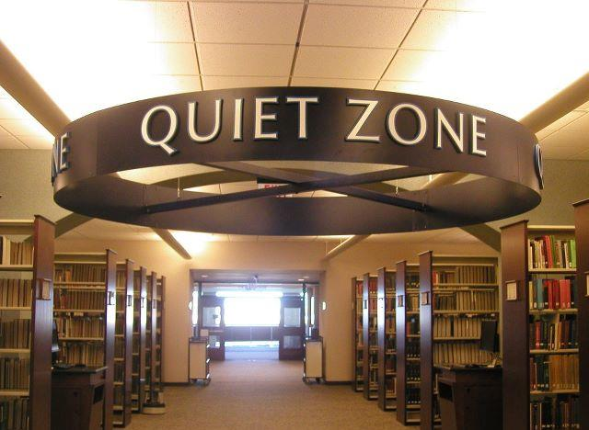
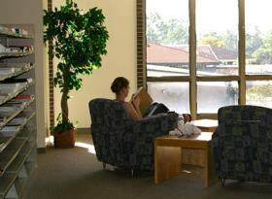
Maintaining Historical Continuity while balancing changing necessities
Libraries are Still Places of
Inspiration, Reflection, Study

Slide 35
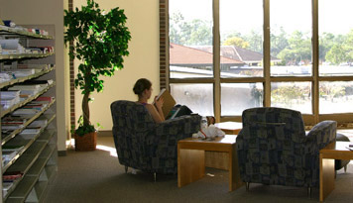
Thank you!
Comments or Questions
Ray Uzwyshyn Ph.D. MBA MLIS
Director, Collections and Digital Services
Texas State University Libraries
http://rayuzwyshyn.net
ruzwyshyn@gmail.com

