Slide 1
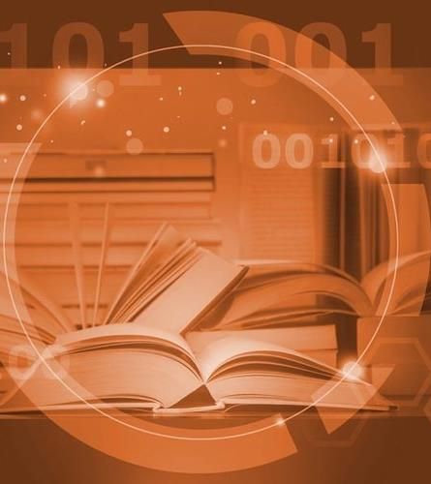
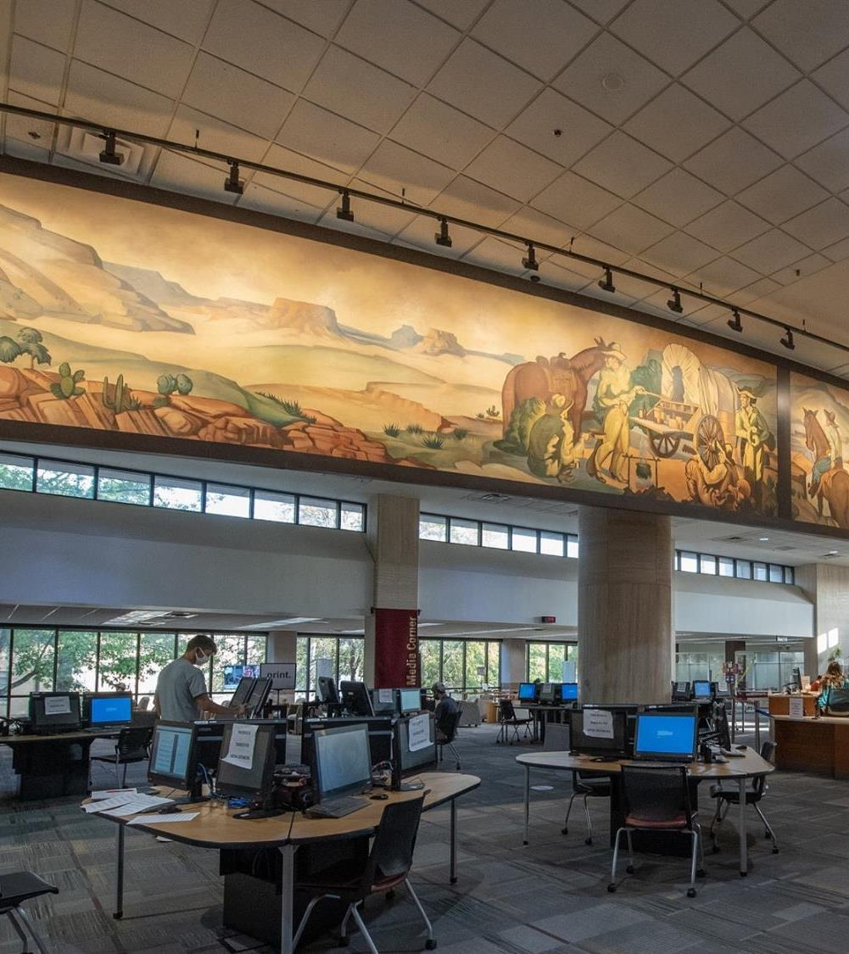
Creating Infrastructures
For Long Term
Digital Preservation
For Libraries, Museums and Memory Institutions
Ray Uzwyshyn, Ph.D. MLIS
Director Collections and Digital Services
Texas State University Libraries
For Internet Librarian: Connect 2021

Slide 2
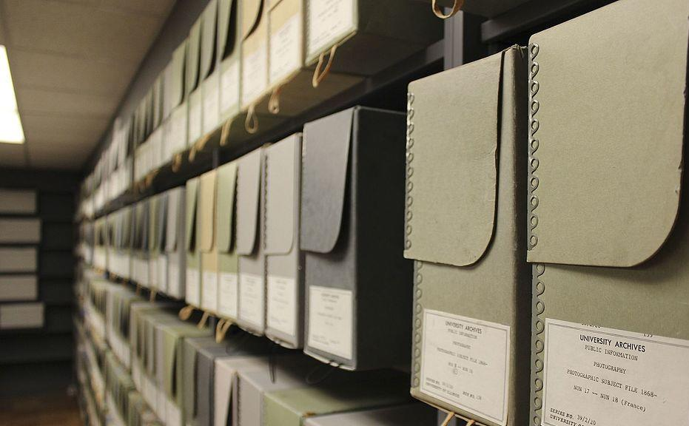
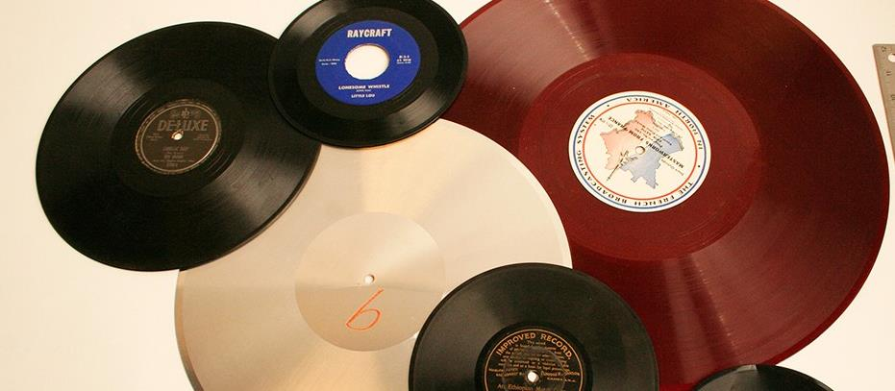
What is Long Term Library Digital Preservation Storage?
Simply put, it is Very long-term Digital Storage, 10 years or more.
Libraries, Special Collections and University Archives collect print materials & other media. Increasingly, they gather and collect digital information, media and data.
There are new millennia archival perspectives and digital storage standards in line with Research library standards (ISO standards: 16363, 16919, 14721)
Notes:
ISO 16363 – Audit and Certification of Trusted Digital Repositories. This is our goal, obviously, but the cost in labor and time to audit for certification is high. Currently, those with certifications are ICPSR (Inter-university Consortium for Political and Social Research), MetaArchive, Portico, Hathi Trust, Chronopolis, Scholar’s Portal, CLOCKSS, Northern Arizona University, University of North Texas Library, and canadiana.ca. (https://github.com/peterVG/awesome-tdr). So 10 places, including 2 universities, Canadian government, and the others are consortia.
ISO 16919 – Requirements for Bodies providing Audit and Certification.
ISO 14721 OAIS Reference Model. Open Archival Information System. DPWG has stated its commitment to the OAIS Reference Model in its Digital Preservation Policy (https://www.thewittliffcollections.txstate.edu/research/visit/policies/dig-pres-policy.html), and this storage request uses OAIS as a guide as well.

Slide 3
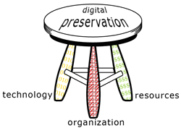
Digital Preservation in Libraries follows a Unique 3-Legged Stool
Library Model
Organization
Leverages existing human and consortial resources in libraries to build on archival/stewardship expertise
Technology
Synthesizes Technological Capabilities to meld with Traditional Library Archival/Collection Preservation Models
Resources
Utilizes Library, IT, Network and Human Resources.
Anne Kenney/Nancy McGovern, 2007

Slide 4
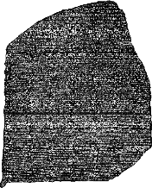
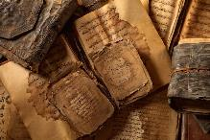
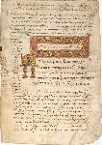


Communications Media
Possess Different Lifespans
>2000 +
Media Durability
in Hundreds
of Years
<1 year

Slide 5


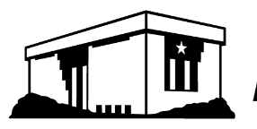
Many Considerations For
Long-Term Digital Preservation
Solutions
Any Solution Must
Allow For
Technological Diversity of Formats
Digital Replication (LOCKSS Principle)
Digital Auditing and Repair (Bitsums)
Geographic Distribution
Best Practice Standards
Succession Agreements
Technological
Disaster Planning
Institutional Failure
Notes:
Analog and born digital documents, content, previous formats and data are preserved and migrated with levels aspiring to similar stewardship roles as previous era’s libraries preserved the book, scroll and tablet .
A Digital Storage infrastructure leverages the libraries’ role in academic environments as custodian of knowledge and keeper of the scholarly record in a digital sphere
Multiple bit-level copies, stored in disparate locations geographically, administratively, and technologically.

Slide 6
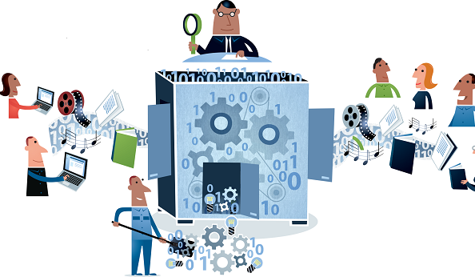
Unique Characteristics of Technology of
Long-Term Digital Preservation
Any Digital Preservation Technology Must Allow for:
Migration and Preservation of Formats for Long Term Storage (Normalization of Files, Migration Forward)
Risk Mitigation for Data and Content.
Multiple bit-level copies, stored in disparate locations geographically, administratively, and technologically.
Leveraging the libraries’ role as keeper of the scholarly and historical record now in a digital arena
Notes:
Analog and born digital documents, content, previous formats and data are preserved and migrated with levels aspiring to similar stewardship roles as previous era’s libraries preserved the book, scroll and tablet .
A Digital Storage infrastructure leverages the libraries’ role in academic environments as custodian of knowledge and keeper of the scholarly record in a digital sphere
Multiple bit-level copies, stored in disparate locations geographically, administratively, and technologically.

Slide 7


Primary Steps
Step 1: Form a Digital Preservation Working Group
(Texas State University Libraries Example)
TXU DPWG Background & History
Technology
Purpose:
A Digital Preservation Working Group provides oversight, direction and responsibility for:
1) Digital Preservation Technology
2) Policy Infrastructure
Group Formed 2015 and consists of members of Libraries’ Digital and Web Services (Digitalization Lab, Institutional Repositories) University Archives, Wittliff Special Collections, Library General Collections
Group began by investigating and then authoring the Libraries’ first Digital Preservation Policy Document (August 2016), benchmark minimums for preservation Masters etc.
Created Dedicated Local Server Space for Preservation Files and Use Files with Library IT/University Technology Resources
Policy
Notes:
DPWG Membership:
Technology and “system administrators”
Todd Peters
Jason Long
Erin Mazzei
Collection Managers (content specialists)
Laura Waugh IR
Nicole Critchley-University Archives
Laura Kennedy-University Archives
Lauren Goodley – Wittliff Collections
Amanda Price –General Libraries
Digital Preservation Policy for the Alkek Library at Texas State University, 2016: https://www.thewittliffcollections.txstate.edu/research/visit/policies/dig-pres-policy.html, scroll down for link to PDF. *Unanimous agreement on this policy, with membership across disciplines and departments.
Another way to think about it: DPWG initially worked on 2 legs of the stool: (1) Organizational, with the DPWG and Digital Preservation Policy, which lays out definitions, roles, and goals, and (2) Technological, with the dedicated server space for preservation and use files, and associated metadata. Also investigated, identified, and implemented Archivematica, a tool that creates Archival Information Packages, suitable for archival, long term storage.
Next steps:
Continue Organizational, by continuing to meet and make collaborative and unanimous decisions on workflows, etc. Continue relationship with TR and Windows Team.
Continue Technological, by creating these AIP packages. And, in an iterative fashion, move to the next step of storage best practices, by requesting off-site, distributed preservation storage

Slide 8

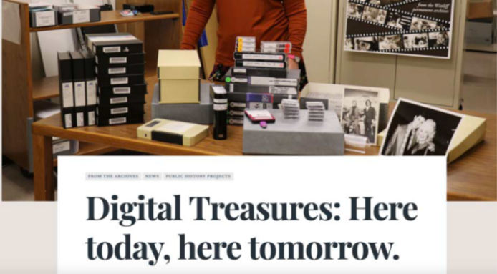
Investigate New Digital Preservation Tools, Platforms and Resources
Archivematica: Middleware standard for Digital Preservation Metadata and Integrity
  Archivematica bundles micro-services for normalizing files, managing metadata and verifying file types, bit-level integrity (checksums) etc.
    Arch
  Texas State Began R&D with Archivematica on Linux Ubuntu and first deployed production level instance on a Linux Red Hat platform
  University Archives and Special Collections began experimenting with, learning and utilizing Software (2016-2018)
  All areas gained expertise in Metadata, middleware workflow process (Archivematica) to create AIP’s (Archival Information Packages) to safely store, archive and retrieve files and metadata for later use

Slide 9
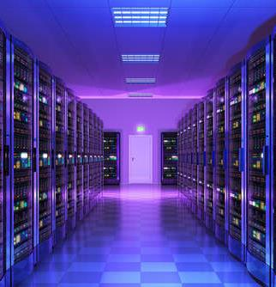


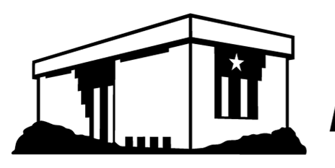
Step 2: Conduct Initial Digital Storage Needs Estimate (DPWG)
University Archives:
  Thesis & Diss. project: 500 GB per year
  Yearbook/Football negatives: 235GB per year
  San Marcos Daily Record Negatives 1500 GB per year
  Audio digitization: 500 GB per year.
  Misc imaging: 500GB per year
Special Collections (Wittliff):
  Unique digitization projects. Lonesome Dove Dailies (20 TB), Powers (10 TB) , Broyles (300 GB). Jerry Jeff Walker 2# reel tapes .
  O’Connor Collection/New Major Donation example (2TB).
  Austin Film Festival: 1.5 TB per year, (2+ years).
  Misc imaging: 2 TB per year
  Audio digitization: Wittliff: 200 GB / year
General Collections:
  Theses and Dissertations
  Streaming media archive: 2 TB per year, General Collections (Not Covered by LOCKSS, PORTICO Memberships)
Conclusions ~ 60-70 TB Initial Digital Storage, required
10-12 new TB/year for access files needed
Notes:
TR given as much lead time as possible.
Texas State file storage in the data center is the primary location for digital files (referred to as files.txstate). It includes both working files, access copies, and preservation copies and associated metadata. The library has worked with Technology Resources to provide a growth estimate of approximately 10-12 TB per year. The Texas State infrastructure provides a RAID-based storage array and daily snapshots copied to storage off campus at the Round Rock Campus providing disaster recovery capability and short-term preservation capability.
However, the existing local infrastructure does not meet the needs for long-term preservation. Best practices for long term preservation require two complete copies that are not collocated. (https://ndsa.org//activities/levels-of-digital-preservation/). Although there is an offsite daily mirror of files in Round Rock, it is a differential backup only reflecting changes since the last mirror. An off-site preservation copy of a file should not be linked to the original source file so that if the original file changes the preservation copy does not change. According to conversations with TR, “ if there is corruption in the source filesystem it will be transferred to the remote system, as well, and we do not perform any corruption detection on the NFS exports and rely on the Linux filesystem and NFS protocols to manage data corruption issues.” In addition, there is only a 30-day window for recovery from backup if files are corrupted or deleted on files.txstate. If a digital file became corrupt it would automatically be copied to Round Rock, if the corruption was not noticed immediately there would be no way to recover preservation copy.
For these reasons, the library will have to look at external storage options for long term digital preservation.

Slide 10
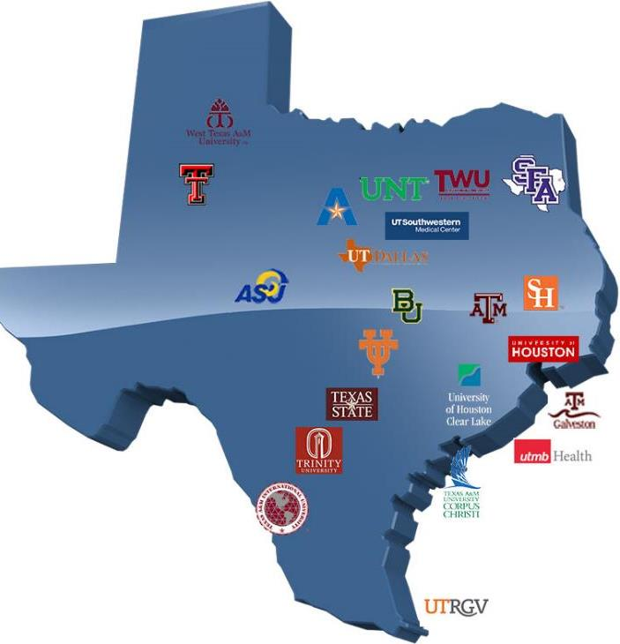
Step 3: If Possible, Join Consortia
Texas Digital Library
Forms First State Digital Preservation
Resource Infrastructure (2016-2018)
2016 TDL Preservation Services Initiated
(Hires Courtney Mumma from Internet Archive (Wayback Machine, Brewster Kale) to Focus on State Digital Preservation Services
2016 TDL Forms Alliance with DuraCloud
(Digital Preservation focused Non-Profit
Duracloud @ TDL )
2017 TDL Creates Digital Preservation Services
Members receive “Space” in DuraCloud@TDL for ingesting content, based on membership level.
2018-2019 Texas wide TDL Digital Preservation Groups and State Committees Formed
Archivematica Users Group Formed
2019 TDL State Digital Preservation Committee Formed

Slide 11
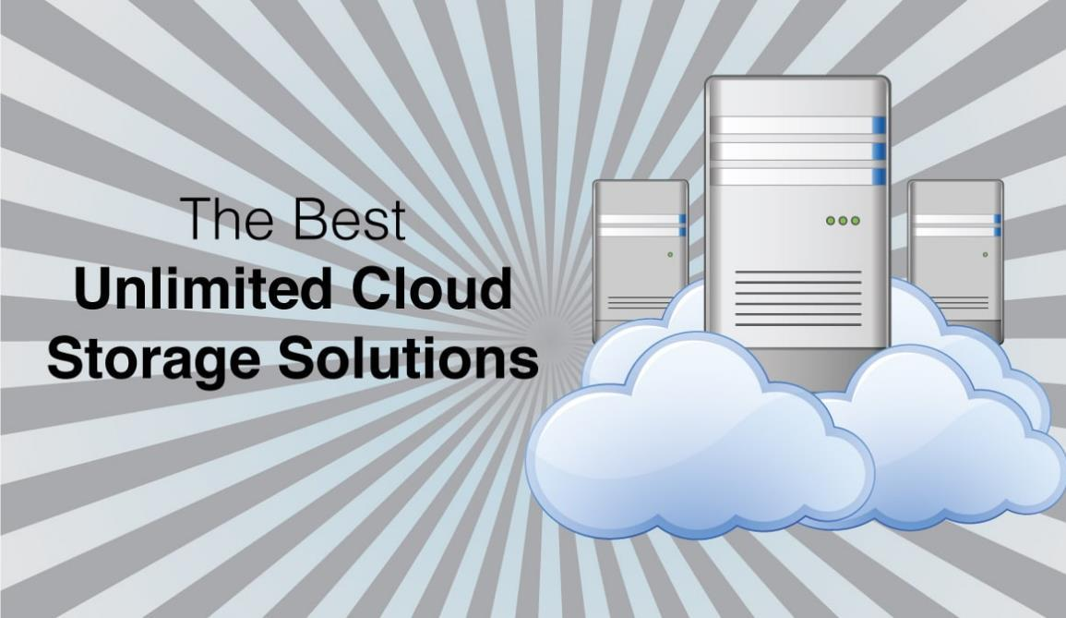
Step 4: Storage Infrastructure Recommendation
2018-2019 Digital Preservation Working Group
Continually Changing Landscape
Recommendation Charge
4 Pillar Methodology
1) Conduct Environmental Scan: to Identify Library Digital Preservation Storage Options
2) Compare Peer Groups (TDL) and National Best Practices for Research Libraries
3) Narrow Focus to Pragmatic options suitable for University Libraries Needs
4) Forward Recommendation: for AVP and VPIT Review and Approval

Slide 12
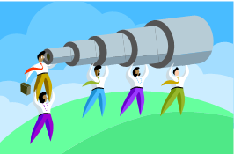
Pillar 1: Environmental Scan
Digital Preservation Solutions (Peer Institutions)
Texas Peer Institutions | University of Texas at San Antonio | University of Houston | UT Rio Grande Valley | University of Texas (Austin) | Texas A & M University
Digital Preservation Solutions | Duracloud Directly (not via Texas Digital Library, TDL) | Amazon S3 and Glacier Directly (Not via Texas Digital Library, TDL) | Chronopolis via DuraCloud through TDL | LTO Tape, moving to Texas Advanced Computing Center | Chronopolis and Amazon via Duracloud @ TDL

Slide 13
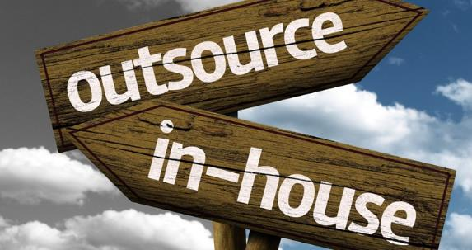
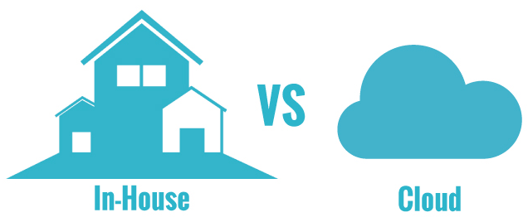
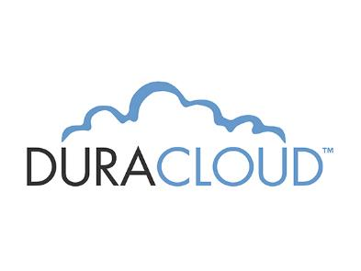
Pillar 2: Narrow Focus
Three Final Candidates
Option 1: Outsource Preservation Digital Storage
  Preservica
Option 2: In-House Texas State Data Center Solution
  files.txstate.edu
Option 3: Mixed Duracloud through TDL/Other
    Options
    AmazonS3
    Amazon Glacier
    Chronopolis
    (Azure)

Slide 14
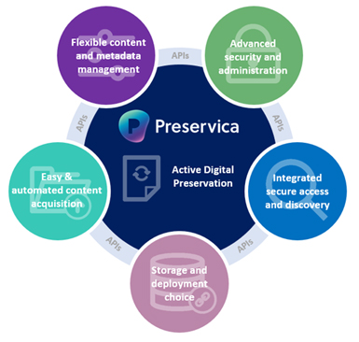
Option 1: Outsource
(All in One Outsource Option, Preservica)
Benefits | Considerations
Preservica creates AIP’s (Archival Information Packages, Metadata) and provides all technology set-up and support | Costs: $35,000.00/year for 20TB
Established Archival Best Practices | No local control or entrance to underlying technology (black box)
Recognized Library Peer and Community of Practice | Variable Response to Local Needs (similar considerations to @mire)

Slide 15
Option 2: In House
Expand TR/Texas State Data Center Relationship
Benefits | Considerations
Proven relationship with University Technology Resources. | Specialization not in place: Metadata Infrastructure, Normalization of Formats, library-related expertise or best practices for this type of Digital Preservation
Storage for working files, access copies, preservation files and associated metadata established | Requirements for geographic, administrative and technological distribution (even if multiple copies) currently not met
Building on our current temporary solution of files.txstate.edu and increasing capacity. Growth estimate of 10-12 TB/year | 30-day window for recovery is currently not sufficient for maintaining long term preservation files and associated infrastructures needed

Slide 16

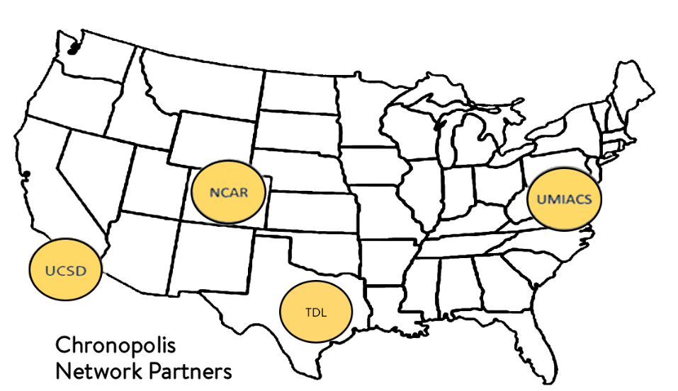
Option 3 :Mixed
Duracloud through Texas Digital Library to Chronopolis
Chronopolis: Geographically Distributed Preservation Network
  UC San Diego
  National Center for Atmospheric Research
  University of Maryland, Institute for Advanced Computing Studies
  TACC (Texas Advanced Computing Center)
Benefits | Considerations
Geographic Distribution at any 3 technologically diverse partner nodes | Subscription cost: $2500 annual fee includes 2TB/year storage and ingest $1000 initial setup (1st year only)
Non-Commercial solution rooted in libraries and cultural heritage community | Storage $165/year/additional TB $120 ingest fee/additional TB
Library community of practice around this (TDL/Duracloud/Chronopolis) | Significant Human resources/time investment for initial technological integration
File Fixity and Data Integrity processes are transparent

Slide 17
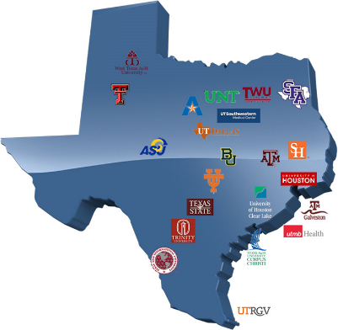
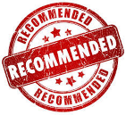

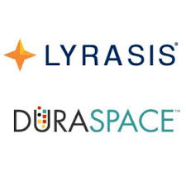

Option 3: Mixed
Duracloud through TDL (Texas Digital Library) to Chronopolis Option
Provides strong library support through four academic library focused organizations (Chronopolis, TDL, Duraspace, Lyrasis) for long term viability and strong peer support networks
Anticipated Budgetary Request:
  Year 1: $3500.00 ($2500.00 TDL Preservation/year, $1000.00 Initial Set-up/Onboarding, Includes 2 TB Storage)
  Year 2-3: $2785.00/year (includes additional 1 TB storage/year)
Review Storage and Staff Needs Annually.

Slide 18
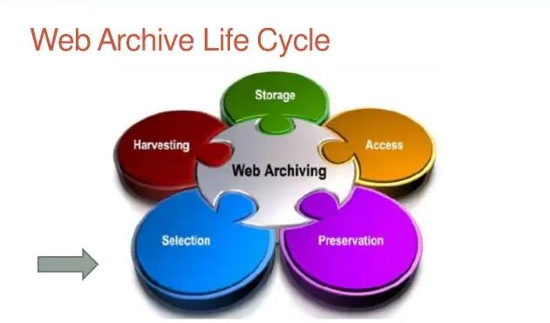
Future Directions (2022 +)
Web Archiving, Digital Forensics, Email Archiving
Web archiving =The process of collecting portions of the World Wide Web to ensure information is preserved in an archive for future researchers, historians, and the public.
Employs web crawlers for automated capture.
Largest web archiving organization based on a bulk crawling approach is the Wayback Machine (Internet Archive) https://archive.org/web/

Slide 19
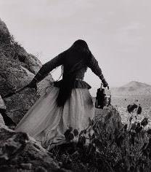
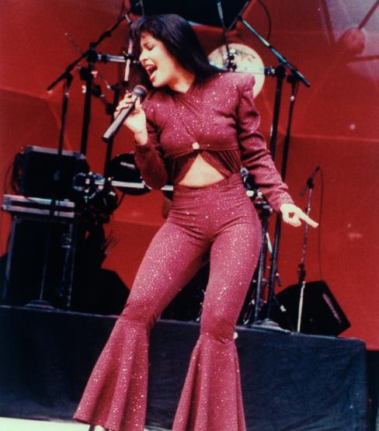
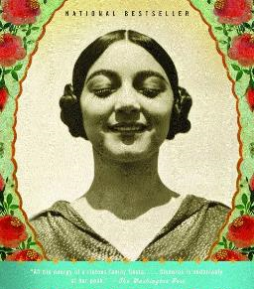
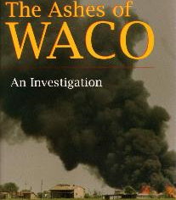
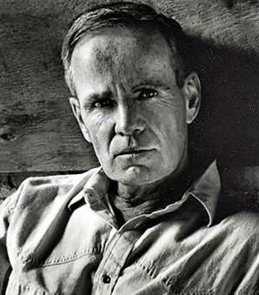
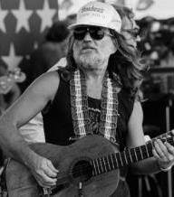

Web Archiving Opportunities
Archives and Special Collections
2022-2027
Wittliff Special Collection Four Pillar Priorities: Texas & Southwestern US
Literature, Film, Music Photography
Crawling quickly disappearing review, article and dedicated fan sites, other areas of interest regarding collection priorities
University Archives
Crawling txstate.edu for what websites/areas are of interest Partnering with Texas State University researchers, colleges, departments, institutional records
Potentially beginning archiving Texas State important Social Media Twitter, Facebook

Slide 20
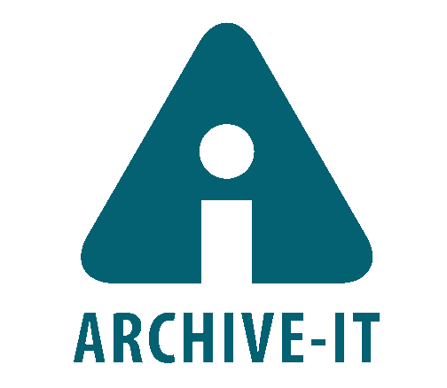

Web Archiving R&D Phase Platforms – Archive-IT, WebRecorder
Launched in 2006
Built by the Internet Archive (Wayback Machine)
End-to-end hosted platform to create, store, and provide access to collections of web content
Most widely-used platform for universities, https://archive-it.org/blog/learn-more/
Pricing
  Different pricing levels based on amount of data archived annually
  TDL is investigating consortial discounts as well as other platforms (WebRecorder)
WebRecorder

Slide 21
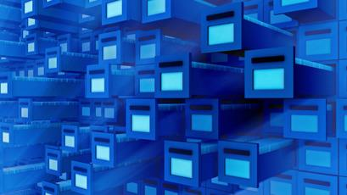
Conclusions and Deeper Rationale
For Long Term Digital Preservation
Storage Infrastructure
Long Term Digital Preservation
Provides a New Level of Service Expected by Donors, Researchers, Faculty and students.
Is a Necessary Focus Area for Research Libraries
Connects The Library with State & National Library Technology Organizations
(Texas Digital Library, Digital Preservation Network, Coalition of Network Information, Lyrasis, Chronopolis, Duraspace)
Places Your Library in Line with other leading-edge institutions working in these new areas
(Association of Research Libraries, ARL, GWLA, Greater Western Library Association, HathiTrust, CNI etc.)

Slide 22
Long Term Digital Preservation
Software and Storage Related Links
Archivematica. https://www.archivematica.org/en/
Amazon Web Services Cloud Storage https://aws.amazon.com/products/storage/
Chronopolis Digital Preservation Network. https://aws.amazon.com/products/storage/
Duracloud Digital Preservation https://duraspace.org/duracloud/
Microsoft Azure https://azure.microsoft.com/en-us/
Preservica https://preservica.com/
Texas Digital Library Digital Preservation Services: https://www.tdl.org/digital-preservation/

Slide 23
Long Term Digital Preservation Standards, Resources,
Articles and Presentations
ISO Policies. #16363 Audit and certification of trustworthy digital repositories. https://www.iso.org/standard/56510.html , #16919 Requirements for Trustworthy Digital Repositories. https://www.iso.org/standard/57950.html , #14721 Open archival information systems (OAIS). https://www.iso.org/standard/57284.html
Kenney, A and McGovern, N. A Digital Decade: Where Have We Been and Where Are We Going in Digital Preservation? RLG DigiNews April 15, 2007. https://deepblue.lib.umich.edu/bitstream/handle/2027.42/60441/McGovern-Digital_Decade.html?sequence=4
Library of Congress. Digital Preservation at the Library of Congress. (Retrieved 2021) https://www.loc.gov/preservation/digital/
Texas State Digital Preservation Working Group. (Retrieved 2021) Texas State University Libraries Digital Preservation Policy. https://www.thewittliffcollections.txstate.edu/research/visit/policies/dig-pres-policy.html
Uzwyshyn, R. (2021). Building Frameworks for Long Term Digital Preservation. Computers in Libraries. September, 2021. Vol. 41, Number 7. pp. 4-8. ISSN: 1041-7915.
https://www.infotoday.com/cilmag/sep21/Uzwyshyn--Building-Frameworks-for-Long-Term-Digital-Preservation.shtml
Uzwyshyn, R. (2020). Digital Preservation Storage Infrastructures Model Proposal Presentation. Texas State University. DOI: 10.13140/RG.2.2.14102.09289, https://www.researchgate.net/publication/339390854_Long_Term_Digital_Preservation_Storage_Infrastructures_for_Libraries_Archives_and_Research_Institutions?channel=doi&linkId=5e4f04dd299bf1cdb9391aeb&showFulltext=true

Slide 24
Questions and Comments
Ray Uzwyshyn, Ph.D. MLIS MBA
email: R_U15@txstate.edu
http://rayuzwyshyn.net
Director Collections and Digital Services
Texas State University Libraries

Slide 26

Step 4
Digital Preservation Storage Recommendation
Focus
Investigation begins into various Historic, Library Centered, University and Commercial Storage Solutions
DPWG Group gaining recognition, awareness of permanent digital preservation storage needs, capabilities of libraries
Resource possibilities maturing and widely available commercially and in the library space
Possible solutions ranged from new to historical models to In-House and Outsourcing possibilities
Notes:
Possible solutions ranged from Duraspace, Chronopolis, Amazon to previous models LOCKSS and Portico to In-House (University Technology resources) possibilities

Slide 27
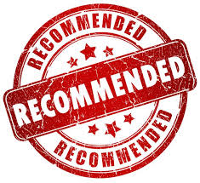
Digital Preservation Storage Working Group
Final Recommendation

Slide 28


Option 3: Duracloud through TDL
Amazon S3 and Glacier Option
Benefits | Considerations
Amazon S3 suitable for streaming, dynamic access. Amazon Glacier suitable for long-term dark archive needs | Commercial: not tailored to cultural heritage institutions. Does not meet requirements for geographic, administrative and technological distribution
Amazon Glacier and Amazon S3 are both part and options within the Duracloud Suite if we ever chose to use them | File fixity and data integrity is a black box (process hidden from owners)
TDL and Duracloud both possess established community of library best practices. | Subscription cost $2500 annual fee includes 2TB/year $1000 initial setup (1st year only) S3 $265/year per additional TB Glacier $50 / year per additional TB
 | HR/Time Investment for Initial Technological Integration

Slide 29

Option 3:
Duracloud Component
Duracloud is a hosted middleware service from DuraSpace that lets organizations control where and how digital content is preserved.
The parent organization Duraspace is a non-profit organization providing academic library leadership for open source technologies focused upon durable, persistent access to digital data. (i.e. Fedora, Dspace).
Currently, Duraspace is part of Lyrasis, a longstanding library related organization supporting libraries and technology initiatives

Slide 30
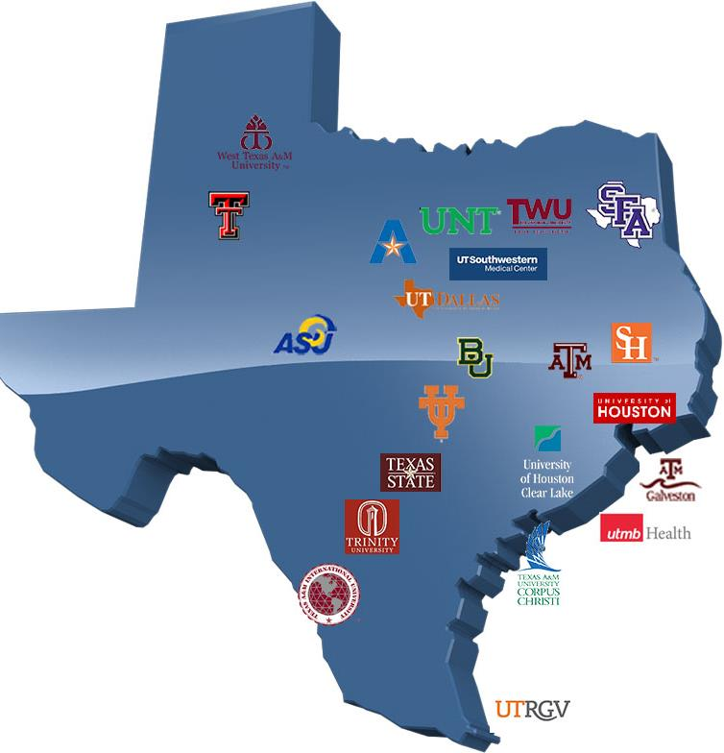
Option 3: Duracloud Through the Texas Digital Library (TDL)
Duracloud would be administered through our TDL membership with these consortial relationships, advantages (usergroups, networks etc.) and constraints
The Texas Digital Library is a Consortial Organization consisting of 22 Texas University Library Organizations
Focused on enabling Texas Libraries Digital Infrastructure and new digital technology Projects.

Slide 31
Conclusions and Deeper Rationale
For Long Term Digital Preservation
Storage Infrastructure
Long Term Digital Preservation Provides a New Level of Service Expected by Donors, Researchers, Faculty and students.
Long Term Digital Preservation is a Necessary Focus Area for Research Libraries
Long Term Digital Preservation Connects Library with State & National Library Technology Organizations
(Texas Digital Library, Digital Preservation Network, Coalition of Network Information, Lyrasis, Chronopolis, Duraspace)
Places Your Library in Line with other leading-edge institutions working in these new areas
(Association of Research Libraries, ARL, GWLA, Greater Western Library Association, HathiTrust, CNI etc.)

