Slide 1
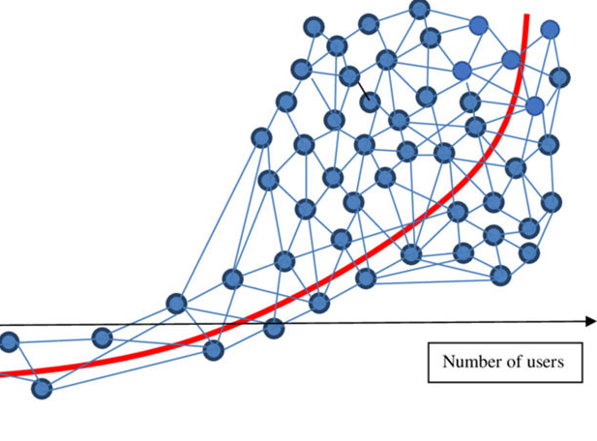
Developing an Open Source Digital Scholarly Research Ecosystem Local and Global Possibilities
Ray Uzwyshyn, Ph.D. MLIS Director, Collections and Digital Services Texas State University Libraries

Slide 2
What is a Digital Scholarly Research Ecosystem? Ecosystem of Several Software Components to Enable Faculty and Student Research
Ecosystem Metaphor Look at Relationships in the Digital Environment Specifically Focuses Upon the Discrete Component Relationships with the Networked Digital Environment

Slide 3
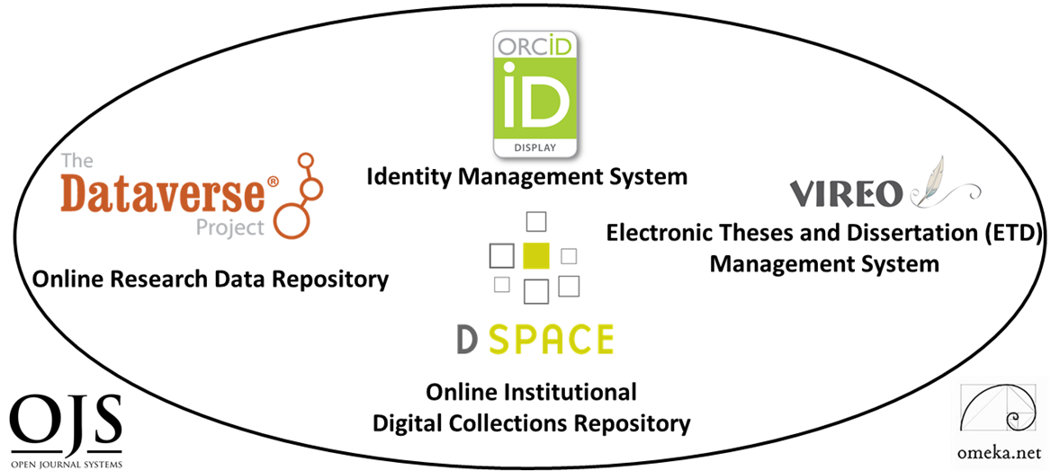
Six Main Software Components
Digital Collections Repository (Dspace)
Research Data Repository (Dataverse)
Identity Management System (ORCID)
ETD Management System (VIREO)
User Interface Software (OMEKA)
Open Journal Software (OJS3)
Hardware: Digitization Lab
Developed and Implemented Texas State University Libraries, 2014-2019

Slide 4
General Characteristics Digital Scholarly Research Ecosystem
Open Source Software
Customizable Components
Active Developer Communities

Slide 5
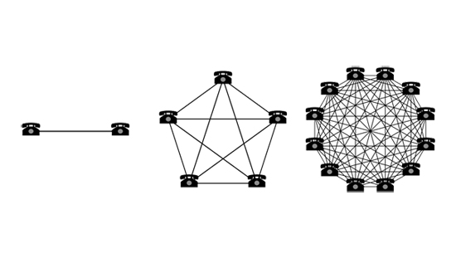
Collocating Digital Components in Networked Research Ecosystem Enables Connections and/or Larger Network Effects
Larger Idea

Slide 6
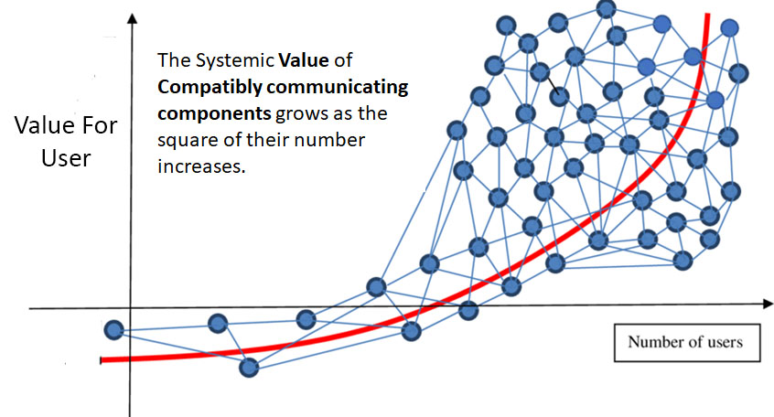
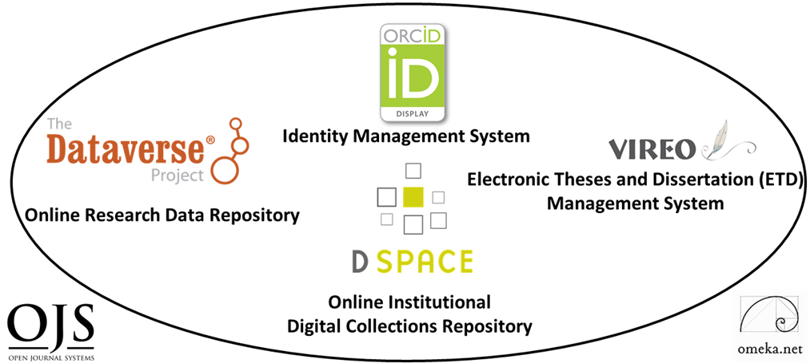
Network Effects: Metcalfe’s Law Early Telecommunications Law for Ethernet (1993)
Component Networks may be Internal and/or External

Slide 7
Texas State University Libraries Digital Scholarly Research Ecosystem Primary Components

Slide 8
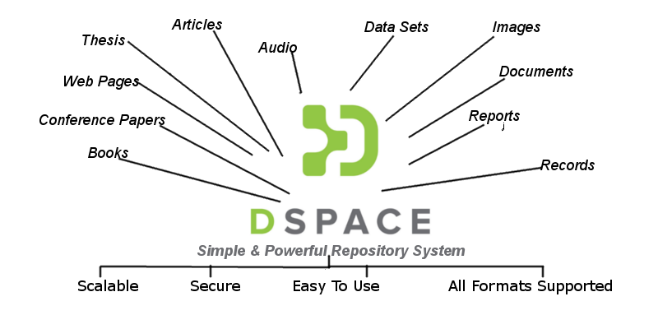
Institutional Digital Collections Repository (Dspace)
Organizes, centralizes and makes accessible research and knowledge generated by the institution’s research community: Pre-prints Faculty Publications White Papers Conference Presentations Graduate Student Theses and Dissertations Historical Legacy Application

Slide 9
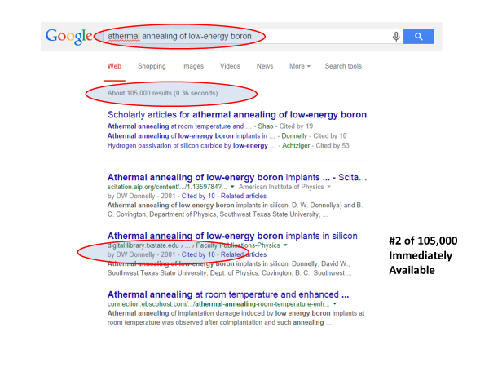
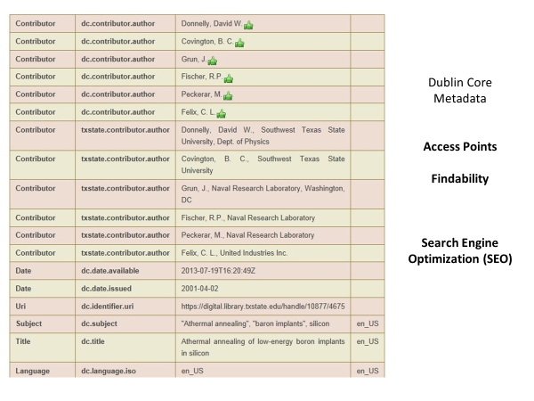
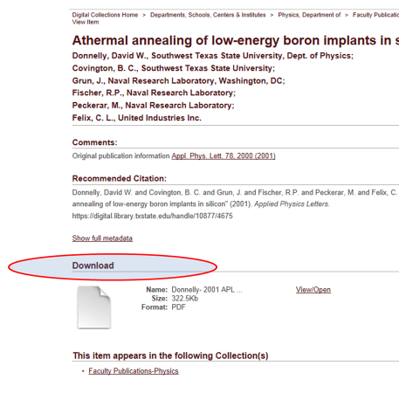
Primary Use Case Value Application of Structured Metadata Schema for Search Engine Optimization Enabling Accessibility and Multiple Points of Access

Slide 10
Efficacy of Structured Metadata Schema Application for Search Engine Optimization Accessibility and Multiple Points of Access

Slide 11
Digital Collection Repositories Gives Insight and another window into Faculty/Student Research (Statistics)

Slide 12
Research Data Repository

Slide 13
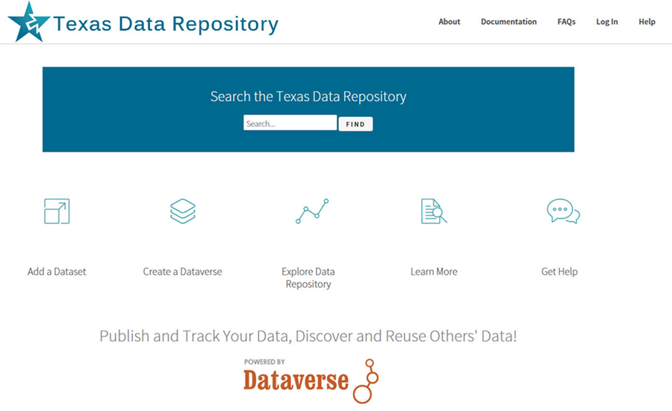
Texas State University Dataverse/TDL Dataverse Larger Consortial Online Research Data Repository

Slide 14
Digital Scholarly Research System Secondary Components

Slide 15
Vireo, Omeka and OJS (Dependent on Primary Content Repositories)
Electronic Thesis and Dissertation Management System Addresses Intermediary steps in the ETD Process
Bridges Student Thesis/Dissertation Submission with
Graduate School Review, Online Publication and ETD Preservation
Open Source User Interface Software allows an elegant portal or gateway entrance to digital collections data repositories, large research projects - linking text,image media and datasets
Open Access Academic Journal Software for the academic refereed journal workflow and online publishing

Slide 16
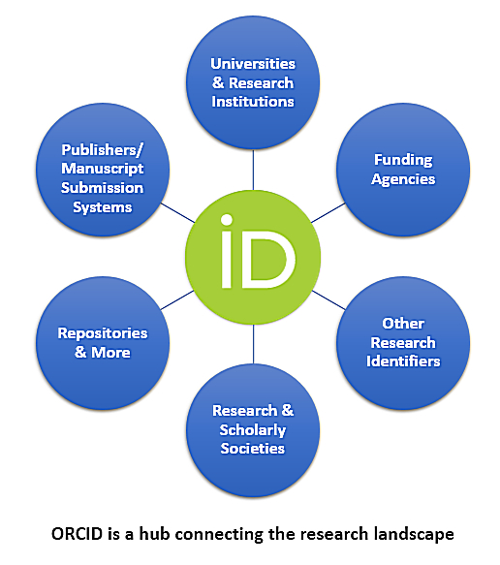
Researcher Identity Management System ORCID
Allows publications from a researcher to be found, linked and aggregated across multiple information Systems
Gives Researchers Unique Number (ORCID ID) Connecting and Disambiguate Scholars names Maria Hernandez, Biochemist Maria Hernandez, M.D. or Astrophysicist
Can also act as a Network Hub

Slide 17
Digital Scholarly Research System Tertiary Components The Digitization Lab Hardware & Specialized Software

Slide 18
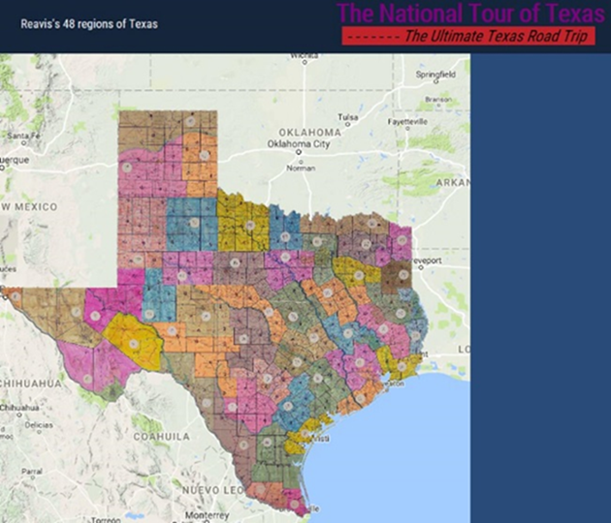
The Digitization Lab Expands Possibilities for Faculty Research Projects
Digitization possibilities on media levels range from OCR to image, book, manuscript & journal digitization, 3D objects, posters, audiovisual material maps, GIS and visualization technologies (IIIF etc)

Slide 19
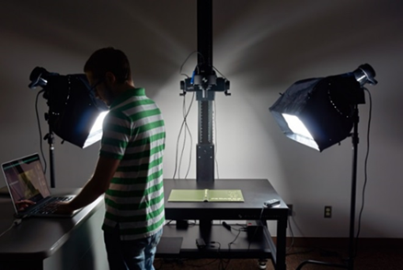
Combining Components System Synergies Digital Scholarly Research Ecosystem

Slide 20
Combining These Research Ecosystem Components Opens Possibilities For Digital Scholarship & Partnership Opportunities
Cognitive Cartography/Multimedia Archives (Video, Text, GIS, Images, Field Notes) Dick Reavis: National Tour of Texas Multimedia, Digital Archives/Retrospective ETD Projects (Digital video, online exhibit images, text, digital archives) Severo Perez: And the Earth Did not Swallow Them Online Exhibits/Digital Archives/ Online Academic Journals (images and text, Omeka front end/Database back end, IIIF) Cabeza de Vaca La Relacion Digitization Santiago Tafolla: Mexican Amer. Confederate Soldier Interactive Image Archives/Data & Research Projects (Image libraries, Interactive Commenting/Metadata) Texas State Flickr Commons
Digital Libraries Archiving & Documentation Projects (Text, Metadata, OCR, Search, Zoom ability, Page Turning) Pedagogs University Yearbooks
Faculty Digitization Proposals/Partnerships
Complexity
Projects,Prototypes Grant Partnerships

Slide 21
Ecosystem Open Source Software Enables Core Research
Articles, Theses, Dissertations in the collections repository can be associated with datasets in the data repository for reference, verification or reproducibility.
Journal article citation lists can be associated with articles and datasets in the Collections and Data Repositories
Papers in the collections repository and datasets in data repository can be associated with ORCID ID’s for aggregation of research profiles. Also, the University’s Faculty Profile Systems (Digital Measures)
Further Desired Connections can also guide developmental paths for both component software and the ecosystem

Slide 22
Network Effects Both In and Between Individual Components and In and Among Component Networks
ORCID Aggregates from Several Sources and Networks and Connects to Other Networks, Internal and External
OMEKA can act as a middleware front end connecting several components and component networks internally. 3) Digitization Lab’s IIIF Framework can create internal or globally distributed Image Libraries.
4) Dataverse can be configured as a single Instance or as a Consortial Model (Texas 22 Individual Instances, TDL)

Slide 23
Network Effects and Opportunities Among Research Institutions
Research
Institution A
Research
Institution B
Research
Institution C

Slide 24
Assessment and Results Quantitative and Qualitative Measures
Ecosystem Implemented in Stages, 2014-2019
Annual Usage Growth (Downloads)
LibQual Biannual Survey 2013-2019, Faculty and Student System Perceptions, Comments
System Downloads | 2015 | 2016 | 2017 | 2018
DSpace | 330,668 | 396,650 | 656,778 | 1,015,314
ETDs | 158,240 | 200,373 | 328,420 | 470,437
Dataverse | N/A | N/A | 455 | 3,451
ORCID ID’s | 190 | 316 | 438 | 545
OJS Journals | 1 | 2 | 2 | 3

Slide 25
Larger Digital Scholarly Research Projects Can Act as Qualitative/Quantitative Benchmarks
Cognitive Cartography/Multimedia Archives (Video, Text, GIS, Images, Field Notes) Dick Reavis: National Tour of Texas Multimedia, Digital Archives/Retrospective ETD Projects (Digital video, online exhibit images, text, digital archives) Severo Perez: And the Earth Did not Swallow Them Online Exhibits/Digital Archives/ Online Academic Journals (images and text, Omeka front end/Database back end, IIIF) Cabeza de Vaca La Relacion Digitization Santiago Tafolla: Mexican Amer. Confederate Soldier Interactive Image Archives/Data & Research Projects (Image libraries, Interactive Commenting/Metadata) Texas State Flickr Commons
Digital Libraries Archiving & Documentation Projects (Text, Metadata, OCR, Search, Zoom ability, Page Turning) Pedagogs University Yearbooks
Faculty Digitization Proposals/Partnerships
Complexity
1) Project Completion (Milestones) 2) Usage Statistics
Projects,Prototypes Grant Partnerships

Slide 26
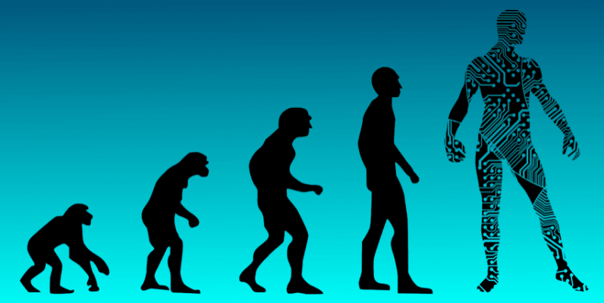
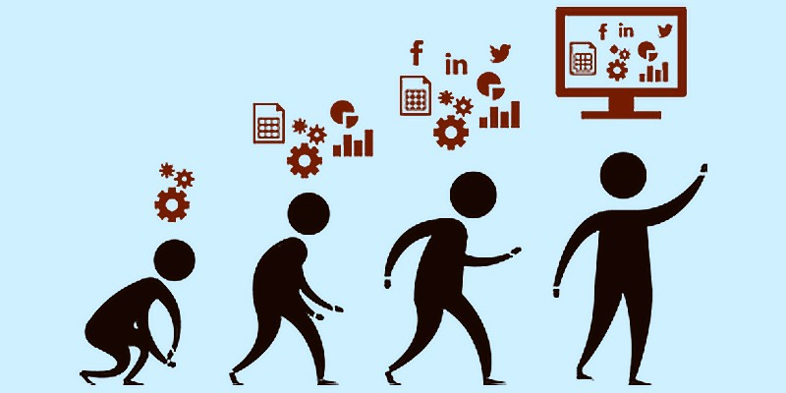
Summary Reflections
Placing Digital Scholarship Components within an Ecosystem Paradigm Usefully Enables:
1) Better Guidelines and Roadmaps for Developing Digital Scholarly Components 2) Pathways Forward and Evolutionary Possibilities for System Development
3) New Possibilities For Researchers working within the academic research cycle

Slide 27
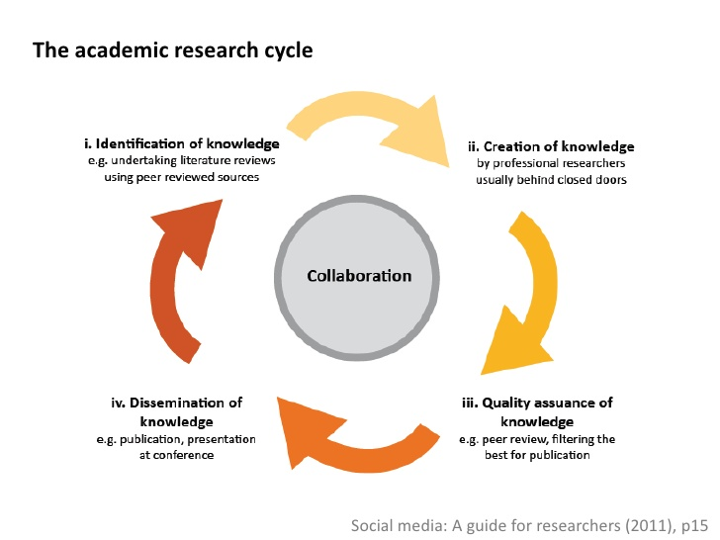
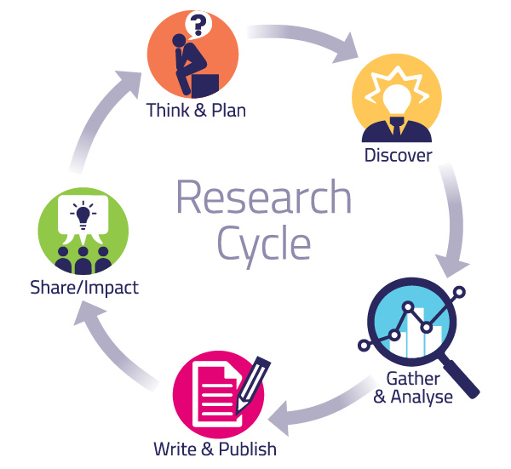
Ecosystem Components Enable Various Parts of the Academic Research Cycle
Abstract Levels
Pragmatic Levels

Slide 28
Digital Scholarly Ecosystem Timelines and Implementation Paths Many Roads To Rome
Year 1 Digital Collection Repository and Digitization Lab Year 2 User Interface Software (OMEKA), Identity Management System, ORCID Year 3 Data Repository Year 4 ETD Middleware (VIREO) and OJS Software Year 5 Complex Digitization Projects, IIIF Server, Faculty Grant Projects etc.

Slide 29
Human Resources
System Administrator/Programmer (server infrastructure set-up/maintenance/basic customization
Digital Collections Librarian: Administration, Marketing, User Support, Collections and Data Repository, OJS/ORCID
Metadata Librarian: Dublin Core, Specialized Schema
Web Developer/Programmer: OMEKA, System Integration
Project Manager/Department Head (PMP Certification)
Digitization Specialist
GIS Specialist/Data Visualization Specialist
AI Specialist/Post-Doc/CLIR Fellow

Slide 30
Further References
Uzwyshyn, R. 2020 Developing an Open Source Digital Scholarship Ecosystem (Preprint). ICEIT2020. Oxford, UK. https://www.researchgate.net/publication/336923249_Developing_an_Open_Source_Digital_Scholarship_Ecosystem
Texas State University Libraries Website. https://www.library.txstate.edu/ Texas State Digital Collections Repository https://digital.library.txstate.edu/ Texas State Data Research Repository https://dataverse.tdl.org/dataverse/txstate Texas State Online Research Identity Management System: https://guides.library.txstate.edu/researcherprofile/orcidTexas State Electronic Thesis and Dissertation Management (VIREO): https://www.tdl.org/etds/ Texas State Digital & Web Services: https://www.library.txstate.edu/services/faculty-staff/digital-web-services.html

Slide 31
Questions, Comments
Ray Uzwyshyn, Ph.D. MLIS Director, Collections and Digital Services Texas State University Libraries ruzwyshyn@txstate.edu, 512-245-5687 http://rayuzwyshyn.net

Slide 32
Envisioning Future Possibilities Networked Global Scholarly Research Environment

Slide 33
Can we Enable Scholarly Research Network Ecosystem Possibilities on Global Levels?
Is it Desirable or Time to Begin Thinking About Empowering a Global Research University Community ?

Slide 34
Research Universities and Digital Research Ecosystems
~266-300 Research Institutions US & Canada, Carnegie R1 & R2, Very High or High Research Activity, 124 ARL Libraries
~1000-1250 Research Universities Worldwide QS Rankings and Times Higher Education Supplement. (40% Europe, 26.5% Asia Pacific, US/Canada 18%, Latin America 9% and Middle East/Africa.
26,000-40,000 Universities Globally. Research Universities 2.7% - 4.2% of all universities worldwide. Highest by Country: US 156, UK 76, Germany 45, Japan 44.
Other Top 2-3% Research Institution Academic Libraries Globally, 1000 Institutions beyond the US and Canada. This represents the other 90% of Research Libraries Globally

Slide 35
Brainstorming & Antecedent Models One Laptop Per Child Dreamed up mid-late 90’s, Launched 2005
Nicholas Negroponte, MIT Media Lab Founding Director
Noble Initiative/Grand Ambitions
Vision: Give each child in world access to a laptop with open source software for less than 100.00 $US/laptop
Gage Effects For Education Globally
Can We do the same thing for academic research globally?

Slide 36
One Server Per Research Institution 2020-2025
Simple Idea
Empower 1000 Research University Institutions/Research Libraries Globally
Give them One Configured Server Ecosystem with 6 Open Source Scholarly Research Software Components, < $1000.00 US/Server or set up Fractional Server Space Globally (SAAS)
Set Up Brief Training
Measure the Effects

Slide 37
Research Universities and Digital Research Ecosystems
124 ARL Research Libraries (US and Canada)
131 US Research Universities (Carnegie R1, Very High Research Activity)
135 Doctoral Universities (Carnegie R2, High Research Activity, US), ~266-300 Research Institutions US & Canada
1011 Research Universities Worldwide (40% Europe, 26.5% Asia Pacific, US/Canada 18%, Latin America 9% and Middle East/Africa. QS Rankings
1250 Research Universities Worldwide, Times Higher Education Supplement (2.7% - 4.2% of all universities worldwide)
By Country: US 156, UK 76, Germany 45, Japan 44
Global Estimates of General University #’s 26,000-40,000 Empower Other Top 2-3% Research Institution Libraries Globally, 1000 Institutions, the other 90% of Research Libraries Globally

