Slide 1
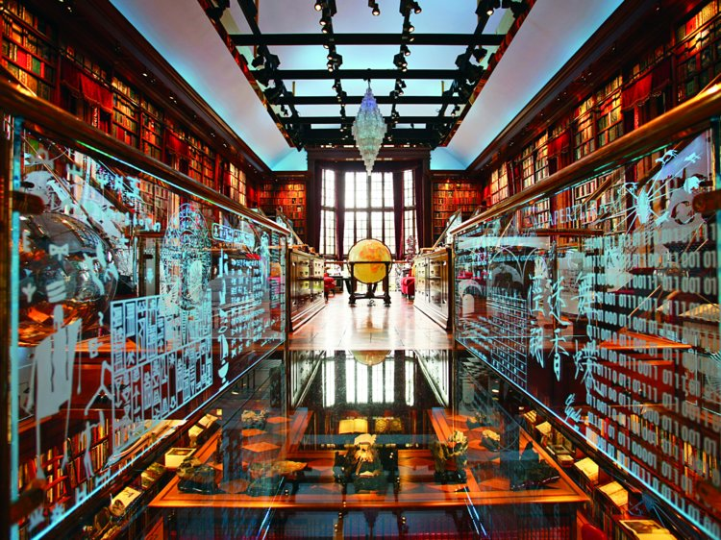
Academic Libraries and The Future
Ray Uzwyshyn, Ph.D. MLIS MBA
Director, Collections and Digital Services
Texas State University Libraries
2018

Slide 2
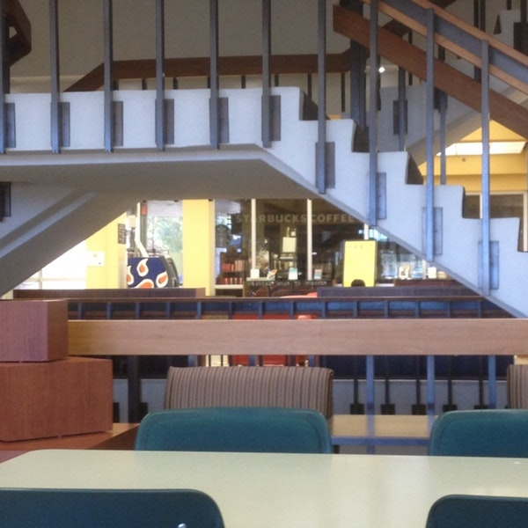
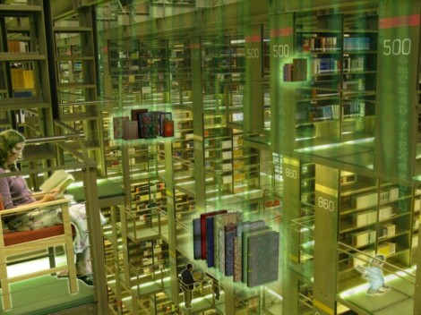
Academic Libraries are Changing
Agenda Overview - Future Possibilities
The Physical Library
Infrastructures
Technology
Collections
Libraries and Publication Possibilities
Faculty Partnerships
The Online Library
Video and Social Media
Digital Collections
Digital Scholarship
Data Repositories and Analytics

Slide 3

Environmental Scans
Preliminary to going into any larger change processes several possibilities and constraints need to be addressed:
Current and Future Library Needs
Budgetary Possibilities
University Administrative Directions
Donor Possibilities
5) Human Resource Possibilities
6) Staff, Stakeholder and University Interests
7) Work Culture and Social Factors

Slide 4
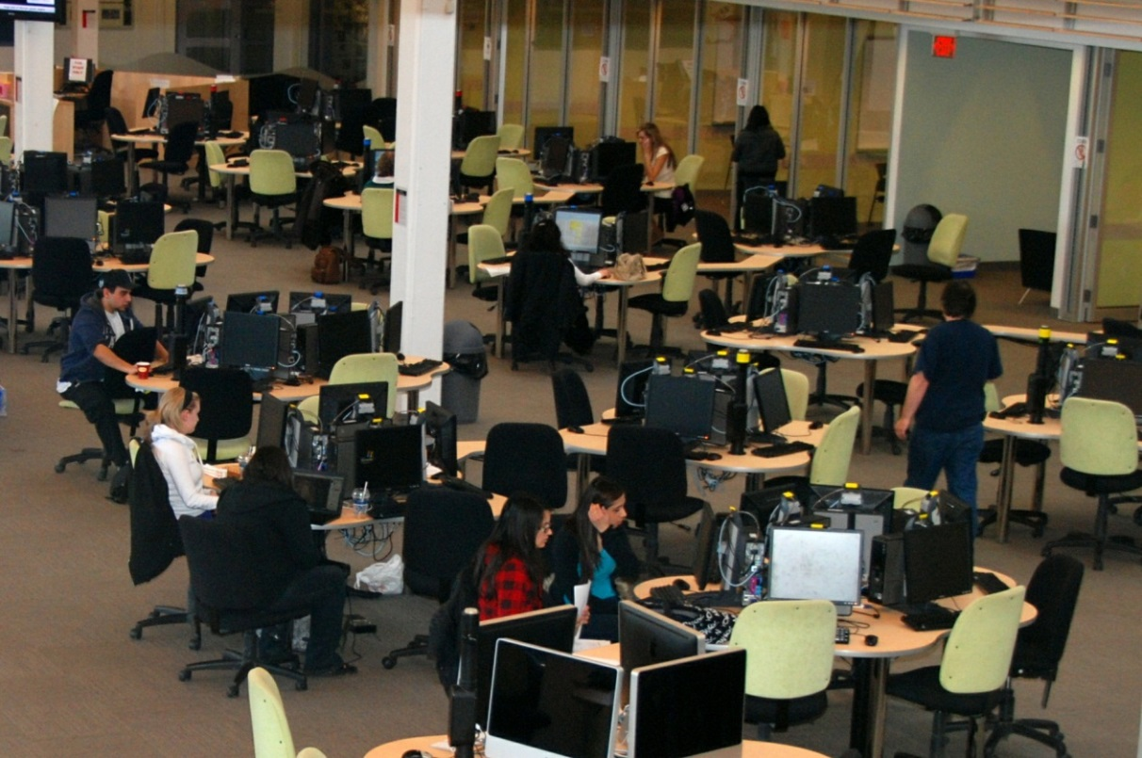
Libraries Are Experiencing A Paradigm Shift
Book Warehouse Model Disappearing Digital Services are Expanding
Student/Faculty Centered Collaborative Learning Spaces,
Digital Literacy Labs, Multimedia Studios

Slide 5
The Physical Library is transforming to Technology Rich Learning Commons
Interdisciplinarity, Digital Literacy, Multimedia, Specialized Software, Hardware
Human Resources Needed

Slide 6
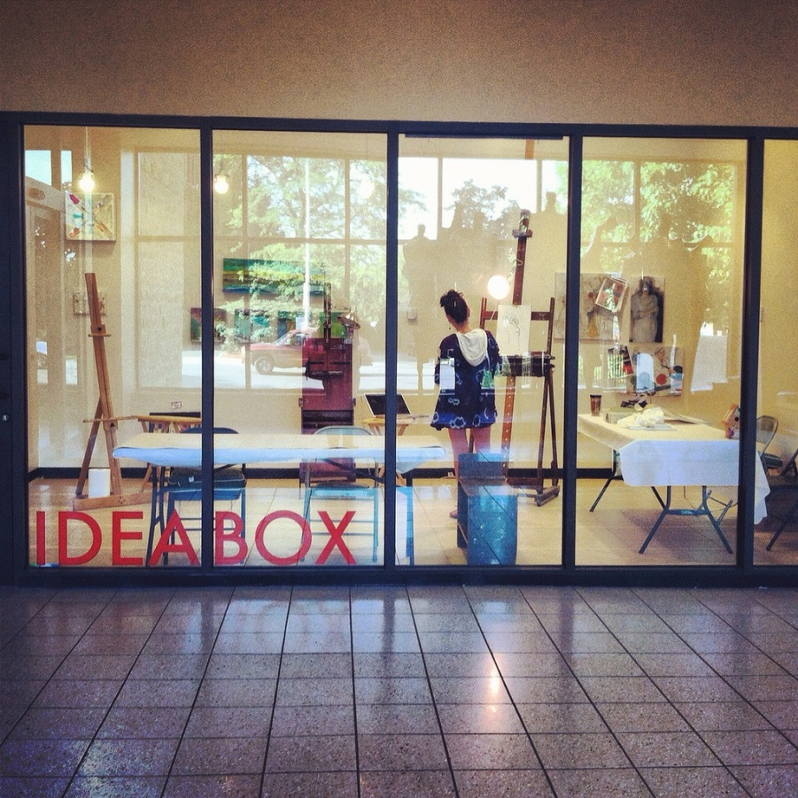
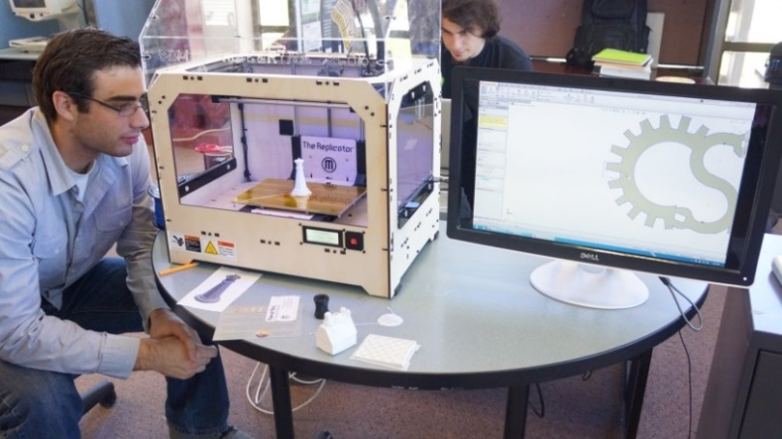
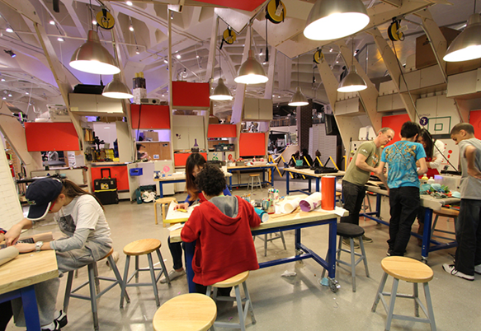
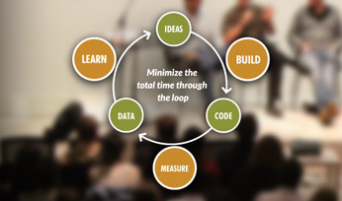
New Academic Library Maker Space Models Appearing

Slide 7
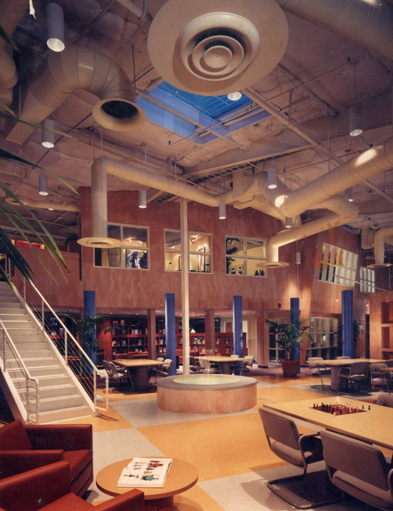
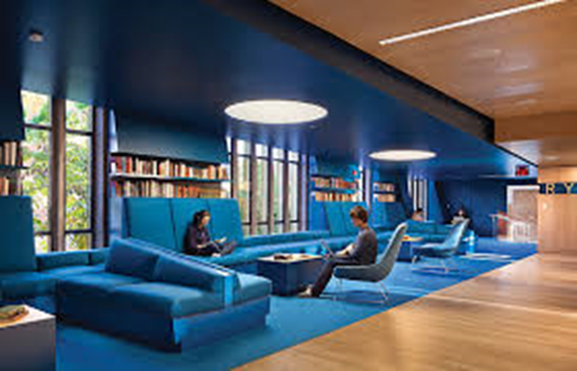
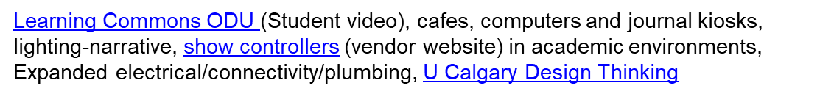
Imagineering Design Potential
For Academic Library Spaces
Hunt Library Video, Learning Space Design Playlist
Instant Theatres, Learning Work Spaces (video)
Lighting Museums and Libraries (lecture video)

Slide 8
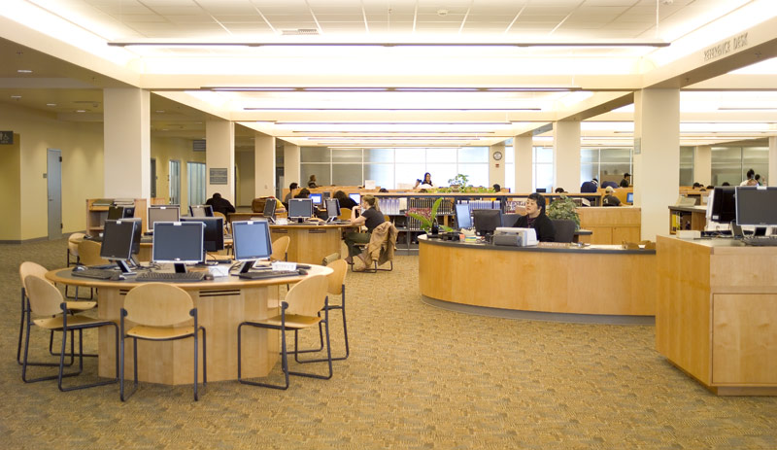
Collaborations are necessary for Physical and Digital Library Environments
Creating Collaborative Infrastructures Among University Divisions
Library
Academic Technology
Faculty Teaching Centre
Core Systems/Technology Resources
Online Learning Division
University IT
Writing Center
Collaboration Infrastructures among Stakeholders
Faculty Students, Librarians/Staff Academic Community

Slide 9
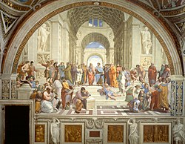
Reestablishment of a Renaissance Model of
Interdisciplinarity
Convergence of Space, Technology, Learning
Library
Humanities &
Social Sciences
Sciences
Technologists &
Engineering
Library as
Third Space for Learning
Cross-fertilization of
Projects, People, Skillsets

Slide 10
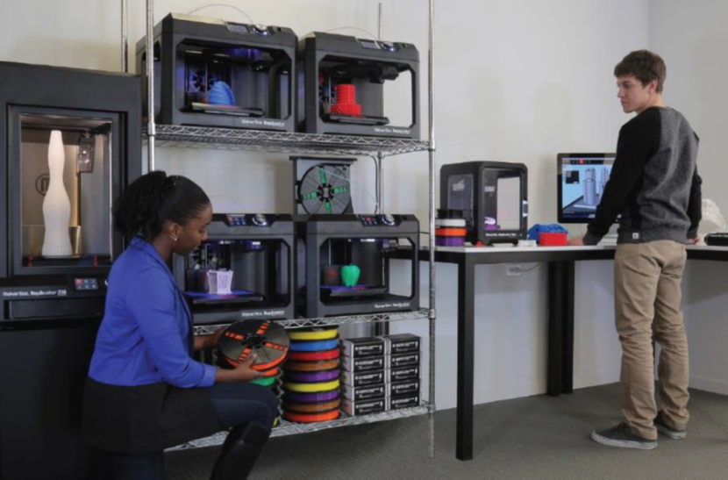
Spectrum of New Technologies Possible
Visualization Walls, 3D Printing Labs, Instant Theatres,

Slide 11


Opportunities to Reimagine Digital, Public and Collection Services for 21st Century
Faculty/Student/Curriculum &
Research Relationships
University/ Classroom/Library Relationships
Library/Faculty Expectations
Curriculum Resources
Hybrid Classroom
Online Classroom
Open Educational Resources

Slide 12
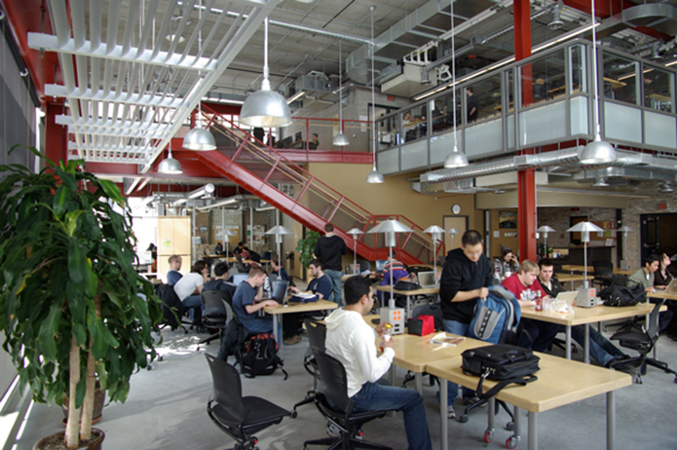
The Academic Library Acquisitions Model is Refocusing on Digital Collections and Resources
~ 80 % of Materials Purchases are currently Electronic Resources, e-journals and e-books.
Only ~ 10-20% of purchases are print materials.

Slide 13
Evolution of online library tools, 1990-2020.
Increasing levels of interactivity and media.

Slide 14
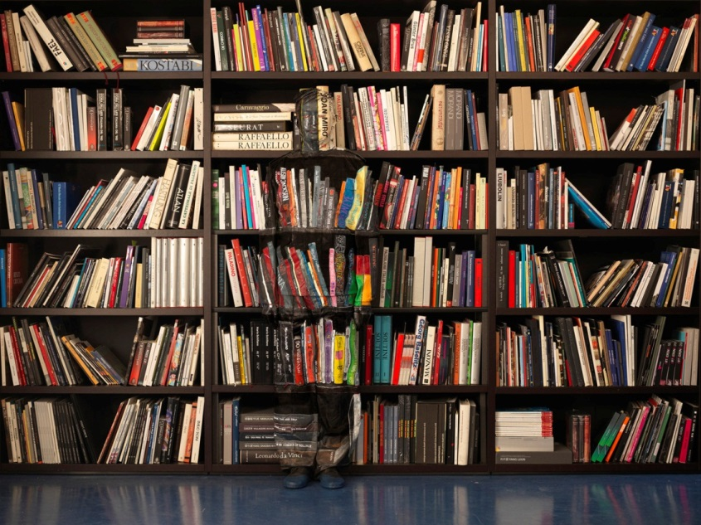
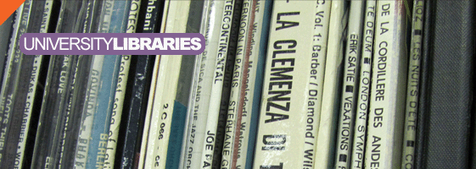
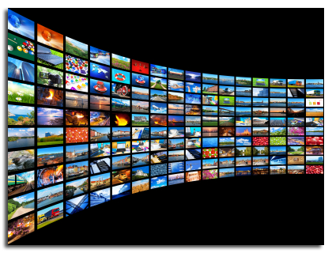
Collection Development Priorities Transforming Through Digital Resource & Media Possibilities
Collection Development Priorities
Shifting
Changing Models From
Ownership of Books to Access to Information
to Software As a Service (SAAS)/Content Database Integration

Slide 15
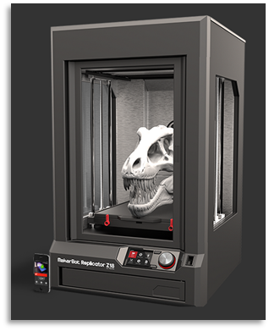
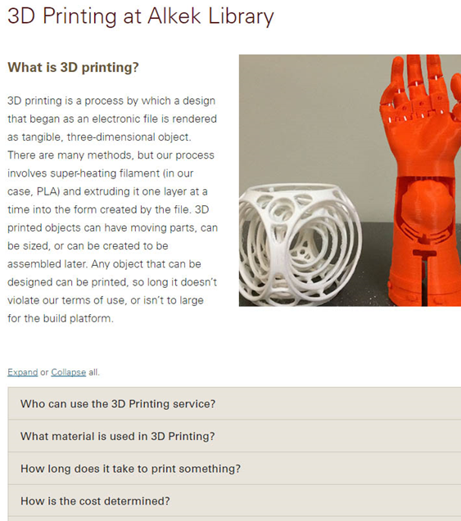
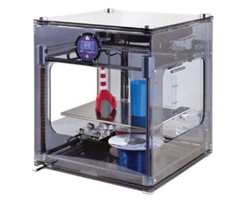
New Digital Literacies Possible
Student and Faculty as Producer

Slide 16
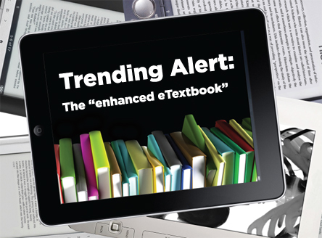
The University Press & Academic Publishing
Possibilities Are Shifting
Books, Players,
Markets and Models
are in a State of
Evolution & Redefinition
Uzwyshyn, R. “Evolving eTextbook Landscapes: Strategies, Platform, Innovation” Journal of Digital Media Management, Spring 2012.

Slide 17


Faculty Library/E-Press Synergies
Publishing on Demand (POD)
Books and Faculty Publications

Slide 18

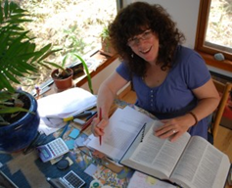
Library/University Press Scholarly Publishing Synthesis
Academic Books and Scholarly Journals
In House Library e-presses (Espresso Book Machine)
University Publishing Infrastructures
E-Press
Editor

Slide 19
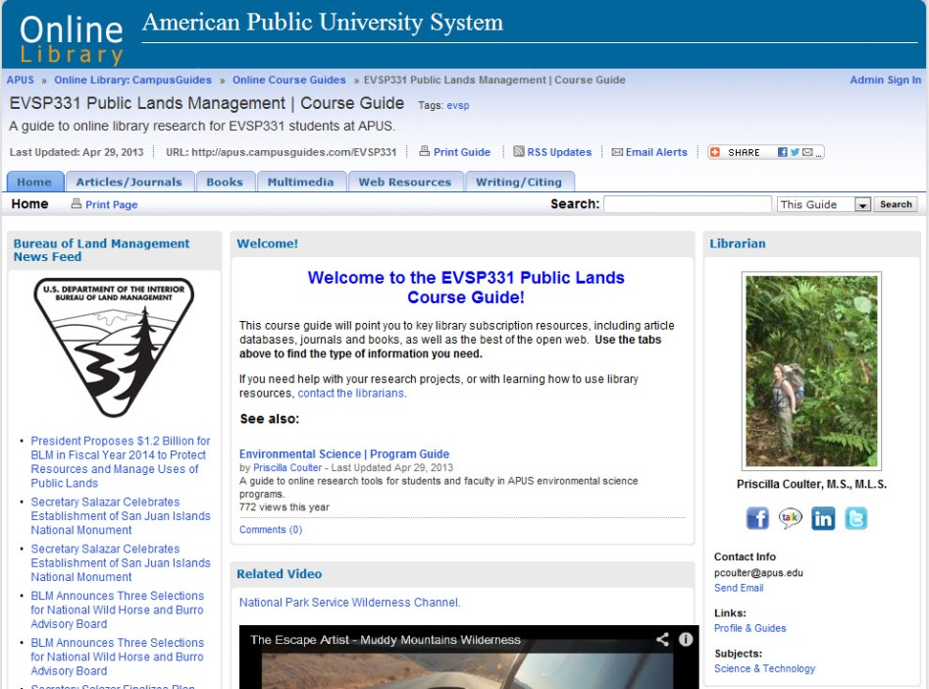

Library Partnerships with Faculty
Online Course Guides
Direct
Curricular
Replacement
Secondary
Multimedia
Bibliography
University Global
Marketing/Branding/ROI

Slide 20
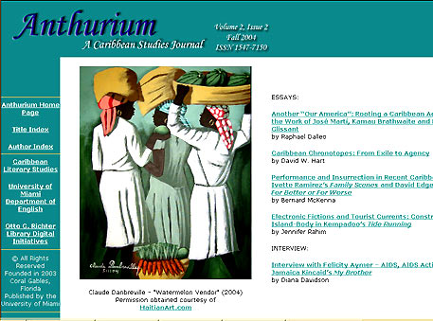

New Genres of Digital Library Services Appearing
Enabling Faculty Research
Scholarly Refereed E-Journals
Open Source Publishing Opportunities

Slide 21
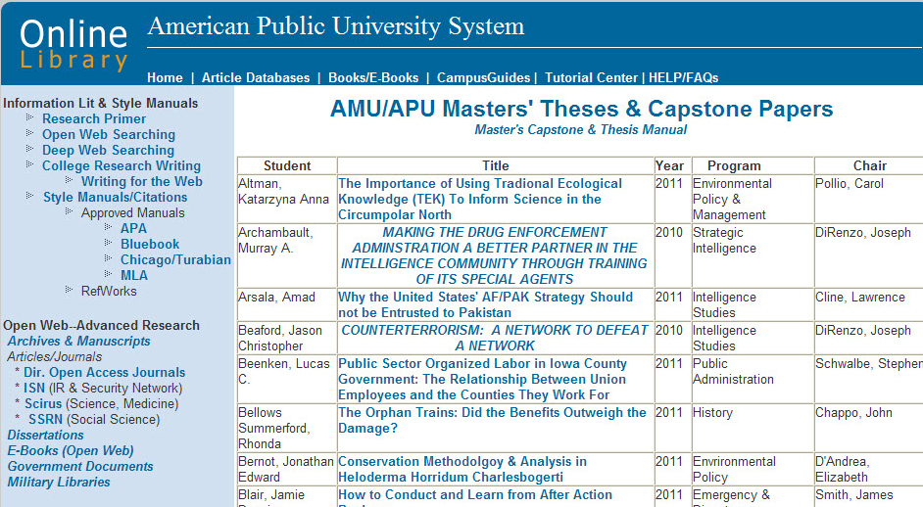
ETD’s Electronic Thesis and Dissertations
Enabling Student Research Online
Institutional Repositories
Online Masters Thesis
(Dark Archives & Institutional Repositories)

Slide 22
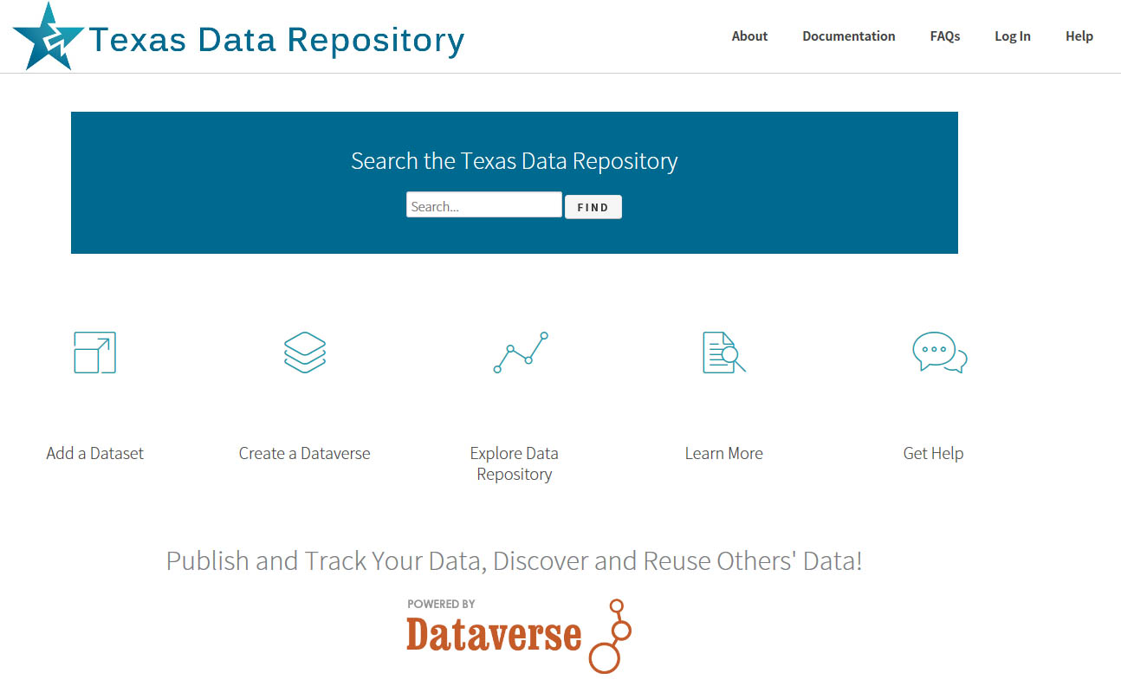
Online Research Data Repositories
Data Visualization, Analytics, Data Science

Slide 23
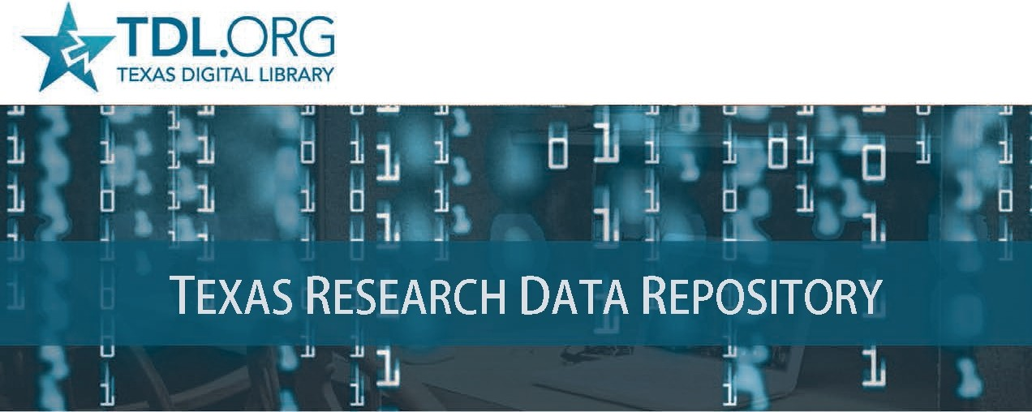

Slide 24
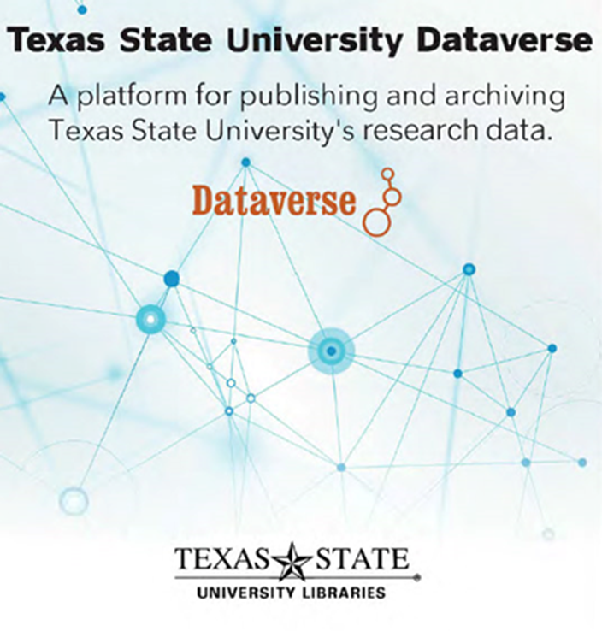
Data Literacy and Data Research Repositories
New Human Resource Possibilities
Data Repository Liaison
Metadata Liaison
Data Visualization and Analytics Librarian
(Tableau, Bayesia)
Machine Learning/Neural Networks/AI Librarian
(the next stage of working with data sets)

Slide 25
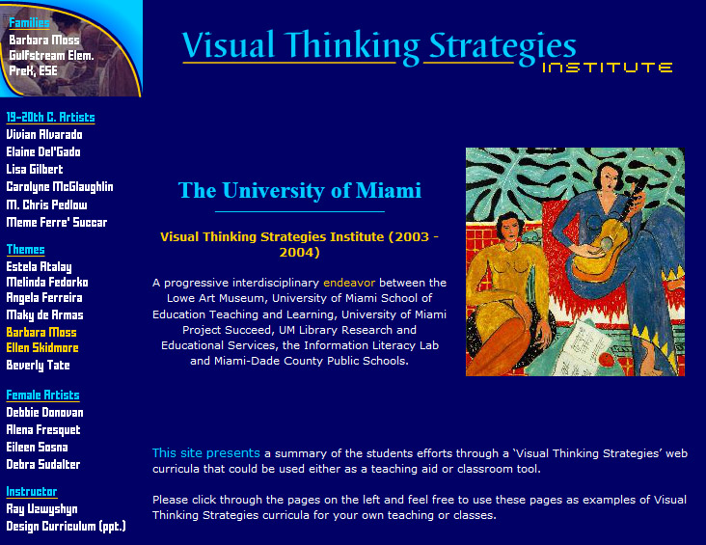
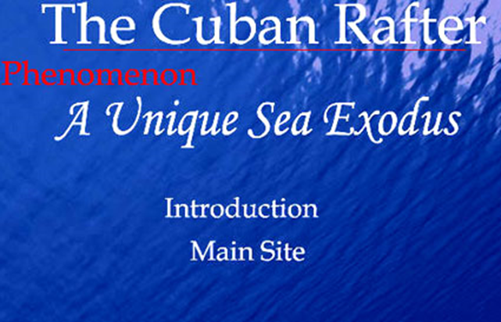
Innovative Partnerships Possible With Faculty Divisions, the Library and Schools
Digital & Information Literacy/ Interdisciplinarity
Partnerships with Library
School of Education
University Art Department/Museum
State Bureau Of Education Grant

Slide 26
Period of High Relevance for Information Literacy
Fake News & Unreliable Information Sources
are widespread.
Librarians Educate Students on Information Seeking
Refereed Scholarly
Journals etc.
The ACRL Framework for Information Literacy

Slide 27
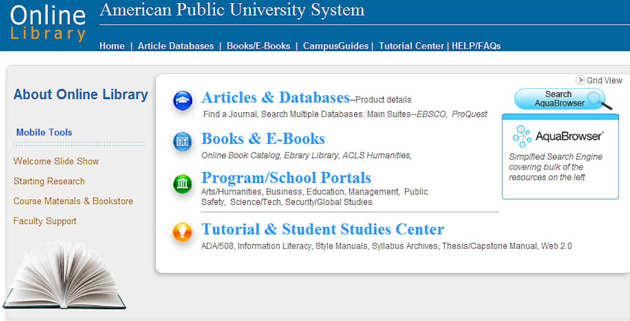
The Textbook is Evolving to Online Modalities
Many Possibilities for Synthesis with Library Resources
The Online library is central to physical, online and hybrid university models.
Serving Curricular and Research Needs
(E-Books, E-Articles, OER, Media)

Slide 28

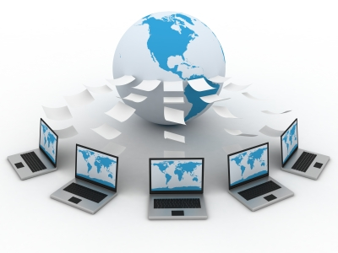
Online Library Help Services Expanding
Research Help Systems, Knowledge bases,
Combining Online Libraries, Learning Management Systems and Human Resources

Slide 29
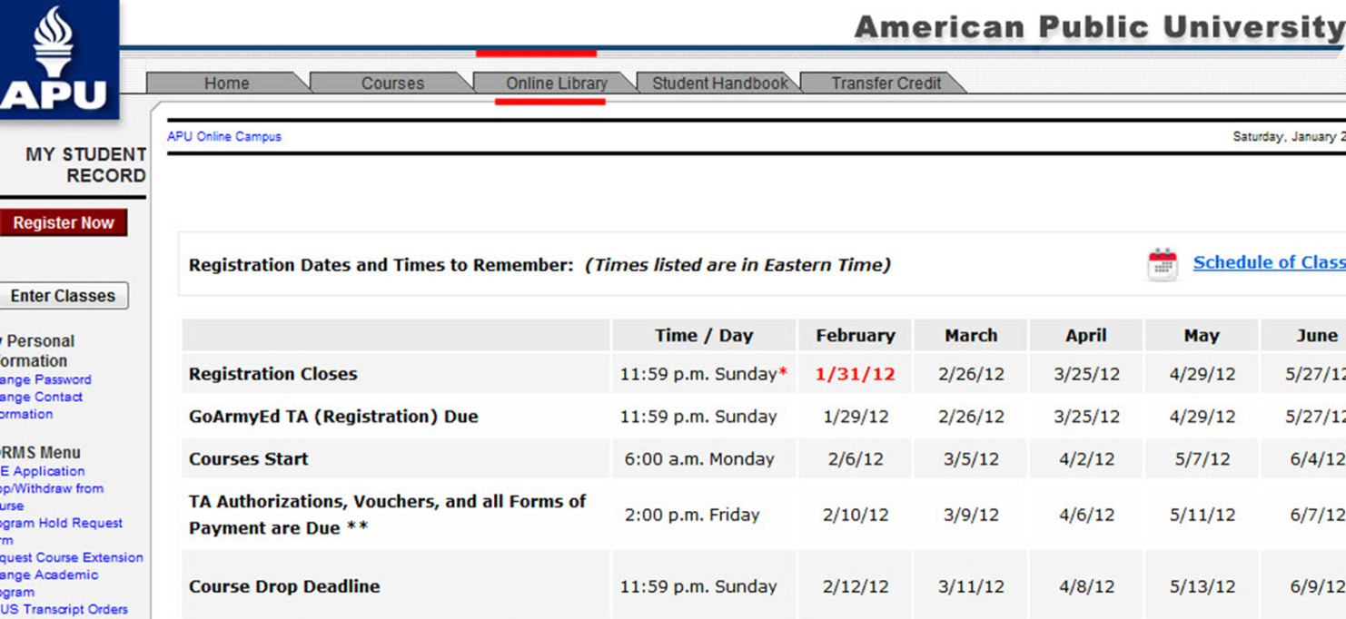
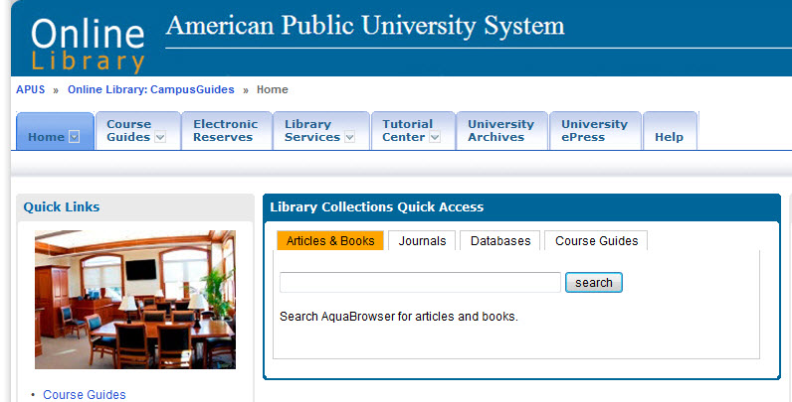
Close Library Integration with Online Classroom
Learning Management System

Slide 30
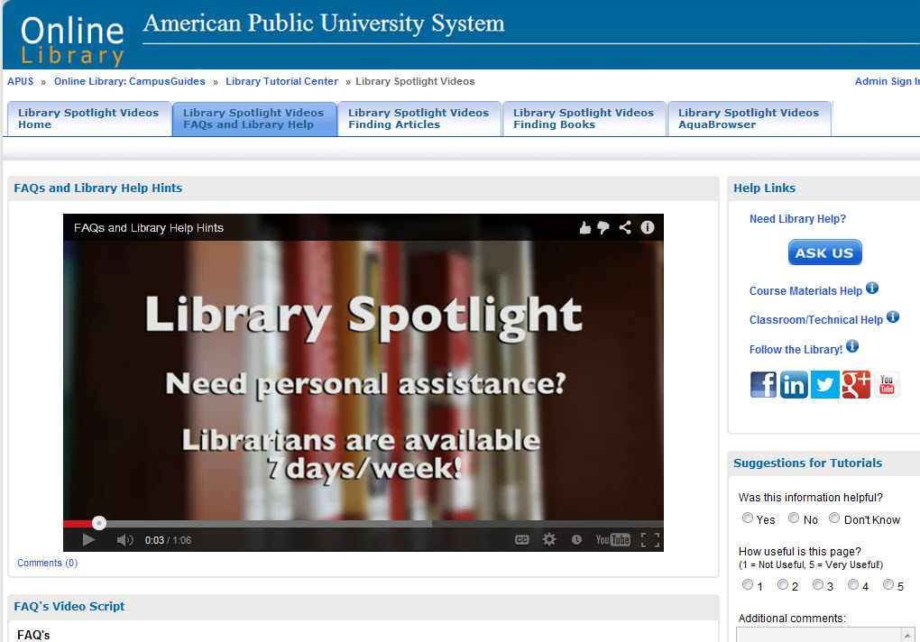
Many Online Video Possibilities
Help Systems, Education and Marketing

Slide 31
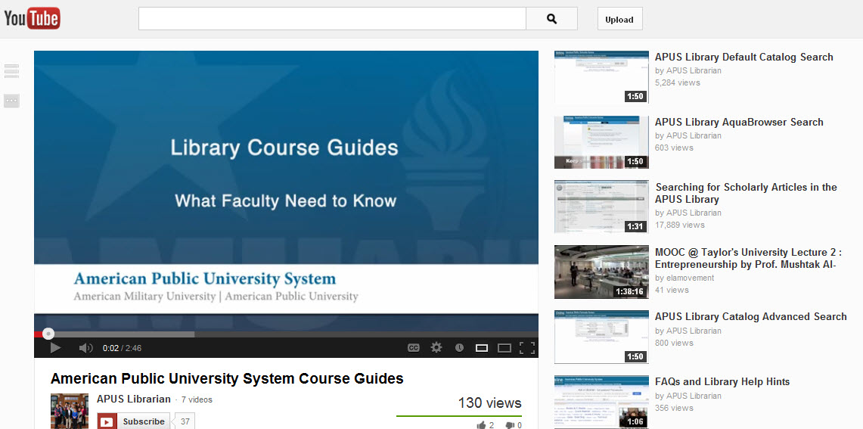
Press, Media
Embedding/Linking Possibilities
Video & Social Media Broadcasting

Slide 32
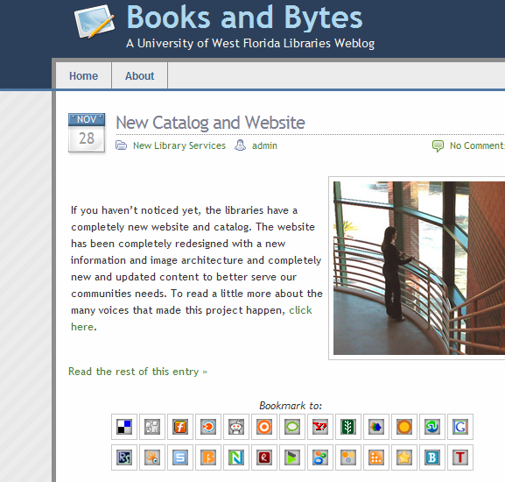
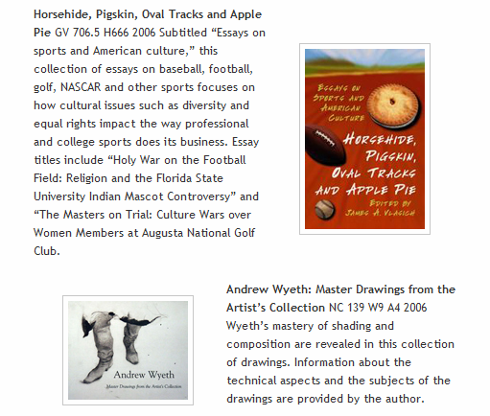
New Ways To Share and Market
Library Content: Social Media and Weblogs

Slide 33

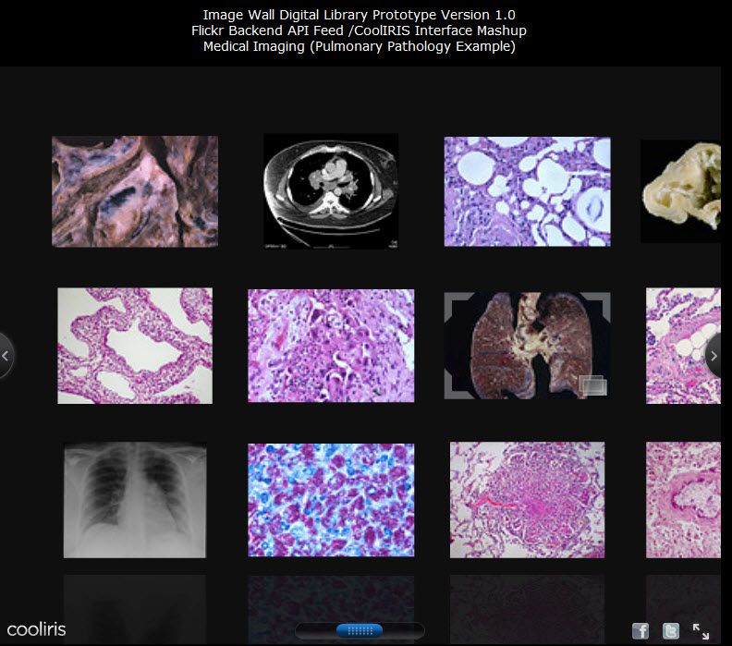
University Archives and Special Collections are Going Digital and Online
From Public History to Biomedical Science (Pulmonary Pathology)

Slide 34
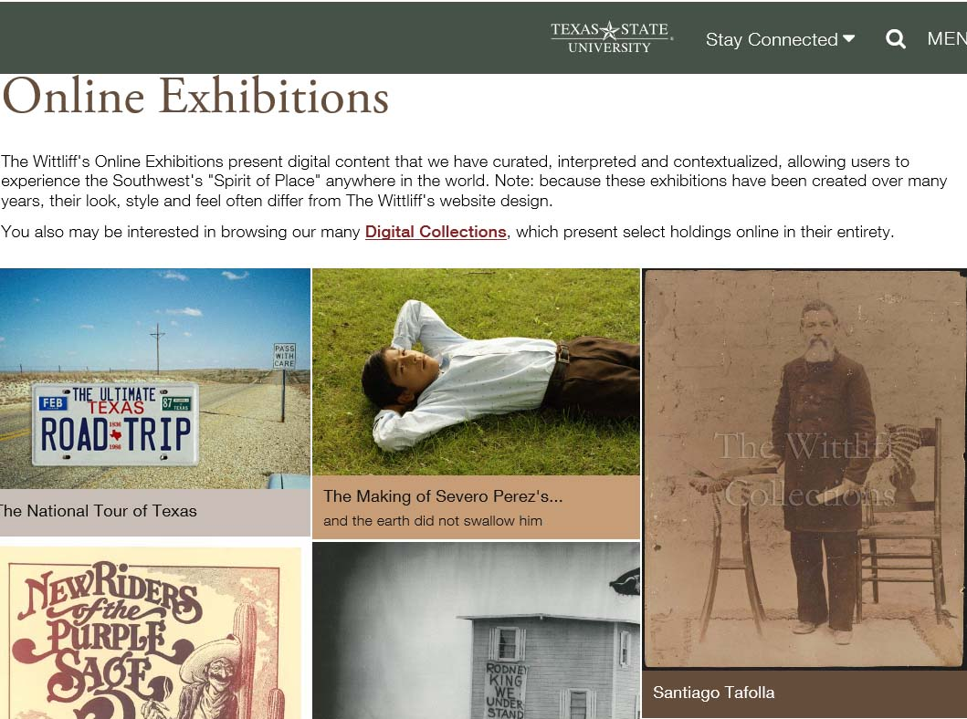
New Online Exhibition Possibilities
Many
Software Options

Slide 35
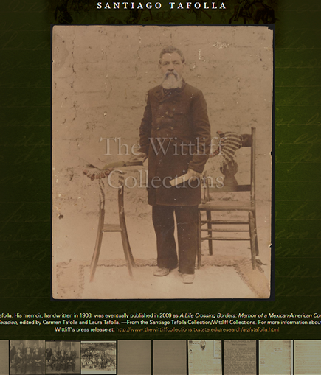
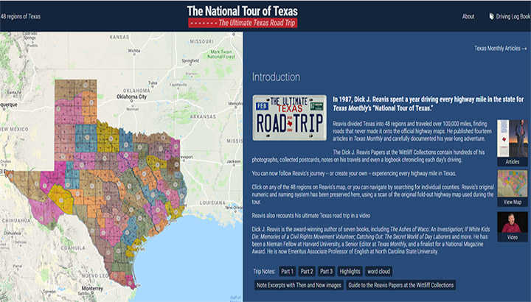
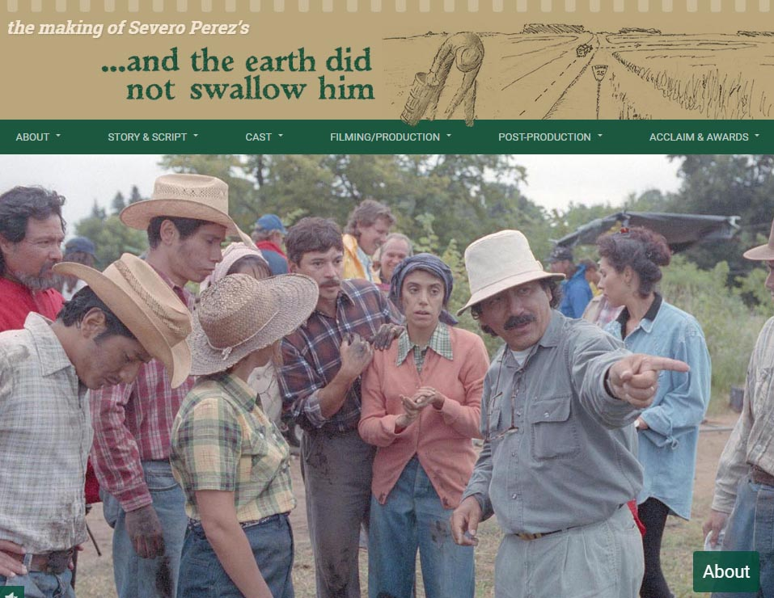
Collaboration with Research Scholars
Special Collections and the Community
Enabling Digital Scholarship

Slide 36
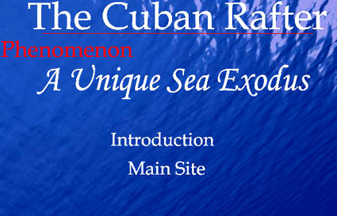
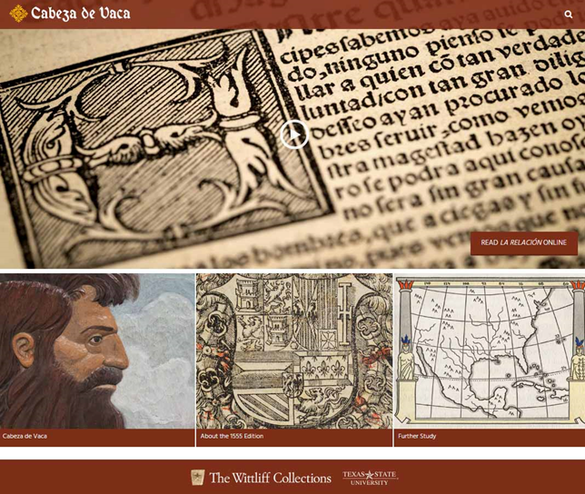

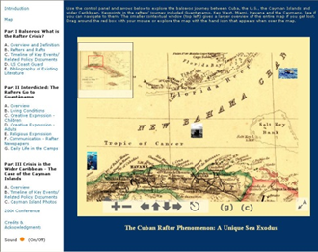

Engagement With Faculty Research/ Special Collections/Multimedia Possibilities
New Genres of Digital Archives Possible

Slide 37
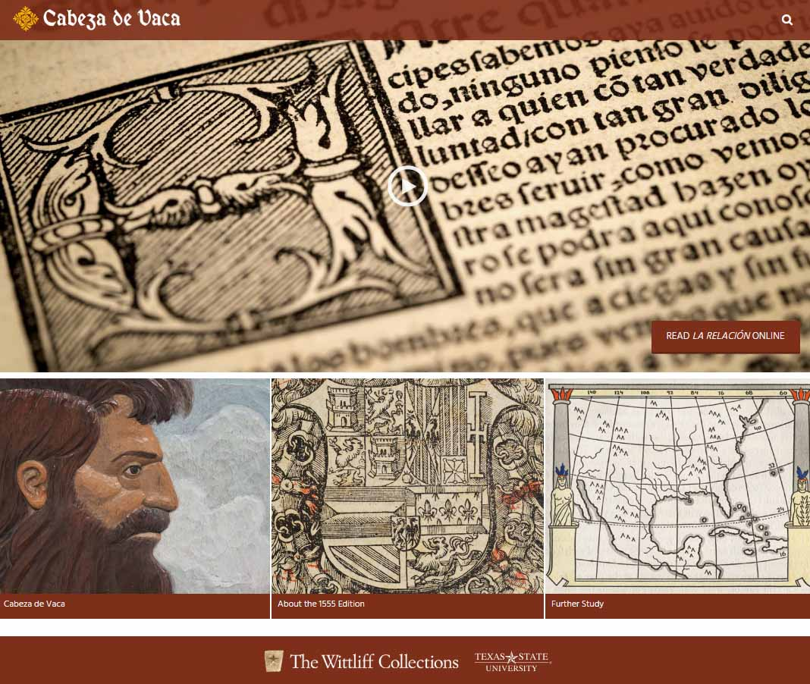

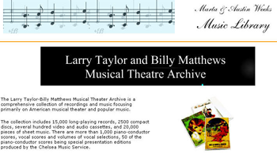
Branding and Marketing the Libraries and University’s Intellectual Riches Globally

Slide 38
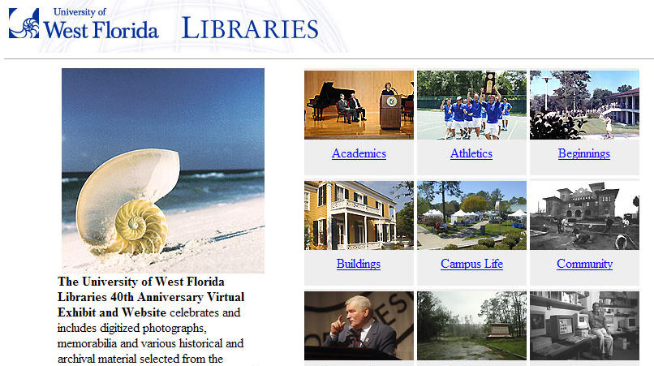
Creating University, Library,
Local and Global Community Bridges

Slide 39


Maintaining Historical Continuity while balancing changing necessities
Libraries are Still Places of
Inspiration, Reflection, Study

Slide 40
Thank you!
Comments or Questions
Ray Uzwyshyn Ph.D. MBA MLIS
http://rayuzwyshyn.net
ruzwyshyn@gmail.com

