Slide 1
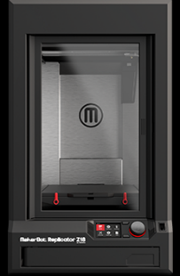
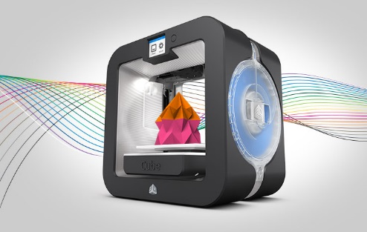
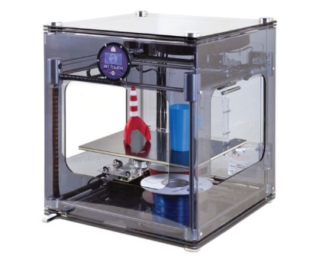
3D Printer Infrastructures for the Digital Humanities (The How and the Why)
Ray Uzwyshyn, Ph.D. MLIS Director, Collections and Digital Services Texas State University Libraries

Slide 2
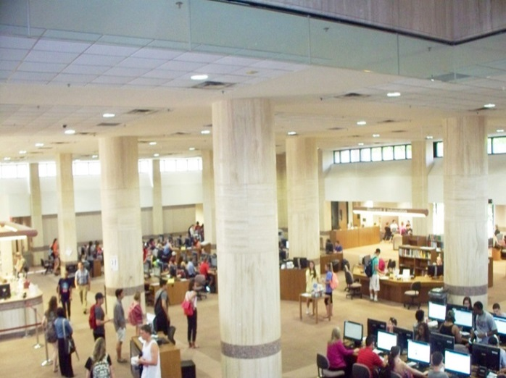
October 2014 Prototype 3D Printing Lab for Texas State University Library Learning Commons Proposed

Slide 3
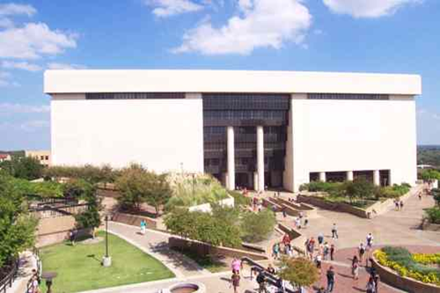
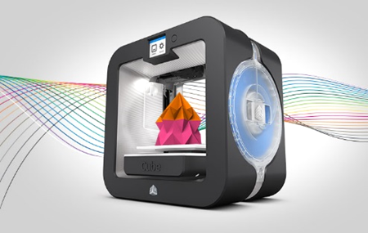
Larger Rationales
Humanities & Social Sciences
Sciences
1. Collaboration 2. Third Space for Learning.
3. Cross fertilization of Projects, People and Skillsets.
4. Interdisciplinarity
Technologists & Engineering
Overview Video

Slide 4
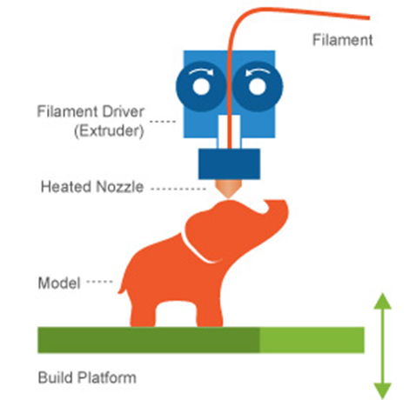
Getting Started
Background Overview
Environmental Scan (Nov/January, 2015) Environmental Scan on TXU Campus of Current 3D Printer Landscape and Needs Assessment Conducted
3D Printing Overview

Slide 5
Environmental Scan Background Scenarios
Six Areas Visited on Campus December 2014 – January 2015, Four with 3D Printers ranging in size from a couple hundred dollars to million dollar set-ups, two others areas wishing to explore this technology further:
Education
Art & Design
Engineering/Engineering Technology
Forensic Anthropology
Geography
STEM Education
Full Report: http://tinyurl.com/mgkkc6e

Slide 6
3D Printer Parameters Generated (From Environmental Scan)
Parameters
Speed of Printing
Resolution (How finely the printer prints)
Cost (Budgetary implications)
Safety (Biodegradable Filament, APL, Ventilation)
Congruence with other University/Library Setups

Slide 7
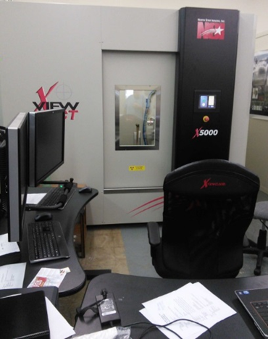
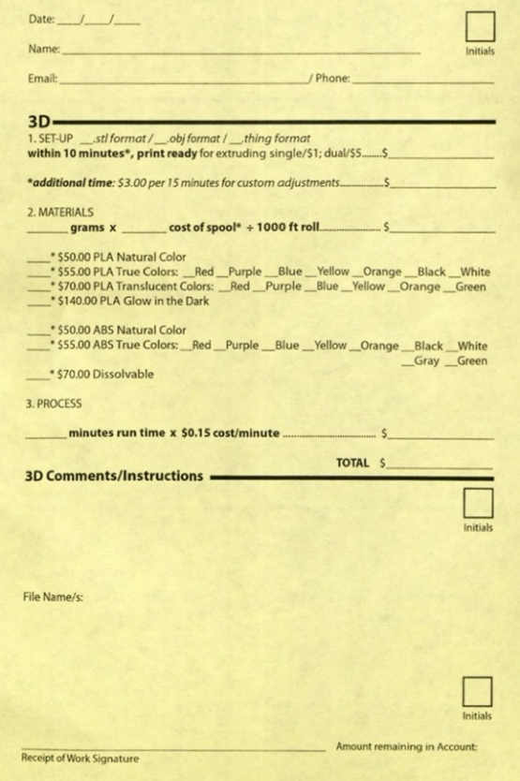
Approval and Subgroups
Approval and Funding (February 2015) Environmental Scan presented to VPIT/Learning Commons Committee. Approval given the library/project to move forward with 3D Printer Infrastructure from environmental scan results.
Subgroups (April, 2015) Two subgroups Formed
1) 3D Printer Selection Subcommittee 2) 3D Printer Infrastructure Policy Committee

Slide 8
3D Printer Subcommittees Charges
3D Printer Selection Subcommittee: Recommend 3D printer, surrounding equipment, 3D scanner, software, filament
3D Printer Policy Infrastructure Subcommittee: Develop policies, procedures, library space allocation and human resource infrastructure recommendations

Slide 9
TXU 3D Printing Landscape (Cost vs. Quality)
100,000+
Forensic Anthropology
50,000
Engineering, STEM
10,000
3D Printer Cost (in USD)
Library Makerspace
5000
Art & Design
2000
Education
Increasing Quality
0
3D Printer Quality (Resolution and Speed)

Slide 10
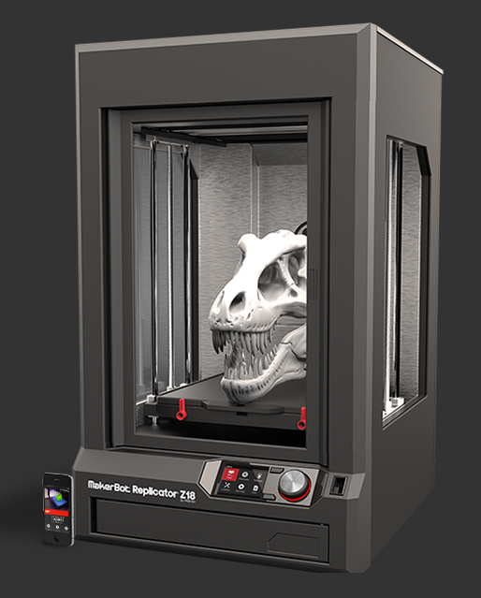
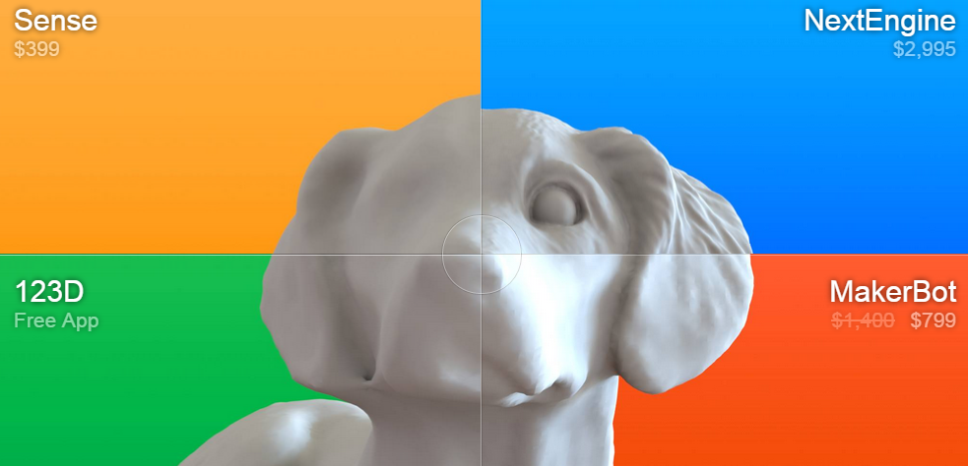
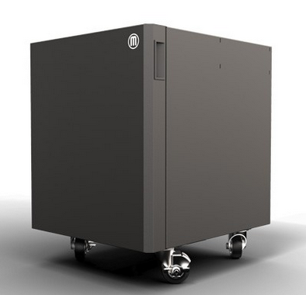
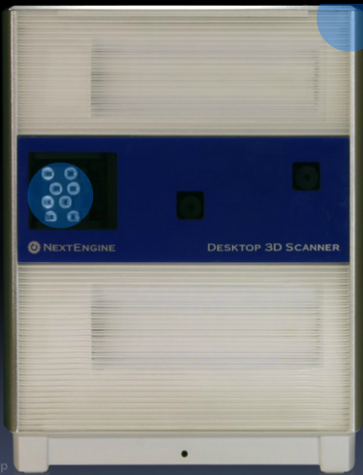
Subgroup Recommendation for 3D Printer Setup May 2015
Makerbot Replicator Z18 $ 5,602.5 Cart 964.87 Extruder (Print Head) 172.92 2 Year Protection Plan 1,224.40 Subtotal: $7964.73 2 Repurposed Computers $0.00
Next Engine 3D Scanner 2,795.00 3D Scanner 3 Year Extended Warranty 295.00 Next Engine MultiDrive 895.00 HD Pro Scanner Software 995.00 20 Spools of Filament 267.12
Sketchup Pro – 2015 (Commercial) 590.00
1 Rhino 3D License 799.00 LC 1200 Line Conditioner 125.00 Subtotal: $6771.12
Grand Total (Est): $14,725.85

Slide 11
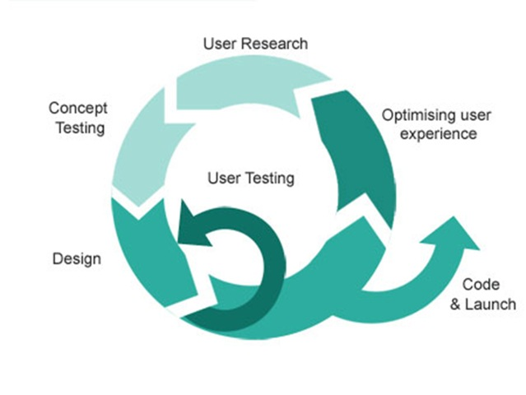
Agile Development Cycles
1)Purchase & Set-up Printer/Equipment/Supplies June-August 2015 (3 Months)
2) Staff Training Soft Launch of New 3D Printing Service, 1 Staff member, 2 Students Sept. – Dec. 2015 (4 months)
3) Official Launch & Marketing January - May 2016 (4 months)

Slide 12
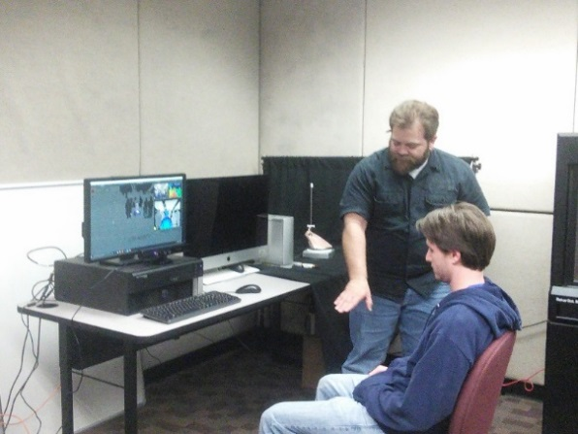
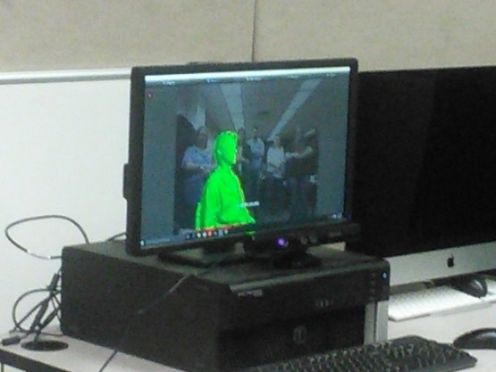
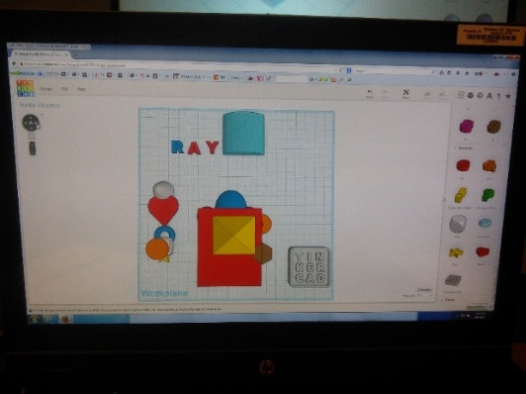
Initial Lab Set-up

Slide 13
Alkek 3D Printing Service Page/FAQ
http://tinyurl.com/zx6sqon

Slide 14
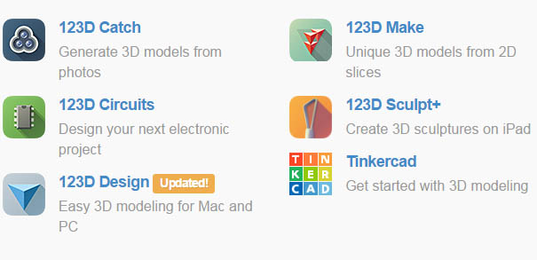
3D Model Software
Rhino (2)
Sketchup 3d (2) (Free & Conversion)
Autodesk123D (Free 3D Toolset/ Scanning Software)
Other Services Shapeways.com

Slide 15
3D Printing Remote Service Form
http://tinyurl.com/gwk3cjn

Slide 16
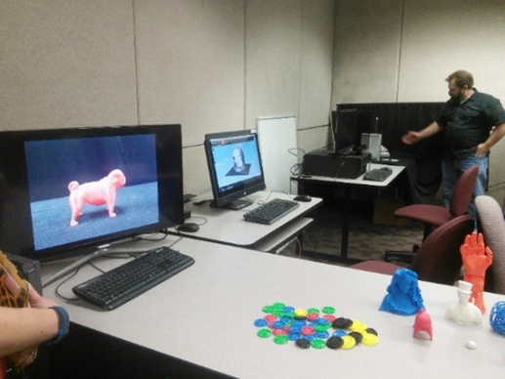
Room Space/Product Dimensions Considerations
Printer Dimensions 49.3 L x 56.5 W x 86.1 H [19.4 W x 22.2 D x 33.9 H IN]
2 Tables – 6 ft x 3 ft. Computer Tables
2 Small Tables – 4ft x 3ft. Separate Scanning Table
Extra Computers
Ventilation

Slide 17
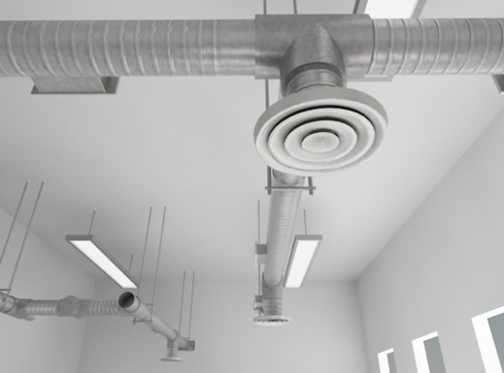
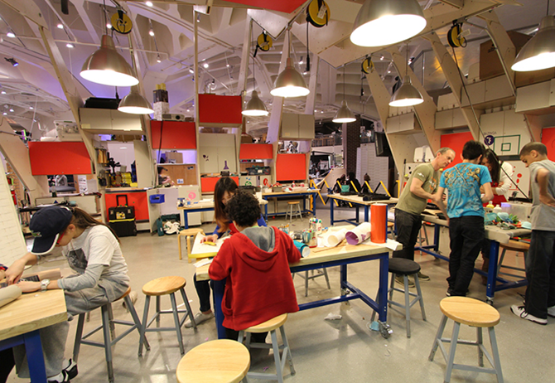
Ventilation ABS vs. PLA Filament

Slide 18
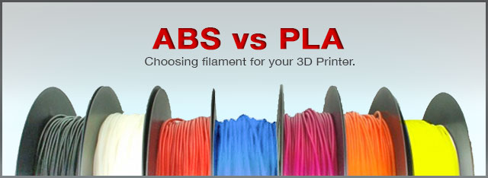
Safety Considerations
ABS – Acrylonitrile Butadiene Styrene Hot Plastic (Oil/Petroleum Based)
PLA, Poly Lactic Acid Biodegradable, Plant-Based, corn, potato, sugar-beet derived, eco-friendly, Sugar smell

Slide 19
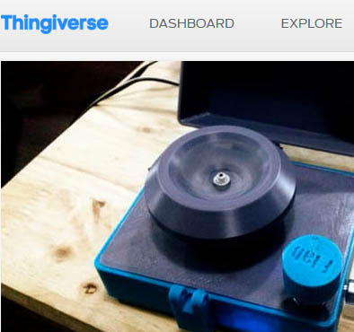
3D Resources for the Humanities
https://www.thingiverse.com/
http://3d.si.edu/
Art History, Archeology, Classics, Theatre Design, History, Music etc.
Thingversity (Educators)
Educator video

Slide 20
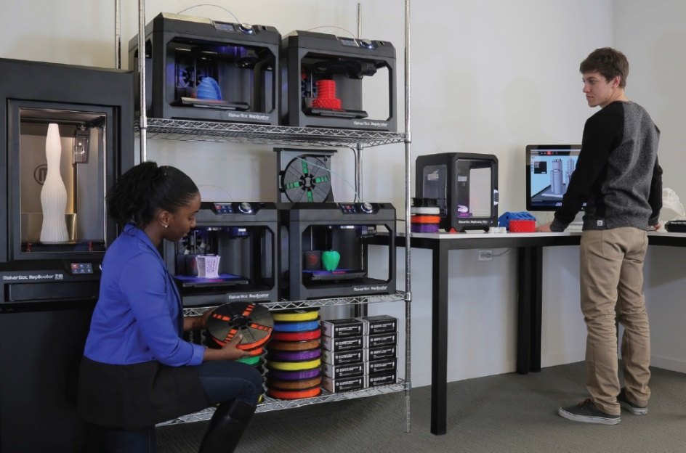
Next Steps (Assessment & Evaluation, 3D Printer Lab Expansion)
(3D Printer Lab Possibility)

Slide 21
Future Trajectories (Scaling)
Learning Commons 5 M + + (Multi-Tiered, Many Labs, Visualization, Multimedia, 3D Printing, Makerspace, Traditional etc. Makerspace 1M – 3M (Physical/Digital Computing Space), CNC Lasercutter, digital embroidery, 3D Printing, Arduino etc.
3D Printing Lab, 100-500 K Multiple and Varying Capability, 3D Printing Space, Scanners, Lab
3D Printer Prototype, 15-50K 3D Printer, 3D Scanner, Software, HR
Infrastructure

Slide 22
Access 3D Models
Smithsonian X 3D (3D scans of historical artifacts)
Morphosource (3D scans of skeletal remains)
Digimorph (3D scans of skeletal remains)
NASA 3D Models (3D scans of topography and aerospace equipment)
Thingiverse (downloadable 3D model files and open community sharing)
Learn more about ways to connect existing 3D models to teaching and learning here.
Create Your Own 3D Models
Autodesk 123d Website (free, must set up account)
TinkerCAD App (free, web-based app to create 3D models)
Tinkercad “quest” lessons and video tutorials
"3D Printing with Autodesk 123D, TinkerCAD, and Makerbot" by Lydia Sloan Cline"
“3D Modeling/Printing with Tinkercad: Create/Print3D Models. James Floyd Kelly”
Autodesk 123d Design (free, downloadable software to create 3D models)
Autodesk 123d Make (free, slice 3D models into 2D puzzle pieces)
Autodesk 123d Sculpt (free, manipulate digital clay on an iPad)
Autodesk 123d Catch (free, upload photos of objects to create 3D models)
Learn more about scanning your own 3D models here.
Order a 3D Print from an Online Service or go to a Makerspace
Shapeways (online service, upload file and they mail print to you, lots of materials choices)
3D Hubs (online network of 3D printers in your community, upload file and pick it up at store)
Article Uzwyshyn, R. “One Size Does Not Fit All: Pragmatic Reflections on 3D Printers for Academic Learning Environments.” Computers in Libraries. 35(10). December 2015. pp. 4-8.
Further Resources (Special Thanks to Dr. Shaunna Smith, Texas State University for this list)

Slide 23
Discussion and Questions Contact Info: Ray Uzwyshyn, Ph.D. MLIS Director, Digital and Collections Services Texas State University, R_U15@txstate.edu http://rayuzwyshyn.net

Slide 25
3D Printer Selection Preliminary Caveats
Requirements
~ 15,000.00 Budget
1 3D Printer/1 extra Extruder
1 3D Scanner
Filament/Software
5-10k 3D Printer Desired (Scenario Constituents)
Safety (Biodegradable Plastic, APL, No hood)
Preferred Congruence with other Universities

Slide 26
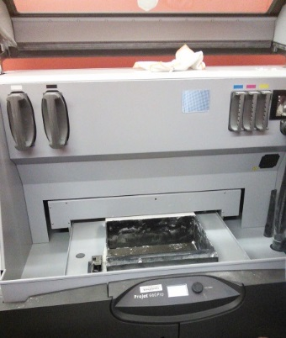
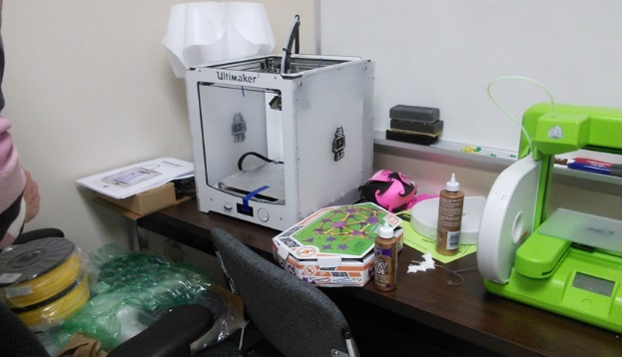
TXU 3D Printer Landscape
Low End – Education < $ 2000.00 – Primarily Geared to Future K-12 Teachers
High End – Forensic Anthropology,
~$ 1,500,000.00 Set-up (800,000.00 Scanner)

Slide 27
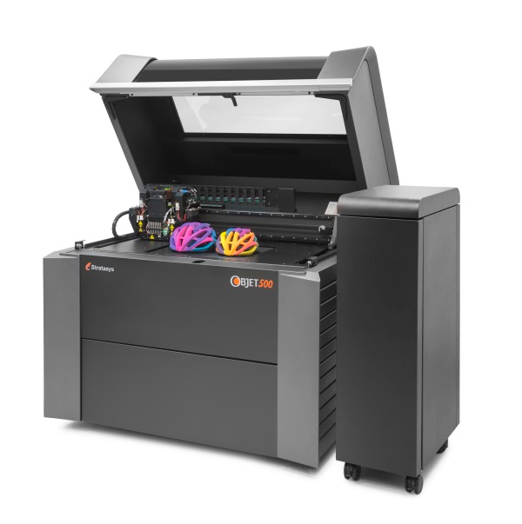
Very High End Stratasys multi-material full color 3D Printer Objet500 Connex3
$330,000.00 (Star Park, Science Technology Applied Research Park Set-up (Other Additions Here include Laser Cutter and 3D Scanner Set-ups)

Slide 28
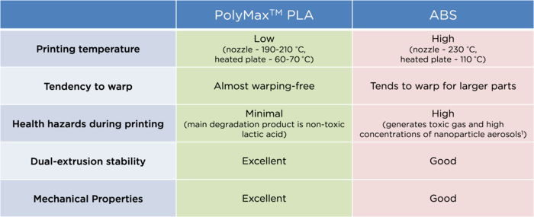
PLA vs ABS Comparisons
PLA is Safer than ABS but ventilation is still recommended
Good Study on “Ultrafine Particles and Potential Risks of 3D Printing (Molitch-Hou, 2013, Stephens, Azimi et al, 2013)

Slide 29
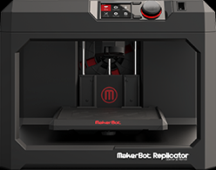
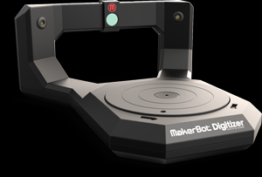
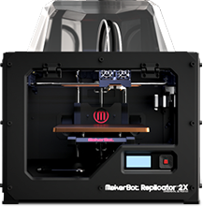
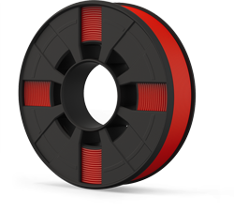
Closest TXU Learning Commons Analogue Art & Design Lab
Makerbot Replicator 3000.00 Software: Rhino (25 Copies, 119 Alkek) Sketchup
Makerbot
3D Scanner 800.00
Filament
Two Staff
Makerbot Replicator
2X (Double Headed Extruder)

Slide 30
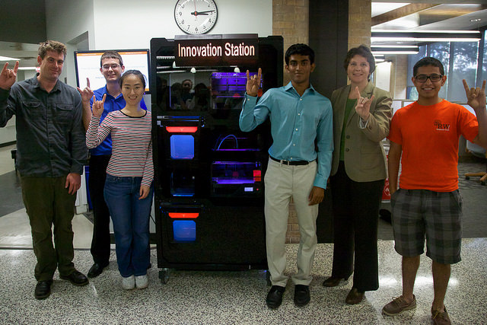
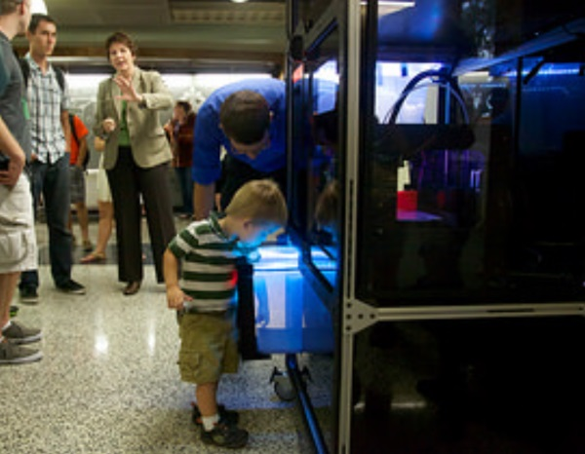
Hands Off Example: UT Austin Innovation Station
Makerbot Vending Machine Innovation Station Video

Slide 31
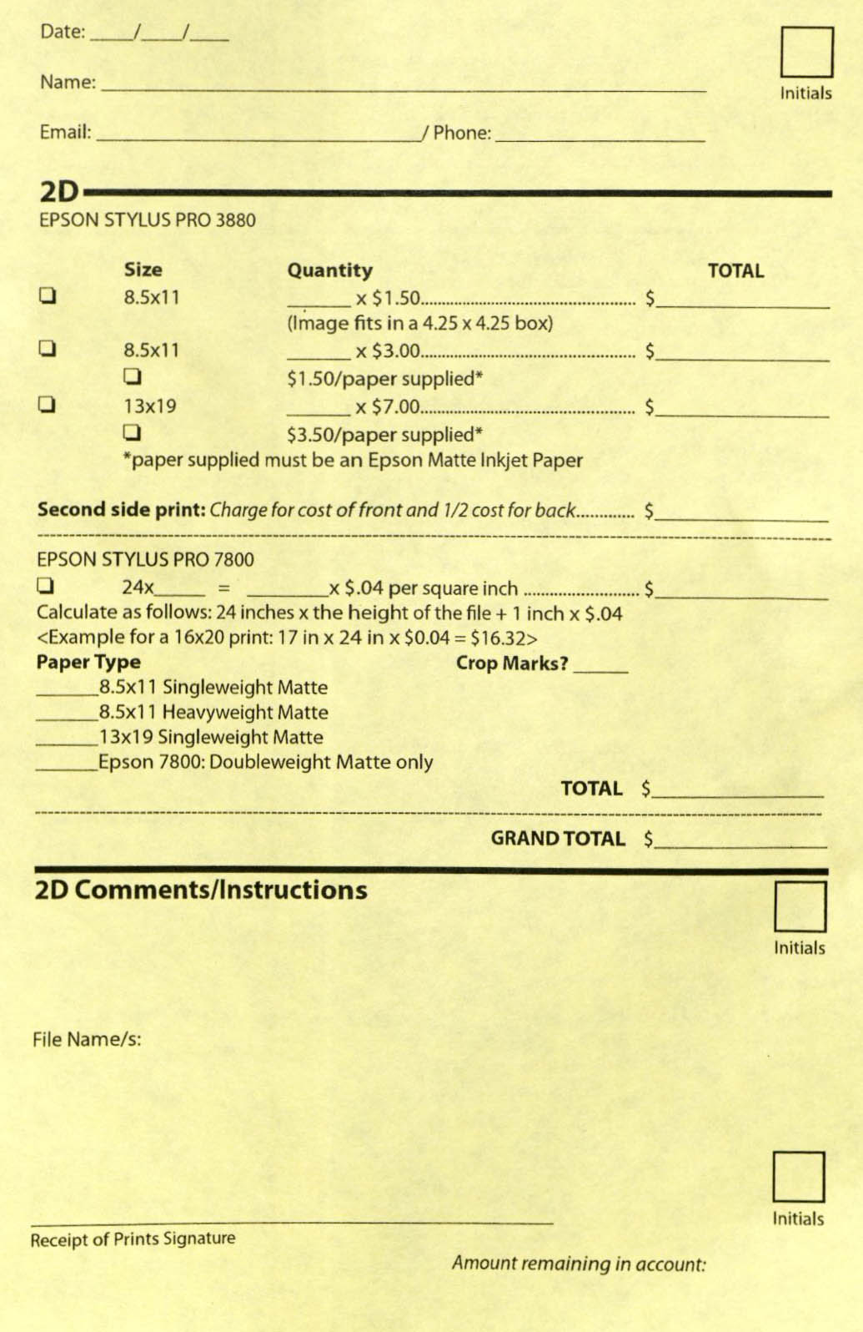
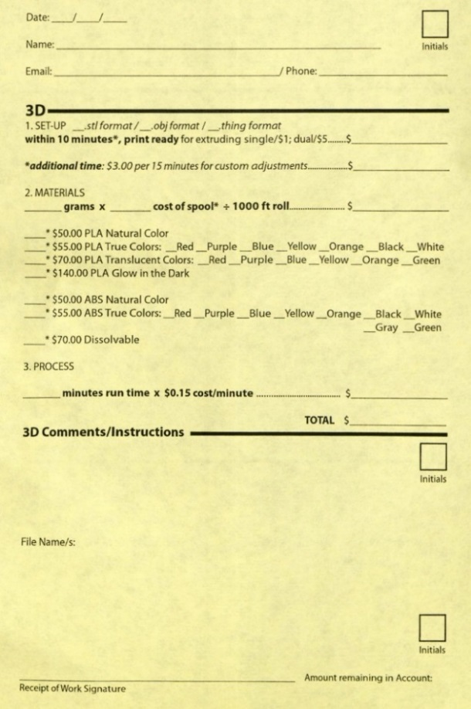
3D Printer Service Set-up Example

Slide 32
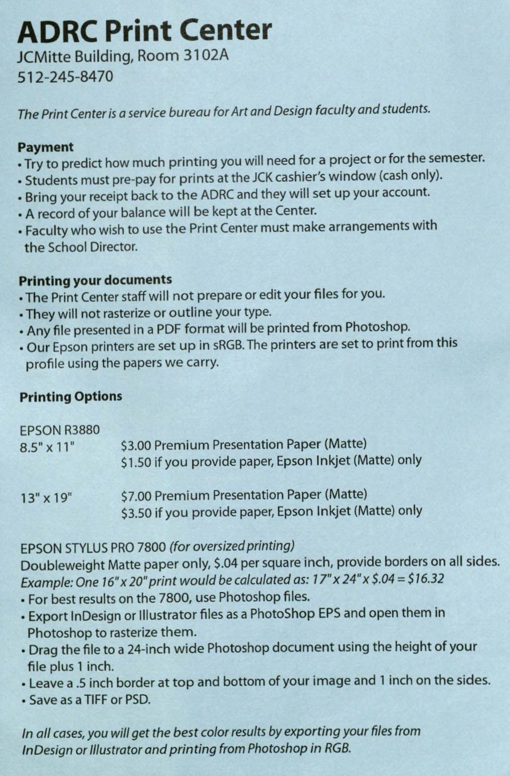
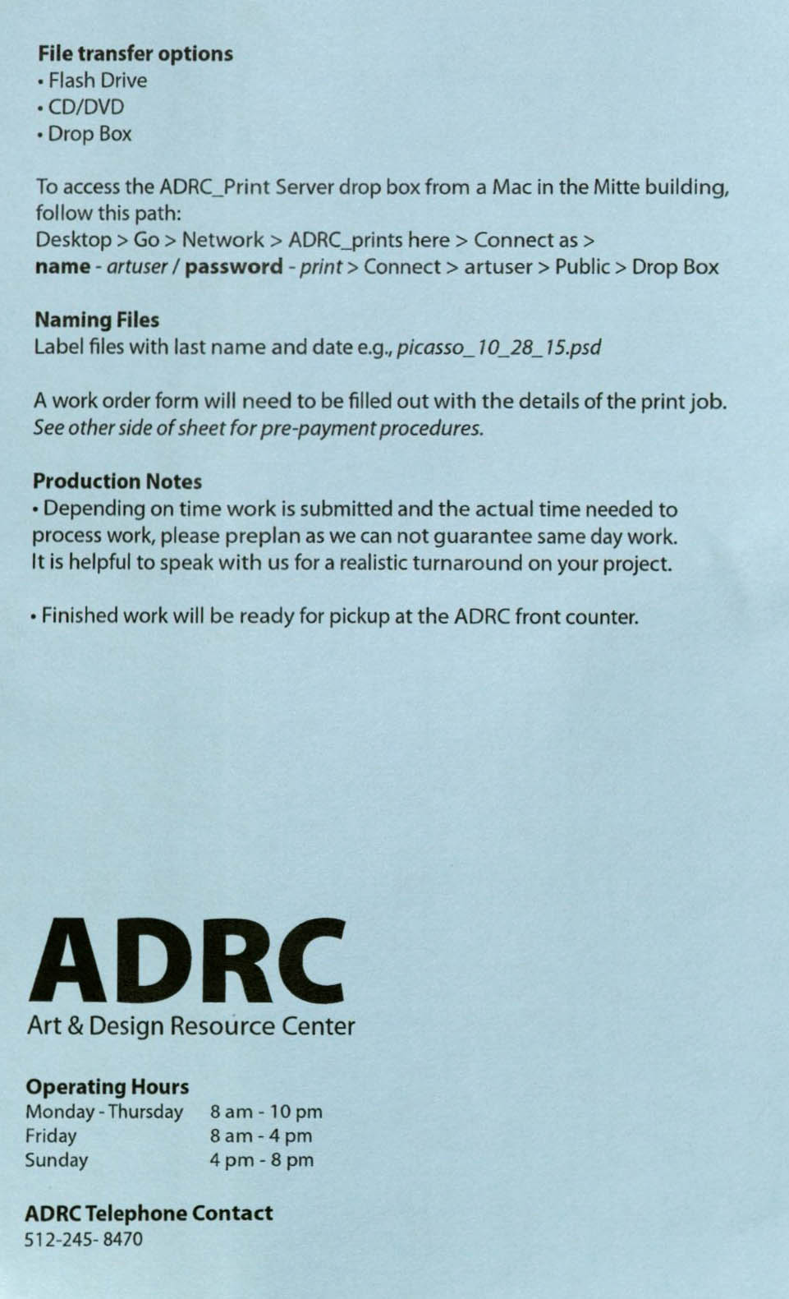
3D Printer Service Policy Example

Slide 33
Enabling 3D Printer Infrastructures for the Digital Humanities
Presented by: Ray Uzwyshyn, Ph.D. MLIS Director, Collections and Digital Services, Texas State University, R_U15@txstate.edu

Slide 34
Enabling 3D Printer Infrastructures for the Digital Humanities
Presented by: Ray Uzwyshyn, Ph.D. MLIS Director, Collections and Digital Services, Texas State University, R_U15@txstate.edu

