Slide 1
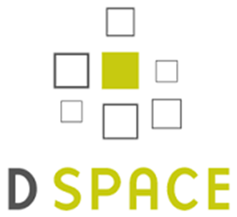
Archivematica, D-Space, Dataverse and other Interdivisional Synergies
Alkek Library Technology Infrastructure Development & Possibilities

Slide 2
Archivematica: Open Source Digital Preservation System Software
Archivematica software:
Processing Digital Materials,
Preparing For Long Term Digital Storage
Desired by: Wittliff (Digital Preservation), University Archives
For Long Term Online Storage and Preservation Management
Connects variously to other systems we use or will be using: D-Space, Dataverse, Archivists Toolkit, LOCKSS, Duracloud
Parent Company
Artefactual (library centered/library technologist created.
Part of larger library trend of open source library software(KOHA, Evergreen, recent purchases by EBSCO, Curriculum Builder, @mire)
Offers paid services in software development technical support, consulting, data migration, training and hosting

Slide 3
Archivematica Used By Larger List of Library ARL & Community Users
University of Houston Libraries (ARL)
MIT Libraries (ARL)
Columbia University Libraries (ARL)
Yale University Library (ARL)
University of British Columbia Library (ARL)
University of Alberta Libraries (ARL)
City of Vancouver Archives;
University of York (ARL)
University of Saskatchewan University Library (ARL)
Bentley Historical Library, University of Michigan (ARL)
Harvard Business School
University of Texas at San Antonio
Art Center College of Design
Baker Library Historical Collections
MoMA-The Museum of Modern Art
Rockefeller Archive Center
Simon Fraser University Archives and Records Management
UNESCO
Ontario Council of University Libraries
University of Hull

Slide 4
Archivematica Architecture
Open Source Architecture
Ubuntu/Python
Many dependencies on open source
packages which use Ubuntu standard packages

Slide 5
Archivematica Set-up
Preferred Technology Staff set-up
Front end application for library
Staff on Ubuntu server located in Library
File Storage located in Data Center (files.txstate.edu)
Relational Database Management
System Located in the Data Center
(MySQL)
Archivematica is not a public access Platform so direct access through the university firewall would not be required
Staff would connect using HTTPS located in Alkek (various floors)

Slide 6
Red Hat Linux Possibility
Pay Archivematica (Artefactual) for porting to Red Hat Linux
Several European libraries. Earlier interest this possibility. No consortium for footing bill. Need for someone to step to plate.
Porting would involve several modules associated with Archivematica and as with D-Space this would involve a multi-year commitment
With porting we would be in same position as with Sierra/Single Server Set-up, D-Space (non-standard community and these challenges: cost)
Leadership role though is possible (funding: Stanford: LOCCKS, MIT: DSPACE Models)

Slide 7
ARL Library Technology Perspectives
125 ARL Libraries Globally 4000 Academic Libraries, US & Canada
ARL Top 3% in North America ARL Top 1% Globally
ARL have responsibilities as leaders with new library technologies
Generating open source applications, setting models and infrastructures for others to follow
Shared, trickle down effect to larger academic library market (college and state university libraries, i.e. D-Space, LOCCKS)
The Enterprise market for ARL Library needs is not large (smaller club). Much open sources software is generated in-house
ARL library IT shops typically separate from central university IT. Specialization of software/skills/technology
Texas State is currently operating with aspiring ARL needs without
the infrastructure required (pushing on limits)

Slide 8
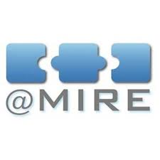
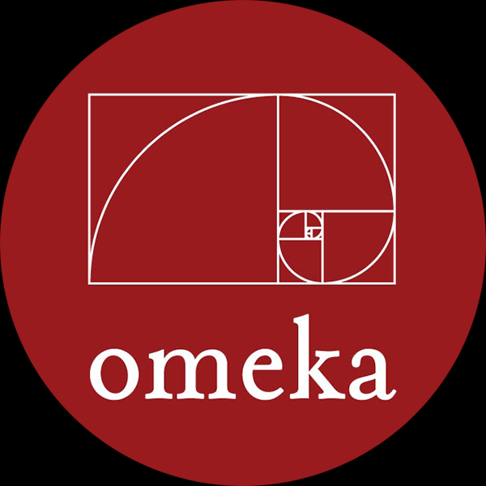
D-Space, Full Time Programmer/ Interface Software (OMEKA)
Currently with @mire we are two
versions behind (v. 4, 5.2, 6)
@mire 9 month upgrade process
We will skip a version to upgrade next
Large Outlay Yearly for Customization
27k for Upgrade, 25k Customization
54K for year if we wish all customizations
Worthwhile methodology?
We are now behind TDL

Slide 9
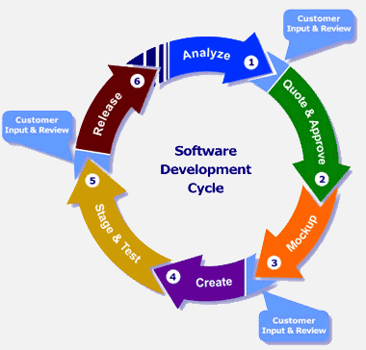
Ongoing Challenges of Outsourcing IT Projects
Needs are increasing
In-house expertise lacking to make minor changes (D-Space)
Timelines with outsourcing are dependent
on vendor
Customization is impossible without further cost outlay
Synergistic research level projects between various Library IT components, systems becomes challenging if not impossible
Agile Development Model

Slide 10
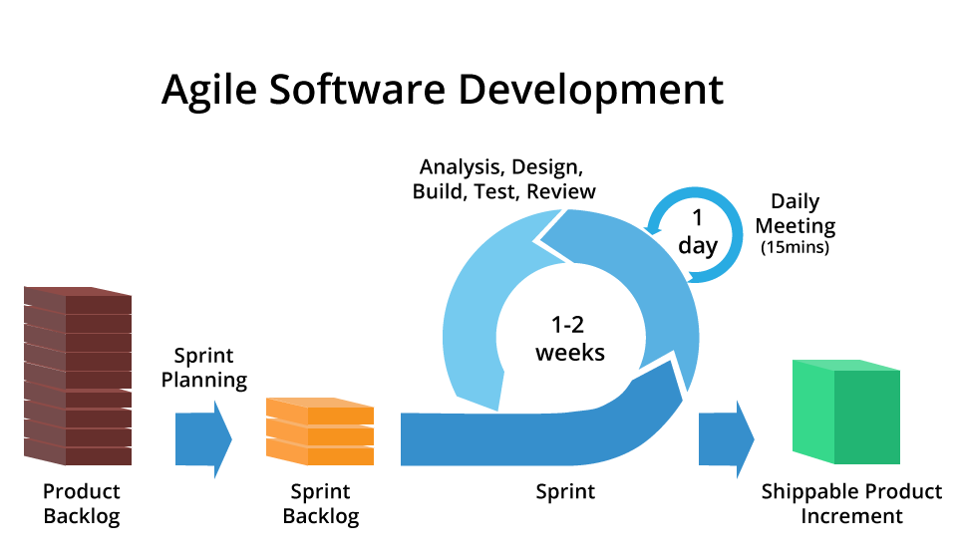
Challenges of Centralized IT Structure and Agile Development

Slide 11
Other Possibilities Sand-Box Server(s) Environment Currently Needed for Library Technology R&D (ARL)
Various Library Technology Units Digitization Unit Core Systems (Sierra, test server) Archives and Wittliff Digitization R&D
Software Examples
Hydra (Digital Library Software)
Fedora (Digital Archives Software)
Open Source Offsite Repository Software (Notre Dame, UBUNTU)
Archivist Toolkit/Archon/Archives Space
Islandora, Arkivum, LOCKSS

Slide 12
Expanding Library Technology Human Resource Needs
Data Research Librarian
Facilitation liaison, Metadata application, marketing between faculty, Research Depository, ARL
Data Visualization, Analytics Specialist
Facilitation (Tableau, Bayesia, Decision Analysis AI and Visualization Software)

Slide 13
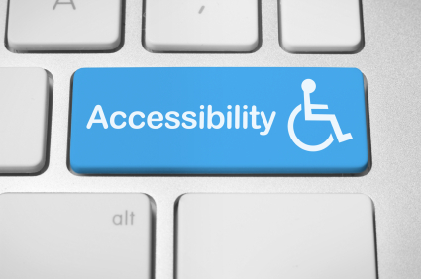
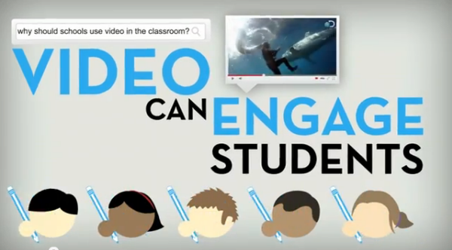
Interdivisional Synergies ADA Access Specialist/Multimedia-Specialist
ADA Access Specialist Questions of central ADA, Access Specialist, Technologist. Currently, this is in ITS and the library projects involving Media flow, closed captioning, ripping DVD’s for streaming if licenses permit, is stretching resources.
Digital Video Specialist Similarly we are not taking advantage of the full potential of video for websites, library. Better processes for use of video, marketing, teaching, Online Exhibits, Digital Archives, Library Website

Slide 14
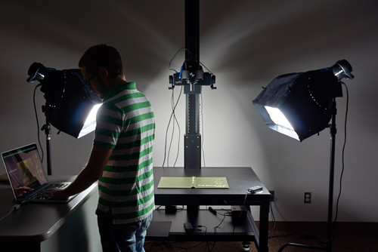
Expansion of Digital Media Lab
Digital Media Lab/Specialist
Need to begin to engage Faculty-level projects for ARL research university projects over next five years.
Currently more work than we can handle (straining seams)
This will require more staff, space, equipment
This can be leveraged towards larger university research aspirations
Digital Libraries, Digital Archives, Online Exhibits for Research Projects

Slide 15
Questions, Comments

Slide 16
Further Documentation Available
Archivematica in the Library (Background Proposal). Digital Preservation Working Group (January, 2016)
D-Space Assessment. Current Landscape. Todd Peters et al. (2015)
Sierra Double-Server Set-up. Todd Peters and Paivi Rentz (2015)
Digital and Web Services Operational Expansion Plan. (Pragmatic 1,2,5 year plans). Digital and Web Services. (March 2016).
Collection and Digital Services, Strategic ARL Comparative Technology Assessment and Preliminary Needs Review. R. Uzwyshyn. (July 2014).
Texas Designated Emerging Research Institutions & ARL Technology Human Resources Comparison (Appendix A), R. Uzwyshyn (July 2014).

Slide 17
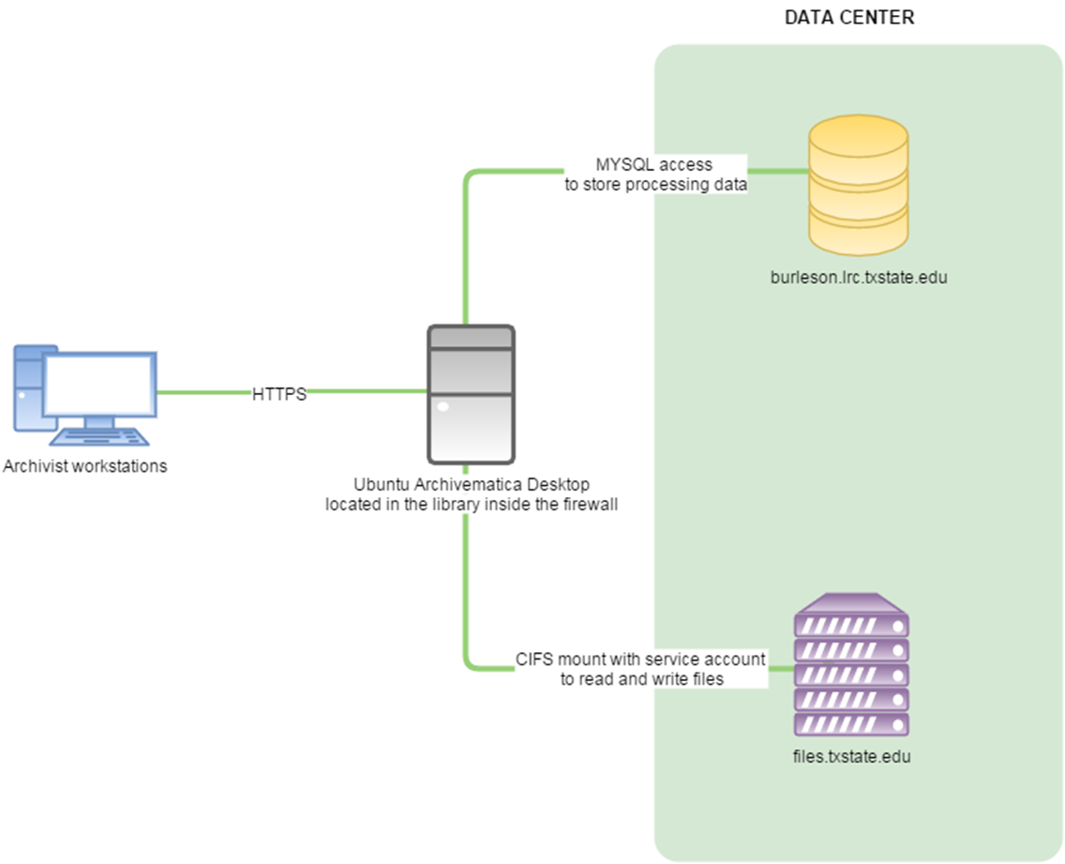
Proposed Archivematica Infrastructure (FurtherSpecifics)
Archivematica running Ubuntu located in 219C Alkek on Dell server (limited access room, card control access)
Staff would connect using HTTPS located in Alkek (various floors)
Txstate firewall access from outside campus will not be allowed
Digital objects for the public will go through either Dspace or Omeka
Archivematica provides Standard User support for Ubuntu

